Slide 1
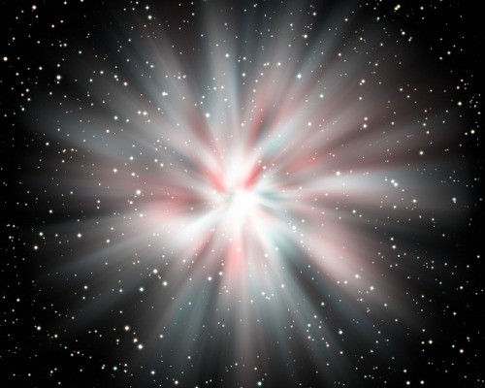
THE BEGINNING OF THE UNIVERSE

Slide 3
What is the Big Bang?
According to the big bang theory, the universe began by expanding from an infinite volume with extremely high density and temperature. The universe was initially significantly smaller than even a pore on your skin. With the big bang, the fabric of space itself began expanding like the surface of an inflating balloon – matter simply rode along the stretching space like dust on the balloon's surface. The big bang is not like an explosion of matter in otherwise empty space; rather, space itself began with the big bang and carried matter with it as it expanded. Physicists think that even time began with the big bang. Today, just about every scientist believes in the big bang model. The evidence is overwhelming enough that in 1951, the Catholic Church officially pronounced the big bang model to be in accordance with the Bible.

Slide 4
We detected a faint afterglow of the big bang that occurred billions of years ago. That the universe began with a big bang is essentially conclusive and may stand as the most profound discovery humans have ever made.

Slide 5
Big bang proponents suggest that some 10 billion to 20 billion years ago, a massive blast allowed all the universe's known matter and energy—even space and time themselves—to spring from some ancient and unknown type of energy. The theory maintains that, in the instant—a trillion-trillionth of a second—after the big bang, the universe expanded with incomprehensible speed from its pebble-size origin to astronomical scope. Expansion has apparently continued, but much more slowly, over the ensuing billions of years. Scientists can't be sure exactly how the universe evolved after the big bang. Many believe that as time passed and matter cooled, more diverse kinds of atoms began to form, and they eventually condensed into the stars and galaxies of our present universe. – National Geographic

Slide 6
The big bang theory leaves several major questions unanswered. One is the original cause of the big bang itself. Several answers have been proposed to address this fundamental question, but none has been proven—and even adequately testing them has proven to be a formidable challenge. –National Geographic

Slide 7
SOME OTHER UNANSWERABLE QUESTIONS
“Matter rode along the stretching space like dust on a balloon’s surface…”
Where did this matter come from?
“Scientists believe that 10 to 20 billion years ago, a massive blast allowed all the universe’s known matter and energy—even space and time themselves to spring from some unknown type of energy…”
Where did this unknown energy and space and time come from?

Slide 8
POPULARITY OF ATHEISM
11.9 % of the world’s population is atheist
161 million people do not believe in God
China – 47%
Japan – 31%
USA – 6%
Florida – 14%
Men – 23%
Woman – 17%
Young people – 34% Older people – 30%

Slide 9
POPULARITY OF ATHEISM
A new study from Pew Research finds that the religiously unaffiliated – a group comprised of atheists, agnostic and those who say their religion is "nothing in particular" – is now the largest cohort in the U.S. They're more prevalent among American adults than Catholics (23%) or evangelical Protestants (24%).

Slide 10
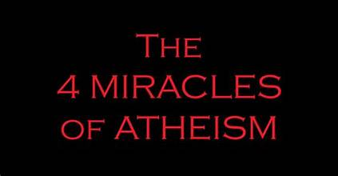

Slide 11
THAT WHICH EXISTS CAME FROM THE NON-EXISTENT
THAT ORDER CAME FROM CHAOS
THAT LIFE CAME FROM NON-LIFE
THAT MORALITY CAME FROM MATTER

Slide 12
HOW MANY HAVE STOOD ON A BEAUTIFUL STARRY NIGHT AND MARVELED?
HOW CAN WE NOT CONCLUDE THERE IS A SUPREME BEING BEHIND IT ALL?
LET’S GO BACK IN TIME 2000 YEARS AND SIT IN ON A SERMON PREACHED BY THE APOSTLE PAUL

Slide 13
Acts 17:24-31 "The God who made the world and everything in it is the Lord of heaven and earth and does not live in temples built by hands. 25 And he is not served by human hands, as if he needed anything, because he himself gives all men life and breath and everything else. 26 From one man he made every nation of men, that they should inhabit the whole earth; and he determined the times set for them and the exact places where they should live. 27 God did this so that men would seek him and perhaps reach out for him and find him, though he is not far from each one of us. 28 'For in him we live and move and have our being.' As some of your own poets have said, 'We are his offspring.'

Slide 14
29 "Therefore since we are God's offspring, we should not think that the divine being is like gold or silver or stone — an image made by man's design and skill. 30 In the past God overlooked such ignorance, but now he commands all people everywhere to repent. 31 For he has set a day when he will judge the world with justice by the man he has appointed. He has given proof of this to all men by raising him from the dead."
LET’S NOTICE SOME THINGS PETER TAUGHT ABOUT GOD

Slide 15
I. THE GOD WHO MADE THE WORLD WANTS TO BE KNOWN
HOW DOES GOD MANIFEST HIMSELF?
IN CREATION
Rom 1:19-20….since what may be known about God is plain to them, because God has made it plain to them. 20 For since the creation of the world God's invisible qualities — his eternal power and divine nature — have been clearly seen, being understood from what has been made, so that men are without excuse.

Slide 16
Ps 19:1 The heavens declare the glory of God; the skies proclaim the work of his hands.
The starry Universe
Planet Earth
Plant & Animal life
Birds
Human Body—birth of a baby
ALL OF THESE
SPEAK
LOUDLY AND
CLEARLY THAT
GOD EXISTS AND
IS THE CREATOR

Slide 17
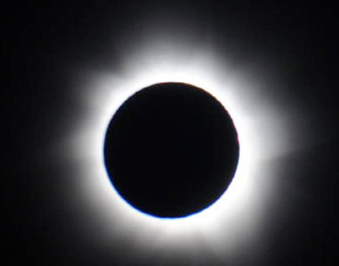

Slide 18
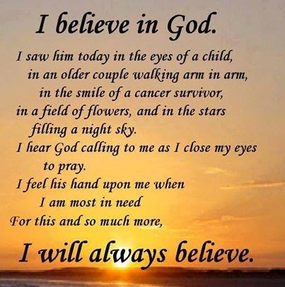

Slide 19
HOW DOES GOD MANIFEST HIMSELF?
IN HIS WORD – THE BIBLE
Gen. 1:1 - “In the beginning God…….”
John 1:1-4 In the beginning was the Word, and the Word was with God, and the Word was God. 2 He was with God in the beginning. 3 Through him all things were made; without him nothing was made that has been made. 4 In him was life, and that life was the light of men.

Slide 20
John 1:10 He was in the world, and though the world was made through him, the world did not recognize him.
John 1:14 The Word became flesh and made his dwelling among us. We have seen his glory, the glory of the One and Only, who came from the Father, full of grace and truth.

Slide 21
THE BIBLE REVEALS GOD’S PERSON
THE BIBLE REVEALS GOD’S POWER
THE BIBLE REVEALS GOD’S PROMISES
THE BIBLE REVEALS GOD’S PLAN
GOD MAKES HIMSELF KNOWN THROUGH HIS WORD
GOD’S WORD ALSO MOTIVATES US TO LIVE FOR HIM
WE NEED TO GET THE WORD TO THE LOST

Slide 22
II. THE GOD WHO MADE THE WORLD NO LONGER OVERLOOKS IGNORANCE
Acts 17:29-30 "Therefore since we are God's offspring, we should not think that the divine being is like gold or silver or stone — an image made by man's design and skill. 30 In the past God overlooked such ignorance, but now he commands all people everywhere to repent.

Slide 23
Acts 17:29-30 "Therefore since we are God's offspring, we should not think that the divine being is like gold or silver or stone — an image made by man's design and skill. 30 In the past God overlooked such ignorance, but now he commands all people everywhere to repent.
WHAT IGNORANCE?
“SUCH IGNORANCE”
Acts 14:16 In the past, he let all nations go their own way.
REFERING TO THE GENTILE WORLD

Slide 24
Rom 1:20 For since the creation of the world God's invisible qualities — his eternal power and divine nature — have been clearly seen, being understood from what has been made, so that men are without excuse.

Slide 25
“But ….I didn’t know…..”
TRY THIS WITH THE OFFICER WHO PULLS YOU OVER FOR SPEEDING
“I didn’t know what the speed limit is….”
“IGNORANCE IS BLISS”
"If ignorance is bliss, why aren't more people jumping up and down for joy."

Slide 26
"Ignorance is not innocence, but sin." Robert Browning (1812 -1889) British poet.
THIS IS TRUE WHEN IT COMES TO IGNORANCE OF GOD AND HIS WILL
Eph 4:18-19 They are darkened in their understanding and separated from the life of God because of the ignorance that is in them due to the hardening of their hearts. 19 Having lost all sensitivity, they have given themselves over to sensuality so as to indulge in every kind of impurity, with a continual lust for more.

Slide 27
1 Peter 1:14 As obedient children, do not conform to the evil desires you had when you lived in ignorance.
1 Cor 15:34 Come back to your senses as you ought, and stop sinning; for there are some who are ignorant of God — I say this to your shame.

Slide 28
Matt 7:21-23 "Not everyone who says to me, 'Lord, Lord,' will enter the kingdom of heaven, but only he who does the will of my Father who is in heaven. 22 Many will say to me on that day, 'Lord, Lord, did we not prophesy in your name, and in your name drive out demons and perform many miracles?' 23 Then I will tell them plainly, 'I never knew you. Away from me, you evildoers!'

Slide 29
IT IS ONE THING TO SAY “LORD, LORD”
IT IS ONE THING TO PROFESS FAITH IN JESUS
IT IS YET ANOTHER THING TO BE OBEDIENT TO HIS WILL
MANY PEOPLE CONFESS FAITH IN JESUS
BUT JUST DON’T WANT TO COMMIT TO HIM

Slide 30
III. THE GOD WHO MADE THE WORLD IS NOT FAR FROM US
God did this so that men would seek him and perhaps reach out for him and find him, though he is not far from each one of us. 28 'For in him we live and move and have our being.' As some of your own poets have said, 'We are his offspring.'
WHERE IS GOD?
WHERE IS GOD WHEN I AM HURTING?
WHERE IS GOD WHEN I AM DEALING WITH PROBLEMS & ISSUES?

Slide 31
GOD IS WHERE HE HAS ALWAYS BEEN
James 4:8 Come near to God and he will come near to you.
If you are a Christian, God is with you, beside you, above you, and in you. God’s presence and watchful care never leave you. If you are not a Christian, God is right in front of you, inviting you, drawing you, offering you the love, mercy, and grace and salvation that He longs to give you.

Slide 32
Job 35:9-14 "Men cry out under a load of oppression; they plead for relief from the arm of the powerful. 10 But no one says, 'Where is God my Maker, who gives songs in the night, 11 who teaches more to us than to the beasts of the earth and makes us wiser than the birds of the air?' 12 He does not answer when men cry out because of the arrogance of the wicked. 13 Indeed, God does not listen to their empty plea; the Almighty pays no attention to it. 14 How much less, then, will he listen when you say that you do not see him,--Elihu

Slide 33
“Where is God? Where can I find him?" we ask. We don't realize that's like a fish swimming frantically through the ocean in search OF the ocean”
Rev 21:2-3 I saw the Holy City, the new Jerusalem, coming down out of heaven from God, prepared as a bride beautifully dressed for her husband. 3 And I heard a loud voice from the throne saying, "Now the dwelling of God is with men, and he will live with them. They will be his people, and God himself will be with them and be their God.

Slide 34
Ps 119:2 Blessed are they who keep his statutes and seek him with all their heart.
Isa 55:6 Seek the Lord while he may be found; call on him while he is near.
Jer 29:13-14 You will seek me and find me when you seek me with all your heart. 14 I will be found by you,"
Heb 11:6 And without faith it is impossible to please God, because anyone who comes to him must believe that he exists and that he rewards those who earnestly seek him.

Slide 35
THE GOD WHO MADE THE WORLD IS NOT FAR FROM US
WE FIND GOD WHEN WE SEEK HIM
HE IS NEAR—BUT WE MUST SEEK

Slide 36
IV. THE GOD WHO MADE THE WORLD IS GOING TO JUDGE THE WORLD
31 For he has set a day when he will judge the world with justice by the man he has appointed. He has given proof of this to all men by raising him from the dead."
Jude 14-15 "See, the Lord is coming with thousands upon thousands of his holy ones 15 to judge everyone, and to convict all the ungodly of all the ungodly acts they have done in the ungodly way, and of all the harsh words ungodly sinners have spoken against him."

Slide 37
2 Cor 5:10 For we must all appear before the judgment seat of Christ, that each one may receive what is due him for the things done while in the body, whether good or bad.
HOW DO WE KNOW GOD IS GOING TO JUDGE THE WORLD?
31 For he has set a day when he will judge the world with justice by the man he has appointed. He has given proof of this to all men by raising him from the dead."

Slide 38
31 For he has set a day when he will judge the world with justice by the man he has appointed. He has given proof of this to all men by raising him from the dead."
Acts 26:6 And now it is because of my hope in what God has promised our fathers that I am on trial today.
Acts 26:8 Why should any of you consider it incredible that God raises the dead?

Slide 39
THE GOD WHO MADE THE WORLD
WHO FLUNG THE STARS INTO THE SKY
WHO MADE THE EARTH AND KEEPS EVERYTHING TOGETHER
WHO MADE YOU AND ME
IS GOING TO RAISE THE DEAD
AND JUDGE THE WORLD

Slide 40
GOD RAISED JESUS FROM THE DEAD
AND HE WILL RAISE YOU AND ME
DO YOU HAVE FAITH IN THE RESURRECTED CHRIST?
Matt 7:21 "Not everyone who says to me, 'Lord, Lord,' will enter the kingdom of heaven, but only he who does the will of my Father who is in heaven.

Slide 41
BELIEVE IN CHRIST
REPENT OF SIN
CONFESS FAITH IN CHRIST
PUT CHRIST ON IN BAPTISM

