Slide 2
Col 3:8-16 But now you must rid yourselves of all such things as these: anger, rage, malice, slander, and filthy language from your lips. 9 Do not lie to each other, since you have taken off your old self with its practices 10 and have put on the new self, which is being renewed in knowledge in the image of its Creator. 11 Here there is no Greek or Jew, circumcised or uncircumcised, barbarian, Scythian, slave or free, but Christ is all, and is in all.

Slide 3
12 Therefore, as God's chosen people, holy and dearly loved, clothe yourselves with compassion, kindness, humility, gentleness and patience. 13 Bear with each other and forgive whatever grievances you may have against one another. Forgive as the Lord forgave you. 14 And over all these virtues put on love, which binds them all together in perfect unity.

Slide 4
15 Let the peace of Christ rule in your hearts, since as members of one body you were called to peace. And be thankful. 16 Let the word of Christ dwell in you richly as you teach and admonish one another with all wisdom, and as you sing psalms, hymns and spiritual songs with gratitude in your hearts to God.

Slide 6
DO WE KNOW WHO WE REALLY ARE?*
MANY CHURCH GOERS GET READY FOR CHURCH
THEY PUT ON THEIR “SUNDAY-GO-TO-CHURCH” CLOTHES
BUT TOO OFTEN THEY HIDE THE REAL PERSON

Slide 7
MANY GO TO CHURH REGULARLY
THEY KNOW WHAT IS EXPECTED OF THEM
THEY KNOW ALL THE “RIGHT” THINGS TO DO
BUT THEY DON’T KNOW WHO THEY REALLY ARE

Slide 9
WE ARE CHILDREN OF GOD
1 John 3:1-3 How great is the love the Father has lavished on us, that we should be called children of God! And that is what we are! The reason the world does not know us is that it did not know him. 2 Dear friends, now we are children of God, and what we will be has not yet been made known. But we know that when he appears, we shall be like him, for we shall see him as he is.

Slide 10
WE ARE CHILDREN OF GOD
IN A PHYSICAL FAMILY—WE WEAR THE FAMILY NAME—WE WEAR THE NAME OF OUR FATHER
WE SHOULD STRIVE NEVER TO BRING REPROACH ON THAT NAME
WE TRY TO LIVE IN SUCH A WAY THAT OUR NAME WILL NEVER BE EVIL SPOKEN OF

Slide 11
WE ARE CHILDREN OF GOD
THE SAME IS TRUE SPIRITUALLY
AS CHILDREN OF GOD—MEMBERS OF HIS FAMILY—WE HAVE CERTAIN RESPONSIBILITIES AS FAMILY MEMBERS
OFTEN WE ACT IN A WAY THAT BRINGS REPROACH ON GOD’S NAME
MANY TIMES OUR ACTIONS ARE UNGODLY

Slide 12
WE ARE CHILDREN OF GOD
Eph 4:31-32 Get rid of all bitterness, rage and anger, brawling and slander, along with every form of malice. 32 Be kind and compassionate to one another, forgiving each other, just as in Christ God forgave you.

Slide 13
WE ARE CHILDREN OF GOD
Col 3:8-11 But now you must rid yourselves of all such things as these: anger, rage, malice, slander, and filthy language from your lips. 9 Do not lie to each other, since you have taken off your old self with its practices 10 and have put on the new self, which is being renewed in knowledge in the image of its Creator.

Slide 14
WE ARE CHILDREN OF GOD
James 1:21 Therefore, get rid of all moral filth and the evil that is so prevalent and humbly accept the word planted in you, which can save you.
1 Peter 2:1-2 Therefore, rid yourselves of all malice and all deceit, hypocrisy, envy, and slander of every kind.
Slander: “Evil speaking, speaking against someone, backbiting”
GOSSIP?

Slide 15
WE ARE SAVED--JUSTIFIED
Titus 3:3-8 At one time we too were foolish, disobedient, deceived and enslaved by all kinds of passions and pleasures. We lived in malice and envy, being hated and hating one another. 4 But when the kindness and love of God our Savior appeared, 5 he saved us, not because of righteous things we had done, but because of his mercy. He saved us through the washing of rebirth and renewal by the Holy Spirit, 6 whom he poured out on us generously through Jesus Christ our Savior,

Slide 16
WE ARE SAVED--JUSTIFIED
7 so that, having been justified by his grace, we might become heirs having the hope of eternal life.
WE ARE THE CHILDREN OF GOD
WE HAVE BEEN SAVED
WE HAVE BEEN WASHED
WE HAVE BEEN JUSTIFIED
WE ARE THE JUSTIFIED CHILDREN OF GOD

Slide 17
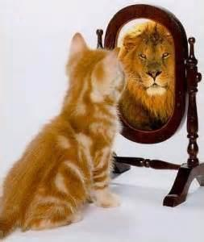
WHAT DO WE LOOK LIKE TO OTHERS?

Slide 18
WHAT WE SEE IN THE MIRROR MAY NOT BE WHAT OTHERS SEE

Slide 19
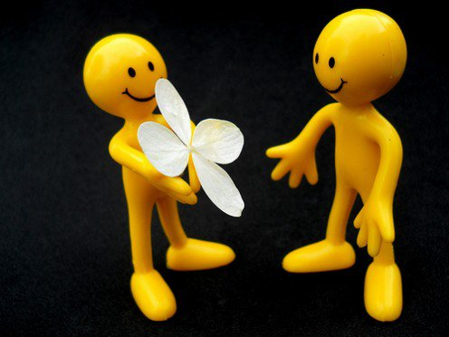
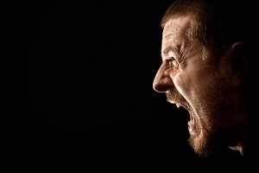
WE MAY SEE OURSELVES AS A KIND, LOVING PERSON
OTHERS MAY SEE US AS A MEAN, ANGRY PERSON

Slide 20
TV PROGRAM---WHAT NOT TO WEAR
THIS PROGRAM WAS DESIGNED TO HELP PEOPLE WHO HAVE NO TASTE IN DRESS
THEY HELPED PEOPLE WEAR CLOTHING THAT WAS STYLISH
THIS WAS SUPPOSE TO HELP BUILD THEIR SELF-CONFIDENCE

Slide 21
Col 3:12-14 Therefore, as God's chosen people, holy and dearly loved, clothe yourselves with compassion, kindness, humility, gentleness and patience. 13 Bear with each other and forgive whatever grievances you may have against one another. Forgive as the Lord forgave you. 14 And over all these virtues put on love, which binds them all together in perfect unity.
SOME TIMES WE ARE THE PEOPLE ON THIS TV PROGRAM
WE ARE WEARING THE WRONG THINGS

Slide 22
NOTICE THINGS WE ARE TO WEAR
“clothe yourselves”
COMPASSION
DO WE DEAL HARSHLY WITH ONE ANOTHER?
ARE WE CRITICAL OF ONE ANOTHER?
KINDNESS

Slide 23
NOTICE THINGS WE ARE TO WEAR
“clothe yourselves”
Gal 5:22-23 But the fruit of the Spirit is love, joy, peace, patience, kindness, goodness, faithfulness, 23 gentleness and self-control.
ARE WE AS KIND AS SHOULD BE?
HOW DO WE REACT TO OTHER PEOPLE?

Slide 24
NOTICE THINGS WE ARE TO WEAR
“clothe yourselves”
HUMILITY
DO OTHERS SEE US AS HUMBLE OR ARROGANT AND HAUGHTY?
Prov 16:18 Pride goes before destruction,
a haughty spirit before a fall.
Phil 2:3-4 Do nothing out of selfish ambition or vain conceit, but in humility consider others better than yourselves.

Slide 25
NOTICE THINGS WE ARE TO WEAR
“clothe yourselves”
GENTILENESS
Col 3:12-13 Since you have been chosen by God who has given you this new kind of life, and because of his deep love and concern for you, you should practice tenderhearted mercy and kindness to others. Don't worry about making a good impression on them, but be ready to suffer quietly and patiently. 13 Be gentle and ready to forgive; never hold grudges.

Slide 26
NOTICE THINGS WE ARE TO WEAR
“clothe yourselves”
GENTLENESS
IT IS OKAY FOR US TO WANT THINGS TO GO OUR WAY
IT IS ALSO OKAY THAT THINGS GO SOMEONE ELSE’S WAY
WE SHOULD FOCUS NOT ON WHAT WE WANT—BUT ON WHAT IS BEST FOR OTHERS

Slide 27
NOTICE THINGS WE ARE TO WEAR
“clothe yourselves”
IN ORDER TO BE PROPERLY CLOTHED WE MAY NEED TO TAKE OFF OUR OLD CLOTHES AND DESPOSE OF THEM
Col 3:7-10 But now you must rid yourselves of all such things as these: anger, rage, malice, slander, and filthy language from your lips. 9 Do not lie to each other, since you have taken off your old self with its practices 10 and have put on the new self, which is being renewed in knowledge in the image of its Creator.

Slide 28
NOTICE THINGS WE ARE TO WEAR
“clothe yourselves”
DO YOU HAVE AN OLD GARMENT THAT IS RAGGED—TORN—DIRTY THAT YOU JUST DON’T WANT TO GET RID OF?
IT MAY BE COMFORTABLE—IT MAY BE SOMETHING YOU LIKE
BUT IT DOESN’T LOOK GOOD WHEN YOU WEAR IT

Slide 29
NOTICE THINGS WE ARE TO WEAR
“clothe yourselves”
THIS VERSE TELLS US THERE MAY BE SOME THINGS WE NEED TO GIT RID OF
WE MAY LIKE THEM
WE MAY BE USED TO THEM
THEY MAY BE COMFORTABLE
BUT THEY NEED TO BE DISCARDED
WE DON’T LOOK GOOD IN THEM
THIS IS NOT HOW WE SHOULD LOOK

Slide 30
NOTICE THINGS WE ARE TO WEAR
“clothe yourselves”
WE ARE TOLD WHAT WE SHOULD CLOTHE OURSELVES WITH
WHEN WE DO THIS WE WILL APPEAR TO THE WORLD IN THE PROPER WAY
Phil 1:27 Whatever happens, conduct yourselves in a manner worthy of the gospel of Christ.

Slide 31
WHO WE ARE IS A MATTER OF THE HEART
1 Sam 16:7 But the Lord said to Samuel, "Do not consider his appearance or his height, for I have rejected him. The Lord does not look at the things man looks at. Man looks at the outward appearance, but the Lord looks at the heart."
HOW WE LOOK TO GOD IS HOW OUR HEART IS
OUR HEART WILL ALSO DETERMINE HOW WE LOOK TO OTHERS

Slide 32
WHO WE ARE IS A MATTER OF THE HEART
MAYBE WE NEED TO THROW AWAY SOME THINGS THAT DO NOT SHOW A PROPER HEART
DO WE SHOW THE CHARACTER OF CHRIST?
WE MAY KNOW ALL THE RIGHT THINGS TO SAY AND THE RIGHT THINGS TO DO IN CHURCH
THE WORLD DOES NOT SEE US IN CHURCH—THEY SEE US IN EVERYDAY LIFE

Slide 33
WHO WE ARE IS A MATTER OF THE HEART
Col 3:15-16 Let the peace of Christ rule in your hearts, since as members of one body you were called to peace. And be thankful.
PEACE IS ON EVERYONE’S MIND
BUT NOT MANY KNOW HOW TO GET IT
WHY?
BECAUSE WE WANT PEACE ON OUR OWN TERMS
IMAGINE A PEACEFUL PICTURE

Slide 35
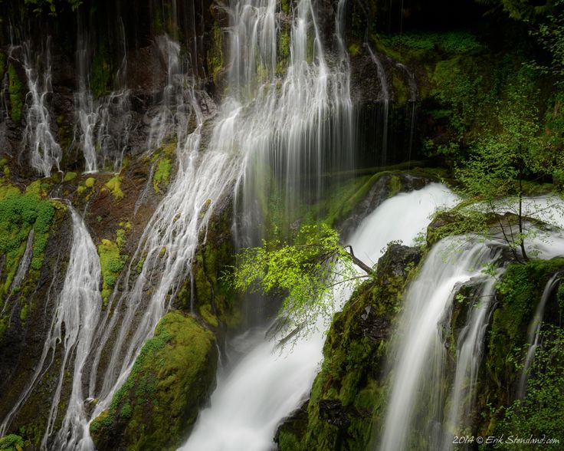

Slide 36
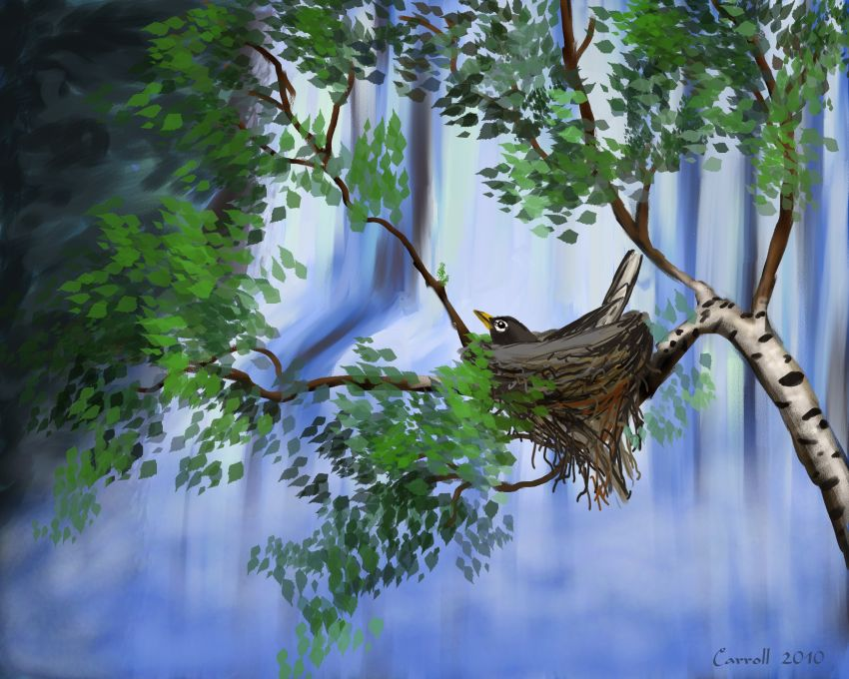

Slide 37
WHO WE ARE IS A MATTER OF THE HEART
THAT IS THE KIND OF PEACE WE CAN HAVE IN CHRIST JESUS
THE PEACE OF CHRIST NEEDS TO RULE OUR HEARTS
BECAUSE WE WERE CALLED TO PEACE
WHEN WE ARE AT PEACE WITH GOD—THE WORLD SEES US AS PEACEFUL

Slide 38
WHO WE ARE IS A MATTER OF THE HEART
And be thankful.
WE HAVE SOMETHNG WE CAN BE THANKFUL FOR EVERY DAY
IF YOU ARE HAVING A GOOD DAY BE THANKFUL THAT NOTHING HAS GONE WRONG
IF YOU ARE HAVING A BAD DAY BE THANKFUL THAT IT ISN’T WORSE

Slide 39
WHO WE ARE IS A MATTER OF THE HEART
And be thankful.
THE WORLD KNOWS HOW GRATEFUL WE ARE
DO YOU EVER THANK SOMEONE FOR LETTING YOU IN A LINE OF TRAFFIC?
DO YOU EVER THANK SOMEONE FOR GIVING YOU A COMPLIMENT?

Slide 40
WHO WE ARE IS A MATTER OF THE HEART
And be thankful.
THE FOCUS OF TODAY’S MESSAGE IS TO REMIND US WHO WE ARE
WE ARE CHILDREN OF GOD
AS SUCH WE MUST LOOK AND ACT LIKE GOD’S CHILDREN
HOW DOES THE WORLD SEE US?
HOW SHOULD THEY SEE US?

Slide 41
WHO WE ARE IS A MATTER OF THE HEART
DO YOU NEED TO REMOVE THE OLD GARMENTS OF BAD TRAITS?
DO YOU NEED TO CLOTHE YOURSELF IN THOSE CHARACTERISTICS THAT SHOW OTHERS WHO WE REALLY ARE?
DO NEED PEACE IN YOUR LIFE?
WHO DO YOU THINK YOU ARE?

