Slide 1
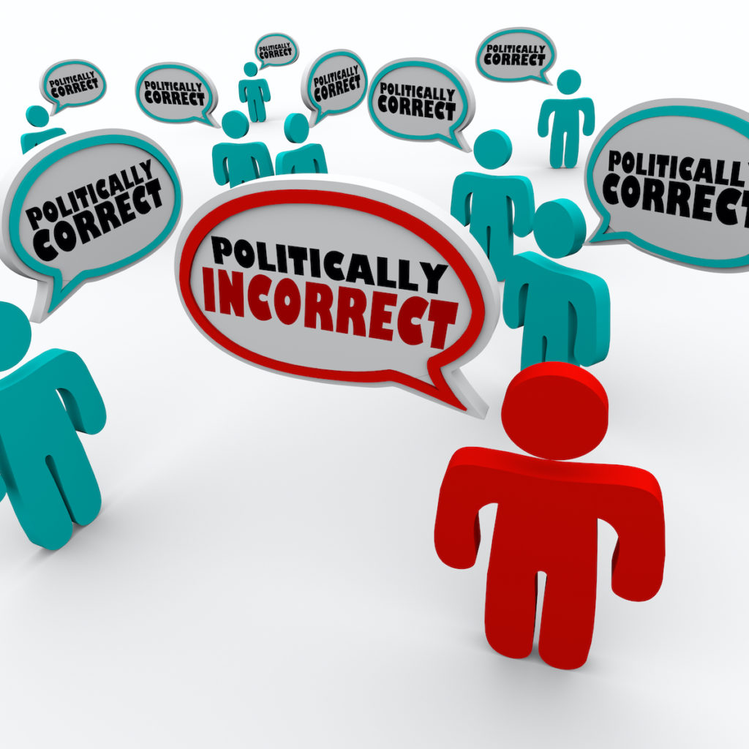
AS WE HEAD INTO AN ELECTION—THERE ARE MANY DISCUSSIONS ON TV AND MANY QUESTIONS ASKED

Slide 2
WHAT ARE TODAY’S ISSUES IN POLITICS?
Anti-Corruption and Transparency in government.
Arms Control and Nonproliferation.
Climate and Environment.
Climate Crisis—Global Warming.
Combating Drugs and Crime.
Countering Terrorism.
Cyber Issues.
Economic Prosperity and Trade Policy.

Slide 3
WHAT ARE TODAY’S ISSUES IN POLITICS?
Energy
Human trafficking
Human rights and democracy
Women’s issues
Scandals
Border Security
Election system

Slide 4
WHAT ARE TODAY’S ISSUES IN POLITICS?
War in Ukraine
Danger from Russia and China
Pollution
Gender Equality
Aging
Gun Control
THESE ARE ONLY A FEW OF THE ISSUES IN POLITICS TODAY

Slide 5
HOW DOES GOD SEE POLITICS?
Does God want Christians to be involved in politics?
Can a Christian vote?
Can a Christian support a particular candidate?
Can a Christian hold political office?
THESE ARE QUESTIONS THAT ARE ON OUR MINDS AS WE ARE SURROUNDED BY POLITICS IN OUR SOCIETY

Slide 6
GOD ALLOWS—BUT DOES NOT COMMAND POLITICAL ACTIVITY
Luke 3:12-13 Tax collectors also came to be baptized. "Teacher," they asked, "what should we do?" "Don't collect any more than you are required to," he told them.
John did not tell these tax collectors they needed to cease government involvement
He told them to do their job based on proper principles

Slide 7
Acts 24:10-11 When the governor motioned for him to speak, Paul replied: "I know that for a number of years you have been a judge over this nation; so I gladly make my defense.
When Paul was before Felix he did not rebuke him for his political involvement
He stated he was glad to make his defense before him

Slide 8
Acts 25:1-4
Three days after arriving in the province, Festus went up from Caesarea to Jerusalem, 2 where the chief priests and Jewish leaders appeared before him and presented the charges against Paul. 3 They urgently requested Festus, as a favor to them, to have Paul transferred to Jerusalem, for they were preparing an ambush to kill him along the way.

Slide 9
Acts 25:8-11
8 Then Paul made his defense: "I have done nothing wrong against the law of the Jews or against the temple or against Caesar."
9 Festus, wishing to do the Jews a favor, said to Paul, "Are you willing to go up to Jerusalem and stand trial before me there on these charges?"

Slide 10
10 Paul answered: "I am now standing before Caesar's court, where I ought to be tried. I have not done any wrong to the Jews, as you yourself know very well. 11 If, however, I am guilty of doing anything deserving death, I do not refuse to die. But if the charges brought against me by these Jews are not true, no one has the right to hand me over to them. I appeal to Caesar!"
Paul did not rebuke Festus for his political involvement
He appealed to Caesar using the political process to protect himself

Slide 11
Rom 13:1-3
Everyone must submit himself to the governing authorities, for there is no authority except that which God has established. The authorities that exist have been established by God. 2 Consequently, he who rebels against the authority is rebelling against what God has instituted, and those who do so will bring judgment on themselves.

Slide 12
1 Peter 2:13-17
Submit yourselves for the Lord's sake to every authority instituted among men: whether to the king, as the supreme authority, 14 or to governors, who are sent by him to punish those who do wrong and to commend those who do right. 15 For it is God's will that by doing good you should silence the ignorant talk of foolish men. 16 Live as free men, but do not use your freedom as a cover-up for evil; live as servants of God. 17 Show proper respect to everyone: Love the brotherhood of believers, fear God, honor the king.

Slide 13
GOD NEVER ASKED US TO ESTABLISH A “CHRISTIAN” NATION
CIVIL
AND
POLITICAL
NATION
ISRAEL
HAD A KING APPOINTED BY GOD
LAWS WRITTEN BY GOD
JUDGES JUDGED BASED ON GOD’S LAW

Slide 14
WHEN GOD ESTABLISHED THE NEW COVENANT HE DID NOT ESTABLISH AN EARTHLY NATION
Heb 12:26-29 At that time his voice shook the earth, but now he has promised, "Once more I will shake not only the earth but also the heavens." 27 The words "once more" indicate the removing of what can be shaken — that is, created things — so that what cannot be shaken may remain. 28Therefore, since we are receiving a kingdom that cannot be shaken, let us be thankful, and so worship God acceptably with reverence and awe, 29 for our "God is a consuming fire."

Slide 15
1 Peter 2:9-10 But you are a chosen people, a royal priesthood, a holy nation, a people belonging to God, that you may declare the praises of him who called you out of darkness into his wonderful light.
Phil 3:20-21 But our citizenship is in heaven. And we eagerly await a Savior from there, the Lord Jesus Christ, 21 who, by the power that enables him to bring everything under his control, will transform our lowly bodies so that they will be like his glorious body.

Slide 16
AS CHRISTIANS WE MAKE UP A HOLY NATION
IT IS NOT THE UNITED STATES OF AMERICA
AS CHRISTIANS WE ARE CITIZENS OF HEAVEN
NOT CITIZENS OF AN EARTHLY KINGDOM

Slide 17
WE NEED TO REMEMBER:
Christ did not die to make America a “Christian” nation
He did not die so a nation could have “Christian” laws
He did not die so Christians would run countries
HE DIED SO THE LOST COULD BE SAVED
THE SAVED MAKE UP HIS NATION

Slide 18
GOD HAS NEVER ASKED US TO SPREAD THE GOSPEL THRU POLITICAL MEANS
Does the Bible teach that God wants us to make sure our President & Congress pass laws that uphold morals?
Does God want people to obey Him?
Does God want His kingdom spread throughout the world?
NO!
YES!
YES!
BUT GOD HAS NOT ASKED US TO DO THIS THRU POLITICAL MEANS
OUR VOTE—OUR PRESIDENT—OUR NATION’S LAWS—ARE NOT PART OF GOD’S PLAN TO SAVE SOULS

Slide 19
Matt 28:19 Therefore go and make disciples of all nations,
This does not say: “Make all nations Christians”
It says: “Make people in all nations Christians”
It does not say: “Go into all the world and campaign for Christian laws” or campaign for a political candidate
It says: “Go into the entire world and preach the Gospel”

Slide 20
WHAT DOES ROMANS 10:15 SAY:
As it is written, "How beautiful are the feet of those who bring good news!"
“How beautiful are the feet of those who run nations in a Christian way” ?
“How beautiful are the feet of those who vote a certain way” ?
“How beautiful are the feet of those who preach the good news”

Slide 21
WE CAN FEEL FREE TO HAVE POLITICAL OPINIONS
WE CAN FEEL FREE TO VOTE OUR CONSCIENCE
BUT DO NOT CONFUSE POLITICAL WORK WITH GOD’S KINGDOM WORK
PREVIOUS SPEAKER OF THE HOUSE: “We are doing God’s work”
GOD HAS NOT ASKED US TO SPREAD THE GOSPEL THRU POLITICAL MEANS

Slide 22
THE CONSTITUTION IS NOT THE BIBLE
We hear a lot about “God-given rights”
Spoken in context of our nation’s “Declaration of Independence” and the “Constitution”
We have been endowed by our Creator with the unalienable rights of life, liberty and the pursuit of happiness
Practice religion
Free speech
Bear arms
Speedy trials
FIND ONE BIBLE
VERSE THAT SAYS
ANY OF US ACTUALY
HAVE ANY OF THESE
RIGHTS

Slide 23
THE DECLARATION OF INDEPENDENCE AND THE CONSTITUTION ARE NOT DIVINE
THEY WERE NOT DIVINELY INSPIRED
THEY DO NOT ENUMERATE GOD GIVEN RIGHTS
THE BIBLE IS GOD’S BOOK
YOU CAN READ IT FROM COVER TO COVER AND NOT LEARN ONE THING ABOUT THE CONSTITUTION
HOW THE CONSTITUTION SHOULD BE READ—INTERPRETED

Slide 24
WE COULD COMPLETELY DO AWAY WITH THE CONSTITUTION
WE COULD ESTABLISH A COMPLETEY DIFFFERENT FORM OF GOVERNMENT
WE COULD CHANGE THE WAY OUR WHOLE SYSTEM WORKS
AND GOD WOULD NOT CARE!

Slide 25
GOD ONLY EXPRESSED ONE POLITICAL OPINION IN THE N.T.
GOD HAS
NOT ONE
TIME
EXPRESSED
A
POLITICAL
CONCERN
ABOUT
ANY OF
THESE
Taxes
Immigration
Healthcare
Homeland security
Defense
Trade
Environment

Slide 26
GOD ONLY EXPRESSED ONE POLITICAL OPINION IN THE N.T.
1 Tim 2:1-4 I urge, then, first of all, that requests, prayers, intercession and thanksgiving be made for everyone— 2 for kings and all those in authority, that we may live peaceful and quiet lives in all godliness and holiness. 3 This is good, and pleases God our Savior,

Slide 27
Rome was not a godly government
Homosexuality was commonplace
Abortion was frequent
Idolatry was rampant
Emperor worship was common
God’s only concern was a government that would allow Christians to live the life God wanted them to live
The only thing God asked was to pray for the nation’s leaders and be subject to them

Slide 28
THERE HAS NOT BEEN A SINGLE LAW PASSED BY MAN THAT HAS BEEN A VICTORY FOR CHRIST
2 Cor 10:3-6 For though we live in the world, we do not wage war as the world does. 4 The weapons we fight with are not the weapons of the world. On the contrary, they have divine power to demolish strongholds. 5 We demolish arguments and every pretension that sets itself up against the knowledge of God, and we take captive every thought to make it obedient to Christ.

Slide 29
GOD EXPECTS US TO UNITE AROUND PRINCIPLES GREATER THAN POLITICS
Have you considered the people Jesus brought together as His apostles?
Matthew—a tax collector
Simon—a zealot
Roman collaborator
Trying to oust the Romans
Being a Christian does not mean being a Democrat—republican—independent
Being a Christian doesn’t mean we have to believe in democracy

Slide 30
BEING A CHRISTIAN MEANS:
Uniting around Christ
SATAN WORKS HARD AT TRYING TO DIVIDE US
Gators—Seminoles—USF—Bucs--Rays
Ford—Chevy—Nissan—Toyota—Honda--Dodge –Honda--Kia
PCs or MACs
Republican—Democrat—Socialist—Libertarian—Constitutionalist- Independent
SATAN IS HAPPY TO DIVIDE US OVER THESE THINGS AS WELL AS OVER POLITICS

Slide 31
JESUS DID NOT DIE TO CHANGE OUR POLITICS
He died to SAVE SOULS
He died to unite us together in something greater than politics
Let’s get politics off our spiritual table
Let’s quit assuming that Christians have to agree with each other politically
It’s fine to discuss politics
It’s alright to disagree….but don’t walk away saying:
“How can that person be a Christian if they disagree with me politically?”

Slide 32
We all have different opinions about the political climate of the day
We all have different degrees of concern about political matters or even who to vote for
What is not okay:
To think our political opinions are a part of God’s kingdom work
To think that what is going on in Washington is a victory or defeat for Christ
To think we have done God’s will by voting instead of talking to people about Jesus
To equate American ideals with God’s will

Slide 33
We are a “chosen nation” because we are in Christ—Not because we are an American - Republican, Democrat, Independent
Our citizenship is in heaven
America is not God’s nation
The Constitution is not God’s document
He did not die to get us into a political party
He did not die to make sure healthcare was privatized or nationalized.

Slide 34
He did not die to get us into an acclimatized atmosphere
He did not die to secure the borders
He did not die to control the economy
He did not die to assure our political freedoms
He did not die to govern and control how we vote
He did not die to make us Republican, Democrats or Independents
He died to make sure our souls were cared for
He died to guarantee our freedom from sin

Slide 35
BOTTOM LINE
We should vote—we have a voice
We should choose men and women who stand for moral principles
We need to pray for our political leaders
We need to remember GOD IS IN CONTROL

Slide 36
BOTTOM LINE
We need to remember GOD IS IN CONTROL
Dan 2:20-21 "Praise be to the name of God for ever and ever; wisdom and power are his.
21 He changes times and seasons; he sets up kings and deposes them.
He gives wisdom to the wise and knowledge to the discerning.
NIV

Slide 37
BOTTOM LINE
We should vote—we have a voice
We should choose men and women who stand for moral principles
We need to pray for our political leaders
We need to remember GOD IS IN CONTROL

Slide 38
BOTTOM LINE
We should vote—we have a voice
We should choose men and women who stand for moral principles
We need to pray for our political leaders
We need to remember GOD IS IN CONTROL
We need to be active in spreading the Kingdom of God not the nations of men

Slide 39
BOTTOM LINE
We need to live peaceful and quiet lives in all godliness and holiness
We need to abolish arguments and pretensions that set themselves up against the knowledge of God
We need to make prayers, supplications and requests for our political leaders
We need to be a holy nation—people who belong to God so we can declare His praises
“This is good, and pleases God our Savior”

