Slide 1
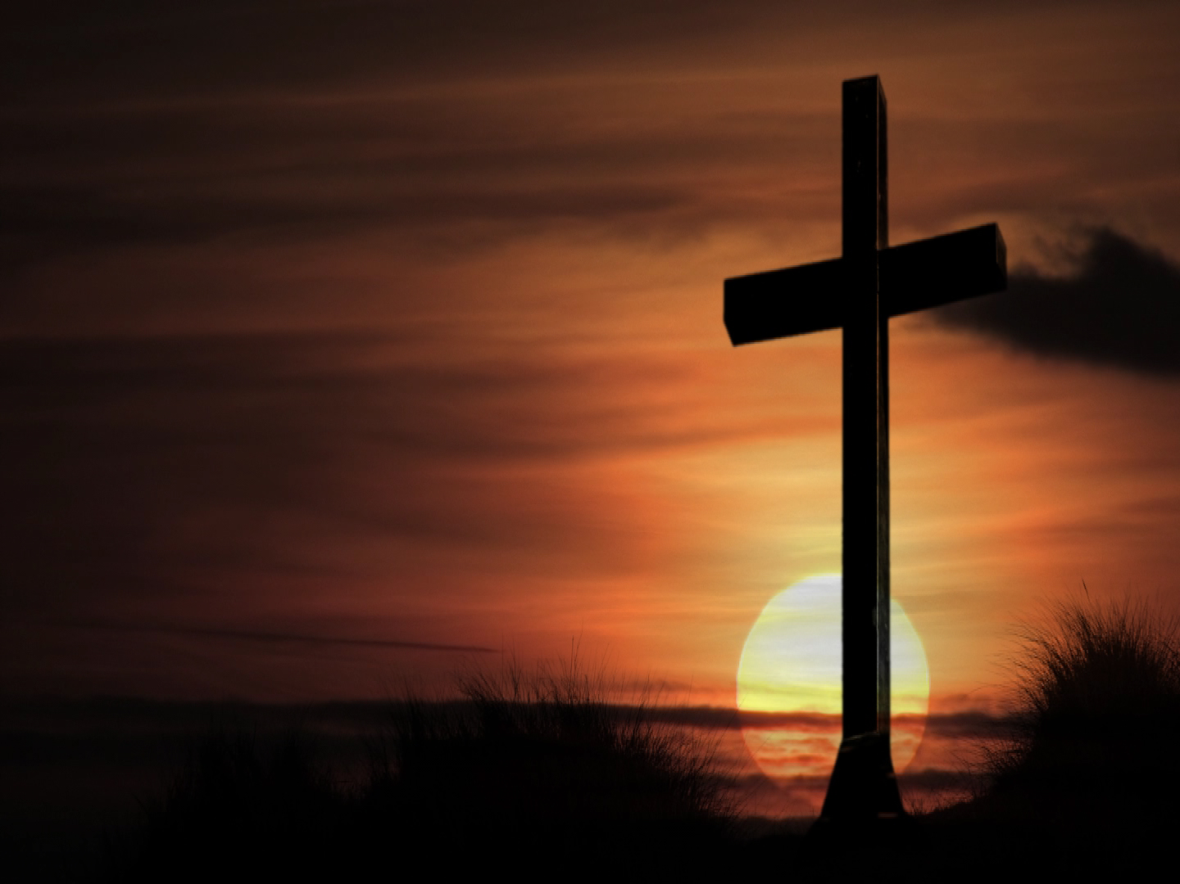
WERE YOU PRESENT AT THE CRUCIFIXION OF CHRIST?
Were you there when they crucified my Lord?
Were you there when they nailed Him to the tree?

Slide 2
WERE YOU PRESENT AT THE CRUCIFIXION OF CHRIST?
This occurred 2000 years ago
Of course we were not physically there
We were not there in person

Slide 3
THE CROSS OF CHRIST HAS A WAY OF EXPOSING US TO OUR TRUE NATURE

Slide 4
THE CROSS OF CHRIST HAS A WAY OF EXPOSING US TO OUR TRUE NATURE
While we were not personally there....
Some who were there may represent us....

Slide 5
THE VERY NATURE OF THE CROSS DEMANDS A COMPLETE CHANGE

Slide 6
Luke 9:23-24 Then he said to them all: "If anyone would come after me, he must deny himself and take up his cross daily and follow me. 24 For whoever wants to save his life will lose it, but whoever loses his life for me will save it.
CHRISTIANITY BY IT’S NATURE IS RADICAL

Slide 7
THE EVENTS SURROUNDING THE CROSS REVEAL THERE IS A DIFFERENCE IN WHO WE THINK WE ARE AND WHO WE REALLY ARE
IT IS SOMETIMES DIFFICULT TO SEE OURSELVES AS WE REALLY ARE

Slide 8
2 Cor 13:5 Examine yourselves to see whether you are in the faith; test yourselves.
THE CROSS BROUGHT SEVERAL FACE TO FACE WITH WHO THEY REALLY WERE

Slide 9
2 Cor 13:5 Examine yourselves to see whether you are in the faith; test yourselves.
WE MIGHT BE REPRESENTED BY THOSE WHO WITNESSED THE CROSS OF JESUS

Slide 11
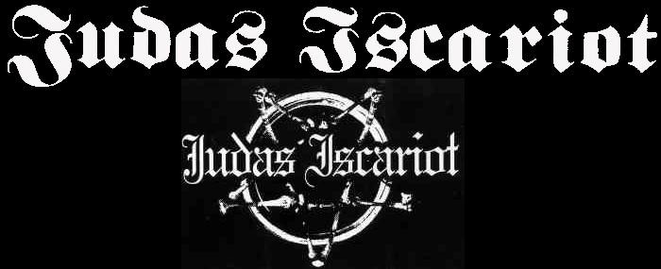
HE PROBABLY NEVER SAW HIMSELF AS HE REALLY WAS

Slide 12
HE PROBABLY NEVER CONSIDERED HIMSELF A THIEF OR A BETRAYER OF JESUS

Slide 13
HE PROBABLY THOUGHT—”I AM LIKE THE OTHER APOSTLES”

Slide 14
I MAY HAVE SOME WEAKNESSES—BUT I LOVE GOD

Slide 15
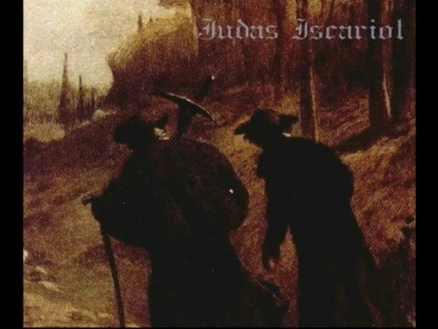
JUDAS WAS CHOSEN BY JESUS TO BE ONE OF THE TWELVE APOSTLES

Slide 16
As an apostle Judas suffered the same things the other apostles suffered
He heard the teachings of Jesus
He was sent out with the others to preach the gospel of Christ

Slide 17
He compromised his former life by following Jesus and doing these good things

Slide 18
John 12:4-6 But one of his disciples, Judas Iscariot, who was later to betray him, objected, 5 "Why wasn't this perfume sold and the money given to the poor? It was worth a year's wages." 6 He did not say this because he cared about the poor but because he was a thief; as keeper of the money bag, he used to help himself to what was put into it.

Slide 19
He perhaps rationalized his sin
He likely had a false view of the kingdom as did the other apostles
He betrayed Jesus because of his love for money

Slide 20
MODERN DAY JUDAS’
THOSE WHO PUT PHYSICAL THINGS OVER SPIRITUAL
Col 3:5 Put to death, therefore, whatever belongs to your earthly nature: sexual immorality, impurity, lust, evil desires and greed, which is idolatry.

Slide 21
MODERN DAY JUDAS’
THOSE WHO PUT PHYSICAL THINGS OVER SPIRITUAL
Matt 6:33 But seek first his kingdom and his righteousness, and all these things will be given to you as well.

Slide 22
MODERN DAY JUDAS’
THOSE WHO PRACTICE SIN WITH NO RESPONSIBILITY
1 John 3:9 No one who is born of God will continue to sin, because God's seed remains in him; he cannot go on sinning, because he has been born of God.

Slide 23
MODERN DAY JUDAS’
DID JUDAS REPRESENT YOU AT THE CRUCIFIXION?

Slide 24
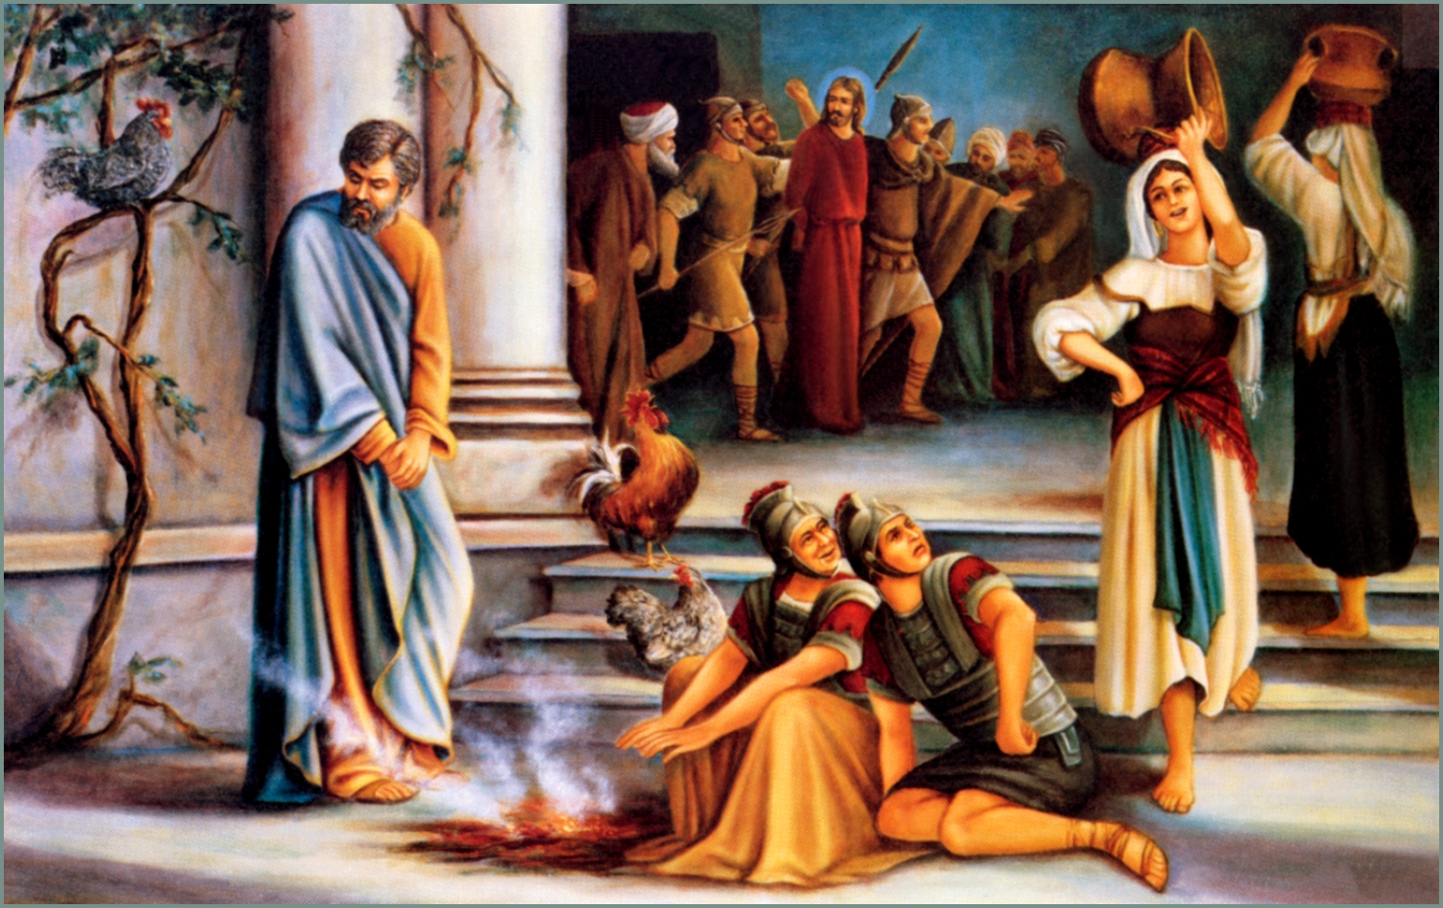
PETER’S DENIAL

Slide 25
PETER’S DENIAL
Peter was over-confident
Matt 26:31-35 Then Jesus told them, "This very night you will all fall away on account of me, for it is written:
"'I will strike the shepherd, and the sheep of the flock will be scattered.'

Slide 26
PETER’S DENIAL
Peter was over-confident
32 But after I have risen, I will go ahead of you into Galilee."
33 Peter replied, "Even if all fall away on account of you, I never will."
34 "I tell you the truth," Jesus answered, "this very night, before the rooster crows, you will disown me three times."

Slide 27
PETER’S DENIAL
Peter was over-confident
35 But Peter declared, "Even if I have to die with you, I will never disown you." And all the other disciples said the same.

Slide 28
PETER’S DENIAL
THIS IS NOT THE 1ST TIME PETER HAD MADE THIS AFFIRMATION
PETER HAD THIS SAME REACTION EARLIER

Slide 29
PETER’S DENIAL
HIS OVER-CONFIDENCE LEFT HIM UNPREPARED
HE DID THE VERY THING HE SAID HE WOULD NEVER DO
HE FAILED TO HEED THE WARNING

Slide 30
PETER’S DENIAL
Matt 26:57-58 Those who had arrested Jesus took him to Caiaphas, the high priest, where the teachers of the law and the elders had assembled. 58 But Peter followed him at a distance, right up to the courtyard of the high priest. He entered and sat down with the guards to see the outcome.

Slide 31
PETER’S DENIAL
Matt 26:69-70 Now Peter was sitting out in the courtyard, and a servant girl came to him. "You also were with Jesus of Galilee," she said.
70 But he denied it before them all. "I don't know what you're talking about," he said.

Slide 32
PETER’S DENIAL
Matt 26:71-72 Then he went out to the gateway, where another girl saw him and said to the people there, "This fellow was with Jesus of Nazareth."
72 He denied it again, with an oath: "I don't know the man!"

Slide 33
PETER’S DENIAL
Matt 26:73-75 After a little while, those standing there went up to Peter and said, "Surely you are one of them, for your accent gives you away."
74 Then he began to call down curses on himself and he swore to them, "I don't know the man!"

Slide 34
PETER’S DENIAL
Immediately a rooster crowed. 75 Then Peter remembered the word Jesus had spoken: "Before the rooster crows, you will disown me three times." And he went outside and wept bitterly.

Slide 35
LIKE PETER—WE CAN BE OVER-CONFIDENT
1 Cor 10:12 So, if you think you are standing firm, be careful that you don't fall!

Slide 36
LIKE PETER—WE CAN IGNORE CLEAR WARNINGS OF SCRIPTURE
1 Cor 15:33 Do not be misled: "Bad company corrupts good character.”

Slide 37
DID PETER REPRESENT YOU AT THE CRUCIFIXION?

Slide 38
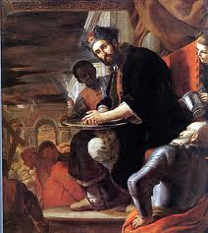
THE COWARDICE OF PILATE
Probably thought of himself as brave
John 18:38 "What is truth?" Pilate asked. With this he went out again to the Jews and said, "I find no basis for a charge against him.

Slide 39
THE COWARDICE OF PILATE
Probably thought of himself as brave
John 19:4 Once more Pilate came out and said to the Jews, "Look, I am bringing him out to you to let you know that I find no basis for a charge against him."

Slide 40
THE COWARDICE OF PILATE
Probably thought of himself as brave
John 19:6 As soon as the chief priests and their officials saw him, they shouted, "Crucify! Crucify!“ But Pilate answered, "You take him and crucify him. As for me, I find no basis for a charge against him."

Slide 41
THE COWARDICE OF PILATE
Probably thought of himself as brave
John 19:12 From then on, Pilate tried to set Jesus free, but the Jews kept shouting, "If you let this man go, you are no friend of Caesar. Anyone who claims to be a king opposes Caesar."

Slide 42
THE COWARDICE OF PILATE
Probably thought of himself as brave
Matt 27:24 When Pilate saw that he was getting nowhere, but that instead an uproar was starting, he took water and washed his hands in front of the crowd. "I am innocent of this man's blood," he said. "It is your responsibility!"

Slide 43
THE COWARDICE OF PILATE
Probably thought of himself as brave
Pilate knew the truth—but wanted others to take a stand first
He thought he could just “wash his hands” after saying the right things

Slide 44
WHO ARE THE PILATES TODAY?
Those who compromise because of peer pressure
Those who are influenced by ungodly people

Slide 45
WERE YOU REPRESENTED BY PILATE AT THE CRUCIFIXION?

Slide 46
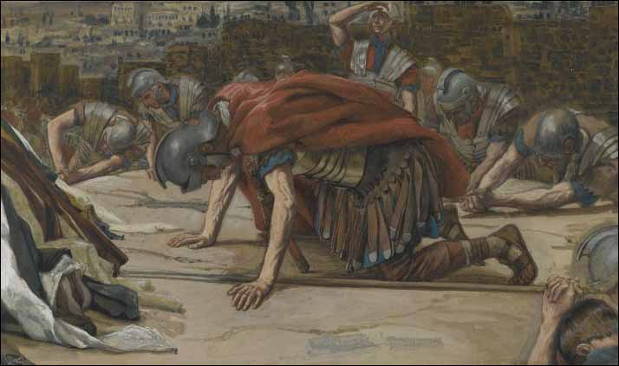
THE PERPLEXITY OF THE CENTURION
The Centurion was troubled by what he saw

Slide 47
THE PERPLEXITY OF THE CENTURION
Matt 27:50-54 And when Jesus had cried out again in a loud voice, he gave up his spirit. 51 At that moment the curtain of the temple was torn in two from top to bottom. The earth shook and the rocks split. 52 The tombs broke open and the bodies of many holy people who had died were raised to life. 53 They came out of the tombs, and after Jesus' resurrection they went into the holy city and appeared to many people.

Slide 48
THE PERPLEXITY OF THE CENTURION
54 When the centurion and those with him who were guarding Jesus saw the earthquake and all that had happened, they were terrified, and exclaimed, "Surely he was the Son of God!"

Slide 49
THE PERPLEXITY OF THE CENTURION
He could see the truth while others could not
He did not have the background of the Jewish crowd
He was the most unlikely prospect to believe in Jesus

Slide 50
THE PERPLEXITY OF THE CENTURION
There are “centurions” in our world today
They may not have “our” background
But we need to seek them out and show them Jesus
Example: Cornelius

Slide 51
THE PERPEXITY OF THE CENTURION
There are “centurions” in our world today
Rom 1:16 I am not ashamed of the gospel, because it is the power of God for the salvation of everyone who believes: first for the Jew, then for the Gentile.

Slide 52
DID THE CENTURION REPRESENT YOU AT THE CRUCIFIXION?

Slide 53
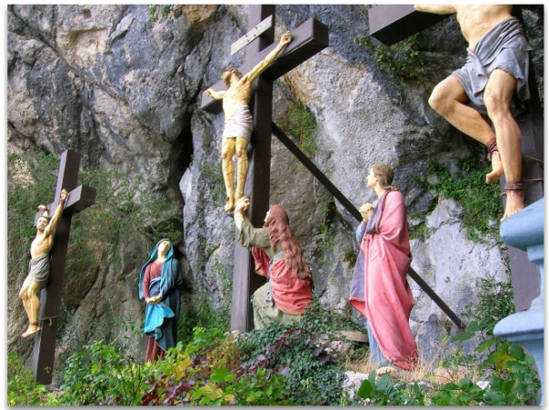
THE STEADFASTNESS OF MARY
Matt 27:55-56 Many women were there, watching from a distance. They had followed Jesus from Galilee to care for his needs. 56 Among them were Mary Magdalene, Mary the mother of James and Joses, and the mother of Zebedee's sons.

Slide 54
THE STEADFASTNESS OF MARY
Mary was with the Lord to the very end
Was she in danger?
YES
Was she afraid?
YES
YET HER FAITH DID NOT WAVER
SHE WAS STEADFAST IN HER DEVOTION TO CHRIST

Slide 55
THE STEADFASTNESS OF MARY
THE LORD NEEDS PEOPLE TODAY LIKE MARY
1 Cor 15:58 Therefore, my dear brothers, stand firm. Let nothing move you. Always give yourselves fully to the work of the Lord, because you know that your labor in the Lord is not in vain.

Slide 56
WERE YOU PRESENT AT THE CRUCIFIXION OF CHRIST?
In many ways we show the same heart of those we have studied today

Slide 57
WERE YOU PRESENT AT THE CRUCIFIXION OF CHRIST?
ARE YOU A JUDAS?
Do you rationalize your sin?
Do you put physical things before spiritual things?

Slide 58
WERE YOU PRESENT AT THE CRUCIFIXION OF CHRIST?
DOES PETER REPRESENT YOU?
Are you over-confident?
Do you associate with the wrong people?

Slide 59
WERE YOU PRESENT AT THE CRUCIFIXION OF CHRIST?
ARE WE A COWARD LIKE PILATE?
We know the truth
But are not willing to take a stand
Do we “wash our hands” ?

Slide 60
WERE YOU PRESENT AT THE CRUCIFIXION OF CHRIST?
DO YOU HAVE THE HEART OF THE CENTURION?
You see the truth of the gospel
You know that Jesus is the Christ
You are willing to act on that

Slide 61
WERE YOU PRESENT AT THE CRUCIFIXION OF CHRIST?
DO YOU HAVE THE STEADFASTNESS OF MARY?
Will you remain faithful regardless?
Will you be steadfast to the end?

Slide 62
WERE YOU PRESENT AT THE CRUCIFIXION OF CHRIST?
Heb 6:4-6 For it is impossible to restore again to repentance those who have once been enlightened, who have tasted the heavenly gift, and have shared in the Holy Spirit, 5 and have tasted the goodness of the word of God and the powers of the age to come, 6 if they then fall away, since they are crucifying once again the Son of God to their own harm and holding him up to contempt. ESV

Slide 63
WERE YOU PRESENT AT THE CRUCIFIXION OF CHRIST?
Heb 6:4-6 For it is impossible to restore again to repentance those who have once been enlightened, who have tasted the heavenly gift, and have shared in the Holy Spirit, 5 and have tasted the goodness of the word of God and the powers of the age to come, 6 if they then fall away, since they are crucifying once again the Son of God to their own harm and holding him up to contempt. ESV

Slide 64
WERE YOU PRESENT AT THE CRUCIFIXION OF CHRIST?
IF YOU ARE NOT A CHRISTIAN—YOU ARE CRUCIFYING THE SON OF GOD AGAIN
IF YOU HAVE FALLEN AWAY—YOU ARE CRUCIFYING THE SON OF GOD AGAIN

Slide 65
WERE YOU PRESENT AT THE CRUCIFIXION OF CHRIST?
WHY NOT SHOW THE GLORY OF THE CROSS TODAY BY YOUR OBEDIENCE?

