Slide 1

WELCOME TO OUR SERVICES

Slide 2

DESIGNED BY JIM INGRAM

Slide 3


Slide 4


Slide 5

SUNDAY – 9:30 AM
MONDAY BIBLE STUDY – 6:30 PM IN WEST ANNEX
WEDNESDAY BIBLE STUDY – 7:00 PM IN WEST ANNEX
W.I.N.G.S. LADIES CLASS THURSDAY– 10 AM IN WEST ANNEX

Slide 6
TODAY’S WORSHIP LEADERS
CALL TO WORSHIP
PRAYER
SONG LEADER
SCRIPTURE
HEADING TABLE
SERMON
CLOSING PRAYER
ANNOUNCEMENTS
Jim Ingram
Henry Oliu
Willard Duncan
Gailand Kiltz
Steve Harrell
Charles Murray
John Smith
Harry Cowan

Slide 7

MONDAY NIGHT BIBLE STUDY 6:30PM will meet in the West Annex
WEDNESDAY BIBLE STUDY will meet in the West Annex until further notice
LADIES BIBLE CLASS W.I.N.G.S (Women In God’s Service) Thursday 10:00 AM – meets in the West Annex

Slide 8

FIVE MINUTE RULE

Slide 9


Slide 10


Slide 11


Slide 12


Slide 14

406 - More About Jesus - Title

Slide 15
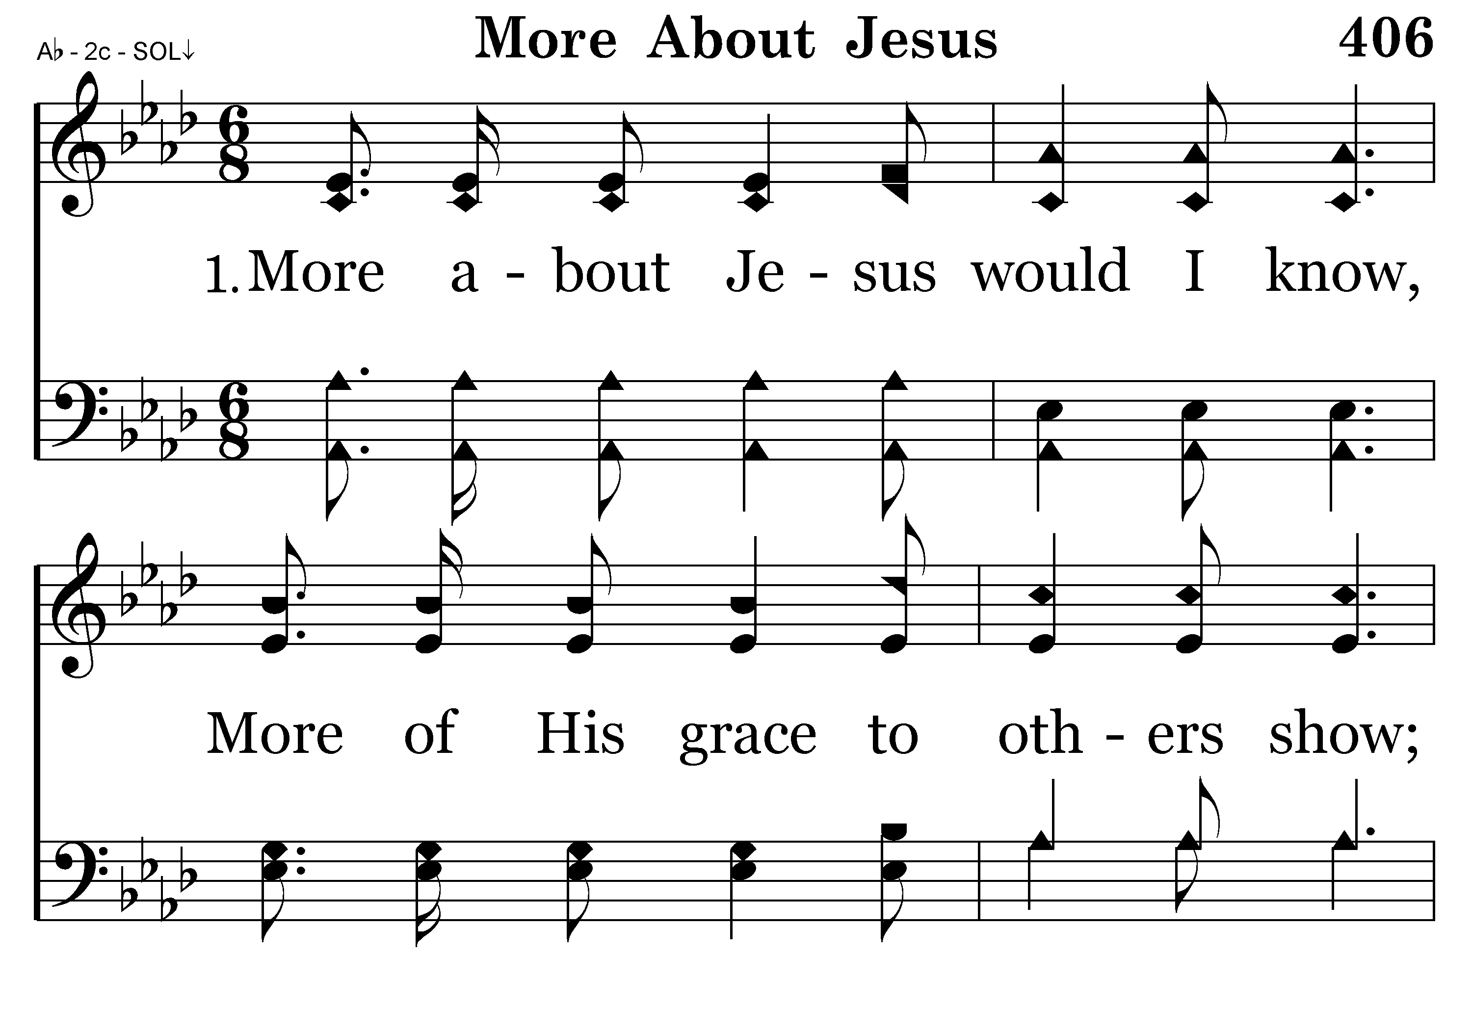
406 - More About Jesus - 1.1

Slide 16
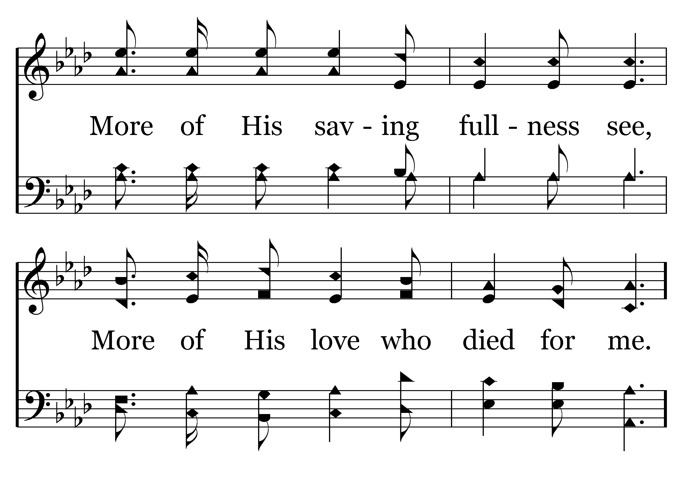
406 - More About Jesus - 1.2

Slide 17
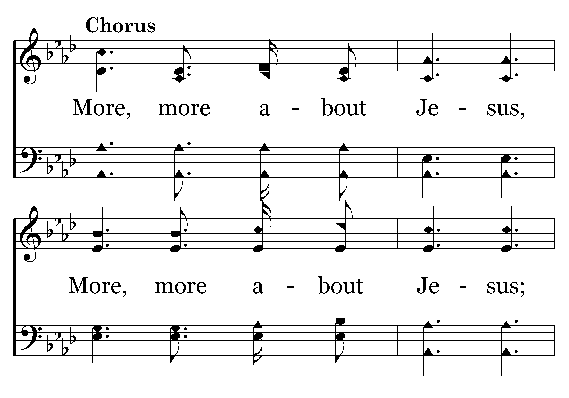
406 - More About Jesus - C.1

Slide 18
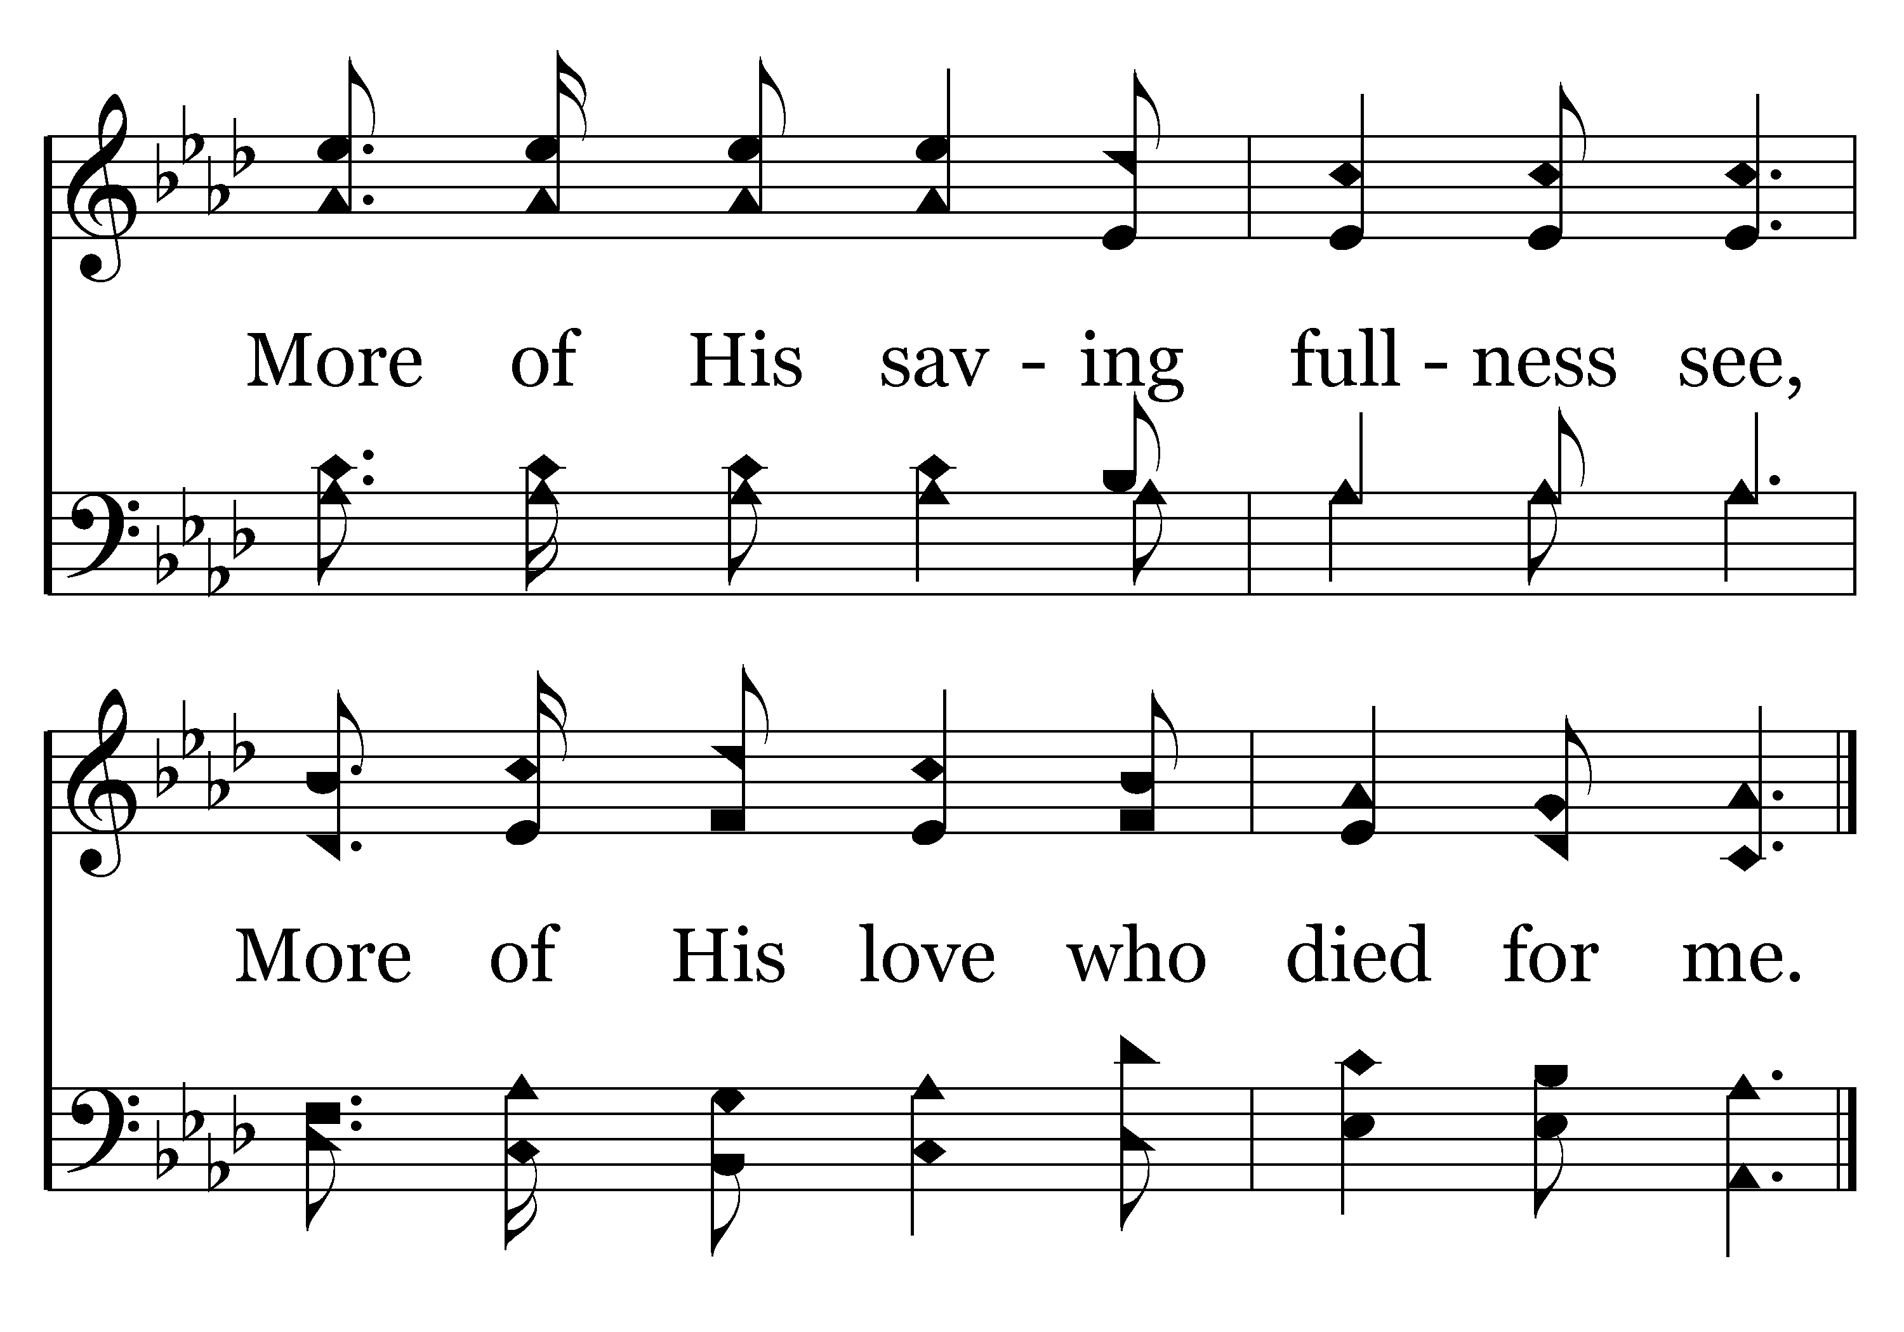
406 - More About Jesus - C.2
End of Verse 1

Slide 19
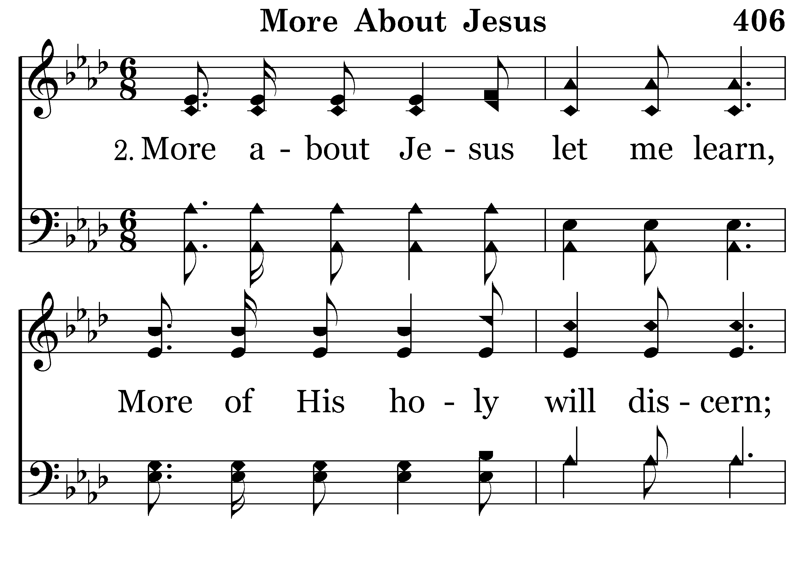
406 - More About Jesus - 2.1

Slide 20
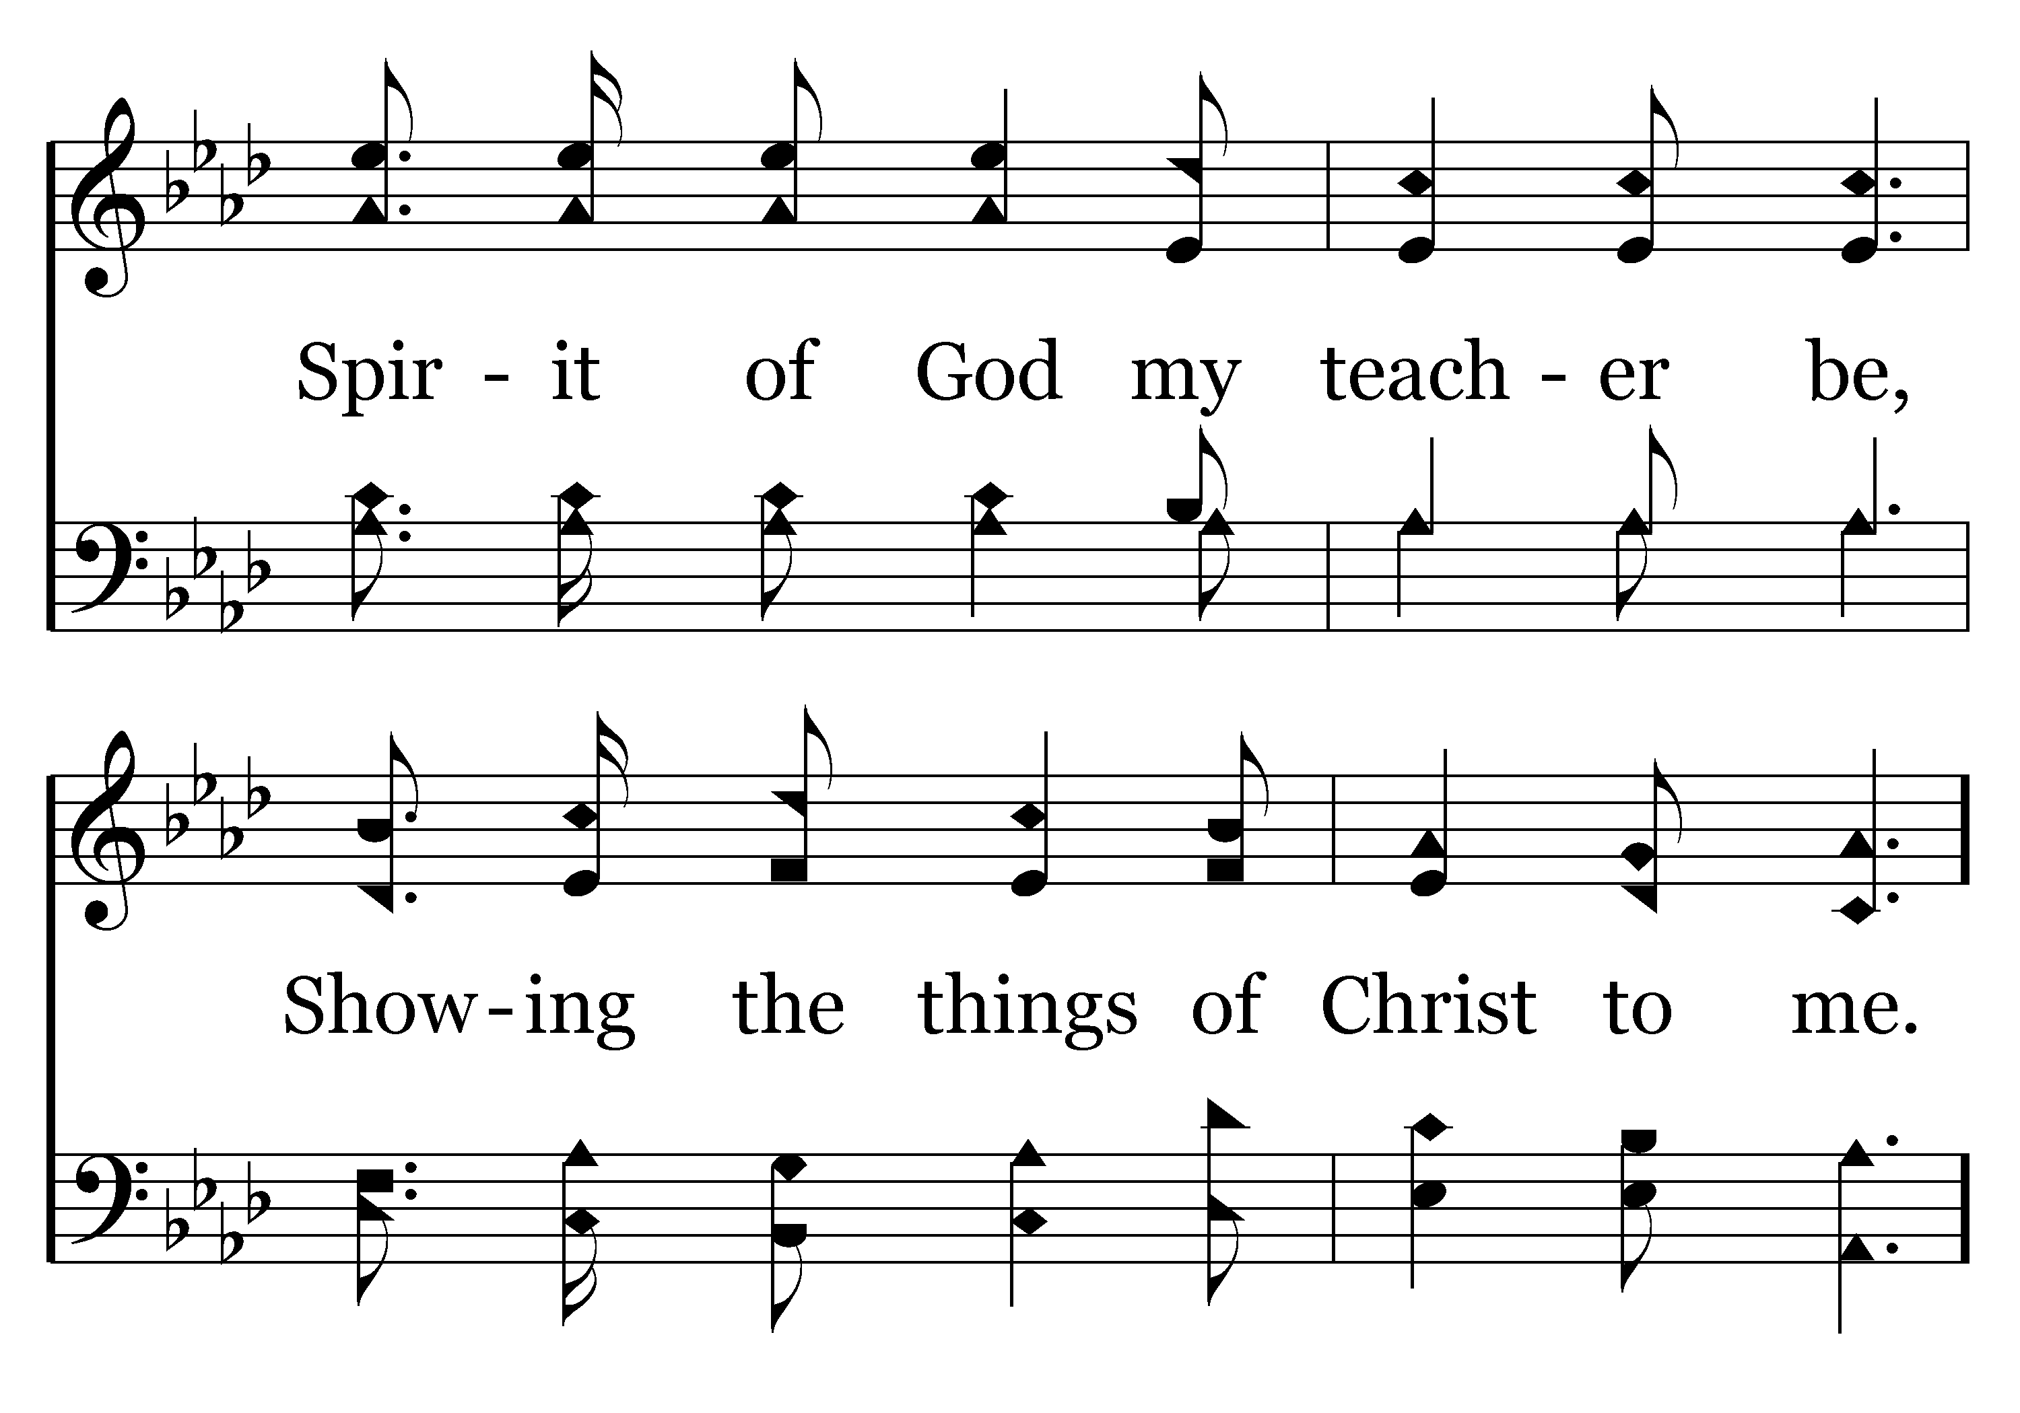
406 - More About Jesus - 2.2

Slide 21
406 - More About Jesus - C.1

Slide 22
406 - More About Jesus - C.2
End of Song

Slide 24

WELCOME BY JIM INGRAM

Slide 25

PRAYER
Jerry Mellish
HENRY OLIU

Slide 27
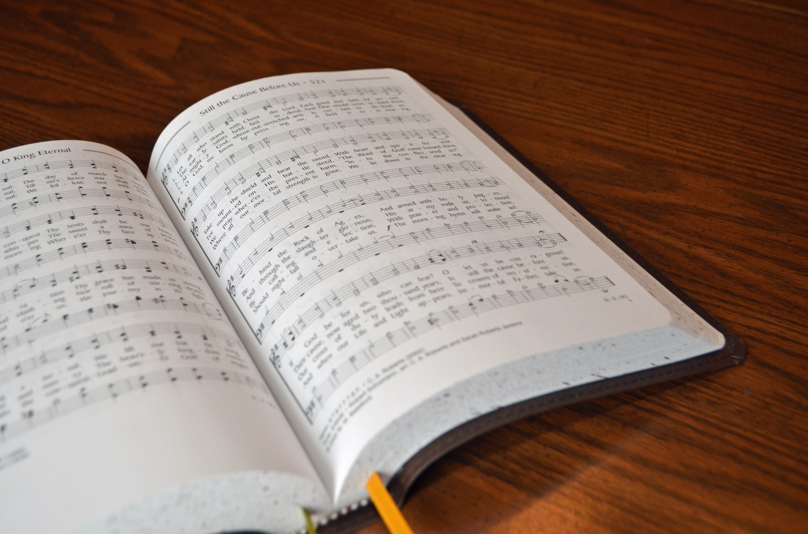
SONG LEADER
WILLARD DUNCAN

Slide 28
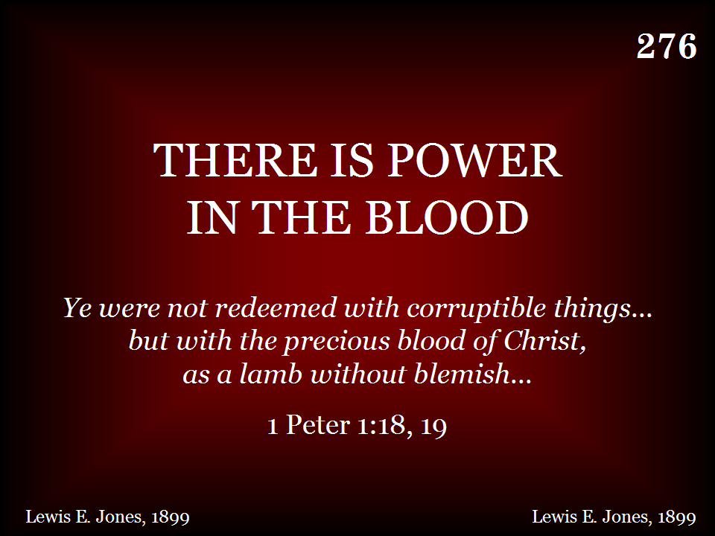
276 - There Is Power In The Blood - Title

Slide 29
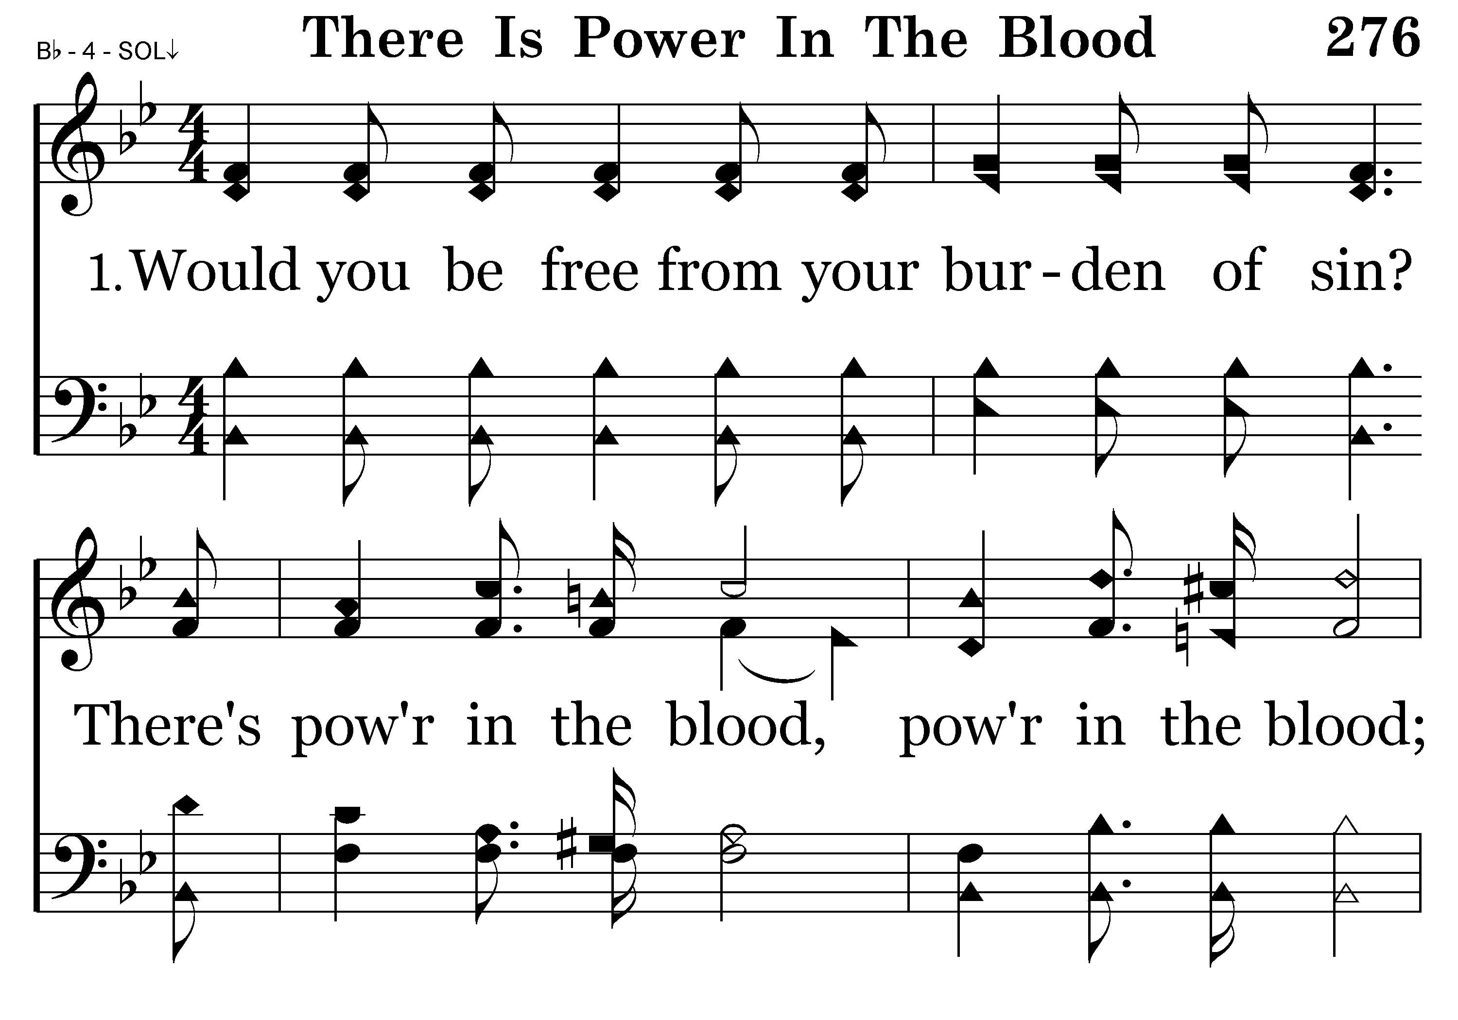
276 - There Is Power In The Blood - 1.1

Slide 30
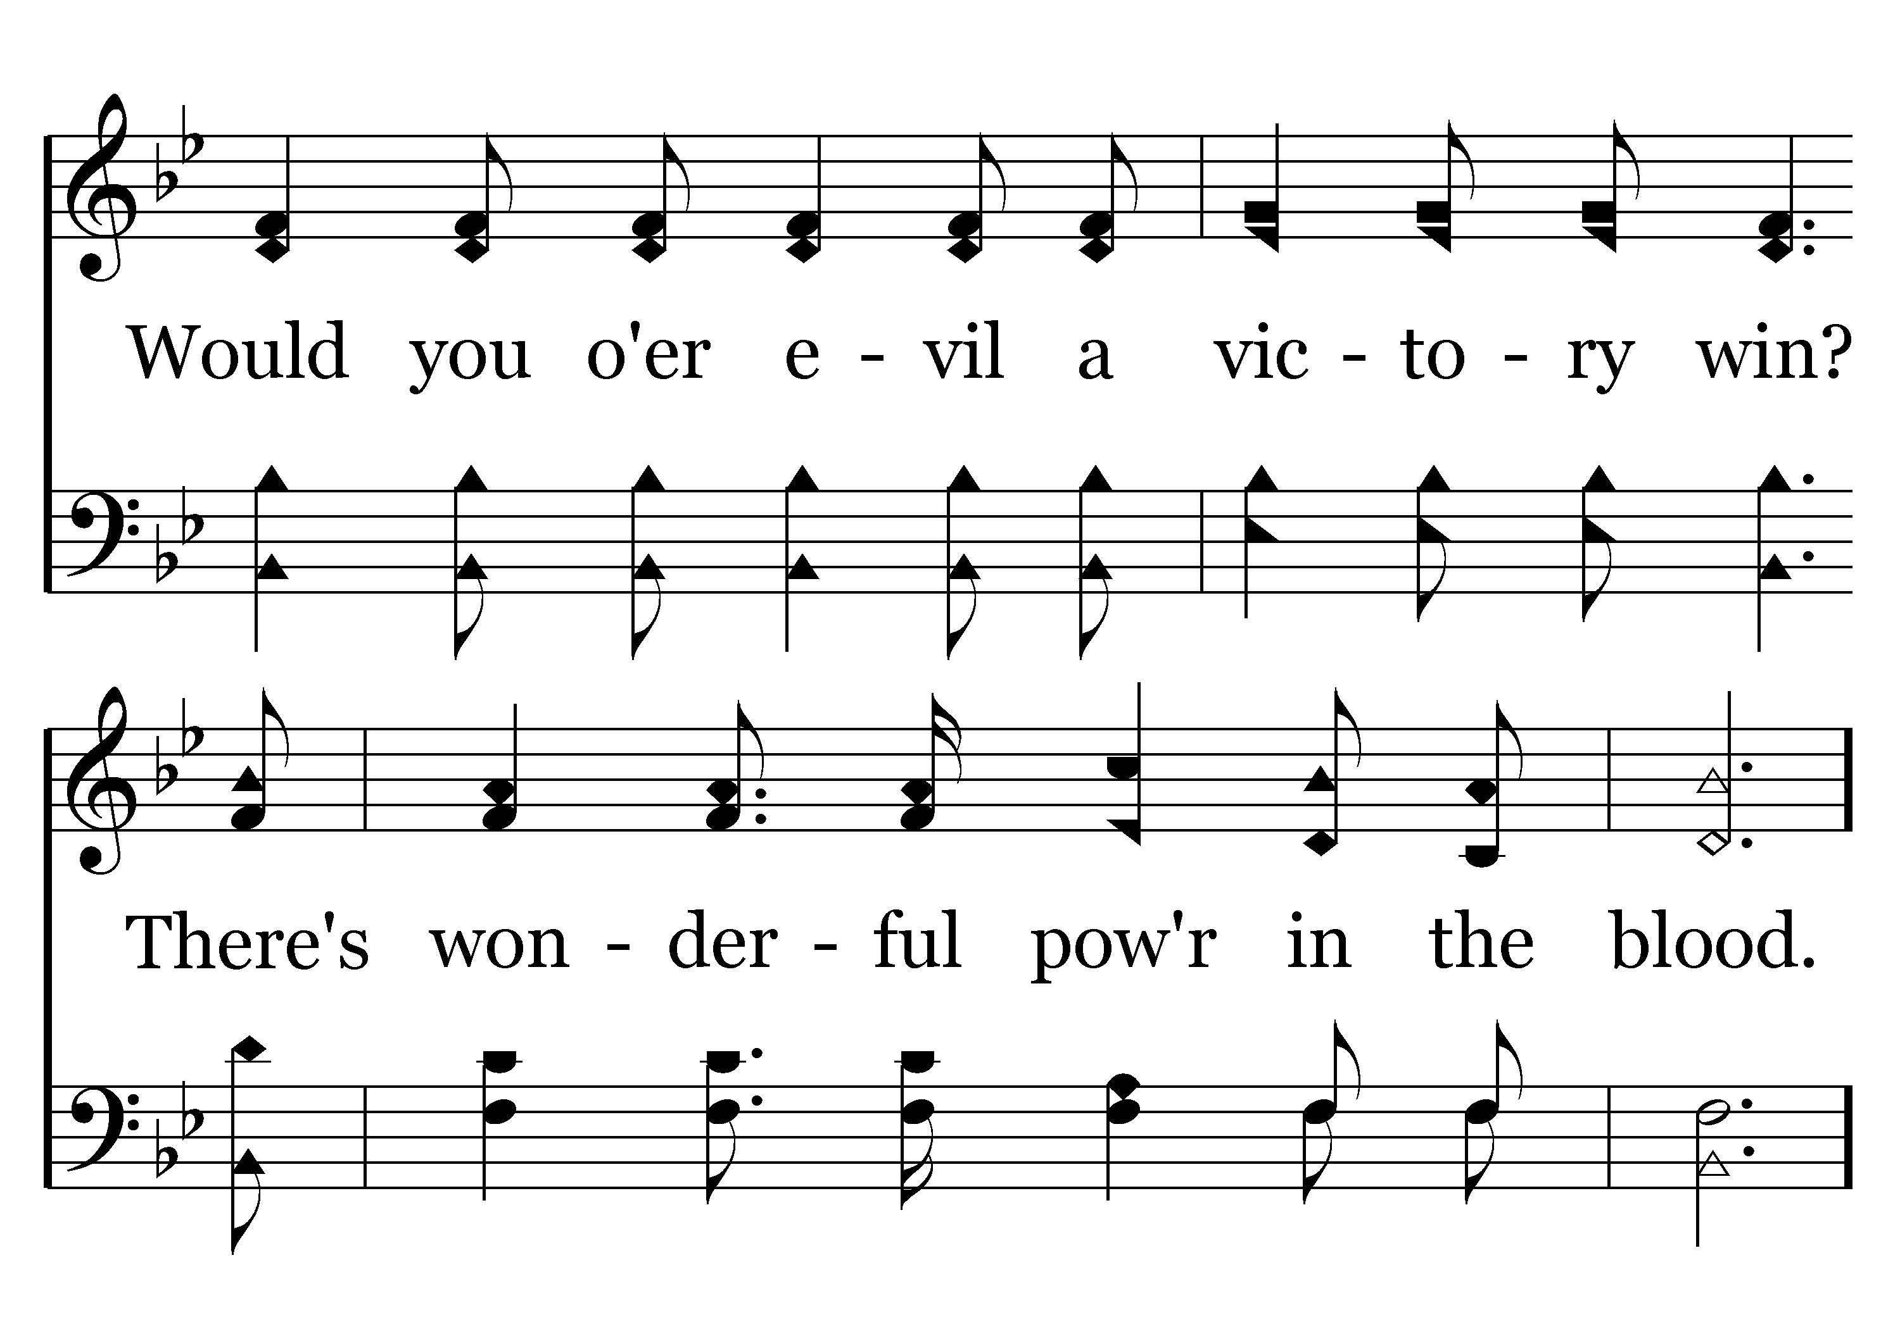
276 - There Is Power In The Blood - 1.2

Slide 31
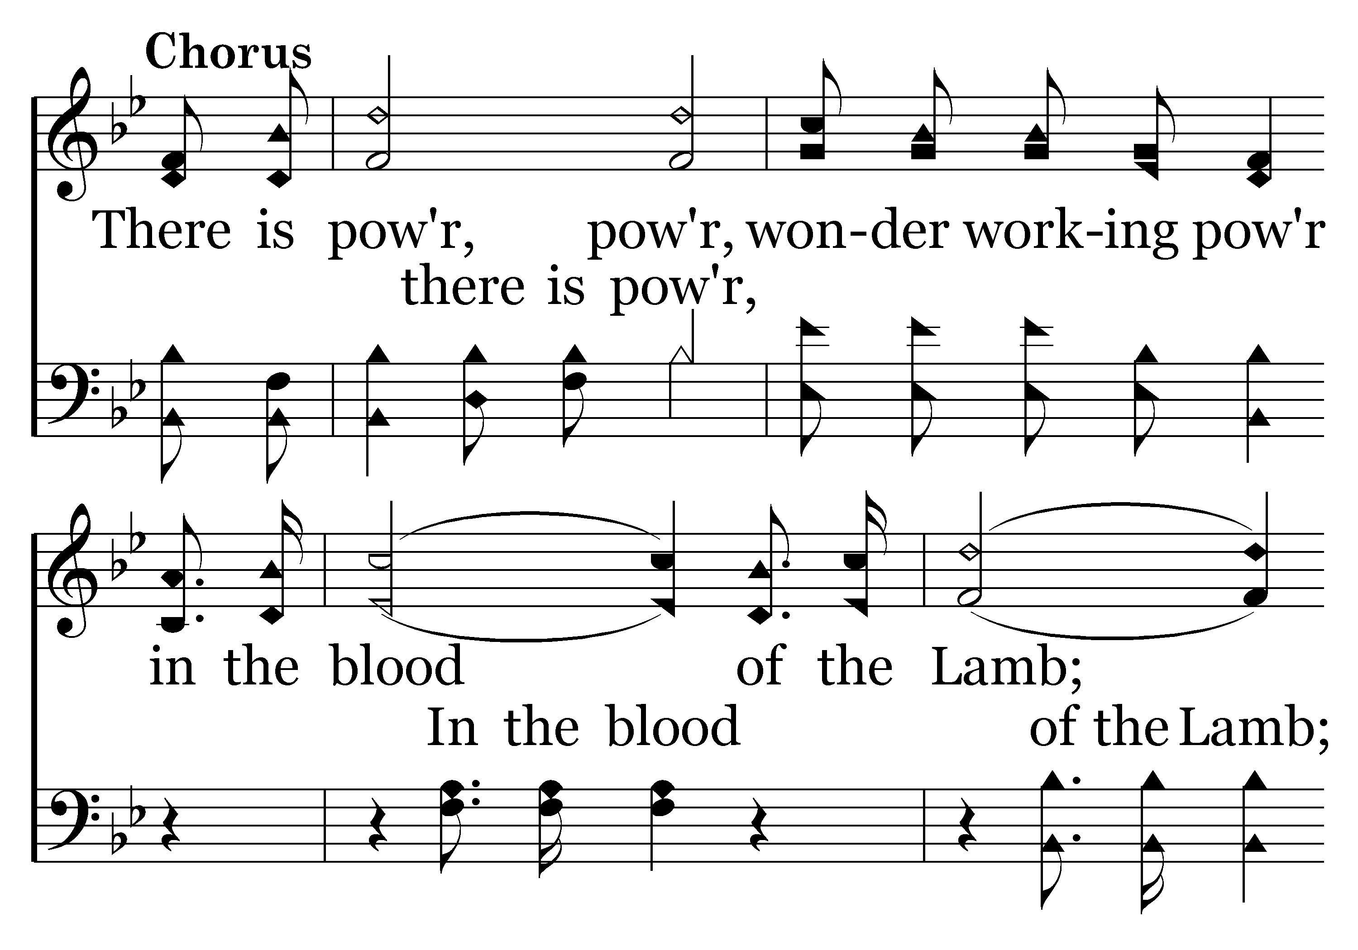
276 - There Is Power In The Blood - C.1

Slide 32
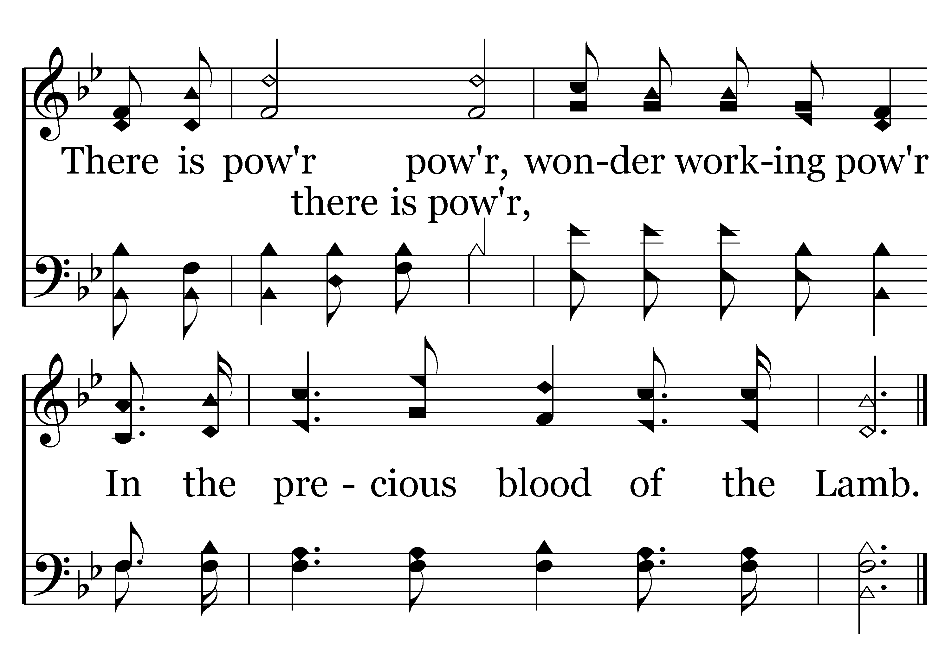
276 - There Is Power In The Blood - C.2
End of Verse 1

Slide 33
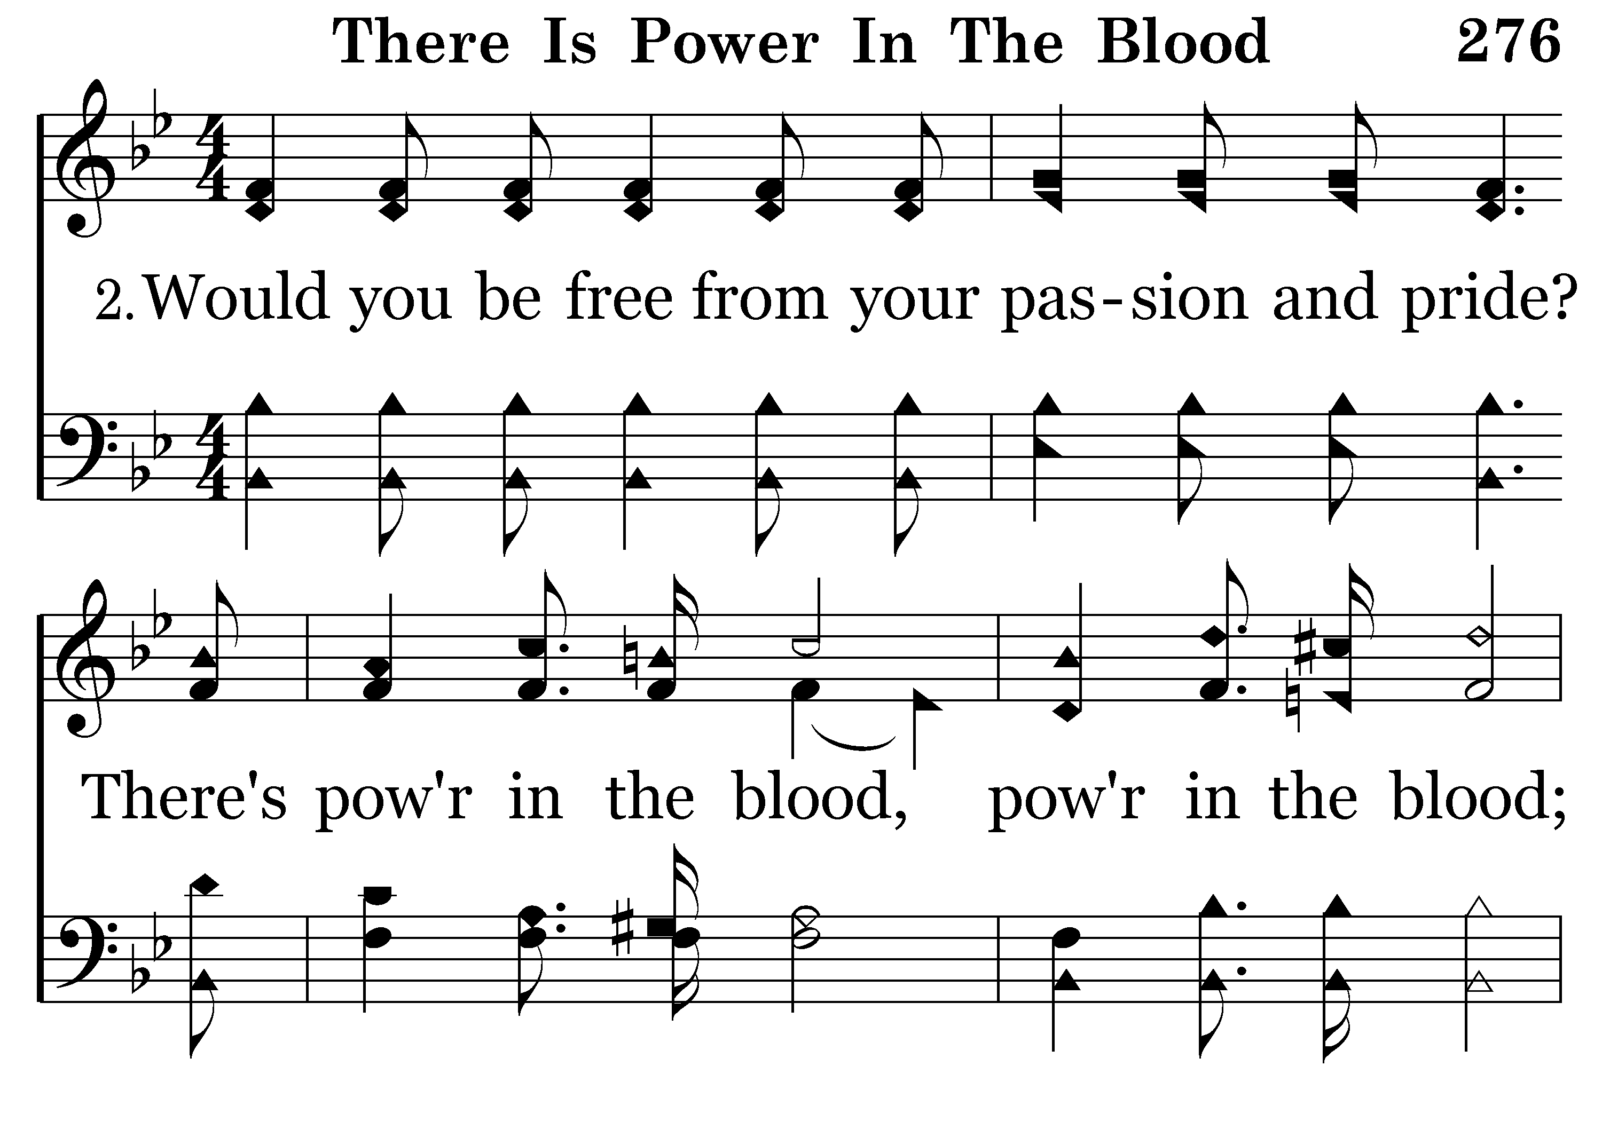
276 - There Is Power In The Blood - 2.1

Slide 34
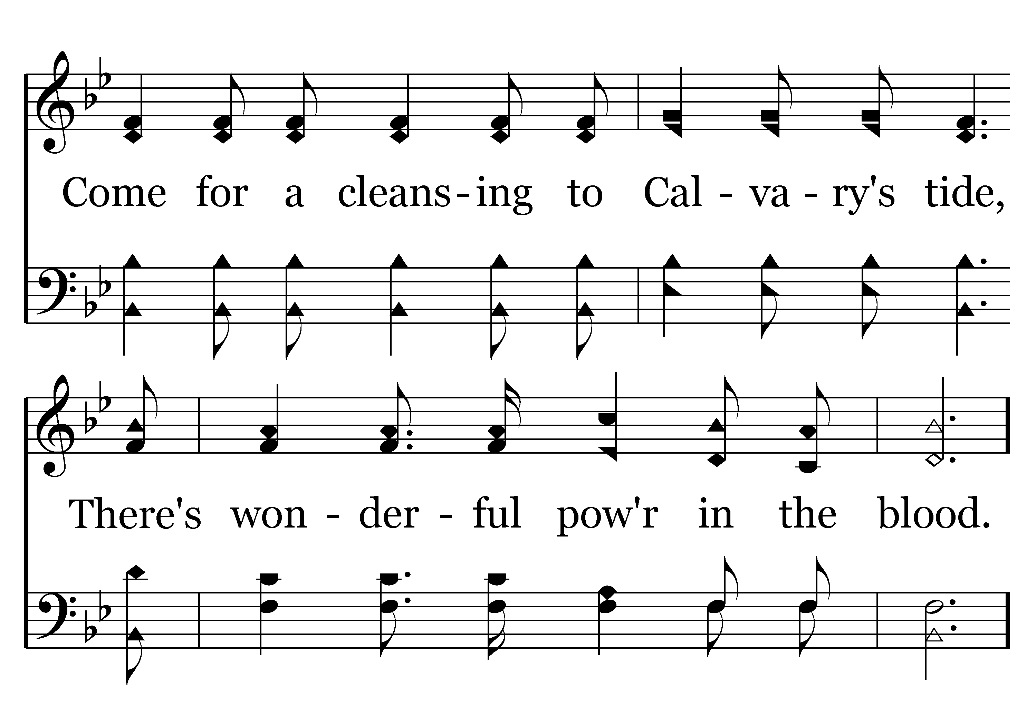
276 - There Is Power In The Blood - 2.2

Slide 35
276 - There Is Power In The Blood - C.1

Slide 36
276 - There Is Power In The Blood - C.2
End of Verse 2

Slide 37
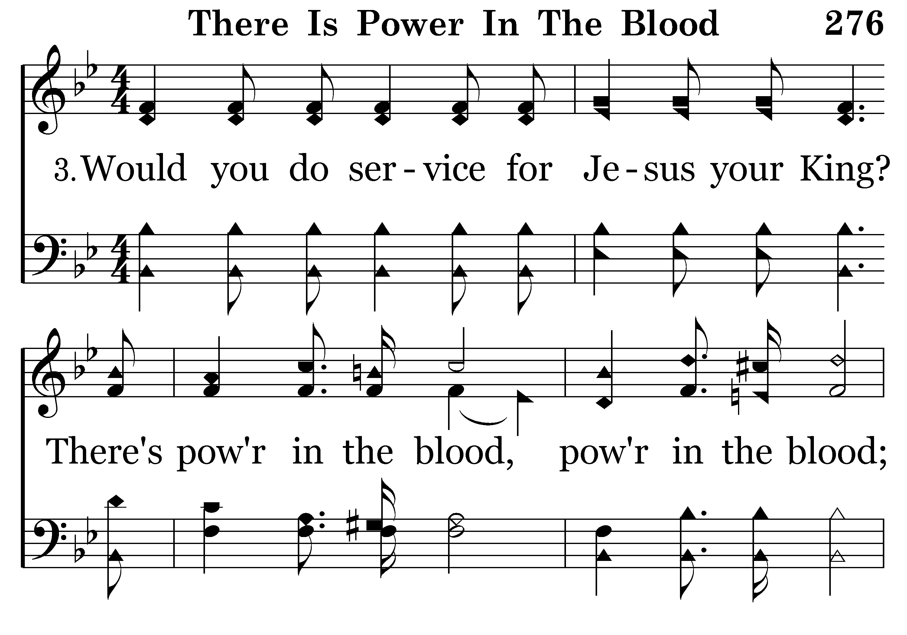
276 - There Is Power In The Blood - 3.1

Slide 38
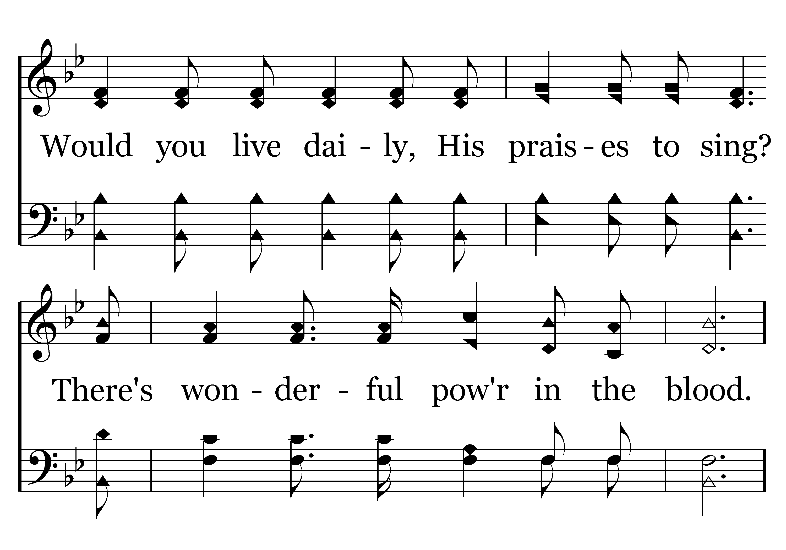
276 - There Is Power In The Blood - 3.2

Slide 39
276 - There Is Power In The Blood - C.1

Slide 40
276 - There Is Power In The Blood - C.2
End of Song

Slide 42
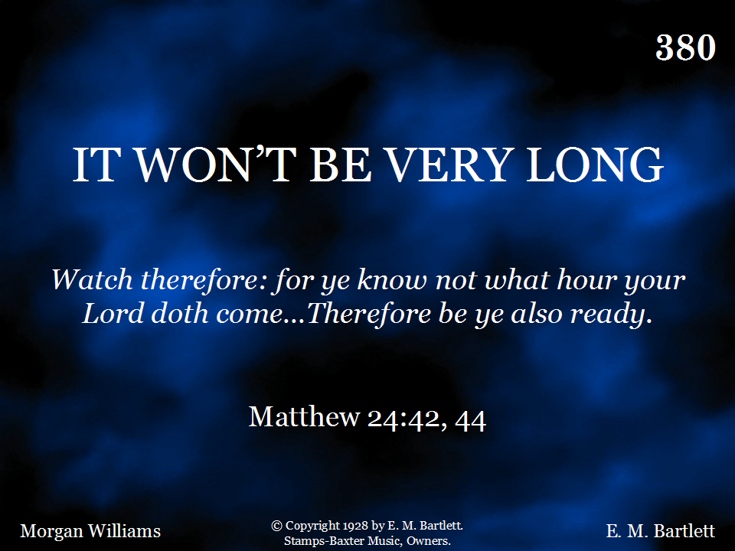
380 - It Won't Be Very Long - Title

Slide 43
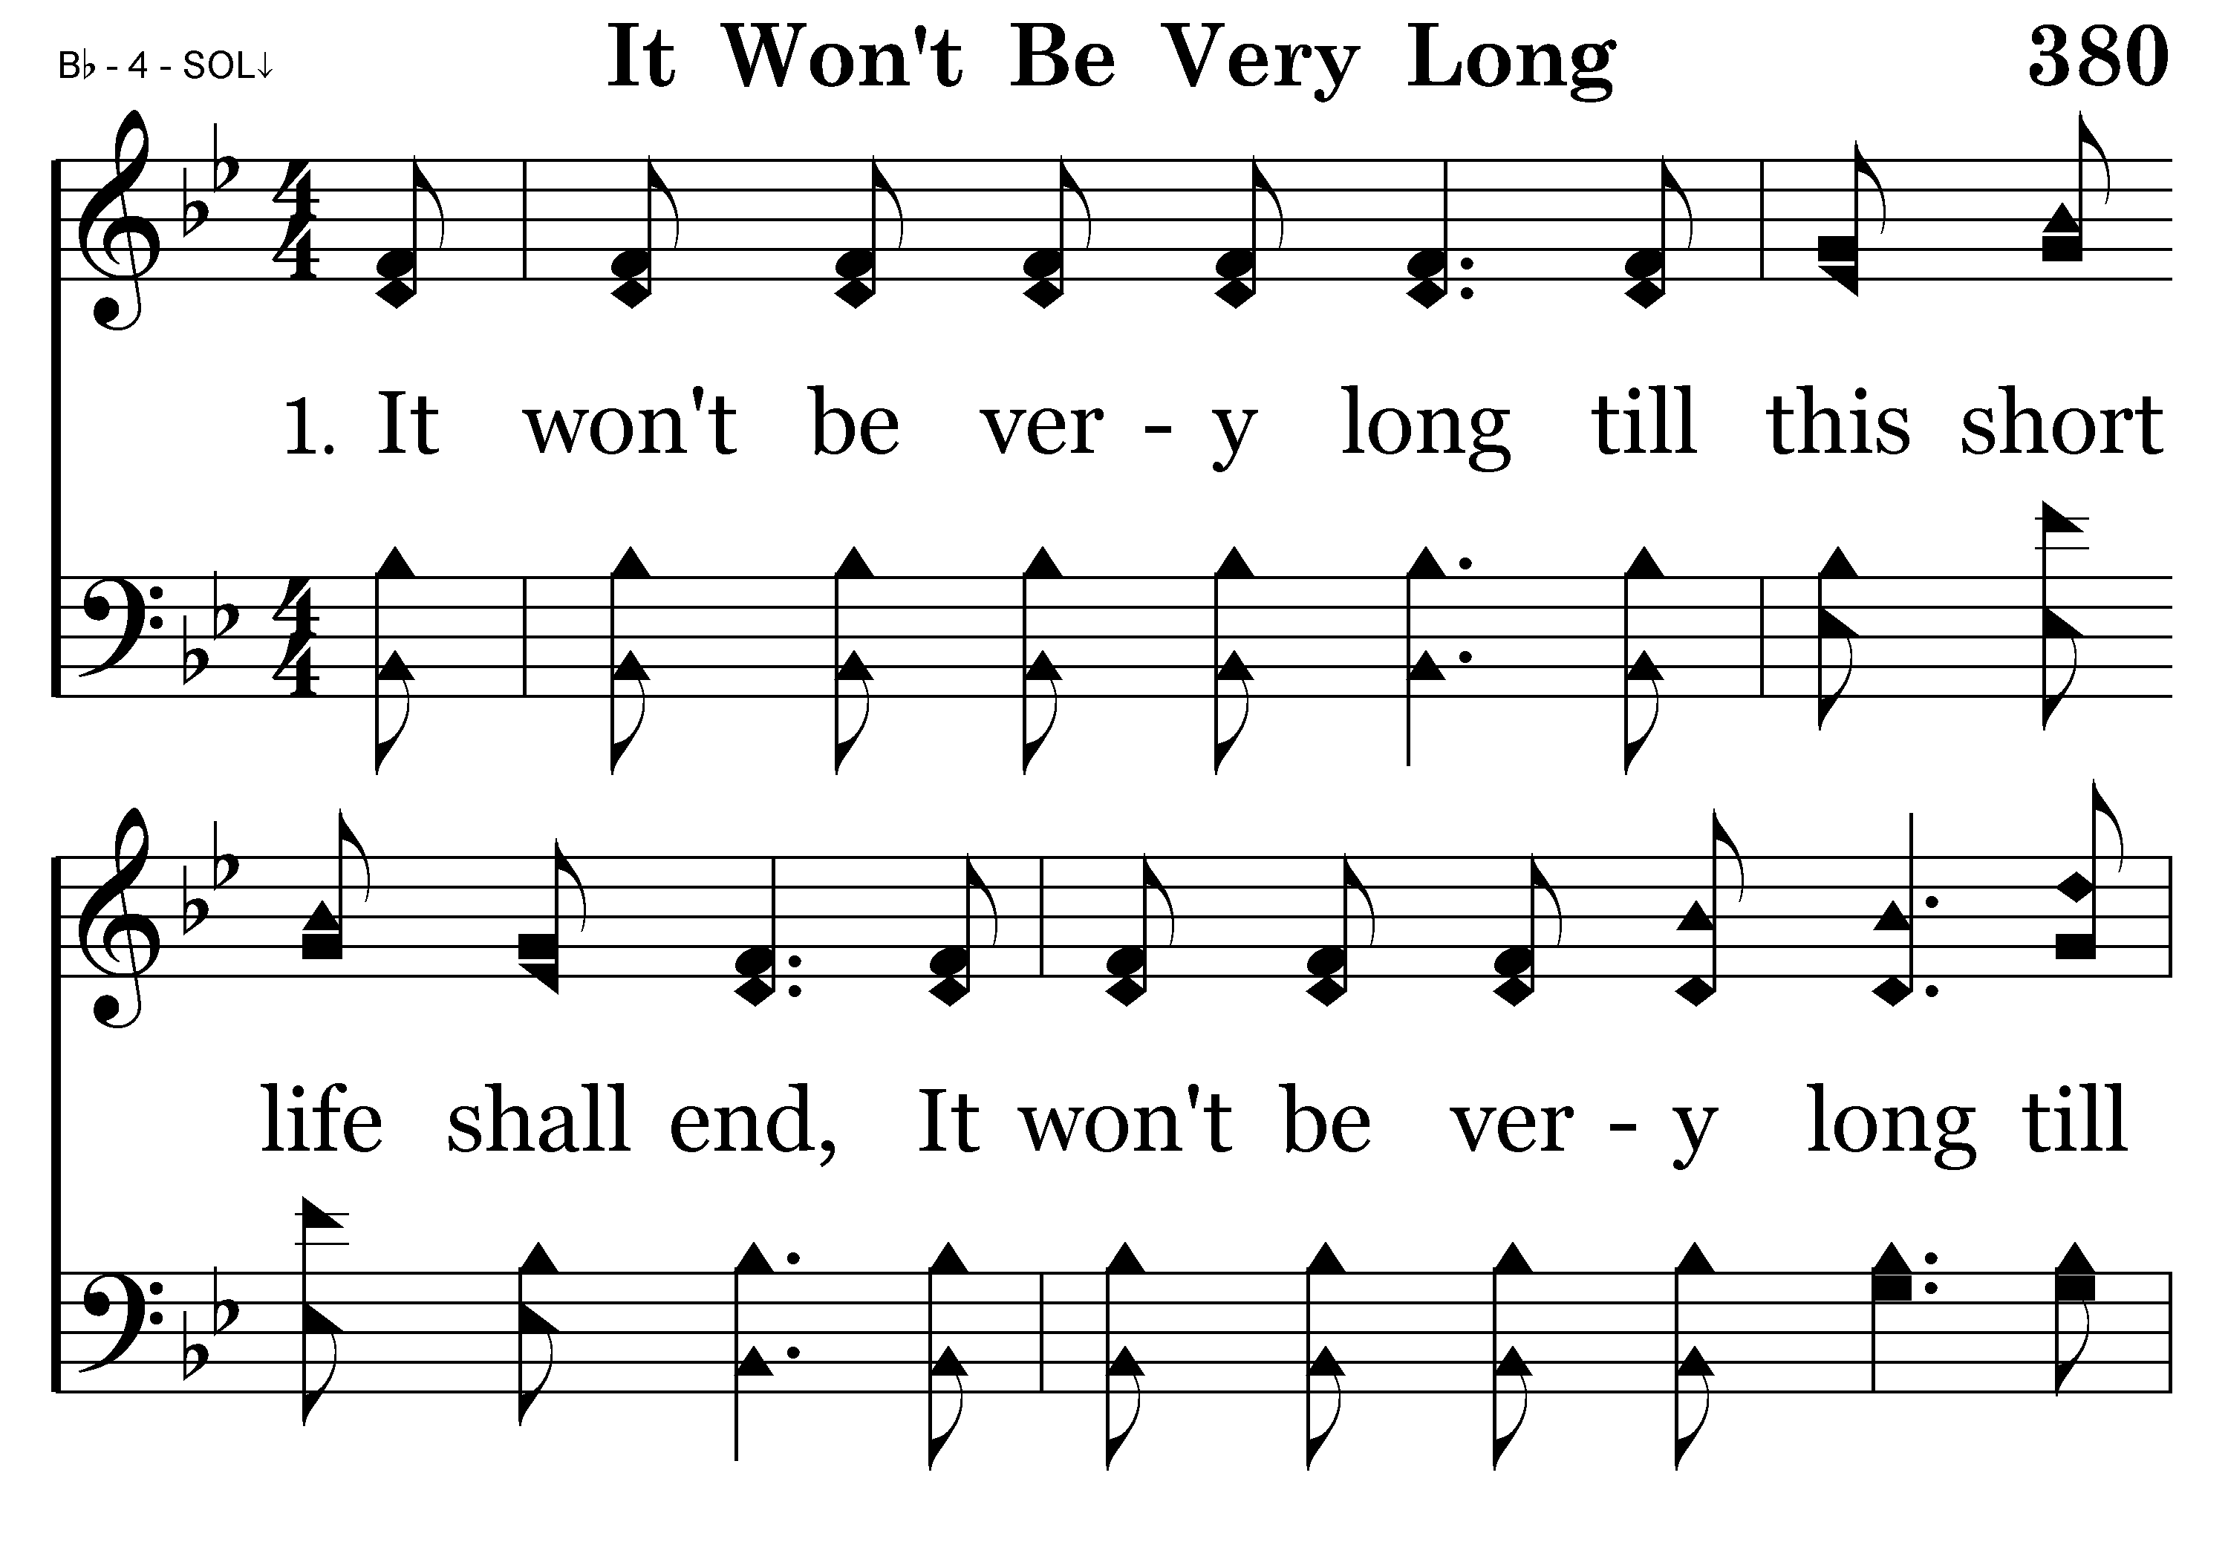
380 - It Won't Be Very Long - 1.1

Slide 44
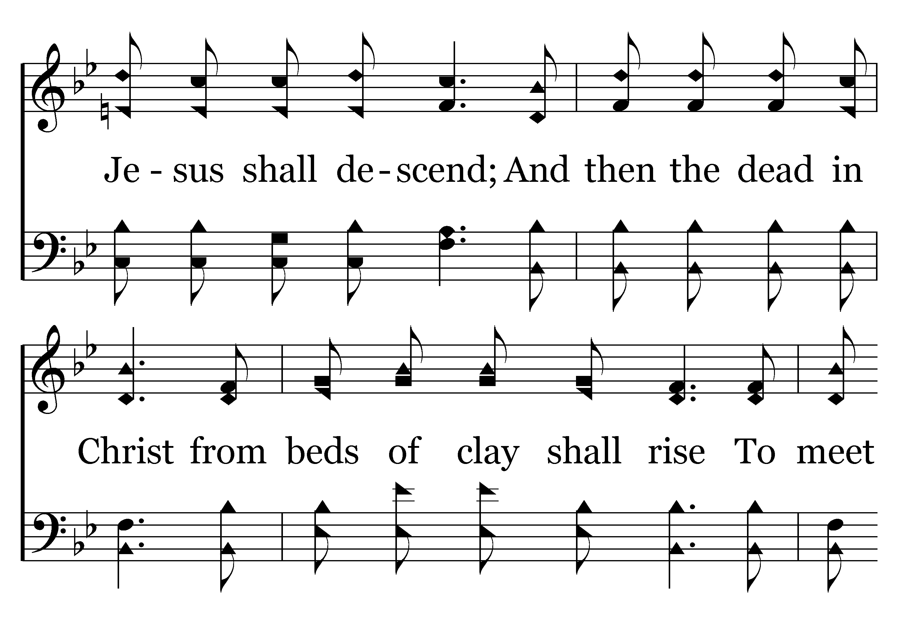
380 - It Won't Be Very Long - 1.2

Slide 45
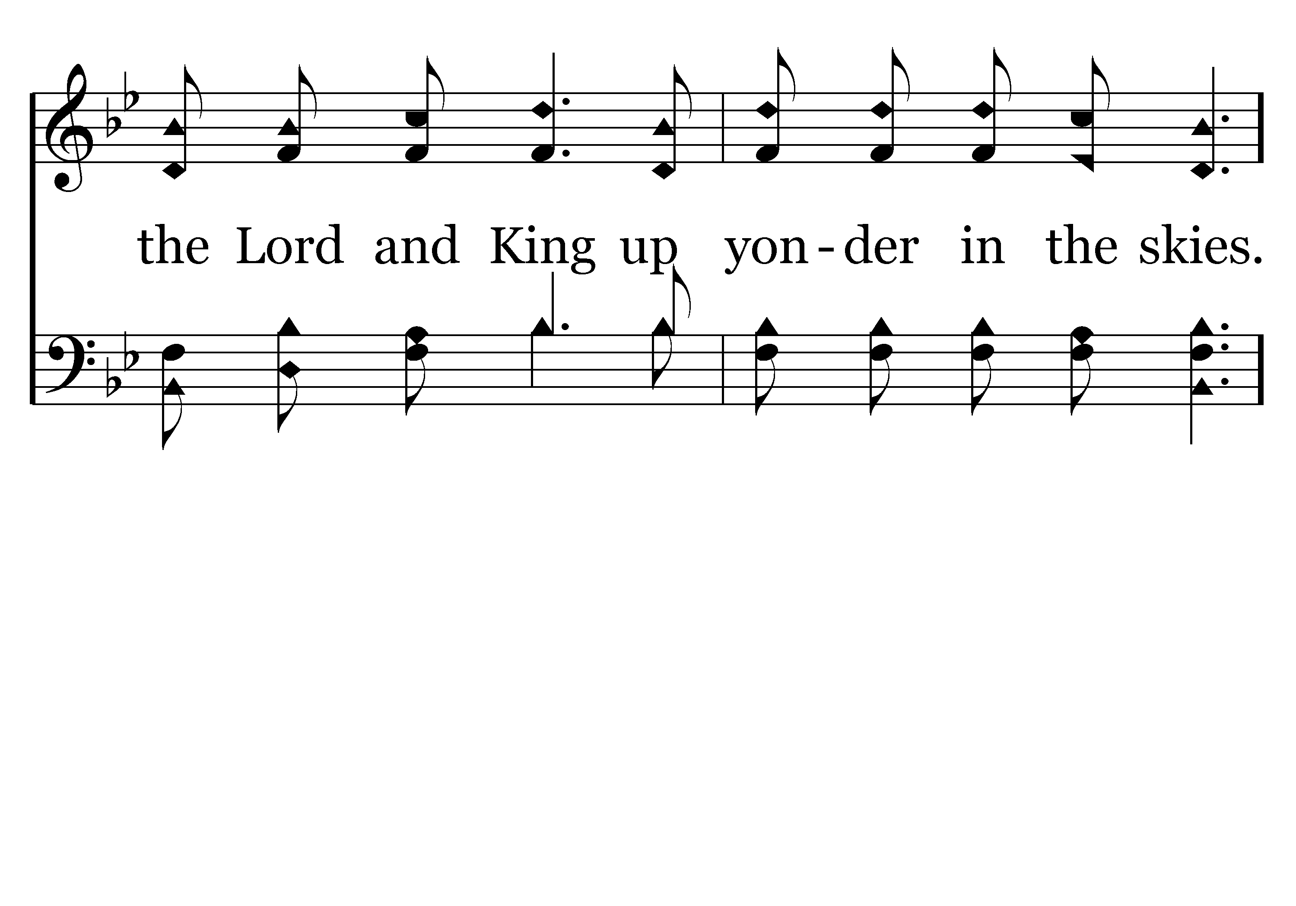
380 - It Won't Be Very Long - 1.3

Slide 46
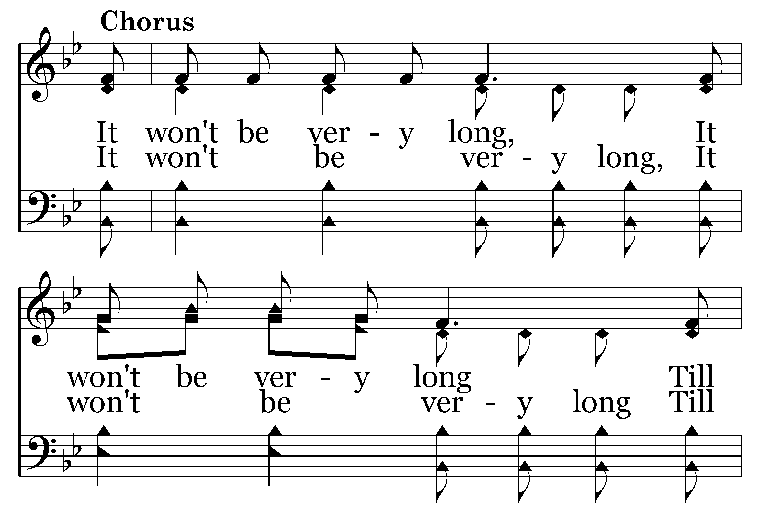
380 - It Won't Be Very Long - C.1

Slide 47
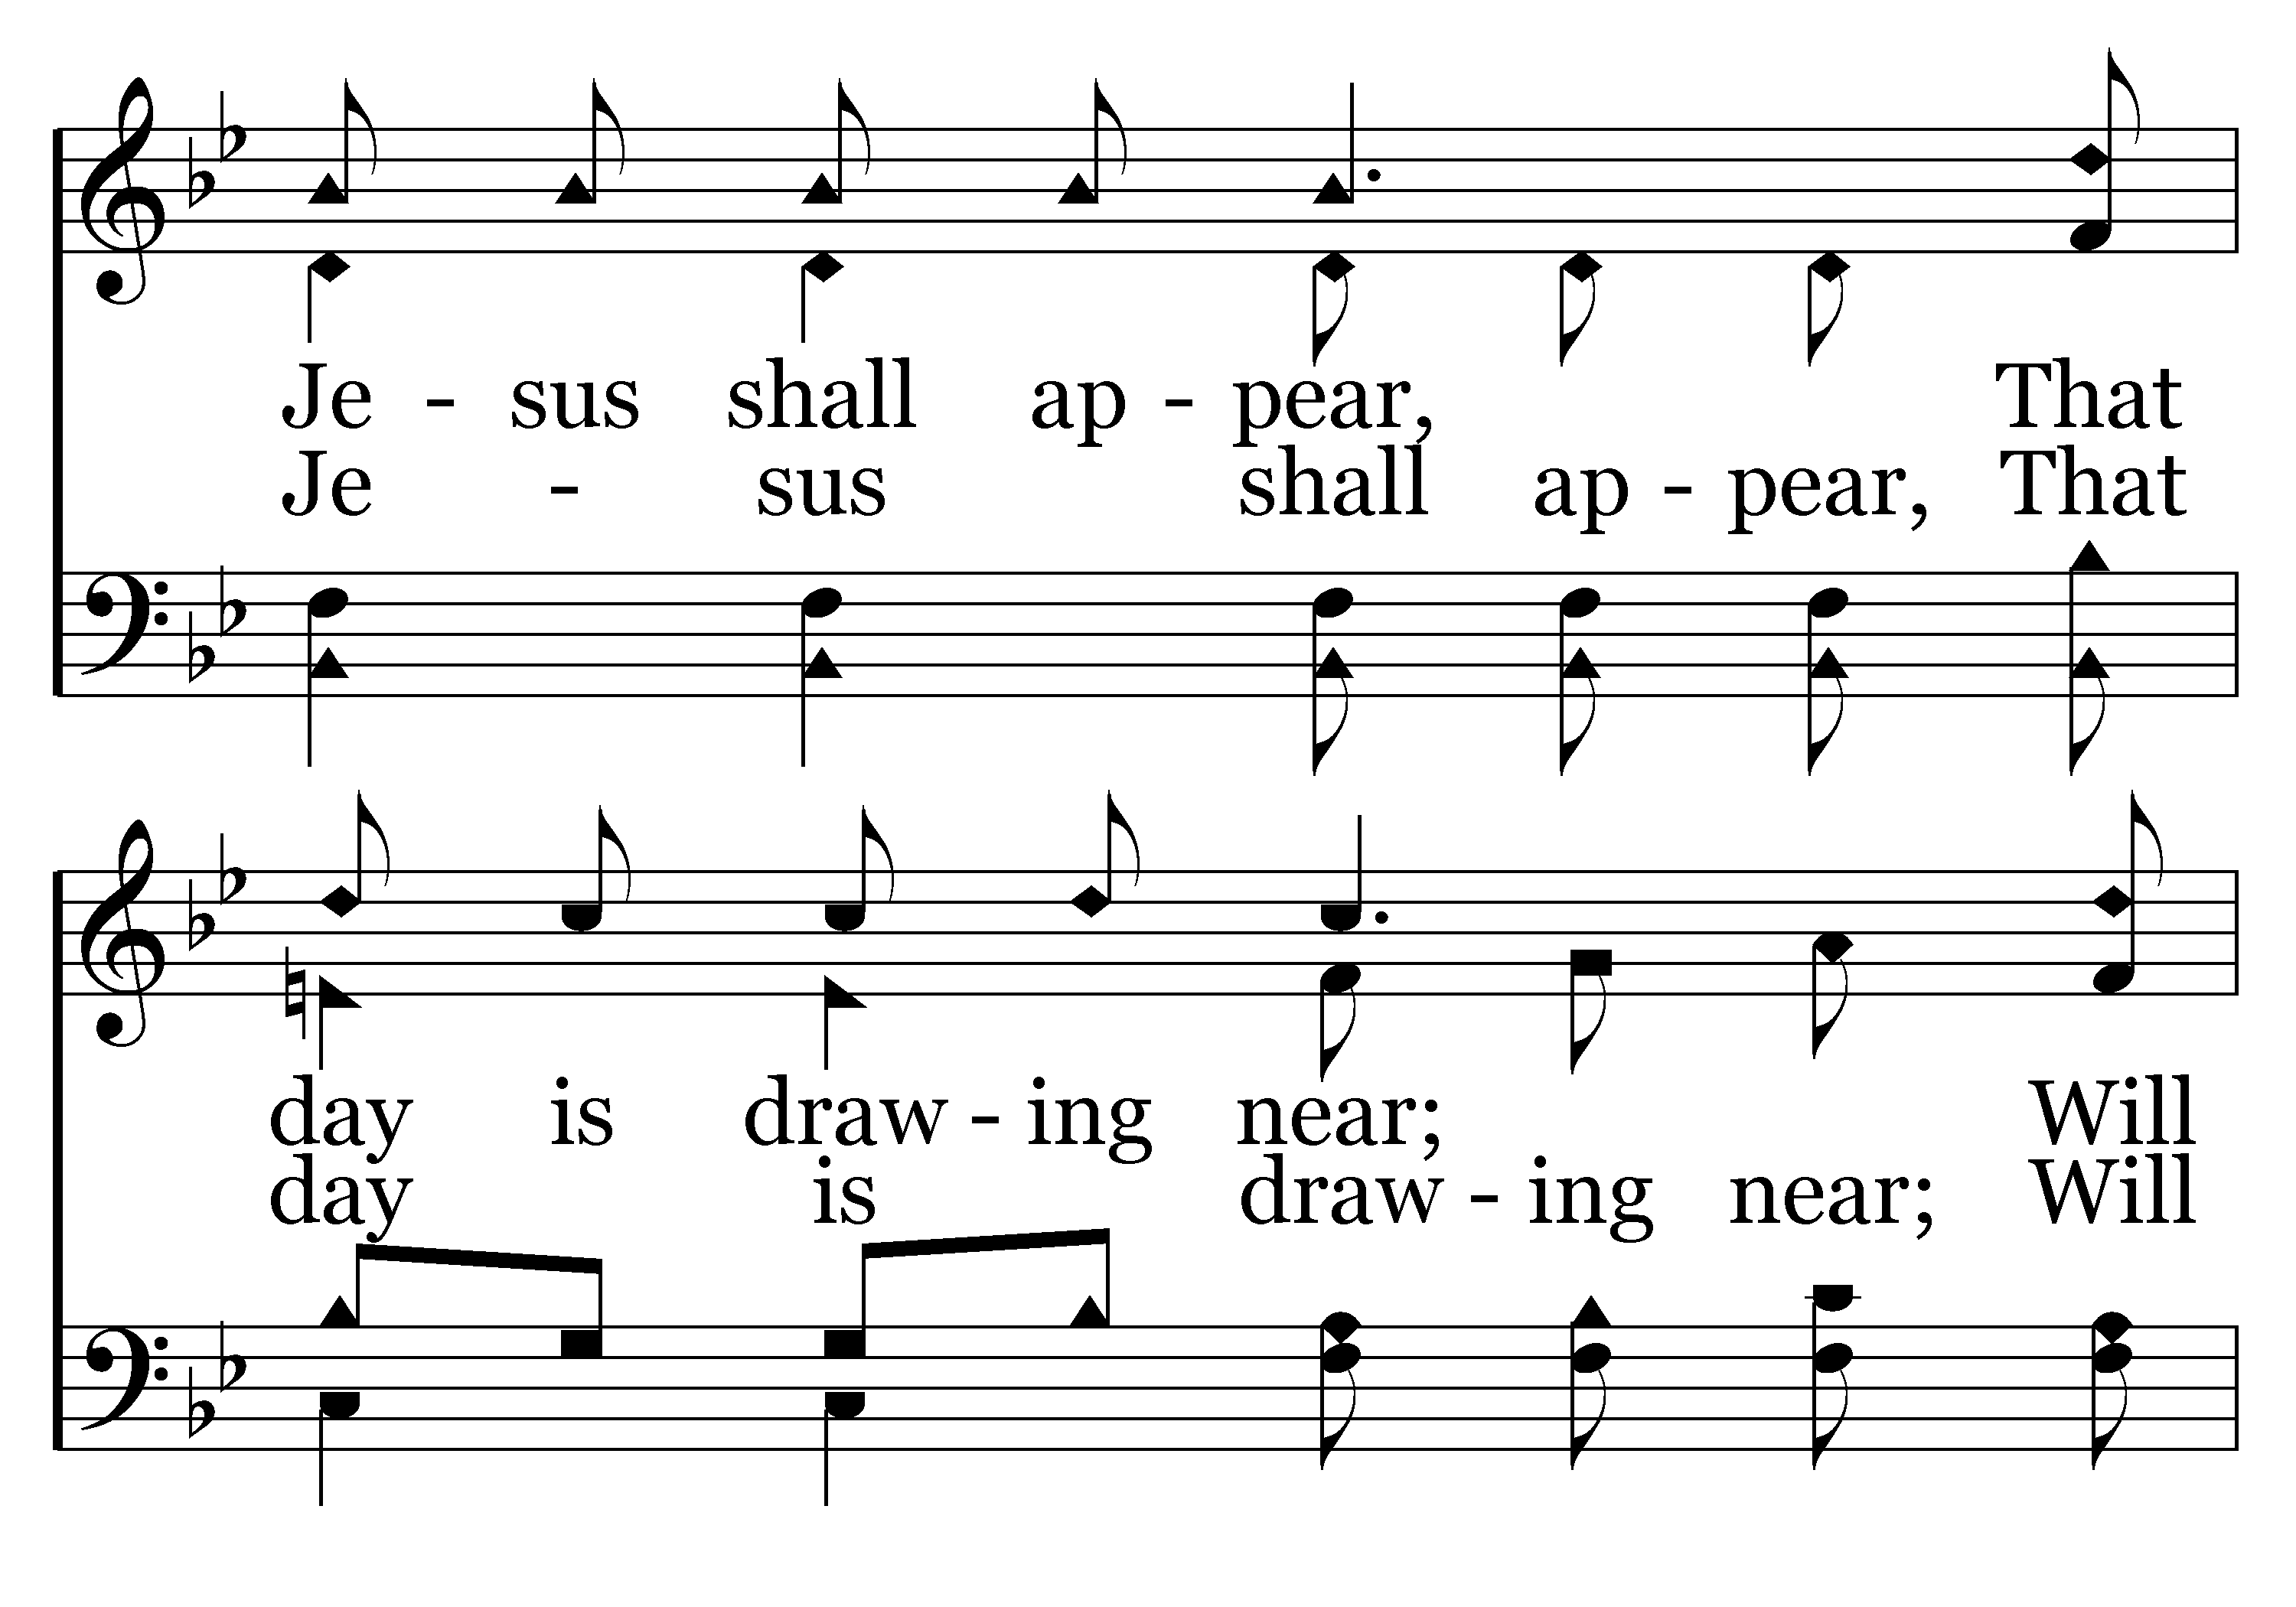
380 - It Won't Be Very Long - C.2

Slide 48
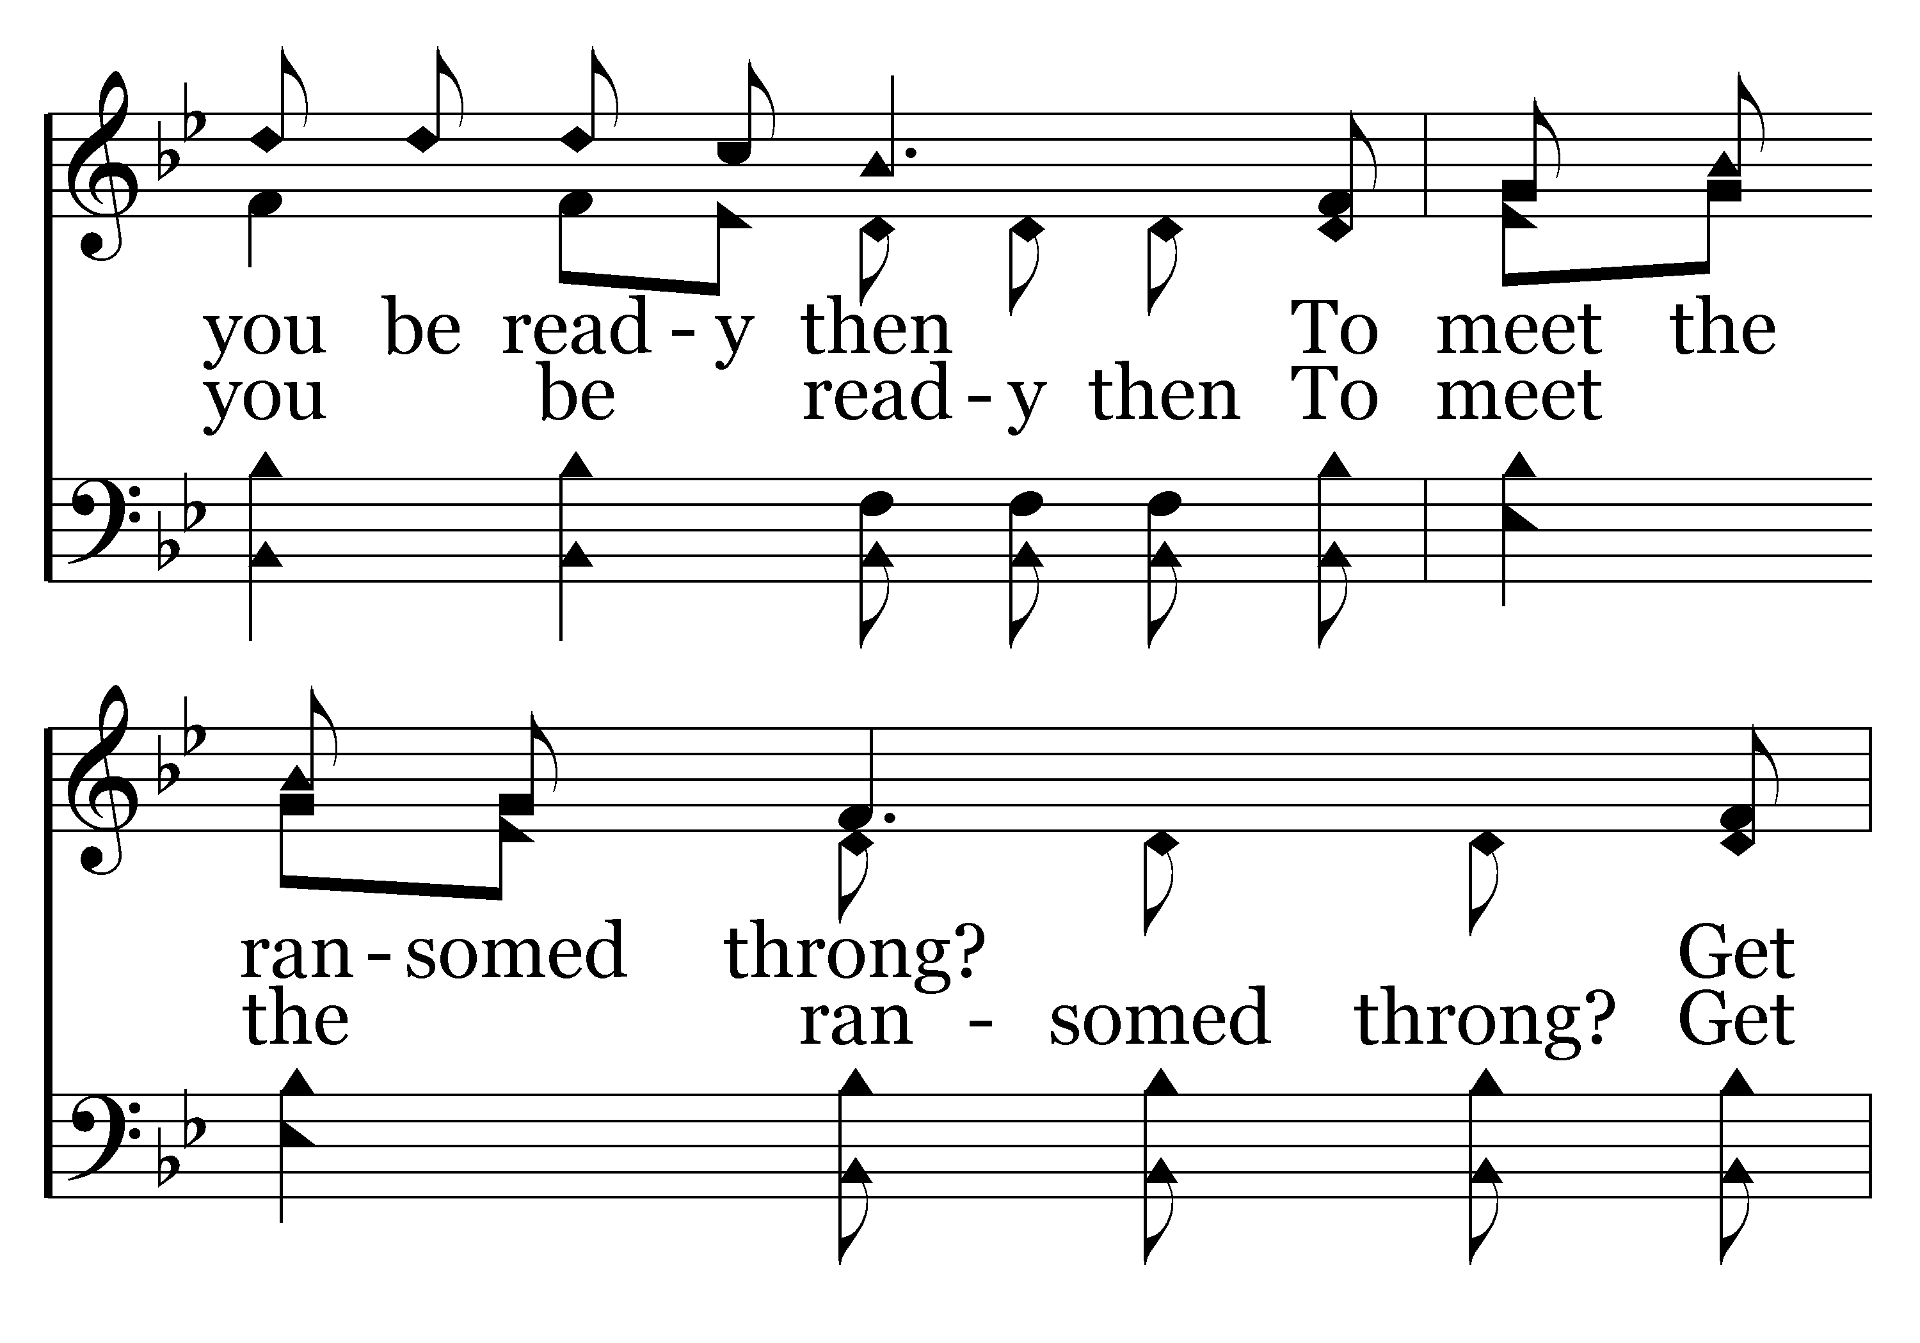
380 - It Won't Be Very Long - C.3

Slide 49
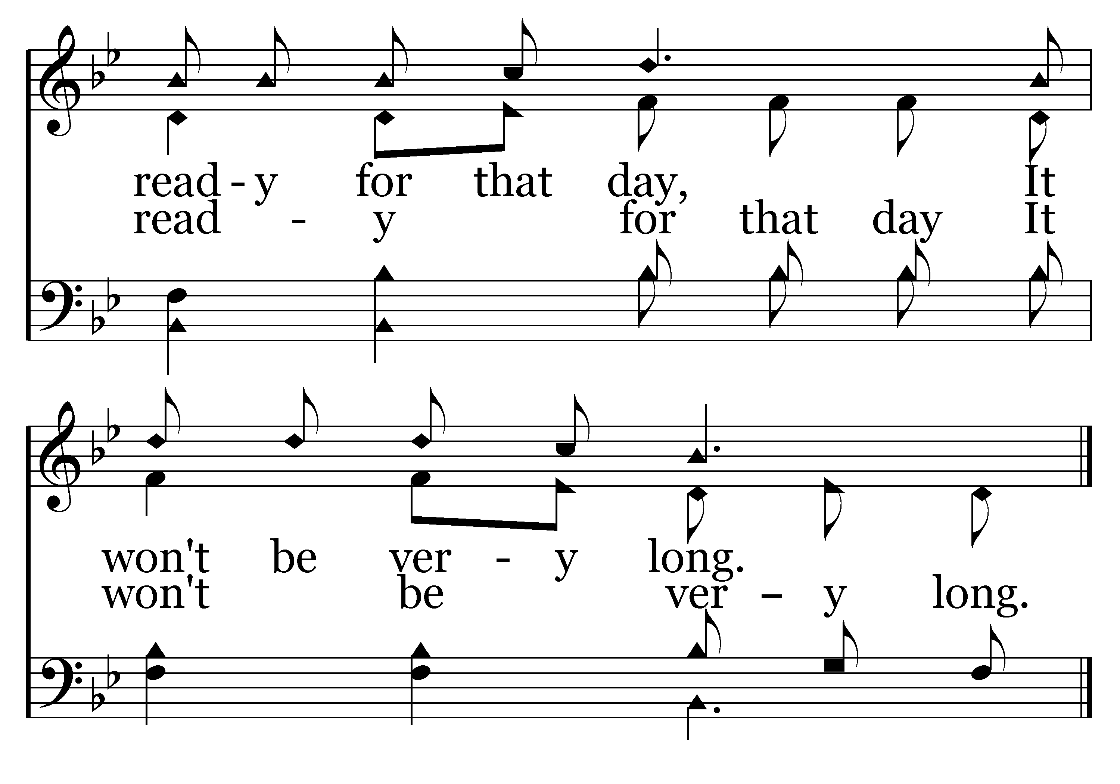
380 - It Won't Be Very Long - C.4
End of Verse 1

Slide 50
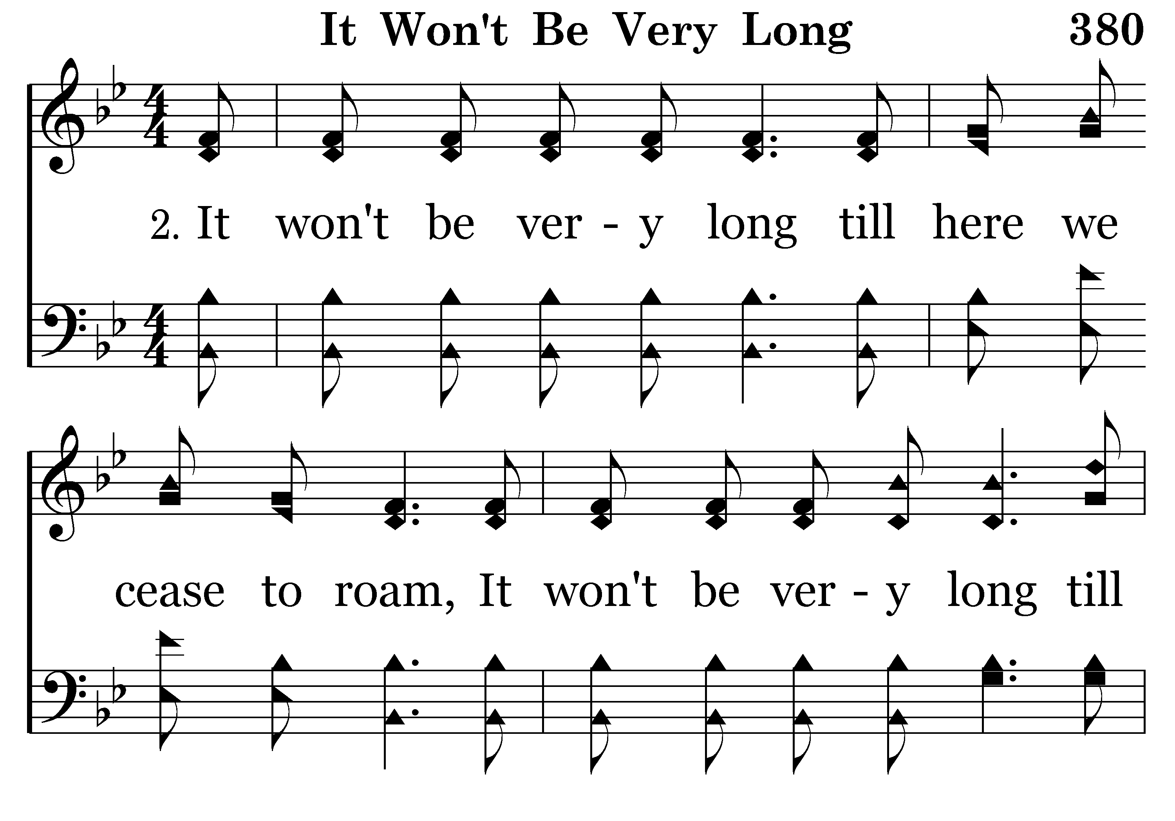
380 - It Won't Be Very Long - 2.1

Slide 51
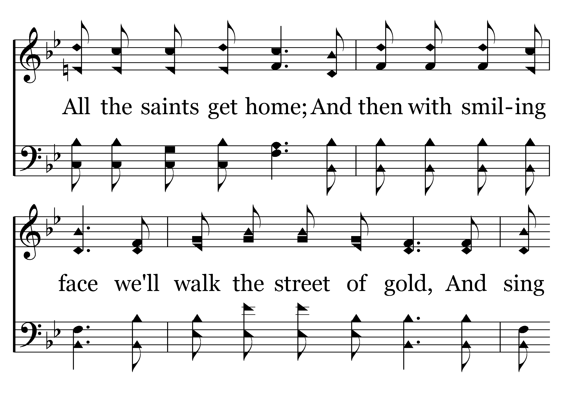
380 - It Won't Be Very Long - 2.2

Slide 52
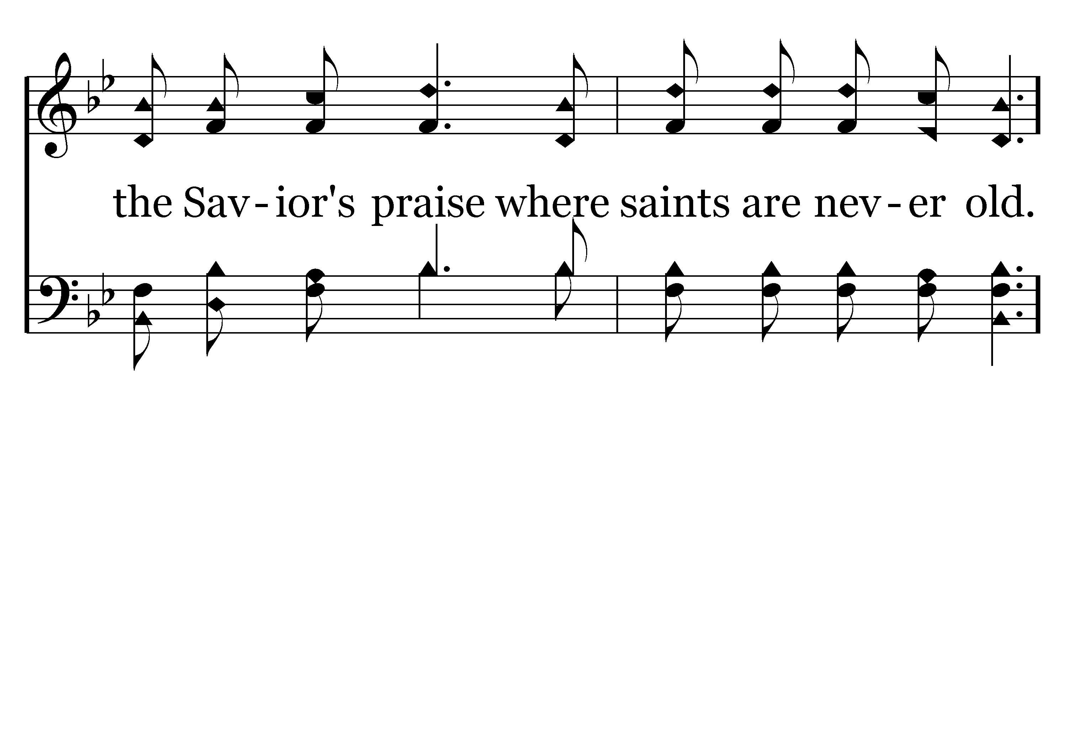
380 - It Won't Be Very Long - 2.3

Slide 53
380 - It Won't Be Very Long - C.1

Slide 54
380 - It Won't Be Very Long - C.2

Slide 55
380 - It Won't Be Very Long - C.3

Slide 56
380 - It Won't Be Very Long - C.4
End of Verse 2

Slide 57
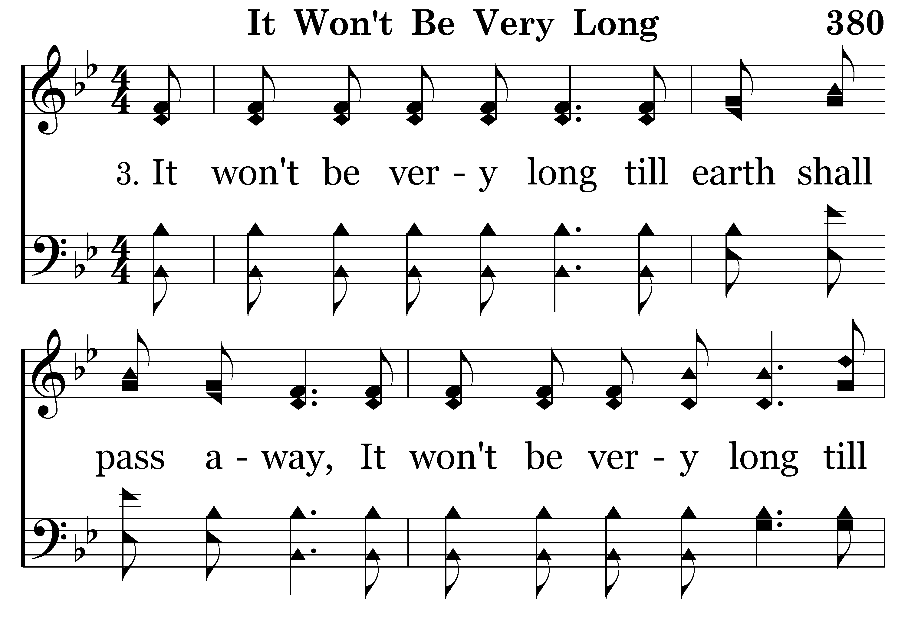
380 - It Won't Be Very Long - 3.1

Slide 58
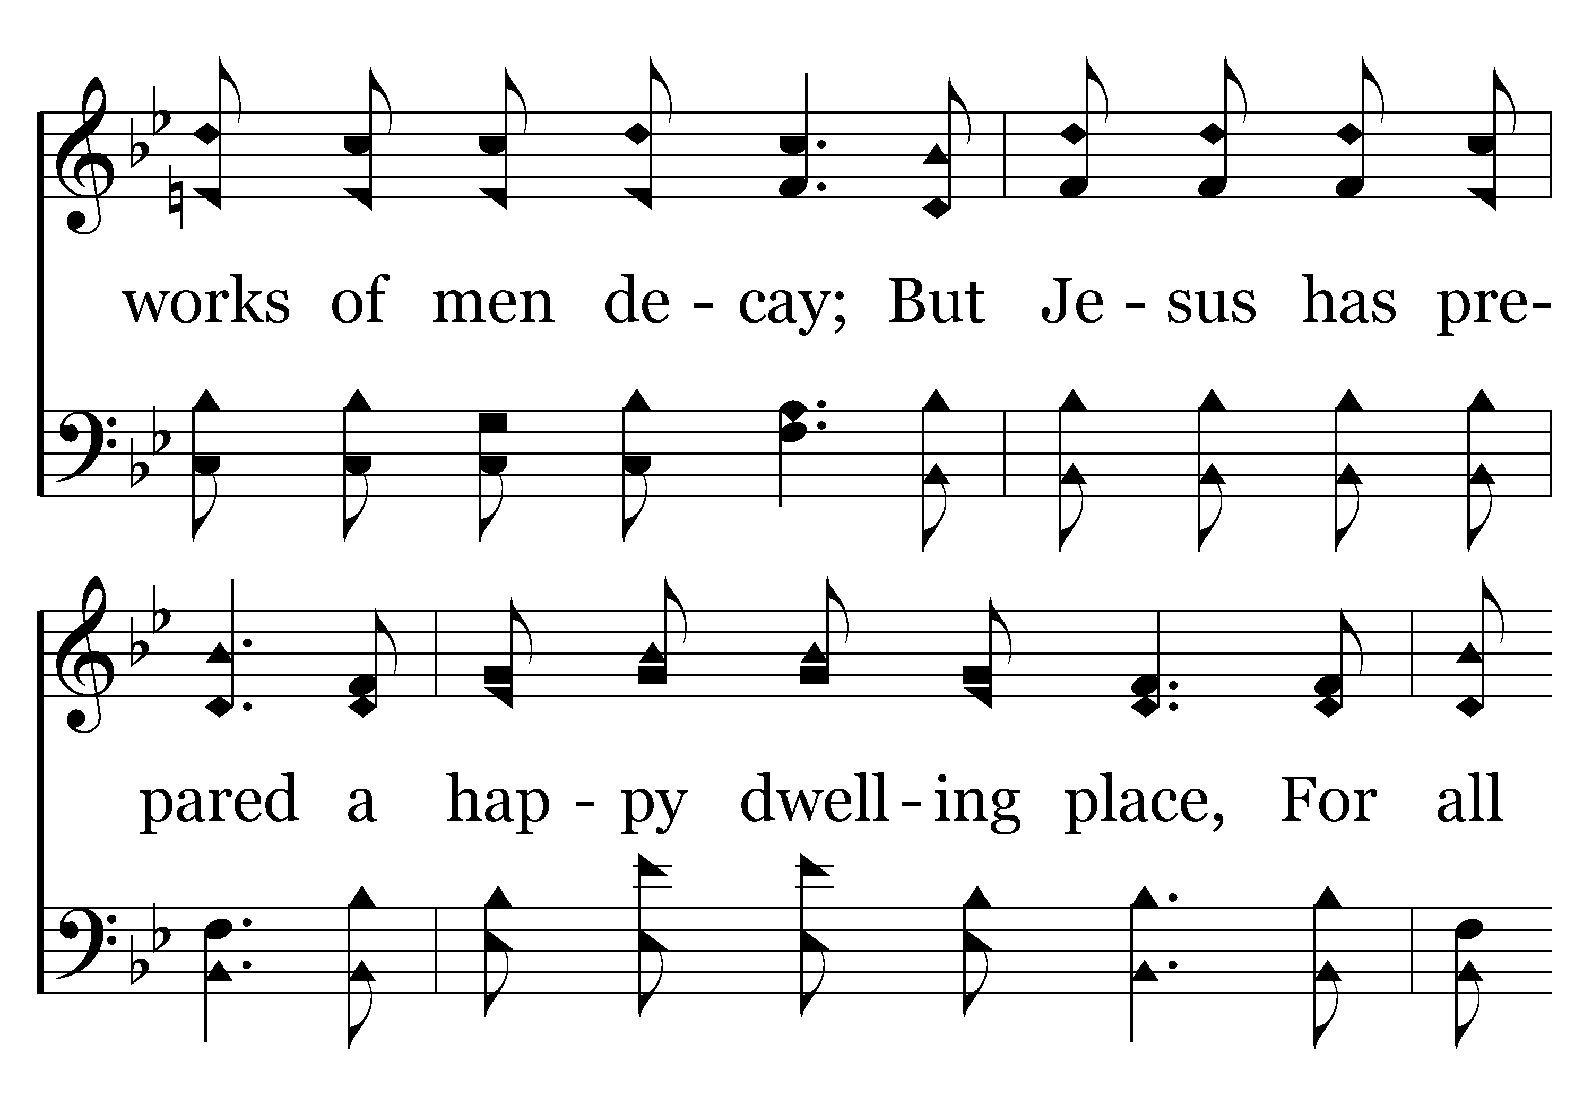
380 - It Won't Be Very Long - 3.2

Slide 59
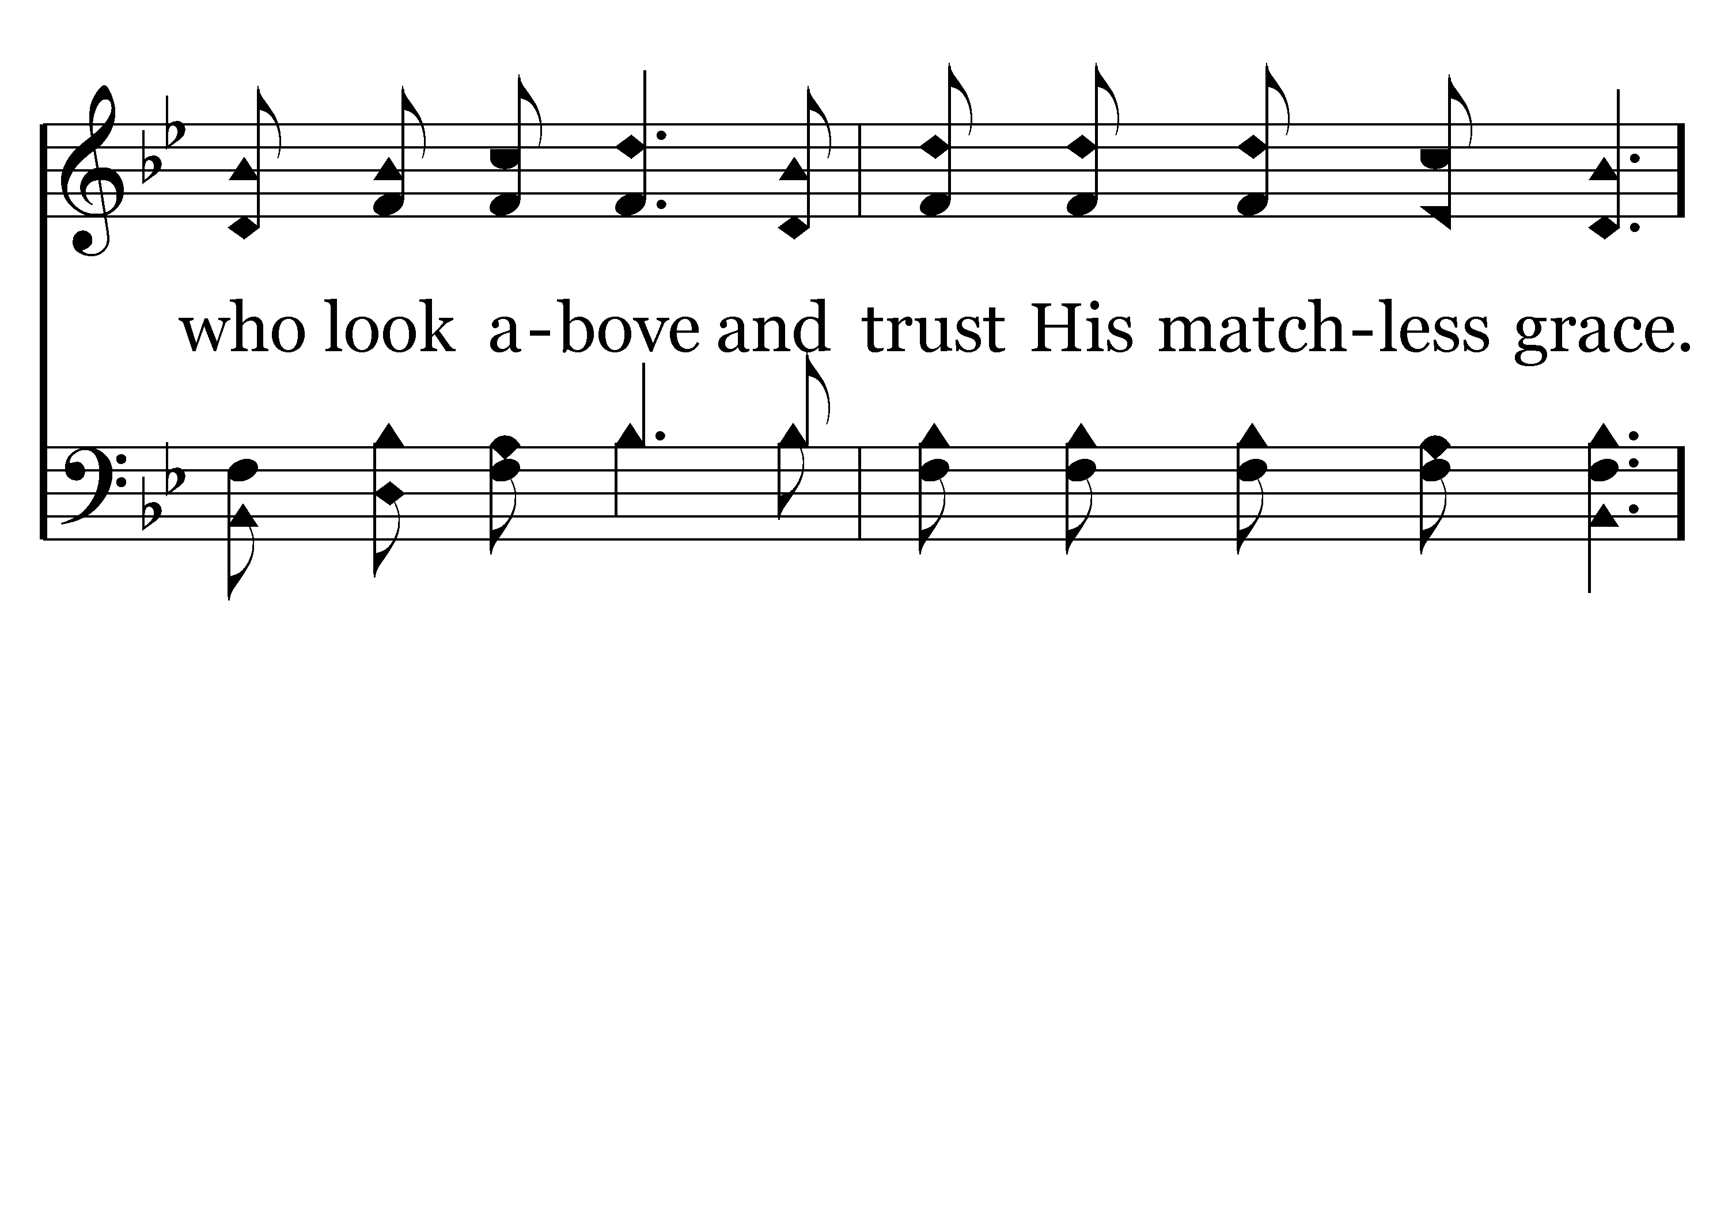
380 - It Won't Be Very Long - 3.3

Slide 60
380 - It Won't Be Very Long - C.1

Slide 61
380 - It Won't Be Very Long - C.2

Slide 62
380 - It Won't Be Very Long - C.3

Slide 63
380 - It Won't Be Very Long - C.4
End of Song

Slide 64
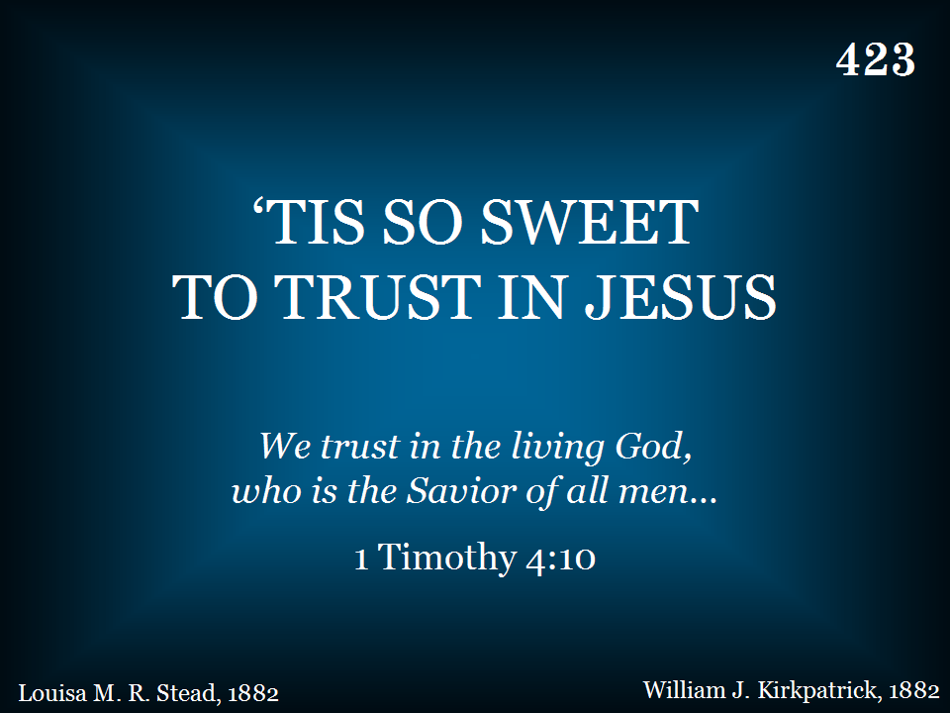
423 - Tis So Sweet To Trust In Jesus - Title

Slide 65
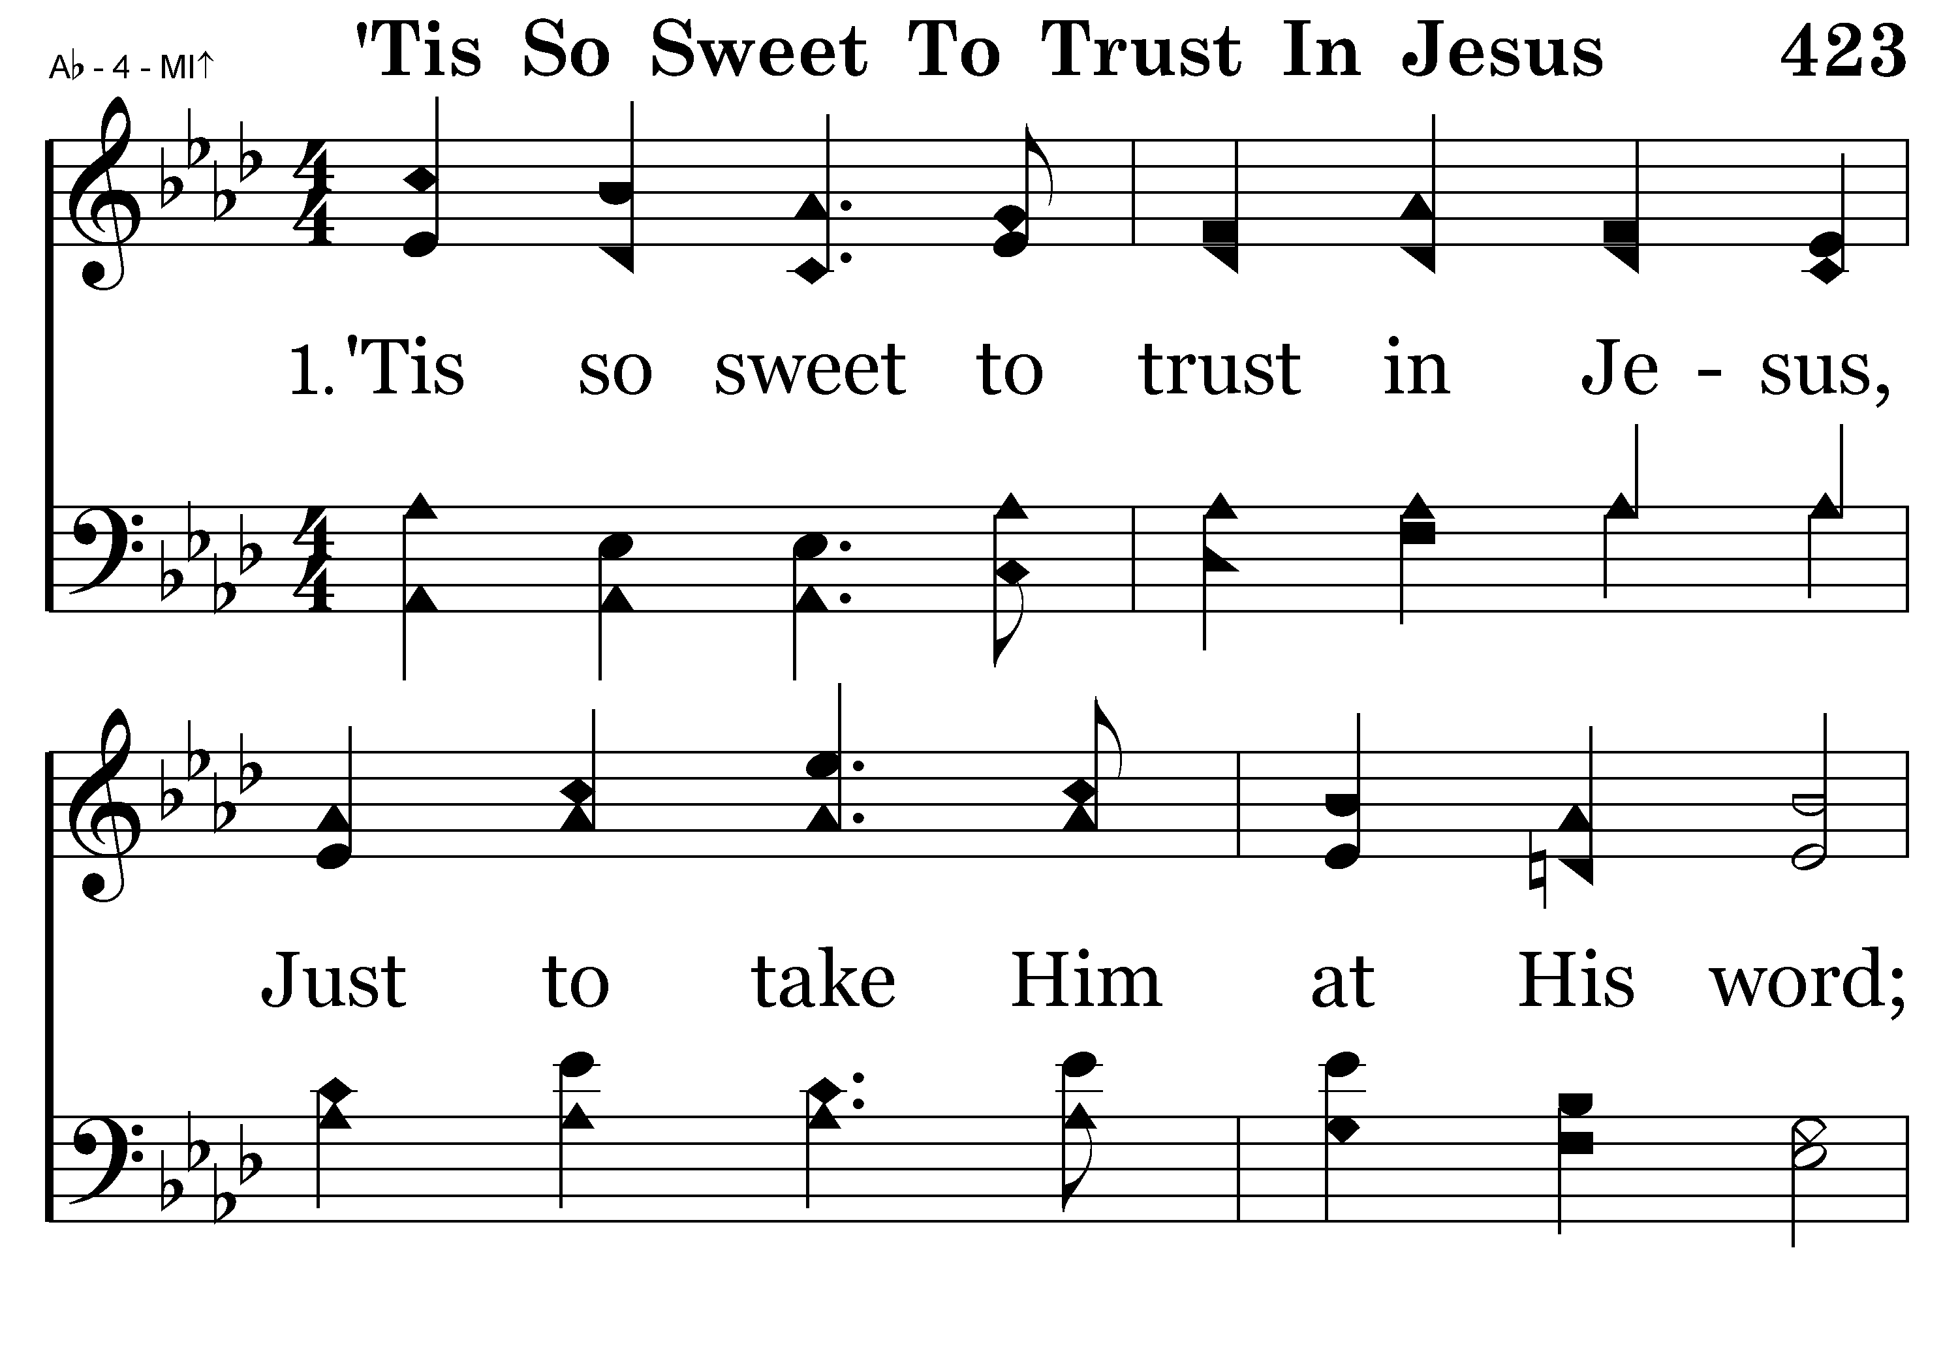
423 - Tis So Sweet To Trust In Jesus - 1.1

Slide 66
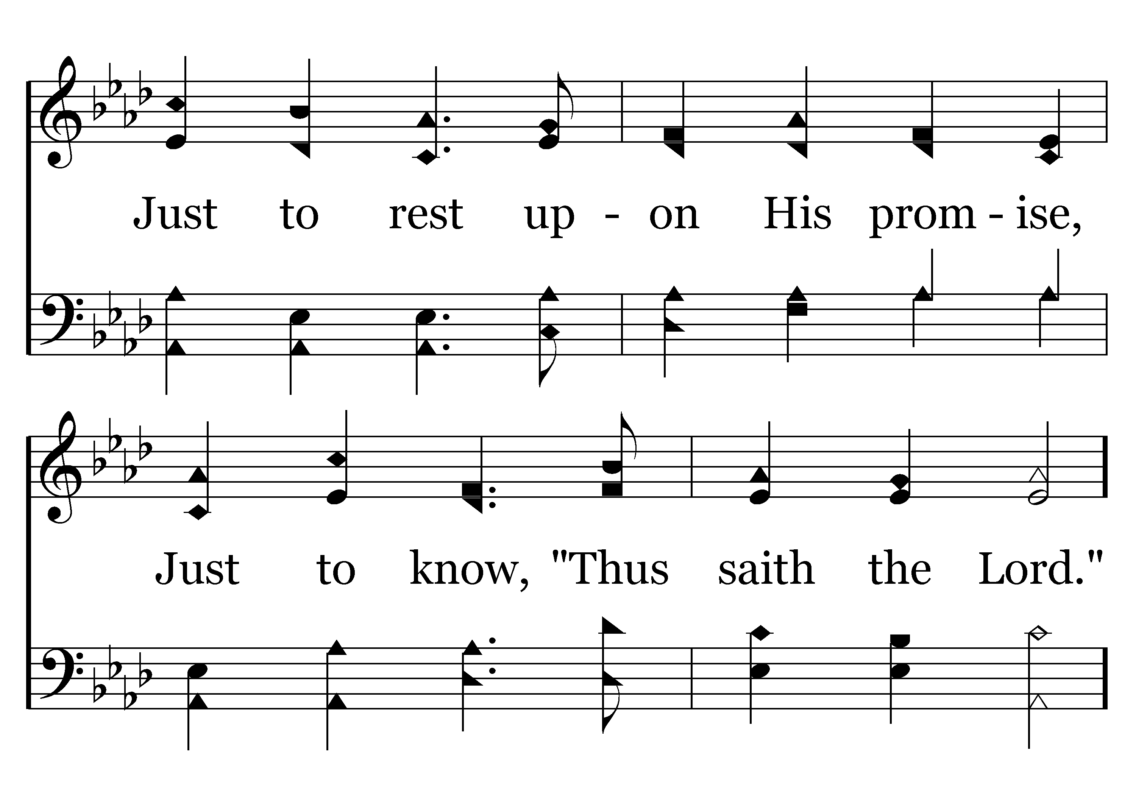
423 - Tis So Sweet To Trust In Jesus - 1.2

Slide 67
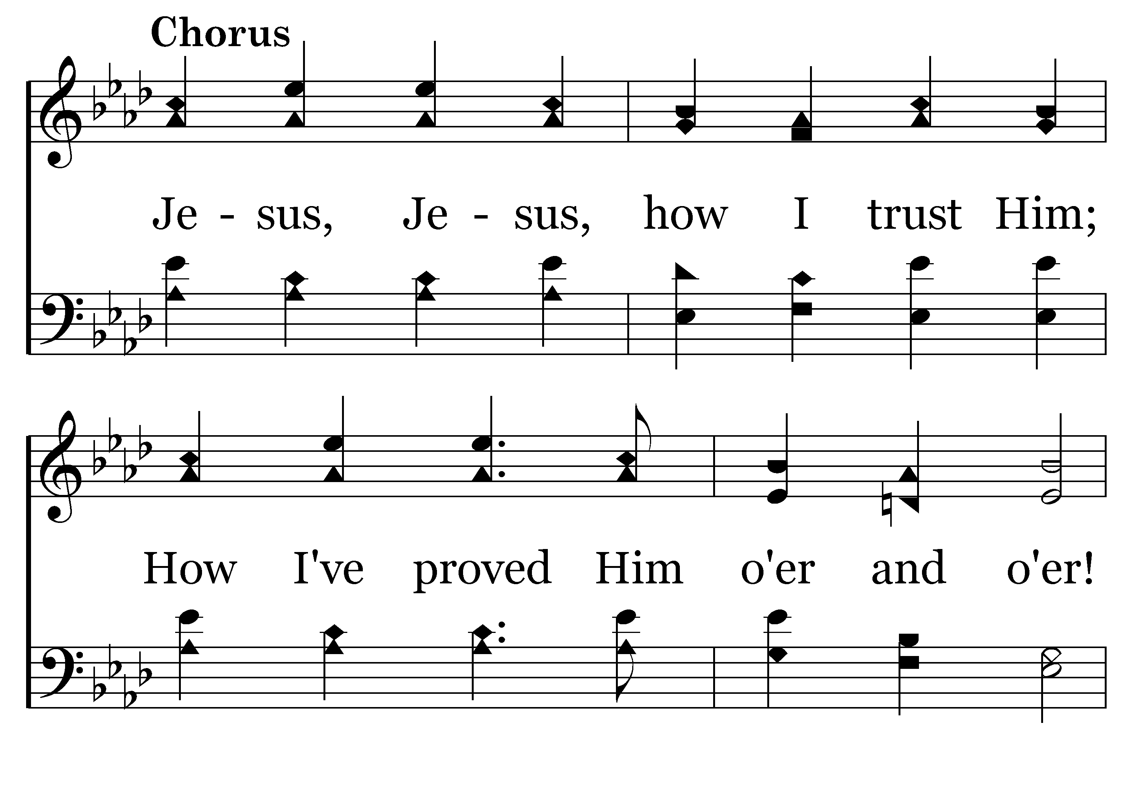
423 - Tis So Sweet To Trust In Jesus - C.1

Slide 68
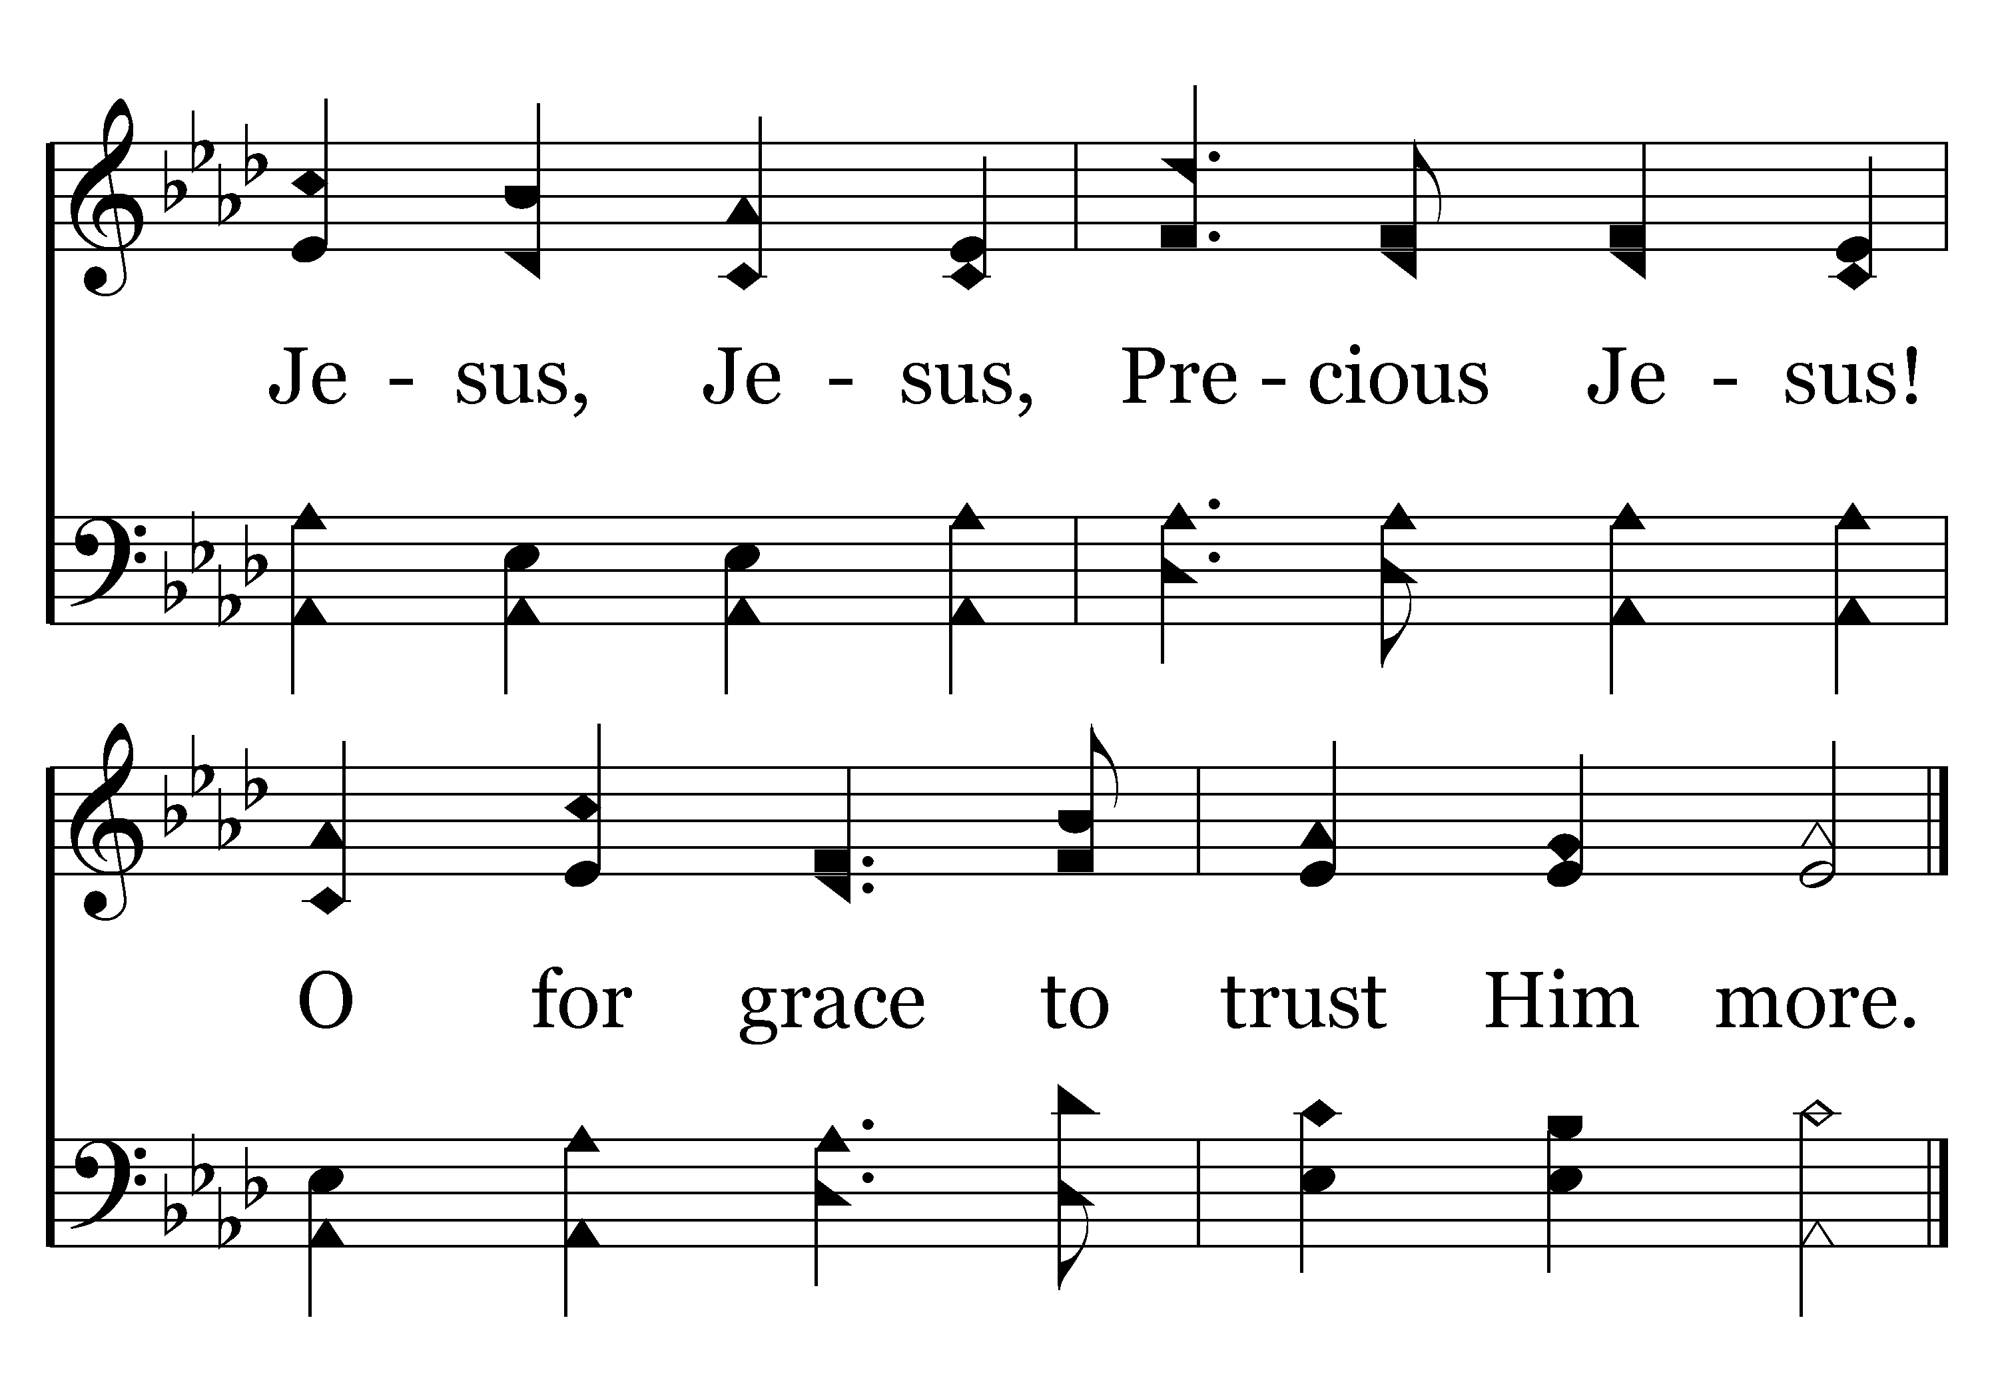
423 - Tis So Sweet To Trust In Jesus - C.2
End of Verse 1

Slide 69
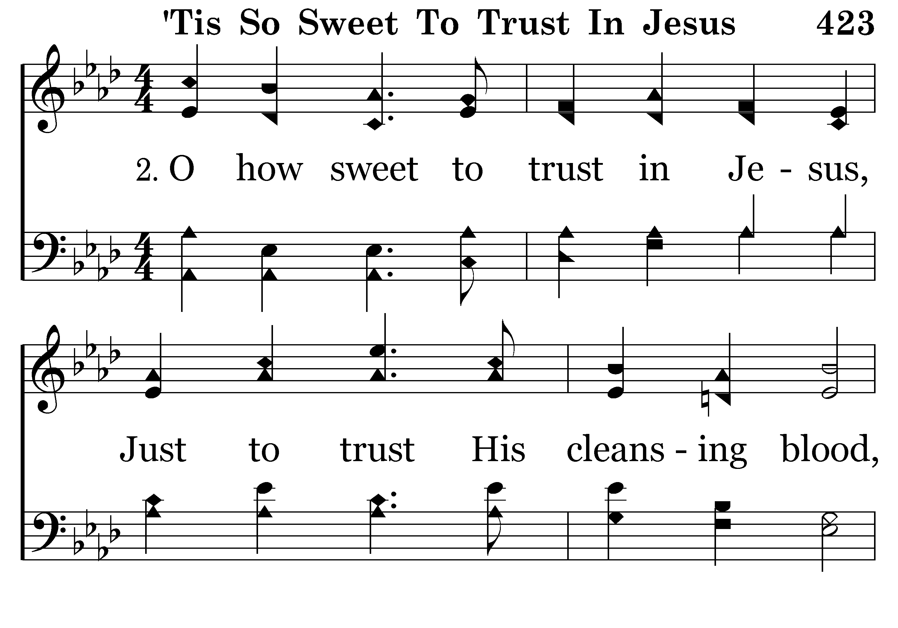
423 - Tis So Sweet To Trust In Jesus - 2.1

Slide 70
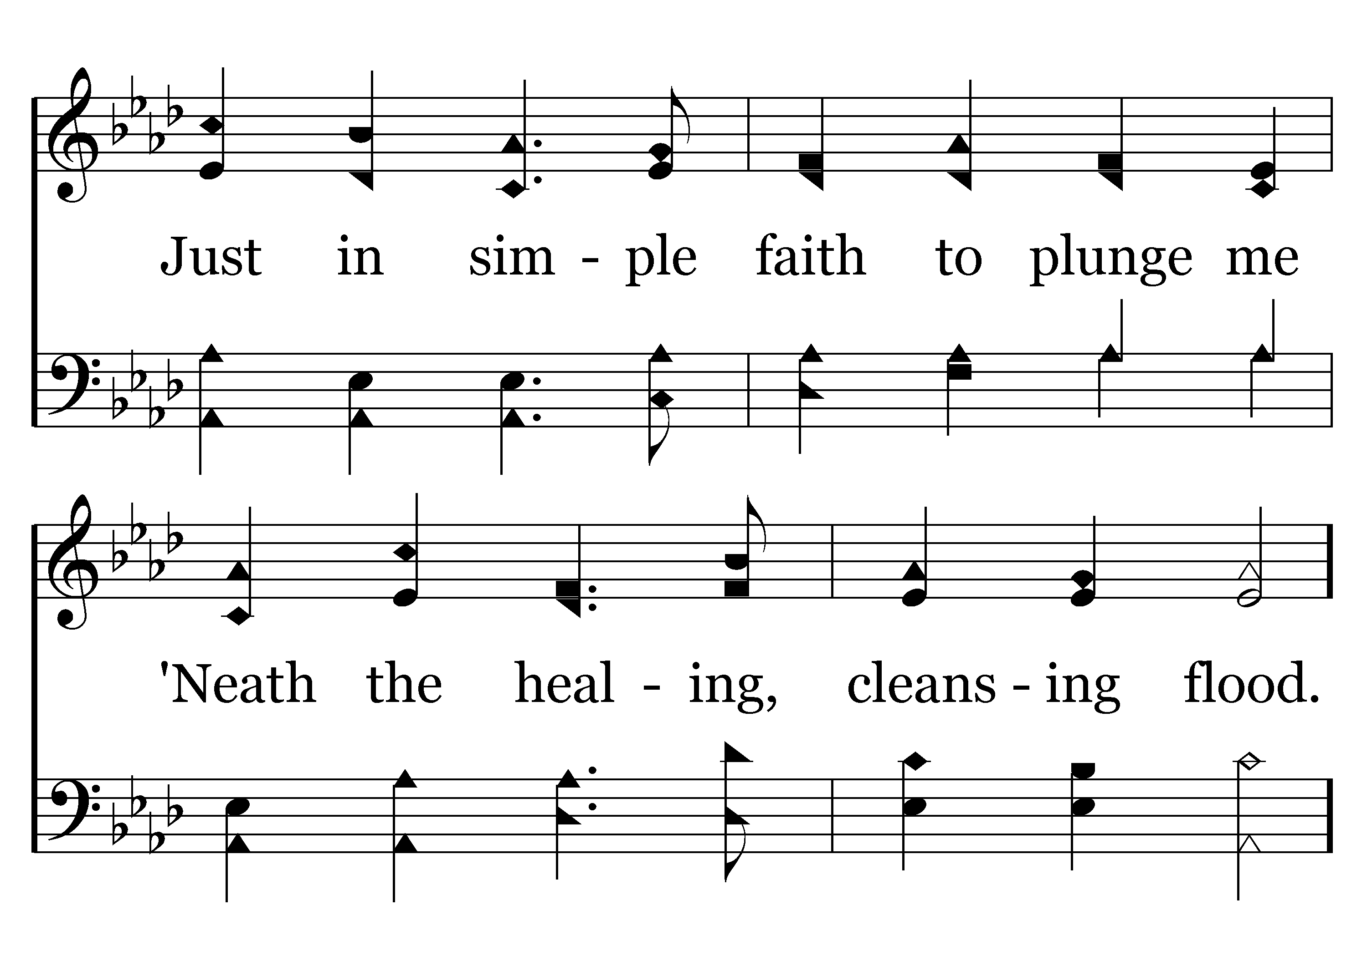
423 - Tis So Sweet To Trust In Jesus - 2.2

Slide 71
423 - Tis So Sweet To Trust In Jesus - C.1

Slide 72
423 - Tis So Sweet To Trust In Jesus - C.2
End of Verse 2

Slide 73
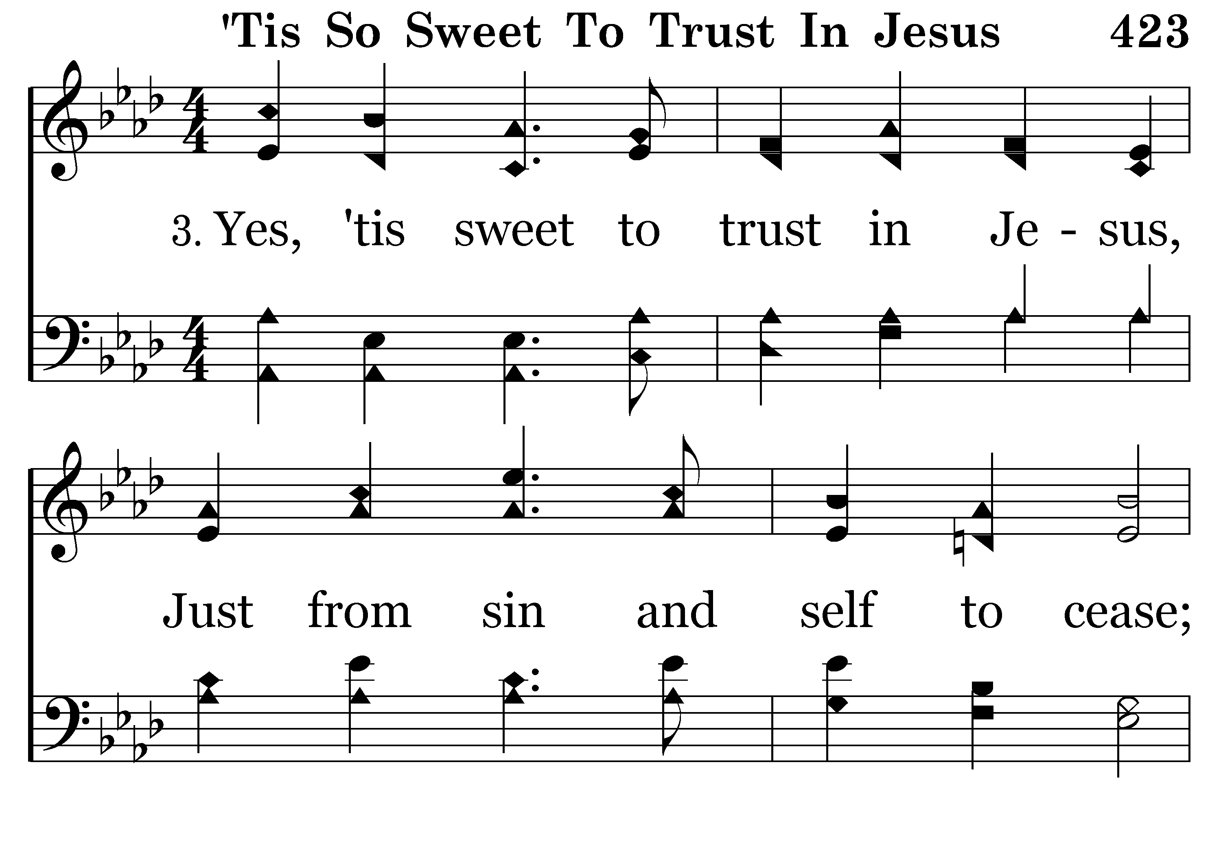
423 - Tis So Sweet To Trust In Jesus - 3.1

Slide 74
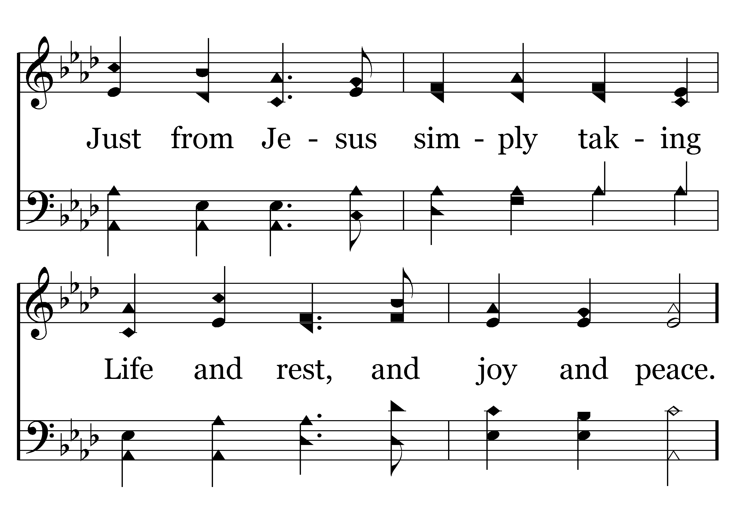
423 - Tis So Sweet To Trust In Jesus - 3.2

Slide 75
423 - Tis So Sweet To Trust In Jesus - C.1

Slide 76
423 - Tis So Sweet To Trust In Jesus - C.2
End of Verse 3

Slide 77
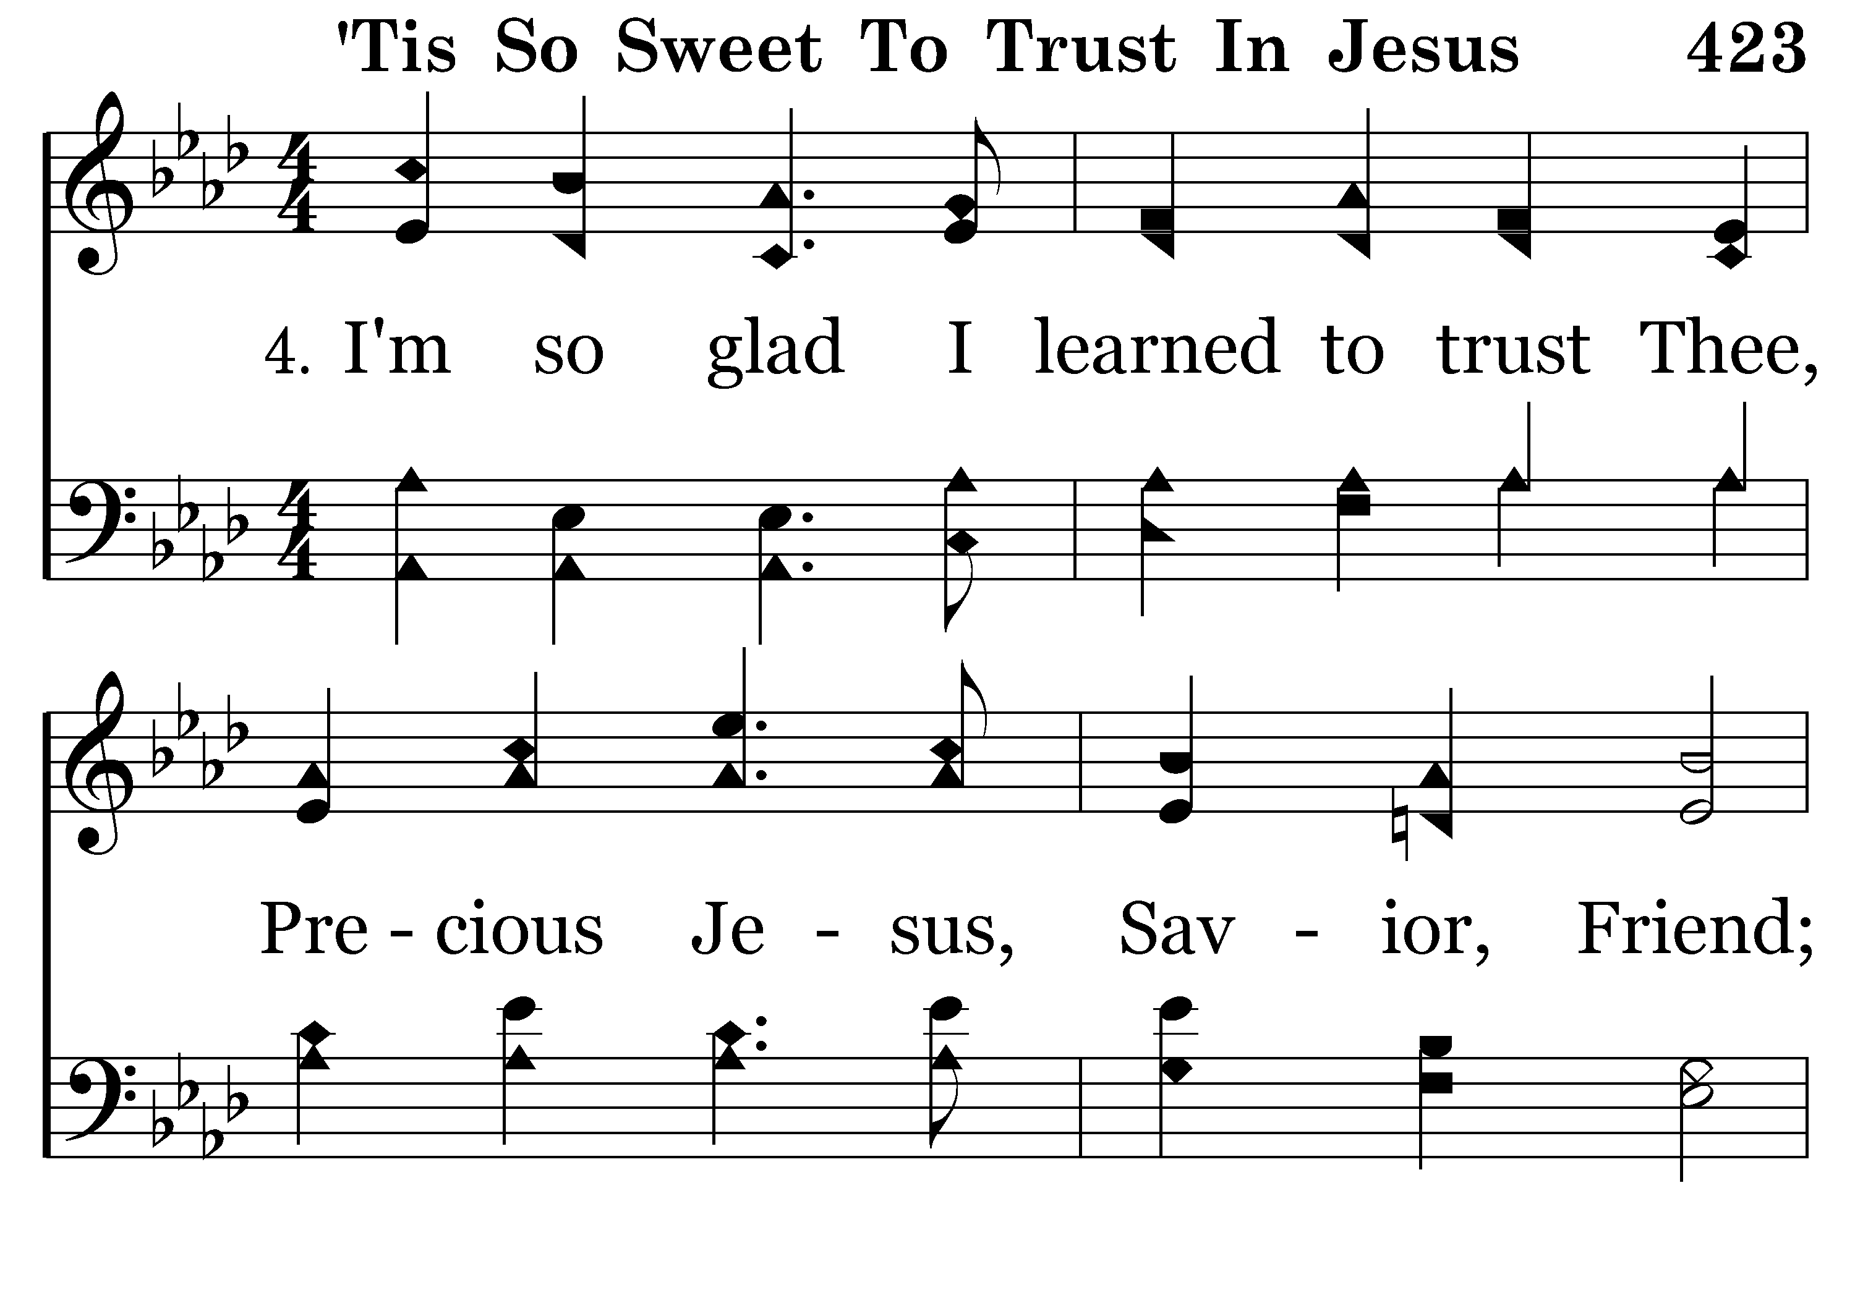
423 - Tis So Sweet To Trust In Jesus - 4.1

Slide 78
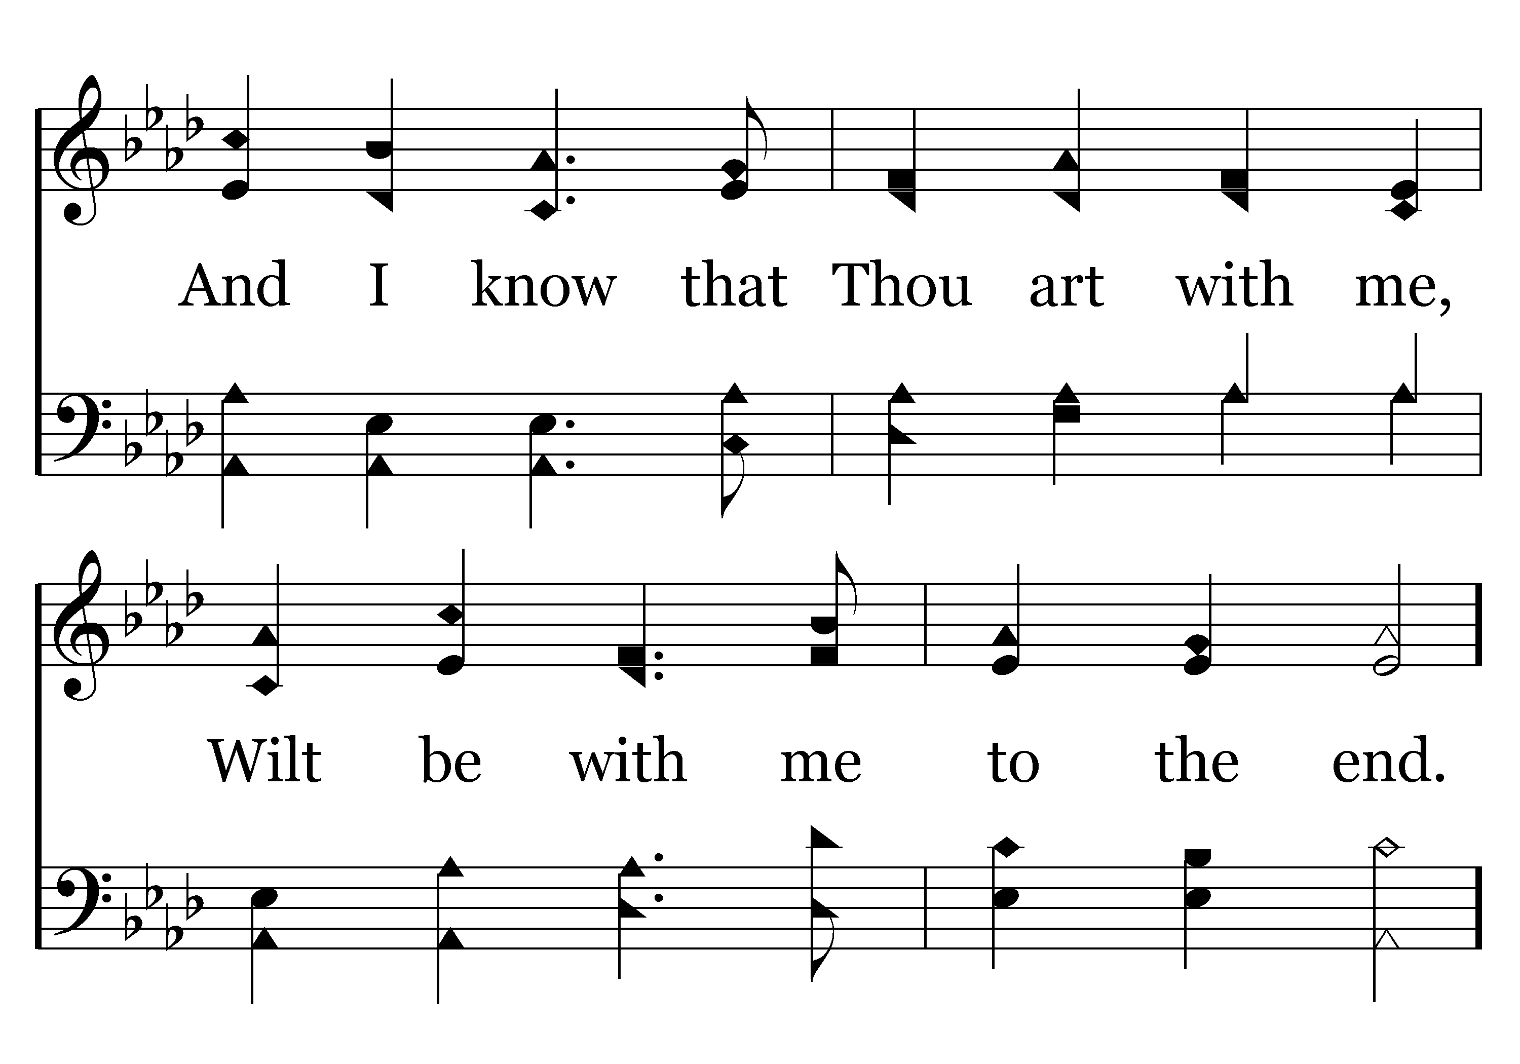
423 - Tis So Sweet To Trust In Jesus - 4.2

Slide 79
423 - Tis So Sweet To Trust In Jesus - C.1

Slide 80
423 - Tis So Sweet To Trust In Jesus - C.2
End of Song

Slide 81
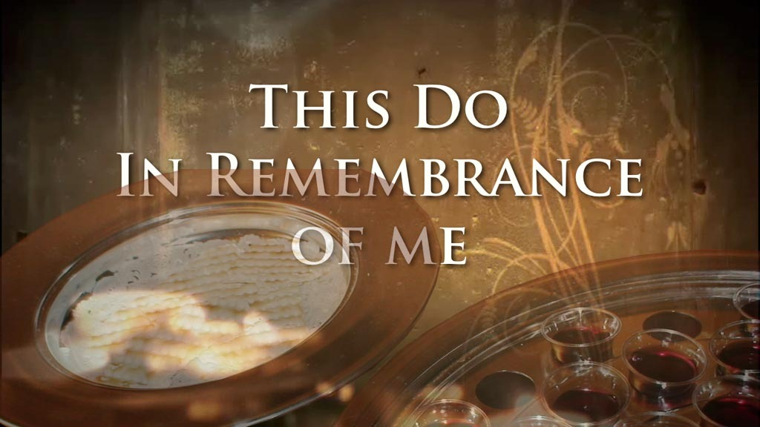
REMARKS BY DAVID HAMMONTREE

Slide 82
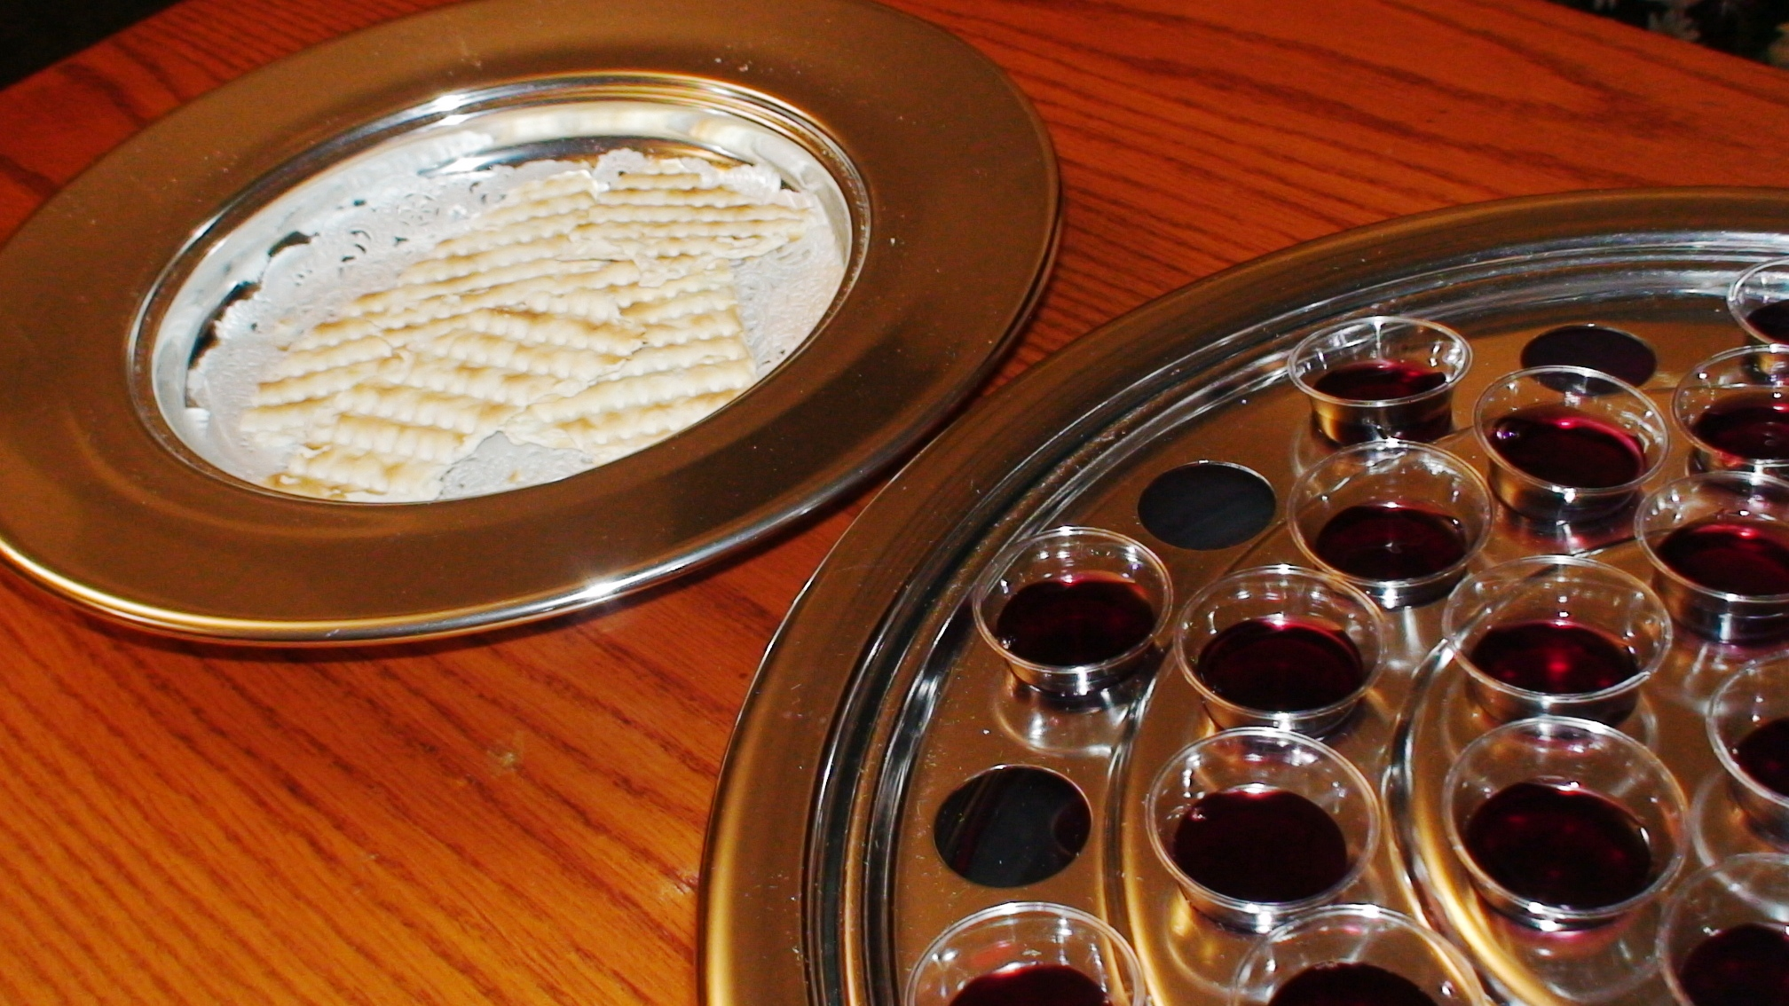
“As often as you eat this bread and drink this cup, you proclaim the Lord’s death….” 1 Corinthians 11:26

Slide 83
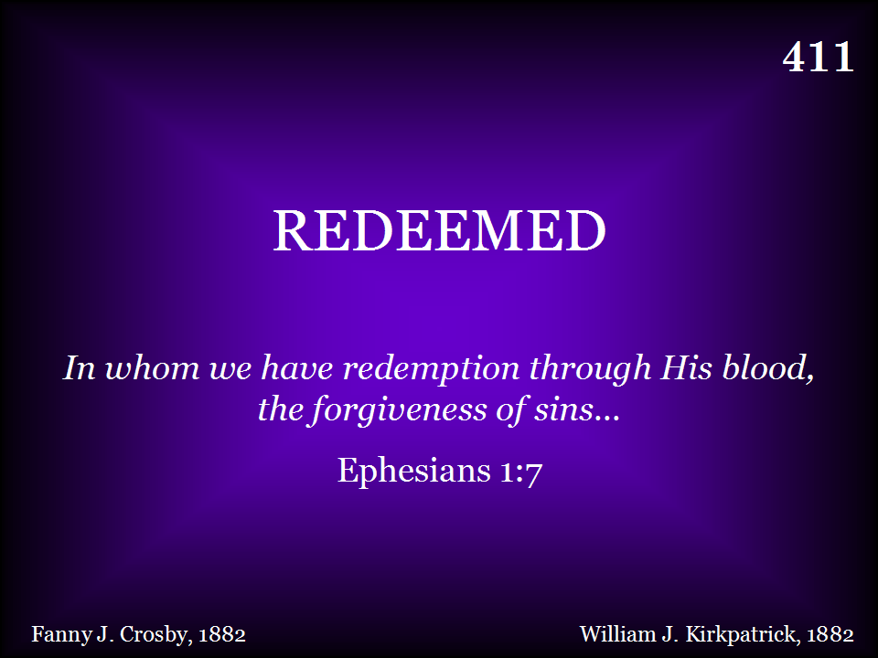
411 - Redeemed - Title

Slide 84
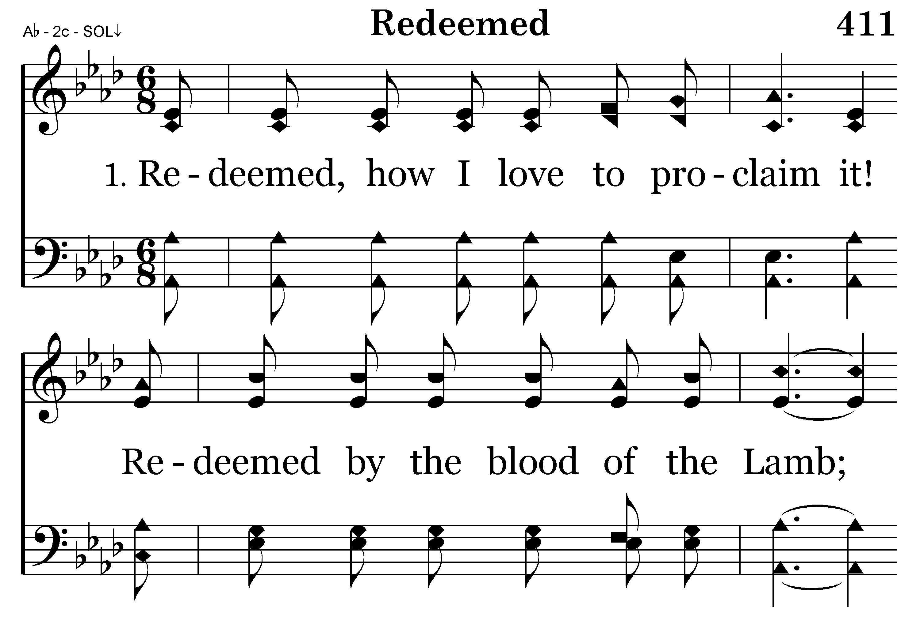
411 - Redeemed - 1.1

Slide 85
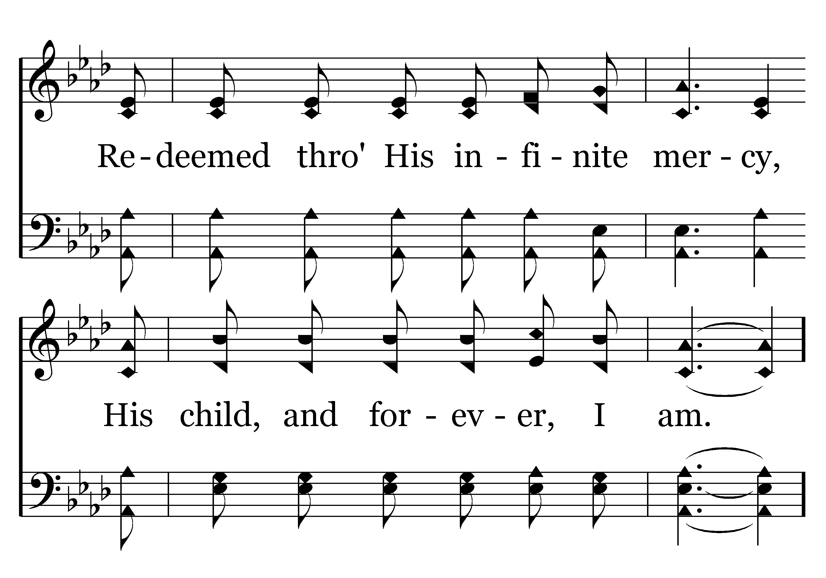
411 - Redeemed - 1.2

Slide 86
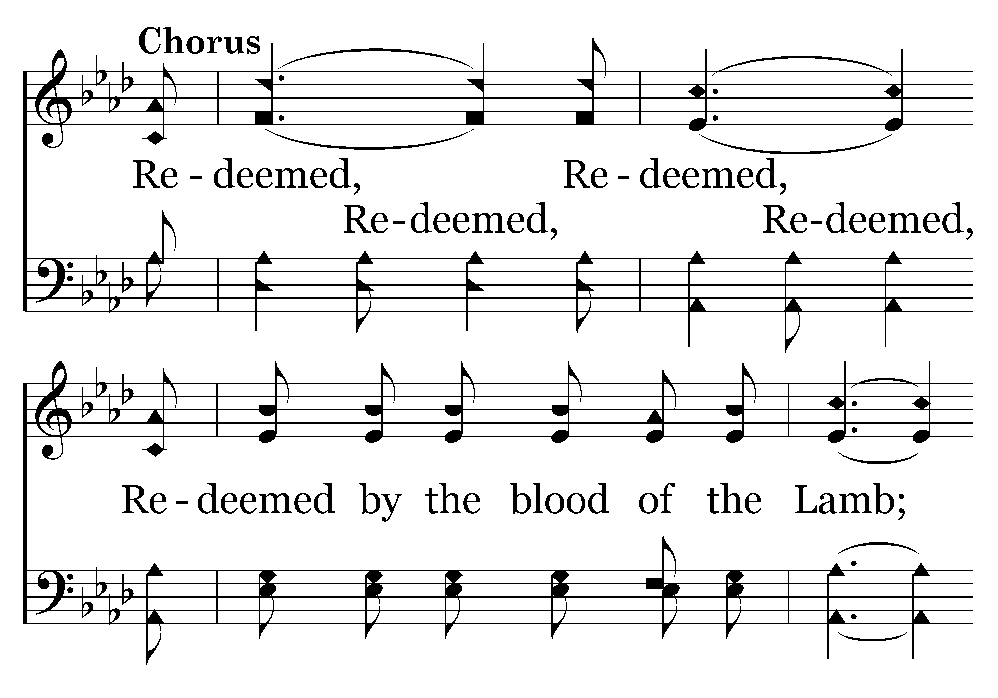
411 - Redeemed - C.1

Slide 87
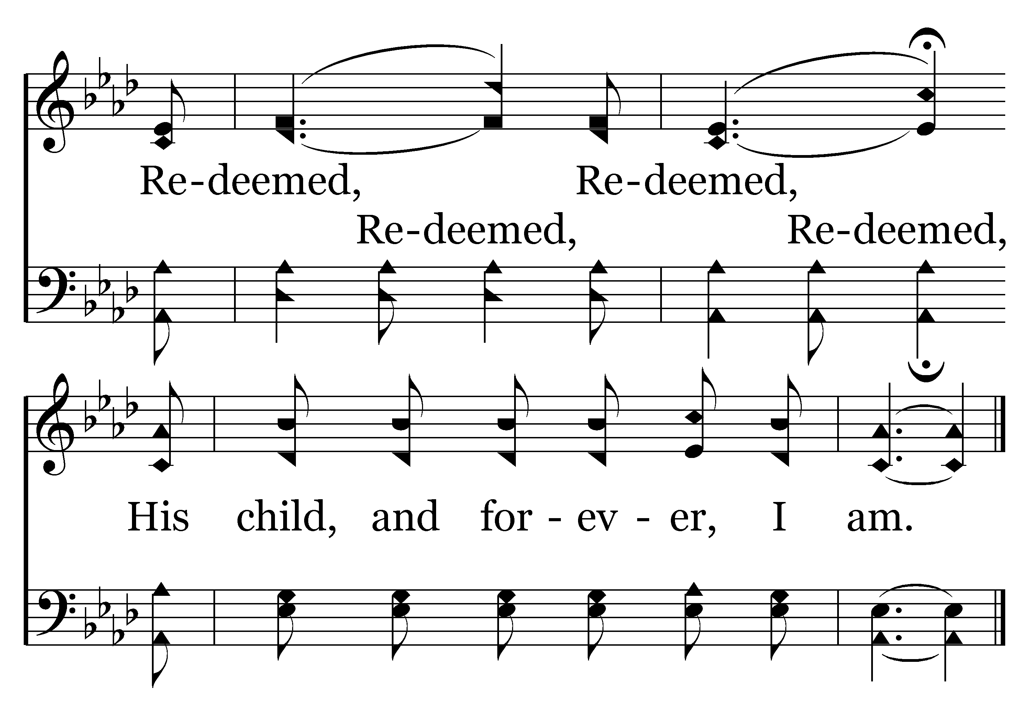
411 - Redeemed - C.2
End of Verse 1

Slide 88
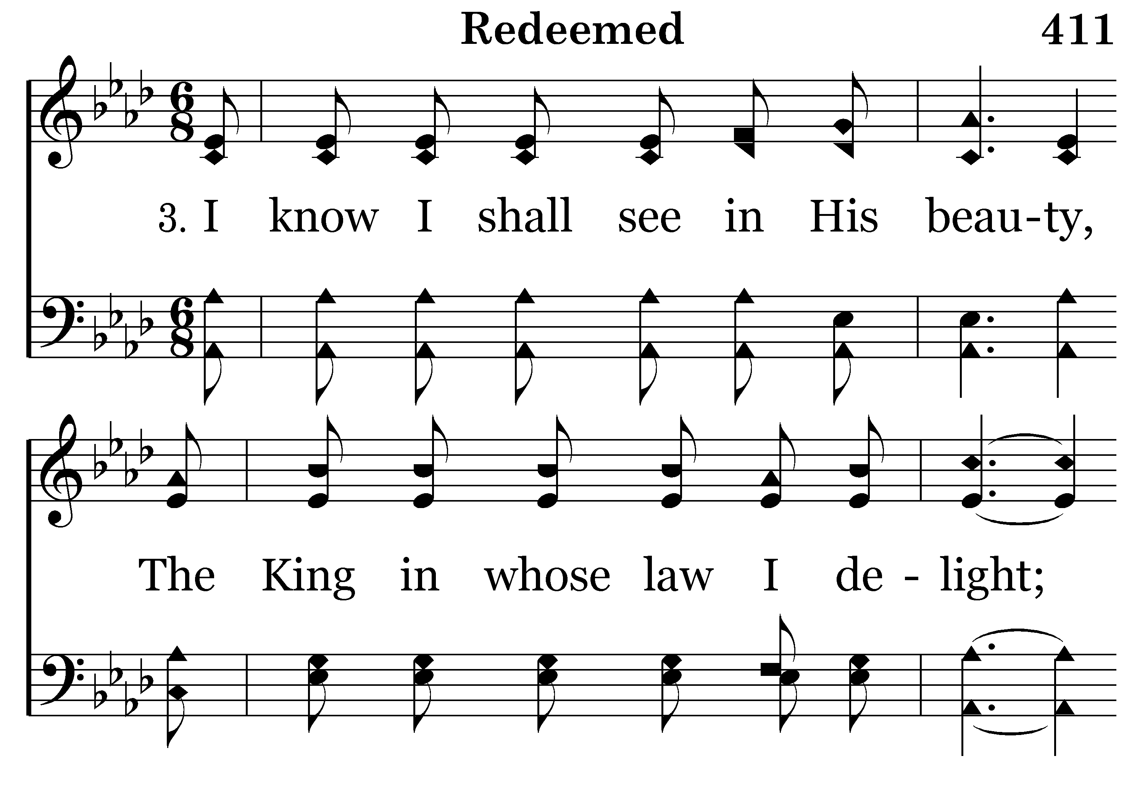
411 - Redeemed - 3.1

Slide 89
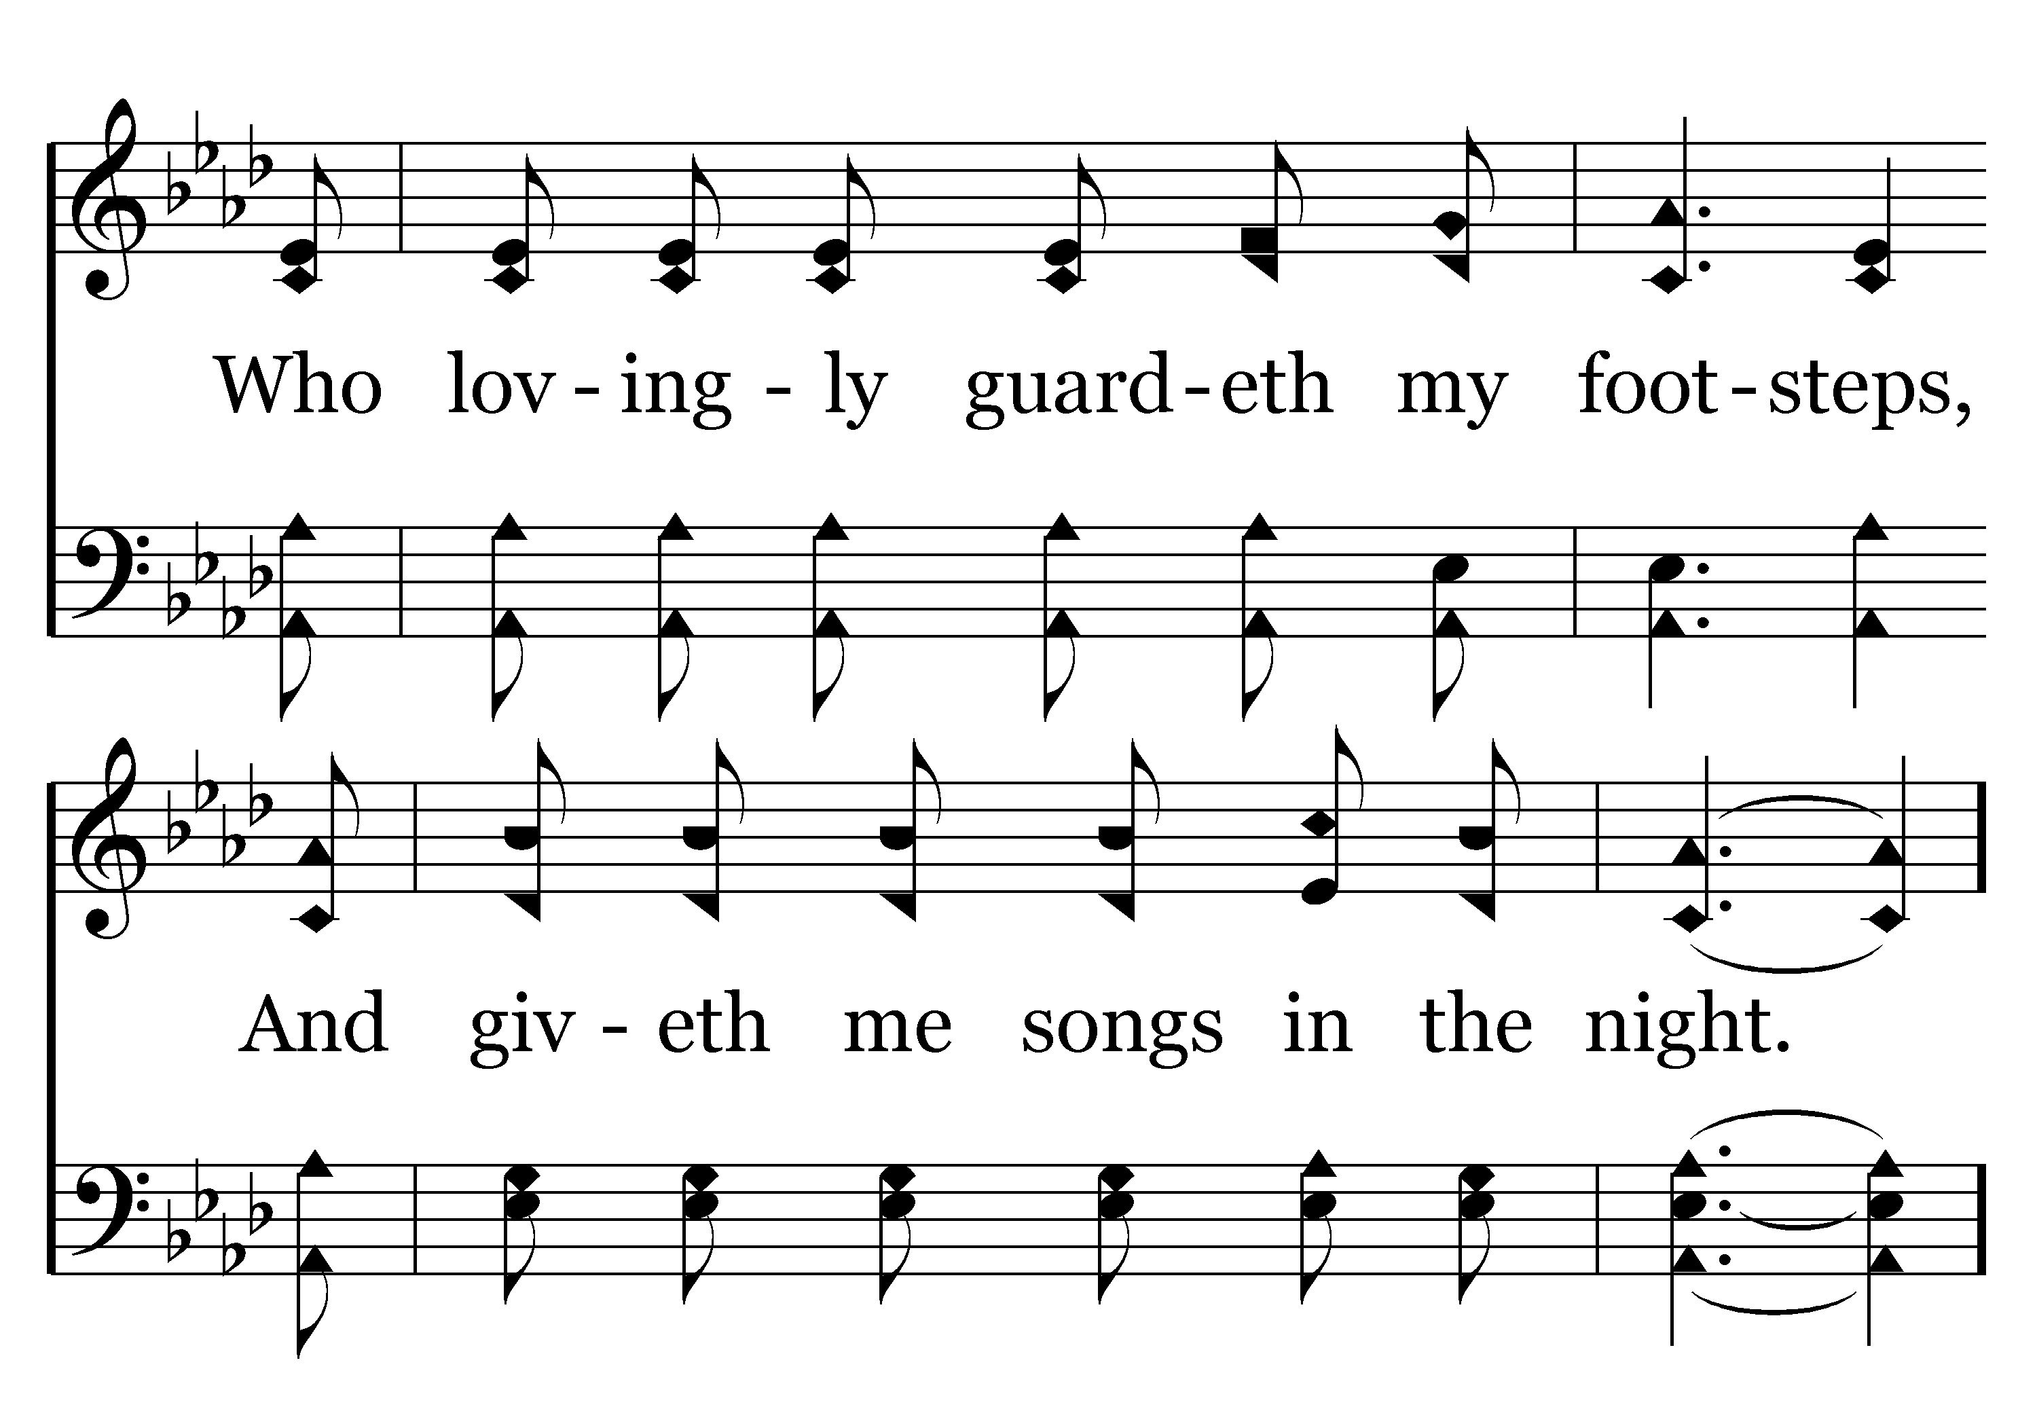
411 - Redeemed - 3.2

Slide 90
411 - Redeemed - C.1

Slide 91
411 - Redeemed - C.2
End of Song

Slide 93

442 - Yield Not To Temptation - Title

Slide 94

442 - Yield Not To Temptation - 1.1

Slide 95

442 - Yield Not To Temptation - 1.2

Slide 96

442 - Yield Not To Temptation - 1.3

Slide 97

442 - Yield Not To Temptation - 1.4

Slide 98

442 - Yield Not To Temptation - C.1

Slide 99

442 - Yield Not To Temptation - C.2
End of Verse 1

Slide 100

442 - Yield Not To Temptation - 2.1

Slide 101

442 - Yield Not To Temptation - 2.2

Slide 102

442 - Yield Not To Temptation - 2.3

Slide 103

442 - Yield Not To Temptation - 2.4

Slide 104
442 - Yield Not To Temptation - C.1

Slide 105
442 - Yield Not To Temptation - C.2
End of Verse 2

Slide 106

442 - Yield Not To Temptation - 3.1

Slide 107

442 - Yield Not To Temptation - 3.2

Slide 108

442 - Yield Not To Temptation - 3.3

Slide 109

442 - Yield Not To Temptation - 3.4

Slide 110
442 - Yield Not To Temptation - C.1

Slide 111
442 - Yield Not To Temptation - C.2
End of Song

Slide 113

TODAY’S TEXT
GAILAND KILTZ
JOHN 11:41-44

Slide 114
John 11:41-44
41 So they took away the stone. Then Jesus looked up and said, "Father, I thank you that you have heard me. 42 I knew that you always hear me, but I said this for the benefit of the people standing here, that they may believe that you sent me."
43 When he had said this, Jesus called in a loud voice, "Lazarus, come out!" 44 The dead man came out, his hands and feet wrapped with strips of linen, and a cloth around his face.
Jesus said to them, "Take off the grave clothes and let him go."
NIV

Slide 115
INVITATION SONG
# 263
IS YOUR HEART RIGHT WITH GOD?

Slide 116

FEAR

Slide 117
DOUBT

Slide 118
UNCERTAINTY

Slide 119
LACK OF TIME

Slide 120
ANGER

Slide 121
WORRY

Slide 122
AFTER THE STONE WAS REMOVED – LAZARUS WAS ALIVE BUT WAS STILL BOUND
HE HAD BEEN DEAD FOR 4 DAYS
MARTHA SAID – “HE STINKS”
WHEN LAZARUS CAME OUT OF THE TOMB HE WAS STILL WRAPPED IN GRAVE CLOTHES
HE COULD WALK – TALK– HE HAD RECEIVED LIFE BUT HE STILL HAD A PROBLEM

Slide 123
AFTER THE STONE WAS REMOVED – LAZARUS WAS ALIVE BUT WAS STILL BOUND
John 11:41-44 So they took away the stone. Then Jesus looked up and said, "Father, I thank you that you have heard me. 42 I knew that you always hear me, but I said this for the benefit of the people standing here, that they may believe that you sent me." 43 When he had said this, Jesus called in a loud voice, "Lazarus, come out!" 44 The dead man came out, his hands and feet wrapped with strips of linen, and a cloth around his face.
Jesus said to them, "Take off the grave clothes and let him go."

Slide 124
AFTER THE STONE WAS REMOVED – LAZARUS WAS ALIVE BUT WAS STILL BOUND
WE CAN ROLL AWAY ALL THE STONES THAT KEEP US CONFINED
WE CAN BE MADE ALIVE AND STILL BE BOUND
JESUS GIVES US LIFE – BUT WE STUGGLE WITH THE STINKING GRAVE CLOTHES OF OUR OLD LIFE

Slide 125


Slide 126
Col 3:1-11 Since, then, you have been raised with Christ, set your hearts on things above, where Christ is seated at the right hand of God. 2 Set your minds on things above, not on earthly things. 3 For you died, and your life is now hidden with Christ in God. 4 When Christ, who is your life, appears, then you also will appear with him in glory.
5 Put to death, therefore, whatever belongs to your earthly nature: sexual immorality, impurity, lust, evil desires and greed, which is idolatry. 6 Because of these, the wrath of God is coming. 7 You used to walk in these ways, in the life you once lived. 8 But now you must rid yourselves of all such things as these: anger, rage, malice, slander, and filthy language from your lips.

Slide 127
9 Do not lie to each other, since you have taken off your old self with its practices 10 and have put on the new self, which is being renewed in knowledge in the image of its Creator.

Slide 128
THIS PASSAGE TEACHES US THE IMPORTANCE OF GETTING RID OF THOSE OLD STINKING GRAVE CLOTHES
LAZARUS WAS RESCUED BUT WAS STILL REEKING
HE WAS ENERGIZED BUT STILL ENTRAPPED
HE HAD LIFE BUT HE WASN’T LIBERTATED
AS A CHRISTIAN WE CAN BE LIKE LAZARUS IN SOME WAYS
WE WILL LOOK AT SOME GRAVE CLOTHES WE NEED TO REMOVE

Slide 129
THROW AWAY YOUR OLD CLOTHES
Do not lie to each other, since you have taken off your old self with its practices 10 and have put on the new self, which is being renewed in knowledge in the image of its Creator.

Slide 130
THROW AWAY YOUR OLD CLOTHES
Do not lie to each other, since you have taken off your old self with its practices 10 and have put on the new self, which is being renewed in knowledge in the image of its Creator.
THIS WAS WRITTEN TO CHRISTIANS WHO WERE STILL STRUGGLING WITH OLD HABITS
EVEN THE APOSTLE PAUL STRUGGLED WITH THIS

Slide 131
THROW AWAY YOUR OLD CLOTHES
Rom 7:15-20 I do not understand what I do. For what I want to do I do not do, but what I hate I do. 16 And if I do what I do not want to do, I agree that the law is good. 17 As it is, it is no longer I myself who do it, but it is sin living in me. 18 I know that nothing good lives in me, that is, in my sinful nature. For I have the desire to do what is good, but I cannot carry it out. 19 For what I do is not the good I want to do; no, the evil I do not want to do — this I keep on doing. 20 Now if I do what I do not want to do, it is no longer I who do it, but it is sin living in me that does it.

Slide 132
THROW AWAY YOUR OLD CLOTHES
21 So I find this law at work: When I want to do good, evil is right there with me. 22 For in my inner being I delight in God's law; 23 but I see another law at work in the members of my body, waging war against the law of my mind and making me a prisoner of the law of sin at work within my members. 24 What a wretched man I am! Who will rescue me from this body of death? 25 Thanks be to God — through Jesus Christ our Lord!

Slide 133
THROW AWAY YOUR OLD CLOTHES
21 So I find this law at work: When I want to do good, evil is right there with me. 22 For in my inner being I delight in God's law; 23 but I see another law at work in the members of my body, waging war against the law of my mind and making me a prisoner of the law of sin at work within my members. 24 What a wretched man I am! Who will rescue me from this body of death? 25 Thanks be to God — through Jesus Christ our Lord!

Slide 134
THROW AWAY YOUR OLD CLOTHES
21 So I find this law at work: When I want to do good, evil is right there with me. 22 For in my inner being I delight in God's law; 23 but I see another law at work in the members of my body, waging war against the law of my mind and making me a prisoner of the law of sin at work within my members. 24 What a wretched man I am! Who will rescue me from this body of death? 25 Thanks be to God — through Jesus Christ our Lord!

Slide 135
THROW AWAY YOUR OLD CLOTHES
DESTROY OLD EARTHLY URGES
5 Put to death, therefore, whatever belongs to your earthly nature: sexual immorality, impurity, lust, evil desires and greed, which is idolatry.

Slide 136
THROW AWAY YOUR OLD CLOTHES
DESTROY OLD EARTHLY URGES
5 Put to death, therefore, whatever belongs to your earthly nature: sexual immorality, impurity, lust, evil desires and greed, which is idolatry.

Slide 137
THROW AWAY YOUR OLD CLOTHES
DESTROY OLD EARTHLY URGES
5 Put to death, therefore, whatever belongs to your earthly nature: sexual immorality, impurity, lust, evil desires and greed, which is idolatry.
THE GREEK “GREED” IS “COVET”
THIS IS CALLED IDOLATRY
IDOLATRY IS NOT LIMITED TO BOWING DOWN TO A STATUE OR IMAGE

Slide 138
THROW AWAY YOUR OLD CLOTHES
DESTROY OLD EARTHLY URGES
SEXUAL IMMORALITY
IMPURITY
LUST
EVIL DESIRES
GREED
WE WOULD CONDEMN THOSE GUILTY OF THESE SINS
BUT DON’T GET TOO COMFORTABLE

Slide 139
THROW AWAY YOUR OLD CLOTHES
DISCARD OLD PRACTICES
8 But now you must rid yourselves of all such things as these: anger, rage, malice, slander, and filthy language from your lips. 9 Do not lie to each other

Slide 140
THROW AWAY YOUR OLD CLOTHES
DISCARD OLD PRACTICES
ANGER IS THE GREEK WORD “THUMOS” AND MEANS A SEETHING KIND OF ANGER THAT BUILDS UP PRESSURE BENEATH THE SURFACE
RAGE IS A VIOLENT OUTBURST OF ANGER – A TEMPER TANTRUM
MALICE IS HAVING ANGER TOWARD SOMEONE

Slide 141
THROW AWAY YOUR OLD CLOTHES
DISCARD OLD PRACTICES
SLANDER IS ATTACKING SOMEONE’S CHARACTER
FILTHY LANGUAGE
DON’T LIE TO ONE ANOTHER

Slide 142
THROW AWAY YOUR OLD CLOTHES
DESTROY OLD PRACTICES
ANGER
RAGE
MALICE
SLANDER
FILTHY LANGUAGE
LIE TO ONE ANOTHER
SEXUAL IMMORALITY
IMPURITY
LUST
EVIL DESIRES
GREED
HAVE WE CREATED A DOUBLE STANDARD?
ALL SIN STINKS
WE MUST RID OURSELVES OF ALL SIN

Slide 143
THROW AWAY YOUR OLD CLOTHES
DESTROY OLD EARTHLY PRACTICES
WE HAVE UNWRAPPED THE OLD STINKING GRAVE CLOTHES
WE HAVE DESTROYED EARTHLY URGES AND EARTHLY PRACTICES
WE HAVE PUT OFF THE OLD MAN
BUT WE ARE NOT FREE-----YET

Slide 144
CHANGE INTO YOUR NEW CLOTHES
CHANGE INVOLVES A CONSCIOUS DECISION
Col 3:9-10 you have taken off your old self with its practices 10 and have put on the new self, which is being renewed in knowledge in the image of its Creator

Slide 145
CHANGE INTO YOUR NEW CLOTHES
CHANGE INVOLVES A CONSCIOUS DECISION
Col 3:9-10 you have taken off your old self with its practices 10 and have put on the new self, which is being renewed in knowledge in the image of its Creator
THIS REQUIRES A WILLINGNESS TO CHANGE
A DECISION TO TAKE OFF THE OLD AND PUT ON THE NEW

Slide 146
CHANGE INTO YOUR NEW CLOTHES
CHANGE INVOLVES A CONTINUAL PROCESS
Col 3:9-10 you have taken off your old self with its practices 10 and have put on the new self, which is being renewed in knowledge in the image of its Creator

Slide 147
CHANGE INTO YOUR NEW CLOTHES
CHANGE INVOLVES A CONTINUAL PROCESS
Col 3:9-10 you have taken off your old self with its practices 10 and have put on the new self, which is being renewed in knowledge in the image of its Creator
THIS DOESN’T HAPPEN INSTANTLY – NOT A ONE-TIME EVENT
EACH OF US IS A WORK IN PROGRESS

Slide 148
CHANGE INTO YOUR NEW CLOTHES
CHANGE INVOLVES DISCOVERING GOD’S PURPOSE FOR OUR LIVES
Col 3:9-10 you have taken off your old self with its practices 10 and have put on the new self, which is being renewed in knowledge in the image of its Creator

Slide 149
CHANGE INTO YOUR NEW CLOTHES
CHANGE INVOLVES DISCOVERING GOD’S PURPOSE FOR OUR LIVES
Col 3:9-10 you have taken off your old self with its practices 10 and have put on the new self, which is being renewed in knowledge in the image of its Creator
THE PURPOSE OF OUR SALVATION IS TO BE RE-CREATED IN THE IMAGE OF GOD

Slide 150
CHANGE INTO YOUR NEW CLOTHES
CHANGE INVOLVES DISCOVERING GOD’S PURPOSE FOR OUR LIVES
Rom 8:28-30 And we know that in all things God works for the good of those who love him, who have been called according to his purpose.
29 For those God foreknew he also predestined to be conformed to the likeness of his Son, that he might be the firstborn among many brothers.

Slide 151
CHANGE INTO YOUR NEW CLOTHES
CHANGE INVOLVES DISCOVERING GOD’S PURPOSE FOR OUR LIVES
Rom 8:28-30 And we know that in all things God works for the good of those who love him, who have been called according to his purpose.
29 For those God foreknew he also predestined to be conformed to the likeness of his Son, that he might be the firstborn among many brothers.

Slide 152
CHANGE INTO YOUR NEW CLOTHES
CHANGE INVOLVES DISCOVERING GOD’S PURPOSE FOR OUR LIVES
THIS DOESN’T MEAN WE WILL LOOK LIKE JESUS PHYSICALLY
IT MEANS OUR PERSONALITY WILL BE MORE LIKE JESUS
THIS IS A DAY IN AND DAY OUT CHANGE
THIS IS WHAT IT MEANS TO TAKE OFF THE OLD CLOTHES AND PUT ON THE NEW

Slide 153
WE MUST BE UNBOUND AND SET FREE
John 11:43-44 Jesus called in a loud voice, "Lazarus, come out!" 44 The dead man came out, his hands and feet wrapped with strips of linen, and a cloth around his face.
Jesus said to them, "Take off the grave clothes and let him go."
JESUS COULD HAVE MIRACOUSLY REMOVED THE GRAVE CLOTHES
BUT HE WANTED OTHERS INVOLVED IN WHAT HE WAS DOING

Slide 154
WE MUST BE UNBOUND AND SET FREE
ARE YOU STRUGGLING WITH SIN – DO YOU NEED TO BE SET FREE?
DO YOU KNOW SOMEONE WHO IS STRUGGLING IN THEIR GRAVE CLOTHES?
“Take off the grave clothes and let him go”
GET RID OF THOSE STINKING GRAVE CLOTHES

Slide 156

263 - Is Thy Heart Right With God - Title

Slide 157

263 - Is Thy Heart Right With God - 1.1

Slide 158

263 - Is Thy Heart Right With God - 1.2

Slide 159

263 - Is Thy Heart Right With God - C.1

Slide 160

263 - Is Thy Heart Right With God - C.2
End of Verse 1

Slide 161

263 - Is Thy Heart Right With God - 2.1

Slide 162

263 - Is Thy Heart Right With God - 2.2

Slide 163
263 - Is Thy Heart Right With God - C.1

Slide 164
263 - Is Thy Heart Right With God - C.2
End of Verse 2

Slide 165

263 - Is Thy Heart Right With God - 3.1

Slide 166

263 - Is Thy Heart Right With God - 3.2

Slide 167
263 - Is Thy Heart Right With God - C.1

Slide 168
263 - Is Thy Heart Right With God - C.2
End of Song

Slide 170


Slide 172

CLOSING PRAYER
JOHN SMITH

Slide 173

HARRY COWAN

Slide 174

THANK YOU FOR VISITING WITH US
PLEASE COME BACK

