Slide 1
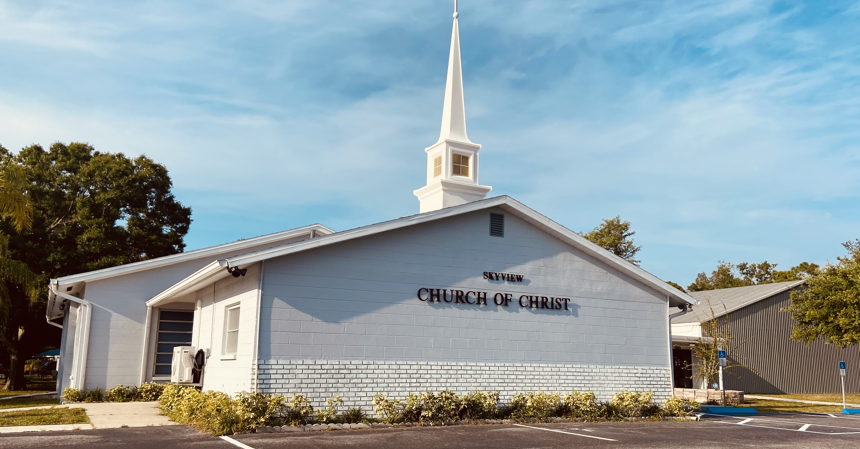
WELCOME TO OUR SERVICES

Slide 2
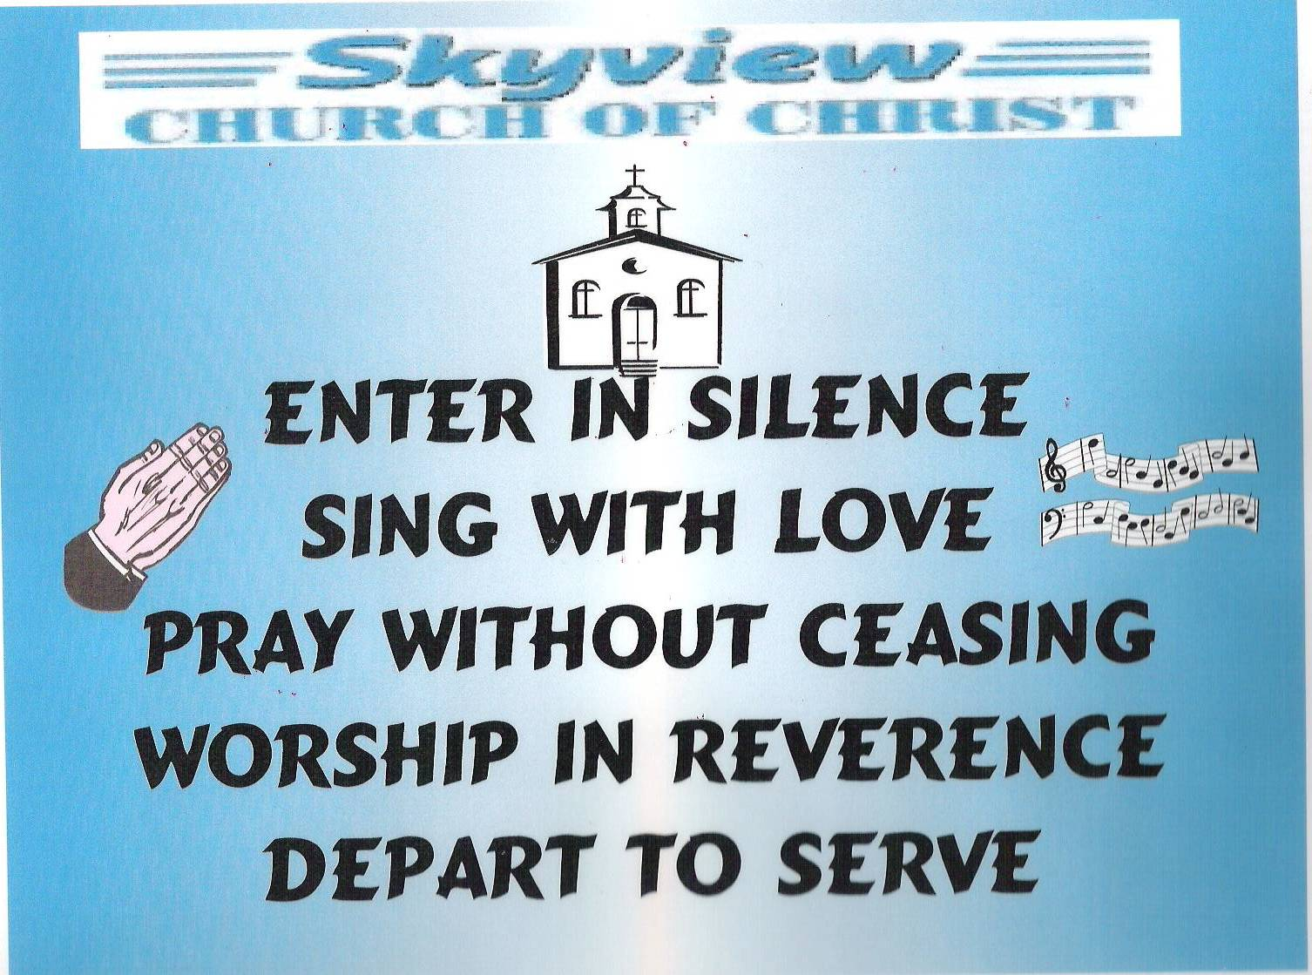
DESIGNED BY JIM INGRAM

Slide 3


Slide 4
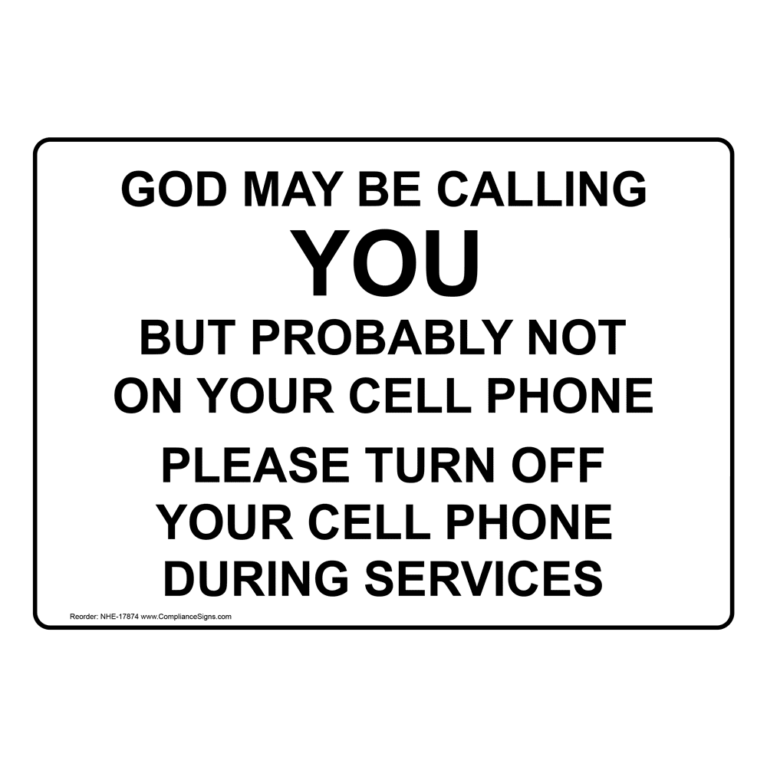

Slide 5

SUNDAY – 9:30 AM
MONDAY BIBLE STUDY – 6:30 PM IN WEST ANNEX
WEDNESDAY BIBLE STUDY – 7:00 PM IN WEST ANNEX
W.I.N.G.S. LADIES CLASS THURSDAY– 10 AM IN WEST ANNEX

Slide 6
TODAY’S WORSHIP LEADERS
CALL TO WORSHIP
PRAYER
SONG LEADER
SCRIPTURE
HEADING TABLE
SERMON
CLOSING PRAYER
ANNOUNCEMENTS
Gailand Kiltz
Chris Peter
Willard Duncn
Harry Cowan
Brad VanHaerents
Charles Murray
Denning Andrews
Brad VanHaerents

Slide 7

MONDAY NIGHT BIBLE STUDY 6:30PM will meet in the West Annex
WEDNESDAY BIBLE STUDY will meet in the West Annex until further notice
LADIES BIBLE CLASS W.I.N.G.S (Women In God’s Service) Thursday 10:00 AM – meets in the West Annex

Slide 8

FIVE MINUTE RULE

Slide 9


Slide 10


Slide 11
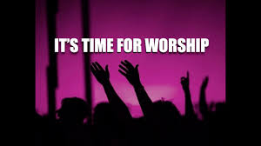

Slide 13
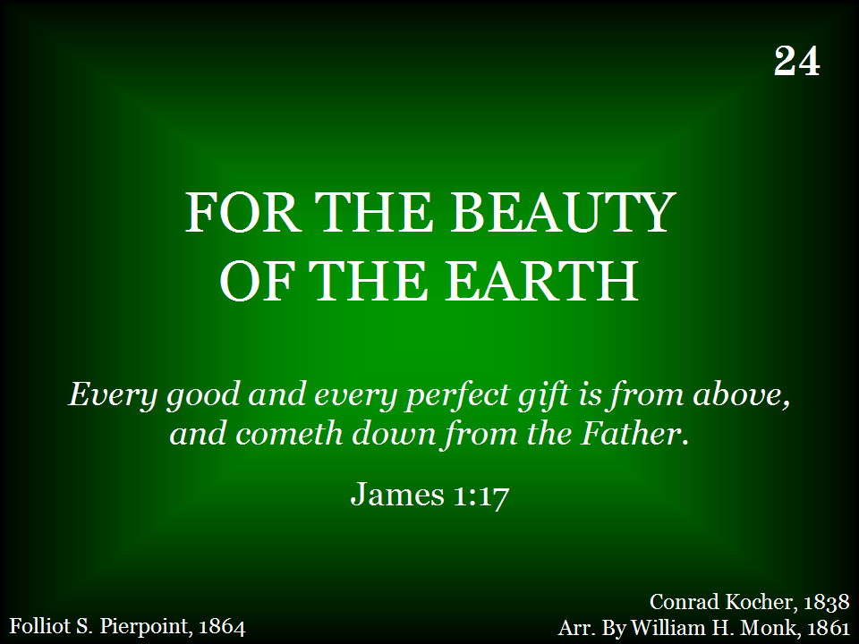
024 - For The Beauty Of The Earth - Title

Slide 14
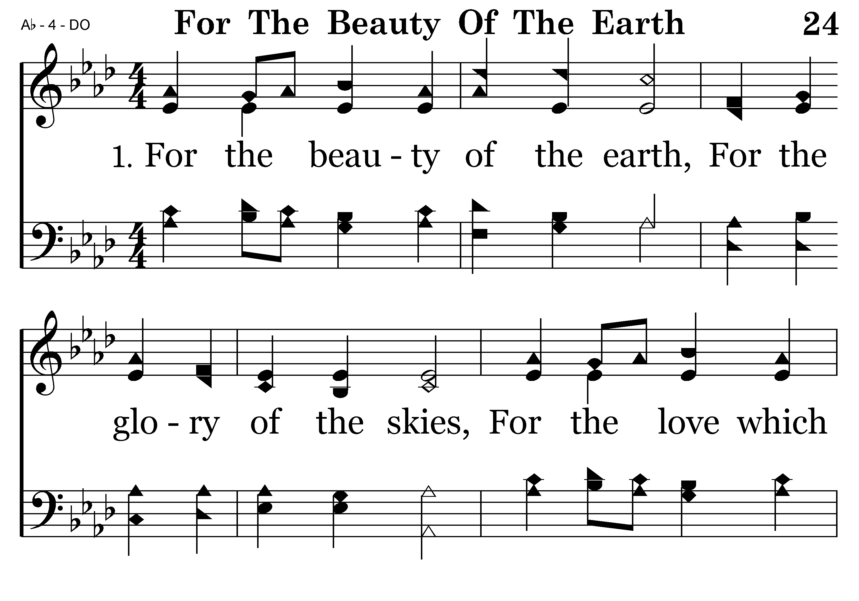
024 - For The Beauty Of The Earth - 1.1

Slide 15
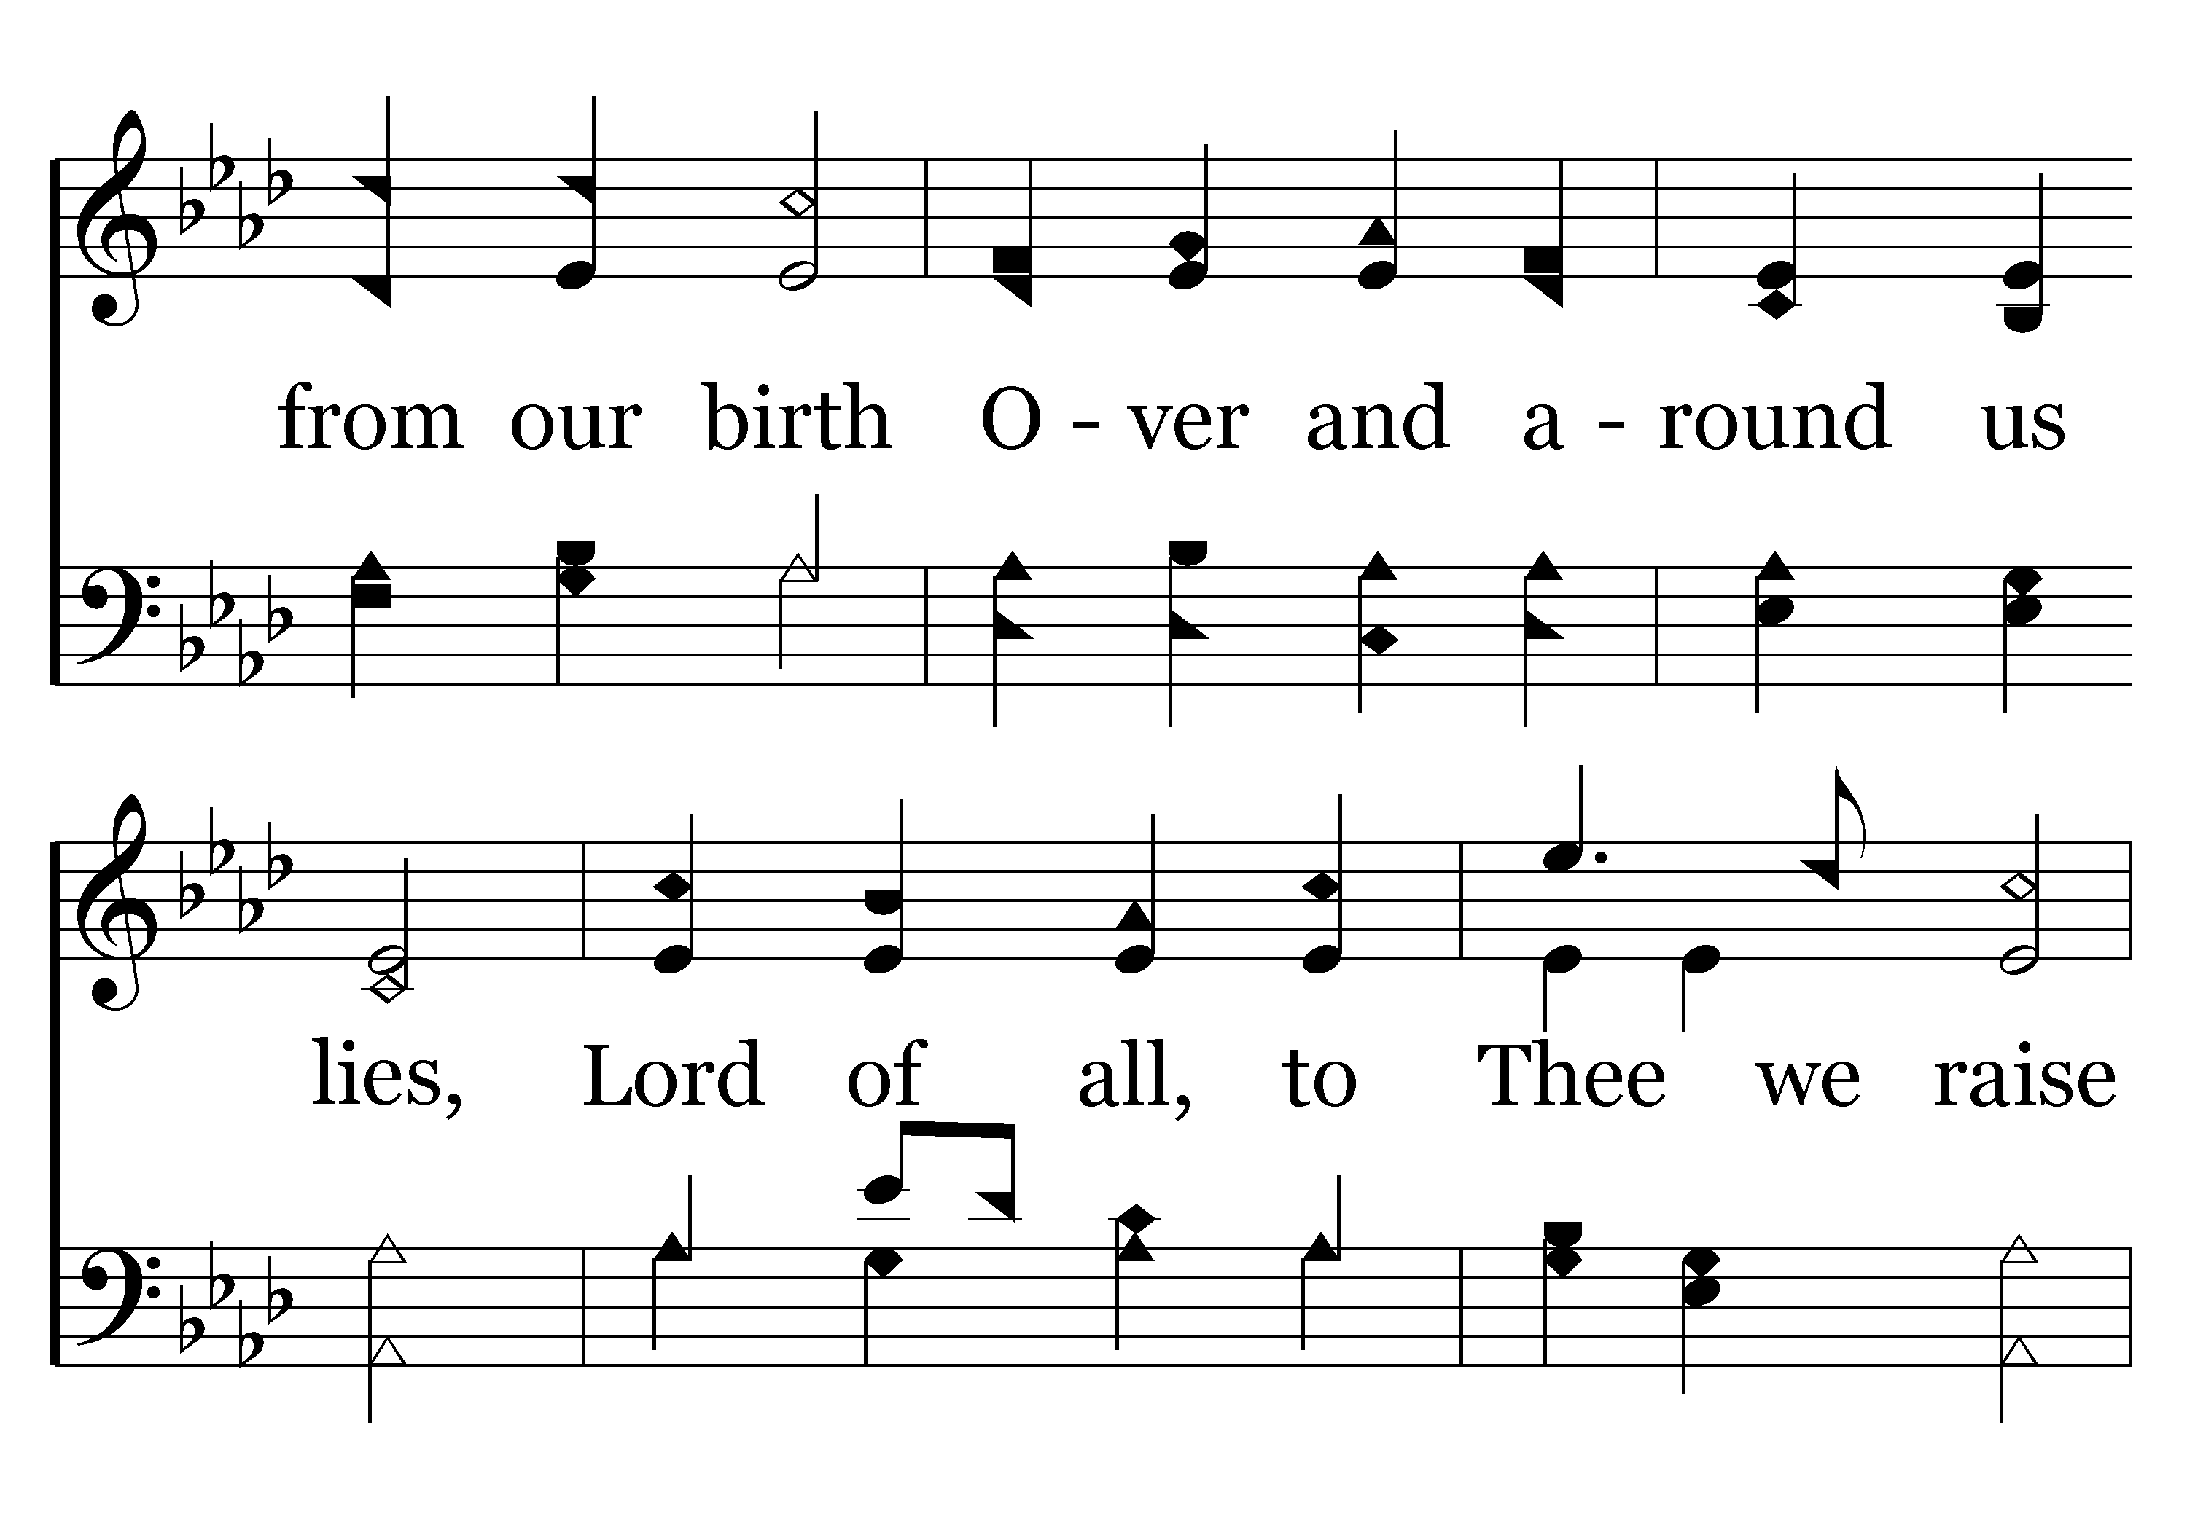
024 - For The Beauty Of The Earth - 1.2

Slide 16
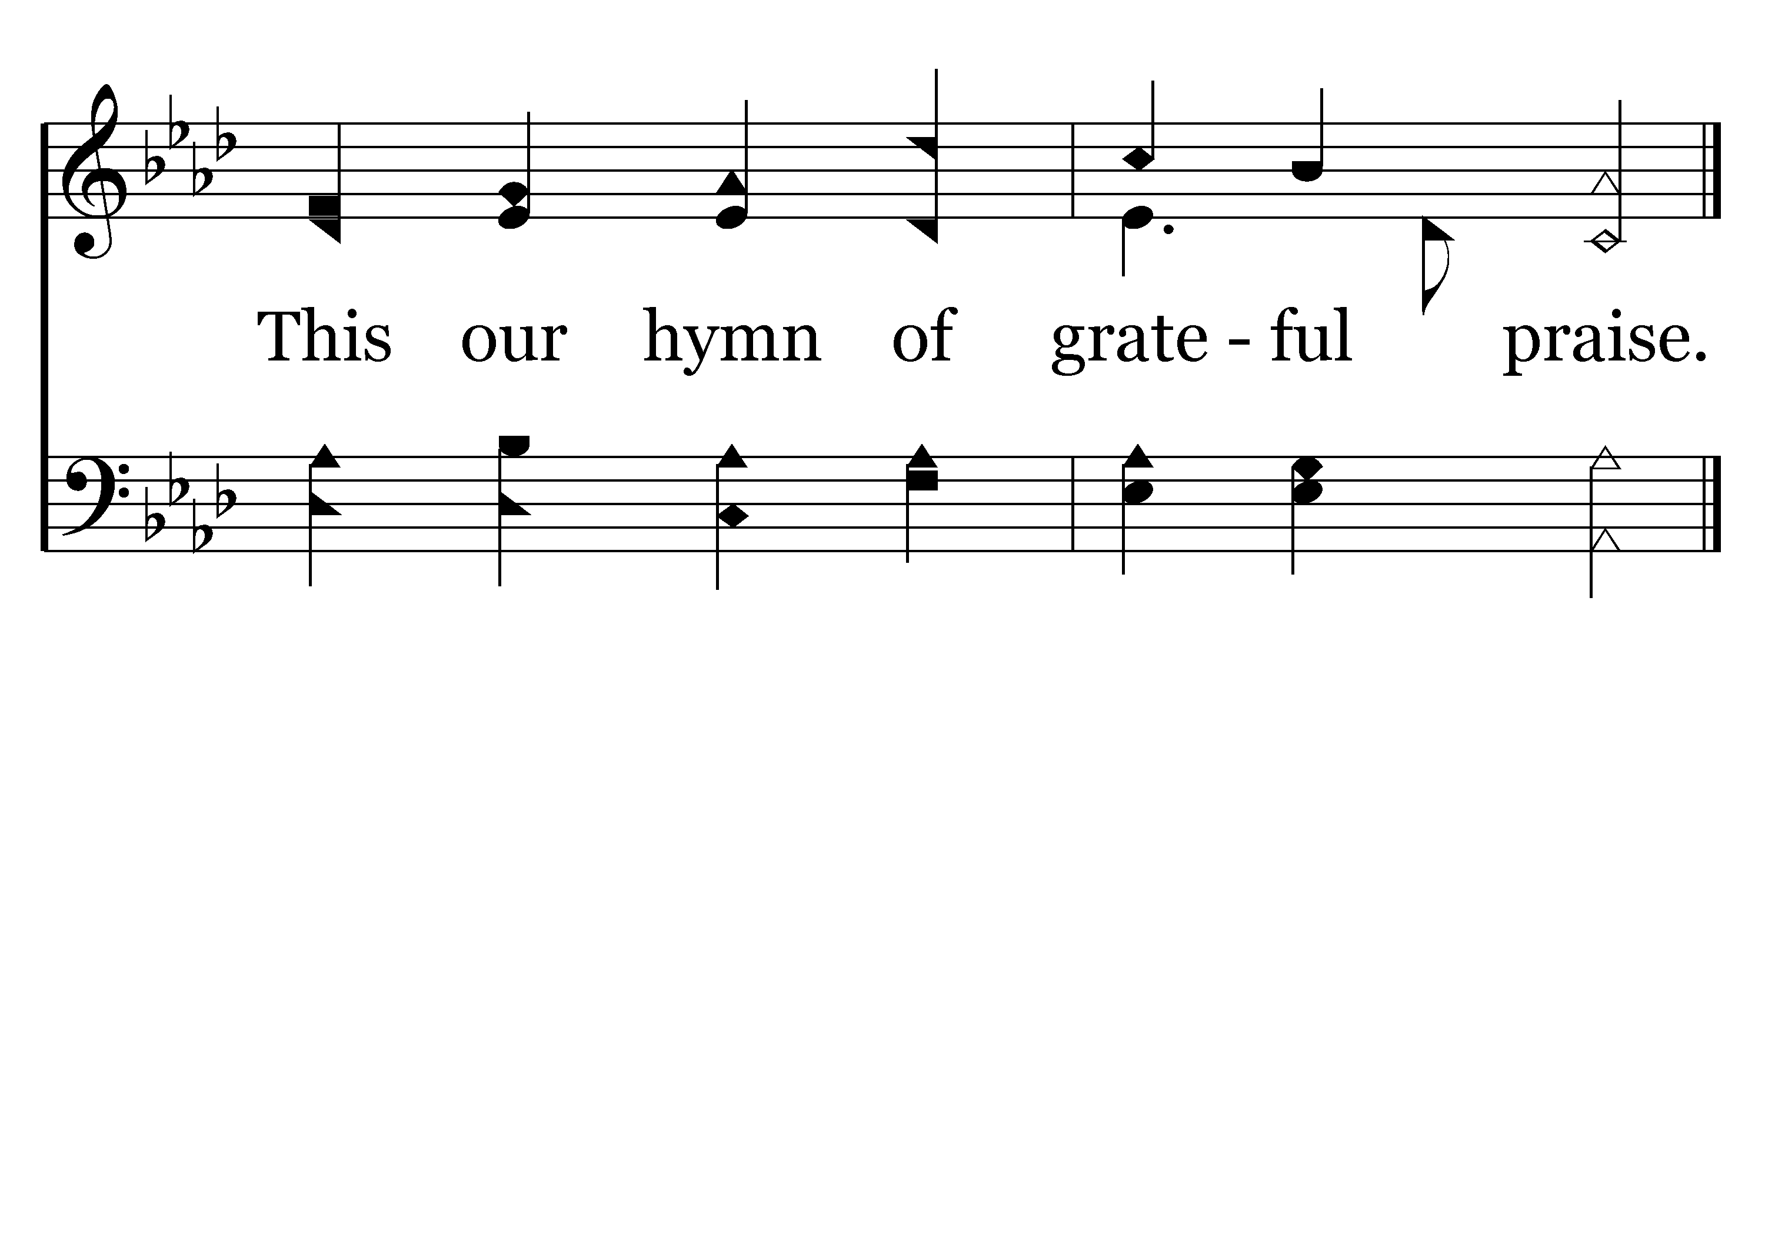
024 - For The Beauty Of The Earth - 1.3
End of Verse 1

Slide 17
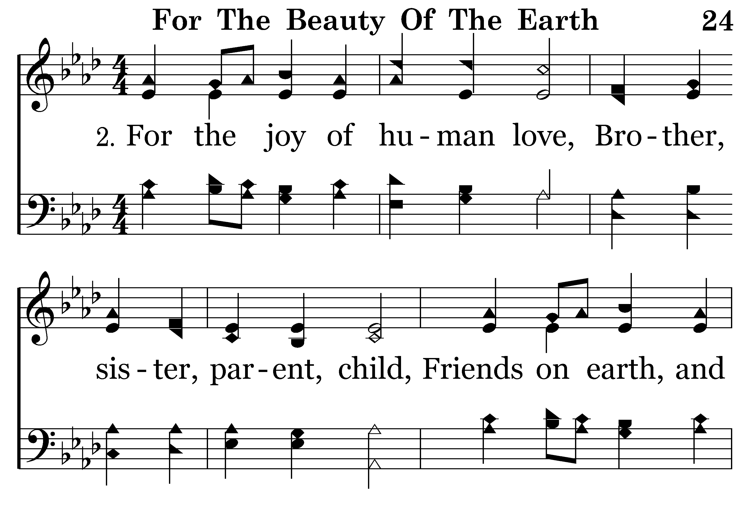
024 - For The Beauty Of The Earth - 2.1

Slide 18
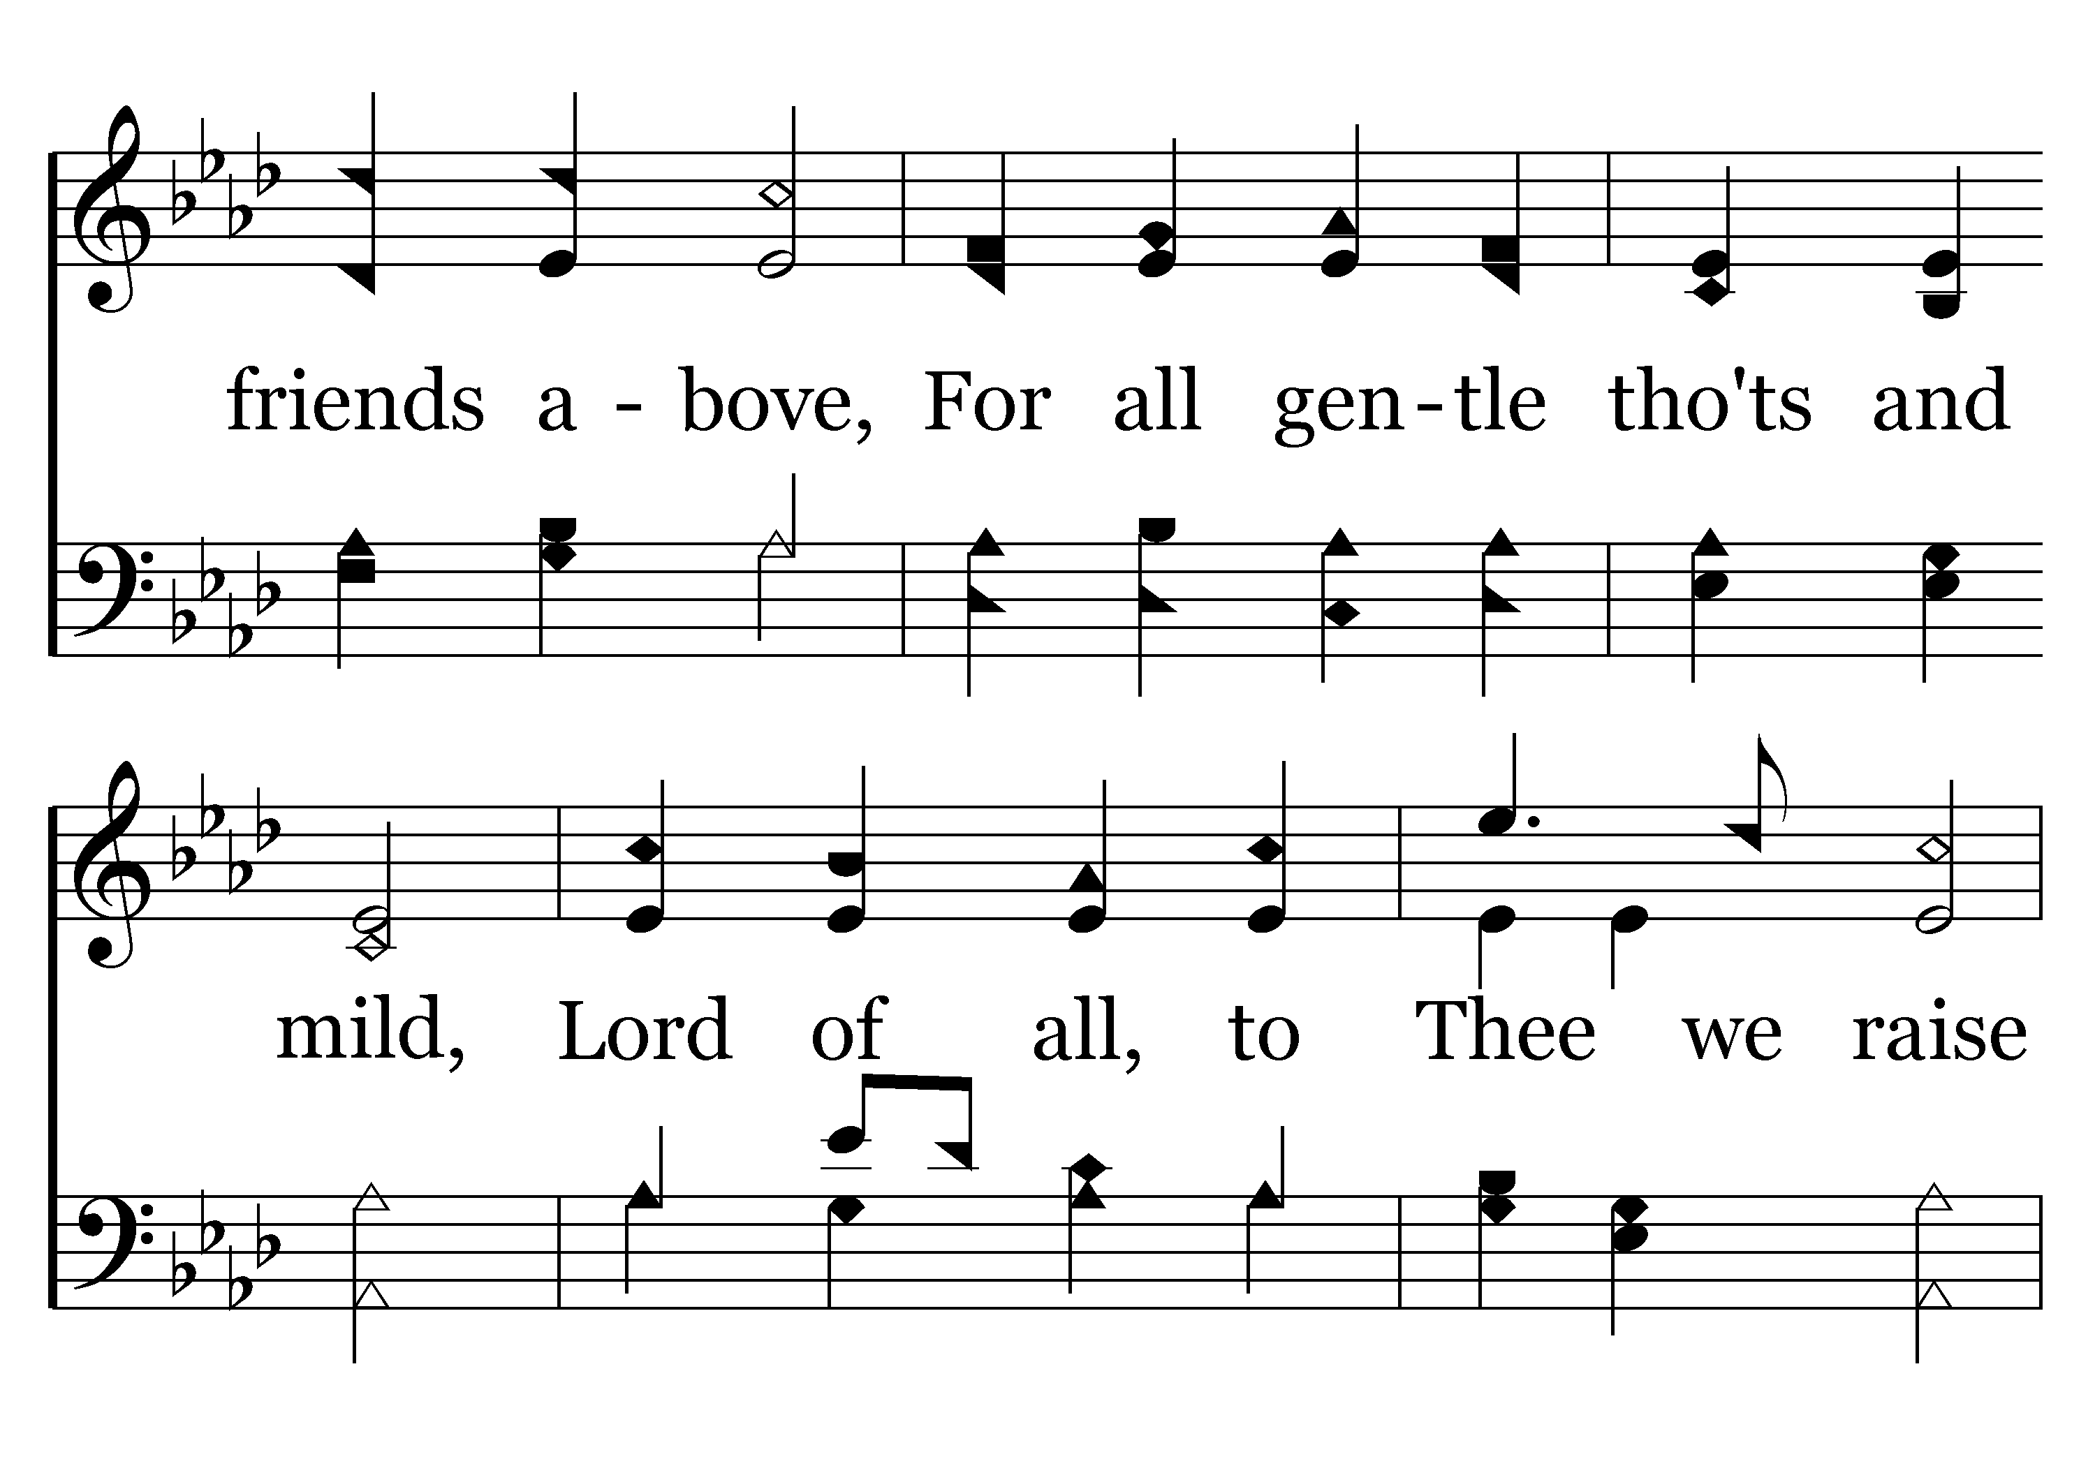
024 - For The Beauty Of The Earth - 2.2

Slide 19
024 - For The Beauty Of The Earth - 2.3
End of Verse 2

Slide 20
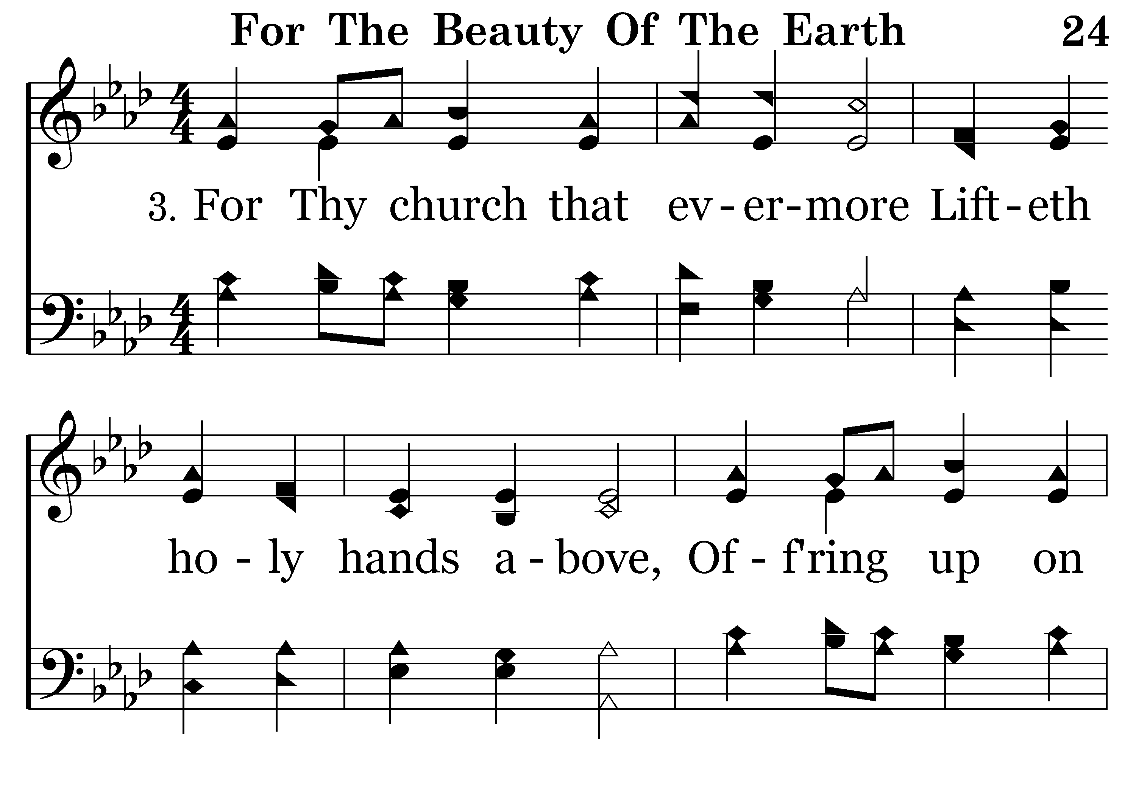
024 - For The Beauty Of The Earth - 3.1

Slide 21
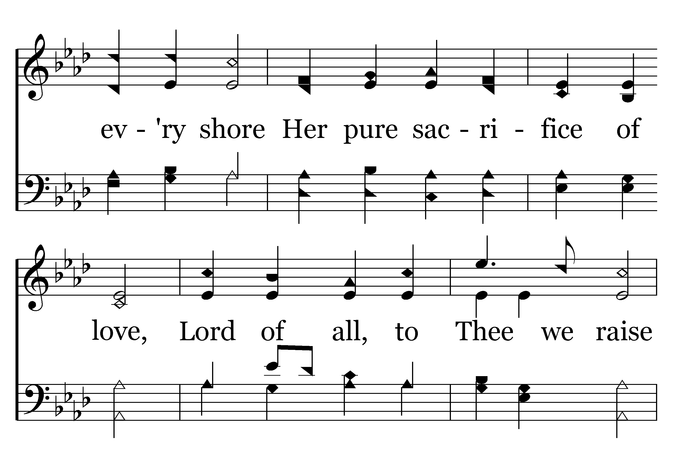
024 - For The Beauty Of The Earth - 3.2

Slide 22
024 - For The Beauty Of The Earth - 3.3
End of Song

Slide 24


Slide 25
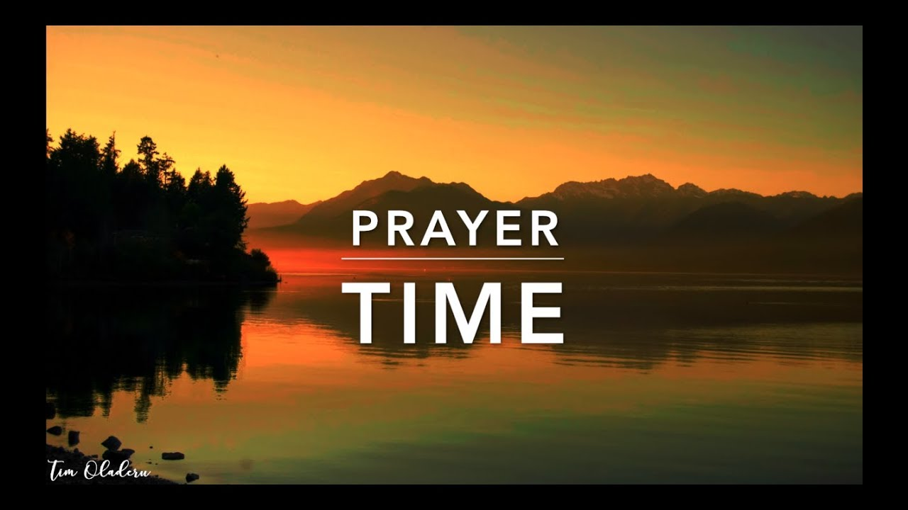
PRAYER
Jerry Mellish
LED BY CHRIS PETER

Slide 27
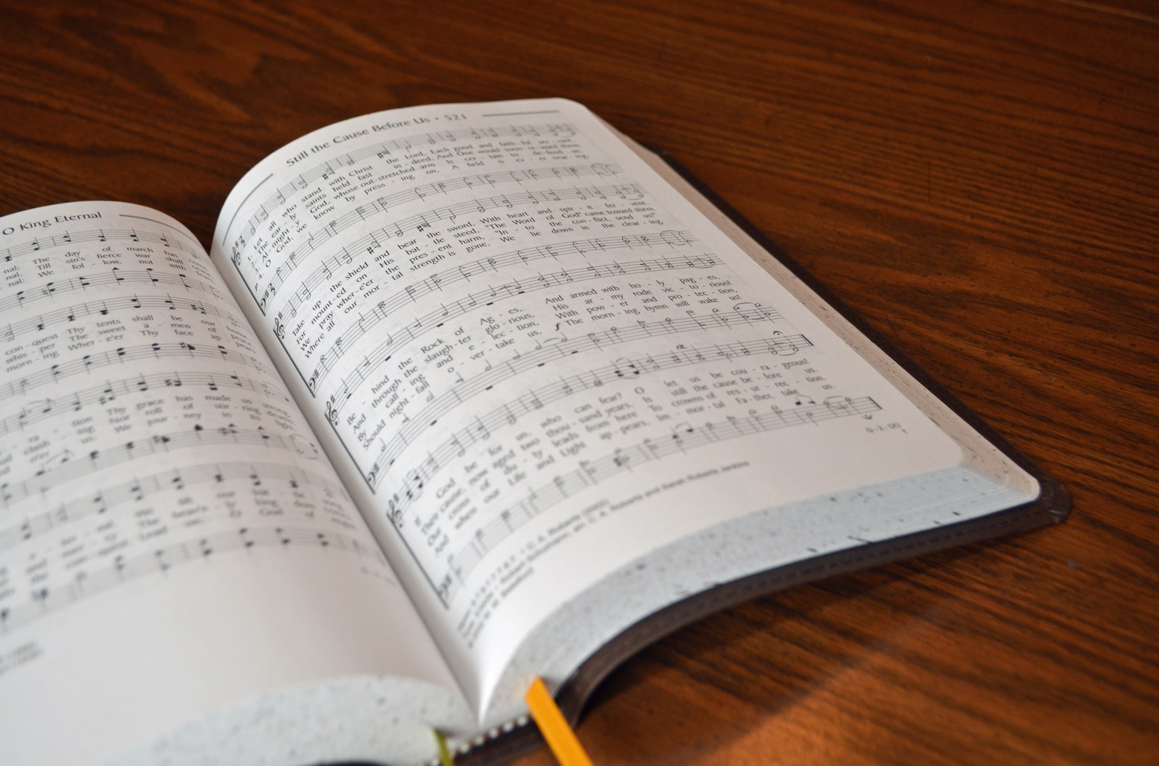
SONG LEADER
WILLIARD DUNCAN

Slide 28
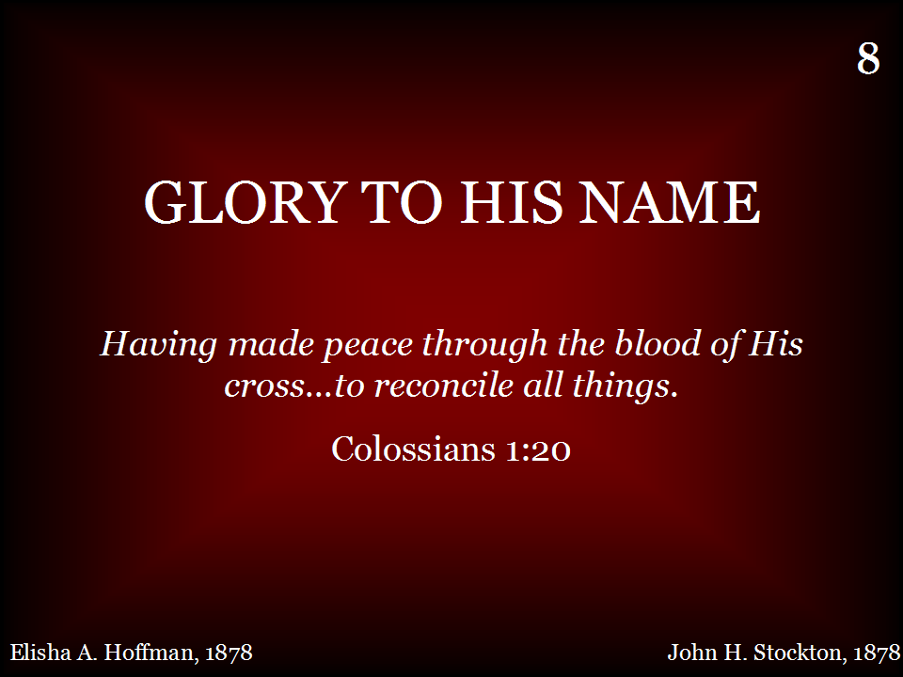
008 - Glory To His Name - Title

Slide 29
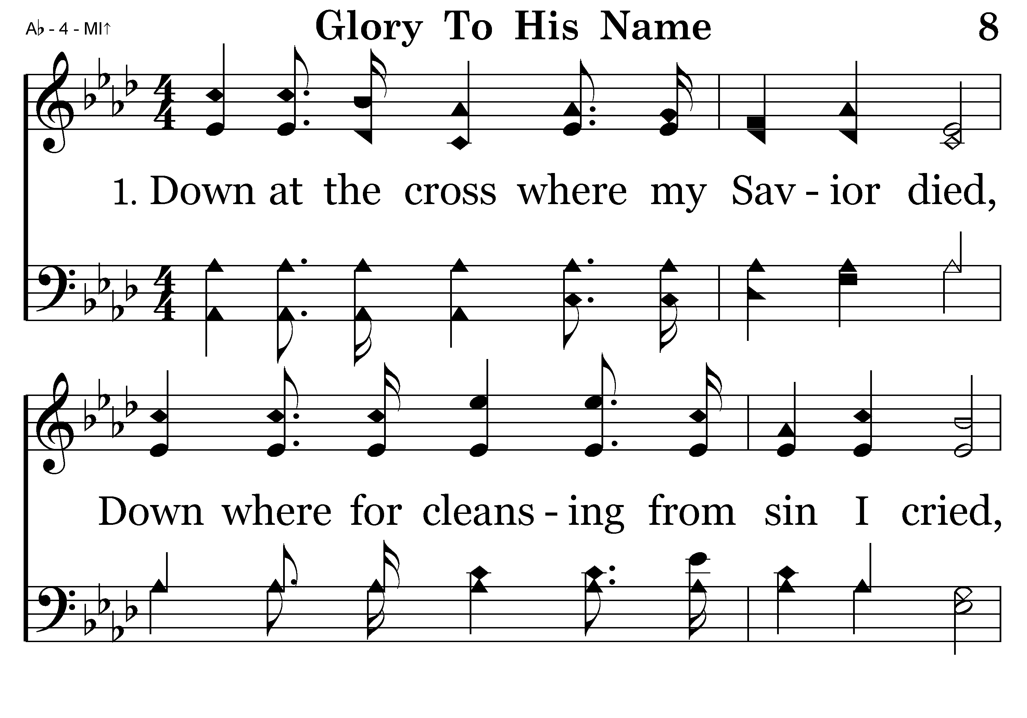
008 - Glory To His Name - 1.1

Slide 30
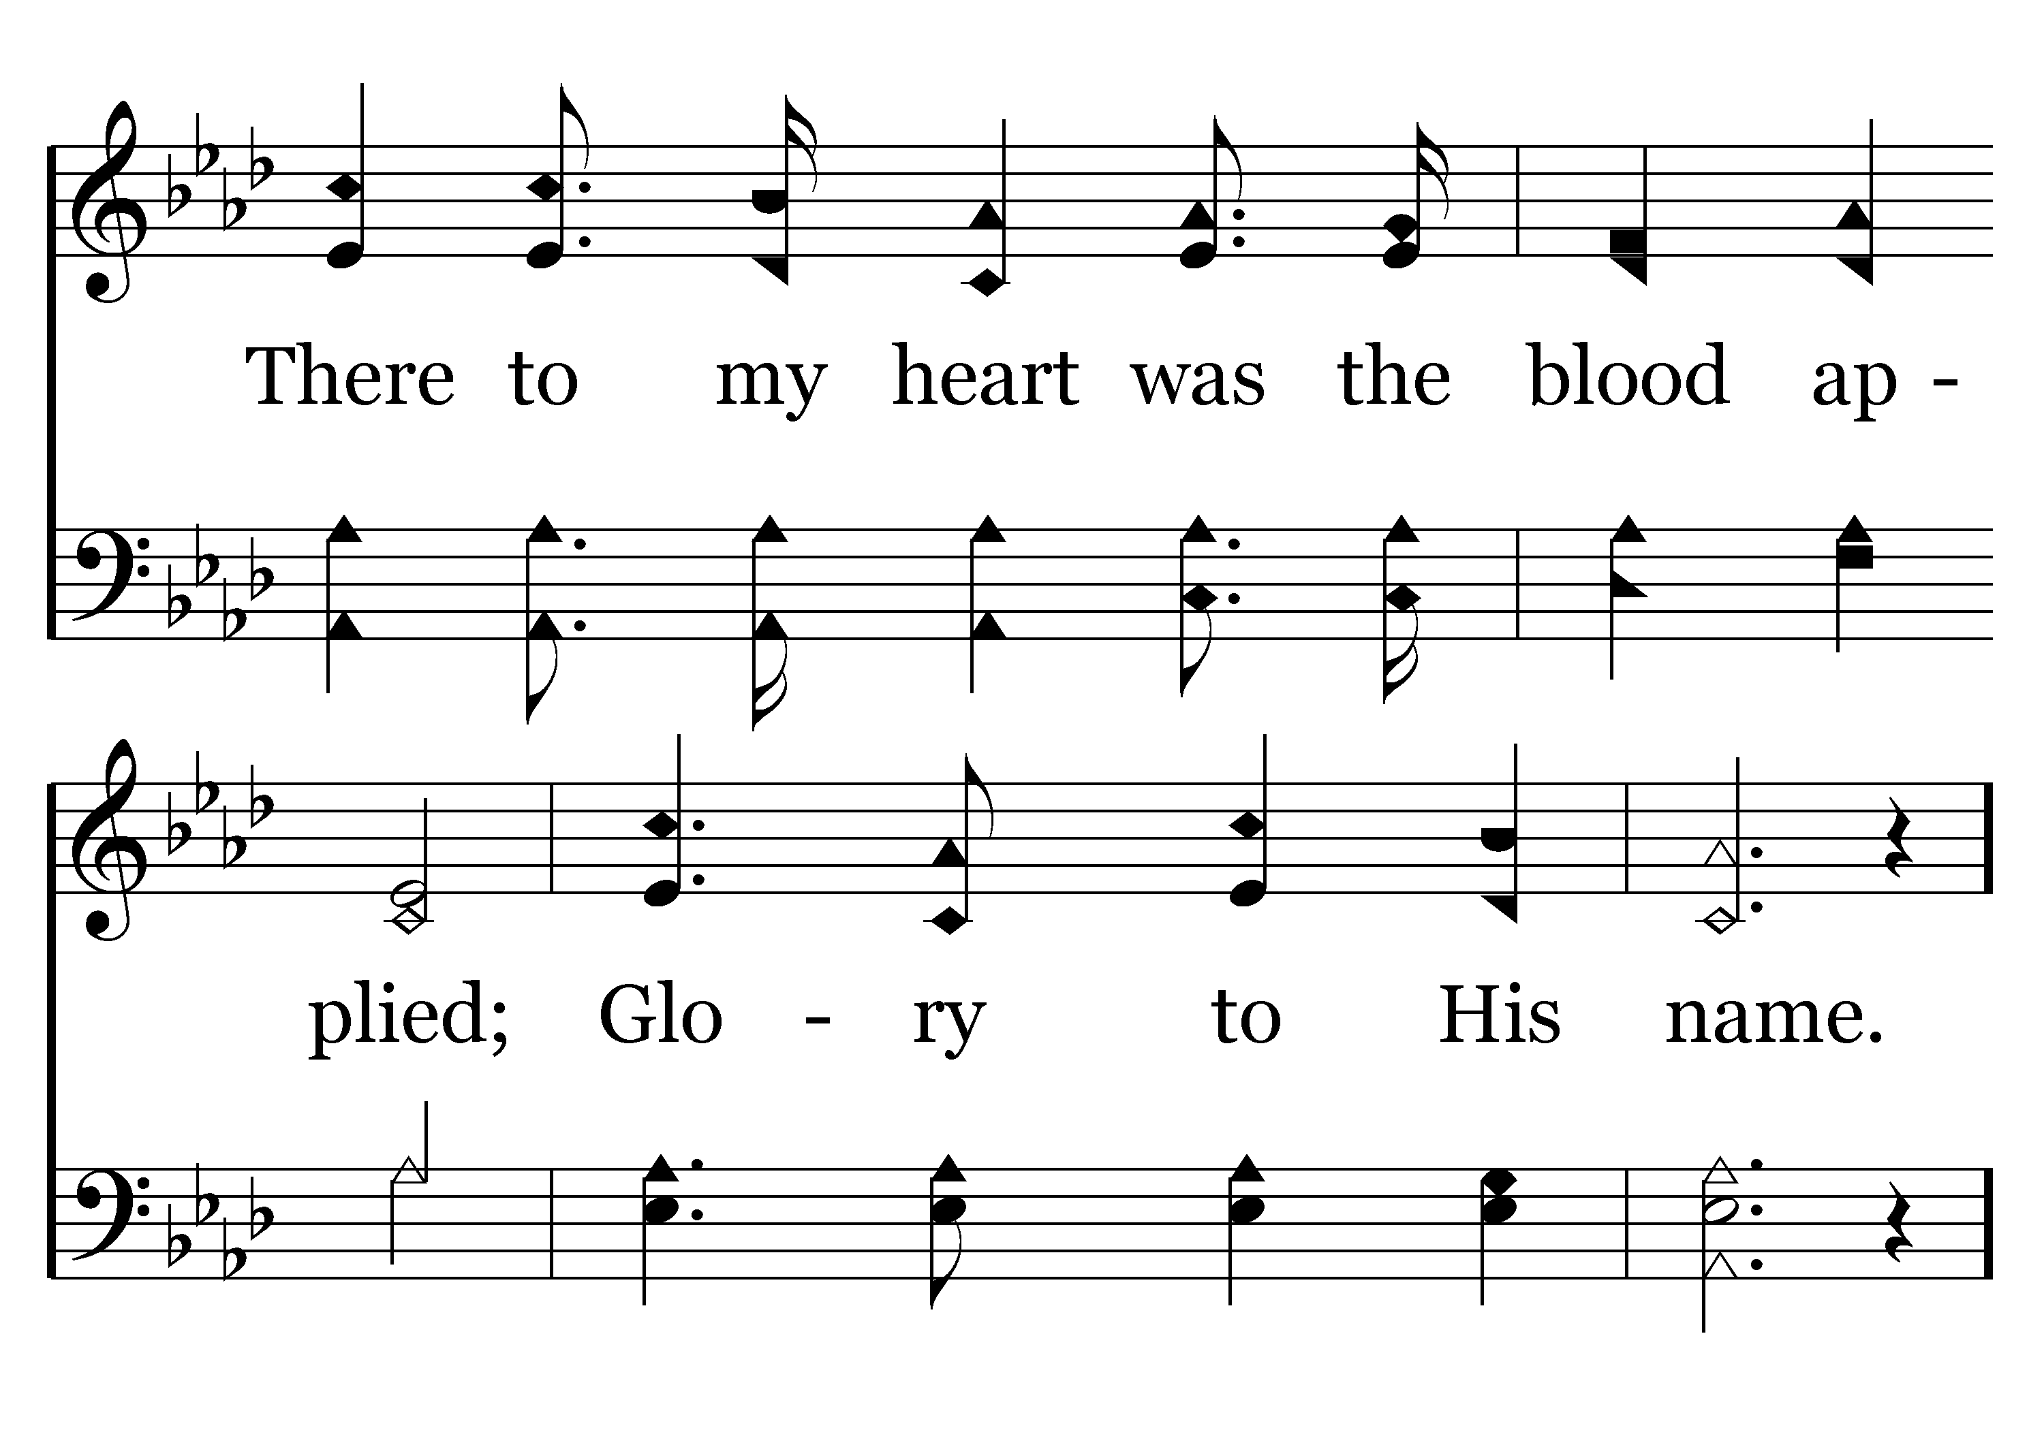
008 - Glory To His Name - 1.2

Slide 31
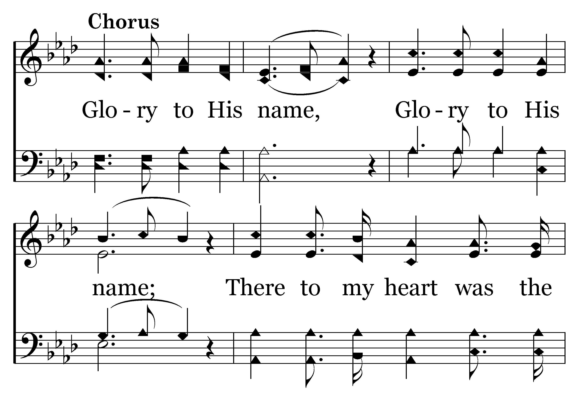
008 - Glory To His Name - C.1

Slide 32
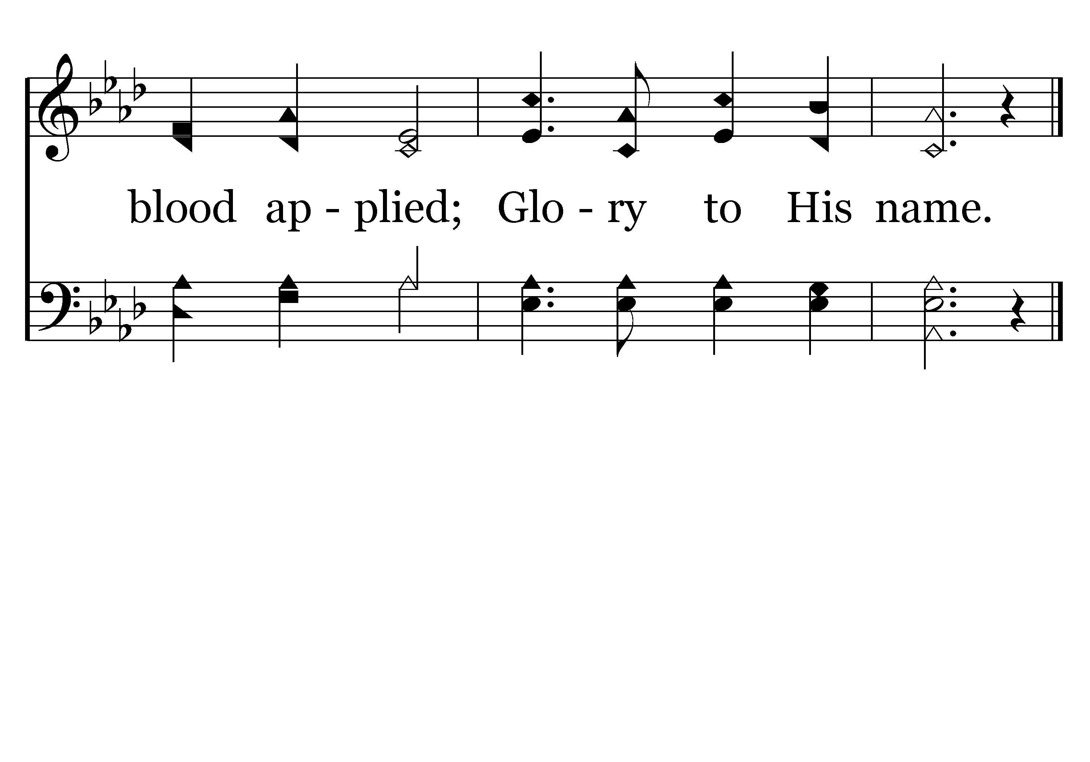
008 - Glory To His Name - C.2
End of Verse 1

Slide 33
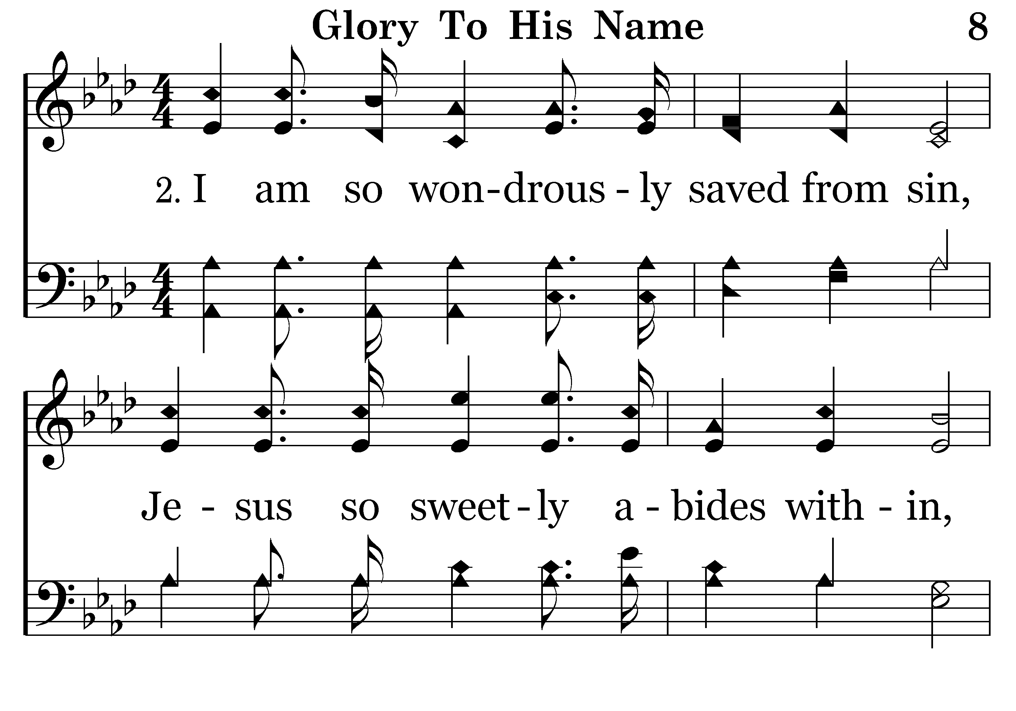
008 - Glory To His Name - 2.1

Slide 34
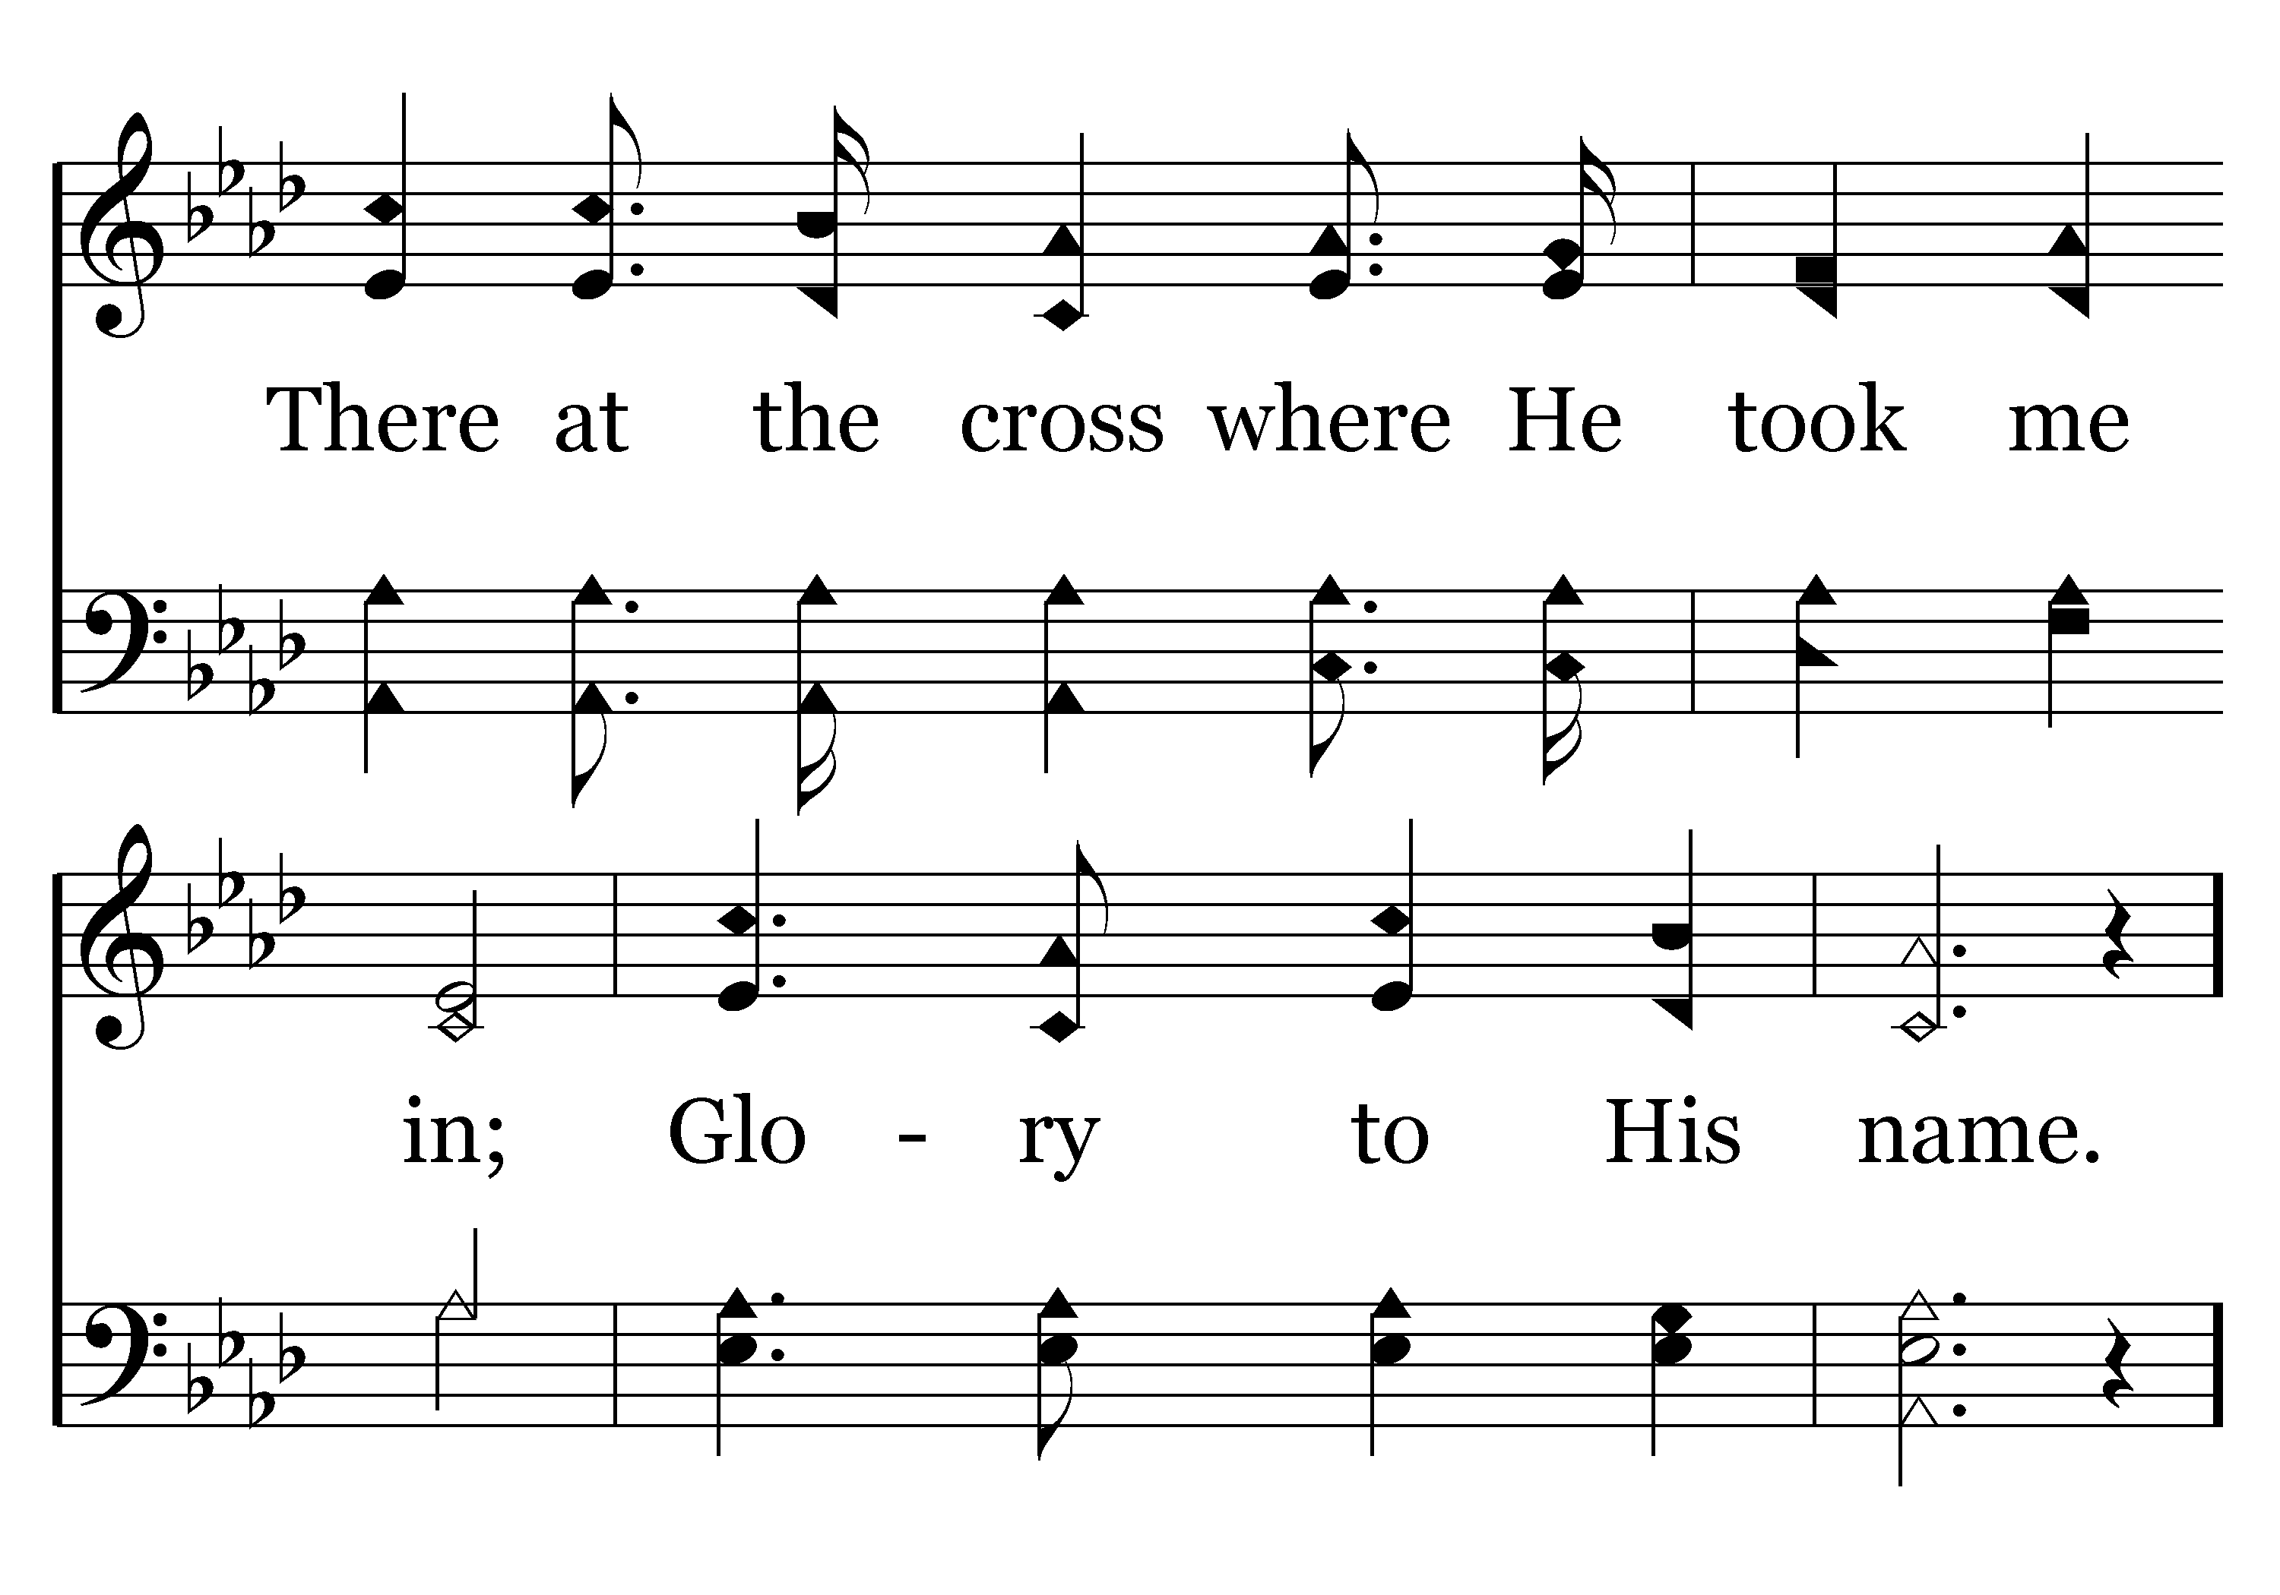
008 - Glory To His Name - 2.2

Slide 35
008 - Glory To His Name - C.1

Slide 36
008 - Glory To His Name - C.2
End of Verse 2

Slide 37
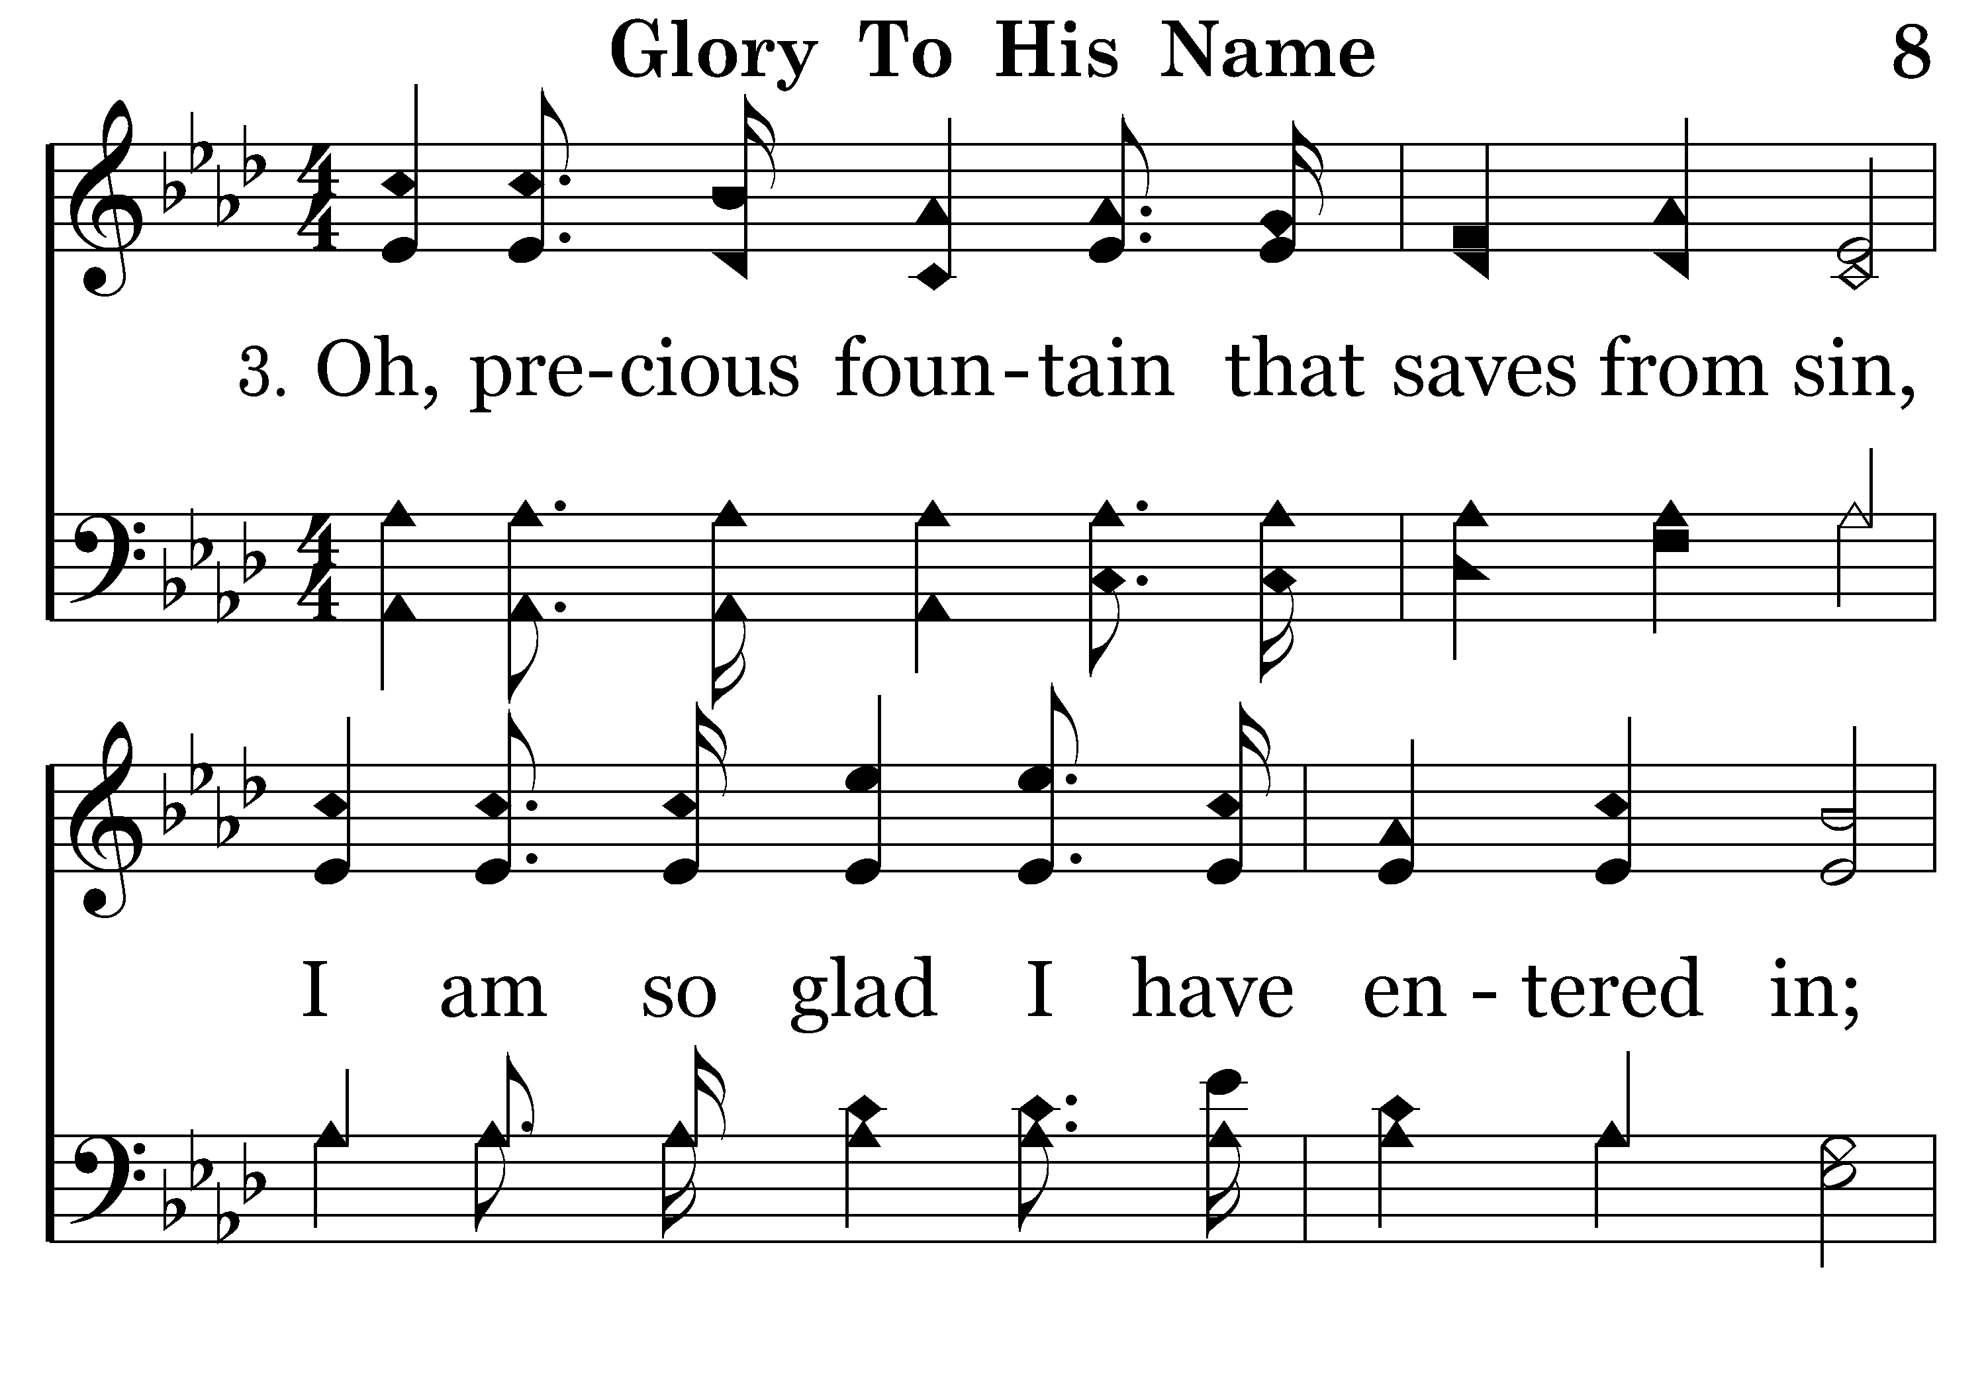
008 - Glory To His Name - 3.1

Slide 38
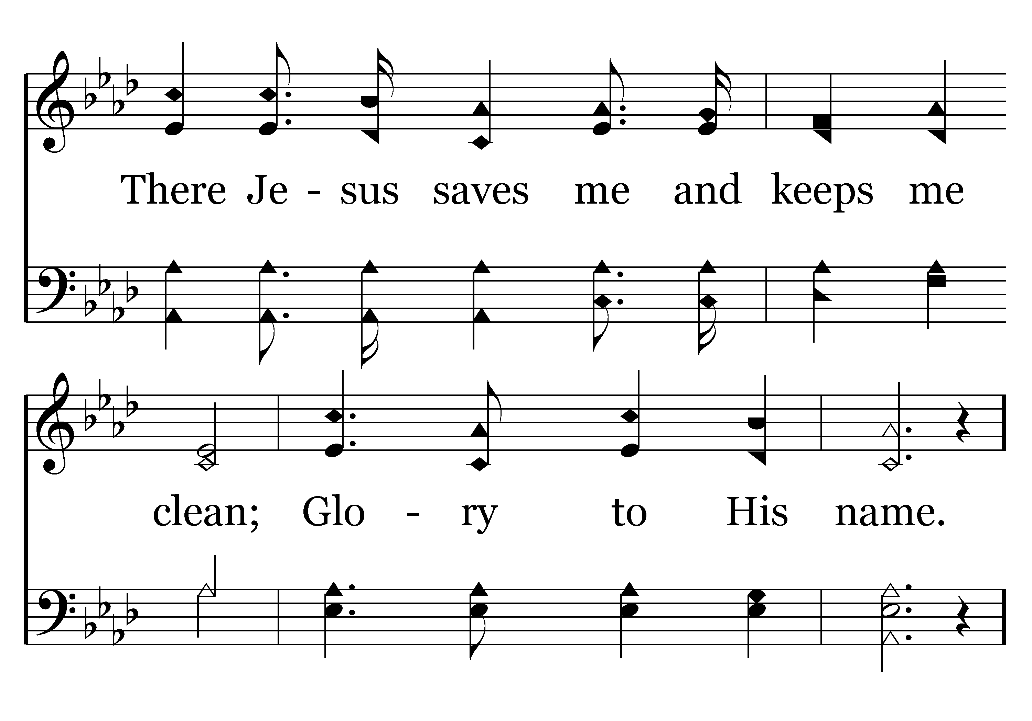
008 - Glory To His Name - 3.2

Slide 39
008 - Glory To His Name - C.1

Slide 40
008 - Glory To His Name - C.2
End of Verse 3

Slide 41
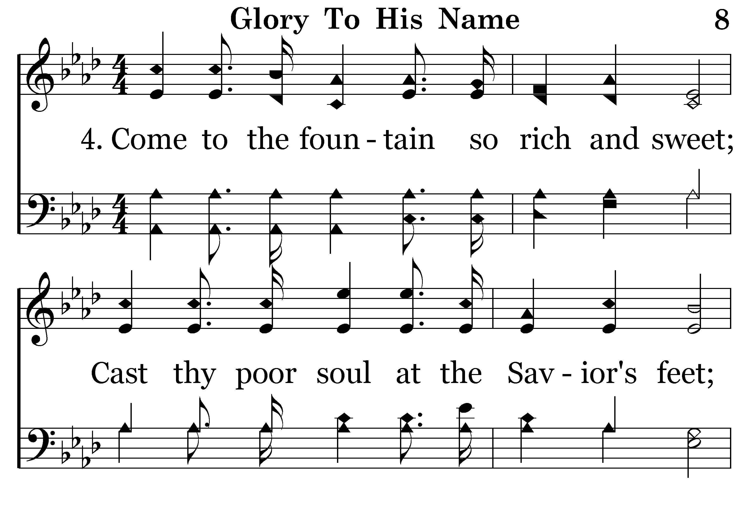
008 - Glory To His Name - 4.1

Slide 42
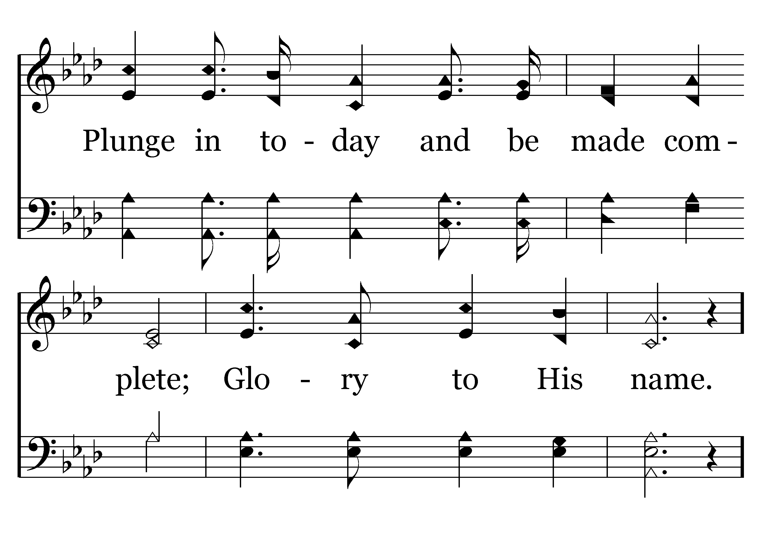
008 - Glory To His Name - 4.2

Slide 43
008 - Glory To His Name - C.1

Slide 44
008 - Glory To His Name - C.2
End of Song

Slide 46
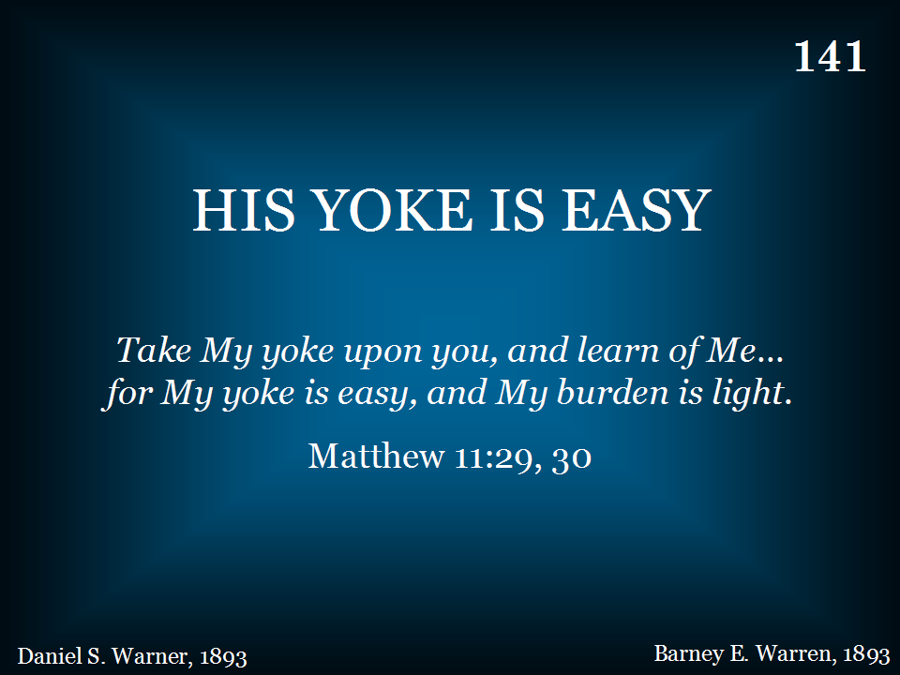
141 - His Yoke Is Easy - Title

Slide 47
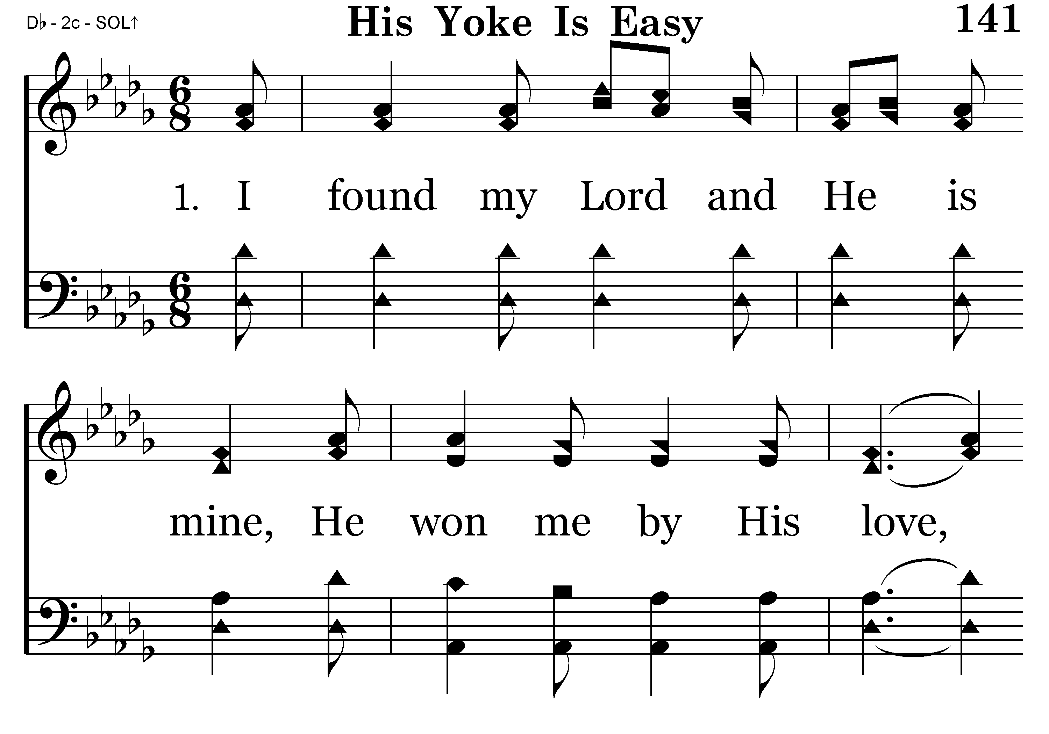
141 - His Yoke Is Easy - 1.1

Slide 48
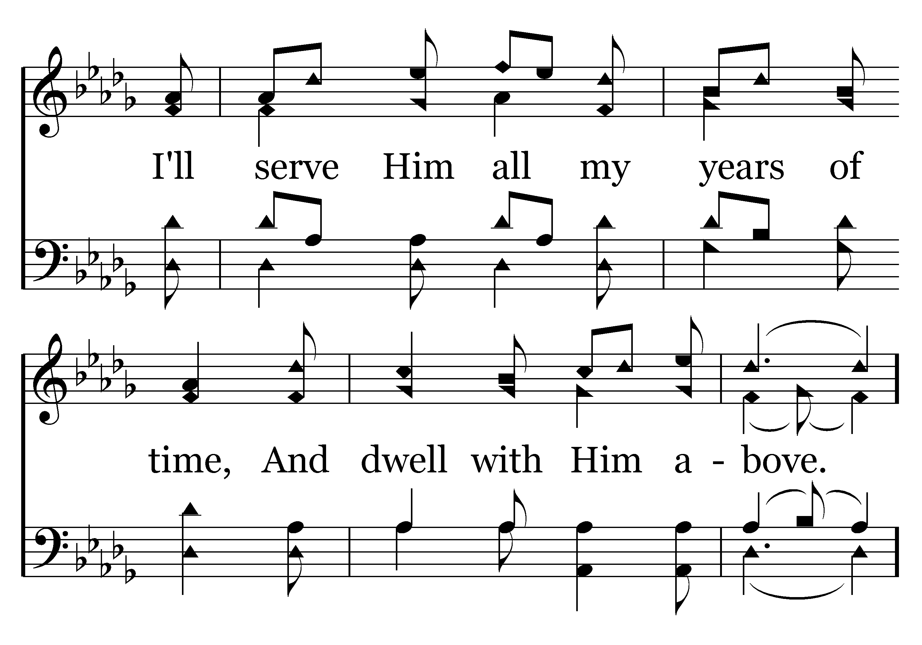
141 - His Yoke Is Easy - 1.2

Slide 49
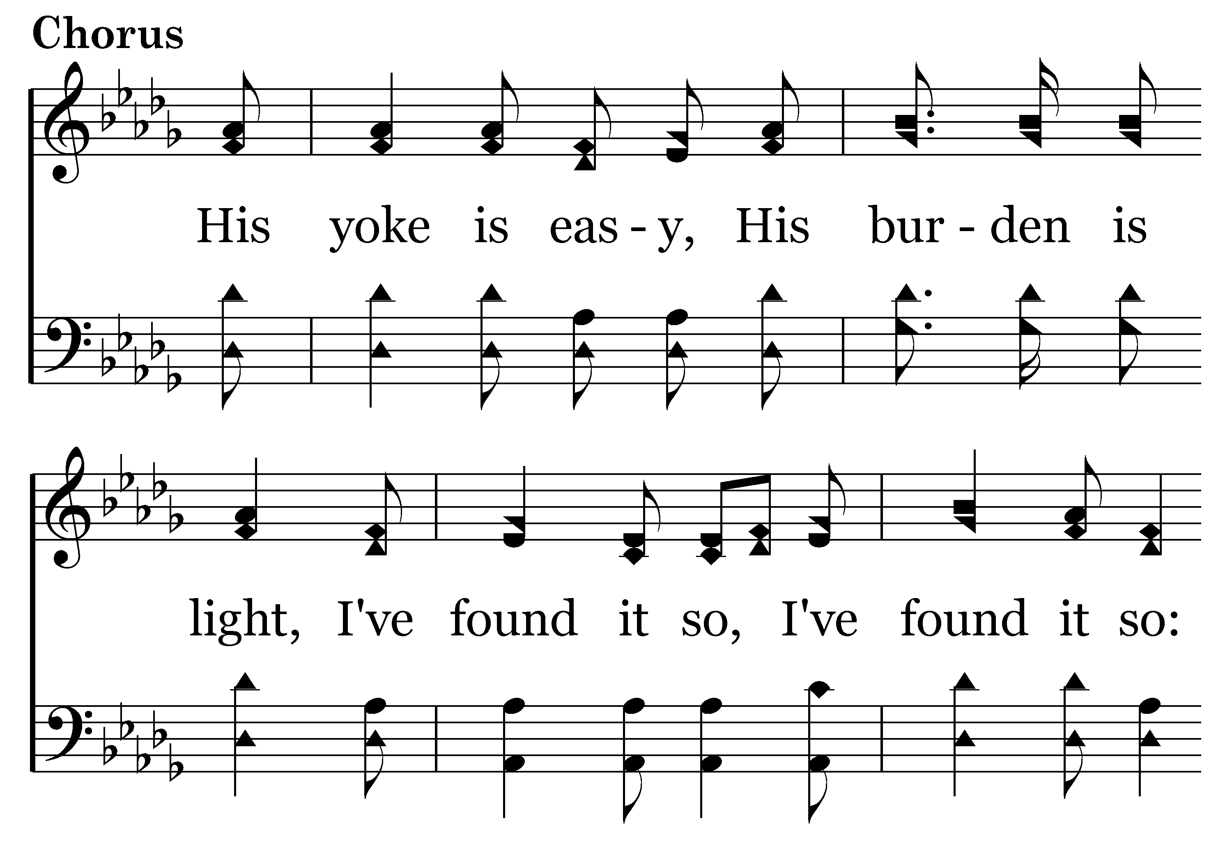
141 - His Yoke Is Easy - C.1

Slide 50
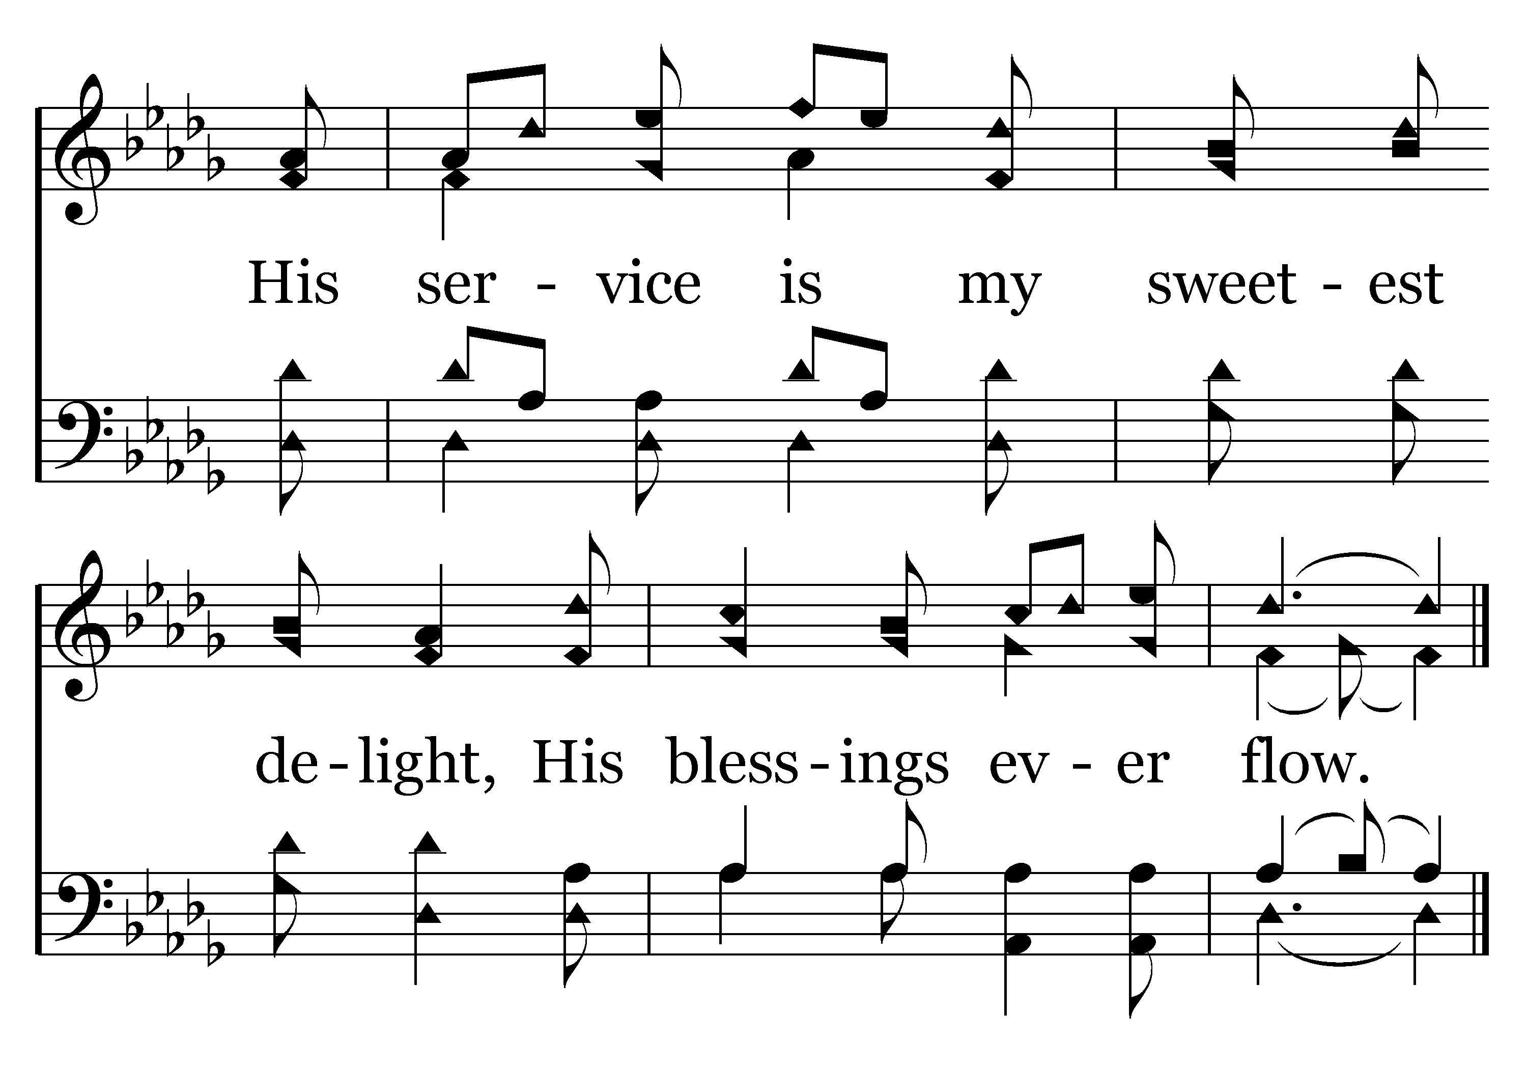
141 - His Yoke Is Easy - C.2
End of Verse 1

Slide 51
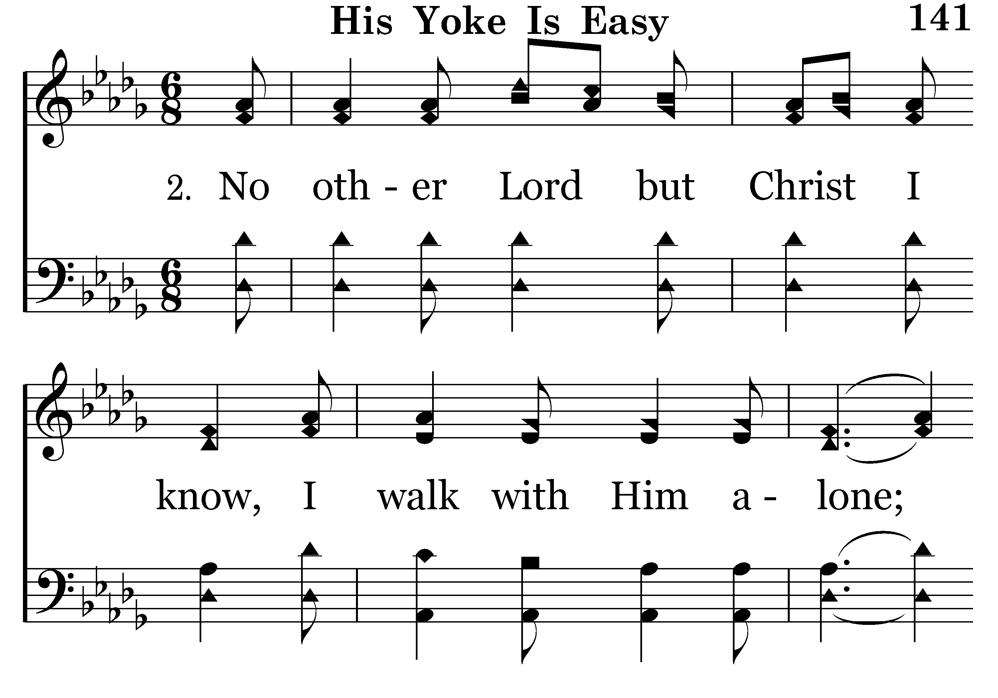
141 - His Yoke Is Easy - 2.1

Slide 52
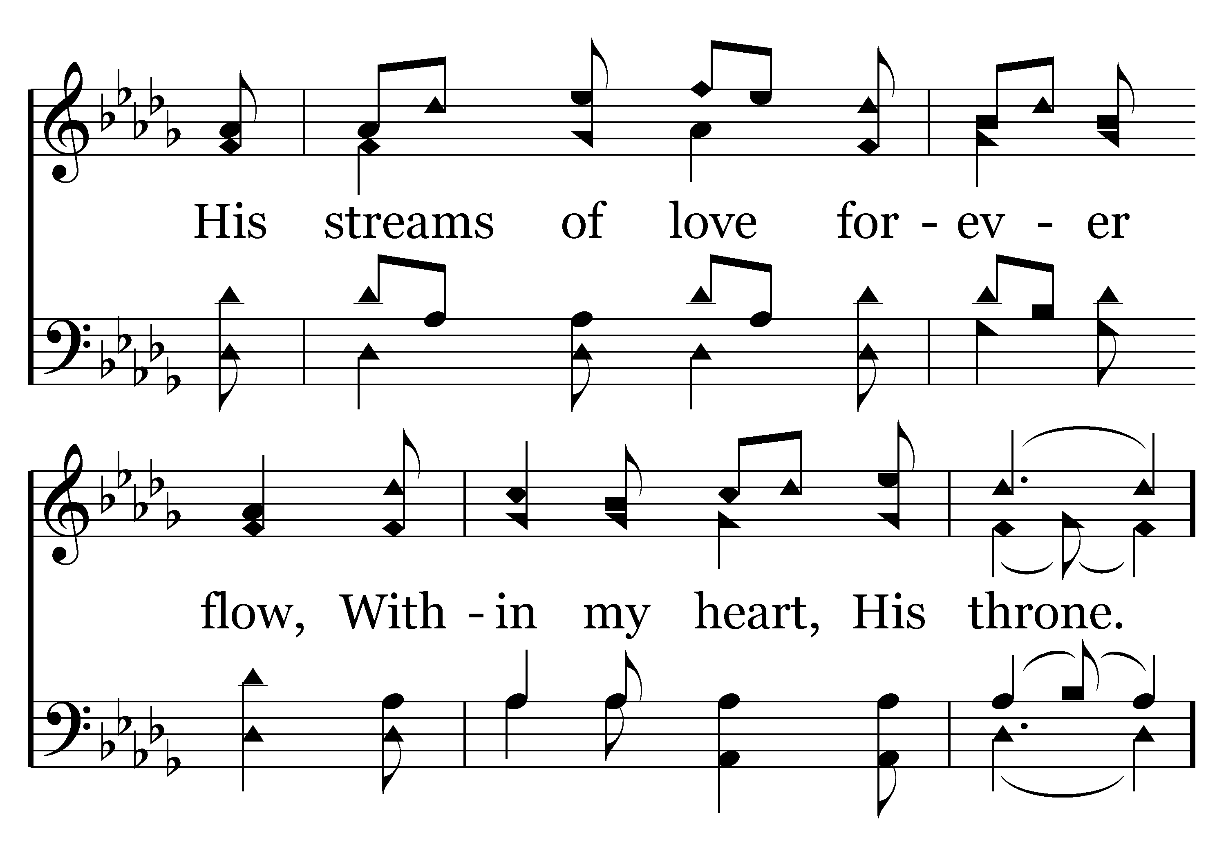
141 - His Yoke Is Easy - 2.2

Slide 53
141 - His Yoke Is Easy - C.1

Slide 54
141 - His Yoke Is Easy - C.2
End of Verse 2

Slide 55
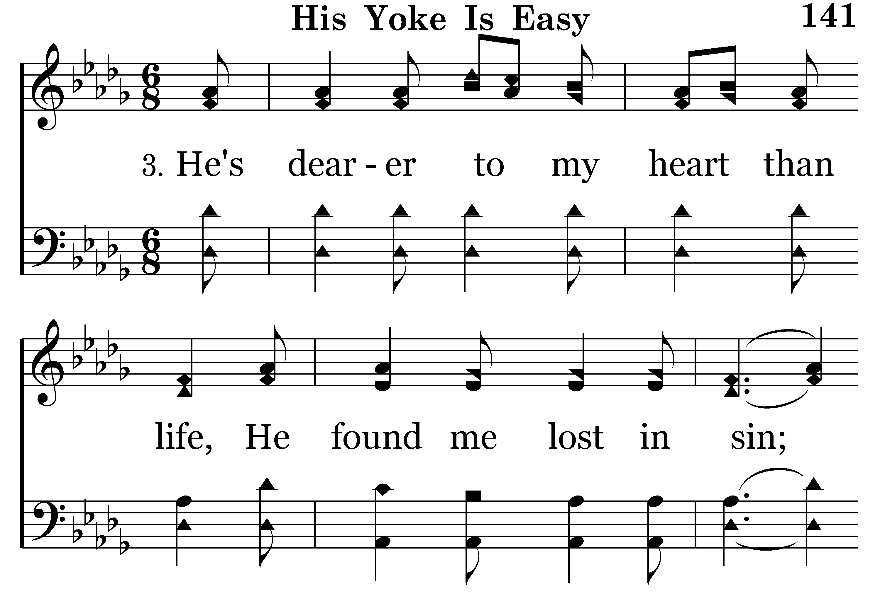
141 - His Yoke Is Easy - 3.1

Slide 56
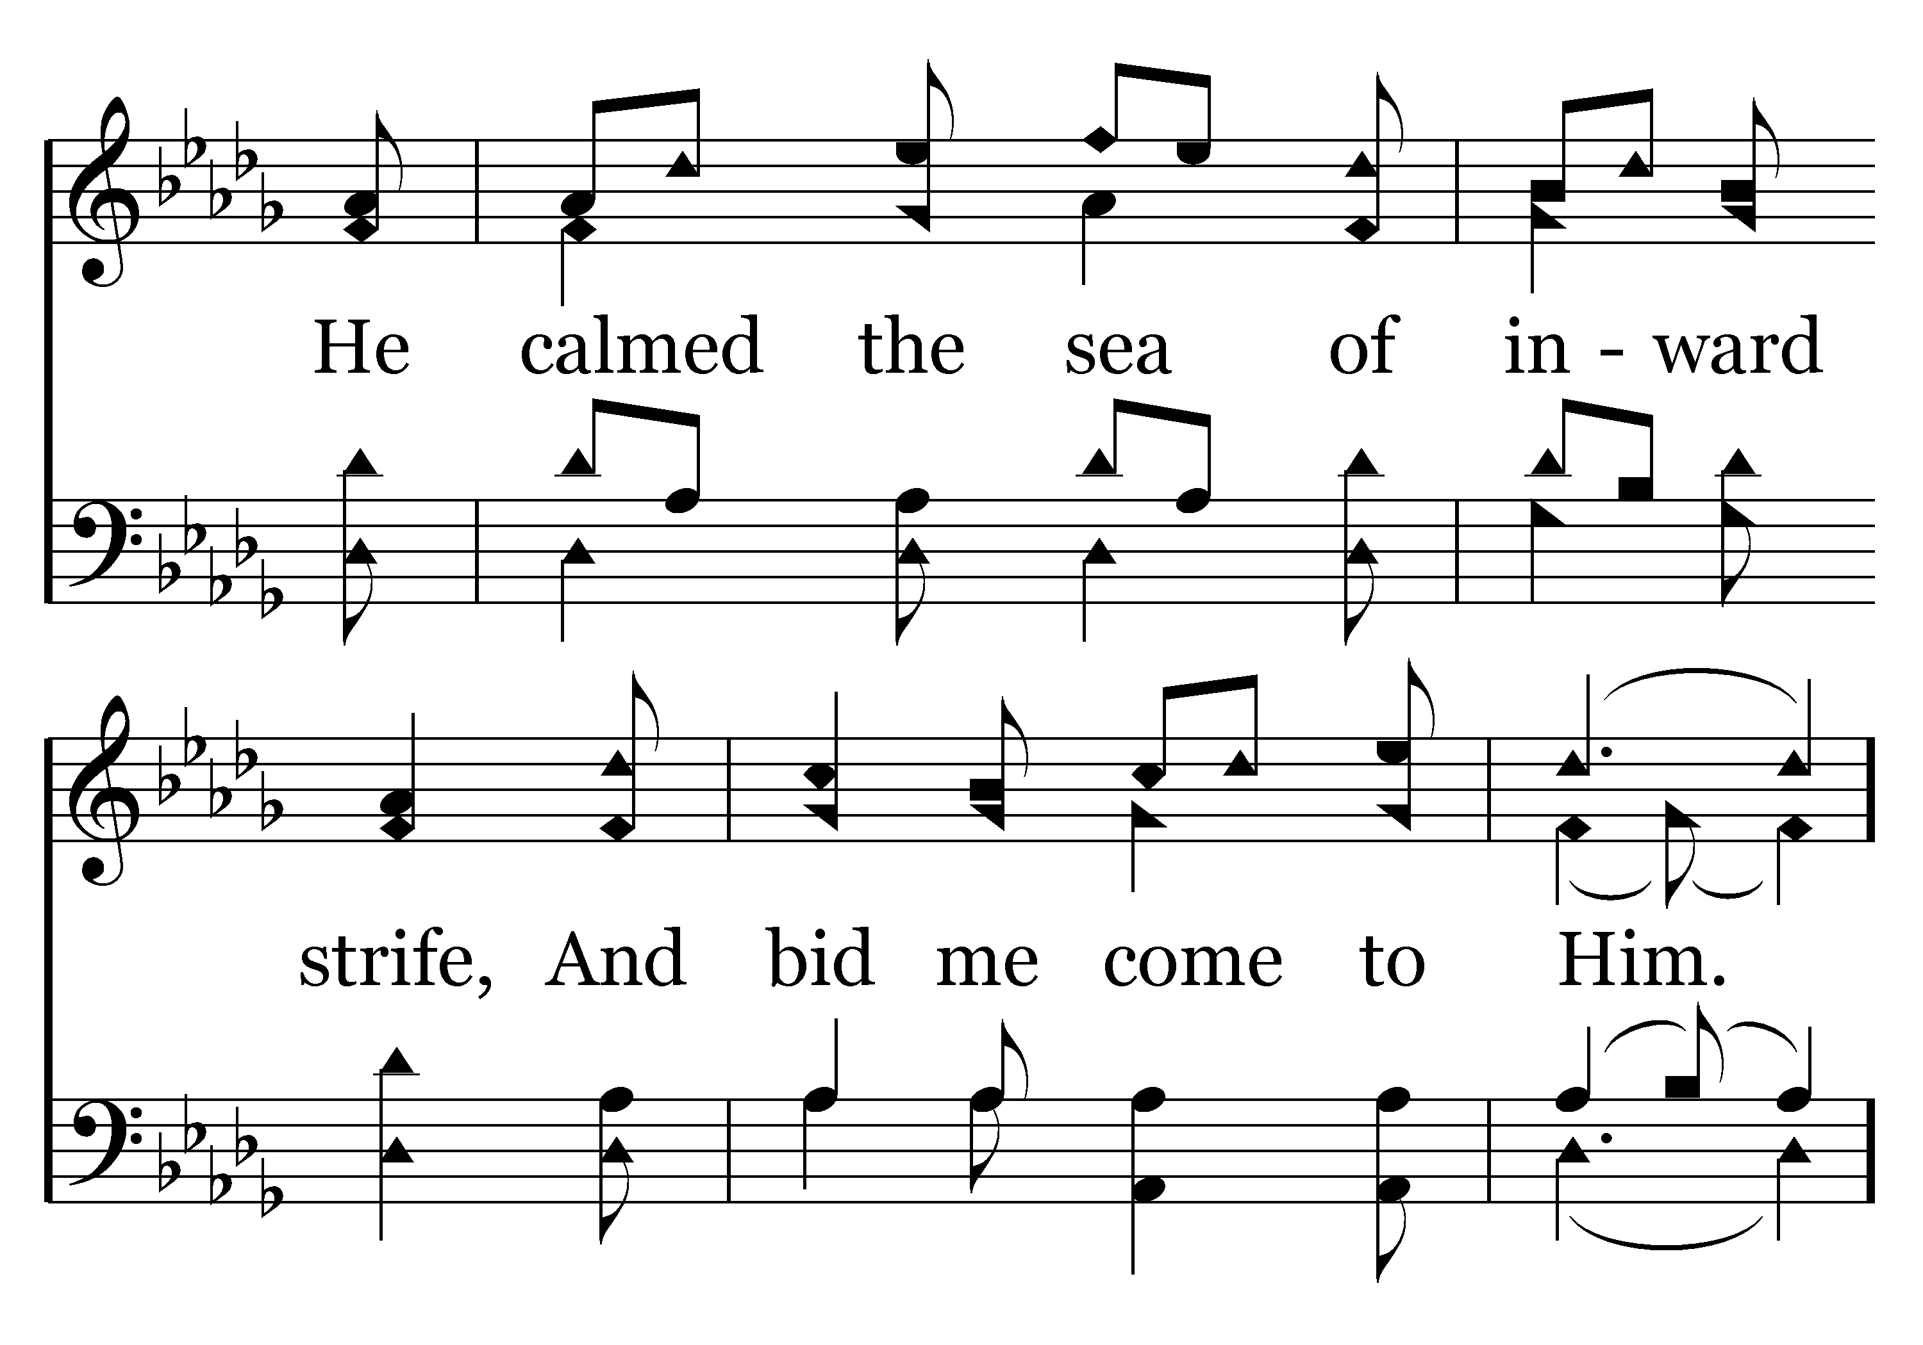
141 - His Yoke Is Easy - 3.2

Slide 57
141 - His Yoke Is Easy - C.1

Slide 58
141 - His Yoke Is Easy - C.2
End of Verse 3

Slide 59
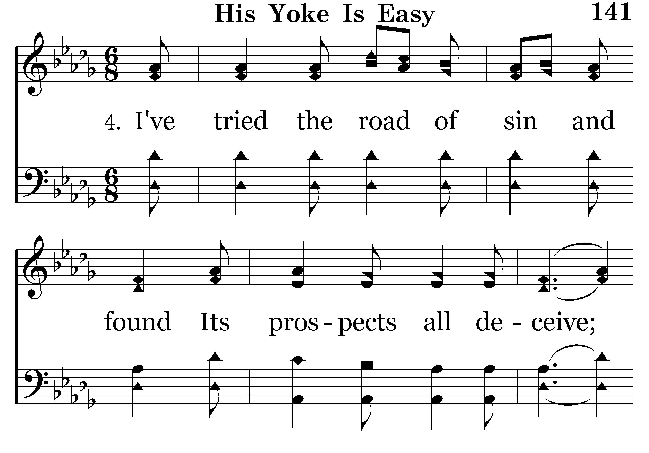
141 - His Yoke Is Easy - 4.1

Slide 60
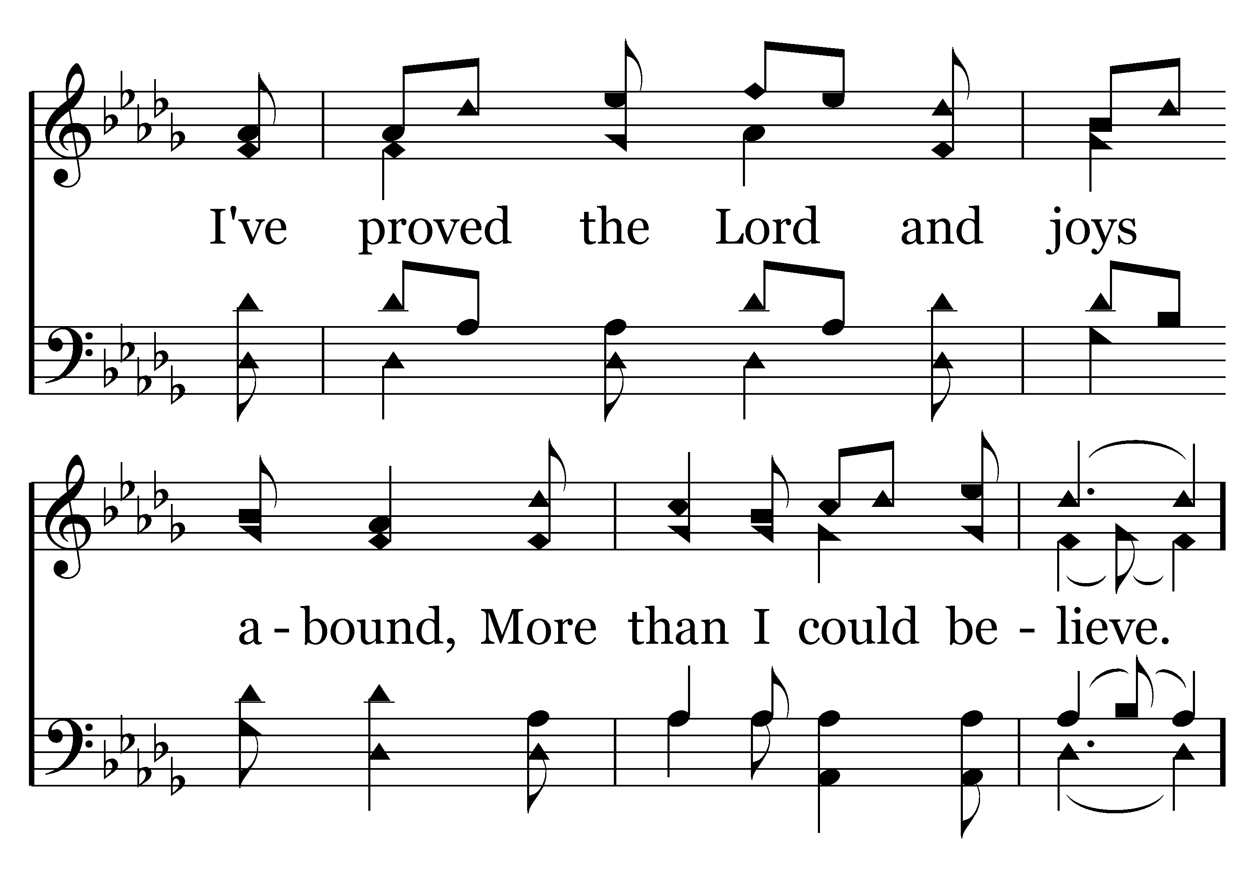
141 - His Yoke Is Easy - 4.2

Slide 61
141 - His Yoke Is Easy - C.1

Slide 62
141 - His Yoke Is Easy - C.2
End of Song

Slide 64
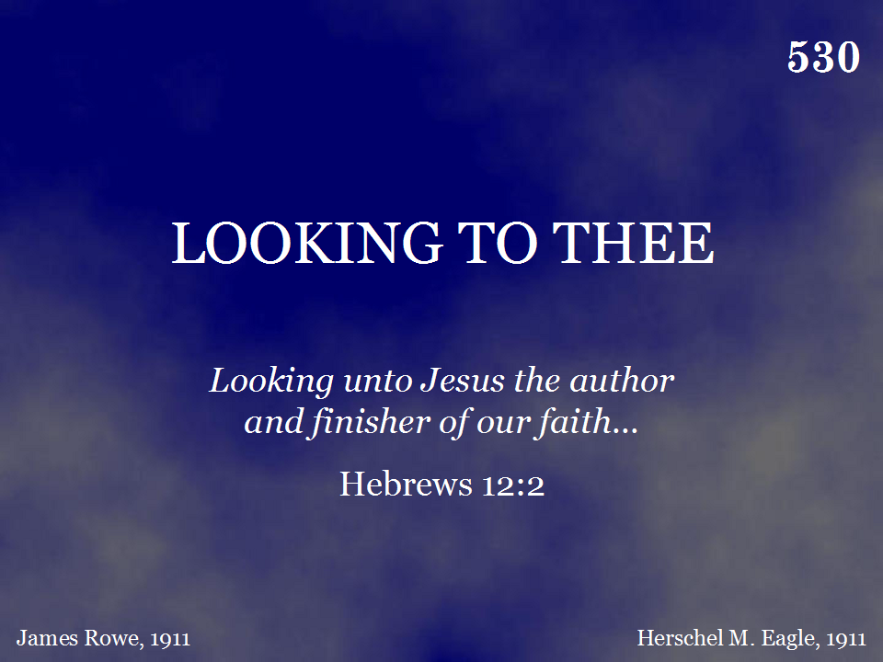
530 - Looking To Thee - Title

Slide 65
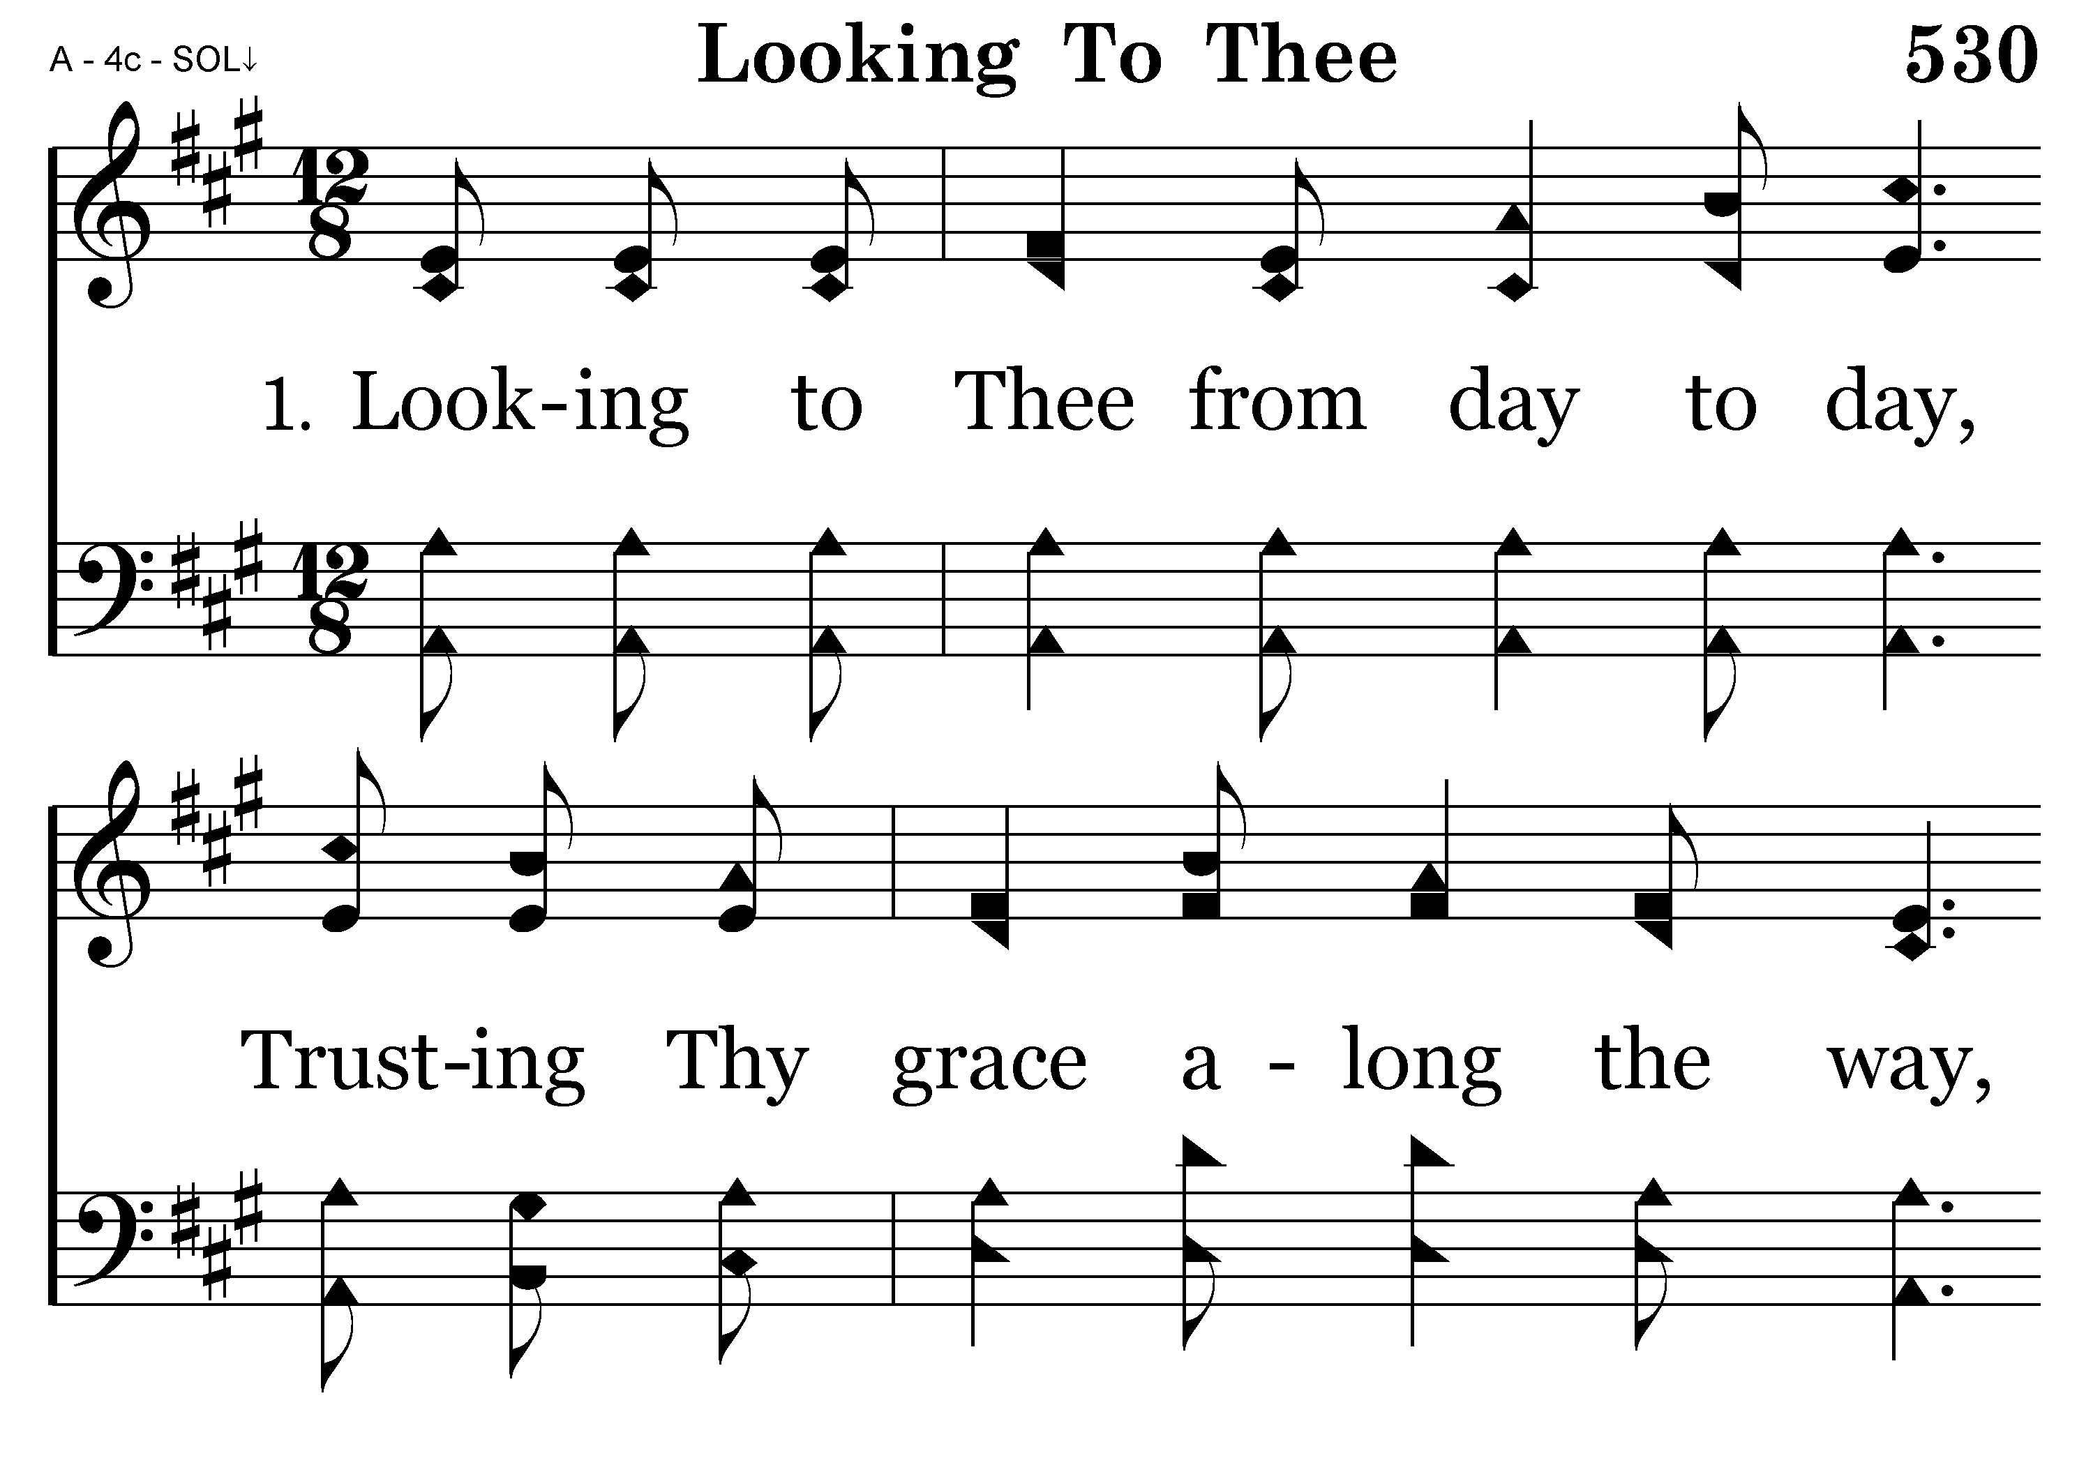
530 - Looking To Thee - 1.1

Slide 66
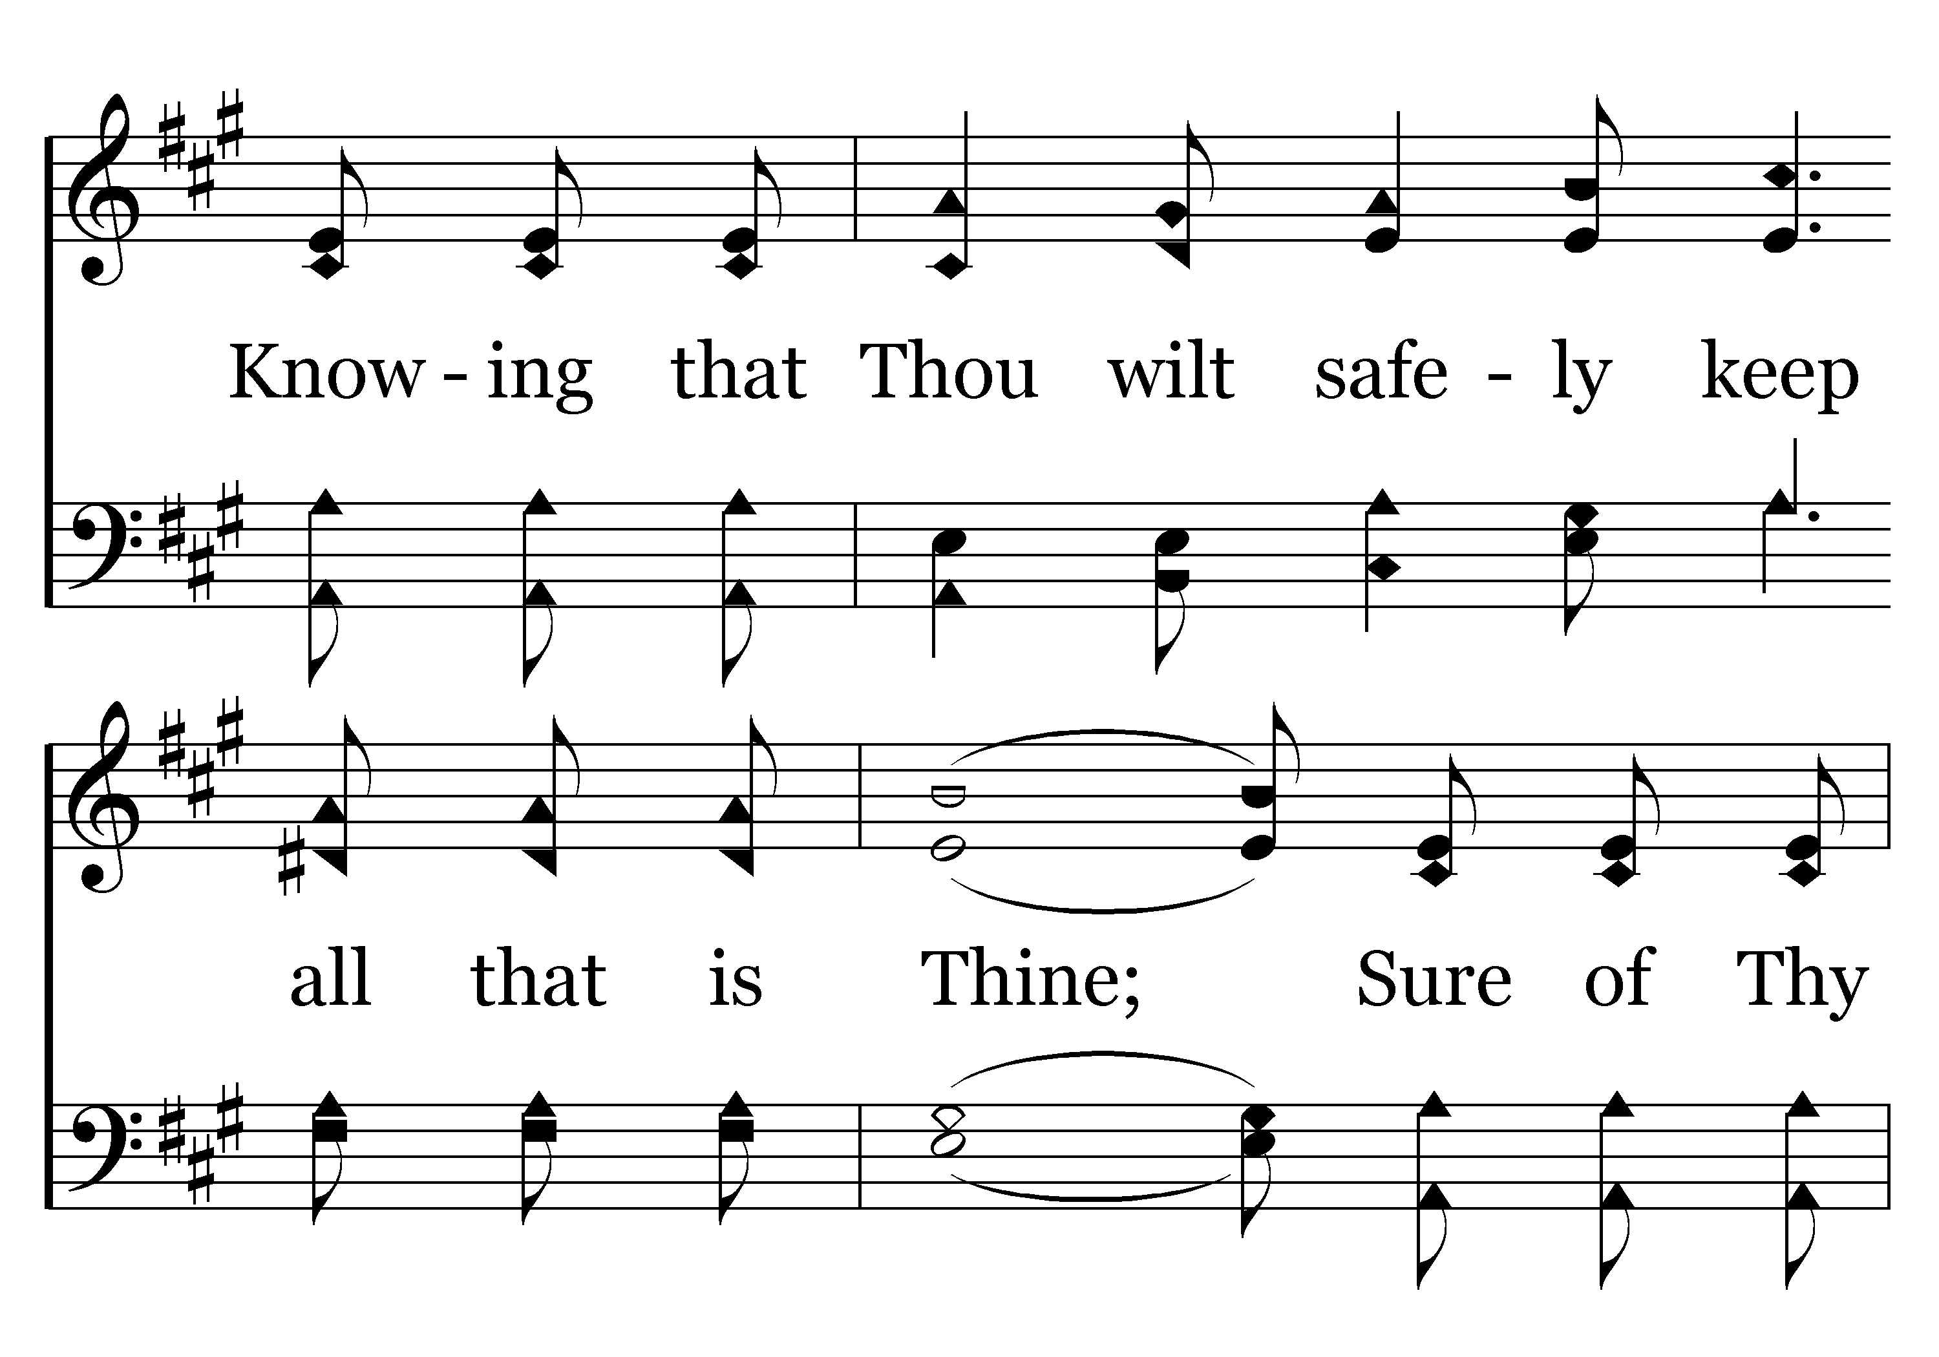
530 - Looking To Thee - 1.2

Slide 67
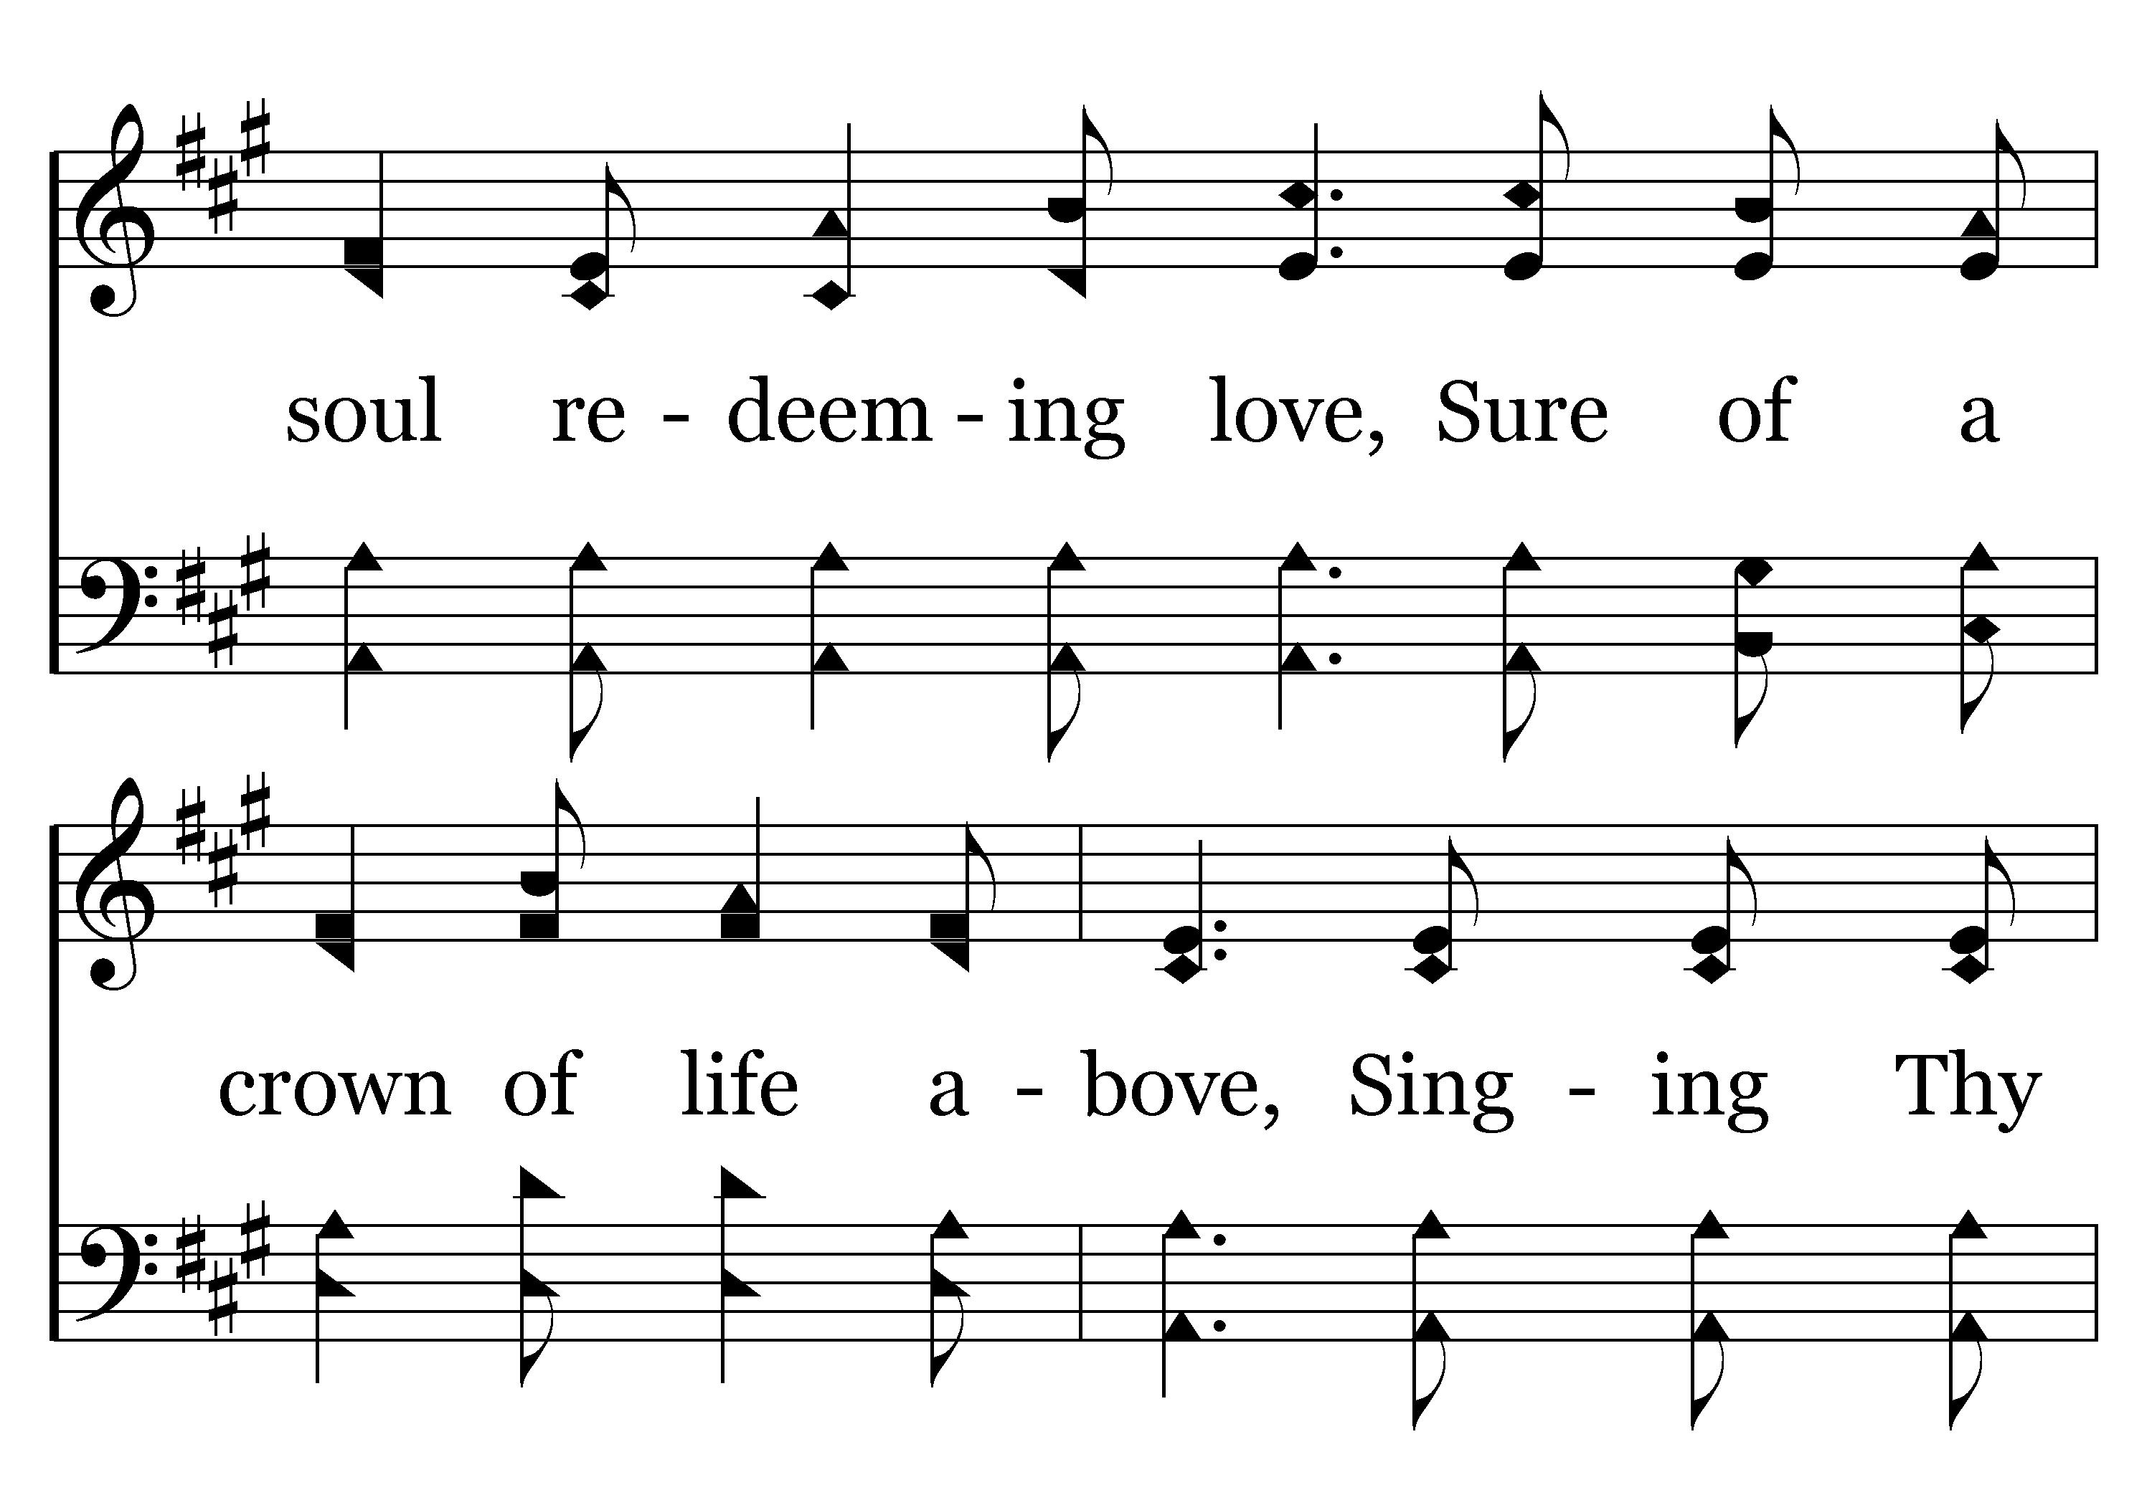
530 - Looking To Thee - 1.3

Slide 68
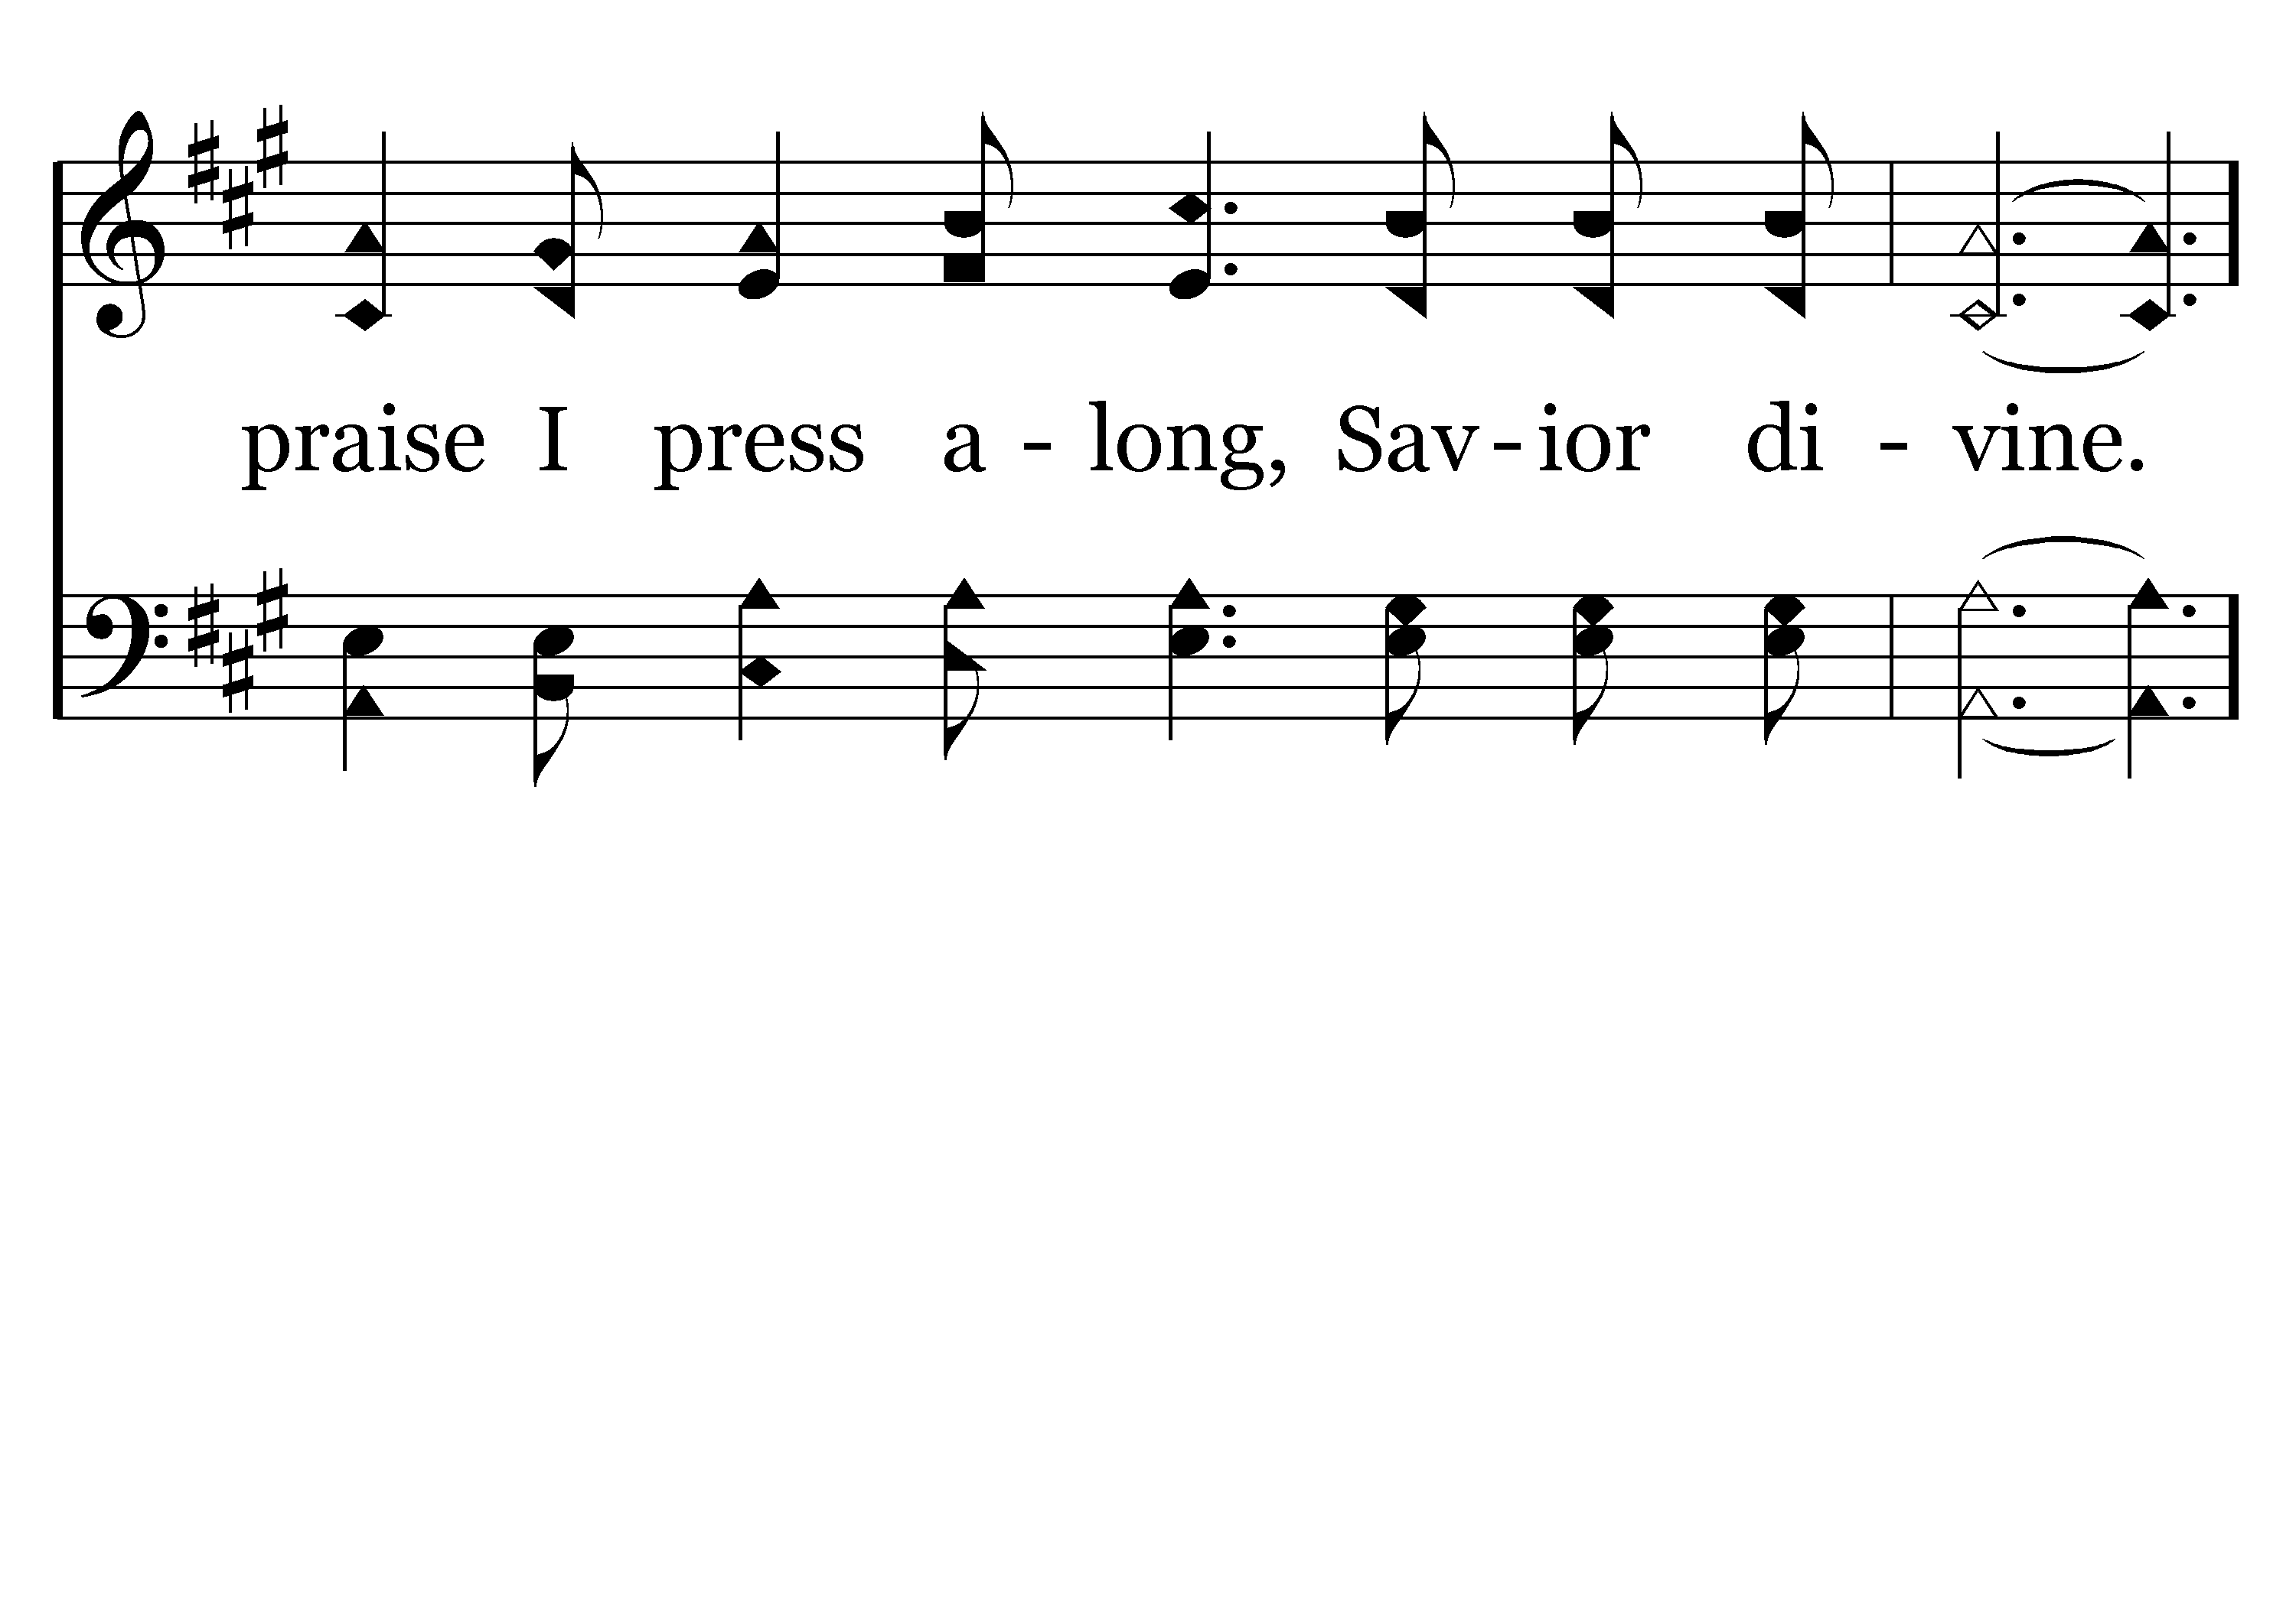
530 - Looking To Thee - 1.4

Slide 69
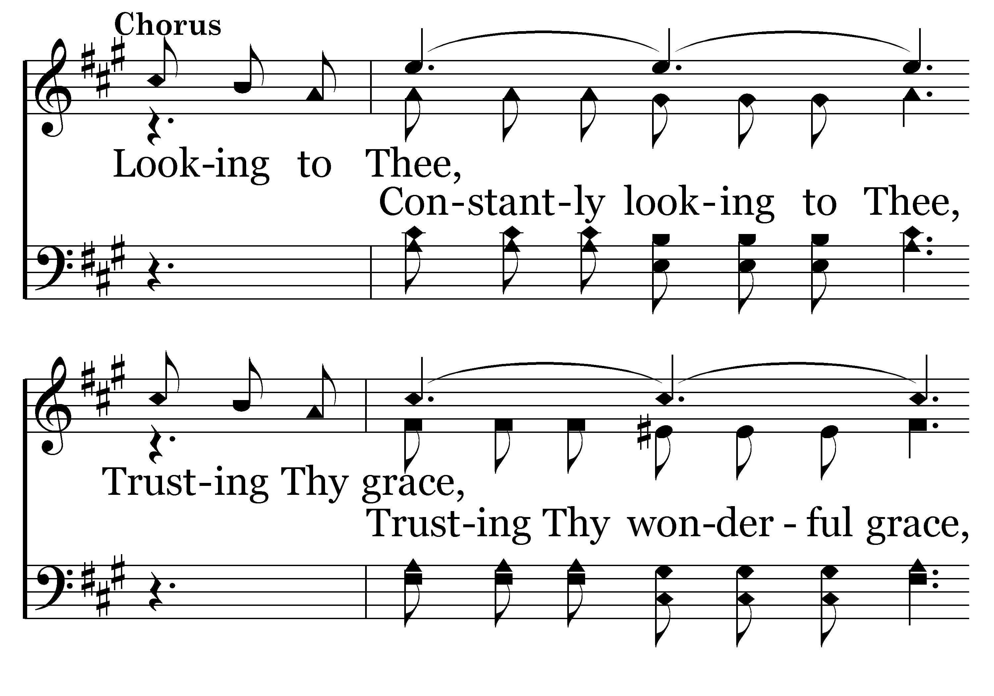
530 - Looking To Thee - C.1

Slide 70
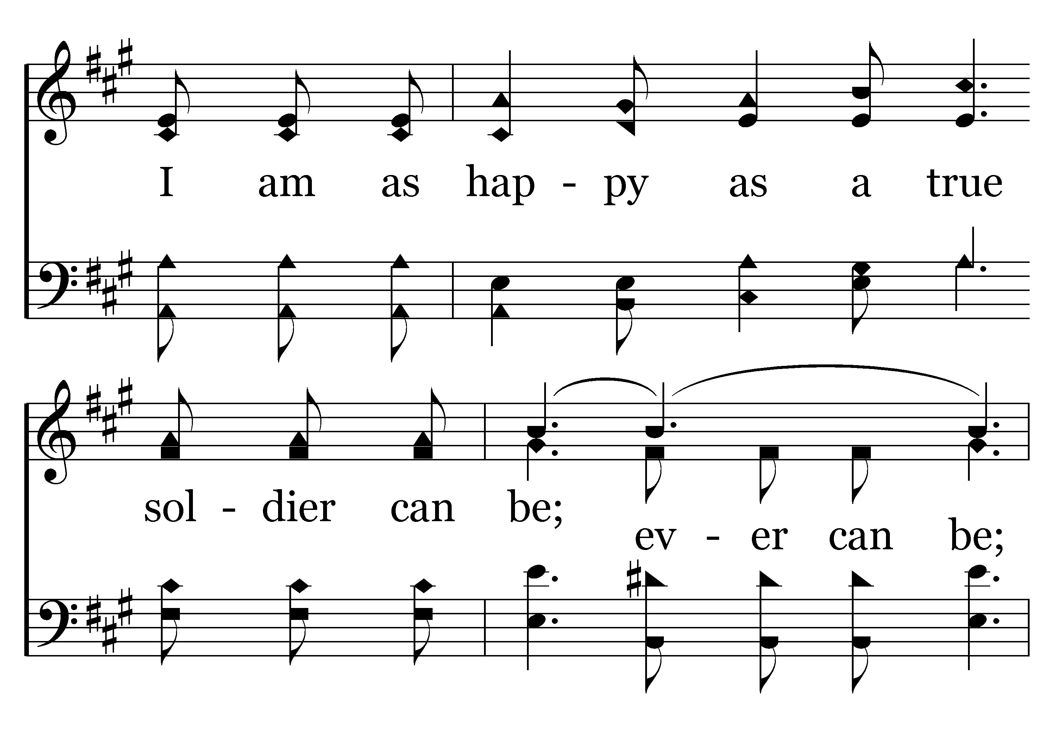
530 - Looking To Thee - C.2

Slide 71
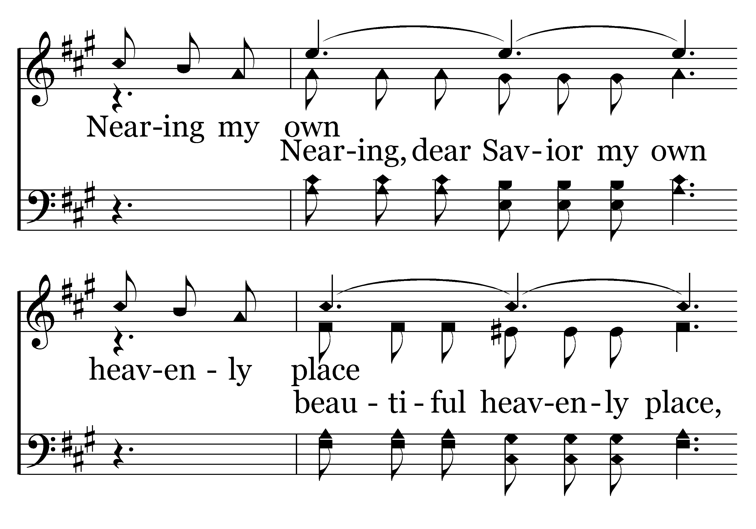
530 - Looking To Thee - C.3

Slide 72
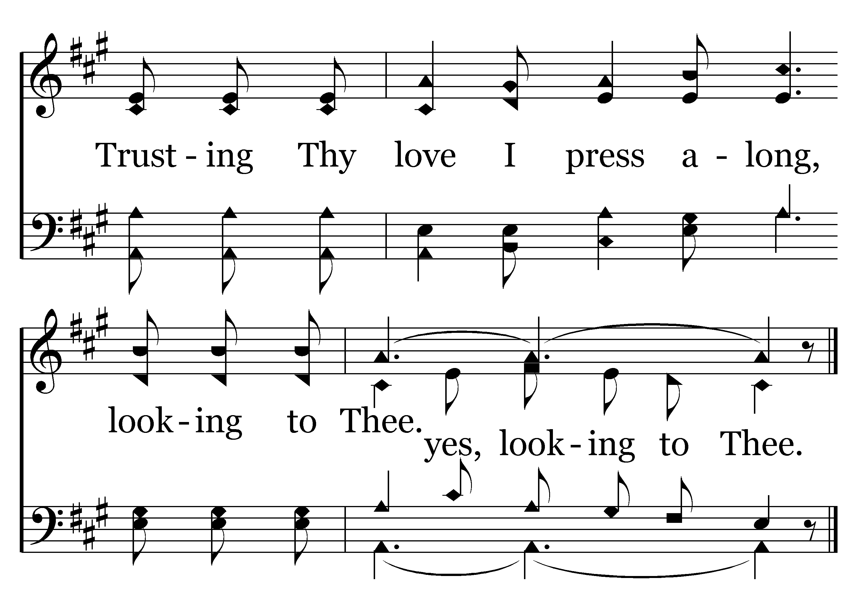
530 - Looking To Thee - C.4
End of Verse 1

Slide 73
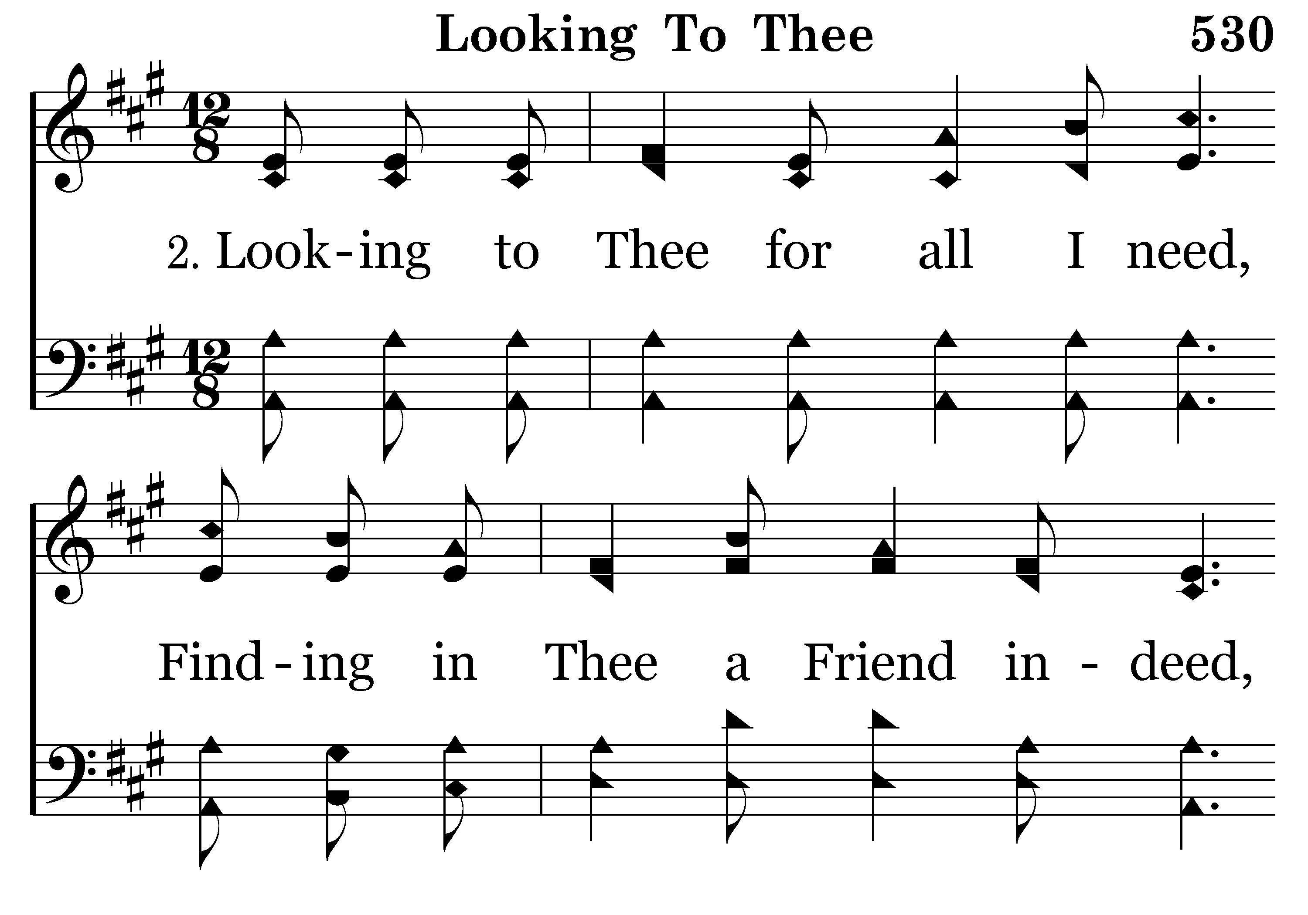
530 - Looking To Thee - 2.1

Slide 74
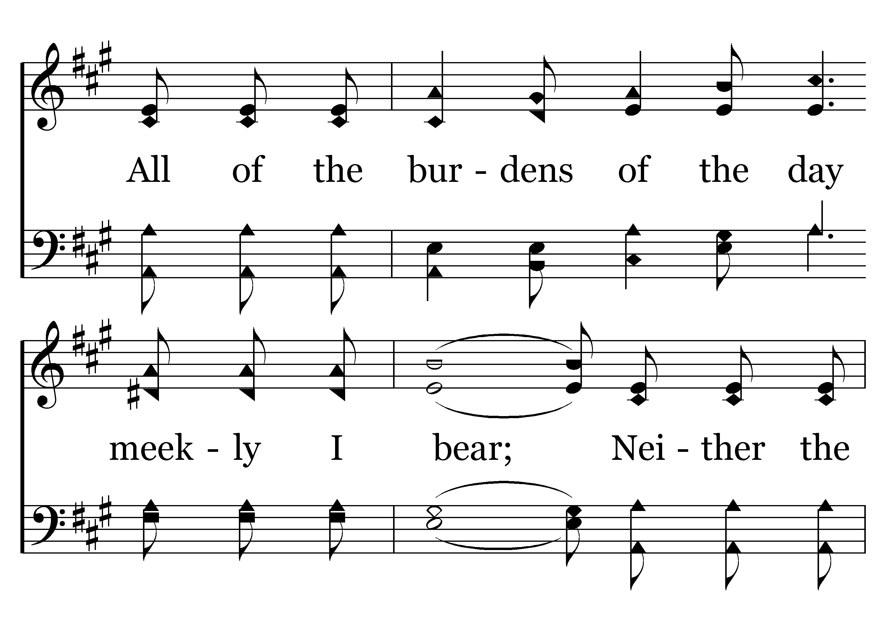
530 - Looking To Thee - 2.2

Slide 75
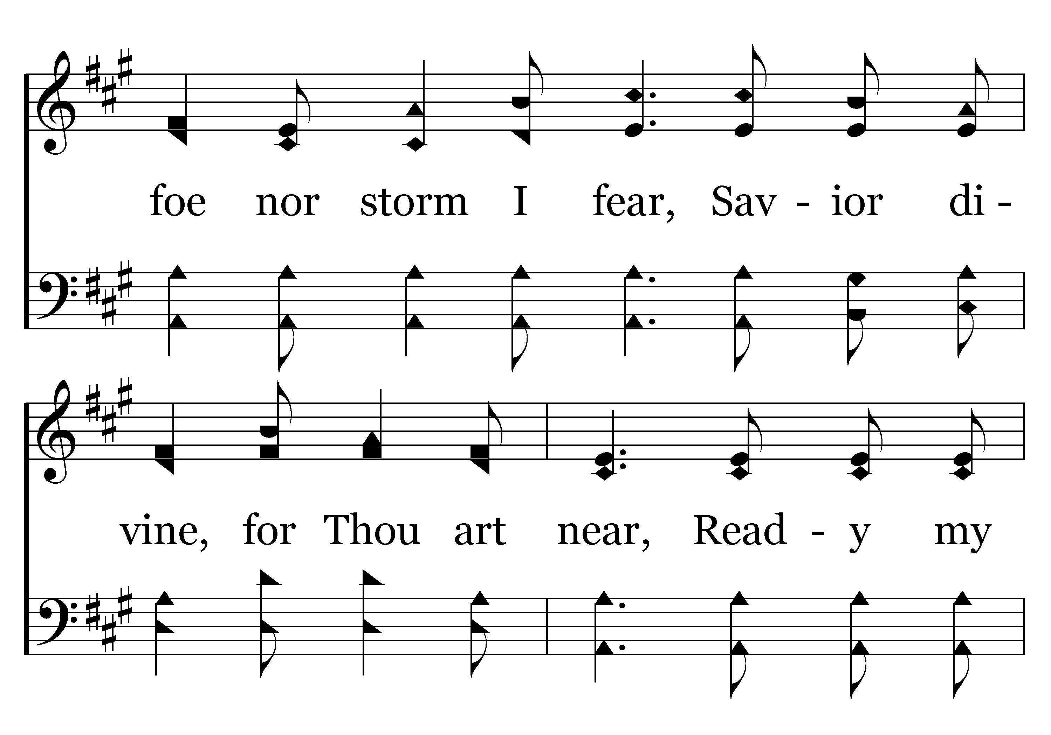
530 - Looking To Thee - 2.3

Slide 76
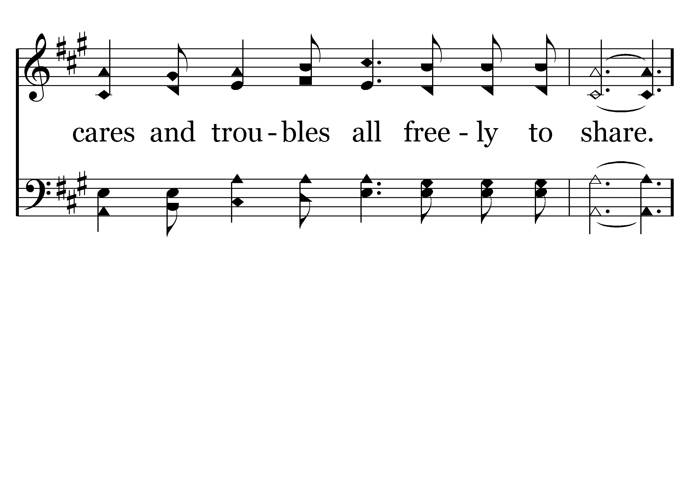
530 - Looking To Thee - 2.4

Slide 77
530 - Looking To Thee - C.1

Slide 78
530 - Looking To Thee - C.2

Slide 79
530 - Looking To Thee - C.3

Slide 80
530 - Looking To Thee - C.4
End of Verse 2

Slide 81
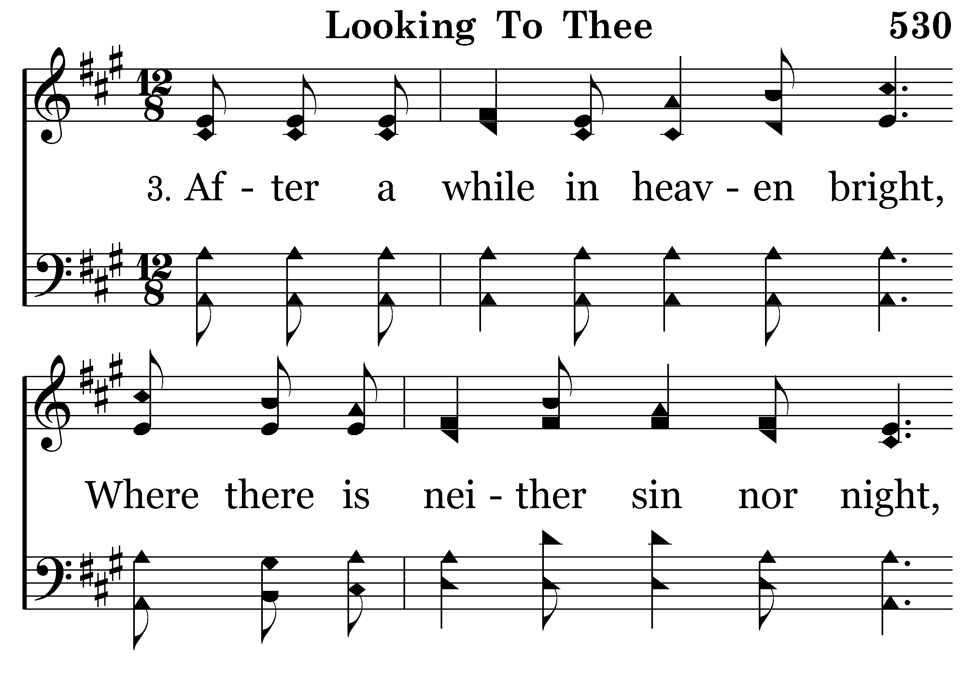
530 - Looking To Thee - 3.1

Slide 82

530 - Looking To Thee - 3.2

Slide 83

530 - Looking To Thee - 3.3

Slide 84

530 - Looking To Thee - 3.4

Slide 85
530 - Looking To Thee - C.1

Slide 86
530 - Looking To Thee - C.2

Slide 87
530 - Looking To Thee - C.3

Slide 88
530 - Looking To Thee - C.4
End of Song

Slide 90

422 - Jesus Saves - Title

Slide 91

422 - Jesus Saves - 1.1

Slide 92

422 - Jesus Saves - 1.2

Slide 93

422 - Jesus Saves - 1.3

Slide 94

422 - Jesus Saves - 1.4
End of Verse 1

Slide 95

422 - Jesus Saves - 3.1

Slide 96

422 - Jesus Saves - 3.2

Slide 97

422 - Jesus Saves - 3.3

Slide 98

422 - Jesus Saves - 3.4
End of Verse 3

Slide 99

422 - Jesus Saves - 4.1

Slide 100

422 - Jesus Saves - 4.2

Slide 101

422 - Jesus Saves - 4.3

Slide 102

422 - Jesus Saves - 4.4
End of Song

Slide 103


Slide 104

“As often as you eat this bread and drink this cup, you proclaim the Lord’s death….” 1 Corinthians 11:26

Slide 105

269 - Nothing But The Blood - Title

Slide 106

269 - Nothing But The Blood - 1.1

Slide 107

269 - Nothing But The Blood - 1.2
SING VS 2 THEN THE CHORUS

Slide 108

269 - Nothing But The Blood - 2.1

Slide 109

269 - Nothing But The Blood - 2.2

Slide 110

269 - Nothing But The Blood - C.1

Slide 111

269 - Nothing But The Blood - C.2
End of Verse 2

Slide 113

395 - A Beautiful Life - Title

Slide 114

395 - A Beautiful Life - 1.1

Slide 115

395 - A Beautiful Life - 1.2

Slide 116

395 - A Beautiful Life - 1.3

Slide 117

395 - A Beautiful Life - 1.4

Slide 118

395 - A Beautiful Life - C.1

Slide 119

395 - A Beautiful Life - C.2

Slide 120

395 - A Beautiful Life - C.3

Slide 121

395 - A Beautiful Life - C.4
End of Verse 1

Slide 122

395 - A Beautiful Life - 2.1

Slide 123

395 - A Beautiful Life - 2.2

Slide 124

395 - A Beautiful Life - 2.3

Slide 125

395 - A Beautiful Life - 2.4

Slide 126
395 - A Beautiful Life - C.1

Slide 127
395 - A Beautiful Life - C.2

Slide 128
395 - A Beautiful Life - C.3

Slide 129
395 - A Beautiful Life - C.4
End of Verse 2

Slide 130

395 - A Beautiful Life - 3.1

Slide 131

395 - A Beautiful Life - 3.2

Slide 132

395 - A Beautiful Life - 3.3

Slide 133

395 - A Beautiful Life - 3.4

Slide 134
395 - A Beautiful Life - C.1

Slide 135
395 - A Beautiful Life - C.2

Slide 136
395 - A Beautiful Life - C.3

Slide 137
395 - A Beautiful Life - C.4
End of Verse 3

Slide 138

395 - A Beautiful Life - 4.1

Slide 139

395 - A Beautiful Life - 4.2

Slide 140

395 - A Beautiful Life - 4.3

Slide 141

395 - A Beautiful Life - 4.4

Slide 142
395 - A Beautiful Life - C.1

Slide 143
395 - A Beautiful Life - C.2

Slide 144
395 - A Beautiful Life - C.3

Slide 145
395 - A Beautiful Life - C.4
End of Song

Slide 147

TODAY’S TEXT
HARRY COWAN
PHILIPPIANS 4:6-9

Slide 148
Phil 4:6-8 Do not be anxious about anything, but in everything, by prayer and petition, with thanksgiving, present your requests to God. ⁷ And the peace of God, which transcends all understanding, will guard your hearts and your minds in Christ Jesus.
Finally, brothers, whatever is true, whatever is noble, whatever is right, whatever is pure, whatever is lovely, whatever is admirable — if anything is excellent or praiseworthy — think about such things.

Slide 149
INVITATION SONG
# 278
GOD IS CALLING

Slide 150



Slide 151


Slide 152

HOLMES STRESS SCALE

Slide 153

100 most stressful events in life:
Death of a spouse
Divorce
Death of close friend or family member
Marriage
Personal injury/illness
Retirement

Slide 154
100 most stressful events in life:
Loss of job
Son or daughter leaving home
Trouble with in-laws
Trouble at work
Mortgage/loan foreclosure
Change in eating habits
Vacation

Slide 155
SINGLE MOST STRESSFUL TIME OF THE YEAR
MOST STRESSFUL
THANKSGIVING
CHRISTMAS
We start to worry about presents
Parties
All kinds of problems
Finances
Relatives we will have to see
“THIS IS THE SEASON TO BE UPTIGHT”

Slide 156
SINGLE MOST STRESSFUL TIME OF THE YEAR
MOST STRESSFUL
THANKSGIVING
CHRISTMAS
Are you guys ready for the holidays? Getting together with friends and family to share food, gifts, and gratitude can be a lot of fun, but it can get overwhelming, too. Need a little help dealing with holiday stress this year? We’ve got eight simple yoga poses to help melt the anxiety away.
HEALTHY LIVING WEBSITE

Slide 157
HOW CAN WE BE THANKFUL IN TOUGH TIMES?
When the economy is so bad?
When things aren’t going our way?
When we have so much stress to deal with?
Phil 4:4 Rejoice in the Lord always. I will say it again: Rejoice!
IS THIS POSSIBLE?
CAN WE ALWAYS BE JOYFUL?
NO MATTER WHAT THE CIRCUMSTANCES?

Slide 158


Slide 159


Slide 160


Slide 161
Meaning of “Thanksgiving” Eucharist
the Greek noun εὐχαριστία (eucharistia), meaning "thanksgiving", is not used in the New Testament as a name for the observance, however, the related verb is found in New Testament texts concerning the Last Supper
1 Cor. 11: 23,24 “For I received from the Lord what I also delivered to you, that the Lord Jesus on the night when he was betrayed took bread, and when he had given thanks, he broke it, and said, "This is my body which is for you. Do this in remembrance of me."

Slide 162


Slide 163
HOW CAN WE BE THANKFUL IN TOUGH TIMES?
How can we survive seasonal stress?
How can we deal with stress at anytime in our life?
THERE ARE 4 KEYS TO SURVIVING STRESS

Slide 164
WORRY ABOUT
NOTHING
HOW CAN WE BE THANKFUL IN TOUGH TIMES?
Phil 4:6-9 Do not be anxious about anything, but in everything, by prayer and petition, with thanksgiving, present your requests to God. 7 And the peace of God, which transcends all understanding, will guard your hearts and your minds in Christ Jesus. 8 Finally, brothers, whatever is true, whatever is noble, whatever is right, whatever is pure, whatever is lovely, whatever is admirable — if anything is excellent or praiseworthy — think about such things.
PRAY ABOUT
EVERYTHING
THANK GOD FOR
ALL THINGS
THINK ABOUT
RIGHT THINGS
4 KEYS TO SURVIVING STRESS

Slide 165
1. WORRY ABOUT NOTHING
Phil 4:6 Don't worry about anything;
Phil 4:6 Do not be anxious about anything, NIV
Easier said than done
The Smithsonian Institute Magazine said:
“WE ARE IN THE GOLDEN AGE OF ANXIETY”

Slide 166

It’s not a COMFORT clock
It’s an ALARM clock

Slide 167


Slide 168
BAD

Slide 169
1. WORRY ABOUT NOTHING
We not only have our own problems
We have the border crisis
We have the Afghanistan problem
A dozen other things happening
We read the news paper
Which is full of great news!?!
No wonder we are stressed out when we get to work

Slide 170
1. WORRY ABOUT NOTHING
Dr. Walter Calvert did a study about worry
40% of worries never happen
30% of worries concern the past
12% of worries are needless health concerns
10% of worries are insignificant and petty
8% of worries are actual, legitimate concerns

Slide 171

SET A WORRY TIME
I AM GOING TO WORRY EACH DAY BETWEEN 4 AND 4:15

Slide 172
1. WORRY ABOUT NOTHING
WORRY IS A LEARNED RESPONSE
Matt 6:34 Therefore do not worry about tomorrow, for tomorrow will worry about itself. Each day has enough trouble of its own.
WE CAN CHOOSE TO WORRY OR NOT TO WORRY

Slide 173
2. PRAY ABOUT EVERYTHING
Phil 4:6 Do not be anxious about anything, but in everything, by prayer and petition, with thanksgiving, present your requests to God.

Slide 174
2. PRAY ABOUT EVERYTHING
Phil 4:6 Do not be anxious about anything, but in everything, by prayer and petition, with thanksgiving, present your requests to God.
Is God interested in your car payments?
YES!
Is God interested in your mortgage?
YES?
Is God interested in your post-nasal drip?
YES!
Is God interested in your outbreak of psoriasis?
YES!
GOD IS INTERESTED IN EVERY DETAIL OF OUR LIFE

Slide 175
2. PRAY ABOUT EVERYTHING
Phillips translation: “When you pray, tell God every detail of your life.”
Phil 4:6 Do not be anxious about anything, but in everything, by prayer and petition, with thanksgiving, present your requests to God.

Slide 176
2. PRAY ABOUT EVERYTHING
Phillips translation: “When you pray, tell God every detail of your life.”
Phil 4:6 Do not be anxious about anything, but in everything, by prayer and petition, with thanksgiving, present your requests to God.
Petition means: “a specific, detailed, direct prayer”

Slide 177
2. PRAY ABOUT EVERYTHING
1 Peter 5:7 Cast all your anxiety on him because he cares for you.
“Cast” in Greek: “lit. Throw upon”
No problem is too big or too small to pray about
INSIGHT:
Worry about NOTHING
Pray about EVERYTHING
TO RELIEVE STRESS

Slide 178

P
R
A
Y
E
R

Slide 179
3. THANK GOD IN ALL THINGS
Phil 4:6 Do not be anxious about anything, but in everything, by prayer and petition, with thanksgiving, present your requests to God.

Slide 180
3. THANK GOD IN ALL THINGS
Phil 4:6 Do not be anxious about anything, but in everything, by prayer and petition, with thanksgiving, present your requests to God.
WHAT IS THE GREATEST HUMAN EMOTION?
IT IS NOT LOVE!
IT IS GRATITUDE

Slide 181


Slide 182
3. THANK GOD IN ALL THINGS
“Count your many blessings, name them one by one”

Slide 183

WIFE/HUSBAND
KIDS
FRIENDS
FELLOW CHRISTIANS
JOB
HOME—HOUSE
FOOD

Slide 184
3. THANK GOD IN ALL THINGS
“Count your many blessings, name them one by one”
1 Thess 5:18 give thanks in all circumstances, for this is God's will for you in Christ Jesus.
This does not say be thankful FOR all circumstances
It says be thankful IN all circumstances
IT DOES NOT SAY “BE THANKFUL FOR EVERYTHING

Slide 185

“THANK YOU LORD”

Slide 186

“PRAISE THE LORD”

Slide 187
3. THANK GOD IN ALL THINGS
WE DON’T HAVE TO BE THANKFUL FOR THE EVIL IN THE WORLD
I would not be thankful if something happened to my family
I was not thankful when my wife was diagnosed with cancer 2 times
I am not thankful that we are in inflation
THE BIBLE DOES NOT SAY “BE THANKFUL FOR EVIL”

Slide 188
3. THANK GOD IN ALL THINGS
IN EVERY CIRCUMSTANCE—BE THANKFUL
IN EVERY CIRCUMSTANCE—NO MATTER HOW BAD—GIVE THANKS BECAUSE:
I know He has a purpose greater than the problem
He will give me power to overcome the problem
I will grow through the experience

Slide 189
3. THANK GOD IN ALL THINGS
give thanks in all circumstances, for this is God's will for you in Christ Jesus.
WHAT IS GOD’S WILL FOR MY LIFE?
IT IS RIGHT HERE
give thanks in all circumstances, for this is God's will for you in Christ Jesus.

Slide 190
3. THANK GOD IN ALL THINGS
BUT—HOW CAN I BE GRATEFUL WHEN I’VE LOST SO MUCH?
I’ve lost my job
I’ve lost my spouse
I’ve lost my health
How can I be thankful?
You look at what you haven’t lost
You look at what you have left

Slide 191
3. THANK GOD IN ALL THINGS
WHAT ARE YOU TAKING FOR GRANTED?
Your health?
Your freedom?
Your relationships?
Your job?
GRATITUDE IS A GREAT STRESS RELIEVER
IT GETS OUR FOCUS OFF OUR PROBLEM AND ON POSTIVE THINGS IN OUR LIFE

Slide 192
4. THINK ABOUT THE RIGHT THINGS
Phil 4:8 Finally, brothers, whatever is true, whatever is noble, whatever is right, whatever is pure, whatever is lovely, whatever is admirable — if anything is excellent or praiseworthy — think about such things.
IF WE WANT TO CHANGE THE STRESS LEVEL IN OUR LIFE
WE HAVE TO CHANGE THE WAY WE THINK

Slide 193
4. THINK ABOUT THE RIGHT THINGS
Phil 4:8 Finally, brothers, whatever is true, whatever is noble, whatever is right, whatever is pure, whatever is lovely, whatever is admirable — if anything is excellent or praiseworthy — think about such things.
THE WAY WE THINK DETERMINES THE WAY WE FEEL
THE WAY WE FEEL DETERMINES THE WAY WE ACT
DO WE READ THE NEWSPAPTER MORE THAN WE READ THE BIBLE?
DO WE WATCH TV MORE THAN WE THINK ABOUT GOOD THINGS?

Slide 194
4. THINK ABOUT THE RIGHT THINGS
Phil 4:8 Finally, brothers, whatever is true, whatever is noble, whatever is right, whatever is pure, whatever is lovely, whatever is admirable — if anything is excellent or praiseworthy — think about such things.
True
Noble
Right
Pure
Lovely
Admirable
Does this describe what we see on TV?
In the movies?
In the newspaper?
In magazines?

Slide 195
4. THINK ABOUT THE RIGHT THINGS
Phil 4:8 Finally, brothers, whatever is true, whatever is noble, whatever is right, whatever is pure, whatever is lovely, whatever is admirable — if anything is excellent or praiseworthy — think about such things.
THE PROBLEM IS NOT THE CIRCUMSTANCE
THE PROBLEM IS HOW WE REACT
THE PROBLEM IS OUR RESPONSE
WE HAVE TO THINK THE RIGHT WAY

Slide 196
4. THINK ABOUT THE RIGHT THINGS
Prov 23:7 For as he thinketh in his heart, so is he:
What he thinks is what he really is. TEV
WHAT IS THE RESULT WHEN WE:
Worry about nothing
Pray about everything
Thank God in all things
Think about right things
And the peace of God, which transcends all understanding, will guard your hearts and your minds in Christ Jesus. V. 7

Slide 197
4. THINK ABOUT THE RIGHT THINGS
IT IS AMAZING WHAT PEOPLE DO TO FIND PEACE OF MIND
HOW DO WE GET PEACE?
IT IS GOD’S GIFT TO US
WHEN UNDER PRESSURE
CALM IN THE CRISIS
STRENGTH IN THE STORM
MAKES ME THANKFUL IN TOUGH TIMES
Yoga
Therapy
Books
Seminars
Tapes
Counselors

Slide 198
4. THINK ABOUT THE RIGHT THINGS
THE KEY: THE LAST PHRASE IN THE VERSE
And the peace of God, which transcends all understanding, will guard your hearts and your minds in Christ Jesus.

Slide 199
4. THINK ABOUT THE RIGHT THINGS
THE KEY: THE LAST PHRASE IN THE VERSE
And the peace of God, which transcends all understanding, will guard your hearts and your minds in Christ Jesus.
IN
CHRIST
JESUS
GUARD OUR HEARTS
GUARD OUR MINDS

Slide 201

278 - God Is Calling The Prodigal - Title

Slide 202

278 - God Is Calling The Prodigal - 1.1

Slide 203

278 - God Is Calling The Prodigal - 1.2

Slide 204

278 - God Is Calling The Prodigal - 1.3

Slide 205

278 - God Is Calling The Prodigal - 1.4

Slide 206

278 - God Is Calling The Prodigal - C.1

Slide 207

278 - God Is Calling The Prodigal - C.2

Slide 208

278 - God Is Calling The Prodigal - C.3

Slide 209

278 - God Is Calling The Prodigal - C.4
End of Verse 1

Slide 210

278 - God Is Calling The Prodigal - 2.1

Slide 211

278 - God Is Calling The Prodigal - 2.2

Slide 212

278 - God Is Calling The Prodigal - 2.3

Slide 213

278 - God Is Calling The Prodigal - 2.4

Slide 214
278 - God Is Calling The Prodigal - C.1

Slide 215
278 - God Is Calling The Prodigal - C.2

Slide 216
278 - God Is Calling The Prodigal - C.3

Slide 217
278 - God Is Calling The Prodigal - C.4
End of Song

Slide 219


Slide 221

CLOSING PRAYER
JOE DRYER

Slide 222


Slide 223

Today after Bible class in the
West Annex

Slide 224
THANK YOU FOR VISITING WITH US
PLEASE COME BACK

