Slide 1
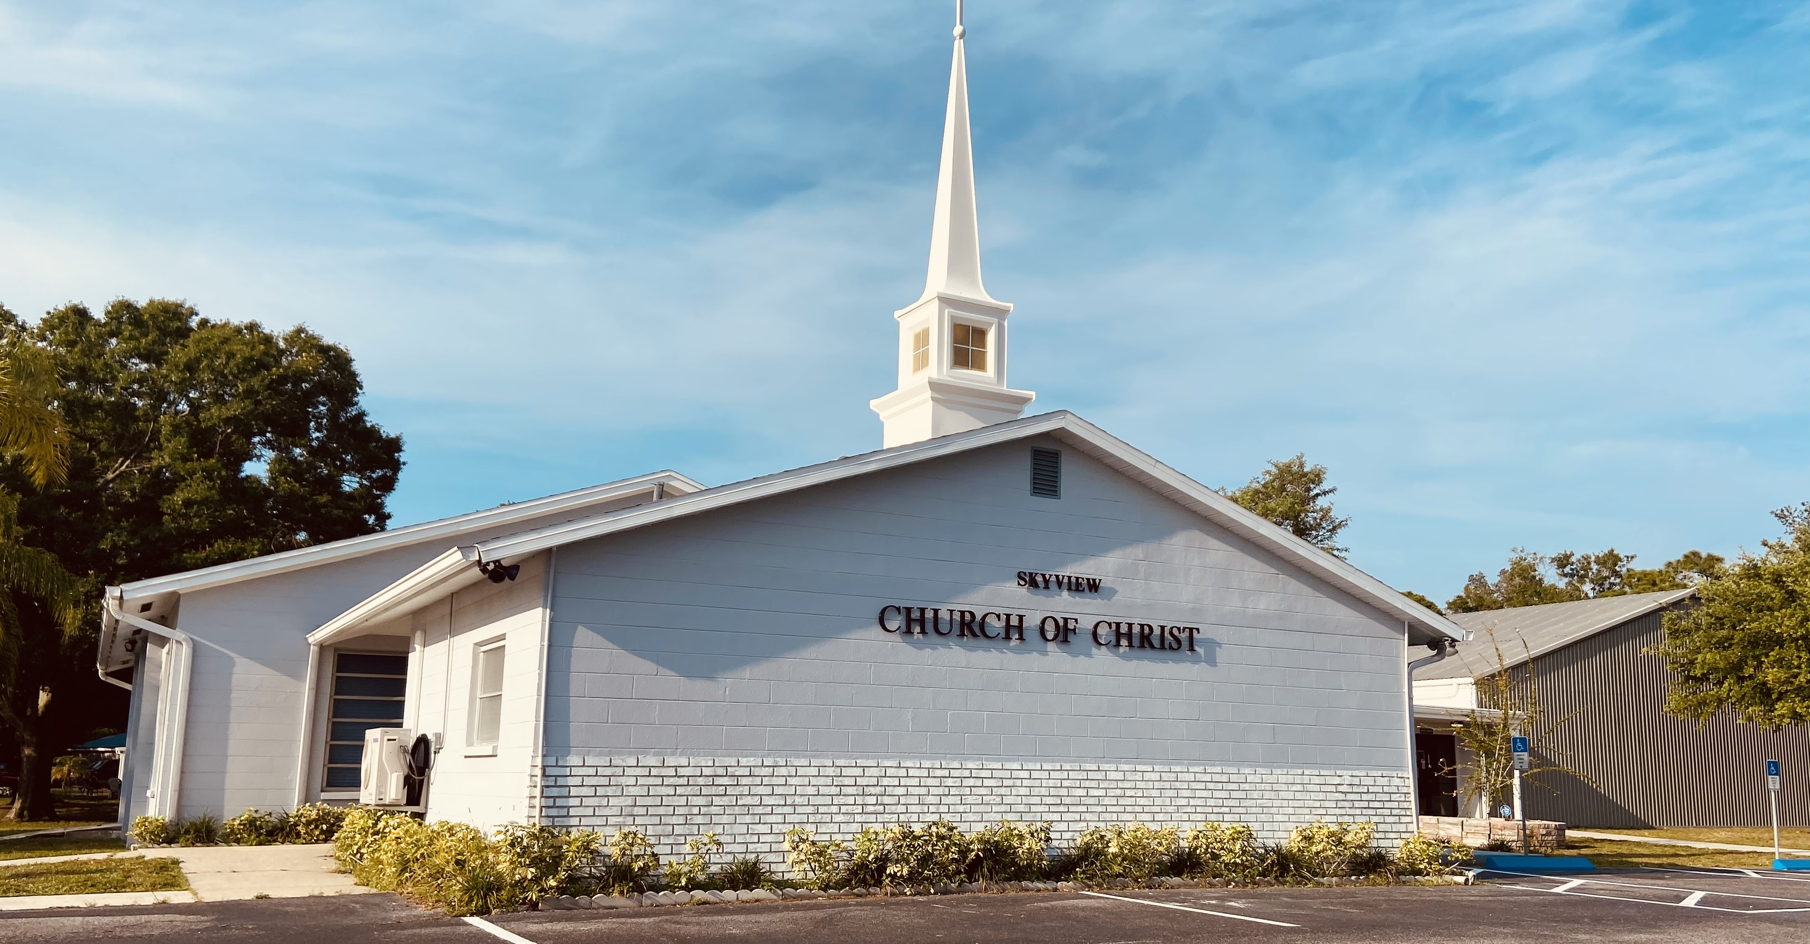
WELCOME TO OUR SERVICES

Slide 2
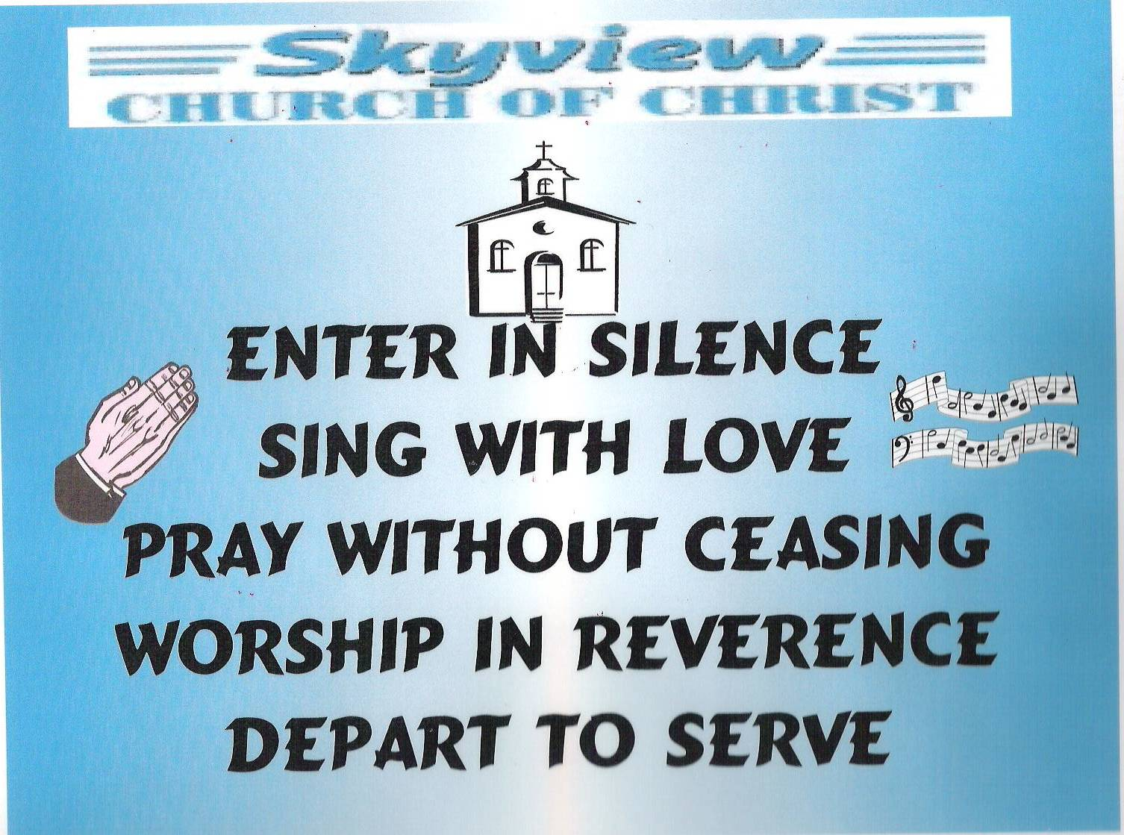
DESIGNED BY JIM INGRAM

Slide 3


Slide 4
TODAY’S WORSHIP LEADERS
CALL TO WORSHIP
PRAYER
SONG LEADER
SCRIPTURE
HEADING TABLE
SERMON
CLOSING PRAYER
ANNOUNCEMENTS
Harry Cowan
Tom Andrick
Sander Fletcher
Gailand Kiltz
Charles Peter
Charles Murray
Henry Oliu
Jim Ingram

Slide 5

MONDAY NIGHT BIBLE STUDY 6:30PM will meet in the West Annex
WEDNESDAY BIBLE STUDY will meet in the West Annex until further notice
LADIES BIBLE CLASS W.I.N.G.S (Women In God’s Service) Thursday 10:00 AM – meets in the West Annex

Slide 6

FIVE MINUTE RULE

Slide 7


Slide 8


Slide 10
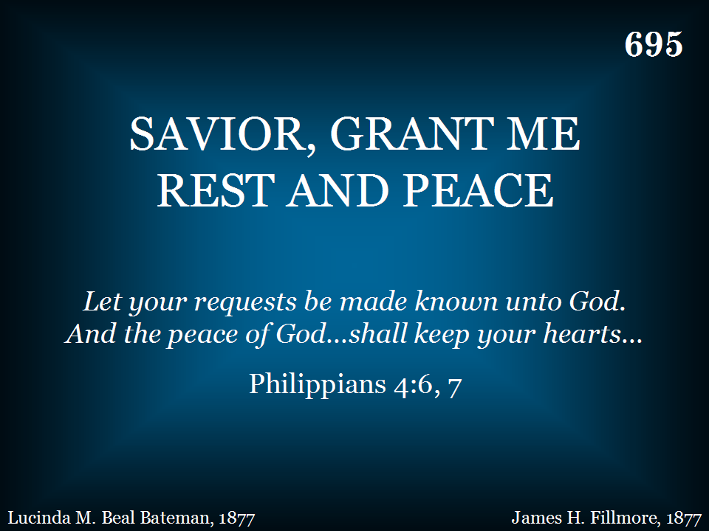
695 - Savior, Grant Me Rest And Peace - Title

Slide 11
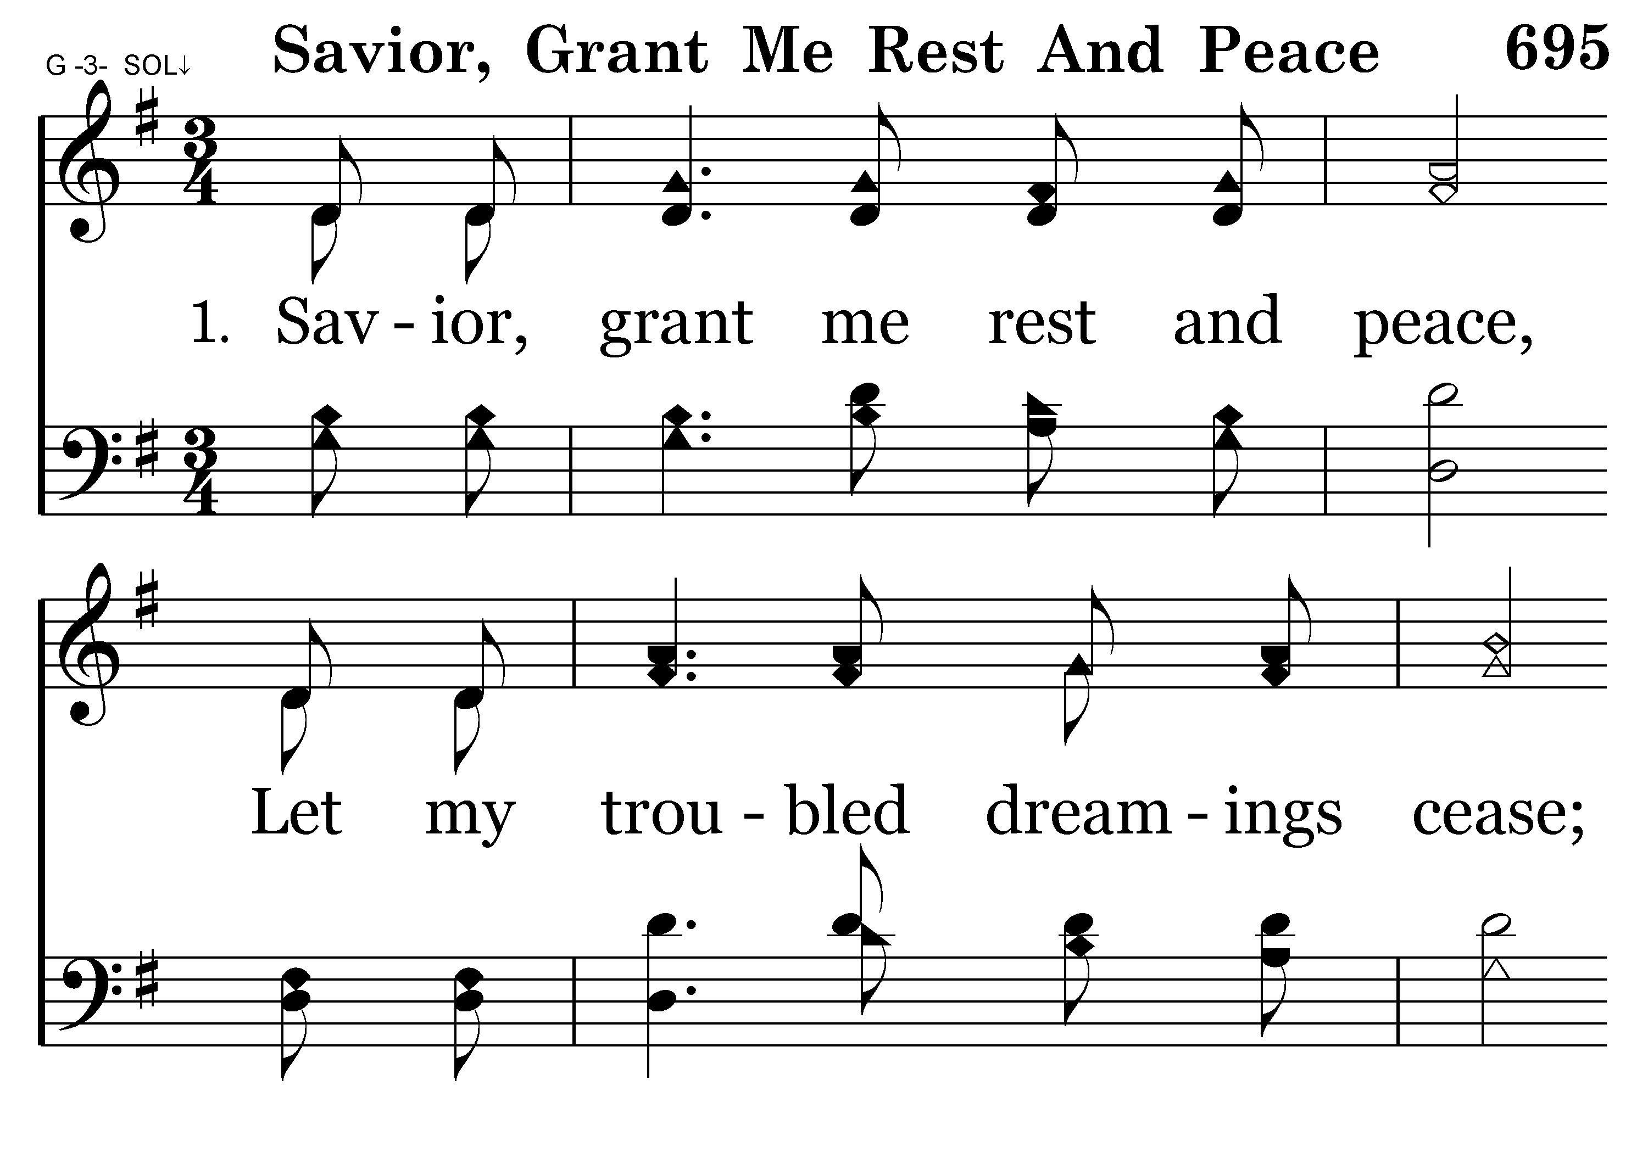
695 - Savior, Grant Me Rest And Peace - 1.1

Slide 12
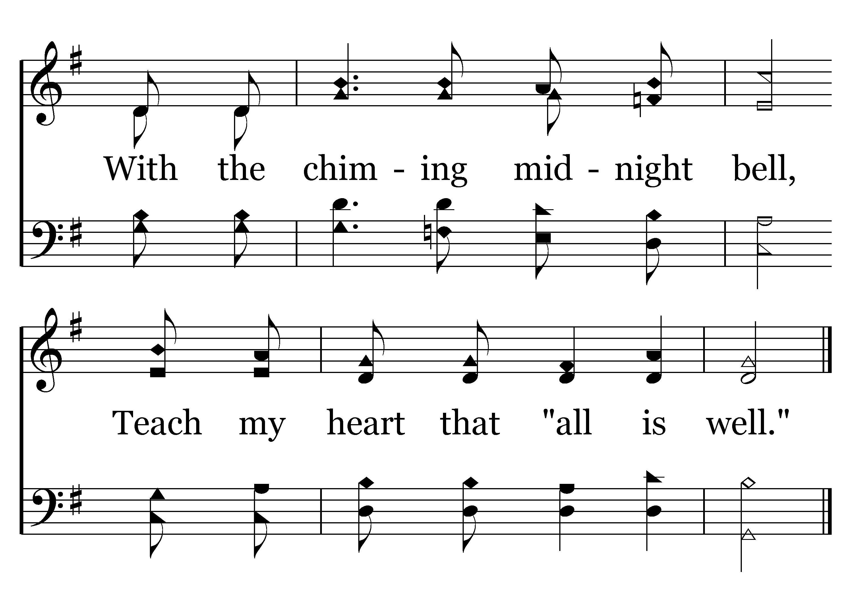
695 - Savior, Grant Me Rest And Peace - 1.2
End of Verse 1

Slide 13
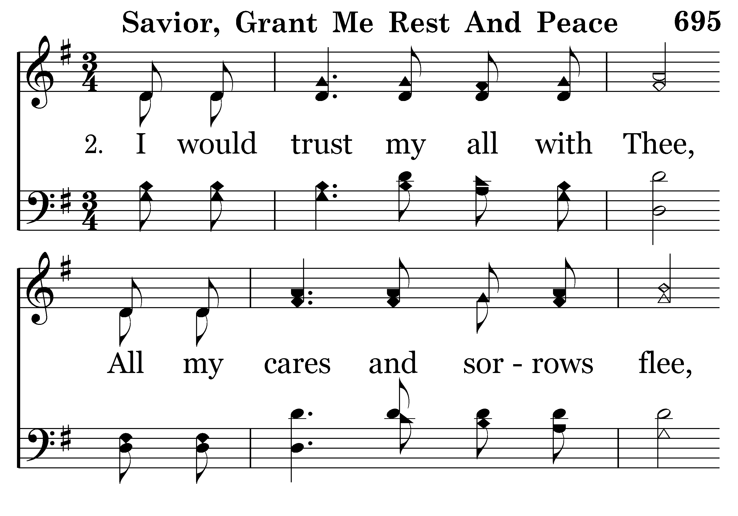
695 - Savior, Grant Me Rest And Peace - 2.1

Slide 14
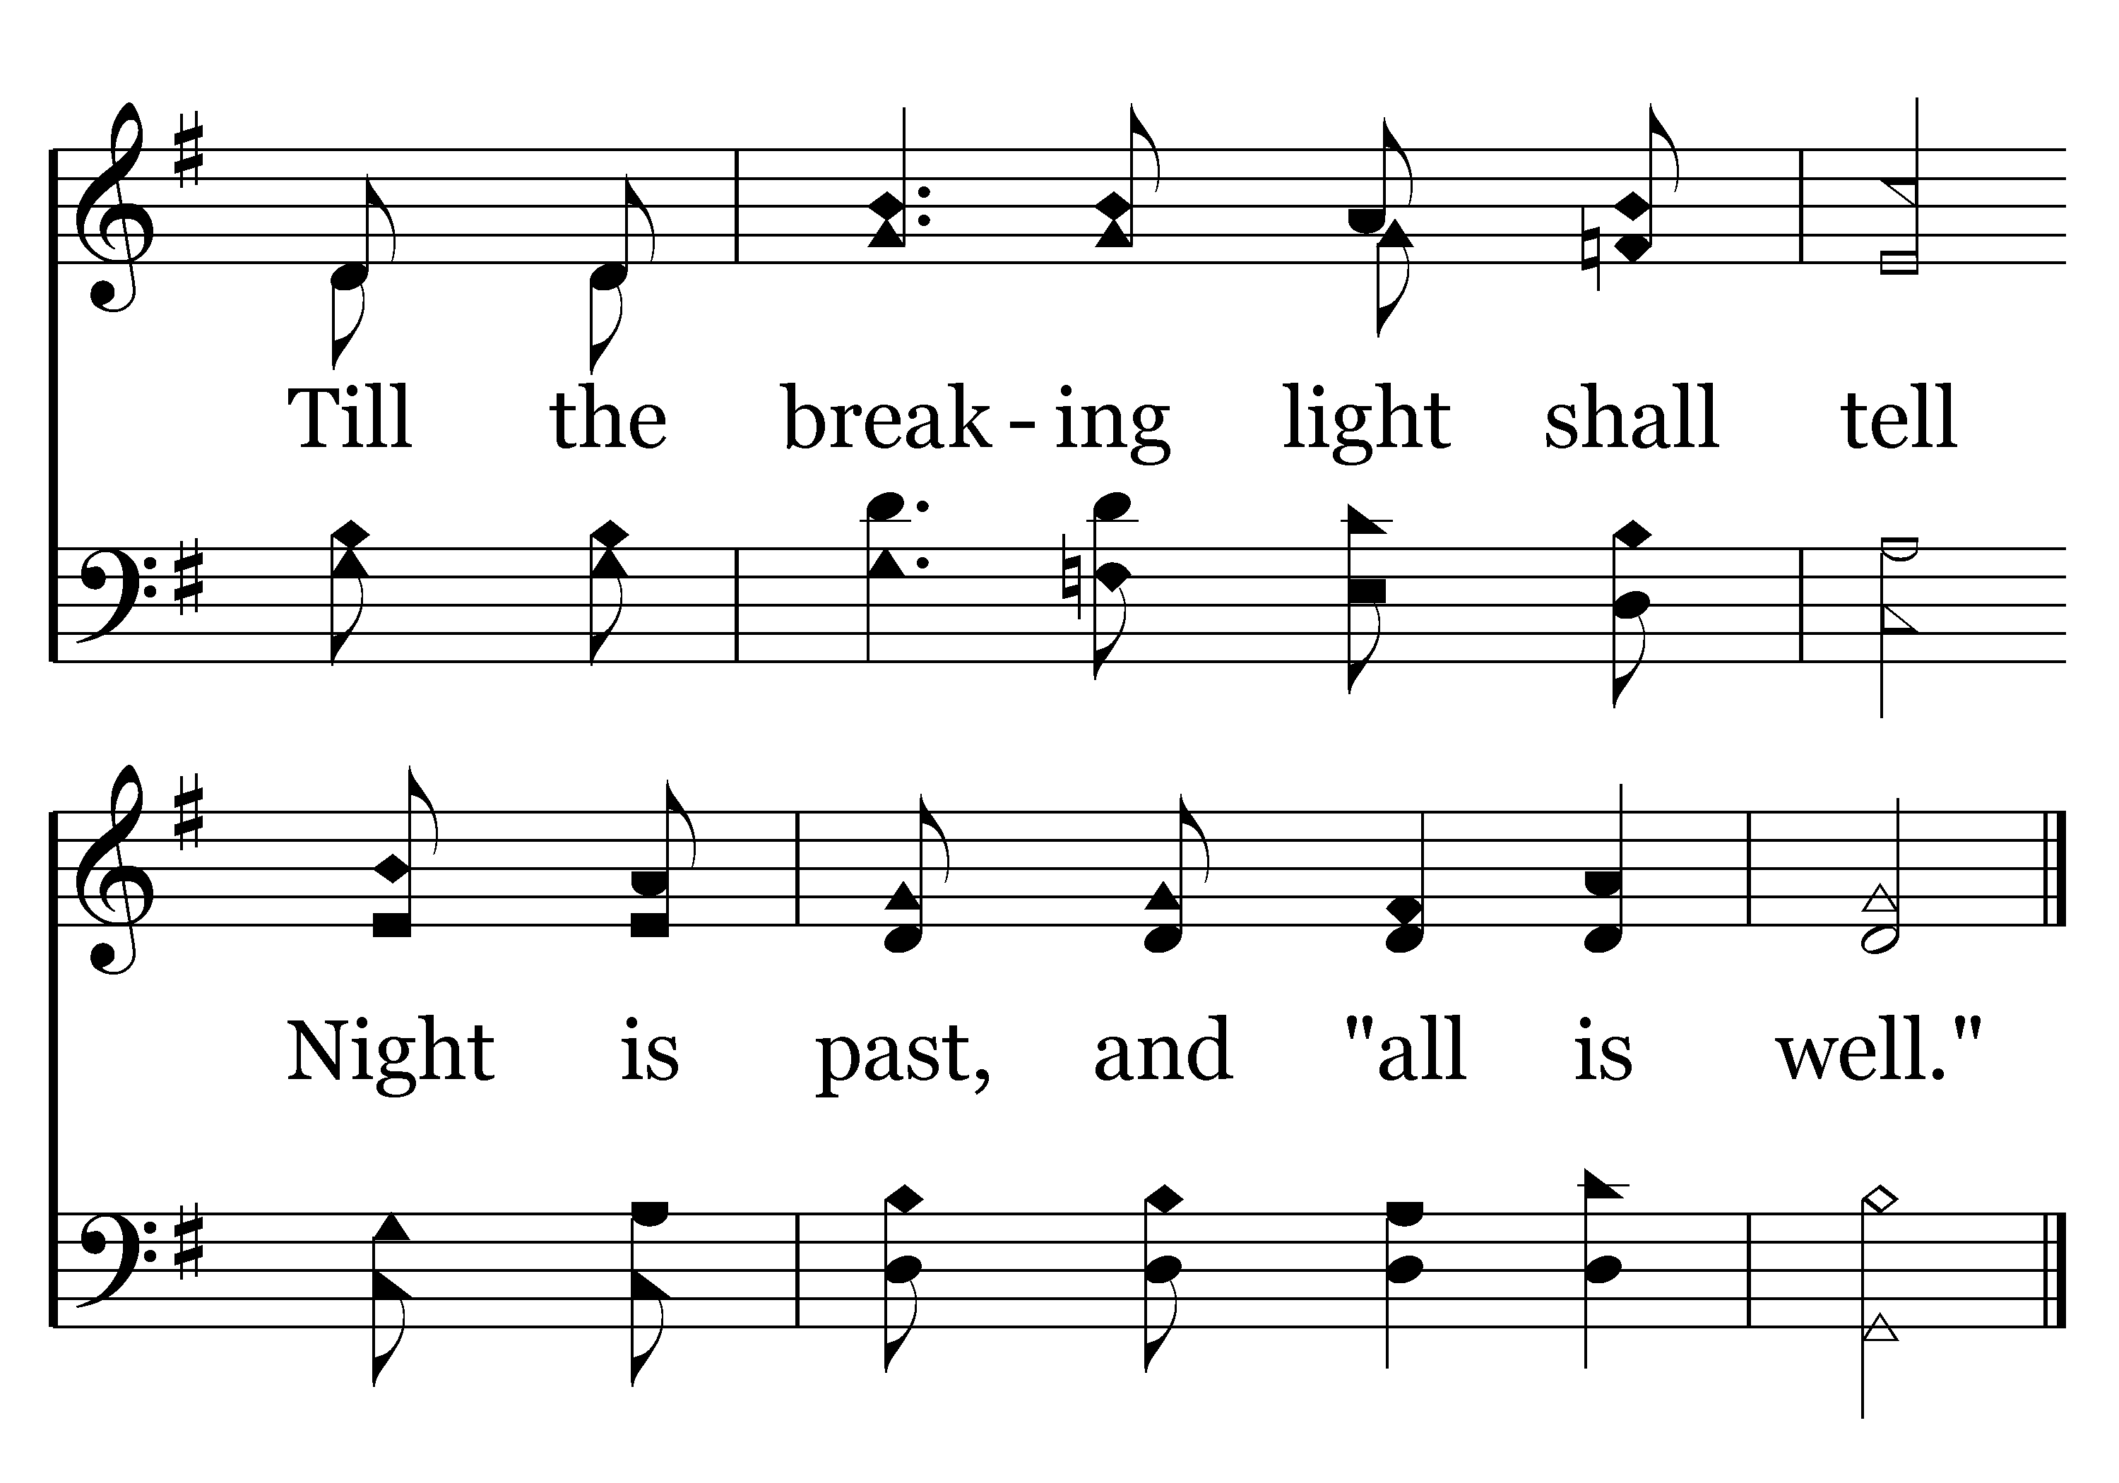
695 - Savior, Grant Me Rest And Peace - 2.2
End of Verse 2

Slide 15
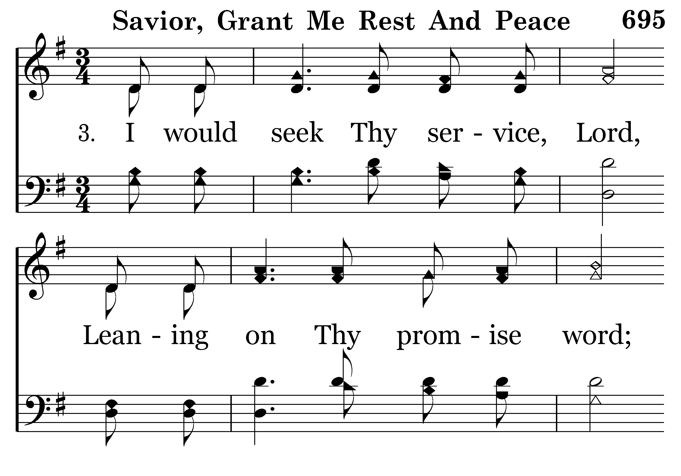
695 - Savior, Grant Me Rest And Peace - 3.1

Slide 16
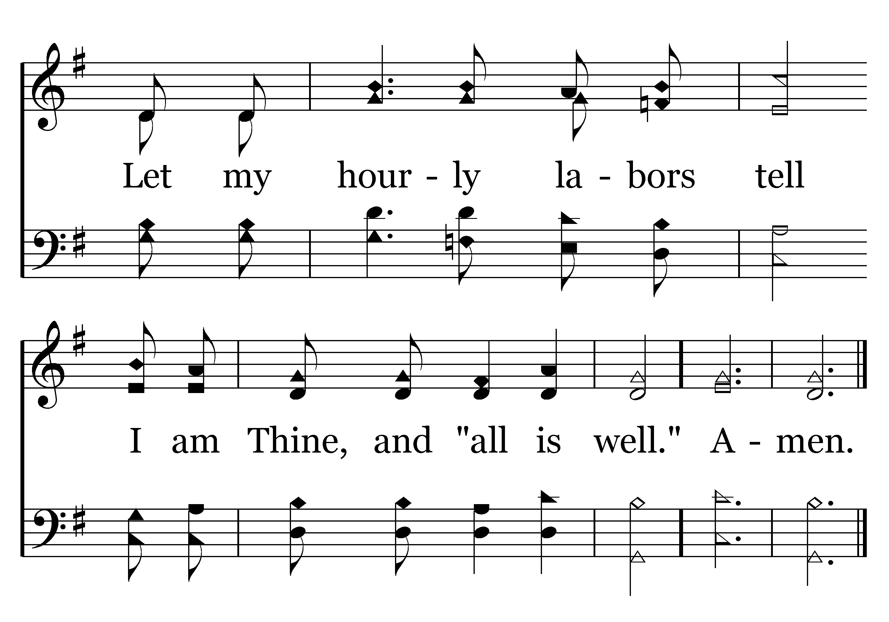
695 - Savior, Grant Me Rest And Peace - 3.2
End of Song

Slide 18


Slide 19

PRAYER
Jerry Mellish
LED BY TOM ANDRICK

Slide 21
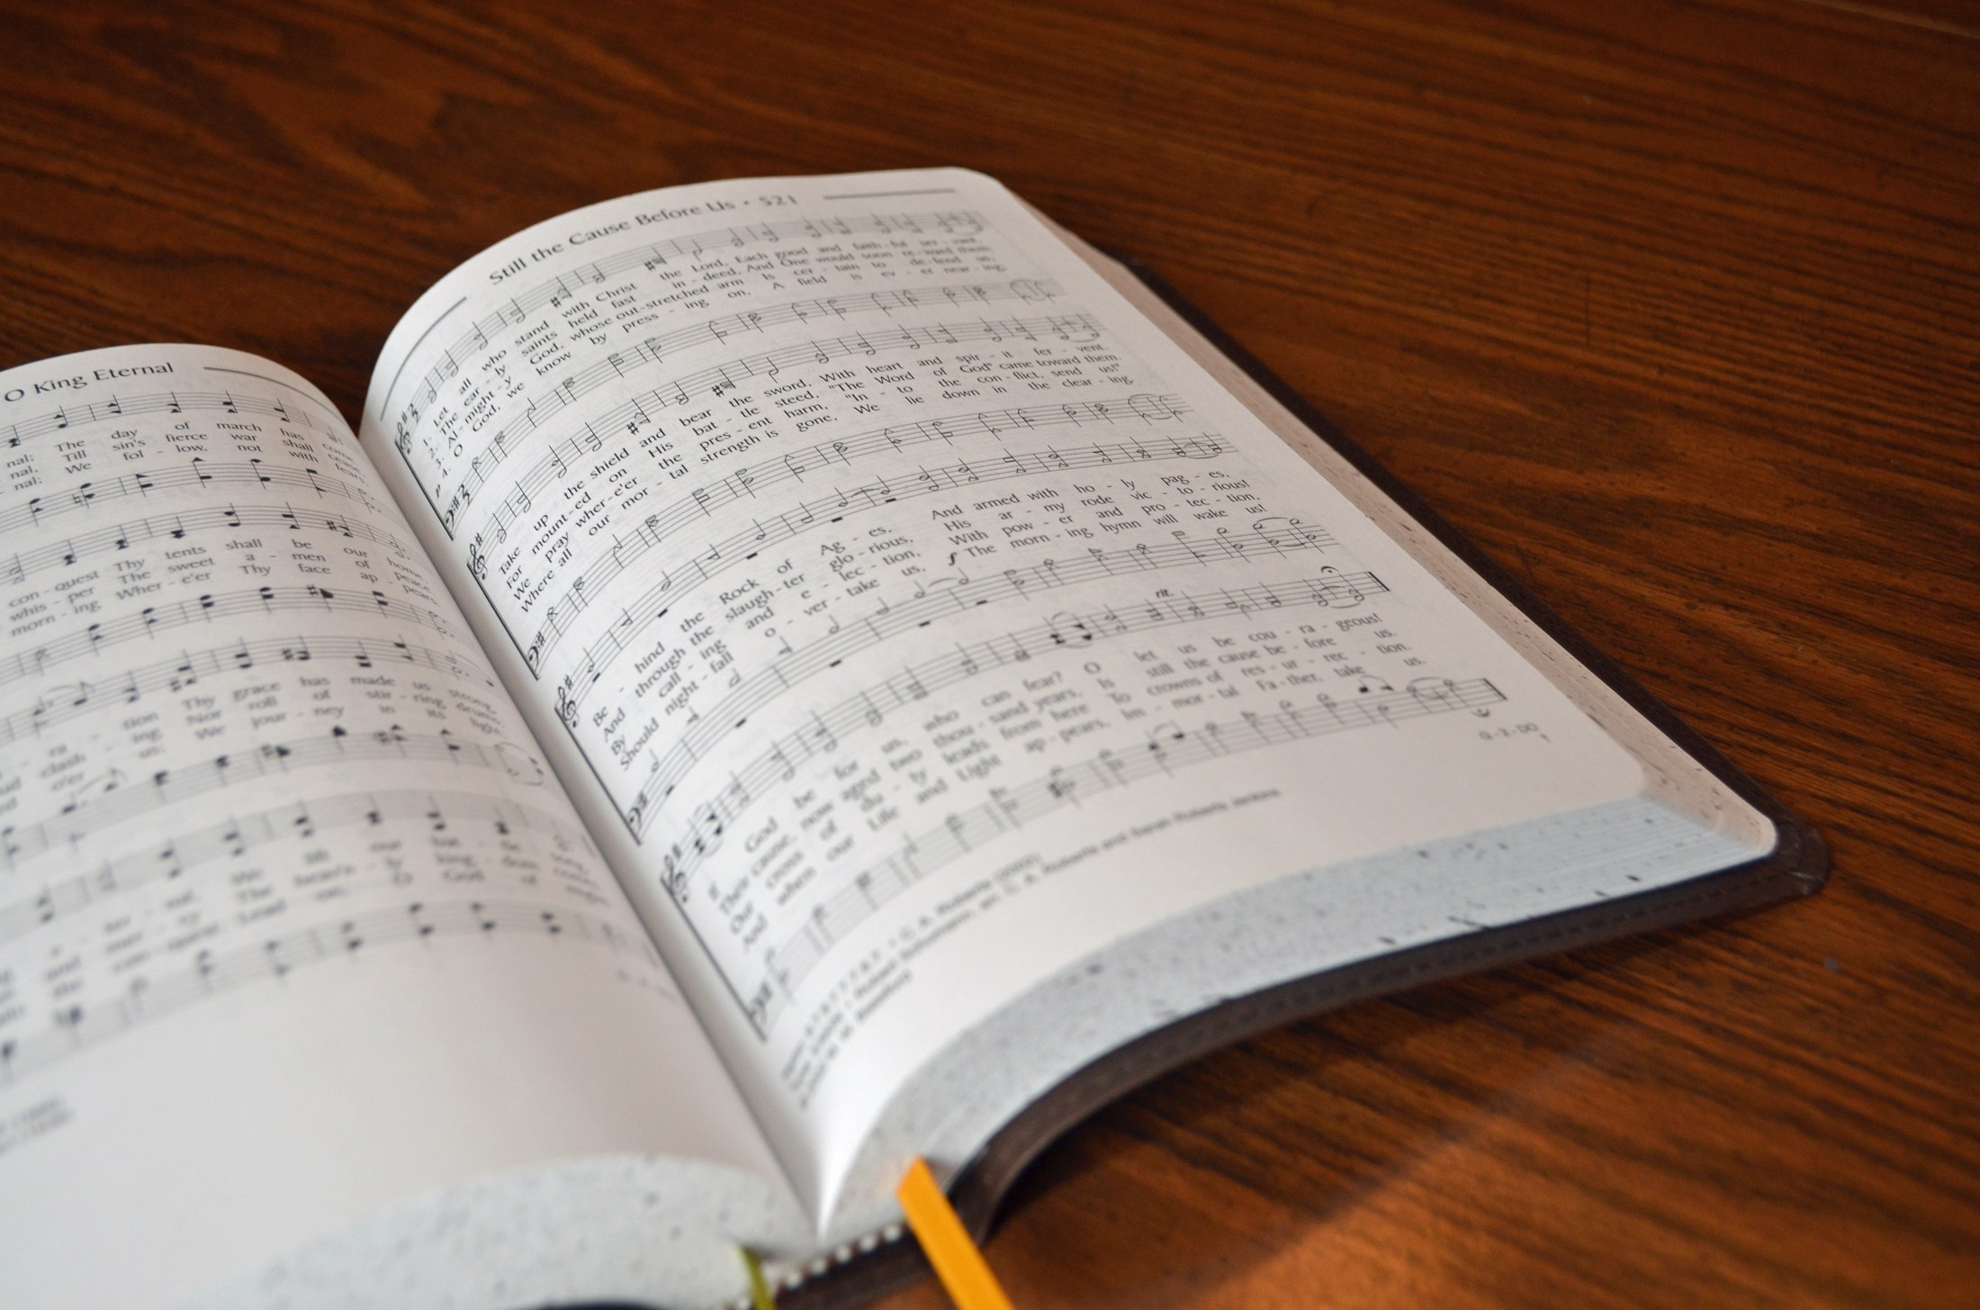
SONG LEADER
SANDER FLETCHER

Slide 22
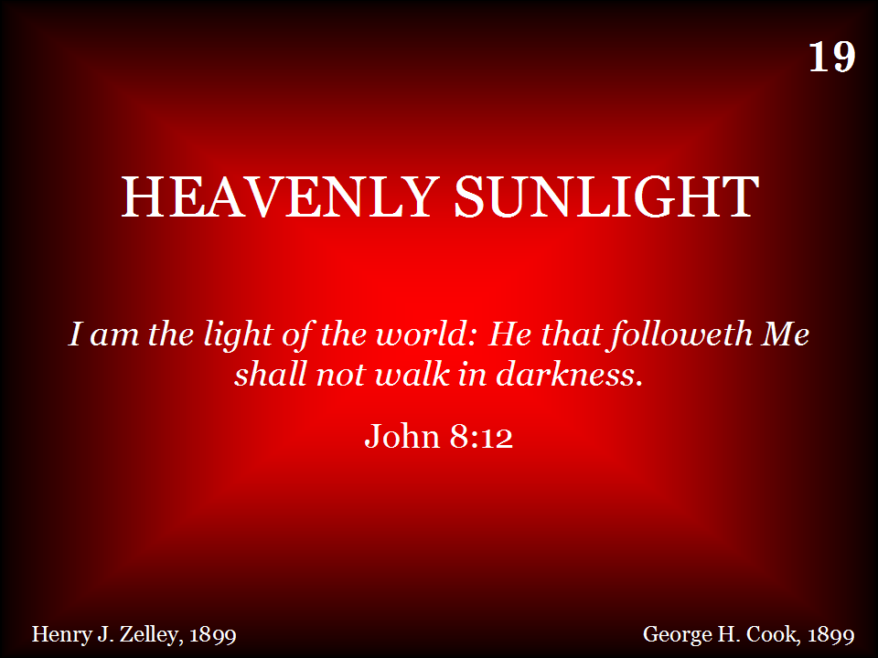
019 - Heavenly Sunlight - Title

Slide 23
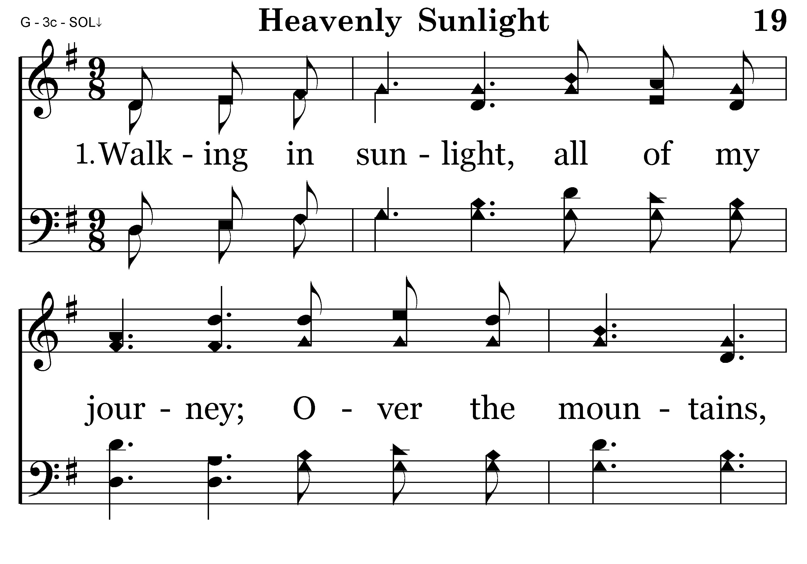
019 - Heavenly Sunlight - 1.1

Slide 24
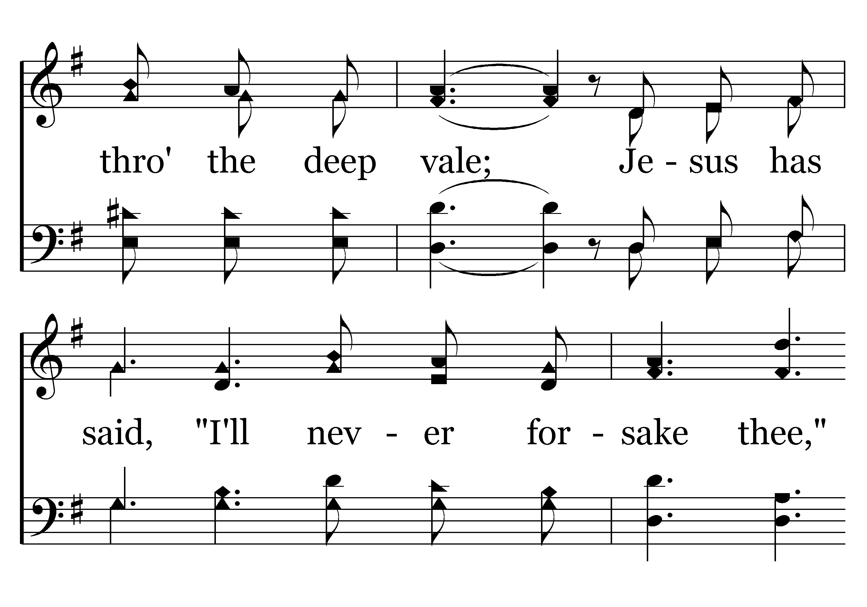
019 - Heavenly Sunlight - 1.2

Slide 25
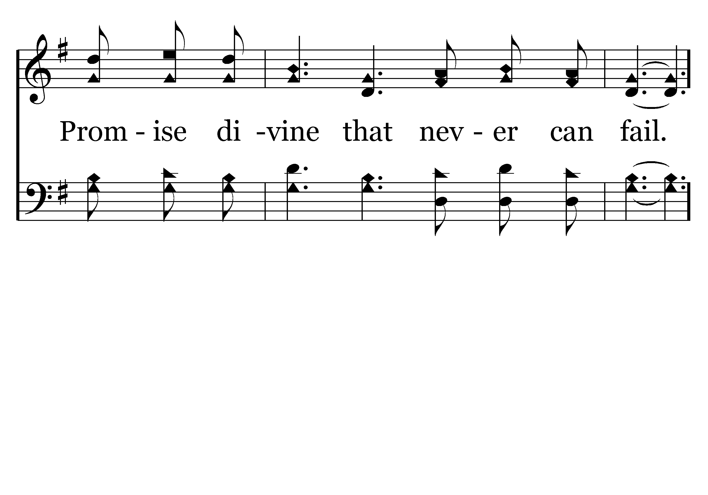
019 - Heavenly Sunlight - 1.3

Slide 26
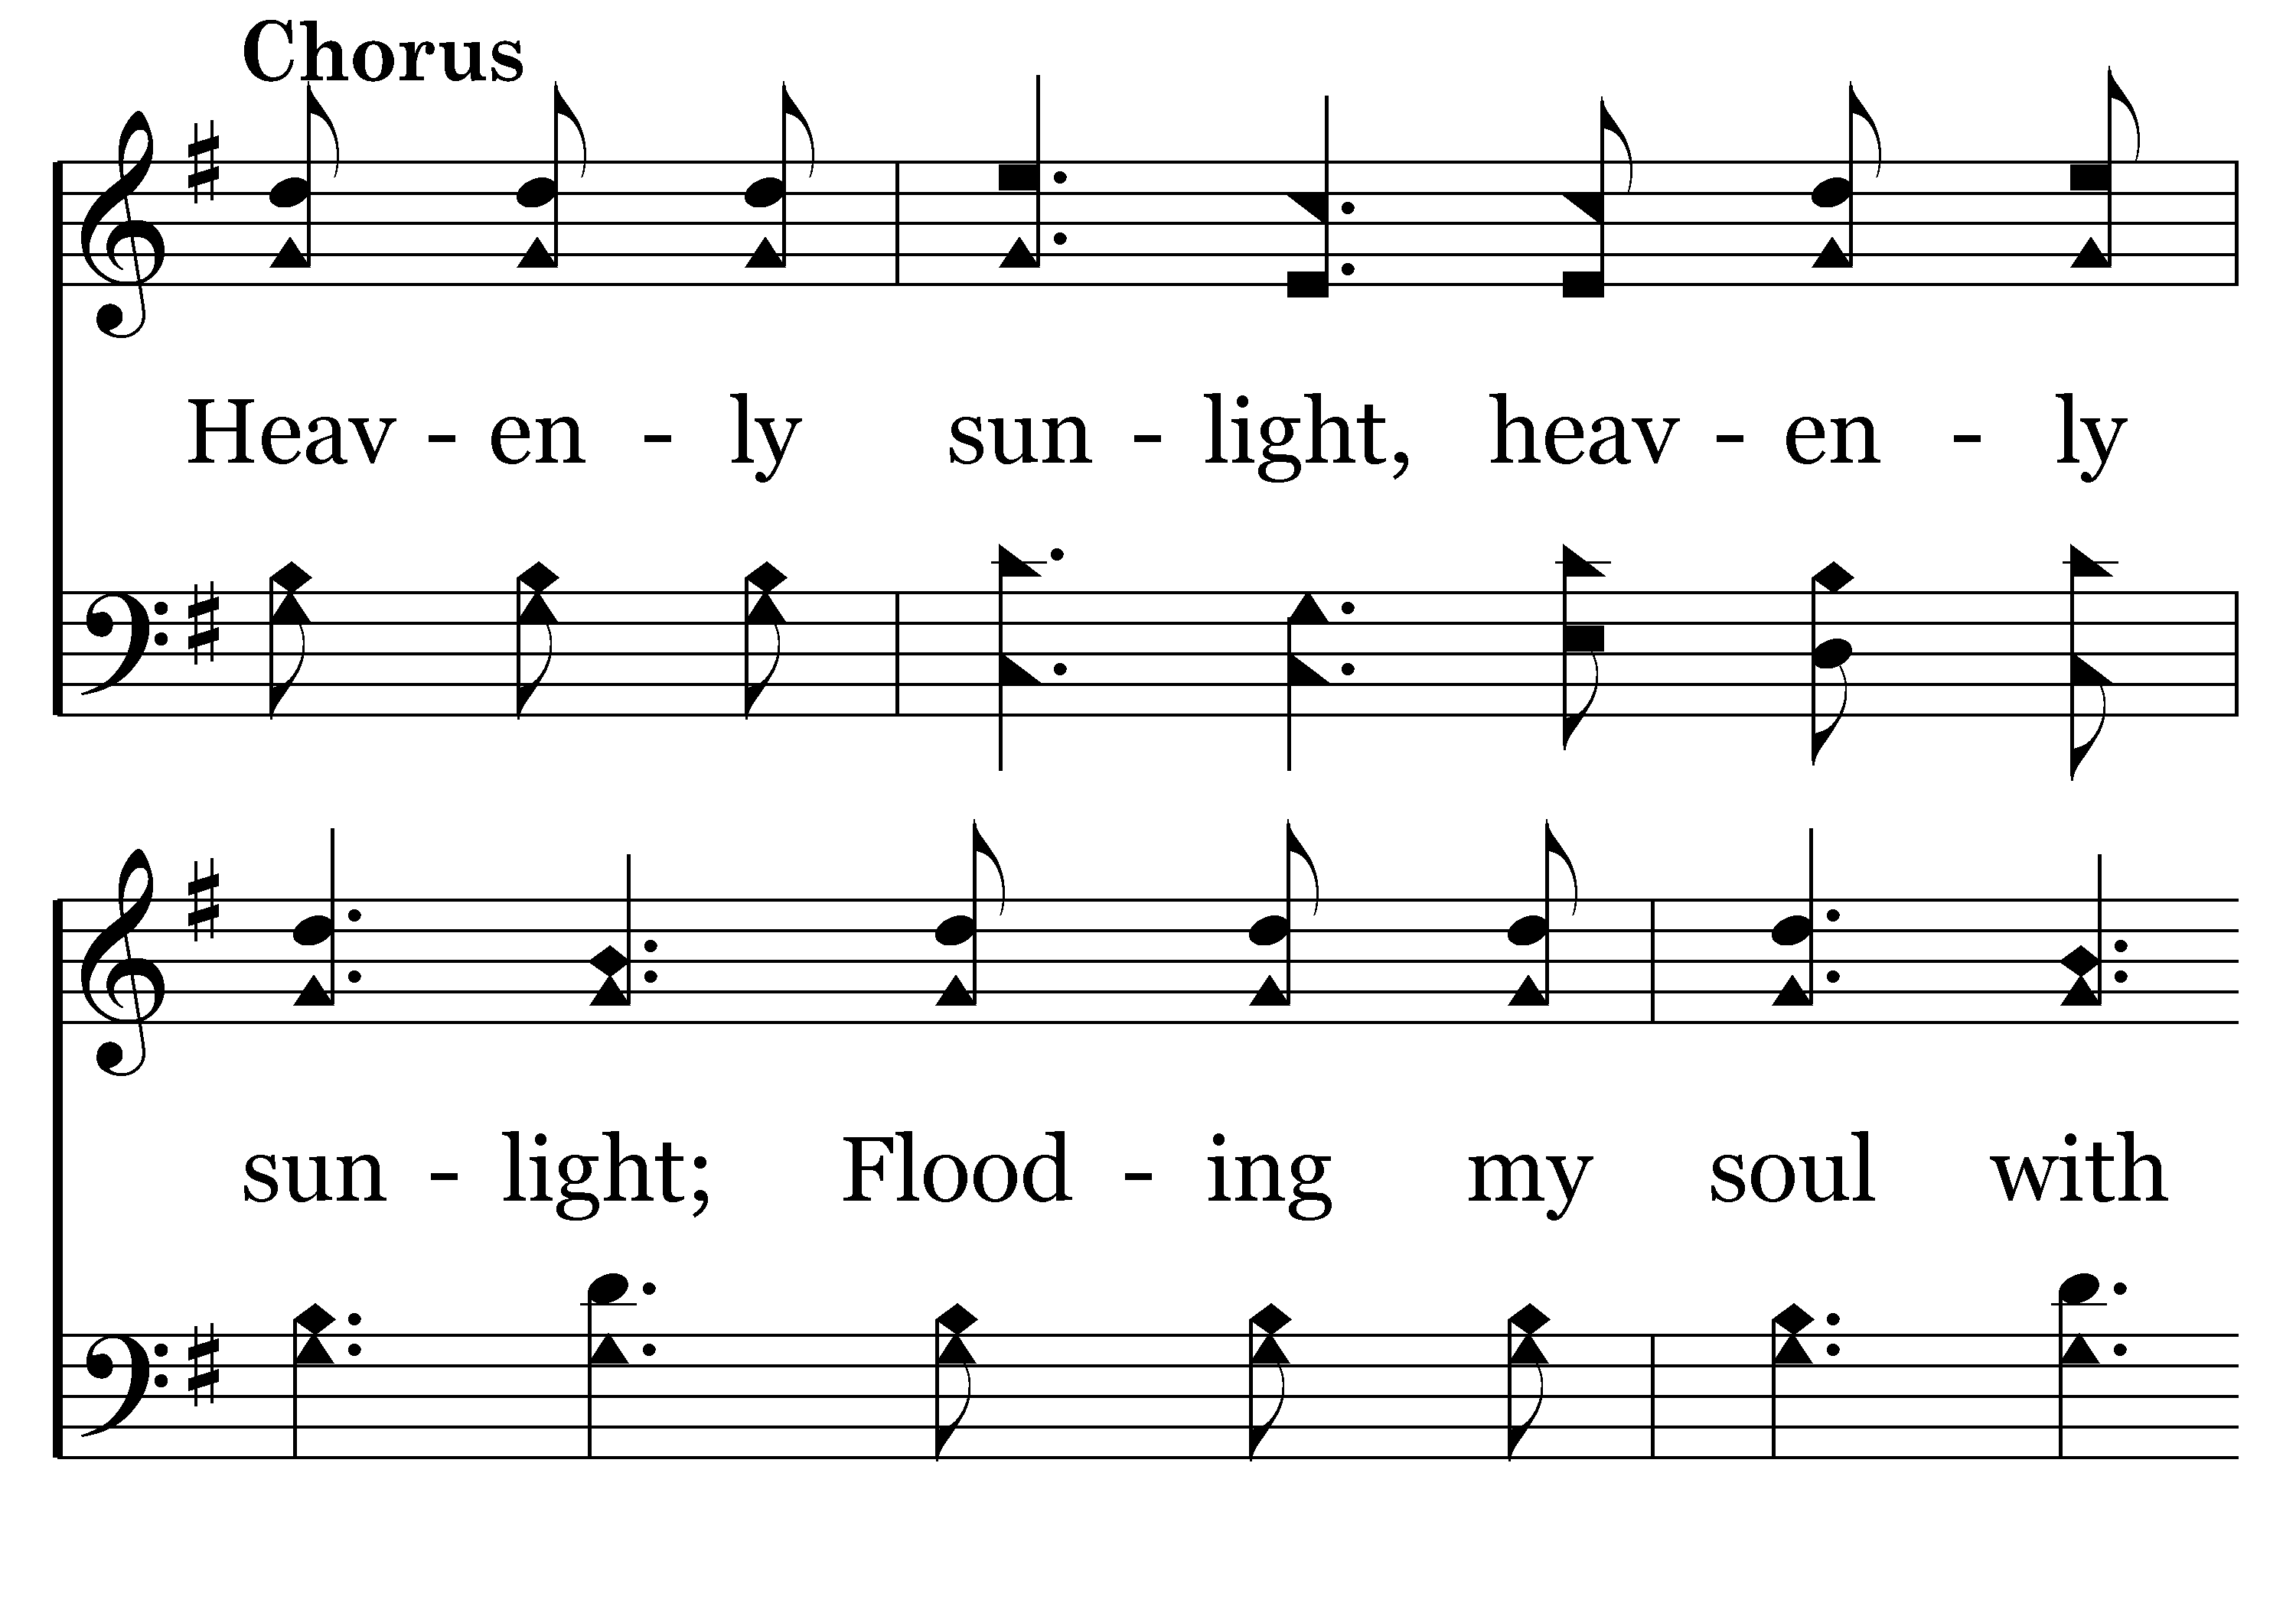
019 - Heavenly Sunlight - C.1

Slide 27
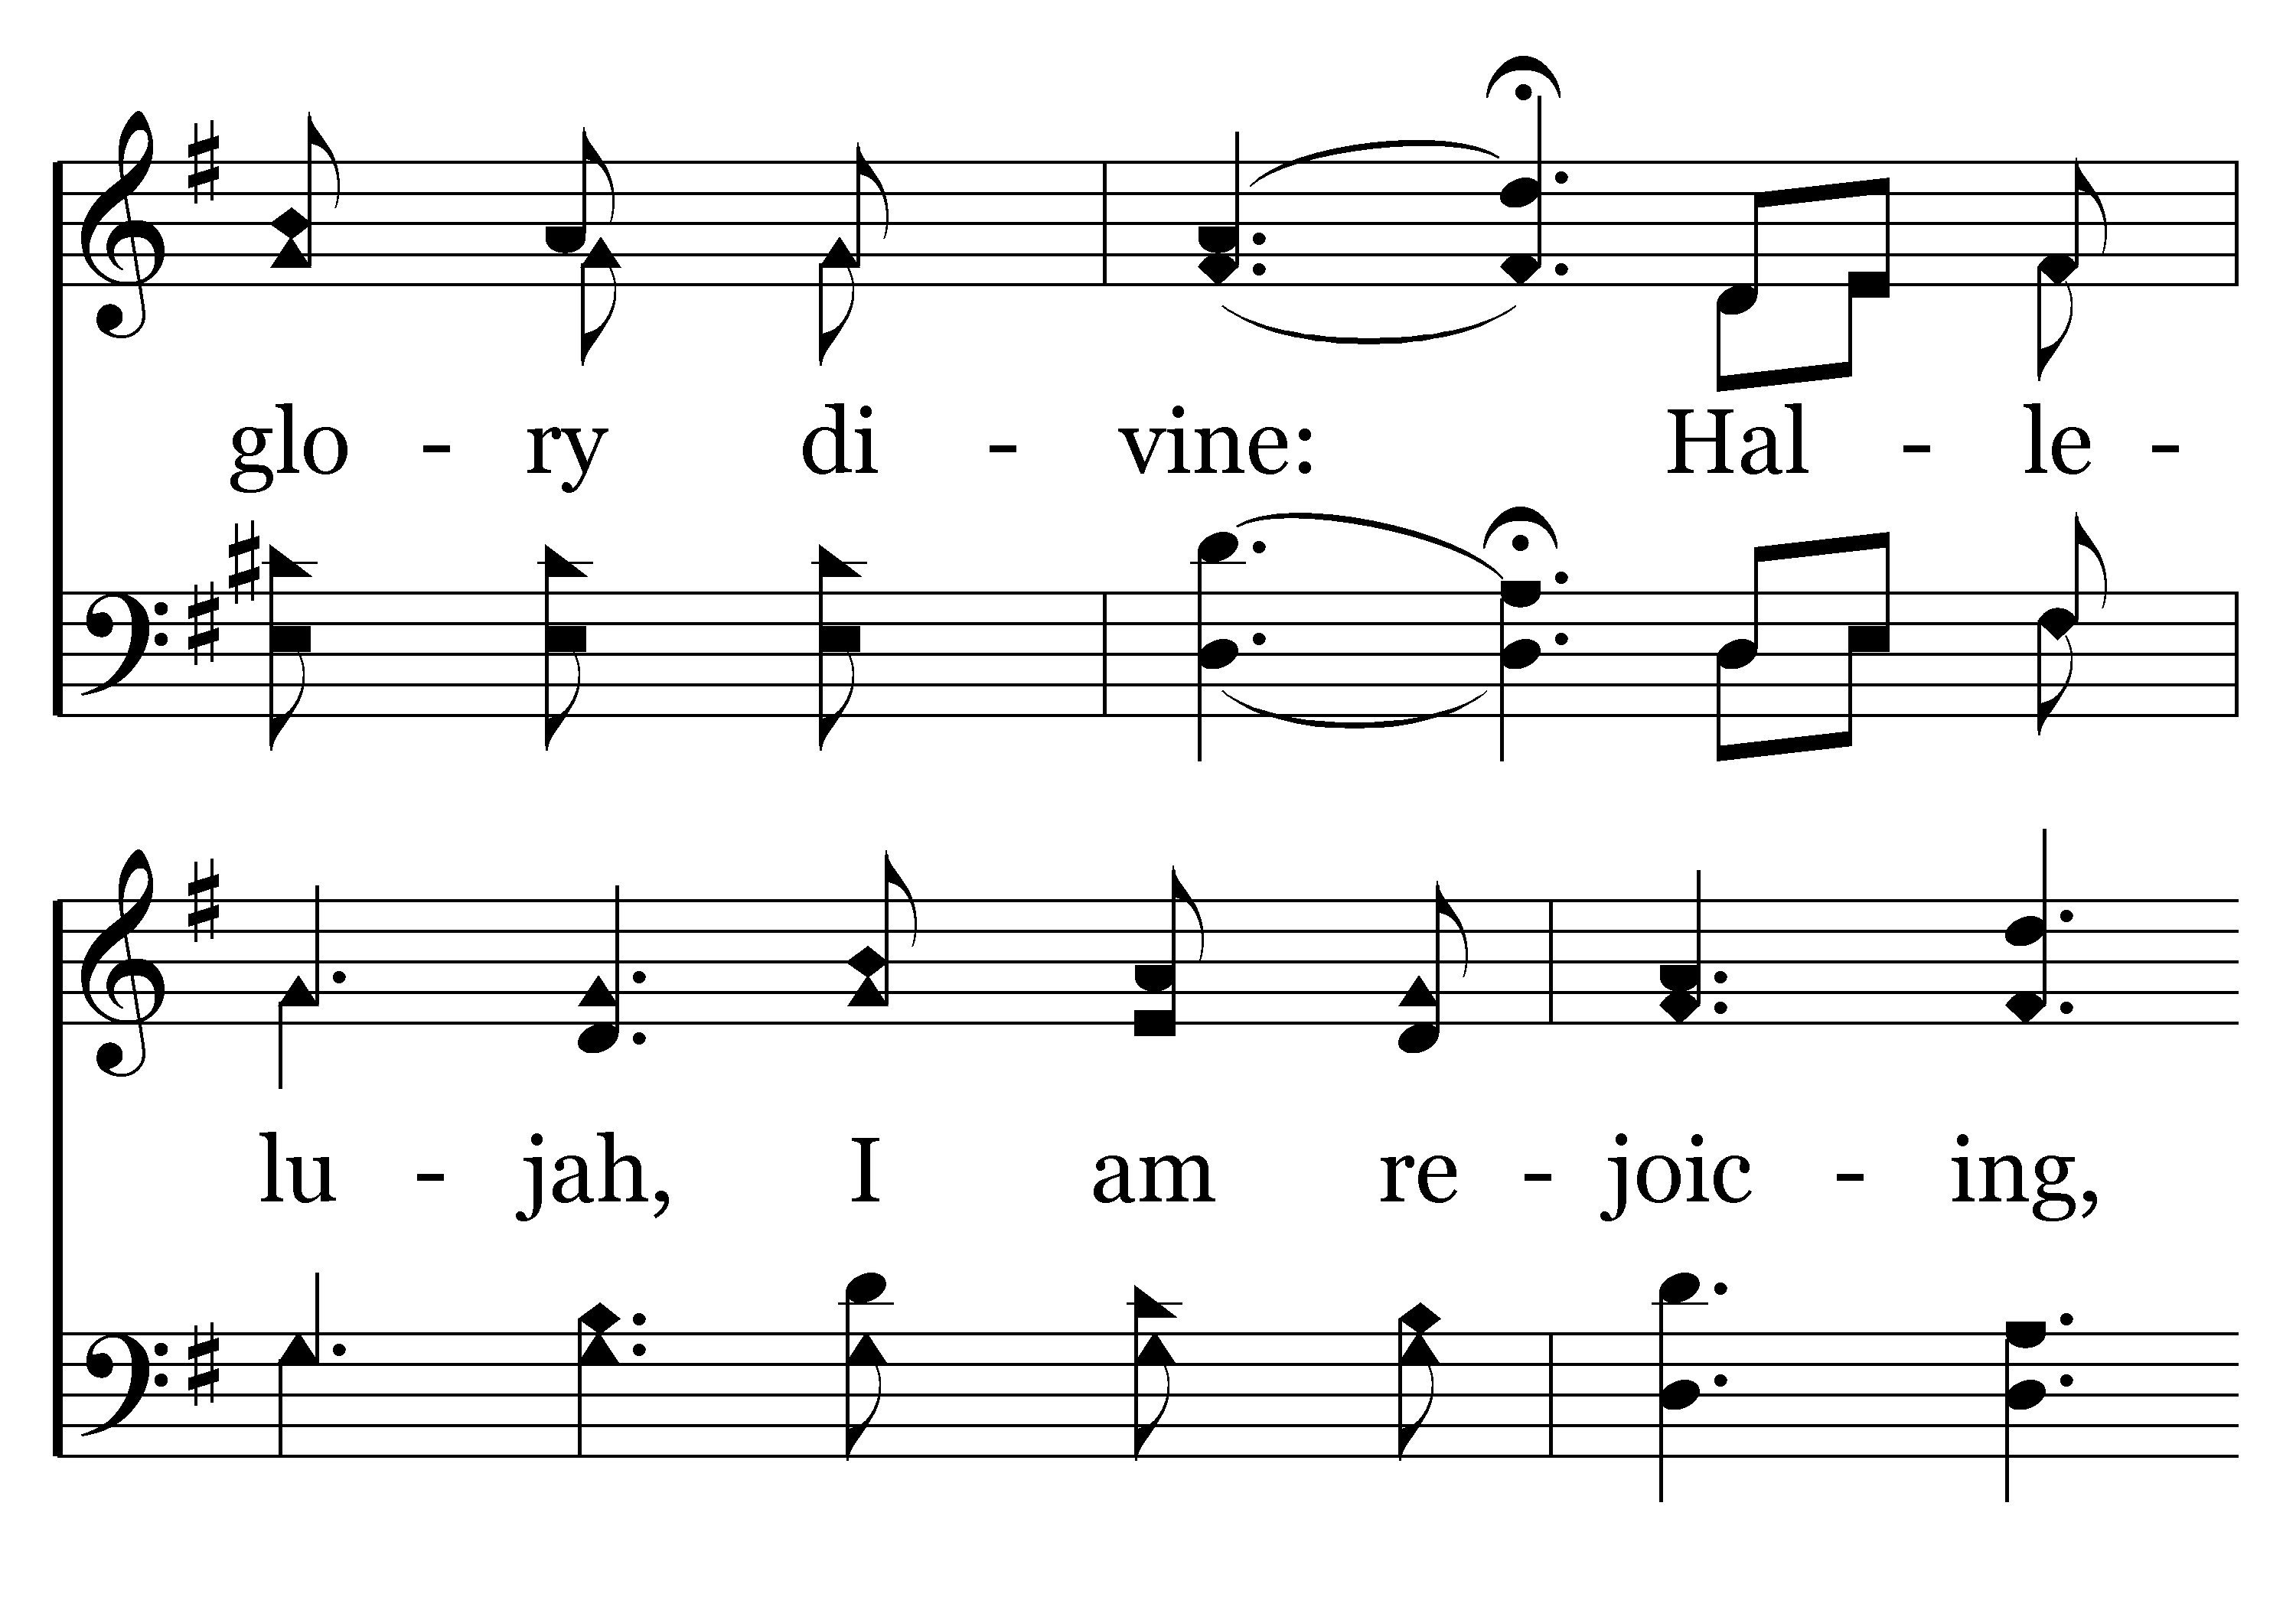
019 - Heavenly Sunlight - C.2

Slide 28
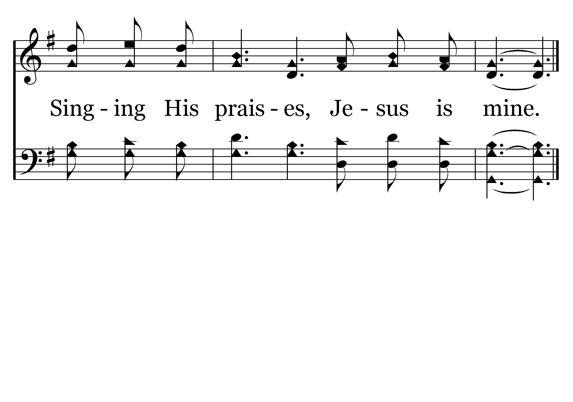
019 - Heavenly Sunlight - C.3
End of Verse 1

Slide 29
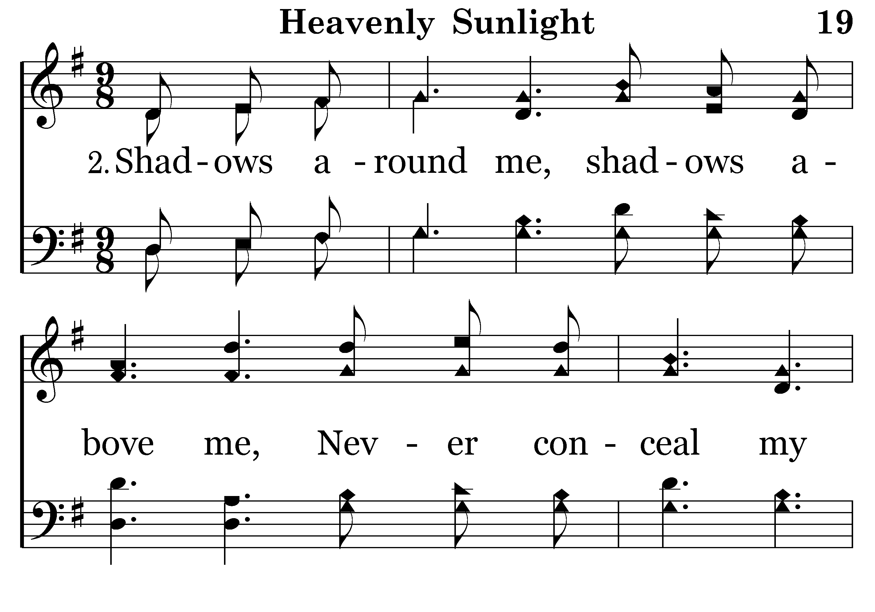
019 - Heavenly Sunlight - 2.1

Slide 30
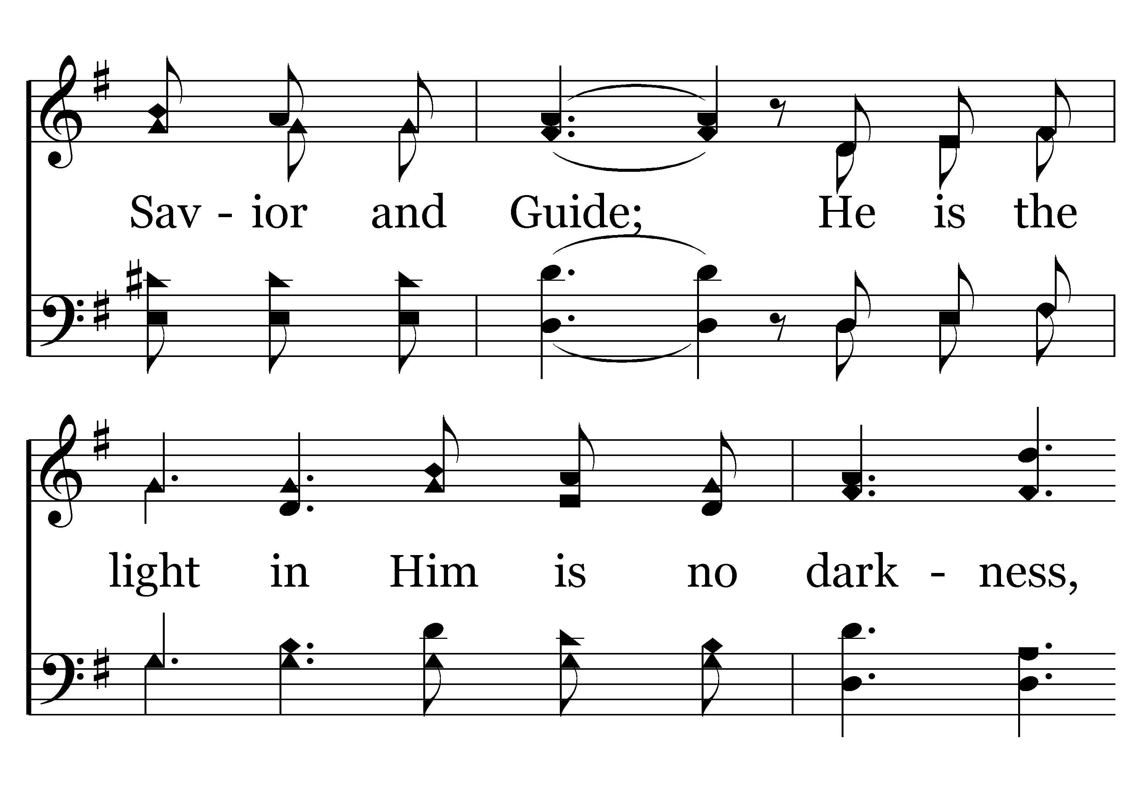
019 - Heavenly Sunlight - 2.2

Slide 31
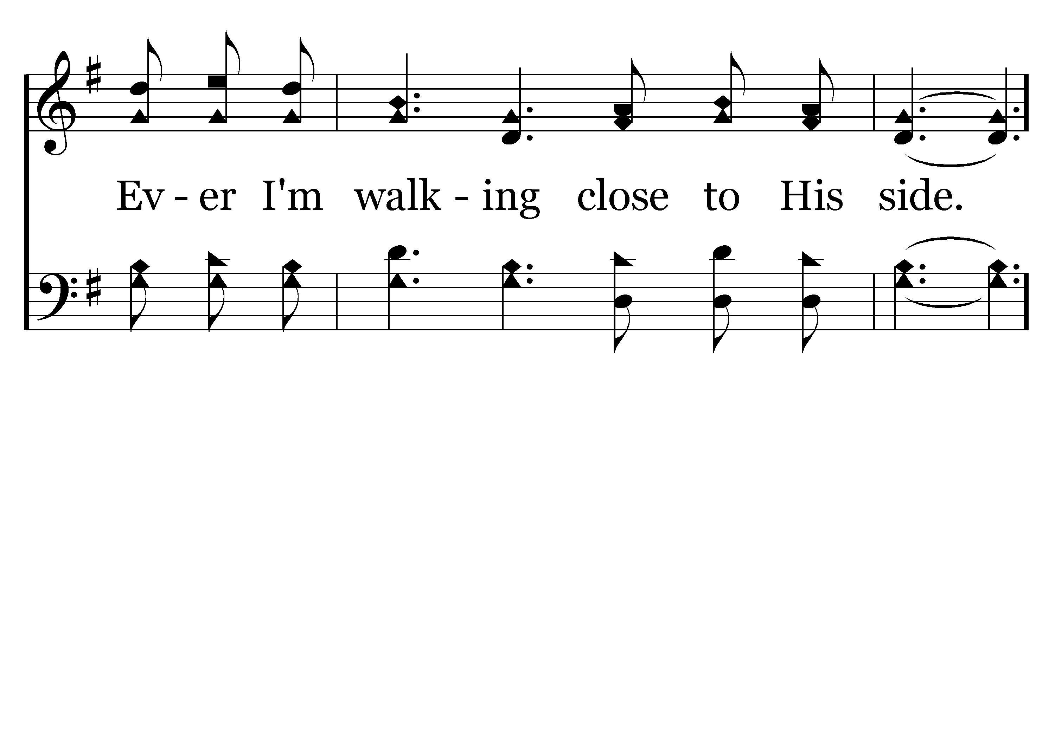
019 - Heavenly Sunlight - 2.3

Slide 32
019 - Heavenly Sunlight - C.1

Slide 33
019 - Heavenly Sunlight - C.2

Slide 34
019 - Heavenly Sunlight - C.3
End of Verse 2

Slide 35
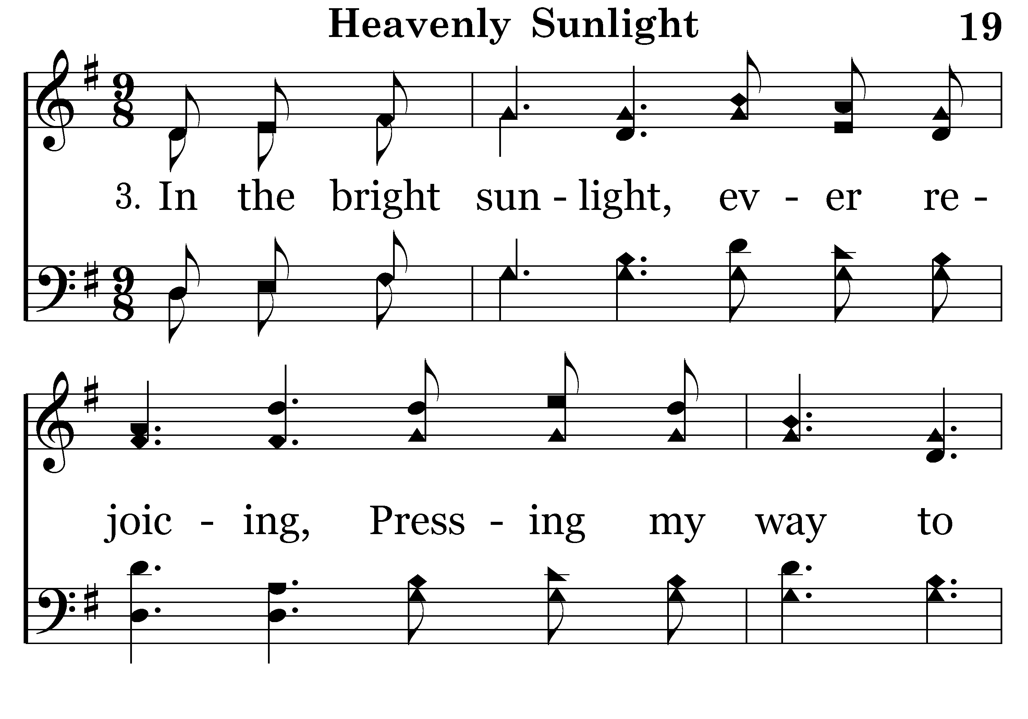
019 - Heavenly Sunlight - 3.1

Slide 36
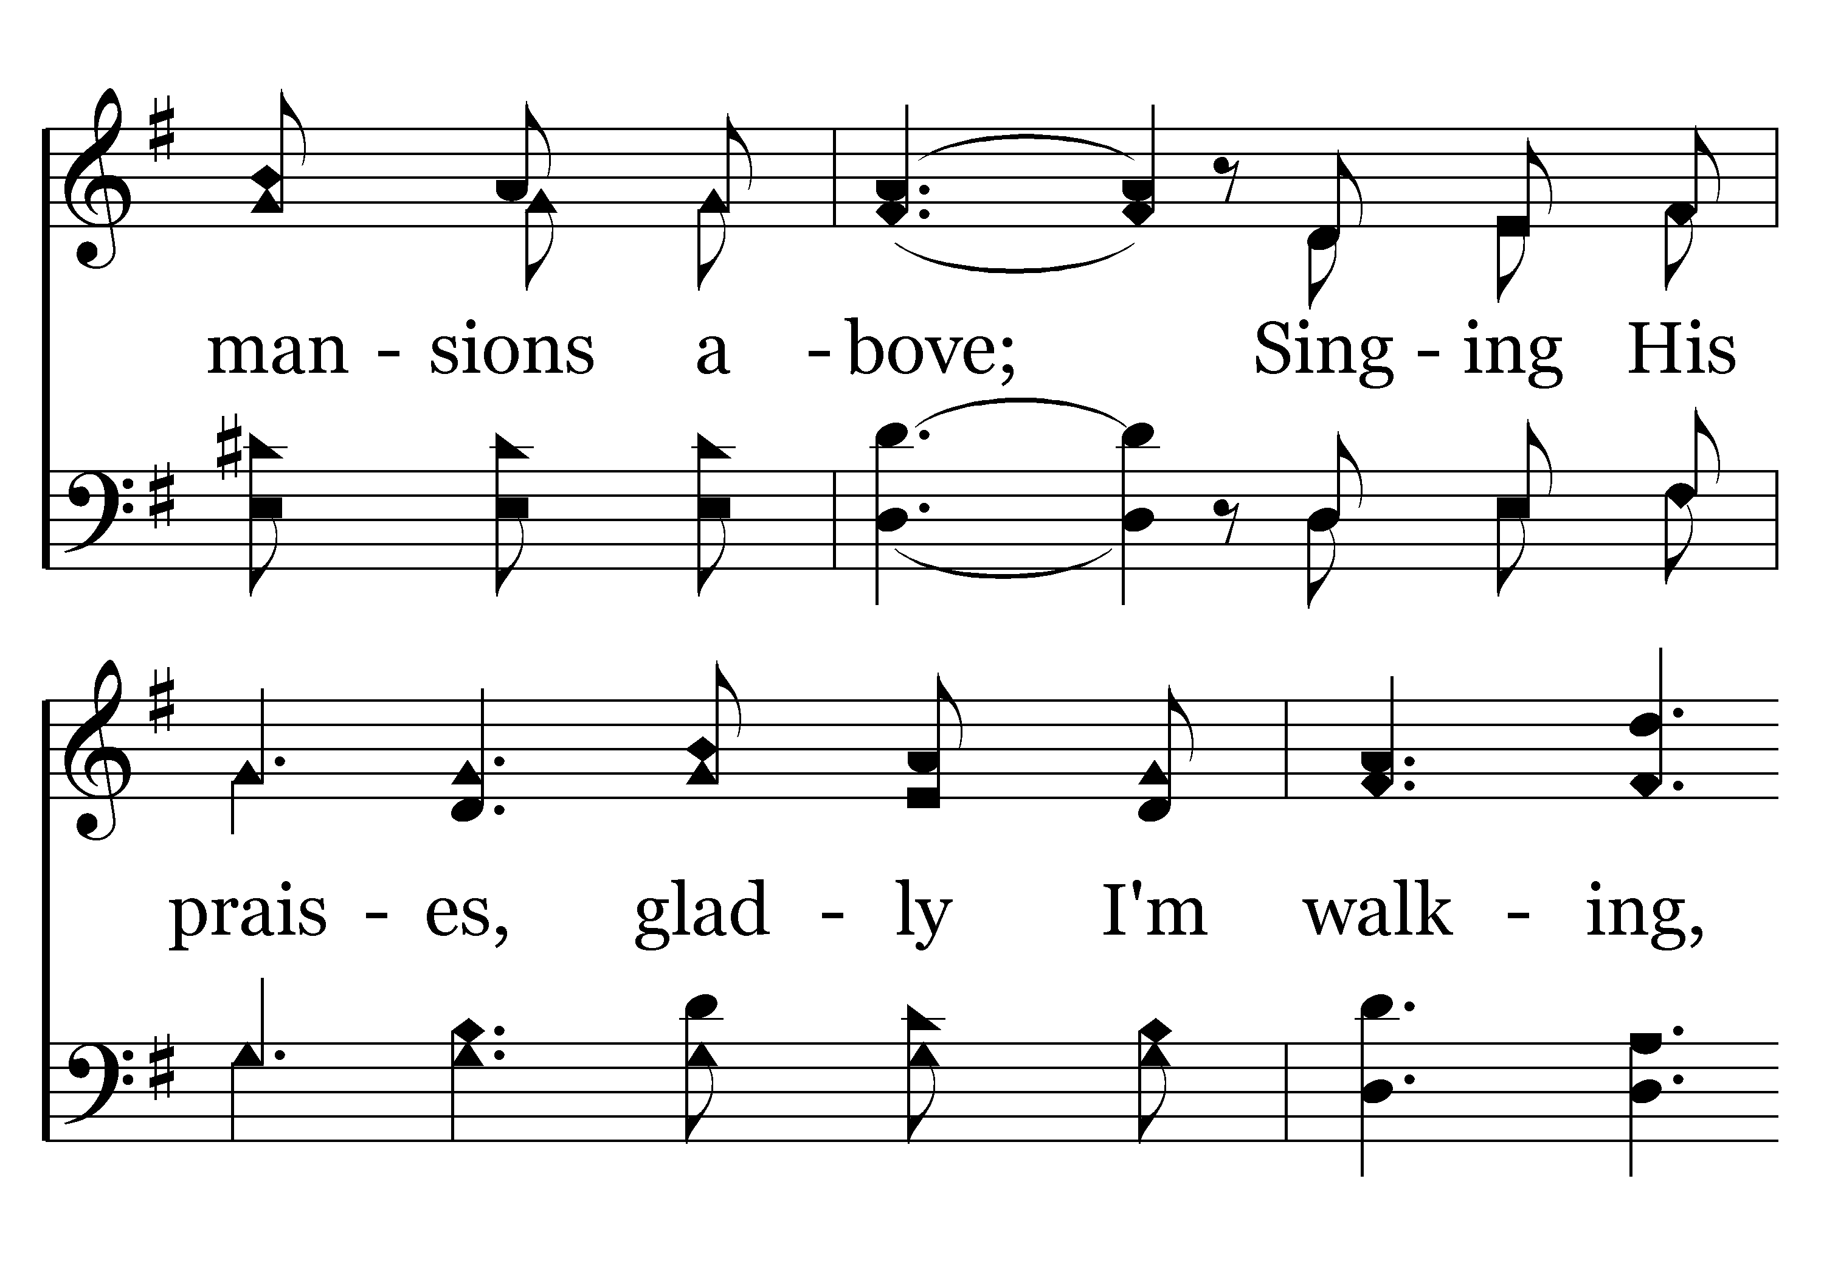
019 - Heavenly Sunlight - 3.2

Slide 37
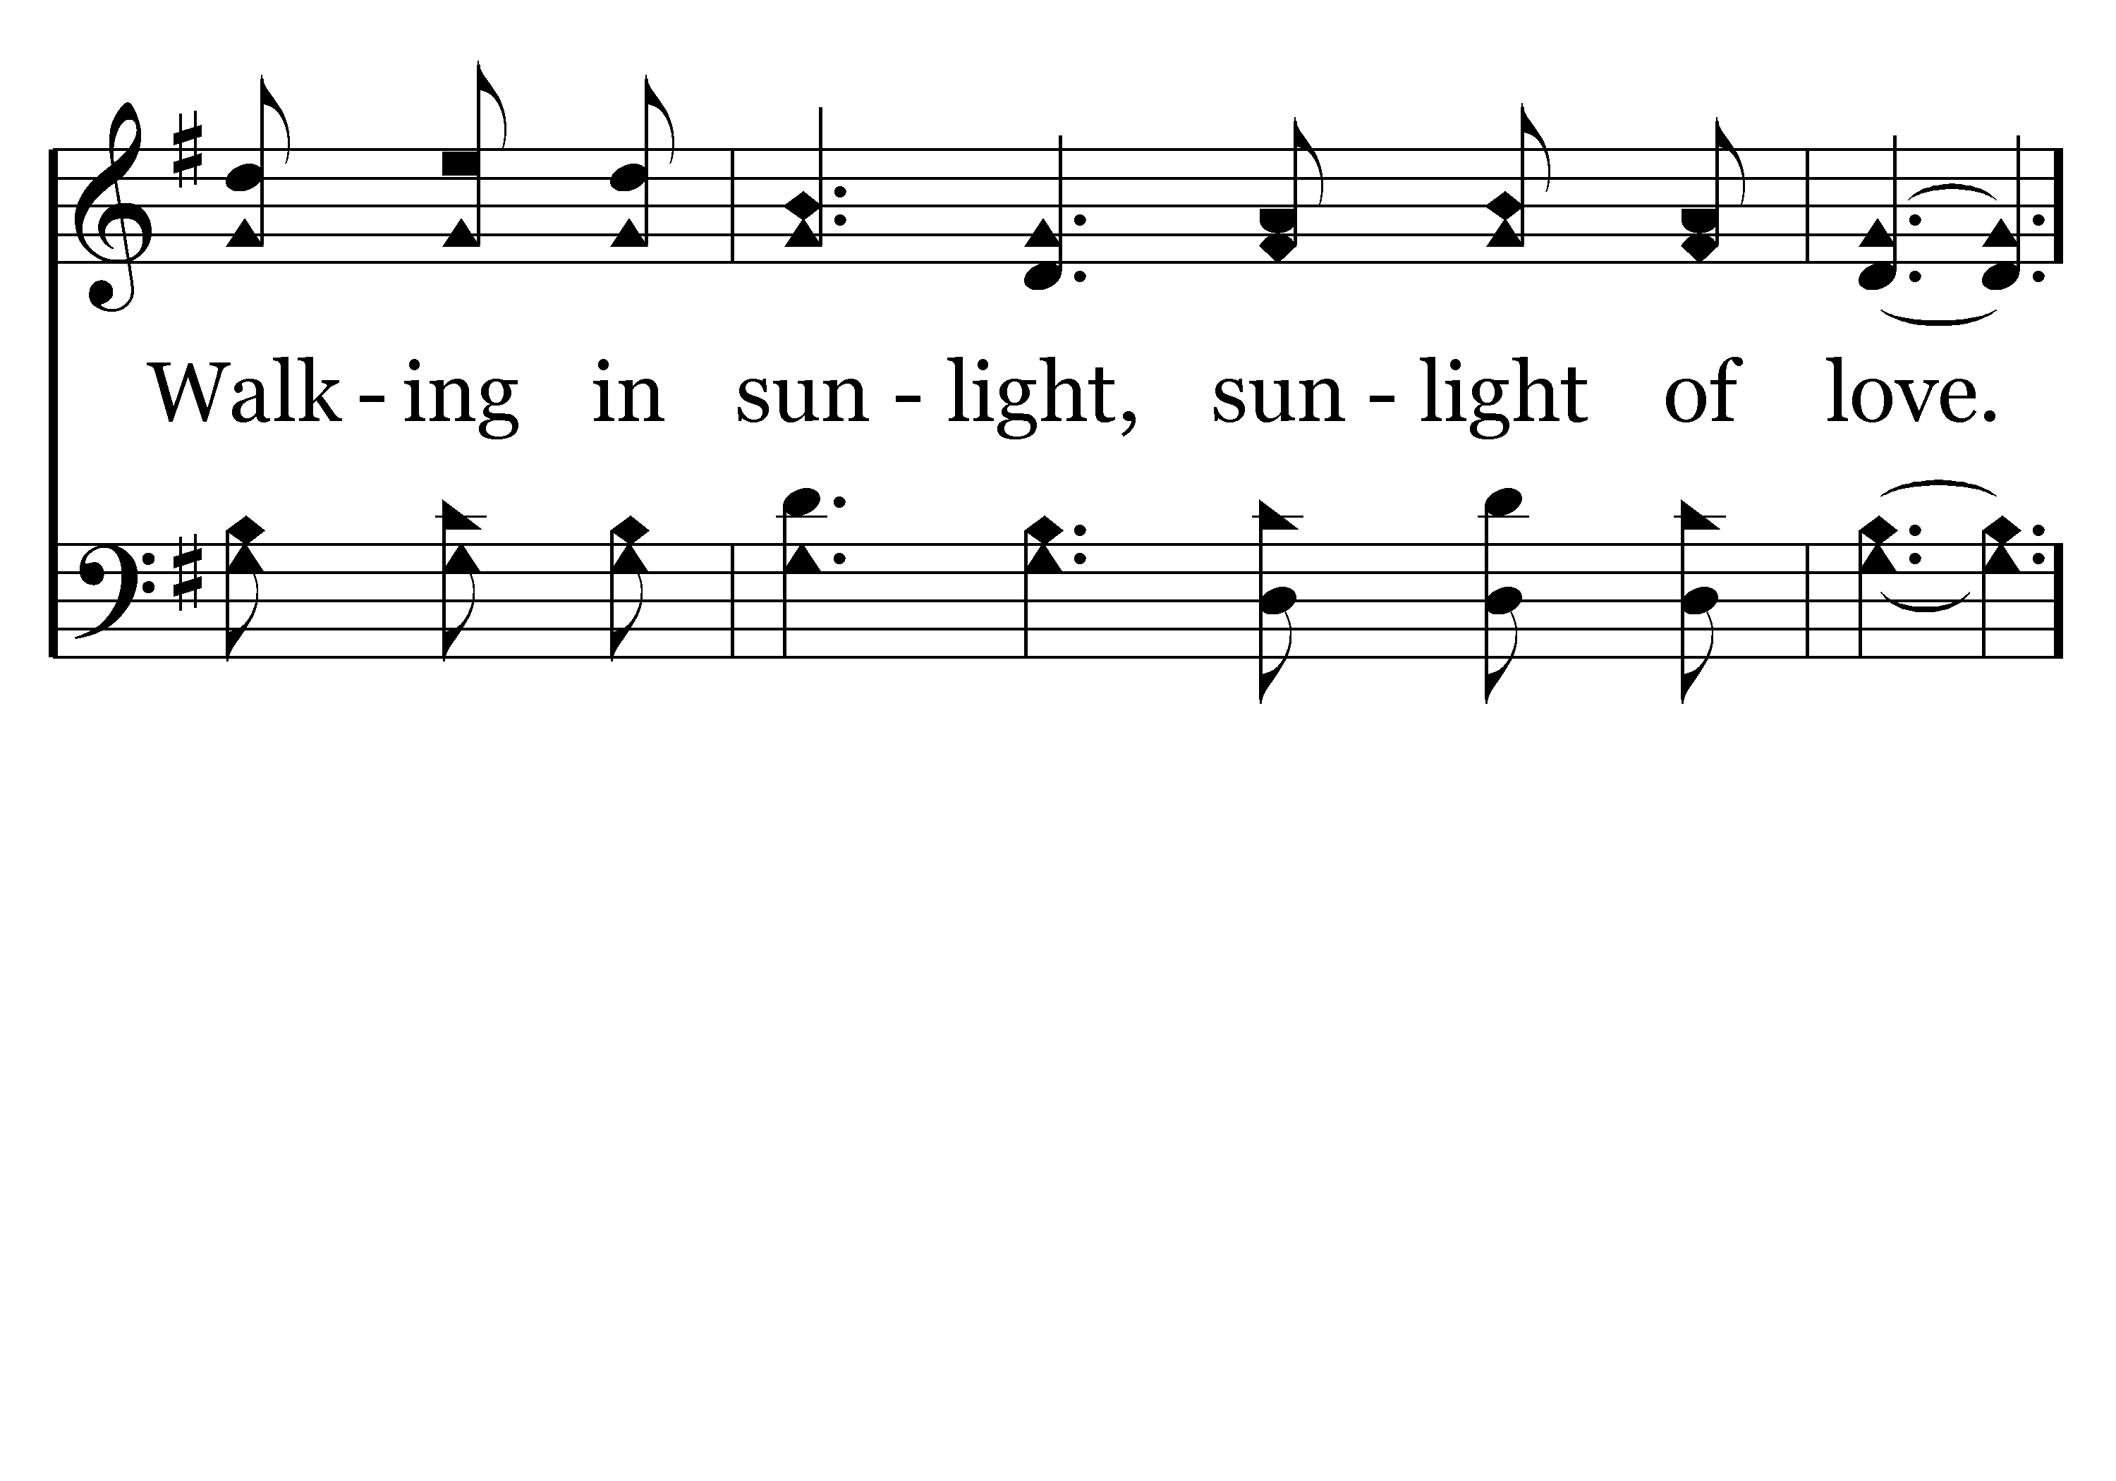
019 - Heavenly Sunlight - 3.3

Slide 38
019 - Heavenly Sunlight - C.1

Slide 39
019 - Heavenly Sunlight - C.2

Slide 40
019 - Heavenly Sunlight - C.3
End of Song

Slide 42
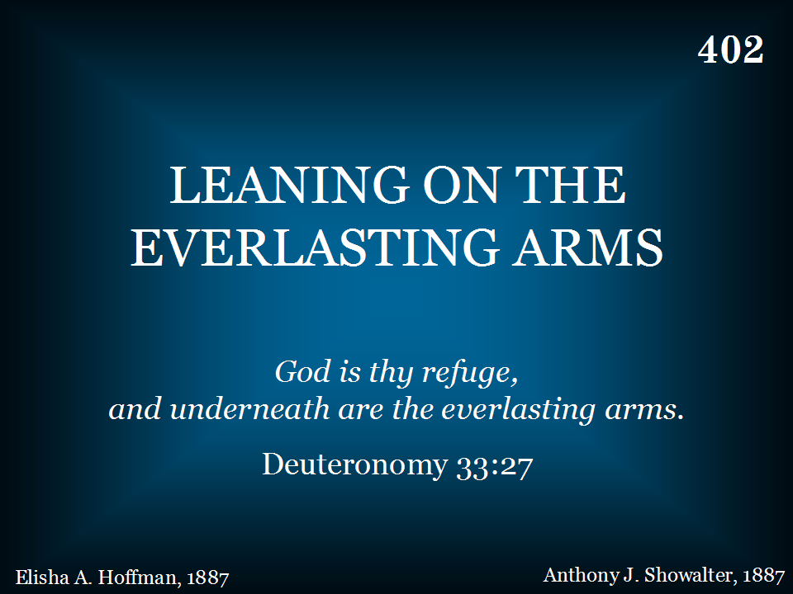
402 - Leaning On The Everlasting Arms - Title

Slide 43
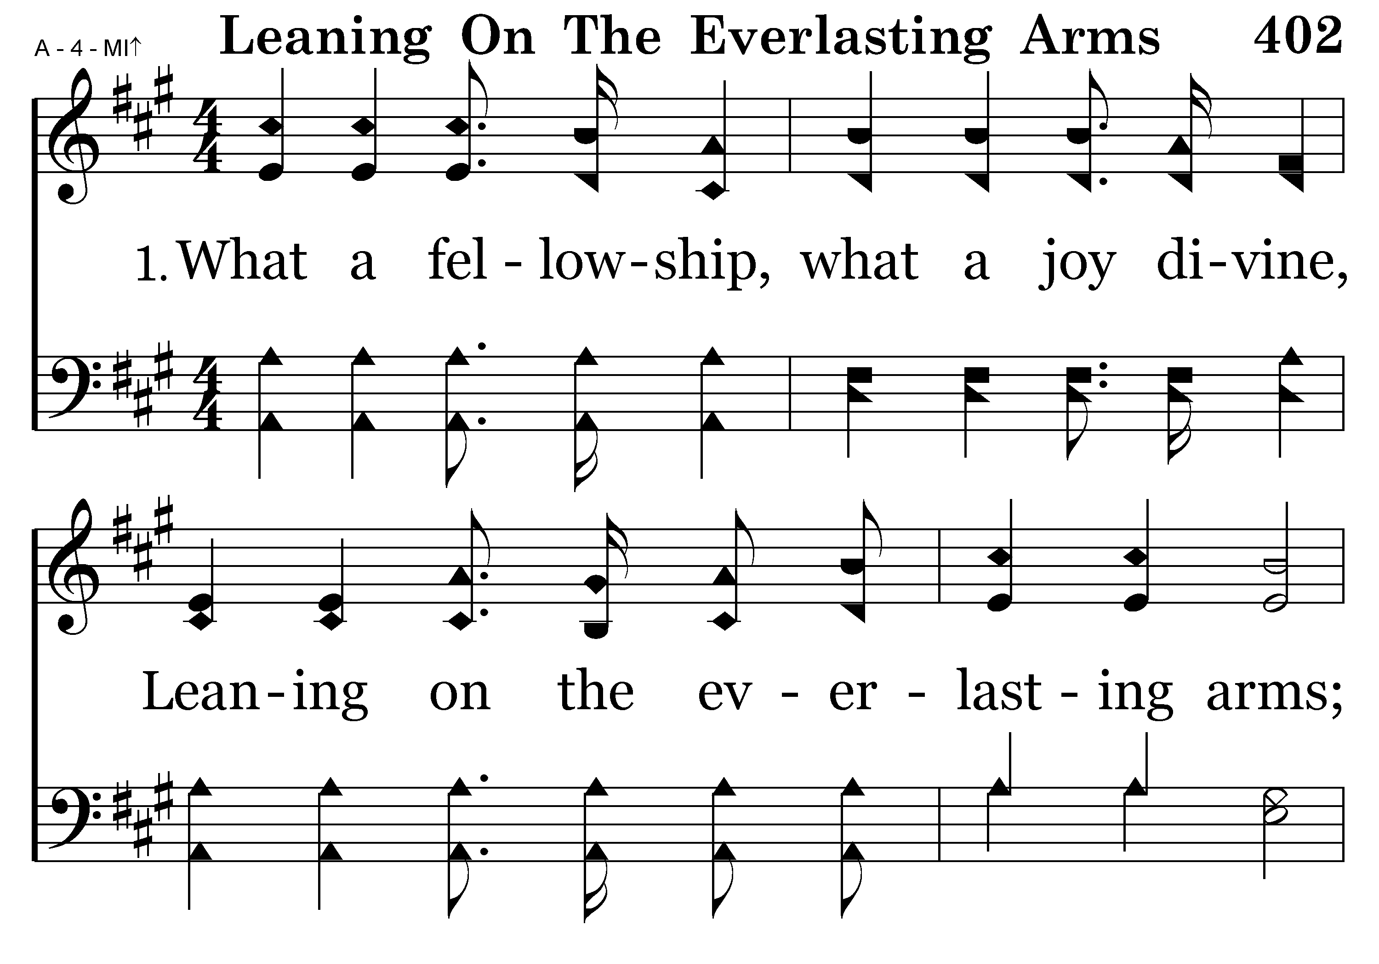
402 - Leaning On The Everlasting Arms - 1.1

Slide 44
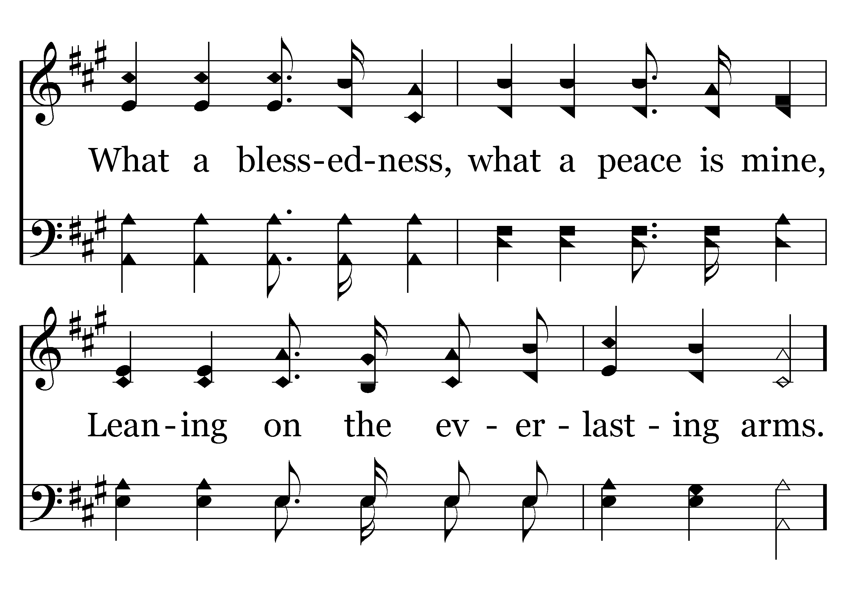
402 - Leaning On The Everlasting Arms - 1.2

Slide 45
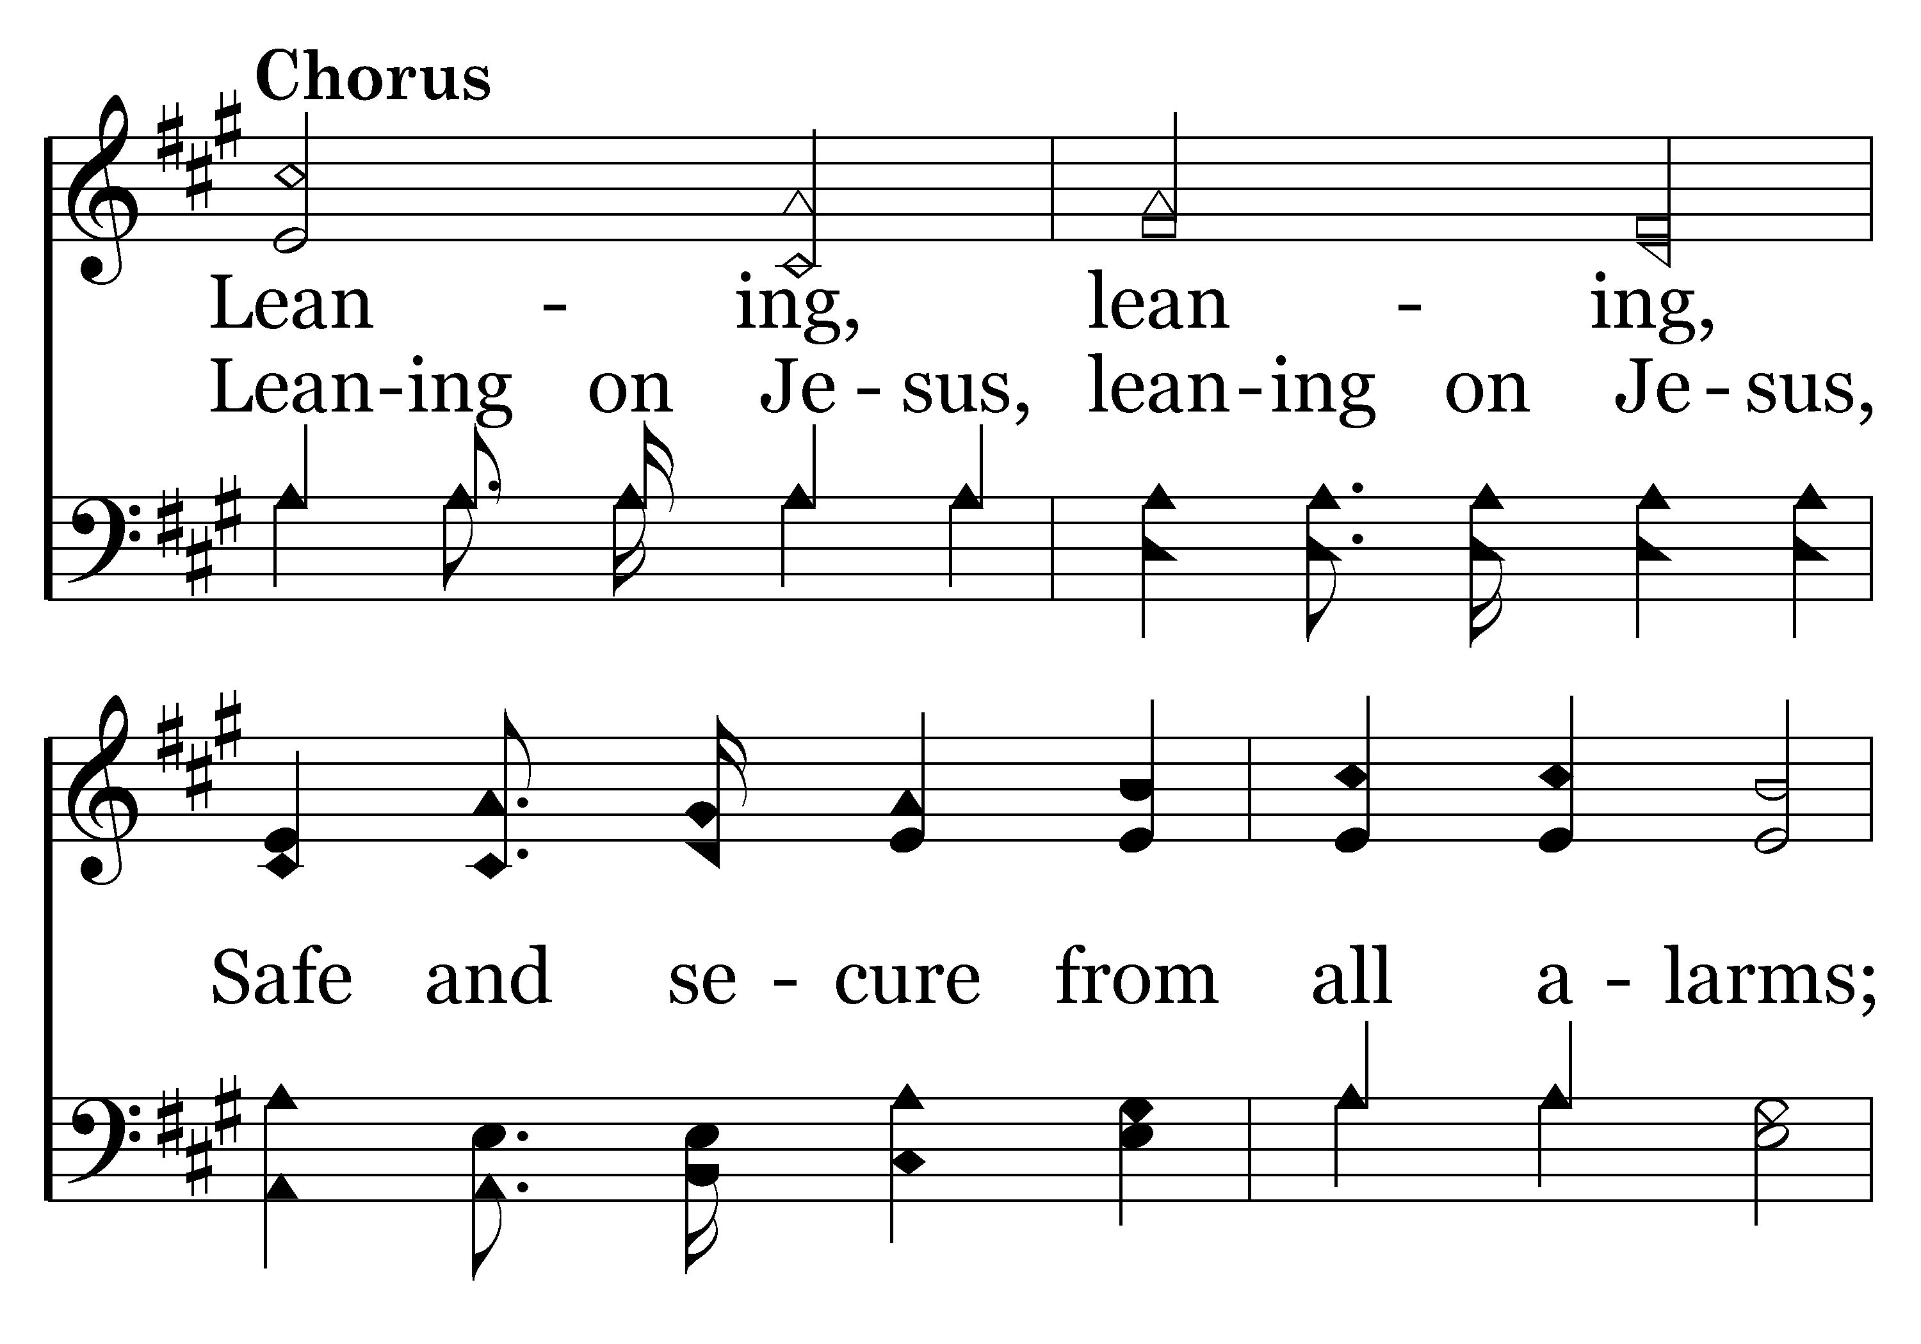
402 - Leaning On The Everlasting Arms - C.1

Slide 46
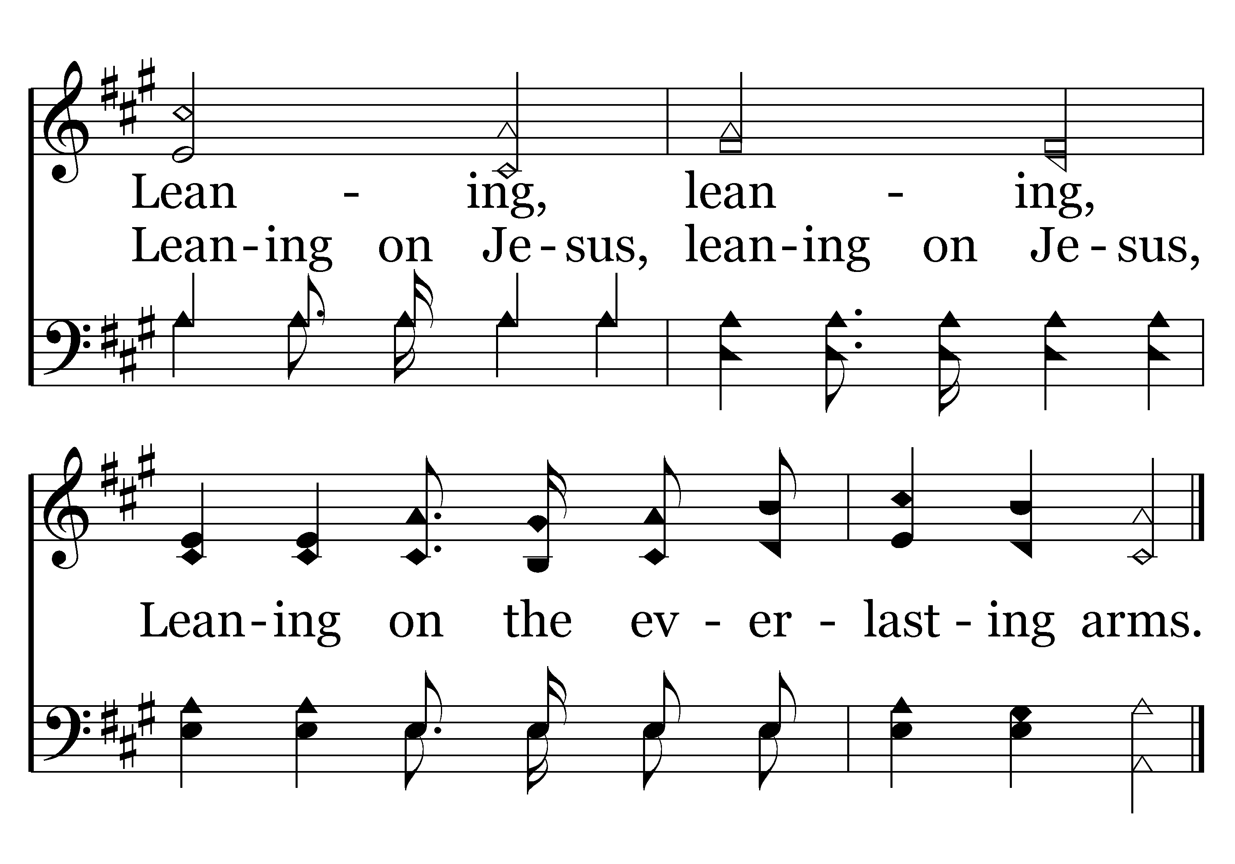
402 - Leaning On The Everlasting Arms - C.2
End of Verse 1

Slide 47
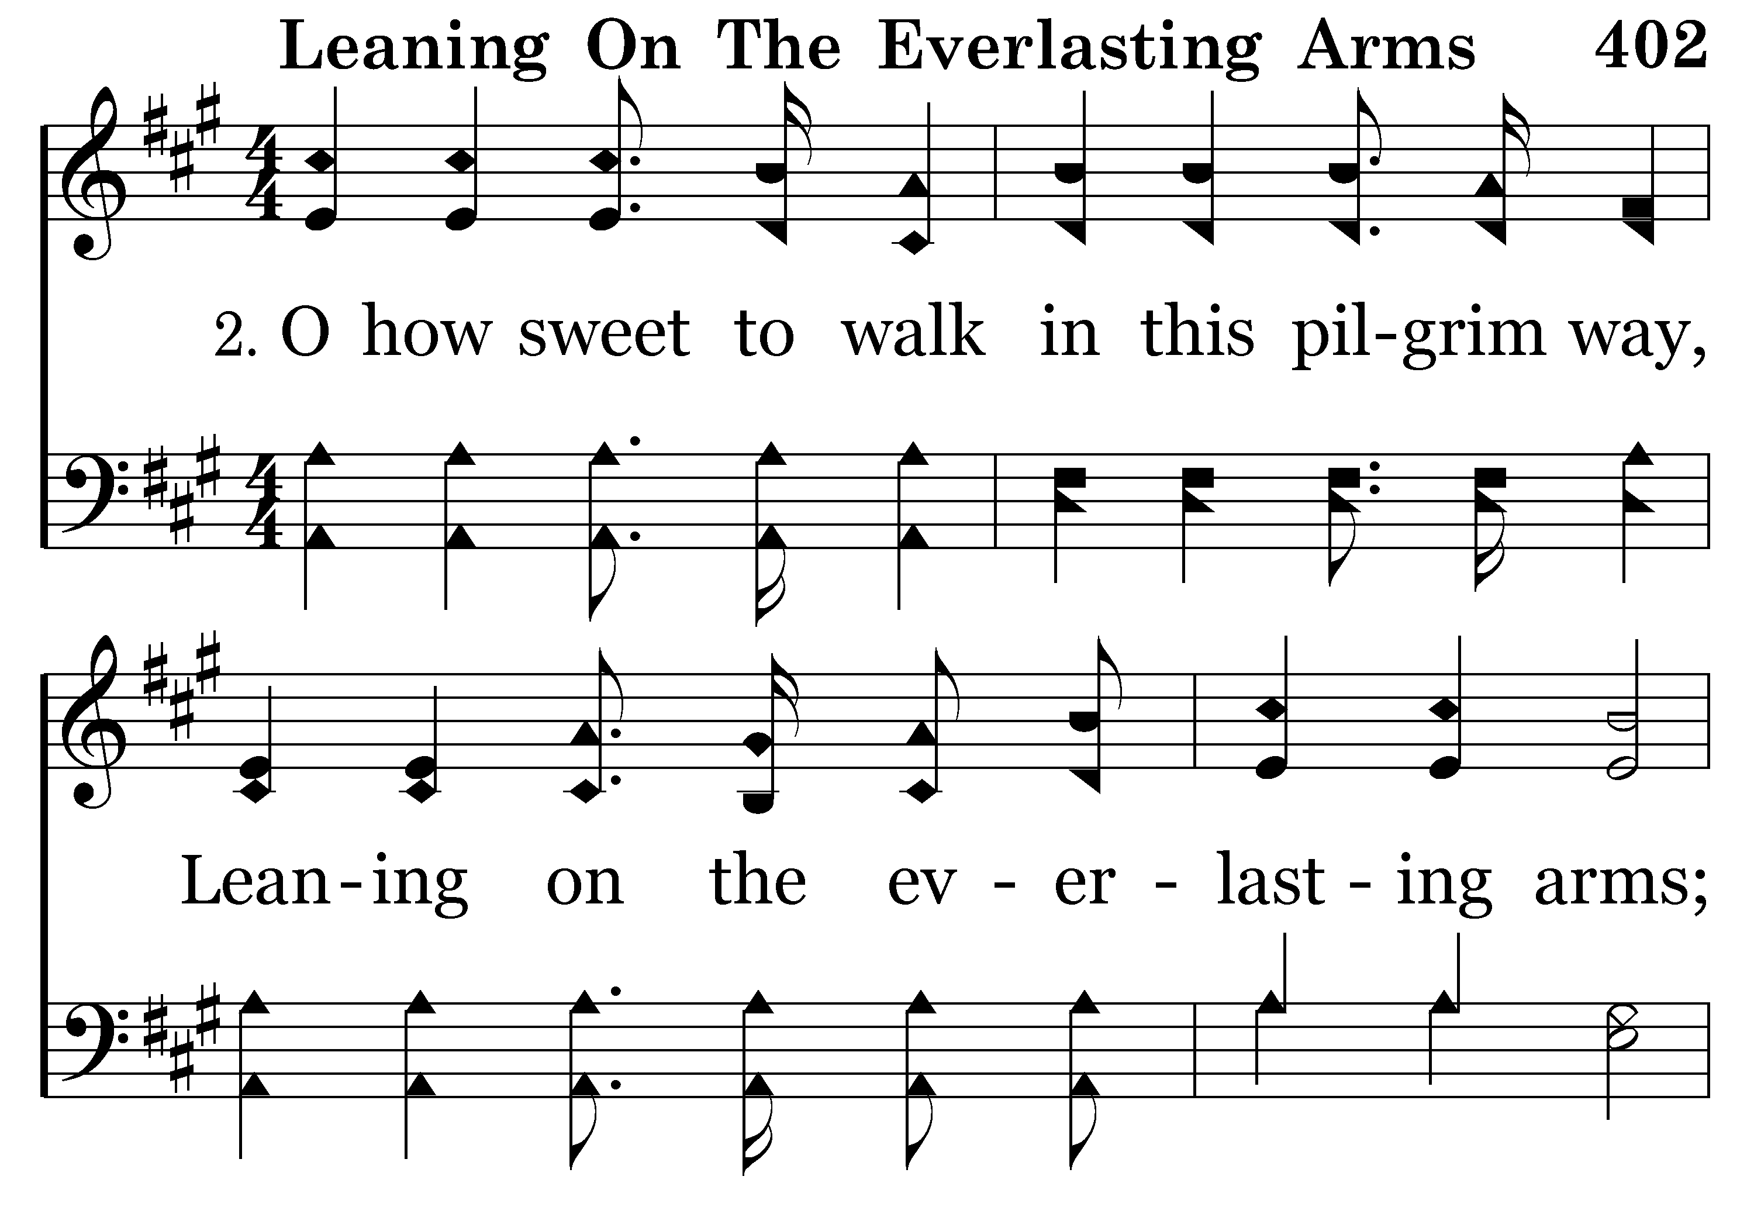
402 - Leaning On The Everlasting Arms - 2.1

Slide 48
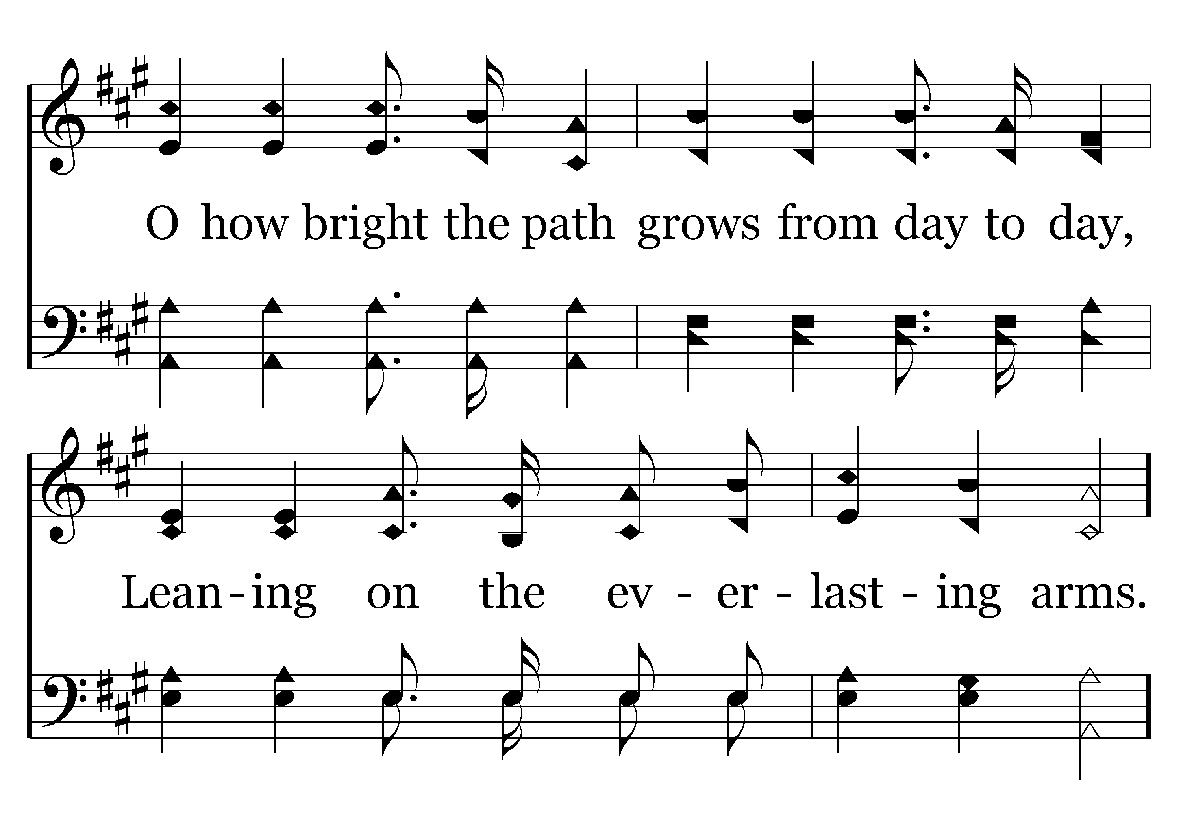
402 - Leaning On The Everlasting Arms - 2.2

Slide 49
402 - Leaning On The Everlasting Arms - C.1

Slide 50
402 - Leaning On The Everlasting Arms - C.2
End of Verse 2

Slide 51
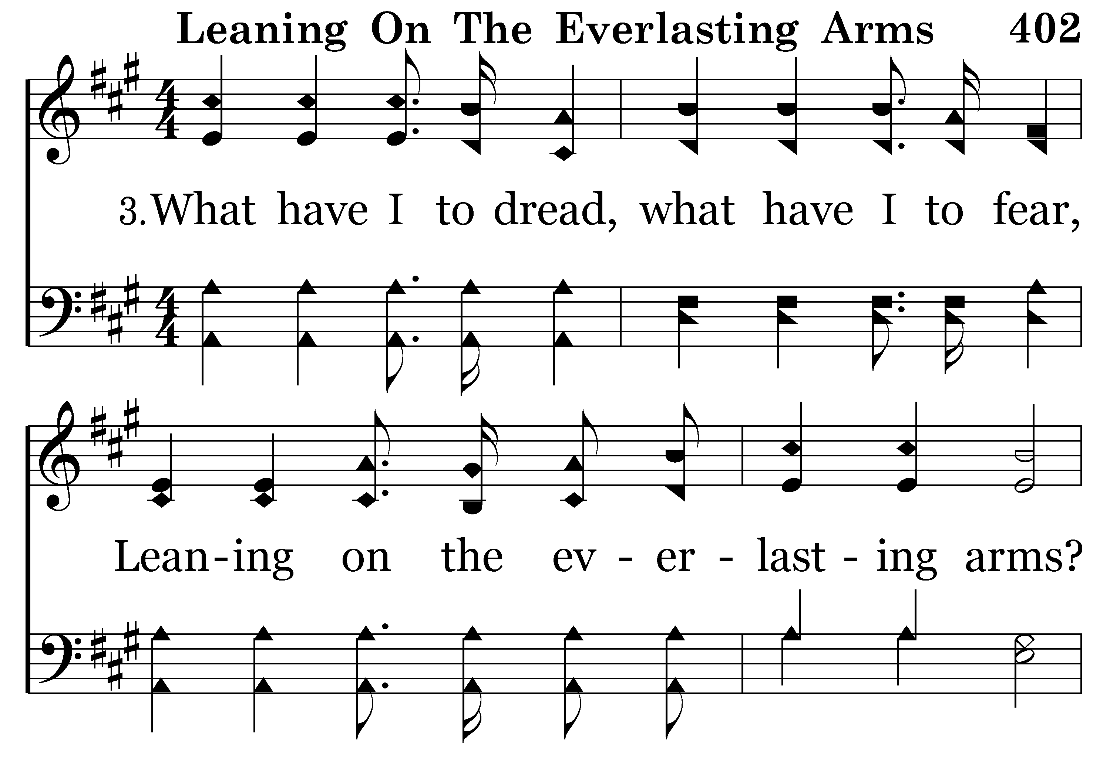
402 - Leaning On The Everlasting Arms - 3.1

Slide 52
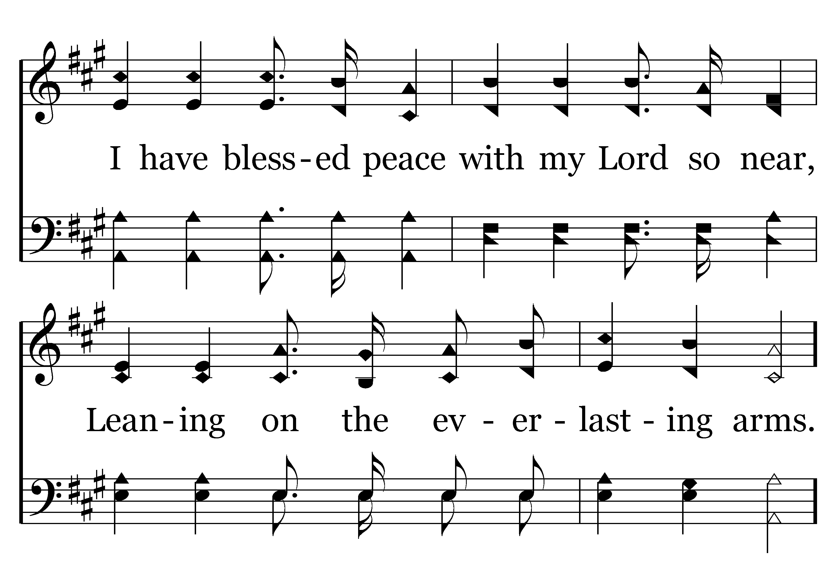
402 - Leaning On The Everlasting Arms - 3.2

Slide 53
402 - Leaning On The Everlasting Arms - C.1

Slide 54
402 - Leaning On The Everlasting Arms - C.2
End of Song

Slide 56
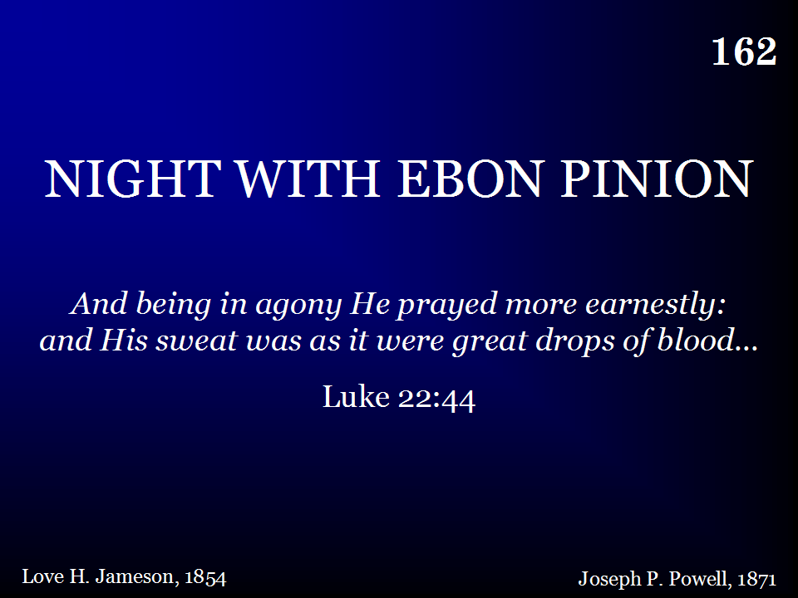
162 - Night With Ebon Pinion - Title

Slide 57
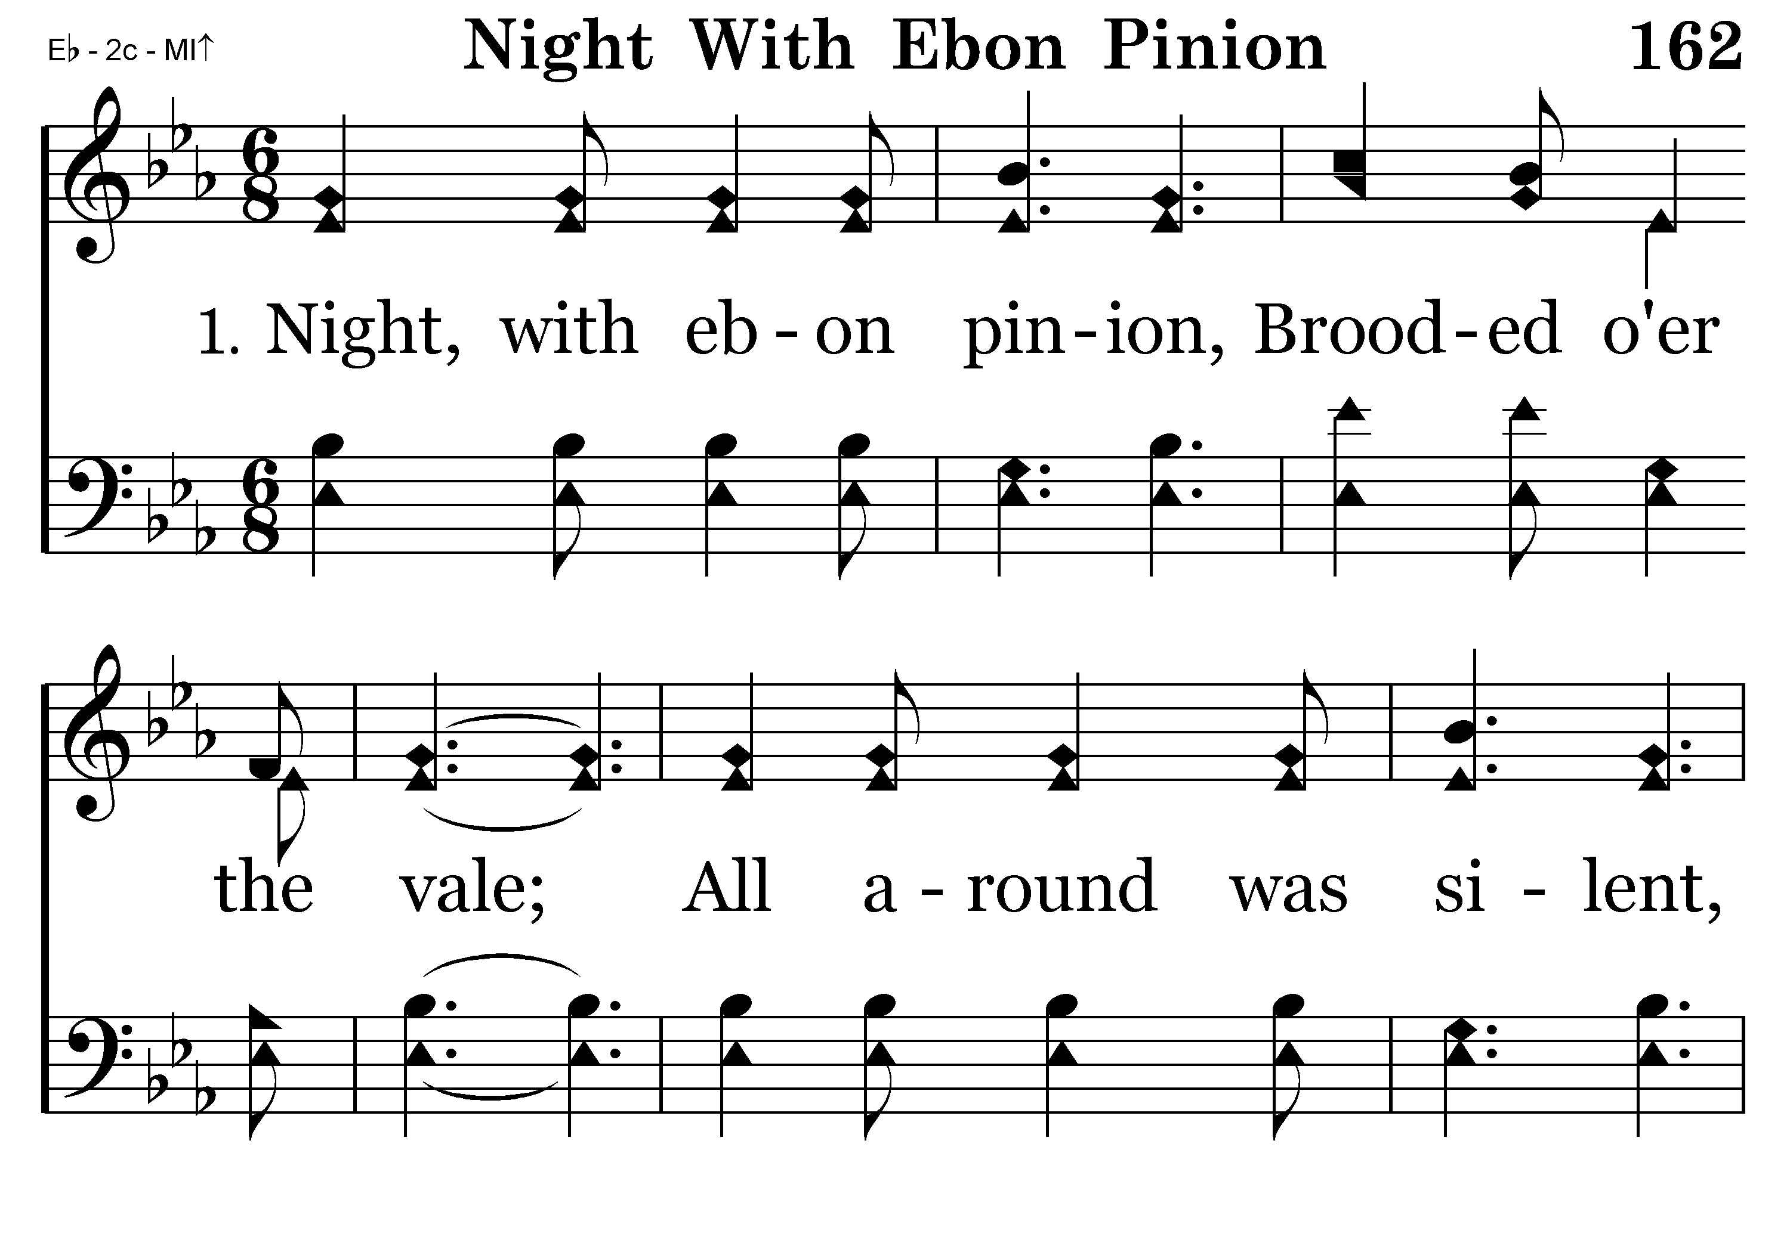
162 - Night With Ebon Pinion - 1.1

Slide 58
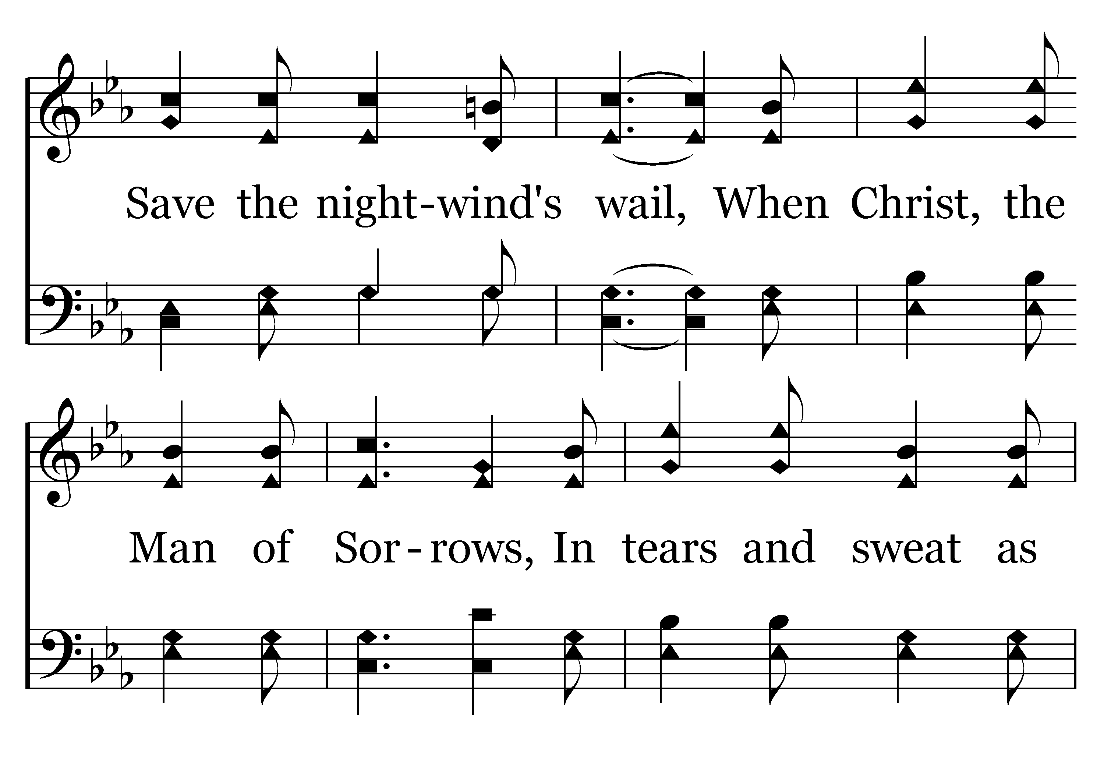
162 - Night With Ebon Pinion - 1.2

Slide 59
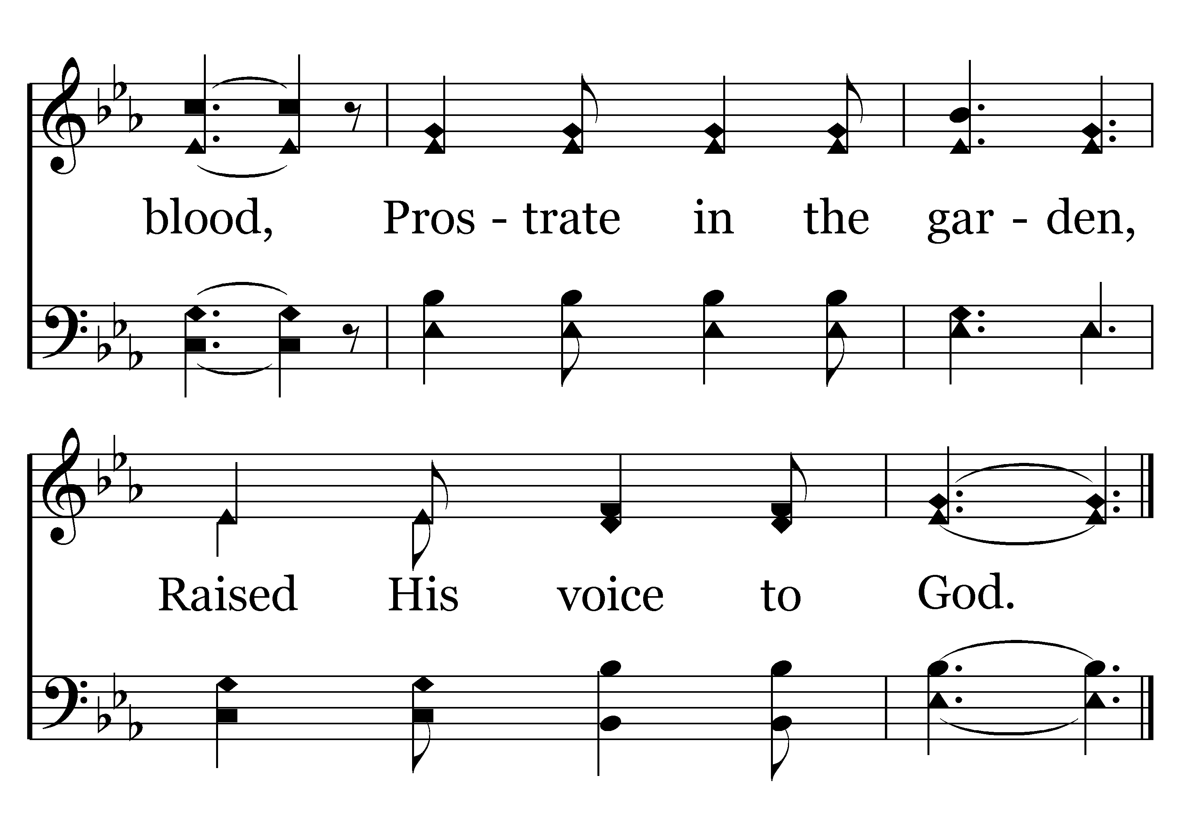
162 - Night With Ebon Pinion - 1.3
End of Verse 1

Slide 60
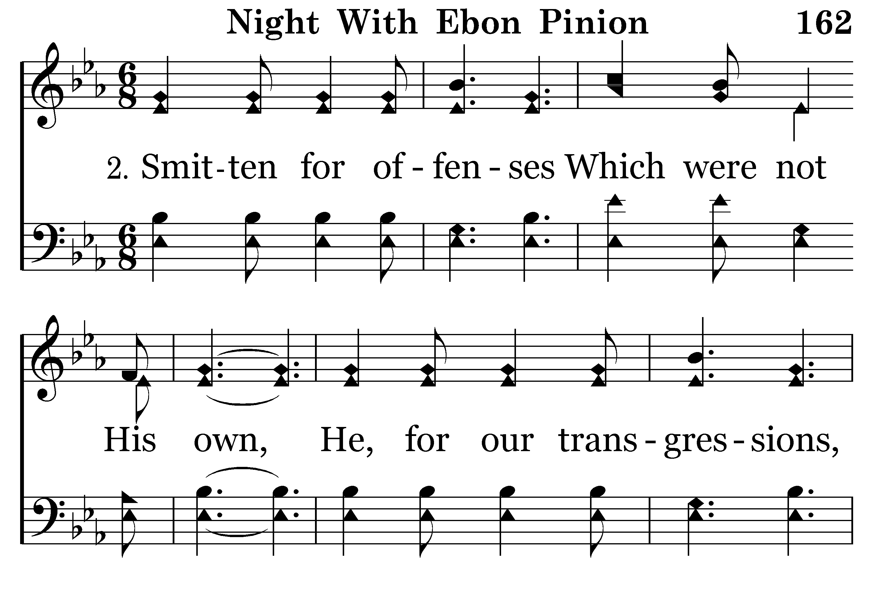
162 - Night With Ebon Pinion - 2.1

Slide 61
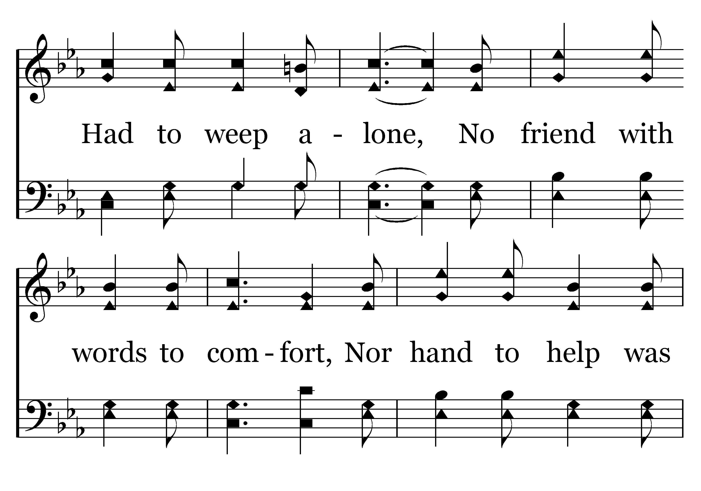
162 - Night With Ebon Pinion - 2.2

Slide 62
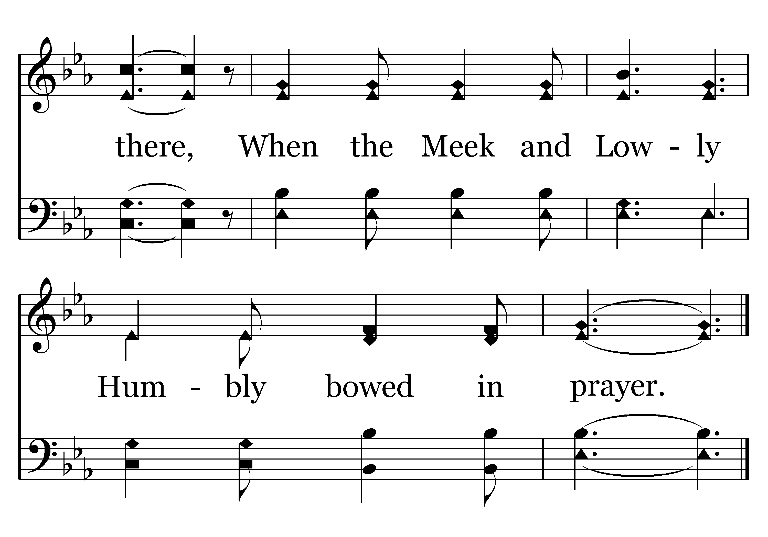
162 - Night With Ebon Pinion - 2.3
End of Verse 2

Slide 63
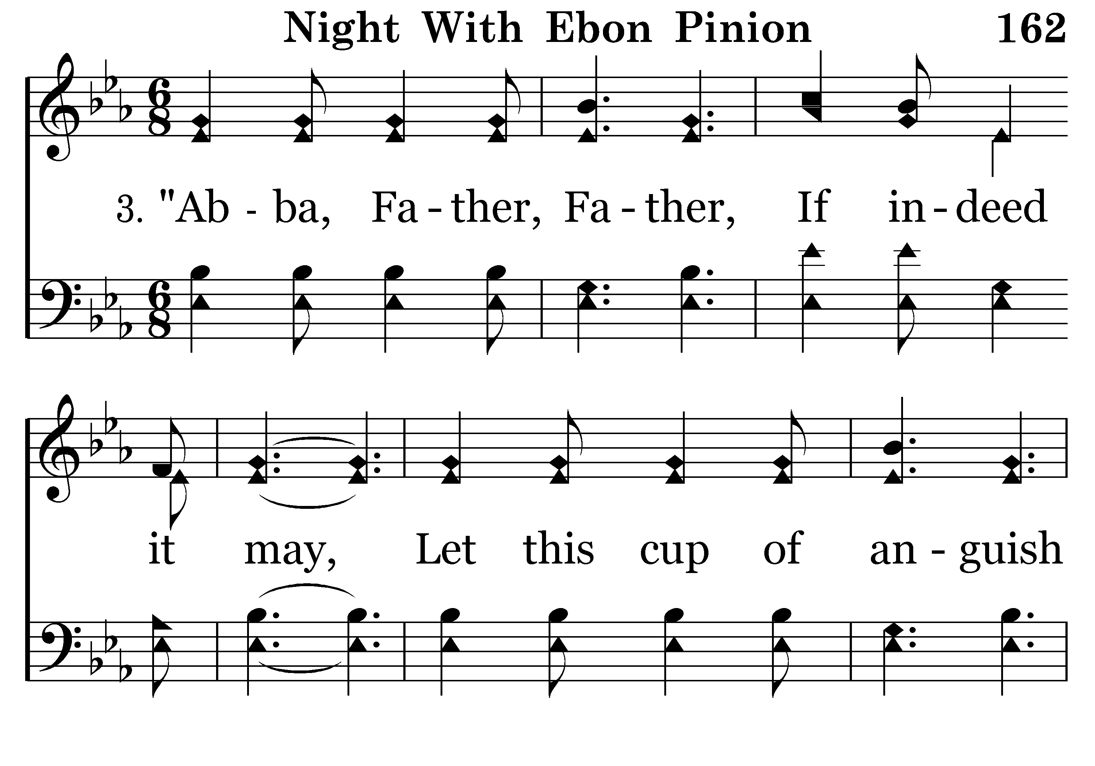
162 - Night With Ebon Pinion - 3.1

Slide 64
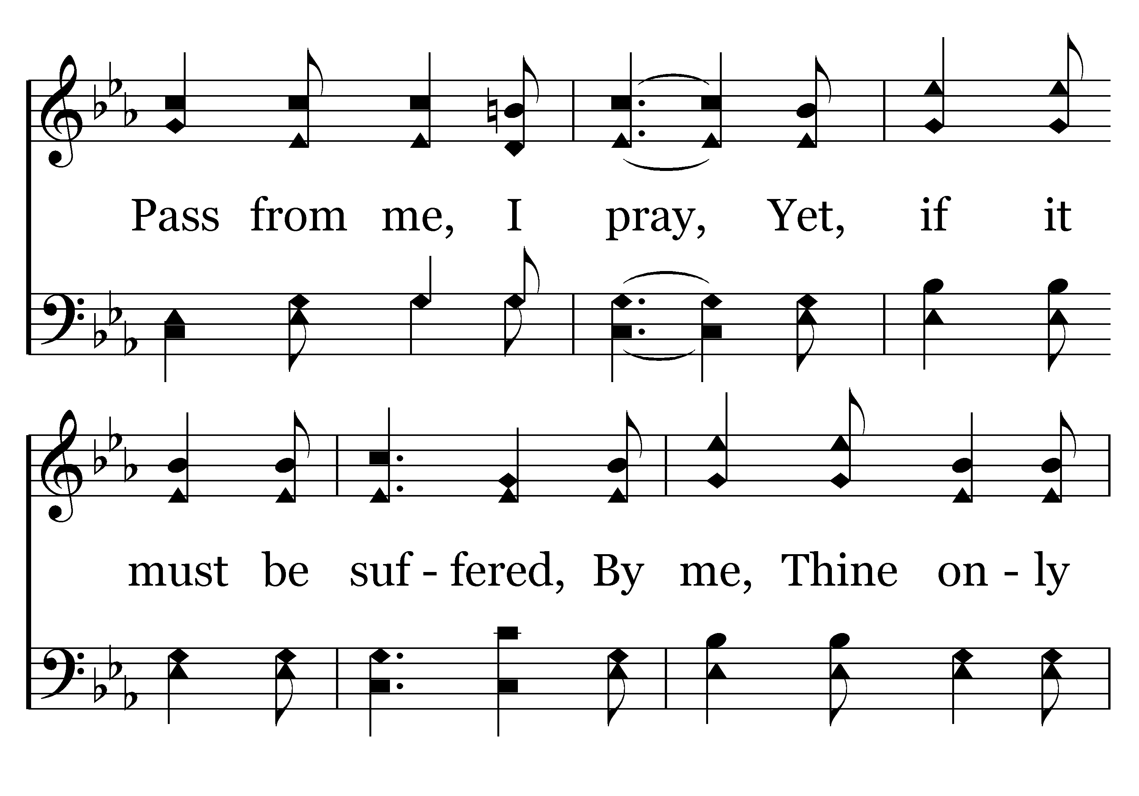
162 - Night With Ebon Pinion - 3.2

Slide 65
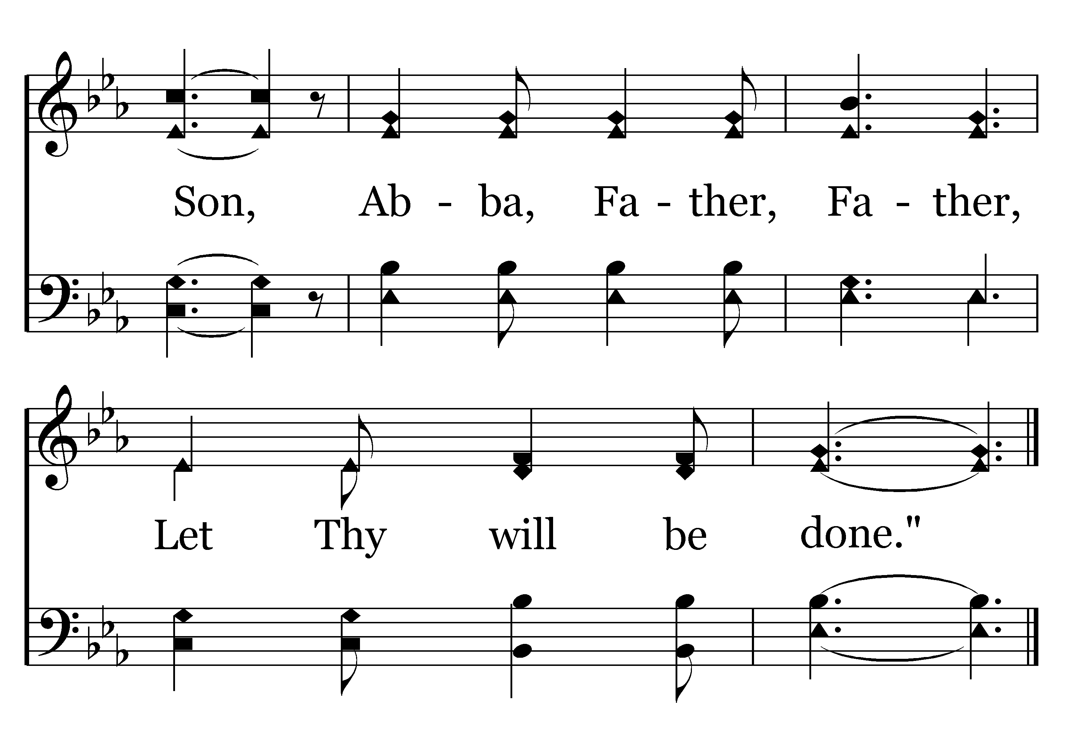
162 - Night With Ebon Pinion - 3.3
End of Song

Slide 66
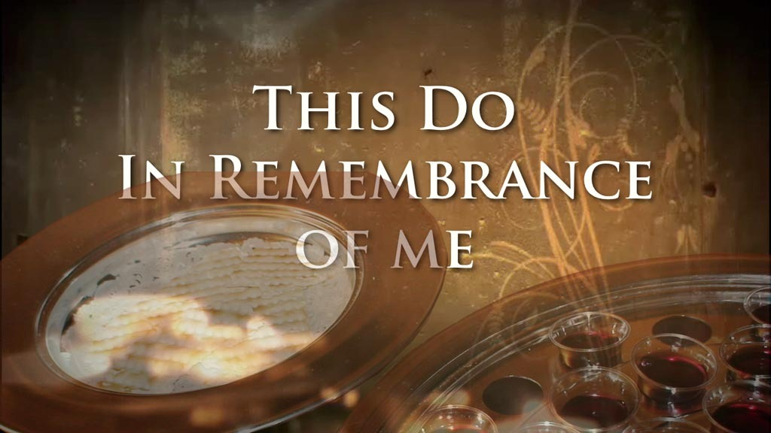

Slide 67
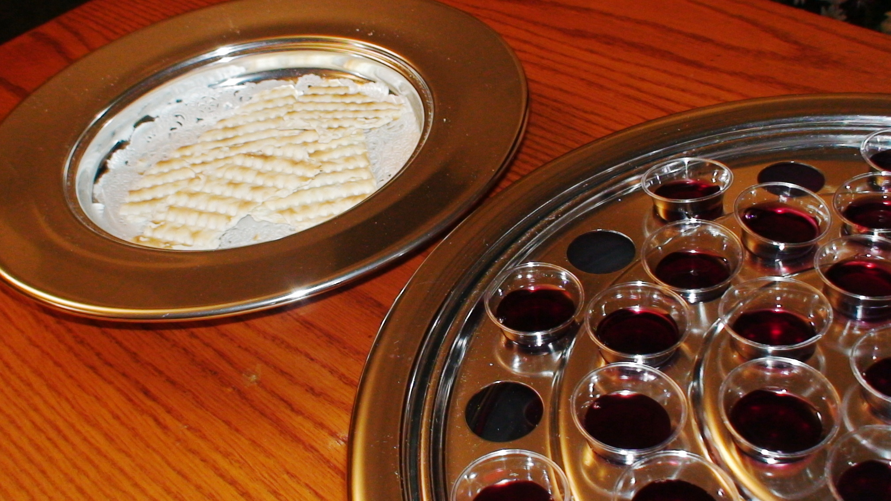
“As often as you eat this bread and drink this cup, you proclaim the Lord’s death….” 1 Corinthians 11:26

Slide 69
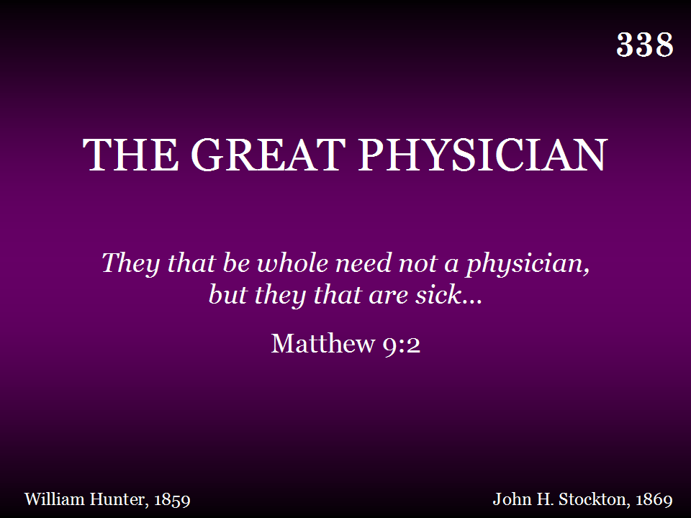
338 - The Great Physician - Title

Slide 70
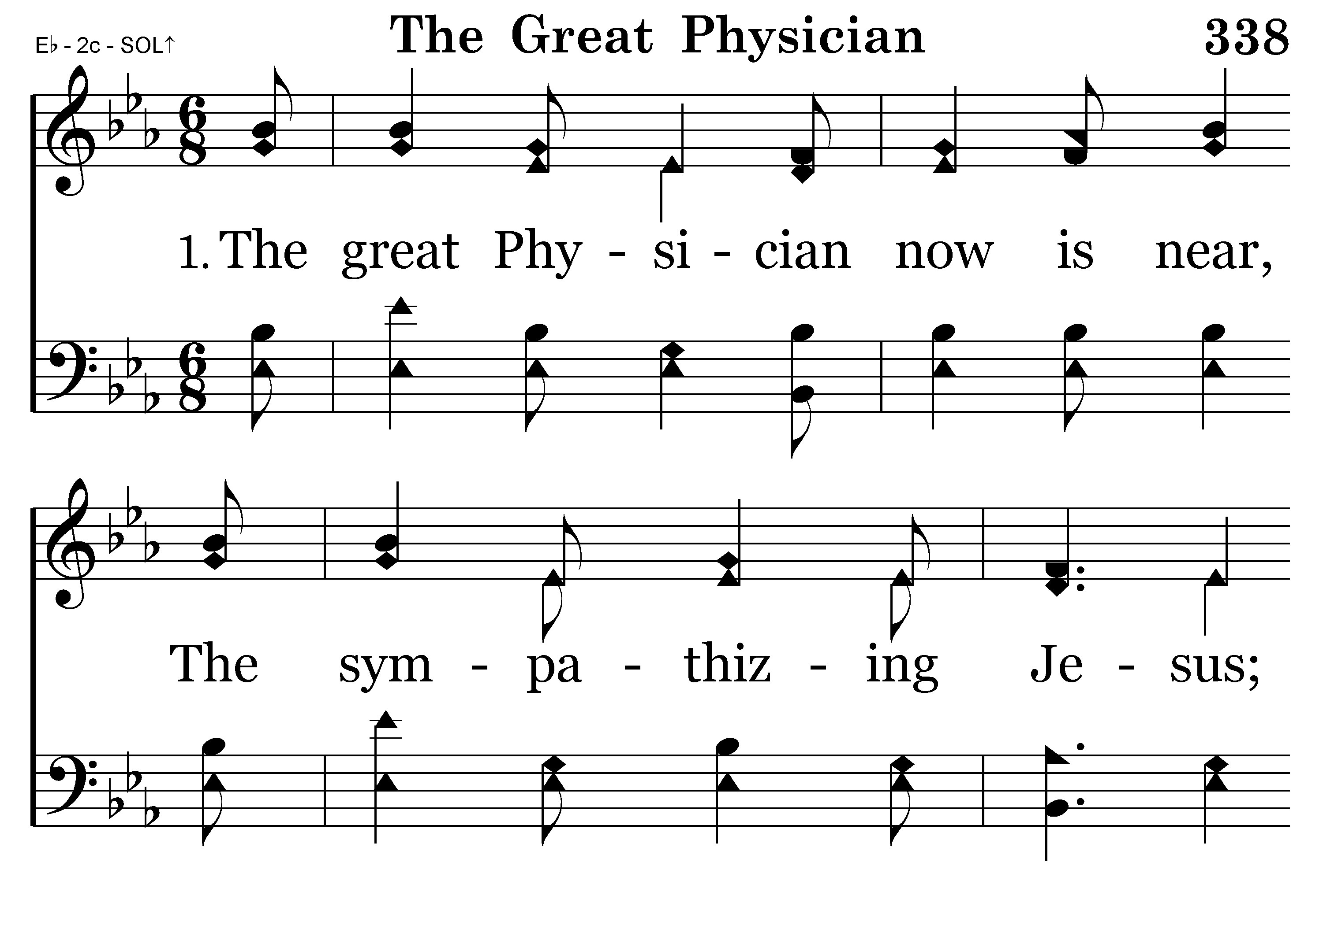
338 - The Great Physician - 1.1

Slide 71
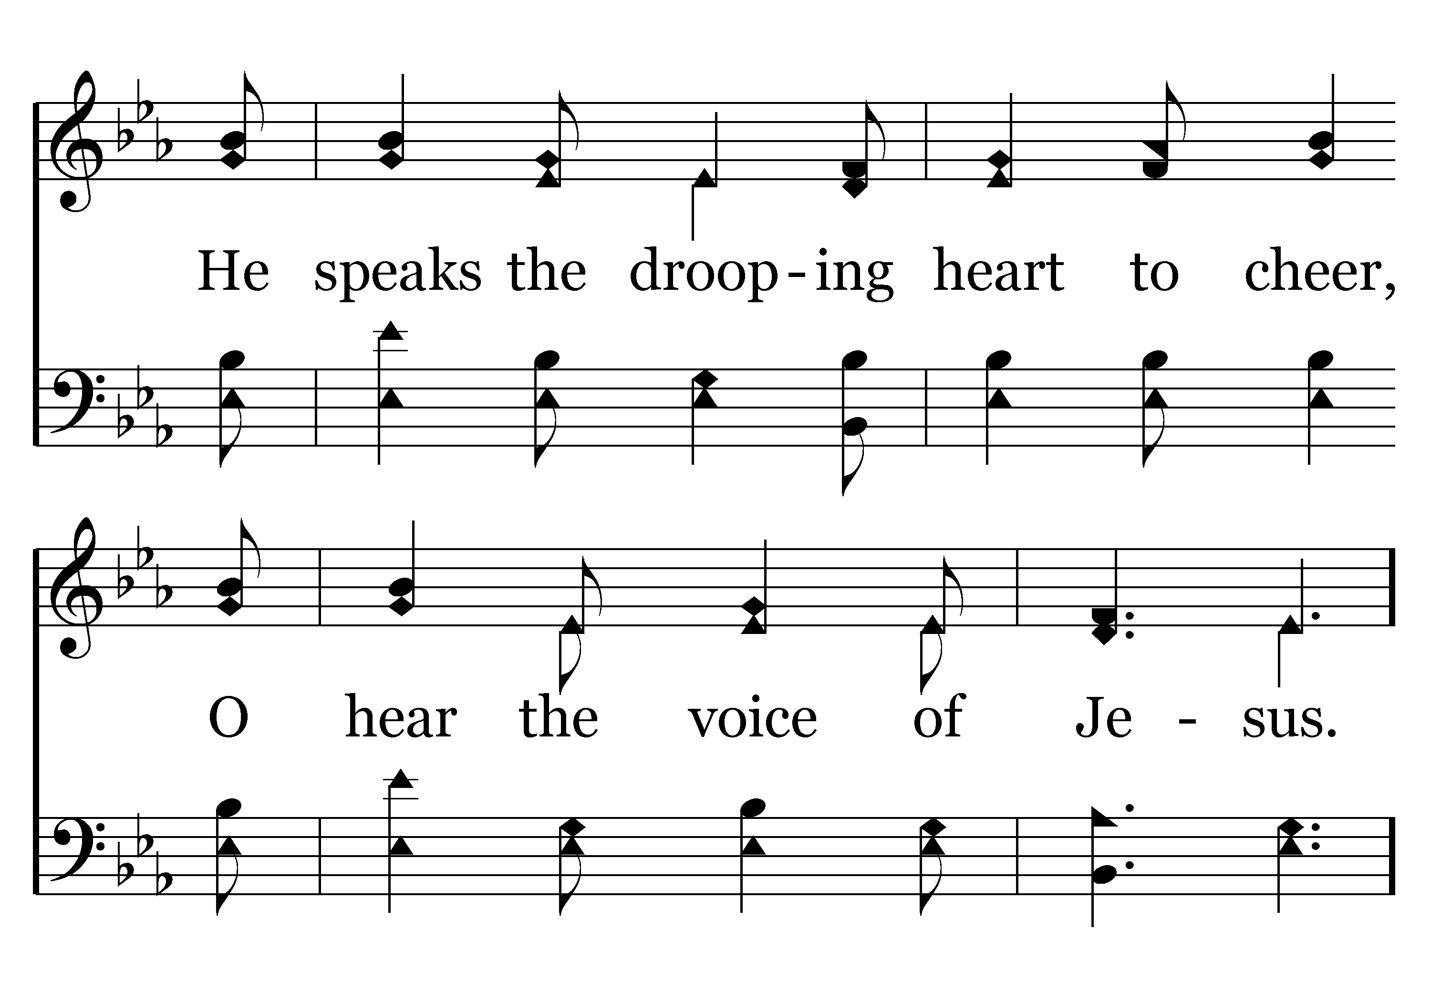
338 - The Great Physician - 1.2
End of Verse 1

Slide 72
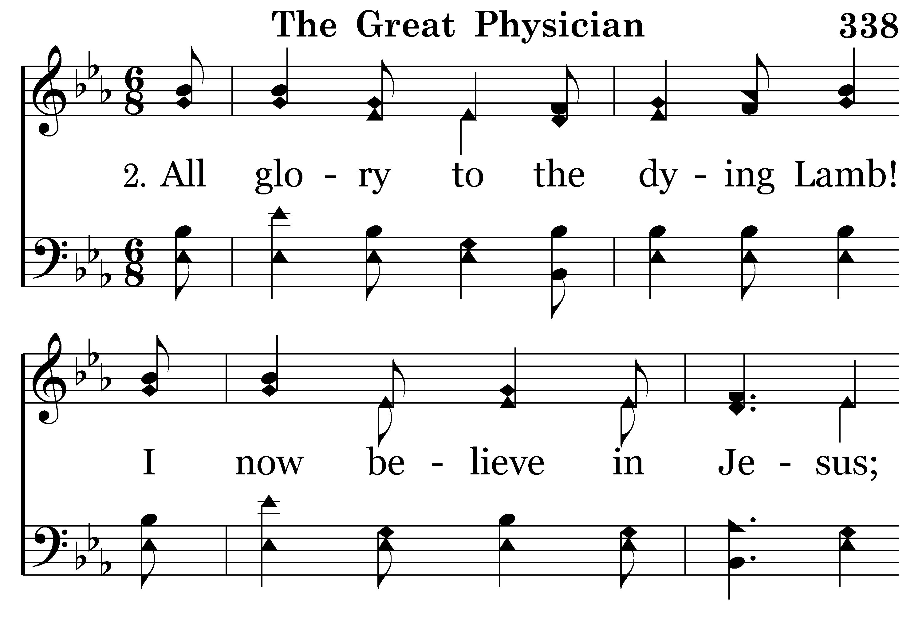
338 - The Great Physician - 2.1

Slide 73
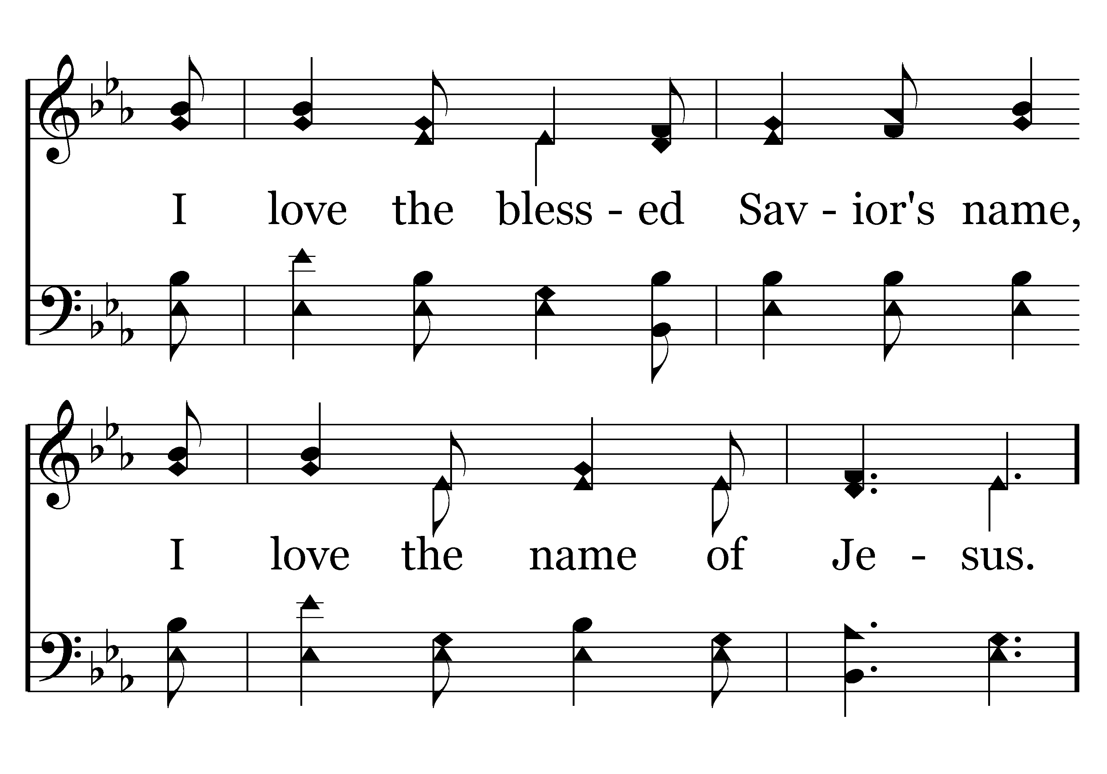
338 - The Great Physician - 2.2
End of Verse 2

Slide 74
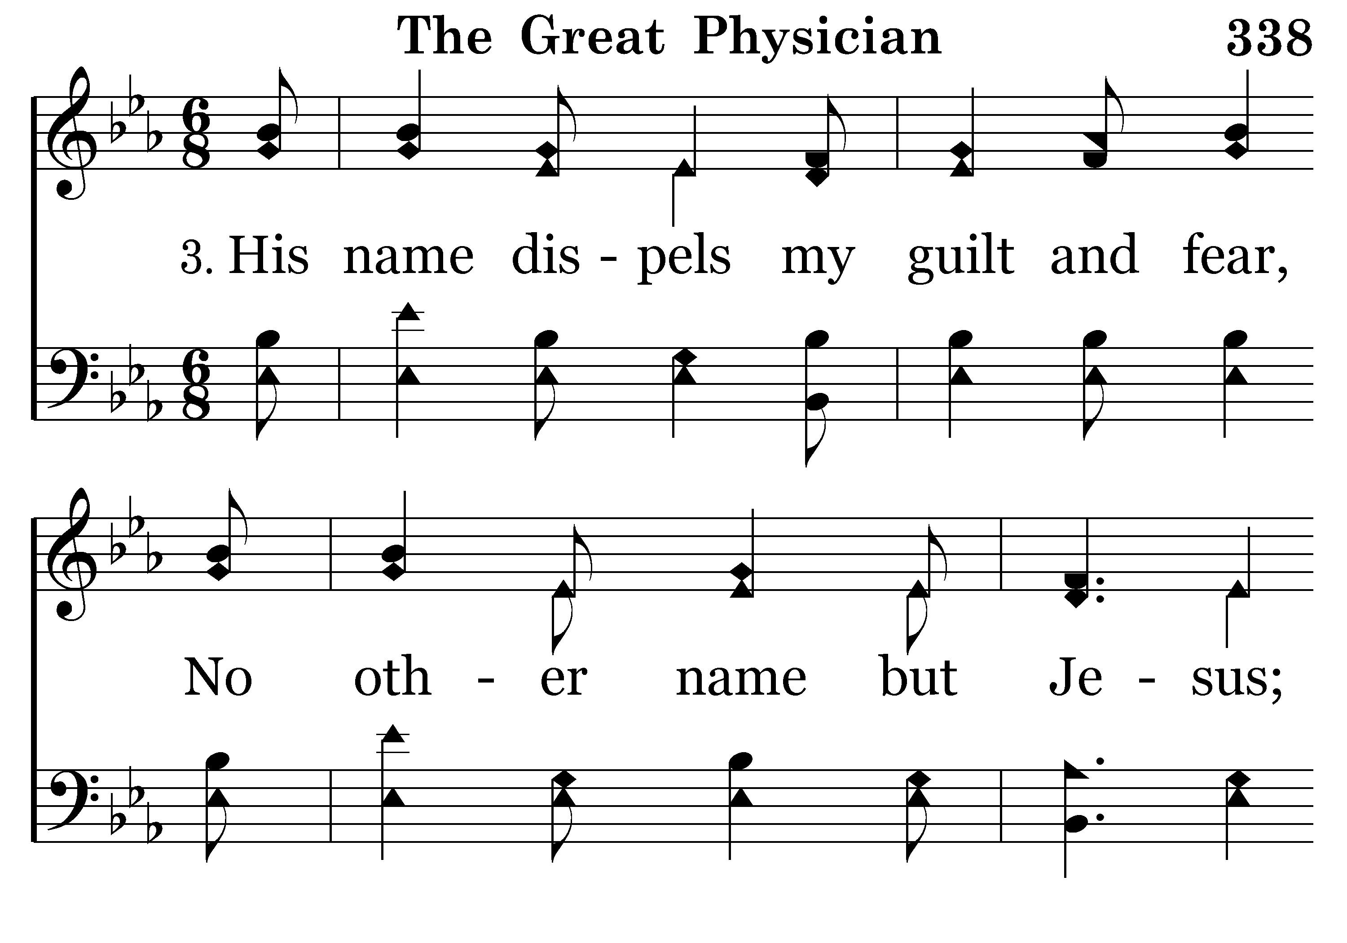
338 - The Great Physician - 3.1

Slide 75

338 - The Great Physician - 3.2

Slide 76

338 - The Great Physician - C.1

Slide 77

338 - The Great Physician - C.2
End of Song

Slide 79

522 - When The Roll Is Called Up Yonder - Title

Slide 80

522 - When The Roll Is Called Up Yonder - 1.1

Slide 81

522 - When The Roll Is Called Up Yonder - 1.2

Slide 82

522 - When The Roll Is Called Up Yonder - 1.3

Slide 83

522 - When The Roll Is Called Up Yonder - C.1

Slide 84

522 - When The Roll Is Called Up Yonder - C.2

Slide 85

522 - When The Roll Is Called Up Yonder - C.3
End of Verse 1

Slide 86

522 - When The Roll Is Called Up Yonder - 2.1

Slide 87

522 - When The Roll Is Called Up Yonder - 2.2

Slide 88

522 - When The Roll Is Called Up Yonder - 2.3

Slide 89
522 - When The Roll Is Called Up Yonder - C.1

Slide 90
522 - When The Roll Is Called Up Yonder - C.2

Slide 91
522 - When The Roll Is Called Up Yonder - C.3
End of Verse 2

Slide 92

522 - When The Roll Is Called Up Yonder - 3.1

Slide 93

522 - When The Roll Is Called Up Yonder - 3.2

Slide 94

522 - When The Roll Is Called Up Yonder - 3.3

Slide 95
522 - When The Roll Is Called Up Yonder - C.1

Slide 96
522 - When The Roll Is Called Up Yonder - C.2

Slide 97
522 - When The Roll Is Called Up Yonder - C.3
Repeat Chorus

Slide 98
522 - When The Roll Is Called Up Yonder - C.1

Slide 99
522 - When The Roll Is Called Up Yonder - C.2

Slide 100
522 - When The Roll Is Called Up Yonder - C.3
End of Song

Slide 101

TODAY’S TEXT
GAILAND KILTZ
MATTHEW 23:23-24

Slide 102
Matt 23:23-24
"Woe to you, teachers of the law and Pharisees, you hypocrites! You give a tenth of your spices — mint, dill and cummin. But you have neglected the more important matters of the law — justice, mercy and faithfulness. You should have practiced the latter, without neglecting the former. 24 You blind guides! You strain out a gnat but swallow a camel.

Slide 103
INVITATION SONG
# 297
PREPARE TO MEET THY GOD

Slide 104

HOW WOULD YOU LIKE TO SWALLOW A CAMEL?
IMPOSSIBLE?
Jesus didn’t think so!

Slide 105
Matt 23:23-24 "Woe to you, teachers of the law and Pharisees, you hypocrites! You give a tenth of your spices-mint, dill and cummin. But you have neglected the more important matters of the law-justice, mercy and faithfulness. You should have practiced the latter, without neglecting the former. 24 You blind guides! You strain out a gnat but swallow a camel.
This is an hyperbole
An exaggeration to make a point
We need to look carefully at our relationship with God to make sure we don’t strain out gnats while swallowing camels

Slide 106
OF COURSE WE SHOULD STRAIN OUT GNATS
But you have neglected the more important matters of the law-justice, mercy and faithfulness. You should have practiced the latter, without neglecting the former.
Jesus said they should have emphasized the weightier matters of law
While not neglecting the minor details
In the Law of Moses tithing was usually about livestock and harvest

Slide 107
Deut. 14:22 Be sure to set aside a tenth of all that your fields produce each year. 23 Eat the tithe of your grain, new wine and oil, and the firstborn of your herds and flocks in the presence of the LORD your God at the place he will choose as a dwelling for his Name, so that you may learn to revere the LORD your God always.
But another statement teaches tithing the seeds of the land

Slide 108
Lev 27:30-31 "'A tithe of everything from the land, whether grain from the soil or fruit from the trees, belongs to the LORD; it is holy to the LORD.
They didn’t simply tithe their herds & produce—they tithed down to the grain from the soil
They tithed their kitchen spices
Jesus said they should have done the weightier things while also getting the details right

Slide 109
Lev 11:20-23 "'All flying insects that walk on all fours are to be detestable to you. 21 There are, however, some winged creatures that walk on all fours that you may eat: those that have jointed legs for hopping on the ground. 22 Of these you may eat any kind of locust, katydid, cricket or grasshopper. 23 But all other winged creatures that have four legs you are to detest.
Gnats were unclean
Gnats should be strained out

Slide 110
STRAINING OUT CAMELS IS MORE IMPORTANT THAN STRAINING OUT GNATS
Camels were also unclean
Lev 11:4 "'There are some that only chew the cud or only have a split hoof, but you must not eat them. The camel, though it chews the cud, does not have a split hoof; it is ceremonially unclean for you.
The Pharisees could picture someone straining out gnats while sharpening their knives to dig into a camel

Slide 111
Hos 6:6 For I desire mercy, not sacrifice, and acknowledgment of God rather than burnt offerings.
Mic 6:6-8 With what shall I come before the LORD and bow down before the exalted God? Shall I come before him with burnt offerings, with calves a year old? 7 Will the LORD be pleased with thousands of rams, with ten thousand rivers of oil? Shall I offer my firstborn for my transgression, the fruit of my body for the sin of my soul? 8 He has showed you, O man, what is good. And what does the LORD require of you? To act justly and to love mercy and to walk humbly with your God.

Slide 112
Ps 15 Lord, who may dwell in your sanctuary? Who may live on your holy hill?
2 He whose walk is blameless and who does what is righteous, who speaks the truth from his heart 3 and has no slander on his tongue, who does his neighbor no wrong and casts no slur on his fellowman, 4 who despises a vile man but honors those who fear the Lord, who keeps his oath even when it hurts, 5 who lends his money without usury and does not accept a bribe against the innocent.
He who does these things will never be shaken.

Slide 113
OF COURSE JESUS WANTED SACRIFICE
BUT HE ALSO WANTED THREE OTHER THINGS:
Justice
Mercy
Acknowledgement of God –walking humbly with God
BASICALLY—THIS IS ALL GOD HAS EVER REQUIRED
THIS IS WHAT GOD REQUIRES TODAY

Slide 114
CONSIDER SOME “WEIGHTER” MATTERS FOR CHRISTIANS TODAY
PREACHING THE GOSPEL
What is weightier?

Slide 115
1 Cor 15:1-4 Now, brothers, I want to remind you of the gospel I preached to you, which you received and on which you have taken your stand. 2 By this gospel you are saved, if you hold firmly to the word I preached to you. Otherwise, you have believed in vain.
3 For what I received I passed on to you as of first importance: that Christ died for our sins according to the Scriptures, 4 that he was buried, that he was raised on the third day according to the Scriptures,

Slide 116
1 Cor 15:1-4 Now, brothers, I want to remind you of the gospel I preached to you, which you received and on which you have taken your stand. 2 By this gospel you are saved, if you hold firmly to the word I preached to you. Otherwise, you have believed in vain.
3 For what I received I passed on to you as of first importance: that Christ died for our sins according to the Scriptures, 4 that he was buried, that he was raised on the third day according to the Scriptures,

Slide 117
1 Cor 2:2 For I resolved to know nothing while I was with you except Jesus Christ and him crucified.
Paul in this letter talked about
Unity
Miraculous gifts
Baptism
Discipline
Foods offered to idols
DEATH
BURIAL
RESURRECTION
IS MOST
IMPORTANT

Slide 118
CONSIDER SOME “WEIGHTER” MATTERS FOR CHRISTIANS TODAY
PREACHING THE GOSPEL
What is weightier?
GOD’S COMMANMENTS
What is weightier?

Slide 119
Matt 22:36-40 "Teacher, which is the greatest commandment in the Law?"
37 Jesus replied: "'Love the Lord your God with all your heart and with all your soul and with all your mind.' 38 This is the first and greatest commandment. 39 And the second is like it: 'Love your neighbor as yourself.' 40 All the Law and the Prophets hang on these two commandments."
Jesus did not say all commandments were equal
He told what the “greatest commandment” was

Slide 120
1 Tim 1:5-6 The goal of this command is love, which comes from a pure heart and a good conscience and a sincere faith.
The aim of our charge is love that issues from a pure heart and good conscience and a sincere faith ESV

Slide 121
CONSIDER SOME “WEIGHTER” MATTERS FOR CHRISTIANS TODAY
PREACHING THE GOSPEL
What is weightier?
GOD’S COMMANMENTS
What is weightier?
RESPONSE TO GOD
What is weightier?

Slide 122
Mark 7:1-23 The Pharisees and some of the teachers of the law who had come from Jerusalem gathered around Jesus and 2 saw some of his disciples eating food with hands that were "unclean," that is, unwashed. 3(The Pharisees and all the Jews do not eat unless they give their hands a ceremonial washing, holding to the tradition of the elders. 4 When they come from the marketplace they do not eat unless they wash. And they observe many other traditions, such as the washing of cups, pitchers and kettles.) 5 So the Pharisees and teachers of the law asked Jesus, "Why don't your disciples live according to the tradition of the elders instead of eating their food with 'unclean' hands?"

Slide 123
6 He replied, "Isaiah was right when he prophesied about you hypocrites; as it is written: "'These people honor me with their lips, but their hearts are far from me. 7 They worship me in vain; their teachings are but rules taught by men.' 8 You have let go of the commands of God and are holding on to the traditions of men." 9 And he said to them: "You have a fine way of setting aside the commands of God in order to observe your own traditions! 10 For Moses said, 'Honor your father and your mother,' and, 'Anyone who curses his father or mother must be put to death.' 11 But you say that if a man says to his father or mother: 'Whatever help you might otherwise have received from me is Corban' (that is, a gift devoted to God),

Slide 124
12 then you no longer let him do anything for his father or mother. 13 Thus you nullify the word of God by your tradition that you have handed down. And you do many things like that." 14 Again Jesus called the crowd to him and said, "Listen to me, everyone, and understand this. 15 Nothing outside a man can make him 'unclean' by going into him. Rather, it is what comes out of a man that makes him 'unclean.'" 17 After he had left the crowd and entered the house, his disciples asked him about this parable. 18 "Are you so dull?" he asked. "Don't you see that nothing that enters a man from the outside can make him 'unclean'? 19 For it doesn't go into his heart but into his stomach, and then out of his body."

Slide 125
(In saying this, Jesus declared all foods "clean.")
20 He went on: "What comes out of a man is what makes him 'unclean.' 21 For from within, out of men's hearts, come evil thoughts, sexual
immorality, theft, murder, adultery, 22 greed, malice, deceit, lewdness, envy, slander, arrogance and folly. 23 All these evils come from inside and make a man 'unclean.'"
The external things did not matter as much as the heart
What was weightier?
The response of the heart—not the mouth

Slide 126
STRAINING OUT GNATS WON’T MAKE UP FOR SWALLOWING CAMELS
Jesus demonstrates how the Pharisees were doing this in Matthew 23
They neglected justice – 23:14
They neglected mercy – 23:4
They neglected faithfulness – 23:16-19
But they were meticulous in their tithing

Slide 127
CAN WE DO THE SAME THING?
Debate the finer details of the work of the church
Ignore brotherly love, kindness & compassion
Argue for attending all of the assemblies
Ignore need for prayer & Bible study
Emphasize pattern for local church
De-emphasize the individual’s work
Titus 2:14 who gave himself for us to redeem us from all wickedness and to purify for himself a people that are his very own, eager to do what is good.

Slide 128
Gal 6:10 Therefore, as we have opportunity, let us do good to all people, especially to those who belong to the family of believers.
We may make the right application of this verse
We may get the pattern of the work of the local church right
If we are not doing what we have been set apart to do—if we are not doing what Gal 6:10 says
Then we are straining out gnats & swallowing camels

Slide 129
STRAINING OUT GNATS IS EASY BECAUSE IT CAN BE EASILY IDENTIFIED
The Pharisees could easily tell when they had tithed enough—all they had to do was count to 10
But when had they practiced enough justice-mercy-faithfulness?
How do we measure the appropriate response to God?
How do we measure the right amount of love for God?
Straining out camels is hard—because the things that matter most to God are hard to measure

Slide 130
WE SYSTEMIZE THINGS BECAUSE IT MAKES US FEEL BETTER
5 STEPS TO SALVATION
3 WORKS OF THE CHURCH
5 ITEMS OF WORSHIP
THIS MAKES
THINGS
EASIER
WHERE DOES THE BIBLE SAY THERE ARE 5 ACTS OF WORSHIP?
What is the weightier matter?
John 4:24 God is spirit, and his worshipers must worship in spirit and in truth."

Slide 131
WE KNOW WHEN WE HAVE DONE ONE OF THE 5 ACTS OF WORSHIP
When do we know when we have worshipped in spirit and truth?
We can check – off these 5 acts without ever worshipping in spirit and truth
Churches can have knock-down drag-out fights with name-calling, backbiting over how to handle the announcements because they are not one of the “5” items of worship
They argue to defend these “gnats” of the 5 acts
They ignore God’s plea for unity, love, kindness, self-sacrifice and compassion

Slide 132
WE KNOW WHEN WE HAVE DONE ONE OF THE 5 ACTS OF WORSHIP
When do we know when we have worshipped in spirit and truth?
We fuss and argue over the mechanics of worship and miss the true spirit of worship
EXAMPLE: “Rip and Sip”
We worry about using the proper container and fail to remember what communion is all about

Slide 133
IT’S EASY TO IDENTIFY THE 5 ACTS OF WORSHIP
IT’S NOT SO EASY TO IDENTIFY LOVING A BROTHER OR SISTER WITH WHOM WE DISAGREE

Slide 134
Matt 12:1-8 At that time Jesus went through the grainfields on the Sabbath. His disciples were hungry and began to pick some heads of grain and eat them. 2 When the Pharisees saw this, they said to him, "Look! Your disciples are doing what is unlawful on the Sabbath." 3 He answered, "Haven't you read what David did when he and his companions were hungry? 4 He entered the house of God, and he and his companions ate the consecrated bread-which was not lawful for them to do, but only for the priests. 5 Or haven't you read in the Law that on the Sabbath the priests in the temple desecrate the day and yet are innocent? 6 I tell you that one greater than the temple is here.

Slide 135
7 If you had known what these words mean, 'I desire mercy, not sacrifice,' you would not have condemned the innocent. 8 For the Son of Man is Lord of the Sabbath."
How many grains could be picked before the law was broken?
The Sabbath was made for man—not man of the Sabbath
How do we identify that?
How do we know when we have violated the principle?

Slide 136
IT WILL ALWAYS BE EASY TO STRAIN OUT GNATS
Because they are identifiable
IT WILL ALWAYS BE EASY TO SWALLOW CAMELS
Because they are hard to identify
WHEN WE STRAIN THE CAMELS – WE WILL ALSO STRAIN THE GNATS
If the Pharisees had gotten faithfulness right—tithing would have been right also
When we get love right– (Mt 22)– we will get the rest of the commandments right
When we work on the heart—we will get the actions right

Slide 137
LET’S MAKE SURE WE ARE PUTTING THE PROPER EMPHASIS ON THE PROPER ISSUES AT THE PROPER TIMES
ONLY THEN CAN WE BE SURE WE PRACTICING THE WHOLE COUNSEL OF GOD

Slide 139

297 - Prepare To Meet Thy God - Title

Slide 140

297 - Prepare To Meet Thy God - 1.1

Slide 141

297 - Prepare To Meet Thy God - 1.2

Slide 142

297 - Prepare To Meet Thy God - C.1

Slide 143

297 - Prepare To Meet Thy God - C.2

Slide 144

297 - Prepare To Meet Thy God - C.3

Slide 145

297 - Prepare To Meet Thy God - C.4
End of Verse 1

Slide 146

297 - Prepare To Meet Thy God - 2.1

Slide 147

297 - Prepare To Meet Thy God - 2.2

Slide 148
297 - Prepare To Meet Thy God - C.1

Slide 149
297 - Prepare To Meet Thy God - C.2

Slide 150
297 - Prepare To Meet Thy God - C.3

Slide 151
297 - Prepare To Meet Thy God - C.4
End of Verse 2

Slide 152

297 - Prepare To Meet Thy God - 3.1

Slide 153

297 - Prepare To Meet Thy God - 3.2

Slide 154
297 - Prepare To Meet Thy God - C.1

Slide 155
297 - Prepare To Meet Thy God - C.2

Slide 156
297 - Prepare To Meet Thy God - C.3

Slide 157
297 - Prepare To Meet Thy God - C.4
End of Song

Slide 159


Slide 161

HENRY OLIU

Slide 162

ANNOUNCEMENTS AND
UPCOMING EVENTS

Slide 163


Slide 164


Slide 165
Rev 19:9-10 Then the angel said to me, "Write: 'Blessed are those who are invited to the wedding supper of the Lamb!'" And he added, "These are the true words of God." At this I fell at his feet to worship him. But he said to me, "Do not do it! I am a fellow servant with you and with your brothers who hold to the testimony of Jesus. Worship God! For the testimony of Jesus is the spirit of prophecy."
Verse 9: An angel instructs John to write these words, “Blessed are those who are invited to the marriage supper of the Lamb.” A seemingly obvious parallel to this is The Parable of the Wedding Feast in Matthew 22:1-11, which follows directly after the Parable of the Tenants

Slide 166
In this parable, speaking of the kingdom of heaven (vs. 2), a king (God) was to prepare a wedding feast for his son (Jesus), but those who were originally invited (the Jews) refused to come (vss. 3-5) and even killed the king’s servants who had invited them (v. 6). Therefore, these murderers were destroyed and their city was burned (cf. Rev. 18:8-10, 18; 19:3). This is precisely what we see having happened in Jerusalem’s destruction and burning in 70 AD. The invitation then goes out to others (Gentiles as well as Jews; vss. 9-10), but only those with proper wedding garments were allowed to remain (vss. 10-14; cf. Rev. 19:8). Those who lacked these garments remained in outer darkness and were not part of the chosen people of God (vss. 13-14; cf. Matt. 8:11-12), despite the claims of John Hagee and other Christian Zionists to the contrary.

Slide 167
Rev 19:10 At this I fell at his feet to worship him. But he said to me, "Do not do it! I am a fellow servant with you and with your brothers who hold to the testimony of Jesus. Worship God! For the testimony of Jesus is the spirit of prophecy."
Rev 19:11 I saw heaven standing open and there before me was a white horse, whose rider is called Faithful and True. With justice he judges and makes war.
In this section we see Christ proceeding out of an open heaven on a white horse, followed by the armies of heaven, and wielding a sharp sword in His mouth. John’s description of Christ here is beautiful.

Slide 168
Interestingly, Josephus recorded that, in the spring of 66 AD shortly before the Jewish-Roman War began, a “star resembling a sword” appeared over Jerusalem (remaining for a year) and there were also many in Judea who saw chariots and soldiers running in the clouds:

Slide 169
“Thus were the miserable people persuaded by these deceivers, and such as belied God himself; while they did not attend nor give credit to the signs that were so evident, and did so plainly foretell their future desolation, but, like men infatuated, without either eyes to see or minds to consider, did not regard the denunciations that God made to them. Thus there was a star resembling a sword, which stood over the city, and a comet, that continued a whole year… Besides these, a few days after that feast, on the one and twentieth day of the month Artemisius, [Jyar,] a certain prodigious and incredible phenomenon appeared:

Slide 170
I suppose the account of it would seem to be a fable, were it not related by those that saw it, and were not the events that followed it of so considerable a nature as to deserve such signals; for, before sun-setting, chariots and troops of soldiers in their armor were seen running about among the clouds, and surrounding of cities” (Wars 6.5.3).
The 1st century Roman historian, Tacitus, also said this:
“There had been seen hosts joining battle in the skies, the fiery gleam of arms, the temple illuminated by a sudden radiance from the clouds” (Histories, Book 5).

Slide 171
Rev 19:12-15 His eyes are like blazing fire, and on his head are many crowns. He has a name written on him that no one knows but he himself. 13 He is dressed in a robe dipped in blood, and his name is the Word of God. 14 The armies of heaven were following him, riding on white horses and dressed in fine linen, white and clean. 15 Out of his mouth comes a sharp sword with which to strike down the nations. "He will rule them with an iron scepter."
Regarding “the armies of heaven, arrayed in fine linen, white and pure” following Christ on white horses, Rev. 19:8 speaks of a company clothed with “fine linen, bright and pure.”

Slide 172
In Zech. 14:7 we read: “And there shall be a unique day, which is known to the Lord, neither day nor night, but at evening time there shall be light.” Josephus records a most interesting event which took place less than a year before Jerusalem was destroyed in 70 AD: “On the eighth of the month Zanthicus, (before the feast of unleavened bread) at the ninth hour of the night, there shone round about the altar, and the circumjacent buildings of the temple, a light equal to the brightness of the day, which continued for the space of half an hour”

Slide 173
The idea that angels are involved in the judgment of Rev. 19:14-15 is also consistent with the statement that Jesus made to His disciples in Matthew 16:27-28, where He said: “For the Son of Man is going to come with His angels in the glory of His Father, and then He will repay each person according to what he has done. Truly, I say to you, there are some standing here who will not taste death until they see the Son of Man coming in His kingdom.”

Slide 174
Rev 19:15-18
15 Out of his mouth comes a sharp sword with which to strike down the nations. "He will rule them with an iron scepter." He treads the winepress of the fury of the wrath of God Almighty. 16 On his robe and on his thigh he has this name written:
KING OF KINGS AND LORD OF LORDS.
17 And I saw an angel standing in the sun, who cried in a loud voice to all the birds flying in midair, "Come, gather together for the great supper of God, 18 so that you may eat the flesh of kings, generals, and mighty men, of horses and their riders, and the flesh of all people, free and slave, small and great."

Slide 175
Verses 15-18: Here is fulfilled what was prophesied in Revelation 1:7. After all, this text (Rev. 19:11-16) speaks of Christ coming to strike down the nations, and being ready to “tread the winepress of the fury of the wrath of God the Almighty” (vs. 15).
Rev 1:7 Look, he is coming with the clouds,
and every eye will see him,
even those who pierced him;
and all the peoples of the earth will mourn because of him.
So shall it be! Amen.

