Slide 1
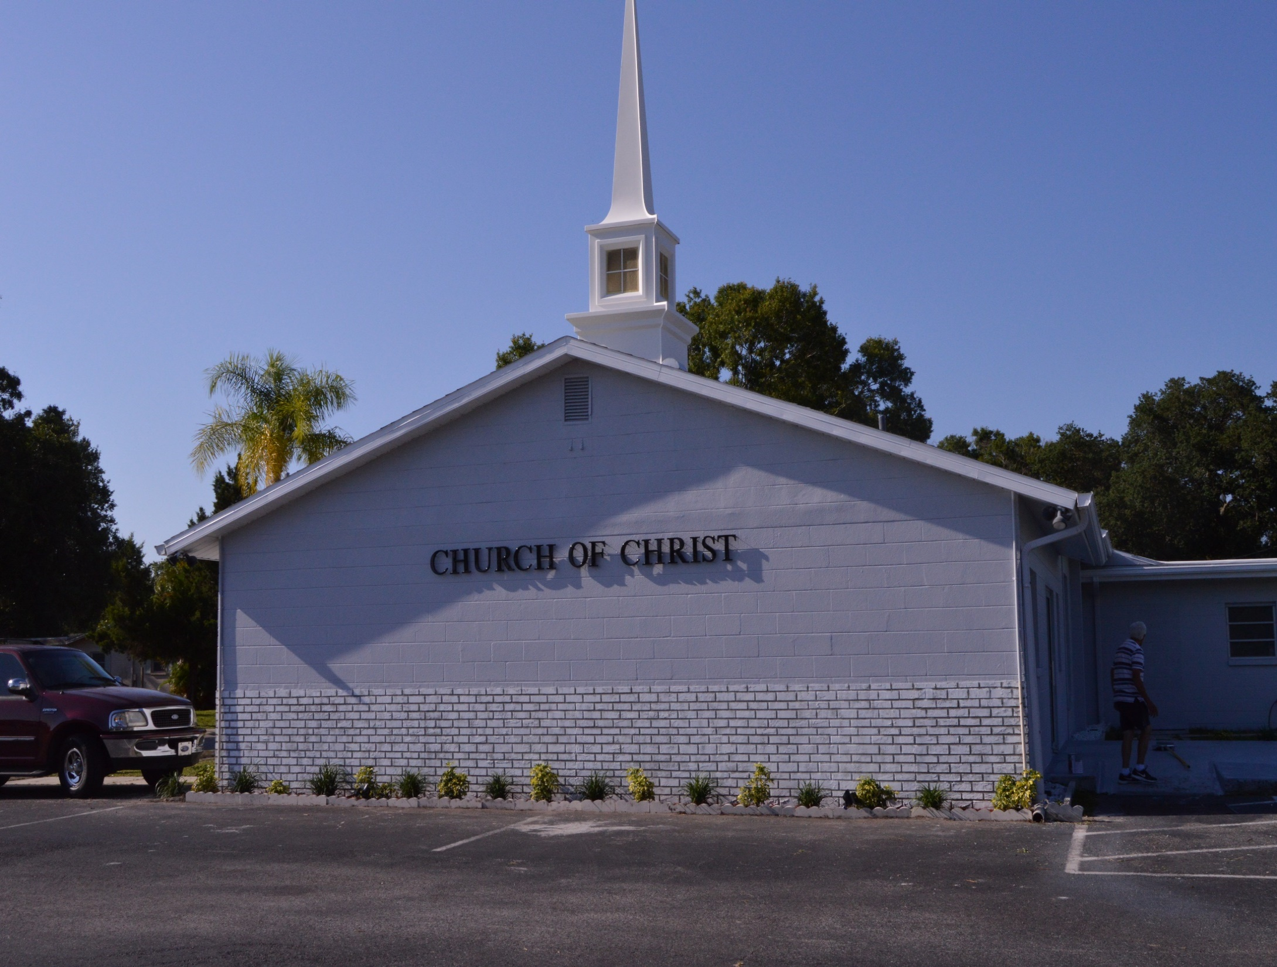
WELCOME TO SKYVIEW

Slide 2
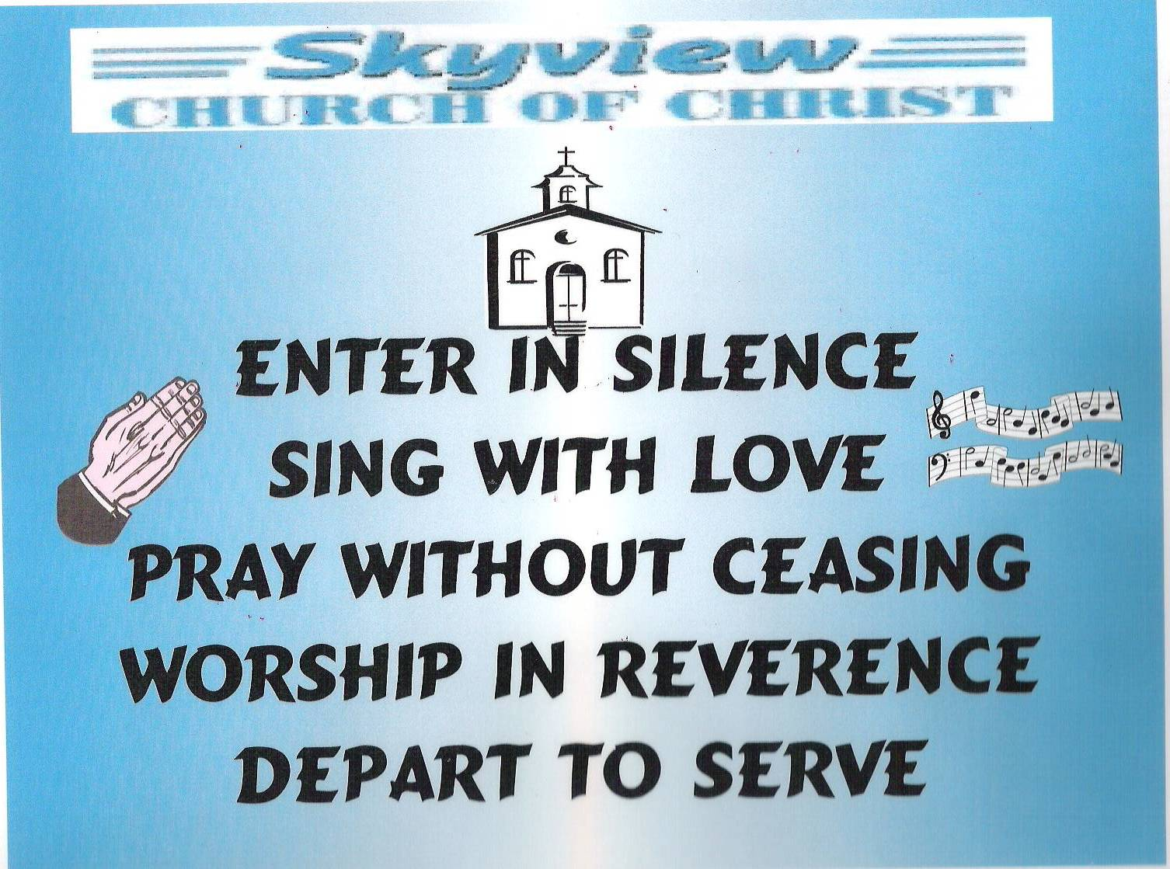
DESIGNED BY JIM INGRAM

Slide 3


Slide 4
TODAY’S WORSHIP LEADERS
CALL TO WORSHIP
PRAYER
SONG LEADER
SCRIPTURE
HEADING TABLE
SERMON
CLOSING PRAYER
ANNOUNCEMENTS
Jim Ingram
Brad VanHaerents
Sander Fletcher
Pat Skidmore
Tom Andrick
Charles Murray
Steve Harrell
Calvin McCoy

Slide 5

MONDAY NIGHT BIBLE STUDY 6:30PM will meet in the West Annex
WEDNESDAY BIBLE STUDY will meet in the West Annex until further notice
LADIES BIBLE CLASS W.I.N.G.S (Women In God’s Service) Thursday 10:00 AM – meets in the West Annex

Slide 6

FIVE MINUTE RULE

Slide 7


Slide 8


Slide 10
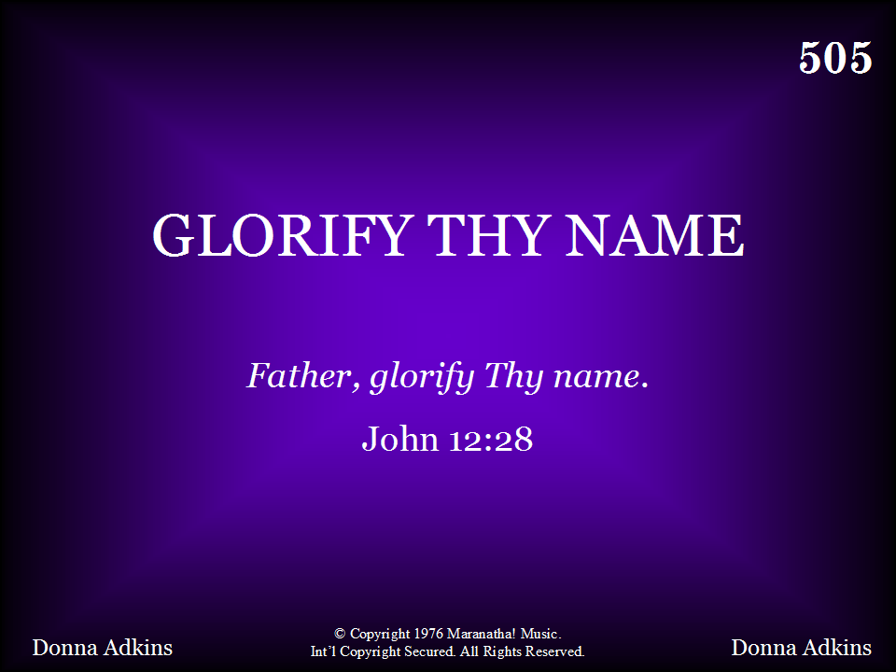
505 - Glorify Thy Name - Title

Slide 11
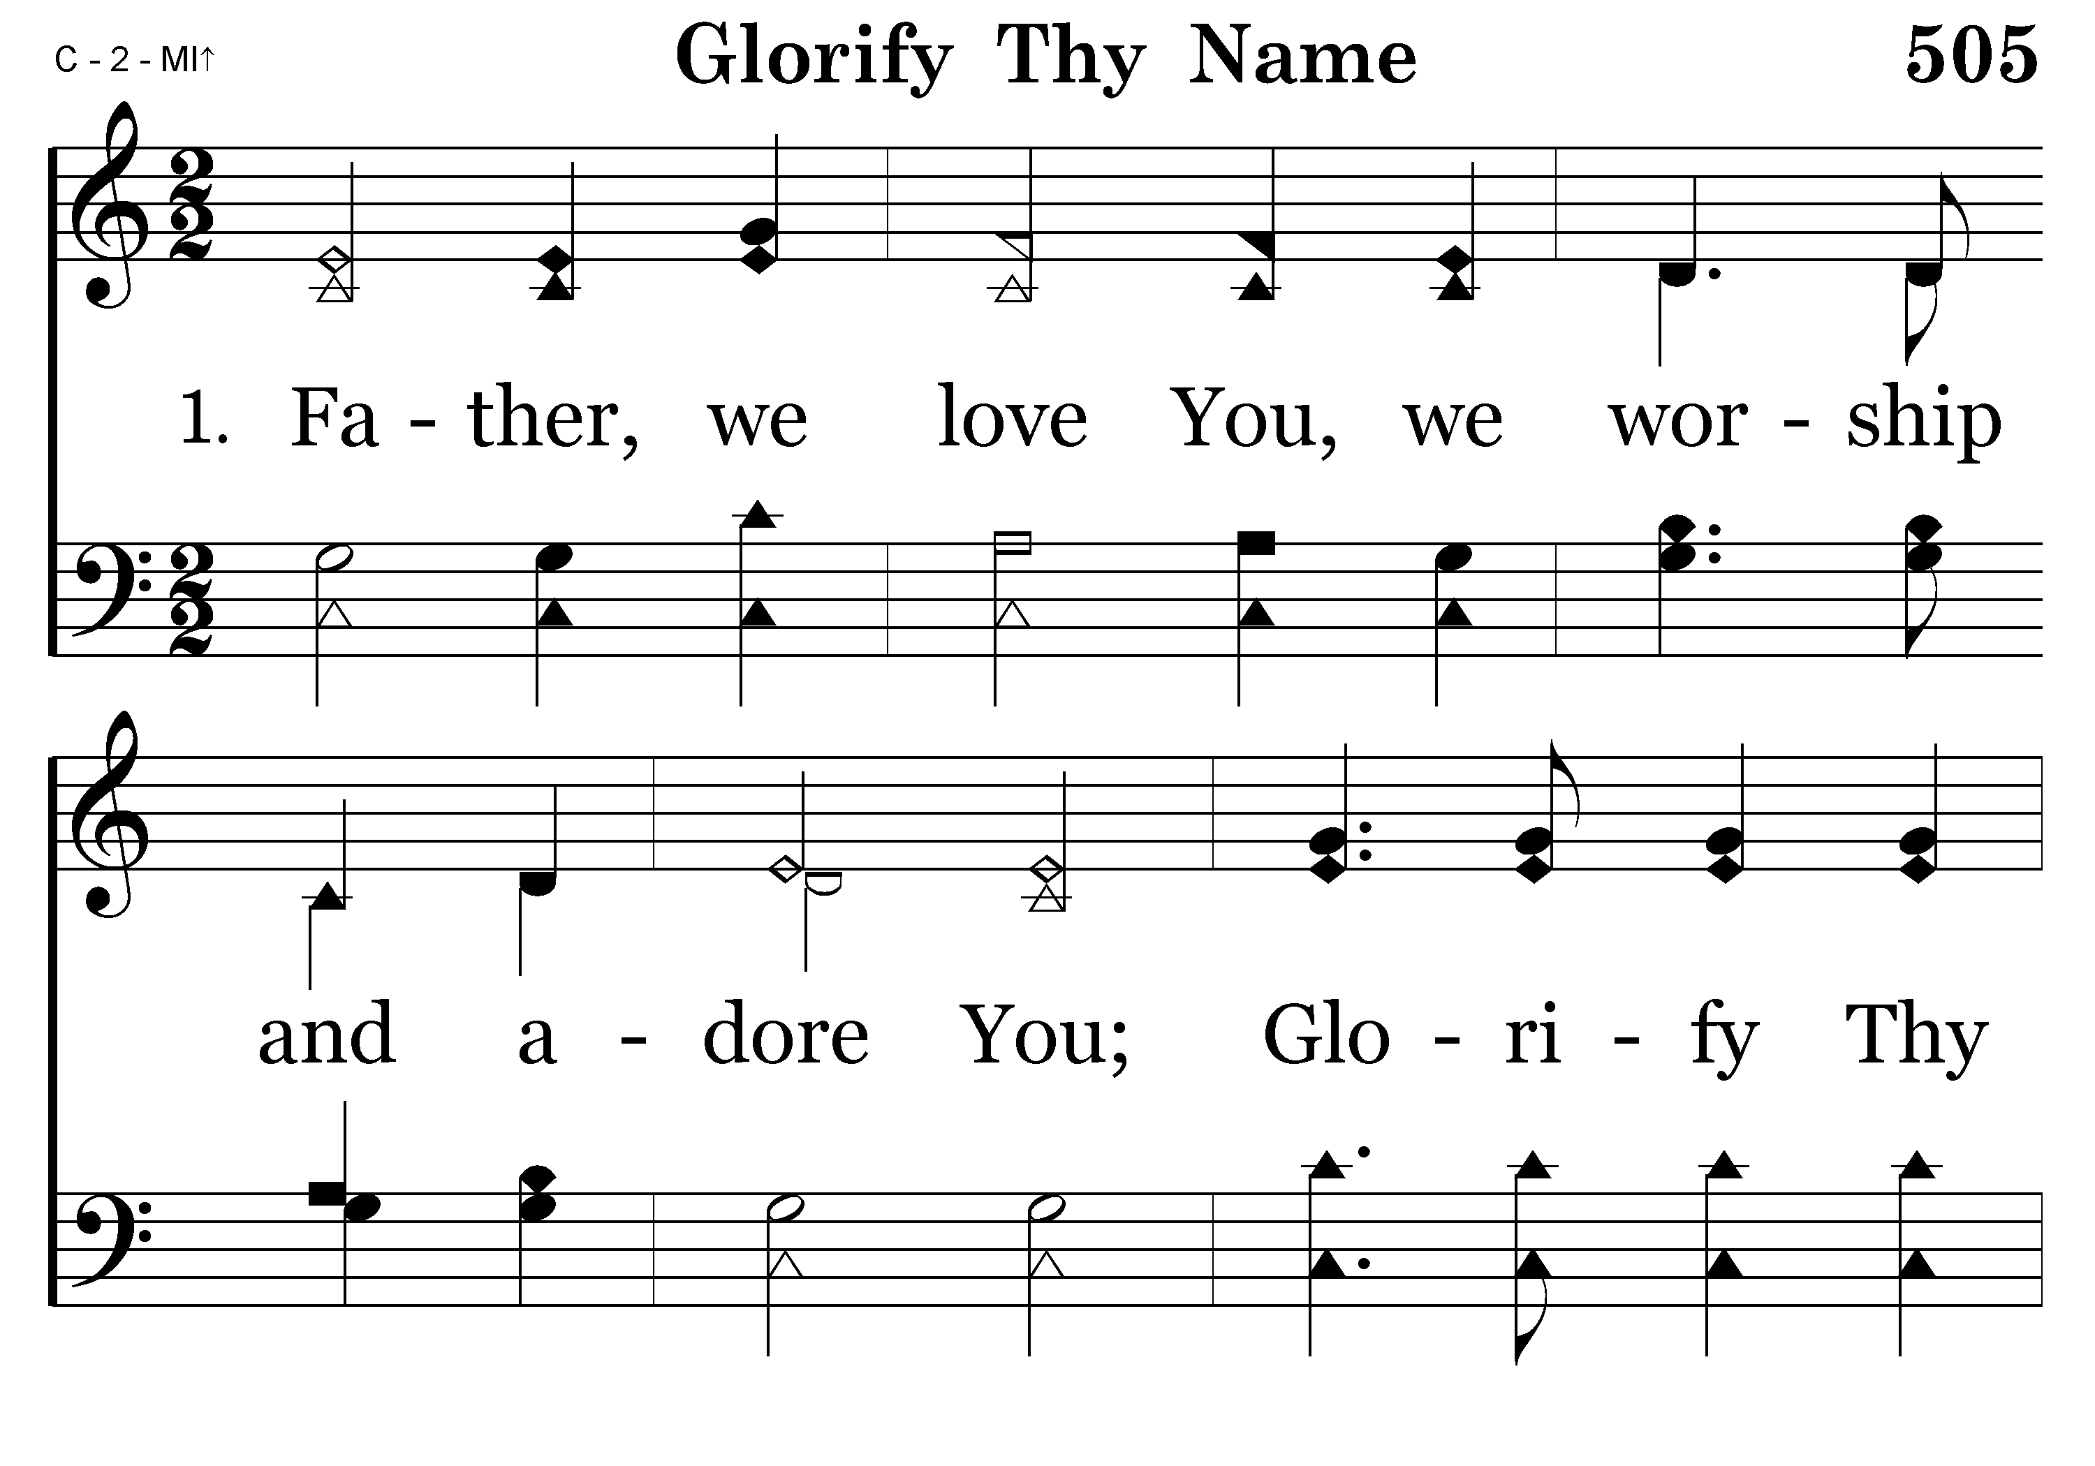
505 - Glorify Thy Name - 1.1

Slide 12
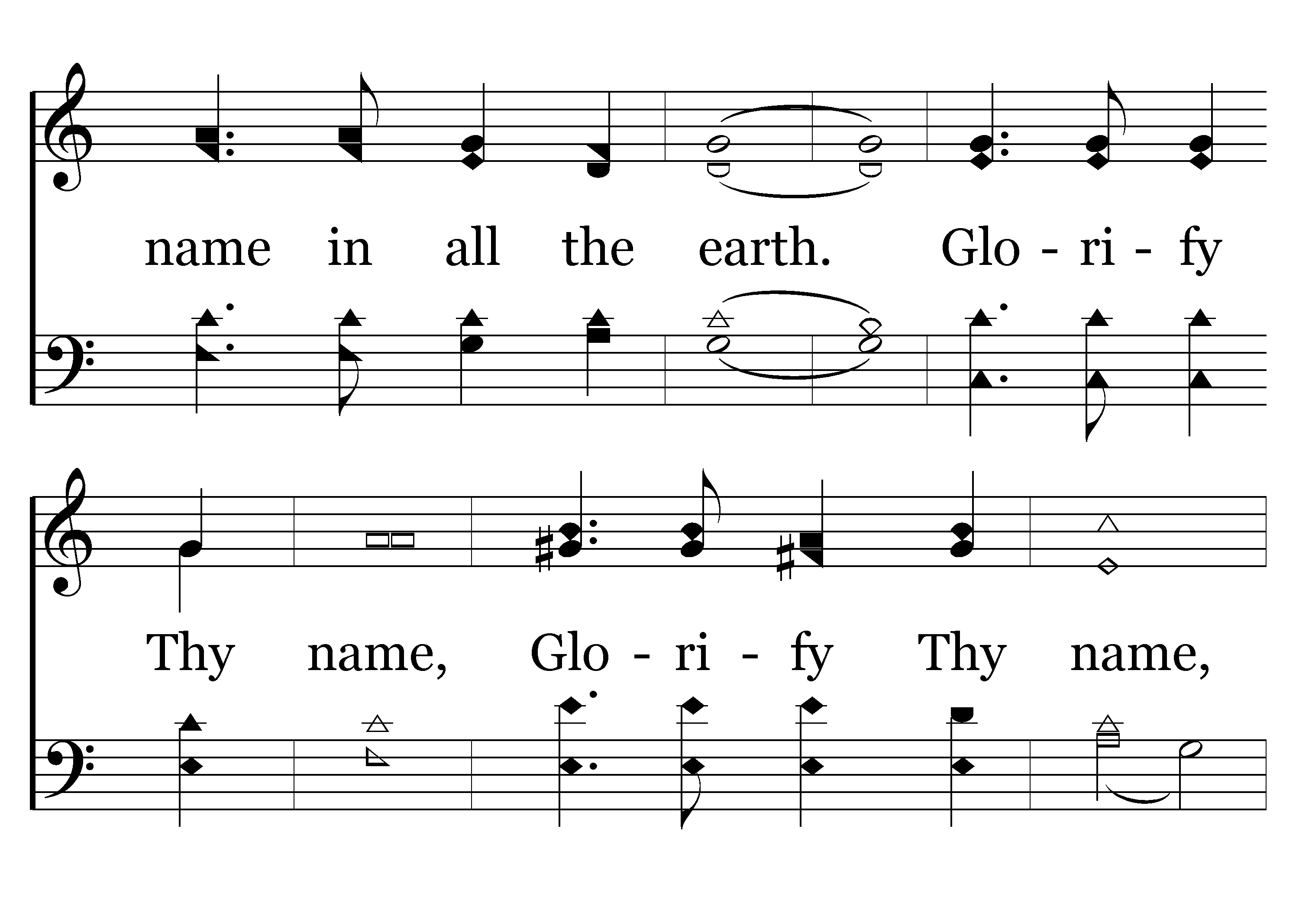
505 - Glorify Thy Name - 1.2

Slide 13
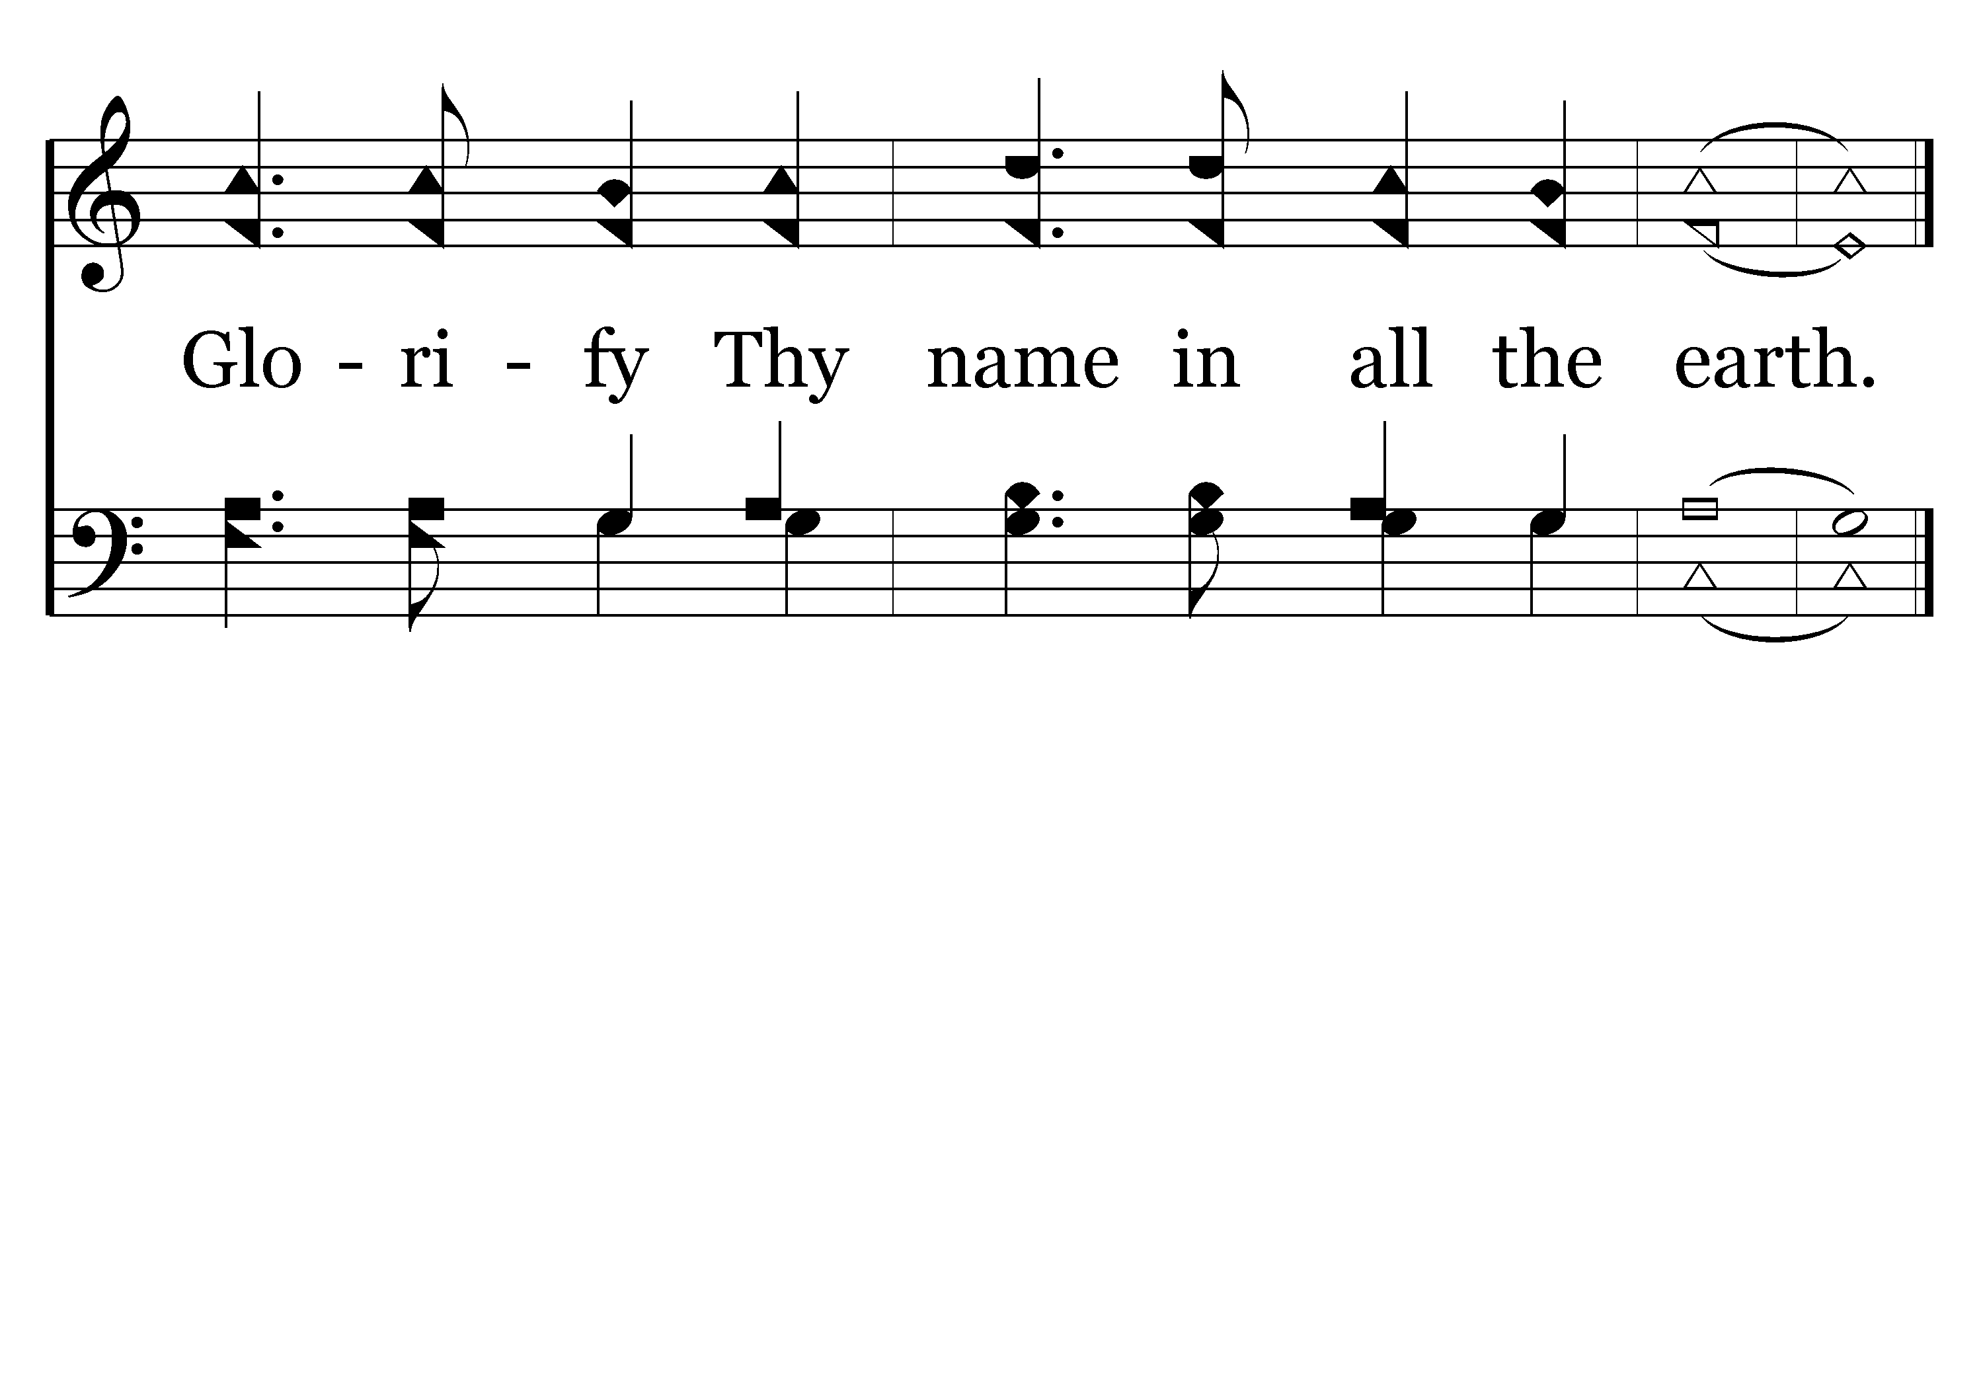
505 - Glorify Thy Name - 1.3
End of Verse 1

Slide 14
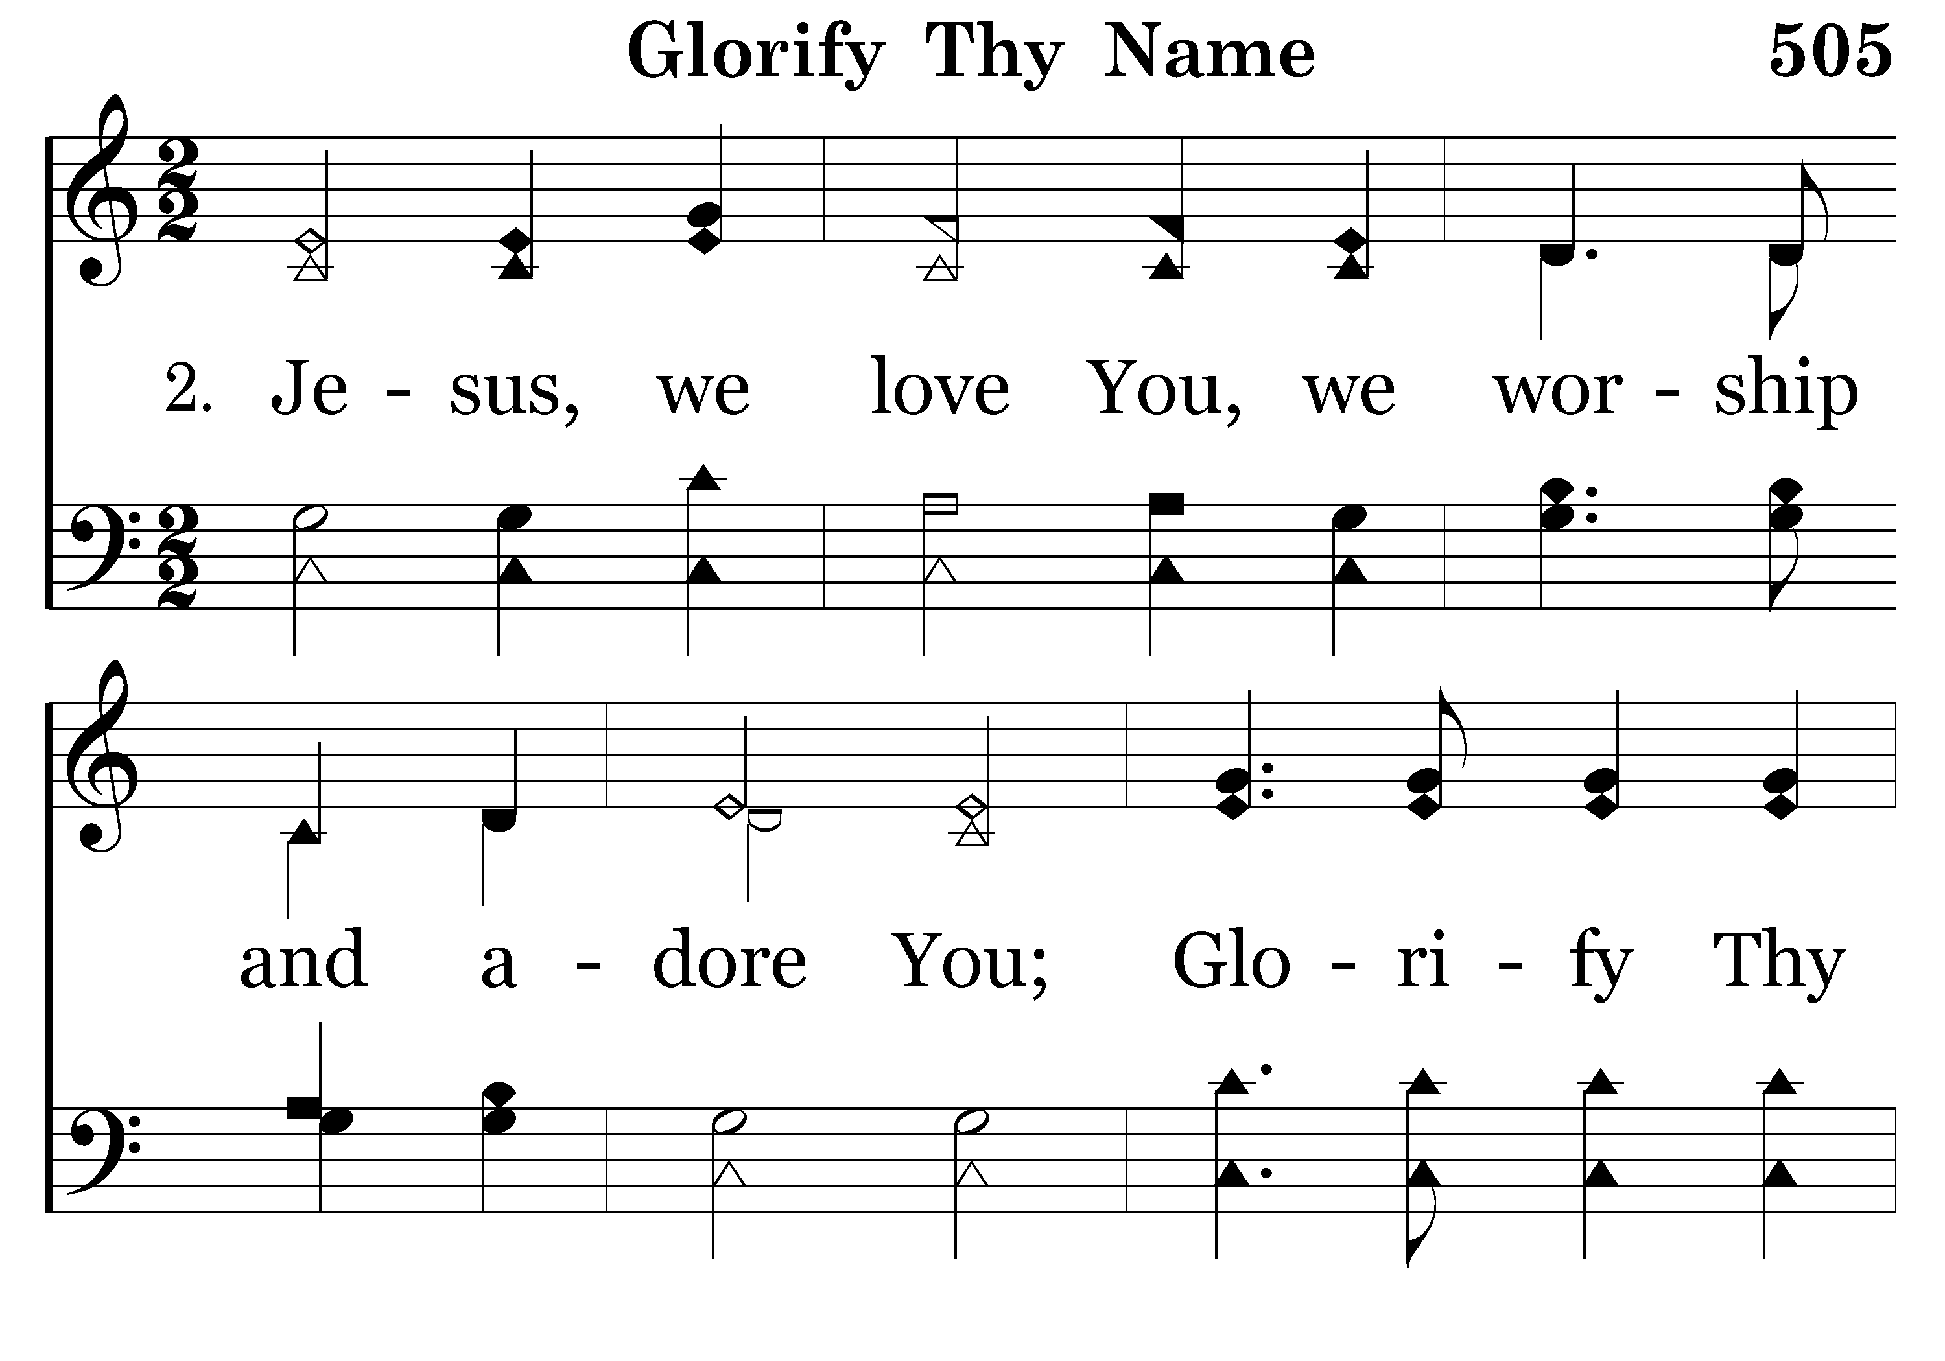
505 - Glorify Thy Name - 2.1

Slide 15
505 - Glorify Thy Name - 2.2

Slide 16
505 - Glorify Thy Name - 2.3
End of Verse 2

Slide 17
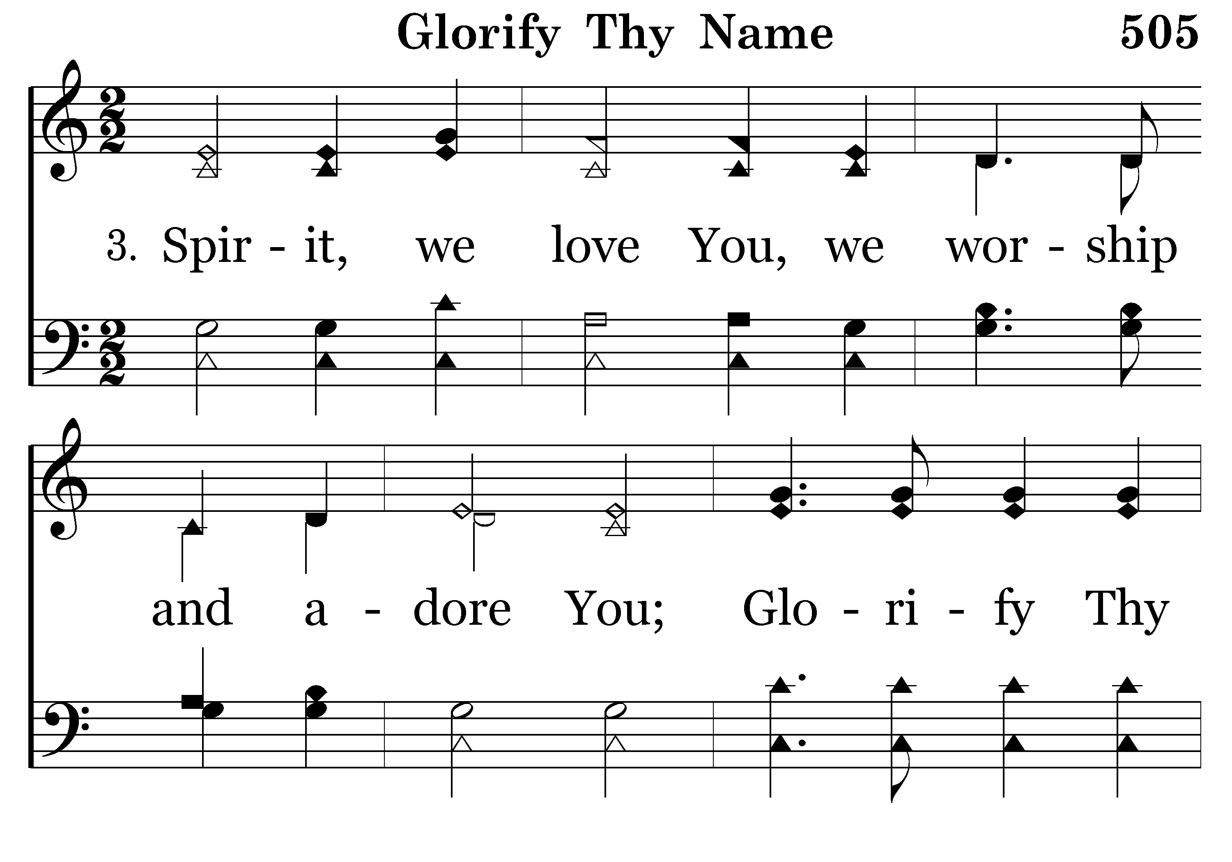
505 - Glorify Thy Name - 3.1

Slide 18
505 - Glorify Thy Name - 3.2

Slide 19
505 - Glorify Thy Name - 3.3

Slide 20
505 - Glorify Thy Name - 3.3
End of Song

Slide 21


Slide 22

PRAYER
Jerry Mellish
LED BY BRAD VANHAERENTS

Slide 24
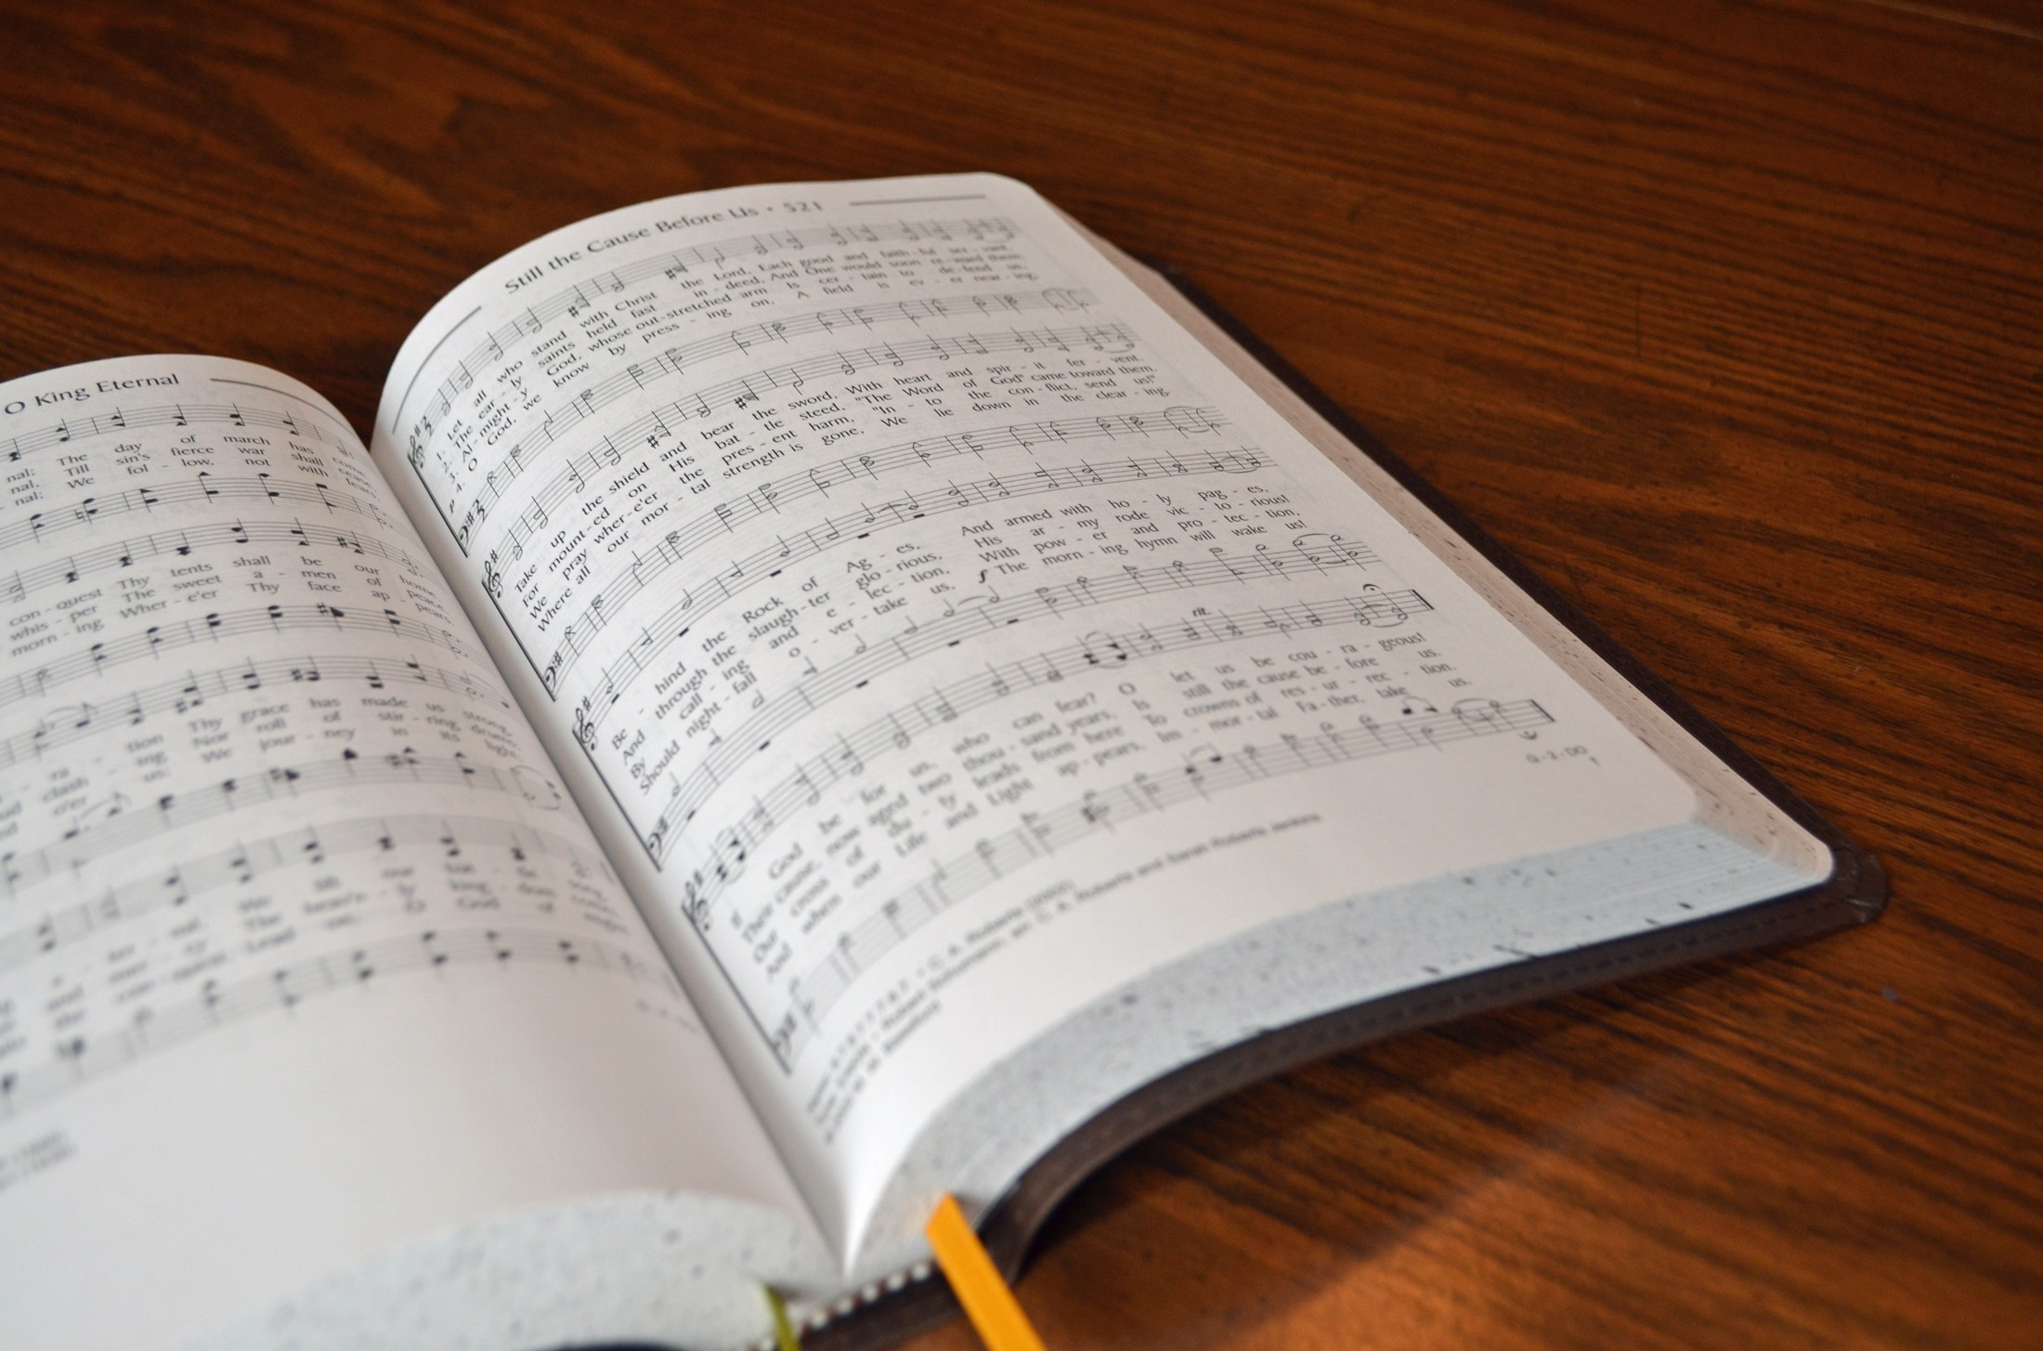
SONG LEADER
SANDER FLETCHER

Slide 25
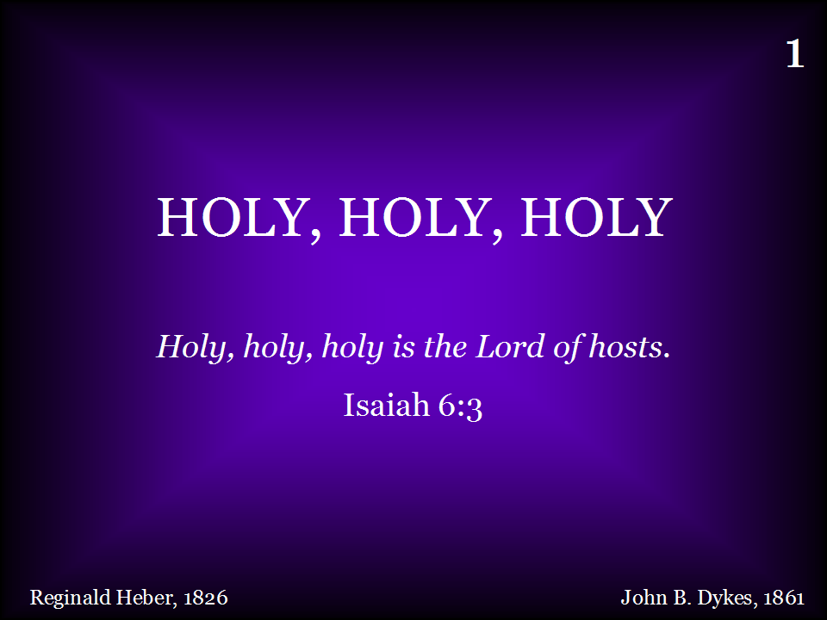
001 - Holy, Holy, Holy - Title

Slide 26
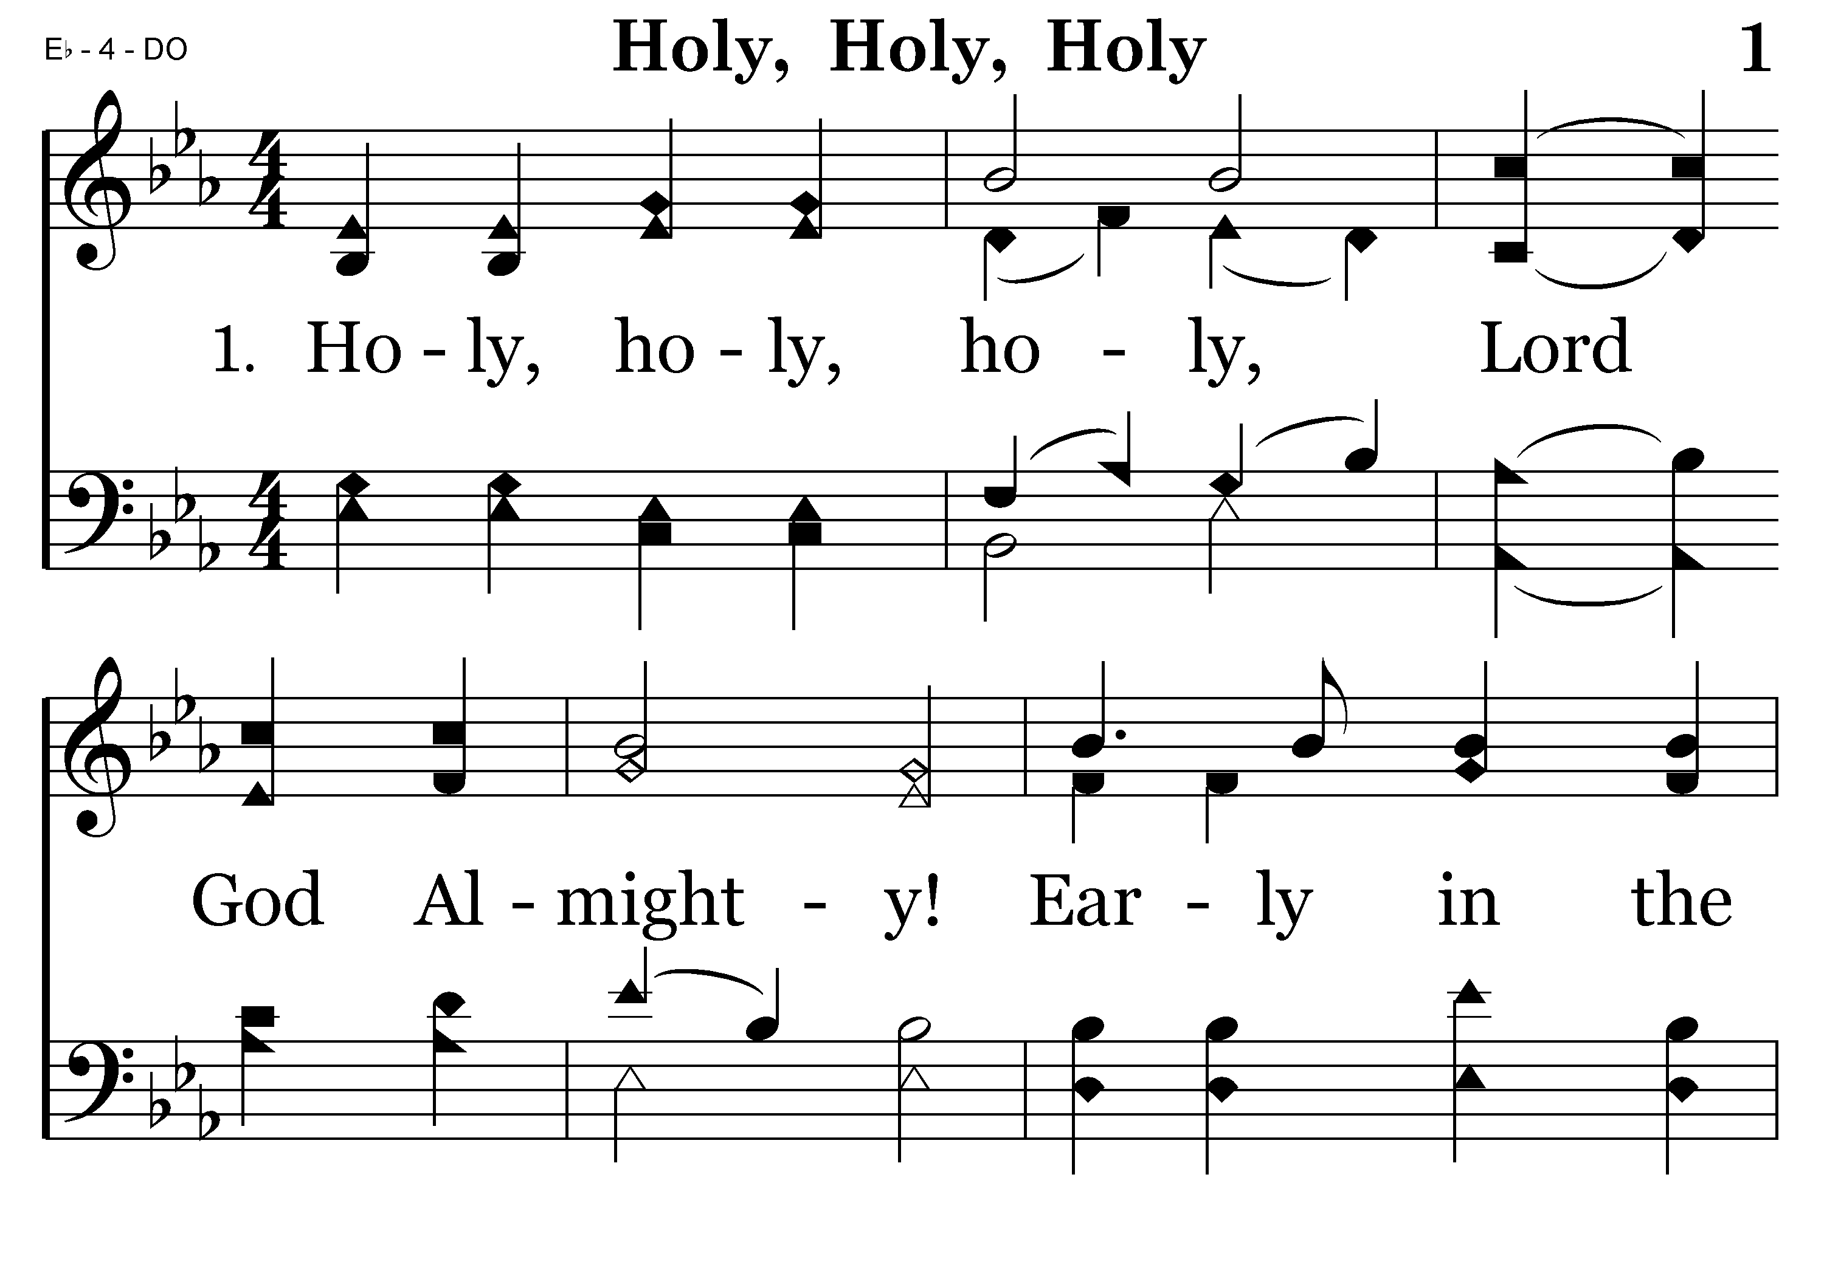
001 - Holy, Holy, Holy - 1.1

Slide 27
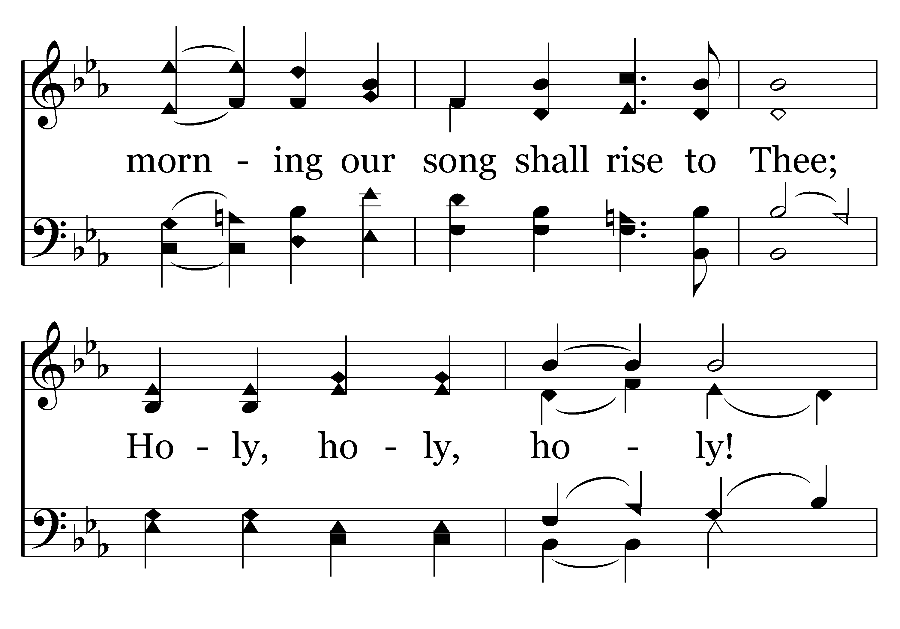
001 - Holy, Holy, Holy - 1.2

Slide 28
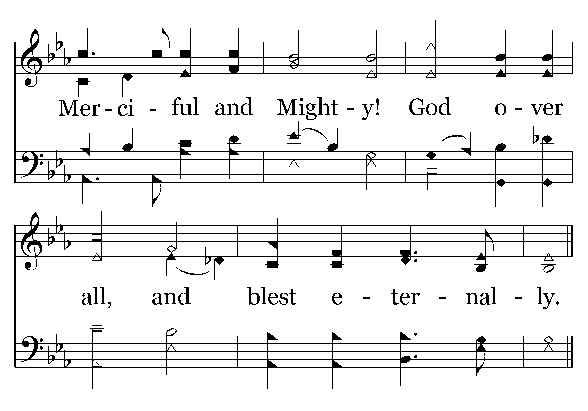
001 - Holy, Holy, Holy - 1.3
End of Verse 1

Slide 29
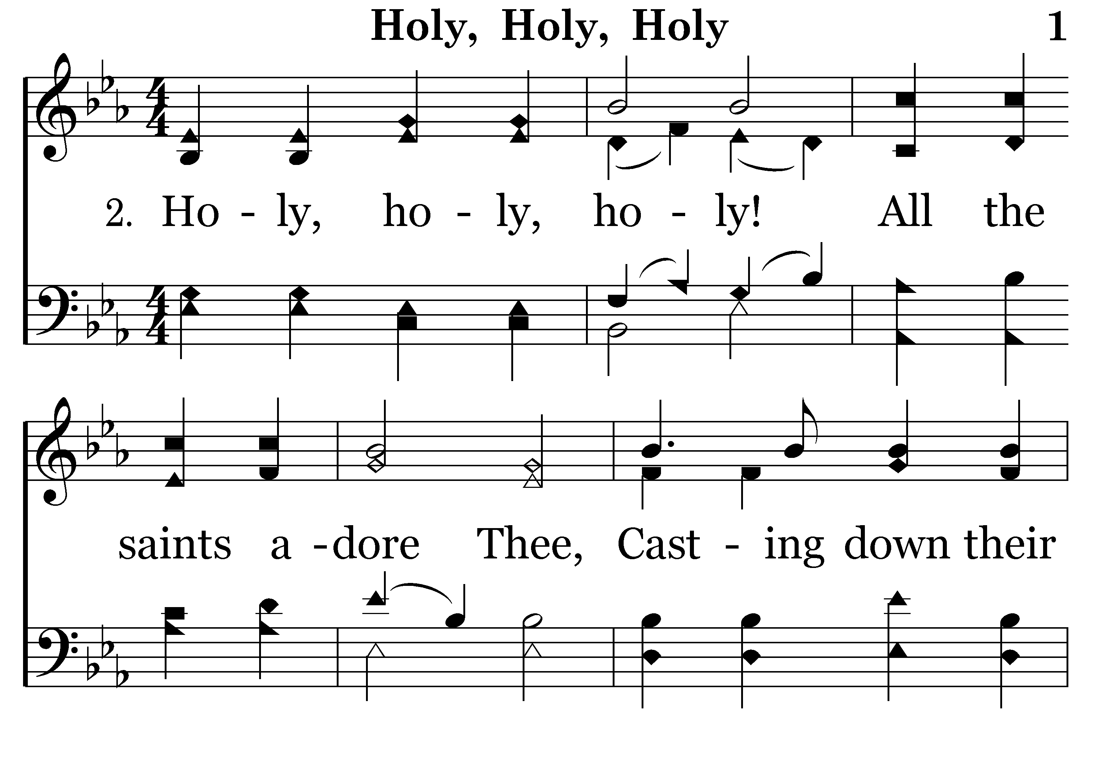
001 - Holy, Holy, Holy - 2.1

Slide 30
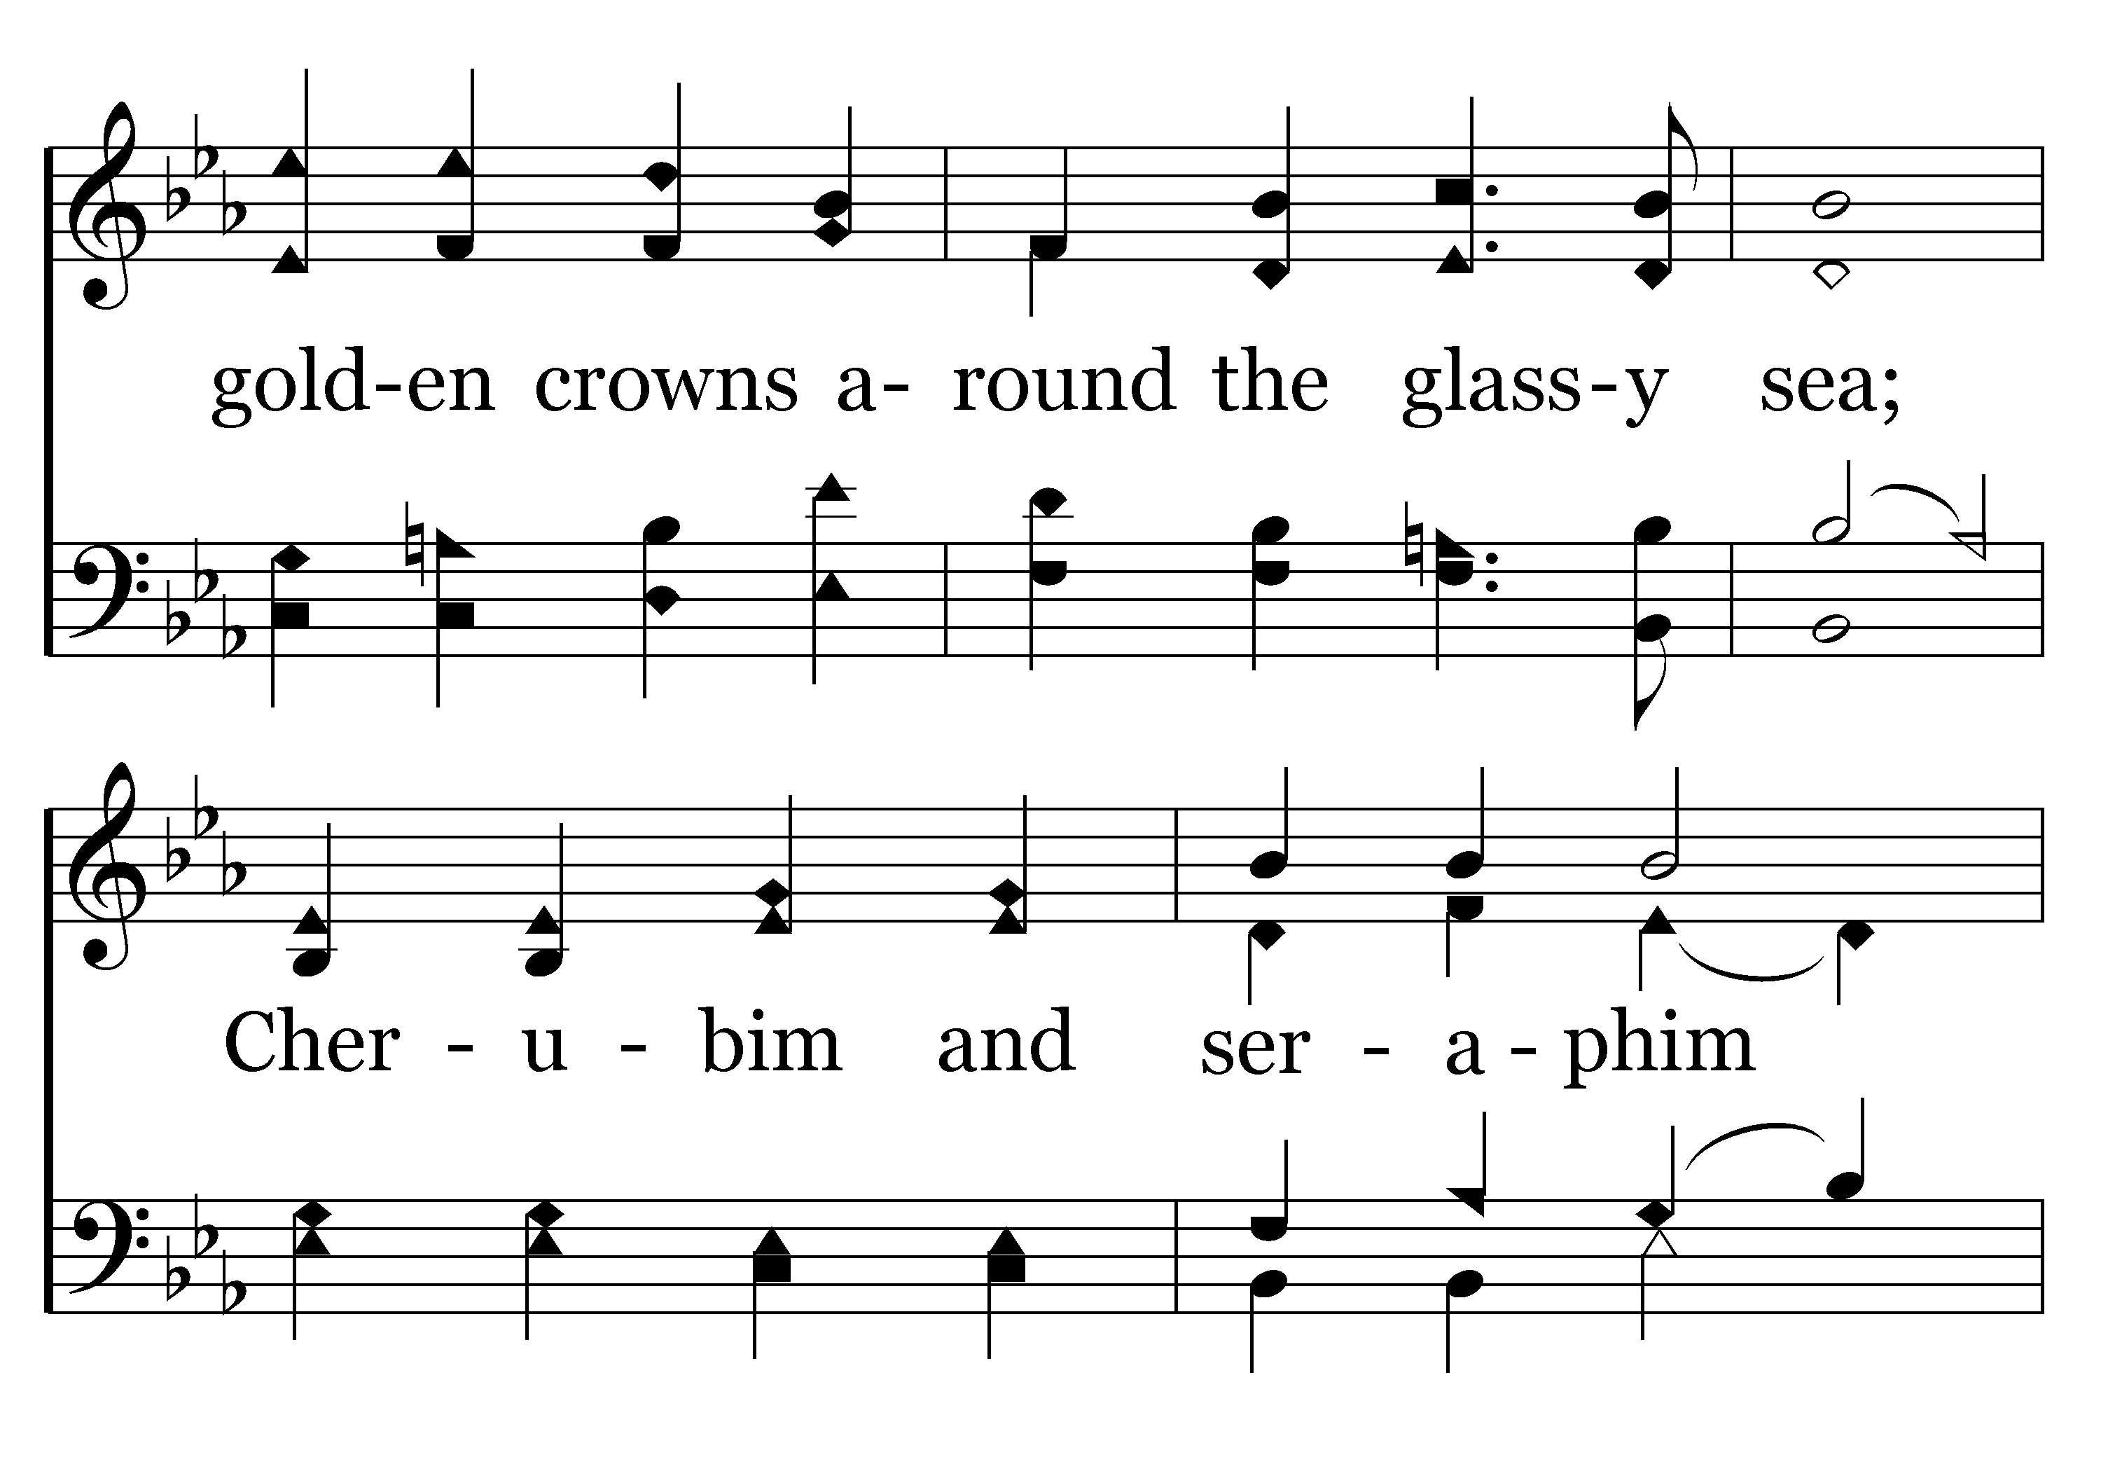
001 - Holy, Holy, Holy - 2.2

Slide 31
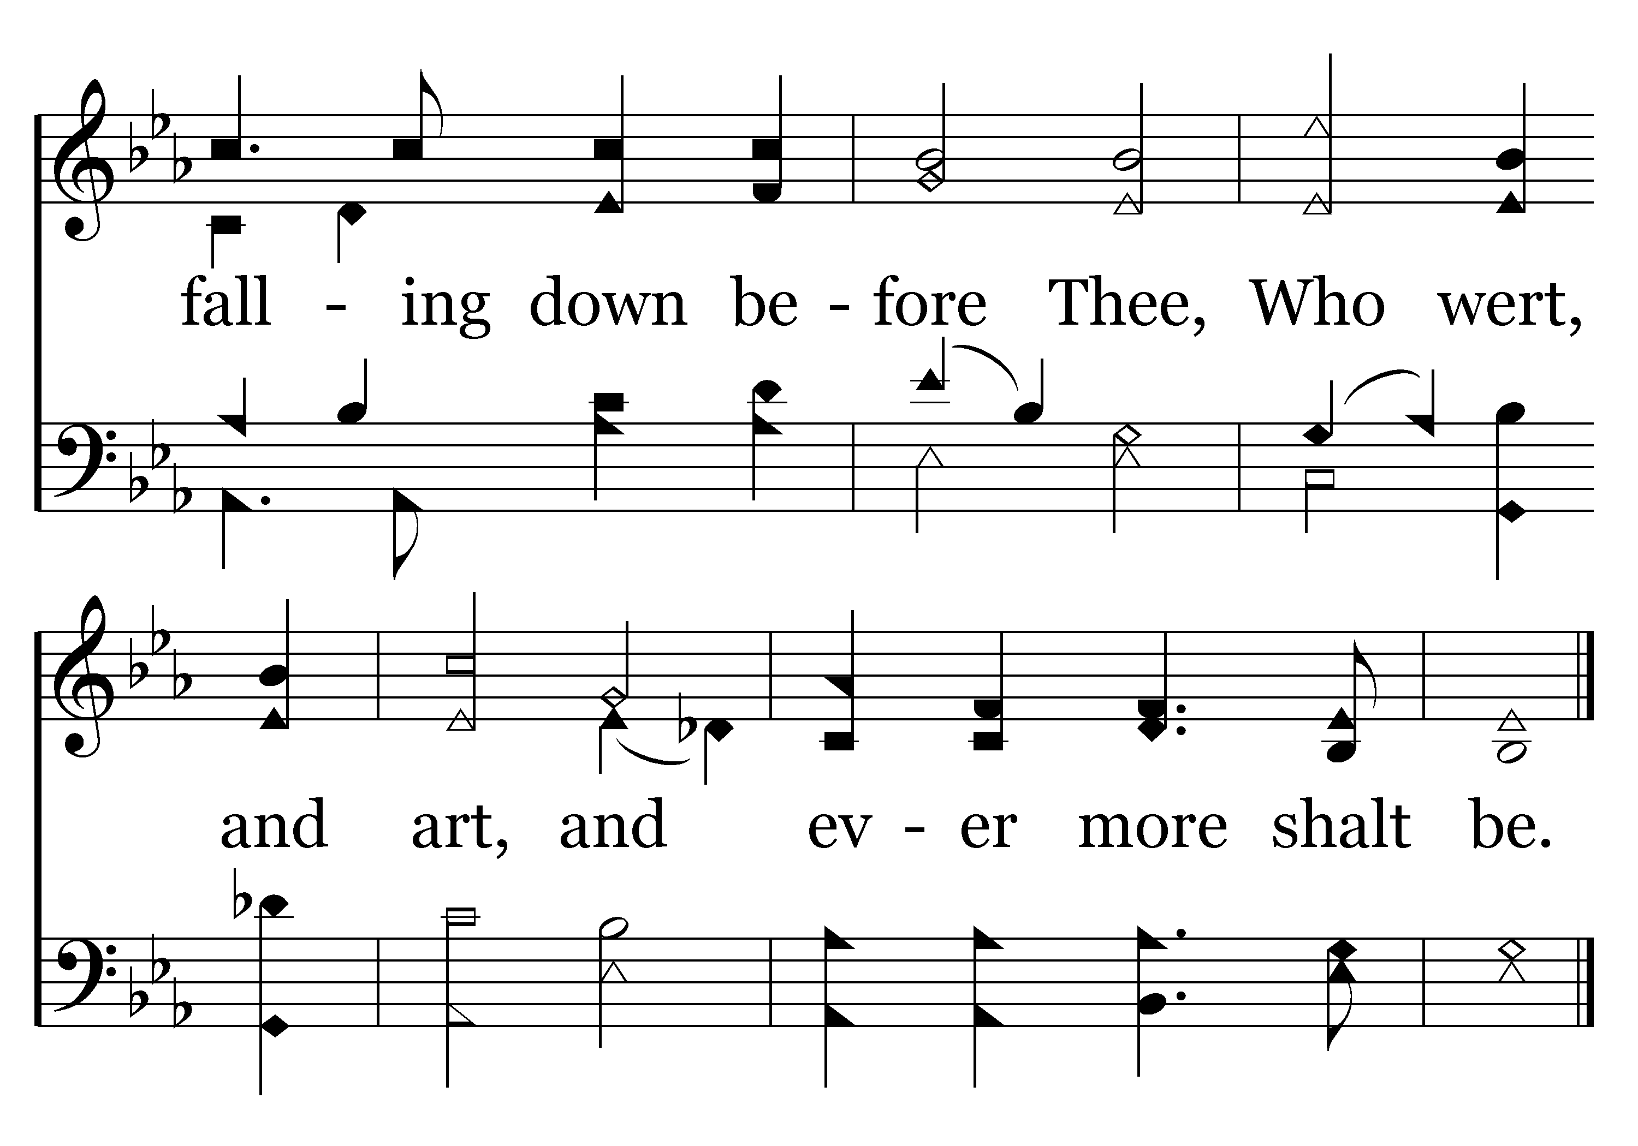
001 - Holy, Holy, Holy - 2.3
End of Verse 2

Slide 32
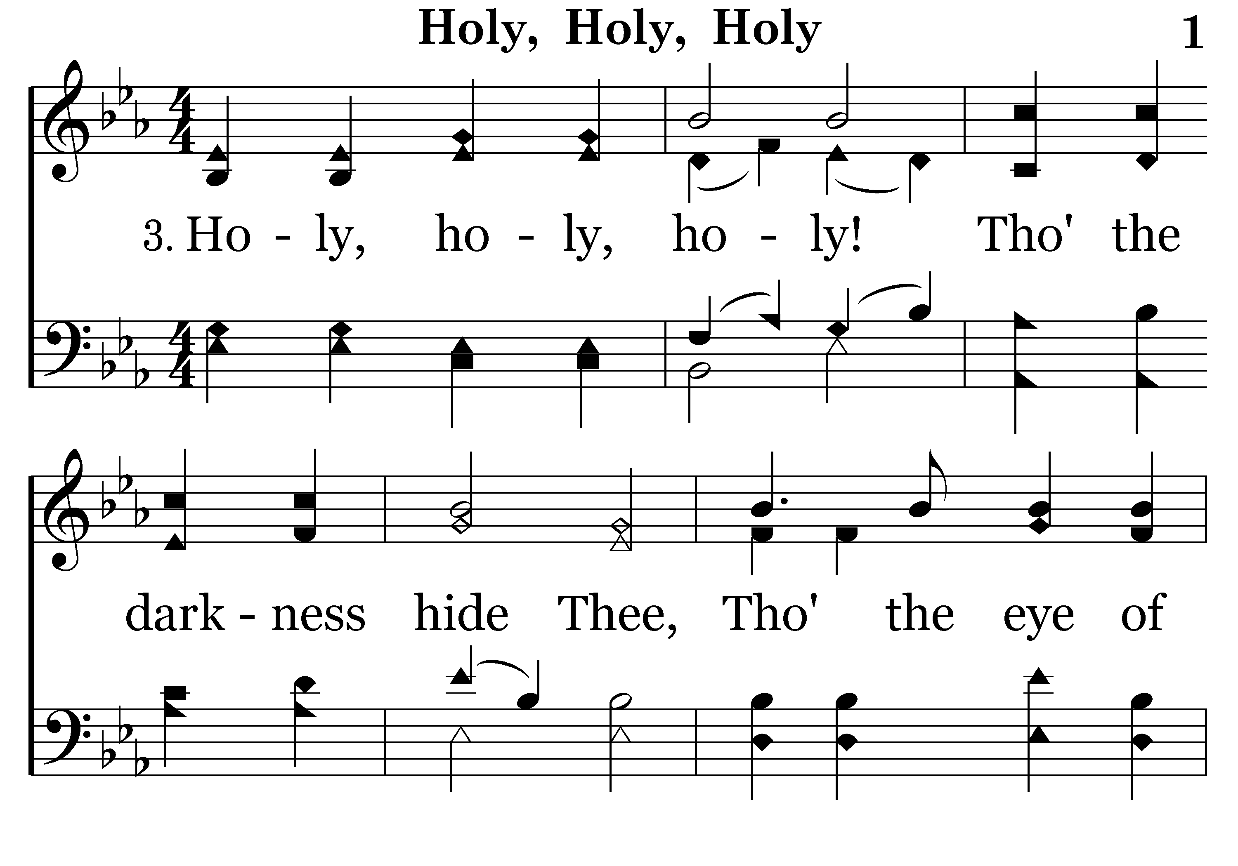
001 - Holy, Holy, Holy - 3.1

Slide 33
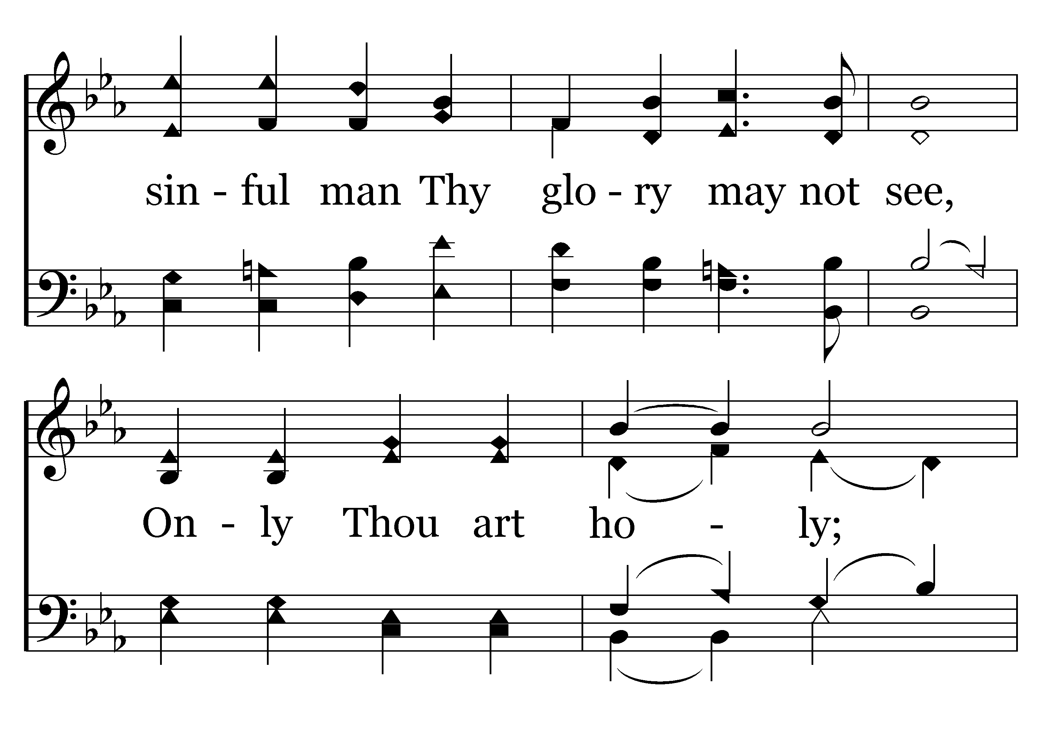
001 - Holy, Holy, Holy - 3.2

Slide 34
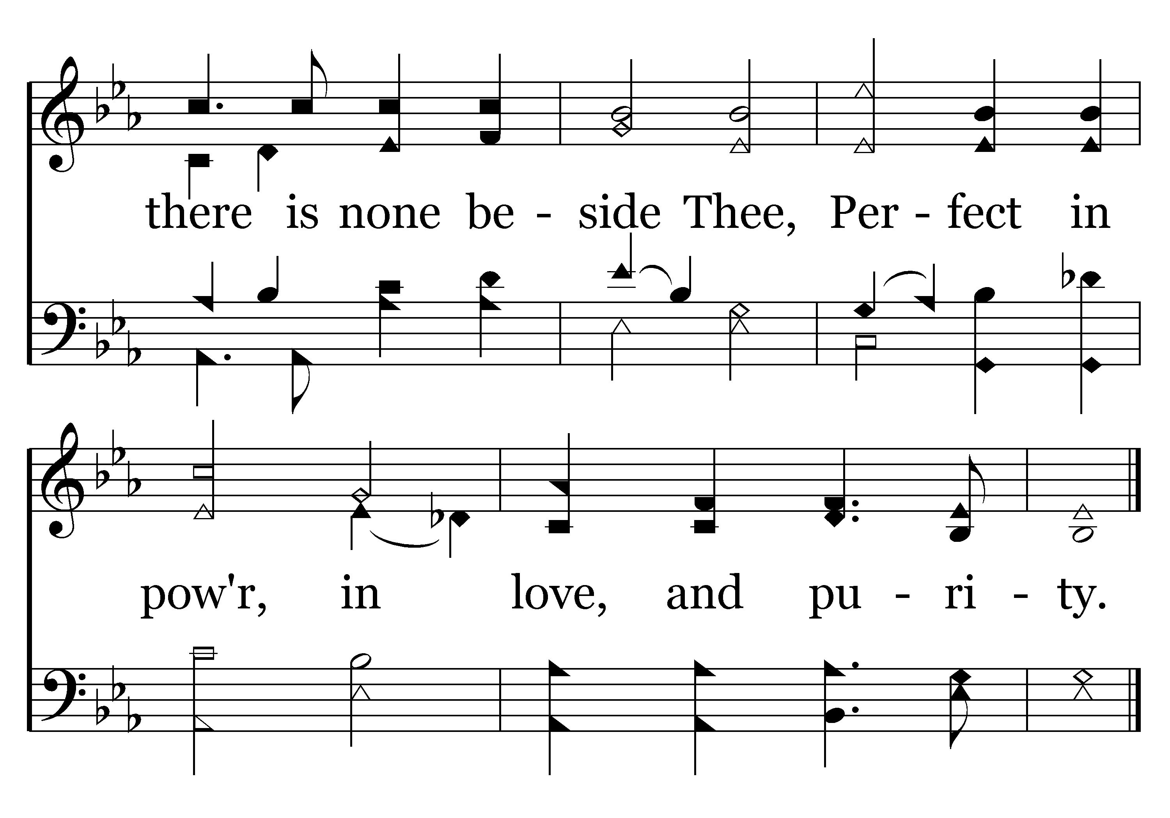
001 - Holy, Holy, Holy - 3.3
End of Verse 3

Slide 35
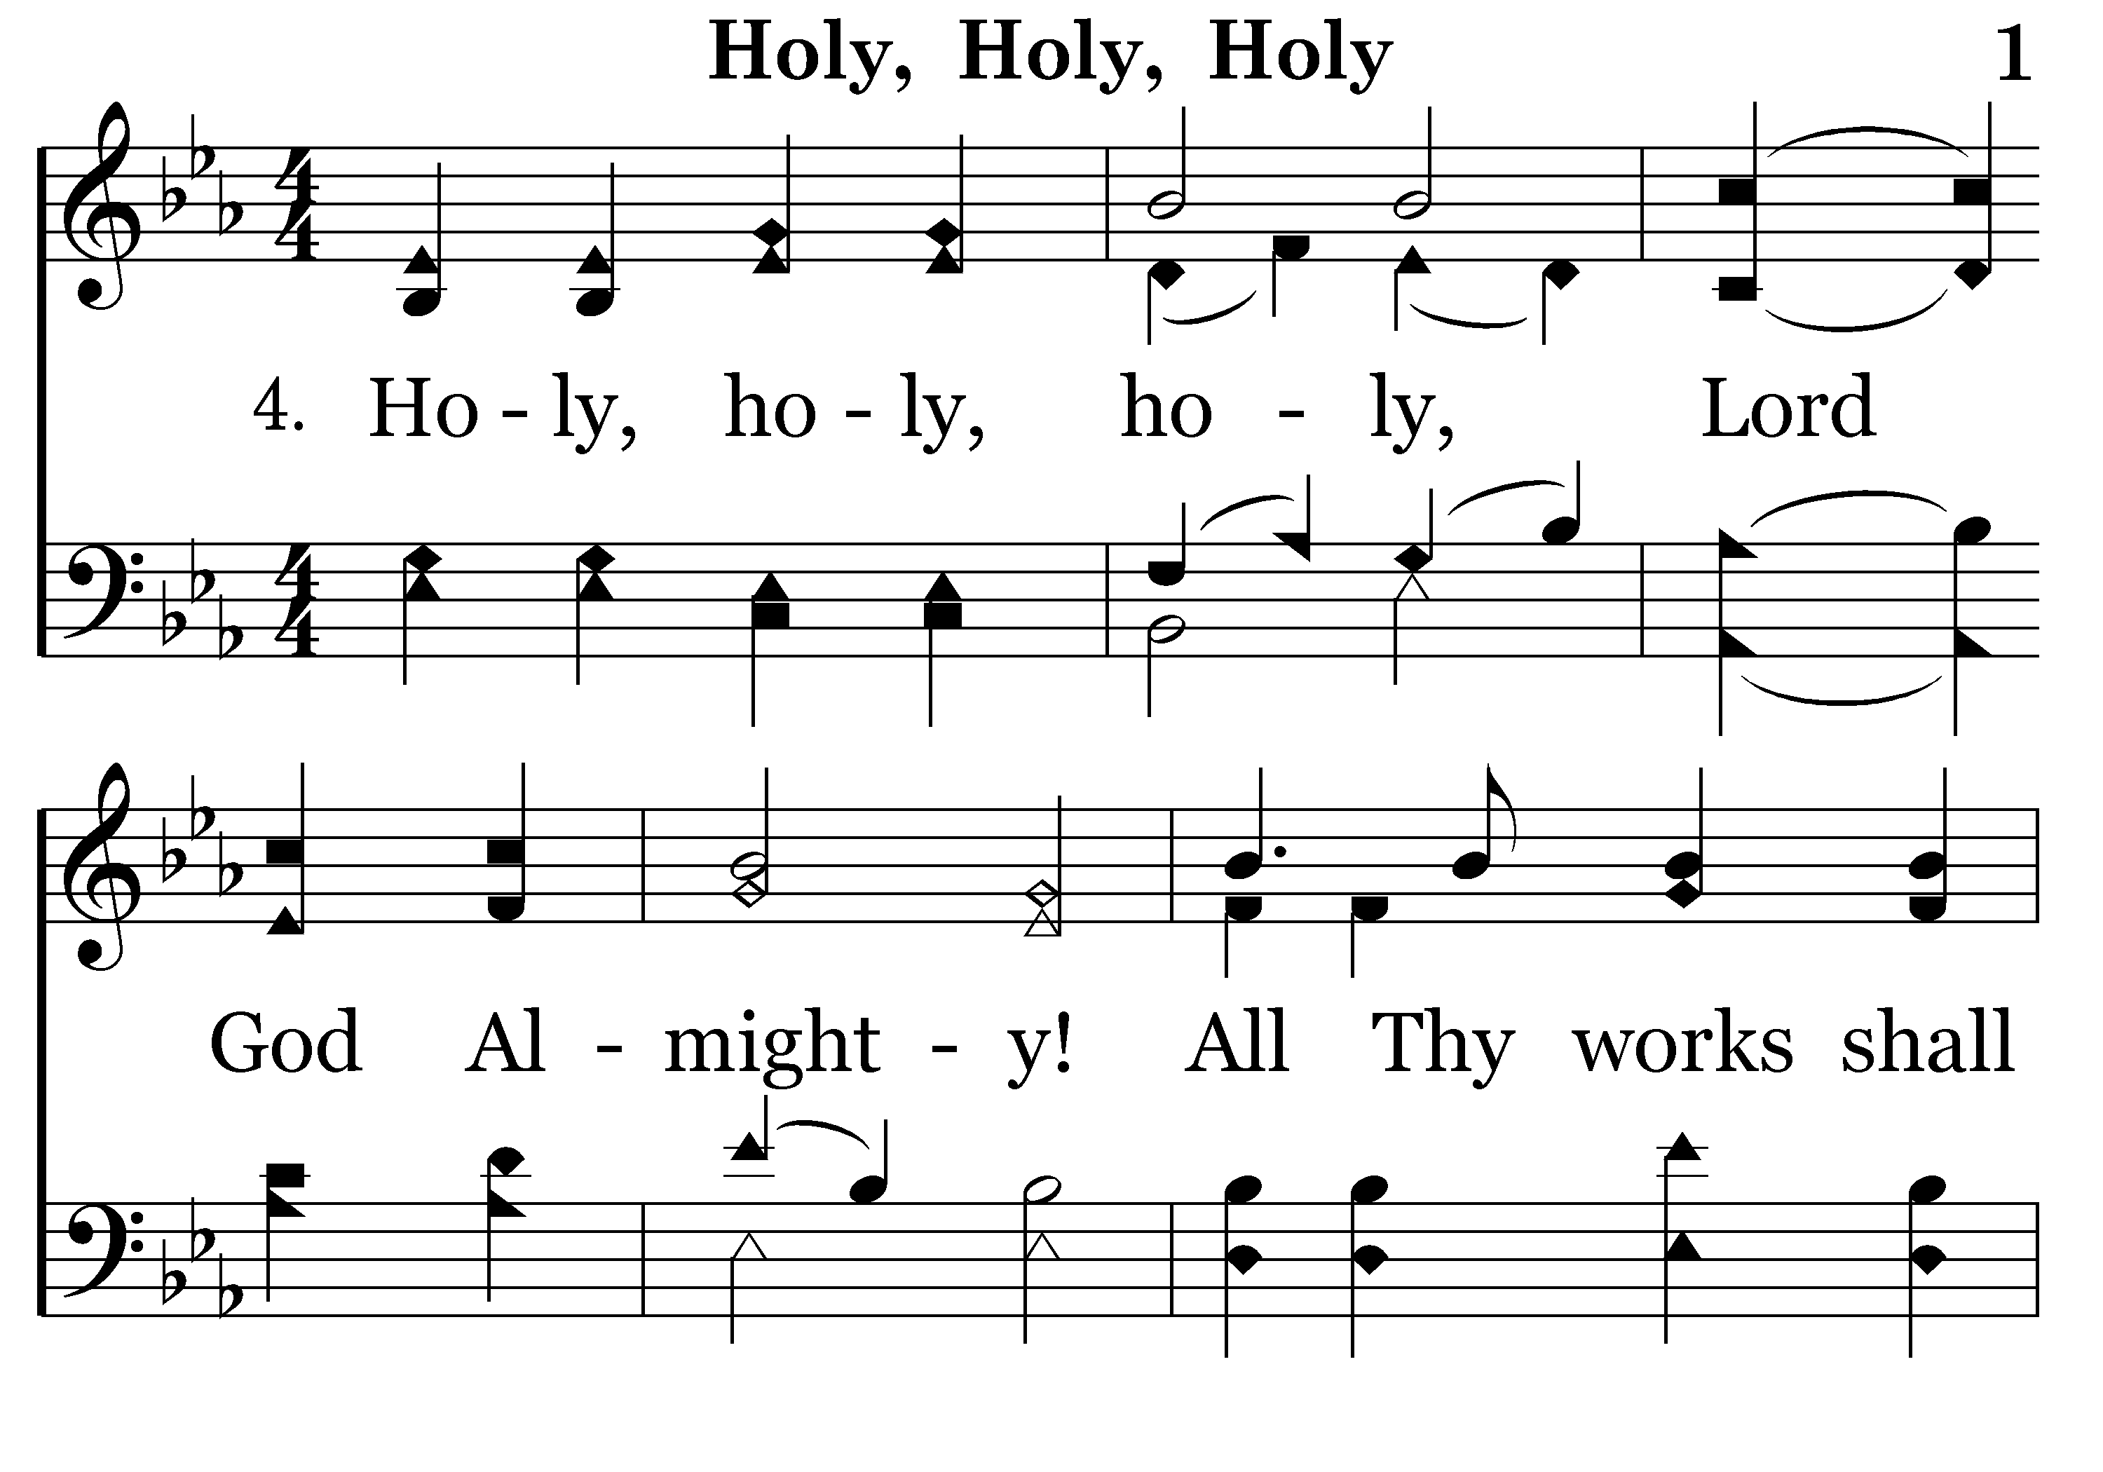
001 - Holy, Holy, Holy - 4.1

Slide 36
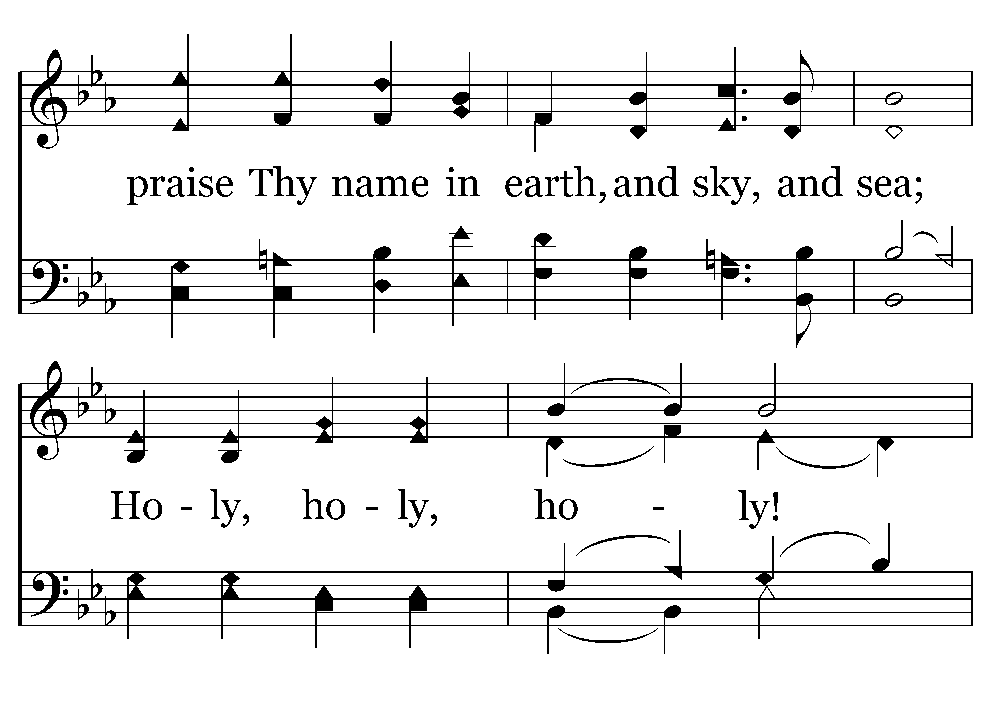
001 - Holy, Holy, Holy - 4.2

Slide 37
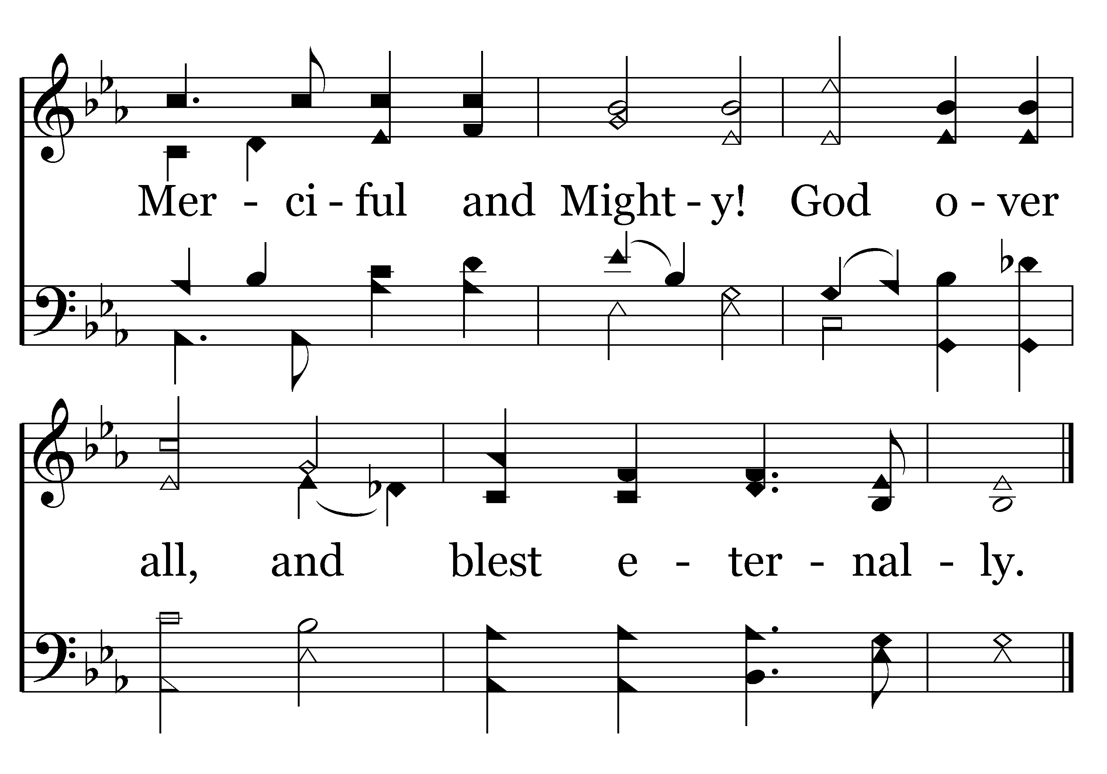
001 - Holy, Holy, Holy - 4.3
End of Song

Slide 39
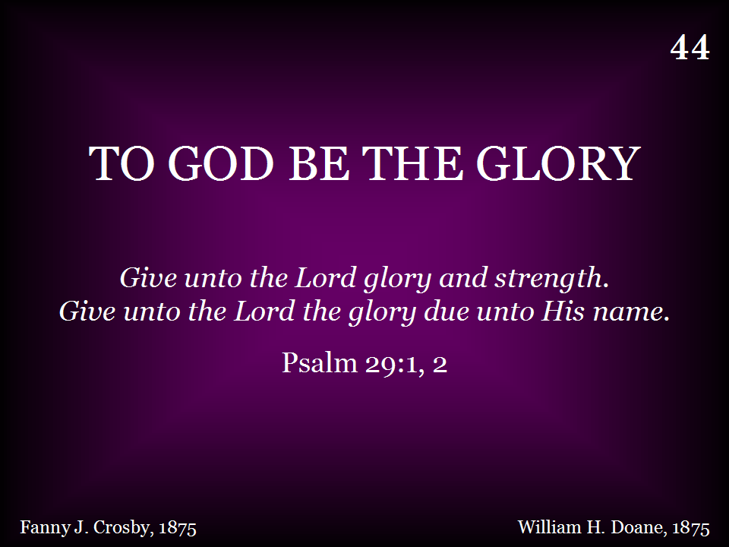
044 - To God Be The Glory - Title

Slide 40
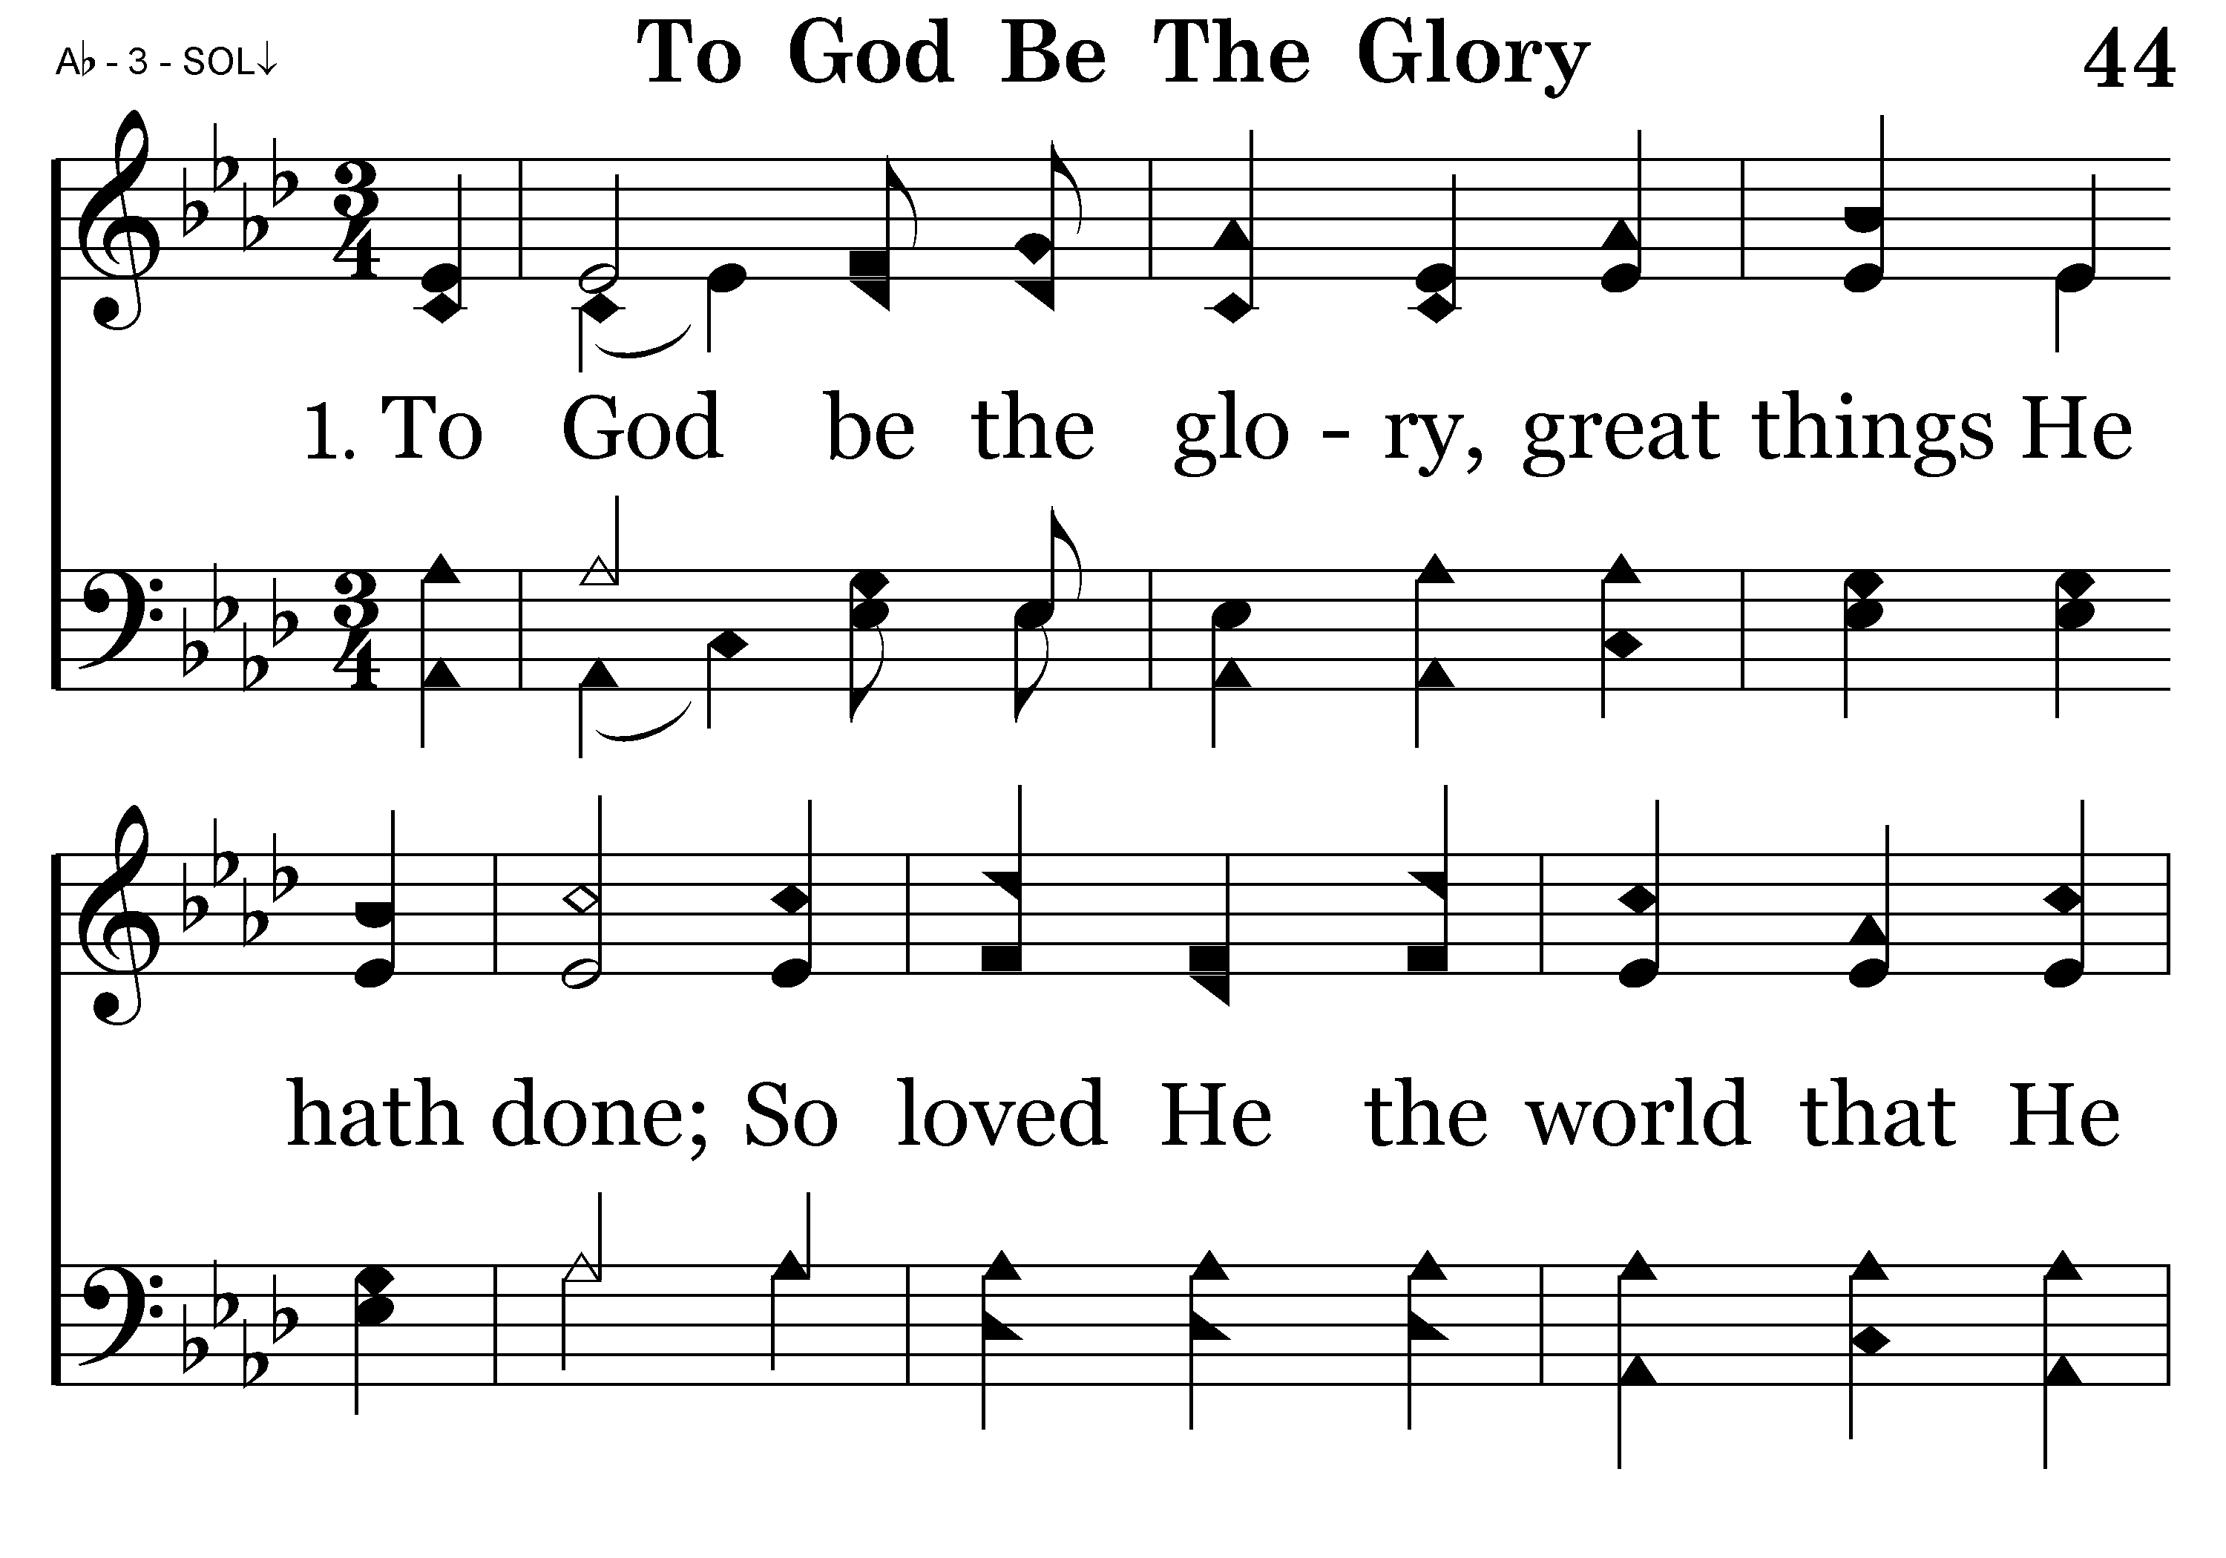
044 - To God Be The Glory - 1.1

Slide 41
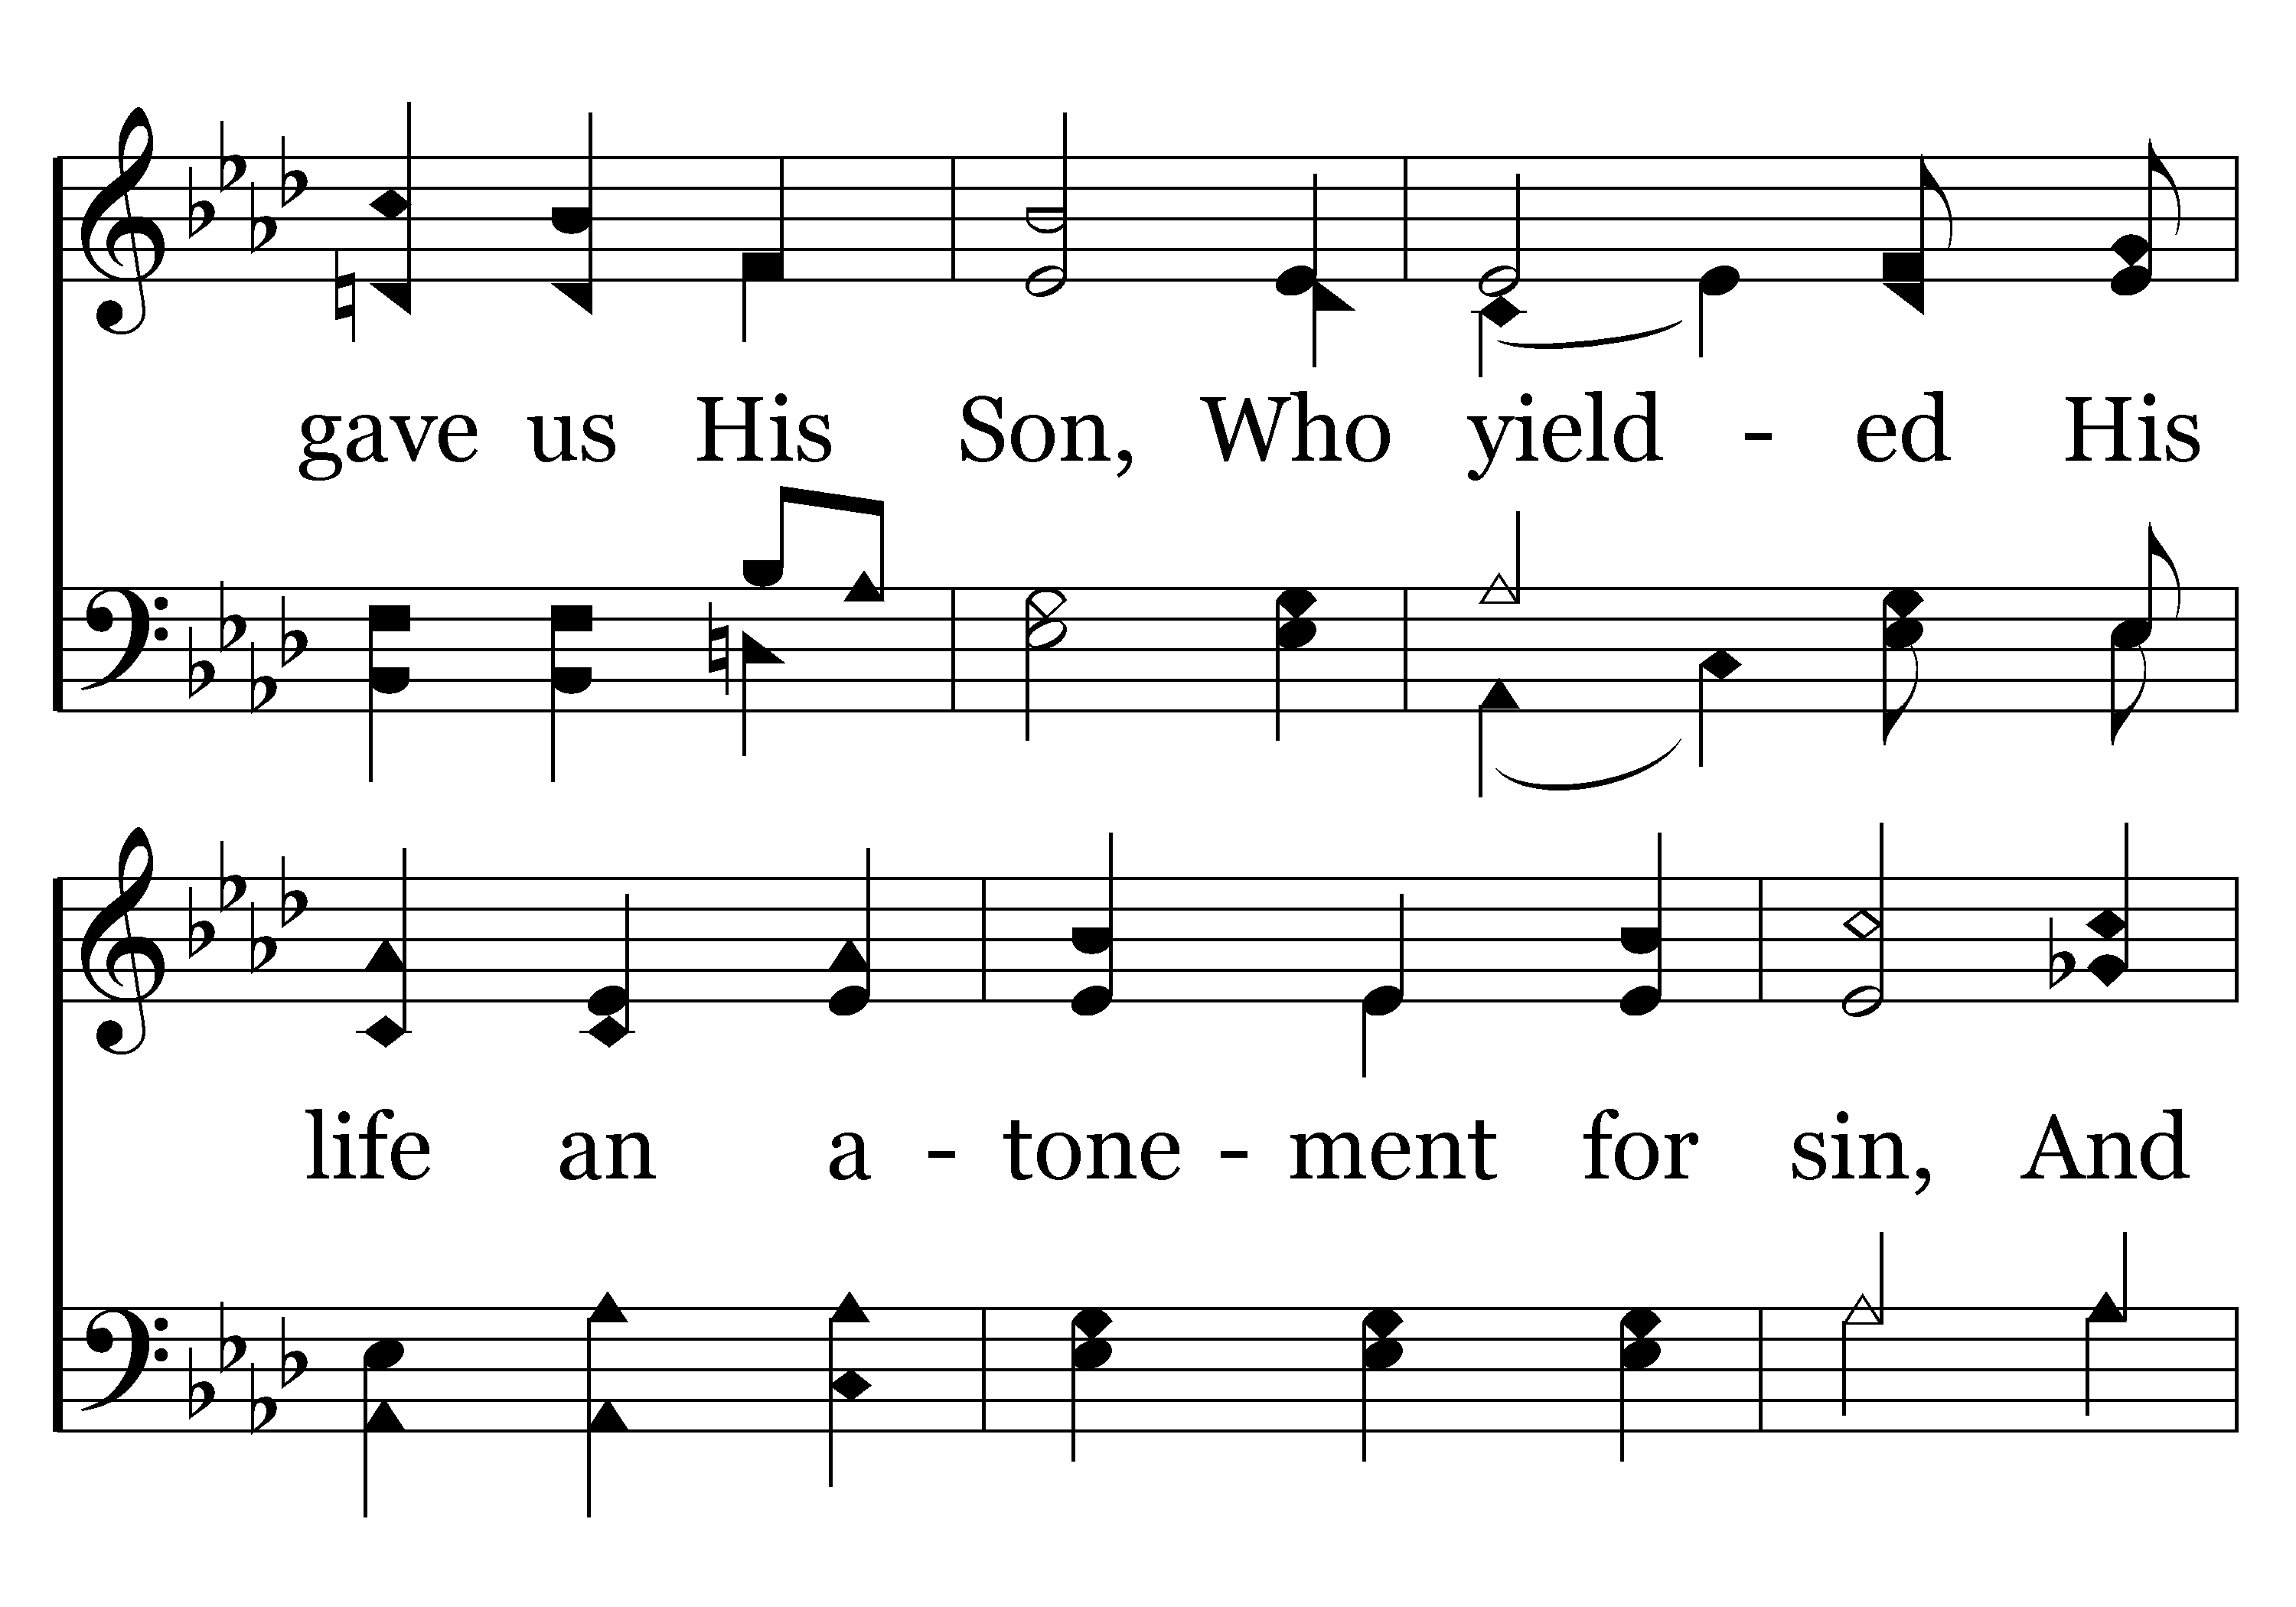
044 - To God Be The Glory - 1.2

Slide 42
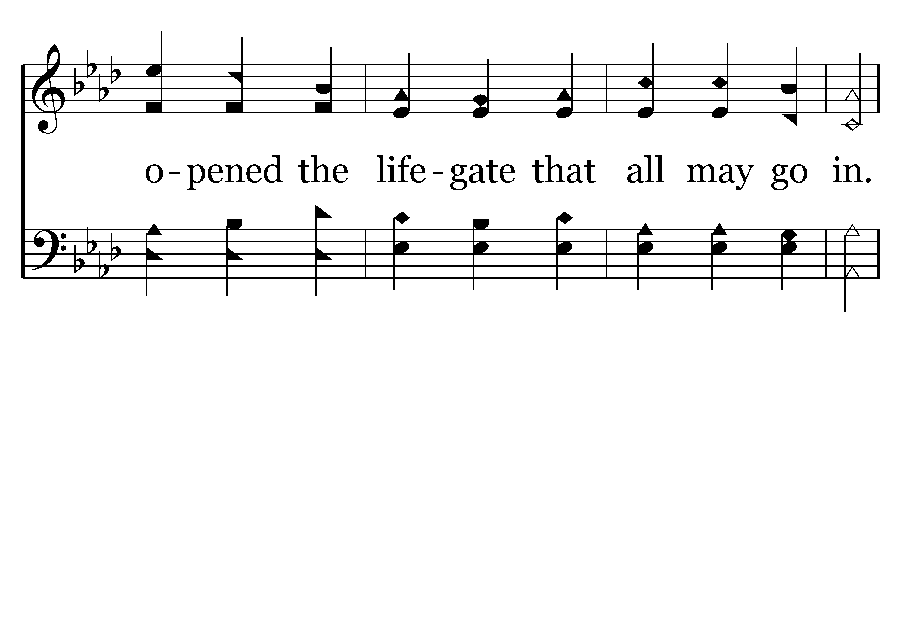
044 - To God Be The Glory - 1.3

Slide 43
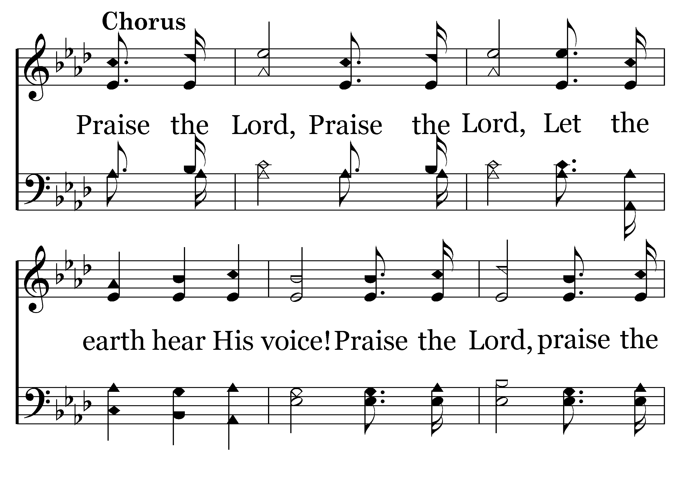
044 - To God Be The Glory - C.1

Slide 44
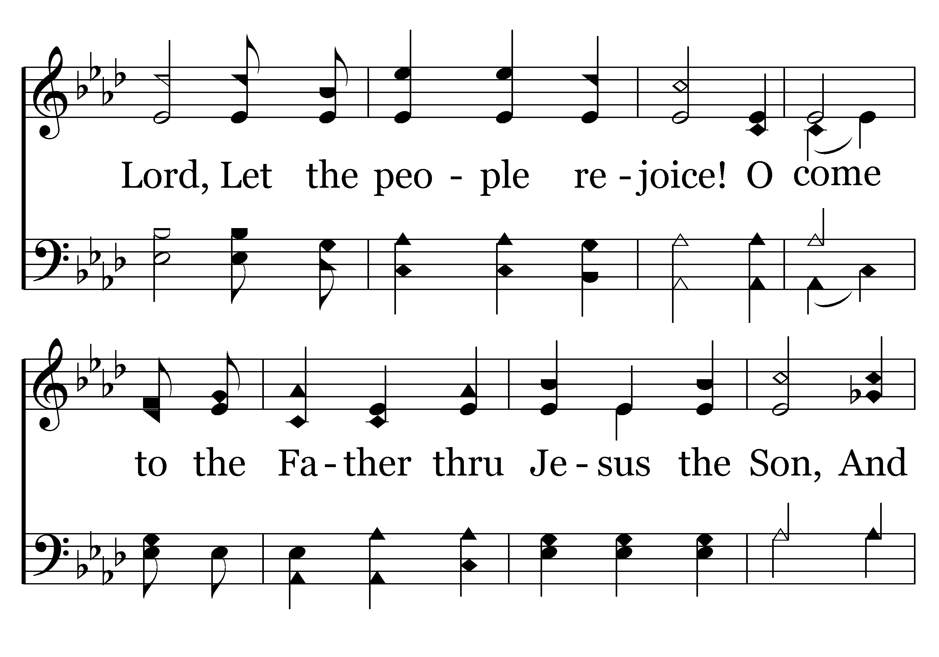
044 - To God Be The Glory - C.2

Slide 45
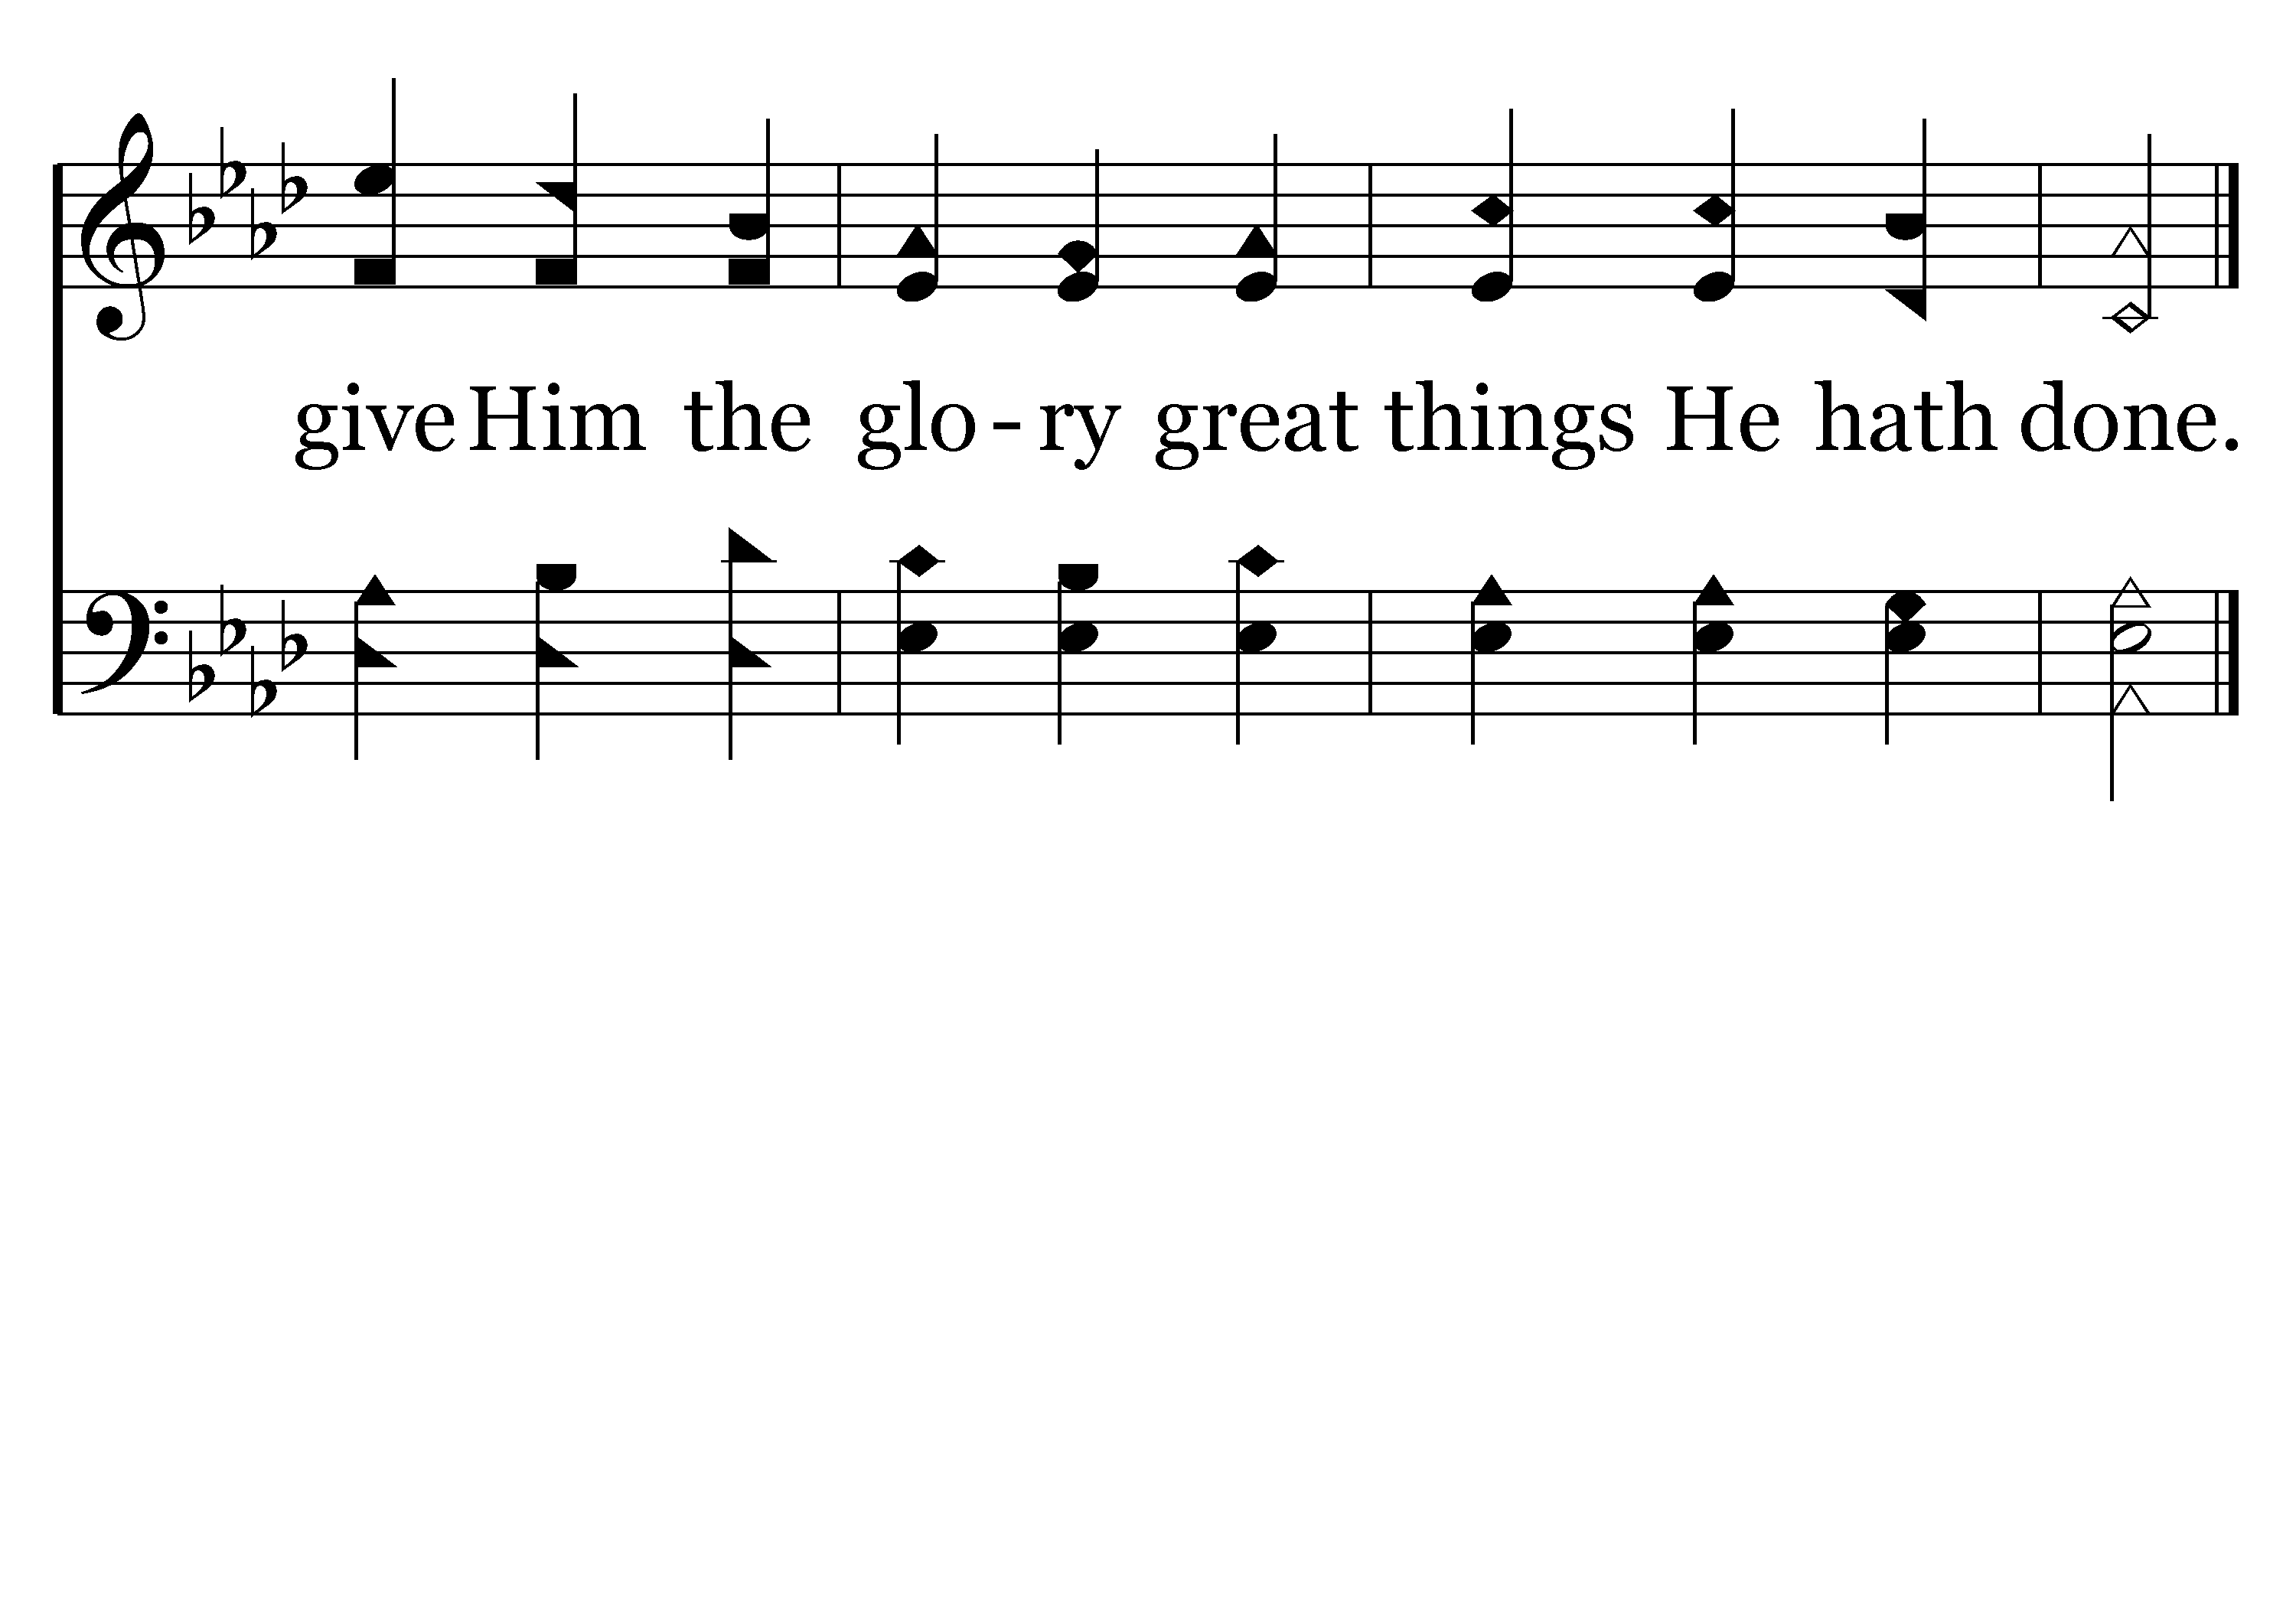
044 - To God Be The Glory - C.3
End of Verse 1

Slide 46
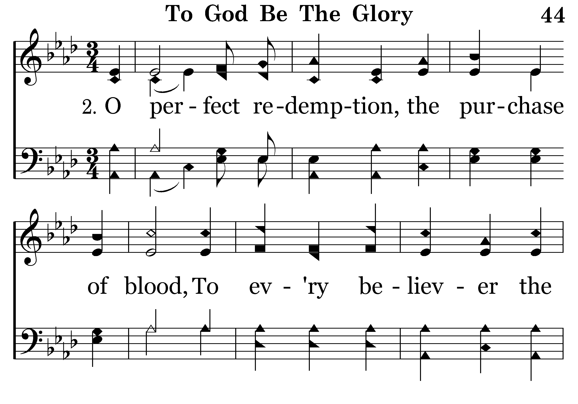
044 - To God Be The Glory - 2.1

Slide 47
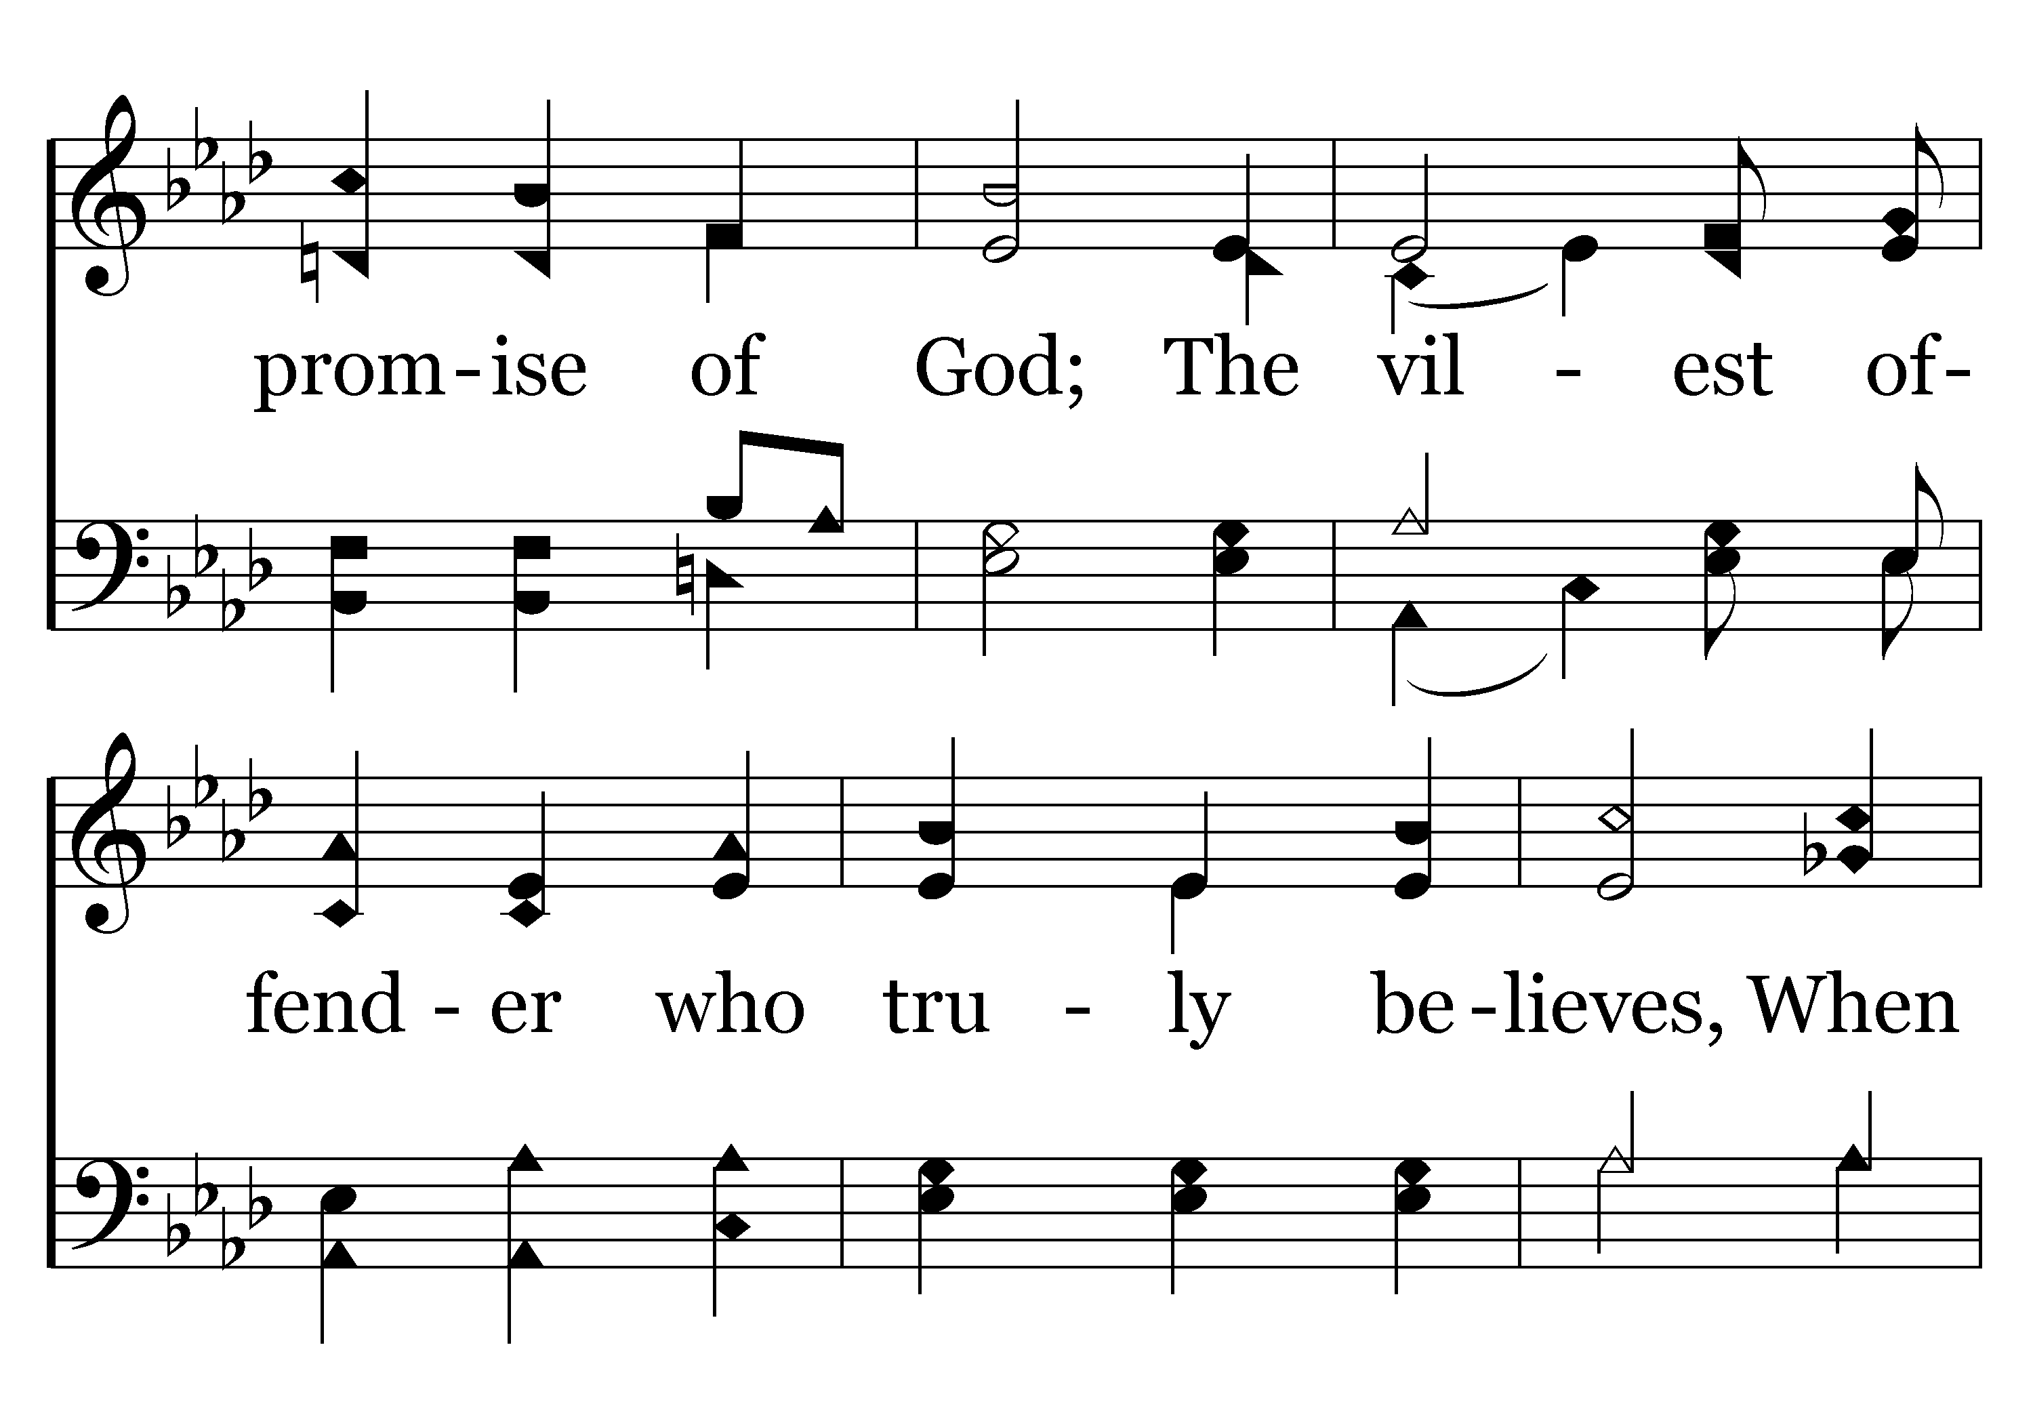
044 - To God Be The Glory - 2.2

Slide 48
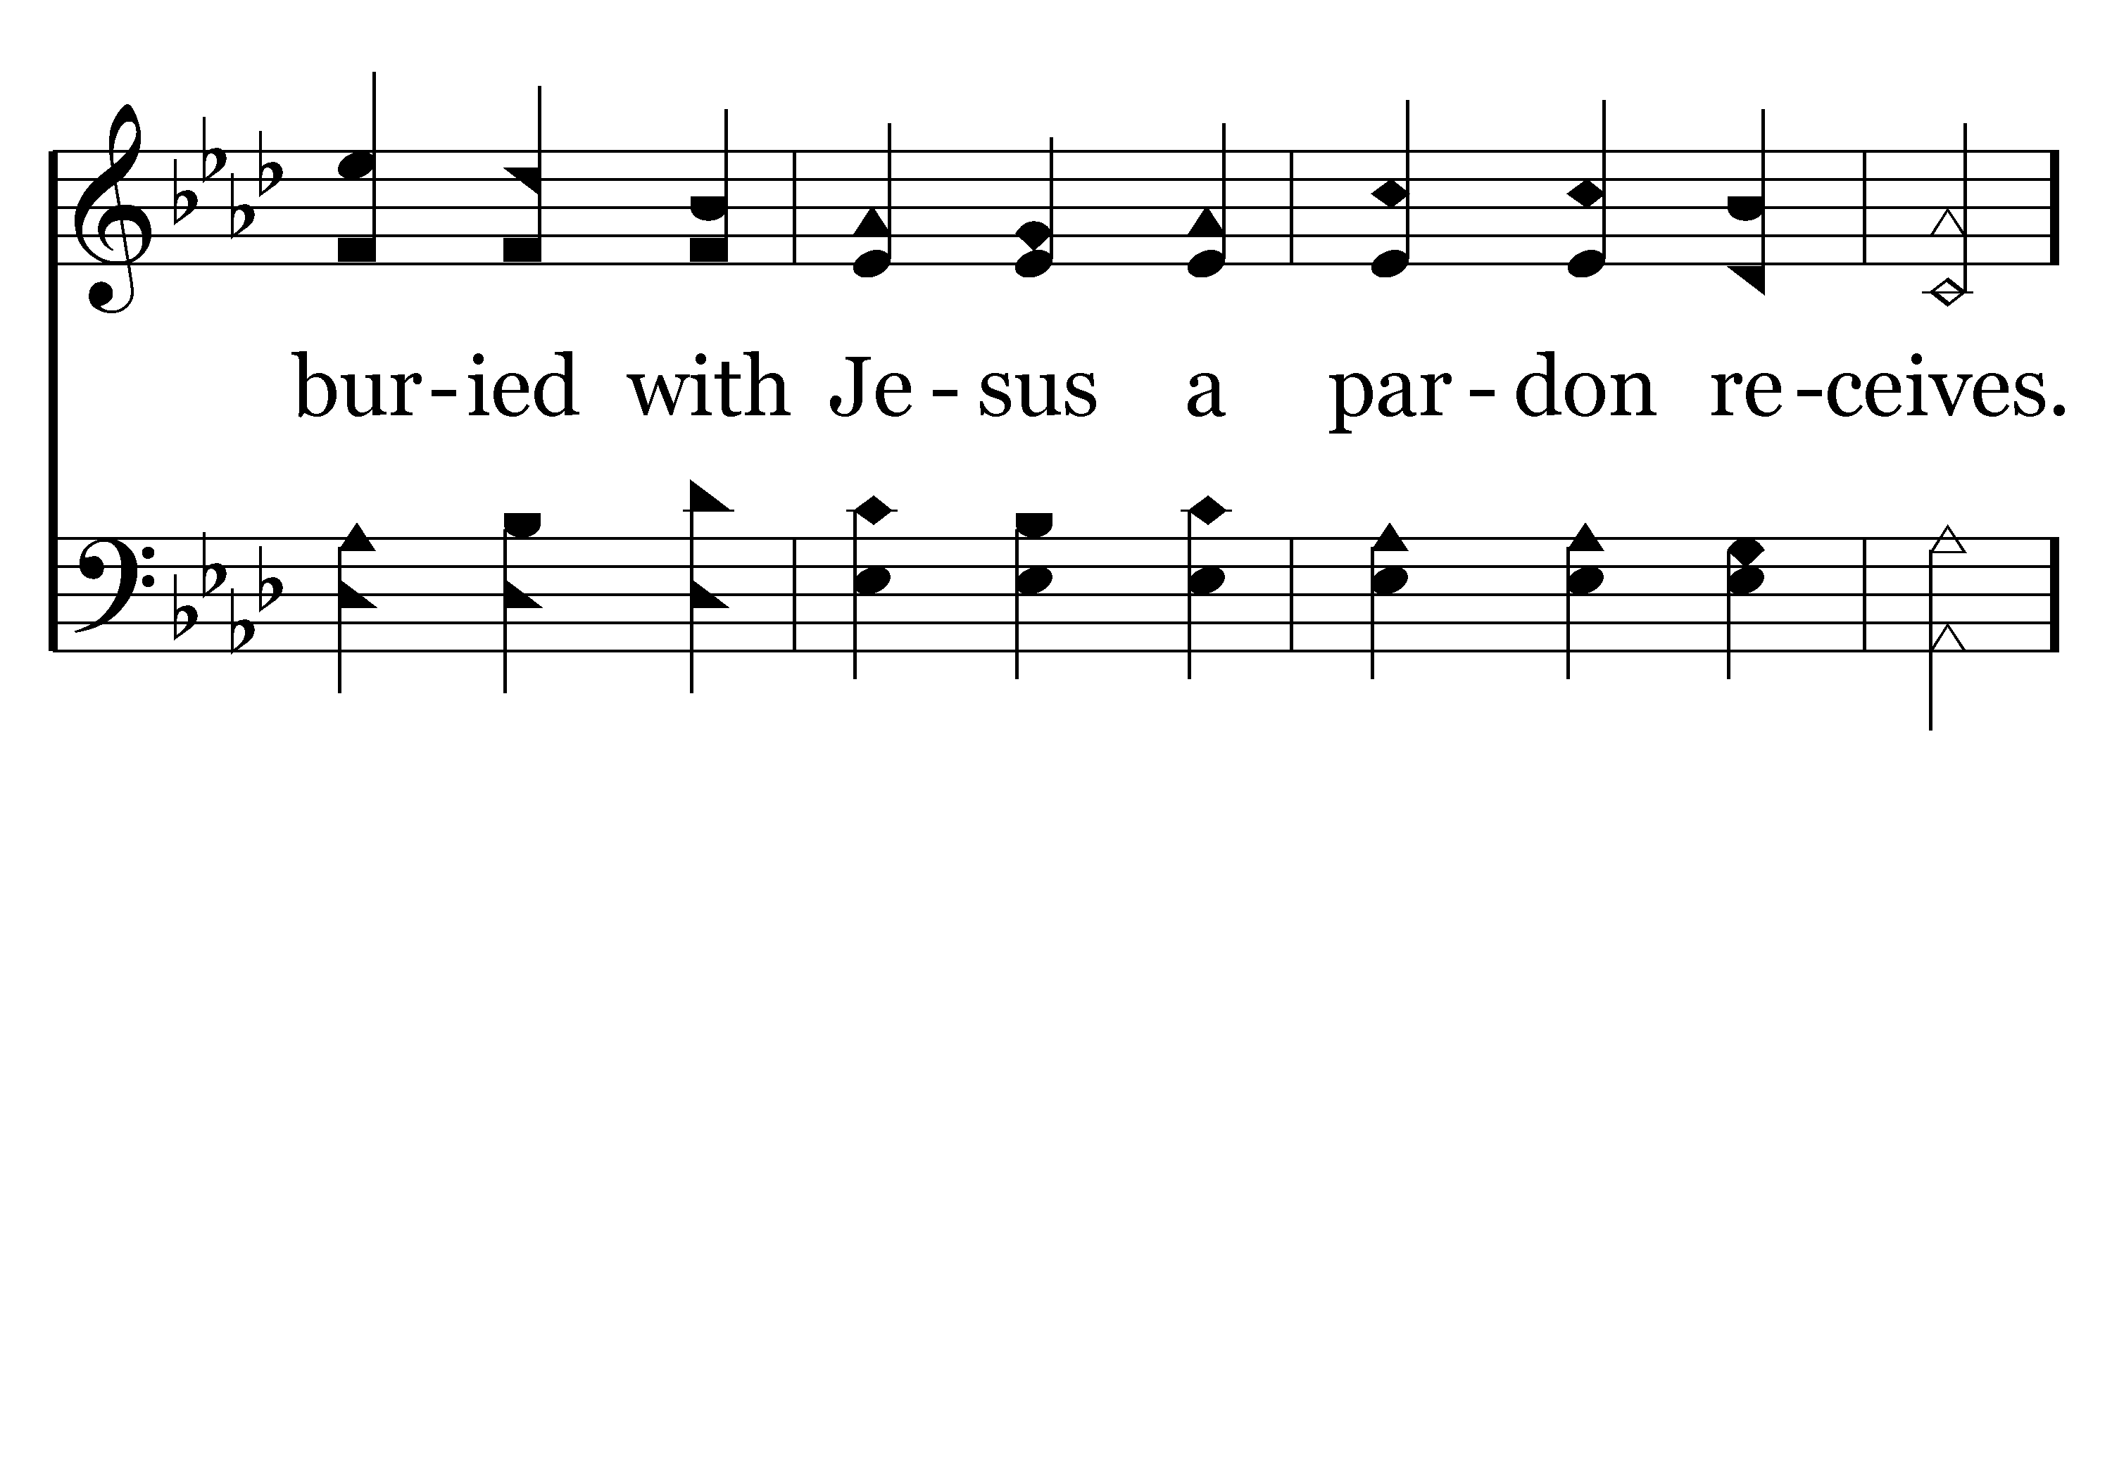
044 - To God Be The Glory - 2.3

Slide 49
044 - To God Be The Glory - C.1

Slide 50
044 - To God Be The Glory - C.2

Slide 51
044 - To God Be The Glory - C.3
End of Verse 2

Slide 52
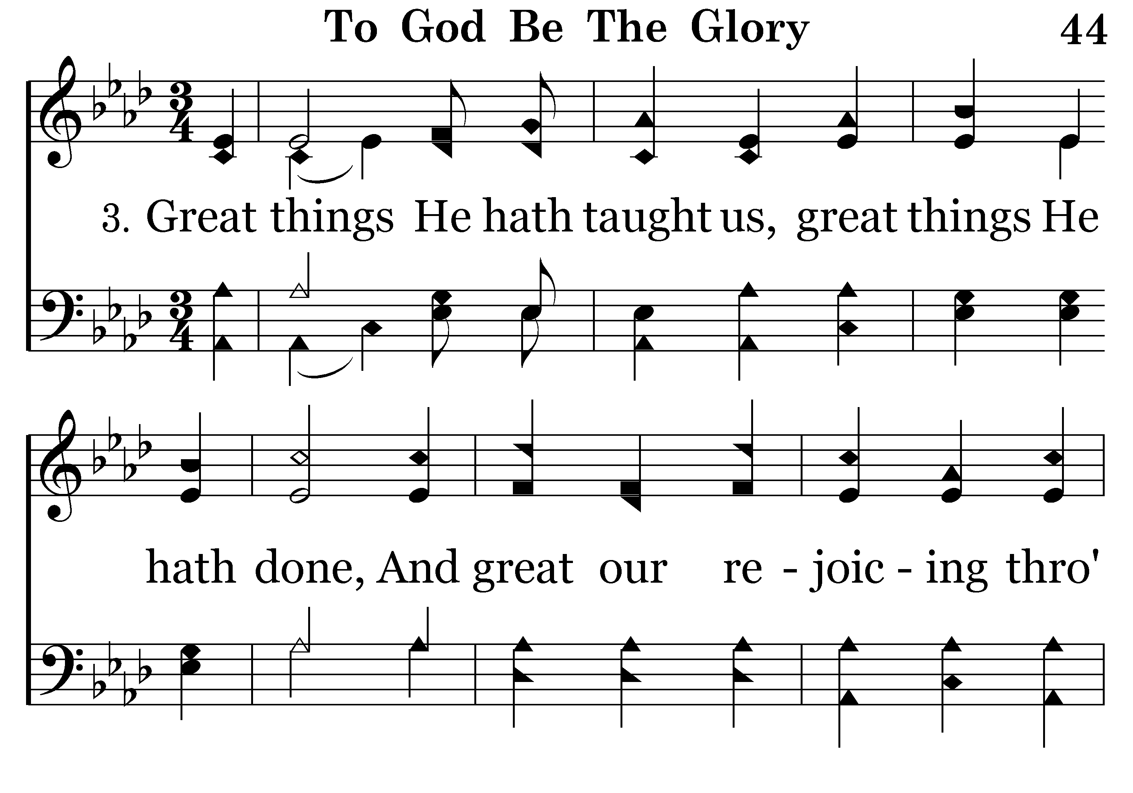
044 - To God Be The Glory - 3.1

Slide 53
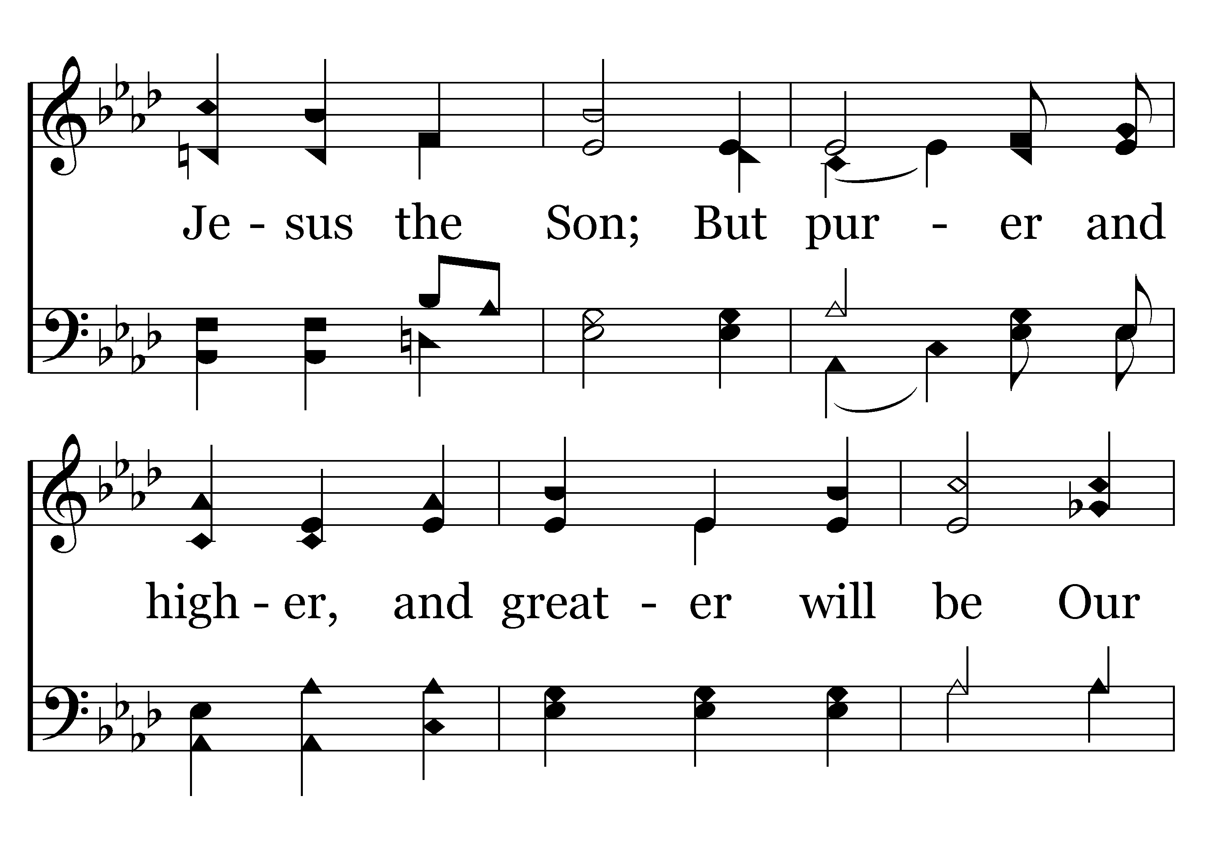
044 - To God Be The Glory - 3.2

Slide 54
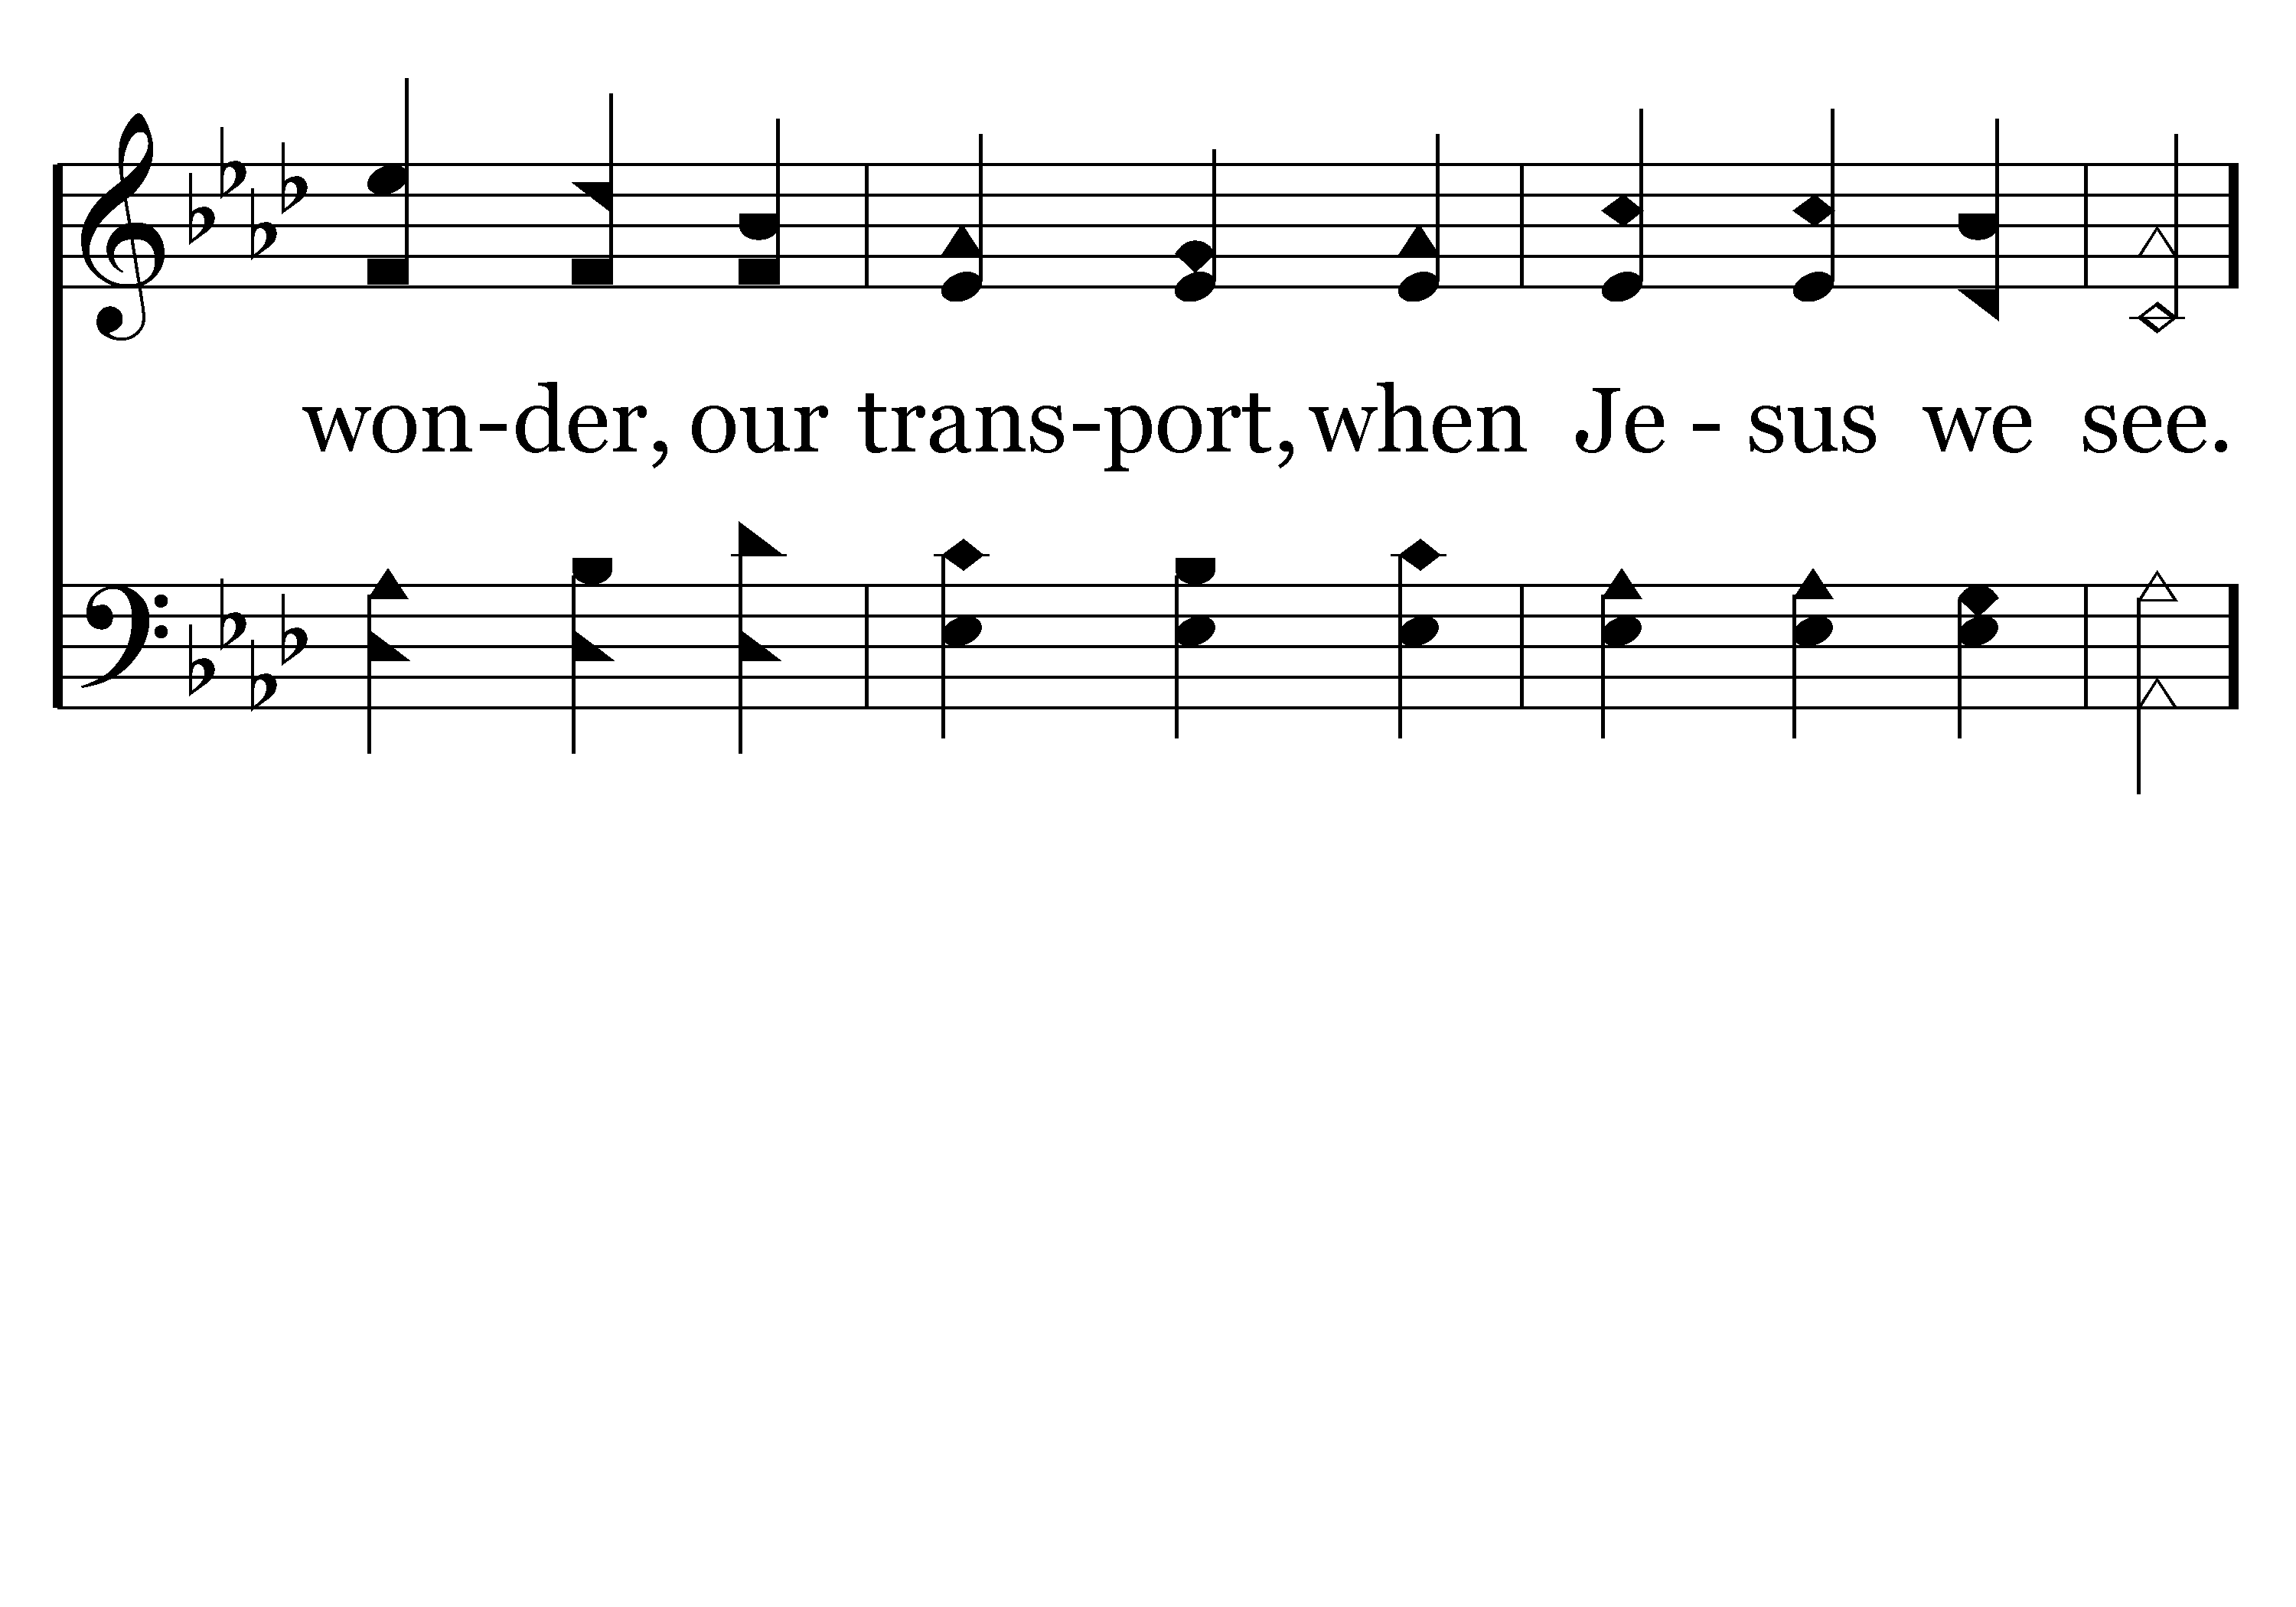
044 - To God Be The Glory - 3.3

Slide 55
044 - To God Be The Glory - C.1

Slide 56
044 - To God Be The Glory - C.2

Slide 57
044 - To God Be The Glory - C.3
End of Song

Slide 59
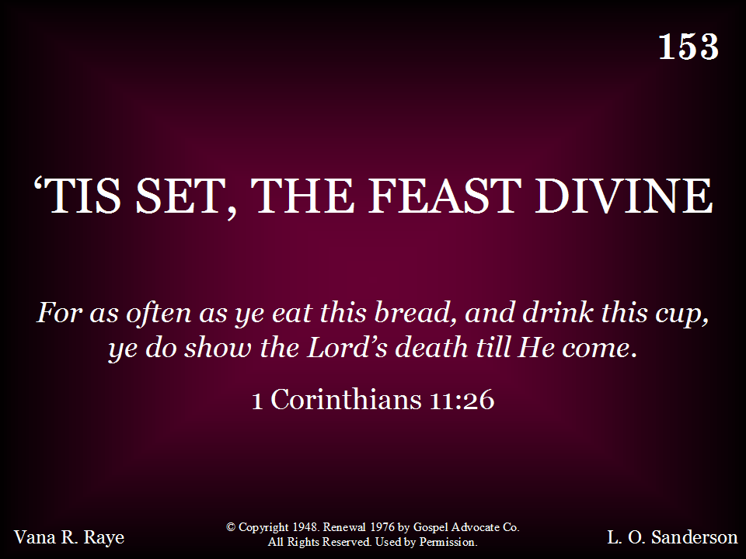
153 - Tis Set, The Feast Divine - Title

Slide 60
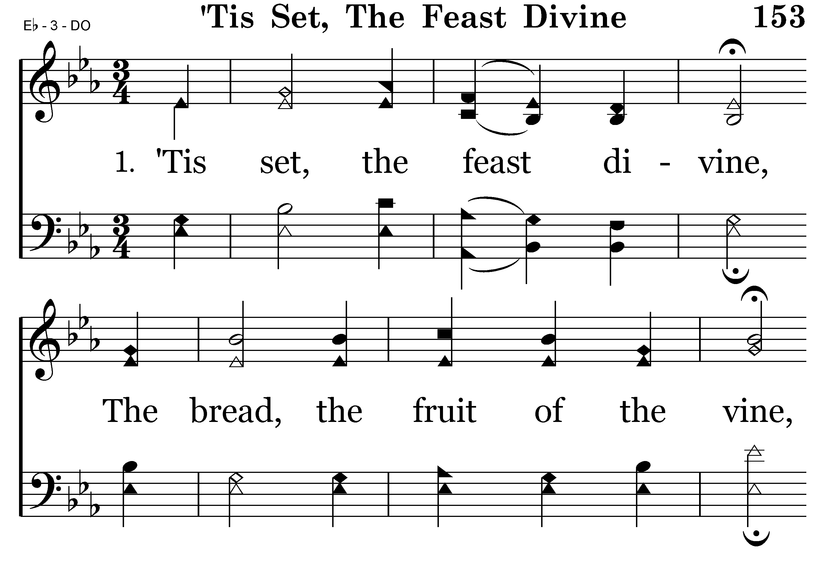
153 - Tis Set, The Feast Divine - 1.1

Slide 61
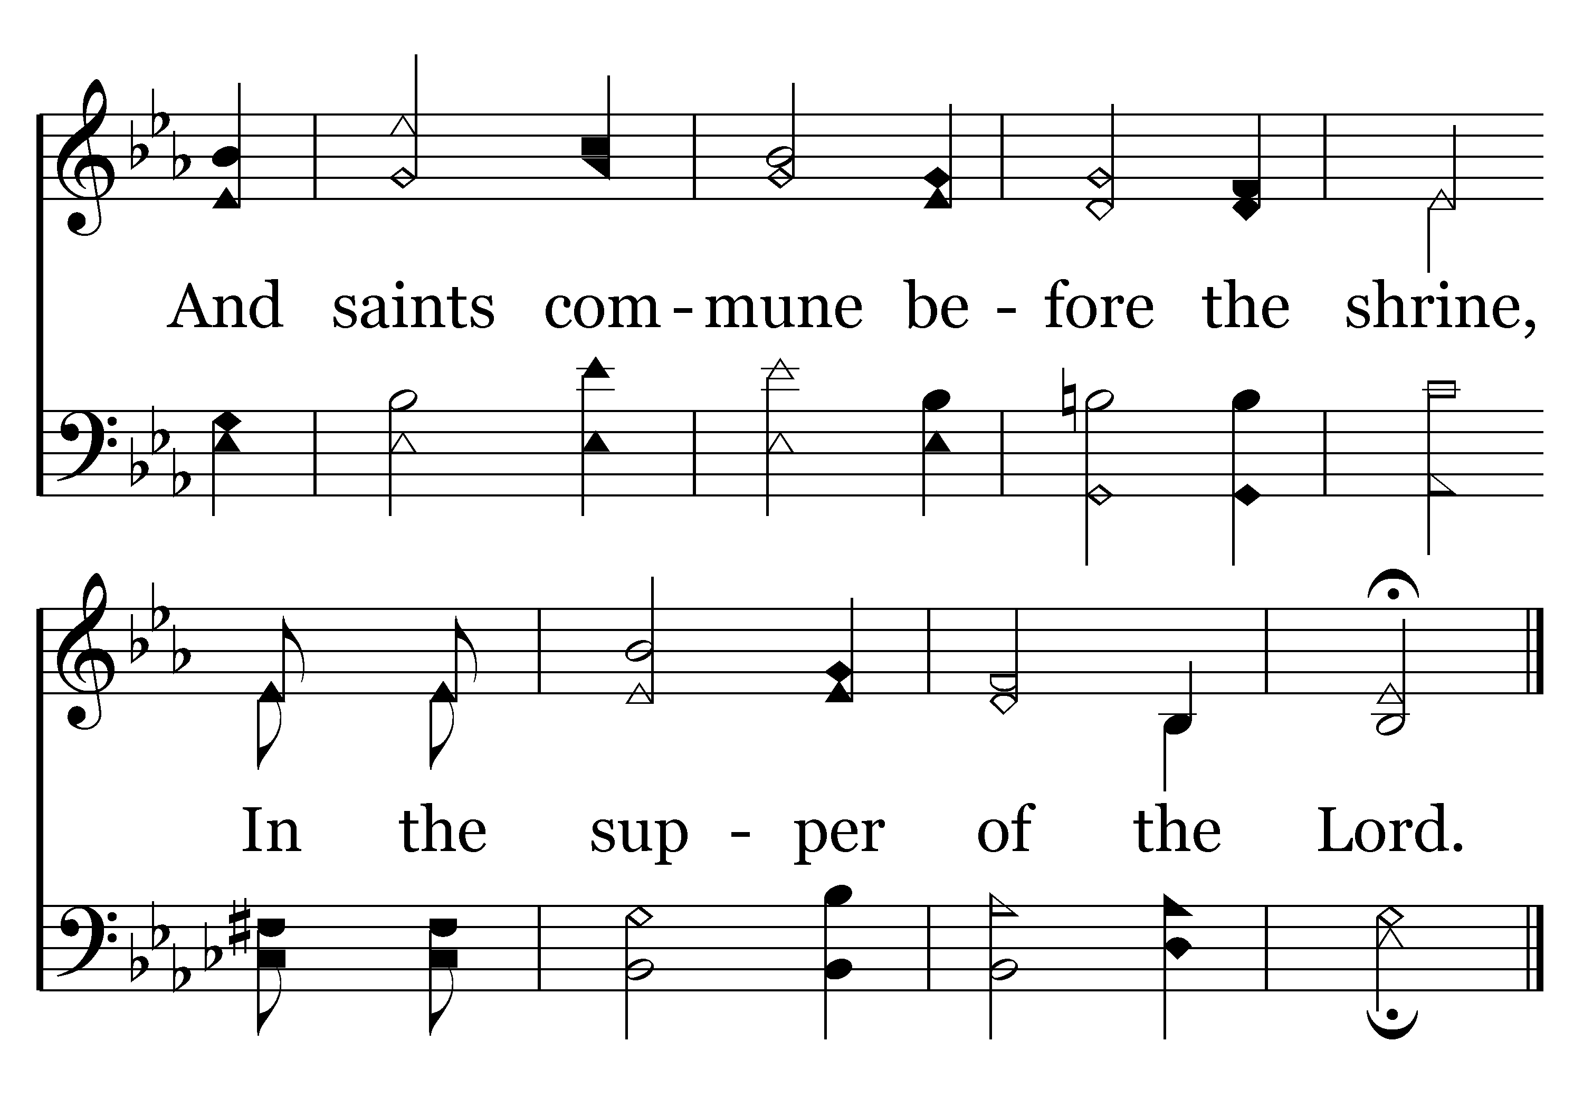
153 - Tis Set, The Feast Divine - 1.2
End of Verse 1

Slide 62
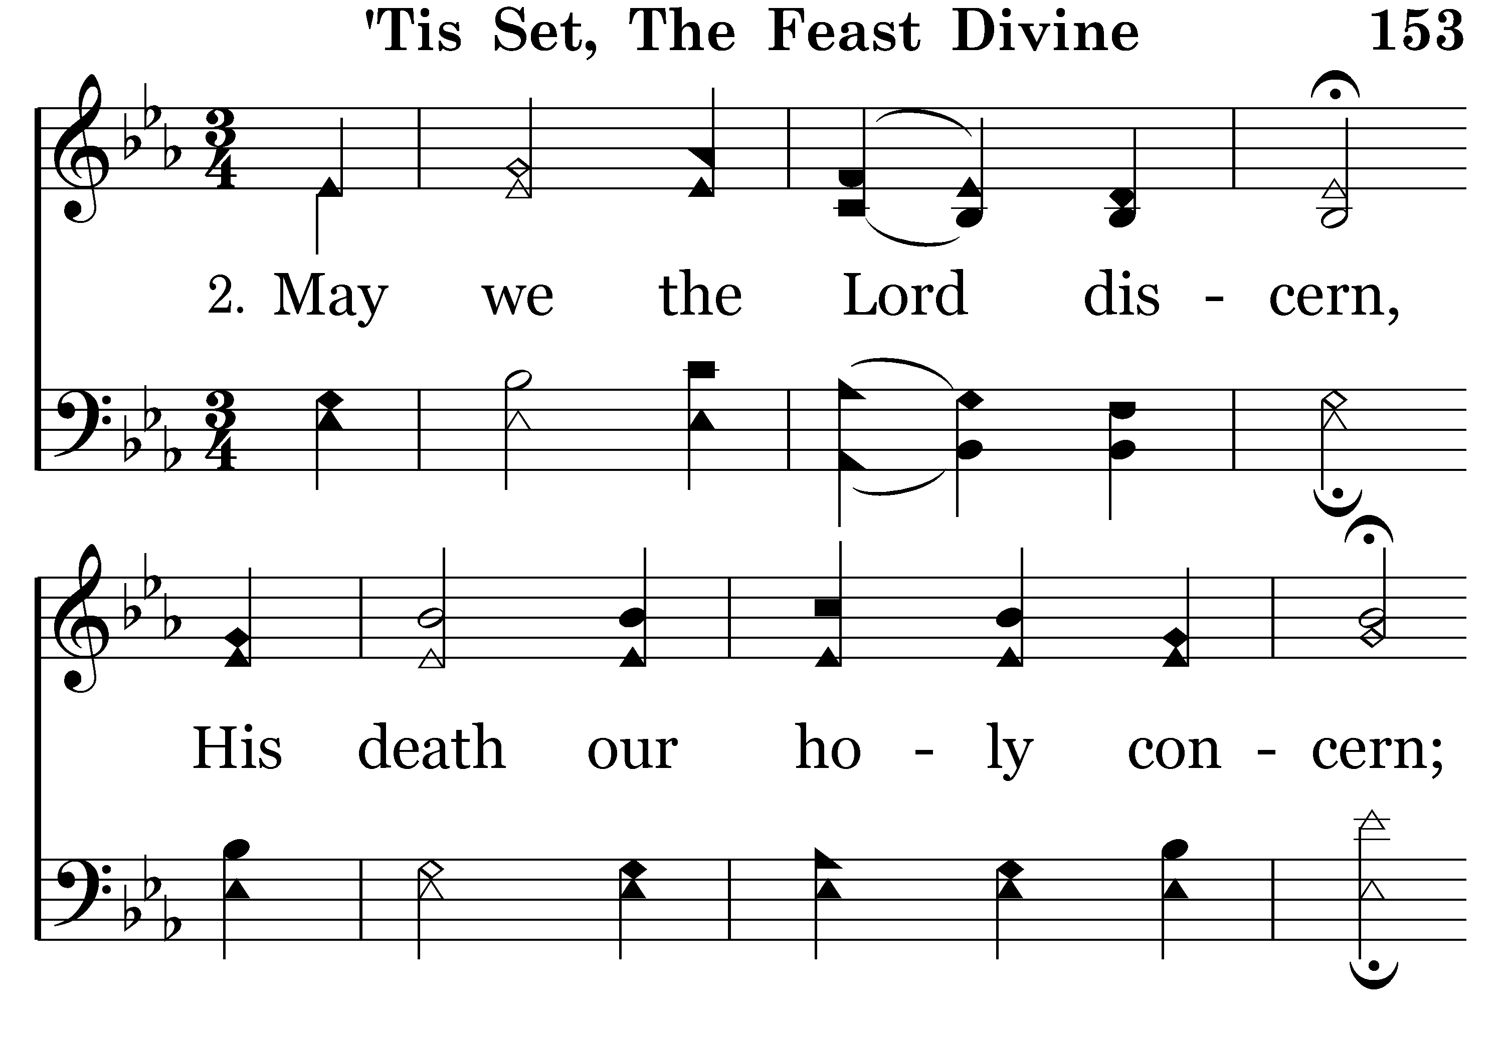
153 - Tis Set, The Feast Divine - 2.1

Slide 63
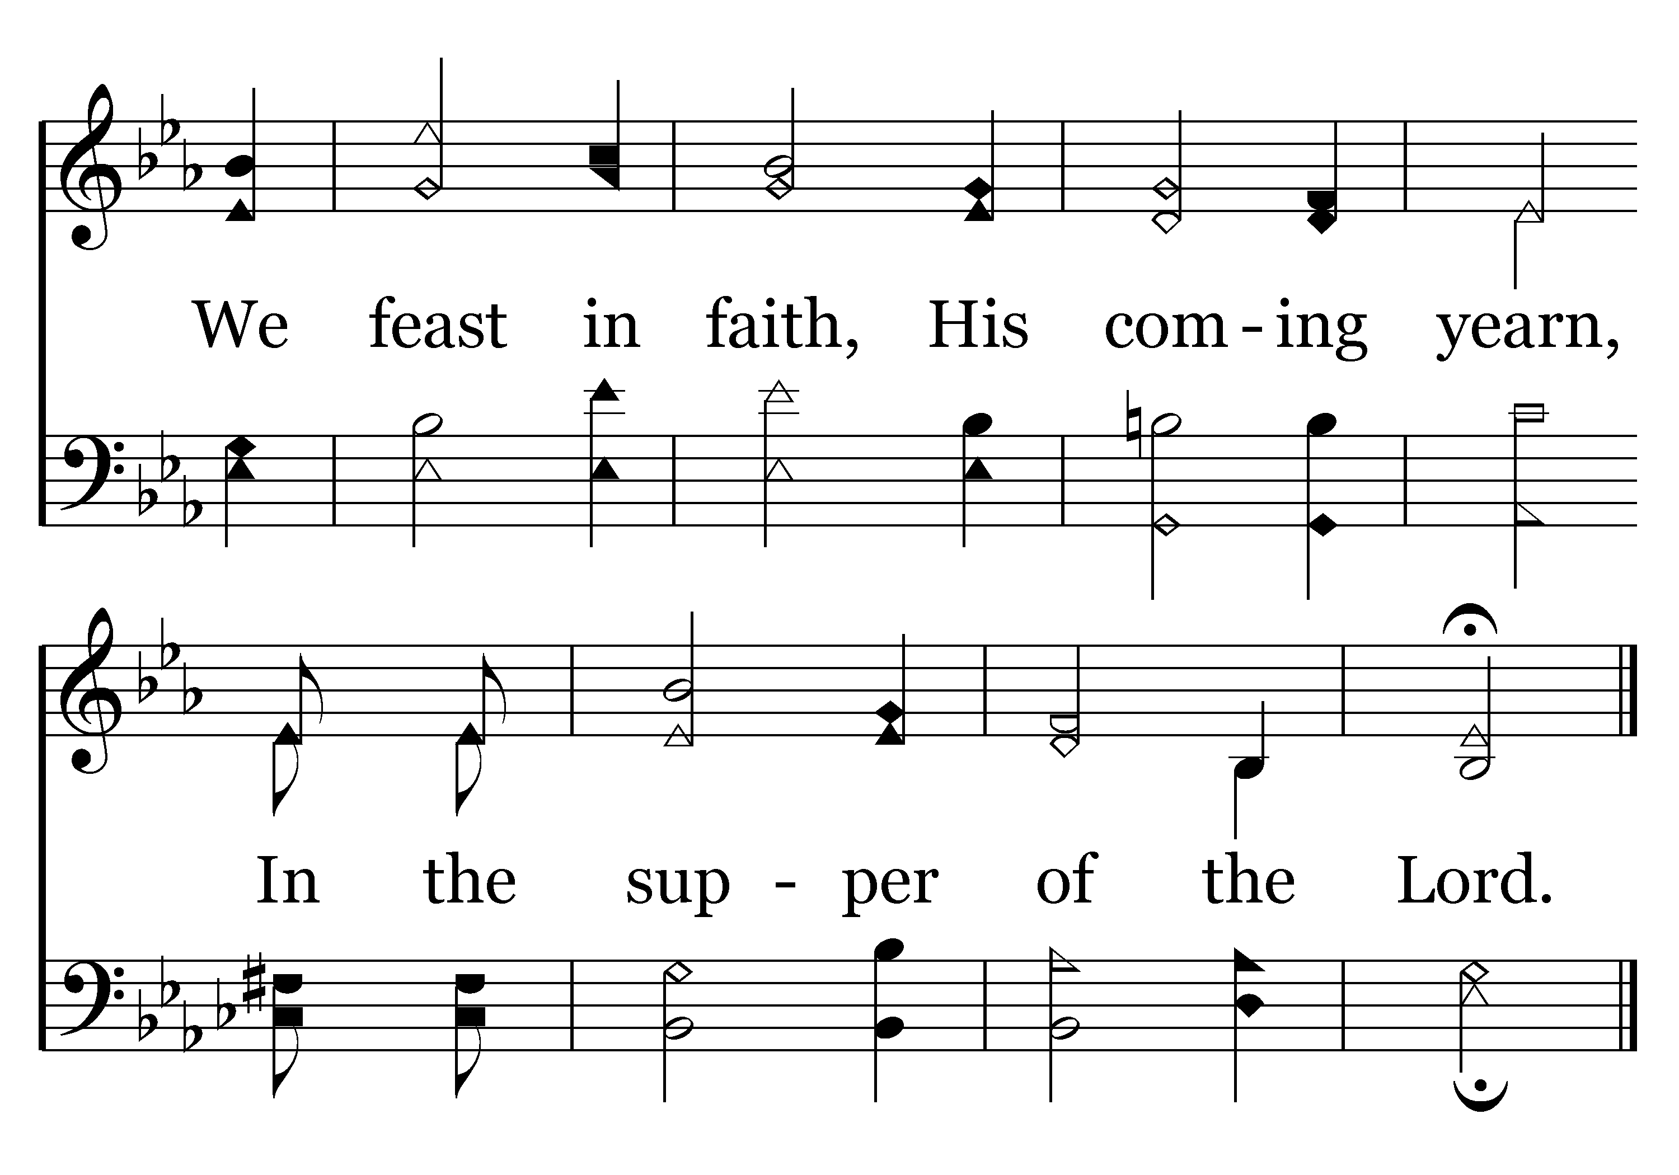
153 - Tis Set, The Feast Divine - 2.2
End of Song

Slide 64
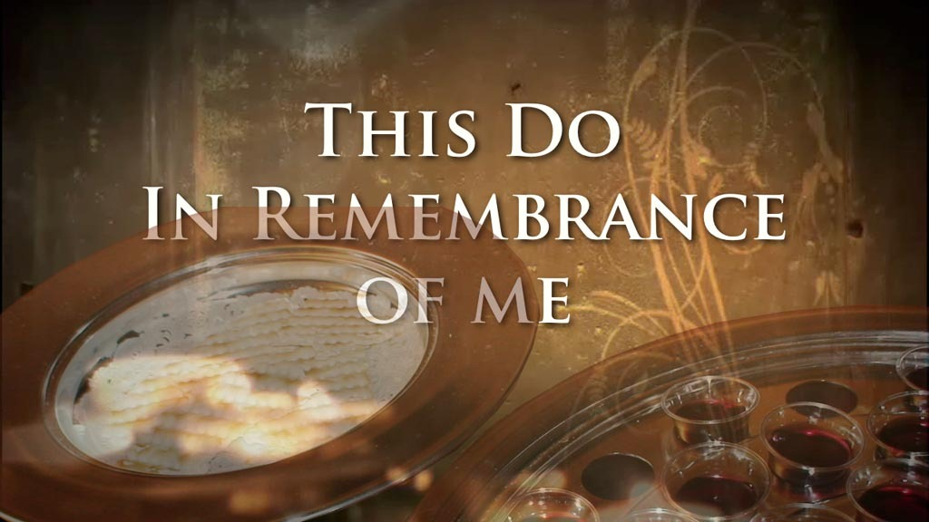

Slide 65
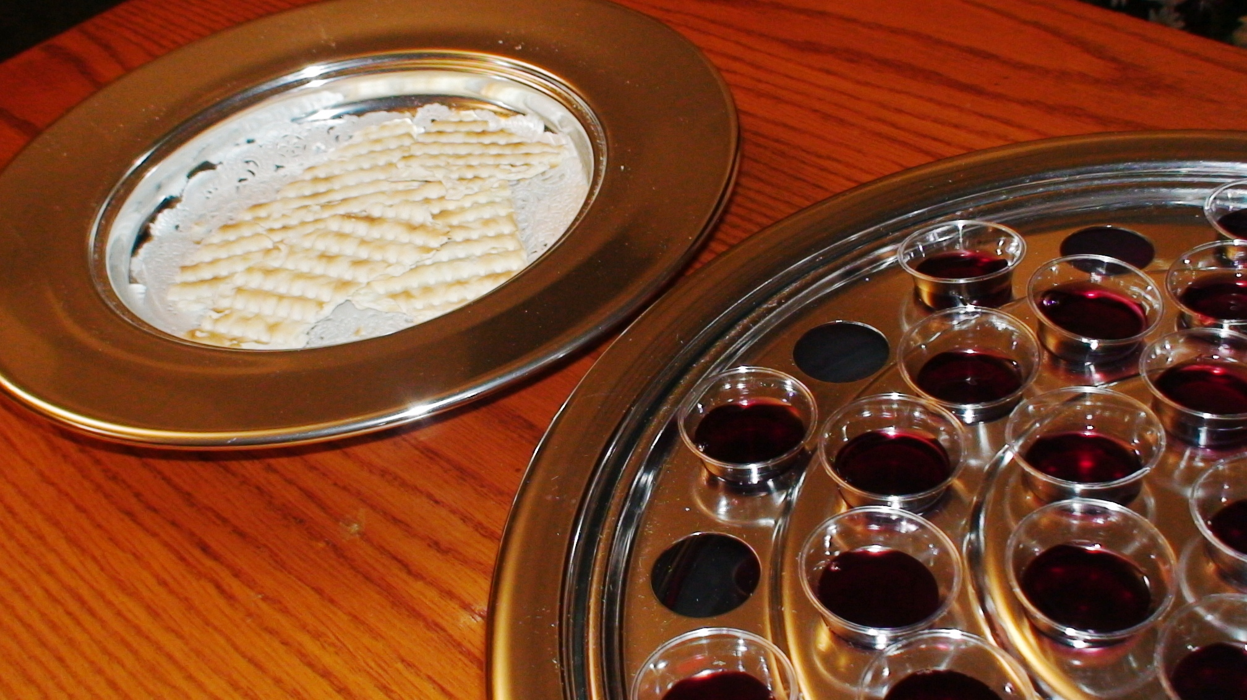
“As often as you eat this bread and drink this cup, you proclaim the Lord’s death….” 1 Corinthians 11:26

Slide 67
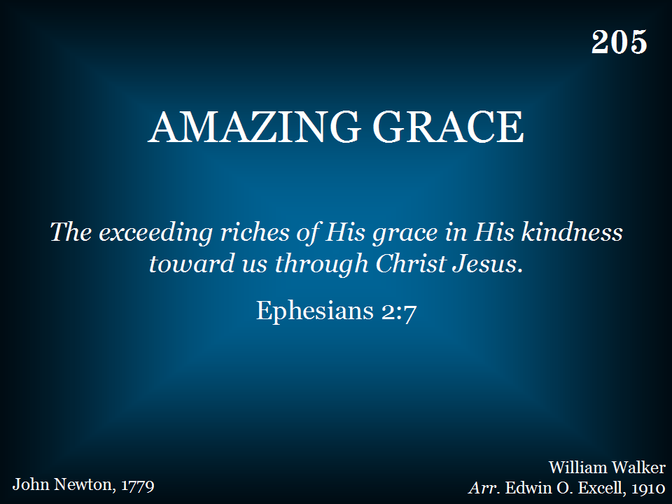
205 - Amazing Grace - Title
COMMUNION VERSION
Verse 2 written by Charles Murray
Notes:
67

Slide 68
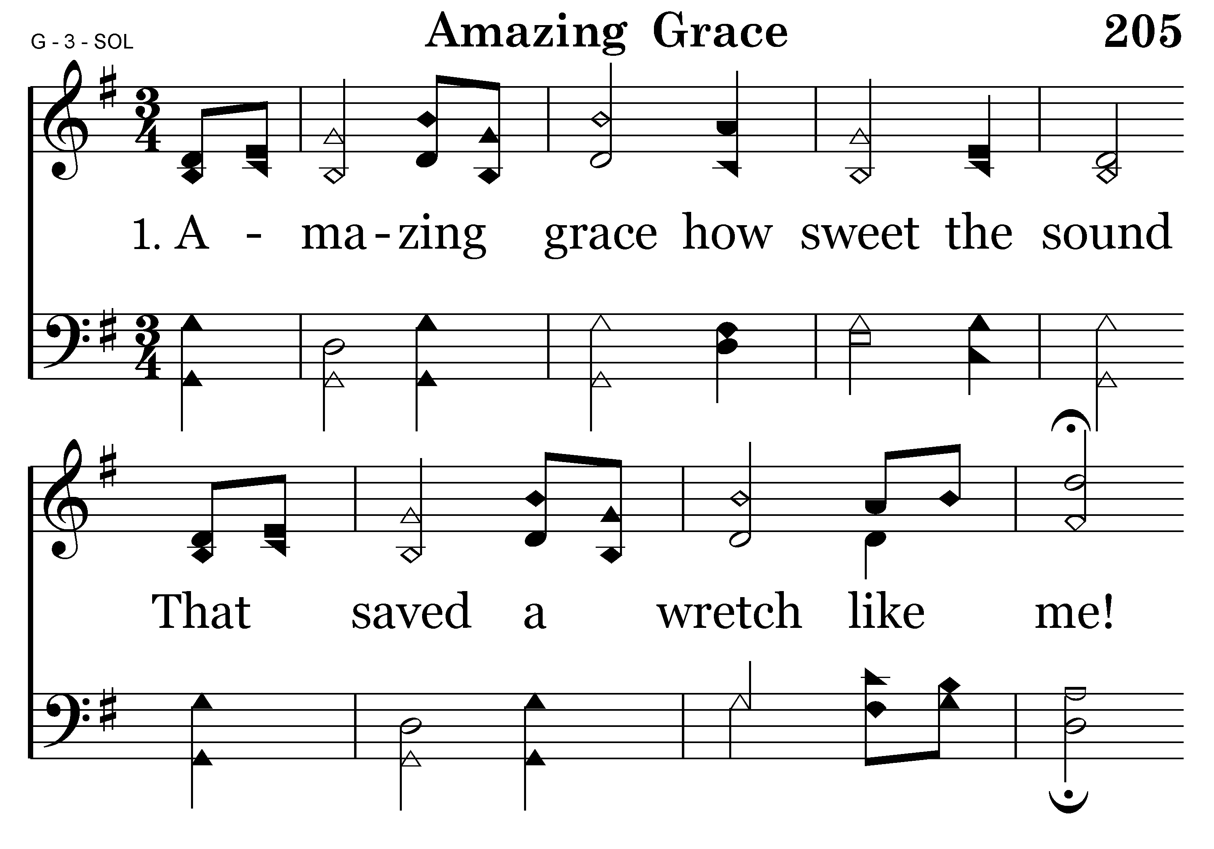
205 - Amazing Grace - 1.1

Slide 69
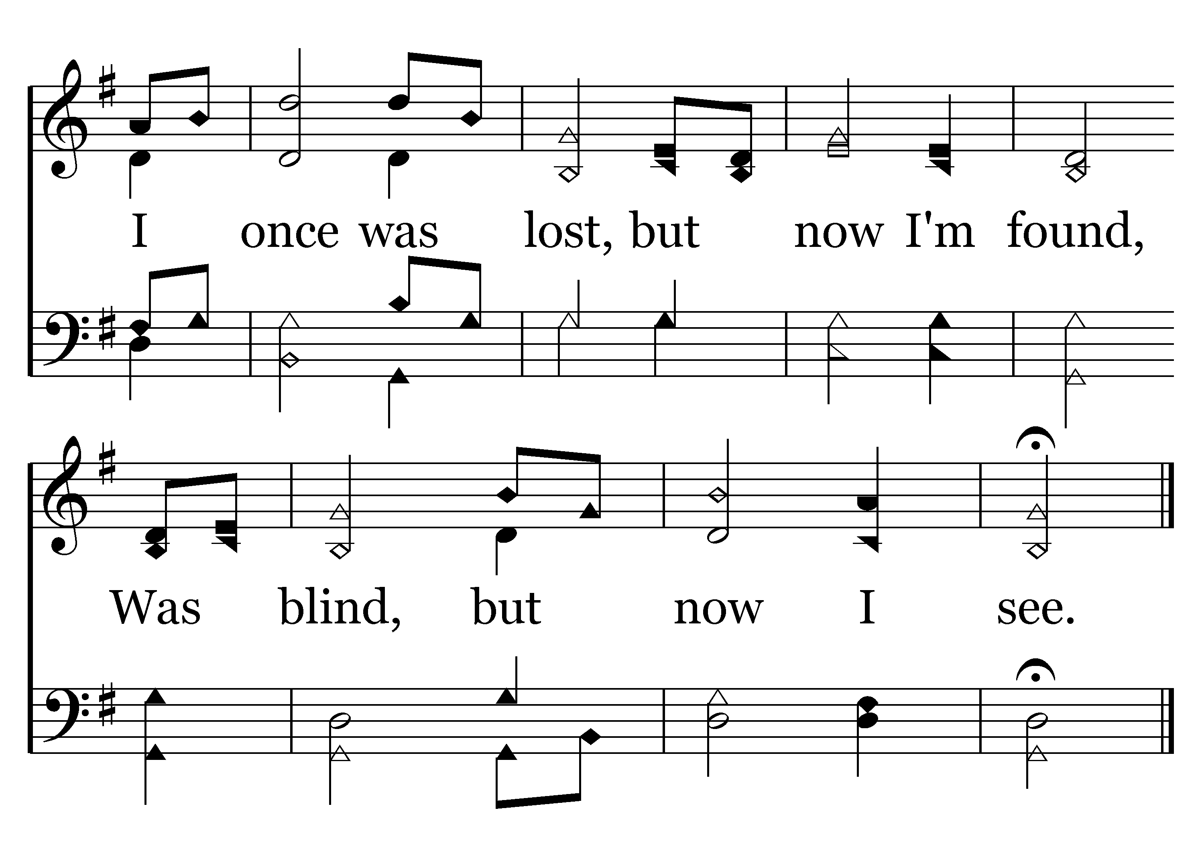
205 - Amazing Grace - 1.2
End of Verse 1

Slide 70
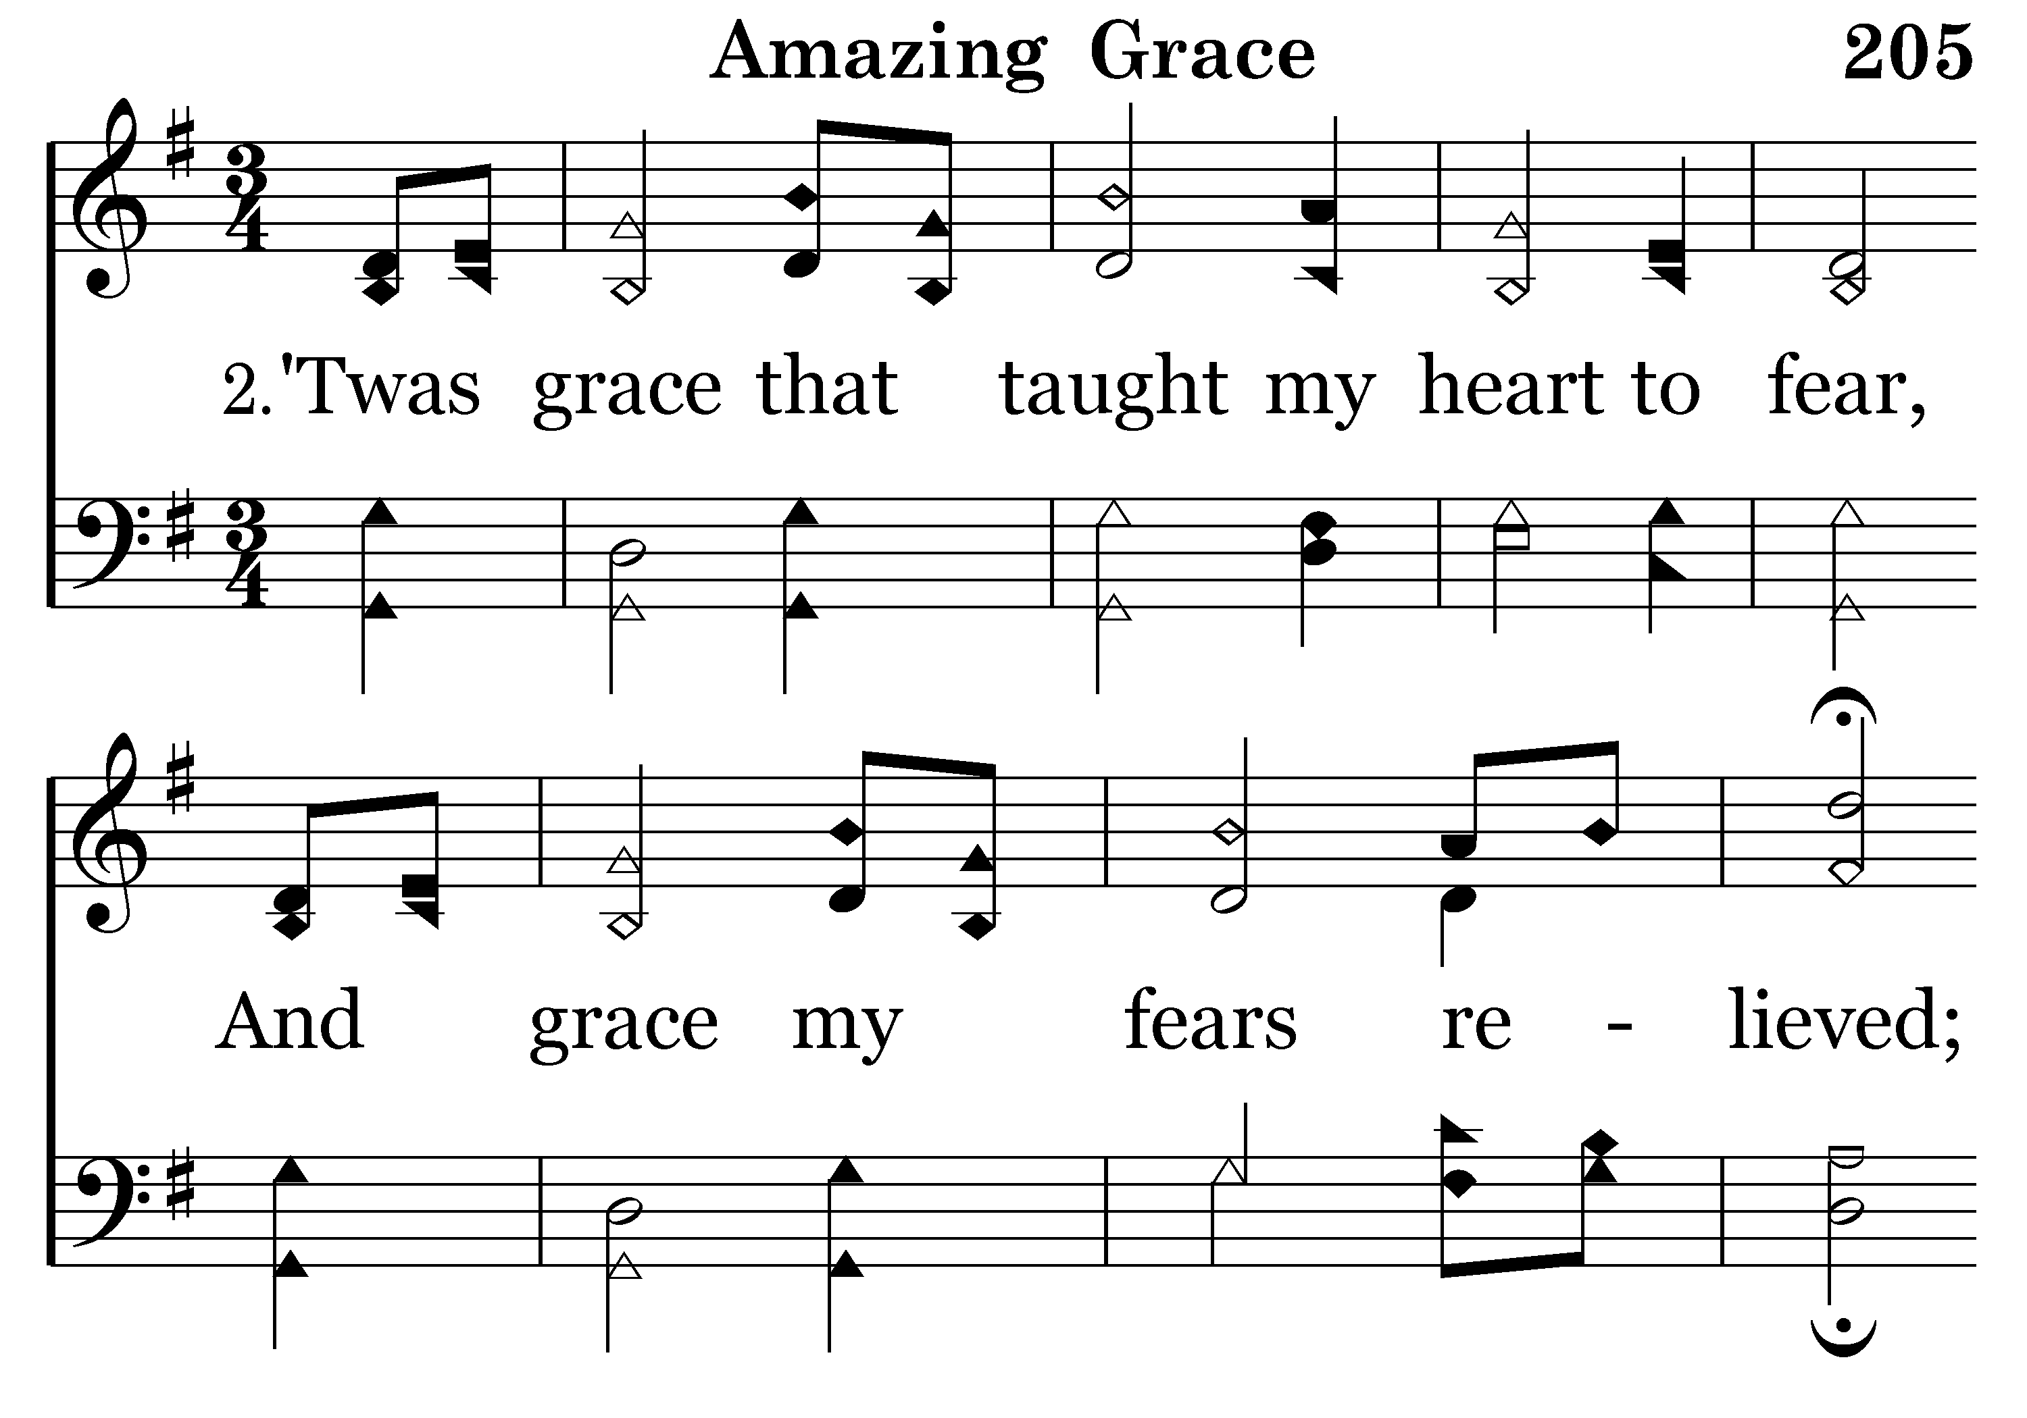
205 - Amazing Grace - 2.1
COMMUNION VERSION
COMMUNION VERSION
The blood of Christ was shed for me
And now from sin I am free!
Written by Charles Murray

Slide 71
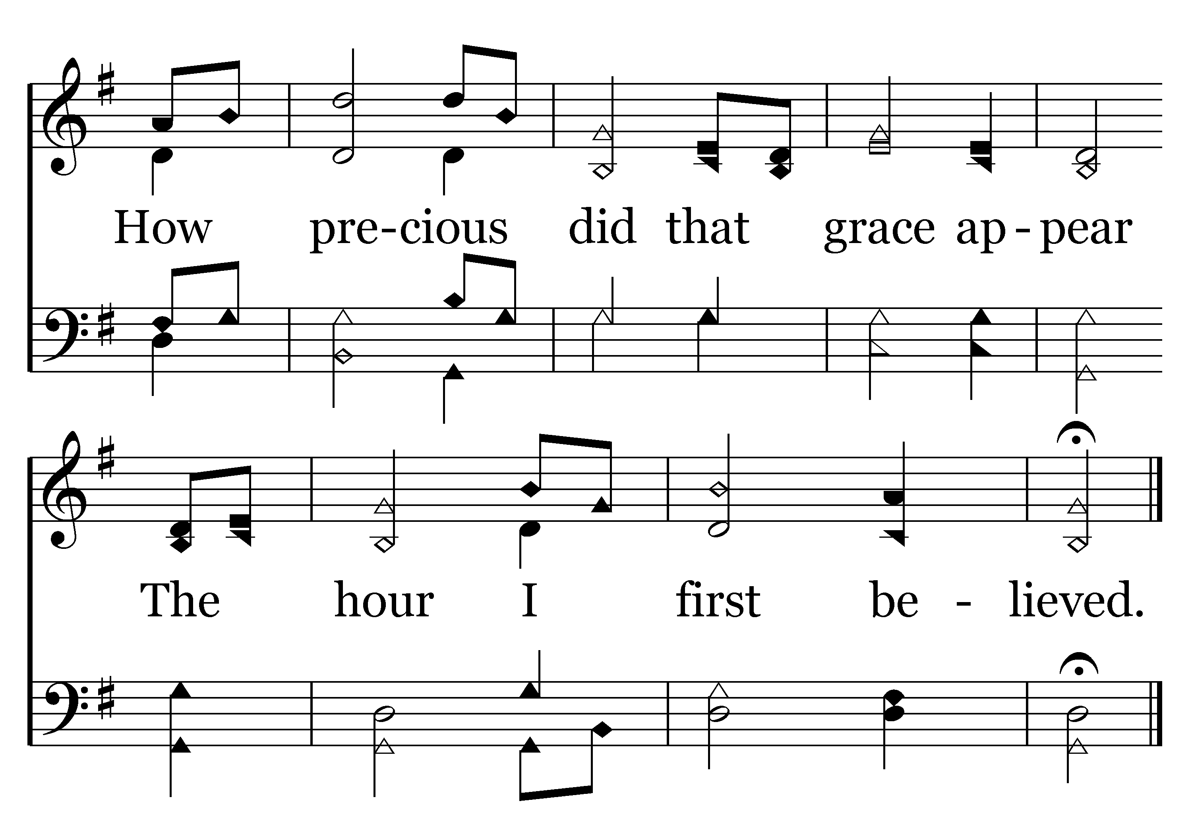
205 - Amazing Grace - 2.2
We eat the bread and drink the cup
In loving memory.
End of Song

Slide 73
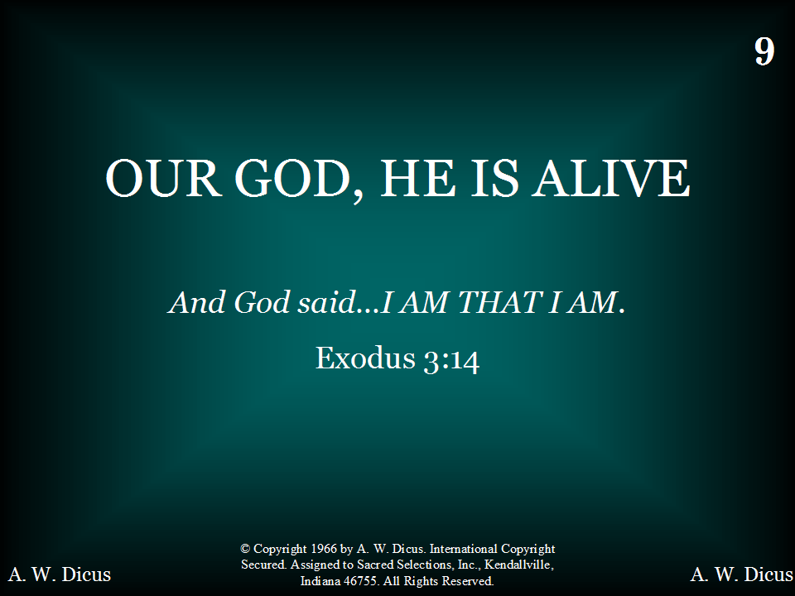
009 - Our God, He Is Alive - Title

Slide 74
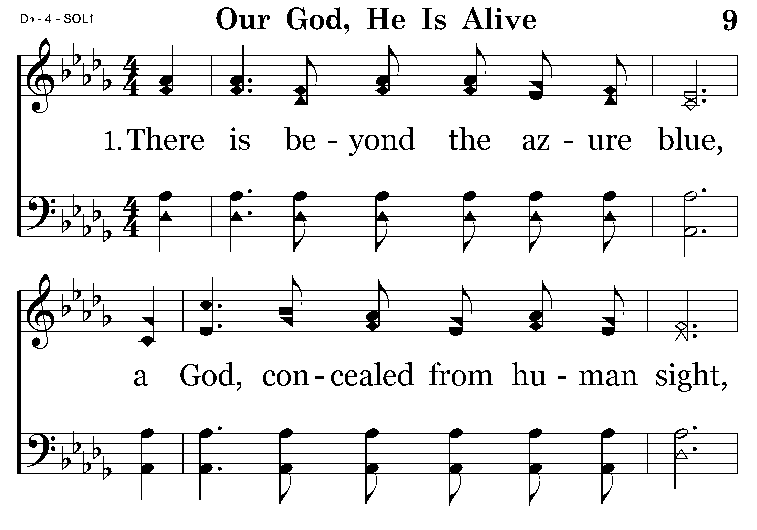
009 - Our God, He Is Alive - 1.1

Slide 75
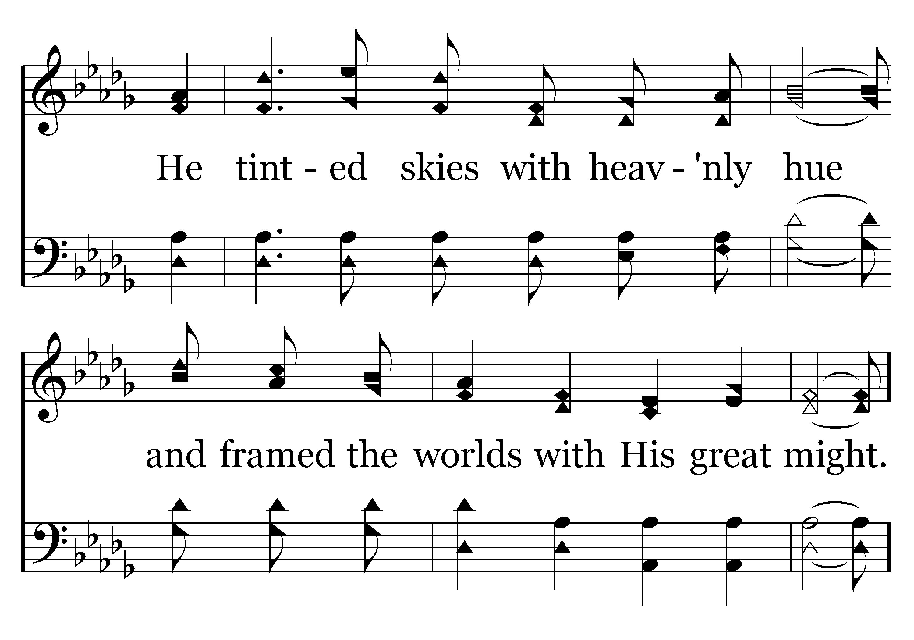
009 - Our God, He Is Alive - 1.2

Slide 76

009 - Our God, He Is Alive - C.1

Slide 77

009 - Our God, He Is Alive - C.2

Slide 78

009 - Our God, He Is Alive - C.3

Slide 79

009 - Our God, He Is Alive - C.4
End of Verse 1

Slide 80

009 - Our God, He Is Alive - 2.1

Slide 81

009 - Our God, He Is Alive - 2.2

Slide 82
009 - Our God, He Is Alive - C.1

Slide 83
009 - Our God, He Is Alive - C.2

Slide 84
009 - Our God, He Is Alive - C.3

Slide 85
009 - Our God, He Is Alive - C.4
End of Verse 2

Slide 86

009 - Our God, He Is Alive - 3.1

Slide 87

009 - Our God, He Is Alive - 3.2

Slide 88
009 - Our God, He Is Alive - C.1

Slide 89
009 - Our God, He Is Alive - C.2

Slide 90
009 - Our God, He Is Alive - C.3

Slide 91
009 - Our God, He Is Alive - C.4
End of Verse 3

Slide 92

009 - Our God, He Is Alive - 4.1

Slide 93

009 - Our God, He Is Alive - 4.2

Slide 94
009 - Our God, He Is Alive - C.1

Slide 95
009 - Our God, He Is Alive - C.2

Slide 96
009 - Our God, He Is Alive - C.3

Slide 97
009 - Our God, He Is Alive - C.4
REPEAT CHORUS

Slide 98
009 - Our God, He Is Alive - C.1

Slide 99
009 - Our God, He Is Alive - C.2

Slide 100
009 - Our God, He Is Alive - C.3

Slide 101
009 - Our God, He Is Alive - C.4
End of Song

Slide 102

TODAY’S TEXT
PAT SKIDMORE
EPHESIANS 1:3-6

Slide 103
Eph 1:3-6 Blessed be the God and Father of our Lord Jesus Christ, who hath blessed us with all spiritual blessings in heavenly places in Christ:
⁴ According as he hath chosen us in him before the foundation of the world, that we should be holy and without blame before him in love:
⁵ Having predestinated us unto the adoption of children by Jesus Christ to himself, according to the good pleasure of his will,
⁶ To the praise of the glory of his grace, wherein he hath made us accepted in the beloved. KJV

Slide 104
INVITATION SONG
# 278
GOD IS CALLING

Slide 105


Slide 106
TODAY IS SPECIAL
NOT ONLY BECAUSE IT IS SUNDAY BUT IT IS A DAY WE HAVE SET ASIDE TO HONOR FATHERS
SOME HAVE A DIFFICULT TIME ON FATHER’S DAY
IT MAY BE THAT SOME DO NOT HAVE FOND MEMORIES OF THEIR FATHER
OTHERS NO LONGER HAVE A FATHER BECAUSE THEY HAVE PASSED AWAY
TODAY WE WANT TO THINK ABOUT A FATHER WE ALL HAVE AND THE PRIVILEGE OF HAVING SUCH A FATHER AND WHAT A BLESSING IT IS TO HAVE THIS FATHER

Slide 107
SINCE GOD CREATED ALL MANKIND HE IS THE FATHER OF EVERYONE
1 Cor 8:6 yet for us there is but one God, the Father, from whom all things came and for whom we live;
Acts 17:28 'For in him we live and move and have our being.' As some of your own poets have said, 'We are his offspring.'

Slide 108
SINCE GOD CREATED ALL MANKIND HE IS THE FATHER OF EVERYONE
THERE IS MORE TO THE THOUGHT OF GOD BEING THE FATHER OF ALL THINGS
THERE IS A SPECIAL SENSE IN WHICH WE CAN CALL GOD OUR “FATHER”
IN OUR TEXT PAUL MENTIONS 4 THINGS GOD HAS DONE FOR US AND WHY WE CAN CALL HIM “FATHER”

Slide 109
Eph 1:3-6 Praise be to the God and Father of our Lord Jesus Christ, who has blessed us in the heavenly realms with every spiritual blessing in Christ. ⁴ For he chose us in him before the creation of the world to be holy and blameless in his sight. In love ⁵ he predestined us to be adopted as his sons through Jesus Christ, in accordance with his pleasure and will— ⁶ to the praise of his glorious grace, which he has freely given us in the One he loves.

Slide 110
WE CAN CALL HIM “FATHER” BECAUSE HE HAS BLESSED US
Praise be to the God and Father of our Lord Jesus Christ, who has blessed us in the heavenly realms with every spiritual blessing in Christ.
FOUR THINGS ARE MENTIONED CONCERNING OUR BLESSINGS FROM GOD

Slide 111
1. THE SOURCE OF OUR BLESSINGS
Praise be to the God and Father of our Lord Jesus Christ, who has blessed us in the heavenly realms with every spiritual blessing in Christ.

Slide 112
1. THE SOURCE OF OUR BLESSINGS
Praise be to the God and Father of our Lord Jesus Christ, who has blessed us in the heavenly realms with every spiritual blessing in Christ.
ALL BLESSINGS COME FROM GOD THE FATHER THROUGH JESUS CHRIST

Slide 113
2. THE SCOPE OF OUR BLESSINGS
Praise be to the God and Father of our Lord Jesus Christ, who has blessed us in the heavenly realms with every spiritual blessing in Christ.
ALL BLESSINGS COME FROM GOD THE FATHER THROUGH JESUS CHRIST

Slide 114
2. THE SCOPE OF OUR BLESSINGS
Praise be to the God and Father of our Lord Jesus Christ, who has blessed us in the heavenly realms with every spiritual blessing in Christ.
NOT JUST SOME OF OUR BLESSINGS BUT EVERY ONE OF THEM

Slide 115
3. THE NATURE OF OUR BLESSINGS
Praise be to the God and Father of our Lord Jesus Christ, who has blessed us in the heavenly realms with every spiritual blessing in Christ.
OUR BLESSINGS FROM GOD ARE SPIRITUAL
GOD BLESSES US WITH MATERIAL BLESSINGS AS WELL
BUT OUR SPIRITUAL BLESSINGS ARE MORE VALUABLE THAN THE MATERIAL ONES

Slide 116
3. THE NATURE OF OUR BLESSINGS
THE NATURE OF OUR BLESSINGS IS SEEN IN THE FOLLOWING VERSES
Eph 1:7-8 In him we have redemption through his blood, the forgiveness of sins, in accordance with the riches of God's grace ⁸ that he lavished on us with all wisdom and understanding.

Slide 117
3. THE NATURE OF OUR BLESSINGS
THE NATURE OF OUR BLESSINGS IS SEEN IN THE FOLLOWING VERSES
Eph 1:7-8 In him we have redemption through his blood, the forgiveness of sins, in accordance with the riches of God's grace ⁸ that he lavished on us with all wisdom and understanding.

Slide 118
3. THE NATURE OF OUR BLESSINGS
THE NATURE OF OUR BLESSINGS IS SEEN IN THE FOLLOWING VERSES
Eph 1:7-8 In him we have redemption through his blood, the forgiveness of sins, in accordance with the riches of God's grace ⁸ that he lavished on us with all wisdom and understanding.

Slide 119
3. THE NATURE OF OUR BLESSINGS
THE NATURE OF OUR BLESSINGS IS SEEN IN THE FOLLOWING VERSES
Eph 1:7-8 In him we have redemption through his blood, the forgiveness of sins, in accordance with the riches of God's grace ⁸ that he lavished on us with all wisdom and understanding.

Slide 120
4. THE SPHERE OF OUR BLESSING
Praise be to the God and Father of our Lord Jesus Christ, who has blessed us in the heavenly realms with every spiritual blessing in Christ.

Slide 121
4. THE SPHERE OF OUR BLESSING
Praise be to the God and Father of our Lord Jesus Christ, who has blessed us in the heavenly realms with every spiritual blessing in Christ.

Slide 122
4. THE SPHERE OF OUR BLESSING
Praise be to the God and Father of our Lord Jesus Christ, who has blessed us in the heavenly realms with every spiritual blessing in Christ.
THOSE WHO ARE NOT CHRISTIANS ARE PRIMARILY INTERESTED IN MATERIAL THINGS
AS A CHRISTIAN OUR LIFE IS FOCUSED ON HEAVENLY THINGS

Slide 123
4. THE SPHERE OF OUR BLESSING
Luke 10:20 However, do not rejoice that the spirits submit to you, but rejoice that your names are written in heaven."
Phil 3:19-21 But our citizenship is in heaven. And we eagerly await a Savior from there, the Lord Jesus Christ, ²
Col 3:1-3 Since, then, you have been raised with Christ, set your hearts on things above, where Christ is seated at the right hand of God. ² Set your minds on things above, not on earthly things.

Slide 124
WE CAN CALL GOD “FATHER” BECAUSE HE HAS CHOSEN US
Eph 1:4 For he chose us in him before the creation of the world to be holy and blameless in his sight.

Slide 125
HE HAS CHOSEN US
Eph 1:4 For he chose us in him before the creation of the world to be holy and blameless in his sight.
THE WORD “CHOSE” IS USED IN SEVERAL WAYS IN THE BIBLE
LK 6:13 – JESUS “CHOSE” THE APOSTLES
ACTS 6:5 –THE CHURCH “CHOSE” 7 MEN TO SERVE AS DEACONS

Slide 126
HE HAS CHOSEN US
Eph 1:4 For he chose us in him before the creation of the world to be holy and blameless in his sight.
THE WORD “CHOSE” IS USED IN SEVERAL WAYS IN THE BIBLE
THE WORD “CHOSE” OR “CHOOSE” MEANS “TO SELECT” OR “PICK OUT”
“CHOSE” IS USED 14 TIMES
“CHOOSE” IS USED 35 TIMES

Slide 127
HE HAS CHOSEN US
Eph 1:4 For he chose us in him before the creation of the world to be holy and blameless in his sight.
WE WERE SELECTED – PICKED OUT—CHOSEN BY GOD TO BE HIS CHILDREN
John 15:16 You did not choose me, but I chose you and appointed you to go and bear fruit —
DO YOU REALIZE HOW SPECIAL THAT MAKES US?

Slide 128
HE HAS CHOSEN US
NOTICE 2 THINGS IN THIS VERSE ABOUT GOD’S CHOICE
“WHEN” HE CHOSE US
For he chose us in him before the creation of the world

Slide 129
HE HAS CHOSEN US
NOTICE 2 THINGS IN THIS VERSE ABOUT GOD’S CHOICE
“WHEN” HE CHOSE US
For he chose us in him before the creation of the world
Matt 25:34-35 "Then the King will say to those on his right, 'Come, you who are blessed by my Father; take your inheritance, the kingdom prepared for you since the creation of the world.

Slide 130
HE HAS CHOSEN US
NOTICE 2 THINGS IN THIS VERSE ABOUT GOD’S CHOICE
“WHEN” HE CHOSE US
For he chose us in him before the creation of the world
Rev 13:8 All inhabitants of the earth will worship the beast — all whose names have not been written in the book of life belonging to the Lamb that was slain from the creation of the world.

Slide 131
HE HAS CHOSEN US
NOTICE 2 THINGS IN THIS VERSE ABOUT GOD’S CHOICE
“WHY” HE CHOSE US
For he chose us in him before the creation of the world to be holy and blameless in his sight.

Slide 132
HE HAS CHOSEN US
NOTICE 2 THINGS IN THIS VERSE ABOUT GOD’S CHOICE
“WHY” HE CHOSE US
For he chose us in him before the creation of the world to be holy and blameless in his sight.
Col 1:22- But now he has reconciled you by Christ's physical body through death to present you holy in his sight, without blemish and free from accusation

Slide 133
HE HAS CHOSEN US
NOTICE 2 THINGS IN THIS VERSE ABOUT GOD’S CHOICE
“WHY” HE CHOSE US
For he chose us in him before the creation of the world to be holy and blameless in his sight.
Rom 8:1-2 Therefore, there is now no condemnation for those who are in Christ Jesus, ª ² because through Christ Jesus the law of the Spirit of life set me free from the law of sin and death. ³

Slide 134
HE HAS CHOSEN US
NOTICE 2 THINGS IN THIS VERSE ABOUT GOD’S CHOICE
“WHY” HE CHOSE US
For he chose us in him before the creation of the world to be holy and blameless in his sight.
Rom 8:1-2 Therefore, there is now no condemnation for those who are in Christ Jesus, ª ² because through Christ Jesus the law of the Spirit of life set me free from the law of sin and death. ³

Slide 135
WE CAN CALL GOD “FATHER” BECAUSE HE HAS ADOPTED US
Eph 1:5 he predestined us to be adopted as his sons through Jesus Christ, in accordance with his pleasure and will—

Slide 136
HE HAS ADOPTED US
Eph 1:5 he predestined us to be adopted as his sons through Jesus Christ, in accordance with his pleasure and will—
THREE THINGS WE NEED TO NOTICE ABOUT THIS ADOPTION
1. THE MEANING OF “ADOPTION”
LITERALLY: “THE PLACING AS SONS”

Slide 137
HE HAS ADOPTED US
Eph 1:5 he predestined us to be adopted as his sons through Jesus Christ, in accordance with his pleasure and will—
THREE THINGS WE NEED TO NOTICE ABOUT THIS ADOPTION
Gal 4:4-7 But when the time had fully come, God sent his Son, born of a woman, born under law, ⁵ to redeem those under law, that we might receive the full rights of sons. ⁶ Because you are sons, God sent the Spirit of his Son into our hearts, the Spirit who calls out, "Abba, ª Father." ⁷ So you are no longer a slave, but a son; and since you are a son, God has made you also an heir.

Slide 138
HE HAS ADOPTED US
Eph 1:5 he predestined us to be adopted as his sons through Jesus Christ, in accordance with his pleasure and will—
THREE THINGS WE NEED TO NOTICE ABOUT THIS ADOPTION
Rom 8:15-17 For you did not receive a spirit that makes you a slave again to fear, but you received the Spirit of sonship. ^{g} And by him we cry, "Abba, ^{h} Father." ¹⁶ The Spirit himself testifies with our spirit that we are God's children. ¹⁷ Now if we are children, then we are heirs — heirs of God and co-heirs with Christ,

Slide 139
HE HAS ADOPTED US
Eph 1:5 he predestined us to be adopted as his sons through Jesus Christ, in accordance with his pleasure and will—
THREE THINGS WE NEED TO NOTICE ABOUT THIS ADOPTION
2. THE MEANS BY WHICH WE ARE ADOPTED
THE DEATH—BURIAL—AND RESURRECTION OF CHRIST IS HOW WE WERE ADOPTED

Slide 140
HE HAS ADOPTED US
Eph 1:5 he predestined us to be adopted as his sons through Jesus Christ, in accordance with his pleasure and will—
THREE THINGS WE NEED TO NOTICE ABOUT THIS ADOPTION
3. THE MOTIVATION OF OUR ADOPTION
WE WERE ADOPTED BY THE GOODNESS AND LOVE OF GOD

Slide 141
WE CAN CALL GOD “FATHER” BECAUSE HE HAS FAVORED US
Eph 1:6 to the praise of his glorious grace, which he has freely given us in the One he loves. ⁷
V
BECAUSE OF HIS GLORIOUS GRACE
GRACE FREELY GIVEN (BESTOWED)
EVERY BLESSING – IS BASED ON GOD’S GRACE
GOD’S UNMERITED FAVOR – GOD NOT GIVING US WHAT WE DESERVE

Slide 142
HE HAS FAVORED US
Eph 1:6 to the praise of his glorious grace, which he has freely given us in the One he loves. ⁷
V
John 1:16 From the fullness of his grace we have all received one blessing after another.
Eph 4:7 But to each one of us grace has been given as Christ apportioned it.
1 Cor 15:10 But by the grace of God I am what I am, and his grace to me was not without effect.

Slide 143
WHY CAN WE CALL GOD OUR “FATHER” ?
BECAUSE HE HAS BLESSED US
BECAUSE HE HAS CHOSEN US
BECAUSE HE HAS ADOPTED US
BECAUSE HE HAS FAVORED US

Slide 144
WE ALL HAVE A FATHER
BEING A CHILD OF GOD IS A GREAT PRIVILEGE
JUST AS WE HONOR OUR EARTHLY FATHERS – WE NEED TO HONOR OUR HEAVENLY FATHER
AS WE HONOR FATHERS TODAY – LET US REJOICE AND HONOR OUR FATHER IN HEAVEN

Slide 146

278 - God Is Calling The Prodigal - Title

Slide 147

278 - God Is Calling The Prodigal - 1.1

Slide 148

278 - God Is Calling The Prodigal - 1.2

Slide 149

278 - God Is Calling The Prodigal - 1.3

Slide 150

278 - God Is Calling The Prodigal - 1.4

Slide 151

278 - God Is Calling The Prodigal - C.1

Slide 152

278 - God Is Calling The Prodigal - C.2

Slide 153

278 - God Is Calling The Prodigal - C.3

Slide 154

278 - God Is Calling The Prodigal - C.4
End of Verse 1

Slide 155

278 - God Is Calling The Prodigal - 2.1

Slide 156

278 - God Is Calling The Prodigal - 2.2

Slide 157

278 - God Is Calling The Prodigal - 2.3

Slide 158

278 - God Is Calling The Prodigal - 2.4

Slide 159
278 - God Is Calling The Prodigal - C.1

Slide 160
278 - God Is Calling The Prodigal - C.2

Slide 161
278 - God Is Calling The Prodigal - C.3

Slide 162
278 - God Is Calling The Prodigal - C.4
End of Verse 2

Slide 163

278 - God Is Calling The Prodigal - 3.1

Slide 164

278 - God Is Calling The Prodigal - 3.2

Slide 165

278 - God Is Calling The Prodigal - 3.3

Slide 166

278 - God Is Calling The Prodigal - 3.4

Slide 167
278 - God Is Calling The Prodigal - C.1

Slide 168
278 - God Is Calling The Prodigal - C.2

Slide 169
278 - God Is Calling The Prodigal - C.3

Slide 170
278 - God Is Calling The Prodigal - C.4
End of Song

Slide 172


Slide 174
TODAY IS THE APPOINTMENT OF
DAVID HAMMONTREE AS A DEACON TO SERVE THE SKYVIEW CONGREGATION

Slide 175

STEVE HARRELL

Slide 176

ANNOUNCEMENTS AND
UPCOMING EVENTS

Slide 177


Slide 178


Slide 179
Rev 18:4-8 Then I heard another voice from heaven say:
"Come out of her, my people, so that you will not share in her sins, so that you will not receive any of her plagues; for her sins are piled up to heaven,
and God has remembered her crimes. Give back to her as she has given; pay her back double for what she has done. Mix her a double portion from her own cup.
⁷ Give her as much torture and grief as the glory and luxury she gave herself. In her heart she boasts,
'I sit as queen; I am not a widow, and I will never mourn.' Therefore in one day her plagues will overtake her: death, mourning and famine. She will be consumed by fire, for mighty is the Lord God who judges her.
NIV

Slide 180
Notice three more parallels to Old Covenant Jerusalem:
[1] The statement that her sins have reached to heaven (v. 5) is an apparent allusion to God’s assessment of Sodom in Genesis 18:21, and Sodom has already been used as a symbolic name for Jerusalem (Rev. 11:8).
[2] One of the provisions of the New Covenant was God’s promise that “I will remember no more” the sins and iniquities of His people (Jer. 31:34). This is one of the “better promises” (Heb. 8:6) by which the New Covenant outshines the first. Contrarily, it can be said of her who related to God on the basis of the Old Covenant, and violated it, that God has remembered her iniquities (v. 5). This was Jerusalem.

Slide 181
Notice three more parallels to Old Covenant Jerusalem:
[3] That God has determined to repay her double (v. 6) for her sins is another link to Jerusalem and Judah, of whom the prophet said, “I will repay double for their iniquity and their sin” (Jer. 16:18) and, “Bring on them the day of doom, and destroy them with double destruction!” (Jer. 17:18).

Slide 182
Verse 7: Here we read of Babylon’s pride, as she says in her heart, “I sit as a queen, I am no widow, and mourning I shall never see.”
The Jewish historian Josephus, writes of the over-confidence of the Jewish people regarding their city and the temple and the bitter anguish they experienced when the temple was destroyed by fire in 70 AD: “No one believed that God would permit His Temple to be destroyed, and when this finally did happen, everyone within the city, men and women, young and old, were crazed with despair. Thousands cast themselves into the fire while others fell on their own swords.”

Slide 183
Verse 7: Here we read of Babylon’s pride, as she says in her heart, “I sit as a queen, I am no widow, and mourning I shall never see.”
The Jewish historian Josephus, writes of the over-confidence of the Jewish people regarding their city and the temple and the bitter anguish they experienced when the temple was destroyed by fire in 70 AD: “No one believed that God would permit His Temple to be destroyed, and when this finally did happen, everyone within the city, men and women, young and old, were crazed with despair. Thousands cast themselves into the fire while others fell on their own swords.”

Slide 184
Verse 8: Just like Babylon in Isaiah’s day (Is. 47:9), the Babylon John was speaking of was to receive her plagues “in a single day”: death, mourning, famine, and burning with fire. It’s well documented that these very things took place in Jerusalem’s destruction in 70 AD.
Rev 18:9-10 "When the kings of the earth who committed adultery with her and shared her luxury see the smoke of her burning, they will weep and mourn over her. ¹⁰ Terrified at her torment, they will stand far off and cry:
"'Woe! Woe, O great city,
O Babylon, city of power!
In one hour your doom has come!'
NIV

Slide 185
Verses 9-10: Josephus, wrote the following graphic details in describing the burning of Jerusalem’s temple in 70 AD:
The Romans, exasperated to the highest pitch against the Jews, seized every person whom they could find, and, without the least regard to sex, age or quality, first plundered and then slew them. The old and the young, the common people and the priests, those who surrendered and those who resisted, were equally involved in this horrible and indiscriminate carnage. Meanwhile the Temple continued burning, until at length, vast as was its size, the flames completely enveloped the whole building; which, from the extent of the conflagration, impressed the distant spectator with an idea that the whole city was now on fire.

Slide 186
The tumult and disorder which ensued upon this event, it is impossible (says Josephus) for language to describe. The Roman legions made the most horrid outcries; the rebels, finding themselves exposed to the fury of both fire and sword, screamed dreadfully; while the unhappy people who were pent up between the enemy and the flames, deplored their situation in the most pitiable complaints. Those on the hill and those in the city seemed mutually to return the groans of each other. Such as were expiring through famine, were revived by this hideous scene, and seemed to acquire new spirits to deplore their misfortunes.

Slide 187
The lamentations from the city were re-echoed from the adjacent mountains, and places beyond Jordan. The flames which enveloped the Temple were so violent and impetuous, that the lofty hill on which it stood appeared, even from its deep foundations, as one large body of fire. The blood of the sufferers flowed in proportion to the rage of this destructive element; and the number of the slain exceeded all calculation. The ground could not be seen for the dead bodies, over which the Romans trampled in pursuit of the fugitives; while the crackling noise of the devouring flames mingled with the clamor of arms, the groans of the dying and the shrieks of despair, augmented the tremendous horror of a scene, to which the pages of history can furnish no parallel.

Slide 188
Rev 18:11-12 "The merchants of the earth will weep and mourn over her because no one buys their cargoes any more—
Verse 11 is the first of five verses which will speak of the permanency of Babylon’s fall, the others being verses 14, 21, 22, and 23. This lends credence to the earlier assertion that what is primarily being seen here is the fall of Old Covenant temple-based Judaism, even more so than simply the city of Jerusalem.

Slide 189
In verses 11-13 there is a list of 28 different types of cargo, no longer to be found in Babylon anymore after her downfall.
Rev 18:12-13 cargoes of gold, silver, precious stones and pearls; fine linen, purple, silk and scarlet cloth; every sort of citron wood, and articles of every kind made of ivory, costly wood, bronze, iron and marble; ¹³ cargoes of cinnamon and spice, of incense, myrrh and frankincense, of wine and olive oil, of fine flour and wheat; cattle and sheep; horses and carriages; and bodies and souls of men.

Slide 190
Most shocking on this list is the mention of “human souls” (verse 13)
Rev 18:12-13 cargoes of gold, silver, precious stones and pearls; fine linen, purple, silk and scarlet cloth; every sort of citron wood, and articles of every kind made of ivory, costly wood, bronze, iron and marble; ¹³ cargoes of cinnamon and spice, of incense, myrrh and frankincense, of wine and olive oil, of fine flour and wheat; cattle and sheep; horses and carriages; and bodies and souls of men.

Slide 191
In these streets and lanes everything might be purchased: the production of Palestine, or imported from foreign lands—nay, the rarest articles from the remotest parts. Exquisitely shaped, curiously designed and jeweled cups, rings, and other workmanship of precious metals; glass, silks, fine linen, woolen stuffs, purple, and costly hangings; essences, ointments, and perfumes, as precious as gold; articles of food and drink from foreign lands—in short, what India, Persia, Arabia, Media, Egypt, Italy, Greece, and even the far-off lands of the Gentiles yielded, might be had in these bazaars. Ancient Jewish writings enable us to identify no fewer than 118 different articles of import from foreign lands, covering more than even modern luxury has devised.” Alfred Edersheim

Slide 192
In these streets and lanes everything might be purchased: the production of Palestine, or imported from foreign lands—nay, the rarest articles from the remotest parts. Exquisitely shaped, curiously designed and jeweled cups, rings, and other workmanship of precious metals; glass, silks, fine linen, woolen stuffs, purple, and costly hangings; essences, ointments, and perfumes, as precious as gold; articles of food and drink from foreign lands—in short, what India, Persia, Arabia, Media, Egypt, Italy, Greece, and even the far-off lands of the Gentiles yielded, might be had in these bazaars. Ancient Jewish writings enable us to identify no fewer than 118 different articles of import from foreign lands, covering more than even modern luxury has devised.” Alfred Edersheim

Slide 193
“The wealth of Jerusalem was a direct result of the blessings promised in Leviticus 26 and Deuteronomy 28. God had made her a great commercial center, but she had abused the gift.

