Slide 1
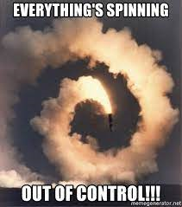

Slide 2
EVEN THOSE WHO SEEM TO COPE WELL—HAVE PROBLEMS THAT WE WOULD NOT TRADE OURS FOR

Slide 3
HOW DO WE COPE WITH THE PROBLEMS OF LIFE?

Slide 4
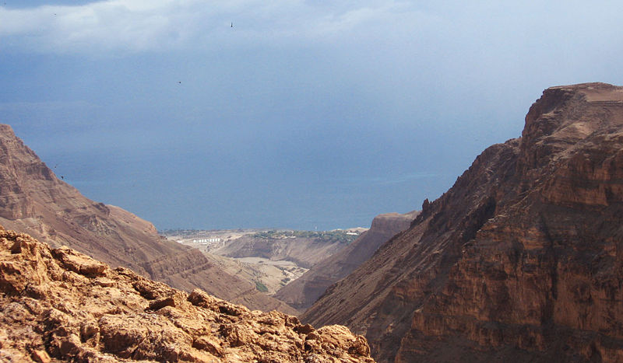
John 10:10 I have come that they may have life, and have it to the full.
KJV– “have it more abundantly”
Greek word: “exceedingly abundantly, beyond measure, superfluous, vehemently”
NOT JUST IN THE FUTURE—BUT ABUNDANT LIFE NOW

Slide 5
JESUS IS INTERESTED IN OUR PHYSICAL WELL-BEING
MUCH OF HIS MINISTRY WAS SPENT IN HEALING AND HELPING PHYSICAL PROBLEMS
BUT HE HAS A GREATER INTEREST IN OUR SPIRITUAL HEALTH
THE REAL MEANING OF LIFE AND THE PURPOSE FOR LIVING COMES FROM THE UNDERSTANDING OF THE POWER OF LOVE

Slide 6
ONLY DAYS BEFORE HE WAS CRUCIFIED HE LOOKED OVER THE CITY OF JERUSALEM AND SAID:
Matt 23:37-39 "O Jerusalem, Jerusalem, you who kill the prophets and stone those sent to you, how often I have longed to gather your children together, as a hen gathers her chicks under her wings, but you were not willing. 38 Look, your house is left to you desolate.
WE DON’T KILL PROPHETS TODAY....
BUT WE IGNORE CHRIST AND HIS POWER FOR OUR LIVES

Slide 7
THE POWER TO LIVE IN DIFFICULT TIMES IS FOUND IN KNOWING AND LOVING GOD
Luke 10:25-37 On one occasion an expert in the law stood up to test Jesus. "Teacher," he asked, "what must I do to inherit eternal life?" "What is written in the Law?" he replied. "How do you read it?" He answered: "'Love the Lord your God with all your heart and with all your soul and with all your strength and with all your mind'; and, 'Love your neighbor as yourself.'" "You have answered correctly," Jesus replied. "Do this and you will live."

Slide 8
THE POWER TO LIVE IN DIFFICULT TIMES IS FOUND IN KNOWING AND LOVING GOD
Luke 10:25-37 On one occasion an expert in the law stood up to test Jesus. "Teacher," he asked, "what must I do to inherit eternal life?" "What is written in the Law?" he replied. "How do you read it?" He answered: "'Love the Lord your God with all your heart and with all your soul and with all your strength and with all your mind'; and, 'Love your neighbor as yourself.'" "You have answered correctly," Jesus replied. "Do this and you will live."

Slide 9
THE POWER TO LIVE IN DIFFICULT TIMES IS FOUND IN KNOWING AND LOVING GOD
Luke 10:25-37 On one occasion an expert in the law stood up to test Jesus. "Teacher," he asked, "what must I do to inherit eternal life?" "What is written in the Law?" he replied. "How do you read it?" He answered: "'Love the Lord your God with all your heart and with all your soul and with all your strength and with all your mind'; and, 'Love your neighbor as yourself.'" "You have answered correctly," Jesus replied. "Do this and you will live."

Slide 10
THE JERICHO ROAD TEST
This will help us discover where we stand with Jesus
Where we stand with Jesus will determine if we have what it takes to live life with the power of God
God’s Word provides the answers

Slide 11
THE JERICHO ROAD TEST
THIS IS A GOOD TEST OF OUR LOVE AND LOYALTY TO GOD

Slide 12
29 But he wanted to justify himself, so he asked Jesus, "And who is my neighbor?"
30 In reply Jesus said: "A man was going down from Jerusalem to Jericho, when he fell into the hands of robbers. They stripped him of his clothes, beat him and went away, leaving him half dead. 31 A priest happened to be going down the same road, and when he saw the man, he passed by on the other side. 32 So too, a Levite, when he came to the place and saw him, passed by on the other side. 33 But a Samaritan, as he traveled, came where the man was; and when he saw him, he took pity on him.

Slide 13
34 He went to him and bandaged his wounds, pouring on oil and wine. Then he put the man on his own donkey, took him to an inn and took care of him. 35 The next day he took out two silver coins and gave them to the innkeeper. 'Look after him,' he said, 'and when I return, I will reimburse you for any extra expense you may have.'
36 "Which of these three do you think was a neighbor to the man who fell into the hands of robbers?"
37 The expert in the law replied, "The one who had mercy on him."
Jesus told him, "Go and do likewise."

Slide 14
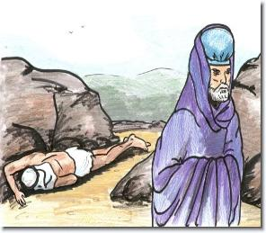
A PRIEST WALKED BY
A LEVITE WALKED BY
NEITHER ONE OFFERED TO HELP

Slide 15
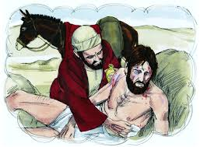
A SAMARITAN – AN OUTCAST OF SOCIETY – STOPPED AND HELPED

Slide 16
“The fact that the Samaritan was traveling in what to him was a foreign district made his deed of mercy even more noteworthy.
The Samaritan knew well that if he had been the wounded victim...he could have expected no mercy from any ordinary Jew. However, the Samaritan, at considerable risk to himself from the attacks of robbers, determined to help the poor victim.”

Slide 17
In a very real way the mercy exhibited by the Samaritan reflects the spirit that moved the Son of God to come to this earth to rescue humanity. God was not obliged to rescue fallen man. He might have passed by, as the priest and the Levite passed the luckless traveler on the road to Jericho. But the Lord was willing to be treated as we deserve, that we might be treated as He deserves.”

Slide 18
This story teaches that we have a responsibility to others
MORE IMPORTANTLY—IT TEACHES US ABOUT LOVE
OF COURSE—WE ARE TO BE GOOD SAMARITANS
BUT IN THIS STORY—CHRIST IS THE GOOD SAMARITAN
WE ARE THE INJURED MAN WHO HAS FALLEN AMONG THIEVES

Slide 19
This story teaches that we have a responsibility to others
MORE IMPORTANTLY—IT TEACHES US ABOUT LOVE
WE HAVE BEEN ROBBED BY SATAN OF ETERNAL LIFE
WE HAVE BEEN ROBBED OF THE SPIRITUAL BLESSINGS THAT ARE FOUND IN CHRIST
CHRIST—THE GOOD SAMARITAN—STOPPED TO BRING US HEALING AND RESTORATION

Slide 20
This story teaches that we have a responsibility to others
MORE IMPORTANTLY—IT TEACHES US ABOUT LOVE
Love is not something to talk about
Love is some we DO

Slide 21
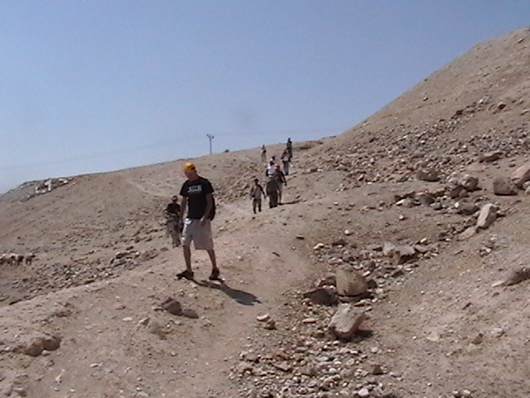
JERICHO ROAD TODAY

Slide 22
MAYBE YOU HAVEN’T BEEN DOWN THE JERICHO ROAD NEAR JERUSALEM

Slide 23
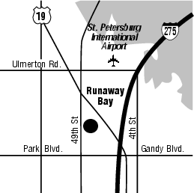
WHAT ABOUT THE JERICHO ROAD IN PINELLAS PARK?

Slide 24
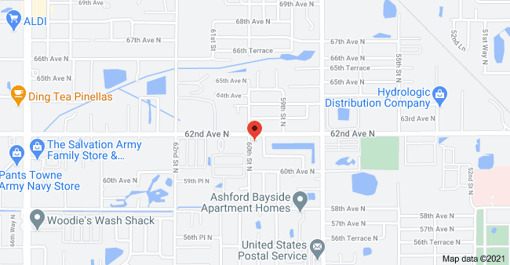
WHAT ABOUT THE JERICO ROAD HERE IN THIS COMMUNITY?

Slide 25
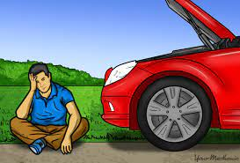

Slide 26
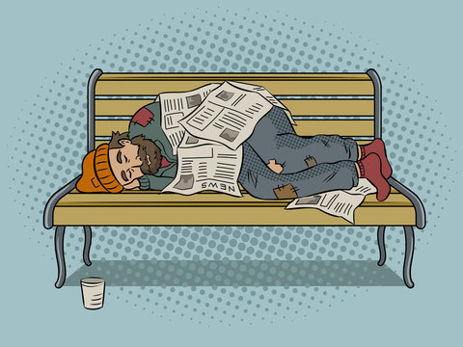

Slide 27
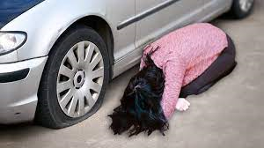

Slide 28
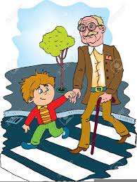

Slide 29
Love is not something we talk about
Love is something we DO
John 14:15 "If you love me, you will obey what I command.
John 15:17 This is my command: Love each other.

Slide 30
Love is not something we talk about
Love is something we DO
Matt 7:21 "Not everyone who says to me, 'Lord, Lord,' will enter the kingdom of heaven, but only he who does the will of my Father who is in heaven.
WHAT IT DOES NOT SAY:
“Not everyone who attends services....”
“Not everyone who prays.....”
“Not everyone who is a good person....”
“Not everyone who is a church member....”

Slide 31
Love is not something we talk about
Love is something we DO
Matt 7:21 "Not everyone who says to me, 'Lord, Lord,' will enter the kingdom of heaven, but only he who does the will of my Father who is in heaven.
Matt 7:22-23 Many will say to me on that day, 'Lord, Lord, did we not prophesy in your name, and in your name drive out demons and perform many miracles?' 23 Then I will tell them plainly, 'I never knew you. Away from me, you evildoers!'

Slide 32
Love is not something we talk about
Love is something we DO
John 14:15 "If you love me, you will obey what I command.
John 15:17 This is my command: Love each other.
“I am convinced—I must love”
How can we learn to love?

Slide 33
We must first love God
Love is more easily “caught” than “taught”

Slide 34
Luke 10:25-37 On one occasion an expert in the law stood up to test Jesus. "Teacher," he asked, "what must I do to inherit eternal life?"
26 "What is written in the Law?" he replied. "How do you read it?"

Slide 35
WHAT WAS WRITTEN IN THE LAW?
Deut 6:5 Love the Lord your God with all your heart and with all your soul and with all your strength.
Lev 19:18 "'Do not seek revenge or bear a grudge against one of your people, but love your neighbor as yourself. I am the Lord.
WHEN WE LOVE GOD WITH A HEART-FELT LOVE
LOVING EACH OTHER IS EASIER

Slide 36
WHAT IS THE BASIS OF OUR LOVE FOR GOD?
1 John 4:19 We love because he first loved us.
1 John 3:1 How great is the love the Father has lavished on us, that we should be called children of God!
1 John 3:16 This is how we know what love is: Jesus Christ laid down his life for us. And we ought to lay down our lives for our brothers.
1 John 4:9-10 This is how God showed his love among us: He sent his one and only Son into the world that we might live through him. 10 This is love: not that we loved God, but that he loved us and sent his Son as an atoning sacrifice for our sins.

Slide 37
WHEN WE KNOW GOD’S LOVE FOR US
OUR RESPONSE IS TO LOVE GOD
IF WE LOVE GOD WE WILL KEEP HIS COMMANDSMENTS
HE HAS COMMANDED US TO LOVE ONE ANOTHER

Slide 38
HEREIN IS THE POWER FOR LIVING
IT IS LEARNING FROM CALVARY HOW MUCH GOD LOVES US
IT IS LEARNING FROM THE JERICHO ROAD HOW LOVE CAN WORK IN OUR OWN HEARTS
HOW DO WE DEMONSTRATE OUR LOVE FOR GOD?
OBEY HIS COMMANDS

Slide 39
THERE’S ANOTHER JERICHO ROAD
Mark 10:46-52 Then they came to Jericho. As Jesus and his disciples, together with a large crowd, were leaving the city, a blind man, Bartimaeus (that is, the Son of Timaeus), was sitting by the roadside begging. 47 When he heard that it was Jesus of Nazareth, he began to shout, "Jesus, Son of David, have mercy on me!" 48 Many rebuked him and told him to be quiet, but he shouted all the more, "Son of David, have mercy on me!" 49 Jesus stopped and said, "Call him." So they called to the blind man, "Cheer up! On your feet! He's calling you." 50 Throwing his cloak aside, he jumped to his feet and came to Jesus.

Slide 40
THERE’S ANOTHER JERICHO ROAD
51 "What do you want me to do for you?" Jesus asked him. The blind man said, "Rabbi, I want to see." 52 "Go," said Jesus, "your faith has healed you." Immediately he received his sight and followed Jesus along the road.

Slide 41
As we travel along on the Jericho Road does the world seem all wrong and heavy your load Just bring it to Christ your sins all confess on the Jericho Road your heart will be blessed.
On the Jericho Road blind Bartimaeus sat, His life was a void, so empty and flat; But Jesus appeared, one word bro’t him sight, On the Jericho Road Christ banished his night.
Oh brother to you this message I bring, though hope may be gone He’ll cause you to sing, at Jesus command sin’s shackles must fall, On the Jericho Road will you answer His call?

Slide 42
On the Jericho Road there’s room for just two, no more or no less, just Jesus and you; each burden He’ll bear, each sorrow He’ll share, there’s never a care for Jesus is there.
WE ARE ON THE JERICHO ROAD TODAY
WE ARE THE MAN WHO FELL AMONG THEIVES
WE ARE BLIND BARTIMAEUS
JESUS IS THE GOOD SAMARITAN
JESUS WANTS TO HEAL US AND GIVE US ABUNDANT LIFE

Slide 43
AS A CHRISTIAN:
Mark 12:30-31 Love the Lord your God with all your heart and with all your soul and with all your mind and with all your strength.' 31 The second is this: 'Love your neighbor as yourself.' There is no commandment greater than these."
1 John 3:18 Dear children, let us not love with words or tongue but with actions and in truth.
1 John 4:7 Dear friends, let us love one another, for love comes from God. Everyone who loves has been born of God and knows God.

Slide 44
AS A CHRISTIAN:
WE NEED TO LOVE OUR FELLOW MAN
WE NEED TO HELP THOSE WHO ARE ON A JERICO ROAD
WE NEED TO REALIZE THAT WE ARE ON THE JERICO ROAD AND WE NEED JESUS’ HELP

