Slide 4
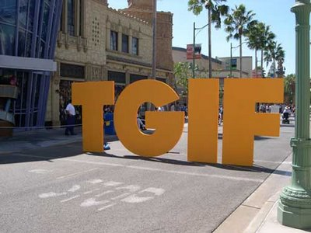
WE LIVE IN A WORLD WHERE PEOPLE LIVE FOR THE WEEK-END

Slide 5
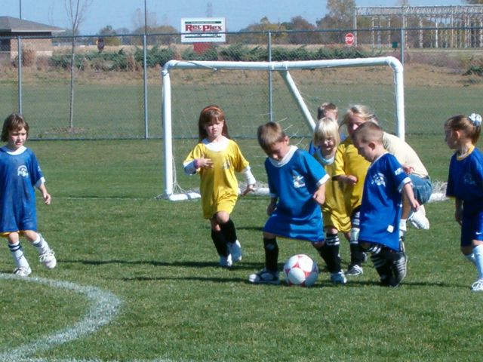

Slide 6
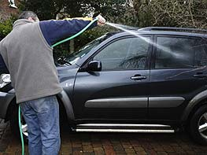

Slide 7
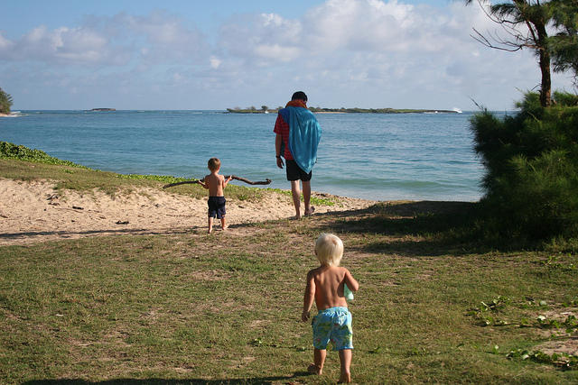

Slide 8
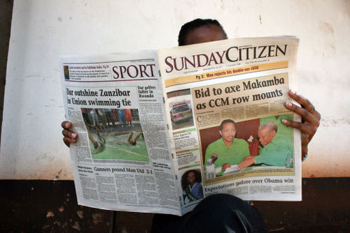

Slide 9
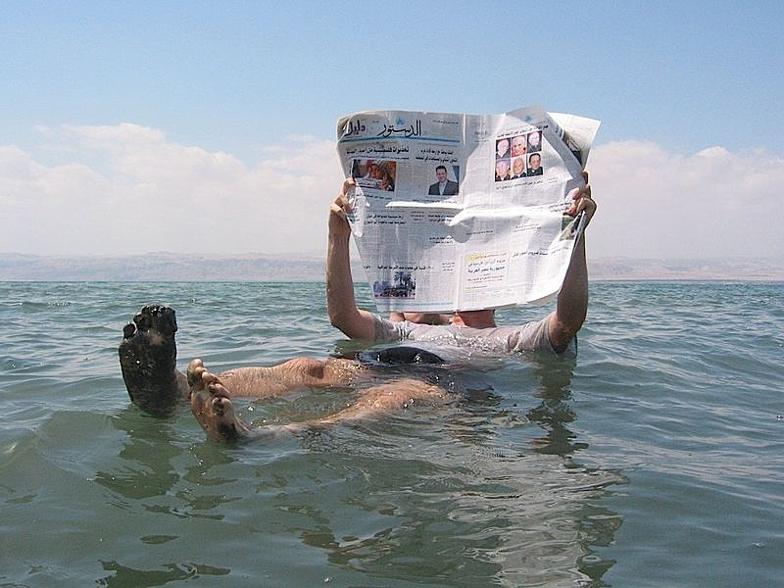

Slide 10
WE LIVE IN A FRIDAY WORLD
WE ARE BORN
WE GET BY
WE DIE
Eccl 5:18 Then I realized that it is good and proper for a man to eat and drink, and to find satisfaction in his toilsome labor under the sun during the few days of life God has given him — for this is his lot.
Eccl 8:15 So I commend the enjoyment of life, because nothing is better for a man under the sun than to eat and drink and be glad.
Eccl 2:24 A man can do nothing better than to eat and drink and find satisfaction in his work.

Slide 11
WE LIVE IN A FRIDAY WORLD
BUT WE ARE SUNDAY PEOPLE
TODAY IS SUNDAY
TODAY IS THE 1ST DAY OF THE WEEK
TODAY WE HAVE ASSEMBLED TO REMEMBER THE DEATH—BURIAL—AND RESURRECTION OF CHRIST

Slide 12
WE ARE SUNDAY PEOPLE
AND WE CLAIM TO BE GOVERNED BY A DIFFERENT SET OF PRIORITIES
WE CLAIM TO BE CITIZENS OF A KINGDOM SHOUTING LOUD “HOSANNA’S” TO JESUS CHRIST OUR “LORD”
WE CLAIM TO BE DIFFERENT FROM THE “FRIDAY PEOPLE”

Slide 13
WE ARE SUNDAY PEOPLE
The “Friday people” may think we are odd—we do not participate with them in the ways of the world
1 Peter 4:4 Of course, your former friends are surprised when you no longer plunge into the flood of wild and destructive things they do. --New Living Translation
We belong to a community of people who believe that what happened 2000 years ago is powerful enough to change us into “SUNDAY” people

Slide 14
WE ARE SUNDAY PEOPLE
We believe that something happened 2000 years ago that gave significance to SUNDAY

Slide 15
WE ARE SUNDAY PEOPLE
Mark 16:1-8 When the Sabbath was over, Mary Magdalene, Mary the mother of James, and Salome bought spices so that they might go to anoint Jesus' body. 2 Very early on the first day of the week, just after sunrise, they were on their way to the tomb 3 and they asked each other, "Who will roll the stone away from the entrance of the tomb?" 4 But when they looked up, they saw that the stone, which was very large, had been rolled away. 5 As they entered the tomb, they saw a young man dressed in a white robe sitting on the right side, and they were alarmed.

Slide 16
WE ARE SUNDAY PEOPLE
6 "Don't be alarmed," he said. "You are looking for Jesus the Nazarene, who was crucified. He has risen! He is not here. See the place where they laid him. 7 But go, tell his disciples and Peter, 'He is going ahead of you into Galilee. There you will see him, just as he told you.'" 8 Trembling and bewildered, the women went out and fled from the tomb. They said nothing to anyone, because they were afraid.
THESE ARE SUNDAY PEOPLE IN A FRIDAY WORLD
THEY HAD JUST WITNESSED THE DARKEST FRIDAY IN THE WORLD’S HISTORY

Slide 17
ON THIS BLACKEST OF ALL FRIDAYS
At the sixth hour darkness came over the whole land until the ninth hour. Mark 15:33
At that moment the curtain of the temple was torn in two from top to bottom. The earth shook and the rocks split. 52 The tombs broke open and the bodies of many holy people who had died were raised to life. 53 They came out of the tombs, Matt 27:51-53
THE DAY THAT MANY RELIGIOUS PEOPLE CALL “GOOD FRIDAY” WAS THE DARKEST FRIDAY OF ALL TIMES

Slide 18
ON THIS BLACKEST OF ALL FRIDAYS
How could any “good” thing come out of this “Friday”?
This text offers some things that relate to 21st Century Sunday people living in a Friday world

Slide 19
THIS STORY SPEAKS TO OUR DISAPPOINTMENT
Mark 16:1-3 When the Sabbath was over, Mary Magdalene, Mary the mother of James, and Salome bought spices so that they might go to anoint Jesus' body. 2 Very early on the first day of the week, just after sunrise, they were on their way to the tomb 3 and they asked each other, "Who will roll the stone away from the entrance of the tomb?"
As they made their way to the tomb—they were no doubt disappointed
Their hope for salvation had been put to death
The stone at the entrance to the tomb was a barrier

Slide 20
THIS STORY SPEAKS TO OUR DISAPPOINTMENT
HOW OFTEN ARE WE DISAPPOINTED?
MAYBE WE ARE DISAPPOINTED WITH LIFE
MAYBE OUR DISAPPOINTMENT IS WITH POLITICS
MAYBE OUR DISAPPOINTMENT IS WITH OURSELVES

Slide 21
THIS STORY SPEAKS TO OUR DISAPPOINTMENT
BUT THERE IS A POSITIVE SIDE
These woman are Sunday people in a Friday world
They are not like the other disciples – hiding in fear
They are not allowing their disappointment to paralyze them from action
They may be disappointed – but not destroyed
Sunday people keep on going

Slide 22
OUR DISBELIEF IS CHALLENGED
Mark 16:5-7 As they entered the tomb, they saw a young man dressed in a white robe sitting on the right side, and they were alarmed. 6 "Don't be alarmed," he said. "You are looking for Jesus the Nazarene, who was crucified. He has risen! He is not here. See the place where they laid him. 7 But go, tell his disciples and Peter, 'He is going ahead of you into Galilee. There you will see him, just as he told you.'"
JESUS HAD TOLD THEM WHAT WOULD HAPPEN
HE TOLD THEM THAT HE WOULD BE PUT TO DEATH AND BE RAISED ON THE 3RD DAY
BUT NOW THEY COME TO THE TOMB EXPECTING TO FIND HIS BODY

Slide 23
OUR DISBELIEF IS CHALLENGED
Go tell Peter and the rest
He is going before you to Galilee and you will meet Him there
Jesus told you this already
Where was their faith?
Why were they surprised at the tomb being empty?
They were challenged to use these Friday experiences in a way that made sense in a Friday world

Slide 24
OUR DISBELIEF IS CHALLENGED
Being Sunday people in a Friday world is not a burden
IT IS A CHALLENGE!
Being Sunday people we get to hear and experience things the Friday world never does
As Sunday people we know our sins are forgiven
We have the faith to believe that Jesus has the power to change our lives and the lives of others
In a world that is dark and depressing—in a Friday world—Jesus brings a message of hope

Slide 25
WE ARE SENT OUT INTO THE FRIDAY WORLD WITH DOUBTS STILL INTACT
Sunday people don’t have all the answers
The women in our text leave the tomb with different questions than when they arrived
“How will we remove the stone?” was their biggest challenge in the beginning
They still have their disappointments
They still have their unbelief
They still don’t have all the answers

Slide 26
WE ARE SENT OUT INTO THE FRIDAY WORLD WITH DOUBTS STILL INTACT
But with doubts intact—they go tell others
They tell Peter and the others to go to Galilee and meet the Risen Jesus
As we live in a Friday world we don’t have all the answers
We can’t explain our trials—issues—problems
But we go out and tell people to meet Jesus in Pinellas Park—in Largo—in Clearwater—in Pinellas County

Slide 27
WE ARE SENT OUT INTO THE FRIDAY WORLD WITH DOUBTS STILL INTACT
Ps 137:4 How can we sing the songs of the Lord while in a foreign land?
How can Sunday people sing the songs of the Lord while in a Friday world?
How can we be Sunday people in a Friday world?
We tell the message of the resurrected Christ

Slide 28
WE ARE SENT OUT INTO THE FRIDAY WORLD WITH DOUBTS STILL INTACT
Luke 24:11 But they did not believe the women, because their words seemed to them like nonsense.
When we preach the gospel of the resurrected Jesus
Some will not believe
Some will think it nonsense
But we still reach out in love

Slide 29
WE ARE SENT OUT INTO THE FRIDAY WORLD WITH DOUBTS STILL INTACT
We as Sunday people can get past a Friday world
We will face adversities and have problems
But we know Jesus is alive
We know He loves us unconditionally
We face life’s struggles knowing our hope is not in this world
We allow the love of God to govern our behavior and response to what life brings

Slide 30
WE ARE SENT OUT INTO THE FRIDAY WORLD WITH DOUBTS STILL INTACT
Although we live in a Friday world—we can be Sunday people
We are not guaranteed anything other than His love for us and His presence with us
As Sunday people we proclaim to the Friday world that even though we have disappointments—we are going to struggle—we will have doubts
We can live and work and act out of gratitude
For God so loved the world that He gave His only begotten Son

Slide 31
WE ARE SENT OUT INTO THE FRIDAY WORLD WITH DOUBTS STILL INTACT
WE ENCOURAGE YOU TODAY TO BECOME A SUNDAY PERSON IN A FRIDAY WORLD

