Slide 1
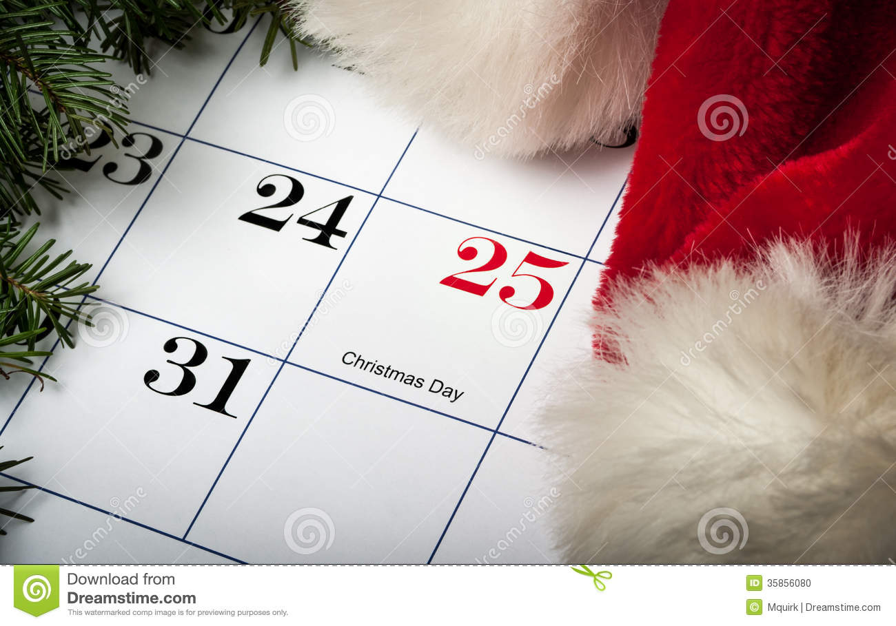
CHRISTMAS DAY IS HERE

Slide 2
BUT WE DON’T NEED A CALENDAR TO REMIND US OF THIS
DECORATIONS STARTED GOING UP BEFORE THANKSGIVING
SANTA STARTED MAKING HIS APPEARANCE AT THE MALLS WEEKS AGO
NEWSPAPERS NEARLY DOUBLED IN SIZE BECAUSE OF THE ADVERTISEMENTS
AND THE TRAFFIC……..

Slide 3
BUT WE DON’T NEED A CALENDAR TO REMIND US OF THIS
SHOPPING FOR PRESENTS BEGAN ON THE DAY AFTER THANKSGIVING KNOWN AS “BLACK FRIDAY”
PICTURES ON TV SHOW CROWDED MALLS & PEOPLE SHOPPING
WE ARE ENCOURAGED TO BUY THINGS WE CANNOT AFFORD—WITH MONEY WE DON’T HAVE—TO GIVE TO PEOPLE WE ARE NOT EVEN SURE WE LIKE

Slide 4
BUT WE DON’T NEED A CALENDAR TO REMIND US OF THIS
THE COMMERCIAL PART OF CHRISTMAS HAS ARRIVED
THE SOCIAL PART OF CHRISTMAS HAS ALSO ARRIVED
THIS IS A FESTIVE TIME
A TIME FOR DRESSING UP
A TIME TO GO TO PARTIES
A TIME TO ENJOY FAMILY & FRIENDS

Slide 5
BUT WE DON’T NEED A CALENDAR TO REMIND US OF THIS
THE COMMERCIAL PART OF CHRISTMAS HAS ARRIVED
THE SOCIAL PART OF CHRISTMAS HAS ALSO ARRIVED
MANY WILL TRAVEL “OVER THE RIVER & THROUGH THE WOODS” TO VISIT FAMILY
FAMILIES & FRIENDS WILL EAT TOGETHER AND SETTLE DOWN FOR AN AFTERNOON OF WATCHING A BALLGAME ON TV

Slide 6
BRETHREN DISCUSS WHETHER OR NOT CHRISTMAS CAN BE OBSERVED
WE CAN BE CERTAIN THAT DECEMBER 25 IS NOT THE ACTUAL BIRTHDAY OF JESUS
1. We know that shepherds were in the fields watching their flocks at the time of Jesus’ birth
2. Jesus’ parents came to Bethlehem to register in a Roman census

Slide 7
WE DON’T KNOW THE EXACT TIME OF JESUS’ BIRTH FOR SURE—WE CAN BE CERTAIN IT WAS NOT IN THE WINTER MONTHS
BUT…IS IT EVER WRONG TO THINK ABOUT AND STUDY ABOUT HIS BIRTH?
SOME ARGUE THAT WE HAVE NO COMMAND TO OBSERVE CHRISTMAS

Slide 8
John 10:22-23 Then came the Feast of Dedication at Jerusalem. It was winter, 23 and Jesus was in the temple area walking in Solomon's Colonnade.
THE FEAST OF DEDICATION OR FEAST OF LIGHTS WAS NOT AN ORDINANCE OF SCRIPTURE
IT WAS OBSERVED AS A TRADITION OF THE JEWS
MANY COMMENTATORS SUGGEST THAT JESUS ATTENDED THIS FEAST

Slide 9
BUT…IS IT EVER WRONG TO THINK ABOUT AND STUDY ABOUT HIS BIRTH?
Rom 14:5 One man considers one day more sacred than another; another man considers every day alike. Each one should be fully convinced in his own mind. 6 He who regards one day as special, does so to the Lord.

Slide 10
BUT…IS IT EVER WRONG TO THINK ABOUT AND STUDY ABOUT HIS BIRTH?
Rom 14:10 You, then, why do you judge your brother? Or why do you look down on your brother? For we will all stand before God's judgment seat.
Rom 14:13 Therefore let us stop passing judgment on one another.

Slide 11
THIS IS THE TIME OF THE YEAR MANY PEOPLE ARE THINKING ABOUT JESUS
WHAT A WONDERFUL OPPORTUNITY OF SHARE THE STORY OF JESUS’ BIRTH, LIFE, DEATH & RESURRECTION
WHILE THE BIRTH OF CHRIST IS ON PEOPLE’S MINDS WE CAN USE THIS TO SHARE THE TRUE STORY OF CHRIST’S BIRTH

Slide 12
WHILE PEOPLE FOCUS ON CHRIST’S PHYSICAL BIRTH WE WANT TO THINK ABOUT HIS BIRTH IN A DIFFERENT WAY
Gal 4:19 My dear children, for whom I am again in the pains of childbirth until Christ is formed in you,

Slide 13
WHILE PEOPLE FOCUS ON CHRIST’S PHYSICAL BIRTH WE WANT TO THINK ABOUT HIS BIRTH IN A DIFFERENT WAY
Gal 4:19 My dear children, for whom I am again in the pains of childbirth until Christ is formed in you,

Slide 14
WHILE PEOPLE FOCUS ON CHRIST’S PHYSICAL BIRTH WE WANT TO THINK ABOUT HIS BIRTH IN A DIFFERENT WAY
Gal 4:19 My dear children, for whom I am again in the pains of childbirth until Christ is formed in you,
PAUL USES THE “PAINS OF CHILDBIRTH” TO DEMONSTRATE HOW CHRIST IS “FORMED” IN US

Slide 15
CHRIST MUST BE “BORN” IN US
Gal 4:19 My dear children, for whom I am again in the pains of childbirth until Christ is formed in you,
FORMED it is used in Gal 4:19, expressing the necessity of a change in character and conduct to correspond with inward spiritual condition, so that there may be moral conformity to Christ. (from Vine's Expository Dictionary of Biblical Words.)
THIS SAYS THAT CHRIST MUST BE “BORN” IN US

Slide 17
THE BIRTH OF CHRIST REPRESENTS OUR SPIRITUAL BIRTH
Gal 4:19 My dear children, for whom I am again in the pains of childbirth until Christ is formed in you,
THE N.T. SPEAKS OF OUR BEING BORN AGAIN
JESUS WAS BORN SO WE CAN BORN AGAIN

Slide 18
THE BIRTH OF CHRIST REPRESENTS OUR SPIRITUAL BIRTH
Gal 4:19 My dear children, for whom I am again in the pains of childbirth until Christ is formed in you,
THE N.T. SPEAKS OF OUR BEING BORN AGAIN
John 3:5-7 Jesus answered, "I tell you the truth, no one can enter the kingdom of God unless he is born of water and the Spirit. 6 Flesh gives birth to flesh, but the Spirit gives birth to spirit. 7 You should not be surprised at my saying, 'You must be born again.'

Slide 19
Gal 4:19 My dear children, for whom I am again in the pains of childbirth until Christ is formed in you,
THE N.T. SPEAKS OF OUR BEING BORN AGAIN
1 Peter 1:23 For you have been born again, not of perishable seed, but of imperishable, through the living and enduring word of God.

Slide 20
Gal 4:19 My dear children, for whom I am again in the pains of childbirth until Christ is formed in you,
THE N.T. SPEAKS OF OUR BEING BORN AGAIN
1 John 2:29 If you know that he is righteous, you know that everyone who does what is right has been born of him.

Slide 21
Gal 4:19 My dear children, for whom I am again in the pains of childbirth until Christ is formed in you,
THE N.T. SPEAKS OF OUR BEING BORN AGAIN
1 John 3:9 No one who is born of God will continue to sin, because God's seed remains in him; he cannot go on sinning, because he has been born of God.

Slide 22
Gal 4:19 My dear children, for whom I am again in the pains of childbirth until Christ is formed in you,
THE N.T. SPEAKS OF OUR BEING BORN AGAIN
1 John 4:7 Everyone who loves has been born of God and knows God.
1 John 5:4 for everyone born of God overcomes the world.
CHRIST WAS BORN SO WE CAN BE BORN AGAIN

Slide 23
WHEN WE ARE BORN AGAIN CHRIST IS BORN IN US
WHEN CHRIST IS “BORN IN US” THINGS CHANGE IN OUR LIVES
WE ADAPT A DIFFERENT LIFE STYLE
WE HAVE ADAPTED FAIRLY WELL TO OUR ENVIRONMENT

Slide 24
WE HAVE LEARNED TO CLEAN UP THE AIR WE BREATHE

Slide 25
WE HAVE LEARNED TO PURIFY THE WATER WE DRINK

Slide 26
WE HAVE LEARNED TO ENRICH THE FOODS WE EAT

Slide 27
WE HAVE ALSO ADAPTED OURSELVES TO TECHNOLOGY

Slide 28
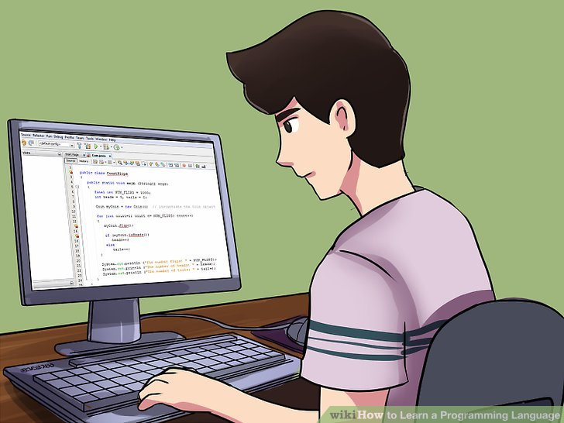
WE HAVE LEARNED HOW TO PROGRAM OUR COMPUTER
?

Slide 29
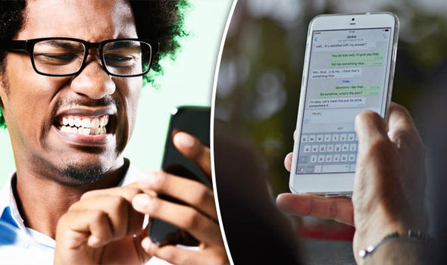
WE HAVE LEARNED HOW TO USE OUR SMART PHONES

Slide 30
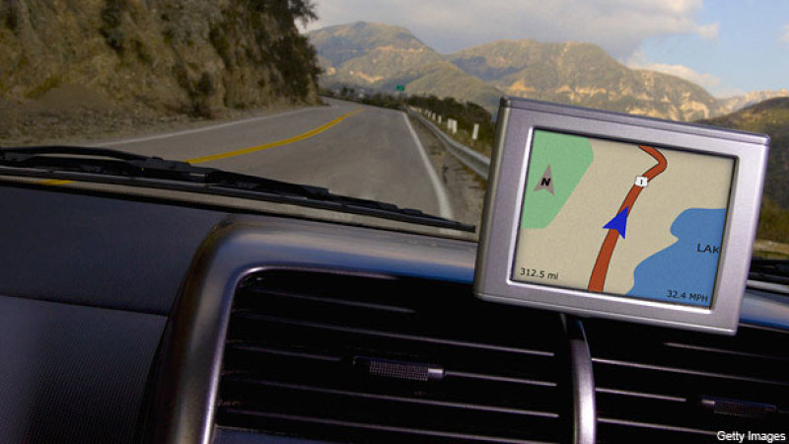
WE HAVE LEARNED HOW TO FIGURE OUT THE GPS SYSTEM

Slide 31
OVER ALL WE HAVE ADAPTED PRETTY WELL TO OUR MODERN WORLD
BUT THERE ARE SOME THINGS WE HAVEN’T LEARNED THAT THE COMING OF CHRIST SHOULD HAVE TAUGHT US
THE ANGELS ANNOUNCED TO THE SHEPHERDS “Peace on earth…good will toward men”
BUT WE HAVEN’T LEARNED TO LIVE IN PEACE WITH ONE ANOTHER

Slide 32
OUR GREATEST NEED IS TO HAVE JESUS FORMED (BORN) IN US
TO LIVE WITH US & IN US
TO SHOW US HOW TO BE AT PEACE WITH ONE ANOTHER

Slide 33
LUKE TAKES US THROUGH THE WHOLE STORY OF THE BIRTH OF JESUS
WE LEARN ABOUT SHEPHERDS AND ANGELS AND WISE MEN AND JESUS BEING BORN AND WRAPPED IN SWADDLING CLOTHES AND PLACED IN A MANGER*
BUT THERE IS SOMETHING HE ADDS THAT WE COULD MISS

Slide 34
Luke 2:7 and she gave birth to her firstborn, a son. She wrapped him in cloths and placed him in a manger, because there was no room for them in the inn.

Slide 35
Luke 2:7 and she gave birth to her firstborn, a son. She wrapped him in cloths and placed him in a manger, because there was no room for them in the inn.
IT IS ALMOST AS IF LUKE ANTICIPATED THE QUESTION: “WHY WAS HE BORN IN A STABLE?”
AS AN AFTERTHOUGHT HE ADDS: “BECAUSE THERE WAS NO ROOM FOR THEM IN THE INN”

Slide 36
Luke 2:7 and she gave birth to her firstborn, a son. She wrapped him in cloths and placed him in a manger, because there was no room for them in the inn.
THERE IS NO CONDEMNATION OF THE INNKEEPER
LUKE DOESN’T SAY HE WAS BAD OR GOOD OR RIGHT OR WRONG
HE DOESN’T COMMENT ABOUT HIM

Slide 37
BUT THIS CROWDED INN STANDS AS A SYMBOL OF CROWDED-CLUTTERED LIVES THAT STILL HAVE NO ROOM FOR HIM
WE ARE BUSY WITH OUR LIVES AND OUR SCHEDULES ARE SO FULL
WORK
SCHOOL/ACTIVITIES
RECREATION
OTHER TIME CONSUMING ACTIVITIES

Slide 38
OUR CROWDED LIVES SOMETIMES CROWD JESUS OUT COMPLETELY
WE HAVE NO TIME TO STUDY THE BIBLE
WE HAVE NO TIME TO ATTEND WORSHIP SERVICES
WE HAVE NO TIME TO “DO GOOD UNTO ALL MEN AND ESPECIALLY THOSE OF THE HOUSEHOLD OF FAITH”
THERE JUST IS NO ROOM FOR JESUS IN OUR LIVES

Slide 39
IF WE DON’T HAVE TIME FOR JESUS—OUR SCHEDULES ARE JUST TOO CLUTTERED
Matt 6:33 But seek first his kingdom and his righteousness, and all these things will be given to you as well.
Rom 12:1-2 Therefore, I urge you, brothers, in view of God's mercy, to offer your bodies as living sacrifices, holy and pleasing to God — this is your spiritual act of worship.

Slide 40
LESSON ONE: WE MUST DE-CLUTTER OUR LIVES AND MAKE ROOM FOR JESUS
LESSON TWO: WE MUST DESIRE FOR CHRIST TO BE FORMED (BORN) IN US
WE WANT HIS BLESSINGS BUT NOT HIS CROSS
WE WANT HIS FORGIVENESS BUT NOT HIS JUDGMENT
WE WANT HIS SALVATION BUT WE DON’T WANT TO SERVE

Slide 41
THE ONE THING JESUS TEACHES OVER AND OVER
WE MUST MAKE HIM AND HIS KINGDOM OUR TOP PRIORITY

Slide 42
Matt 13:44 The Parable of the Hidden Treasure
"Again, the kingdom of heaven is like treasure hidden in a field, which a man found and hid; and for joy over it he goes and sells all that he has and buys that field.
The Parable of the Pearl of Great Price
"Again, the kingdom of heaven is like a merchant seeking beautiful pearls, 46 who, when he had found one pearl of great price, went and sold all that he had and bought it.

Slide 43
LESSON ONE: WE MUST DECLUTTER OUR LIVES AND MAKE ROOM FOR JESUS
LESSON TWO: WE MUST DESIRE FOR CHRIST TO BE FORMED (BORN) IN US
LESSON THREE: THE NEED FOR HUMILITY

Slide 44
CHRIST WAS BORN IN A STABLE
WE SEE MARY & JOSEPH ENTERING THAT SMELLING STABLE
INSIDE MARY’S WOMB IS GOD IN THE FLESH
I MARVEL THAT GOD WOULD COME DOWN THAT FAR
SACRIFICE THAT MUCH TO ENTER OUR WORLD

Slide 45
THERE IS A LESSON HERE
GOD WAS SAYING: “NOW THERE IS NOTHING THAT STANDS BETWEEN GOD AND MAN”
“THERE IS NO PLACE FOR ARROGANCE OR PRIDE”
“I BECAME MAN– IN FLESH – SO THERE WOULD BE NOTHING BETWEEN ME AND MAN”

Slide 46
THROUGH THE DOORS OF THAT STABLE COME COWS & SHEEP & LIVESTOCK
THROUGH THE DOORS OF THAT STABLE COME MARY & JOSEPH
THROUGH THE DOORS OF THAT STABLE WE COME HUMBLY BEFORE HIM AND SAY: “HERE AM I LORD—USE ME”
THIS IS WHAT IT WILL TAKE FOR CHRIST TO BE BORN IN US

Slide 47
WE MUST DECLUTTER OUR LIVES AND MAKE ROOM FOR HIM IN THE INN OF OUR HEARTS
WE MUST WANT CHRIST TO BE FORMED (BORN) IN US
WE MUST HUMBLY BE WILLING TO GIVE EVERYTHING TO HIM
HAS CHRIST BEEN BORN IN YOU?
HAVE YOU ALLOWED CHRIST TO BE FORMED IN YOU?

