Slide 3
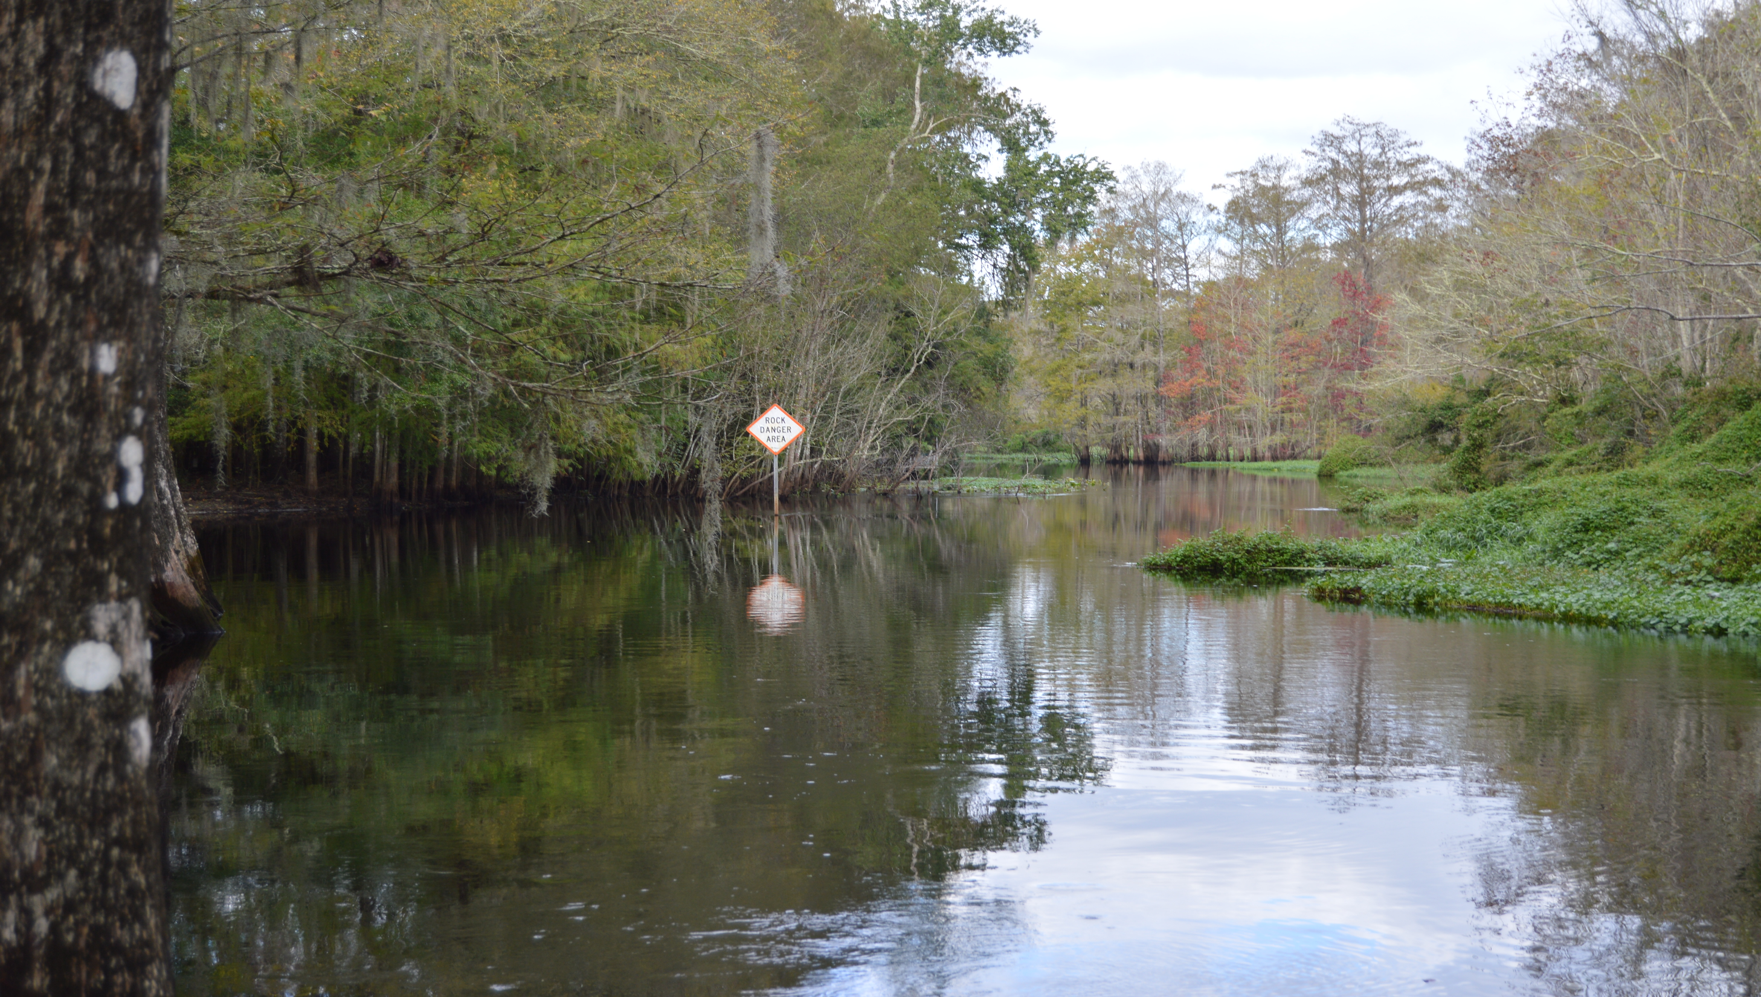

Slide 4
Rom 1:20
For since the creation of the world God's invisible qualities — his eternal power and divine nature — have been clearly seen, being understood from what has been made, so that men are without excuse.

Slide 5
Rom 1:20
For since the creation of the world God's invisible qualities — his eternal power and divine nature — have been clearly seen, being understood from what has been made, so that men are without excuse.

Slide 6
Rom 1:20
For since the creation of the world God's invisible qualities — his eternal power and divine nature — have been clearly seen, being understood from what has been made, so that men are without excuse.

Slide 7
Rom 1:20
For since the creation of the world God's invisible qualities — his eternal power and divine nature — have been clearly seen, being understood from what has been made, so that men are without excuse.
WHAT GOD HAS CREATED REVEALS THE QUALITIES AND GREATNESS OF GOD

Slide 8
HOW DOES AN ATHEIST EXPLAIN THE BEAUTIES OF NATURE?
“As an atheist, I look at the natural world and am amazed at all the wondrous things that have come into existence purely through the operation of natural laws and random chance.”
“There’s nothing religious about it. [ beauty of nature ] It’s just nature: elusive, expansive and enveloping. You don’t need to look for a higher power to give thanks.”

Slide 9
HOW DOES AN ATHEIST EXPLAIN THE BEAUTIES OF NATURE?
“The woods where I grew up, It’s beautiful, yes? It’s even more beautiful to me, because it is full of meaningful events. I never ever heard any evidence of “God” in the woods. He was in the church, in crazy peoples head, threats, yelling, if you don’t —- , you will go to hell. That’s what “God” was — the threat of hell, spoken by mean and nasty people. Not something you find in the woods. There you find peace. And nature. And shy animals that scoot when they knew you have seen them. Of trees, the crunch of the forest floor, and wild flowers.”

Slide 10
HOW DOES AN ATHEIST EXPLAIN THE BEAUTIES OF NATURE?
“To me it [ the world ] is beautiful but the creation part is an ill informed childish speculation.”

Slide 13
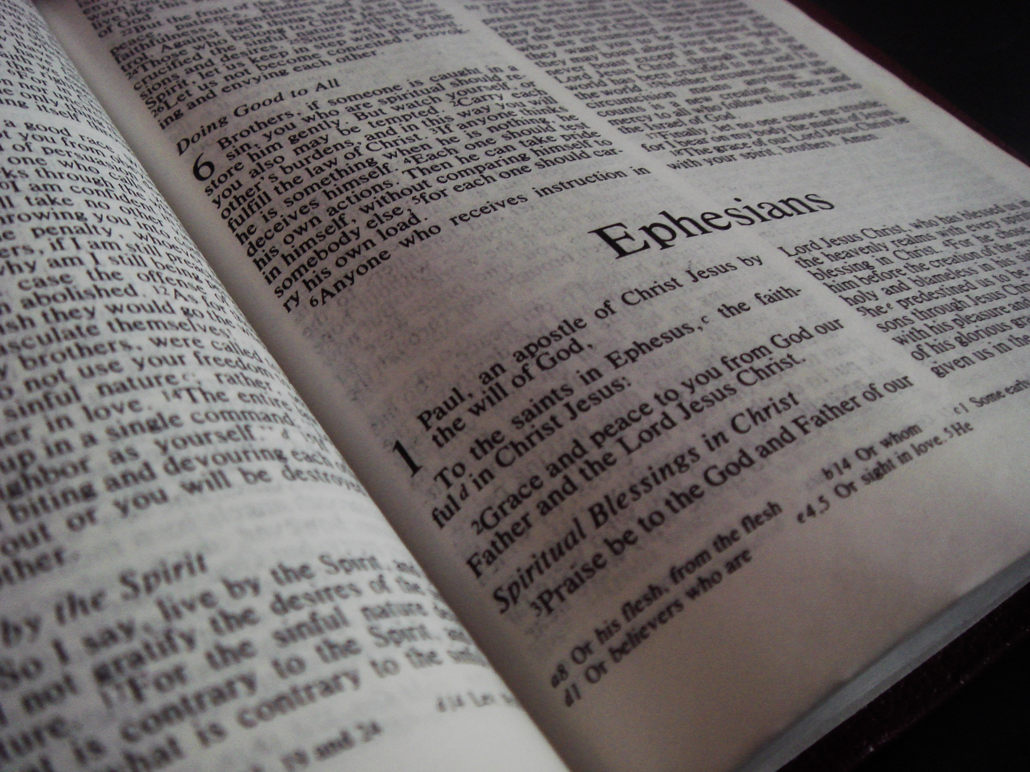
PAUL’S LETTER TO THE EPHESIANS REVEALED MYSTERIES THAT WERE HIDDEN FROM THE FOUNDATION OF THE WORLD
IN THE LAST PART OF CHAPTER 3 PAUL PRAISES GOD FOR ALL THAT HE HAS MADE POSSIBLE THROUGH JESUS CHRIST
AFTER HE PRAYS FOR THESE CHRISTIANS HE LIFTS HIS VOICE IN PRAISE TO THE ONE WHO HAS PROVIDED ALL THESE SPIRITUAL BLESSINGS
2 TIMES PAUL USES THE PHRASE “TO HIM”

Slide 14
Eph 3:14-21 For this reason I kneel before the Father, 15 from whom his whole family in heaven and on earth derives its name. 16 I pray that out of his glorious riches he may strengthen you with power through his Spirit in your inner being, 17 so that Christ may dwell in your hearts through faith. And I pray that you, being rooted and established in love, 18 may have power, together with all the saints, to grasp how wide and long and high and deep is the love of Christ, 19 and to know this love that surpasses knowledge — that you may be filled to the measure of all the fullness of God. 20 Now to him who is able to do immeasurably more than all we ask or imagine, according to his power that is at work within us, 21 to him be glory in the church and in Christ Jesus throughout all generations, for ever and ever! Amen.

Slide 15
Eph 3:14-21 For this reason I kneel before the Father, 15 from whom his whole family in heaven and on earth derives its name. 16 I pray that out of his glorious riches he may strengthen you with power through his Spirit in your inner being, 17 so that Christ may dwell in your hearts through faith. And I pray that you, being rooted and established in love, 18 may have power, together with all the saints, to grasp how wide and long and high and deep is the love of Christ, 19 and to know this love that surpasses knowledge — that you may be filled to the measure of all the fullness of God. 20 Now to him who is able to do immeasurably more than all we ask or imagine, according to his power that is at work within us, 21 to him be glory in the church and in Christ Jesus throughout all generations, for ever and ever! Amen.

Slide 16
PAUL MAKES A PYRAMID OF GOD’S GREATNESS
GRACE
GLORY
GREATNESS

Slide 17
I. THERE IS A STATEMENT ABOUT GOD’S GREATNESS
SOME OF THE TRUTHS PAUL SHARED
We were chosen in Christ
We were dead in trespasses and sins
We were brought back to life
We are saved by grace
We receive the power of God
We have been brought near to God

Slide 18
I. THERE IS A STATEMENT ABOUT GOD’S GREATNESS
A REVIEW OF THE TRUTHS PAUL HAS ALREADY SHARED
We were aliens
We have been brought near by Jesus Christ
We are fellow citizens
We are in God’s family
We are God’s temple
We are God’s body

Slide 19
I. THERE IS A STATEMENT ABOUT GOD’S GREATNESS
THERE ARE MANY MORE THINGS PAUL SHARES WITH US THAT SHOULD CAUSE US TO PRAISE AND GLORIFY GOD
GOD IS WORTHY OF OUR LOVE
GOD IS WORTHY OF OUR DEVOTION
GOD IS WORTHY OF OUR PRAISE
NOTICE SOME COMMANDS TO PRAISE GOD

Slide 20
I. THERE IS A STATEMENT ABOUT GOD’S GREATNESS
Ps 47:1-2 Clap your hands, all you nations; shout to God with cries of joy. 2 How awesome is the Lord Most High, the great King over all the earth!
Ps 113:1-3 Praise the Lord. Praise, O servants of the Lord, praise the name of the Lord. 2 Let the name of the Lord be praised, both now and forevermore. 3 From the rising of the sun to the place where it sets, the name of the Lord is to be praised.

Slide 21
I. THERE IS A STATEMENT ABOUT GOD’S GREATNESS
Ps 135:1-6 Praise the Lord. Praise the name of the Lord; praise him, you servants of the Lord, 2 you who minister in the house of the Lord, in the courts of the house of our God. 3 Praise the Lord, for the Lord is good; sing praise to his name, for that is pleasant. 4 For the Lord has chosen Jacob to be his own, Israel to be his treasured possession. 5 I know that the Lord is great, that our Lord is greater than all gods. 6 The Lord does whatever pleases him, in the heavens and on the earth, in the seas and all their depths.

Slide 22
I. THERE IS A STATEMENT ABOUT GOD’S GREATNESS
Heb 13:15 Through Jesus, therefore, let us continually offer to God a sacrifice of praise — the fruit of lips that confess his name.
PAUL PRAYS THREE THINGS FOR THE CHURCH
That they would be filled with God’s power
That they will both know and live out the awesome love of God
That they can experience the fullness and greatness of God

Slide 23
I. THERE IS A STATEMENT ABOUT GOD’S GREATNESS
1. THE GREATNESS OF HIS ABILITY
Eph 3:20 Now to him who is able to do immeasurably more than all we ask or imagine

Slide 24
I. THERE IS A STATEMENT ABOUT GOD’S GREATNESS
1. THE GREATNESS OF HIS ABILITY
Eph 3:20 Now to him who is able to do immeasurably more than all we ask or imagine
THE WORD “ABLE” MEANS “TO BE CAPABLE, STRONG AND POWERFUL”
A CHILDREN’S SONG EXPRESSES THE GREATNESS OF GOD

Slide 25
My God is so big, so strong and so mighty There's nothing my God cannot do My God is so big, so strong and so mighty There's nothing my God cannot do He made the trees He made the seas He made the elephants too My God is so big, so strong and so mighty There's nothing my God cannot do My God is so great, so strong and so mighty There's nothing my God cannot do My God is so great, so strong and so mighty There's nothing my God cannot do

Slide 26
The skies are his handy works too My God is so great, so strong and so mighty There's nothing my God cannot do There's nothing my God cannot do There's nothing my God cannot do For you

Slide 27
I. THERE IS A STATEMENT ABOUT GOD’S GREATNESS
1. THE GREATNESS OF HIS ABILITY
Eph 3:20 Now to him who is able to do immeasurably more than all we ask or imagine
THE WORD “ABLE” MEANS “TO BE CAPABLE, STRONG AND POWERFUL”
THERE IS NO POWER GREATER THAN GOD

Slide 28
I. THERE IS A STATEMENT ABOUT GOD’S GREATNESS
1. THE GREATNESS OF HIS ABILITY
HE IS THE GOD OF CREATION
HE IS THE GOD OF REVELATION
HE IS THE GOD OF SALVATION
HE IS THE GOD OF MANIFESTATION
HE IS THE GOD OF RESURRECTION
HE IS ABLE TO EMPOWER US—ENABLE US TO KNOW HIS LOVE – ENABLE US TO BE A DWELLING FOR HIM

Slide 29
I. THERE IS A STATEMENT ABOUT GOD’S GREATNESS
2. THE GREATNESS OF HIS ABUNDANCE
Eph 3:20 Now to him who is able to do immeasurably more than all we ask or imagine,

Slide 30
I. THERE IS A STATEMENT ABOUT GOD’S GREATNESS
2. THE GREATNESS OF HIS ABUNDANCE
Eph 3:20 Now to him who is able to do immeasurably more than all we ask or imagine,
“IMMEASURABLY” IS “EXCEEDINGLY ABUNDANT” IN KJV
THE PHRASE MEANS “GOING ABOVE AND BEYOND”
GOD’S ABILITY EXCEEDS WHAT OUR MINDS CAN COMPREHEND

Slide 31
I. THERE IS A STATEMENT ABOUT GOD’S GREATNESS
2. THE GREATNESS OF HIS ABUNDANCE
Eph 3:20 Now to him who is able to do immeasurably more than all we ask or imagine,
THIS VERSE CREATES A PYRAMID DECLARING GOD’S ABILITY

Slide 32
I. THERE IS A STATEMENT ABOUT GOD’S GREATNESS
2. THE GREATNESS OF HIS ABUNDANCE
HE IS ABLE
HE IS ABLE TO DO
HE IS ABLE TO DO EXCEEDINGLY MORE
HE IS ABLE TO DO EXCEEDINGLY MORE THAN WE ASK
HE IS ABLE TO DO EXCEEDINGLY MORE THAN WE ASK OR THINK

Slide 33
I. THERE IS A STATEMENT ABOUT GOD’S GREATNESS
2. THE GREATNESS OF HIS ABUNDANCE
GOD IS ABLE
ARE WE ENJOYING THE PRIVILEGE OF GOD DOING IN OUR LIVES MORE THAN WE CAN THINK OR IMAGINE?
WHEN WE WALK IN HIS POWER
WHEN WE WALK IN HIS LOVE
WHEN WE WALK FILLED WITH HIS FULLNESS
WE TAP INTO THE AWESOME POWER OF GOD

Slide 34
I. THERE IS A STATEMENT ABOUT GOD’S GREATNESS
2. THE GREATNESS OF HIS ABUNDANCE
THERE IS NO LIMIT TO GOD’S POWER
HE CAN MOVE MOUNTAINS
HE CAN CHANGE LIVES
HE CAN LIFT BURDENS
HE CAN MEET NEEDS
HE PROVIDES ALL OUR NEEDS*
THIS IS A SMALL GLIMPSE OF WHAT GOD CAN DO

Slide 35
II. THERE IS A STATEMENT ABOUT GOD’S GRACE
Eph 3:20 Now to him who is able to do immeasurably more than all we ask or imagine, according to his power that is at work within us,
THE WORD “GRACE” IS NOT MENTIONED BUT IMPLIED IN THIS PASSAGE
THIS VERSE GIVES US INSIGHT INTO HOW GOD WORKS IN OUR LIVES TO ACCOMPLISH HIS WILL IN THE WORLD

Slide 36
II. THERE IS A STATEMENT ABOUT GOD’S GRACE
1 HIS GRACE EMPOWERS US
Eph 3:20 Now to him who is able to do immeasurably more than all we ask or imagine, according to his power that is at work within us,

Slide 37
II. THERE IS A STATEMENT ABOUT GOD’S GRACE
1. HIS GRACE EMPOWERS US
Eph 3:20 Now to him who is able to do immeasurably more than all we ask or imagine, according to his power that is at work within us,
WE ARE EMPOWERED BY GOD’S GRACE FOR SERVICE
HIS POWER IS AT WORK WITHIN US

Slide 38
II. THERE IS A STATEMENT ABOUT GOD’S GRACE
2. HIS GRACE ENLIVENS US
Eph 3:20 Now to him who is able to do immeasurably more than all we ask or imagine, according to his power that is at work within us,
BY GOD’S GRACE WE ARE EMPOWERED TO LIVE FOR GOD
Phil 4:13 I can do everything through him who gives me strength.

Slide 39
II. THERE IS A STATEMENT ABOUT GOD’S GRACE
2. HIS GRACE ENLIVENS US
Gal 2:20-21 I have been crucified with Christ and I no longer live, but Christ lives in me. The life I live in the body, I live by faith in the Son of God, who loved me and gave himself for me. 21 I do not set aside the grace of God, for if righteousness could be gained through the law, Christ died for nothing!"

Slide 40
II. THERE IS A STATEMENT ABOUT GOD’S GRACE
2. HIS GRACE ENLIVENS US
John 14:12-13 12 I tell you the truth, anyone who has faith in me will do what I have been doing. He will do even greater things than these, because I am going to the Father. 13 And I will do whatever you ask in my name, so that the Son may bring glory to the Father.

Slide 41
II. THERE IS A STATEMENT ABOUT GOD’S GRACE
2. HIS GRACE ENLIVENS US
Eph 3:20 Now to him who is able to do immeasurably more than all we ask or imagine, according to his power that is at work within us,
GOD’S POWER WORKS WITHIN US
HIS GRACE EMPOWERS US FOR SERVICE
HIS GRACE ENLIVENS US FOR LIVING

Slide 42
III. THERE IS A STATEMENT ABOUT GOD’S GLORY
1. THE PLACE OF HIS GLORY
Eph 3:21 to him be glory in the church and in Christ

Slide 43
III. THERE IS A STATEMENT ABOUT GOD’S GLORY
1. THE PLACE OF HIS GLORY
Eph 3:21 to him be glory in the church and in Christ
WHY DOES THE CHURCH EXIST?
IT EXISTS AS THE “BODY” OF CHRIST
IT EXISTS AS A COMMUNITY OF BELIEVERS
IT EXISTS TO PREACH THE GOSPEL

Slide 44
III. THERE IS A STATEMENT ABOUT GOD’S GLORY
1. THE PLACE OF HIS GLORY
Eph 3:21 to him be glory in the church and in Christ
THE MAIN REASON IT EXISTS IS TO BRING GLORY TO GOD
Rom 15:17 Therefore I glory in Christ Jesus in my service to God.

Slide 45
III. THERE IS A STATEMENT ABOUT GOD’S GLORY
1. THE PLACE OF HIS GLORY
Eph 3:21 to him be glory in the church and in Christ
WHEN WE GATHER FOR WORSHIP
WHEN WE SING
WHEN WE PRAY
WHEN WE OBSERVE THE LORD’S SUPPER
WHEN WE WORK AND SERVE GOD IS GLORIFIED

Slide 46
III. THERE IS A STATEMENT ABOUT GOD’S GLORY
1. THE PLACE OF HIS GLORY
Eph 3:21 to him be glory in the church and in Christ
EVERYTHING WE DO AS A CHURCH SHOULD BE DONE TO GLORIFY GOD
EVERY DECISION MADE
EVERY DOLLAR SPENT
EVERY JOB THAT IS ASSIGNED

Slide 47
III. THERE IS A STATEMENT ABOUT GOD’S GLORY
1. THE PLACE OF HIS GLORY
Eph 3:21 to him be glory in the church and in Christ
EVERY PERSON WHO SERVES IN ANY CAPACITY
SHOULD DO SO TO THE GLORY OF GOD
1 Cor 10:31 whatever you do, do it all for the glory of God.

Slide 48
III. THERE IS A STATEMENT ABOUT GOD’S GLORY
1. THE PLACE OF HIS GLORY
Eph 3:21 to him be glory in the church and in Christ
WHAT WE DO SHOULD NOT BE FOR THE PRAISE OF MAN
IT SHOULD NOT BE TO MAKE A NAME FOR OURSELVES
IT SHOULD BE FOR THE GLORY OF GOD

Slide 49
III. THERE IS A STATEMENT ABOUT GOD’S GLORY
2. THE PERSON OF HIS GLORY
Eph 3:21 to him be glory in the church and in Christ

Slide 50
III. THERE IS A STATEMENT ABOUT GOD’S GLORY
2. THE PERSON OF HIS GLORY
Eph 3:21 to him be glory in the church and in Christ
GOD IS GLORIFIED IN THE PERSON OF HIS SON – JESUS CHRIST
WE NEED TO EXAMINE OUR SERVICE AND BE SURE THAT WHAT WE DO MAGNIFIES THE ONE WHO BRINGS GLORY TO GOD

Slide 51
III. THERE IS A STATEMENT ABOUT GOD’S GLORY
2. THE PERSON OF HIS GLORY
Eph 3:21 to him be glory in the church and in Christ
THE THEME OF THE PREACHING IN THE 1ST CENTURY WAS JESUS CHRIST AND HIM CRUCIFIED

Slide 52
III. THERE IS A STATEMENT ABOUT GOD’S GLORY
2. THE PERSON OF HIS GLORY
Eph 3:21 to him be glory in the church and in Christ
WHEN WE TALK ABOUT JESUS
PREACH ABOUT JESUS
SING ABOUT JESUS
PRAISE THE NAME OF JESUS
GOD WILL BE GLORIFIED BY OUR LIVES

Slide 53
III. THERE IS A STATEMENT ABOUT GOD’S GLORY
2. THE PERSON OF HIS GLORY
Eph 3:21 to him be glory in the church and in Christ
WE NEED TO HAVE THIS ATTITUDE IN OUR WORSHIP SERVICE
WHEN WE DO GOD WILL BE GLORIFIED

Slide 54
III. THERE IS A STATEMENT ABOUT GOD’S GLORY
3. THE PERMANENCE OF HIS GLORY
Eph 3:21 to him be glory in the church and in Christ Jesus throughout all generations, for ever and ever! Amen.

Slide 55
III. THERE IS A STATEMENT ABOUT GOD’S GLORY
3. THE PERMANENCE OF HIS GLORY
Eph 3:21 to him be glory in the church and in Christ Jesus throughout all generations, for ever and ever! Amen.

Slide 56
III. THERE IS A STATEMENT ABOUT GOD’S GLORY
3. THE PERMANENCE OF HIS GLORY
Eph 3:21 to him be glory in the church and in Christ Jesus throughout all generations, for ever and ever! Amen.
Eph 3:21 throughout all ages, world without end. KJV
GOD WILL BE GLORIFIED EVEN WHEN THE END OF TIME COMES

Slide 57
III. THERE IS A STATEMENT ABOUT GOD’S GLORY
3. THE PERMANENCE OF HIS GLORY
Rev 5:13 "To him who sits on the throne and to the Lamb be praise and honor and glory and power, for ever and ever!"
WE PRAISE GOD IN THIS LIFE
AND WE WILL PRAISE GOD IN THE LIFE TO COME

Slide 58
DO WE AS THE CHURCH NEED TO GET BUSY BRINGING HIM GLORY?
DO YOU AS AN INDIVIDUAL NEED TO BEGIN TO GLORIFY GOD IN YOUR LIFE?
DO YOU NEED TO BEGIN TELLING OTHERS ABOUT JESUS SO THEY CAN GLORY GOD?
DO YOU NEED TO GET INTO CHRIST SO YOU CAN HAVE ALL SPIRITUAL BLESSINGS?
DO YOU NEED TODAY TO BEGIN TO FOLLOW JESUS?

