Slide 1
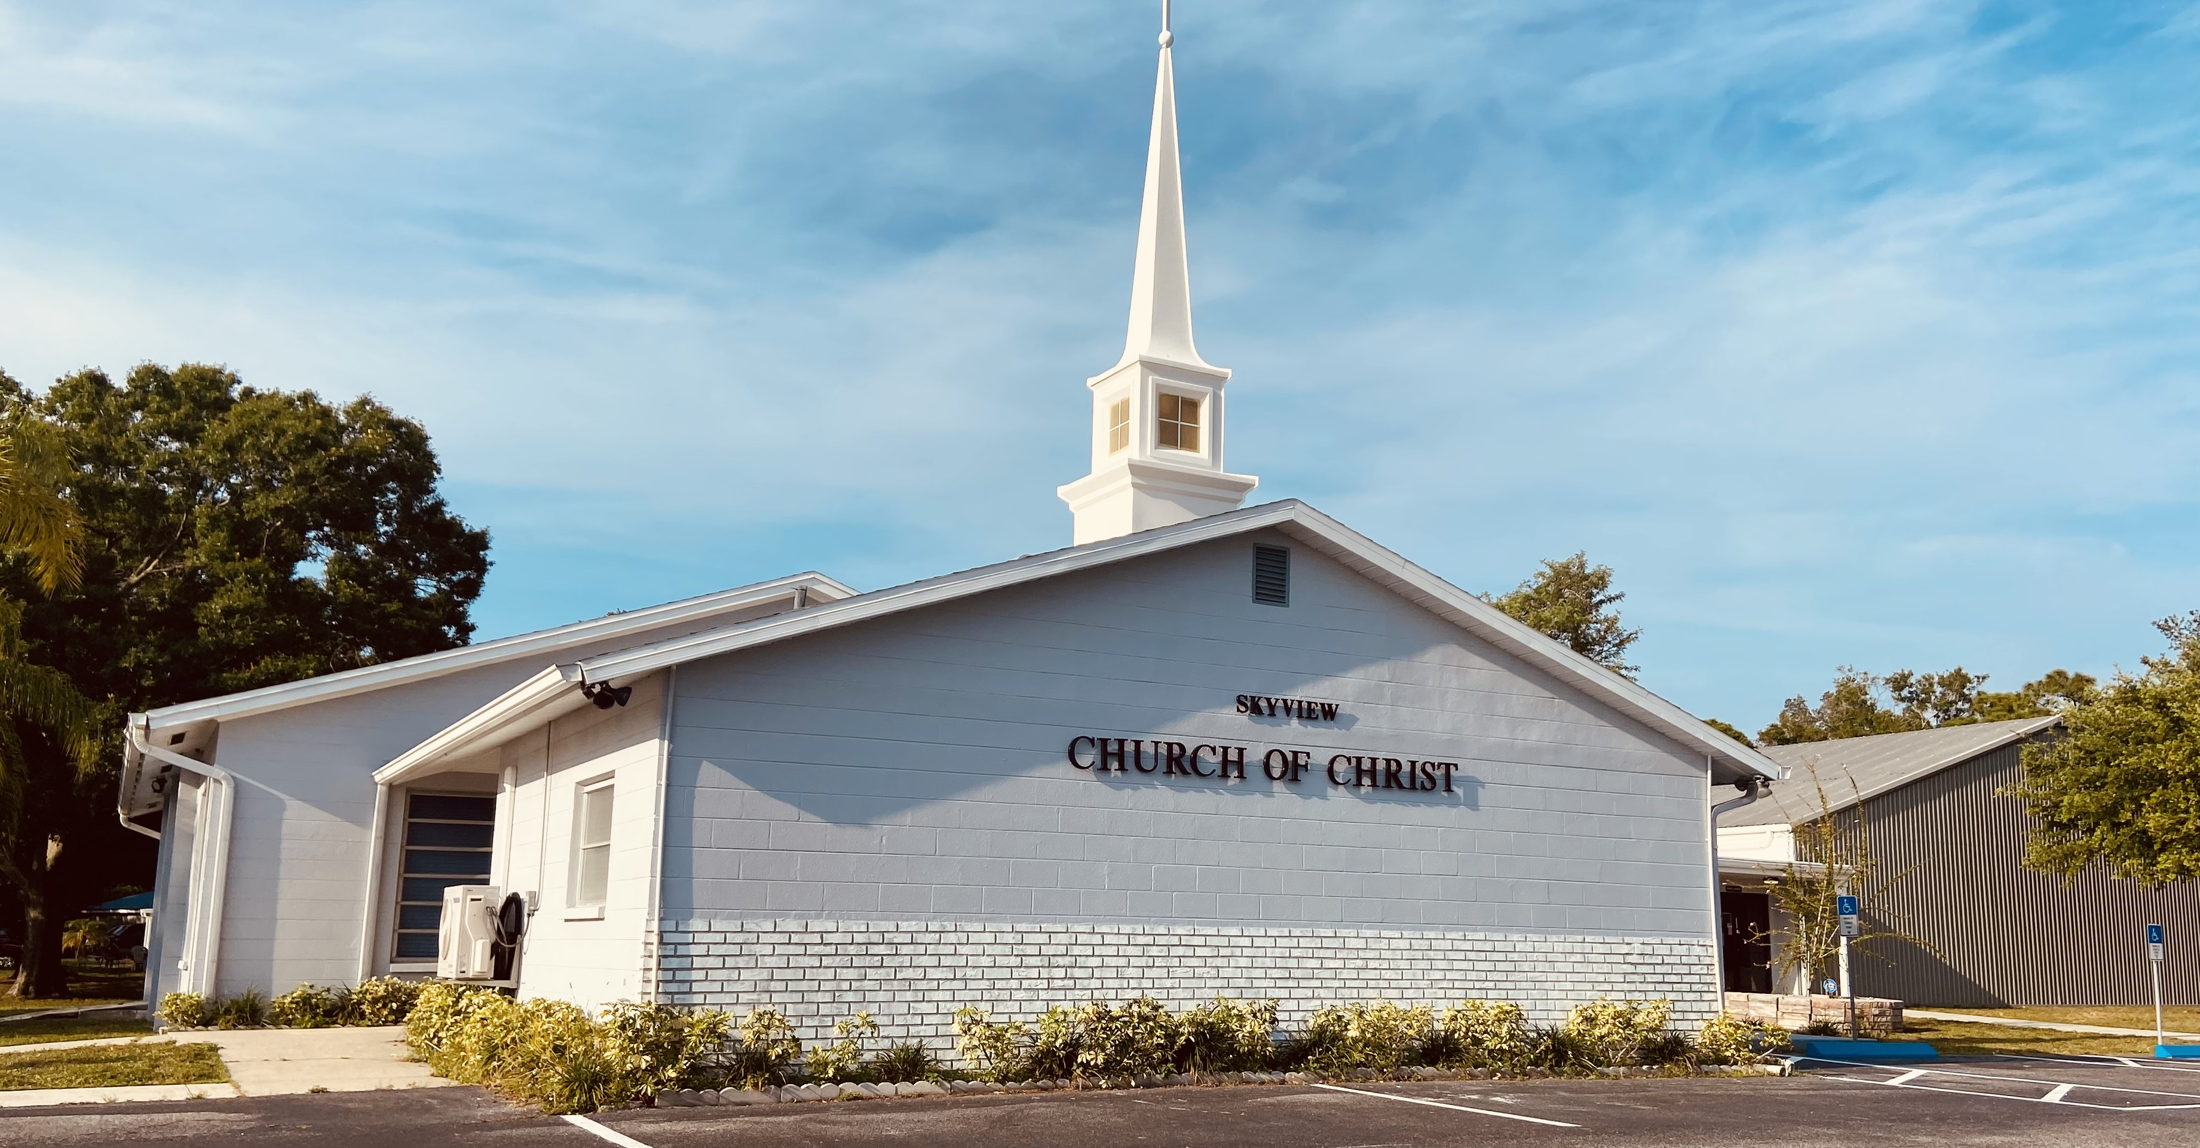
WELCOME TO OUR SERVICES

Slide 2
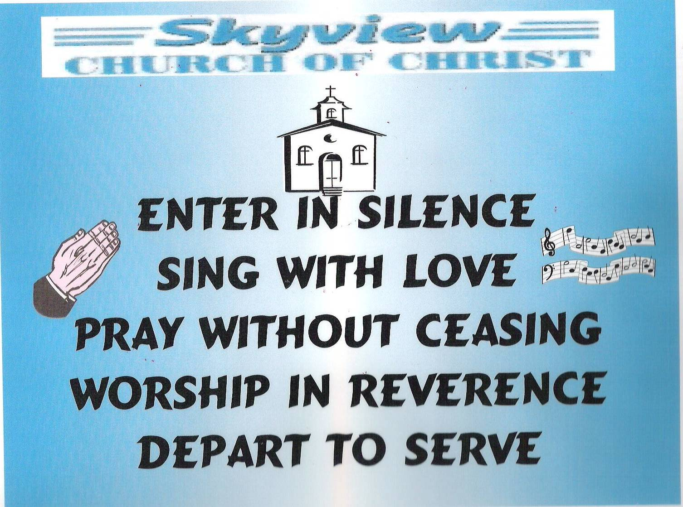
DESIGNED BY JIM INGRAM

Slide 3
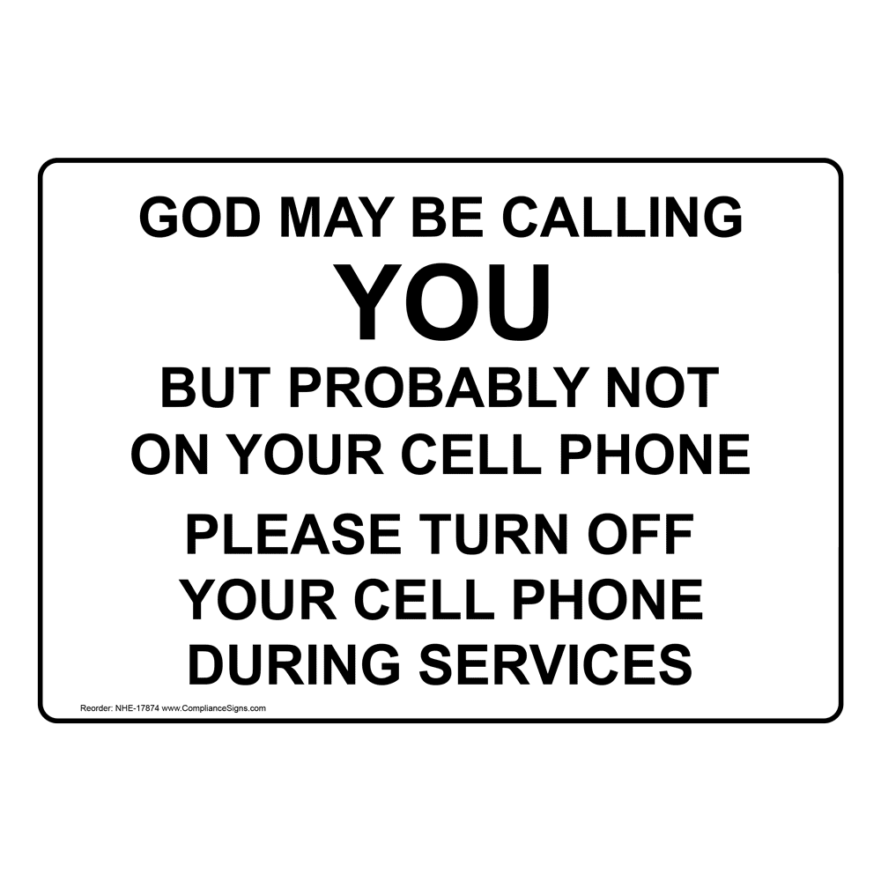

Slide 4


Slide 5

SUNDAY – 9:30 AM
MONDAY BIBLE STUDY – 6:30 PM IN WEST ANNEX
WEDNESDAY BIBLE STUDY – 7:00 PM IN WEST ANNEX
W.I.N.G.S. LADIES CLASS THURSDAY– 10 AM IN WEST ANNEX

Slide 6
TODAY’S WORSHIP LEADERS
CALL TO WORSHIP
PRAYER
SONG LEADER
SCRIPTURE
HEADING TABLE
SERMON
CLOSING PRAYER
ANNOUNCEMENTS
Jim Ingram
Barry Brown
Willard Duncan
Chuck RePass
Charles Peter
Charles Murray
David Cole
Harry Cowan

Slide 7

MONDAY NIGHT BIBLE STUDY 6:30PM will meet in the West Annex
WEDNESDAY BIBLE STUDY will meet in the West Annex until further notice
LADIES BIBLE CLASS W.I.N.G.S (Women In God’s Service) Thursday 10:00 AM – meets in the West Annex

Slide 8

FIVE MINUTE RULE

Slide 9


Slide 10


Slide 11
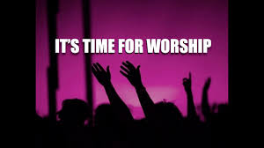

Slide 13
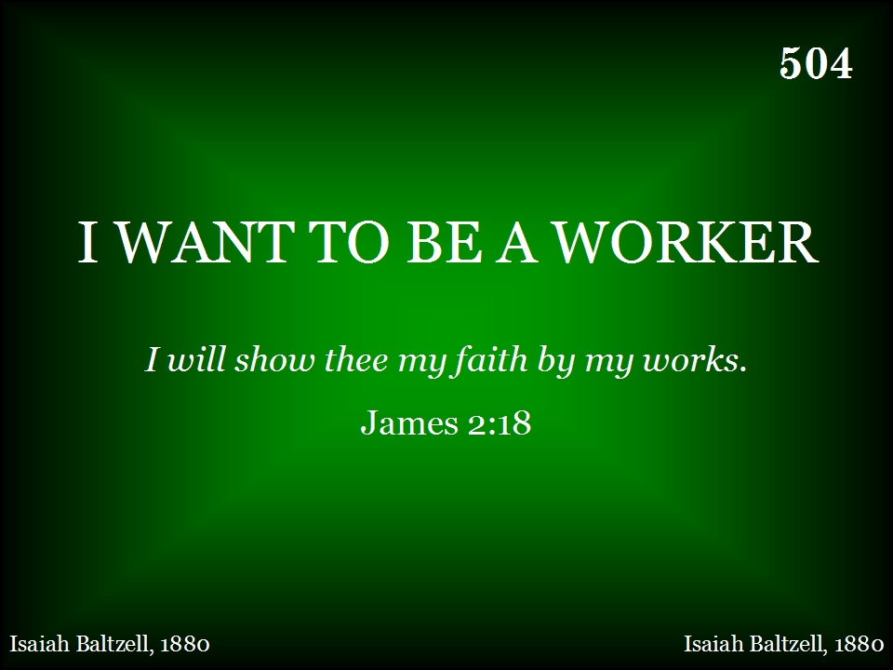
504 - I Want To Be A Worker - Title
LET’S STAND AS WILL DUNCAN LEADS US

Slide 14
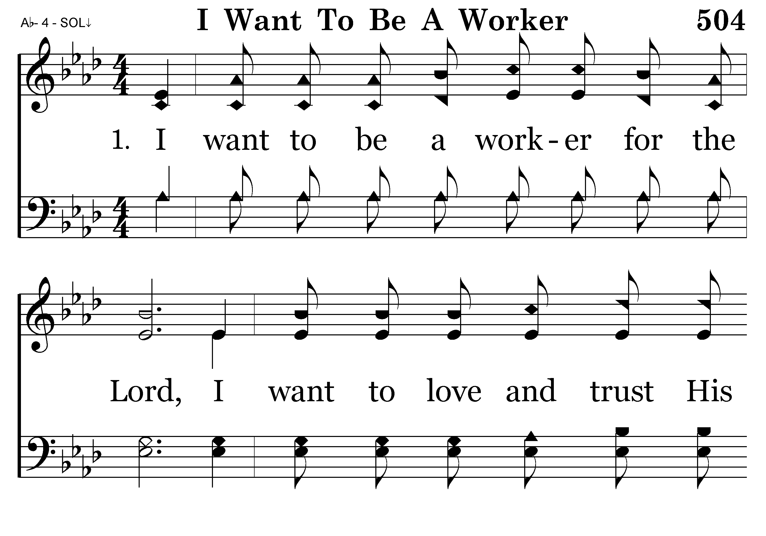
504 - I Want To Be A Worker - 1.1

Slide 15
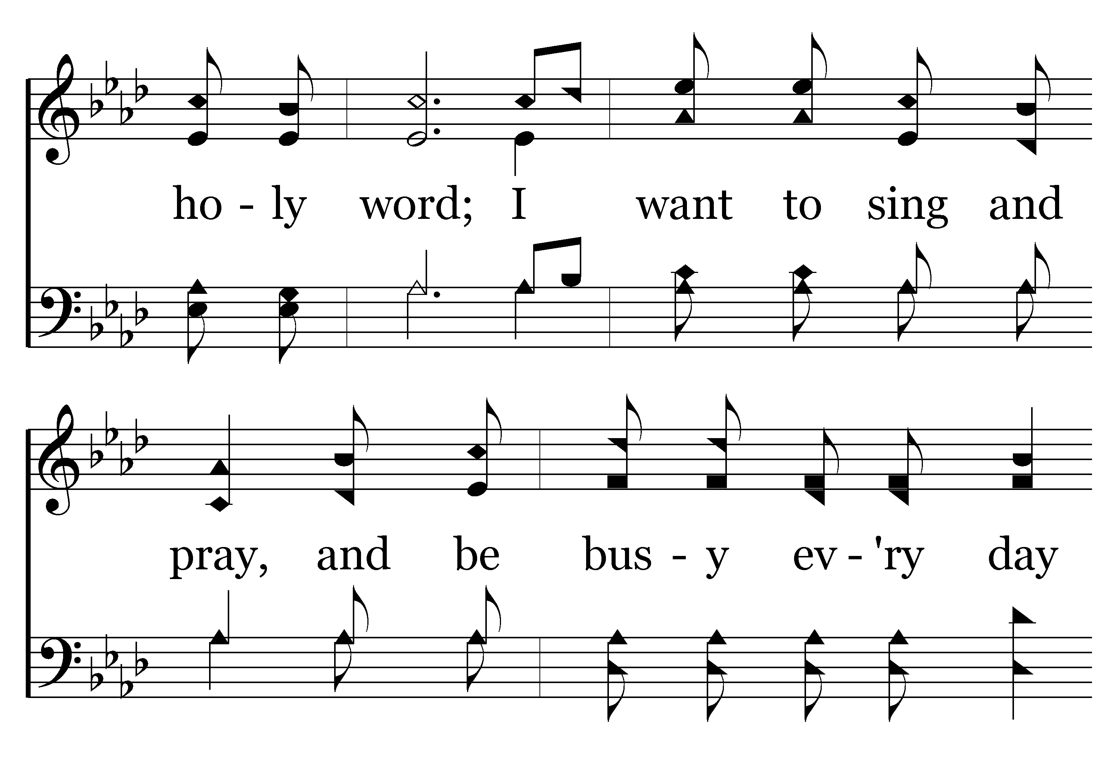
504 - I Want To Be A Worker - 1.2

Slide 16
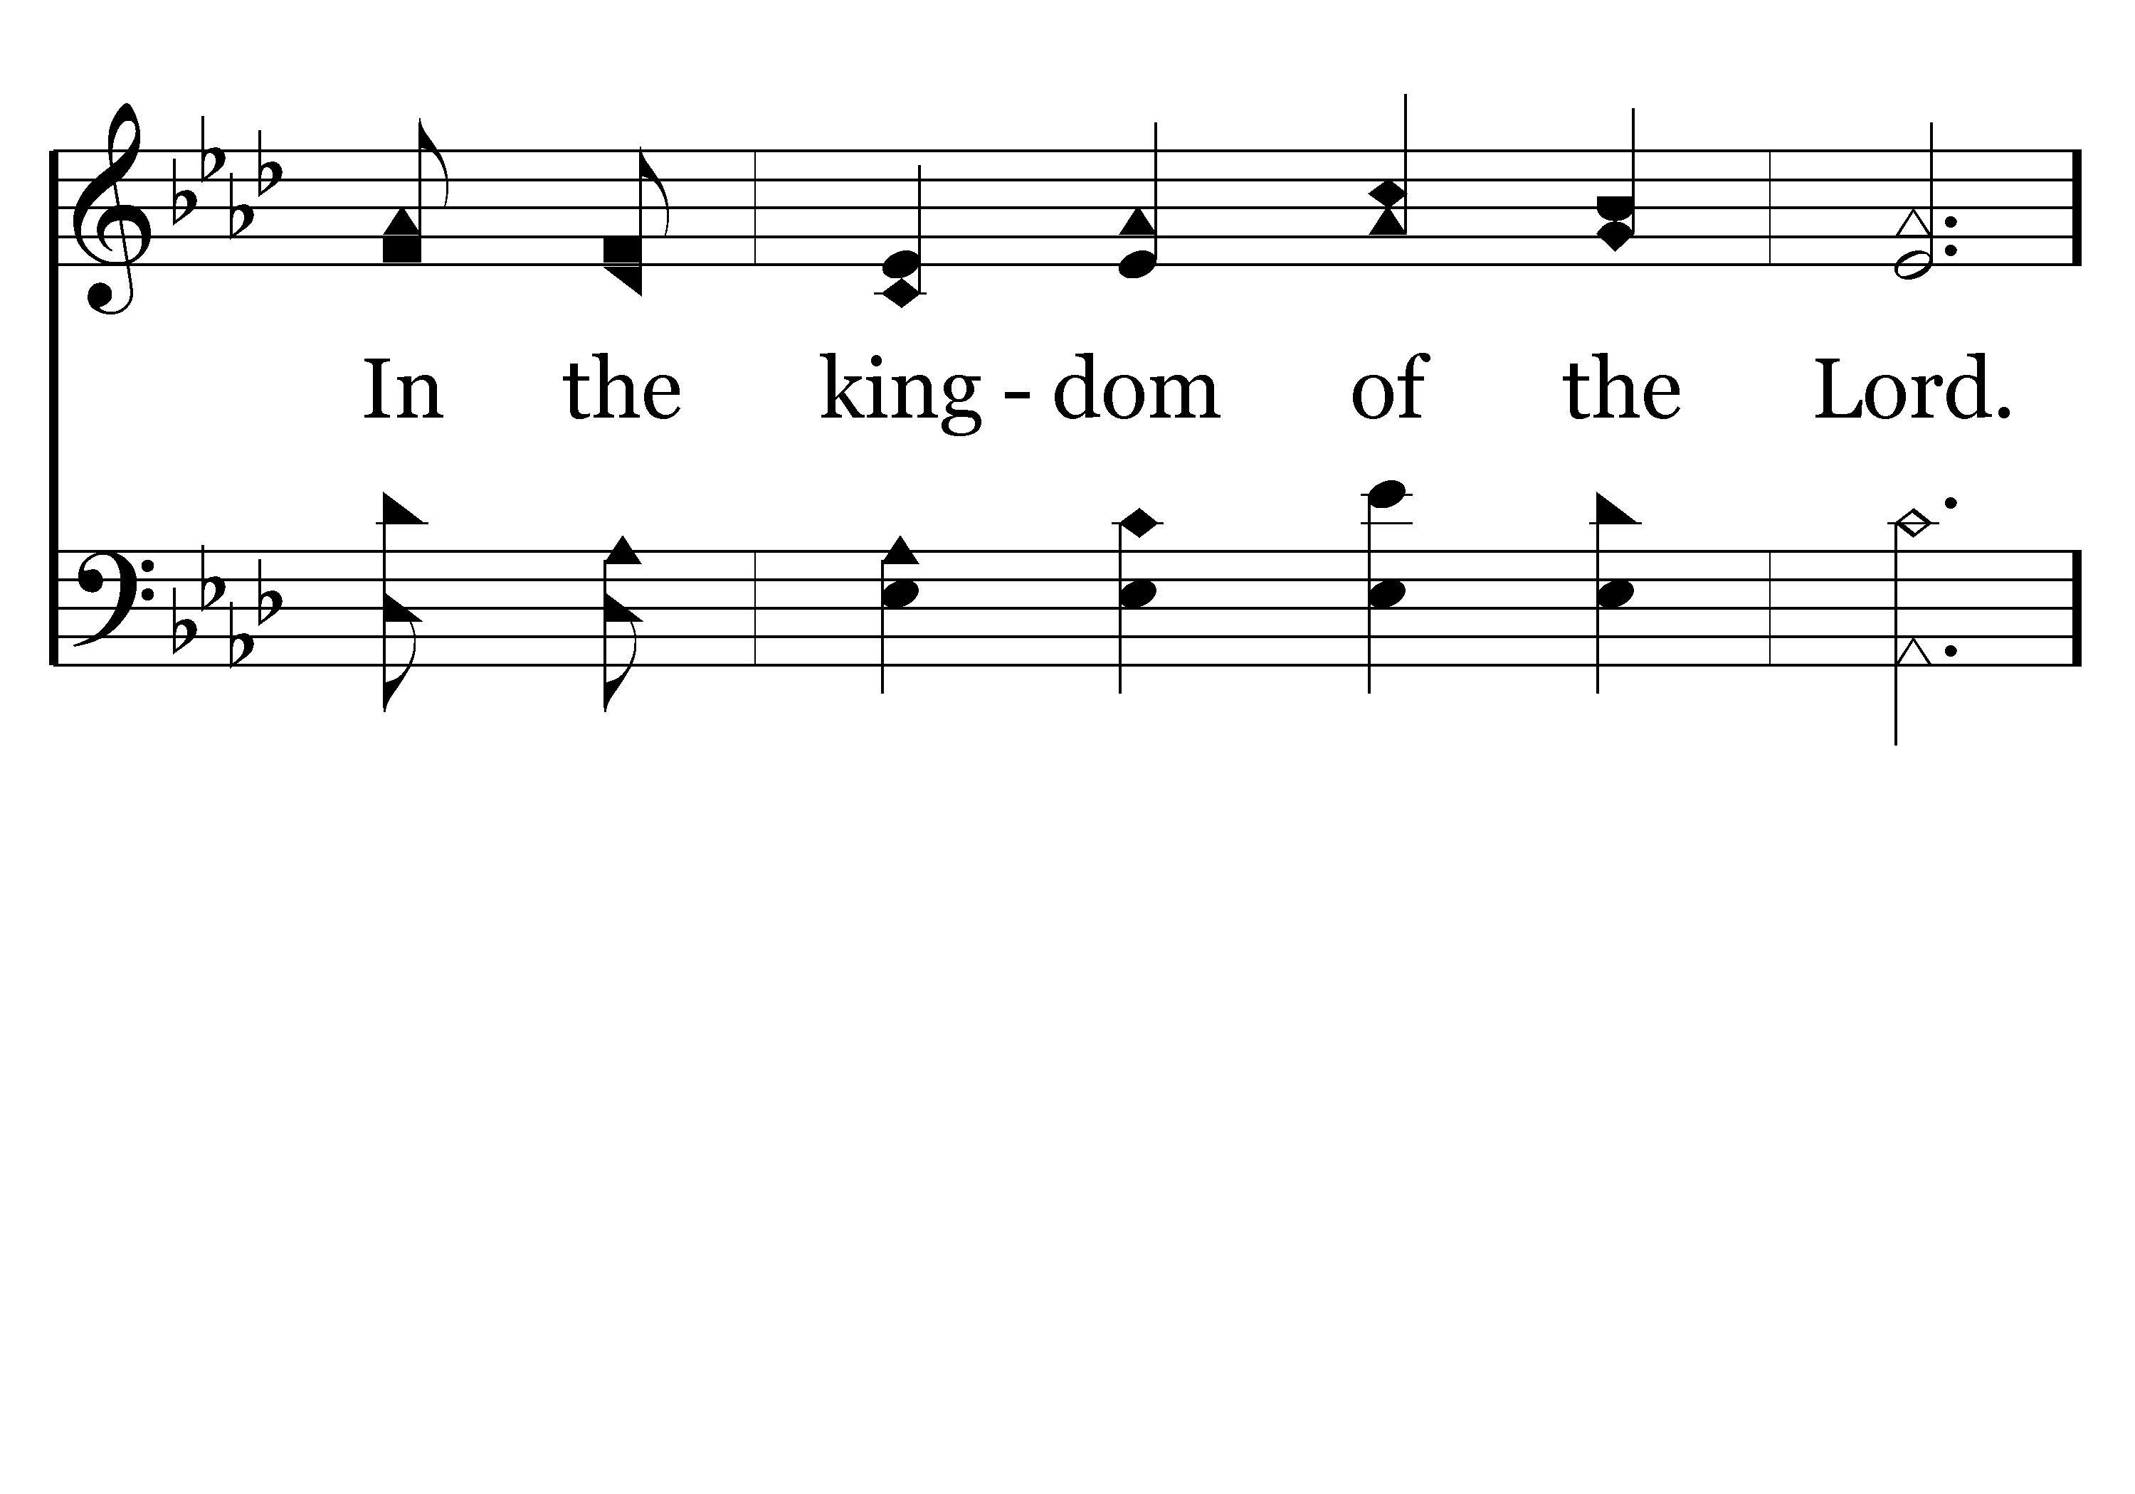
504 - I Want To Be A Worker - 1.3

Slide 17
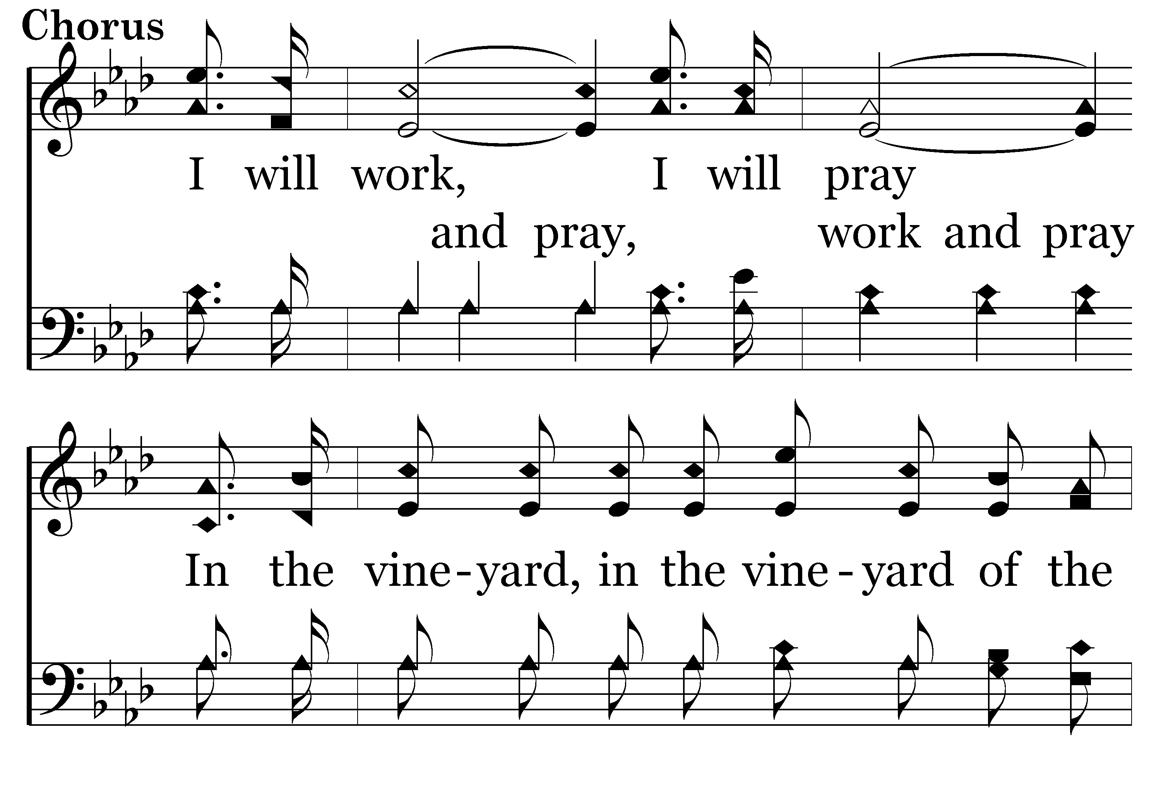
504 - I Want To Be A Worker - C.1

Slide 18
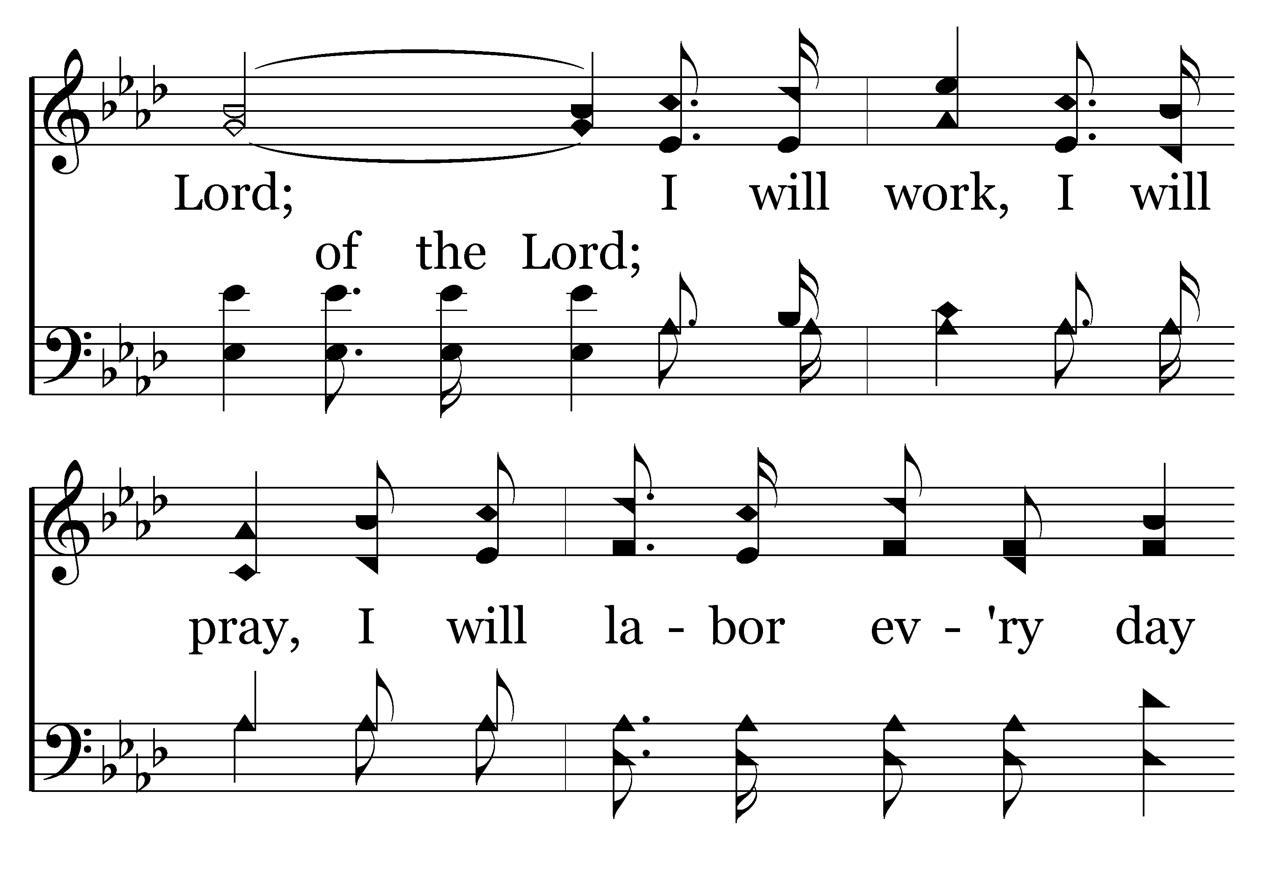
504 - I Want To Be A Worker - C.2

Slide 19
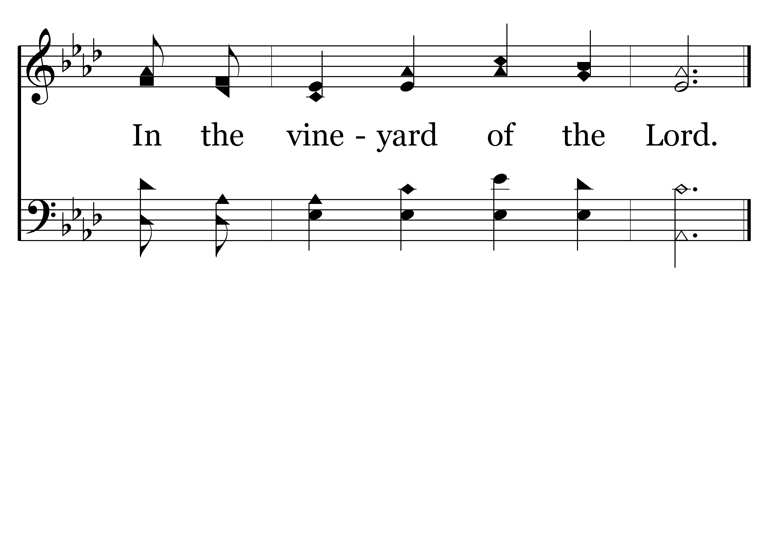
504 - I Want To Be A Worker - C.3
End of Verse 1

Slide 20
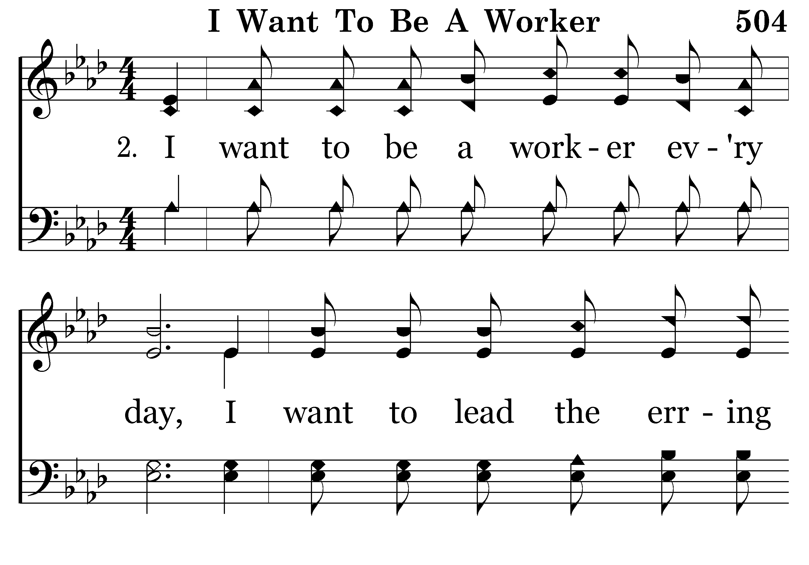
504 - I Want To Be A Worker - 2.1

Slide 21
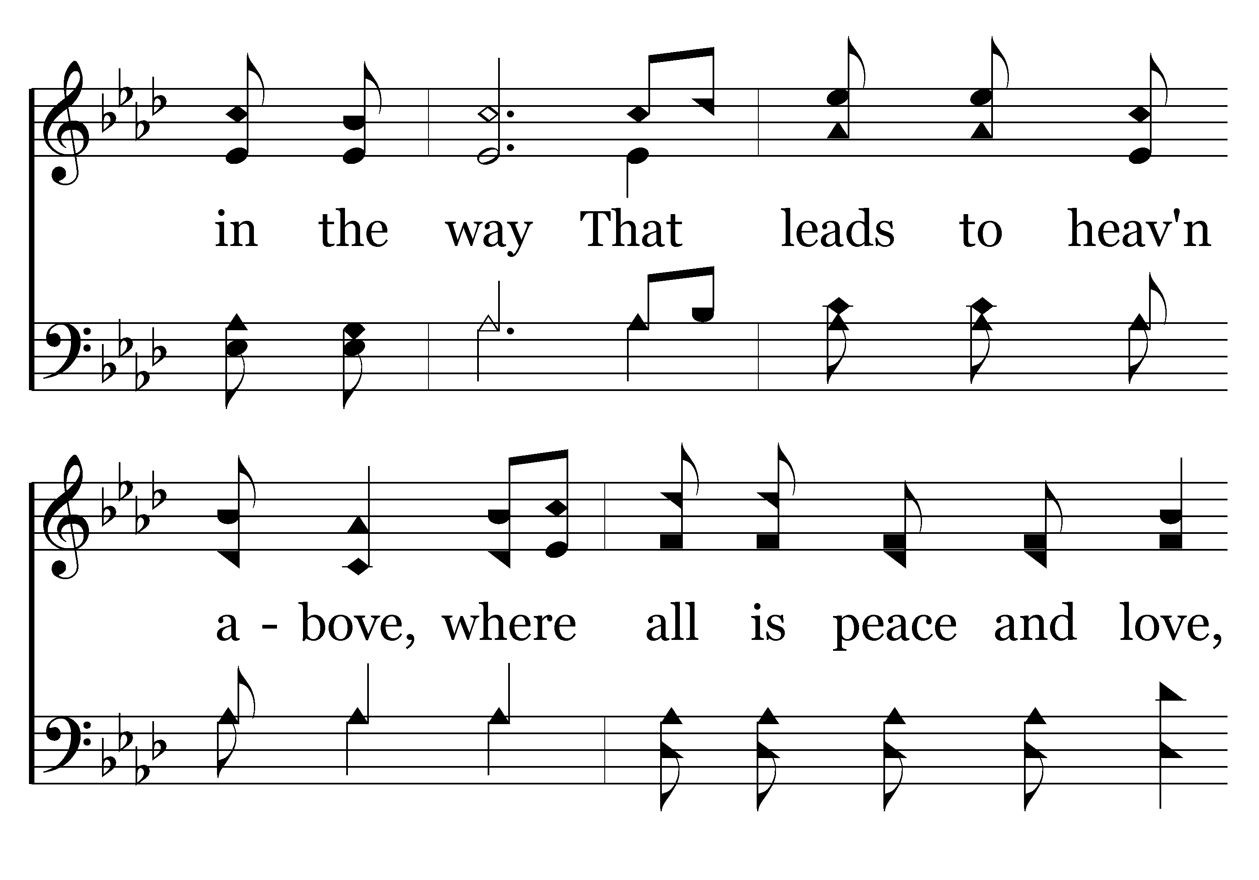
504 - I Want To Be A Worker - 2.2

Slide 22
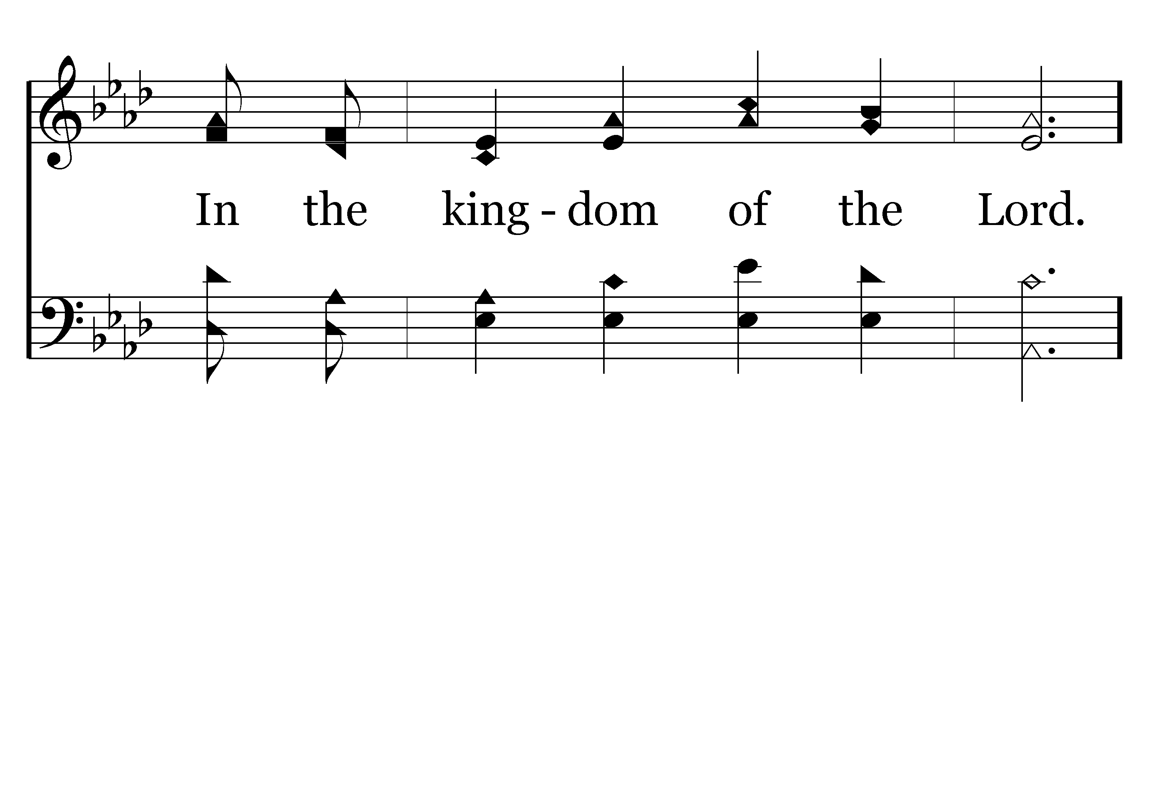
504 - I Want To Be A Worker - 2.3

Slide 23
504 - I Want To Be A Worker - C.1

Slide 24
504 - I Want To Be A Worker - C.2

Slide 25
504 - I Want To Be A Worker - C.3
End of Verse 2

Slide 26
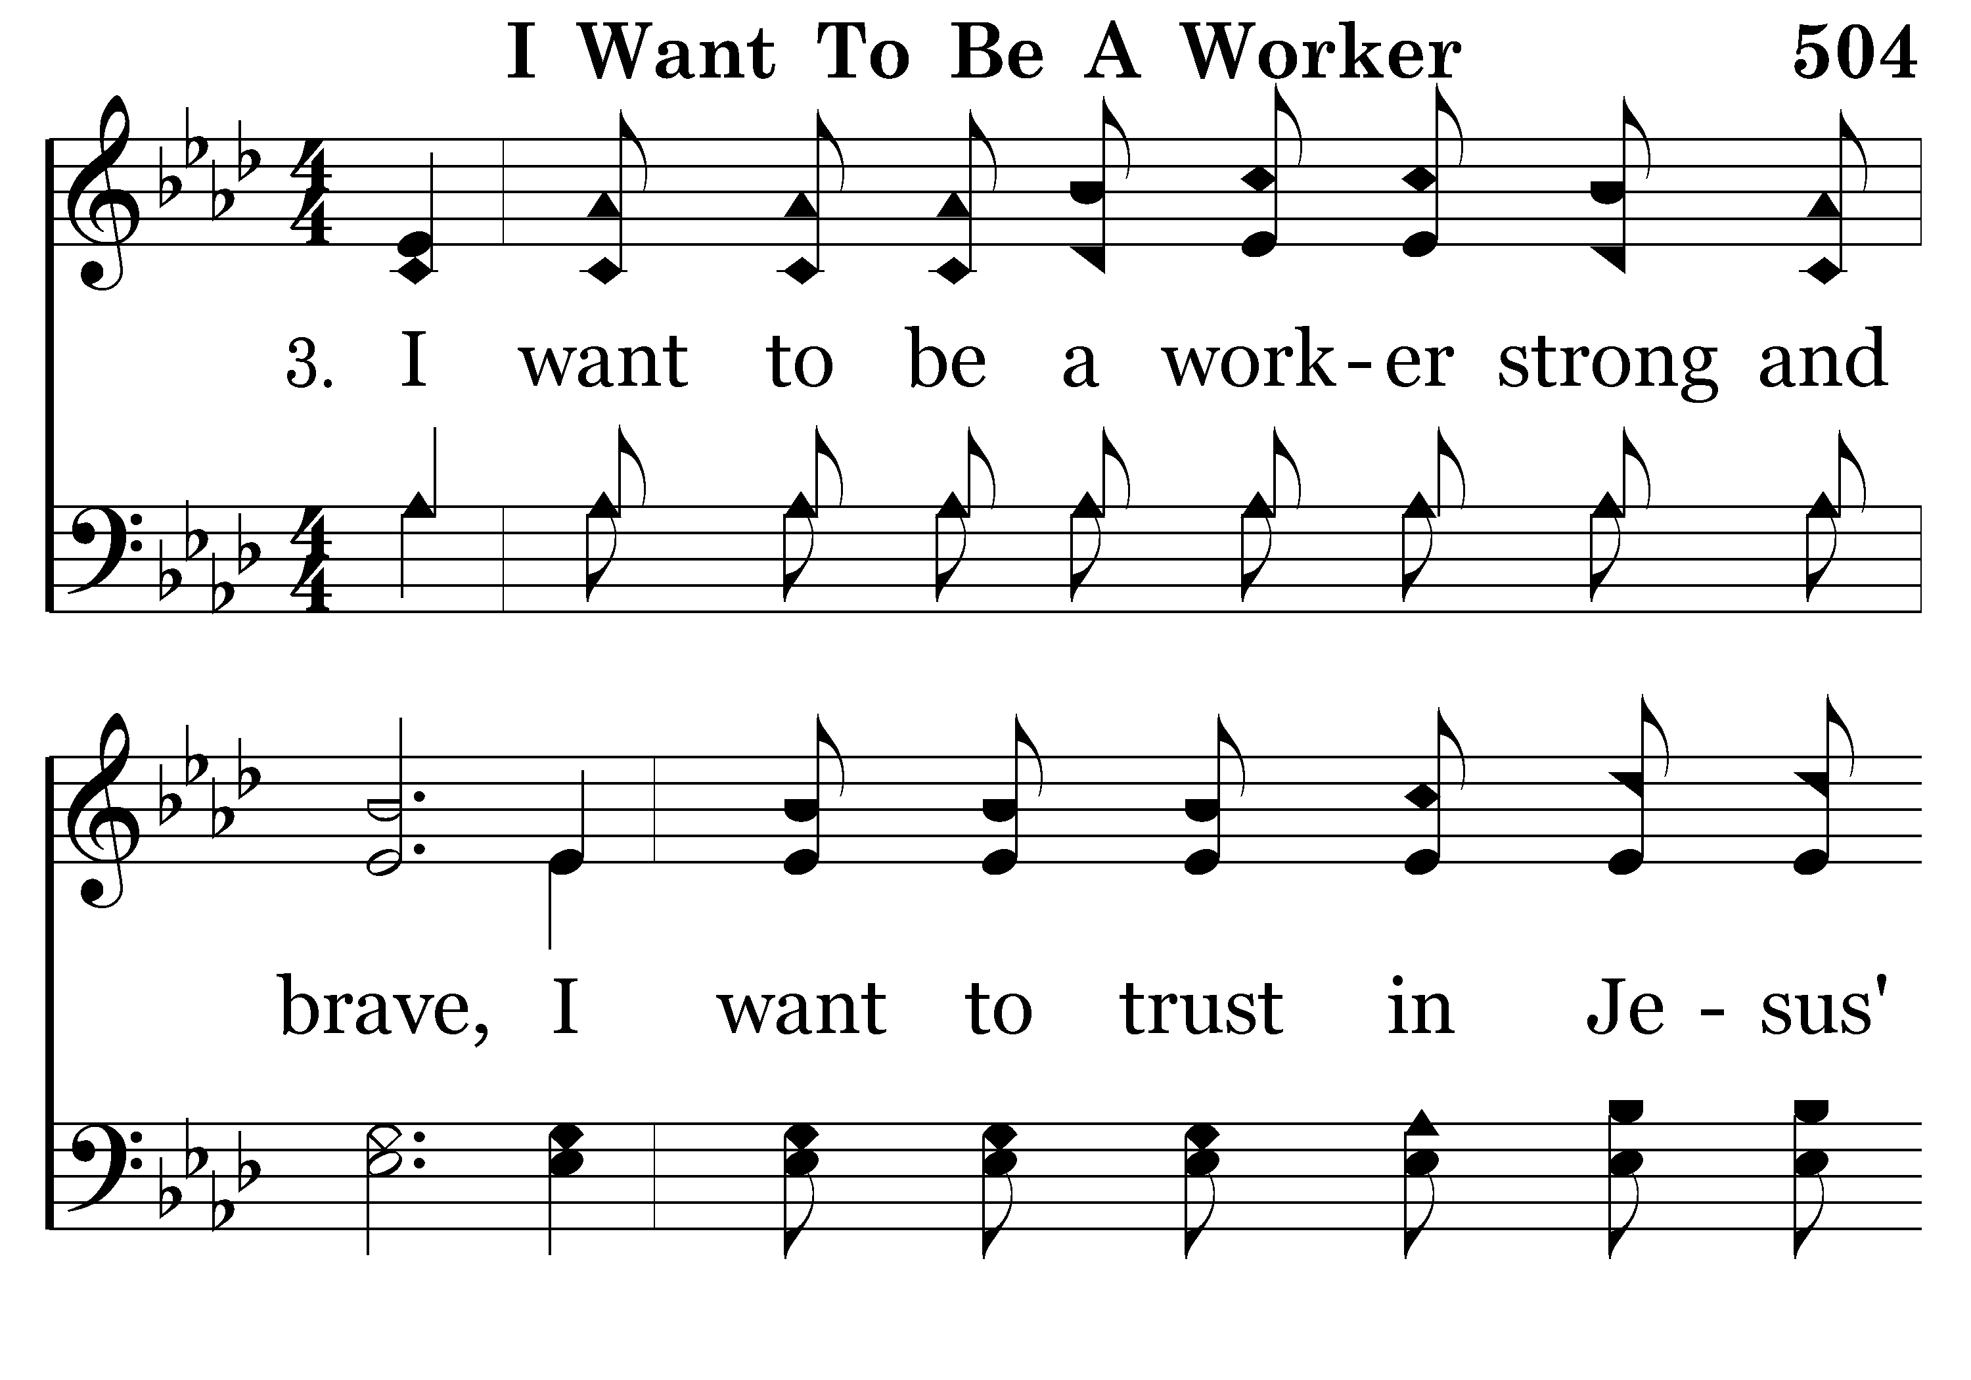
504 - I Want To Be A Worker - 3.1

Slide 27
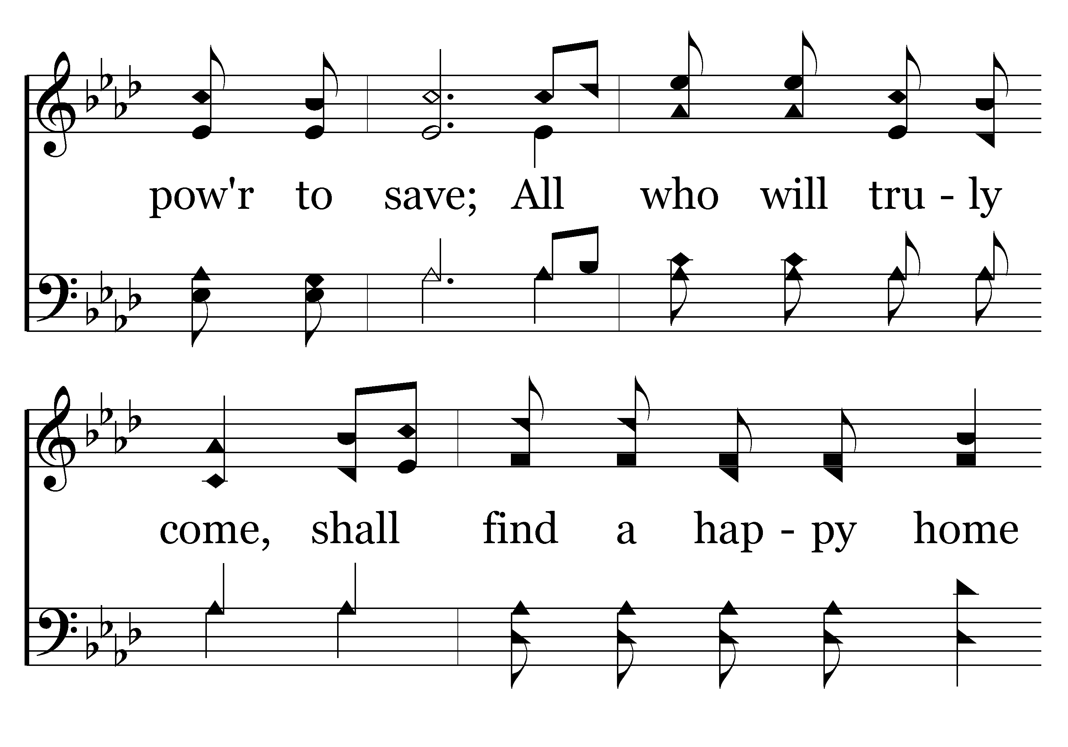
504 - I Want To Be A Worker - 3.2

Slide 28
504 - I Want To Be A Worker - 3.3

Slide 29
504 - I Want To Be A Worker - C.1

Slide 30
504 - I Want To Be A Worker - C.2

Slide 31
504 - I Want To Be A Worker - C.3
End of Song

Slide 33

WELCOME BY JIM INGRAM

Slide 34
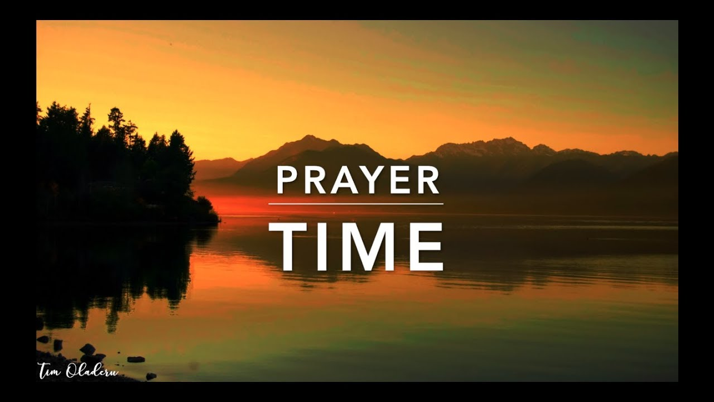
PRAYER
Jerry Mellish
LED BY BARRY BROWN

Slide 36
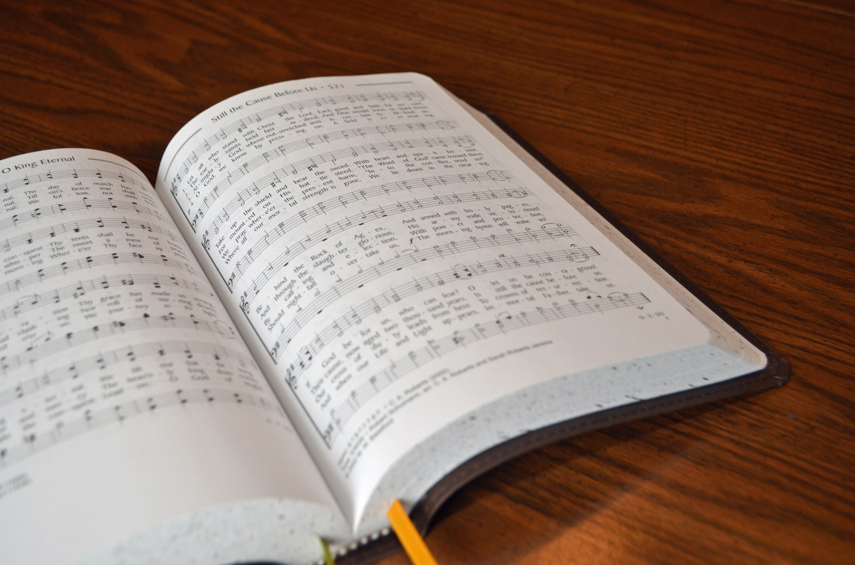
SONG LEADER
WILLARD DUNCAN

Slide 37
PAGE 26 IN THE SUPPLIMENT
SING HALLELUJAH UNTO THE LORD

Slide 38
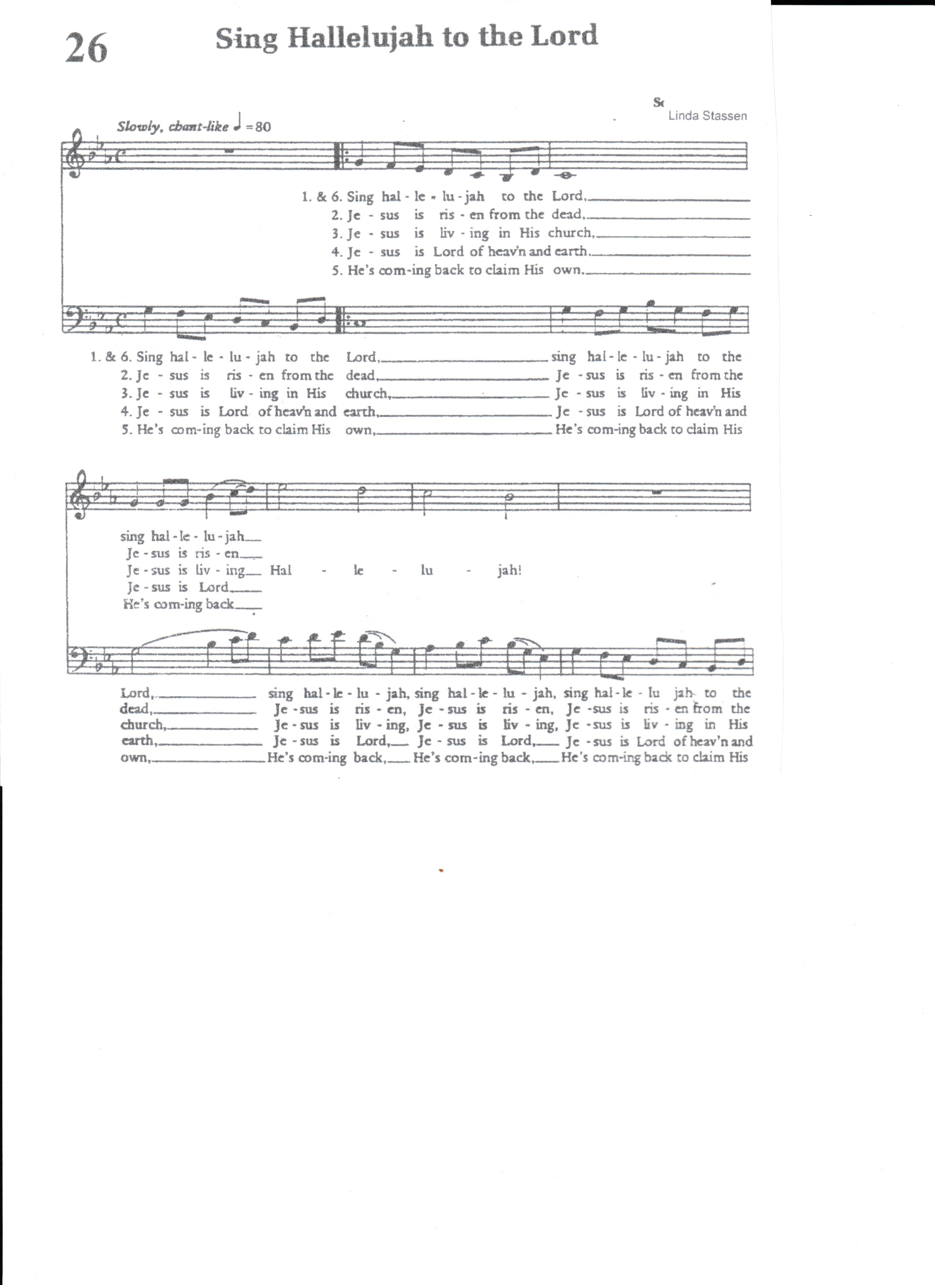

Slide 39
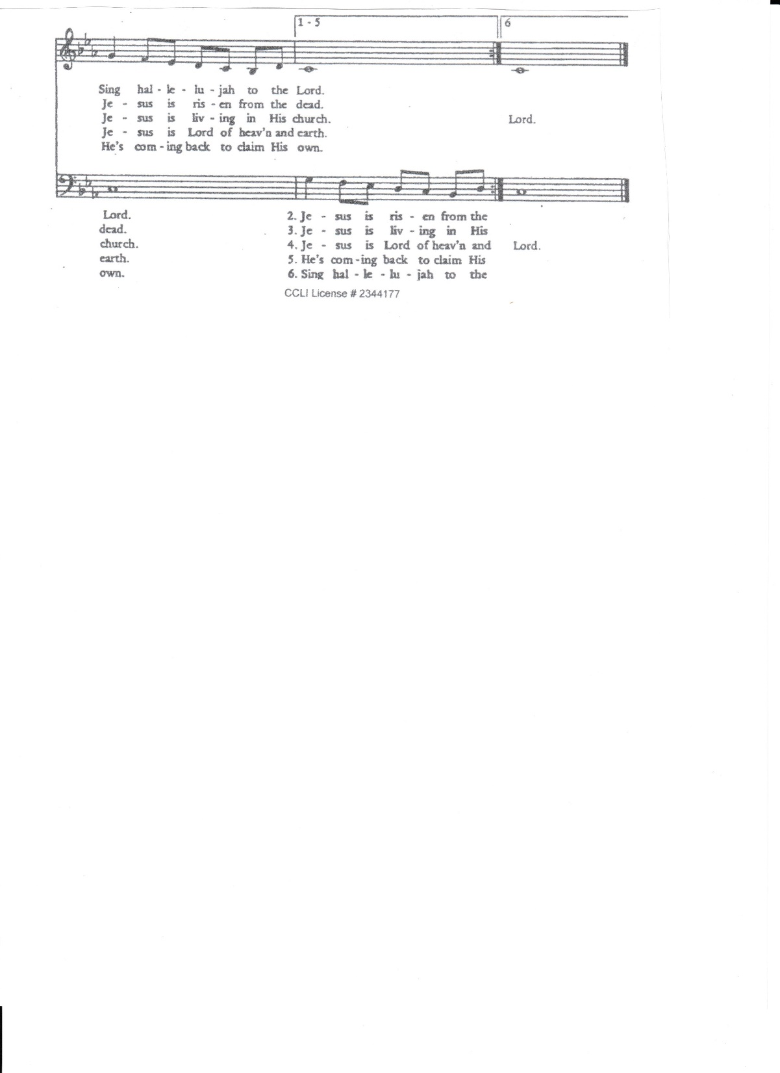

Slide 41
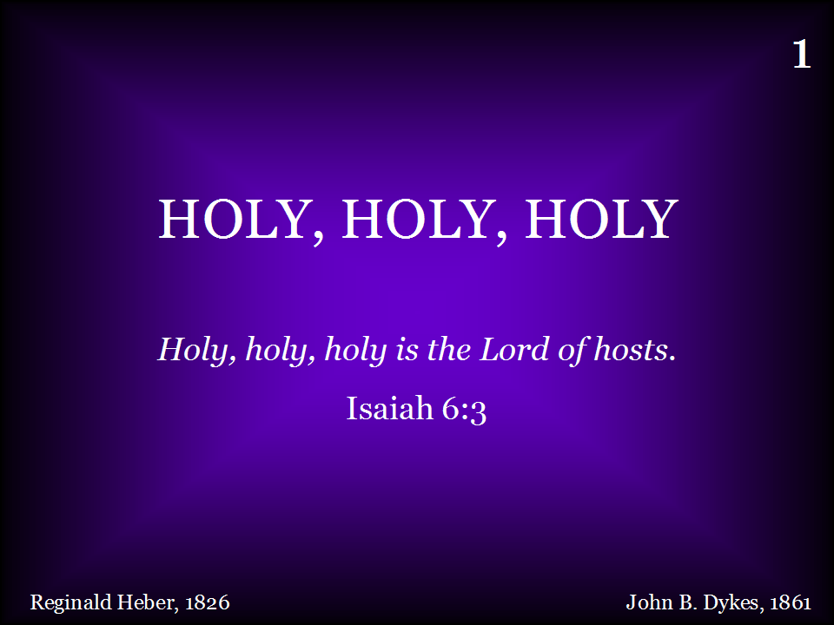
001 - Holy, Holy, Holy - Title

Slide 42
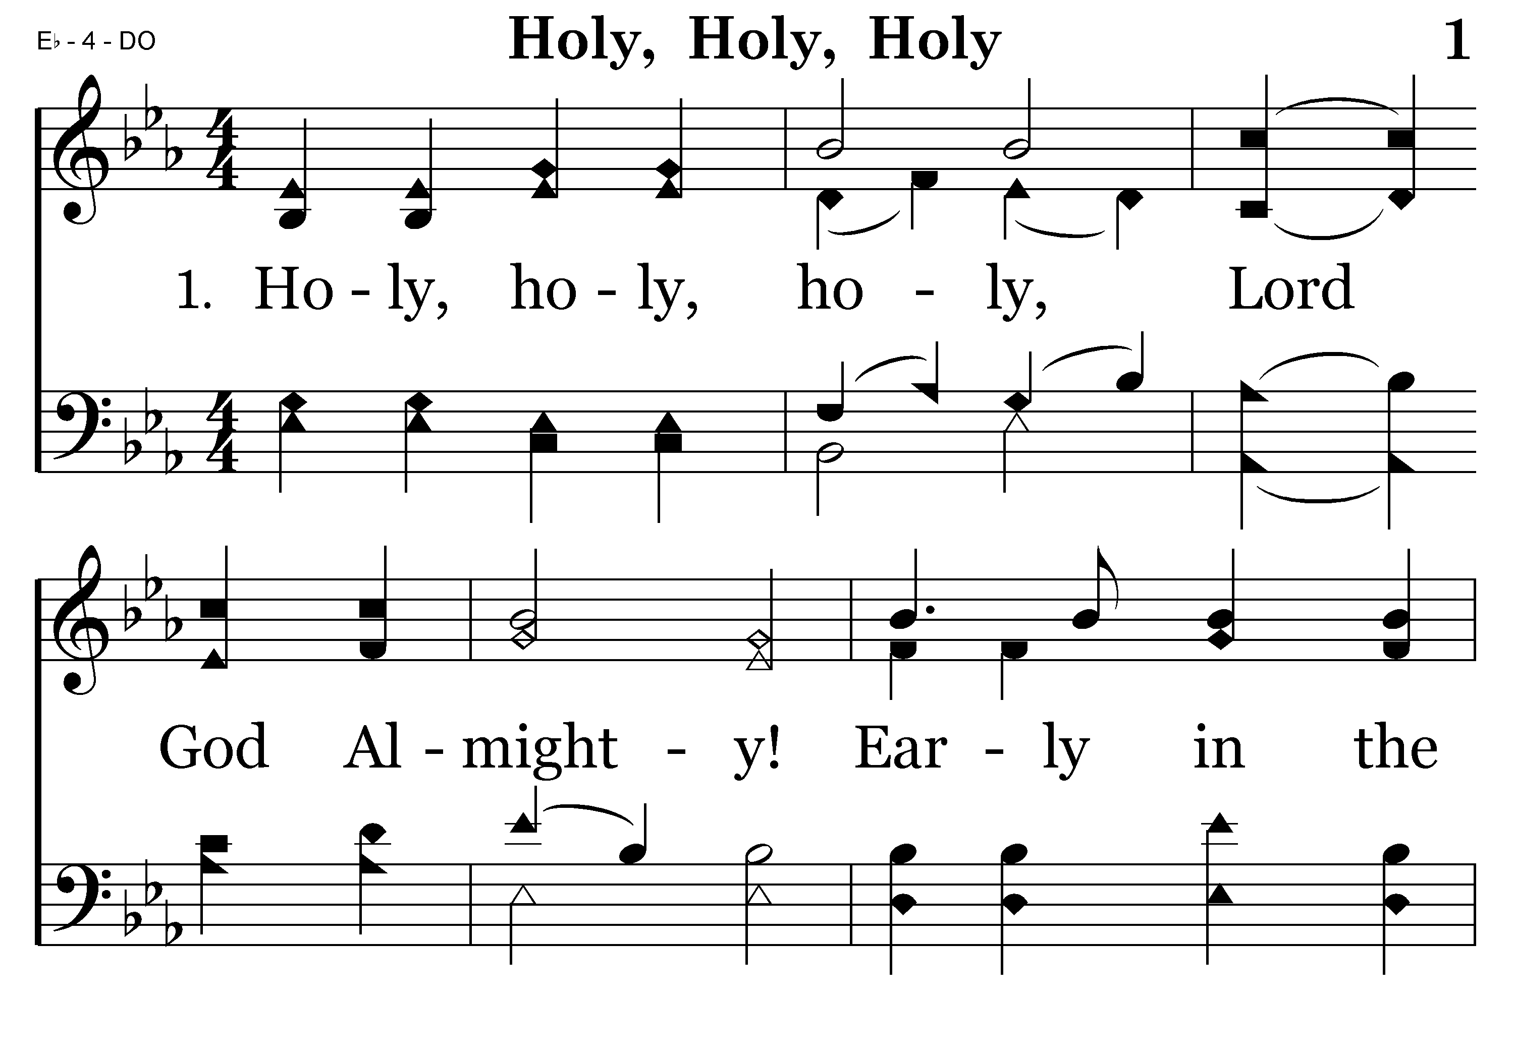
001 - Holy, Holy, Holy - 1.1

Slide 43
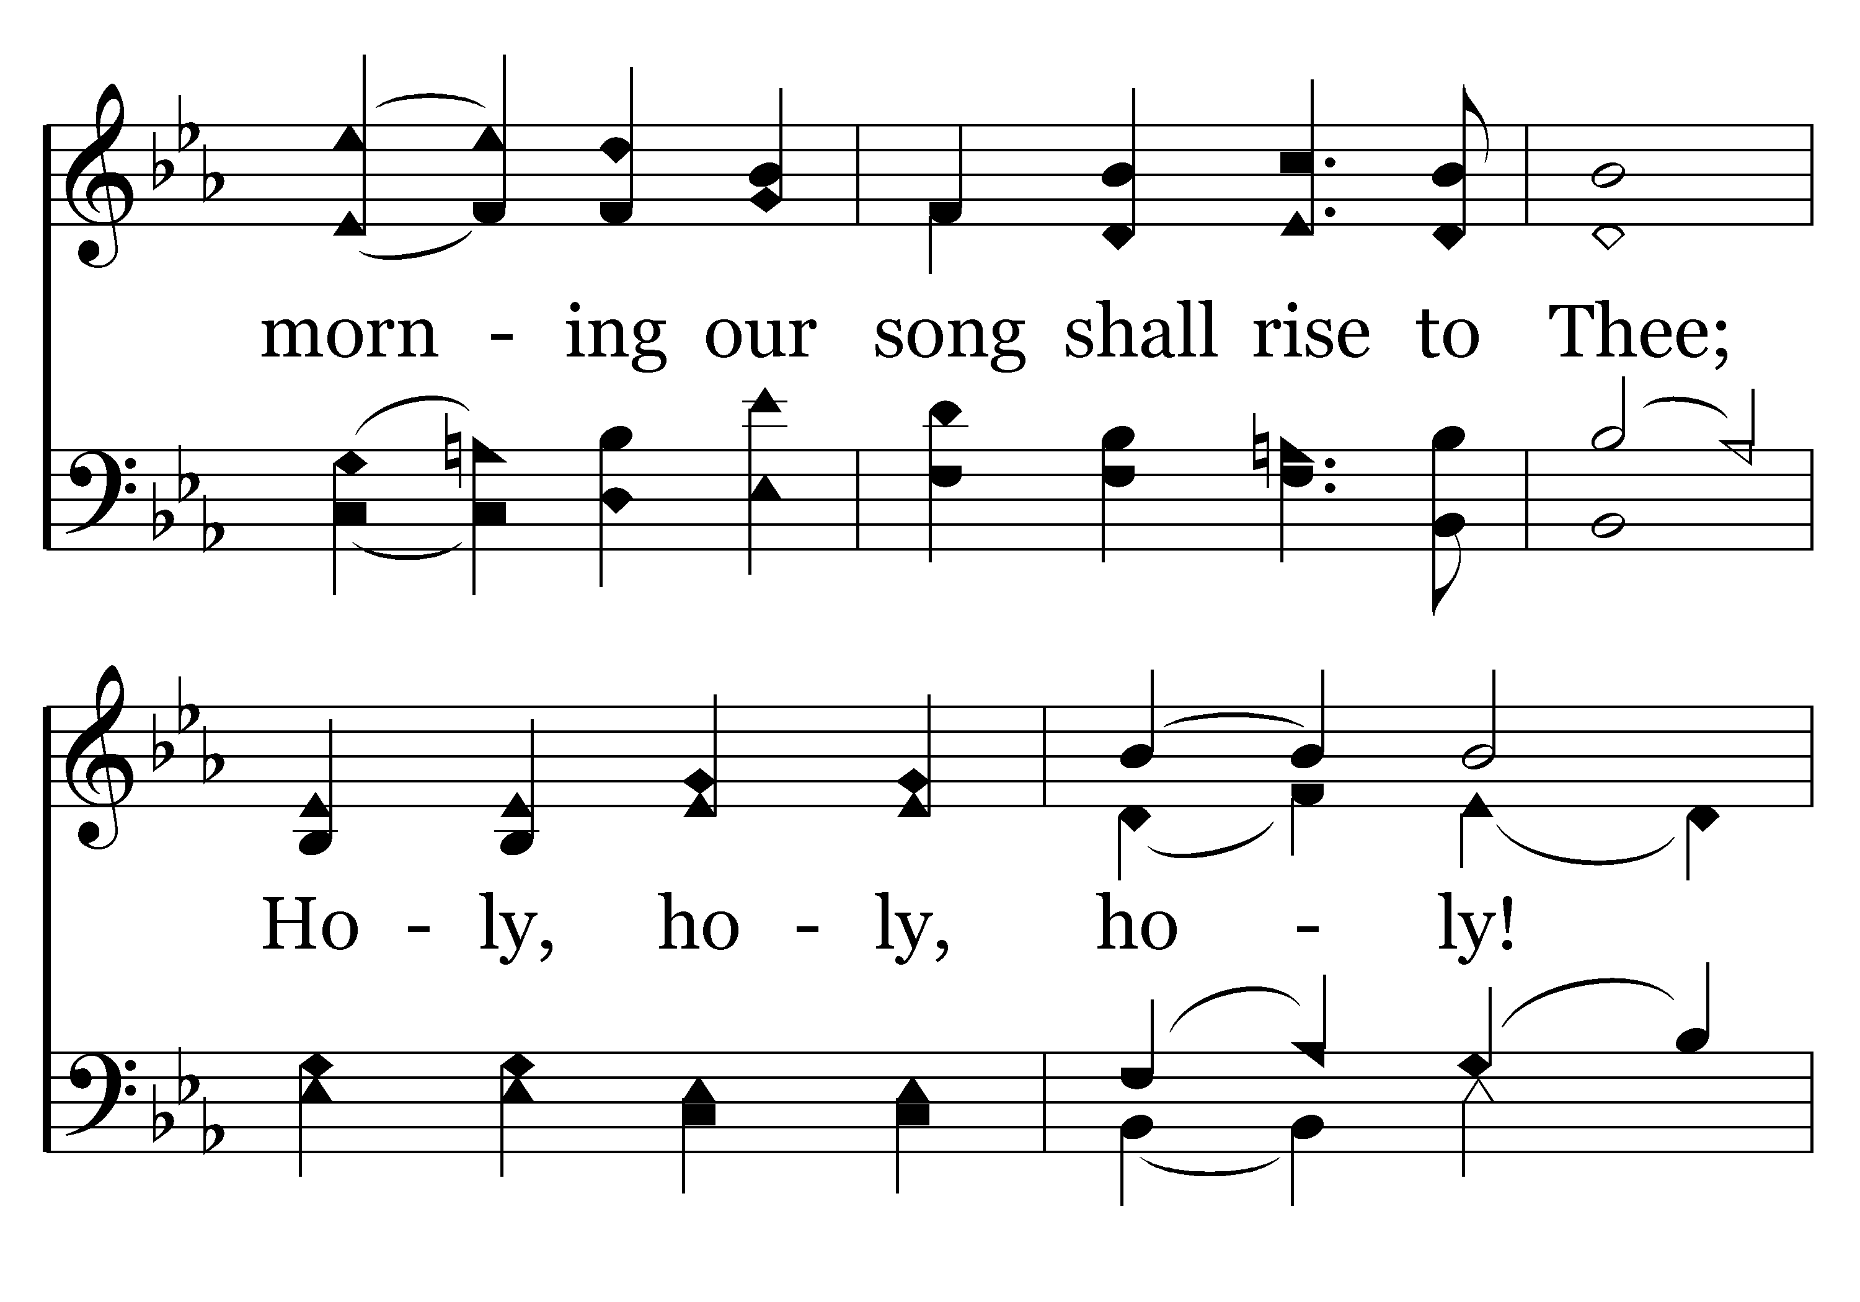
001 - Holy, Holy, Holy - 1.2

Slide 44
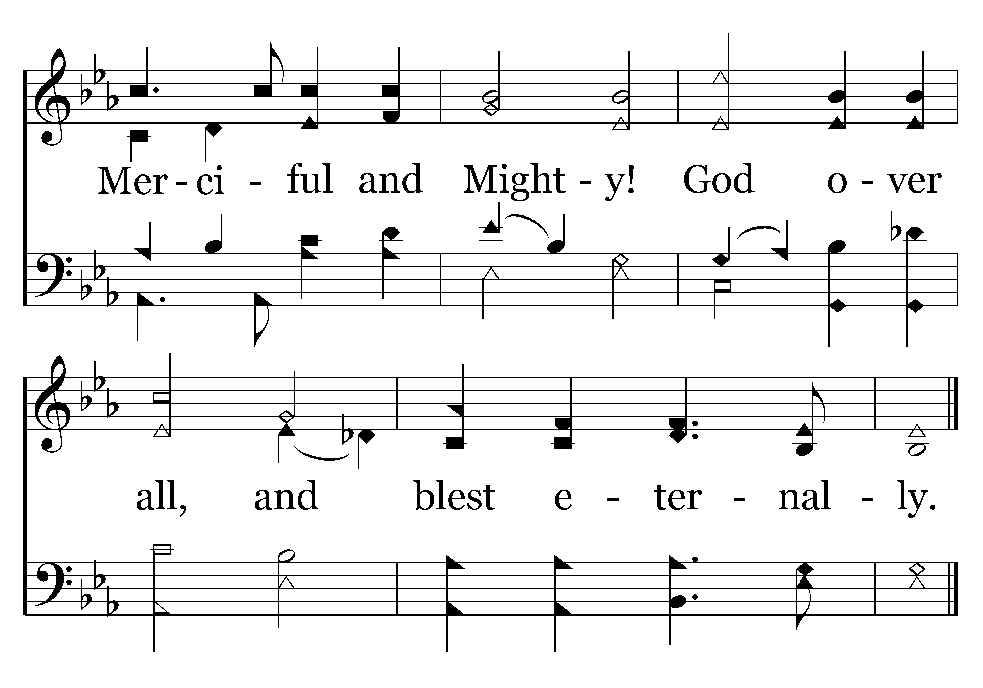
001 - Holy, Holy, Holy - 1.3
End of Verse 1

Slide 45
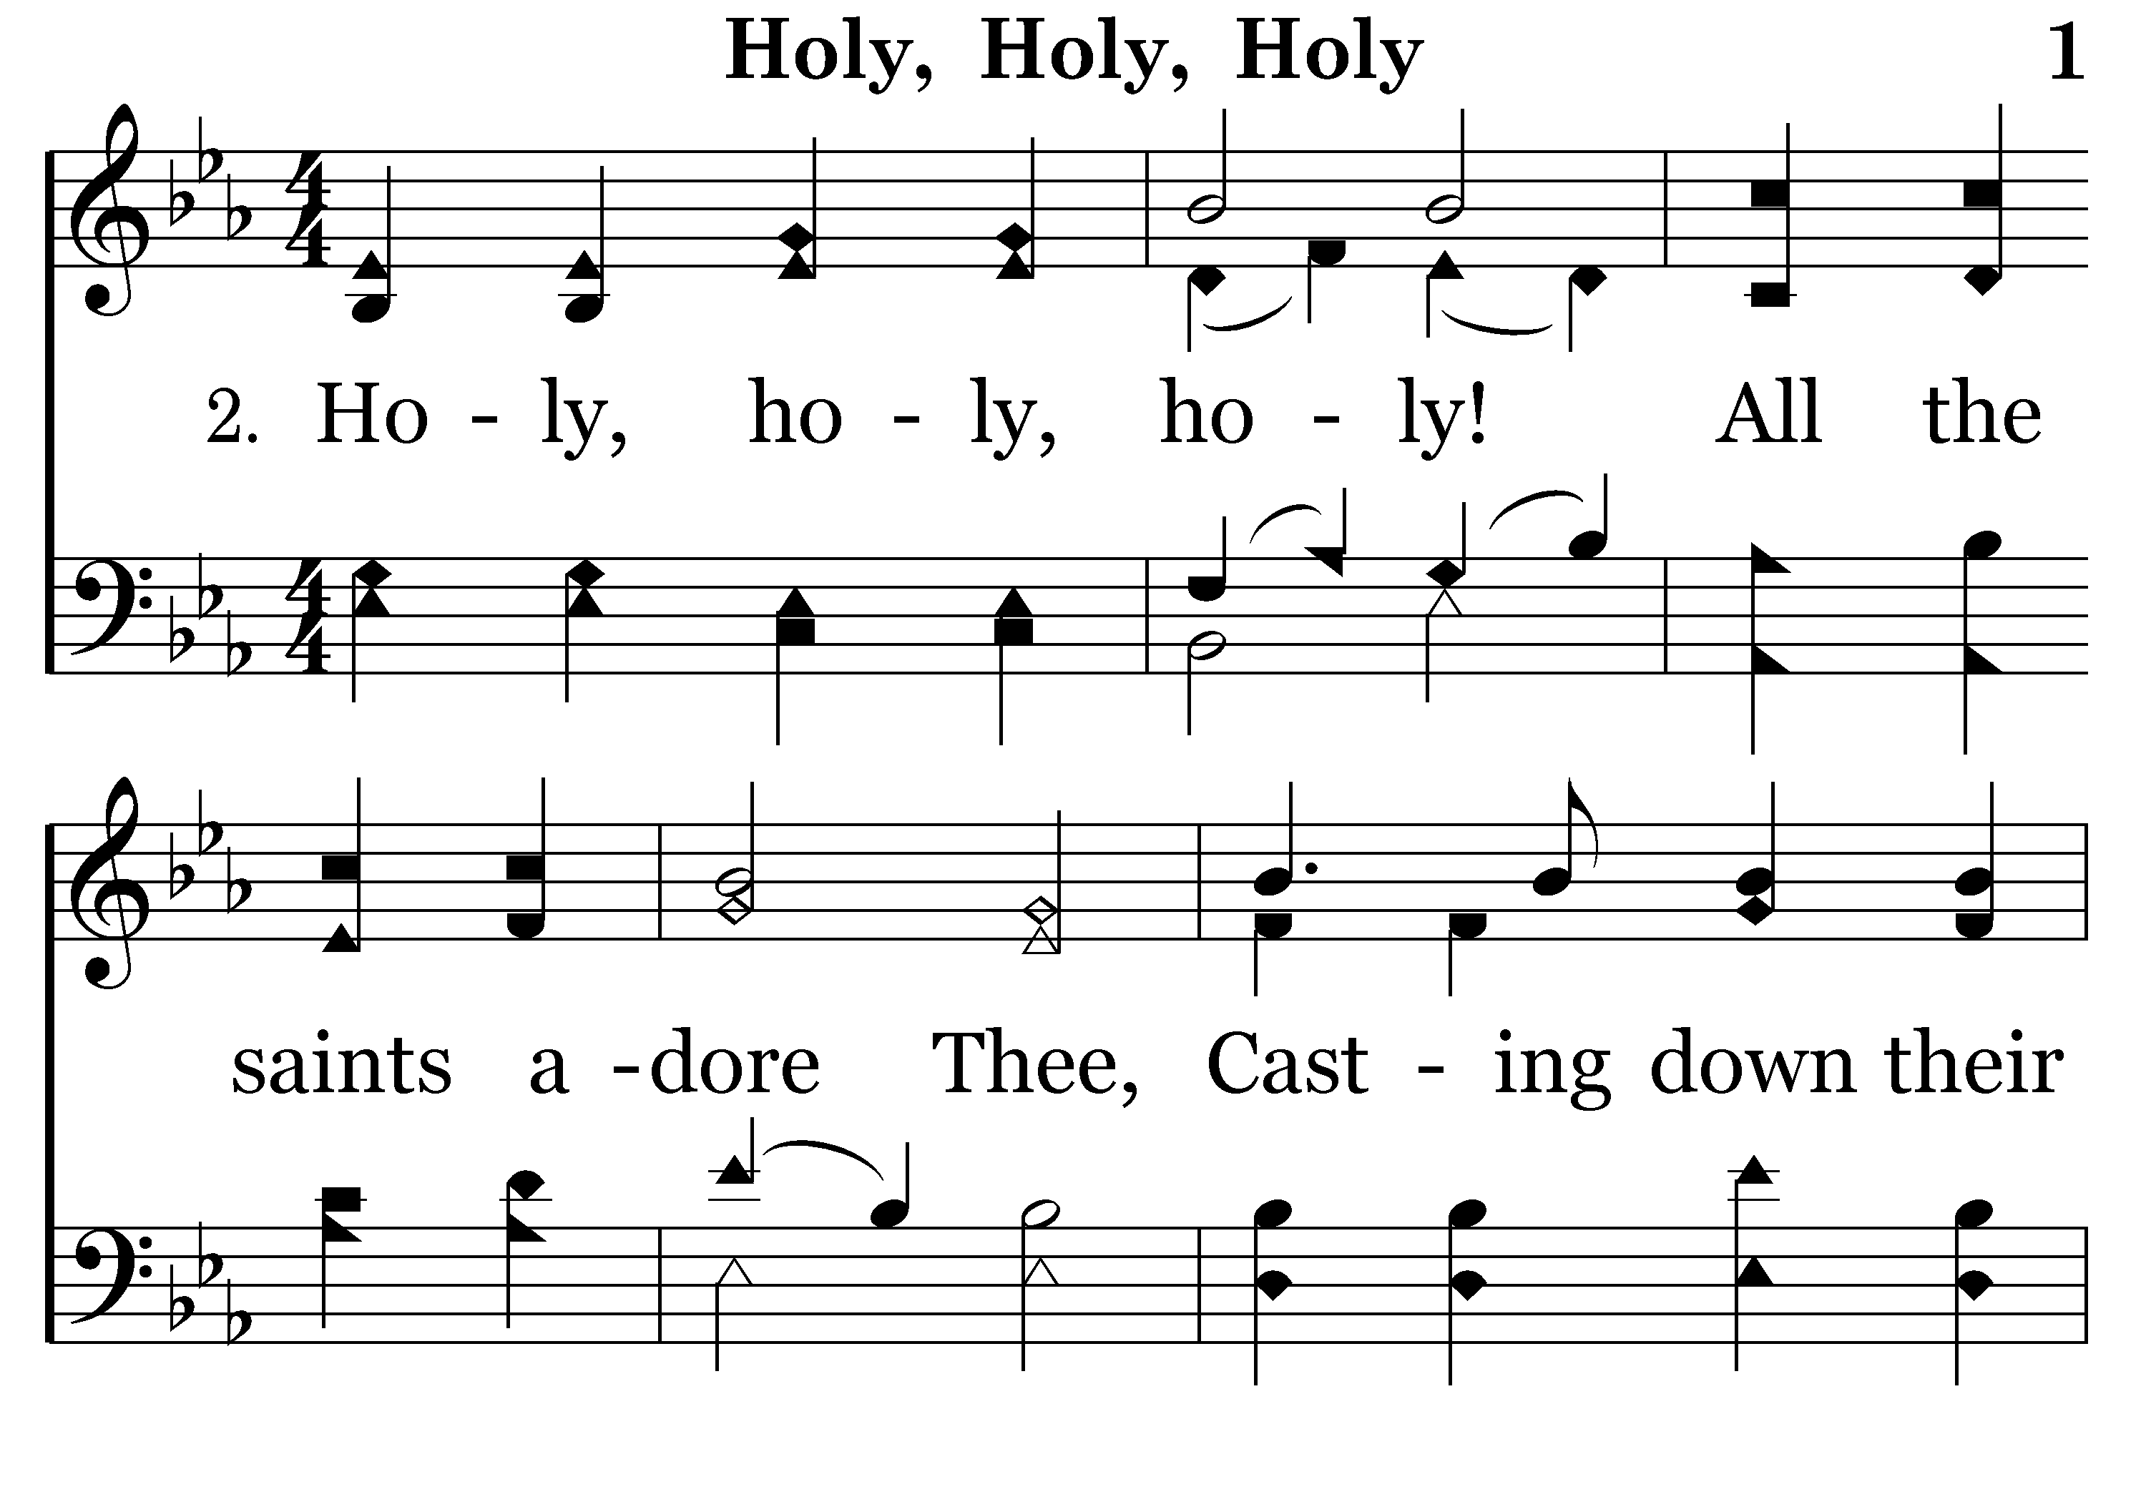
001 - Holy, Holy, Holy - 2.1

Slide 46
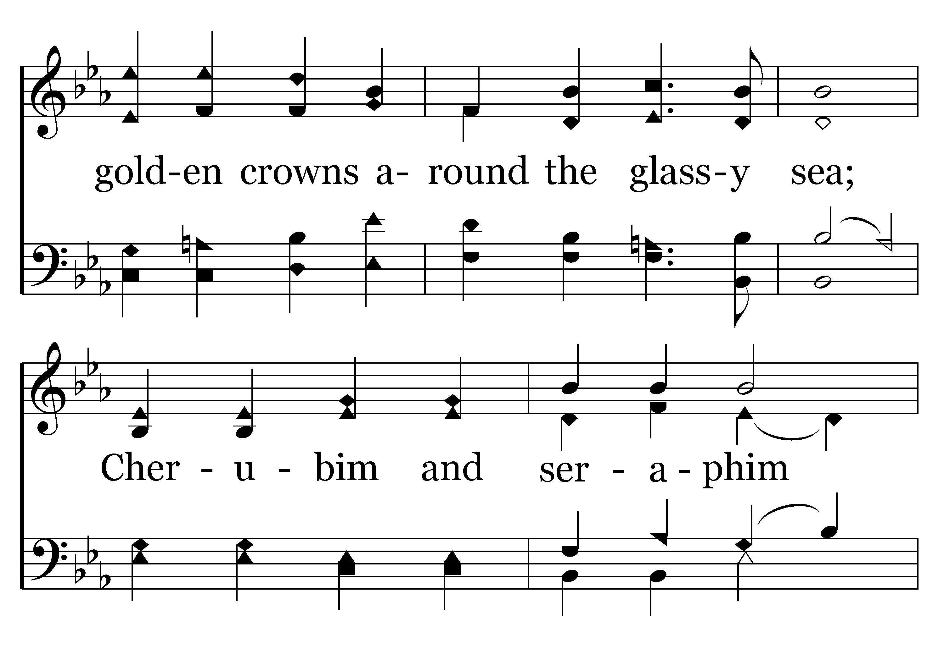
001 - Holy, Holy, Holy - 2.2

Slide 47
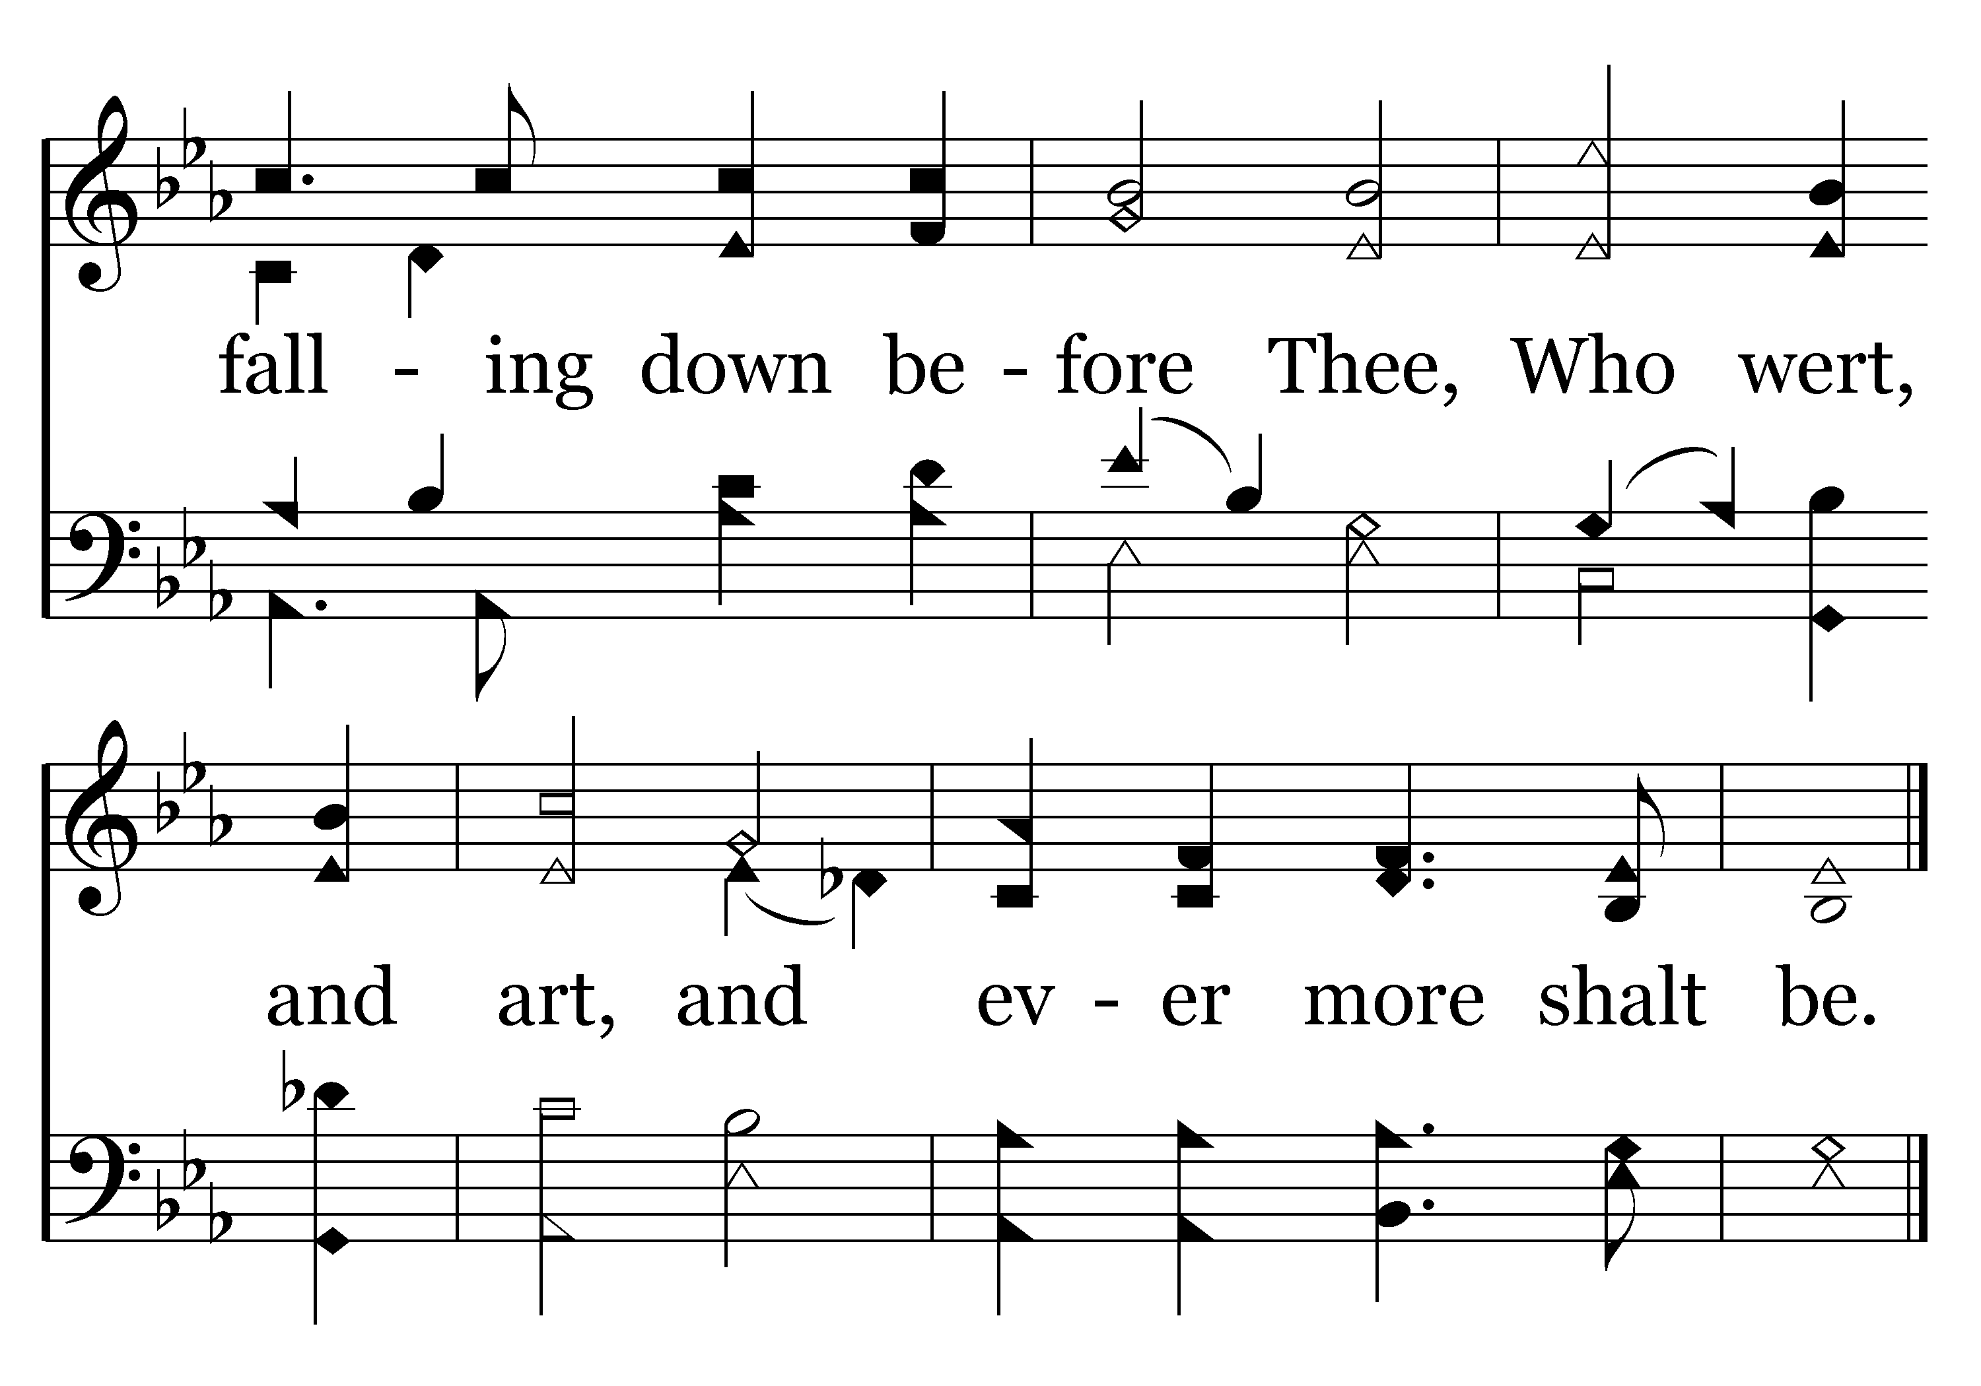
001 - Holy, Holy, Holy - 2.3
End of Verse 2

Slide 48
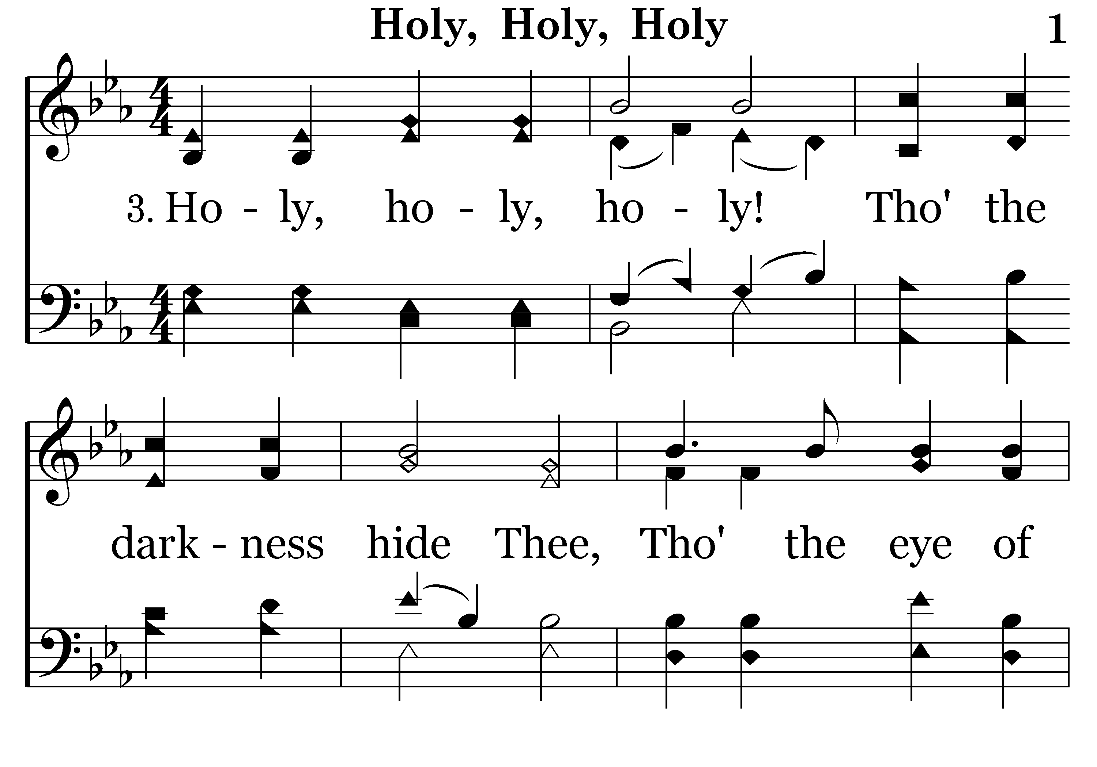
001 - Holy, Holy, Holy - 3.1

Slide 49
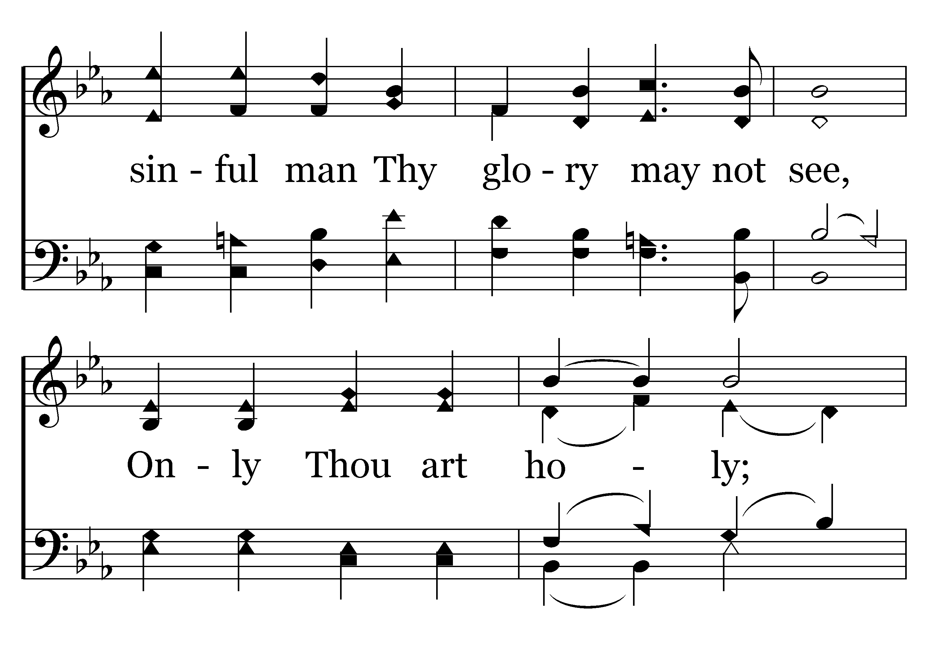
001 - Holy, Holy, Holy - 3.2

Slide 50
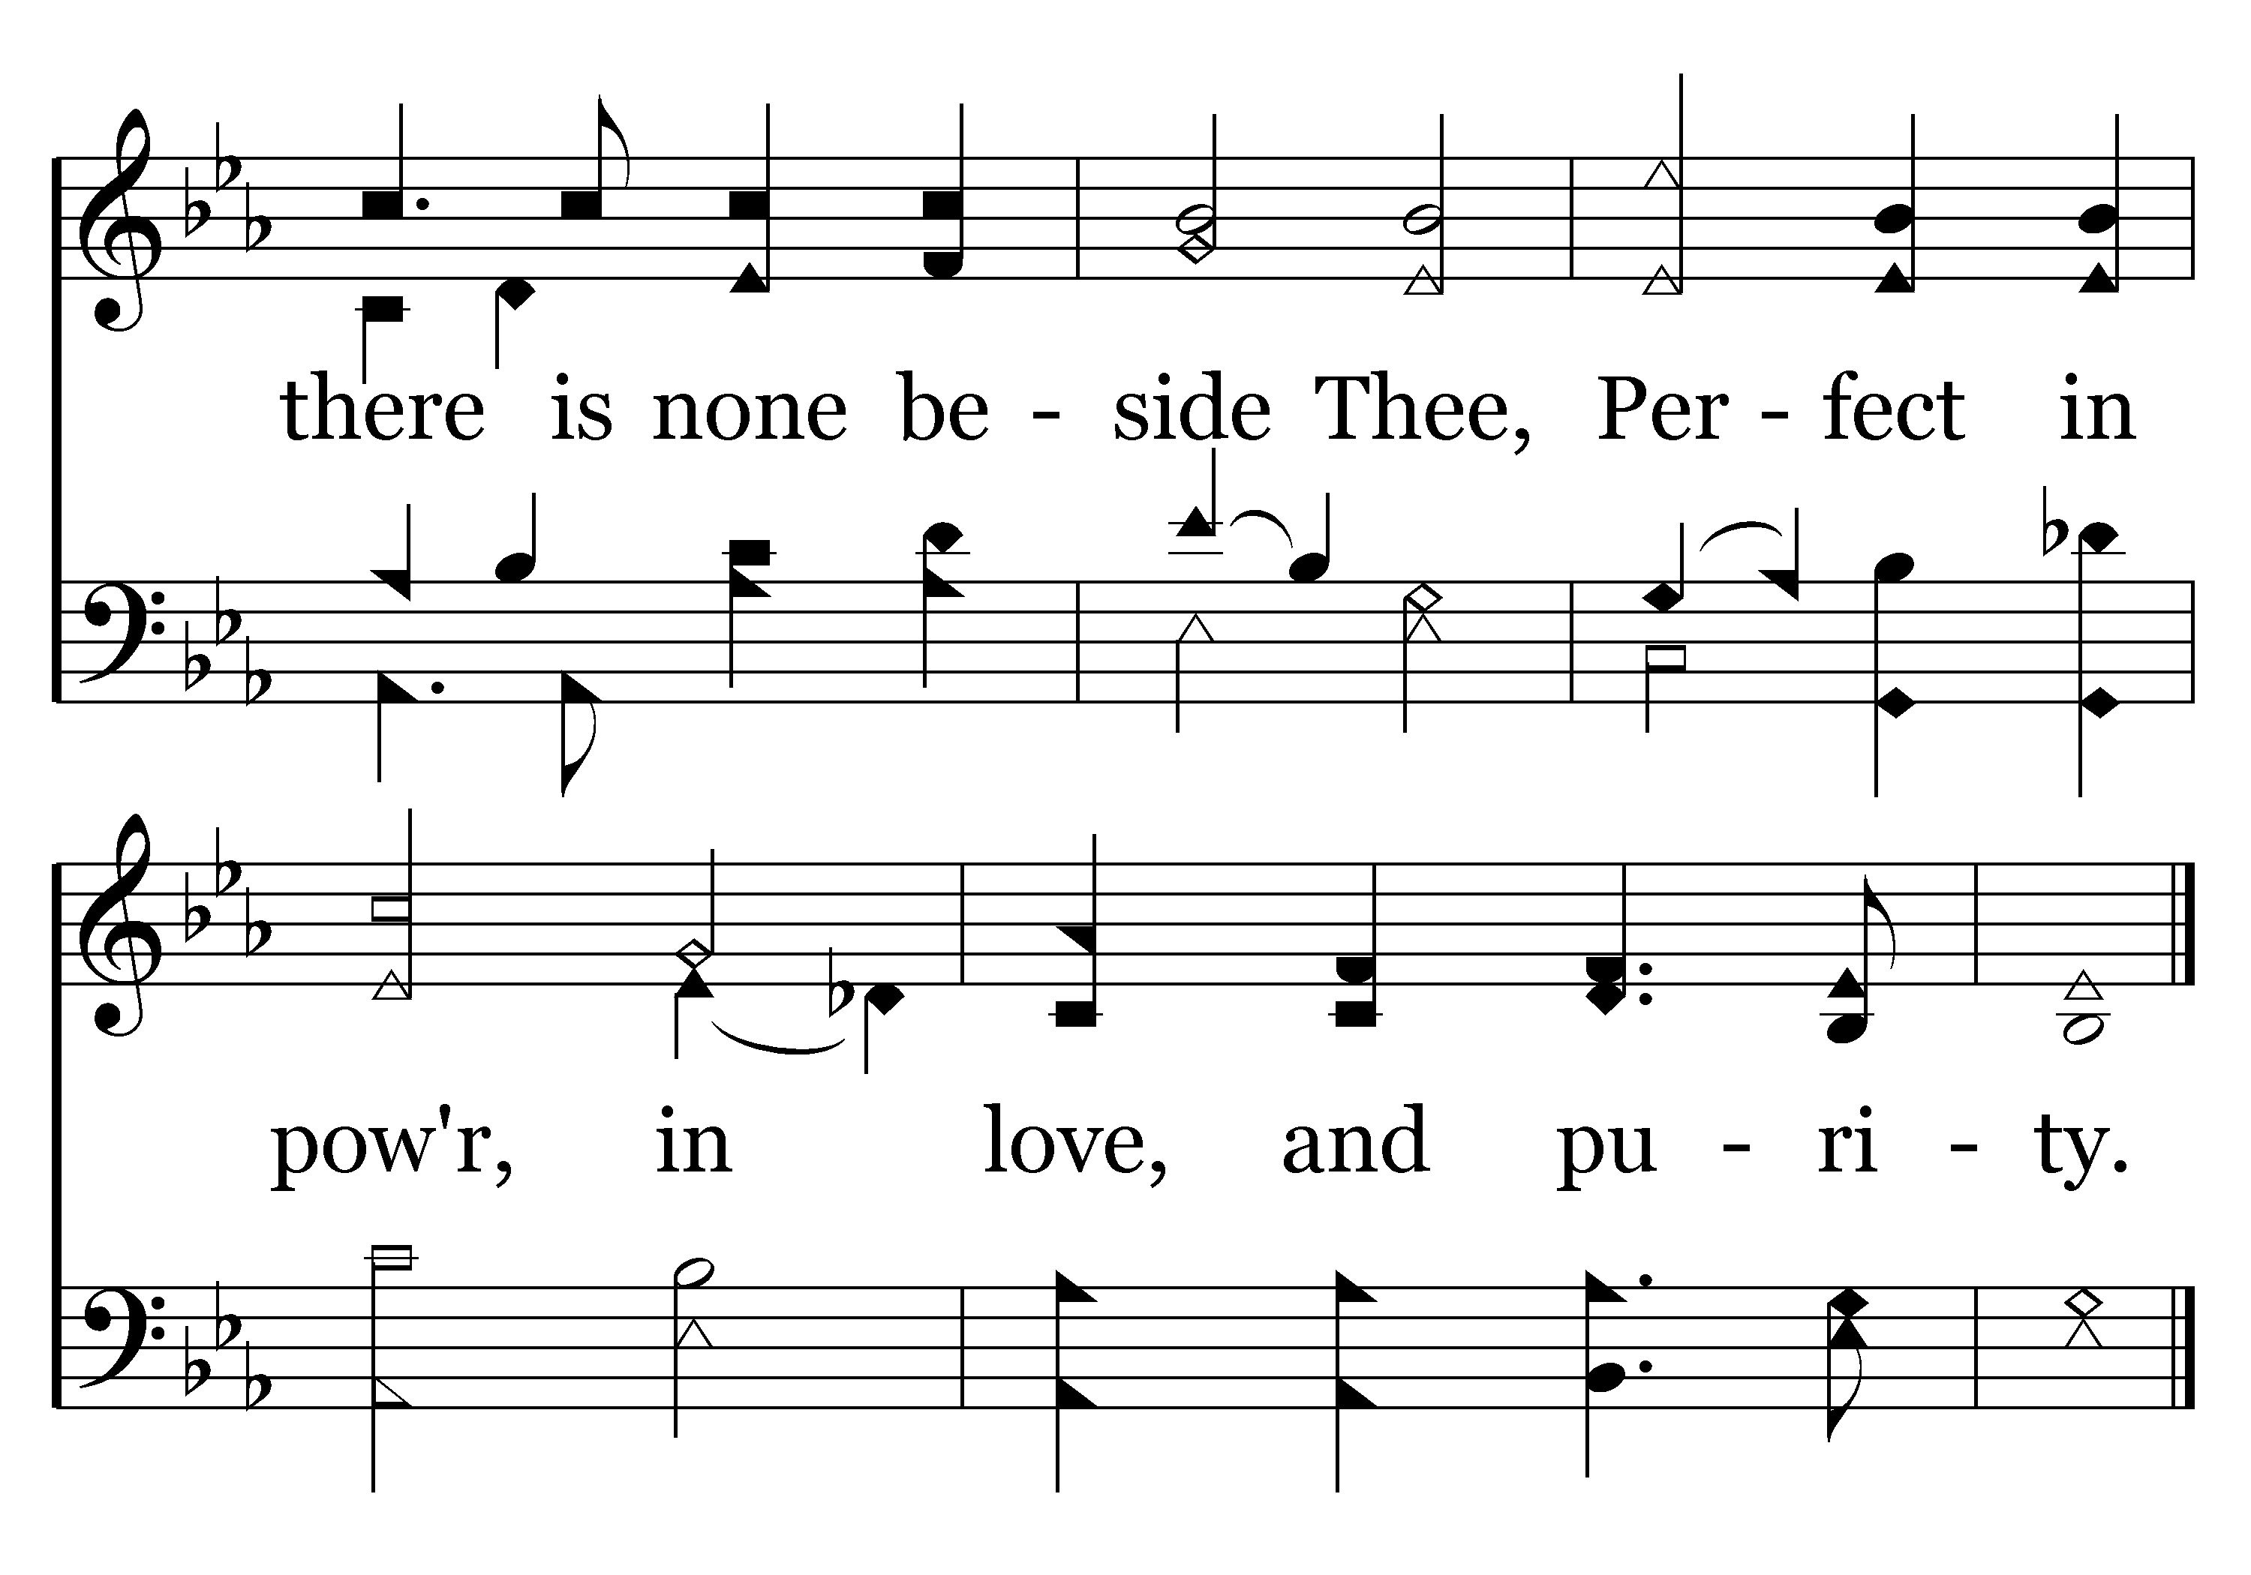
001 - Holy, Holy, Holy - 3.3
End of Verse 3

Slide 51
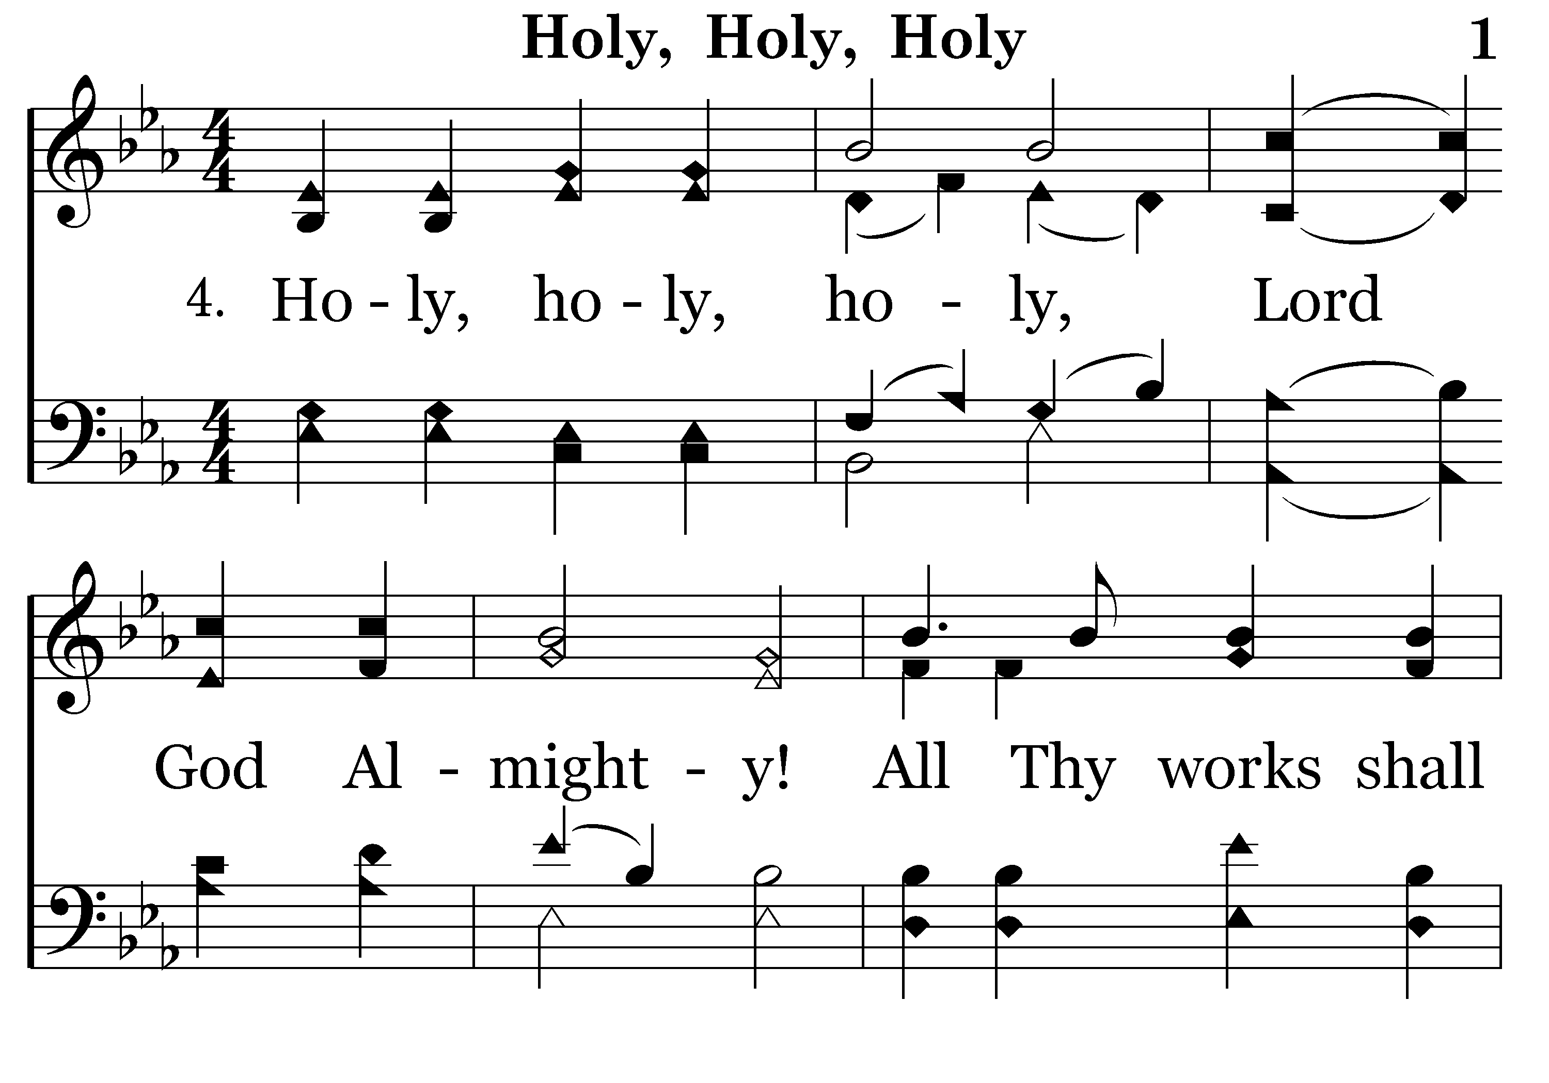
001 - Holy, Holy, Holy - 4.1

Slide 52
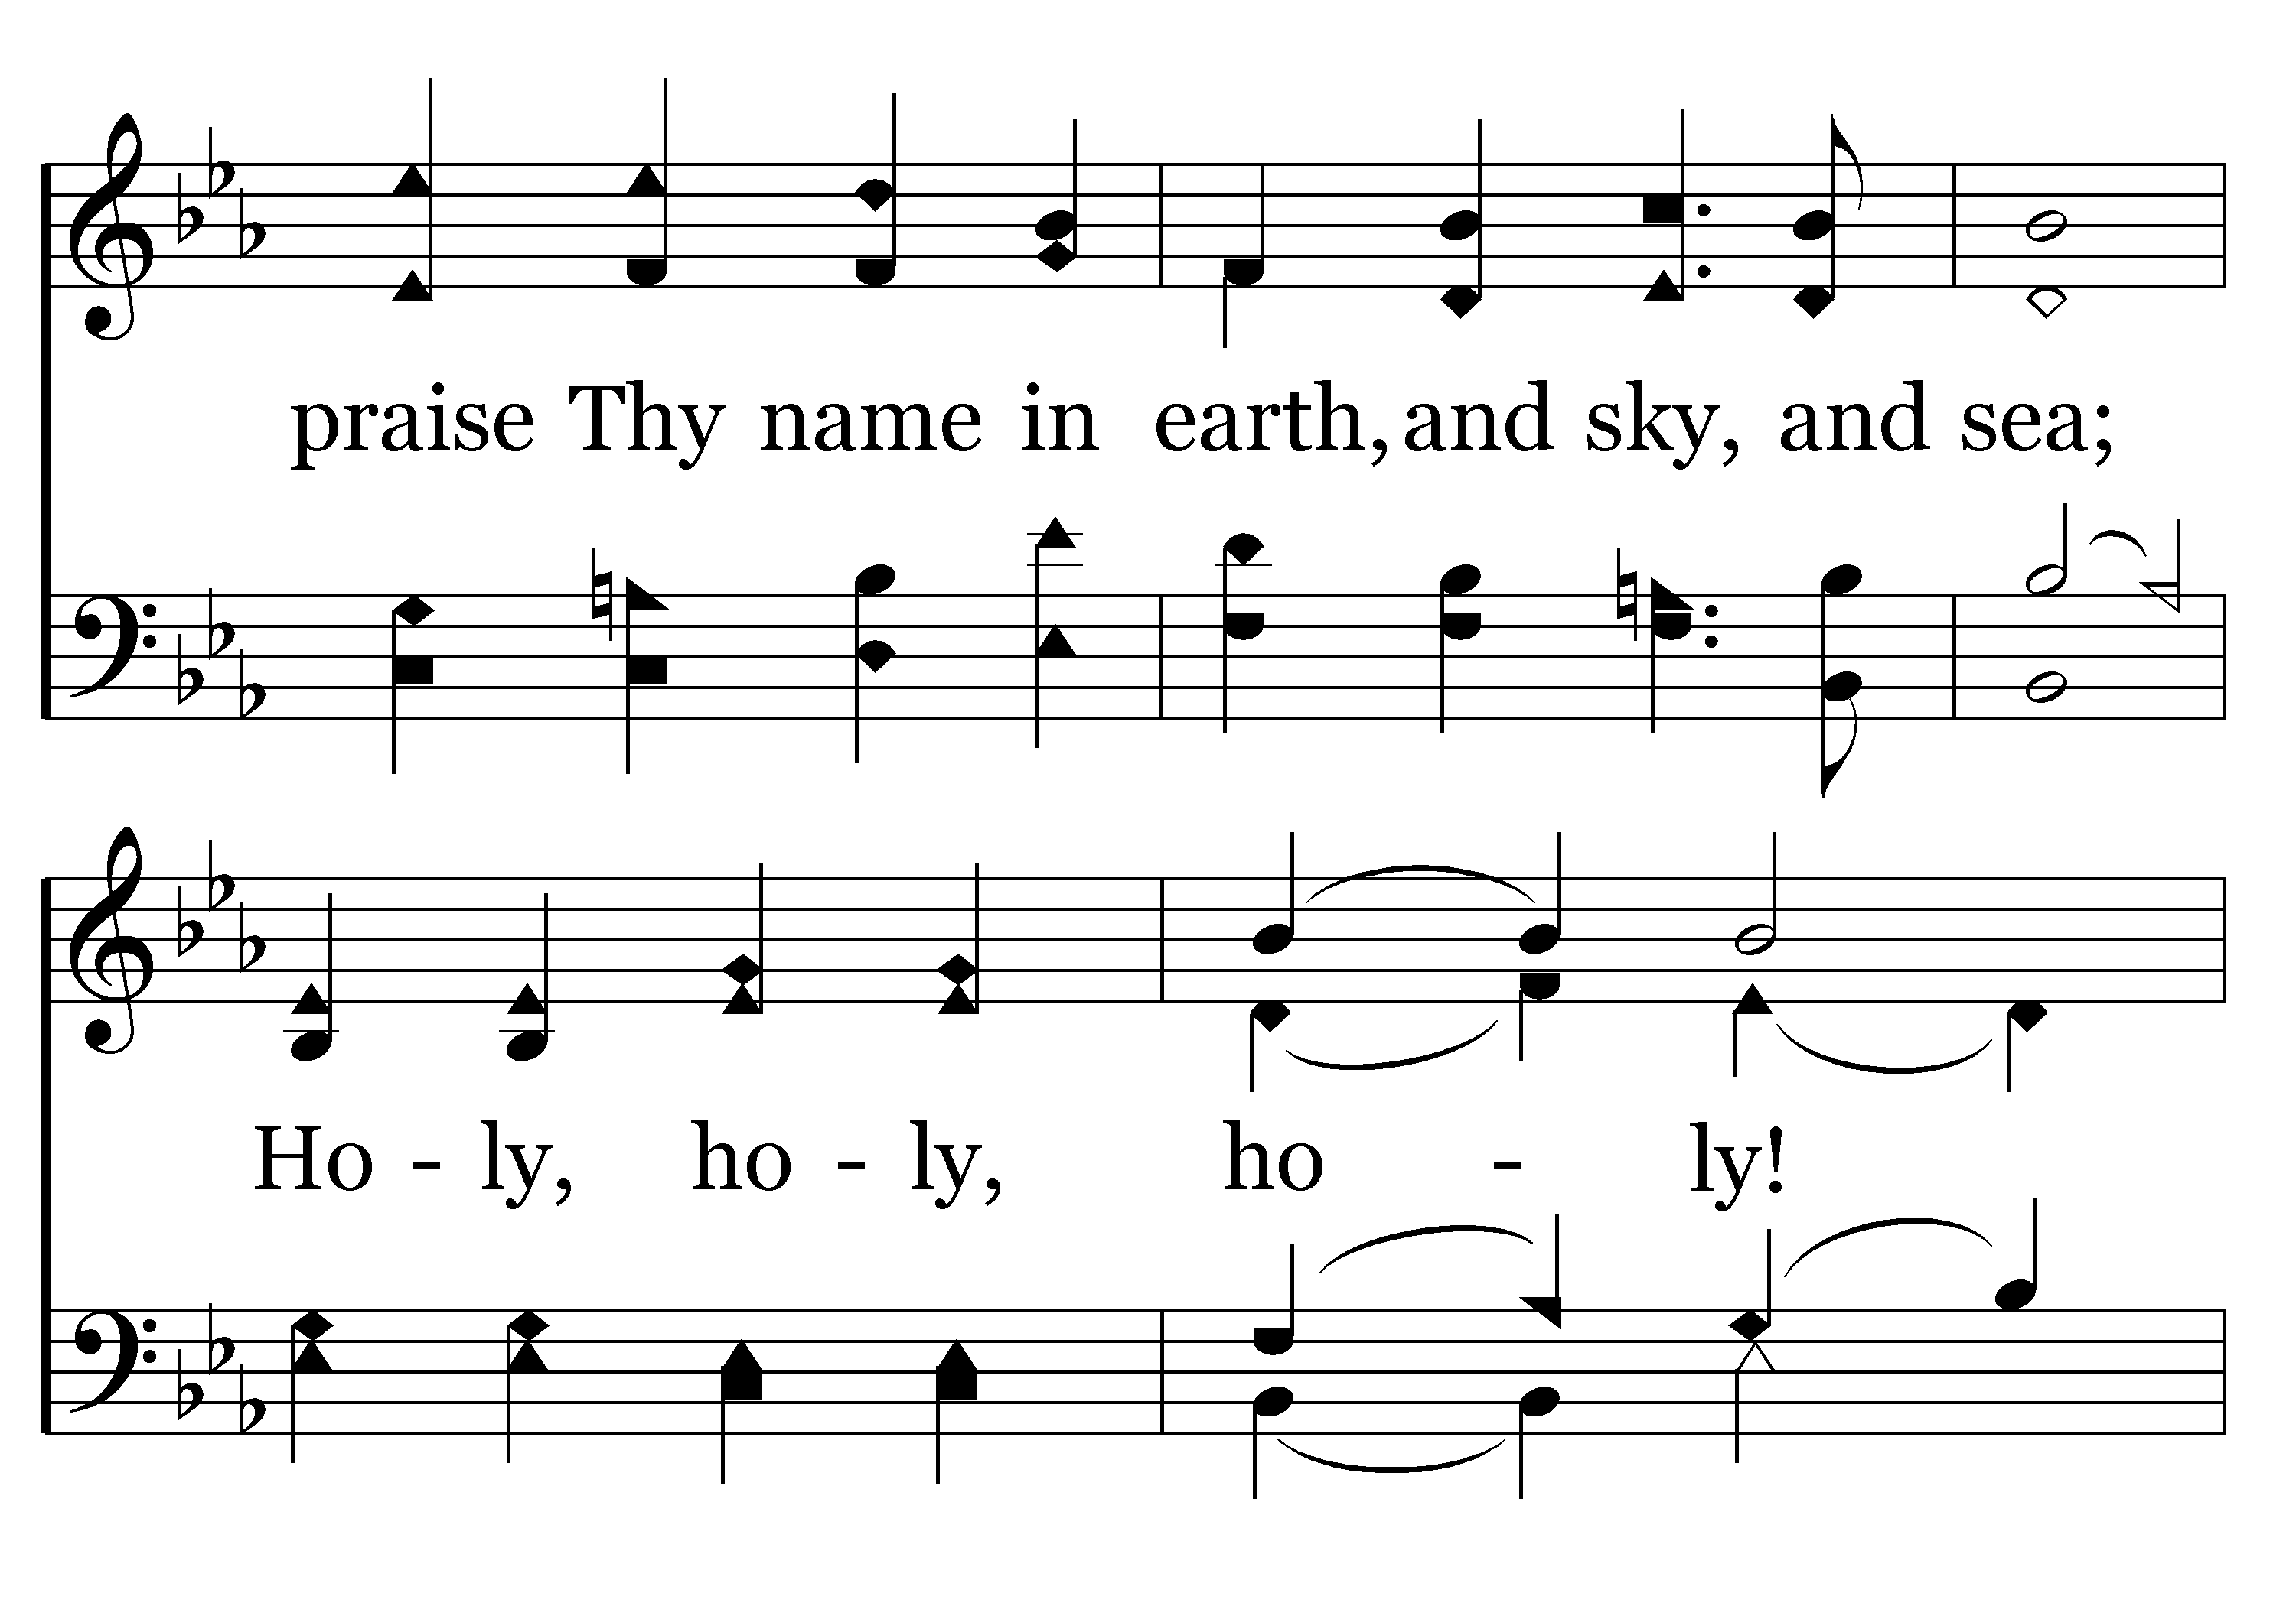
001 - Holy, Holy, Holy - 4.2

Slide 53
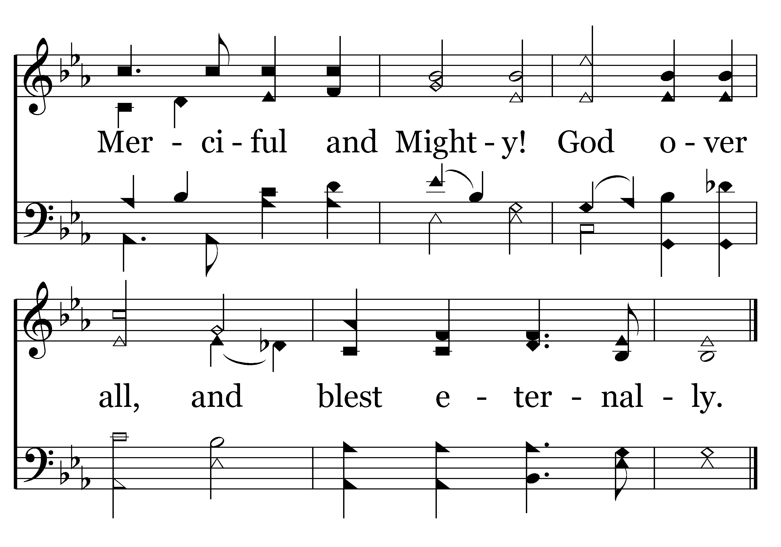
001 - Holy, Holy, Holy - 4.3
End of Song

Slide 55
NUMBER 12 IN THE SUPPLEMNT
COME SHARE THE LORD

Slide 56
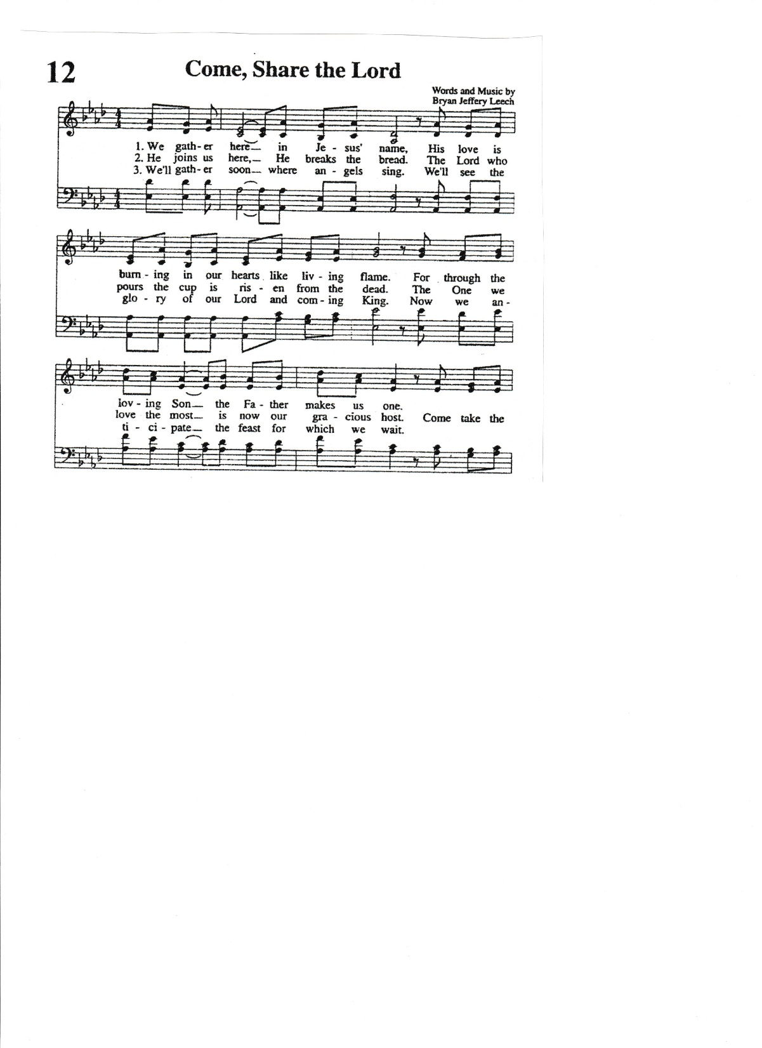

Slide 57
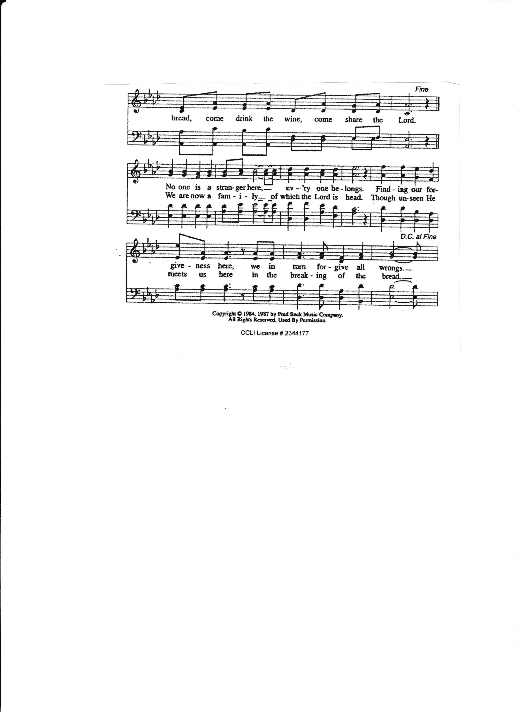

Slide 58
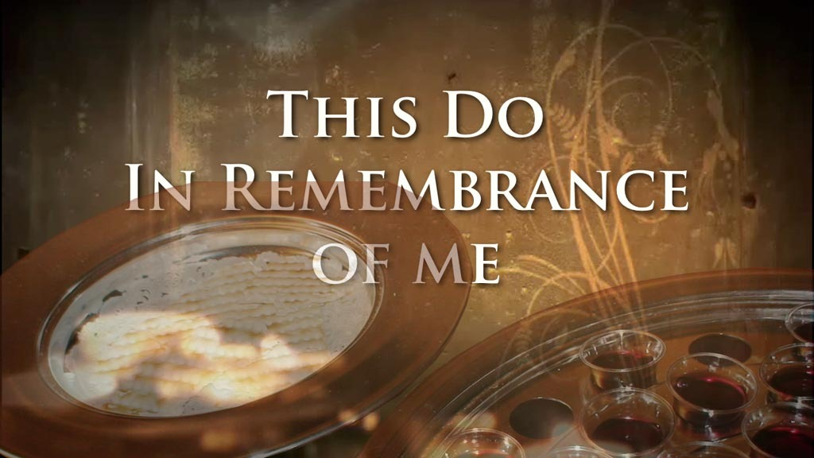
REMARKS BY JIM INGRAM

Slide 59
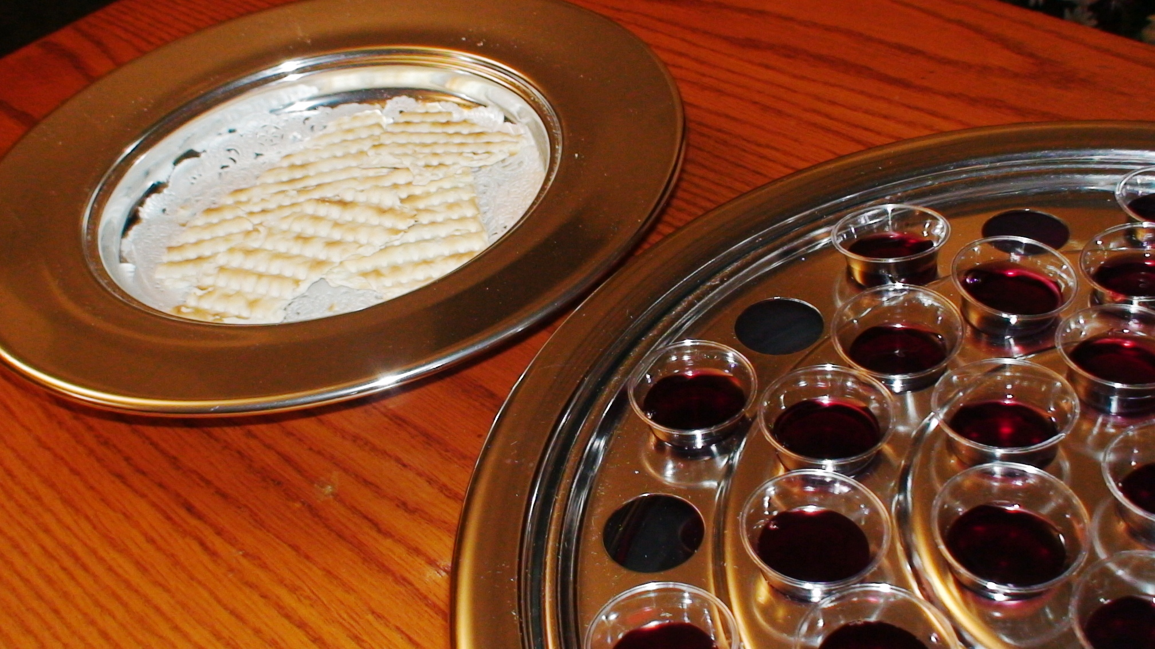
“As often as you eat this bread and drink this cup, you proclaim the Lord’s death….” 1 Corinthians 11:26

Slide 60
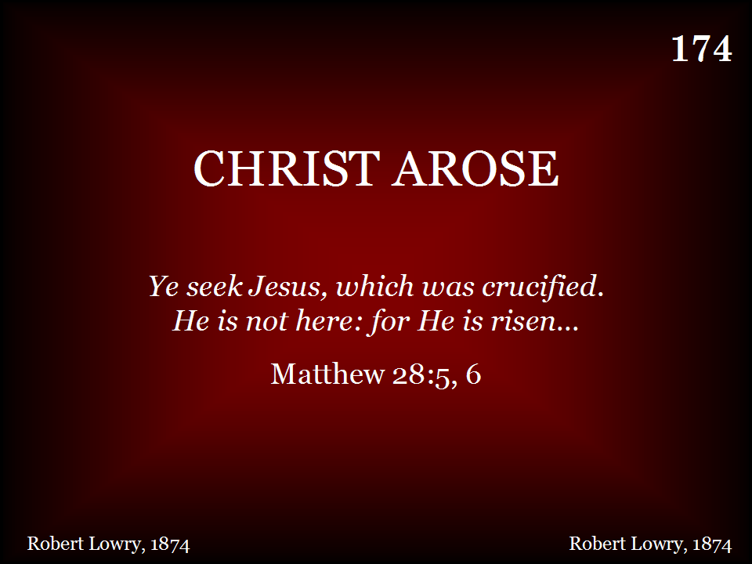
174 - Christ Arose - Title
SING ALL VERSES THEN THE CHORUS

Slide 61
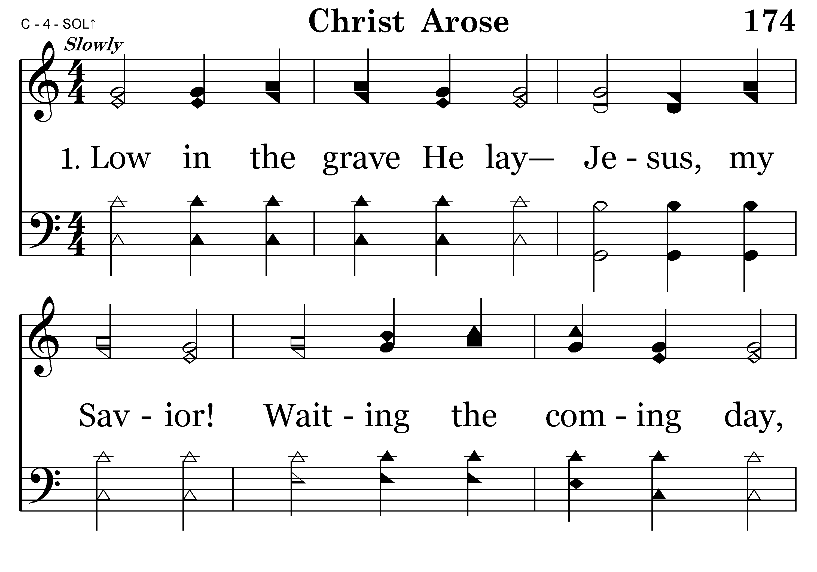
174 - Christ Arose - 1.1

Slide 62
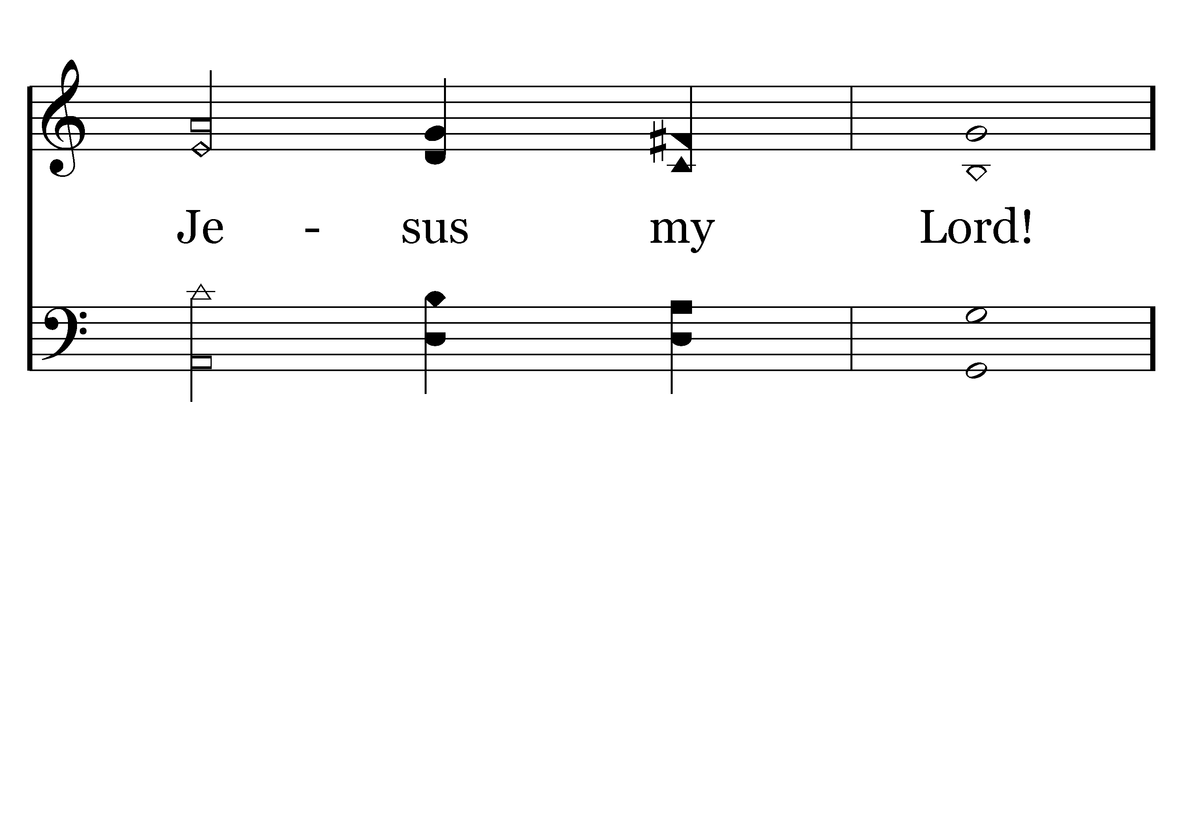
174 - Christ Arose - 1.2
End of Verse 1

Slide 63
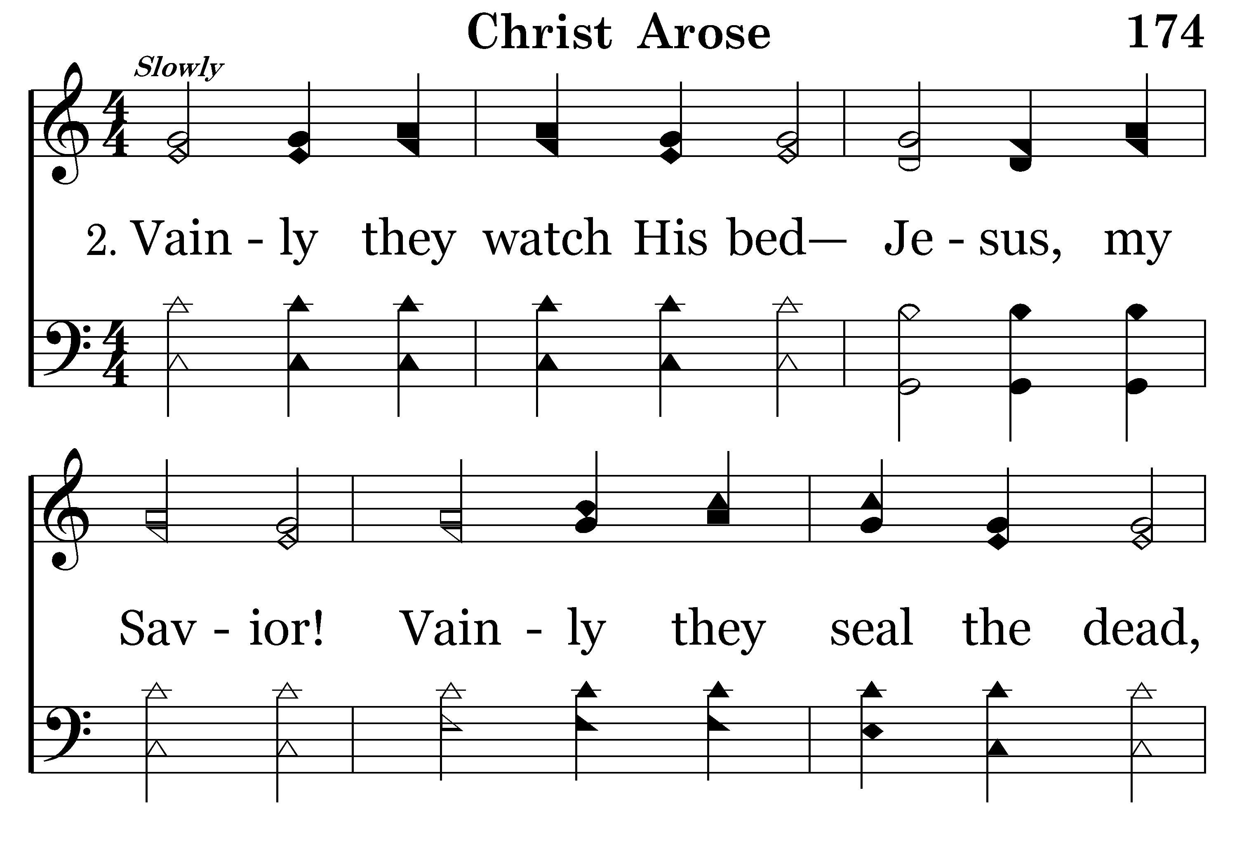
174 - Christ Arose - 2.1

Slide 64

174 - Christ Arose - 2.2
End of Verse 2

Slide 65
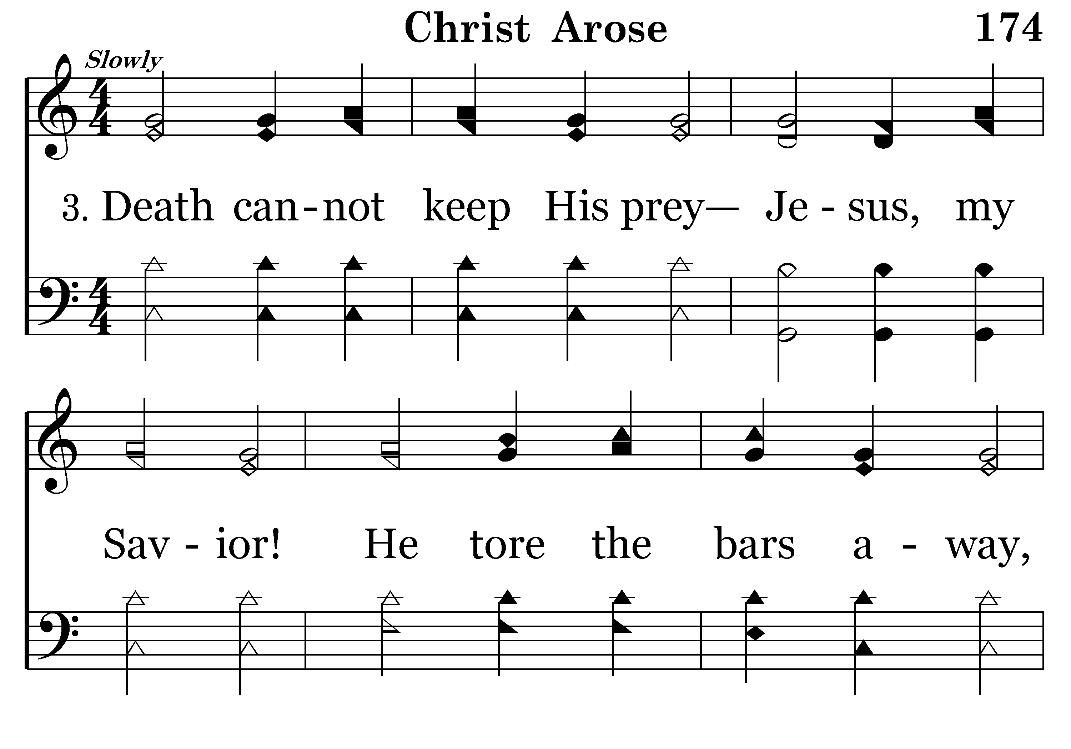
174 - Christ Arose - 3.1

Slide 66
174 - Christ Arose - 3.2

Slide 67
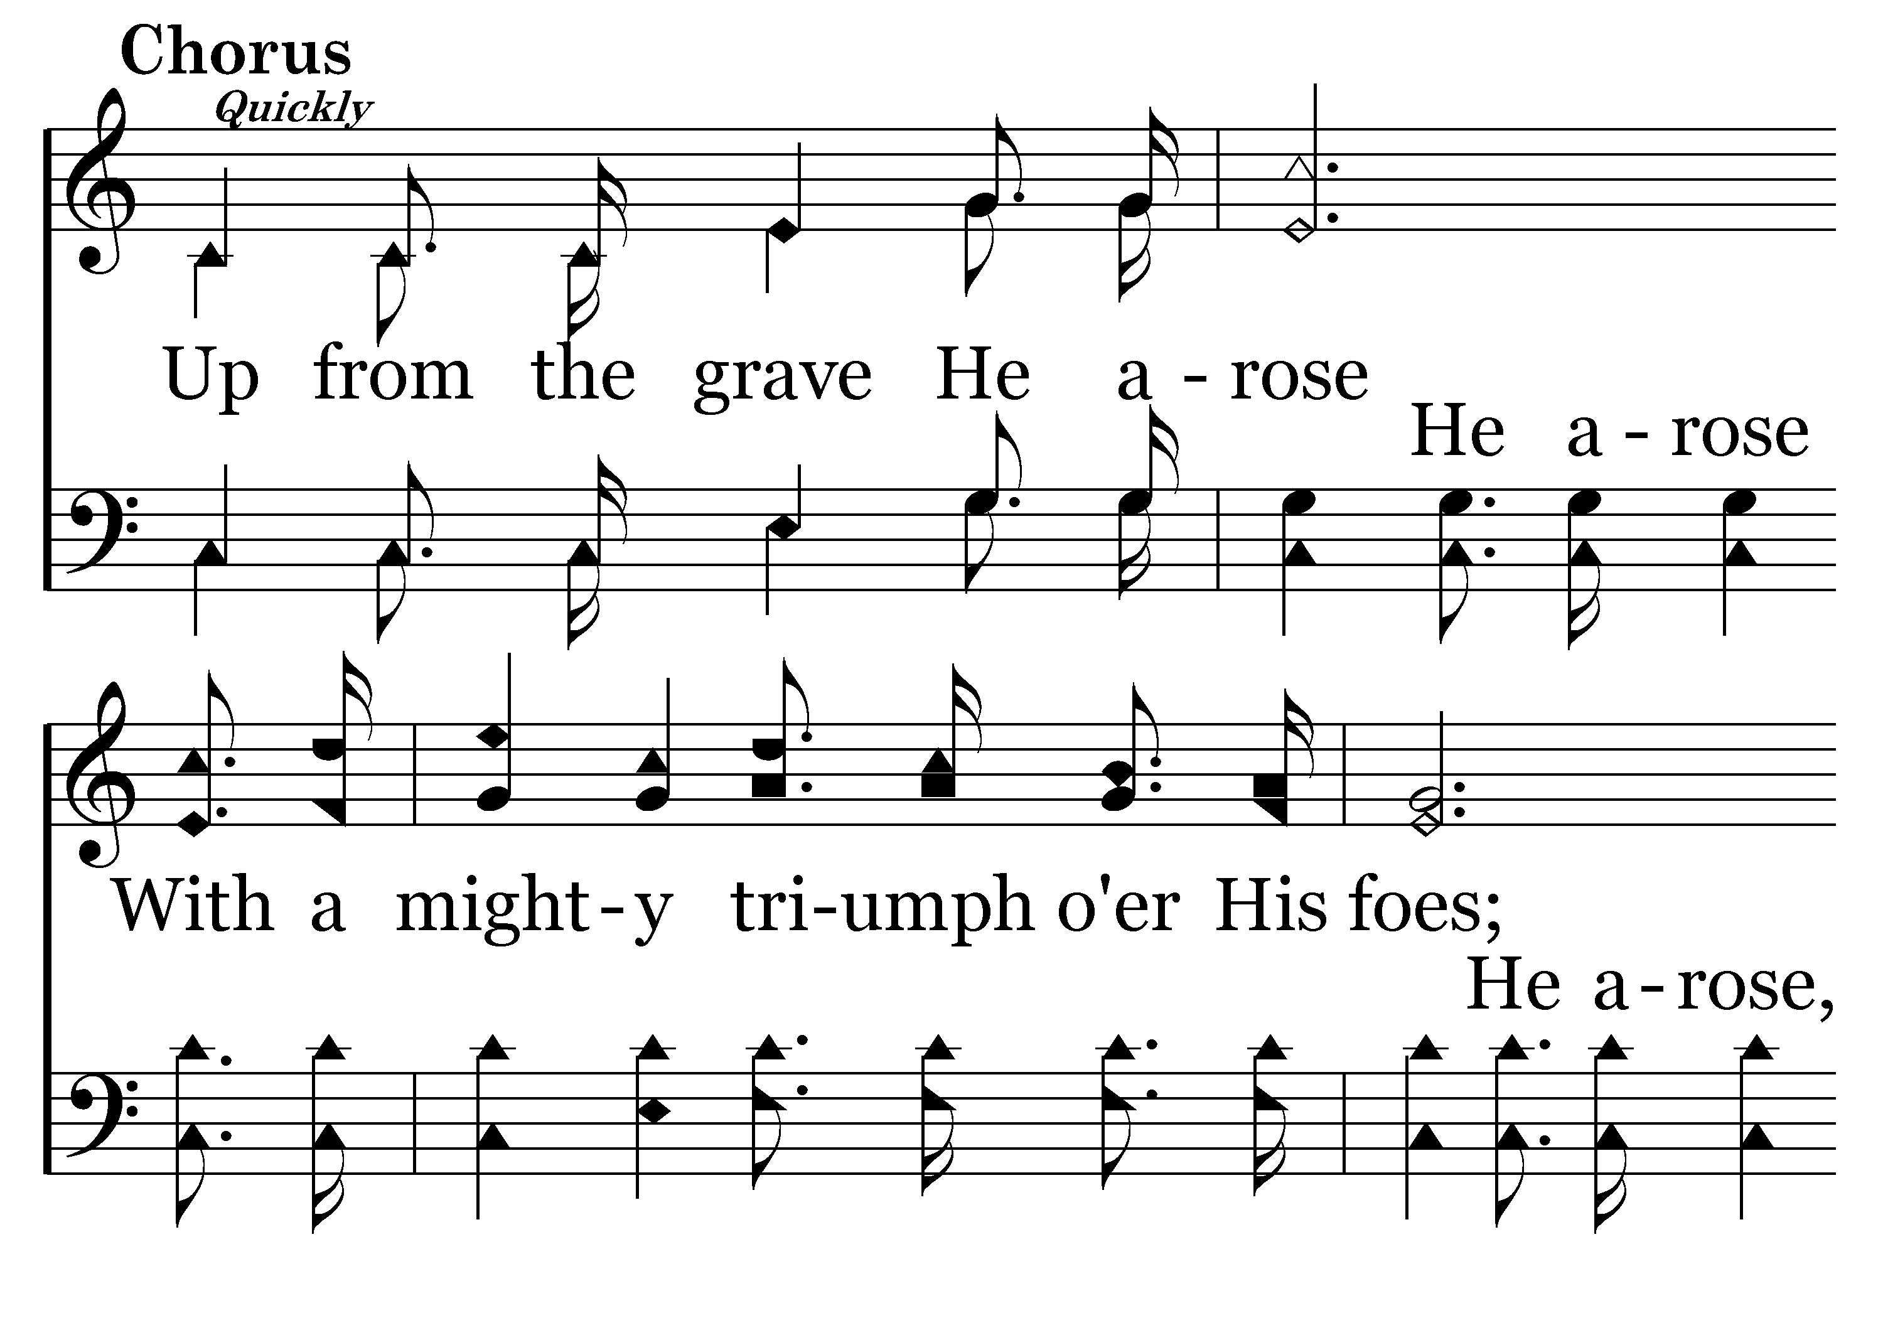
174 - Christ Arose - C.1

Slide 68
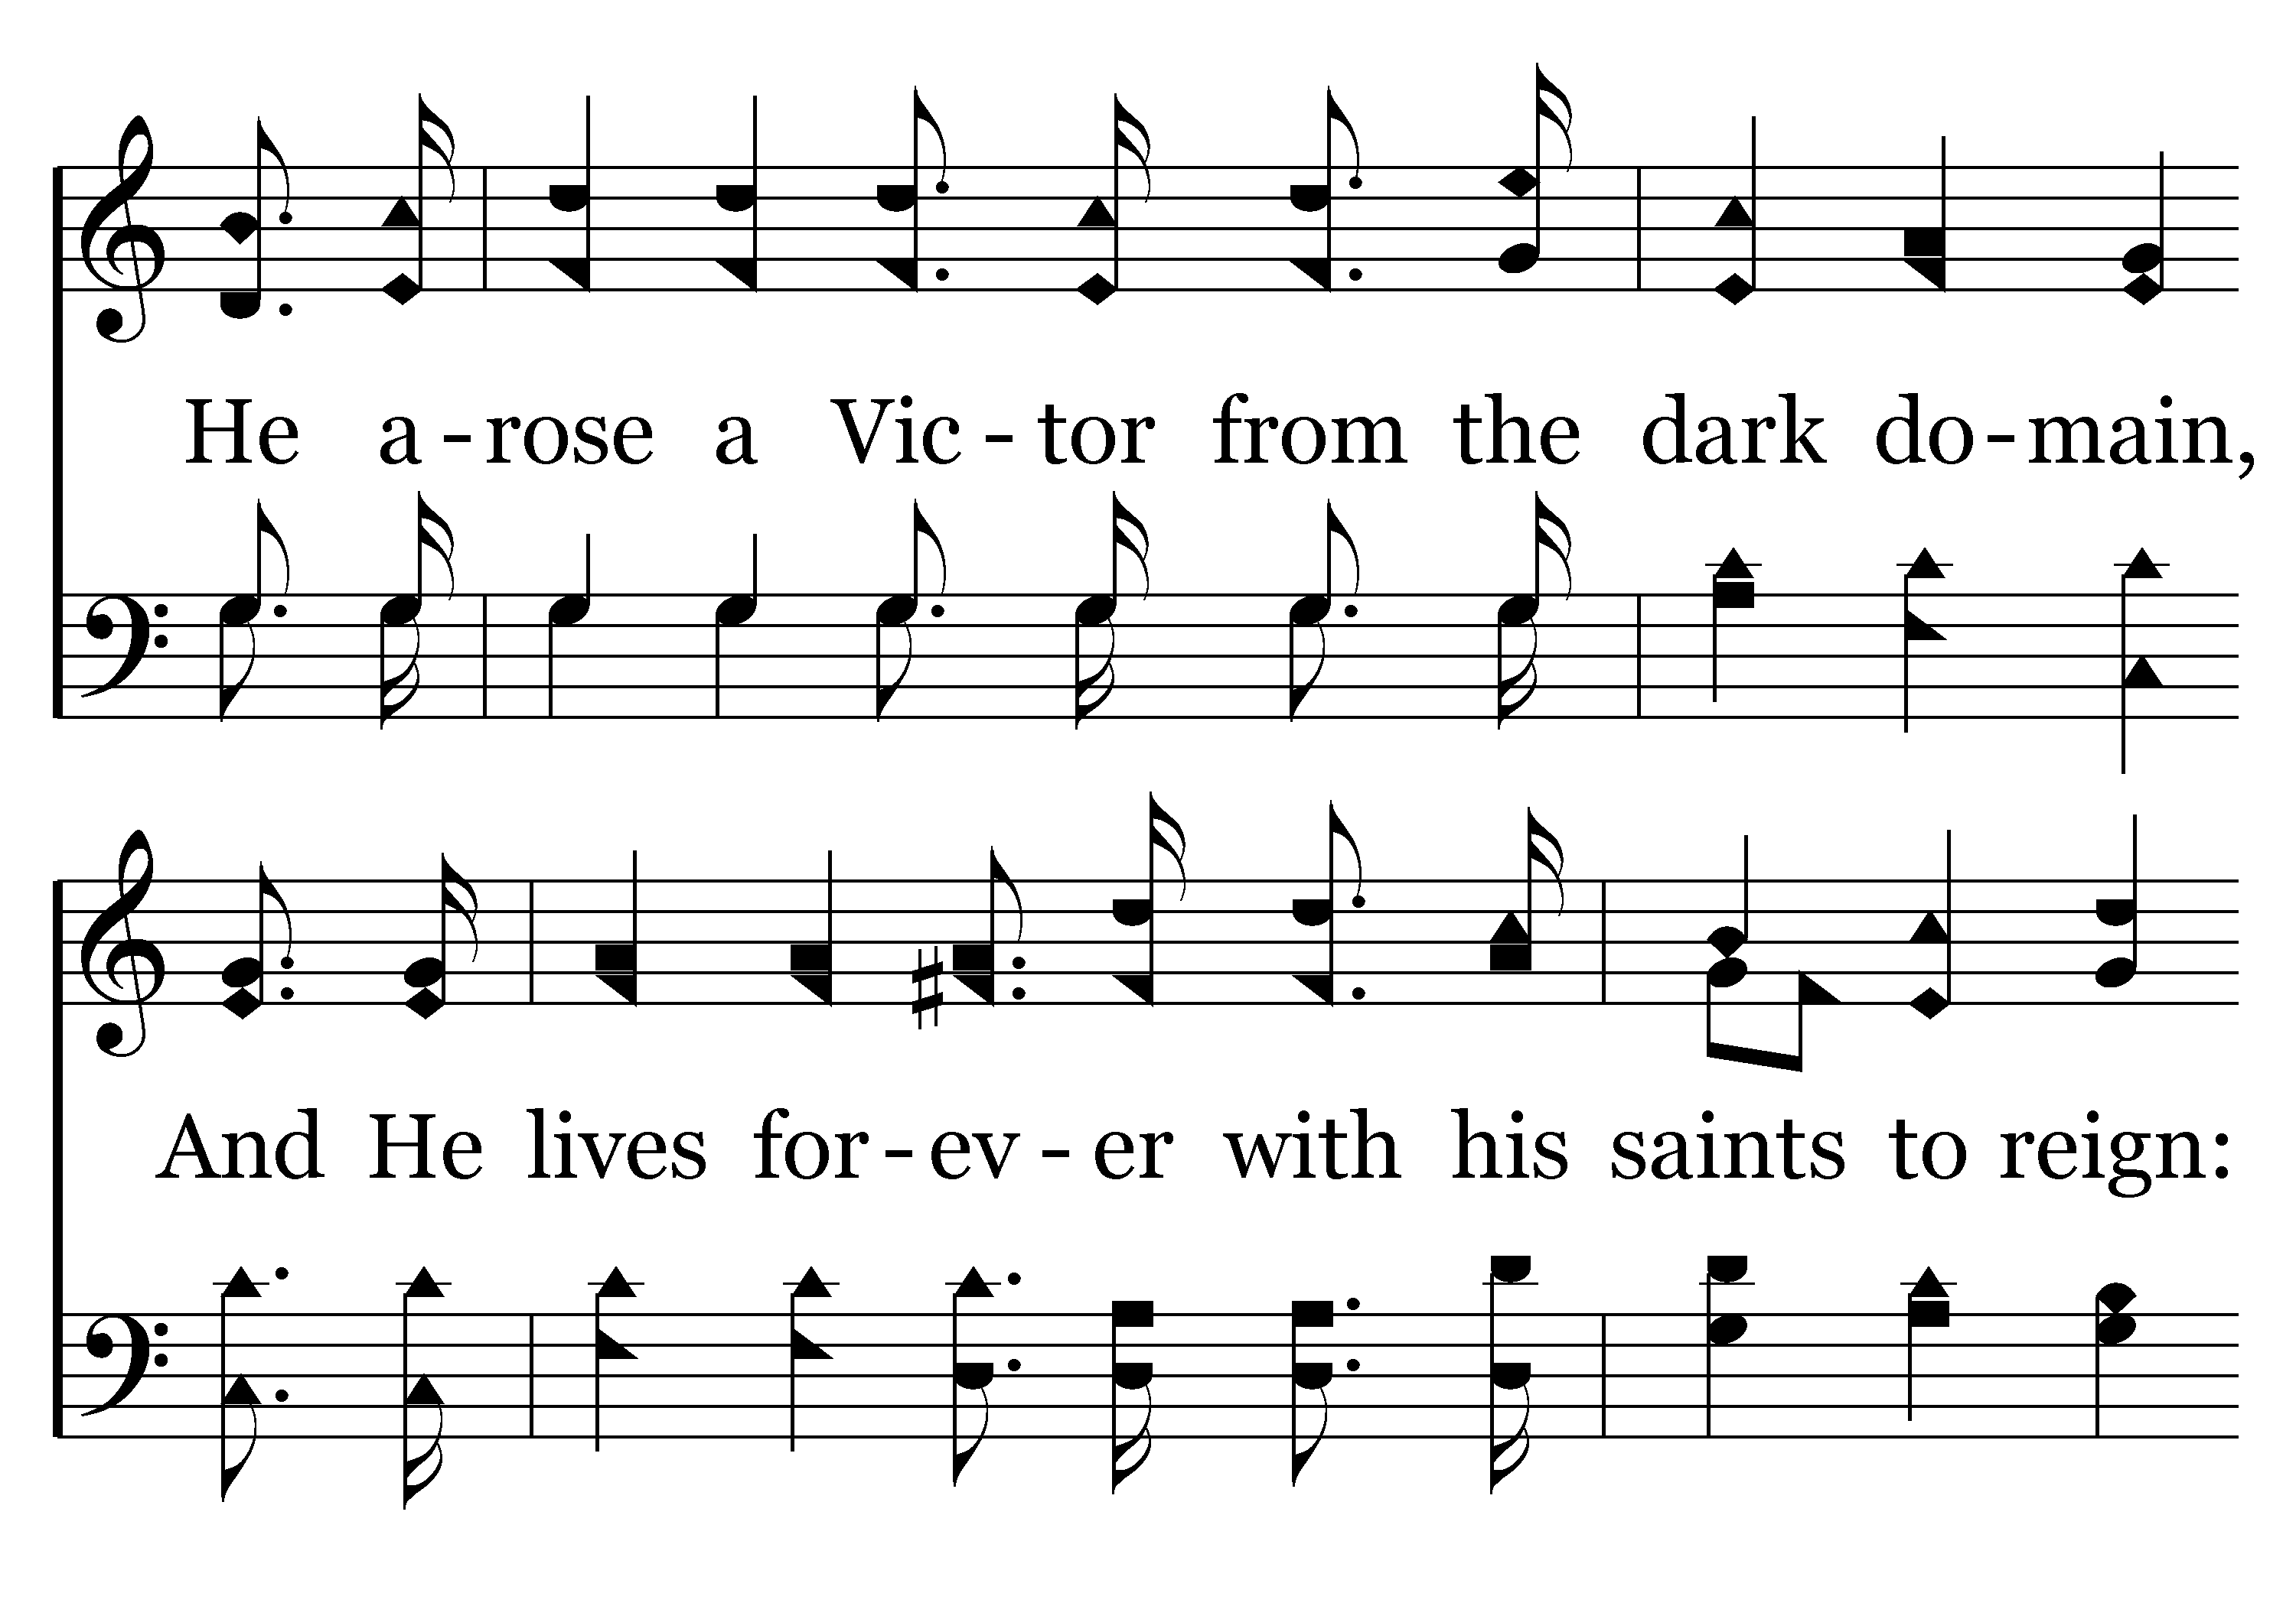
174 - Christ Arose - C.2

Slide 69
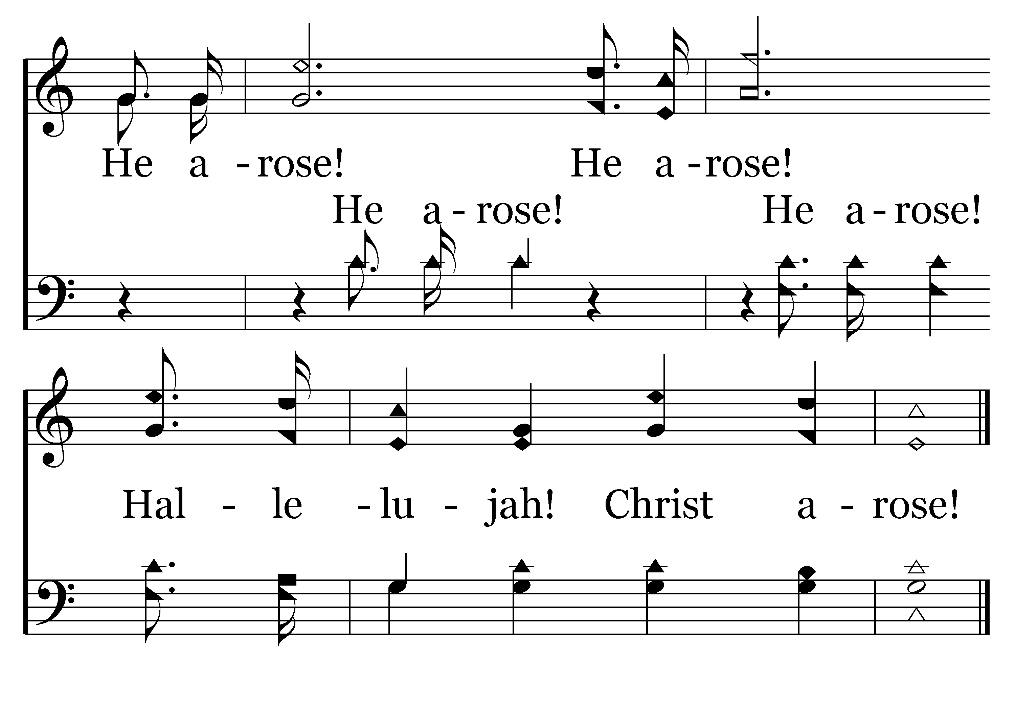
174 - Christ Arose - C.3
End of Song

Slide 71
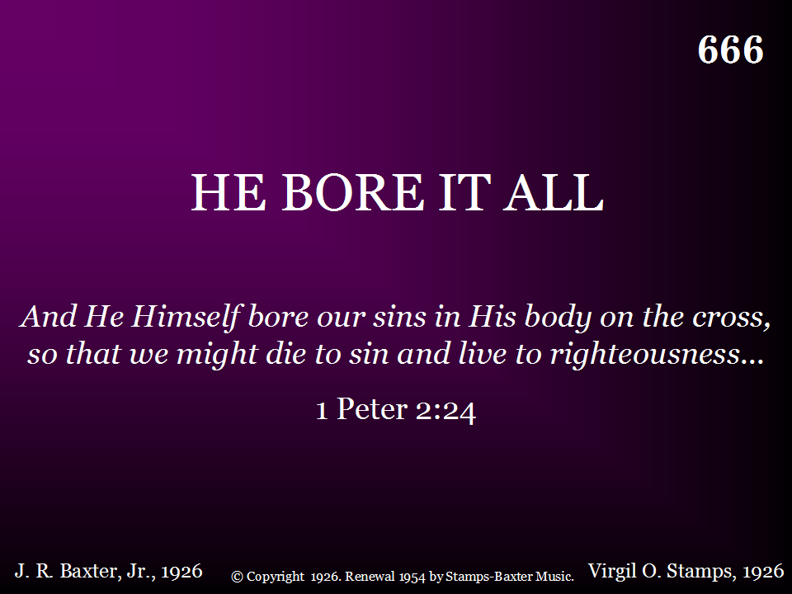
666 - He Bore It All - Title

Slide 72
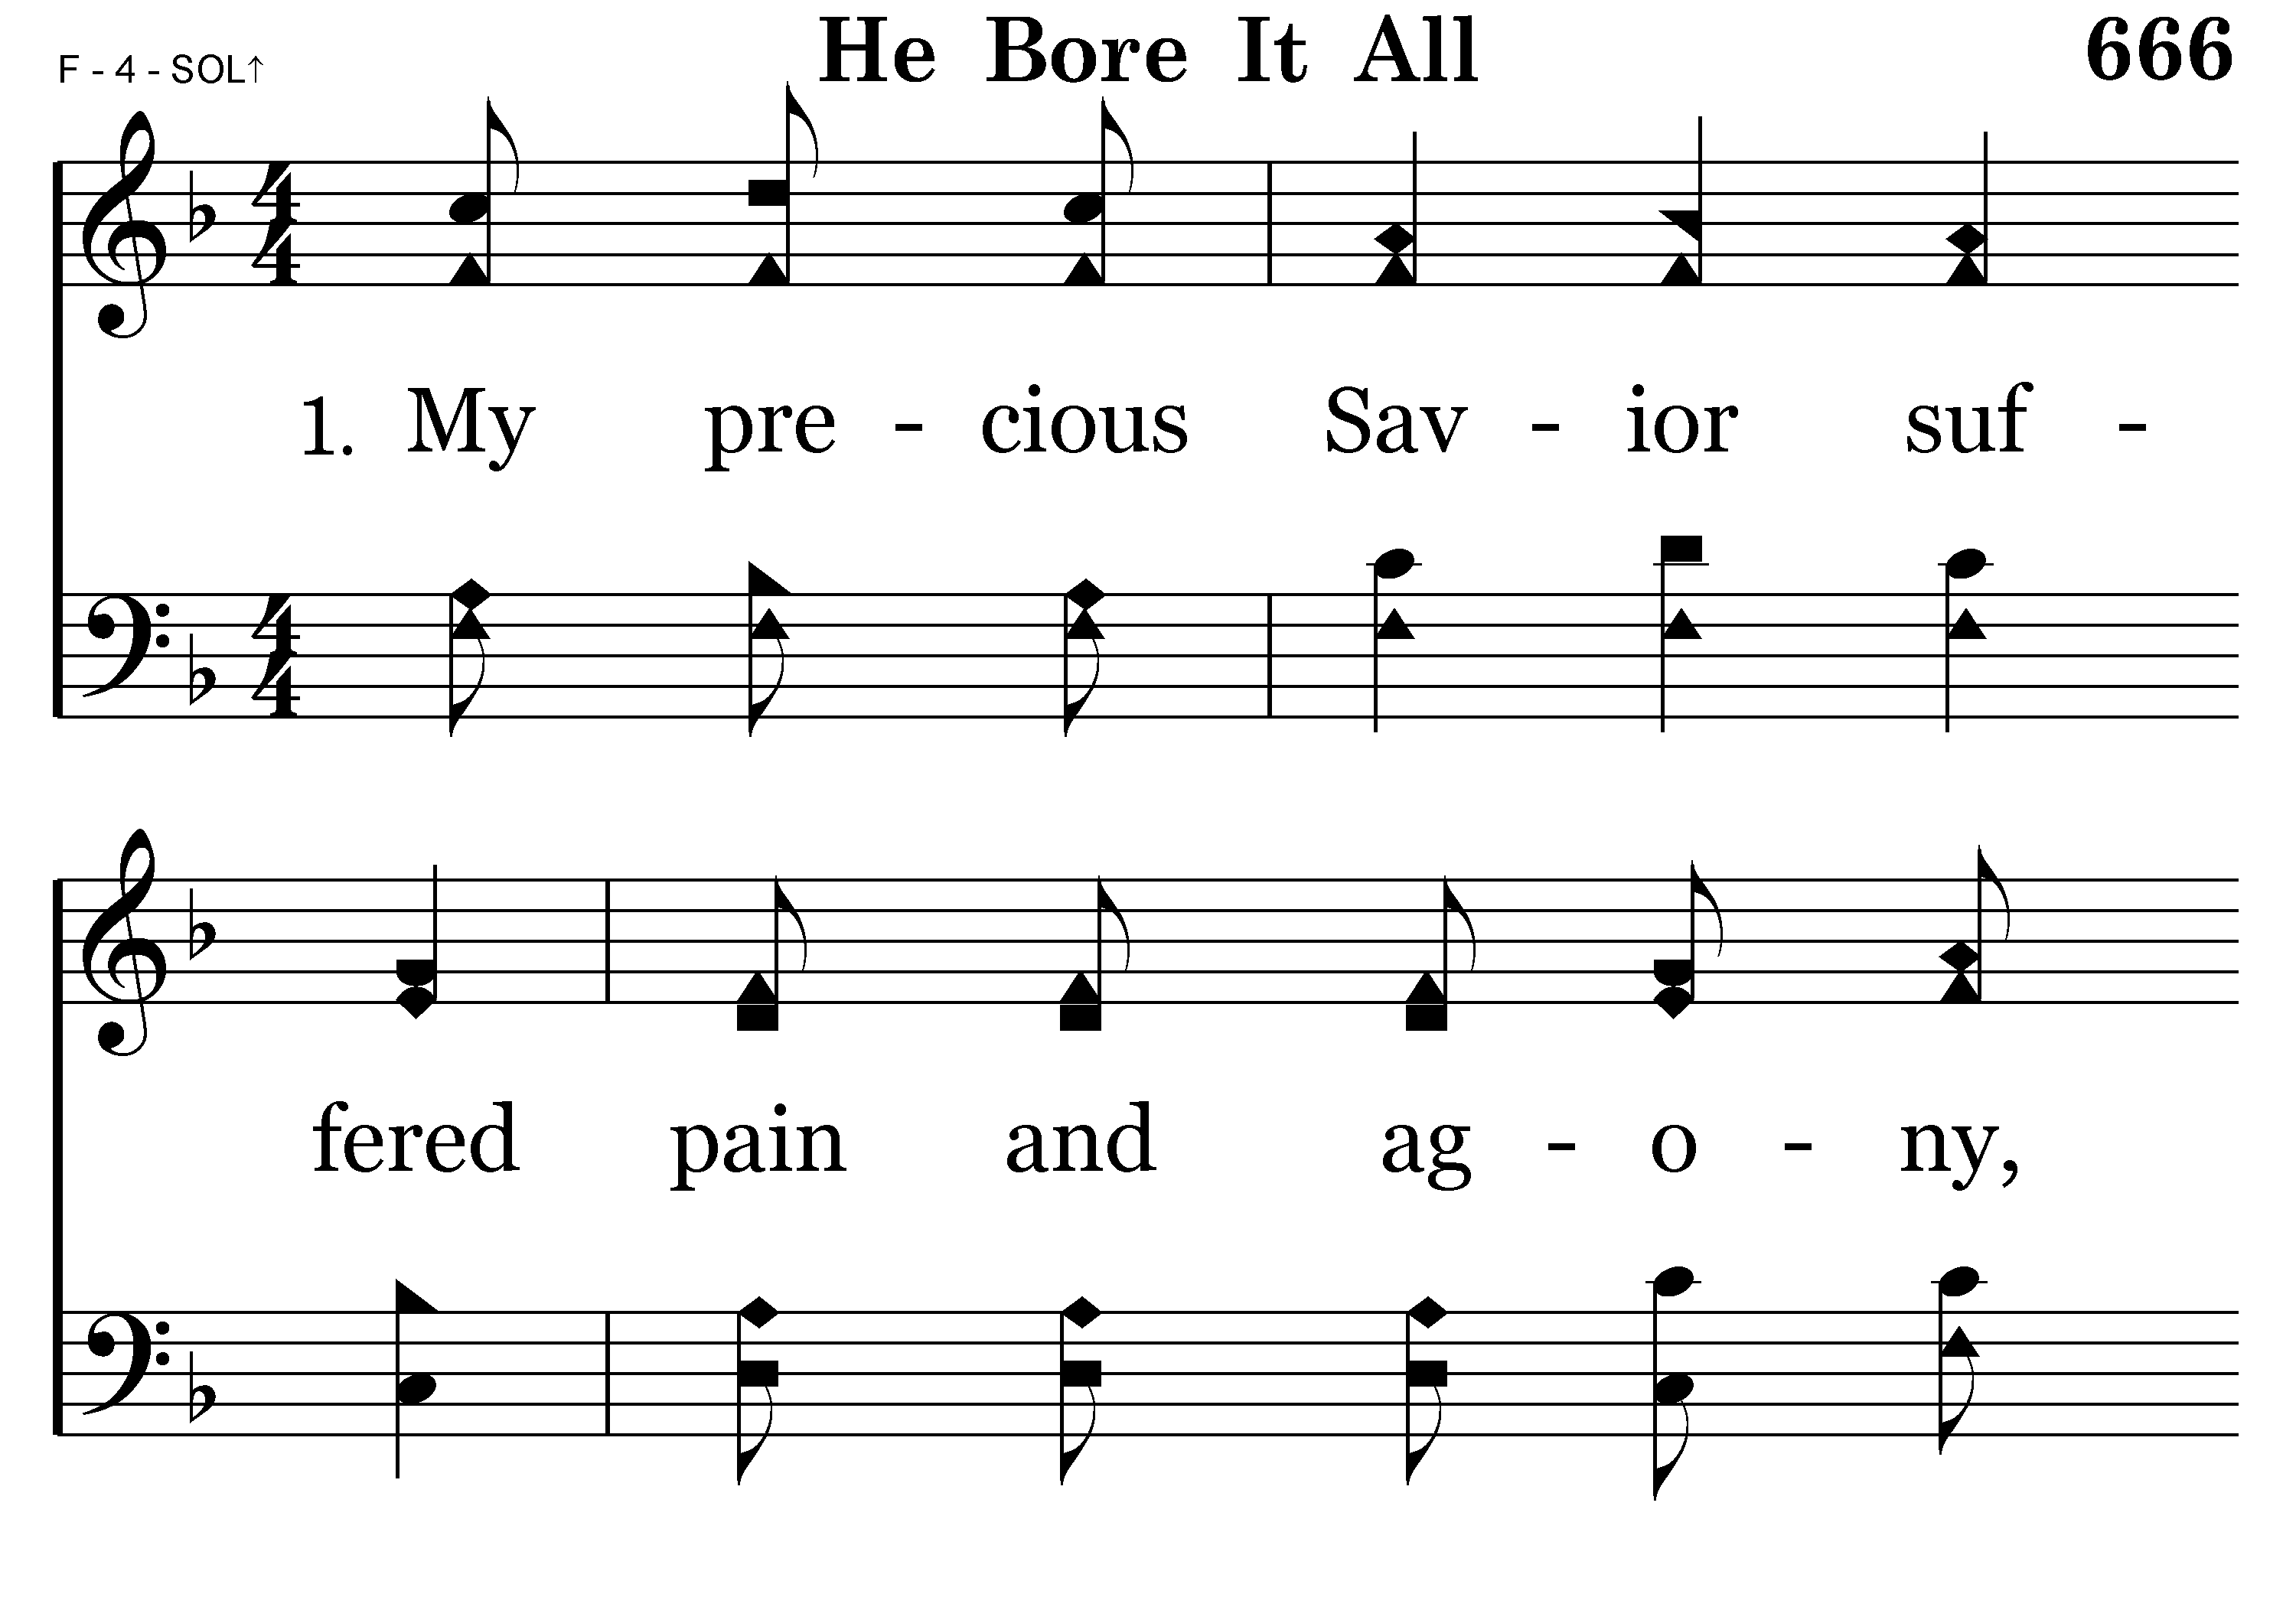
666 - He Bore It All - 1.1

Slide 73
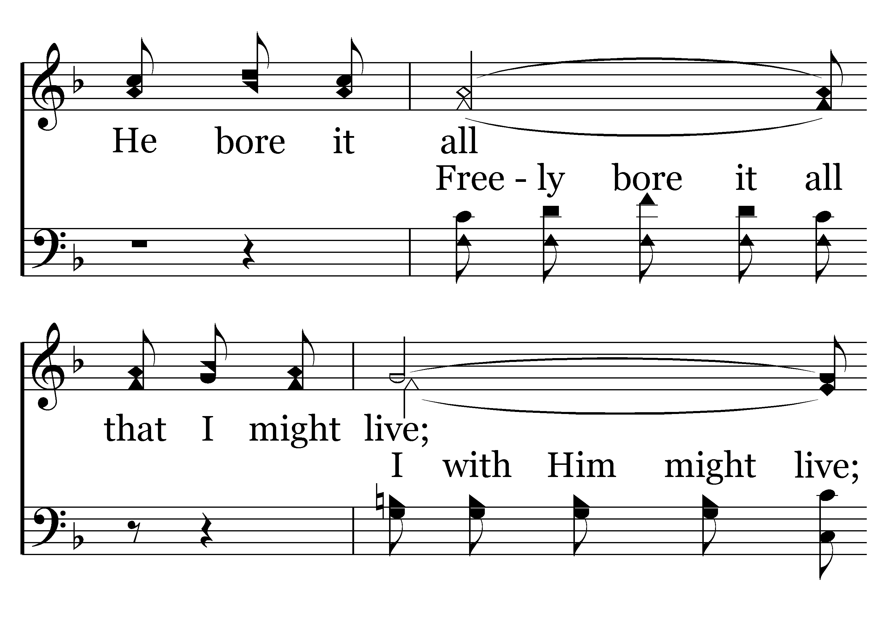
666 - He Bore It All - 1.2

Slide 74
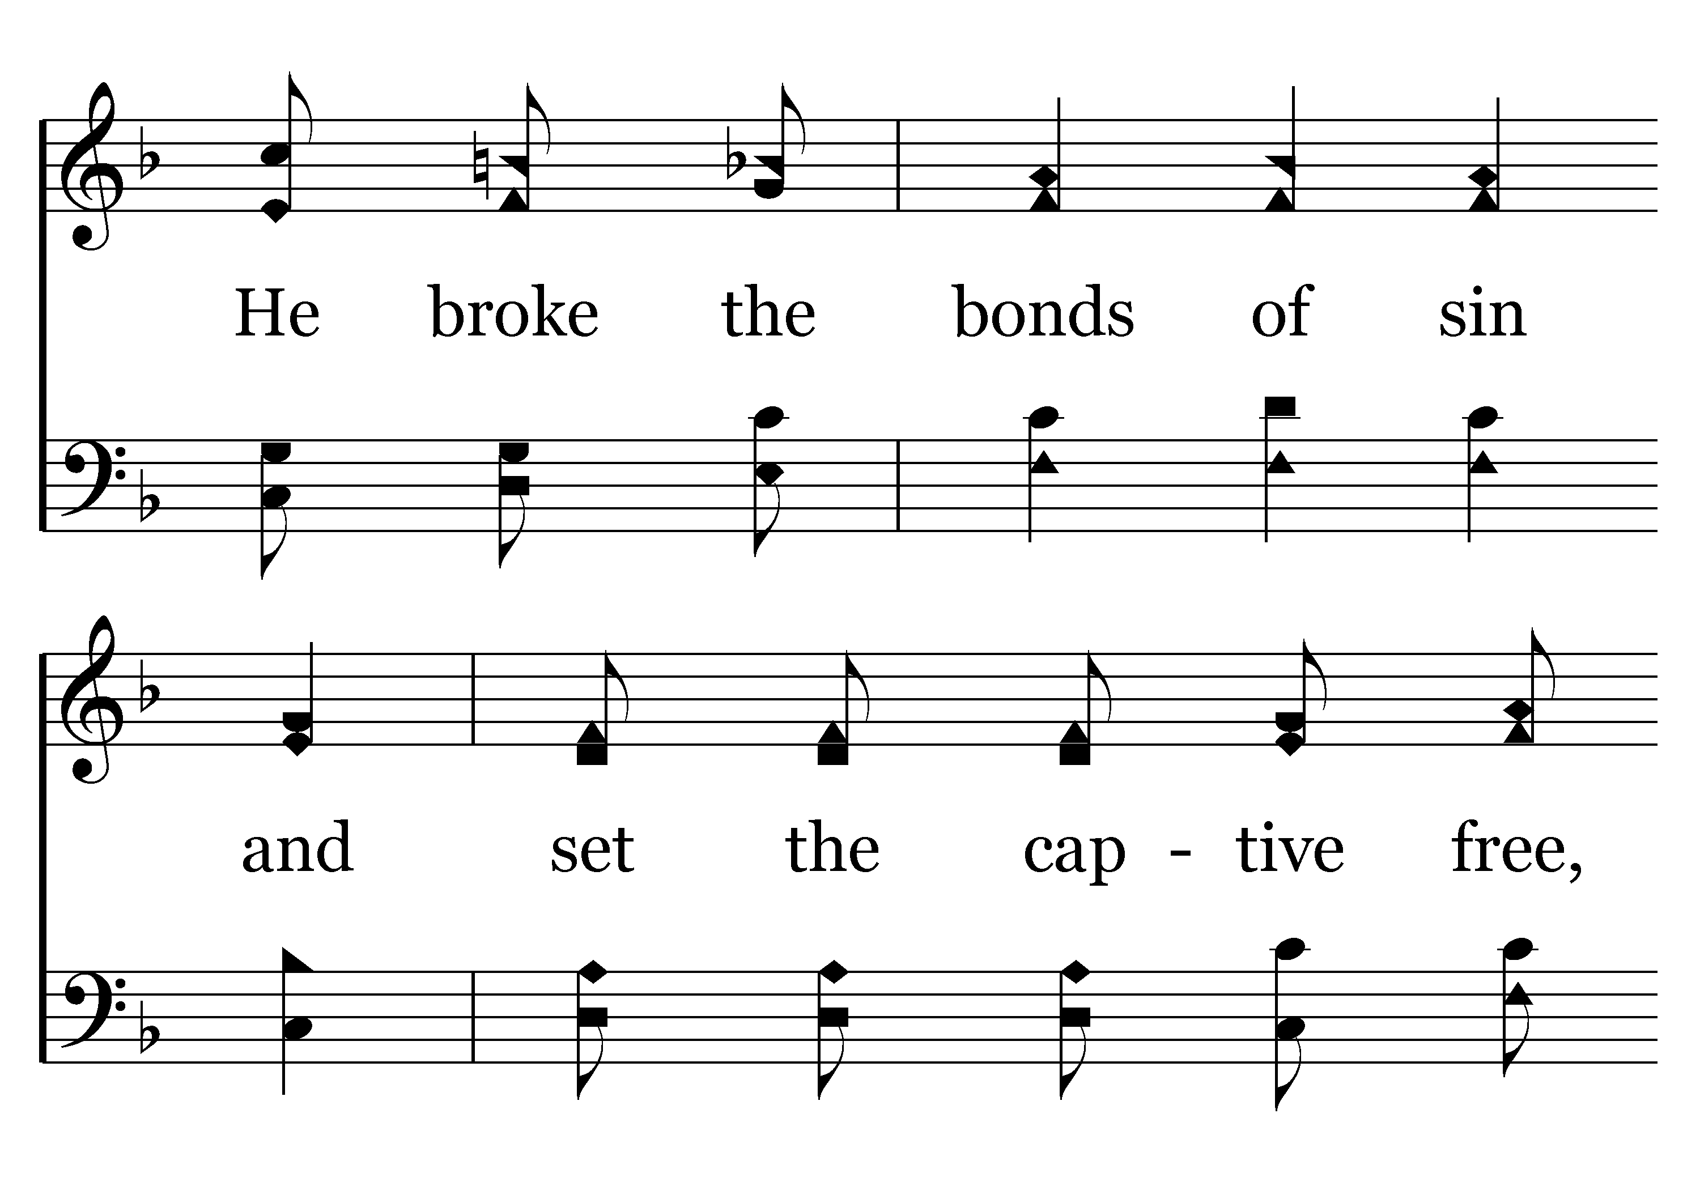
666 - He Bore It All - 1.3

Slide 75
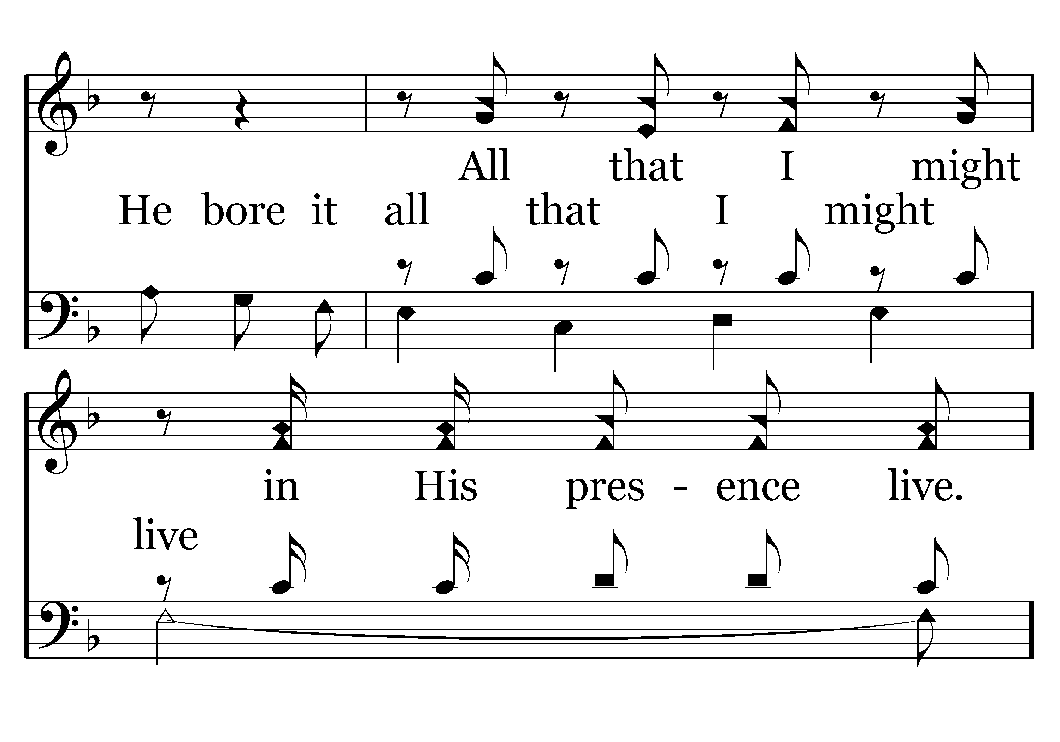
666 - He Bore It All - 1.4

Slide 76

666 - He Bore It All - C.1

Slide 77

666 - He Bore It All - C.2

Slide 78

666 - He Bore It All - C.3

Slide 79

666 - He Bore It All - C.4
End of Verse 1

Slide 80

666 - He Bore It All - 2.1

Slide 81

666 - He Bore It All - 2.2

Slide 82

666 - He Bore It All - 2.3

Slide 83

666 - He Bore It All - 2.4

Slide 84
666 - He Bore It All - C.1

Slide 85
666 - He Bore It All - C.2

Slide 86
666 - He Bore It All - C.3

Slide 87
666 - He Bore It All - C.4
End of Verse 2

Slide 88

666 - He Bore It All - 3.1

Slide 89

666 - He Bore It All - 3.2

Slide 90

666 - He Bore It All - 3.3

Slide 91
666 - He Bore It All - 3.4

Slide 92
666 - He Bore It All - C.1

Slide 93
666 - He Bore It All - C.2

Slide 94
666 - He Bore It All - C.3

Slide 95
666 - He Bore It All - C.4
End of Song

Slide 97

TODAY’S TEXT
CHUCK REPASS
1 COR 15:12-19

Slide 98
1 Cor 15:12-19 But if it is preached that Christ has been raised from the dead, how can some of you say that there is no resurrection of the dead? 13 If there is no resurrection of the dead, then not even Christ has been raised. 14 And if Christ has not been raised, our preaching is useless and so is your faith. 15 More than that, we are then found to be false witnesses about God, for we have testified about God that he raised Christ from the dead. But he did not raise him if in fact the dead are not raised. 16 For if the dead are not raised, then Christ has not been raised either. 17 And if Christ has not been raised, your faith is futile; you are still in your sins. 18 Then those also who have fallen asleep in Christ are lost. 19 If only for this life we have hope in Christ, we are to be pitied more than all men. NIV

Slide 99
INVITATION SONG
#344
WHO AT MY DOOR IS STANDING?

Slide 100


Slide 101


Slide 102

THE EVIDENCE OF CHRIST’S RESURRECTION IS ABUNDANT
EVIDENCE FROM THE SCRIPTURE
THE EMPTY TOMB
1 Cor 15:3-8 For what I received I passed on to you as of first importance: that Christ died for our sins according to the Scriptures, 4 that he was buried, that he was raised on the third day according to the Scriptures, 5 and that he appeared to Peter, and then to the Twelve. 6 After that, he appeared to more than five hundred of the brothers at the same time, most of whom are still living, though some have fallen asleep. 7 Then he appeared to James, then to all the apostles, 8 and last of all he appeared to me also, as to one abnormally born.

Slide 103
THE EVIDENCE OF CHRIST’S RESURRECTION IS ABUNDANT
EVIDENCE FROM THE SCRIPTURE
THE EMPTY TOMB
1 Cor 15:3-8 For what I received I passed on to you as of first importance: that Christ died for our sins according to the Scriptures, 4 that he was buried, that he was raised on the third day according to the Scriptures, 5 and that he appeared to Peter, and then to the Twelve. 6 After that, he appeared to more than five hundred of the brothers at the same time, most of whom are still living, though some have fallen asleep. 7 Then he appeared to James, then to all the apostles, 8 and last of all he appeared to me also, as to one abnormally born.

Slide 104
THE EVIDENCE OF CHRIST’S RESURRECTION IS ABUNDANT
EVIDENCE FROM THE SCRIPTURE
THE EMPTY TOMB
1 Cor 15:3-8 For what I received I passed on to you as of first importance: that Christ died for our sins according to the Scriptures, 4 that he was buried, that he was raised on the third day according to the Scriptures, 5 and that he appeared to Peter, and then to the Twelve. 6 After that, he appeared to more than five hundred of the brothers at the same time, most of whom are still living, though some have fallen asleep. 7 Then he appeared to James, then to all the apostles, 8 and last of all he appeared to me also, as to one abnormally born.

Slide 105
THE EVIDENCE OF CHRIST’S RESURRECTION IS ABUNDANT
EVIDENCE FROM THE SCRIPTURE
THE EMPTY TOMB
1 Cor 15:3-8 For what I received I passed on to you as of first importance: that Christ died for our sins according to the Scriptures, 4 that he was buried, that he was raised on the third day according to the Scriptures, 5 and that he appeared to Peter, and then to the Twelve. 6 After that, he appeared to more than five hundred of the brothers at the same time, most of whom are still living, though some have fallen asleep. 7 Then he appeared to James, then to all the apostles, 8 and last of all he appeared to me also, as to one abnormally born.

Slide 106
THE EVIDENCE OF CHRIST’S RESURRECTION IS ABUNDANT
EVIDENCE FROM THE SCRIPTURE
THE EMPTY TOMB
1 Cor 15:3-8 For what I received I passed on to you as of first importance: that Christ died for our sins according to the Scriptures, 4 that he was buried, that he was raised on the third day according to the Scriptures, 5 and that he appeared to Peter, and then to the Twelve. 6 After that, he appeared to more than five hundred of the brothers at the same time, most of whom are still living, though some have fallen asleep. 7 Then he appeared to James, then to all the apostles, 8 and last of all he appeared to me also, as to one abnormally born.

Slide 107
WE ARE NOT GOING TO ARGUE A DEFENSE OF THE RESURRECTION
THE EVIDENCE SUPPORTS IT THE WITNESSES TESTIFY IT’S REALITY
1ST WITNESS – PETER
2ND WITNESS – THE 12 APOSTLES
3RD WITNESSES – OVER 500 BRETHREN
4TH WITNESS – JAMES
5TH WITNESS – THE APOSTLE PAUL

Slide 108


Slide 109
I. IF CHRIST IS NOT RISEN PREACHING IS USELESS
1 Cor 15:14 And if Christ has not been raised, our preaching is useless
IT MAY BE THAT PREACHING IS USELESS MOST OF THE TIME

Slide 110
I. IF CHRIST IS NOT RISEN PREACHING IS USELESS
James 1:22-25 Do not merely listen to the word, and so deceive yourselves. Do what it says. 23 Anyone who listens to the word but does not do what it says is like a man who looks at his face in a mirror 24 and, after looking at himself, goes away and immediately forgets what he looks like. 25 But the man who looks intently into the perfect law that gives freedom, and continues to do this, not forgetting what he has heard, but doing it — he will be blessed in what he does.

Slide 111
I. IF CHRIST IS NOT RISEN PREACHING IS USELESS
WE ARE PRETTY GOOD LISTENERS BUT POOR DOERS
WE OFTEN DO NOT RESPOND TO GOD’S WORD
WE MAY NOT EVEN HEAR WHAT IS BEING PREACHED
BUT EVEN IF WE DO WE OFTEN DO NOTHING ABOUT IT

Slide 112
II. IF CHRIST IS NOT RISEN OUR FAITH IS WORTHLESS
James 2:14-15 What good is it, my brothers, if a man claims to have faith but has no deeds? Can such faith save him?
17 In the same way, faith by itself, if it is not accompanied by action, is dead.
18 But someone will say, "You have faith; I have deeds."
Show me your faith without deeds, and I will show you my faith by what I do.
26 As the body without the spirit is dead, so faith without deeds is dead.

Slide 113
II. IF CHRIST IS NOT RISEN OUR FAITH IS WORTHLESS
OUR FAITH MUST MAKE A DIFFERENCE IN OUR LIVES
WHAT WE DO
HOW WE LIVE
BUT IF CHRIST WAS NOT RAISED – ALL THE FAITH IN THE WORLD MEANS NOTHING – IT IS USELESS

Slide 114
II. IF CHRIST IS NOT RISEN OUR FAITH IS WORTHLESS
OUR FAITH MUST MAKE A DIFFERENCE IN OUR LIVES
WHAT WE DO
HOW WE LIVE

Slide 115
II. IF CHRIST IS NOT RISEN OUR FAITH IS WORTHLESS
Rom 6:1-4 What shall we say, then? Shall we go on sinning so that grace may increase? 2 By no means! We died to sin; how can we live in it any longer? 3 Or don't you know that all of us who were baptized into Christ Jesus were baptized into his death? 4 We were therefore buried with him through baptism into death in order that, just as Christ was raised from the dead through the glory of the Father, we too may live a new life.

Slide 116
II. IF CHRIST IS NOT RISEN OUR FAITH IS WORTHLESS
Rom 6:1-4 What shall we say, then? Shall we go on sinning so that grace may increase? 2 By no means! We died to sin; how can we live in it any longer? 3 Or don't you know that all of us who were baptized into Christ Jesus were baptized into his death? 4 We were therefore buried with him through baptism into death in order that, just as Christ was raised from the dead through the glory of the Father, we too may live a new life.
IF CHRIST WAS NOT RAISED OUR FAITH IS WORTHLESS
IF OUR LIVES ARE NOT CHANGED OUR FAITH US WORTHLESS

Slide 117
III. IF CHRIST IS NOT RISEN WE ARE STILL IN OUR SINS
1 Cor 15:17 And if Christ has not been raised, your faith is futile; you are still in your sins.
PAUL HAS PAINTED A VERY DEVESTATING PICTURE:
VAIN PREACHING
WORTHLESS FAITH
BUT THERE IS SOMETHING WORSE

Slide 118
III. IF CHRIST IS NOT RISEN WE ARE STILL IN OUR SINS
THERE IS NO HOPE FOR ETERNAL SALVATION
THE LIFE OF CHRIST
THE MINISTRY OF CHRIST
THE SUFFERING OF CHRIST
THE DEATH OF CHRIST
IS ALL MEANINGLESS
WE WOULD ALL BE HOPELESSLY LOST

Slide 119
III. IF CHRIST IS NOT RISEN WE ARE STILL IN OUR SINS
A CHRISTIAN WOULD BE NO BETTER THAN A NON-CHRISTIAN
1 Cor 15:18 Then those also who have fallen asleep in Christ are lost.
WHAT IS YOUR GREATEST SIN?
DON’T WORRY ABOUT IT – INDULGE YOURSELF
IF CHRIST DID NOT RISE IT DOESN’T MATTER

Slide 120
III. IF CHRIST IS NOT RISEN WE ARE STILL IN OUR SINS
A CHRISTIAN WOULD BE NO BETTER THAN A NON-CHRISTIAN
1 Cor 15:18 Then those also who have fallen asleep in Christ are lost.
WHAT IS YOUR GREATEST SIN?
DON’T WORRY ABOUT IT – INDULGE YOURSELF
IF CHRIST DID NOT RISE IT DOESN’T MATTER

Slide 121
IV. IF CHRIST IS NOT RISEN WE HAVE NO HOPE
1 Cor 15:19 If only for this life we have hope in Christ, we are to be pitied more than all men.
PAUL IS SAYING WE MUST HAVE HOPE IN THINGS OTHER THAN THIS LIFE
CHRIST’S RESURRECTION GIVES US HOPE
THE RESURRECTION IS TO OUR FAITH WHAT WATER IS TO THE OCEAN – WHAT THE STONE IS TO THE MOUNTAIN—WHAT BLOOD IS TO OUR BODY

Slide 122
IV. IF CHRIST IS NOT RISEN WE HAVE NO HOPE
THE RESURRECTION IS THE FIRST AND FINAL WORD IN THE DICTIONARY OF GOD
IT SAYS THAT CHRIST IS THE AUTHOR AND FINISHER OF OUR FAITH

Slide 123
BUT CHRIST HAS RISEN
1 Cor 15:20 But Christ has indeed been raised from the dead,
HE IS RISEN AND BECAUSE HE IS RISEN WE HAVE A PURPOSE IN LIFE
WE HAVE BEEN PARDONED
WE HAVE HOPE AND PEACE
WE HAVE POWER

Slide 124
BUT CHRIST HAS RISEN
1 Cor 15:20 But Christ has indeed been raised from the dead,
BECAUSE HE IS RISEN WE HAVE CAUSE TO PRAISE HIS WORTHY NAME
1 Cor 15:54-57 "Death has been swallowed up in victory." 55 "Where, O death, is your victory? Where, O death, is your sting?"
56 The sting of death is sin, and the power of sin is the law. 57 But thanks be to God! He gives us the victory through our Lord Jesus Christ.

Slide 126

344 - Who At My Door Is Standing - Title

Slide 127

344 - Who At My Door Is Standing - 1.1

Slide 128

344 - Who At My Door Is Standing - 1.2

Slide 129

344 - Who At My Door Is Standing - C.1

Slide 130

344 - Who At My Door Is Standing - C.2
End of Verse 1

Slide 131

344 - Who At My Door Is Standing - 2.1

Slide 132

344 - Who At My Door Is Standing - 2.2

Slide 133
344 - Who At My Door Is Standing - C.1

Slide 134
344 - Who At My Door Is Standing - C.2
End of Verse 2

Slide 135

344 - Who At My Door Is Standing - 3.1

Slide 136

344 - Who At My Door Is Standing - 3.2

Slide 137
344 - Who At My Door Is Standing - C.1

Slide 138
344 - Who At My Door Is Standing - C.2
End of Song

Slide 140


Slide 142

CLOSING PRAYER
CHUCK REPASS

Slide 143

TOM ANDRICK

Slide 144
THANK YOU FOR VISITING WITH US
PLEASE COME BACK

