Slide 1
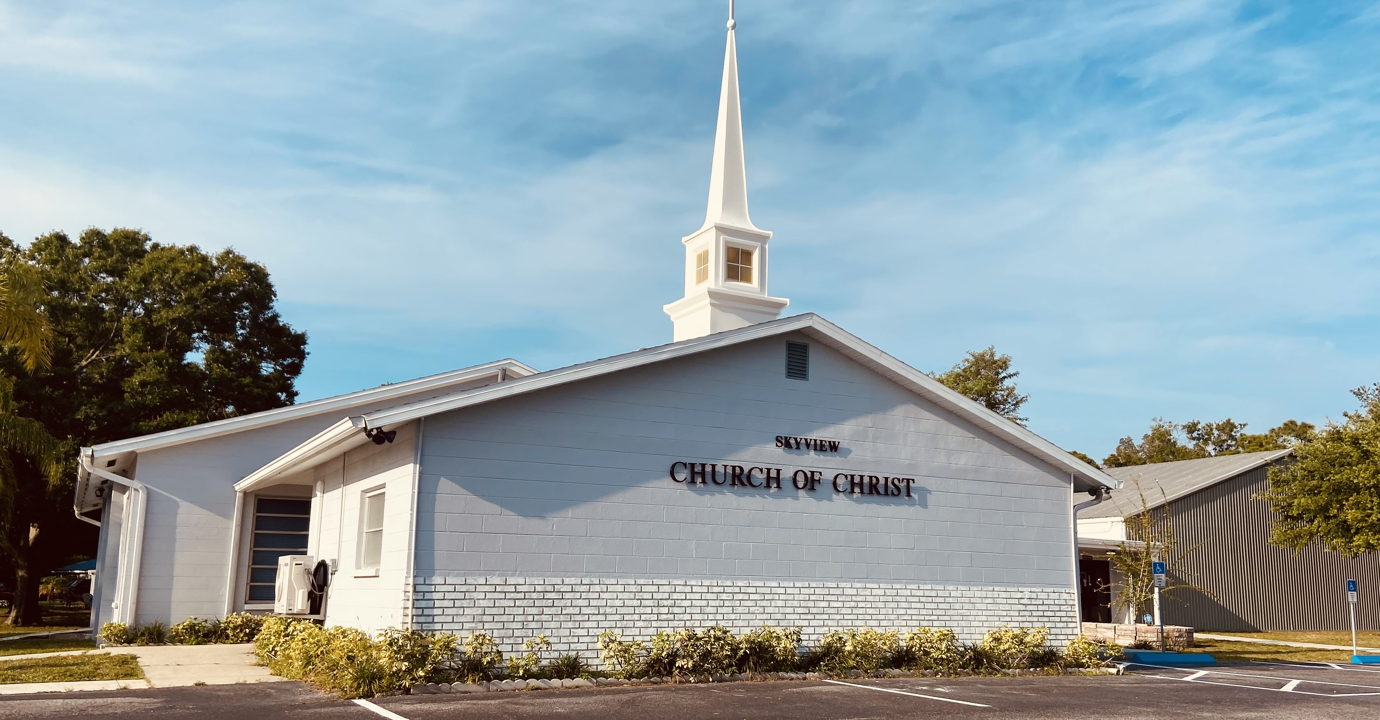
WELCOME TO OUR SERVICES

Slide 2
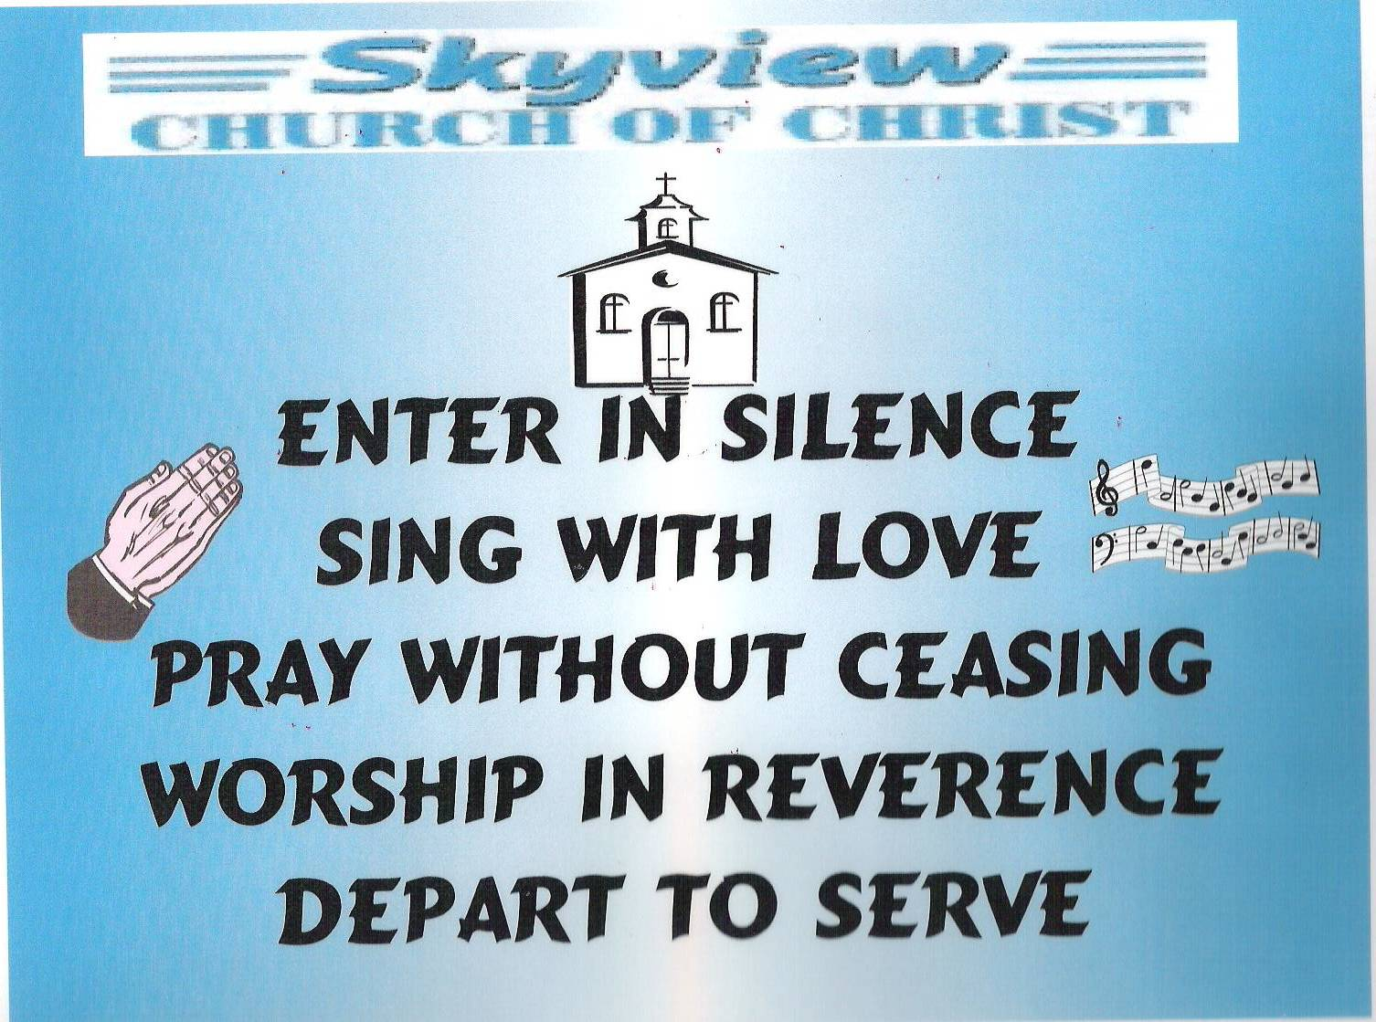
DESIGNED BY JIM INGRAM

Slide 3
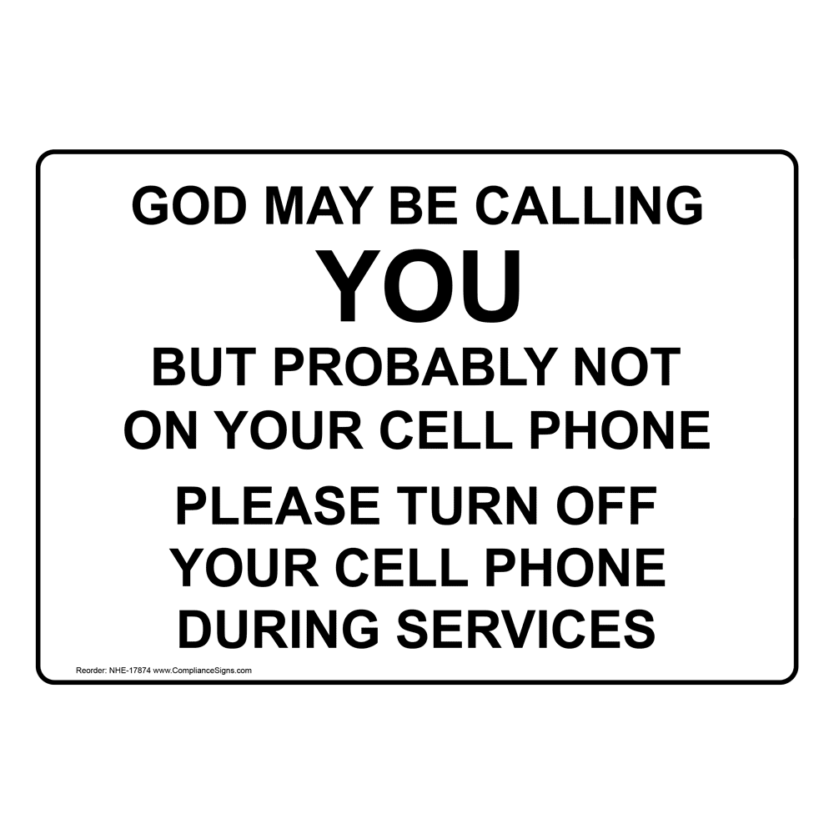

Slide 4


Slide 5

SUNDAY – 9:30 AM
MONDAY BIBLE STUDY – 6:30 PM IN WEST ANNEX
WEDNESDAY BIBLE STUDY – 7:00 PM IN WEST ANNEX
W.I.N.G.S. LADIES CLASS THURSDAY– 10 AM IN WEST ANNEX

Slide 6
TODAY’S WORSHIP LEADERS
CALL TO WORSHIP
PRAYER
SONG LEADER
SCRIPTURE
HEADING TABLE
SERMON
CLOSING PRAYER
ANNOUNCEMENTS
Joe Dryer
Brad VanHaerents
Sander Fletcher
Pat Skidmore
Steve Harrell
Charles Murray
Jerry Mellish
Jim Ingram

Slide 7

MONDAY NIGHT BIBLE STUDY 6:30PM will meet in the West Annex
WEDNESDAY BIBLE STUDY will meet in the West Annex until further notice
LADIES BIBLE CLASS W.I.N.G.S (Women In God’s Service) Thursday 10:00 AM – meets in the West Annex

Slide 8

FIVE MINUTE RULE

Slide 9


Slide 10


Slide 11
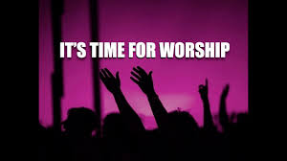

Slide 13
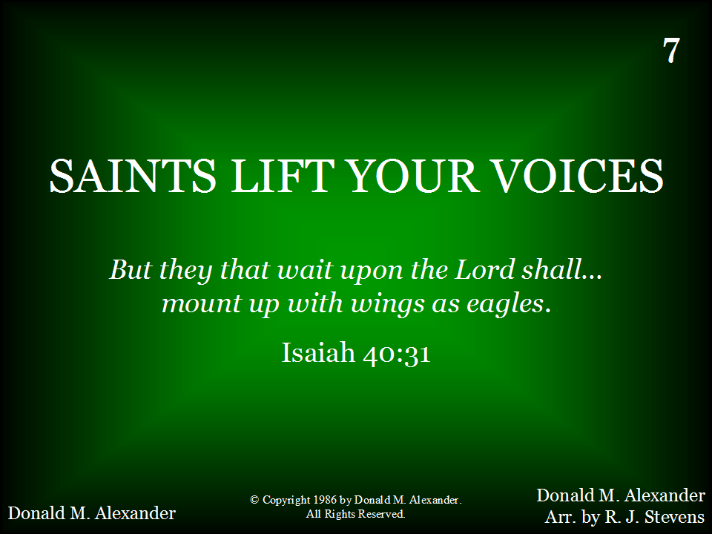
007 - Saints Lift Your Voices - Title

Slide 14
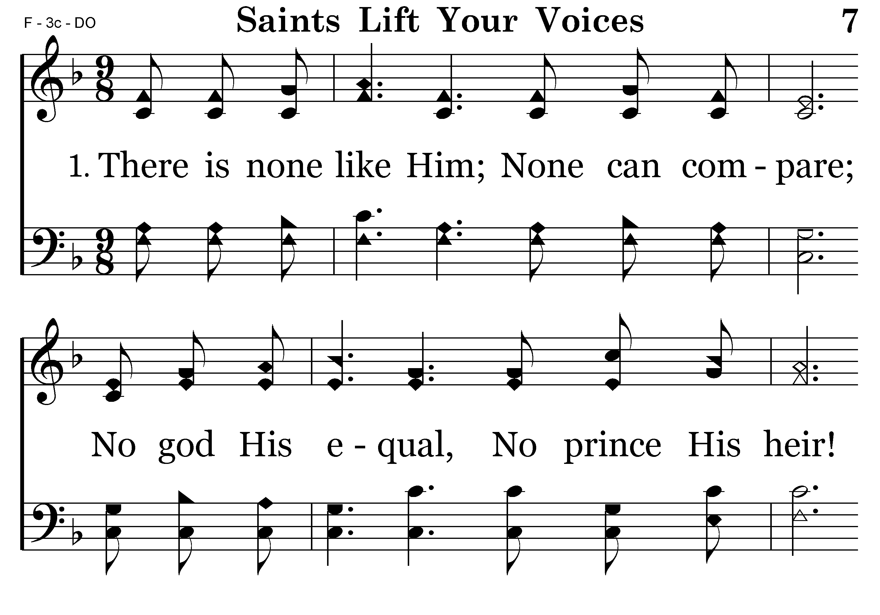
007 - Saints Lift Your Voices - 1.1

Slide 15
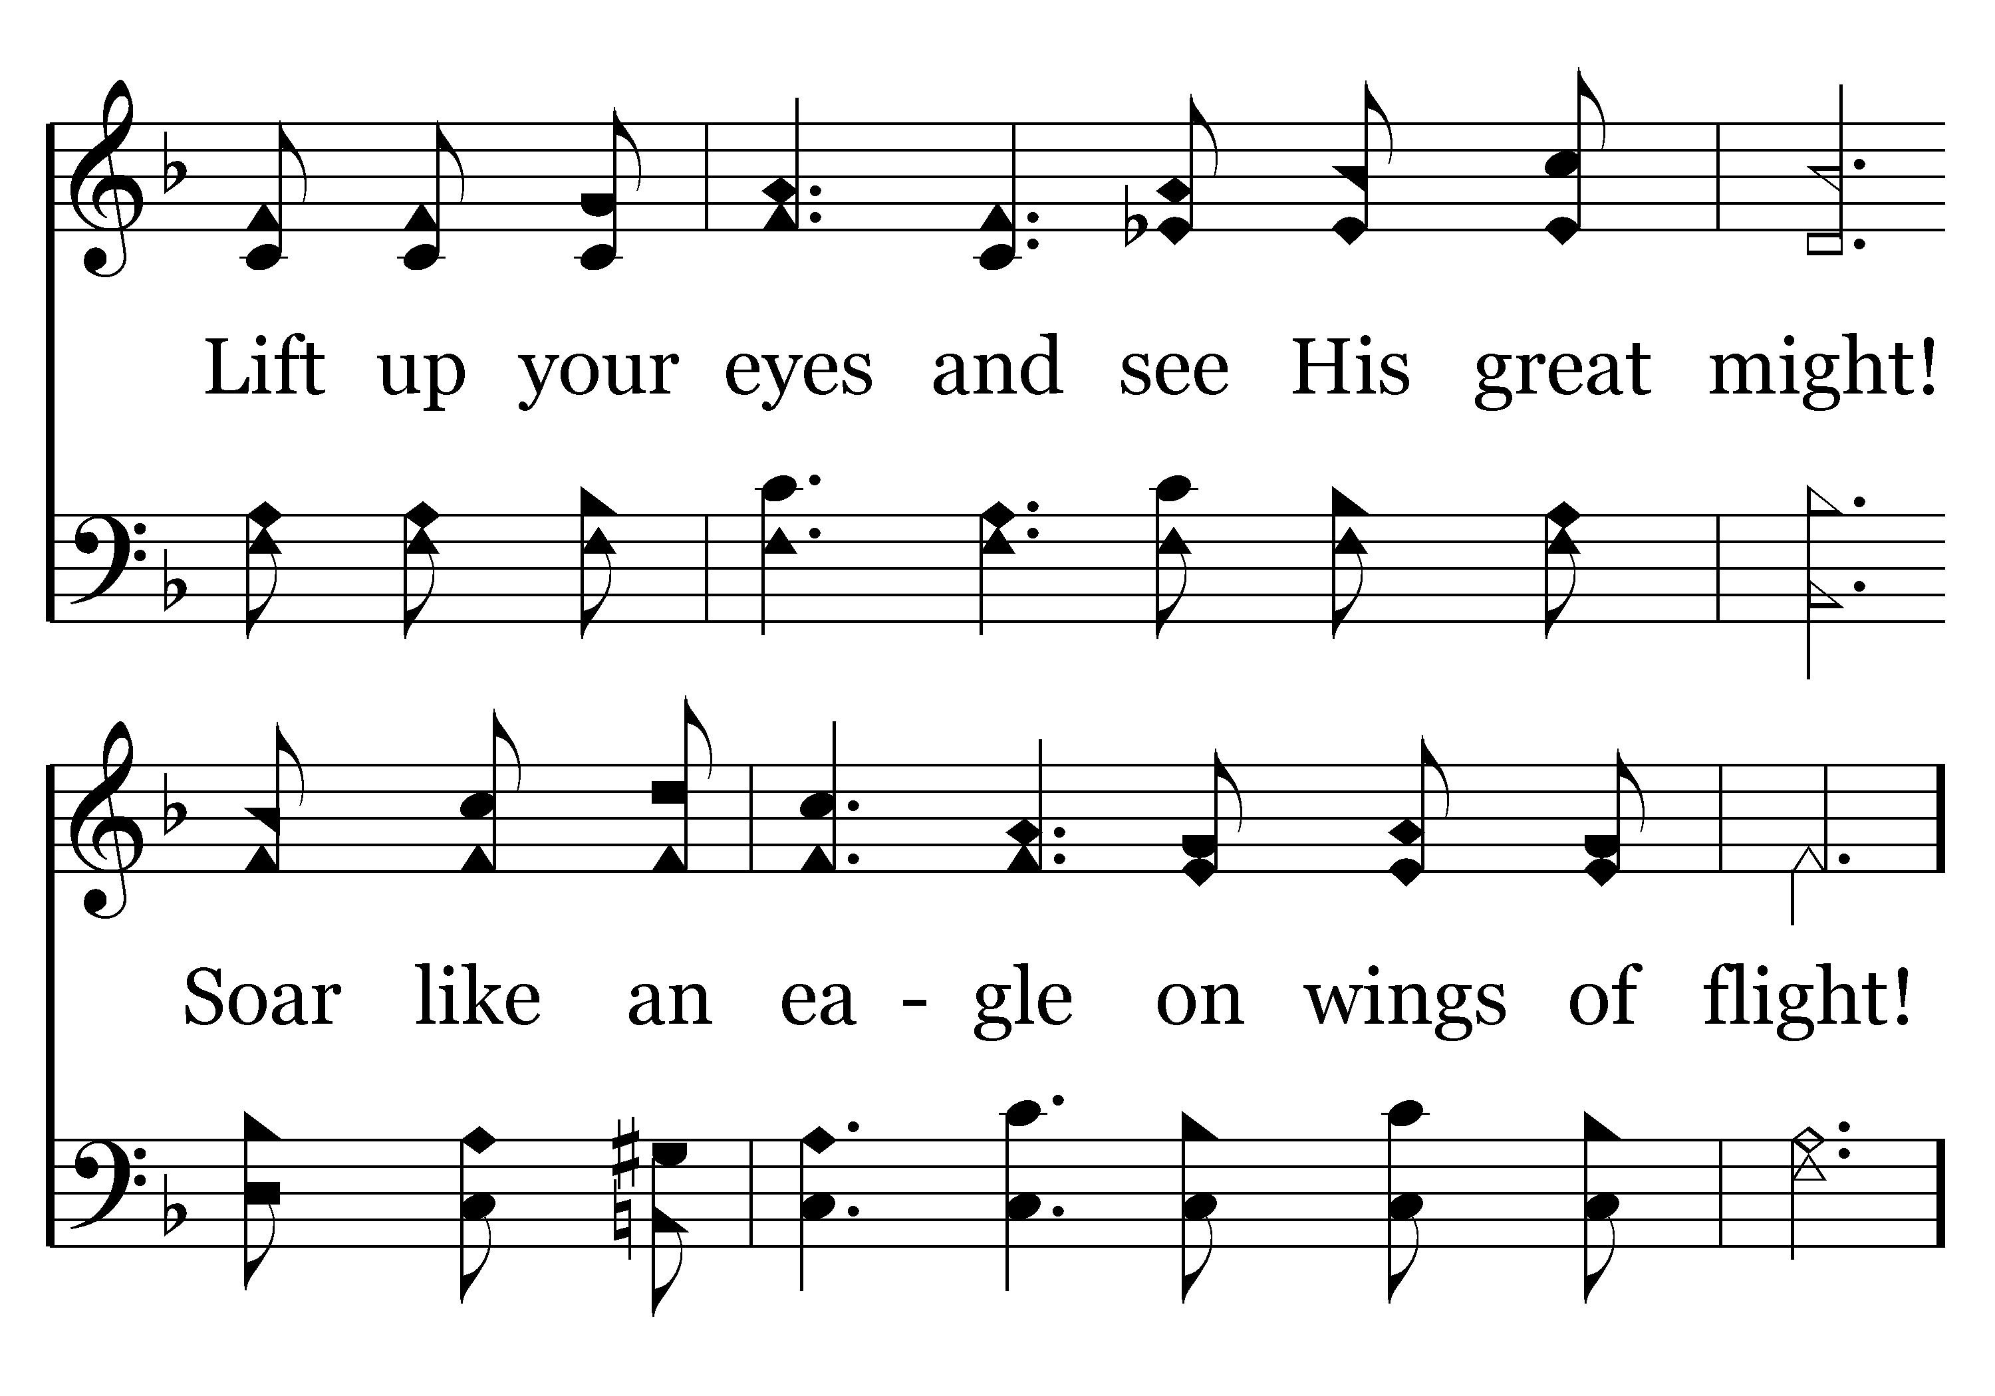
007 - Saints Lift Your Voices - 1.2
End of Verse 1
SING ALL VERSES THEN THE CHORUS

Slide 16
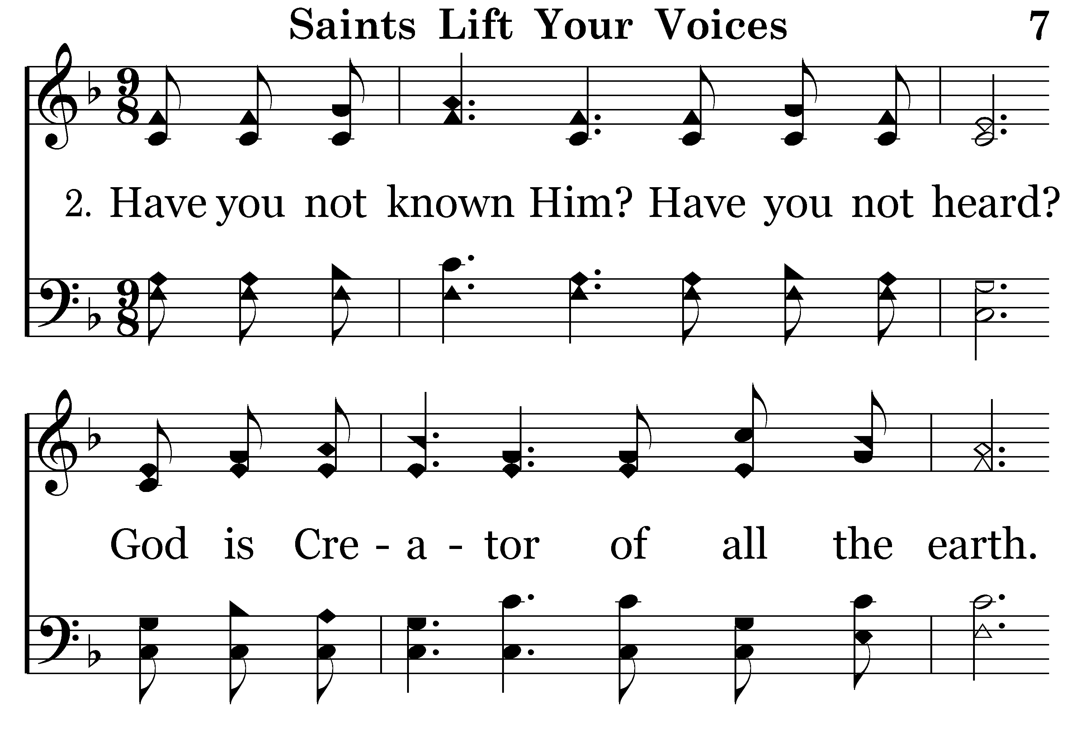
007 - Saints Lift Your Voices - 2.1

Slide 17

007 - Saints Lift Your Voices - 2.2
End of Verse 2
SING ALL VERSES THEN THE CHORUS

Slide 18
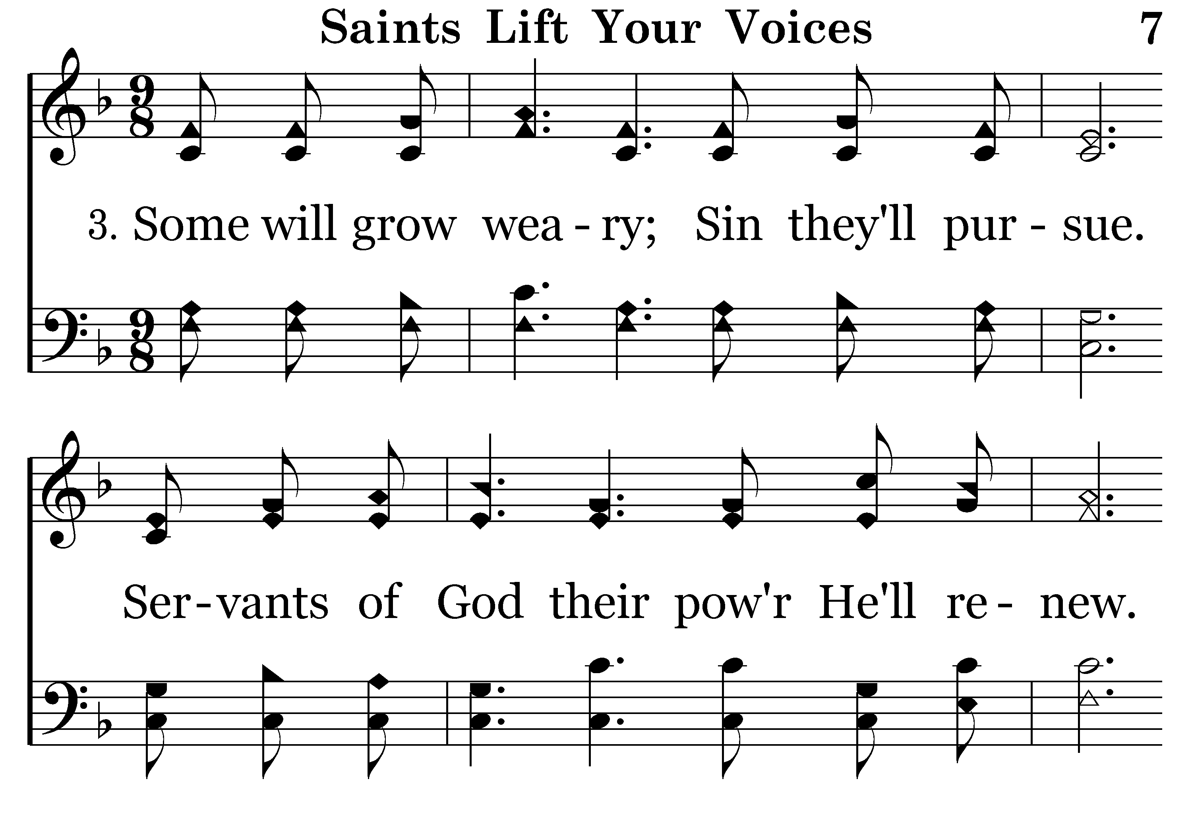
007 - Saints Lift Your Voices - 3.1

Slide 19

007 - Saints Lift Your Voices - 3.2

Slide 20
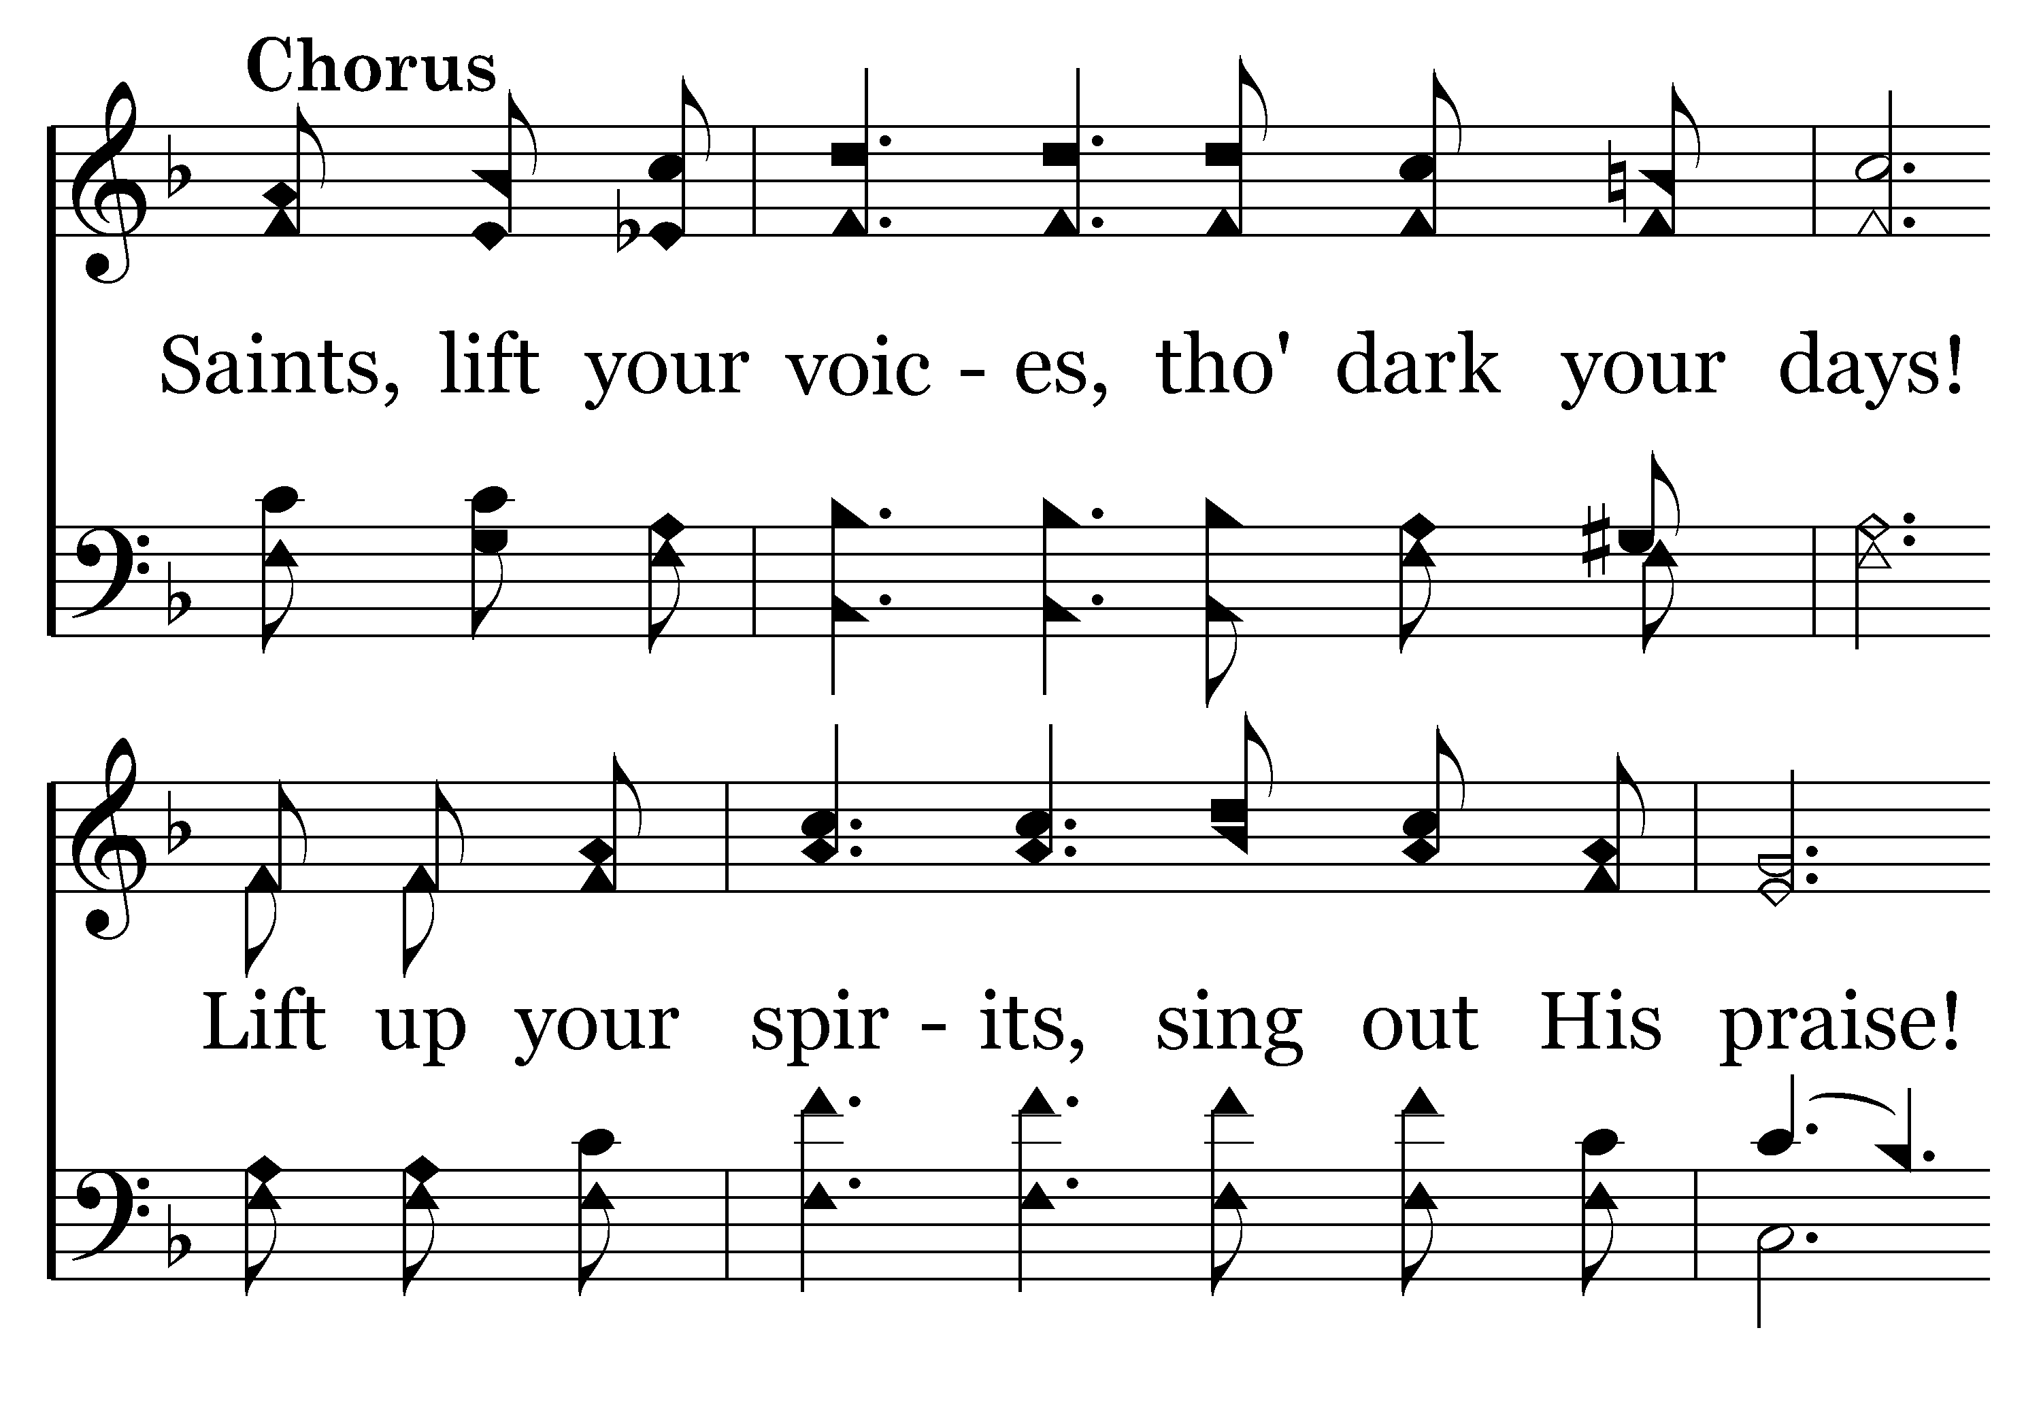
007 - Saints Lift Your Voices - C.1

Slide 21
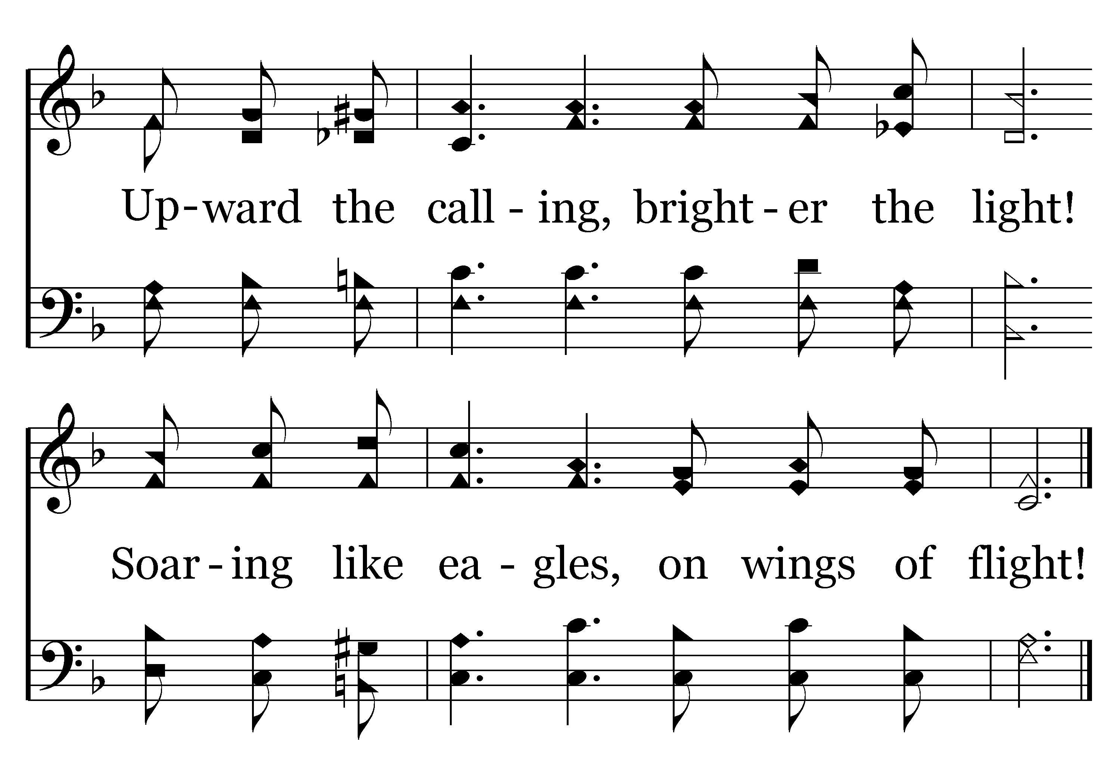
007 - Saints Lift Your Voices - C.2
End of Song

Slide 23


Slide 24
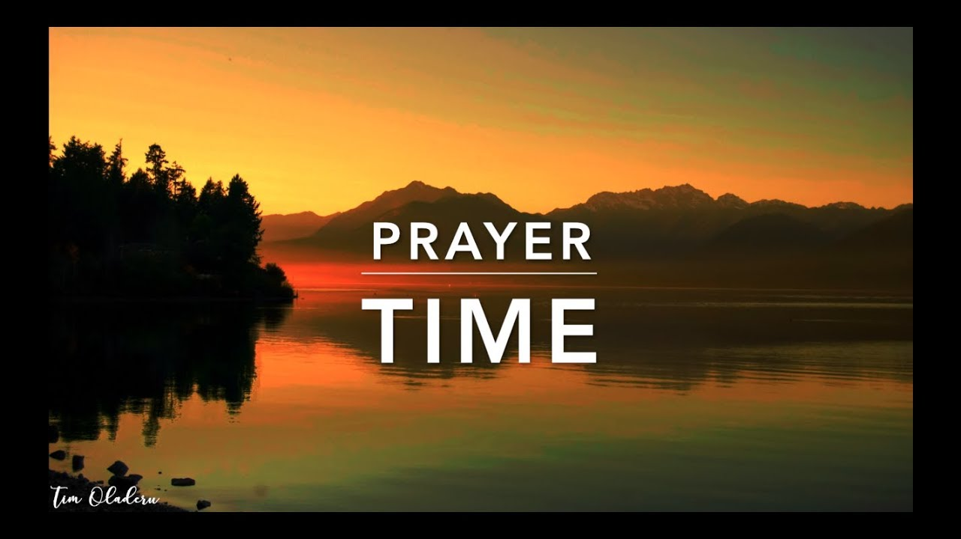
PRAYER
Jerry Mellish
LED BY CHARLES PETER

Slide 26
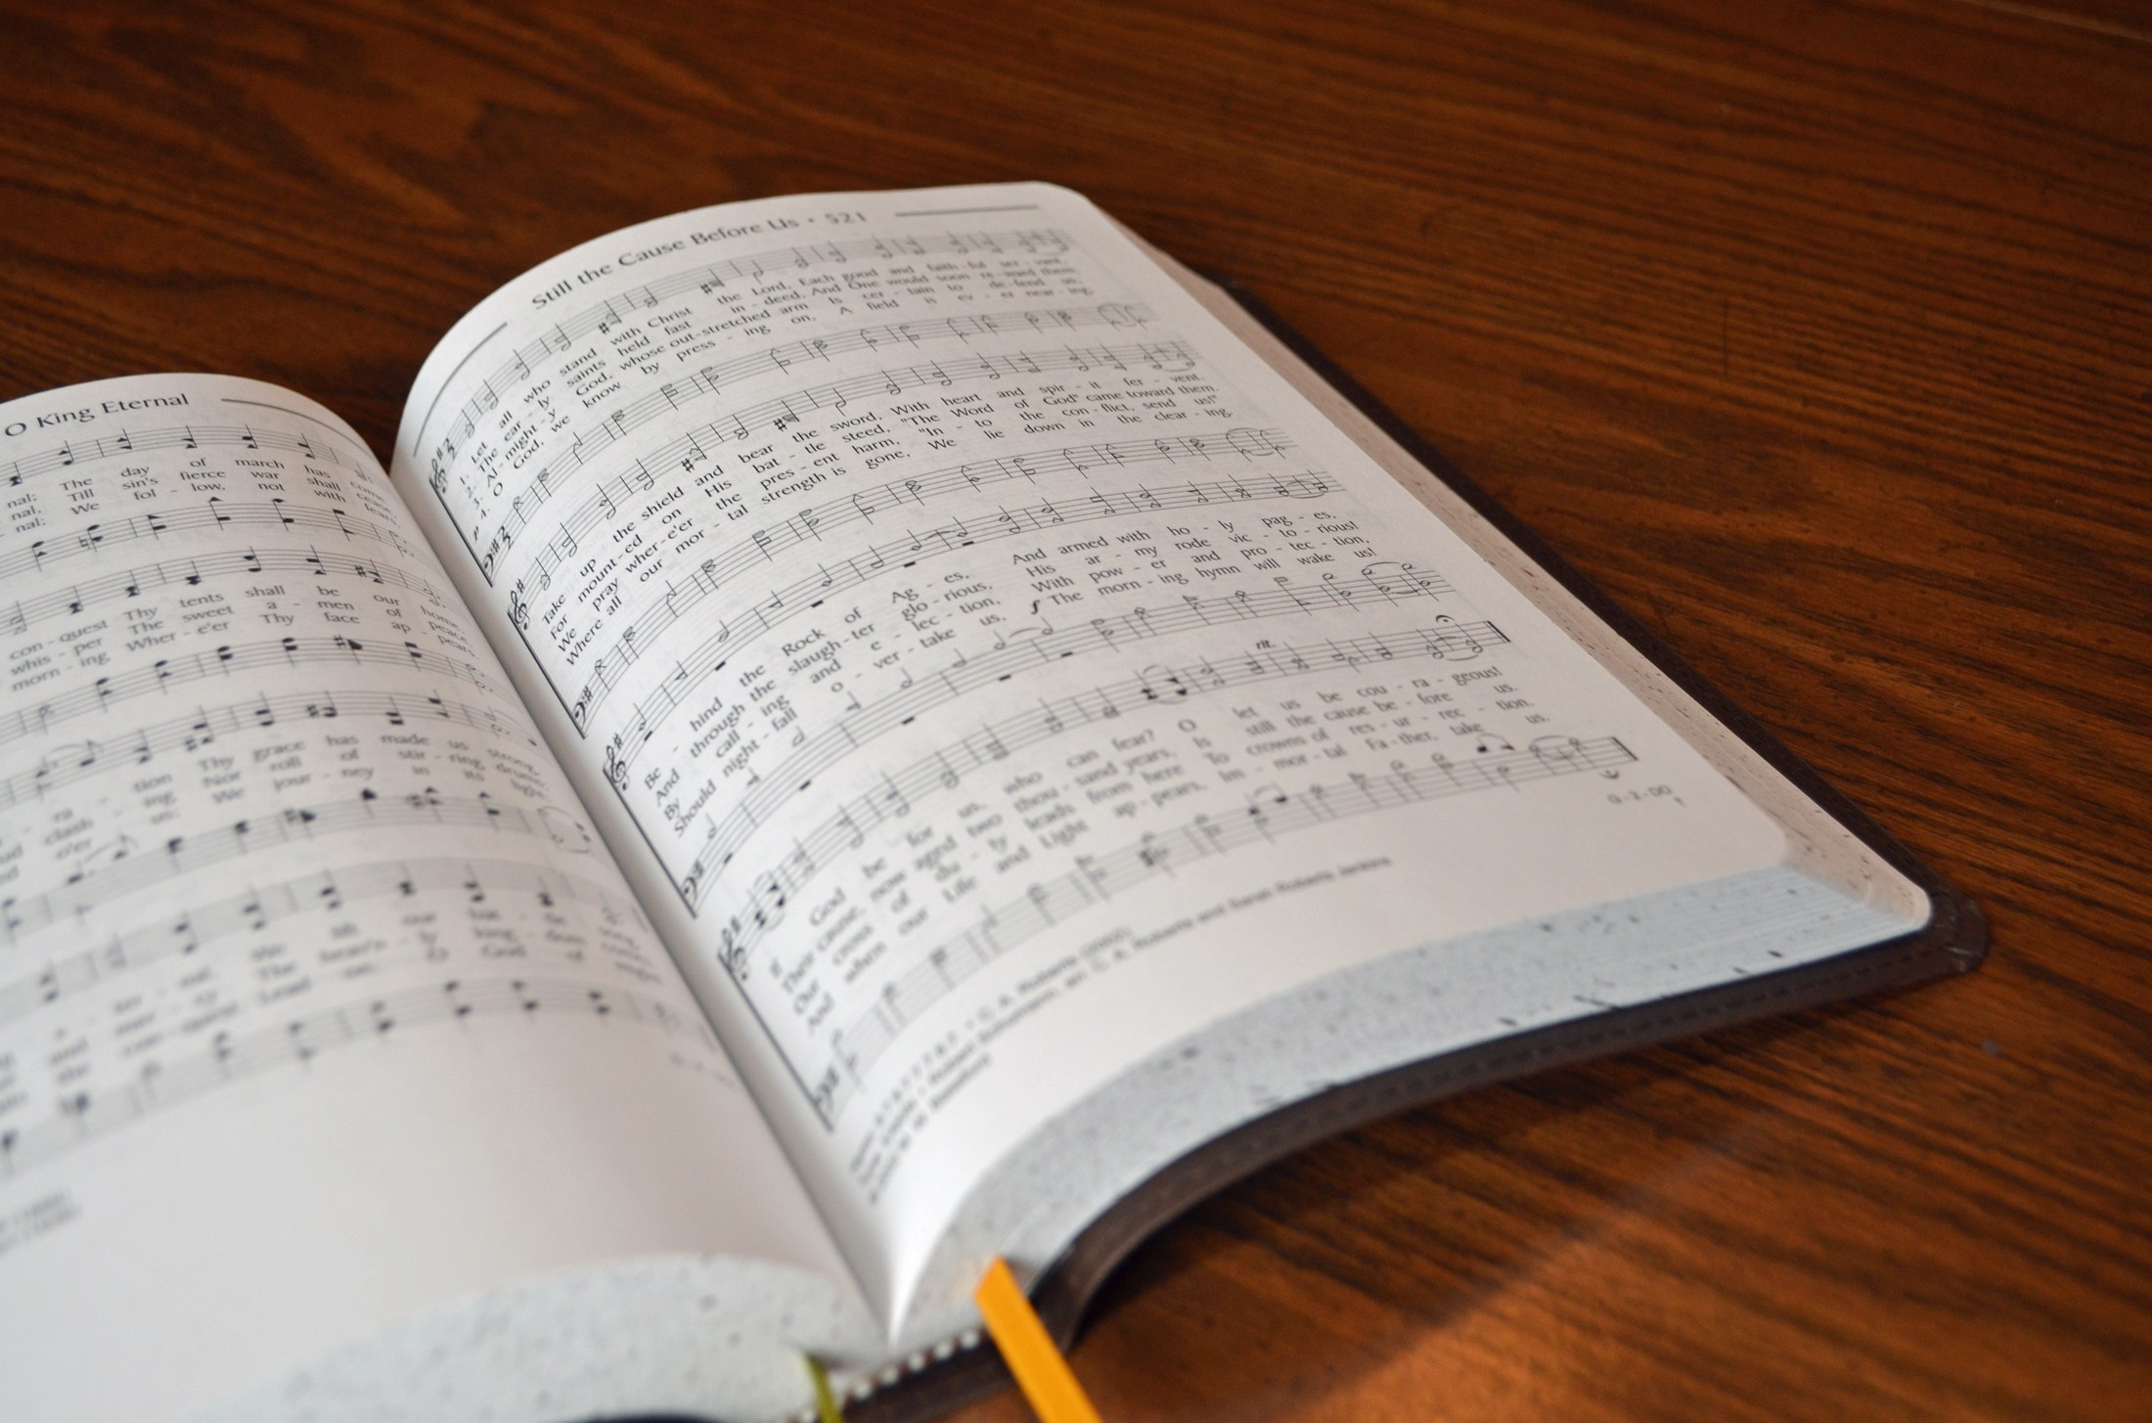
SONG LEADER
SANDER FLETCHER

Slide 27
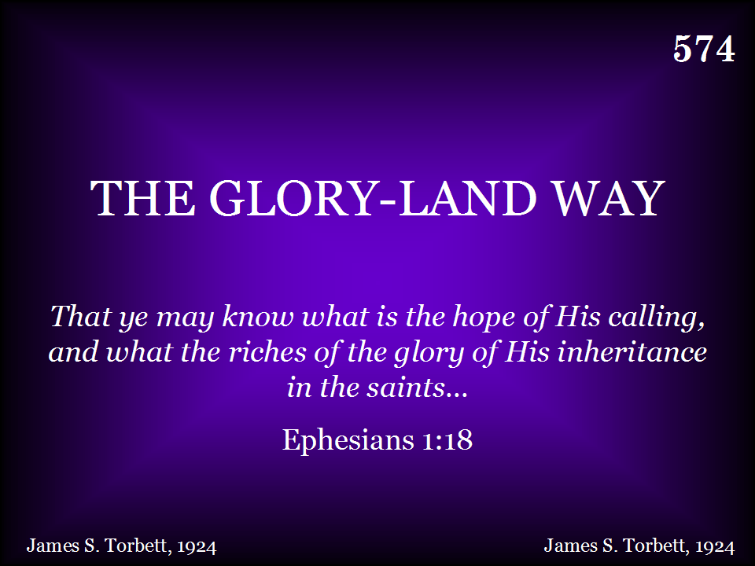
574 - The Gloryland Way - Title

Slide 28
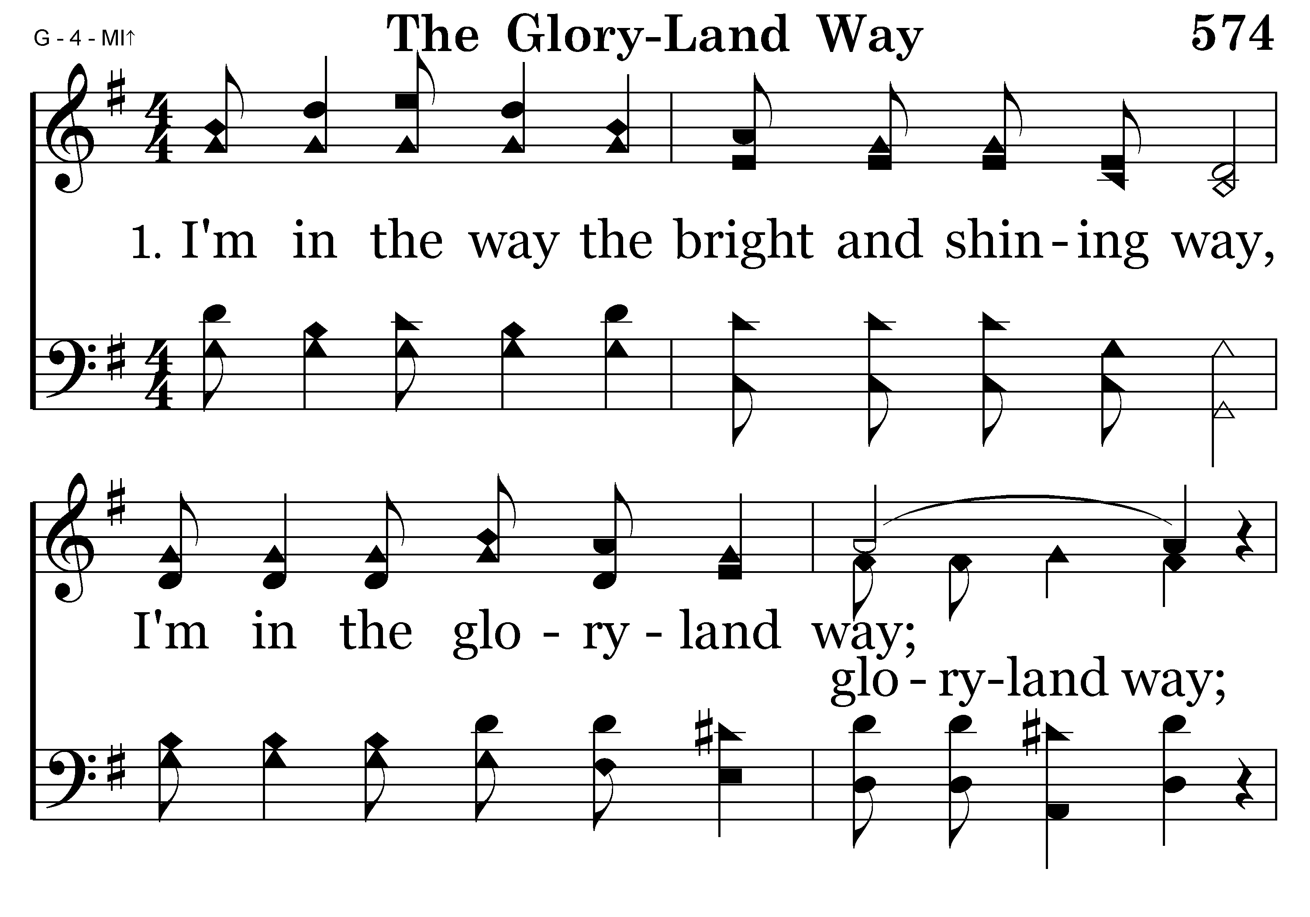
574 - The Gloryland Way - 1.1

Slide 29
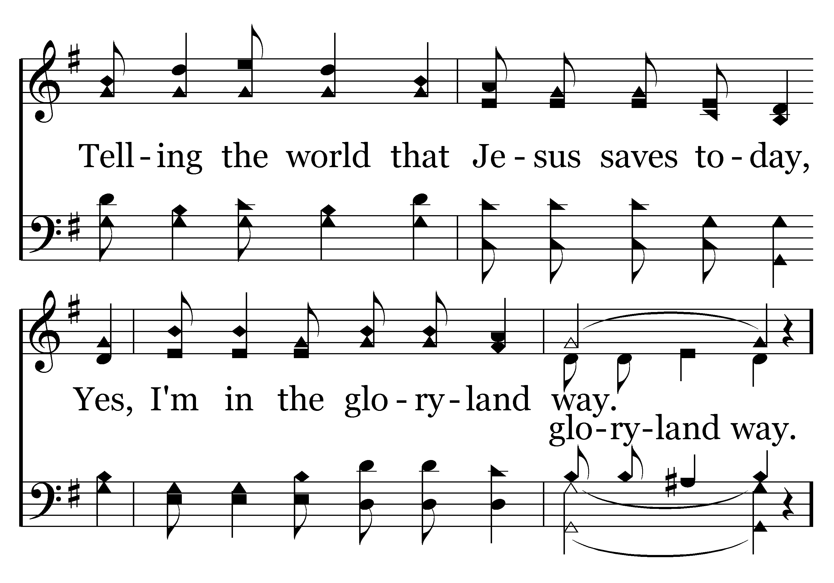
574 - The Gloryland Way - 1.2

Slide 30
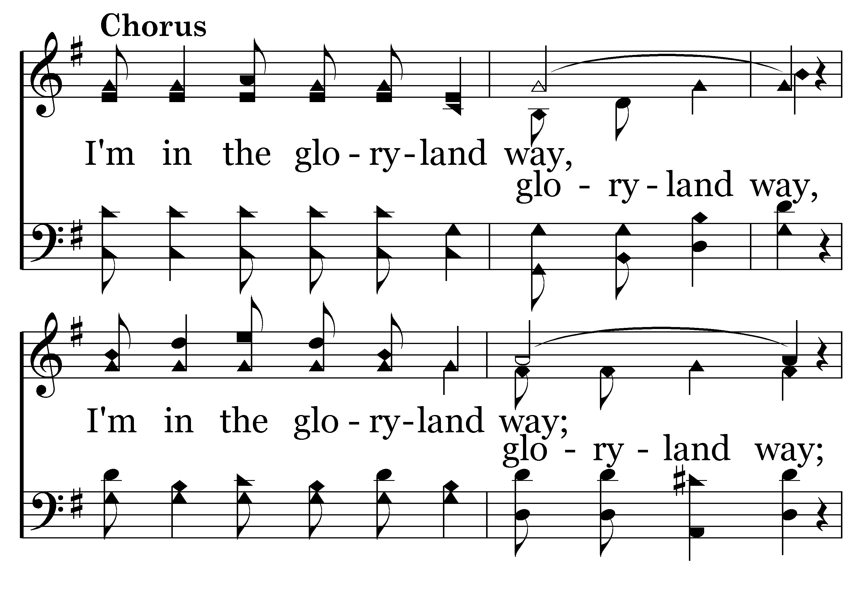
574 - The Gloryland Way - C.1

Slide 31
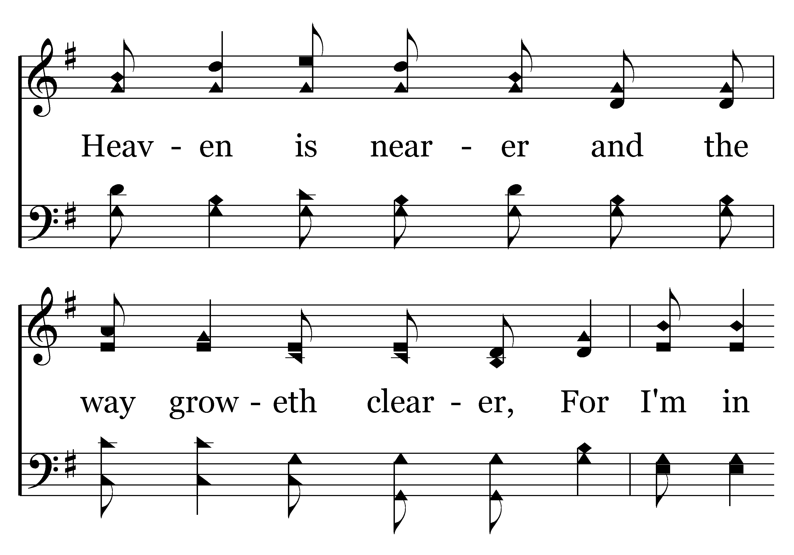
574 - The Gloryland Way - C.2

Slide 32
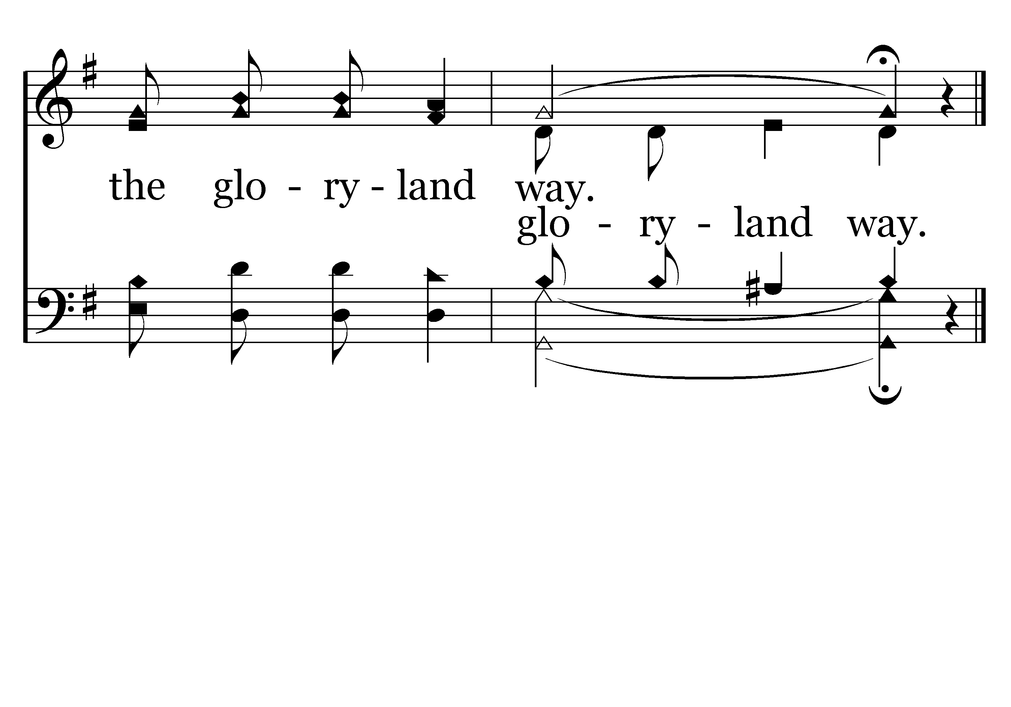
574 - The Gloryland Way - C.3
End of Verse 1

Slide 33

574 - The Gloryland Way - 2.1

Slide 34
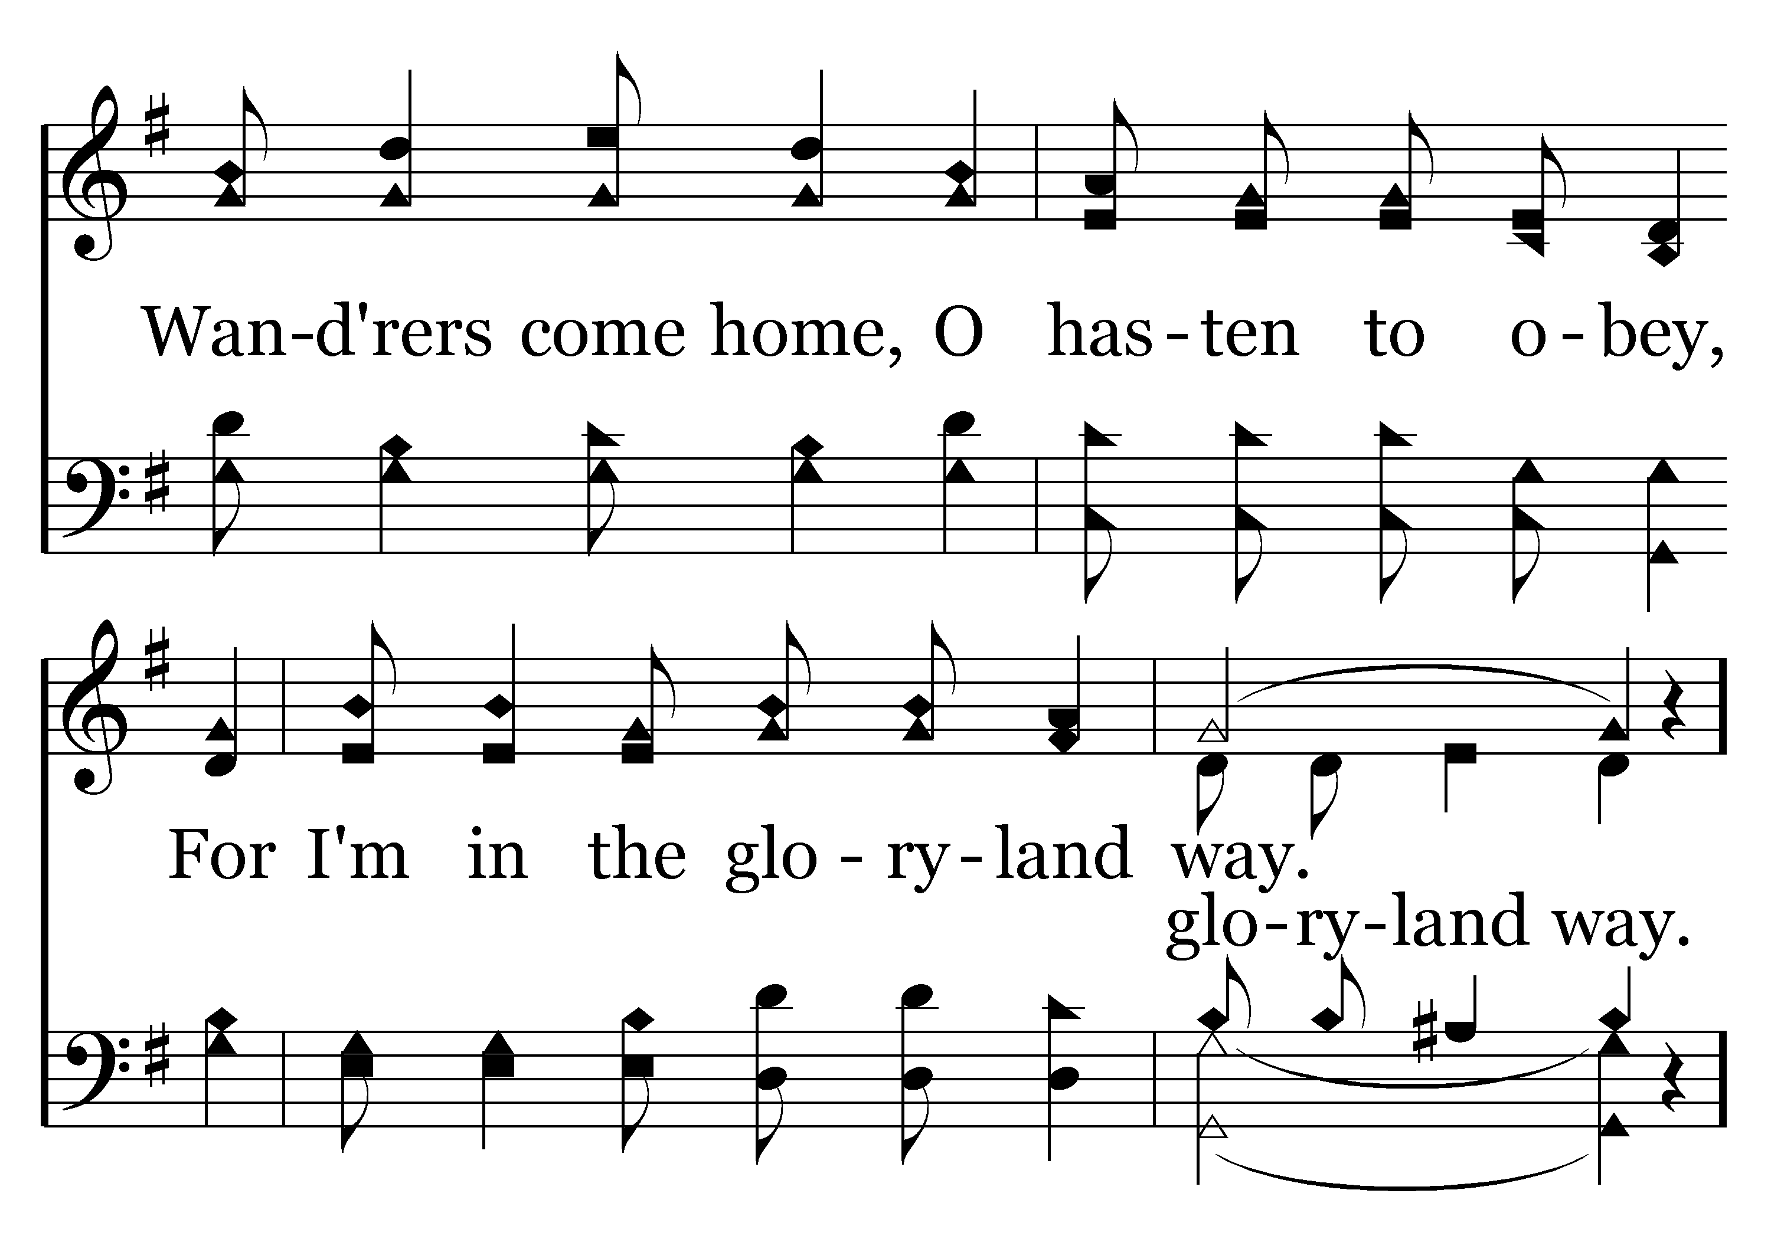
574 - The Gloryland Way - 2.2

Slide 35
574 - The Gloryland Way - C.1

Slide 36
574 - The Gloryland Way - C.2

Slide 37
574 - The Gloryland Way - C.3
End of Verse 2

Slide 38
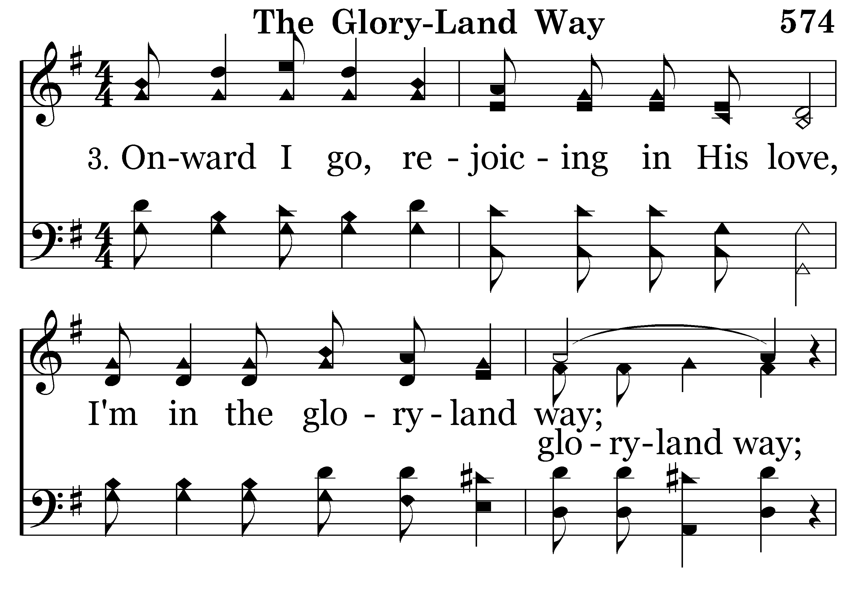
574 - The Gloryland Way - 3.1

Slide 39
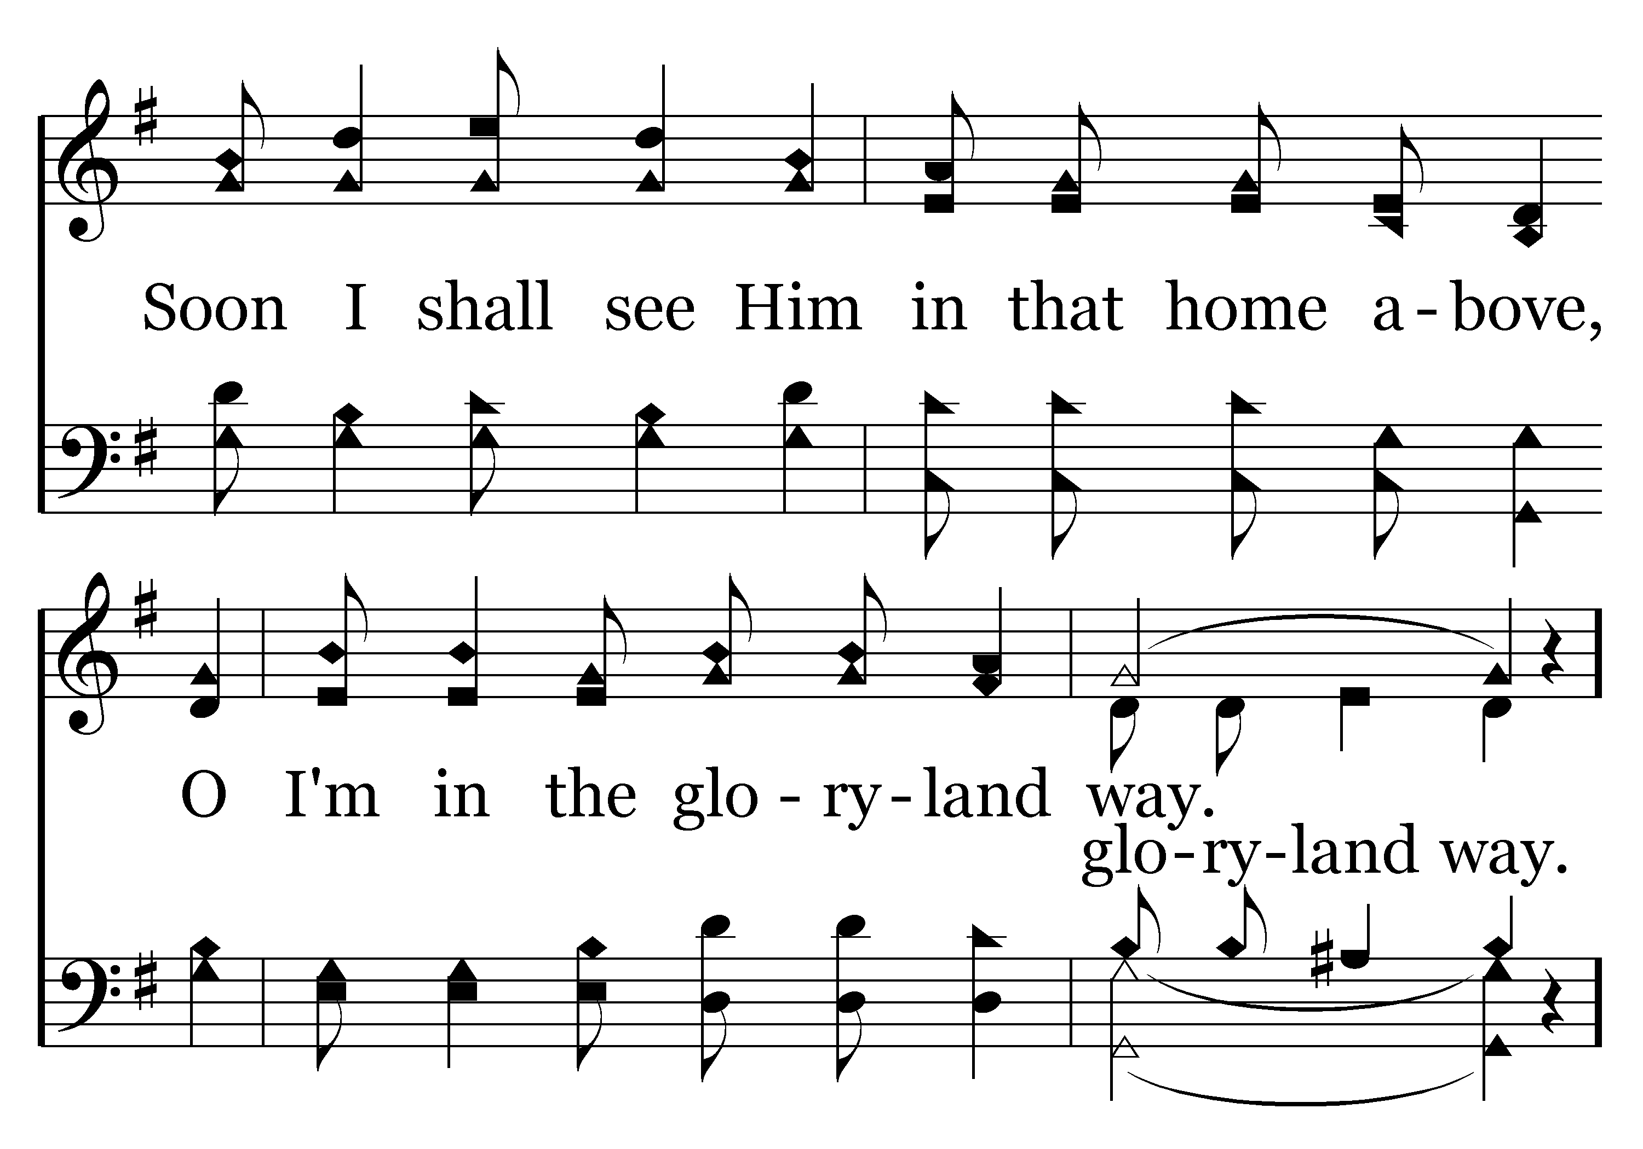
574 - The Gloryland Way - 3.2

Slide 40
574 - The Gloryland Way - C.1

Slide 41
574 - The Gloryland Way - C.2

Slide 42
574 - The Gloryland Way - C.3
End of Song

Slide 44
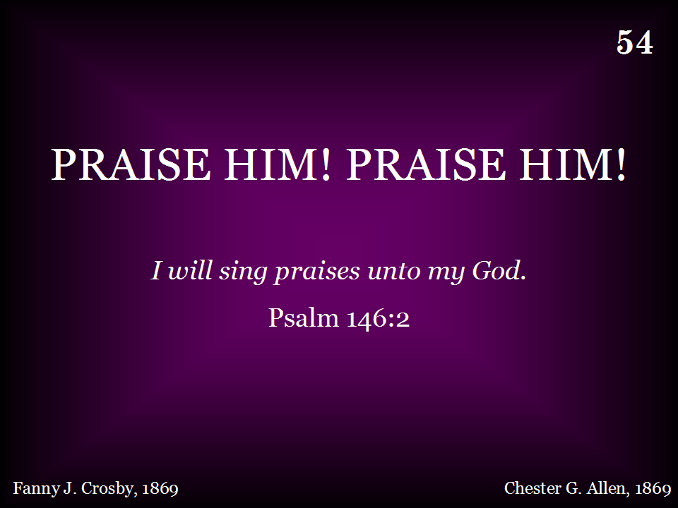
054 - Praise Him! Praise Him! - Title

Slide 45
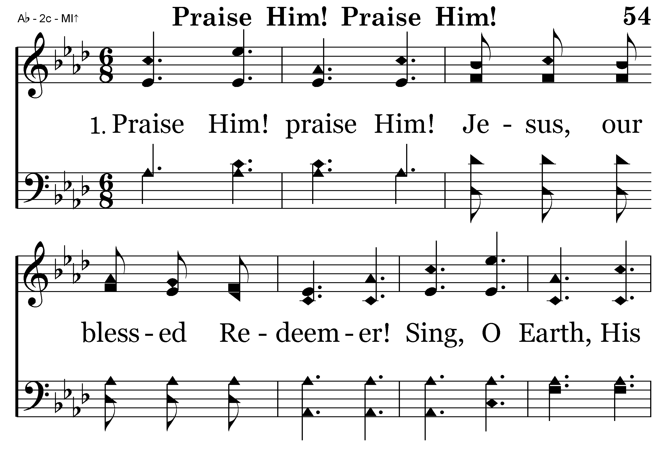
054 - Praise Him! Praise Him! - 1.1

Slide 46
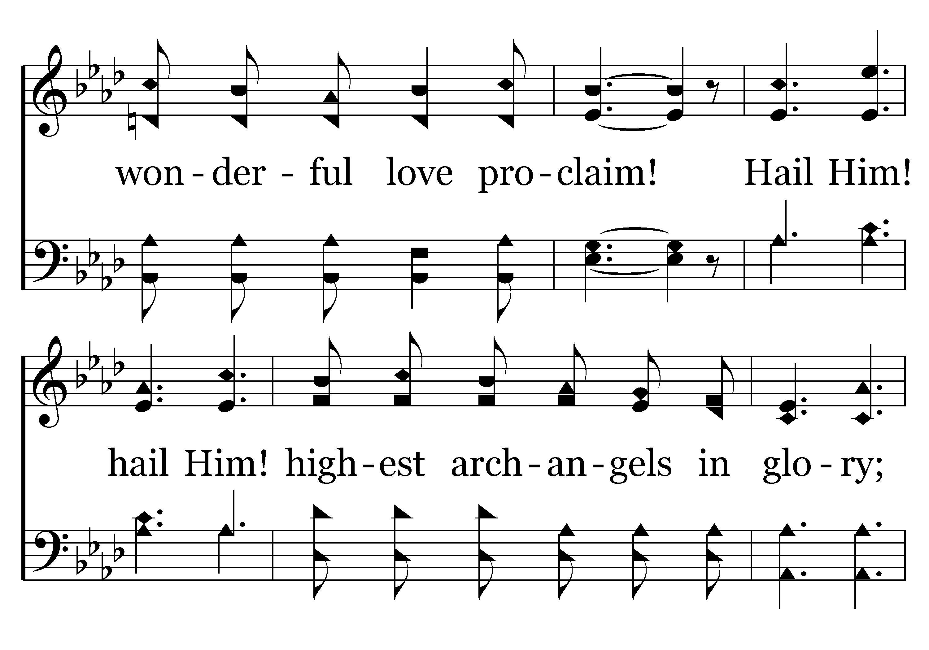
054 - Praise Him! Praise Him! - 1.2

Slide 47
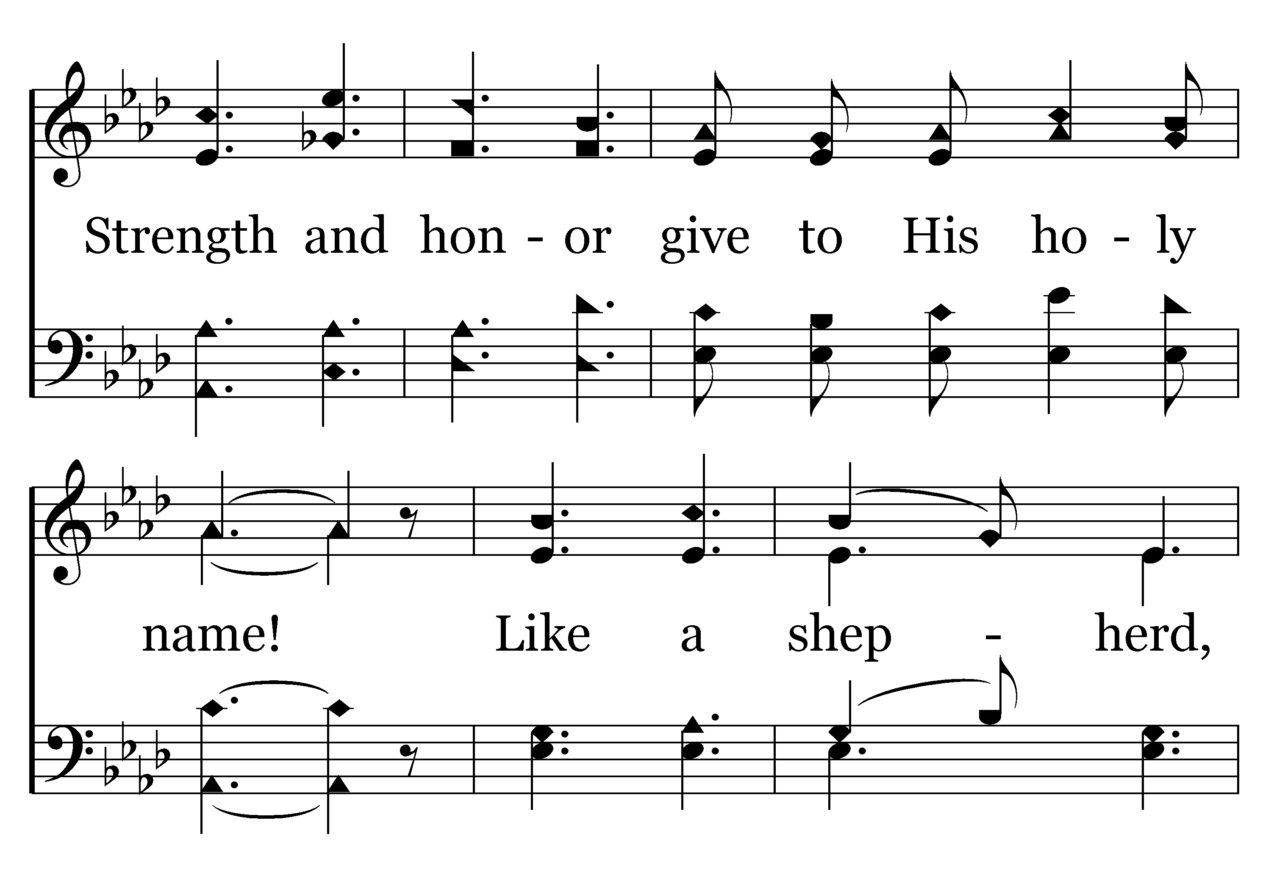
054 - Praise Him! Praise Him! - 1.3

Slide 48
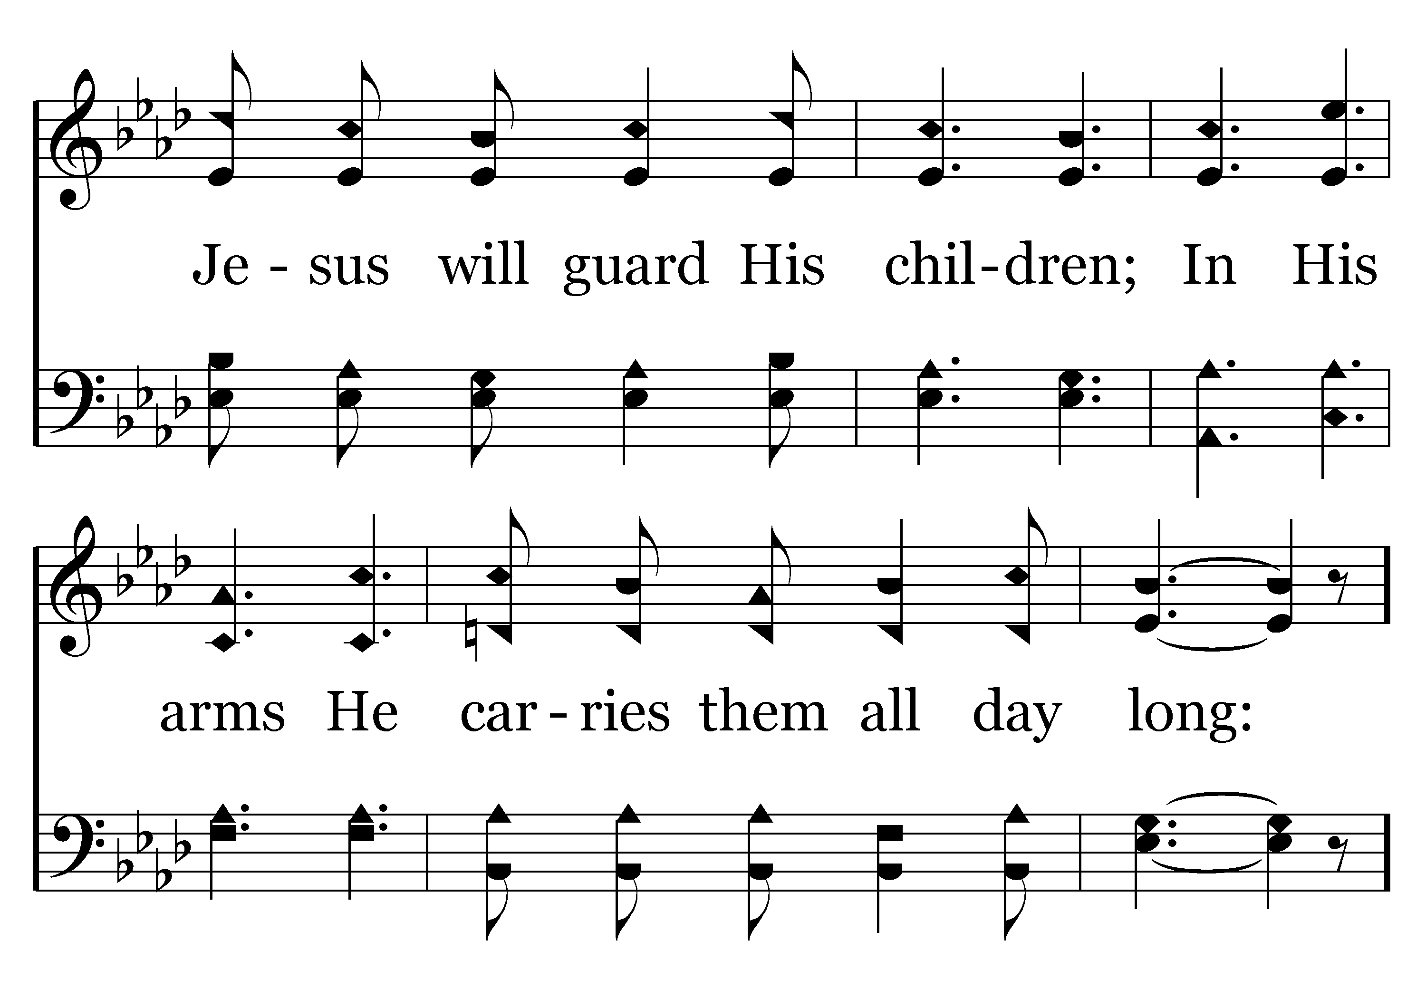
054 - Praise Him! Praise Him! - 1.4

Slide 49
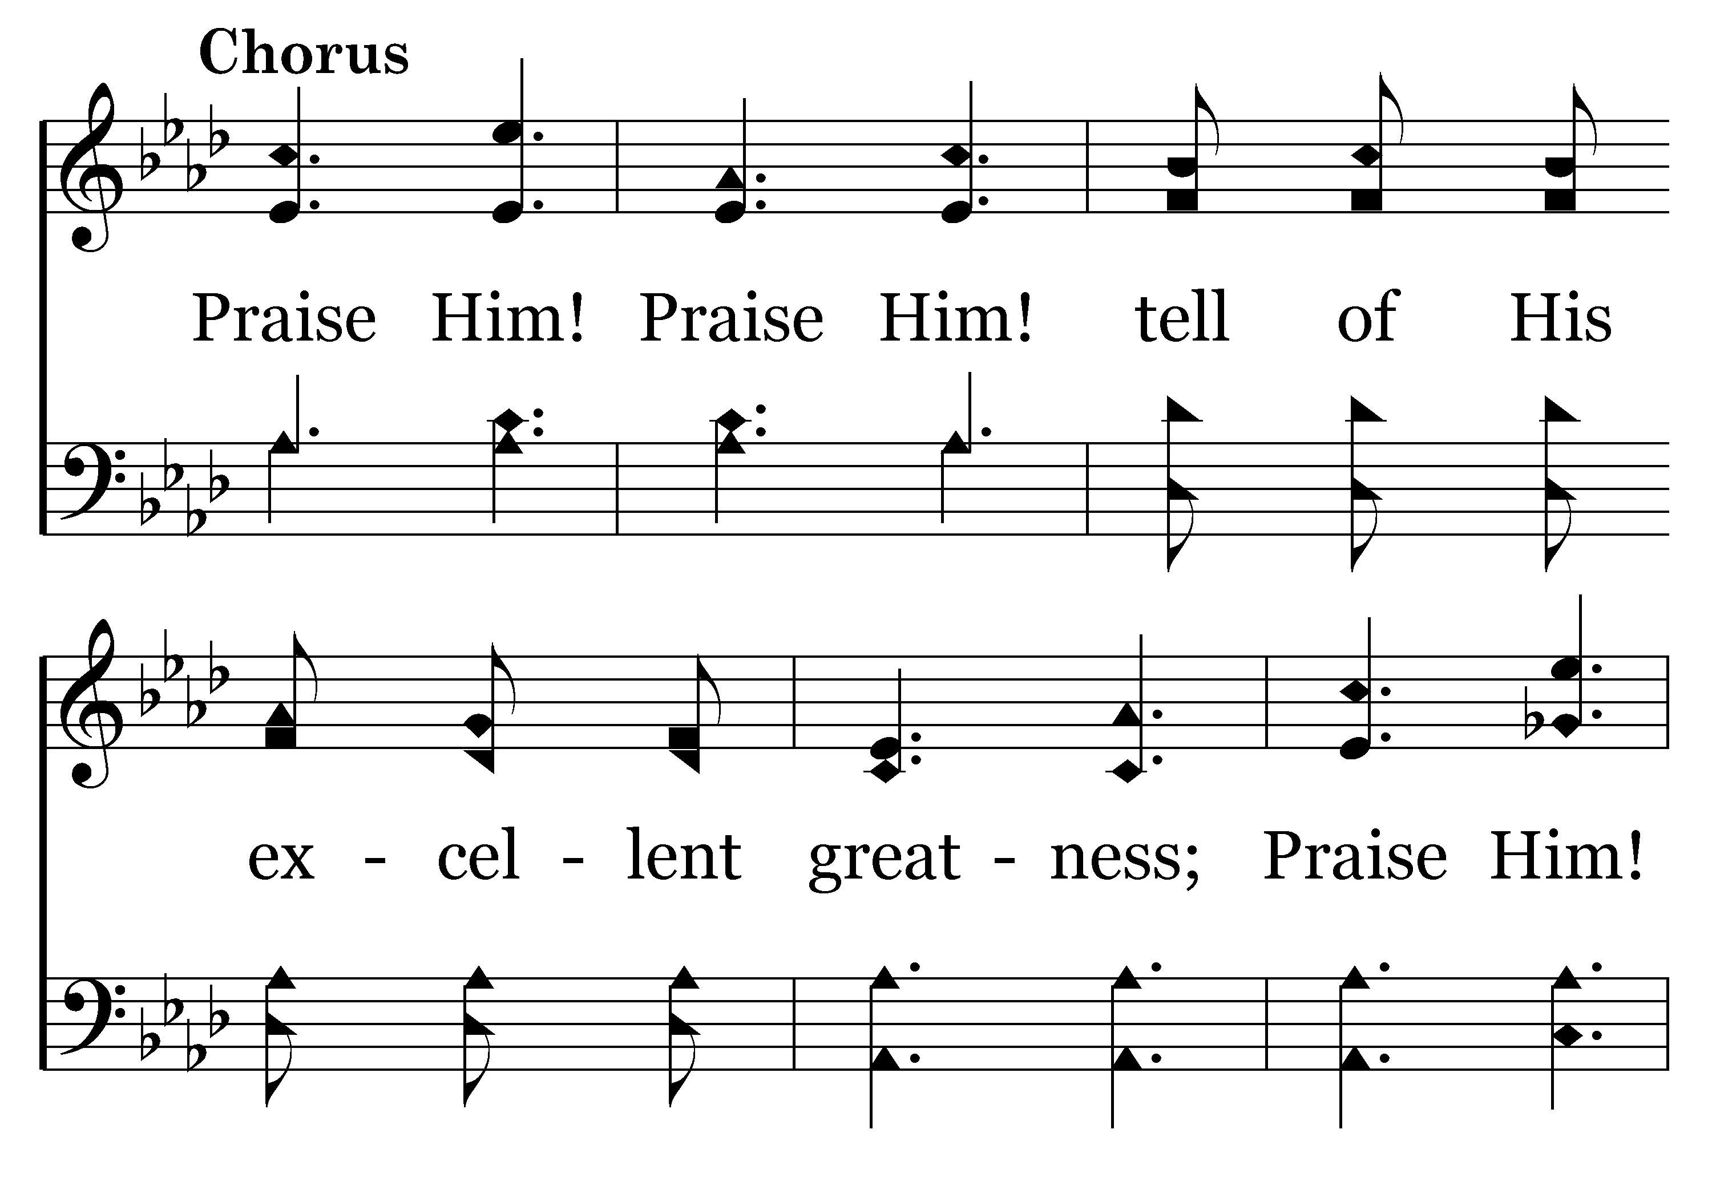
054 - Praise Him! Praise Him! - C.1

Slide 50
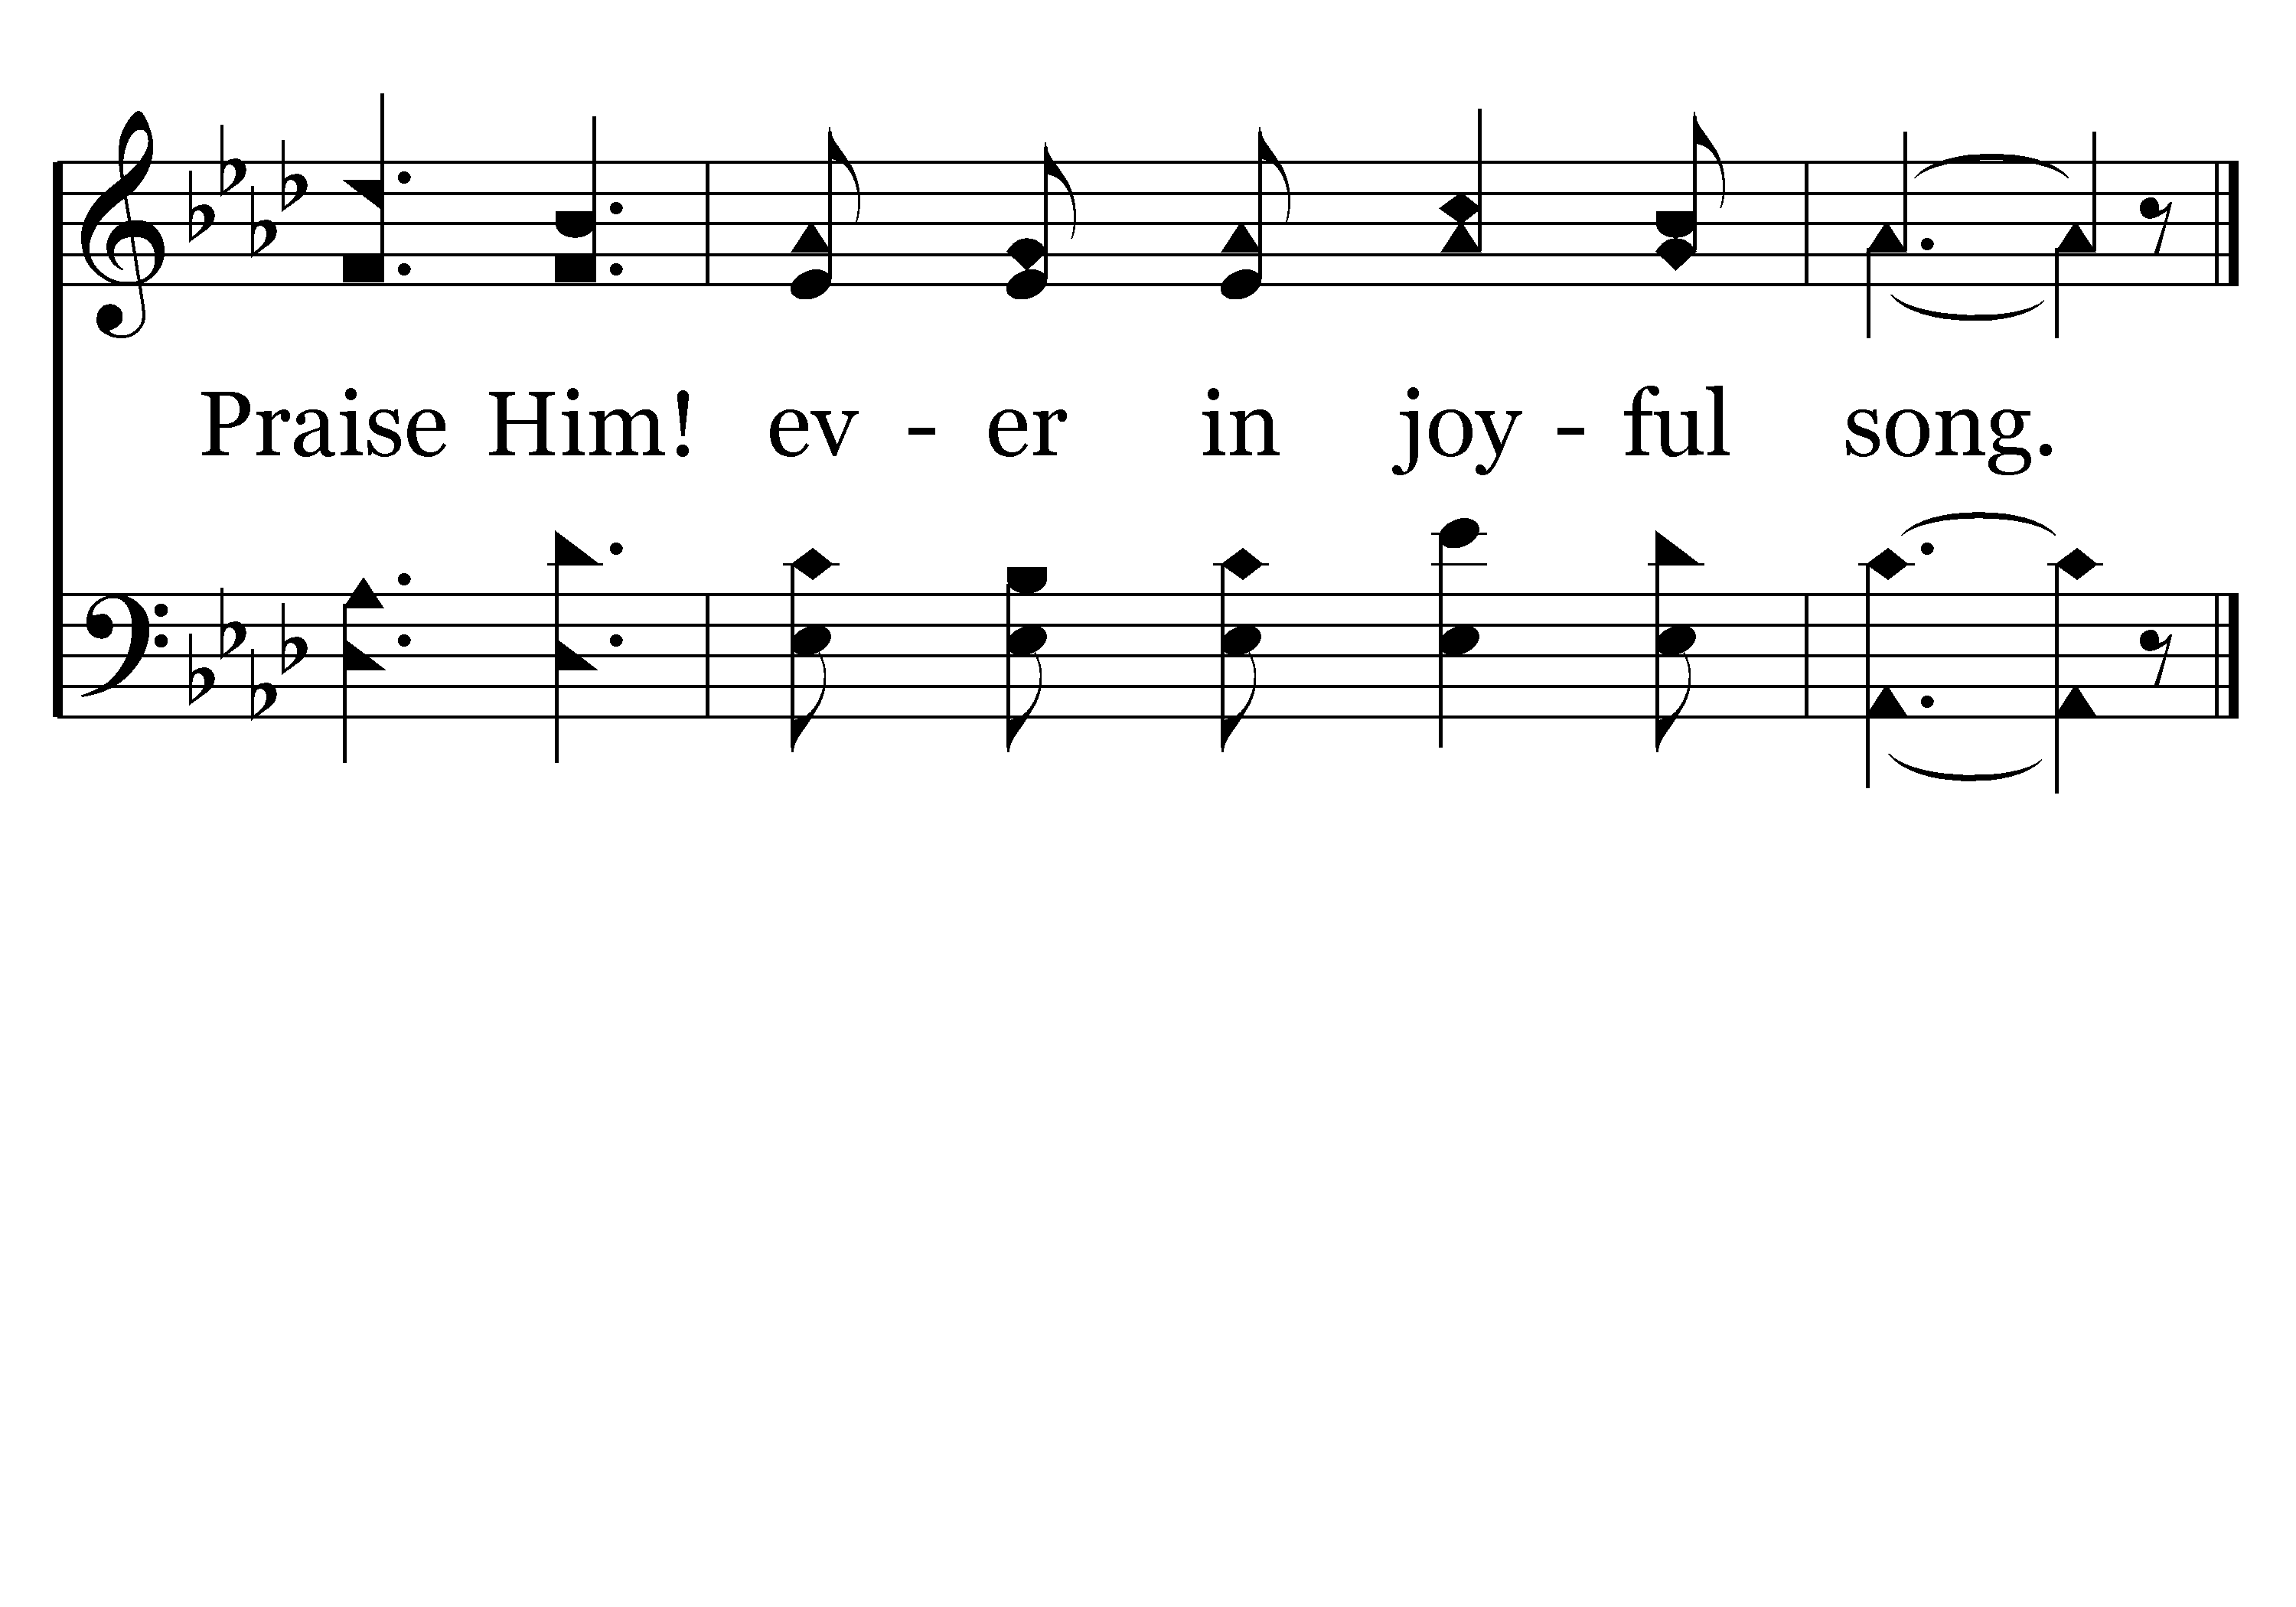
054 - Praise Him! Praise Him! - C.2
End of Verse 1

Slide 51
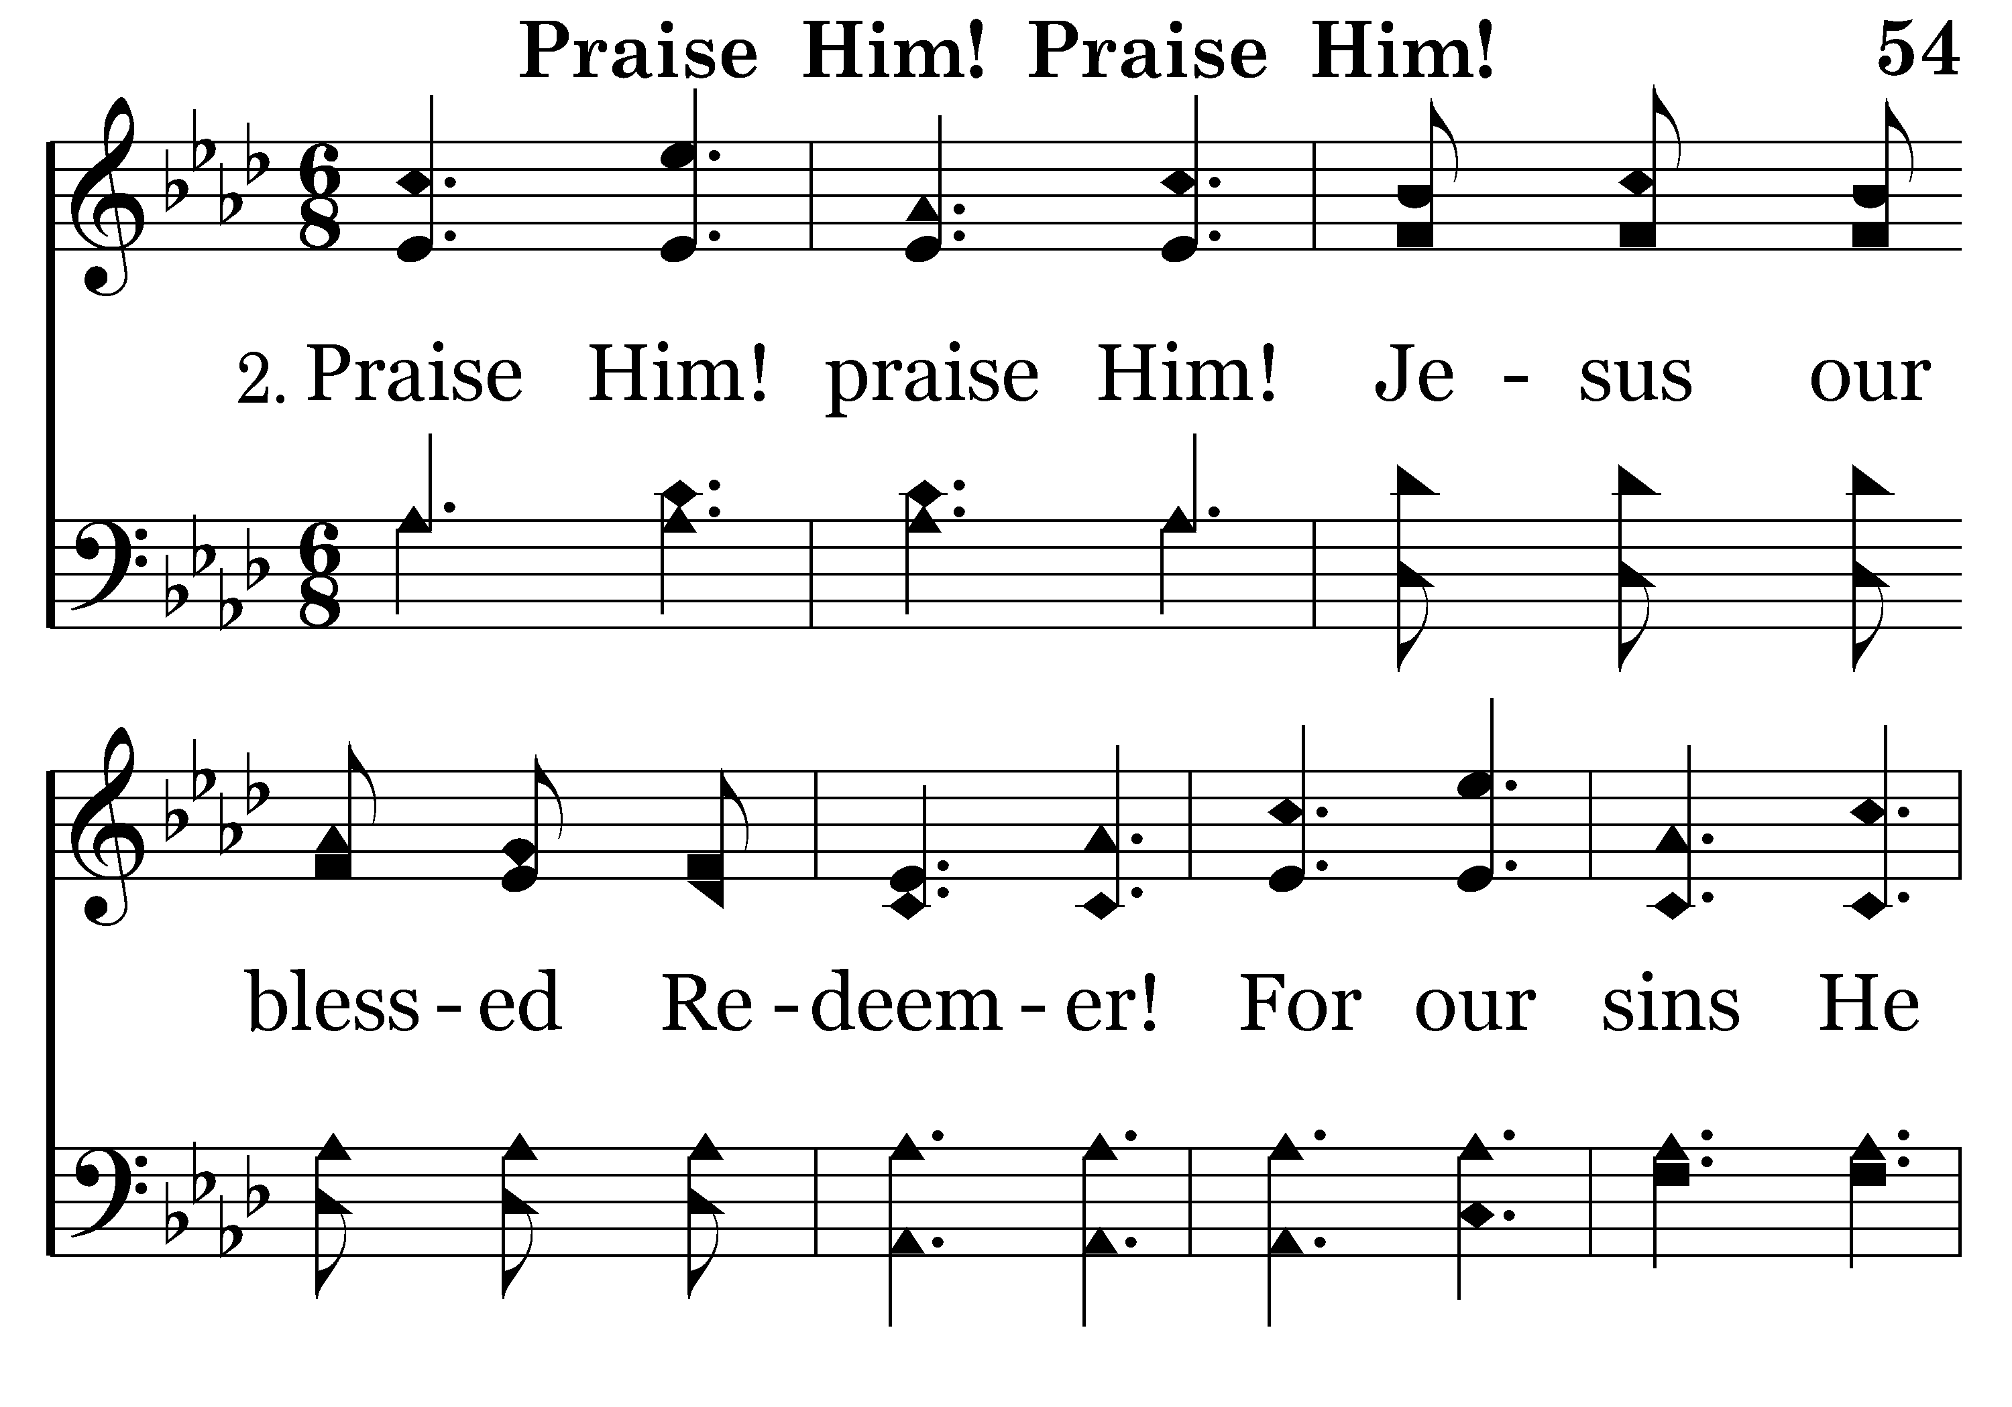
054 - Praise Him! Praise Him! - 2.1

Slide 52
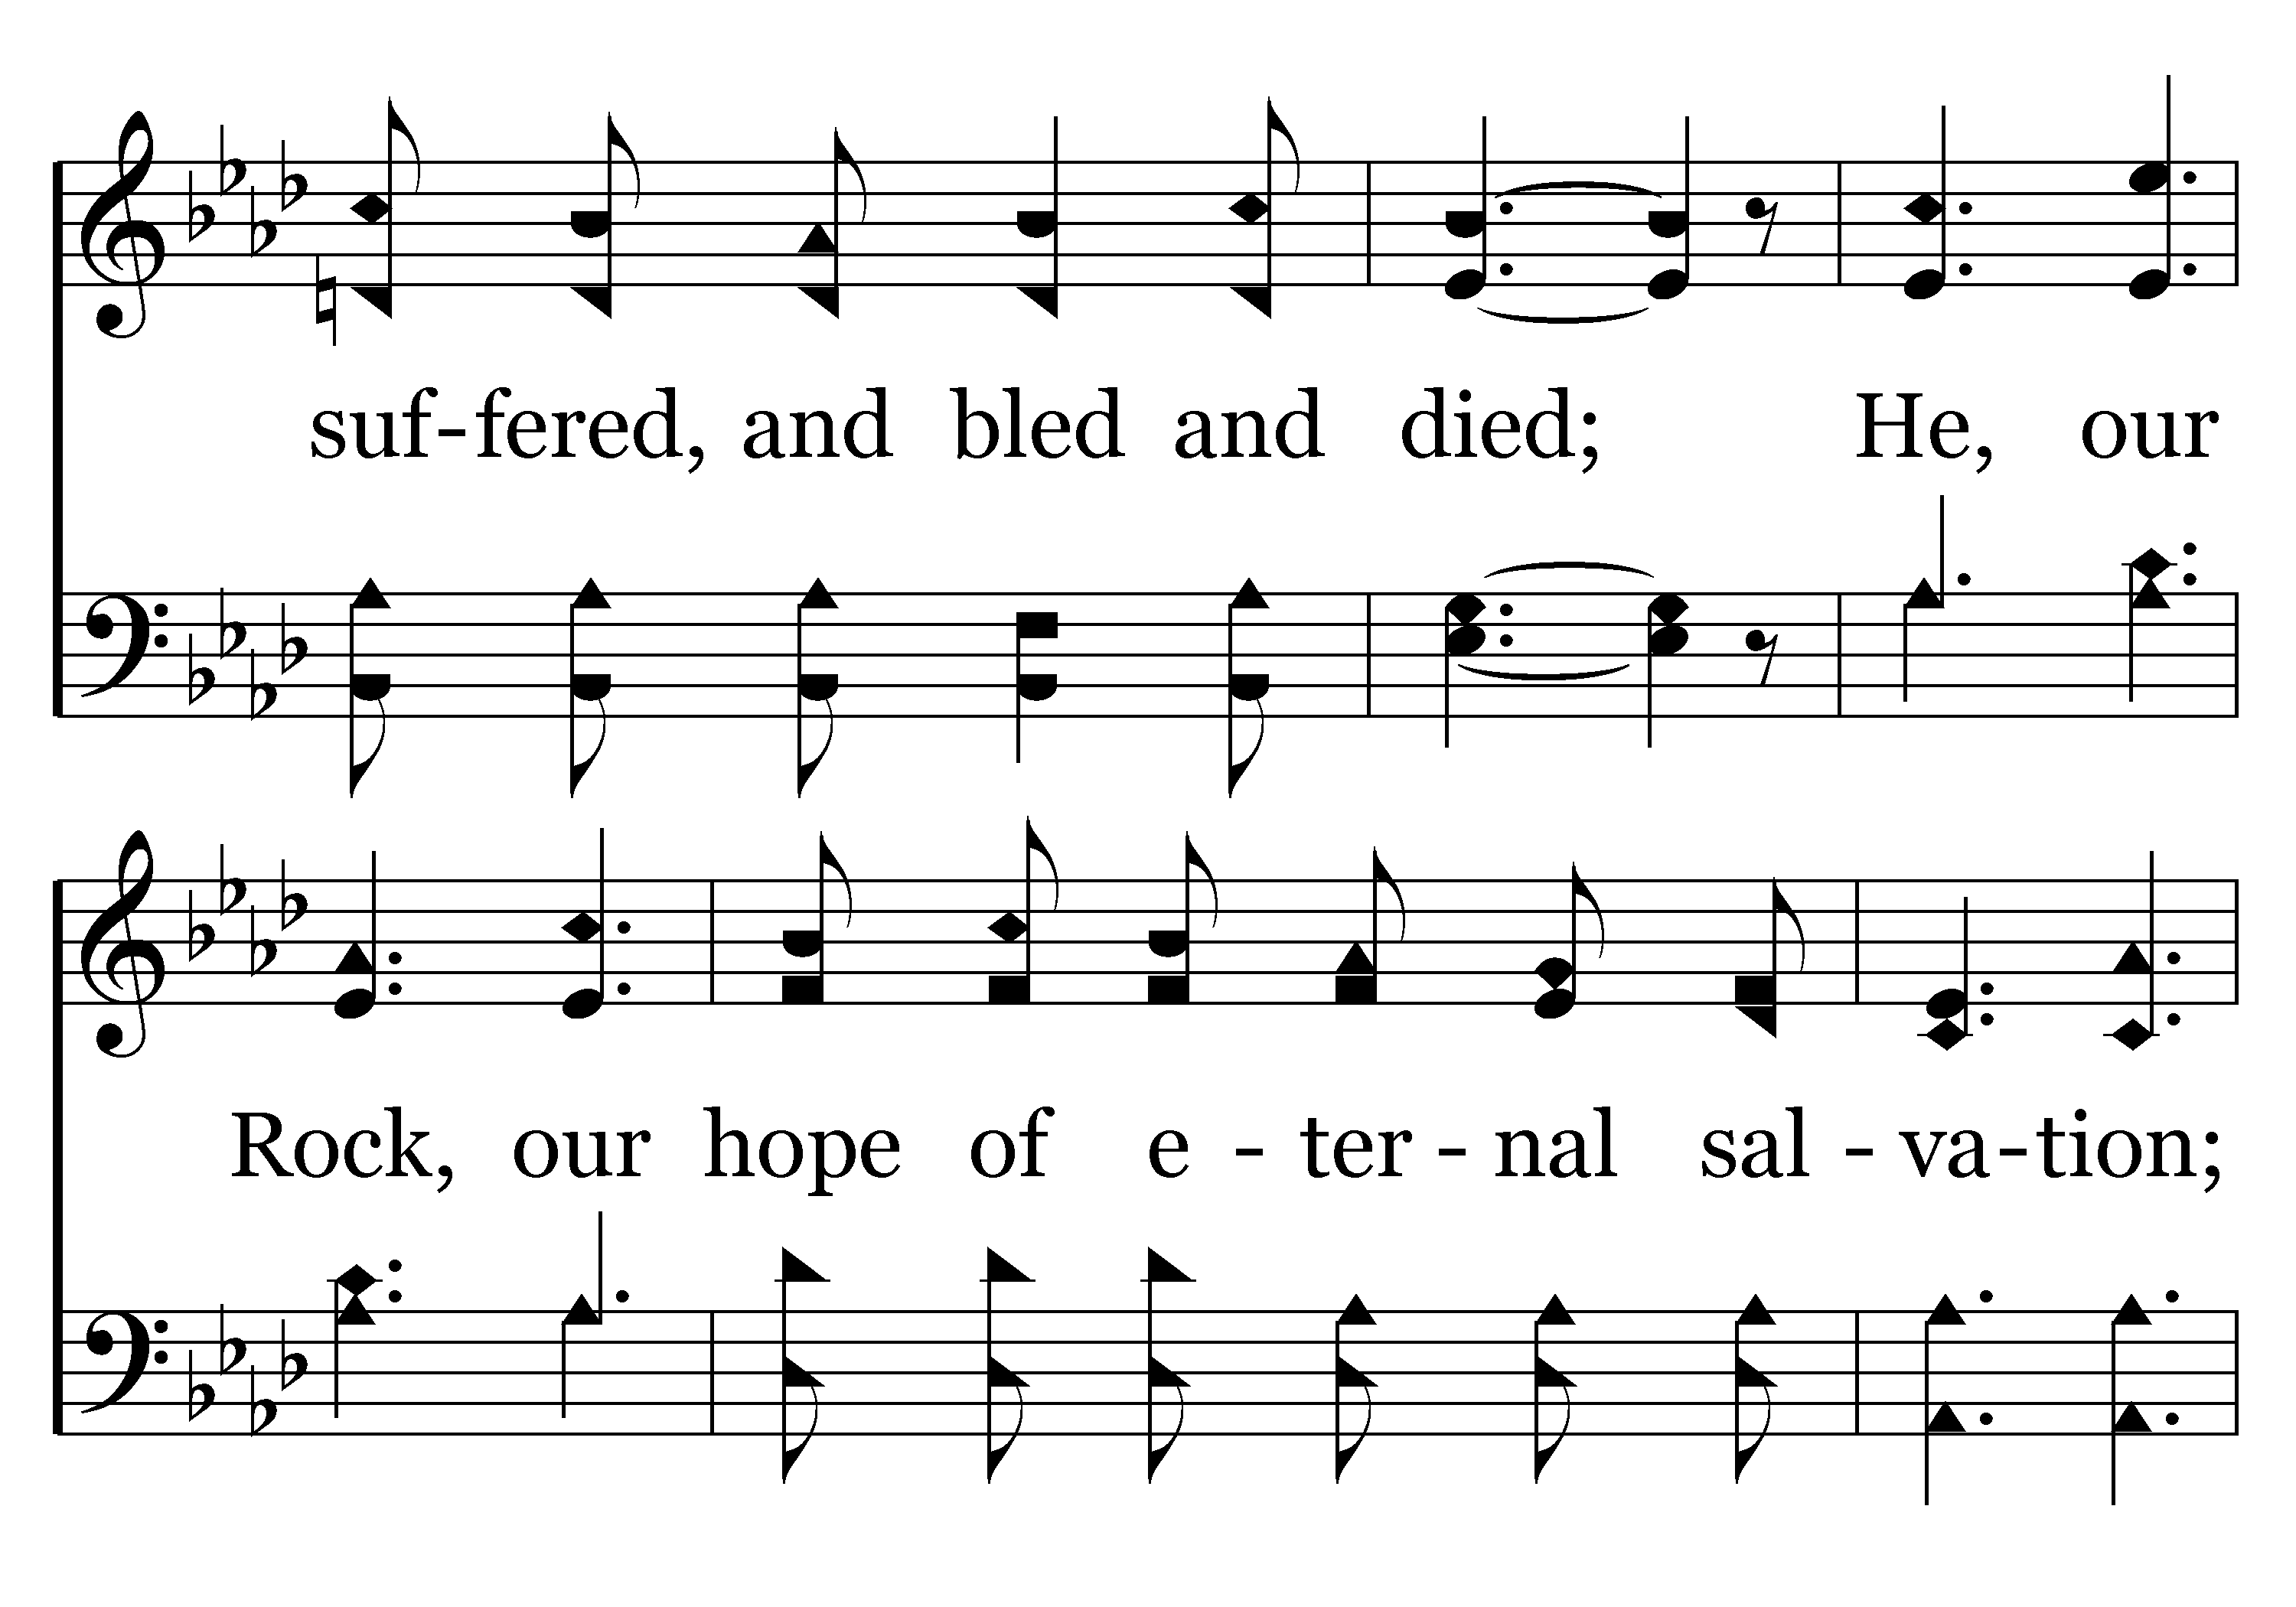
054 - Praise Him! Praise Him! - 2.2

Slide 53
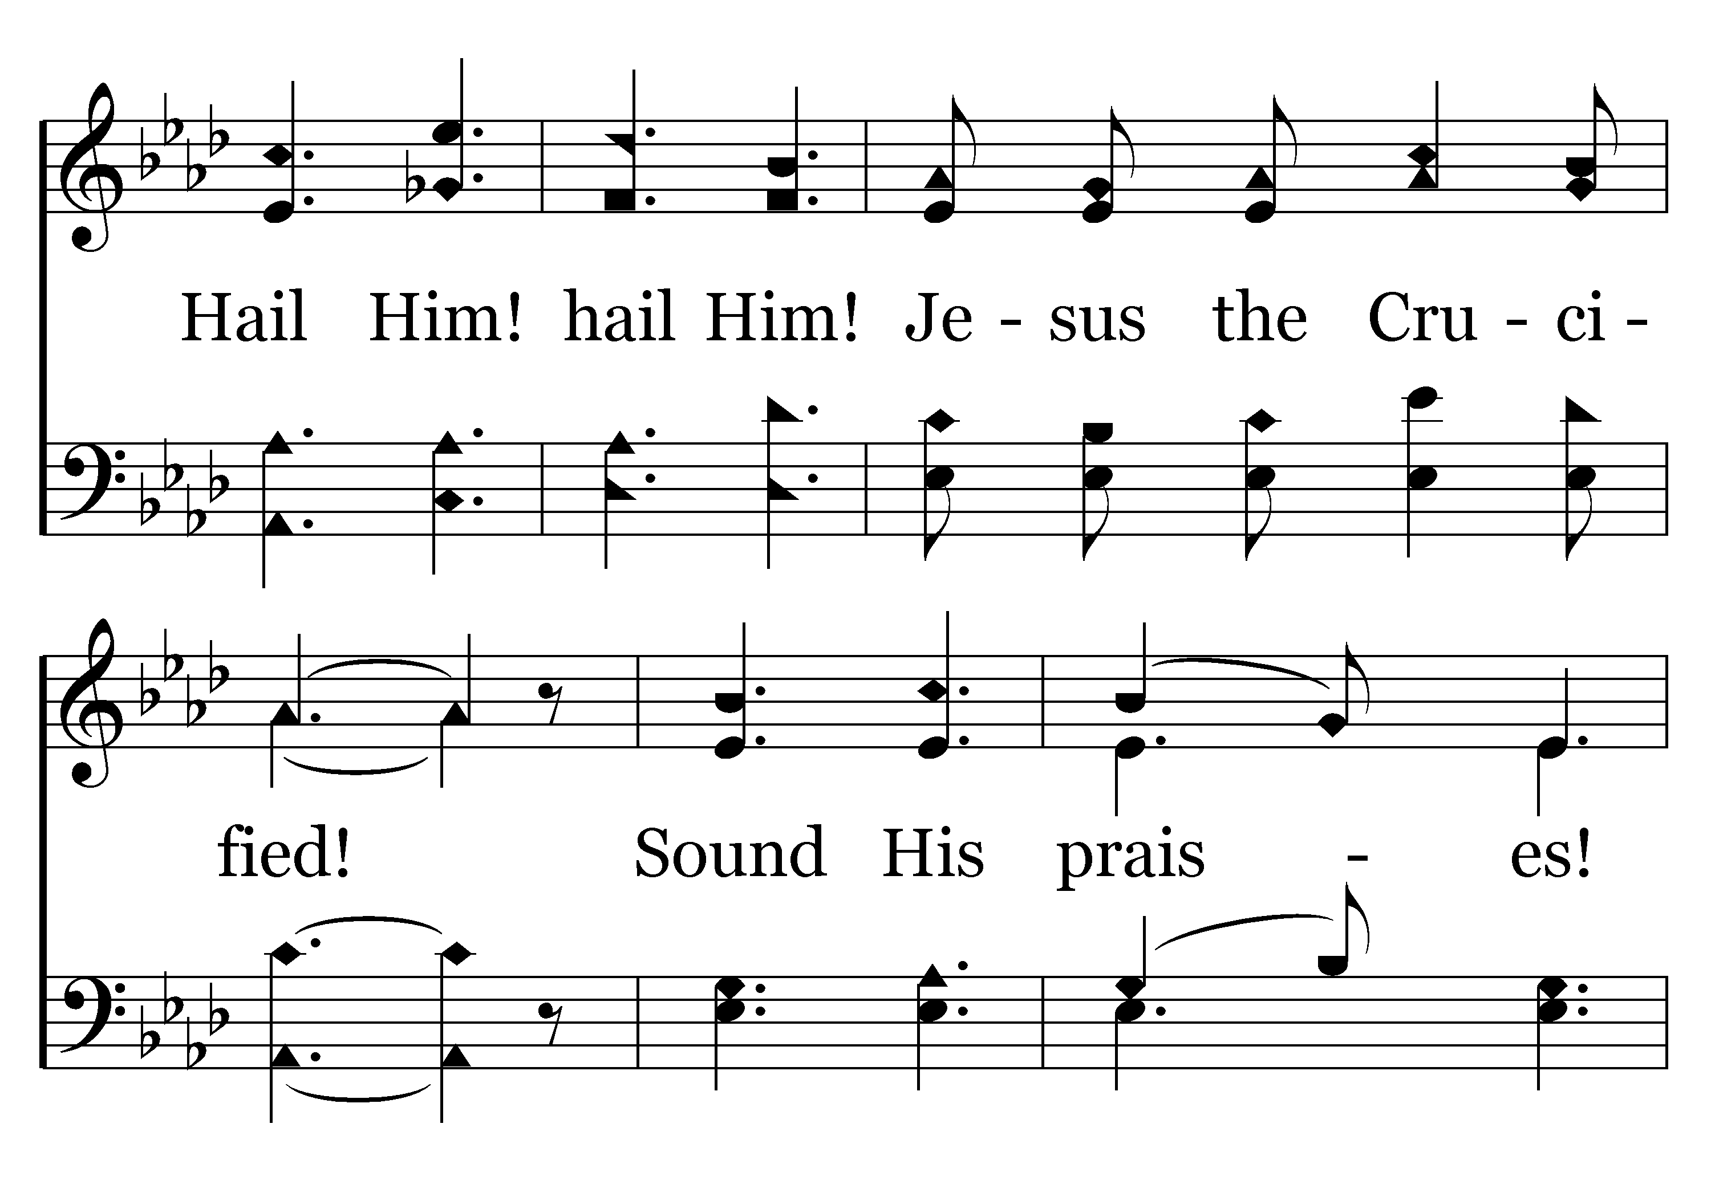
054 - Praise Him! Praise Him! - 2.3

Slide 54
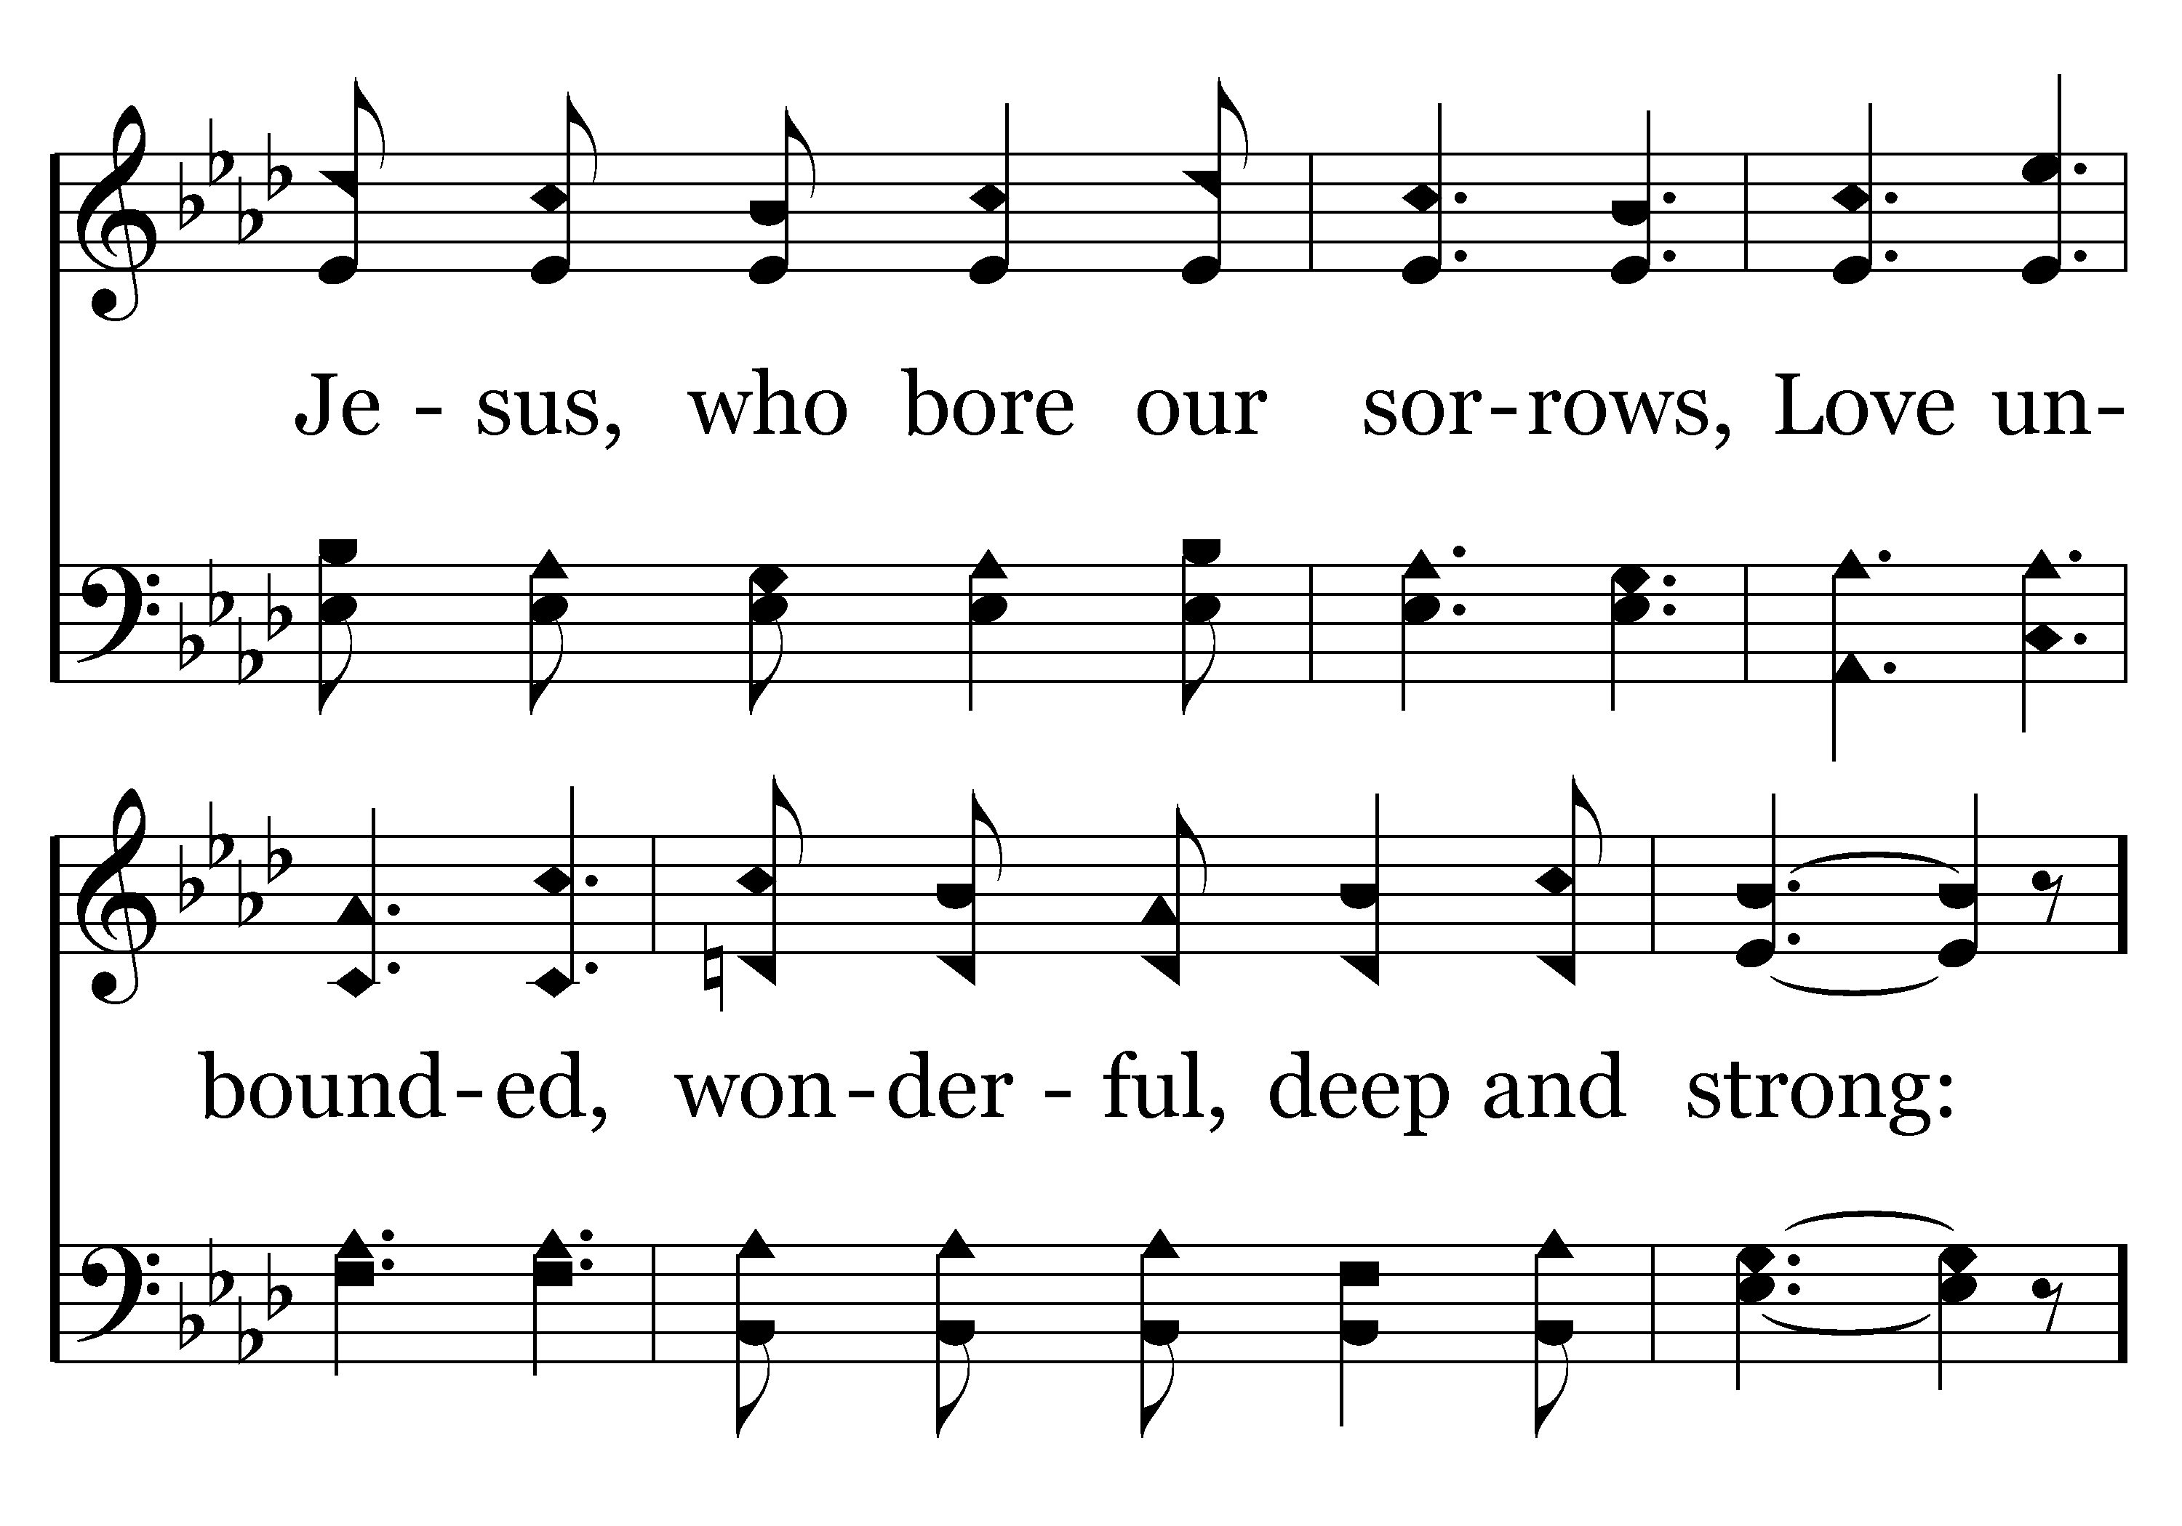
054 - Praise Him! Praise Him! - 2.4

Slide 55
054 - Praise Him! Praise Him! - C.1

Slide 56
054 - Praise Him! Praise Him! - C.2
End of Verse 2

Slide 57
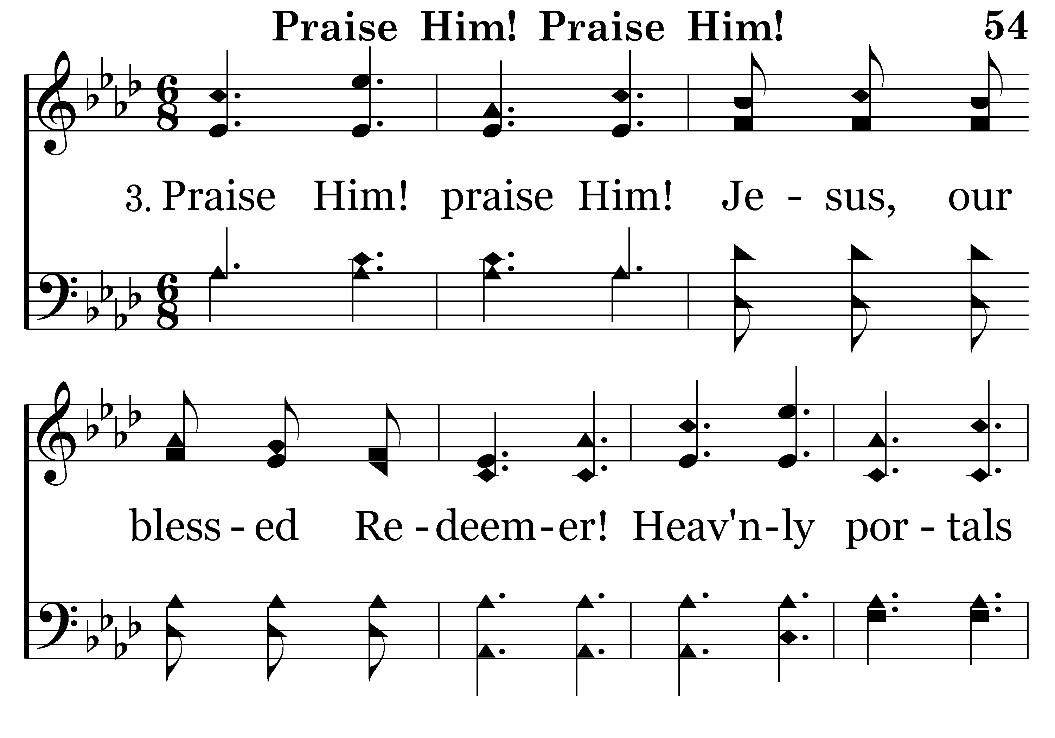
054 - Praise Him! Praise Him! - 3.1

Slide 58
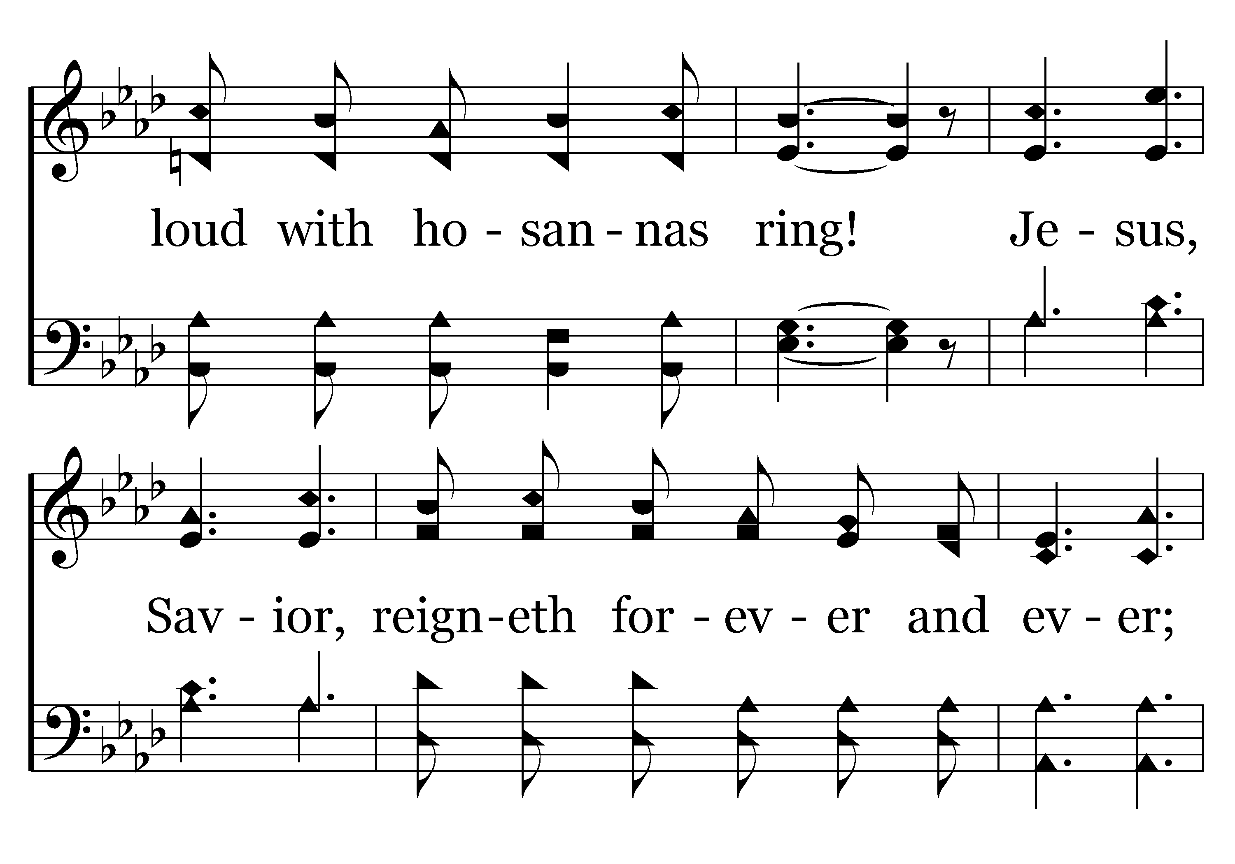
054 - Praise Him! Praise Him! - 3.2

Slide 59
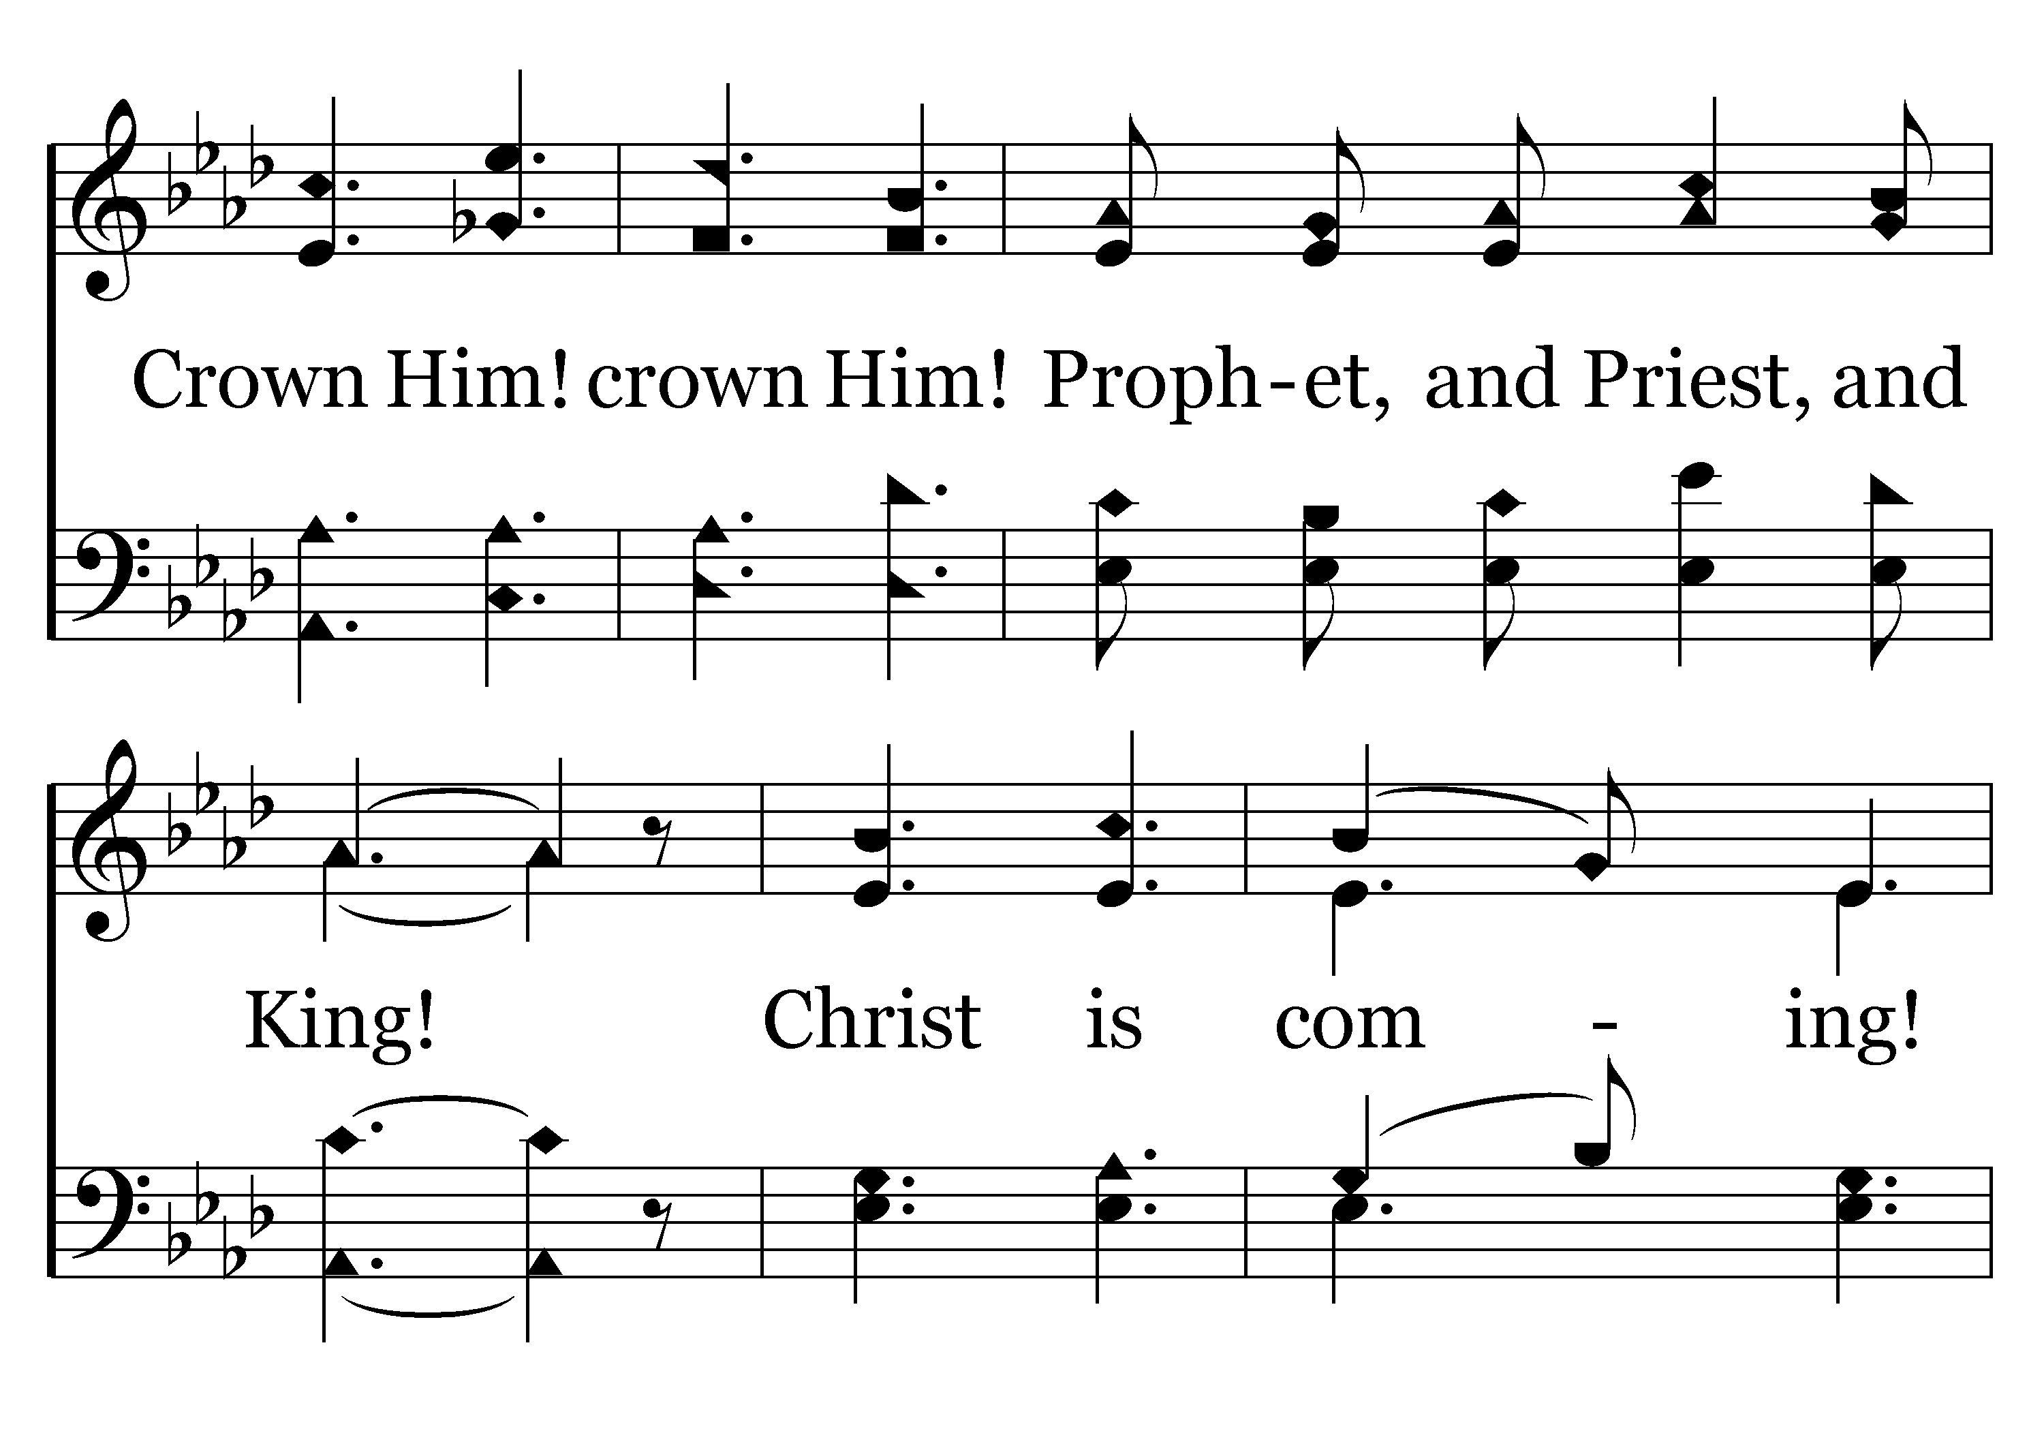
054 - Praise Him! Praise Him! - 3.3

Slide 60
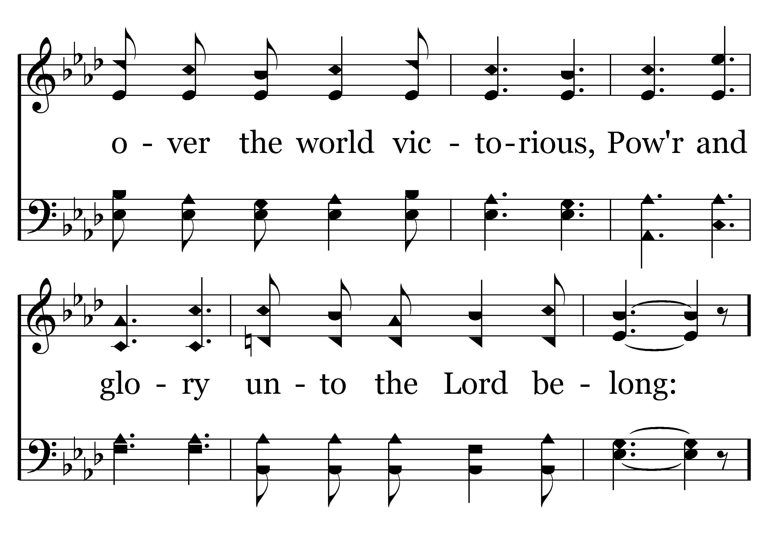
054 - Praise Him! Praise Him! - 3.4

Slide 61
054 - Praise Him! Praise Him! - C.1

Slide 62
054 - Praise Him! Praise Him! - C.2
End of Song

Slide 64
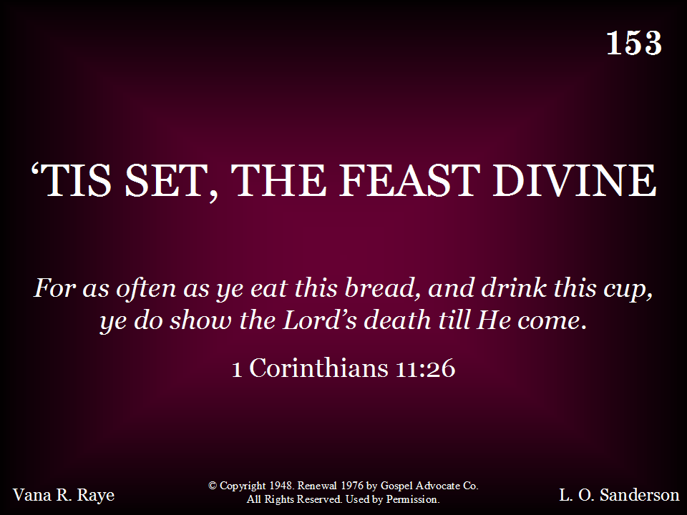
153 - Tis Set, The Feast Divine - Title

Slide 65
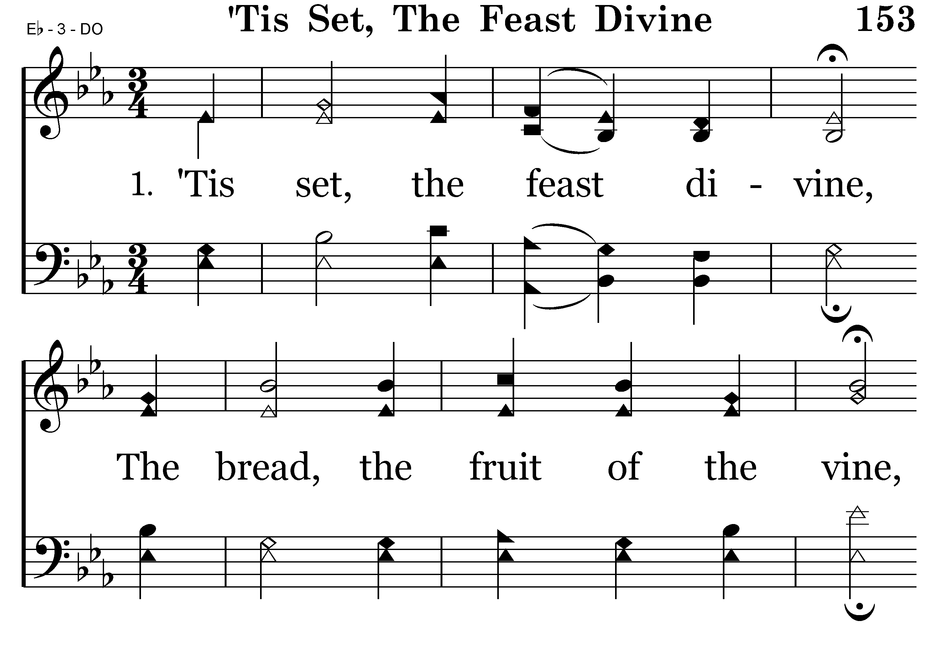
153 - Tis Set, The Feast Divine - 1.1

Slide 66
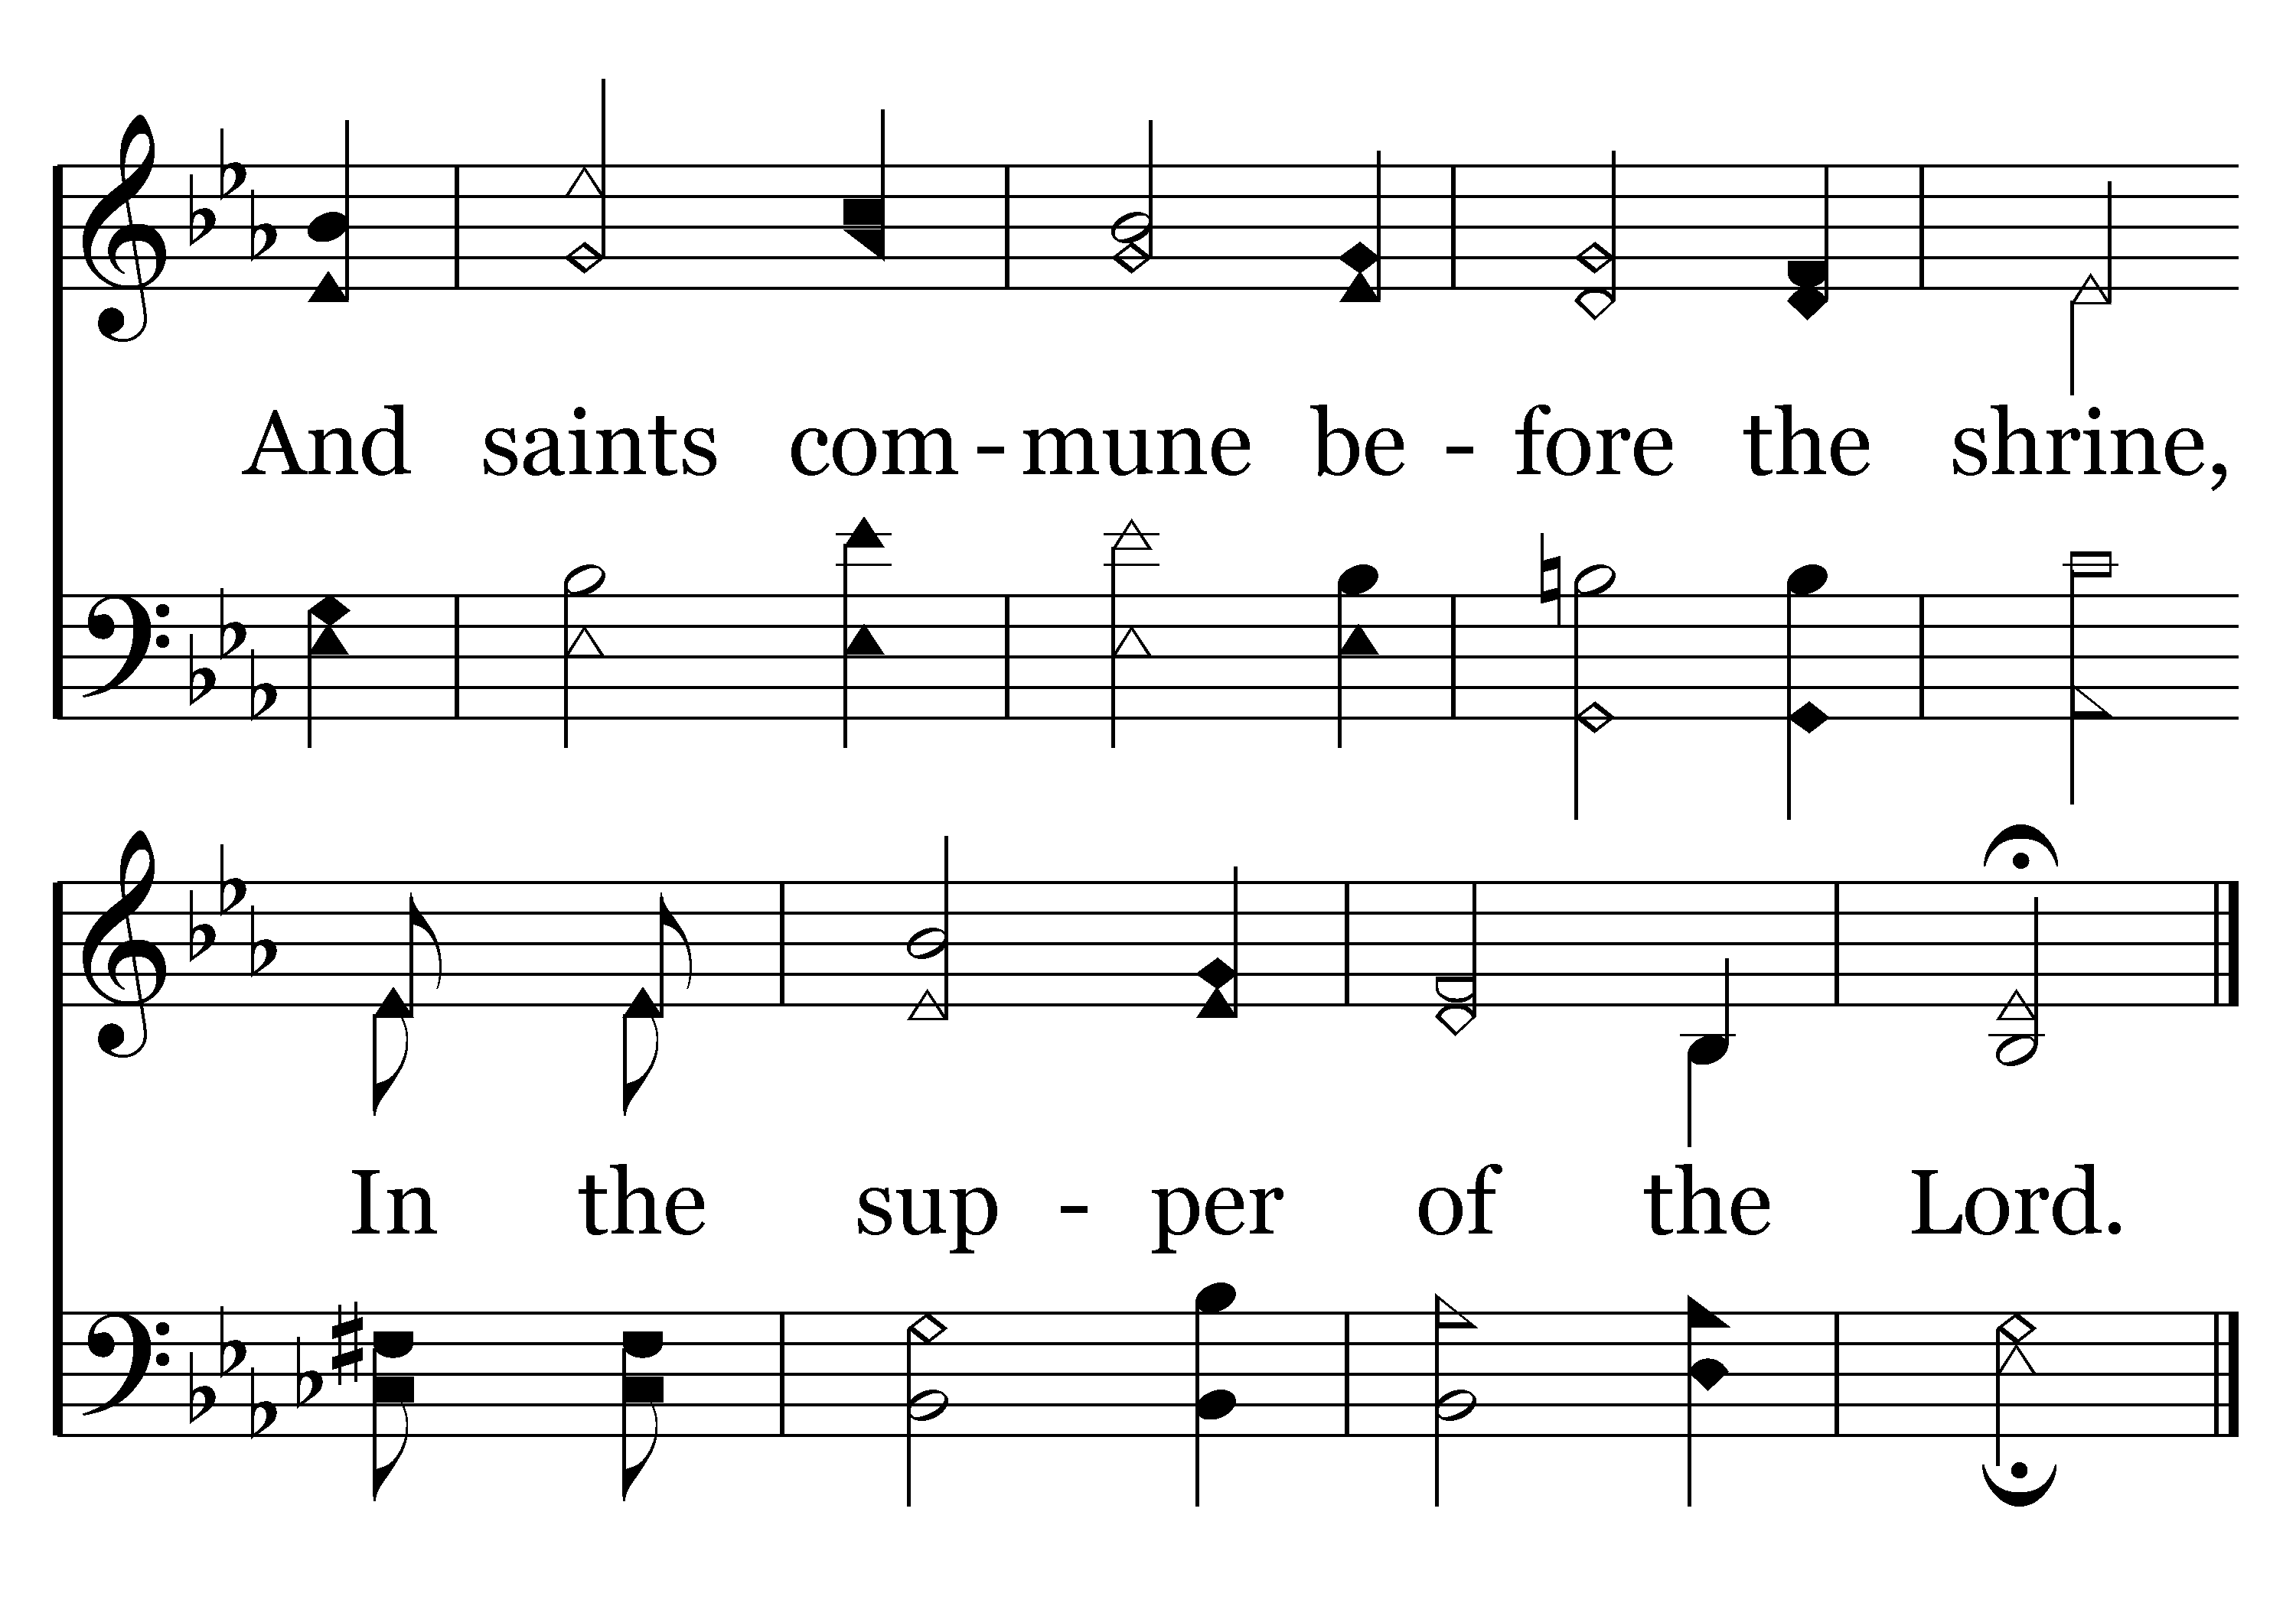
153 - Tis Set, The Feast Divine - 1.2
End of Verse 1

Slide 67
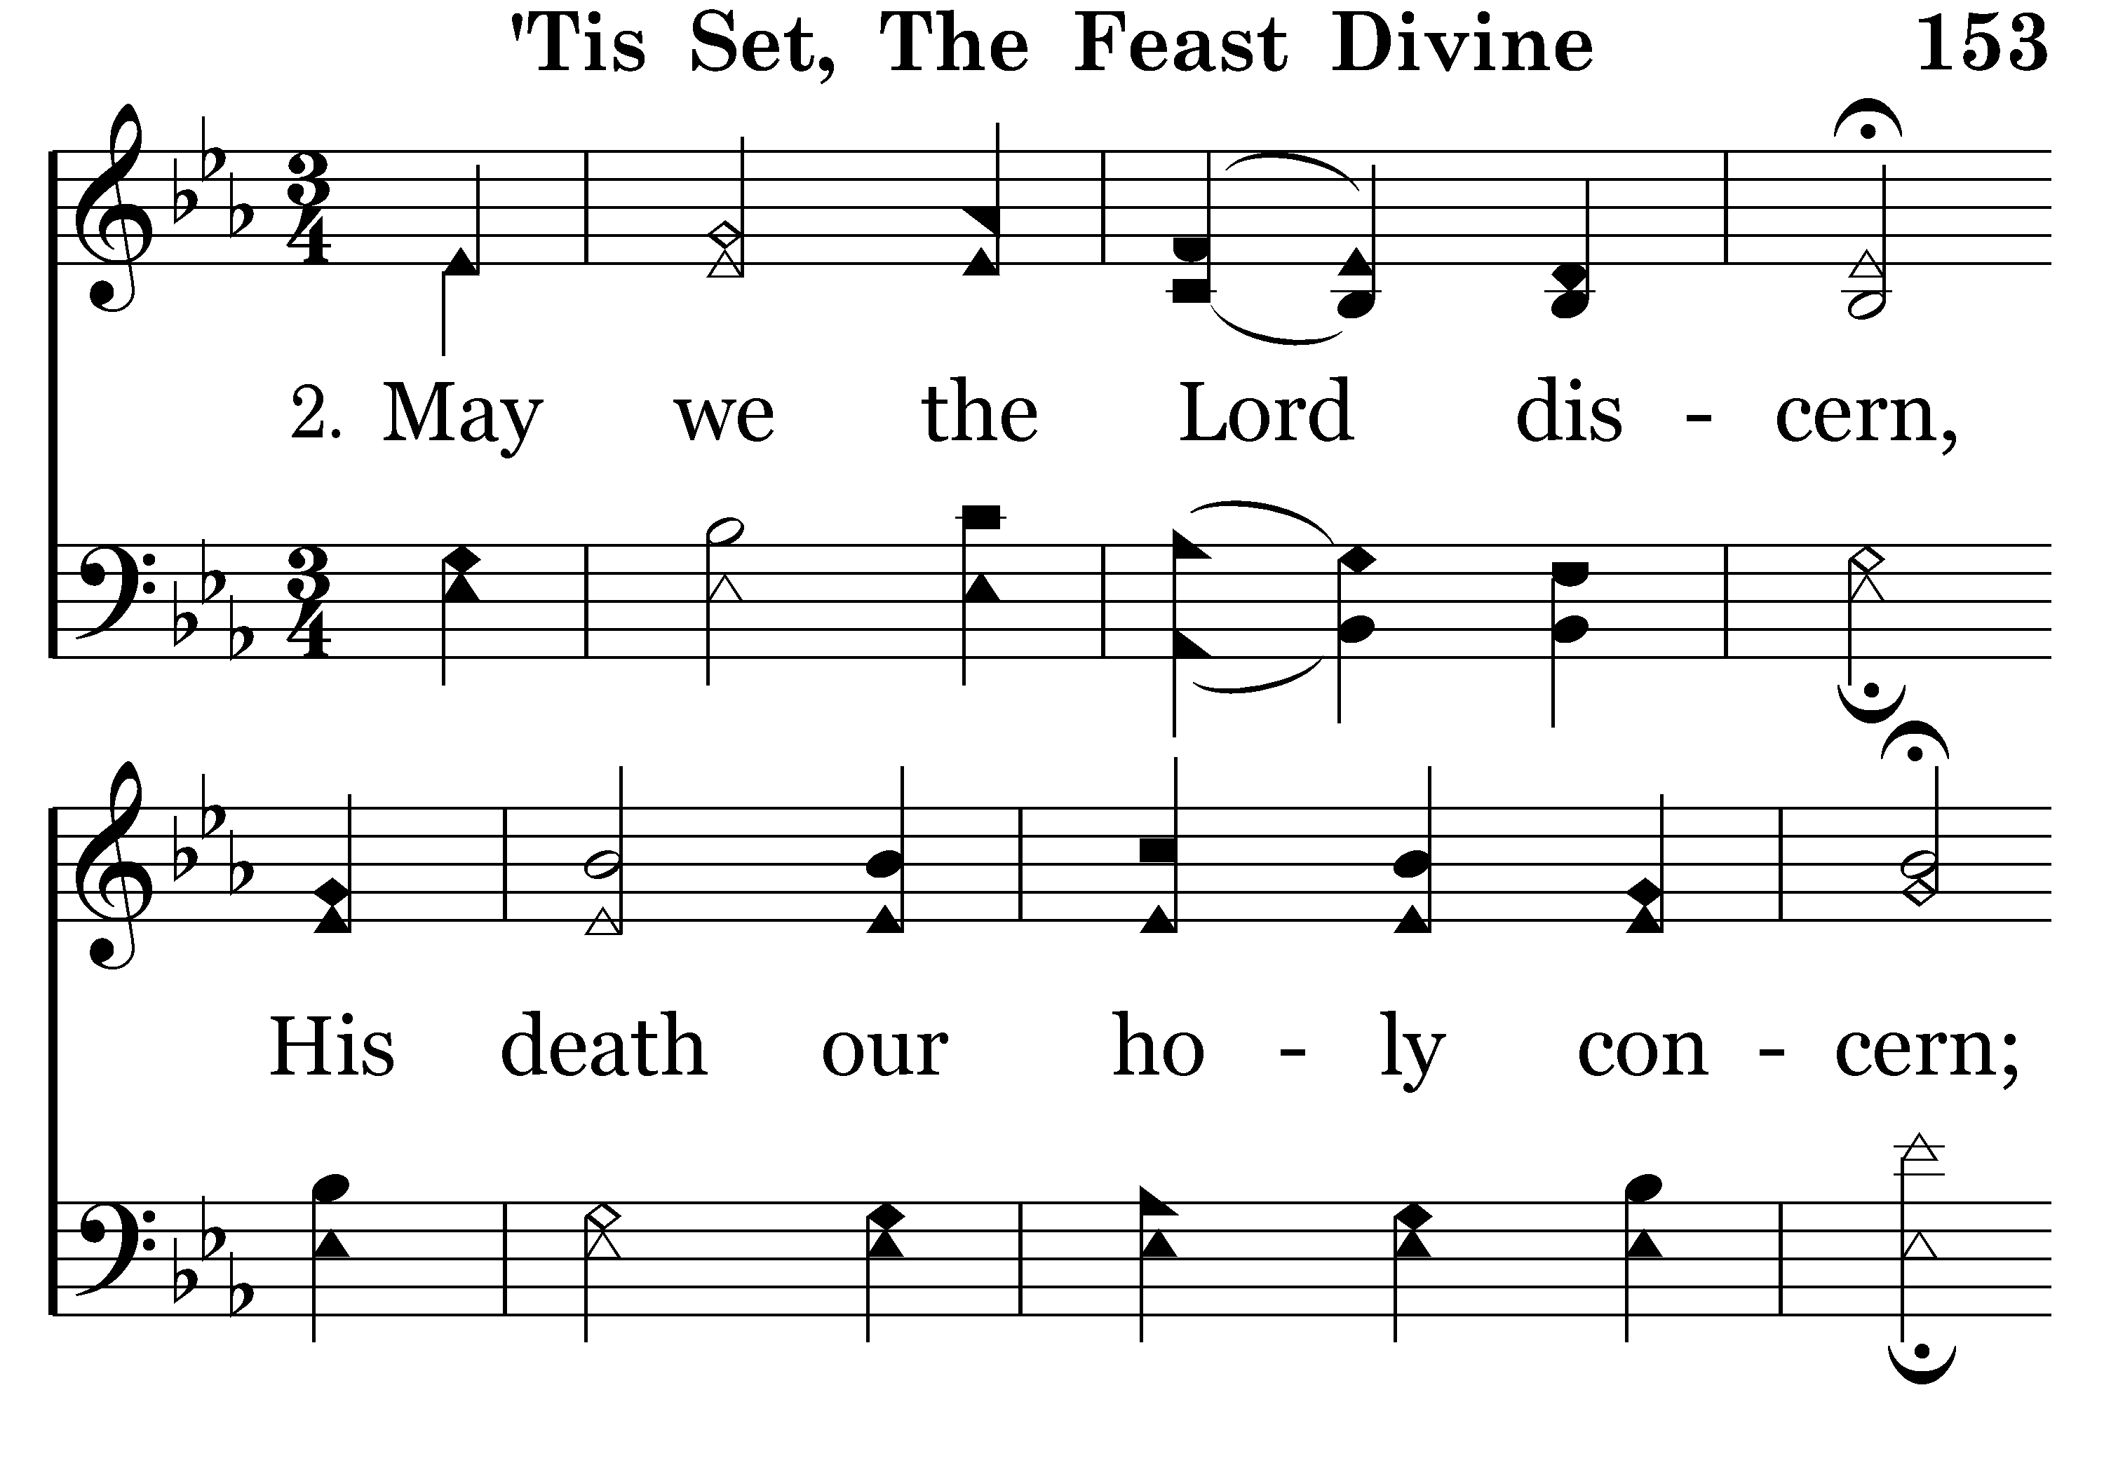
153 - Tis Set, The Feast Divine - 2.1

Slide 68
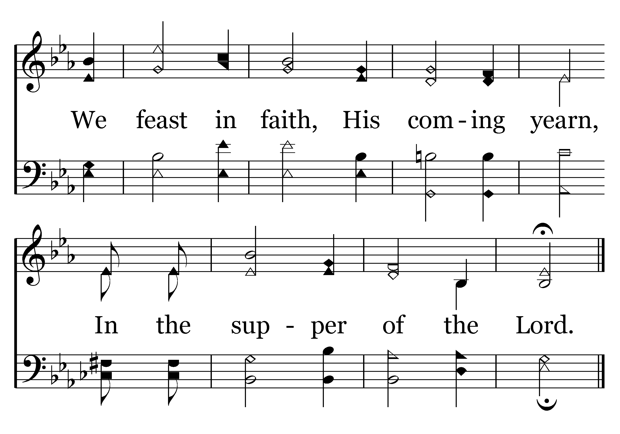
153 - Tis Set, The Feast Divine - 2.2
End of Song

Slide 70
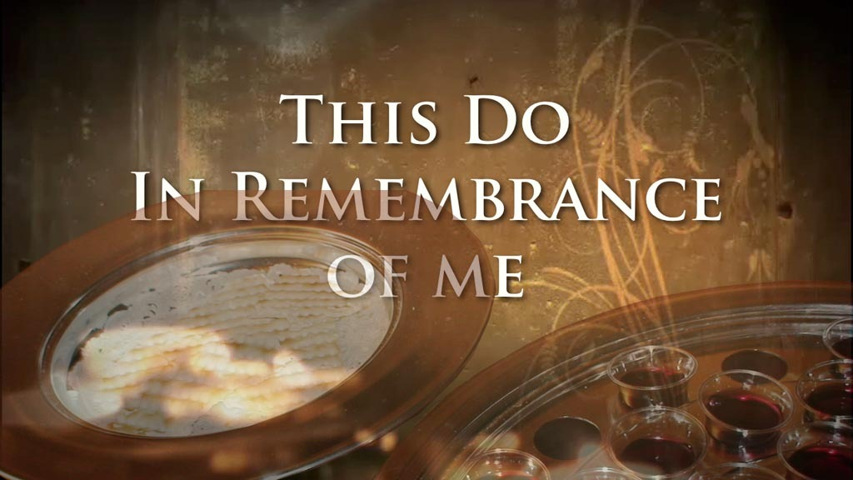

Slide 71
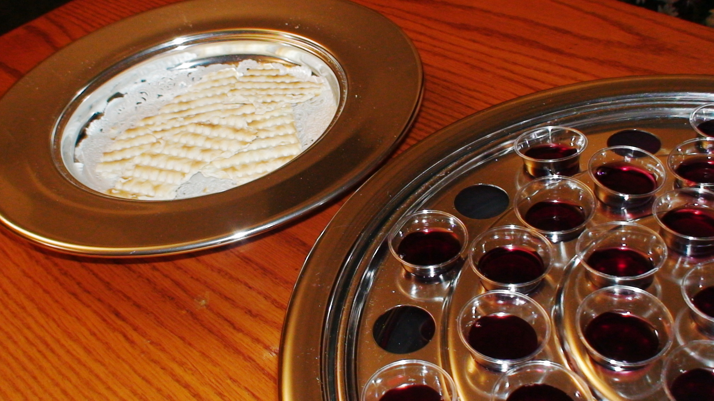
“As often as you eat this bread and drink this cup, you proclaim the Lord’s death….” 1 Corinthians 11:26

Slide 72
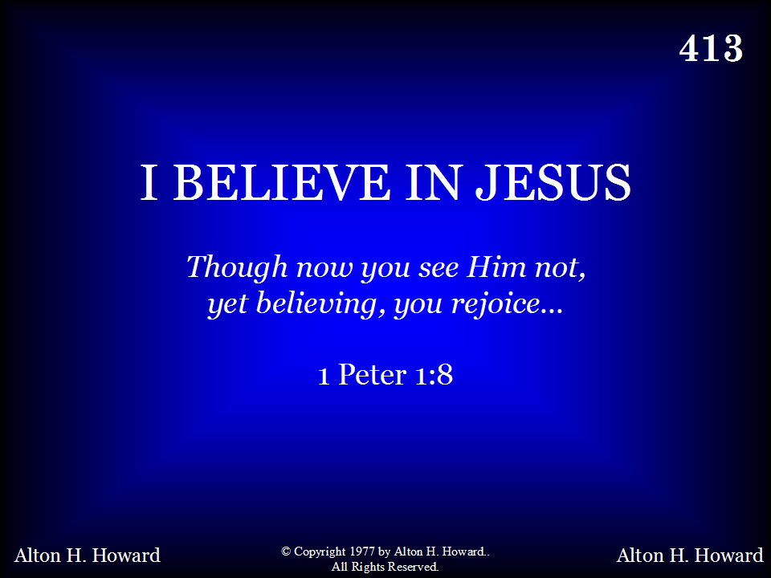
413 - I Believe In Jesus - Title

Slide 73
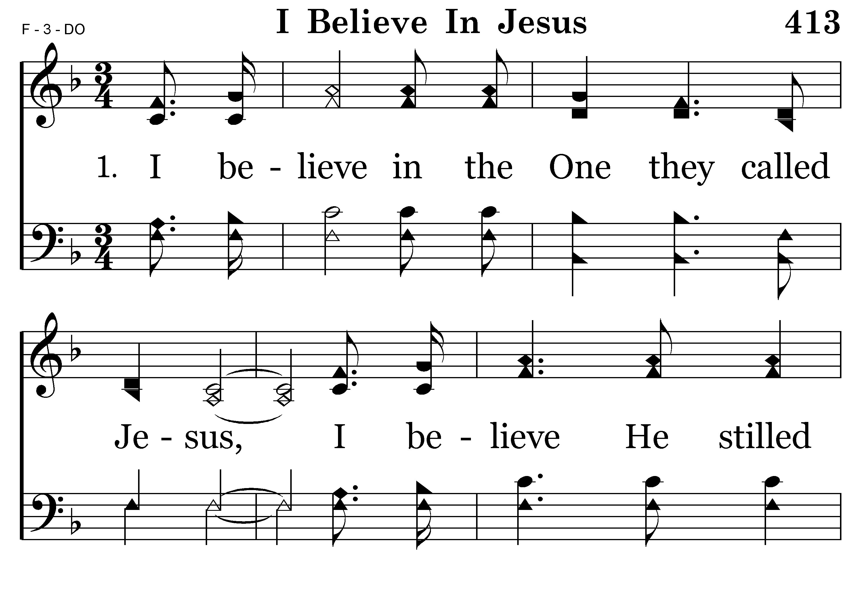
413 - I Believe In Jesus - 1.1

Slide 74
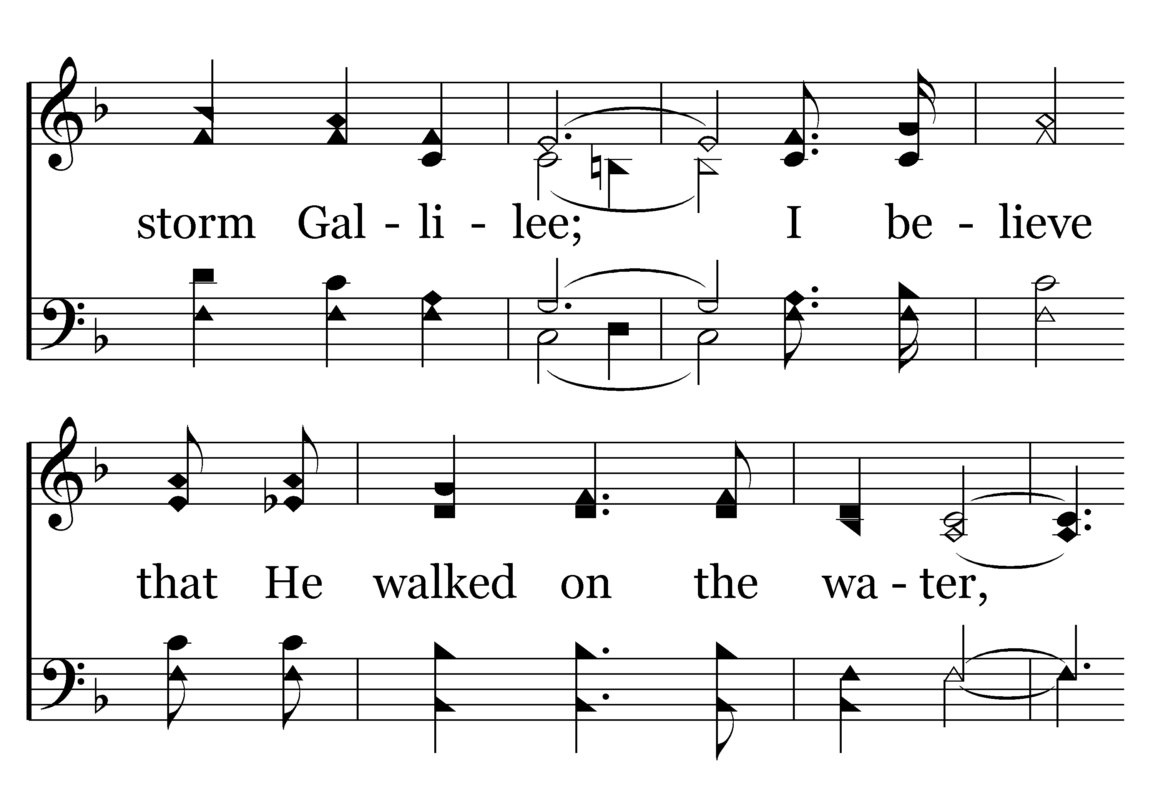
413 - I Believe In Jesus - 1.2

Slide 75
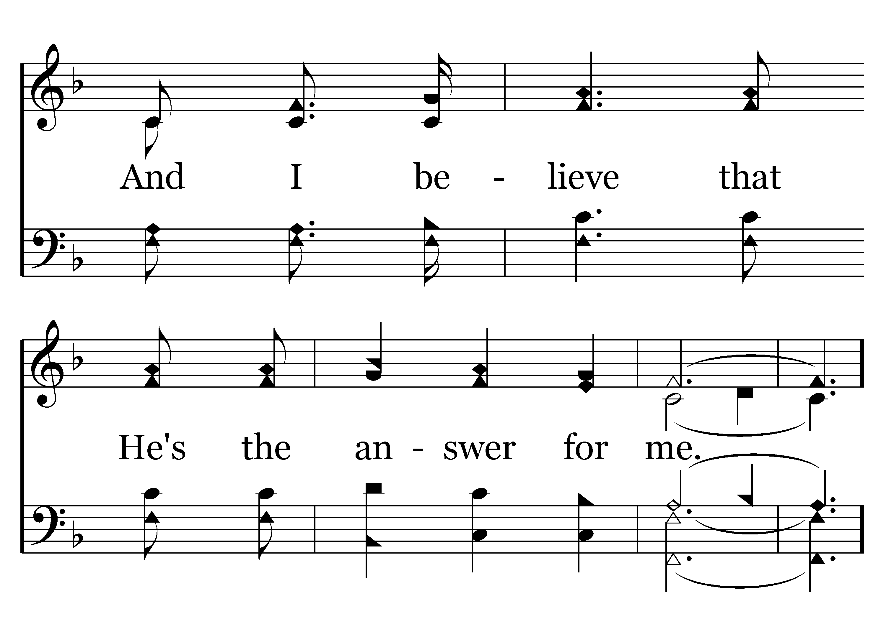
413 - I Believe In Jesus - 1.3
Sing the Chorus after all verses
End of Verse 1

Slide 76
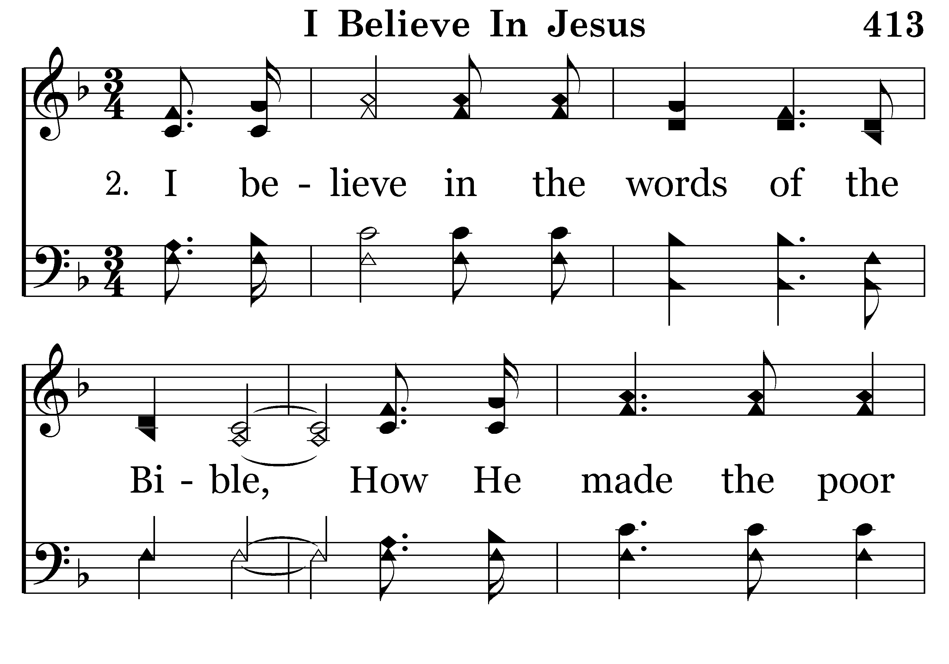
413 - I Believe In Jesus - 2.1

Slide 77
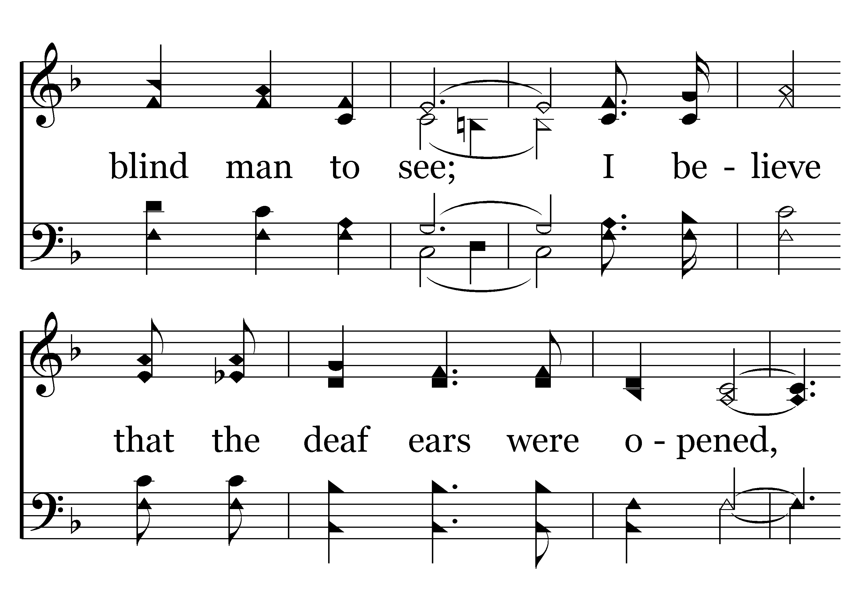
413 - I Believe In Jesus - 2.2

Slide 78

413 - I Believe In Jesus - 2.3
SING THE CHORUS AFTER ALL VERSES
End of Verse 2

Slide 79

413 - I Believe In Jesus - 3.1

Slide 80

413 - I Believe In Jesus - 3.2

Slide 81

413 - I Believe In Jesus - 3.3

Slide 82

413 - I Believe In Jesus - C.1

Slide 83

413 - I Believe In Jesus - C.2

Slide 84

413 - I Believe In Jesus - C.3
End of Song

Slide 86

416 - Do All In The Name Of The Lord - Title

Slide 87

416 - Do All In The Name Of The Lord - 1.1

Slide 88

416 - Do All In The Name Of The Lord - 1.2

Slide 89

416 - Do All In The Name Of The Lord - C.1

Slide 90

416 - Do All In The Name Of The Lord - C.2
End of Verse 1

Slide 91

416 - Do All In The Name Of The Lord - 2.1

Slide 92

416 - Do All In The Name Of The Lord - 2.2

Slide 93
416 - Do All In The Name Of The Lord - C.1

Slide 94
416 - Do All In The Name Of The Lord - C.2
End of Verse 2

Slide 95

416 - Do All In The Name Of The Lord - 3.1

Slide 96

416 - Do All In The Name Of The Lord - 3.2

Slide 97
416 - Do All In The Name Of The Lord - C.1

Slide 98
416 - Do All In The Name Of The Lord - C.2
REPEAT CHORUS

Slide 99
416 - Do All In The Name Of The Lord - C.1

Slide 100
416 - Do All In The Name Of The Lord - C.2
End of Song

Slide 102

TODAY’S TEXT
PAT SKIDMORE
JOSHUA 24:14-15

Slide 103
"Josh 24:14-15 Now fear the Lord and serve him with all faithfulness. Throw away the gods your forefathers worshiped beyond the River and in Egypt, and serve the Lord. 15 But if serving the Lord seems undesirable to you, then choose for yourselves this day whom you will serve, whether the gods your forefathers served beyond the River, or the gods of the Amorites, in whose land you are living. But as for me and my household, we will serve the Lord."
NIV

Slide 104
INVITATION SONG
# 325
I AM RESOLVED

Slide 105
MAKING CHOICES
EVERY DAY WE ARE FACED WITH CHOICES

Slide 106
THE BIBLE TALKS ABOUT CHOICES
THE WORD “CHOICES” IS USED 66 TIMES IN THE BIBLE
Josh 24:14-15 "Now fear the Lord and serve him with all faithfulness. Throw away the gods your forefathers worshiped beyond the River and in Egypt, and serve the Lord. ¹⁵ But if serving the Lord seems undesirable to you, then choose for yourselves this day whom you will serve, whether the gods your forefathers served beyond the River, or the gods of the Amorites, in whose land you are living. But as for me and my household, we will serve the Lord."

Slide 107
THE BIBLE TALKS ABOUT CHOICES
THE WORD “CHOICES IS USED 66 TIMES IN THE BIBLE
Josh 24:14-15 "Now fear the Lord and serve him with all faithfulness. Throw away the gods your forefathers worshiped beyond the River and in Egypt, and serve the Lord. ¹⁵ But if serving the Lord seems undesirable to you, then choose for yourselves this day whom you will serve, whether the gods your forefathers served beyond the River, or the gods of the Amorites, in whose land you are living. But as for me and my household, we will serve the Lord."
JOSHUA CALLED UPON ISRAEL TO MAKE A CHOICE BETWEEN IDOLS AND GOD

Slide 108

SHOULD I GET A DOG?

Slide 109

OR HAVE CHILDREN?

Slide 110
SMALL CHOICES
OFTEN A
PATTERN OF
BEHAVIOR
DEFINES OUR
SMALLER CHOICES
WILL WE GET UP?
WHAT WILL WE WEAR?
WHAT WILL WE EAT?
BIGGER CHOICES
WHAT WILL I DO FOR A LIVING?
WHO WILL I MARRY?
WE CHOOSE OUR ATTITUDE
WILL I BE HAPPY?
WILL I BE SAD?
FEW PEOPLE CONSIDER CHOICES IN THE GREATER CONTEXT OF LIFE & CONSEQUENCES

Slide 111
MOST GO THRU EACH DAY MAKING CHOICES..
WITHOUT THINKING WHERE THEY WILL LEAD
THEY FEEL THEY DON’T DESERVE WHAT IS HAPPENING TO THEM
WHEN CONSEQUENCES STARE THEM IN THE FACE
WE WANT SOMEONE TO COVER UP FOR US
OR WE WANT TO BLAME SOMEONE ELSE
IN REALITY—IT IS OUR OWN UNWISE CHOICES THAT BRING US WHERE WE ARE

Slide 112


Slide 113


Slide 114


Slide 115


Slide 116


Slide 117
JEHOSHAPHAT – KING OF JUDAH
Jehoshaphat was a good man who made some bad choices…….
2 Chron 17:3-6 The Lord was with Jehoshaphat because in his early years he walked in the ways his father David had followed. He did not consult the Baals 4 but sought the God of his father and followed his commands rather than the practices of Israel. 5 The Lord established the kingdom under his control; and all Judah brought gifts to Jehoshaphat, so that he had great wealth and honor. 6 His heart was devoted to the ways of the Lord; furthermore, he removed the high places and the Asherah poles from Judah.

Slide 118
JEHOSHAPHAT – KING OF JUDAH
Jehoshaphat kept making sinful alliances…..
1 Kings 16:30-33 Ahab son of Omri did more evil in the eyes of the Lord than any of those before him. 31 He not only considered it trivial to commit the sins of Jeroboam son of Nebat, but he also married Jezebel daughter of Ethbaal king of the Sidonians, and began to serve Baal and worship him. 32 He set up an altar for Baal in the temple of Baal that he built in Samaria. 33 Ahab also made an Asherah pole and did more to provoke the Lord, the God of Israel, to anger than did all the kings of Israel before him.

Slide 119
JEHOSHAPHAT – KING OF JUDAH
Jehoshaphat kept making sinful alliances…..
JEHOSPHAPHAT..THE BEST KING JUDAH HAD SINCE DAVID
AHAB THE WORST KING ISREAL EVER HAD
SEVERAL TIMES JEHOSPHAPHAT MADE ALLIANCES WITH AHAB & HIS SONS

Slide 120
JEHOSHAPHAT – KING OF JUDAH
2 Chron 18:1 Now Jehoshaphat had great wealth and honor, and he allied himself with Ahab by marriage.
His son-Jehoram married Abab’s daughter –2 Chron 18:1
He allied with Ahab in war – 2 Chron. 18:3
He allied with Ahab in business – 2 Chron. 20:35
JEHOSPHAT WAS A GOOD MAN
JEHOSPHAT WAS A GOOD KING
JEHOSPHAT WAS A FAITHFUL SERVANT

Slide 121
JEHOSHAPHAT – KING OF JUDAH
WHEN IT CAME TO THIS ISSUE OF ALLIANCES
HE KEPT MAKING BAD CHOICES
THESE BAD CHOICES CAME BACK TO HAUNT HIM
THERE ARE LESSONS WE CAN LEARN FROM JEHOSPHAT’S CHOICES

Slide 122
OUR CHOICES WILL AFFECT OUR LIVES
Jehoshaphat’s good life did not prevent him facing consequences in his own life
The war alliance with Ahab—ended in defeat

Slide 123
2 Chron 18:28-34 So the king of Israel and Jehoshaphat king of Judah went up to Ramoth Gilead. 29 The king of Israel said to Jehoshaphat, "I will enter the battle in disguise, but you wear your royal robes." So the king of Israel disguised himself and went into battle.
30 Now the king of Aram had ordered his chariot commanders, "Do not fight with anyone, small or great, except the king of Israel." 31 When the chariot commanders saw Jehoshaphat, they thought, "This is the king of Israel." So they turned to attack him, but Jehoshaphat cried out, and the Lord helped him. God drew them away from him, 32 for when the chariot commanders saw that he was not the king of Israel, they stopped pursuing him.

Slide 124
33 But someone drew his bow at random and hit the king of Israel between the sections of his armor. The king told the chariot driver, "Wheel around and get me out of the fighting. I've been wounded." 34 All day long the battle raged, and the king of Israel propped himself up in his chariot facing the Arameans until evening. Then at sunset he died.

Slide 125
OUR CHOICES WILL AFFECT OUR LIVES
Jehoshaphat’s good life did not prevent him facing consequences in his own life
The war alliance with Ahab—ended in defeat
In the business alliance with Ahab’s son– Jehoshaphat lost his investment

Slide 126
2 Chron 20:35-37 Later, Jehoshaphat king of Judah made an alliance with Ahaziah king of Israel, who was guilty of wickedness. 36 He agreed with him to construct a fleet of trading ships. After these were built at Ezion Geber, 37 Eliezer son of Dodavahu of Mareshah prophesied against Jehoshaphat, saying, "Because you have made an alliance with Ahaziah, the Lord will destroy what you have made." The ships were wrecked and were not able to set sail to trade.

Slide 127
OUR CHOICES WILL AFFECT OUR LIVES
Jehoshaphat’s good life did not prevent him facing consequences in his own life
The war alliance with Ahab—ended in defeat
In the business alliance with Ahab’s son– Jehoshaphat lost his investment
The marriage alliance—Jehoshpaphat’s son—married Athaliah, Ahab’s daughter—ended in disaster

Slide 128
OUR CHOICES WILL AFFECT OUR FAMILY
By marrying Jehoram – Jehoshaphat’s son to Athaliah– Ahab’s daughter– the spiritual state of his son and grandson was affected
2 Chron 21:5-7 Jehoram was thirty-two years old when he became king, and he reigned in Jerusalem eight years. 6 He walked in the ways of the kings of Israel, as the house of Ahab had done, for he married a daughter of Ahab. He did evil in the eyes of the Lord.

Slide 129
2 Chron 22:2-4 Ahaziah [ Jehosphaphat’s grandson ] was twenty-two years old when he became king, and he reigned in Jerusalem one year. His mother's name was Athaliah, a granddaughter of Omri.
3 He too walked in the ways of the house of Ahab, for his mother encouraged him in doing wrong. 4 He did evil in the eyes of the Lord, as the house of Ahab had done, for after his father's death they became his advisers, to his undoing.

Slide 130
2 Chron 21:4 When Jehoram established himself firmly over his father's kingdom, he put all his brothers to the sword along with some of the princes of Israel.
2 Chron 22:10-11 When Athaliah the mother of Ahaziah saw that her son was dead, she proceeded to destroy the whole royal family of the house of Judah.
These consequences all began with Jehoshaphat’s bad choices
WE ARE NOT DIFFERENT
OUR CHOICES WILL AFFECT OUR FAMILY

Slide 131
OUR CHOICES WILL AFFECT OTHERS
Lives of soldiers who died as a result of Jehoshaphat’s alliance with Ahab in war
Imagine how their families must have felt—knowing their loved ones died because of Jehoshaphat’s bad choice
Jehoshaphat’s choice to ally himself with Ahab in marriage affected the entire nation for 14 years

Slide 132
OUR CHOICES WILL AFFECT OTHERS
At the end of these 14 years:
A temple had been built to worship Baal
God’s house had been defaced
God’s house had been damaged
God’s house had been disgraced

Slide 133
OUR CHOICES WILL AFFECT OTHERS
We cry: “It’s not fair that these people suffered the consequences of one man’s choice”
But that is life
Choices have consequences
We will be held accountable for the ill affects of our bad choices

Slide 134
CONSIDER WHERE YOUR CHOICES WILL LEAD AND CHOOSE WISELY
We are not kings
Our choices will not have the far-reaching affects his did
But—our choices will have consequences
Our choices will bring consequences on
Us
Our families
Others

Slide 135

WHEN YOU PICK UP A SNAKE BY THE TAIL….YOU ALSO PICK UP HIS HEAD

Slide 136
WE CAN READILY SEE JEHOSHAPHAT’S ERROR
He put political concerns for his nation above the spiritual concerns for his family…..
His alliance with Ahab by allowing his son to marry Ahab’s daughter was the worst decision of his life…..
His desire to unite a divided kingdom (Judah & Israel) overweighed his concerns for the affects on his family…..
Our choices may not affect nations—but they will affect the spiritual status of our family…..

Slide 137
Josh 24:14-15 "Now fear the Lord and serve him with all faithfulness. Throw away the gods your forefathers worshiped beyond the River and in Egypt, and serve the Lord. 15 But if serving the Lord seems undesirable to you, then choose for yourselves this day whom you will serve, whether the gods your forefathers served beyond the River, or the gods of the Amorites, in whose land you are living. But as for me and my household, we will serve the Lord."
MAY WE LIKE JOSHUA RESOLVE THAT WE AND OUR HOUSE HOLD WILL CHOOSE TO SERVE THE LORD

Slide 138
Instead of complaining about the consequences of our choices
We need instead to think about the consequences before we make our choices
When making a choice we cannot think about the MOMENT—we must think about the long-term effects of that choice
If we think about the consequences FIRST….
We won’t have to face them LATER……..

Slide 139
EVERY CHOICE HAS A CONSEQUENCE!!!!
If you are a Christian—you will have some moral & spiritual choices to make
What you choose will have consequences
If you are not a Christian—you have a choice right now
What you choose will have consequences

Slide 141

325 - I Am Resolved - Title

Slide 142

325 - I Am Resolved - 1.1

Slide 143

325 - I Am Resolved - 1.2

Slide 144

325 - I Am Resolved - C.1

Slide 145

325 - I Am Resolved - C.2

Slide 146

325 - I Am Resolved - C.3
End of Verse 1

Slide 147

325 - I Am Resolved - 2.1

Slide 148

325 - I Am Resolved - 2.2

Slide 149
325 - I Am Resolved - C.1

Slide 150
325 - I Am Resolved - C.2

Slide 151
325 - I Am Resolved - C.3
End of Verse 2

Slide 152

325 - I Am Resolved - 3.1

Slide 153

325 - I Am Resolved - 3.2

Slide 154
325 - I Am Resolved - C.1

Slide 155
325 - I Am Resolved - C.2

Slide 156
325 - I Am Resolved - C.3
End of Verse 3

Slide 157

325 - I Am Resolved - 4.1

Slide 158

325 - I Am Resolved - 4.2

Slide 159
325 - I Am Resolved - C.1

Slide 160
325 - I Am Resolved - C.2

Slide 161
325 - I Am Resolved - C.3
End of Song

Slide 163


Slide 165

CLOSING PRAYER
JERRY MELLISH

Slide 166


Slide 167
THANK YOU FOR VISITING WITH US
PLEASE COME BACK

