Slide 1
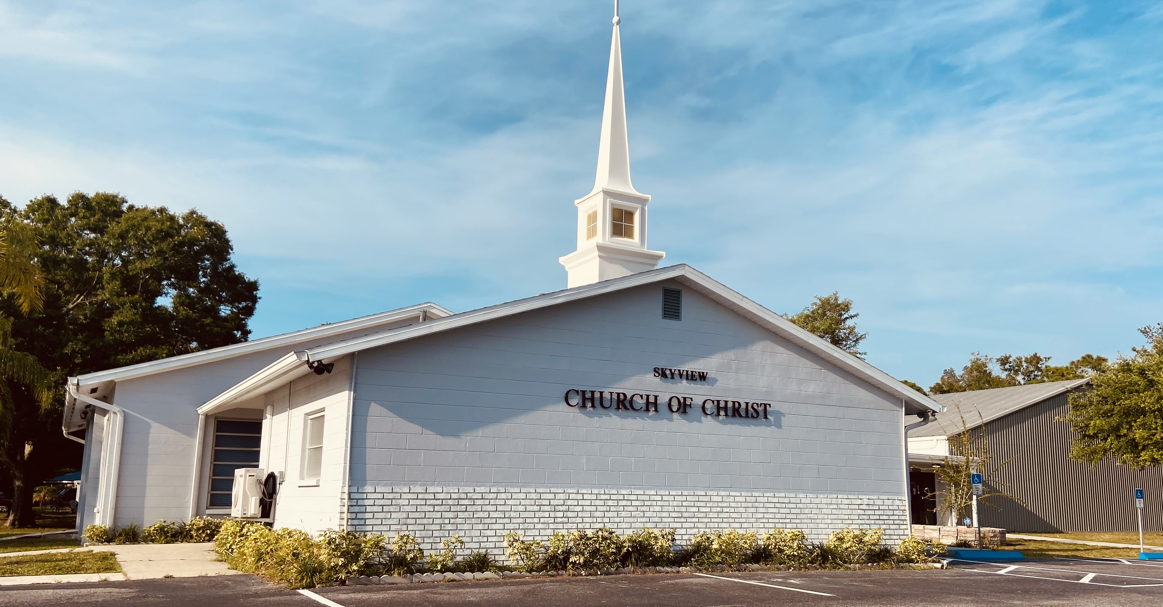
WELCOME TO OUR SERVICES

Slide 2
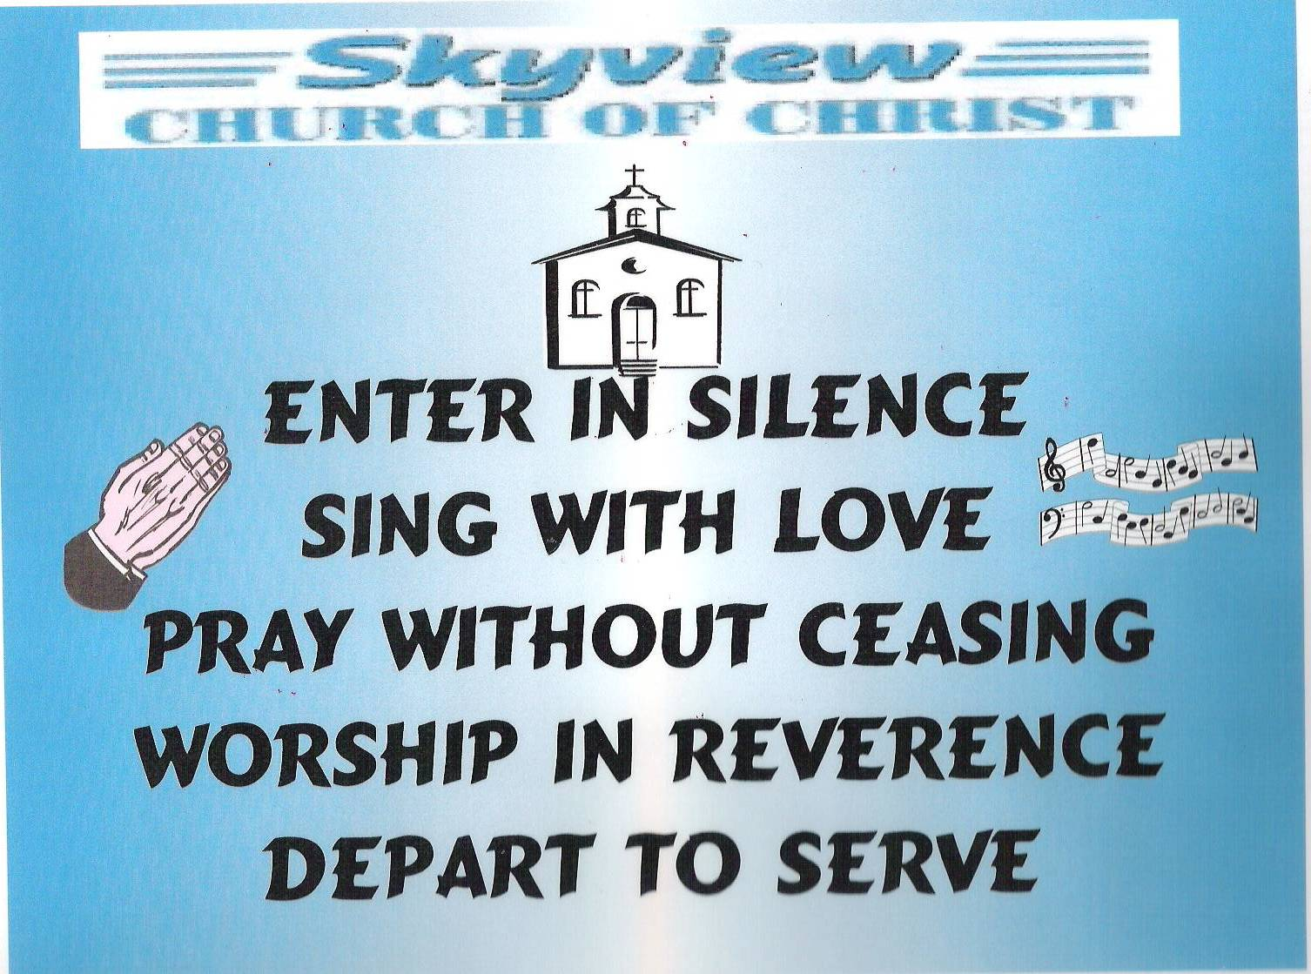
DESIGNED BY JIM INGRAM

Slide 3


Slide 4


Slide 5

SUNDAY – 9:30 AM
MONDAY BIBLE STUDY – 6:30 PM IN WEST ANNEX
WEDNESDAY BIBLE STUDY – 7:00 PM IN WEST ANNEX
W.I.N.G.S. LADIES CLASS THURSDAY– 10 AM IN WEST ANNEX

Slide 6
TODAY’S WORSHIP LEADERS
CALL TO WORSHIP
PRAYER
SONG LEADER
SCRIPTURE
HEADING TABLE
SERMON
CLOSING PRAYER
ANNOUNCEMENTS
Jim Ingram
Henry Oliu
Sander Fletcher
Denning Andrews
David Hammontree
Charles Murray
Derrick Cowan
Brad VanHaerents

Slide 7

MONDAY NIGHT BIBLE STUDY 6:30PM will meet in the West Annex
WEDNESDAY BIBLE STUDY will meet in the West Annex until further notice
LADIES BIBLE CLASS W.I.N.G.S (Women In God’s Service) Thursday 10:00 AM – meets in the West Annex

Slide 8

FIVE MINUTE RULE

Slide 9


Slide 10


Slide 11


Slide 13
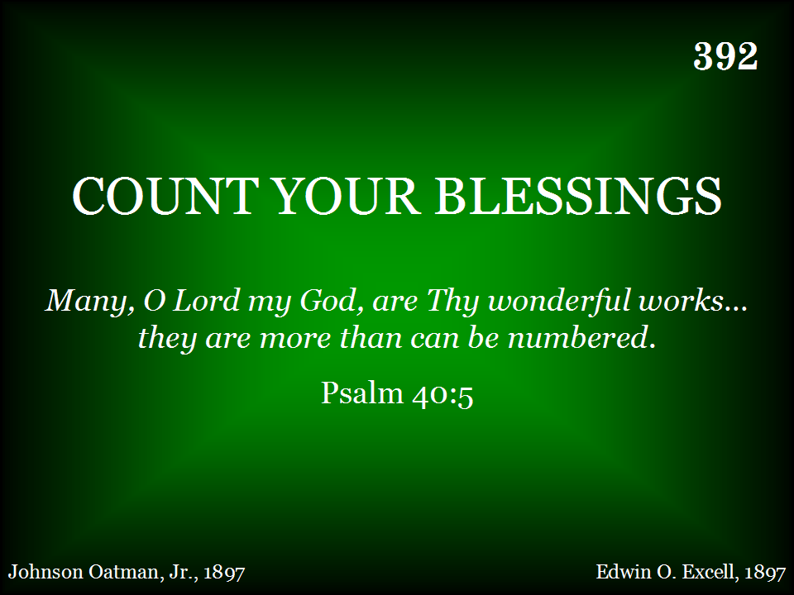
392 - Count Your Blessings - Title

Slide 14
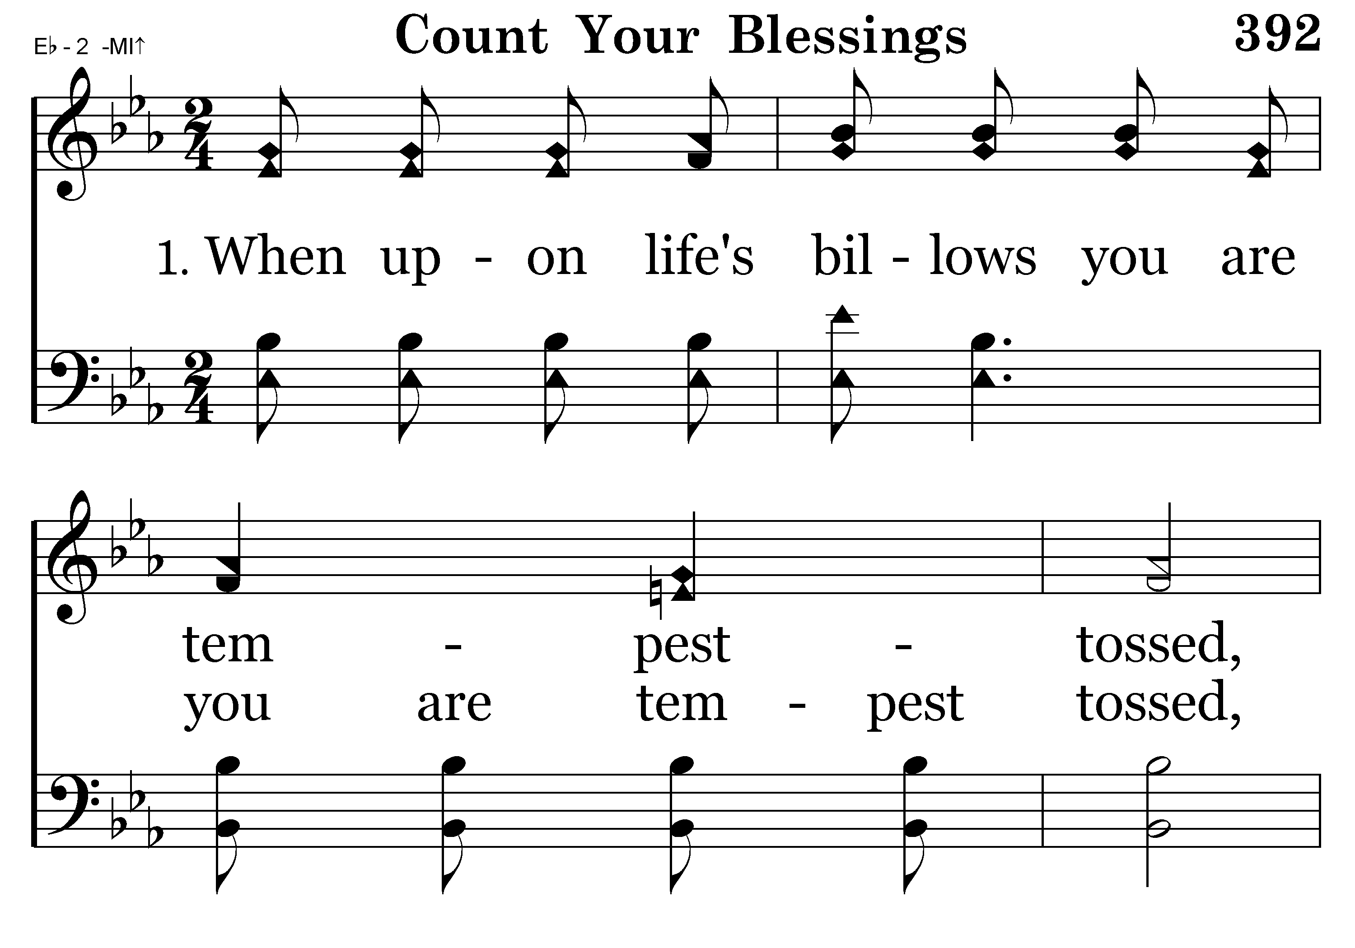
392 - Count Your Blessings - 1.1

Slide 15
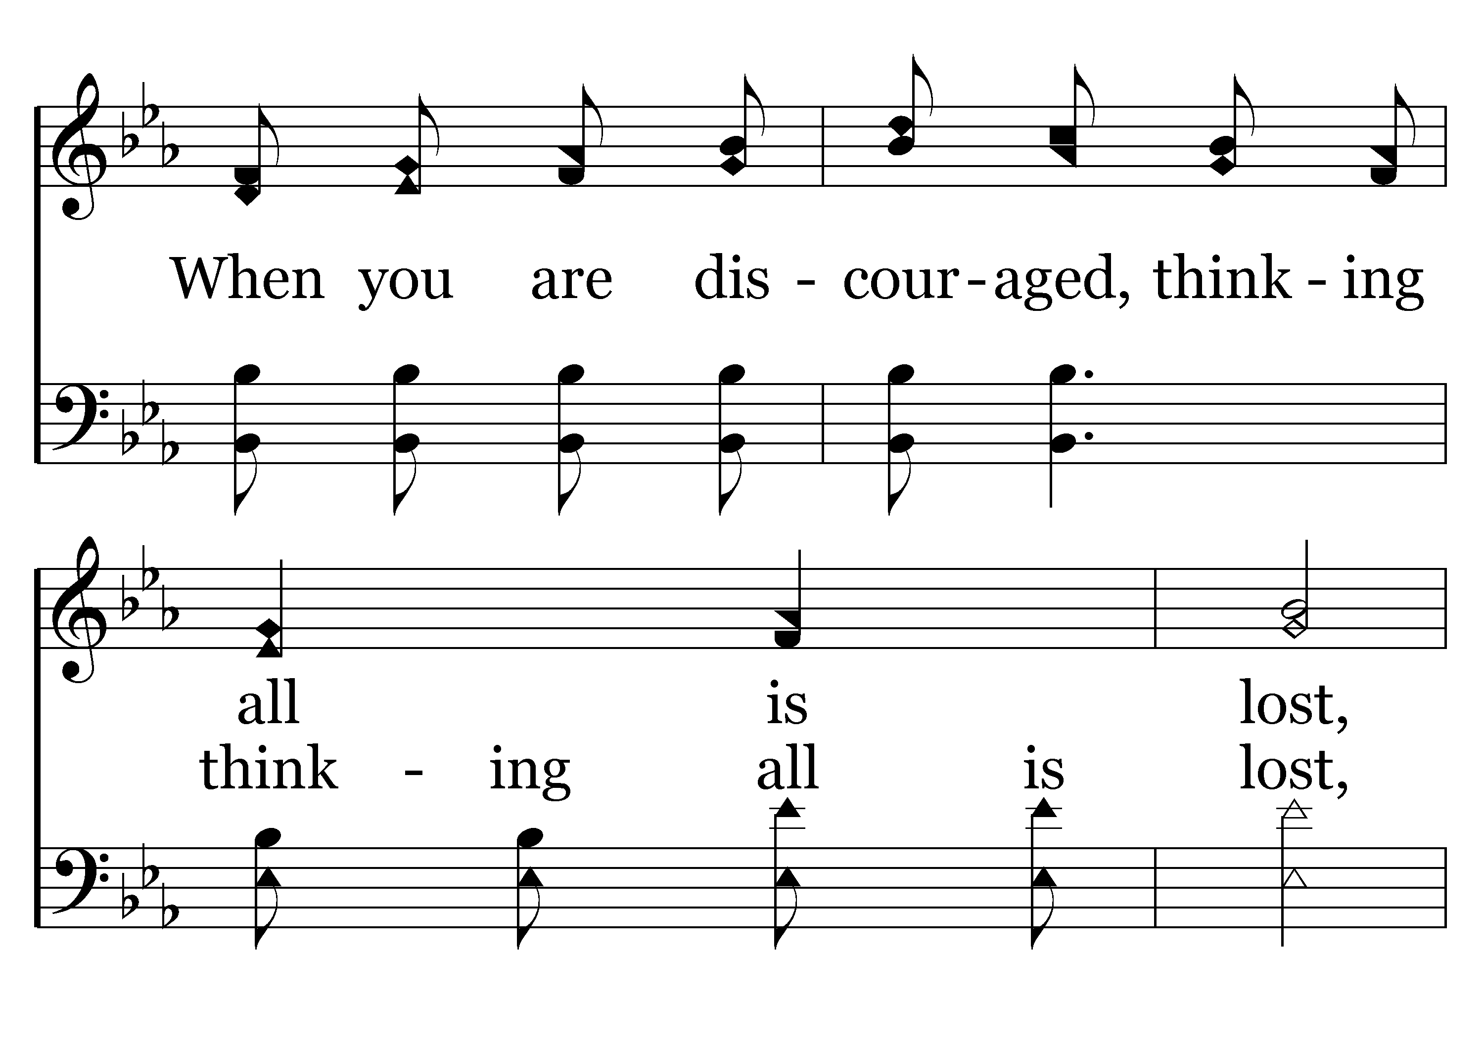
392 - Count Your Blessings - 1.2

Slide 16
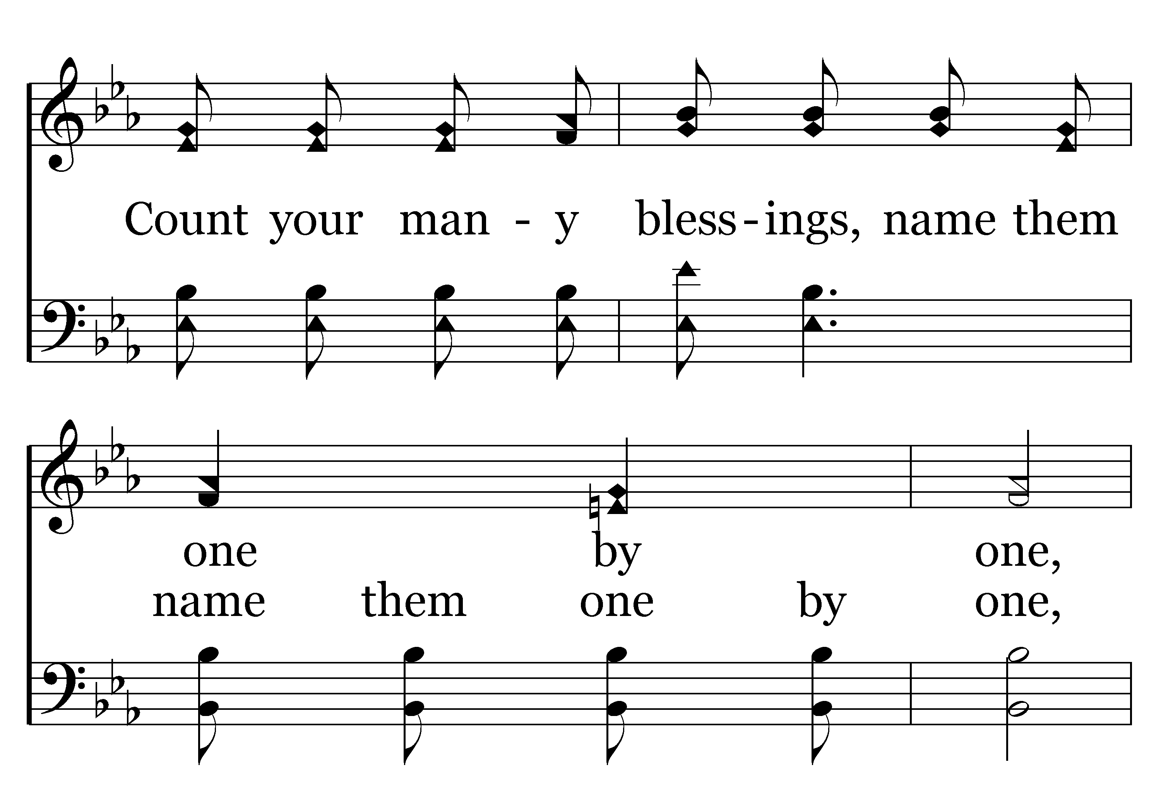
392 - Count Your Blessings - 1.3

Slide 17
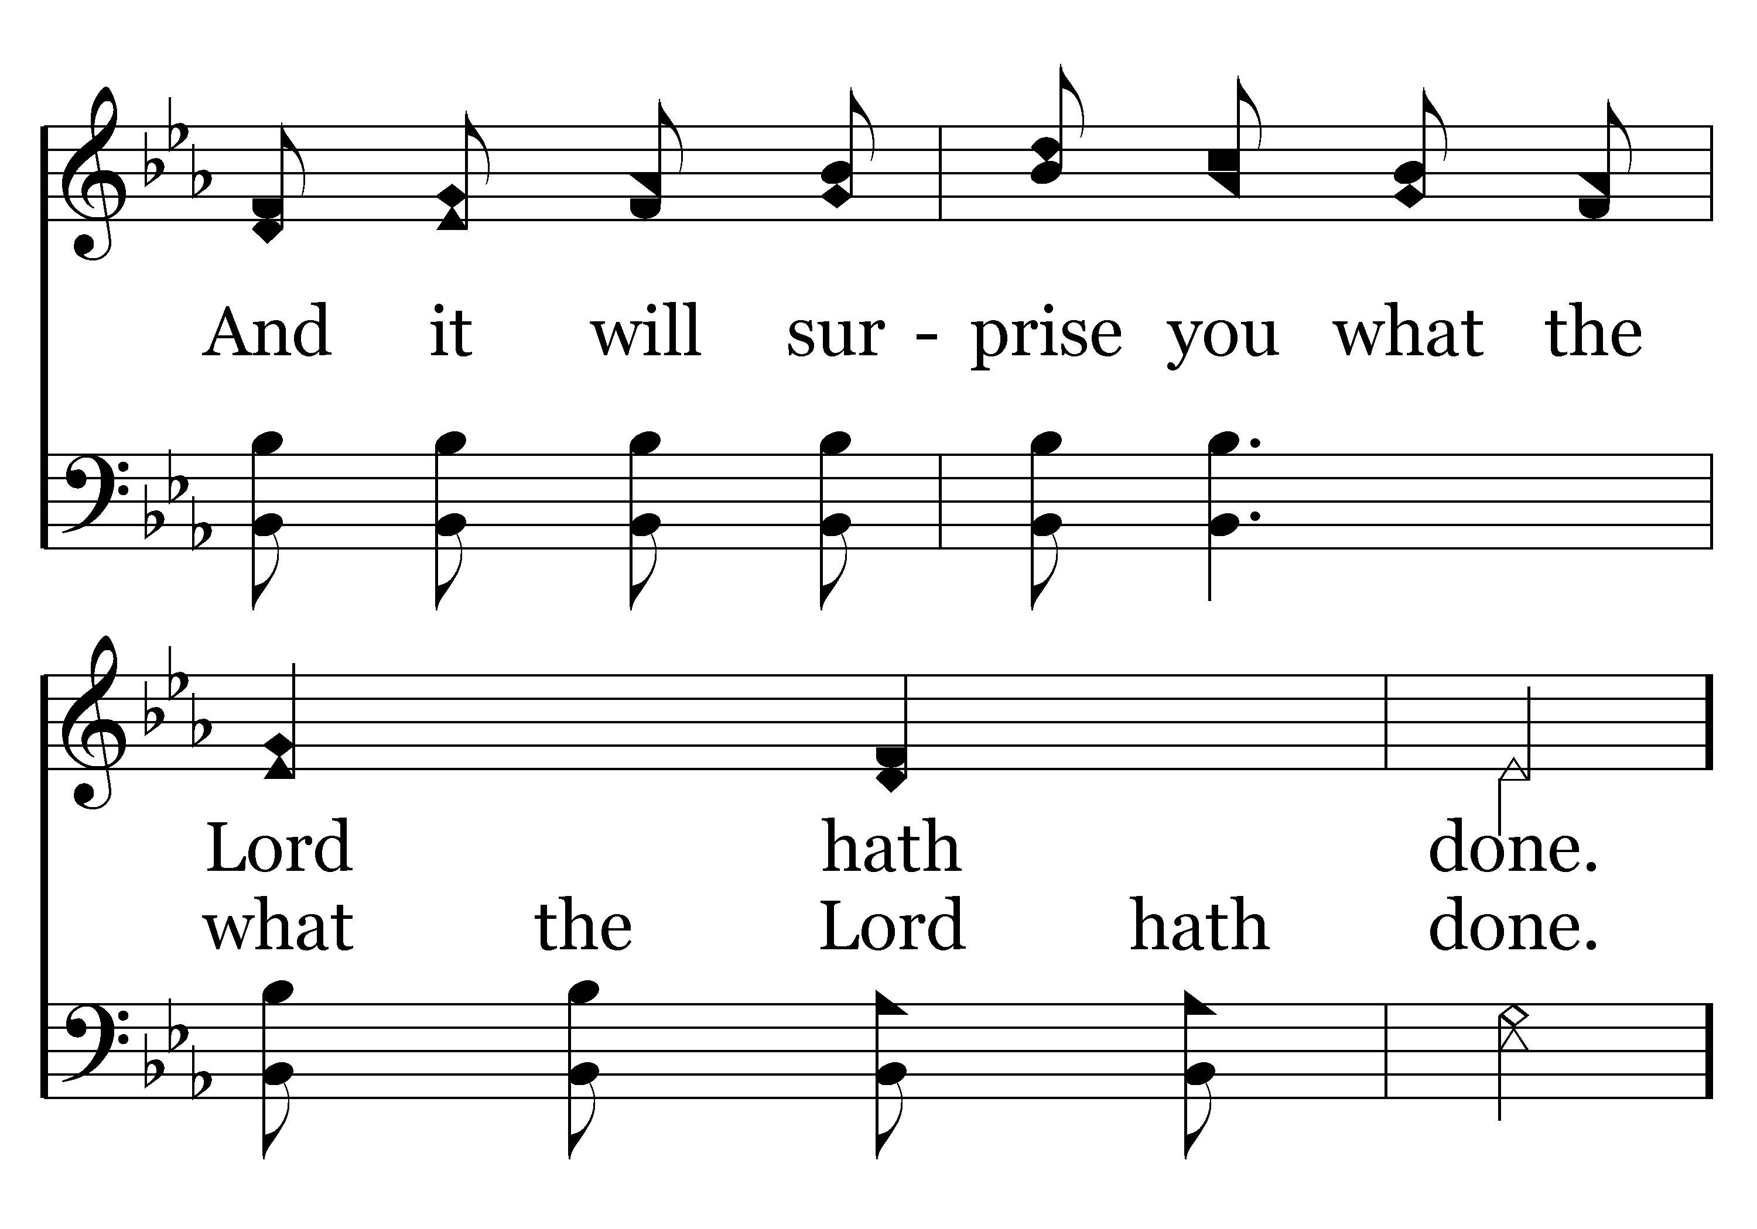
392 - Count Your Blessings - 1.4
End of Verse 1

Slide 18
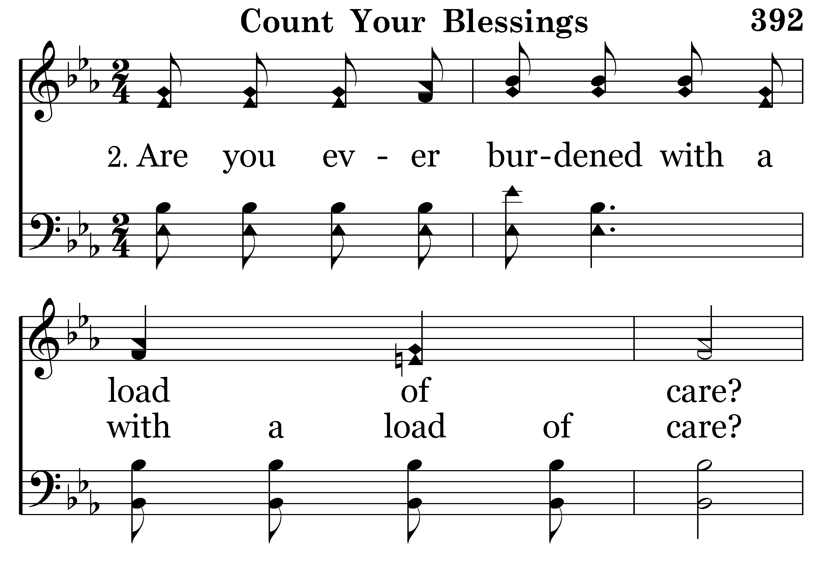
392 - Count Your Blessings - 2.1

Slide 19
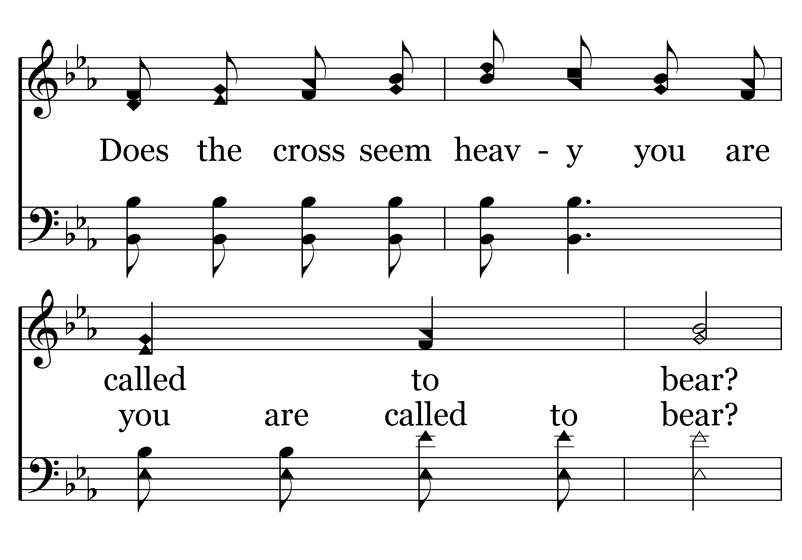
392 - Count Your Blessings - 2.2

Slide 20
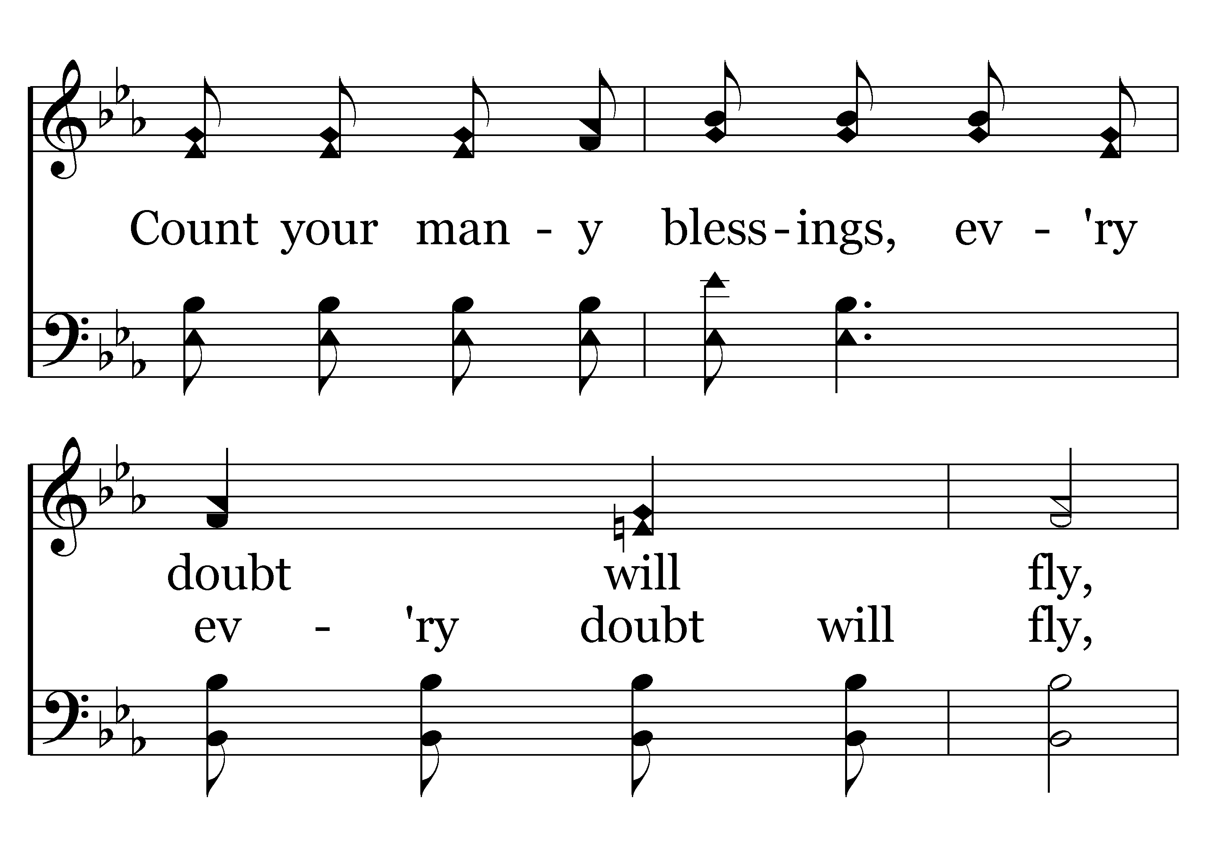
392 - Count Your Blessings - 2.3

Slide 21
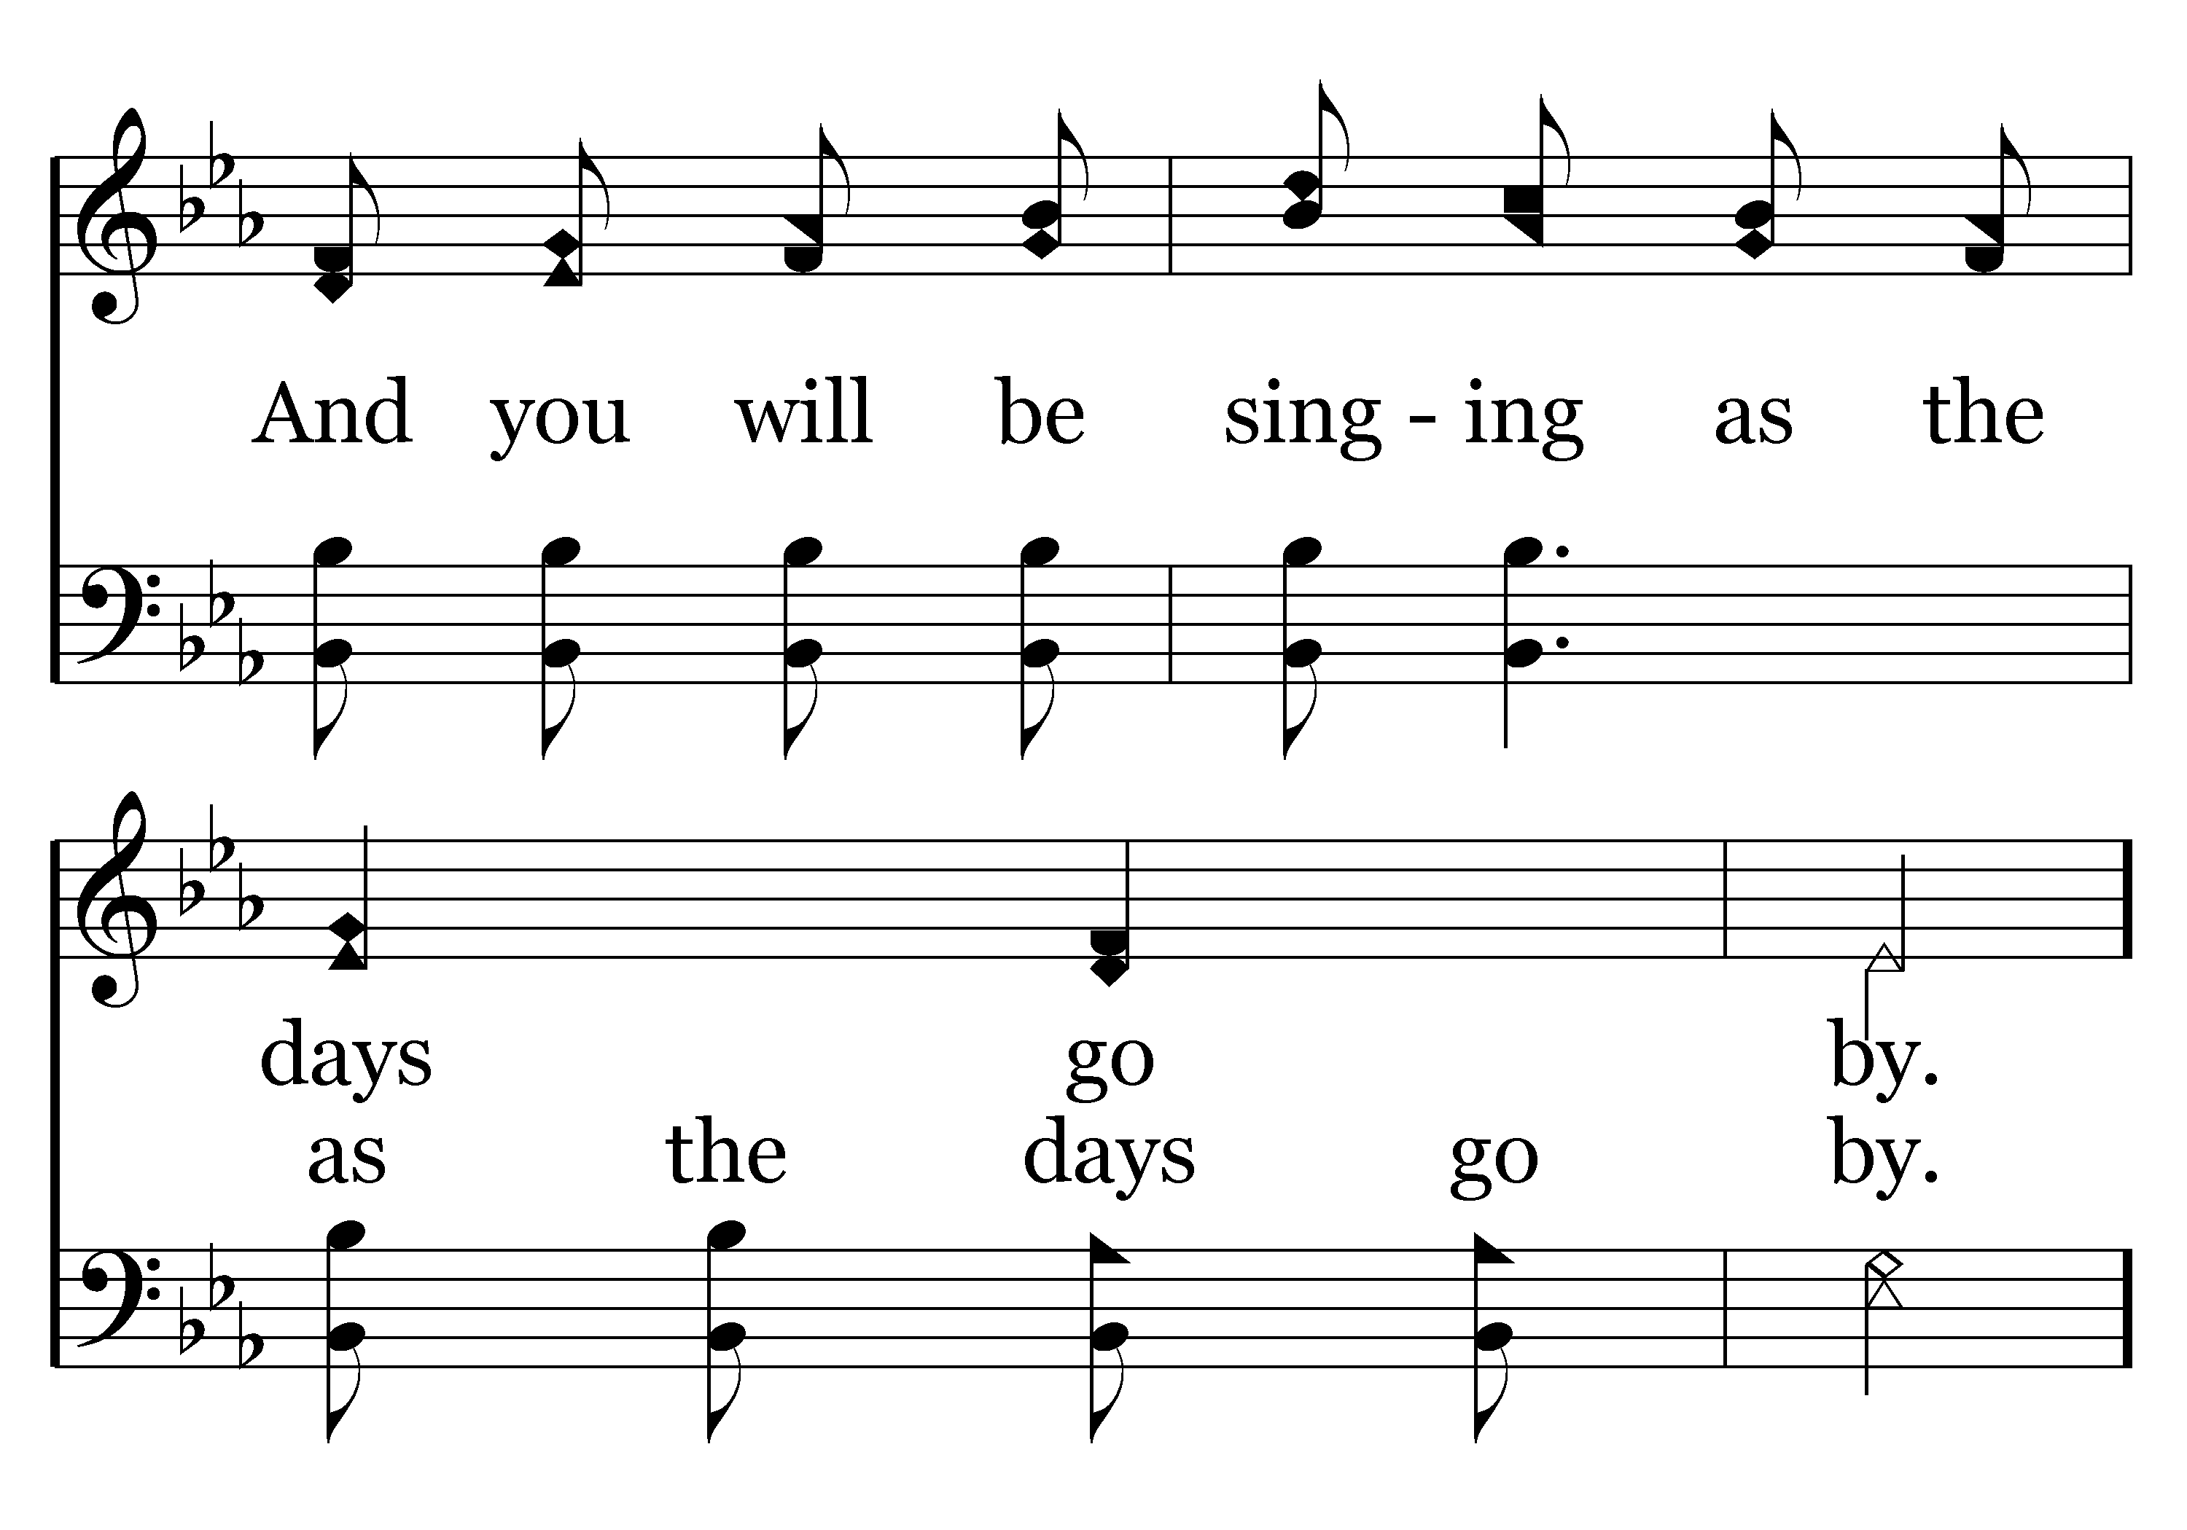
392 - Count Your Blessings - 2.4
End of Verse 2

Slide 22
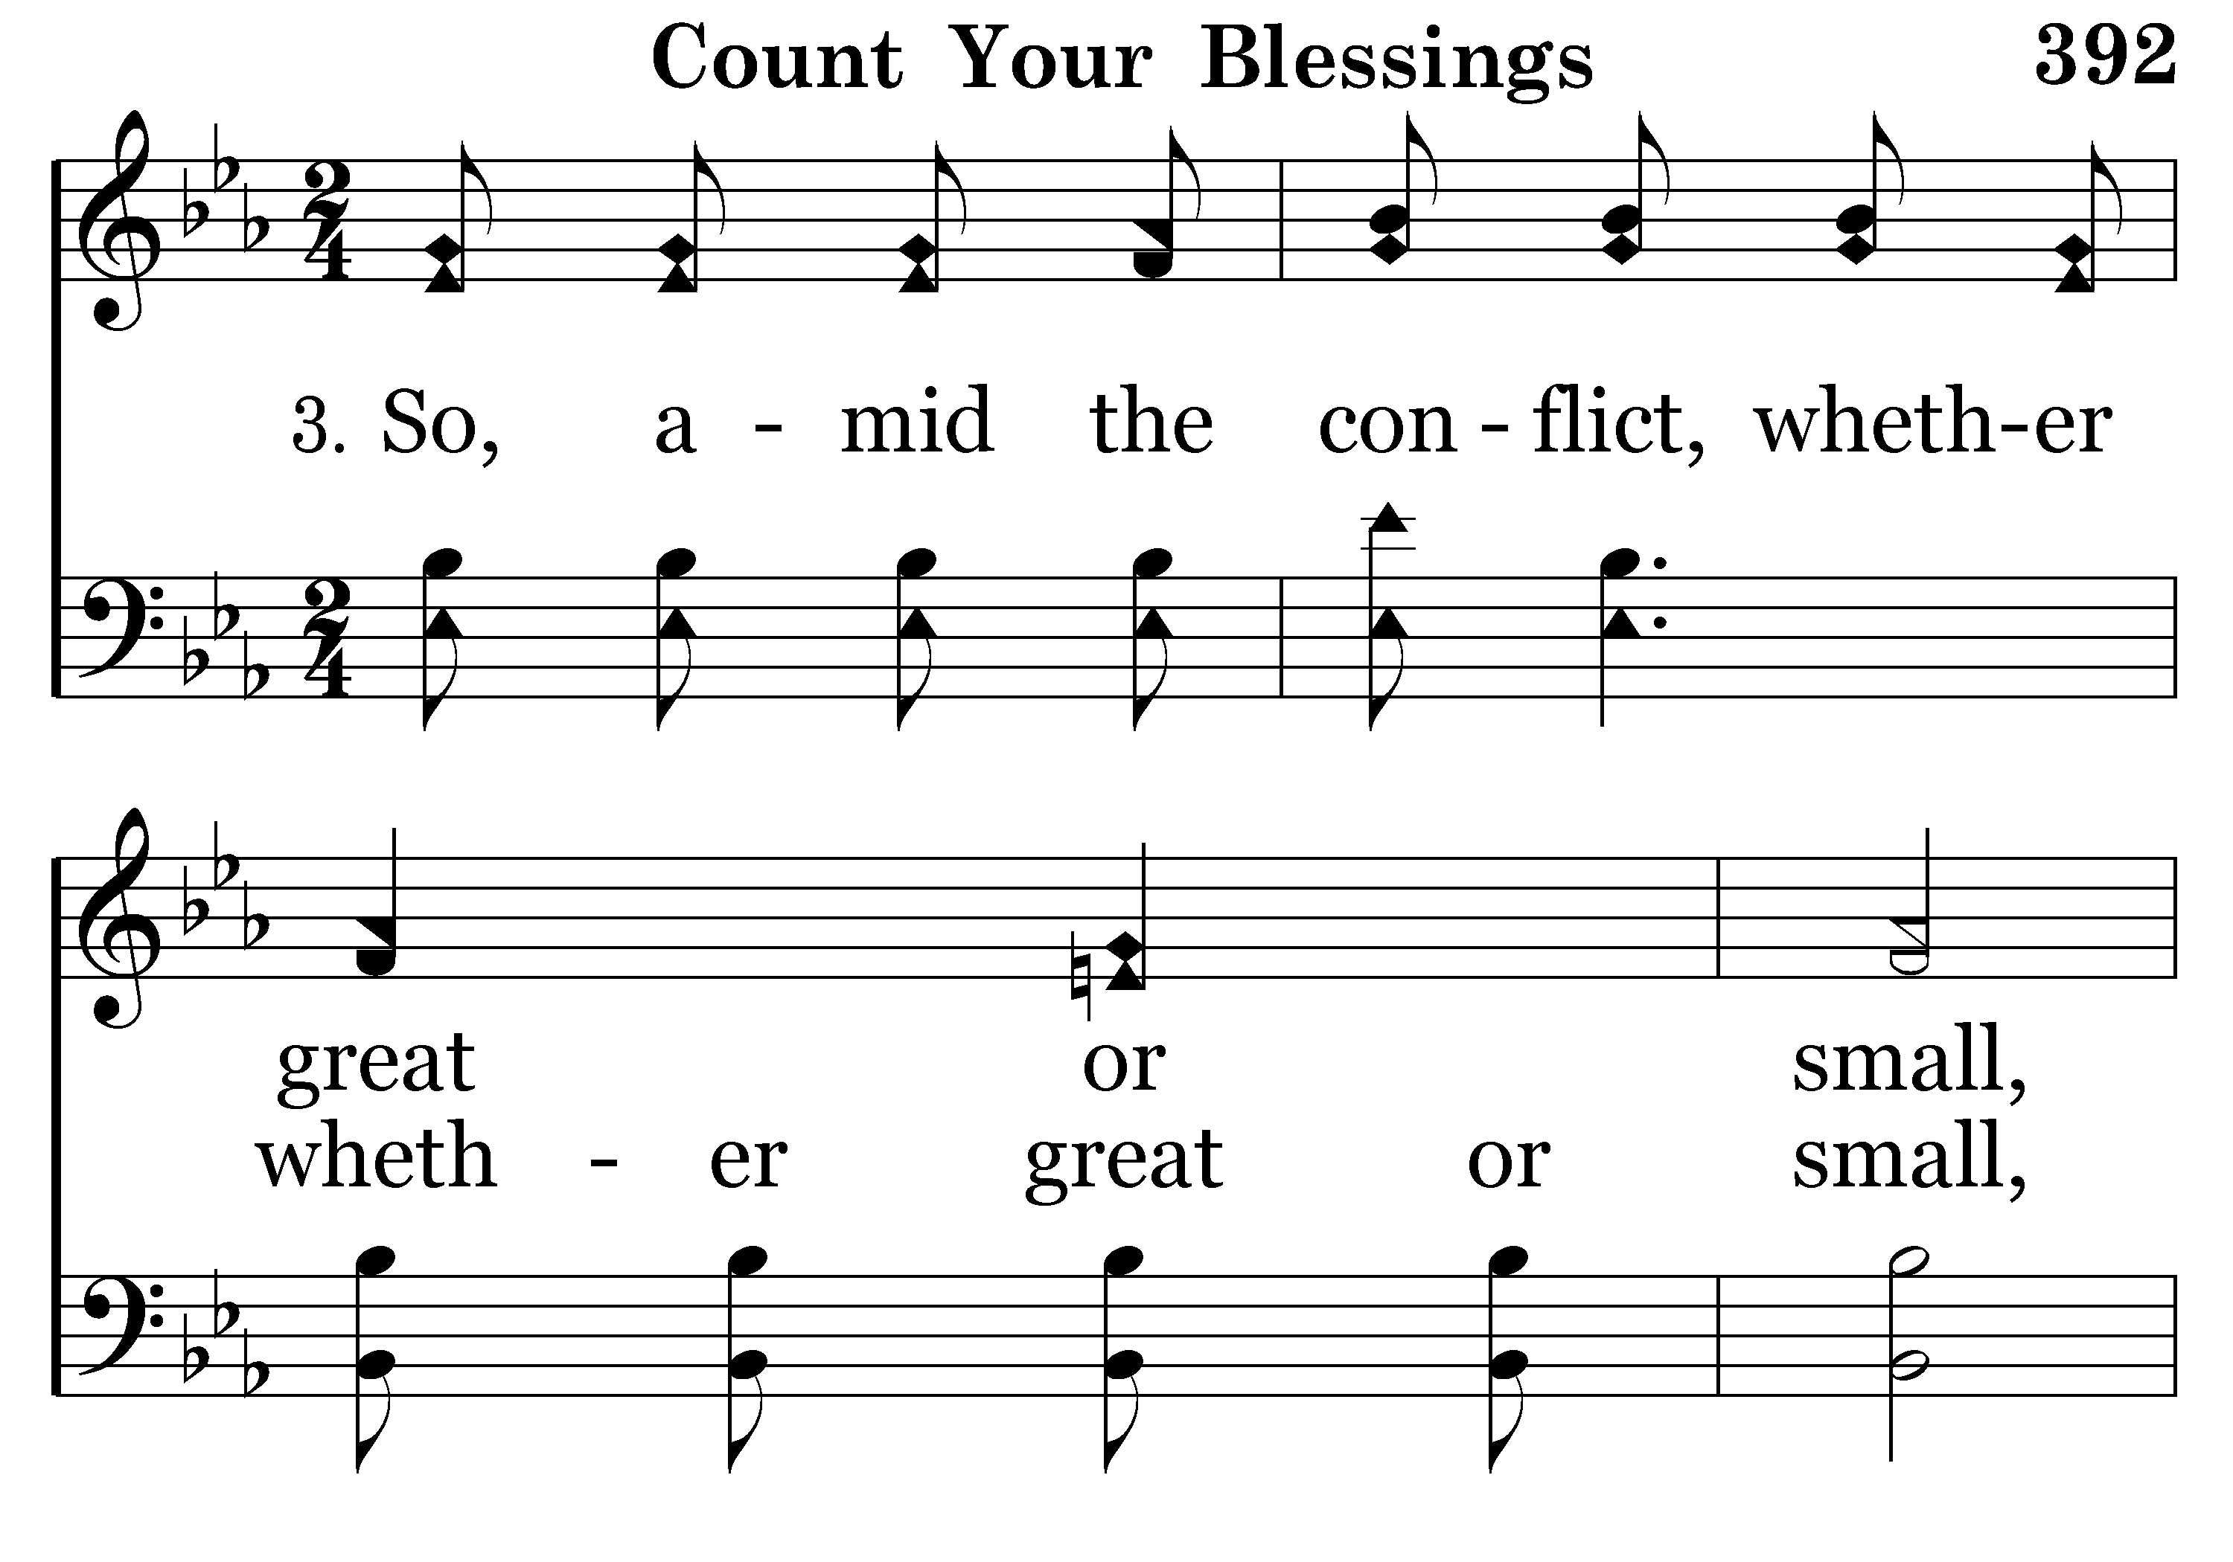
392 - Count Your Blessings - 3.1

Slide 23
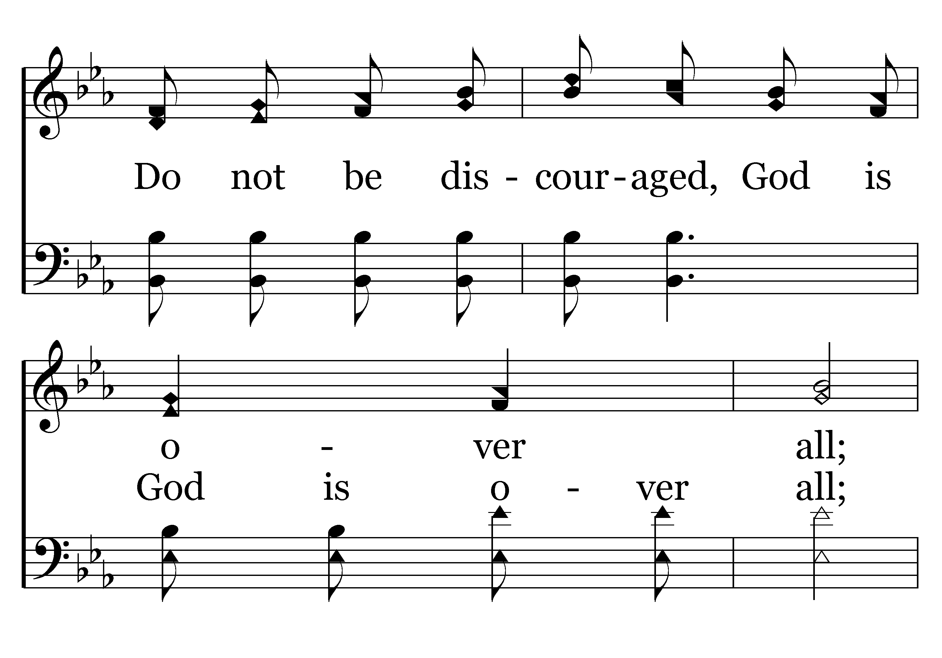
392 - Count Your Blessings - 3.2

Slide 24
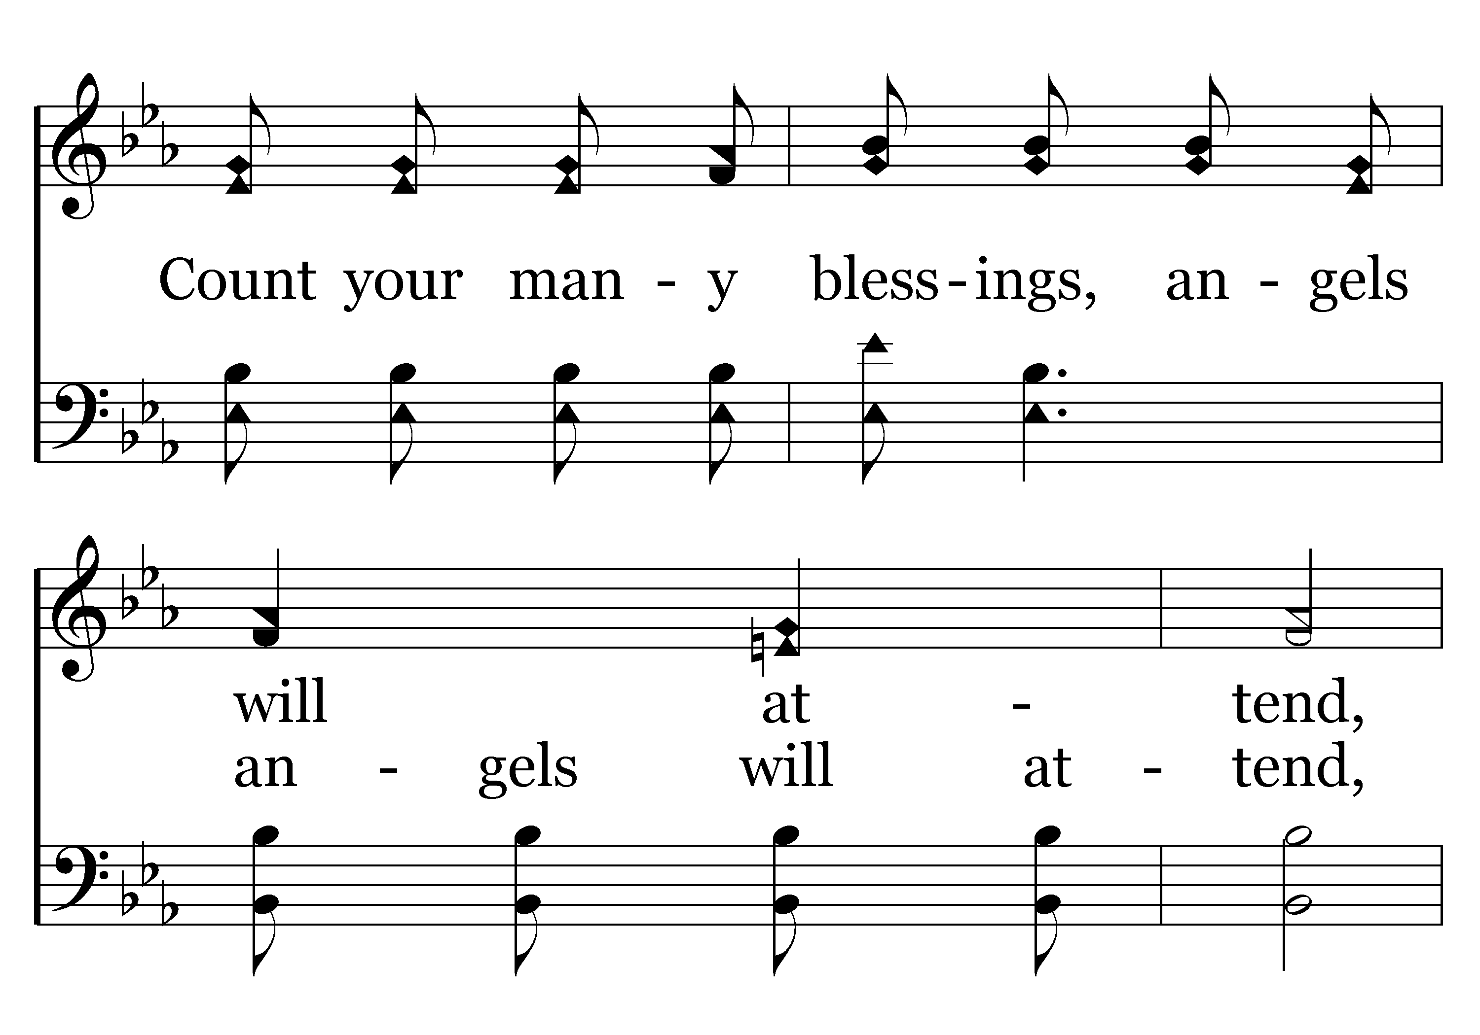
392 - Count Your Blessings - 3.3

Slide 25
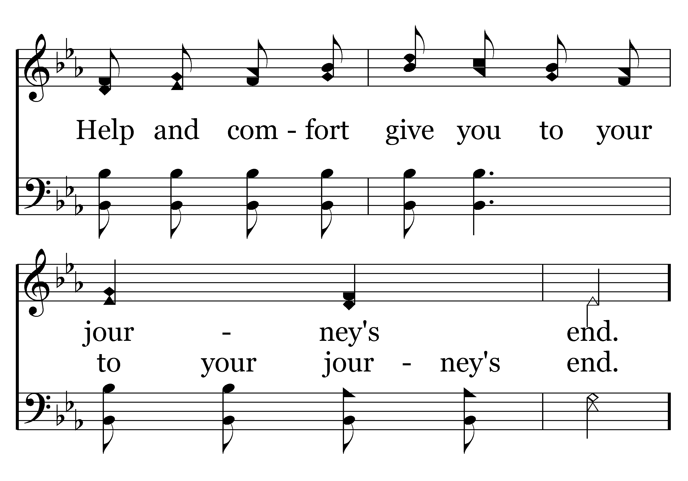
392 - Count Your Blessings - 3.4

Slide 26
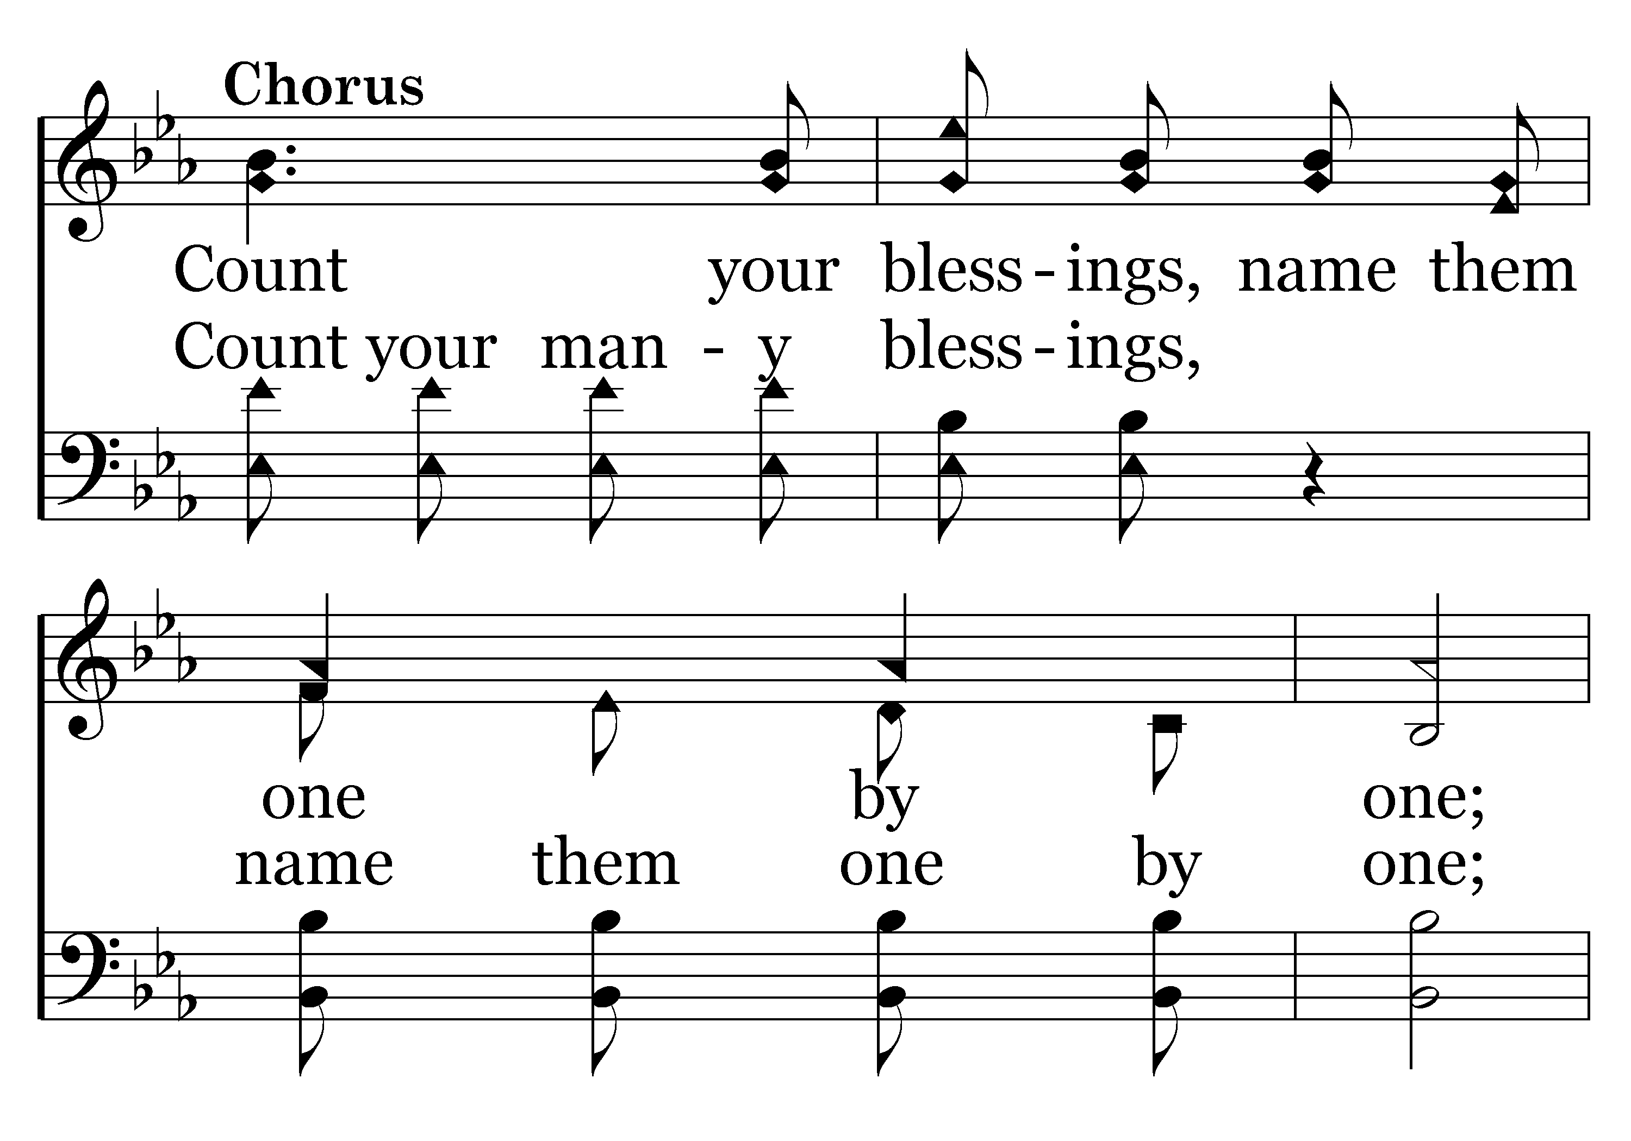
392 - Count Your Blessings - C.1

Slide 27
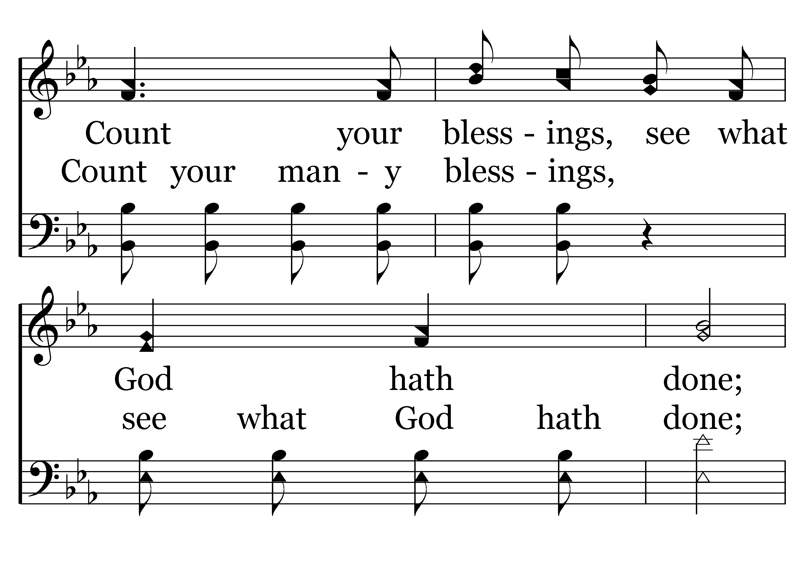
392 - Count Your Blessings - C.2

Slide 28
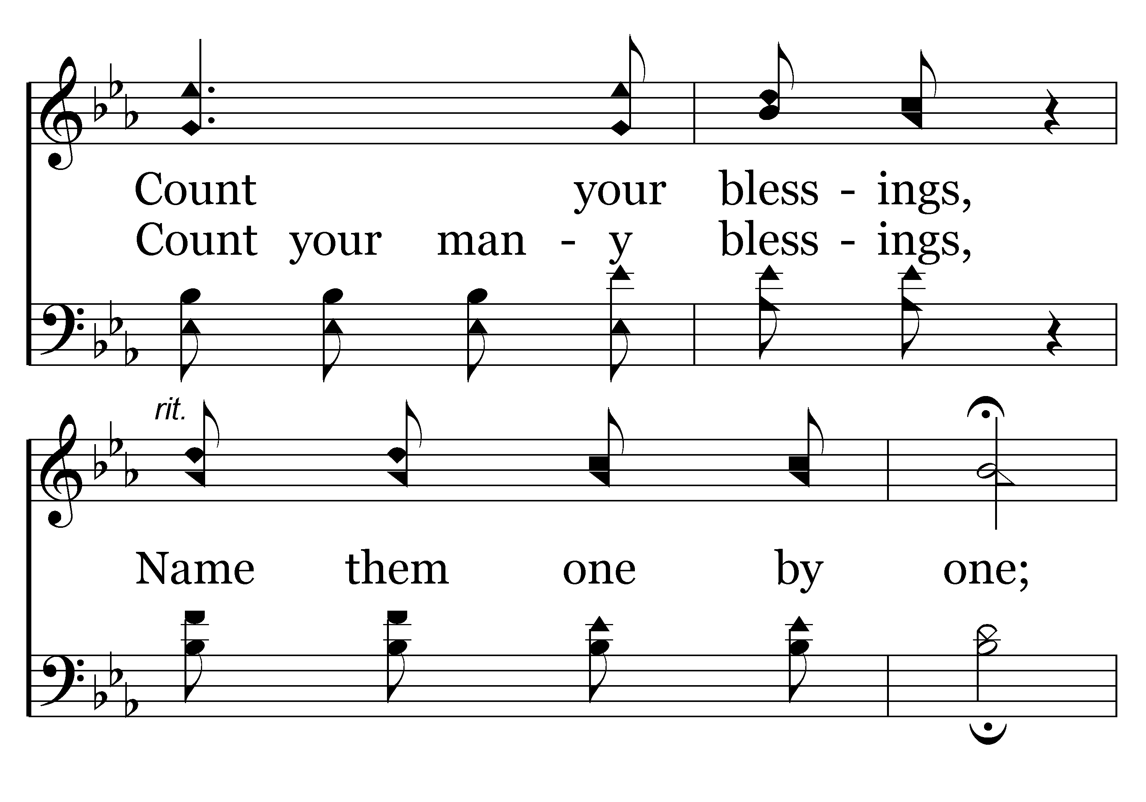
392 - Count Your Blessings - C.3

Slide 29
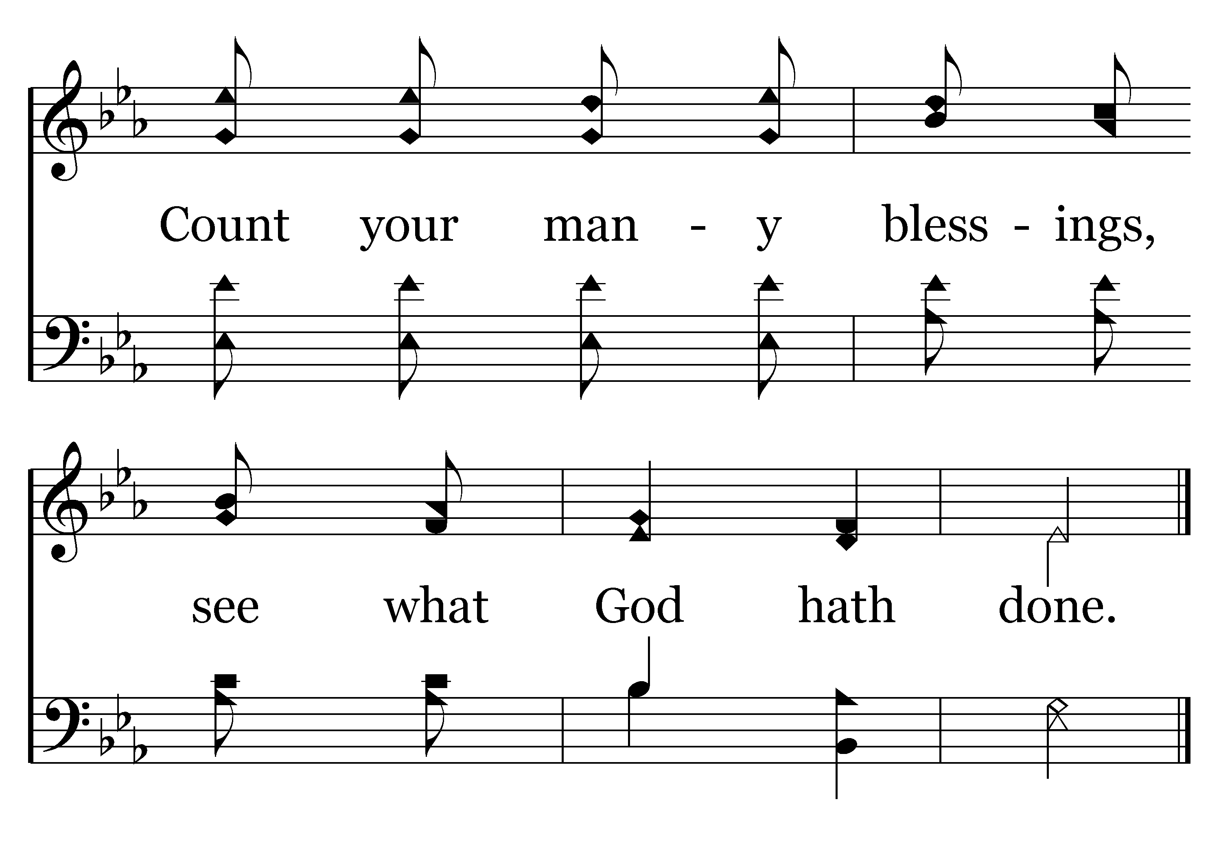
392 - Count Your Blessings - C.4
End of Song

Slide 31


Slide 32

PRAYER
Jerry Mellish
LED BY HENRY OLIU

Slide 34
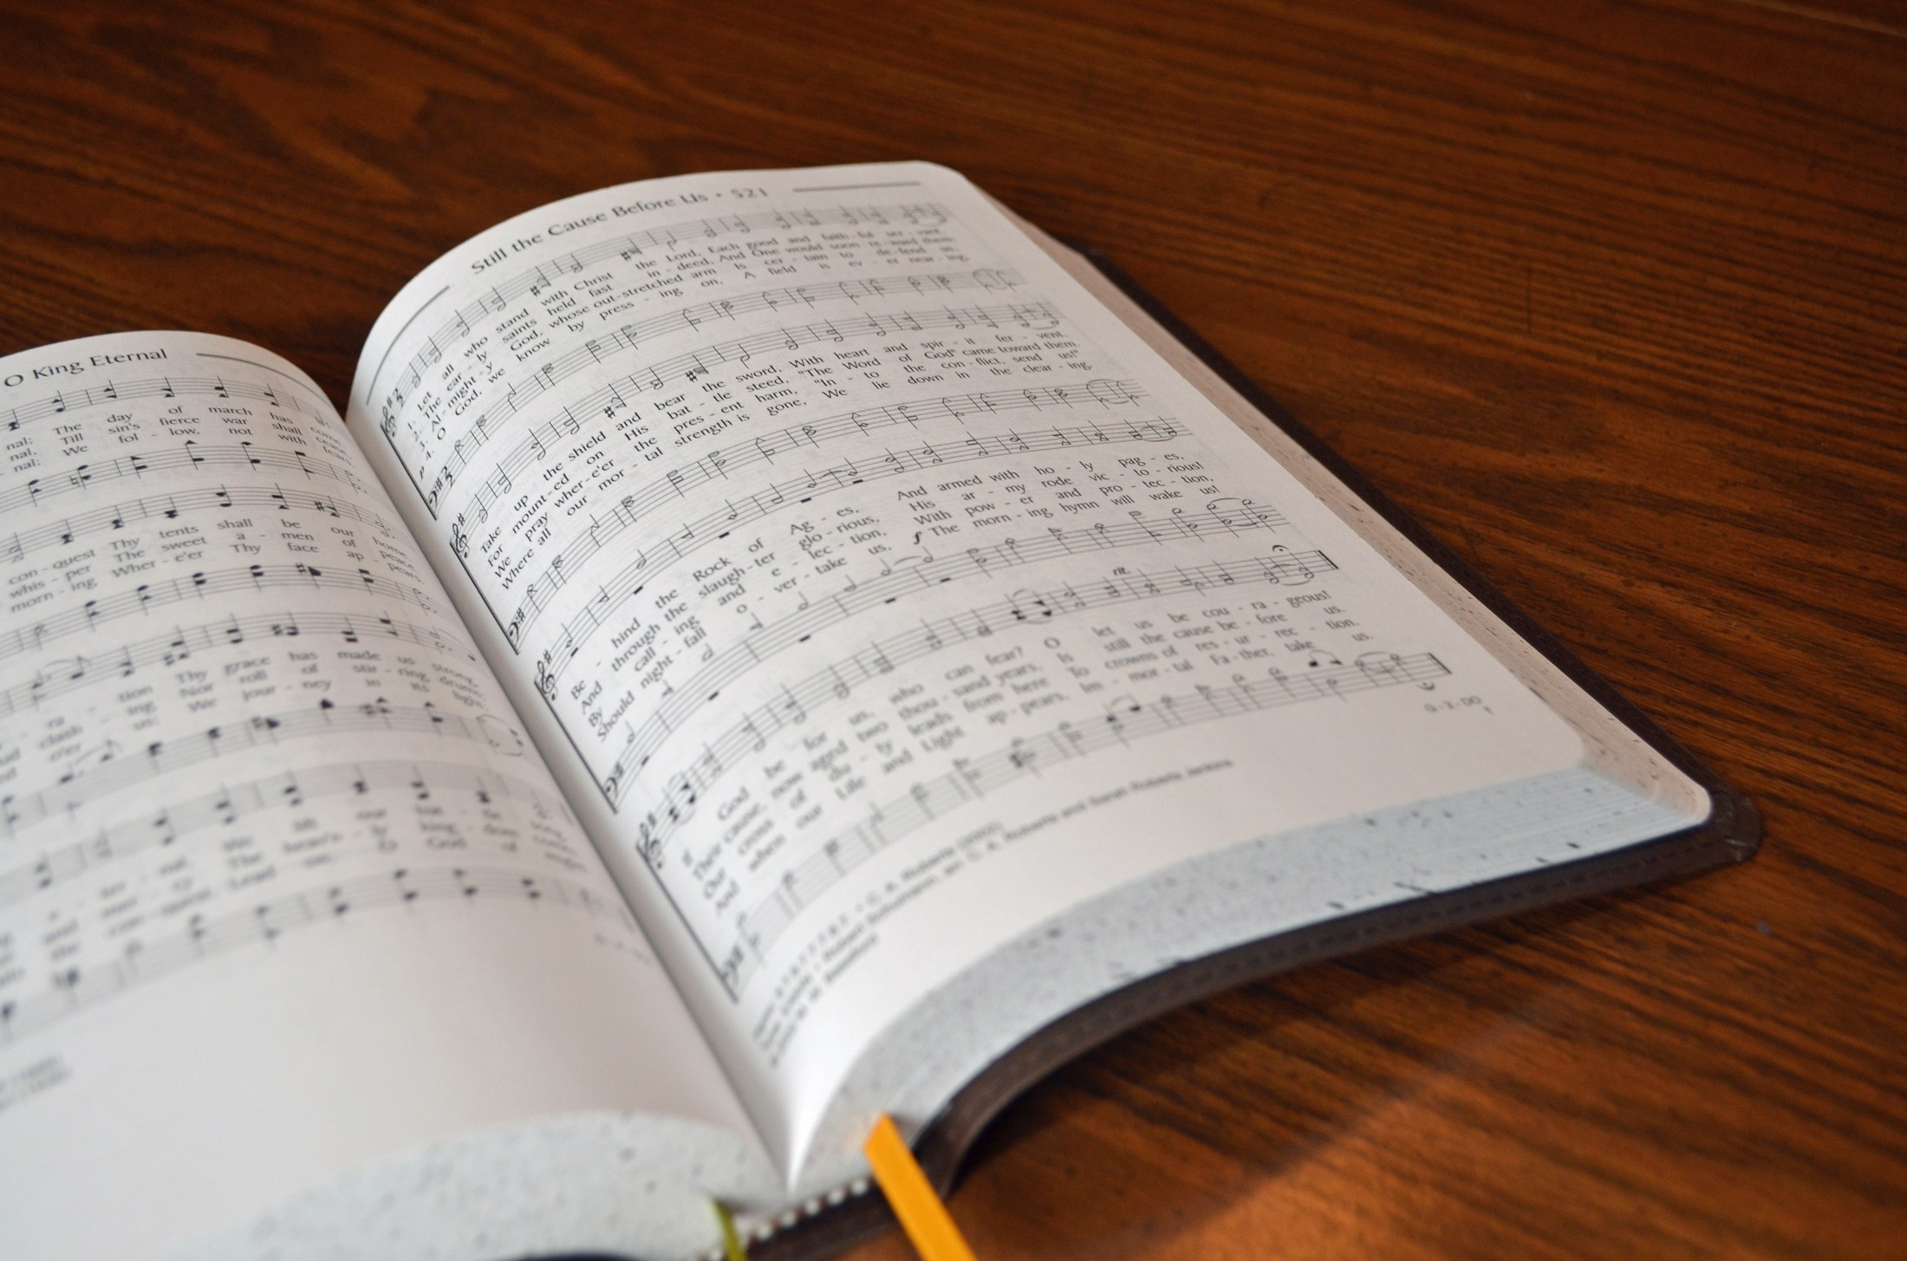
SONG LEADER
SANDER FLETCHER

Slide 35
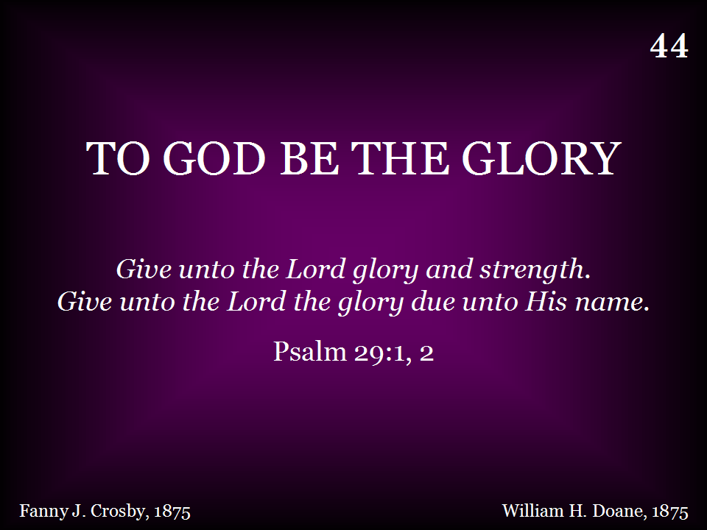
044 - To God Be The Glory - Title

Slide 36
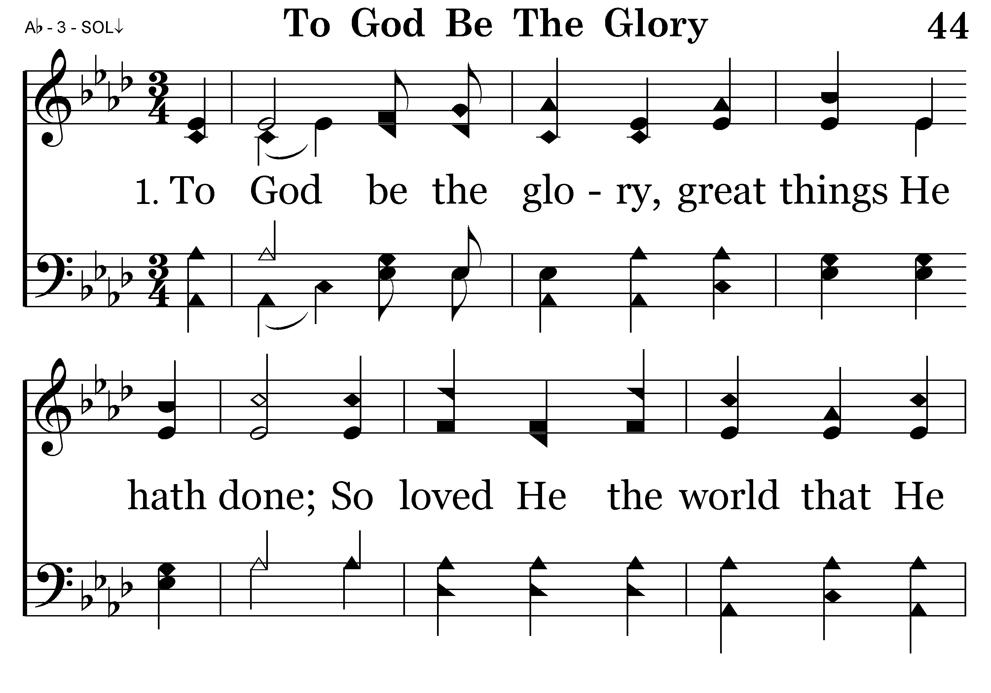
044 - To God Be The Glory - 1.1

Slide 37
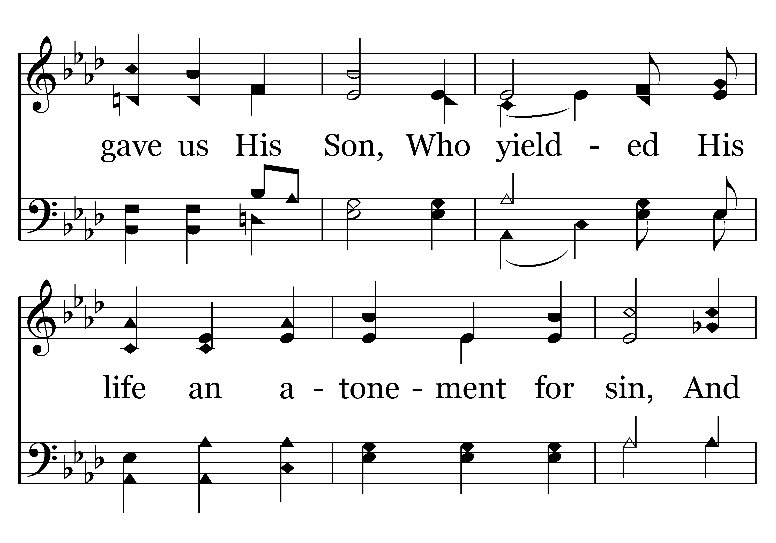
044 - To God Be The Glory - 1.2

Slide 38
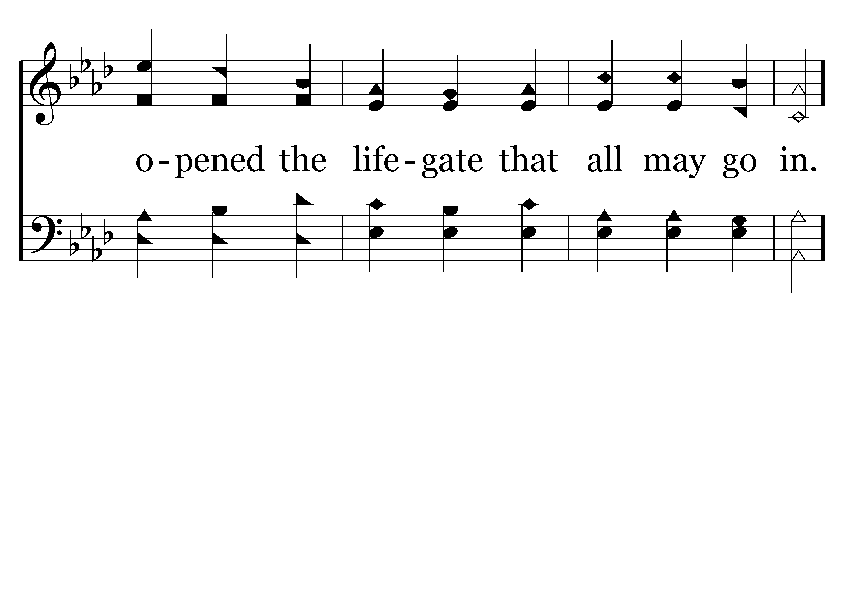
044 - To God Be The Glory - 1.3

Slide 39
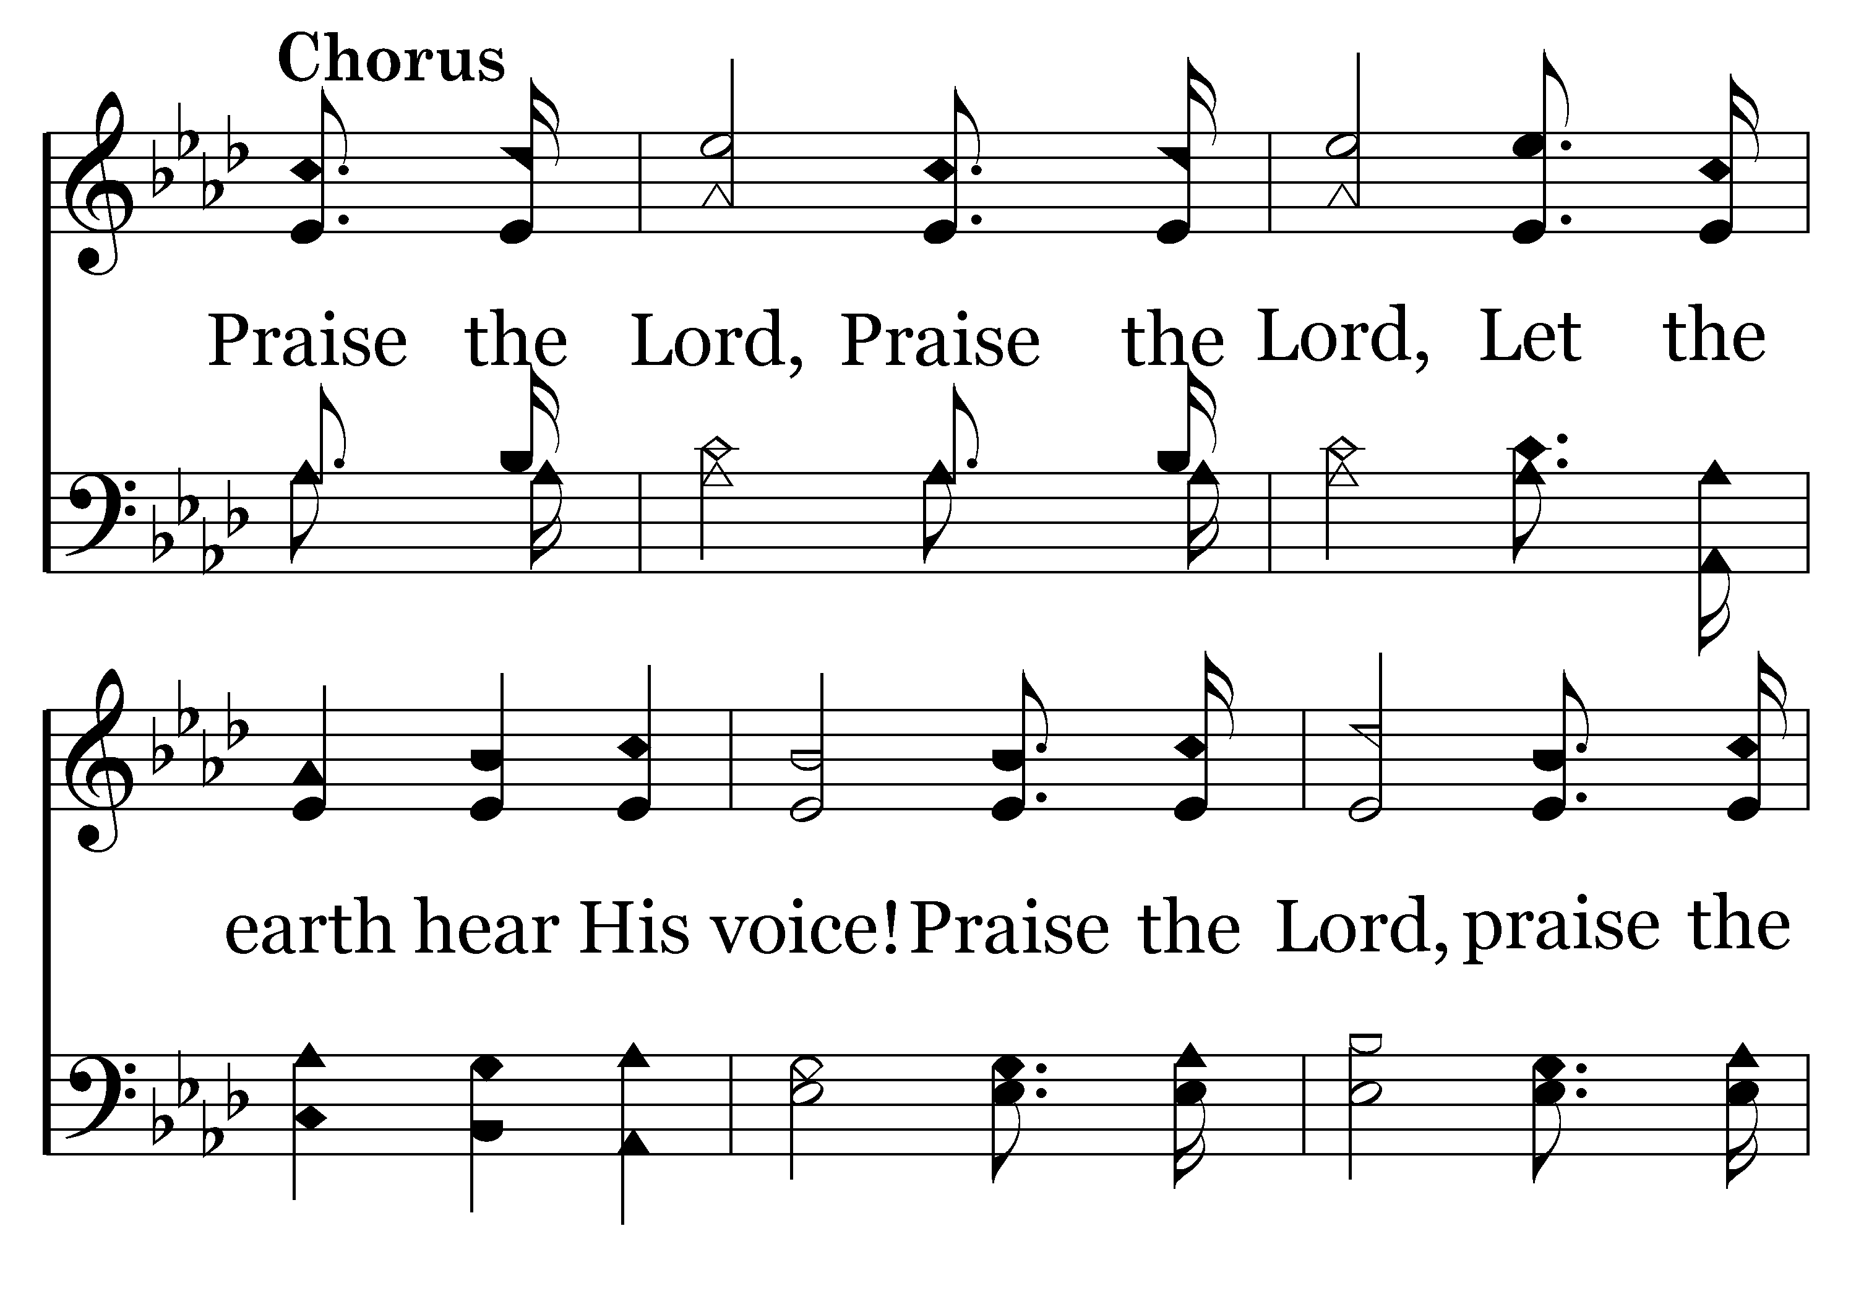
044 - To God Be The Glory - C.1

Slide 40
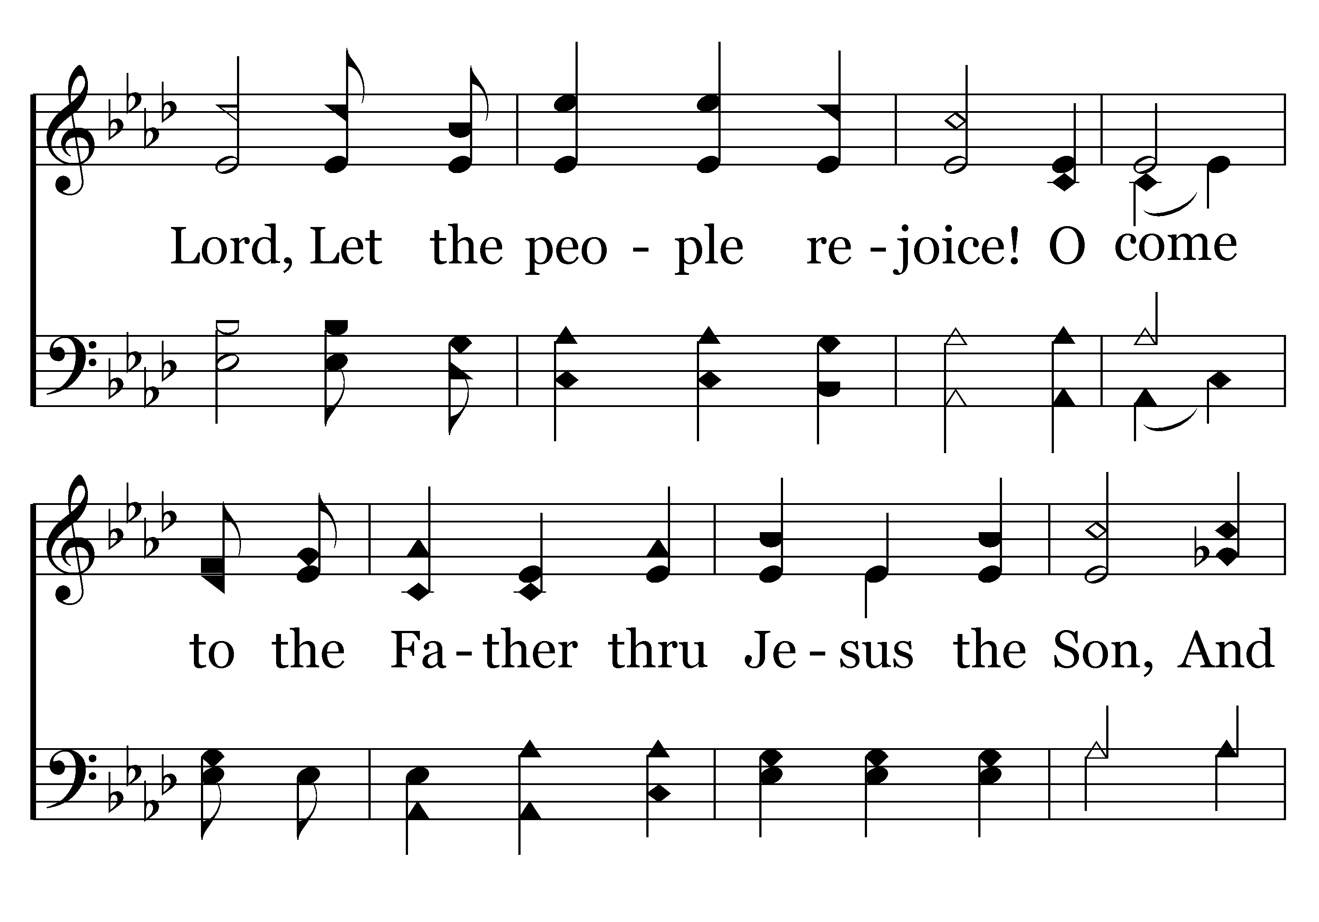
044 - To God Be The Glory - C.2

Slide 41
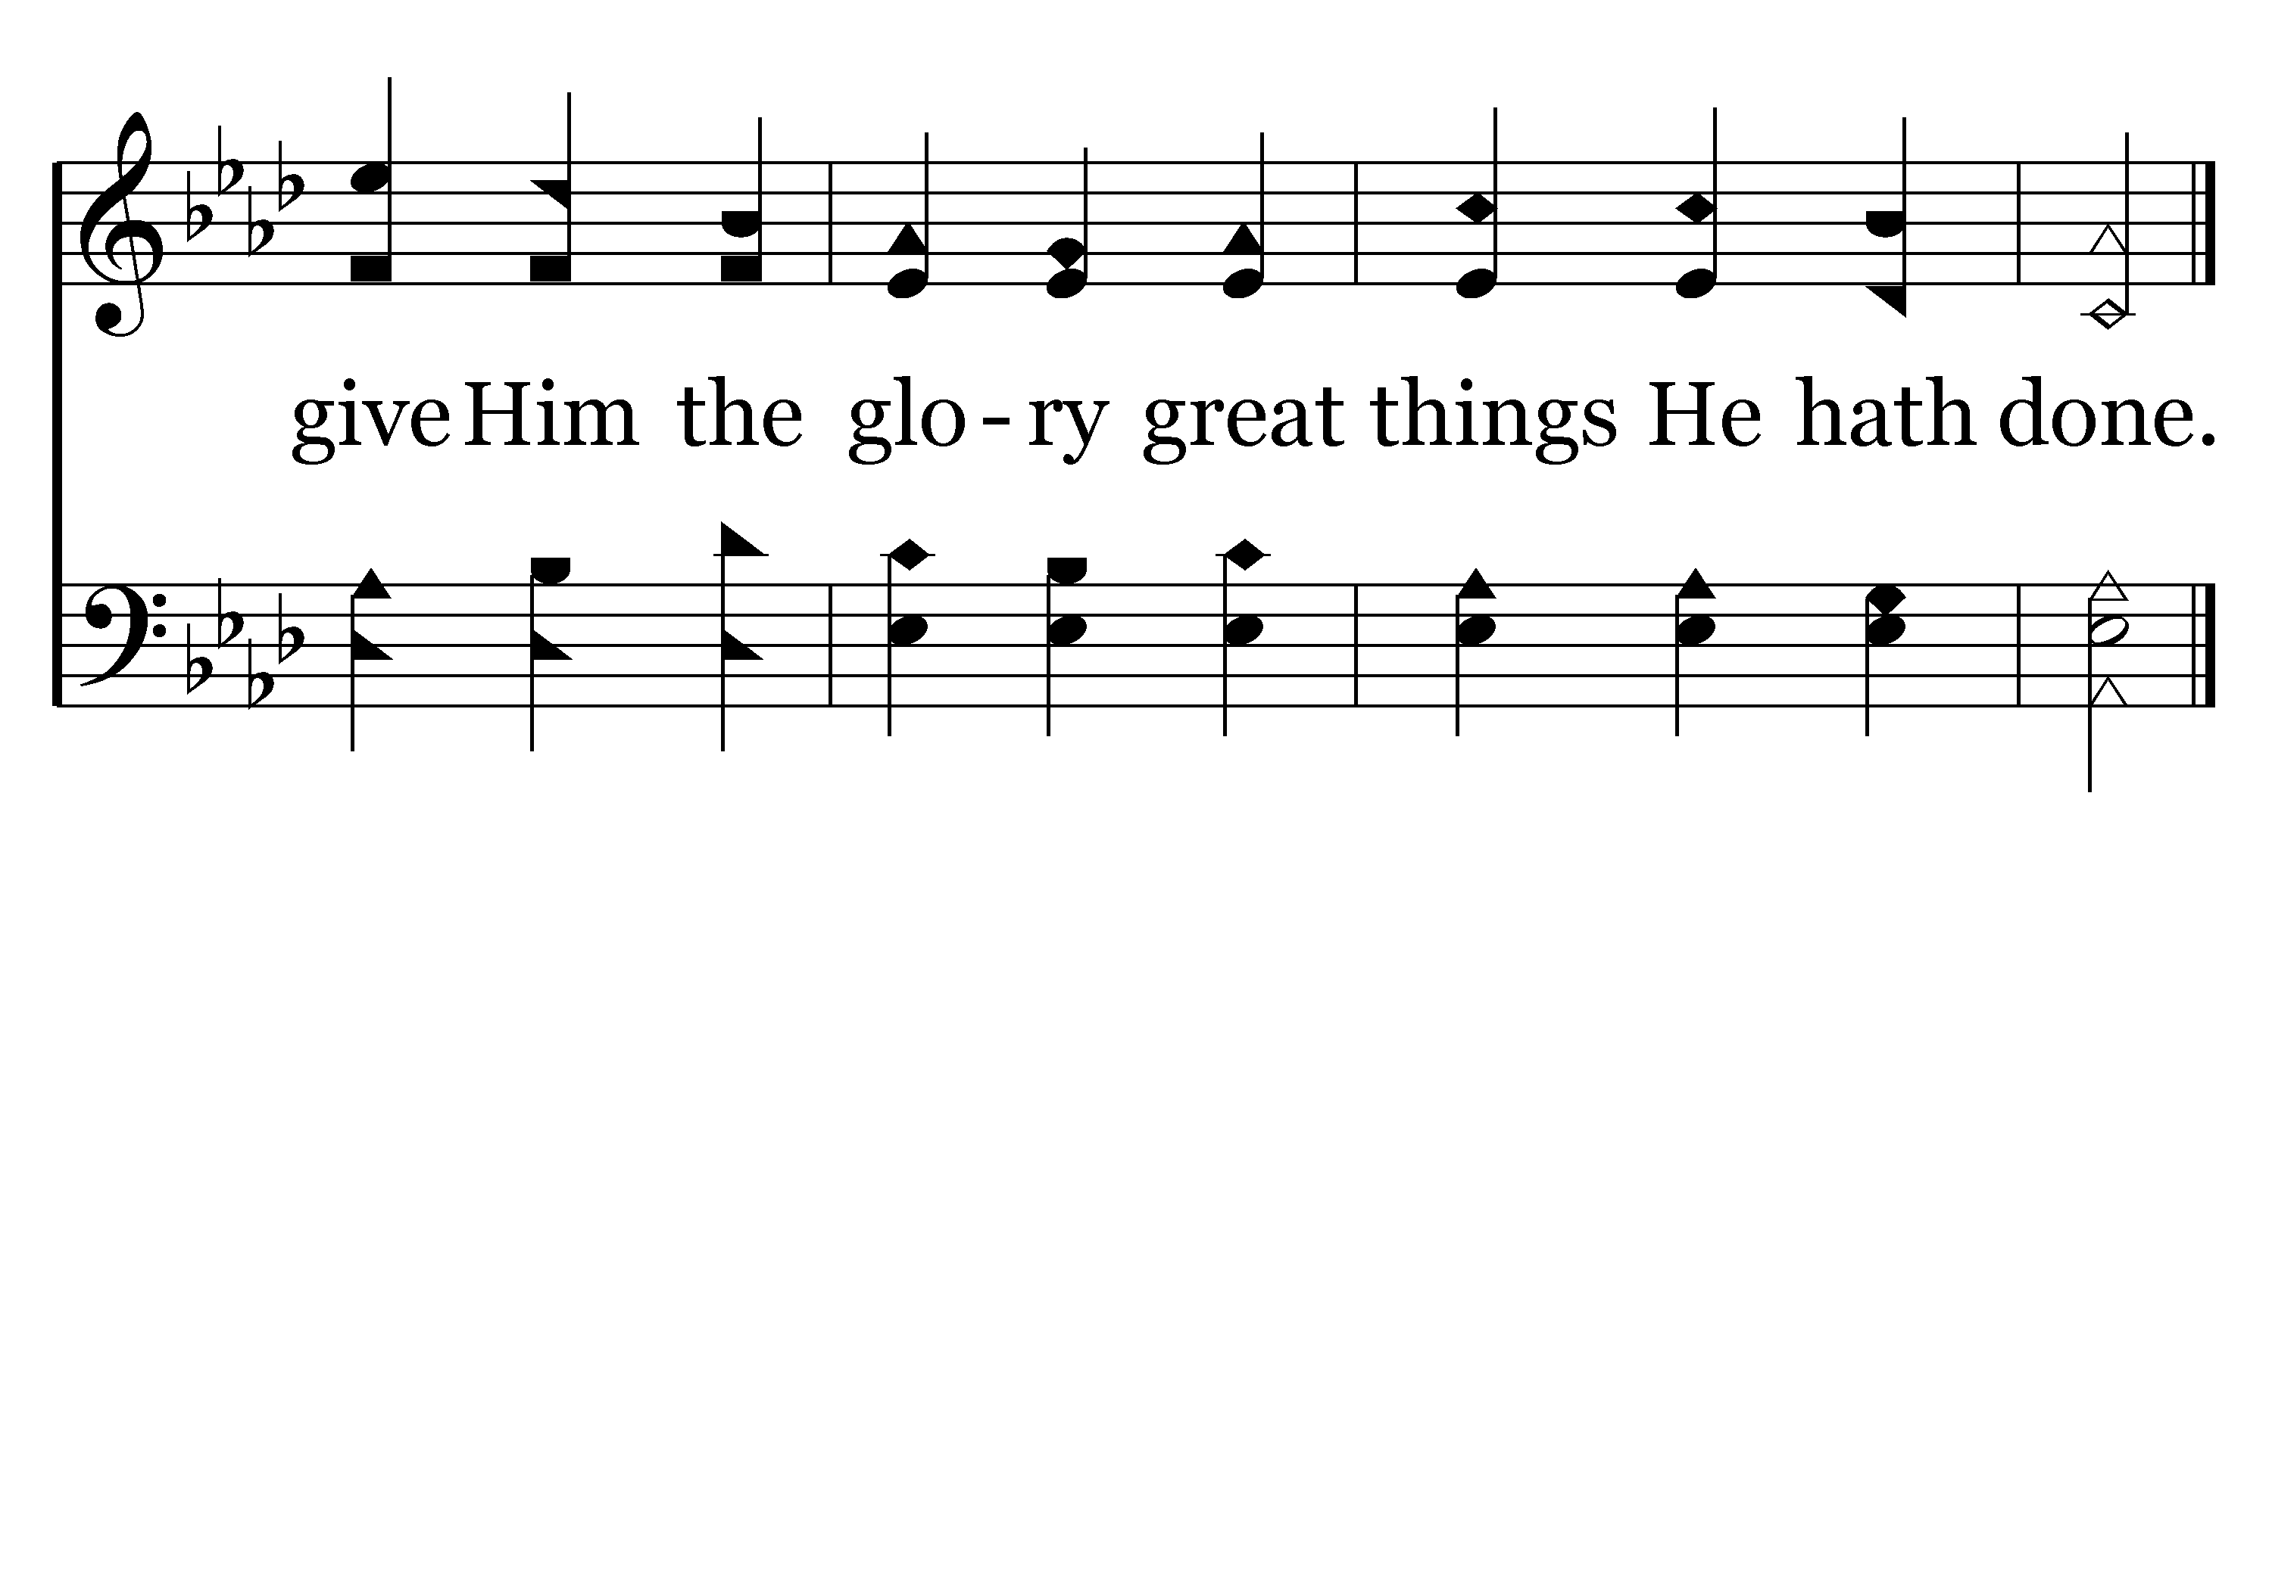
044 - To God Be The Glory - C.3
End of Verse 1

Slide 42
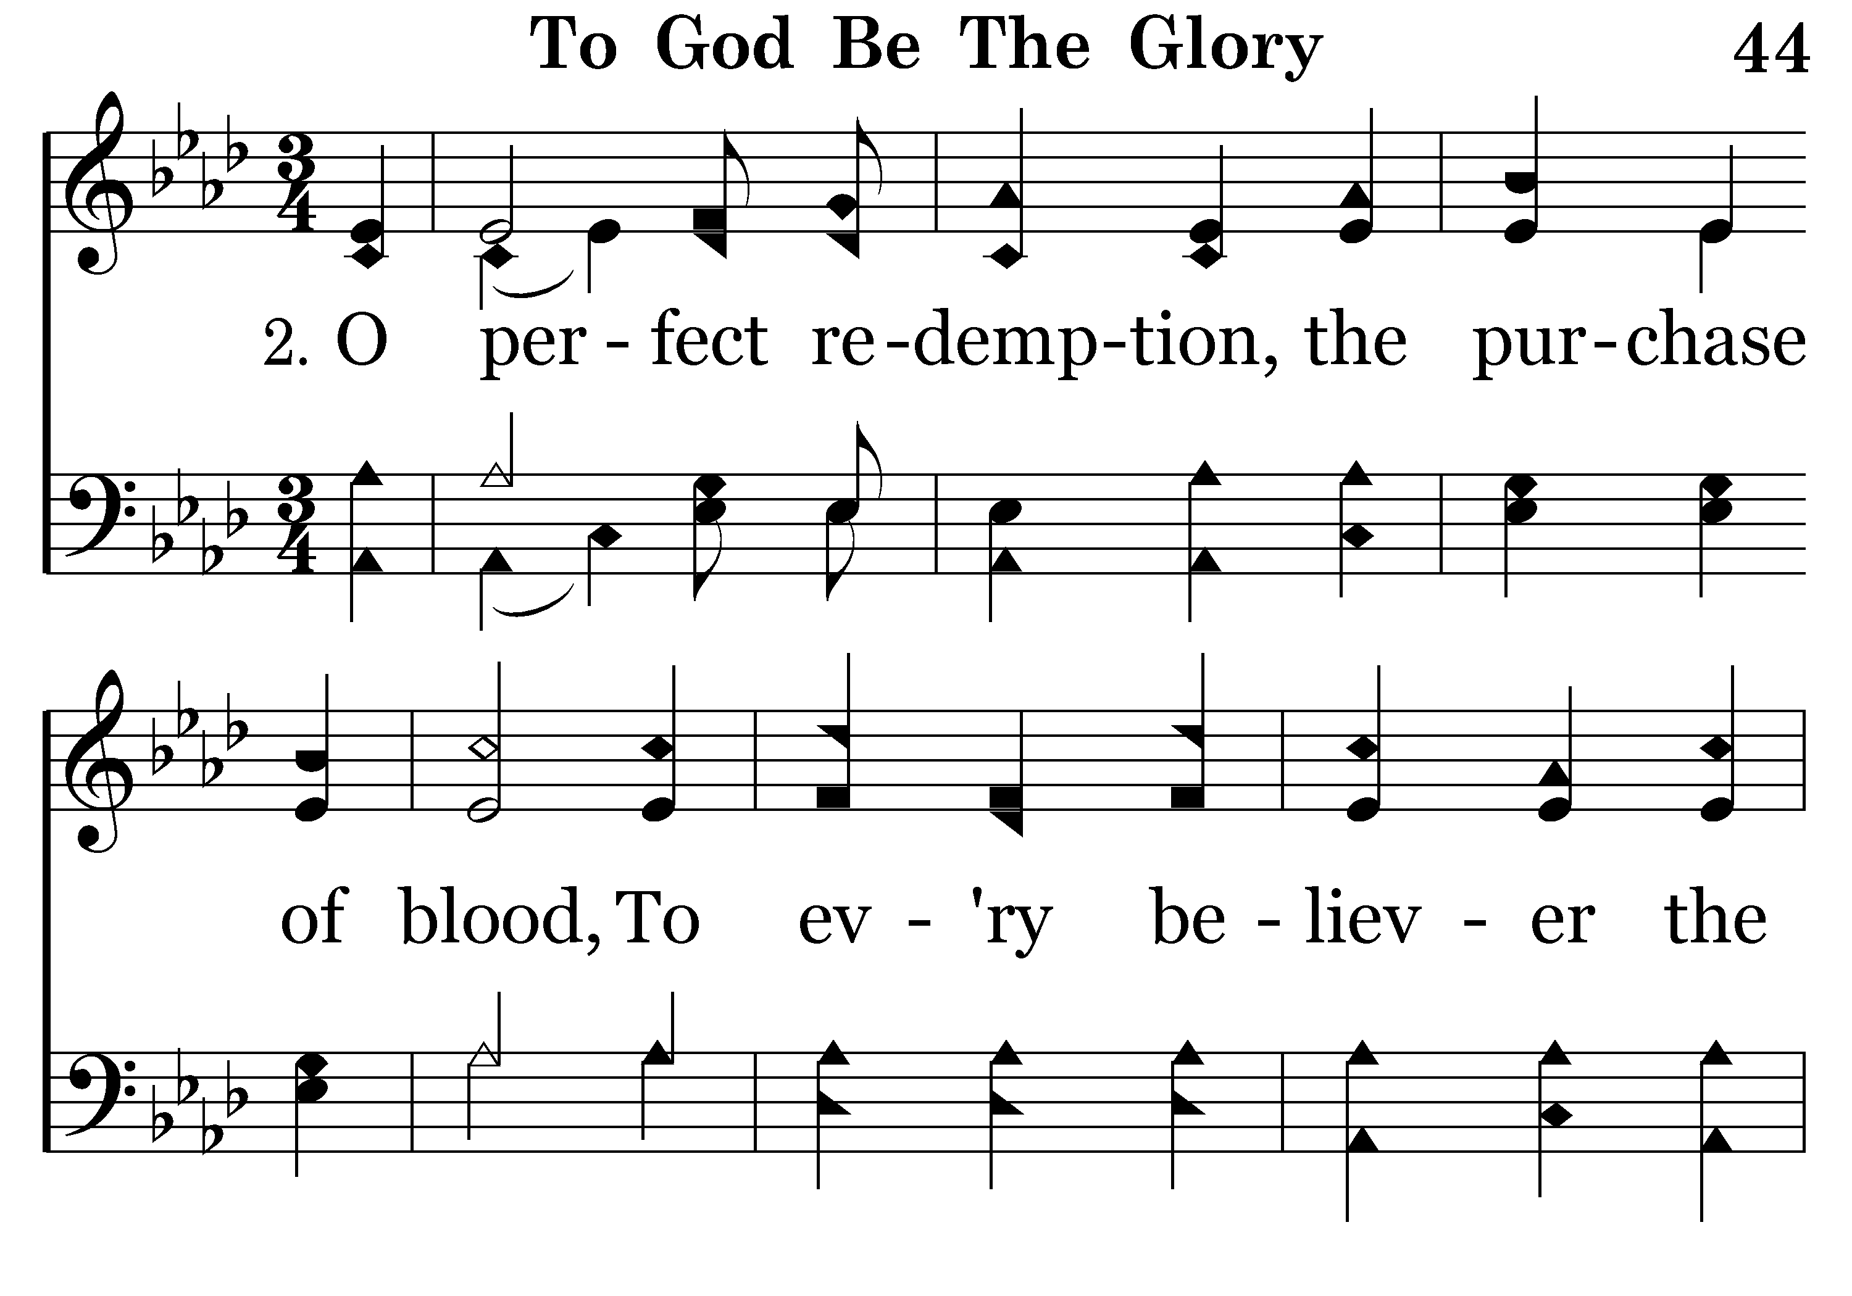
044 - To God Be The Glory - 2.1

Slide 43
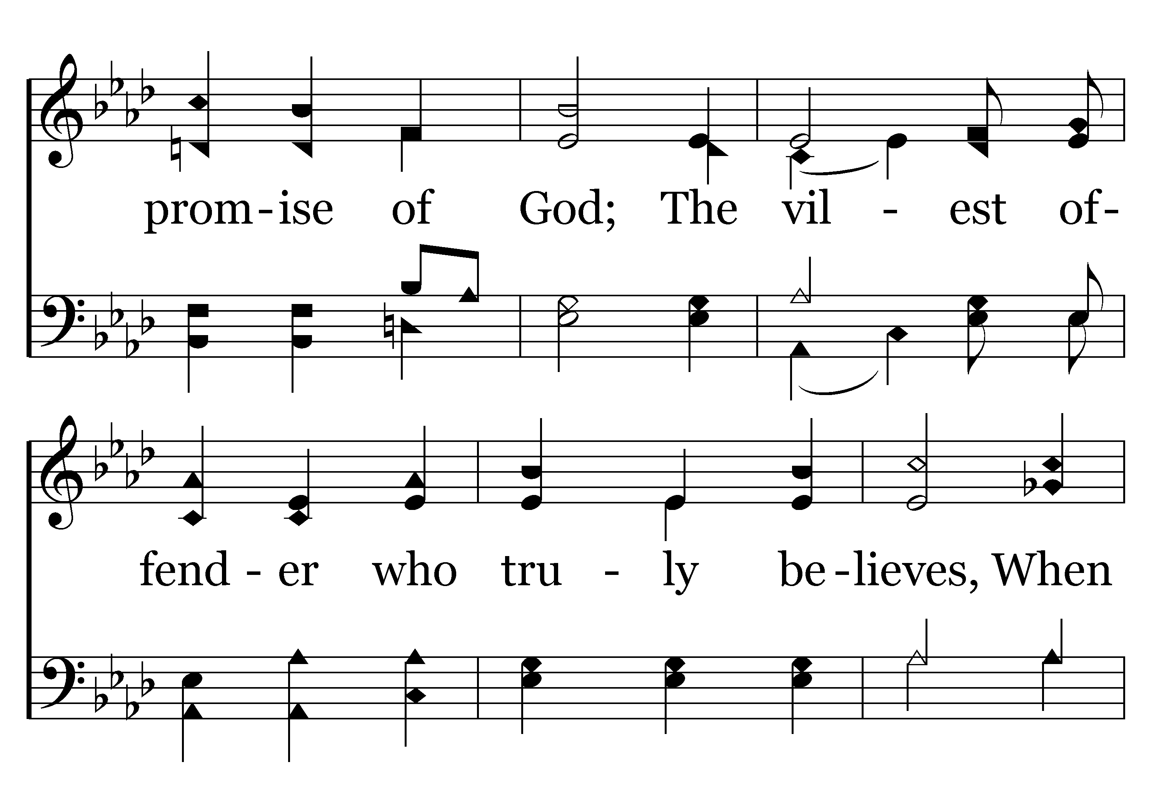
044 - To God Be The Glory - 2.2

Slide 44
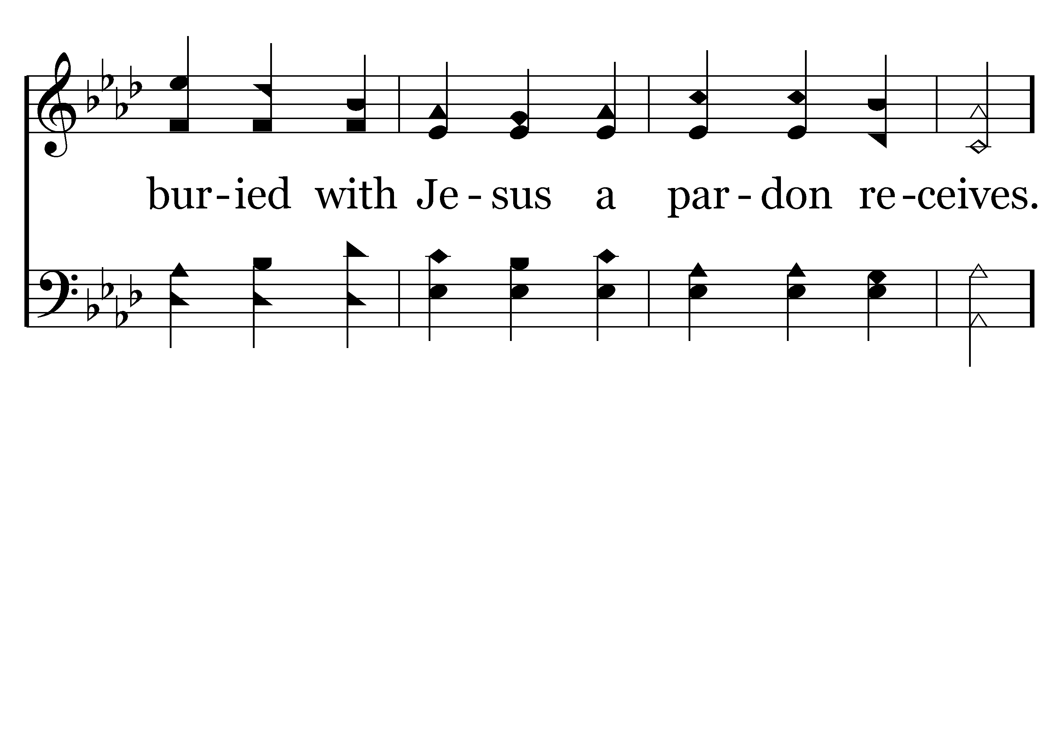
044 - To God Be The Glory - 2.3

Slide 45
044 - To God Be The Glory - C.1

Slide 46
044 - To God Be The Glory - C.2

Slide 47
044 - To God Be The Glory - C.3
End of Verse 2

Slide 48
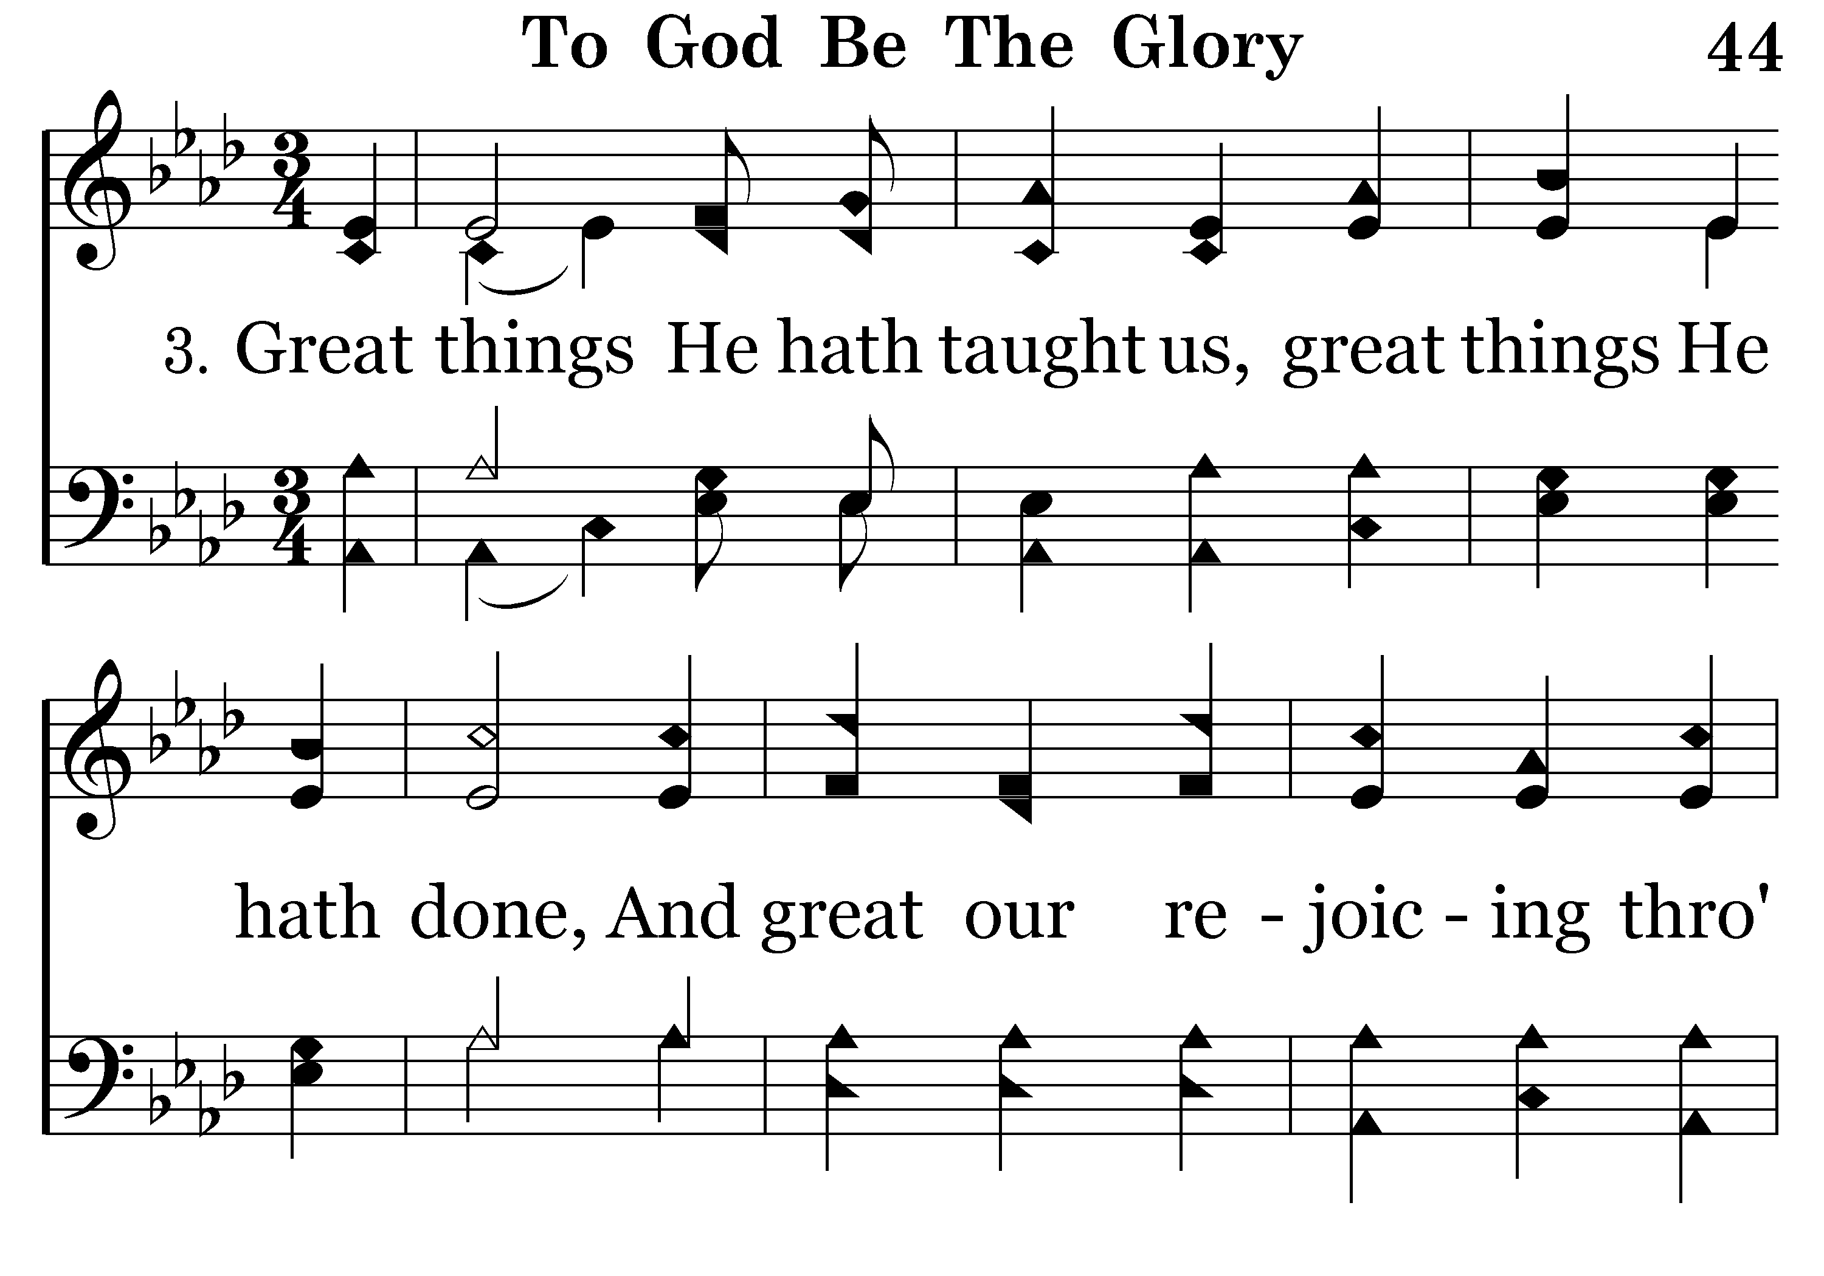
044 - To God Be The Glory - 3.1

Slide 49
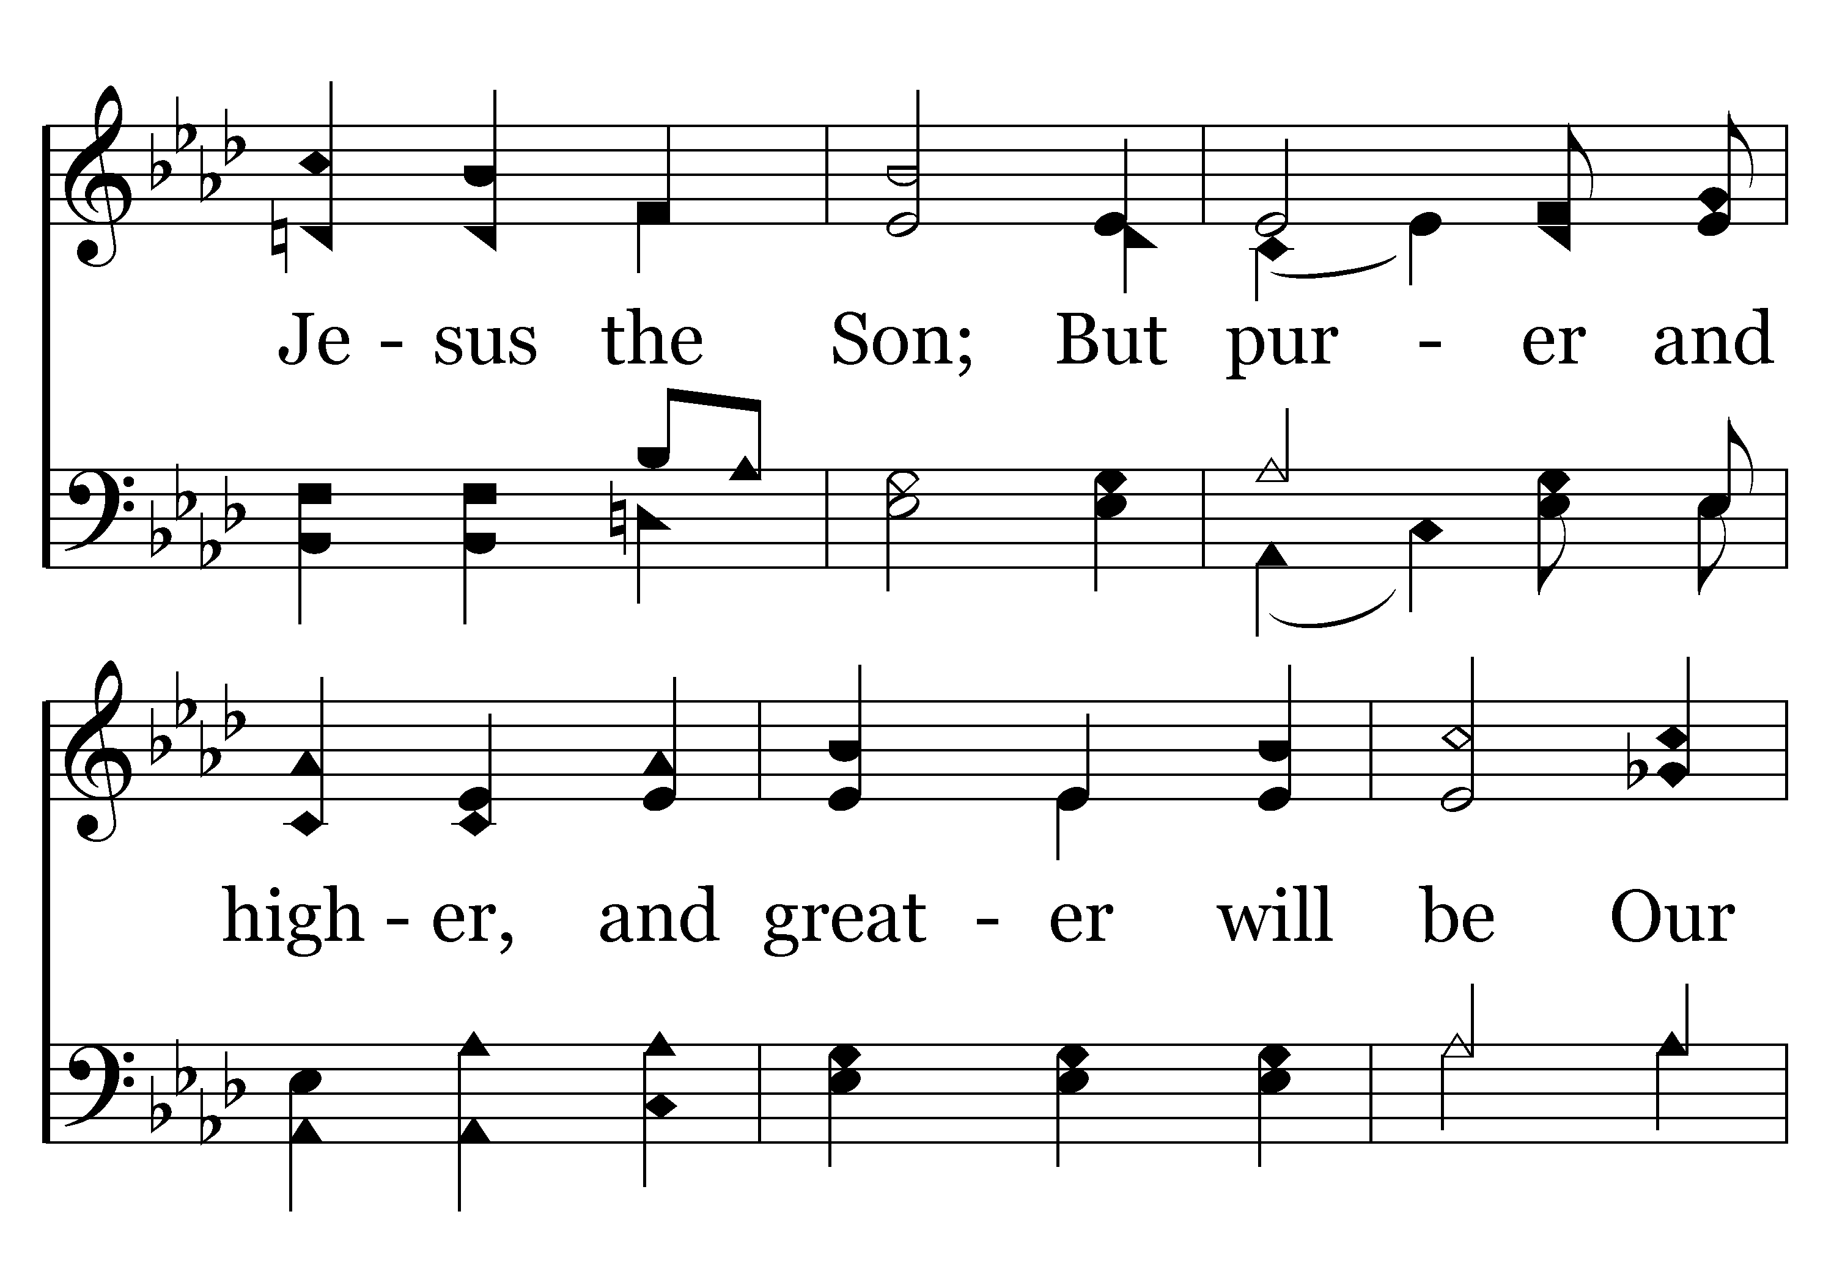
044 - To God Be The Glory - 3.2

Slide 50
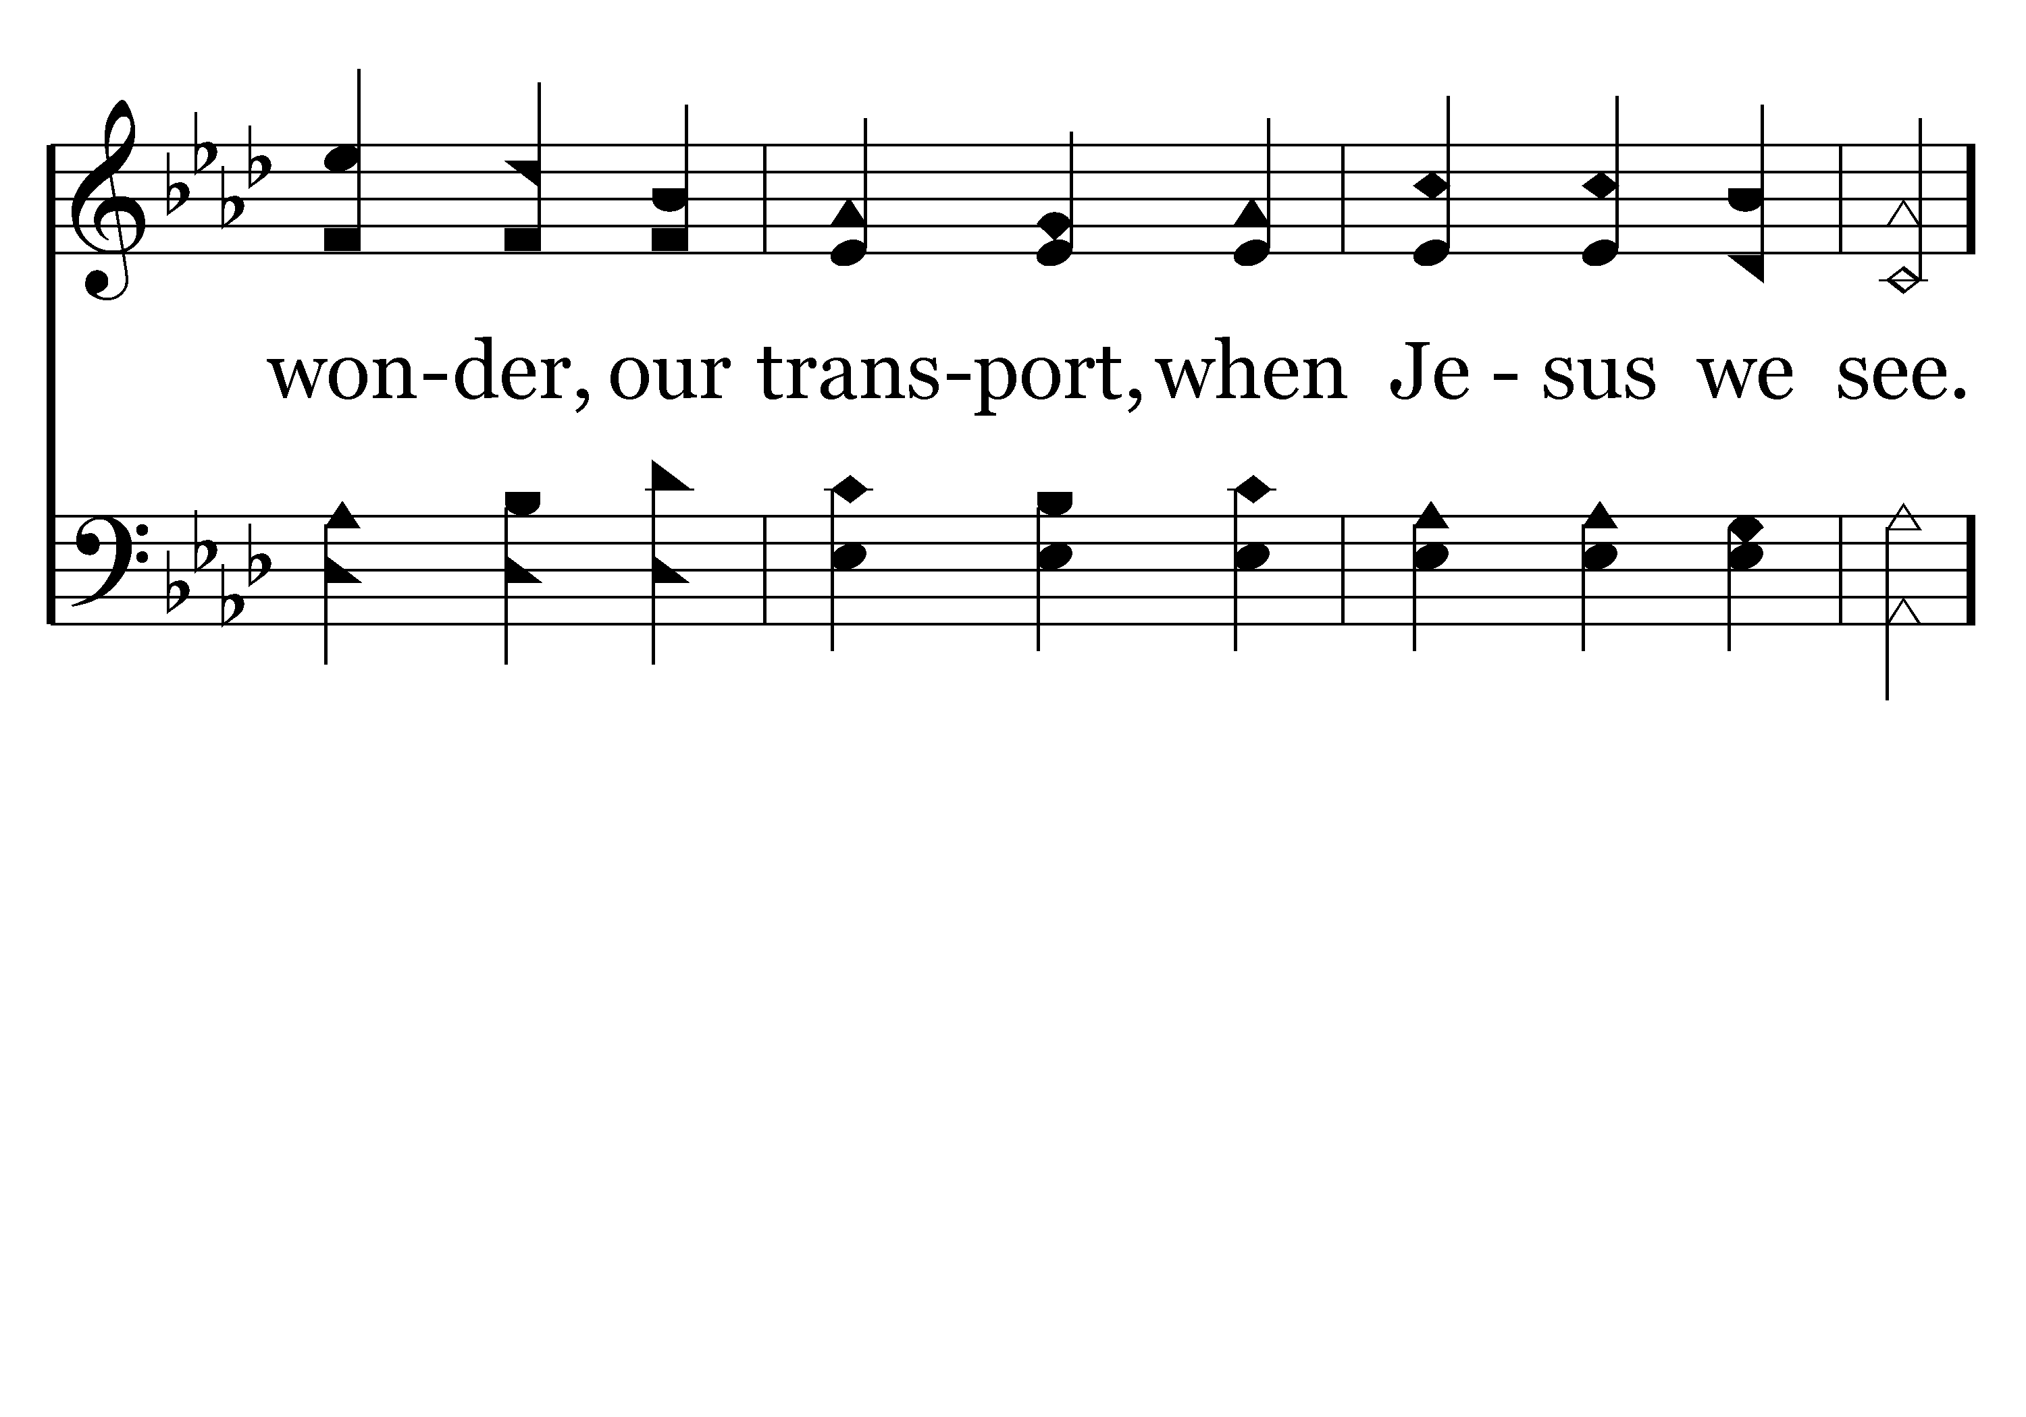
044 - To God Be The Glory - 3.3

Slide 51
044 - To God Be The Glory - C.1

Slide 52
044 - To God Be The Glory - C.2

Slide 53
044 - To God Be The Glory - C.3
End of Song

Slide 55
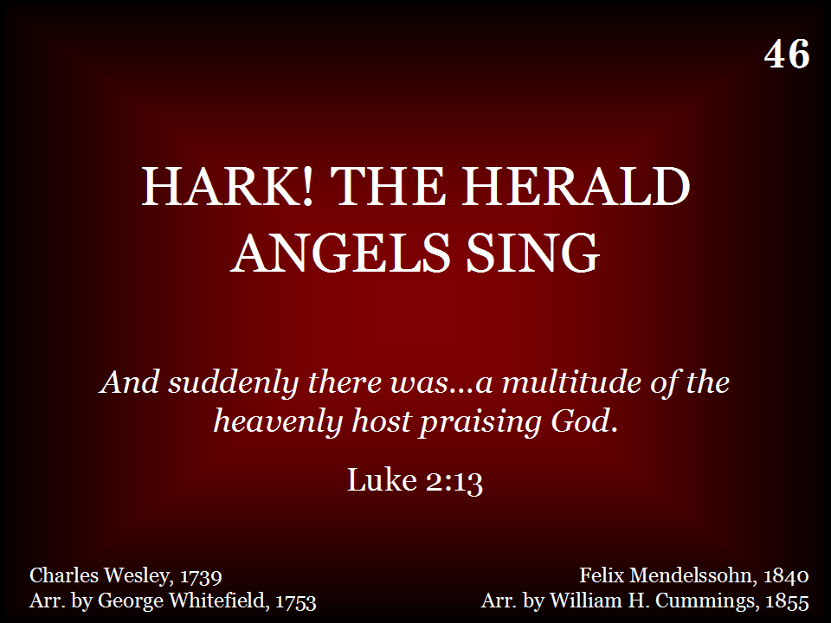
046 - Hark, The Herald Angels Sing - Title

Slide 56
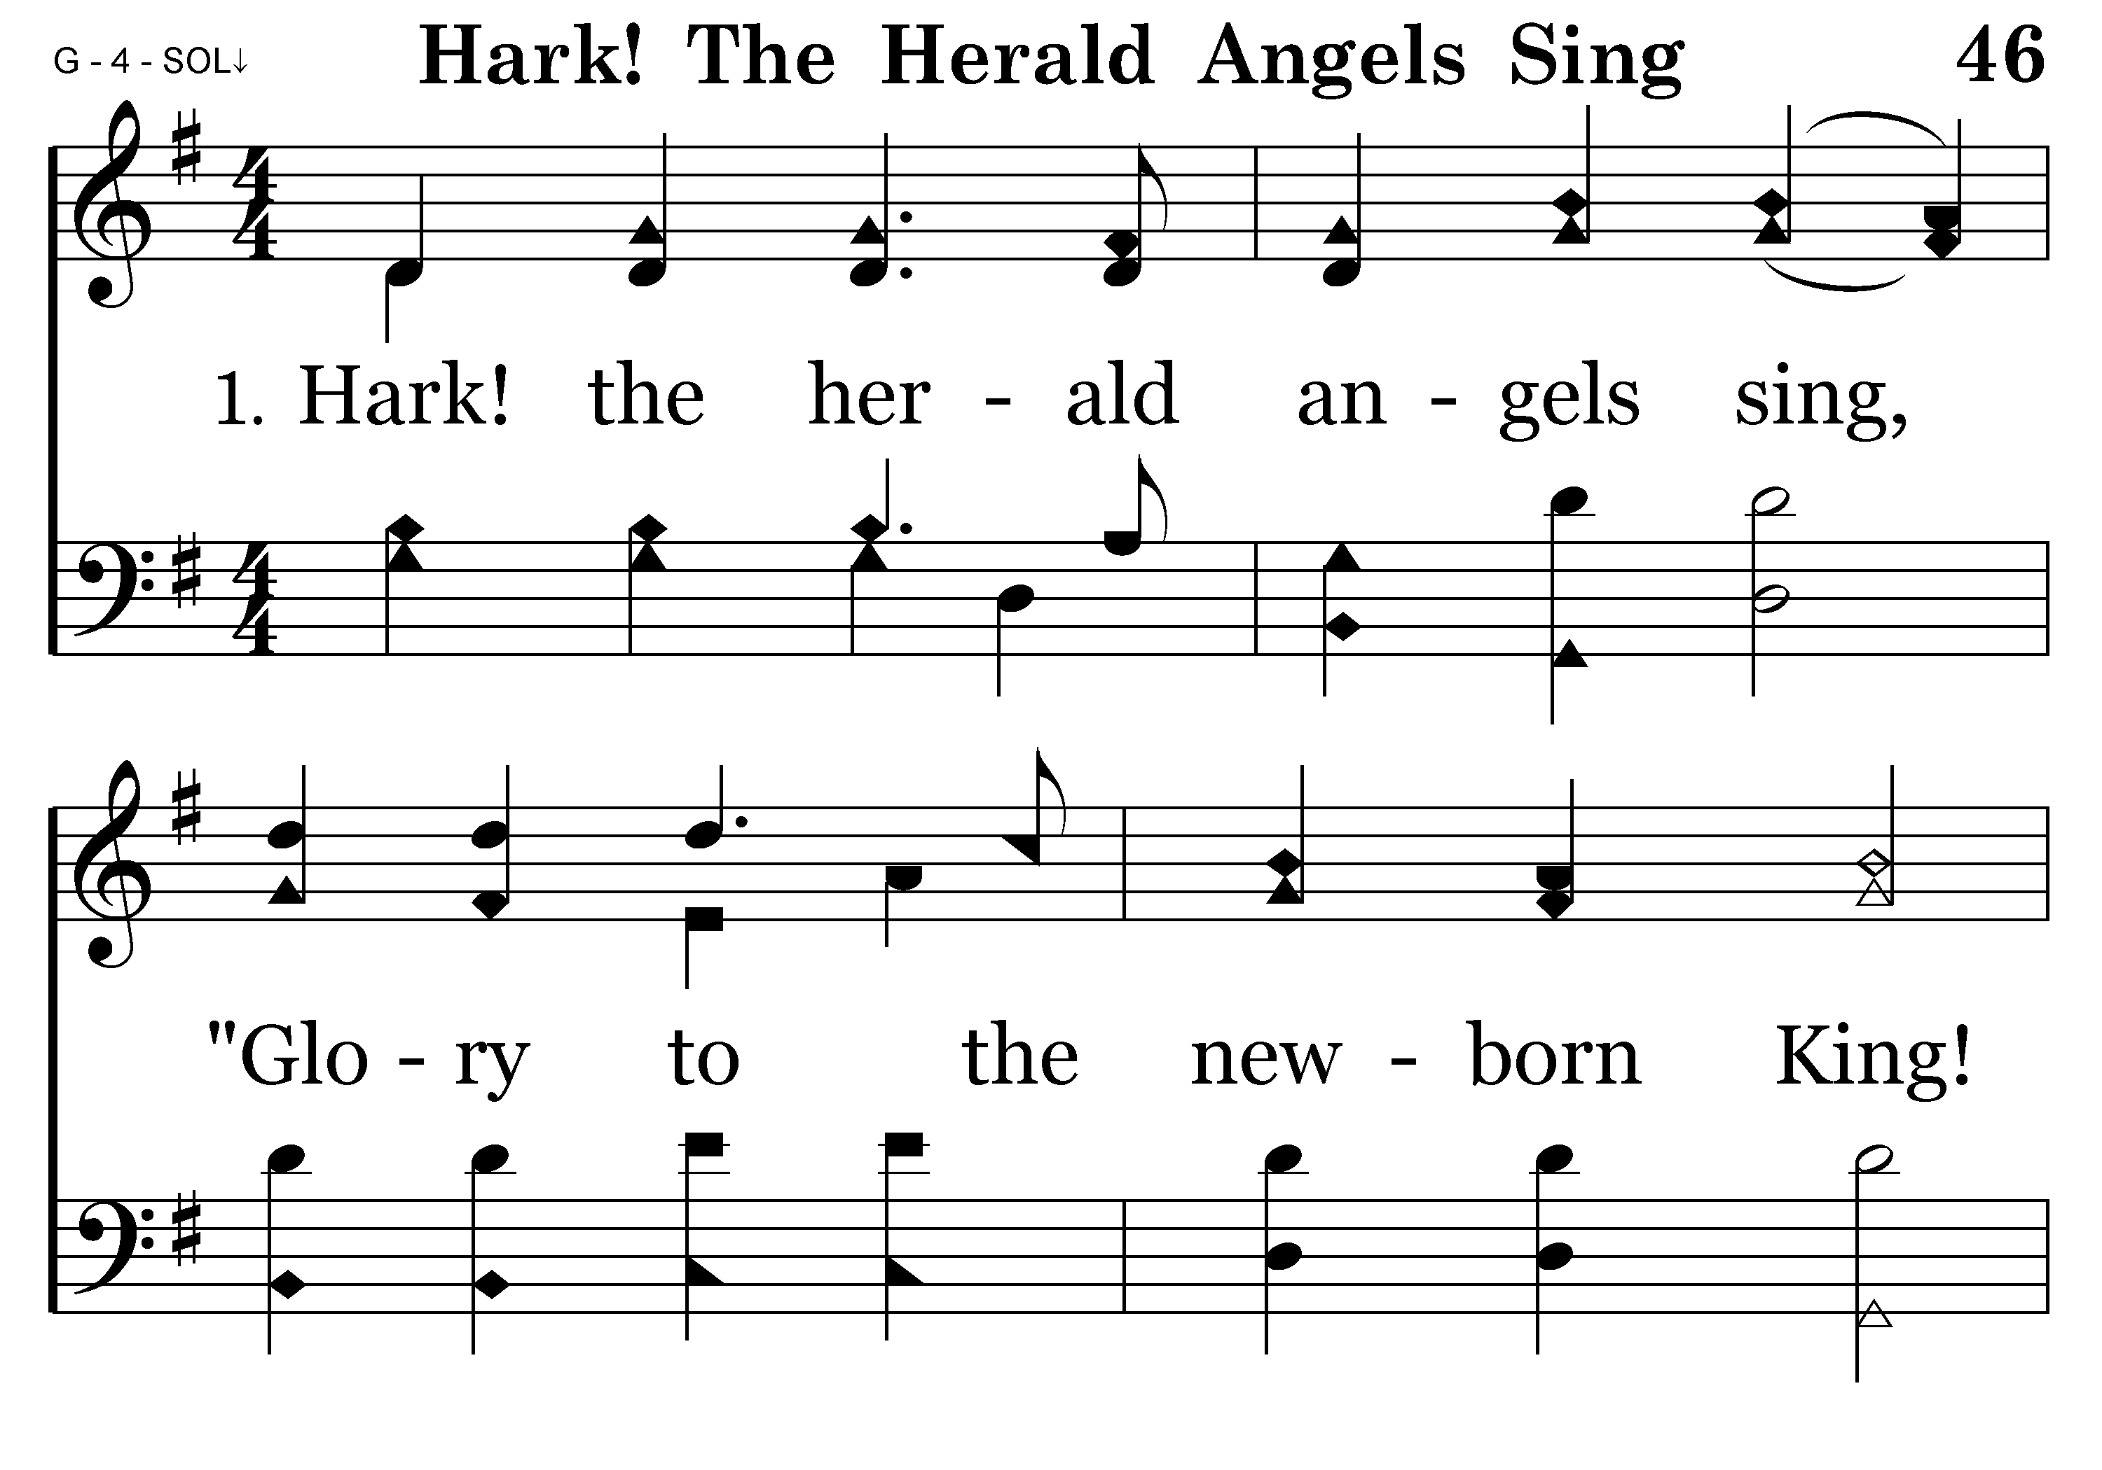
046 - Hark, The Herald Angels Sing - 1.1

Slide 57
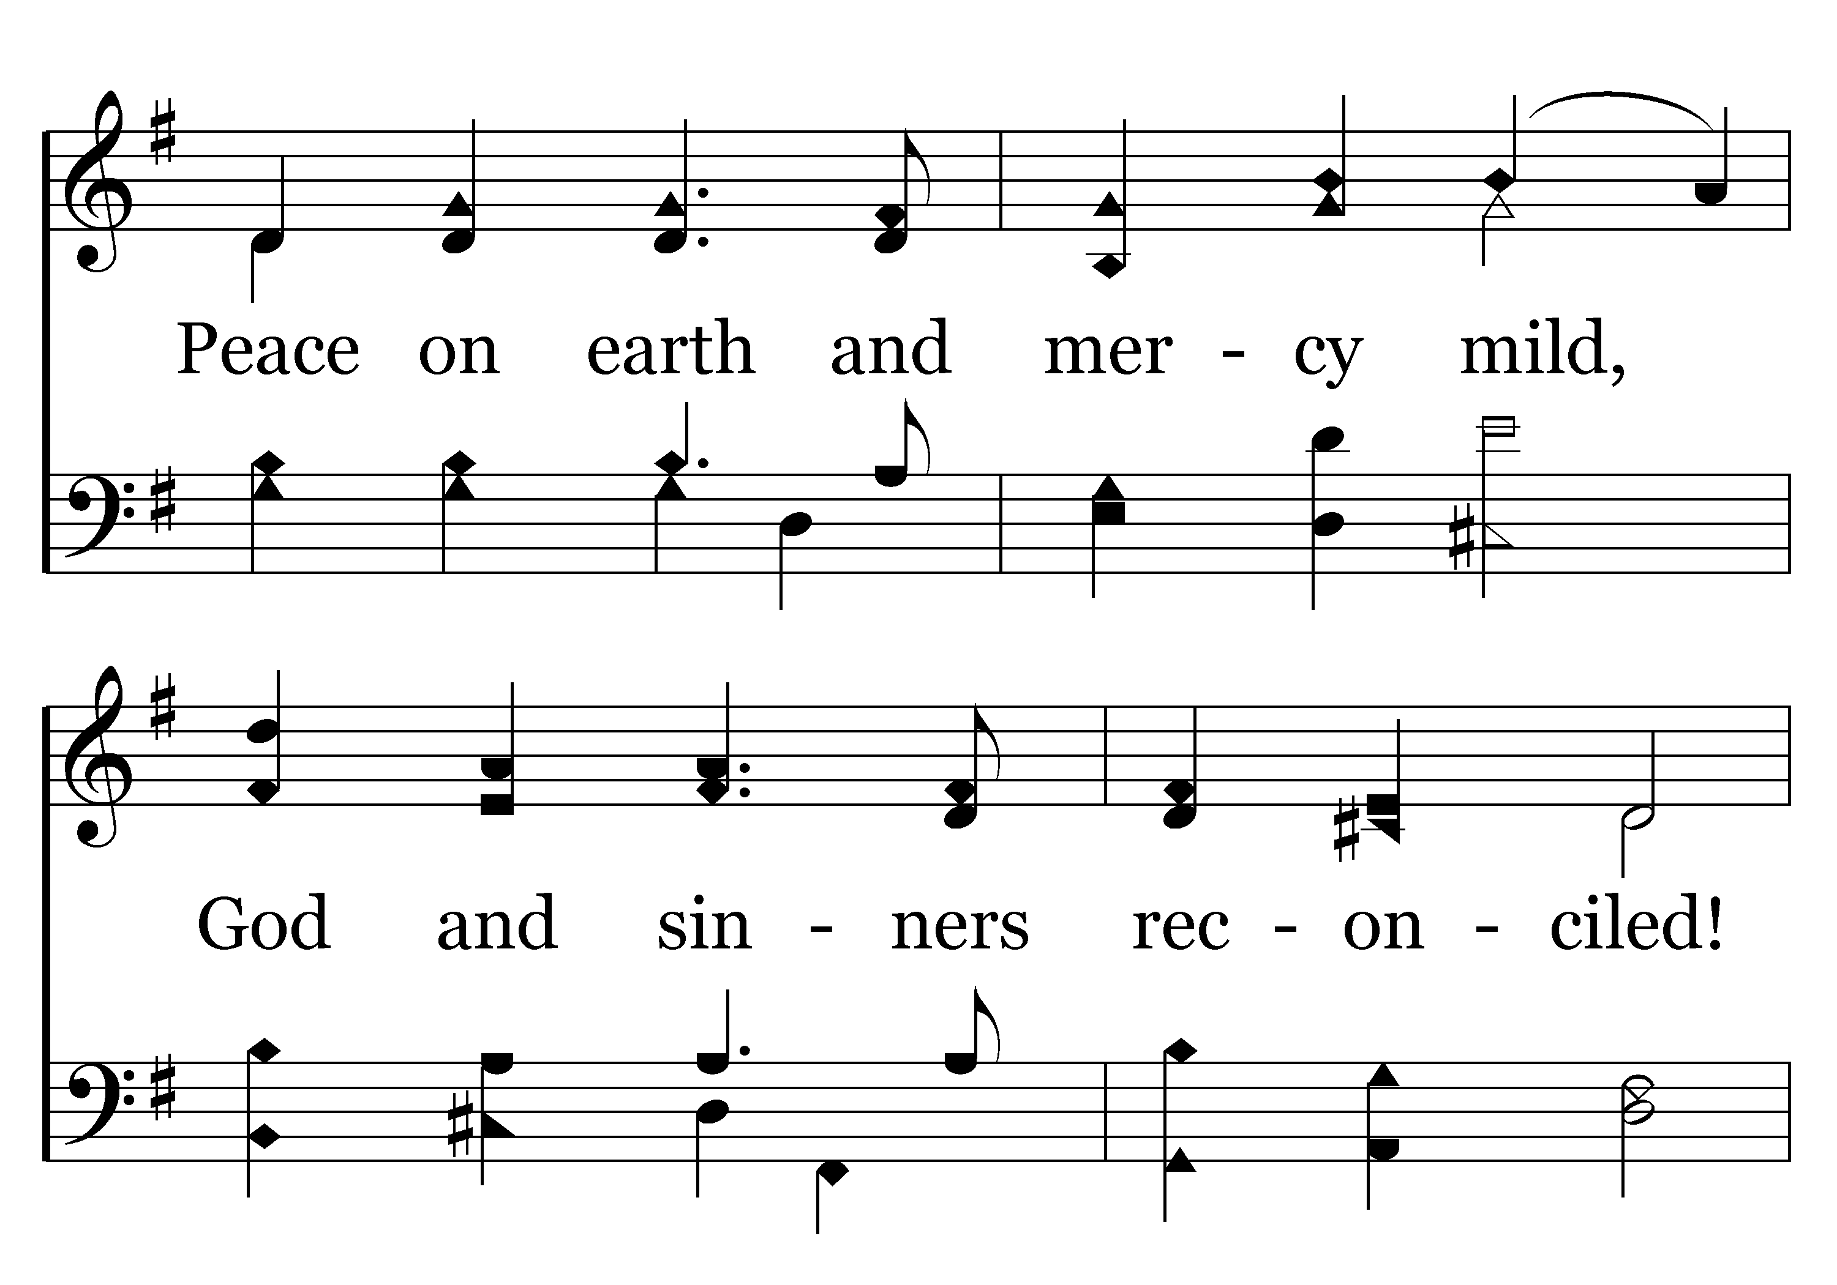
046 - Hark, The Herald Angels Sing - 1.2

Slide 58
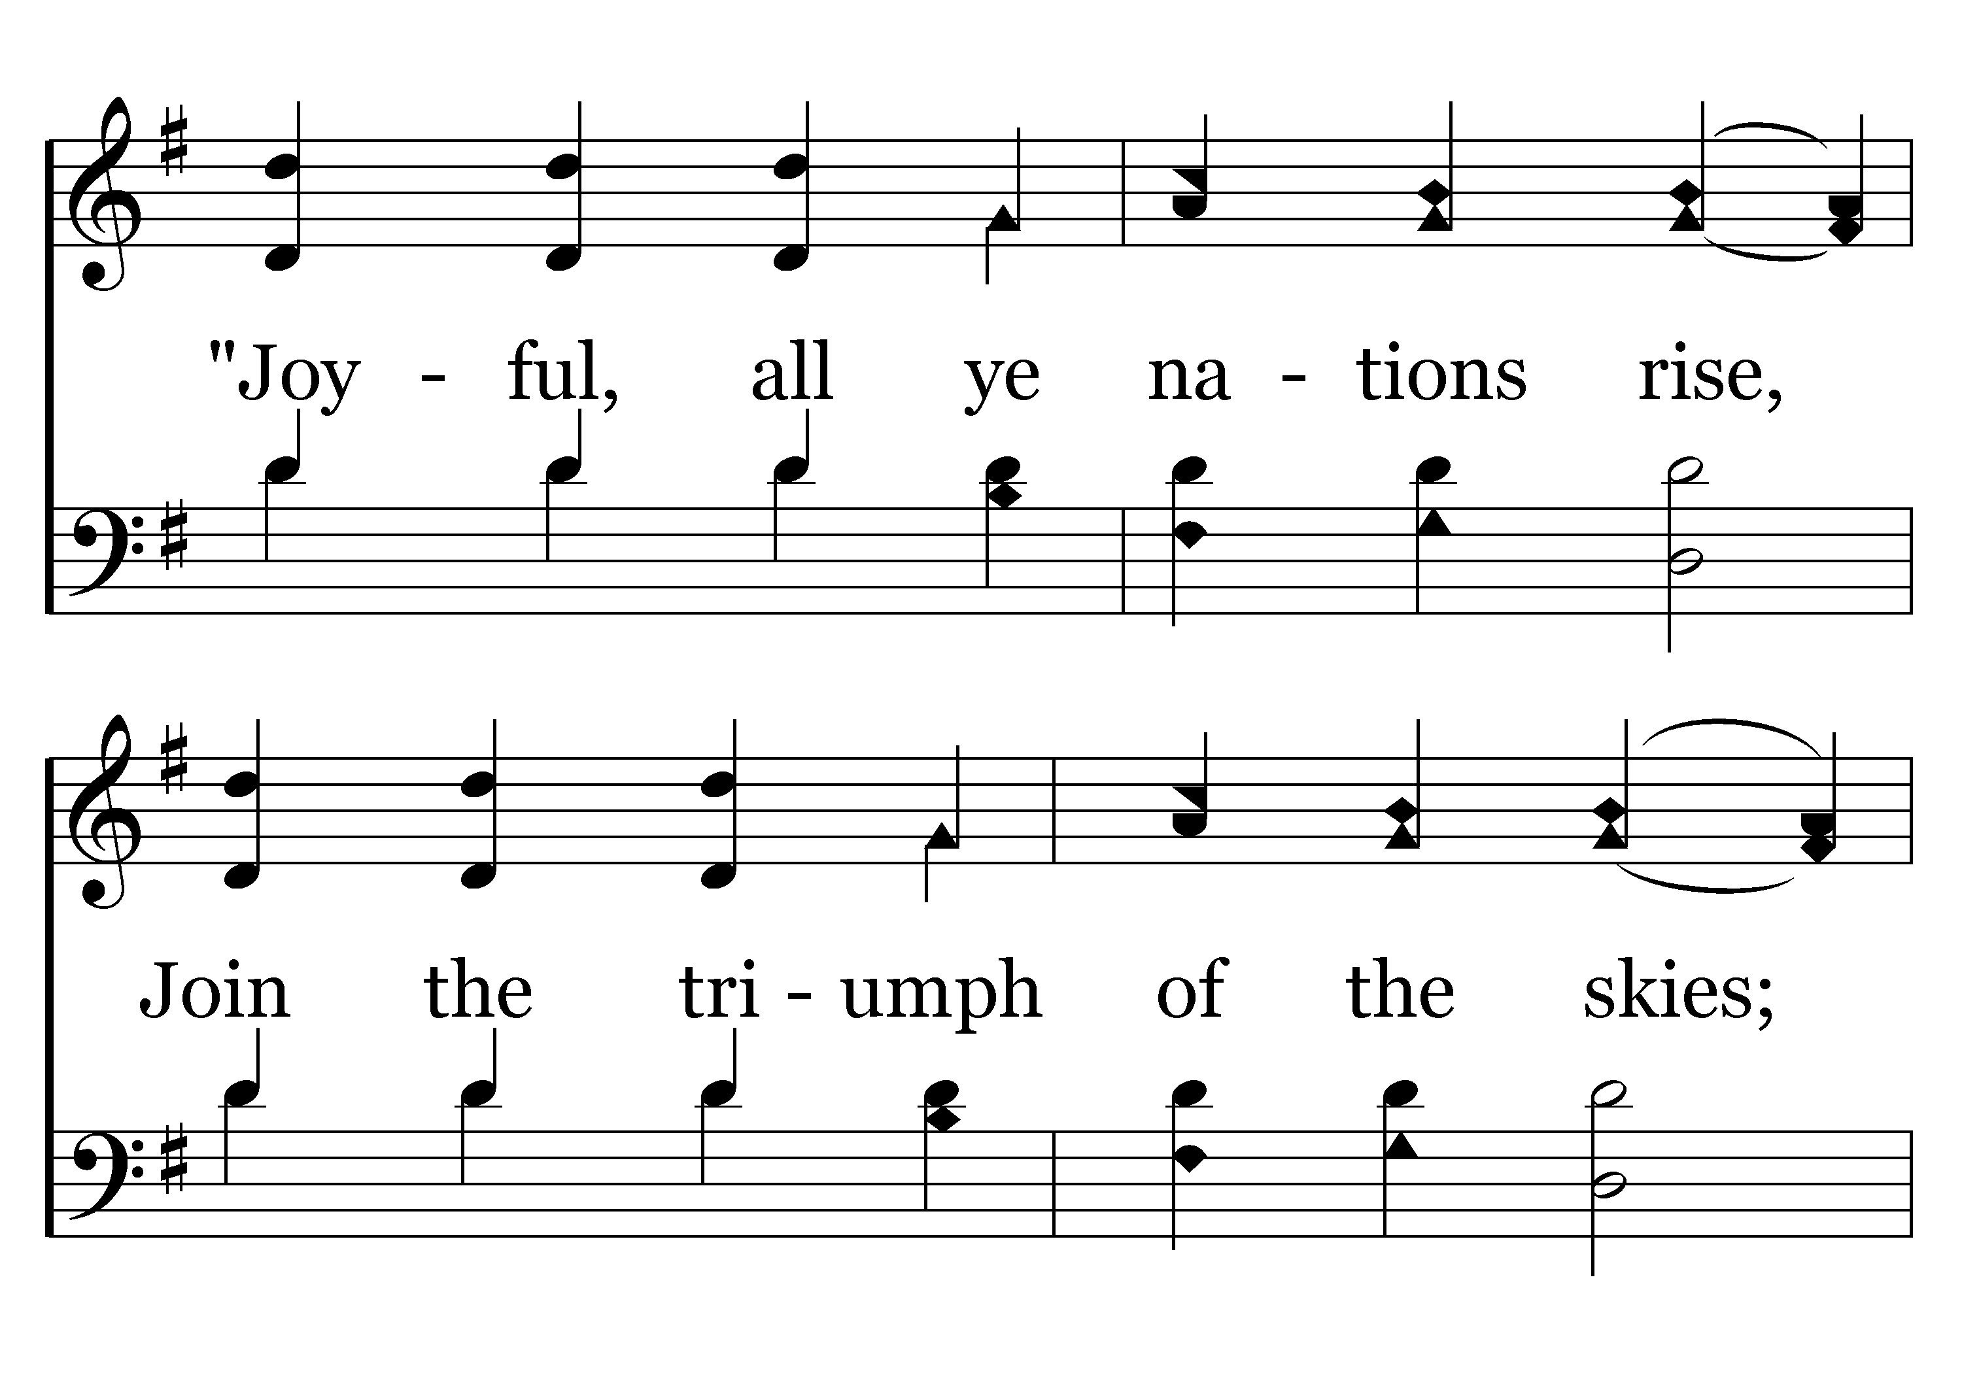
046 - Hark, The Herald Angels Sing - 1.3

Slide 59
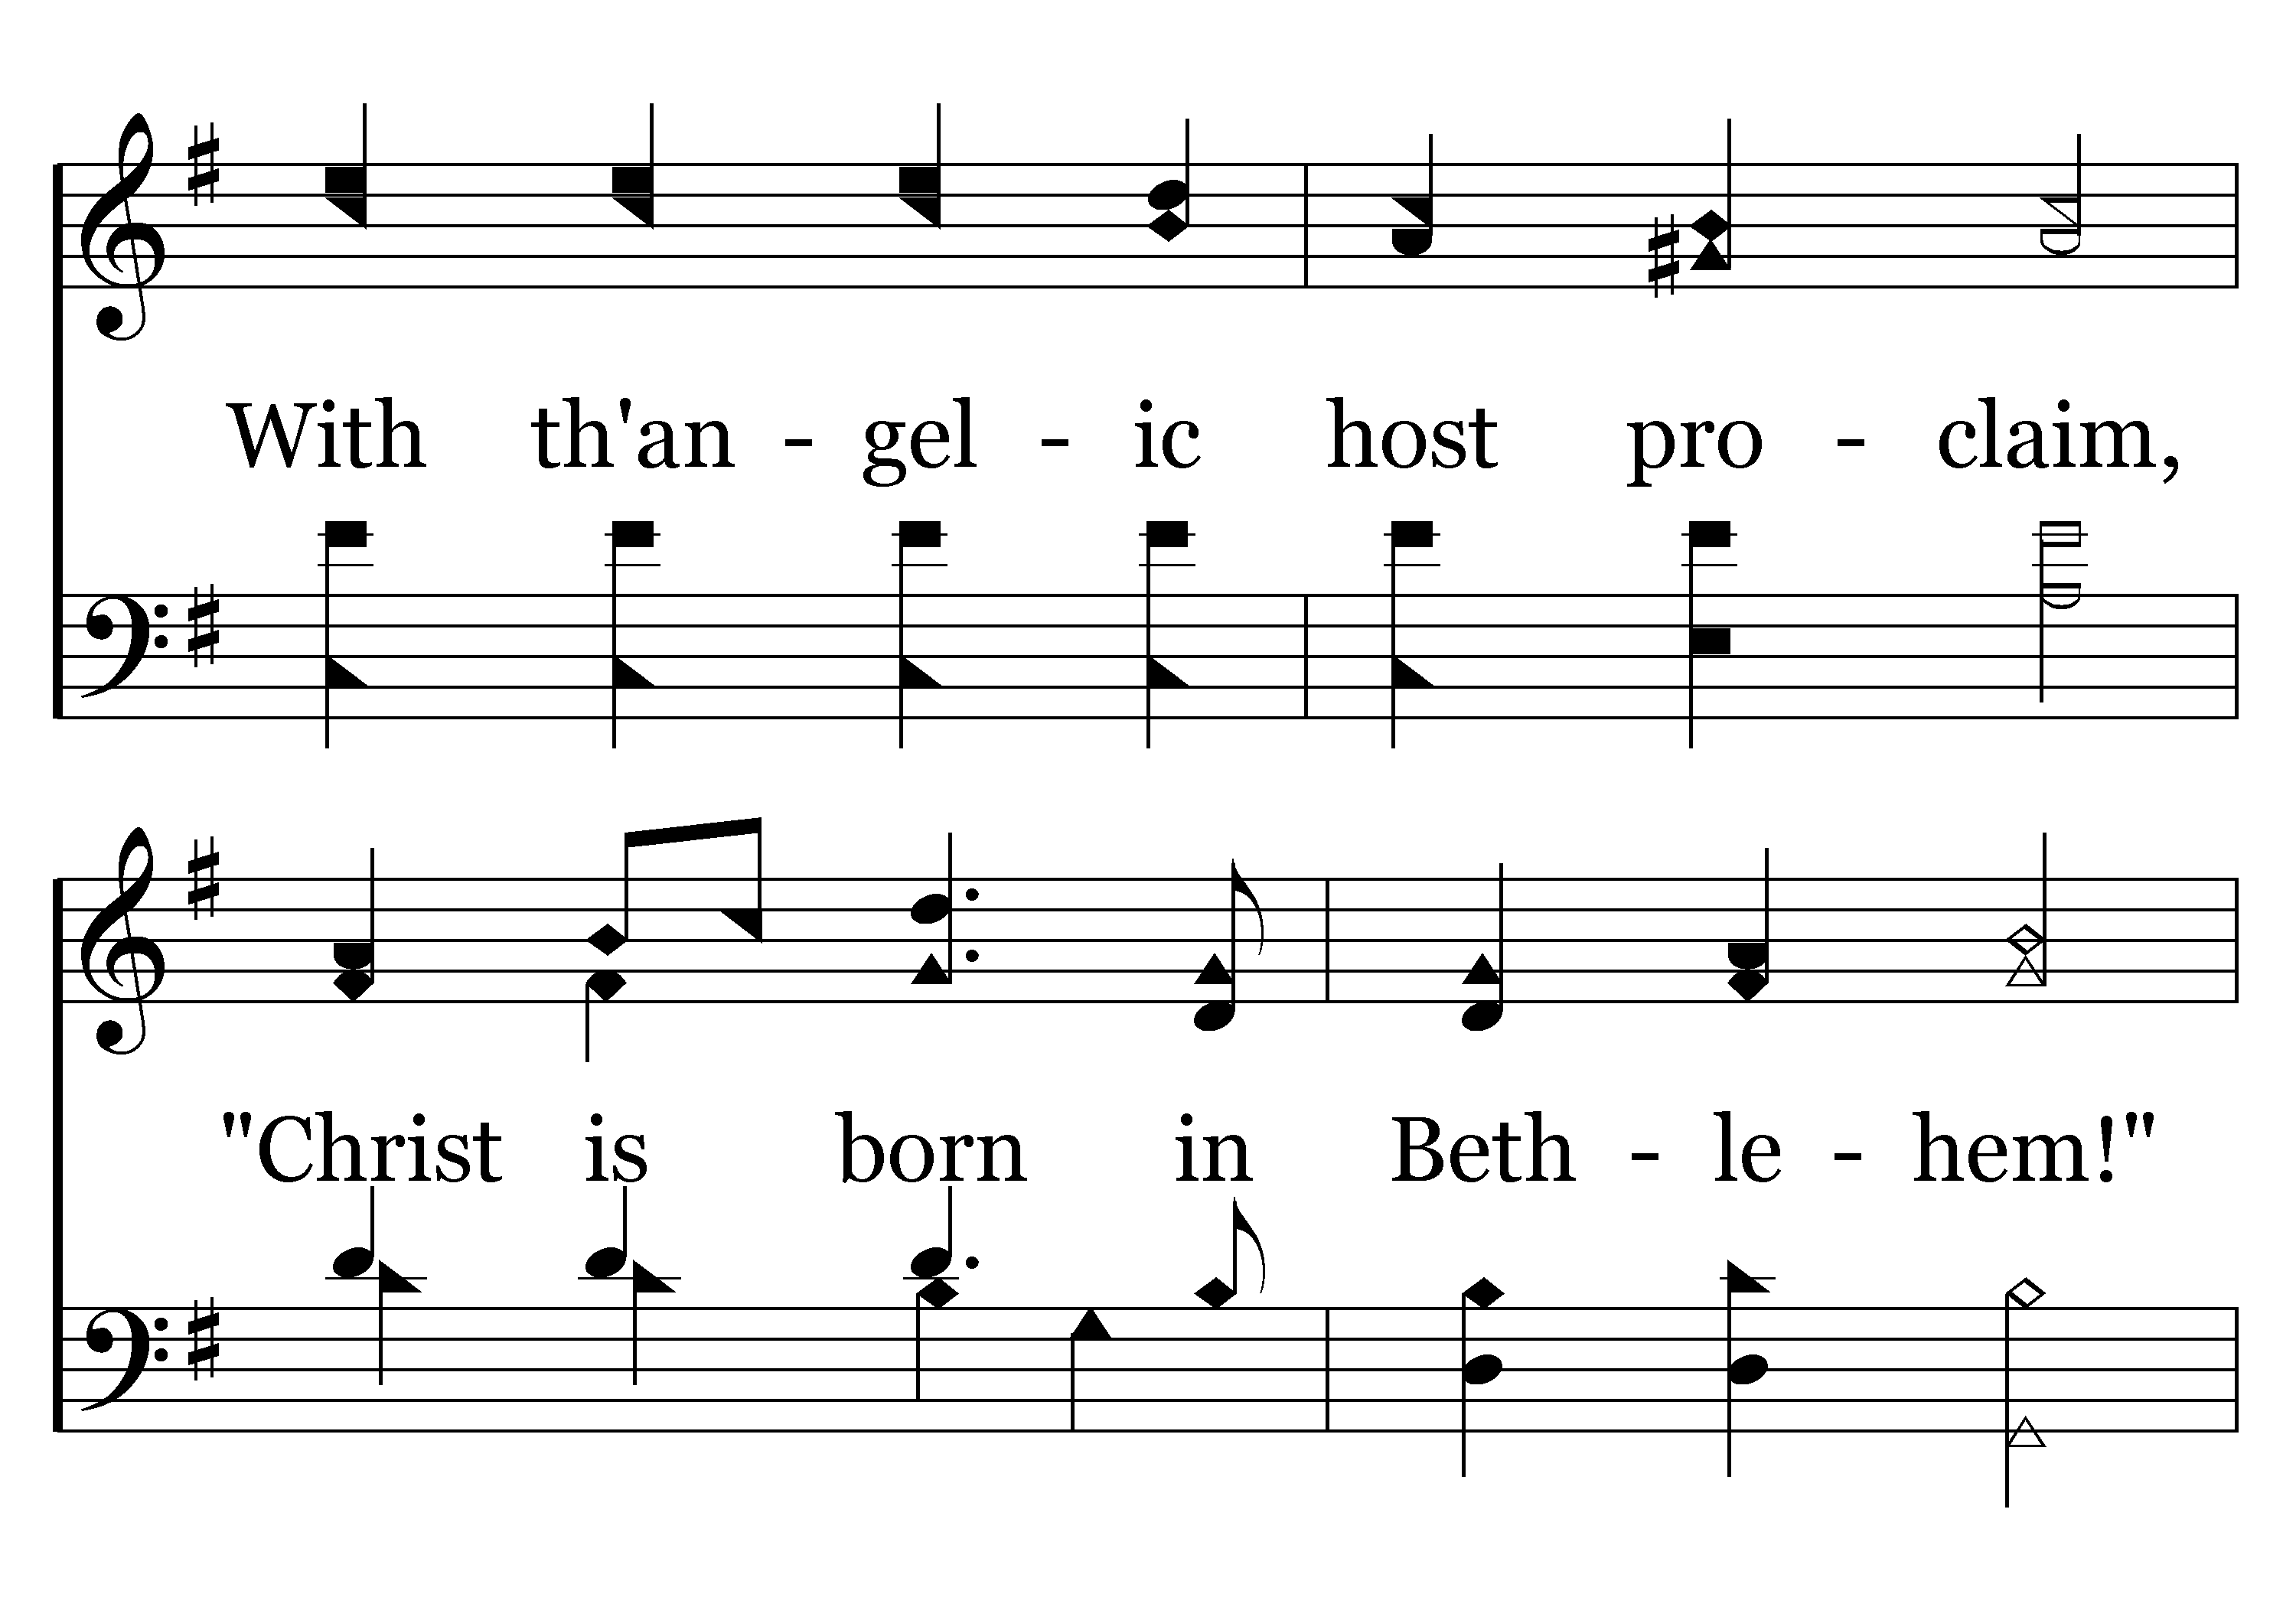
046 - Hark, The Herald Angels Sing - 1.4

Slide 60
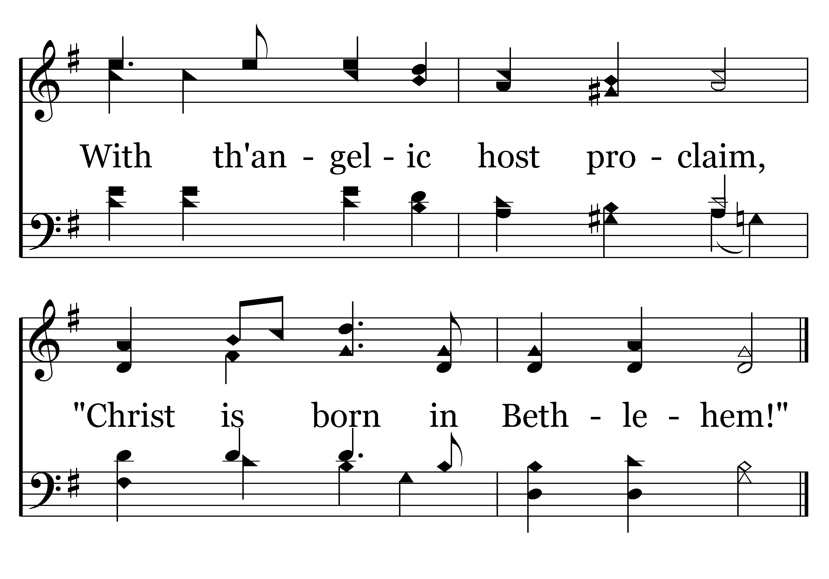
046 - Hark, The Herald Angels Sing - 1.5
End of Verse 1

Slide 61
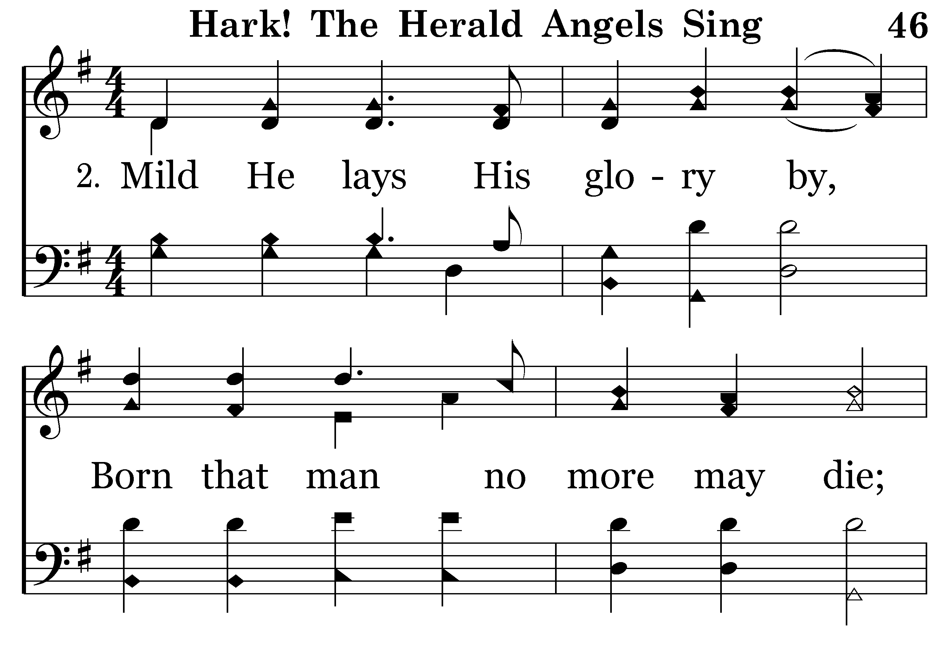
046 - Hark, The Herald Angels Sing - 2.1

Slide 62
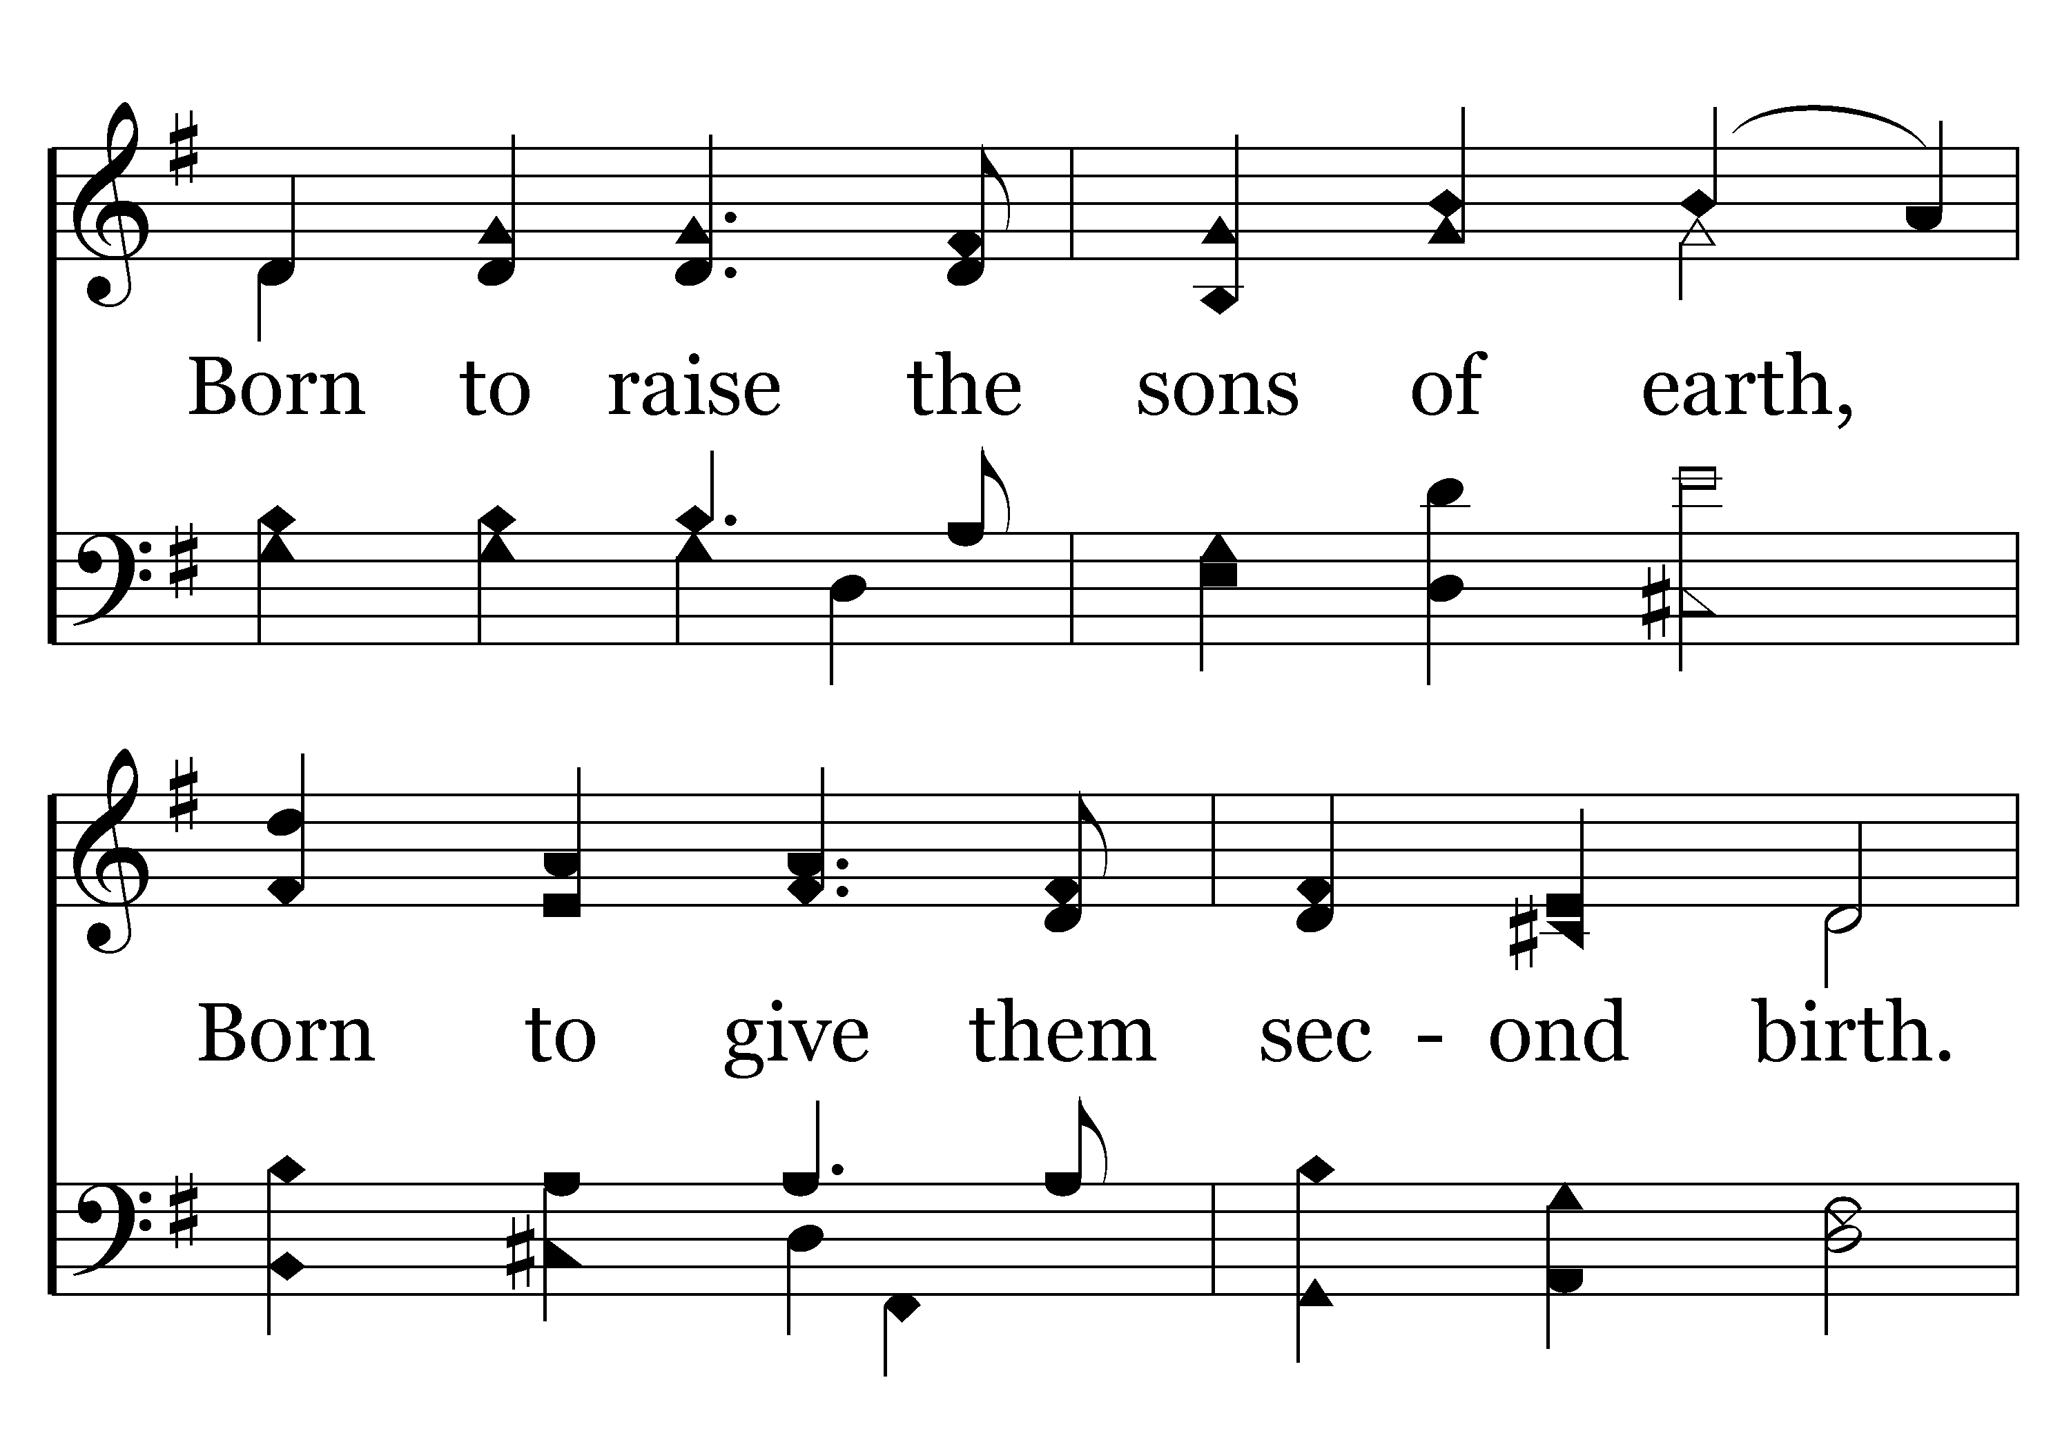
046 - Hark, The Herald Angels Sing - 2.2

Slide 63
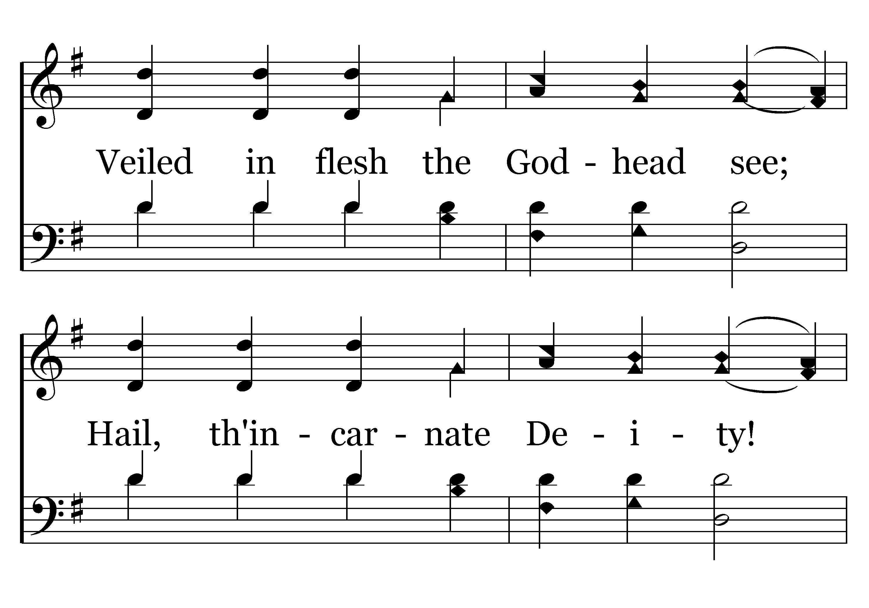
046 - Hark, The Herald Angels Sing - 2.3

Slide 64
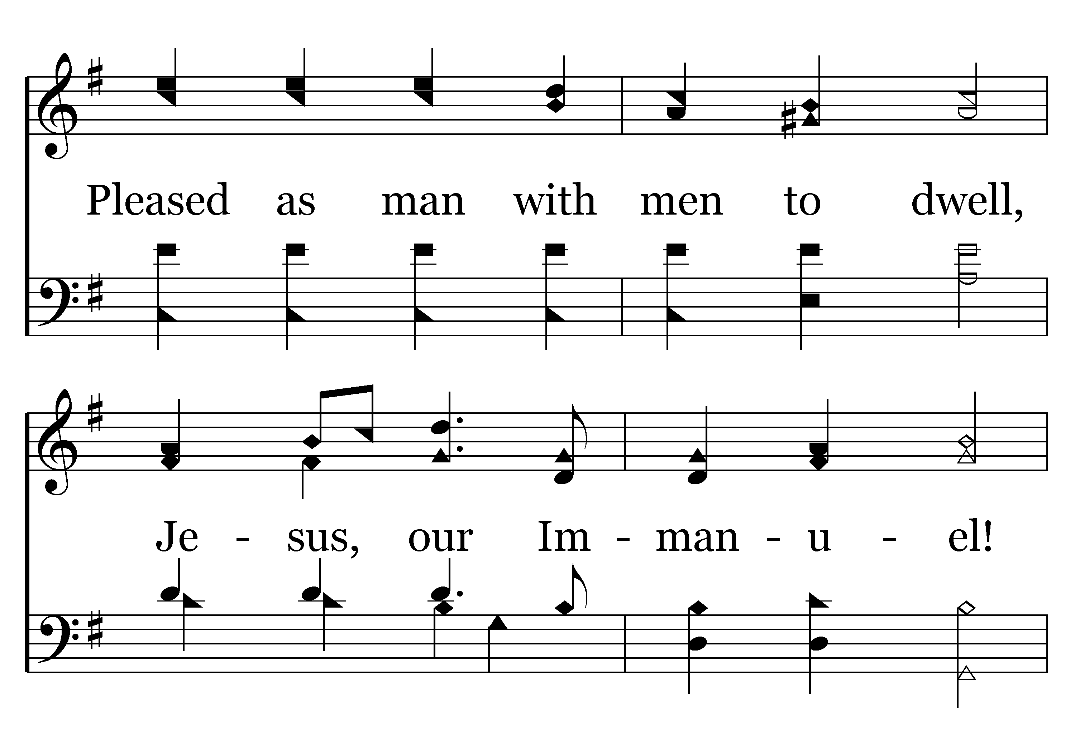
046 - Hark, The Herald Angels Sing - 2.4

Slide 65
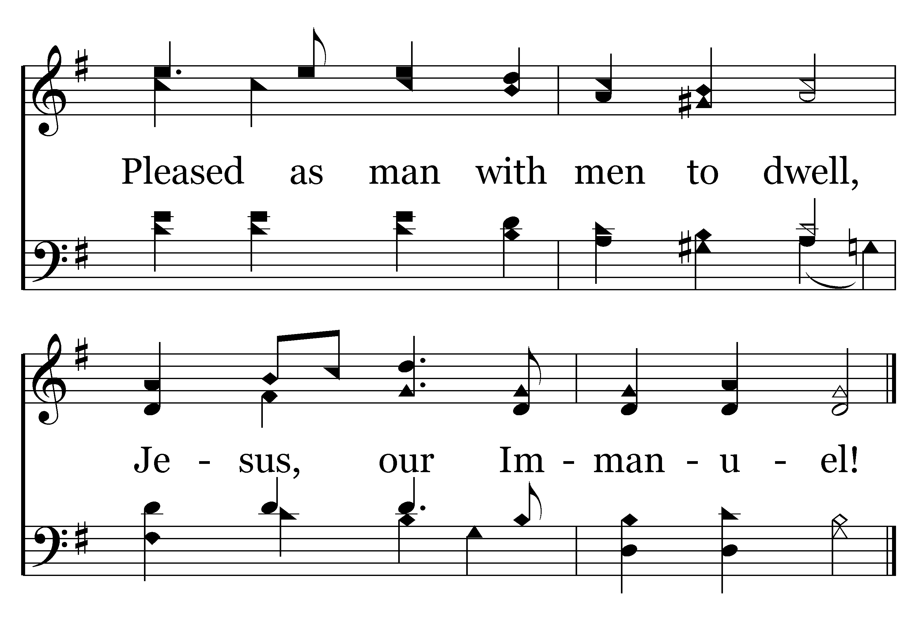
046 - Hark, The Herald Angels Sing - 2.5
End of Verse 2

Slide 66
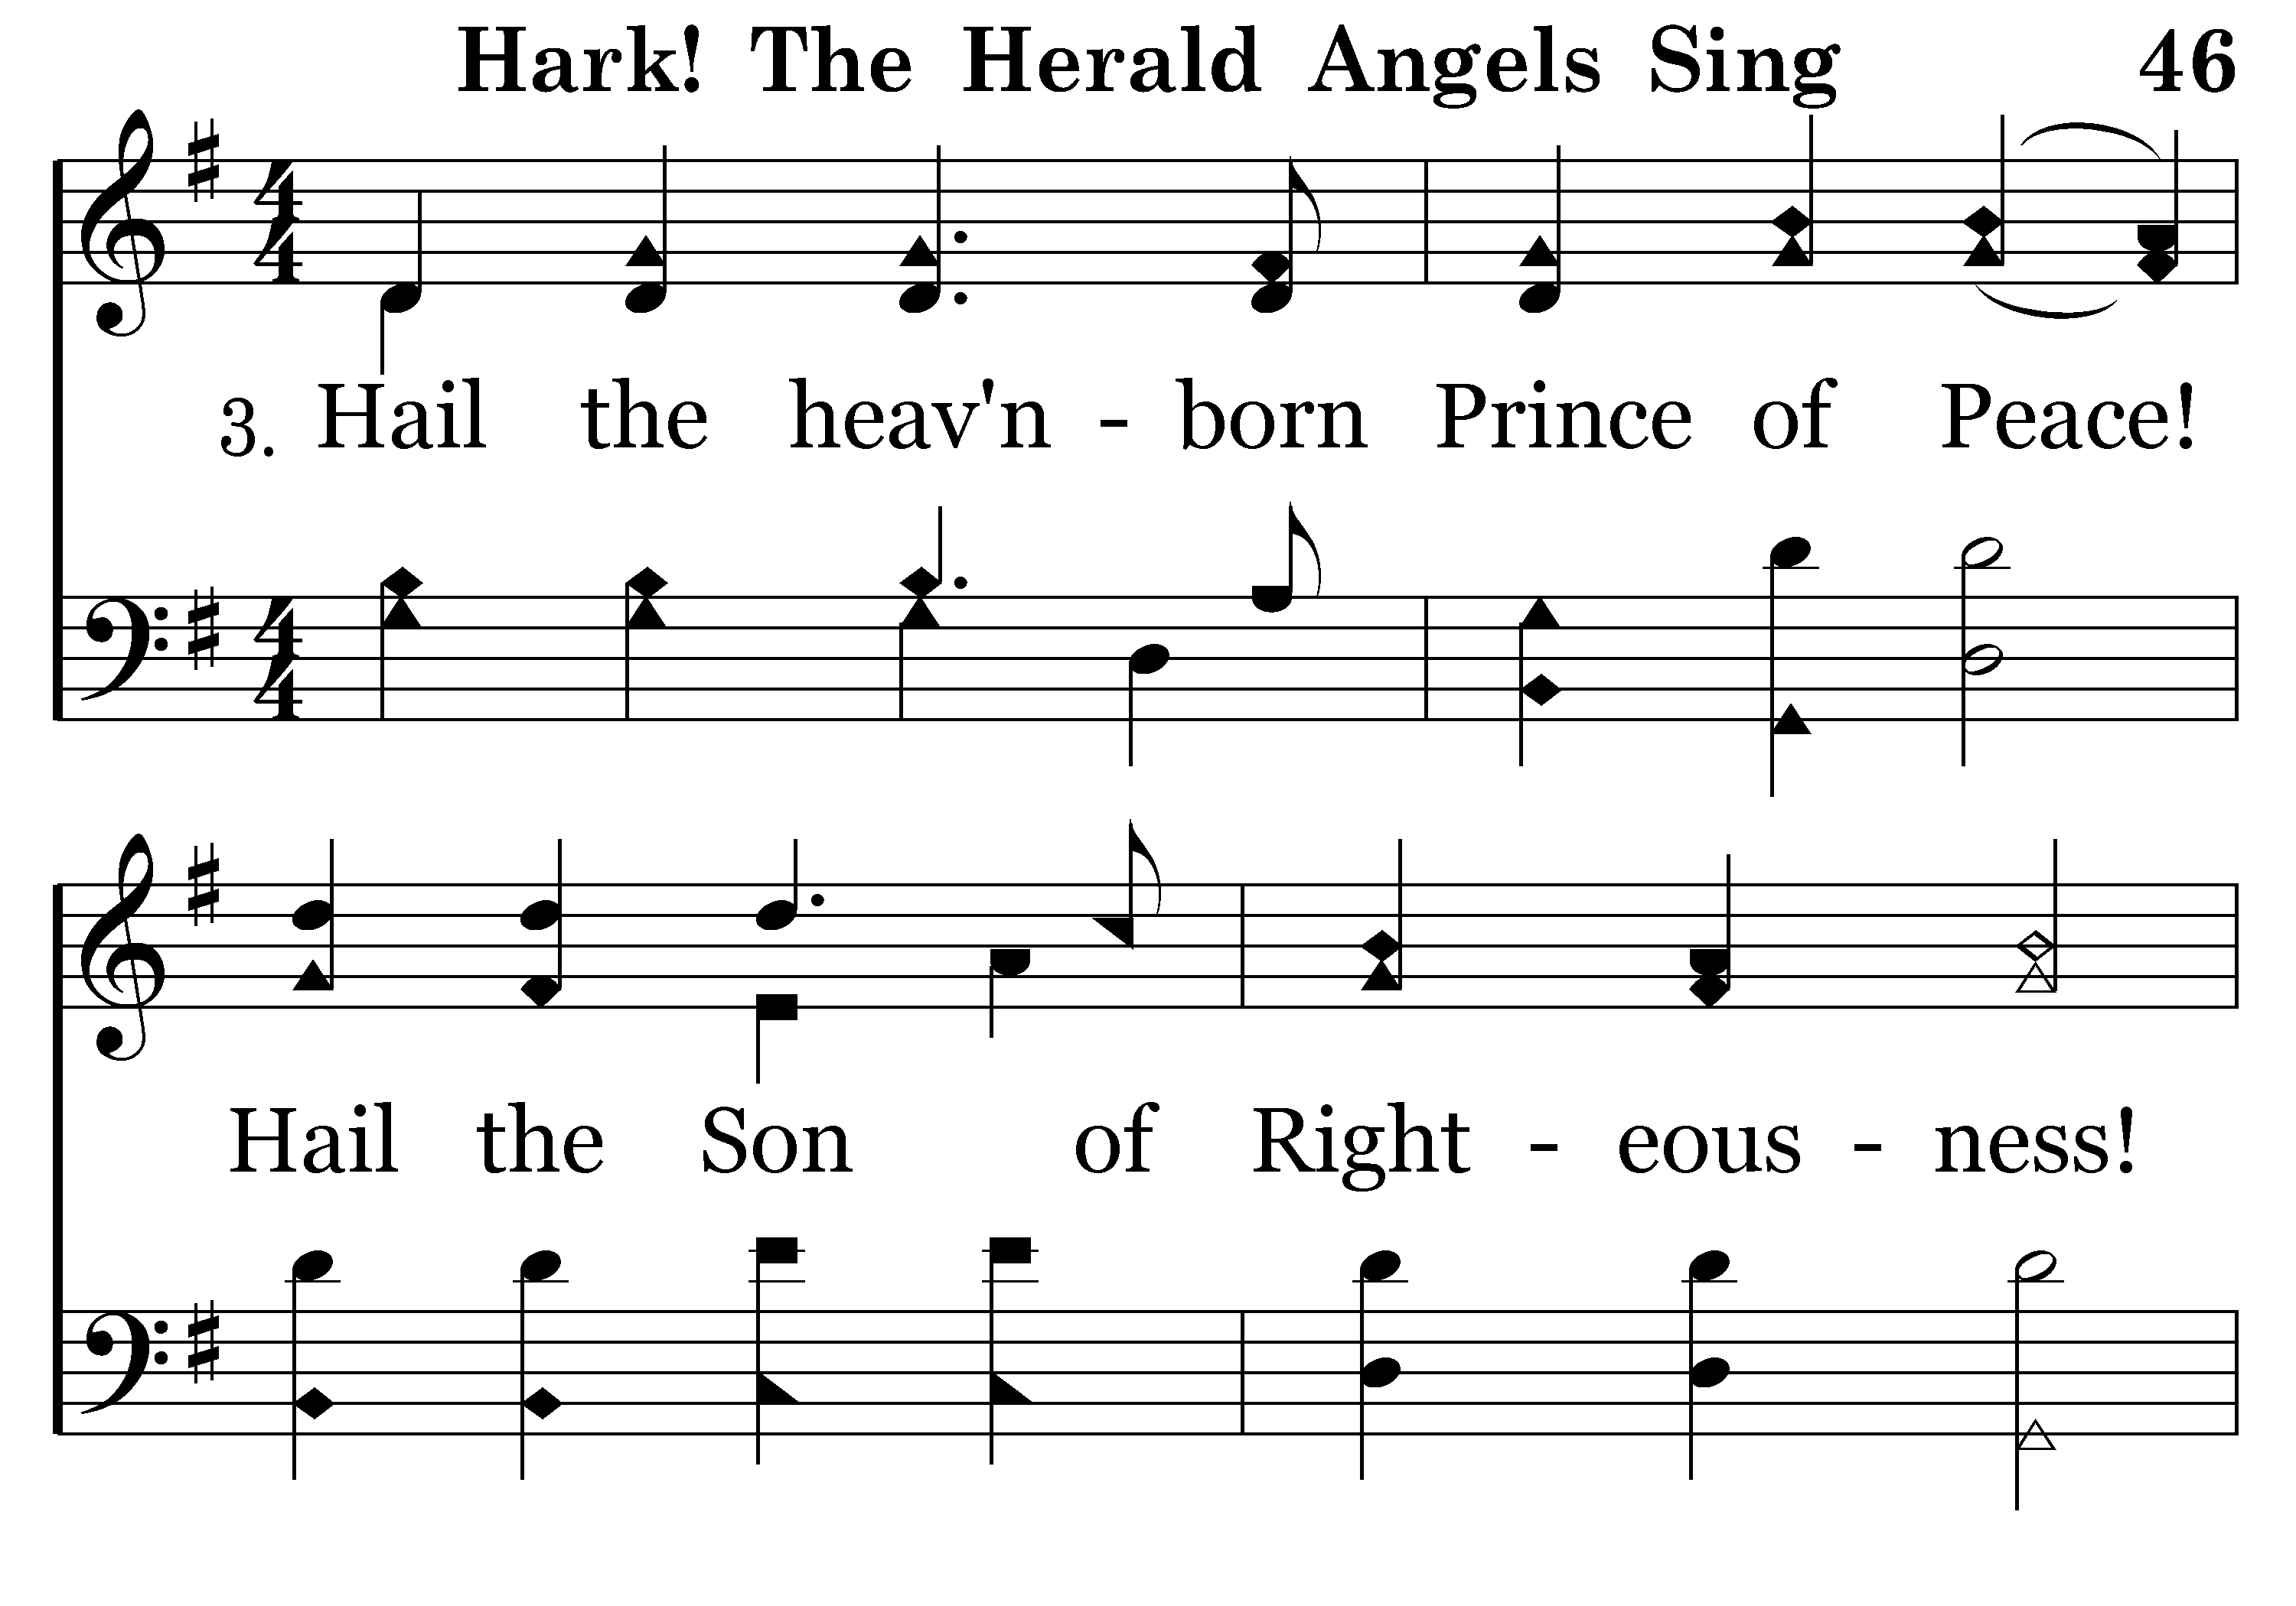
046 - Hark, The Herald Angels Sing - 3.1

Slide 67
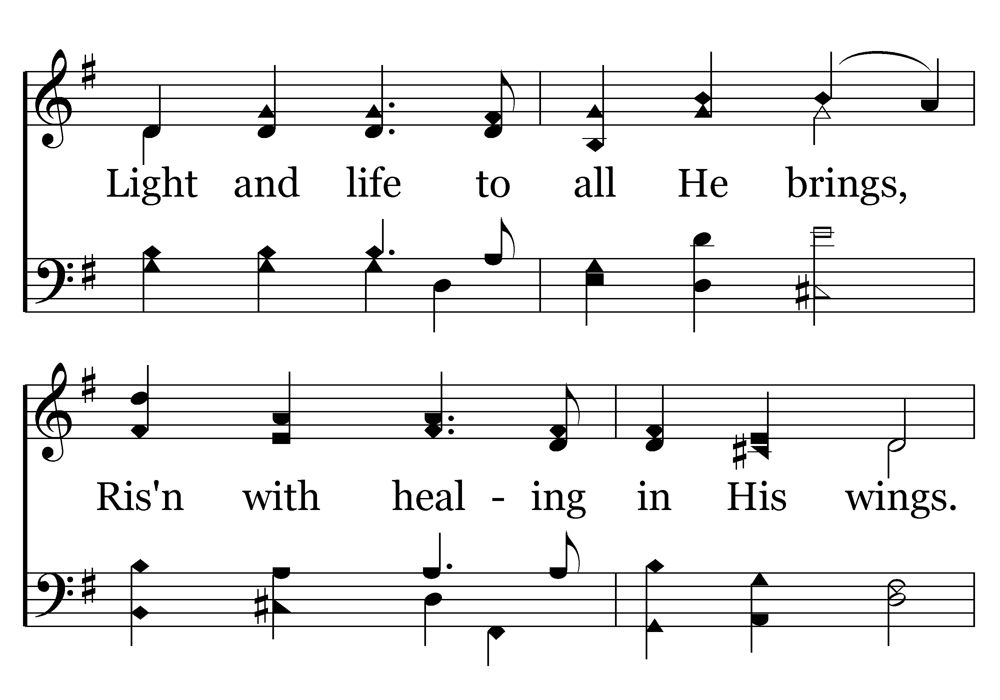
046 - Hark, The Herald Angels Sing - 3.2

Slide 68
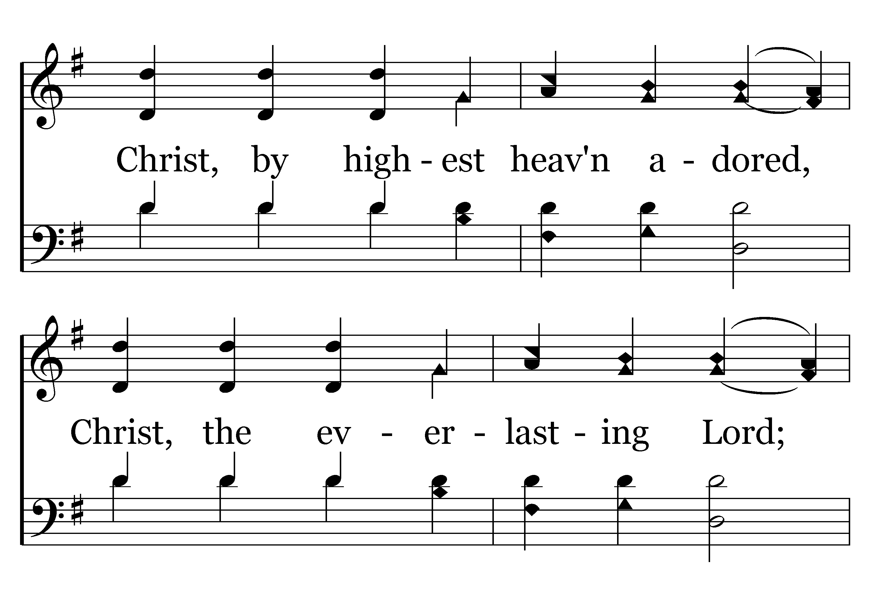
046 - Hark, The Herald Angels Sing - 3.3

Slide 69
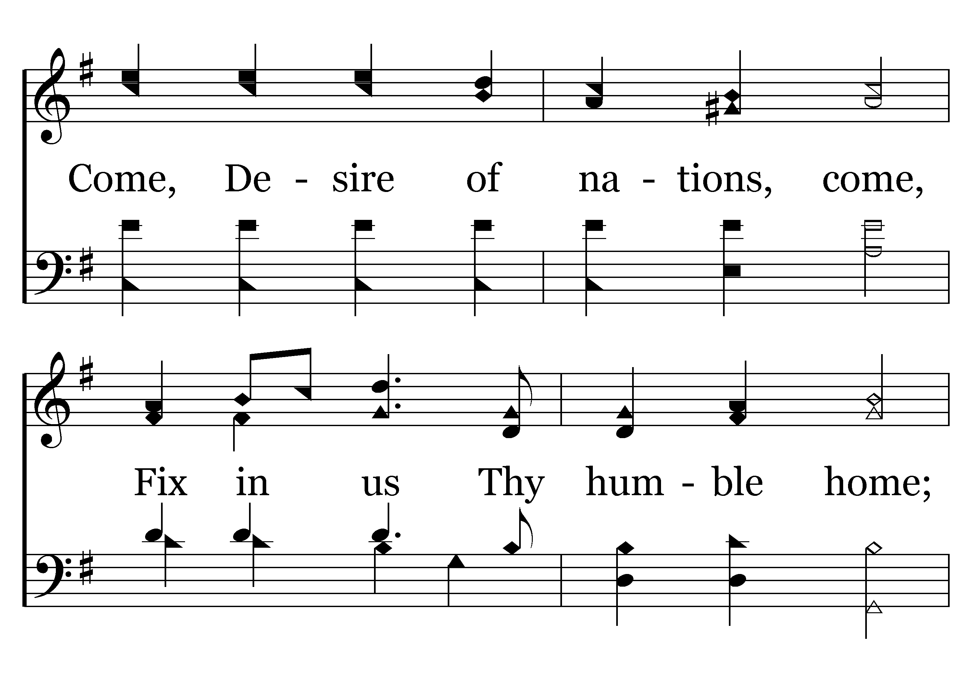
046 - Hark, The Herald Angels Sing - 3.4

Slide 70
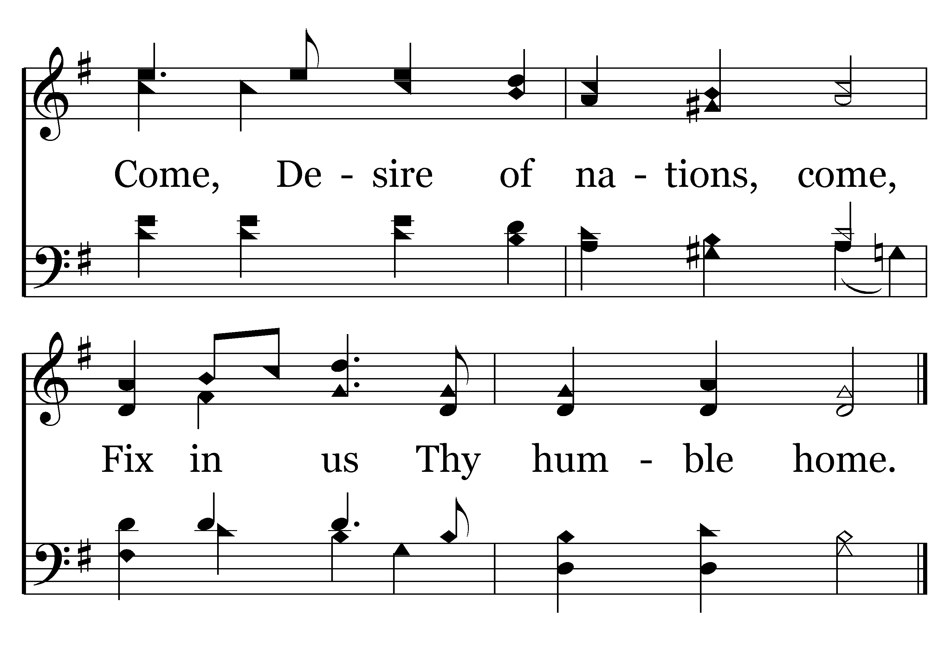
046 - Hark, The Herald Angels Sing - 3.5
End of Song

Slide 72
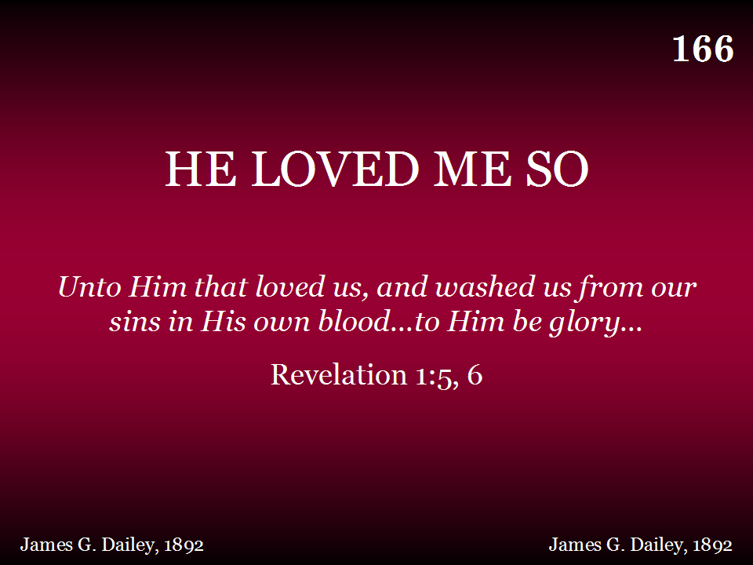
166 - He Loved Me So - Title

Slide 73

166 - He Loved Me So - 1.1

Slide 74

166 - He Loved Me So - 1.2

Slide 75

166 - He Loved Me So - C.1

Slide 76

166 - He Loved Me So - C.2
End of Verse 1

Slide 77

166 - He Loved Me So - 2.1

Slide 78

166 - He Loved Me So - 2.2

Slide 79
166 - He Loved Me So - C.1

Slide 80
166 - He Loved Me So - C.2
End of Verse 2

Slide 81

166 - He Loved Me So - 3.1

Slide 82

166 - He Loved Me So - 3.2

Slide 83
166 - He Loved Me So - C.1

Slide 84
166 - He Loved Me So - C.2
End of Song

Slide 86


Slide 87

“As often as you eat this bread and drink this cup, you proclaim the Lord’s death….” 1 Corinthians 11:26

Slide 88

414 - O, How I Love Jesus - Title

Slide 89

414 - O, How I Love Jesus - 1.1

Slide 90

414 - O, How I Love Jesus - 1.2
End of Verse 1

Slide 91

414 - O, How I Love Jesus - 2.1

Slide 92

414 - O, How I Love Jesus - 2.2
End of Verse 2

Slide 93

414 - O, How I Love Jesus - 3.1

Slide 94

414 - O, How I Love Jesus - 3.2

Slide 95

414 - O, How I Love Jesus - C.1

Slide 96

414 - O, How I Love Jesus - C.2
End of Song

Slide 98
PLEASE TURN TO PAGE 555a IN THE BROWN HYMNAL
COME ALL YE FAITHFUL
REPEAT CHORUS

Slide 99

Notes:
You are welcome to use or modify these PowerPoints as needed. Feel free to change the design or layout to suit your ministry, school, home, or company. More PowerPoint slides can be found at mobilehymns.org

Slide 100


Slide 101


Slide 102


Slide 103


Slide 104

Bright hosts

Slide 106


Slide 107


Slide 108
REPEAT CHORUS

Slide 110

TODAY’S TEXT
DENNING ANDREWS
1 CORINTHIANS 1:26-30

Slide 111
1 Cor 1:26-30 Brothers, think of what you were when you were called. Not many of you were wise by human standards; not many were influential; not many were of noble birth. ²⁷ But God chose the foolish things of the world to shame the wise; God chose the weak things of the world to shame the strong. ²⁸ He chose the lowly things of this world and the despised things — and the things that are not — to nullify the things that are, ²⁹ so that no one may boast before him. ³⁰ It is because of him that you are in Christ Jesus, who has become for us wisdom from God — that is, our righteousness, holiness and redemption.

Slide 112
INVITATION SONG
# 331
KNEEL AT THE CROSS

Slide 113


Slide 114

THERE ARE MORE PINE NEEDLES ON THE CARPET THAN ON THE TREE

Slide 115

YOUR CREDIT CARD IS SMOKED ALONG WITH THE TURKEY AND HAM

Slide 116

YOU HAVE SEEN “A WONDERFUL LIFE” 24 TIMES IN THE LAST 2 WEEKS

Slide 117

A TRIP TO THE MALL TO RETURN GIFTS IS MORE CHALLENGING THAN THE INDY 500

Slide 118

YOUR SHOPPING LIST WAS WRITTEN IN BLACK – YOUR CHECKBOOK BALANCE IS IN RED

Slide 119

WE ALL LIKE SURPRISES – OPENING A GIFT AND BEING SURPRISED AT WHAT IS INSIDE
WE ALL LIKE OPENING GIFTS
WE ALL LIKE THE SURPRISE OF WHAT IS HIDING BEHIND ALL OF THE FESTIVE WRAPPING PAPER
OR WHAT IS IN THE ENVELOPE

Slide 120


Slide 121
THE BIRTH OF CHRIST WAS A GREAT MOMENT IN HISTORY
OF COURSE HIS DEATH AND RESURRECTION ARE THE GREATEST MOMENTS
BUT HAD IT NOT BEEN FOR HIS BIRTH – HIS DEATH & RESURRECTION WOULD NOT HAVE OCCURED

Slide 122
I WANT US TO THINK ABOUT THE SURPRISES SURROUNDING THE BIRTH OF JESUS & THE GIFTS GOD GIVES US
I. HIS PARENTS WERE SURPRISING
IF THE CHOICE OF PARENTS HAD BEEN YOURS TO MAKE WHO WOULD YOU HAVE CHOSEN?

Slide 123

WE WOULD HAVE SELECTED WEALTHY PARENTS
THEY WOULD HAVE BEEN PEOPLE OF CULTURE
THEY WOULD HAVE HAD THE RIGHT EDUCATION
THEY WOULD HAVE BEEN INFLUENTIAL

Slide 124
WHEN THE WISE MEN CAME TO JERUSALEM THEY WENT IMMEDIATELY TO THE PALACE
WHERE IS HE WHO IS BORN A KING?
THE OBVIOUS PLACE TO LOOK FOR A KING IS A PALACE
THIS IS WHERE PARENTS OF A KING WOULD BE

Slide 125
II. THE TIMING OF HIS BIRTH WAS A SURPRISE
AT WHAT TIME IN HISTORY WOULD WE HAVE CHOSEN?

Slide 126
MAYBE WE WOULD HAVE CHOSEN THE TIME WHEN DAVID WAS KING
MAYBE THE TIME THE JEWS WERE THE SUPER POWER OF THE WORLD
MAYBE WE WOULD HAVE CHOSEN THE 21ST CENTURY
AIR TRAVEL – SATELLITE COMMUINICATION
TELEVISION

Slide 127
THIS WOULD SEEM A PERFECT TIME
HIS MESSAGE COULD HAVE BEEN HEARD ALL OVER THE WORLD
HIS PICTURE MIGHT BE ON THE COVER OF TIME MAGAZINE
HE COULD HAVE BEEN INTERVIEWED BY THE TOP NEWS REPORTERS
MAYBE EVEN CNN COULD HAVE GOTTEN THE STORY RIGHT

Slide 128
Gal 4:4 says, “When the time had fully come, God sent His Son, born of a woman, born under the law….”

Slide 129
Gal 4:4 says, “When the time had fully come, God sent His Son, born of a woman, born under the law….”
THIS WAS PERFECT TIMING
THIS WAS THE TIME WHEN HIS BIRTH WOULD HAVE HAD THE MOST IMPACT ON THE WORLD

Slide 130
HERE’S WHY THE TIMING WAS RIGHT
1. 300 YEARS BEFORE CHRIST ALEXANDER THE GREAT CONQUERED THE WORLD AND ESTABLISHED THE GREEK LANGUAGE AS THE UNIVERSAL LANGUAGE
2. ROME BUILT ROADS – GARRISONS – KEPT A STRONG MILITARY PRESENCE WHICH MADE TRAVEL RELATIVELY SAFE
3. AFTER 400 YEARS OF SILENCE FROM GOD THERE WAS A WIDE SPREAD EXPECTANCY OF THE COMING OF THE MESSIAH

Slide 131
HERE’S WHY THE TIMING WAS RIGHT
4. THE JEWS WERE CONVINCED AS THEY WATCHED THE CORRUPTION OF THEIR LEADERS AND THEIR FAILURE TO KEEP THE LAW – THEY NEEDED A SAVIOR
THIS WOULD NOT BE THE TIME WE WOULD HAVE PLANNED
BUT THESE EVENTS WERE PLANNED BY GOD—IT WASN’T AN ACCIDENT

Slide 132
GOD PICKED THE PERFECT TIME IN HISTORY
AFTER THE RESURRECTION THE GOSPEL SPREAD RAPIDLY THROUGHOUT THE ROMAN EMPIRE

Slide 133
III. THE PLACE OF JESUS’ BIRTH IS SURPRISING
BETHLEHEM – SMALL—INSIGNIFICANT
WE PROBABLY WOULD HAVE CHOSEN JERUSALEM – ROME– ATHENS –ALEXANDRIA
700 YEARS BEFORE CHRIST MICAH PROPHESIED THAT CHRIST WOULD BE BORN IN BETHLEHEM

Slide 134
Mic 5:2 "But you, Bethlehem Ephrathah, though you are small among the clans ^{b} of Judah, out of you will come for me one who will be ruler over Israel, whose origins ^{c} are from of old, from ancient times. ^{d} "

Slide 135
IV. THE SEEMINGLY UNEVENTFUL NATURE OF JESUS’ BIRTH
WHAT AN EVENT
GOD COMING TO EARTH AND BECOMING A MAN
THIS IS BIG NEWS

Slide 136

IV. THE SEEMINGLY UNEVENTFUL NATURE OF JESUS’ BIRTH
Luke 2:6 ….the time came for the baby to be born, ⁷ and she gave birth to her firstborn, a son.
HOW ORDINARY – THIS COULD HAVE BEEN SAID ABOUT ANY BABY
WE WOULD HAVE HAD NEWS CREWS ON THE SCENE – INTERVIEWS WITH MARY AND JOSEPH – REGULAR PROGRAMING WOULD HAVE BEEN INTERRUPED WITH A “BREAKING NEWS”

Slide 137
V. THE ONES WHO RECEIVED THE ANNOUNCENT OF JESUS’ BIRTH
THE SHEPHERDS OUT IN THEIR FIELDS -- A LOWER CLASS OF SOCIETY
WE WOULD HAVE PICKED THE THEOLOGIANS OF THE DAY
MAYBE WE WOULD HAVE CHOSEN THE PHARISEES
OR KING HEROD
NOT LOWLY SHEPHERDS

Slide 138

WE ALL LIKE GIFTS – AND THE SURPRISES THAT COME WITH THEM

Slide 139
NOW THAT WE HAVE LOOKED AT SOME CHRISTMAS SURPRISES – LET’S LOOK AT SOME CHRISTMAS GIFTS

Slide 140
I. GOD’S USE OF ORDINARY PEOPLE
WE WOULD NOT HAVE CHOSEN MARY & JOSEPH – BUT GOD DID
GOD DOESN’T USE SUPERSTARS– EDUCATED GENIUSES– THOSE HIGH ON THE ECONOMIC PLAIN

Slide 141
I. GOD’S USE OF ORDINARY PEOPLE
1 Cor 1:26-30 For you see your calling, brethren, that not many wise according to the flesh, not many mighty, not many noble, are called. ²⁷ But God has chosen the foolish things of the world to put to shame the wise, and God has chosen the weak things of the world to put to shame the things which are mighty; ²⁸ and the base things of the world and the things which are despised God has chosen, and the things which are not, to bring to nothing the things that are, ²⁹ that no flesh should glory in His presence.

Slide 142
WE MIGHT BE SURPRISED AT GOD’S SELECTION OF MARY & JOSEPH
BUT WHAT A WONDERFUL GIFT – GOD CAN USE ORDINARY PEOPLE LIKE YOU AND ME

Slide 143
II. GOD’S CONTROL
GOD IS IN CONTROL OF WHAT IS HAPPENING IN THE WORLD TODAY
HE CONTROLLED THE EVENTS THAT LED UP TO THE BIRTH OF CHRIST
GOD WAS IN CONTROL WHEN HEROD THOUGHT BY KILLING ALL MALE CHILDREN HE WOULD END CHRIST’S LIFE

Slide 144
Isa 14:24 The Lord Almighty has sworn, "Surely, as I have planned, so it will be, and as I have purposed, so it will stand.
GOD DOES DRAMATIC THINGS IN UNDRAMATIC WAYS
AN ORDINARY CHILD
AN ORDINARY PLACE
AN ORDINARY WAY
BUT THE MOST DRAMATIC EVENT – GOD COMING TO DWELL WITH MAN

Slide 145
III. GIFT OF THE WAY GOD WORKS
PEOPLE TODAY STILL CRAVE THE SENSATIONAL & DRAMATIC
LOOK AT THE TV TALK SHOWS
THE RELIGIOUS SPEAKERS – THE HUGE GATHERINGS
WHEN PEOPLE CRAVE THE DRAMATIC THEY OFTEN MISS THE SIMPLE STORY OF CHRIST’S COMING AND DYING FOR OUR SINS

Slide 146
THOSE WHO LIVED 2000 YEARS AGO WHO WERE LOOKING FOR DRAMA—MISSED THE COMING OF CHRIST
PEOPLE TODAY, WHO ARE LOOKING FOR THE DRAMATIC ARE MISSING GOD’S GIFT TO MAN

Slide 147
IV. GIFT FROM THE SHEPHERDS
GOD ACCEPTS ALL PEOPLE
UNTO THE LOWEST—GOD GAVE HIS HIGHEST
UNTO THE POOR GOD GAVE HIS RICHES
IN APPEARING 1ST TO THE SHEPHERDS GOD WAS UNDERSCORING THE PURPOSE OF JESUS’ COMING
HE CAME TO BE THE LAMB OF GOD WHO WOULD TAKE AWAY THE SINS OF THE WORLD

Slide 148
TO THOSE WHO WERE LOOKING AFTER LAMBS—HE FIRST APPEARED
THE SHEPHERDS WERE THE FIRST TO OBSERVE THE LAMB OF GOD
WHAT DOES THIS MEAN TO US?

Slide 149
DO YOU LOOK AT THE WORLD AND LOSE HEART?
JESUS HAS OVERCOME THE WORLD
DO YOU FEEL INSIGNIFICANT AND UNLOVED?
JESUS CAME TO MAKE US ACCEPTABLE

Slide 150
GOD HAS GIVEN US SO MUCH
LET US GIVE OUR GIFT TO HIM
LET’S GIVE OURSELVES

Slide 152

331 - Kneel At The Cross - Title

Slide 153

331 - Kneel At The Cross - 1.1

Slide 154

331 - Kneel At The Cross - 1.2

Slide 155

331 - Kneel At The Cross - C.1

Slide 156

331 - Kneel At The Cross - C.2
End of Verse 1

Slide 157

331 - Kneel At The Cross - 2.1

Slide 158

331 - Kneel At The Cross - 2.2

Slide 159
331 - Kneel At The Cross - C.1

Slide 160
331 - Kneel At The Cross - C.2
End of Verse 2

Slide 161

331 - Kneel At The Cross - 3.1

Slide 162

331 - Kneel At The Cross - 3.2

Slide 163
331 - Kneel At The Cross - C.1

Slide 164
331 - Kneel At The Cross - C.2
End of Song

Slide 166


Slide 168

CLOSING PRAYER
BRAD VANHEARENTS

Slide 169


Slide 170

SUNDAY, JAN 2, 2022, FOLLOWING MORNING SERVICE
IN WEST ANNEX

Slide 171
THANK YOU FOR VISITING WITH US
PLEASE COME BACK

