Slide 1
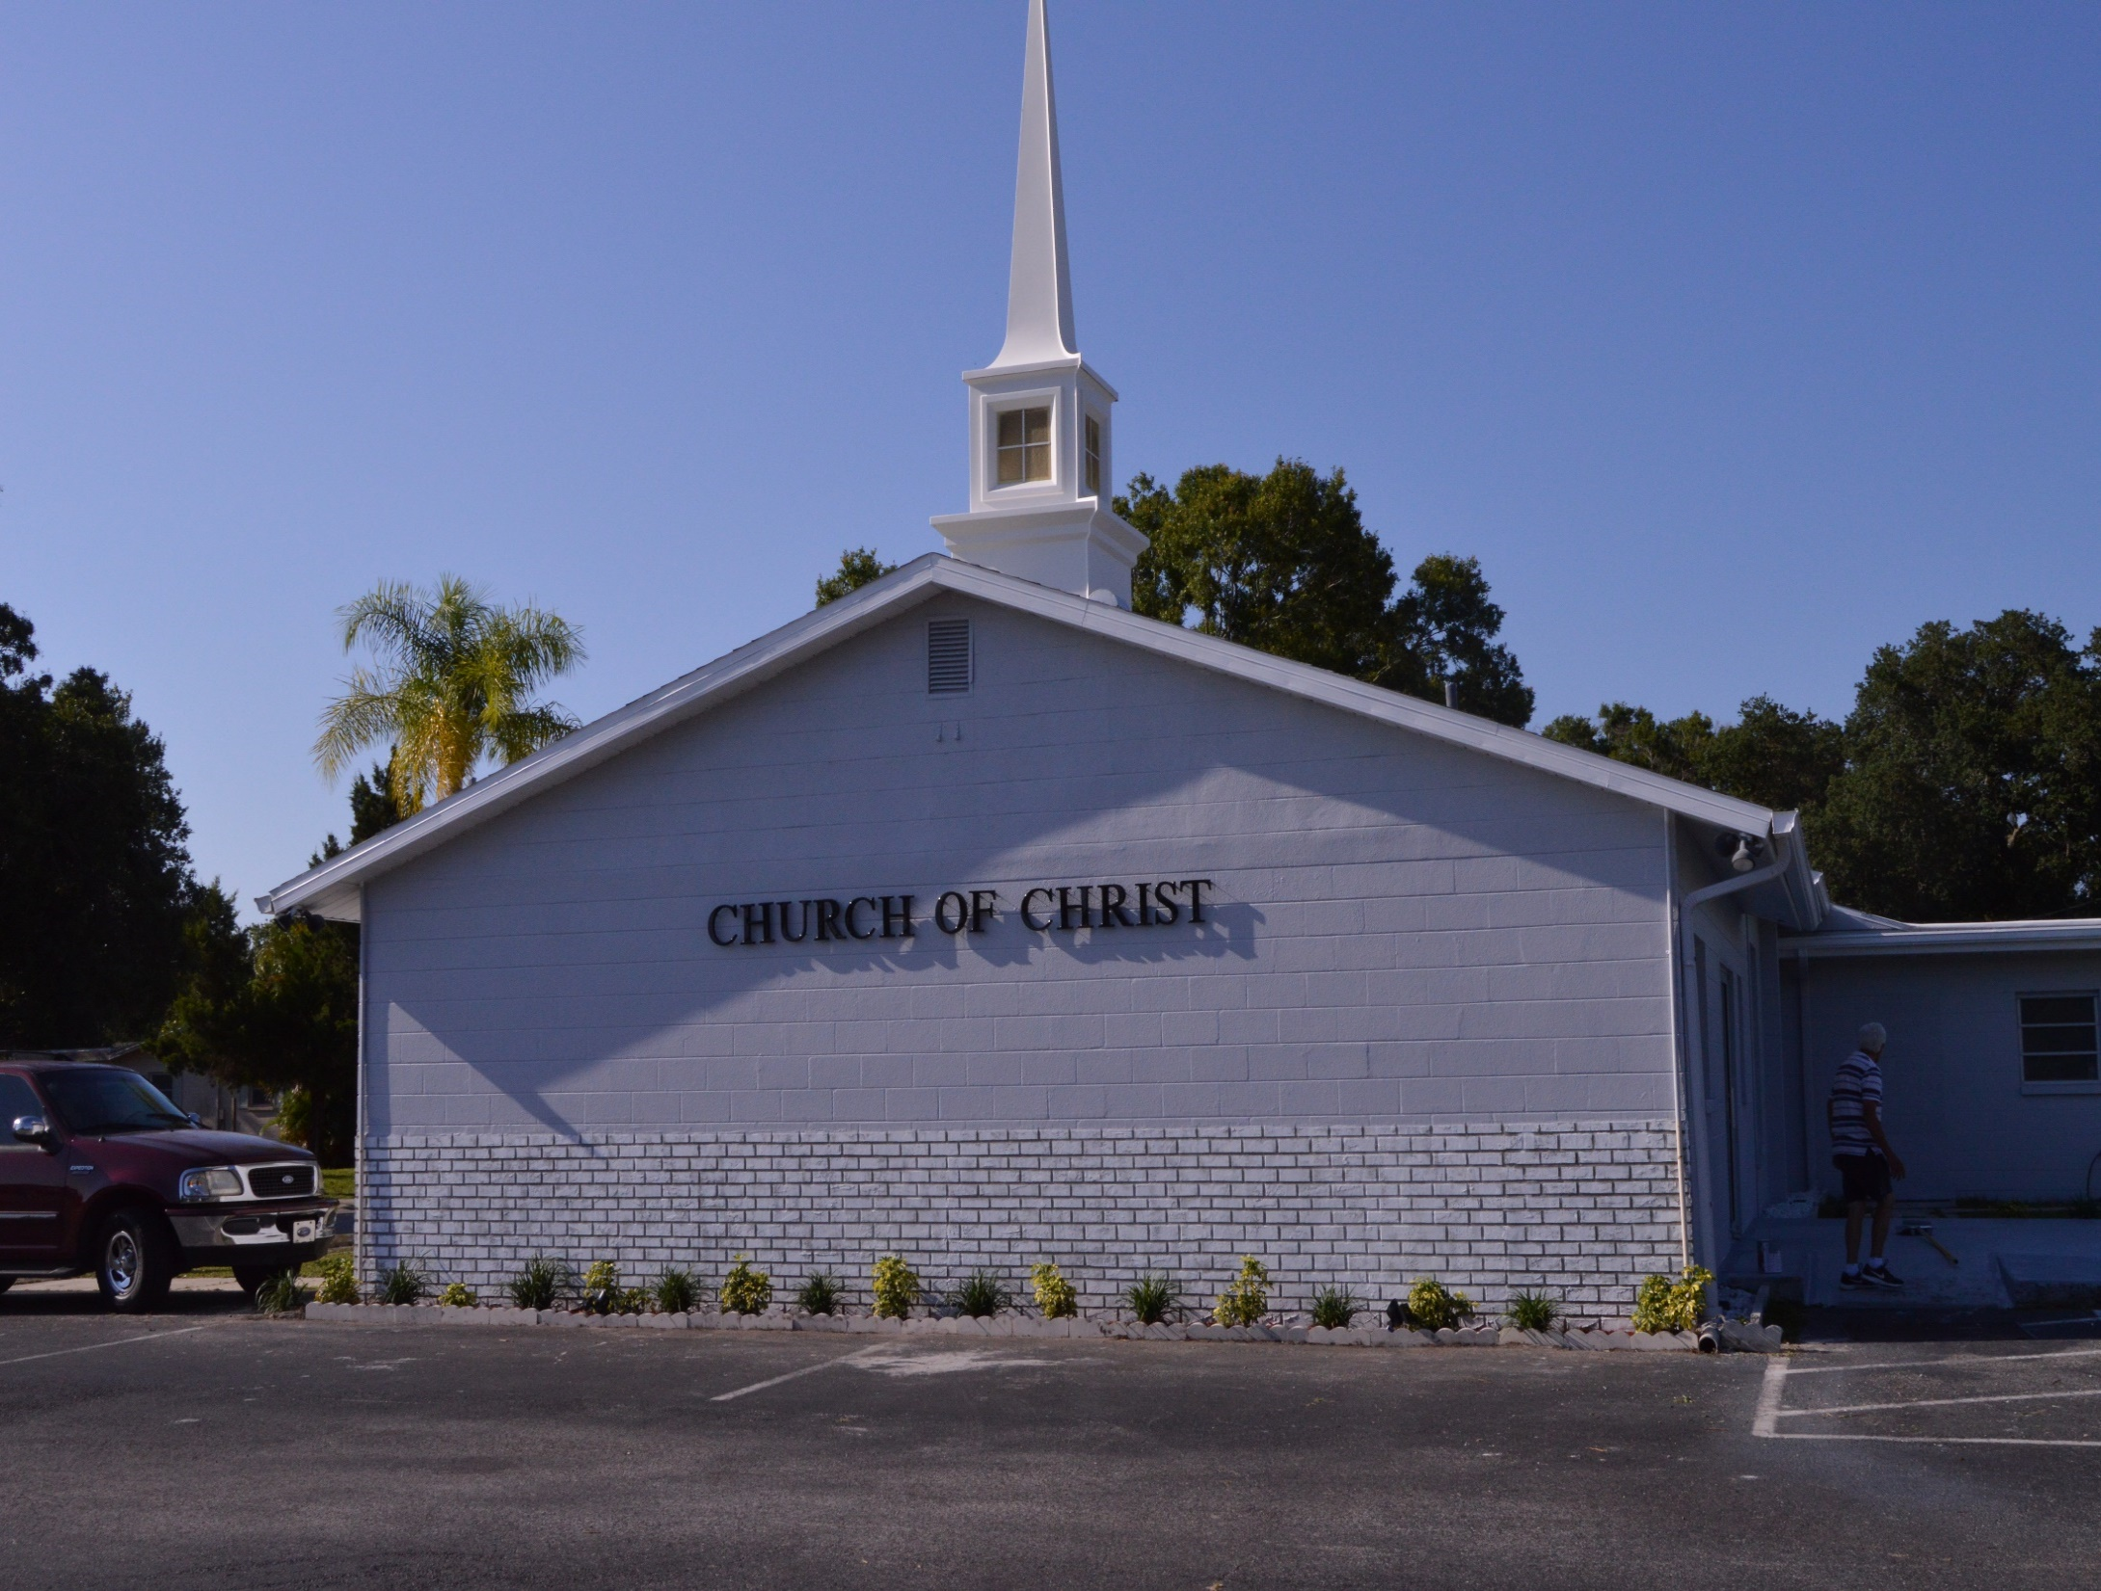
WELCOME TO SKYVIEW

Slide 2
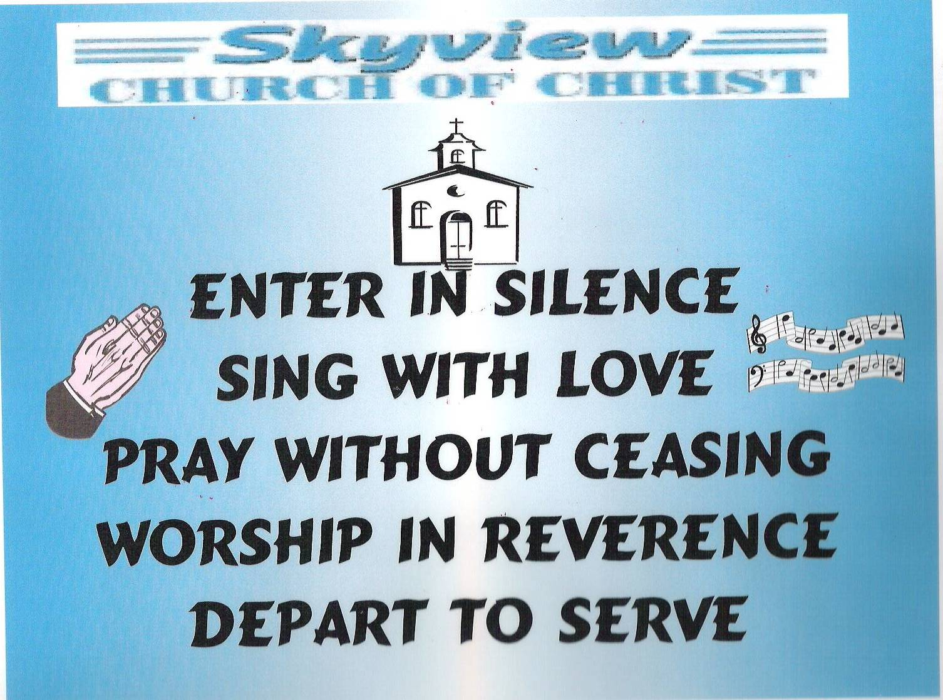
DESIGNED BY JIM INGRAM

Slide 3


Slide 4
TODAY’S WORSHIP LEADERS
CALL TO WORSHIP
PRAYER
SONG LEADER
SCRIPTURE
HEADING TABLE
SERMON
CLOSING PRAYER
ANNOUNCEMENTS
Charles Murray
David Hammontree
Sander Fletcher
Derrick Cowan
Steve Harrell
Charles Murray
Joe Dryer
Jim Ingram

Slide 5

MONDAY NIGHT BIBLE STUDY 6:30PM will meet in the West Annex
WEDNESDAY BIBLE STUDY will meet in the West Annex until further notice
LADIES BIBLE CLASS W.I.N.G.S (Women In God’s Service) Thursday 10:00 AM – meets in the West Annex

Slide 6

FIVE MINUTE RULE

Slide 7


Slide 8


Slide 10
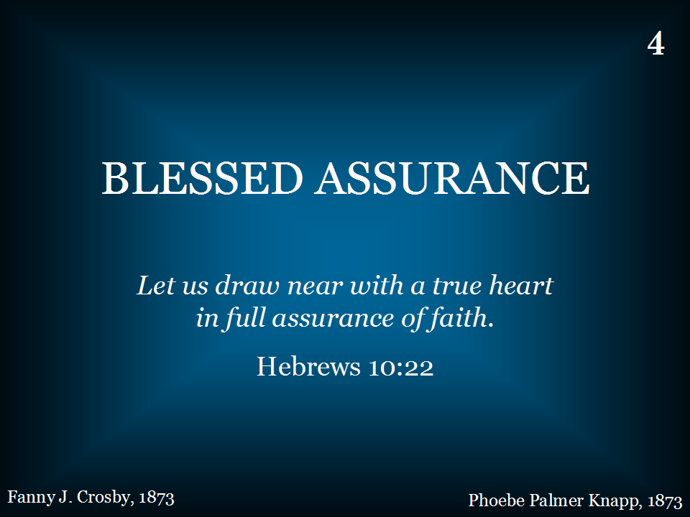
004 - Blessed Assurance - Title

Slide 11
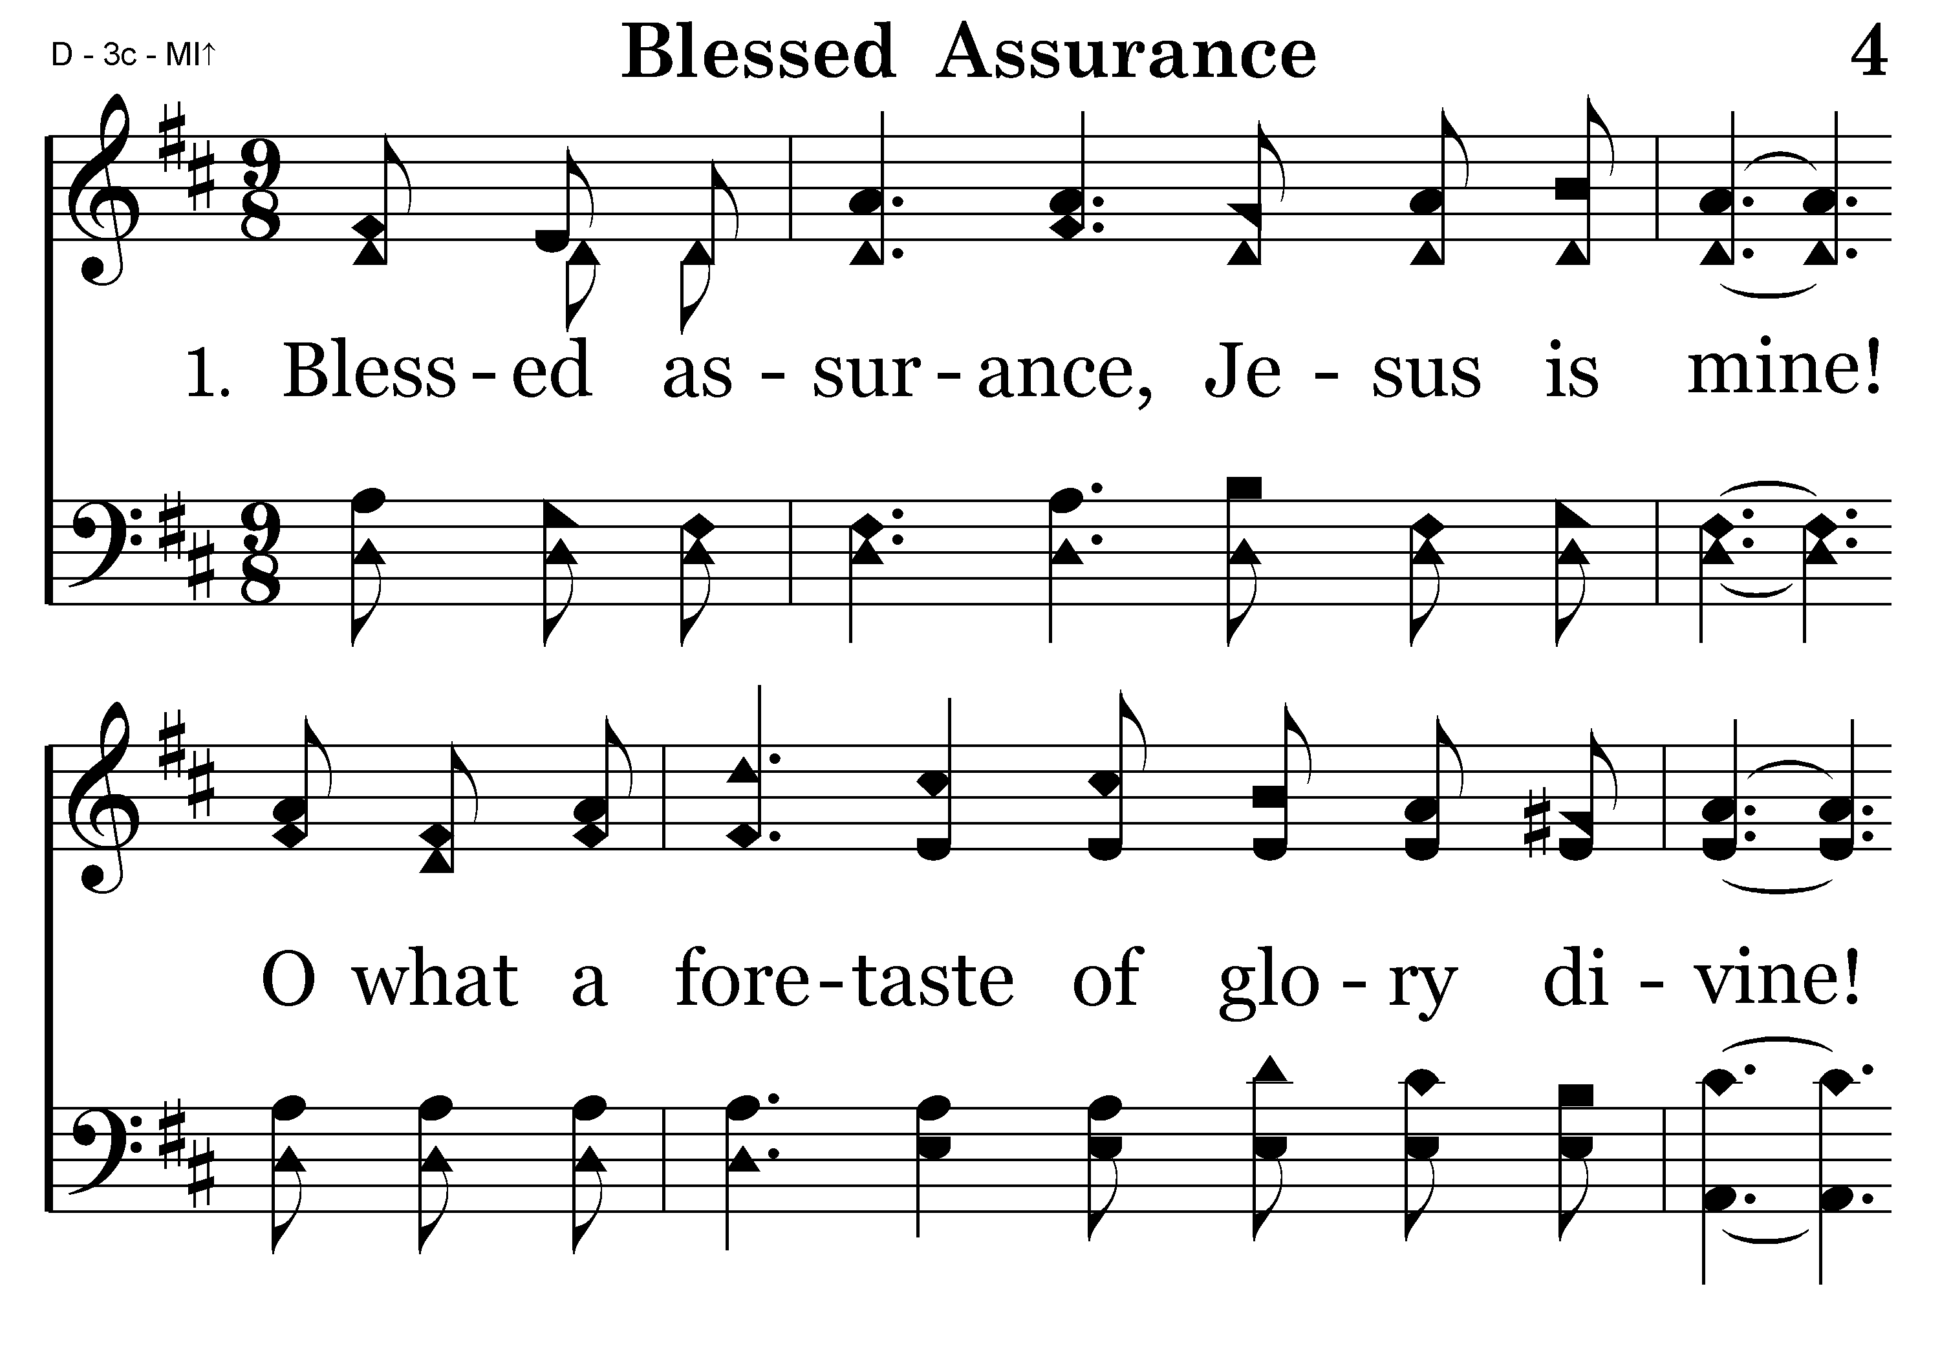
004 - Blessed Assurance - 1.1

Slide 12
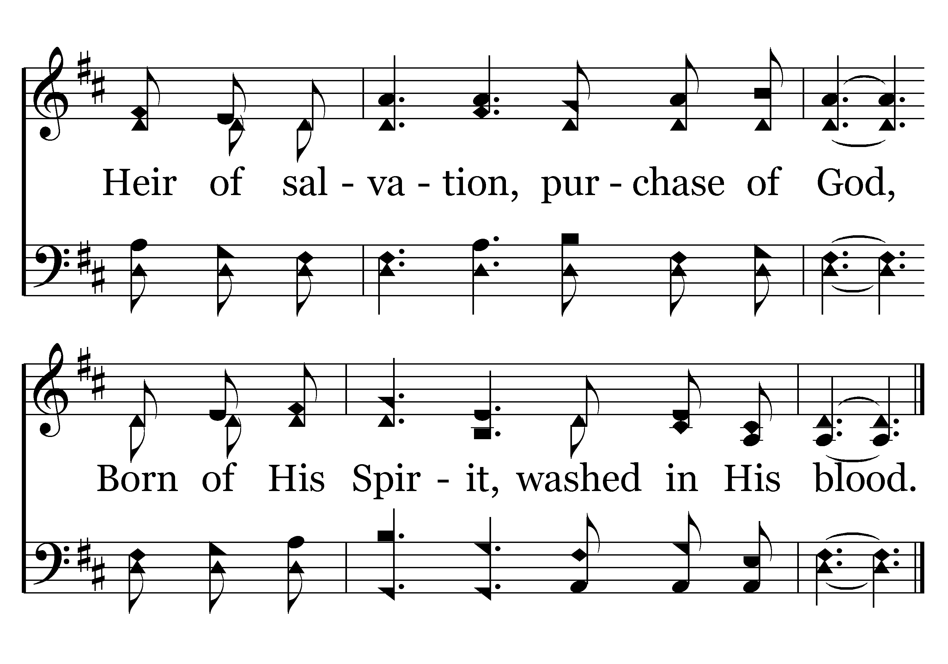
004 - Blessed Assurance - 1.2
SING CHORUS AFTER LAST VERSE
End of Verse 1

Slide 13
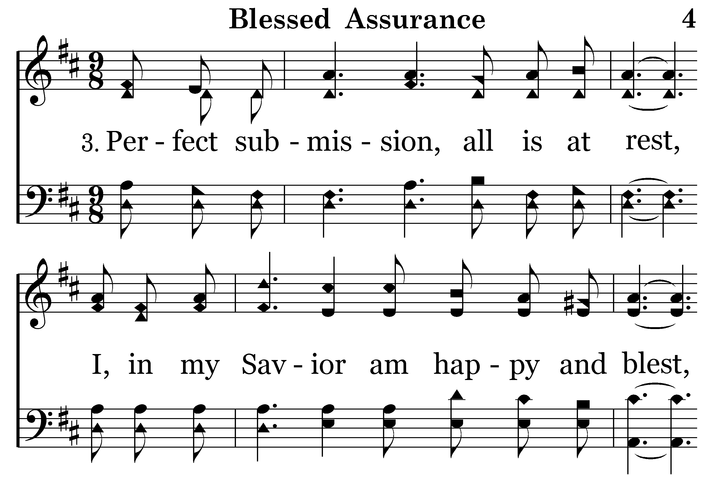
004 - Blessed Assurance - 3.1

Slide 14
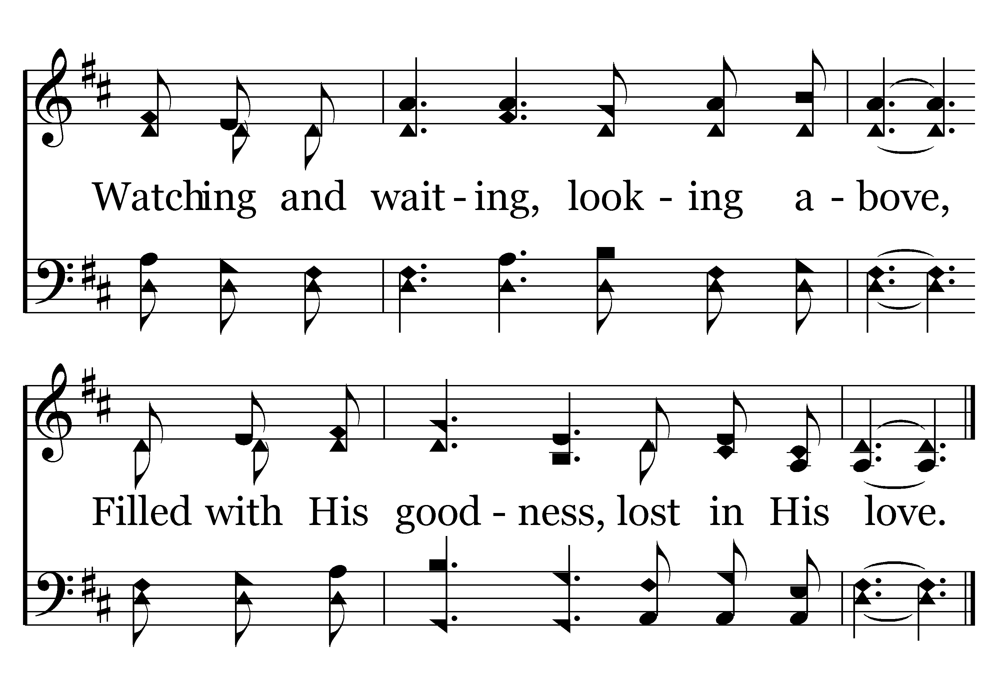
004 - Blessed Assurance - 3.2

Slide 15
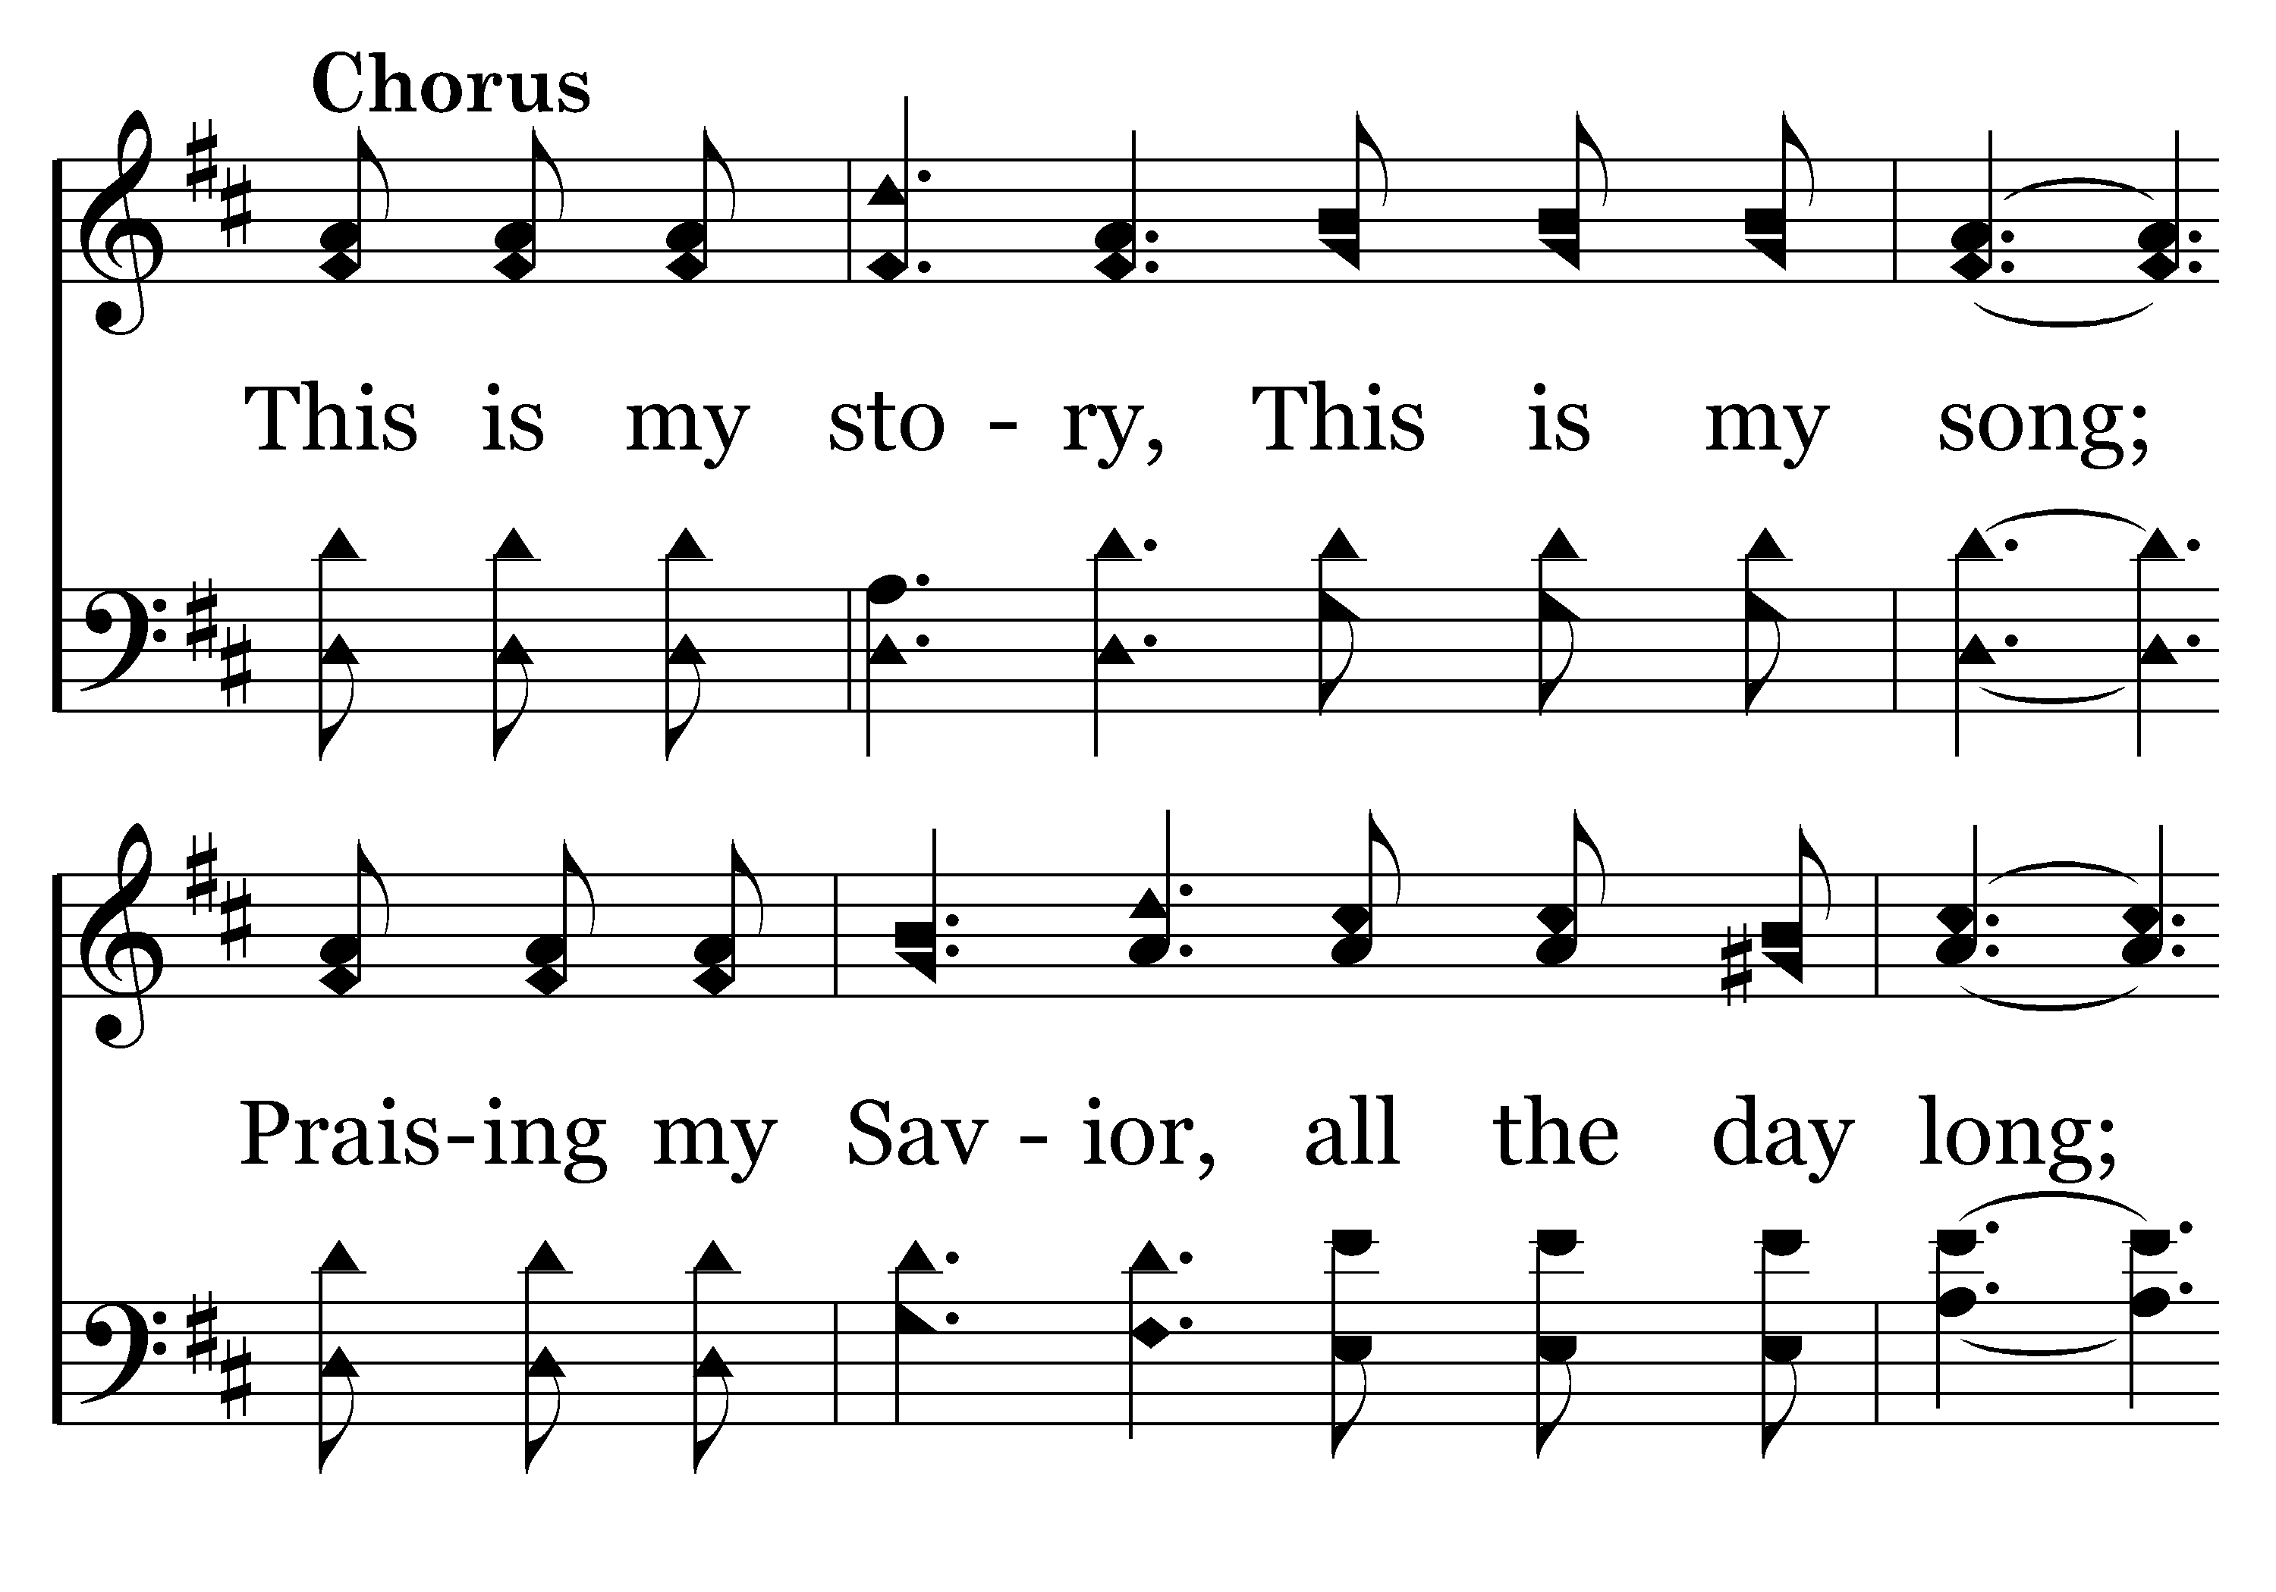
004 - Blessed Assurance - C.1

Slide 16
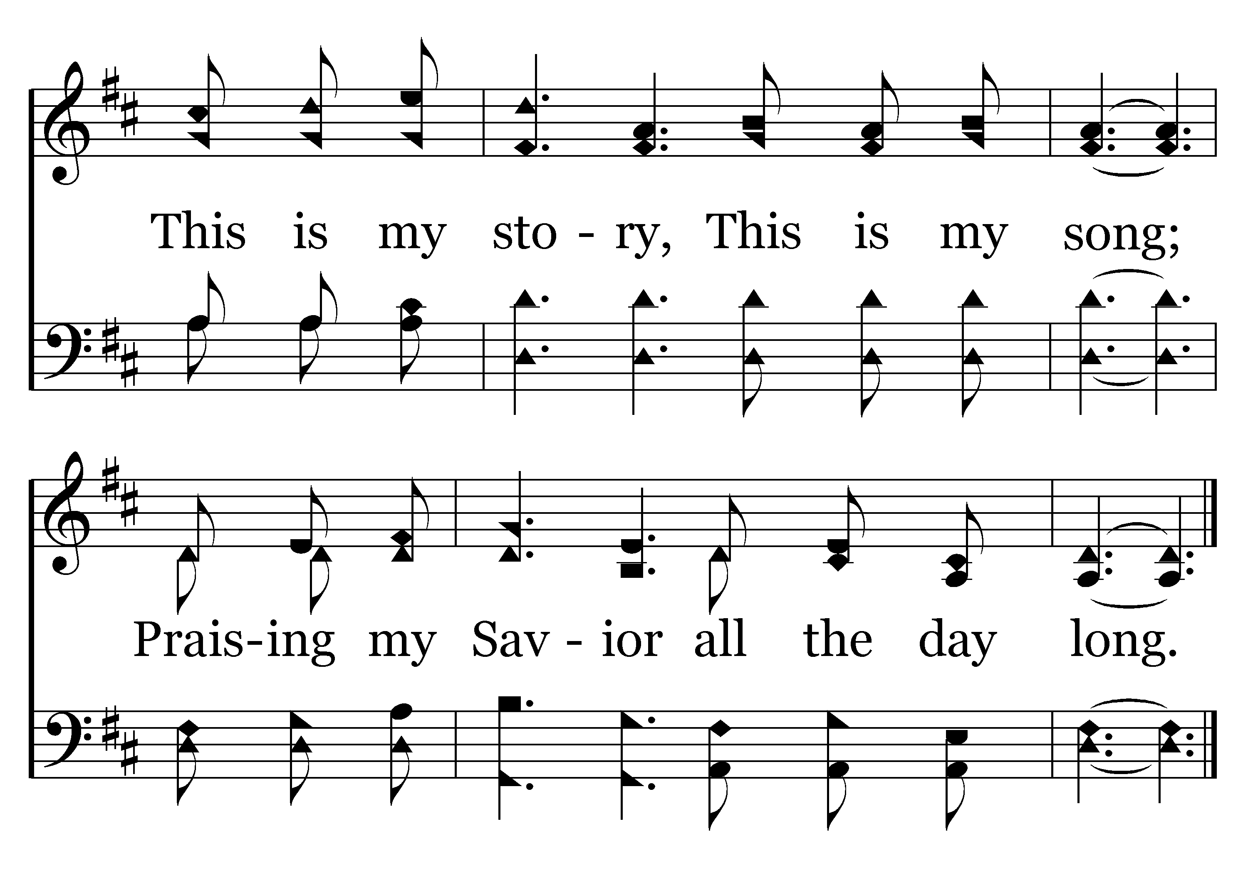
004 - Blessed Assurance - C.2
End of Song

Slide 17


Slide 18

PRAYER
Jerry Mellish
LED BY DAVID HAMMONTREE

Slide 20
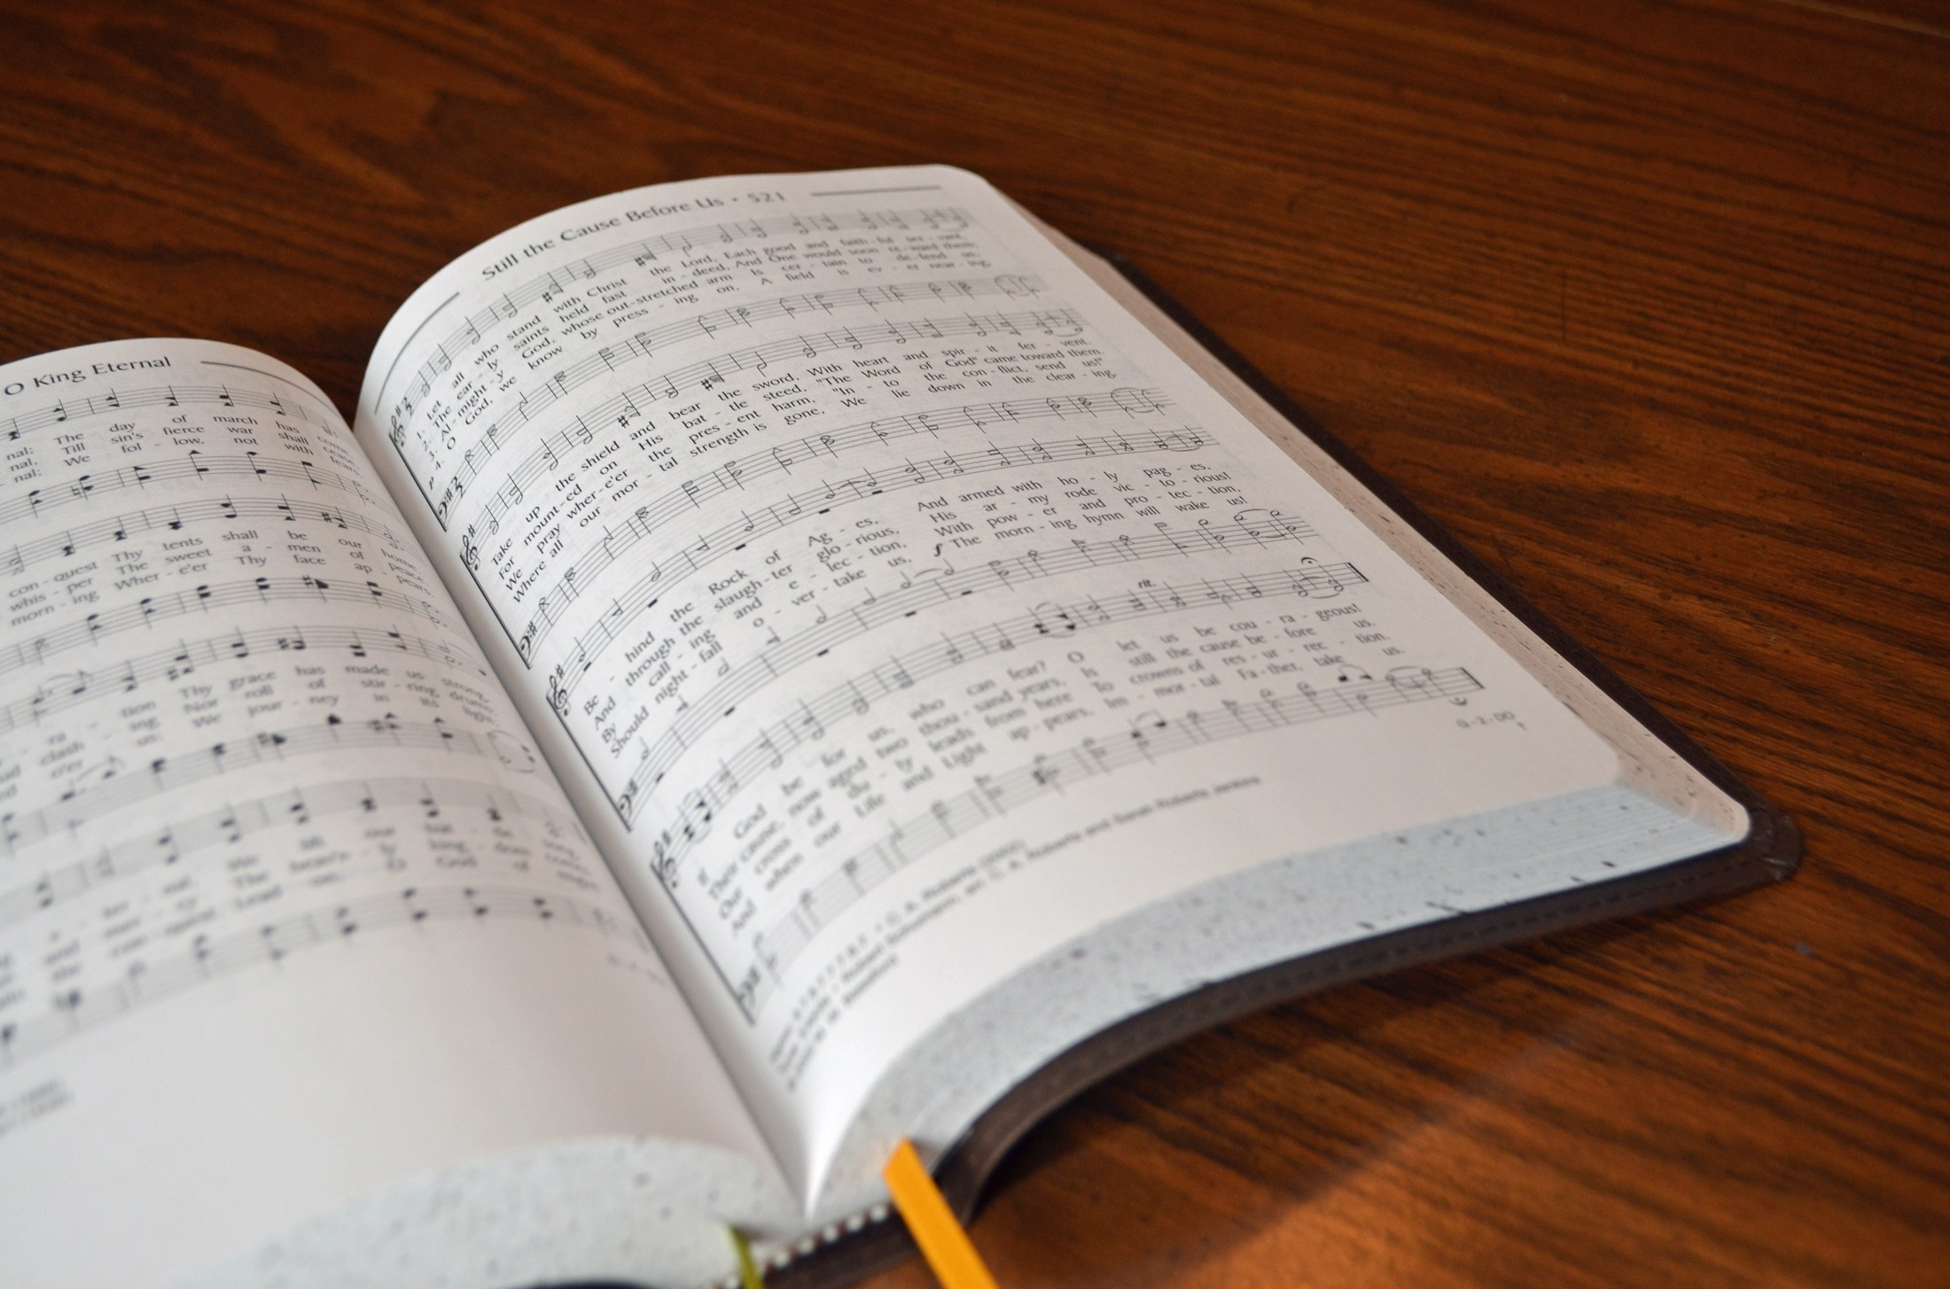
SONG LEADER
SANDER FLETCHER

Slide 21
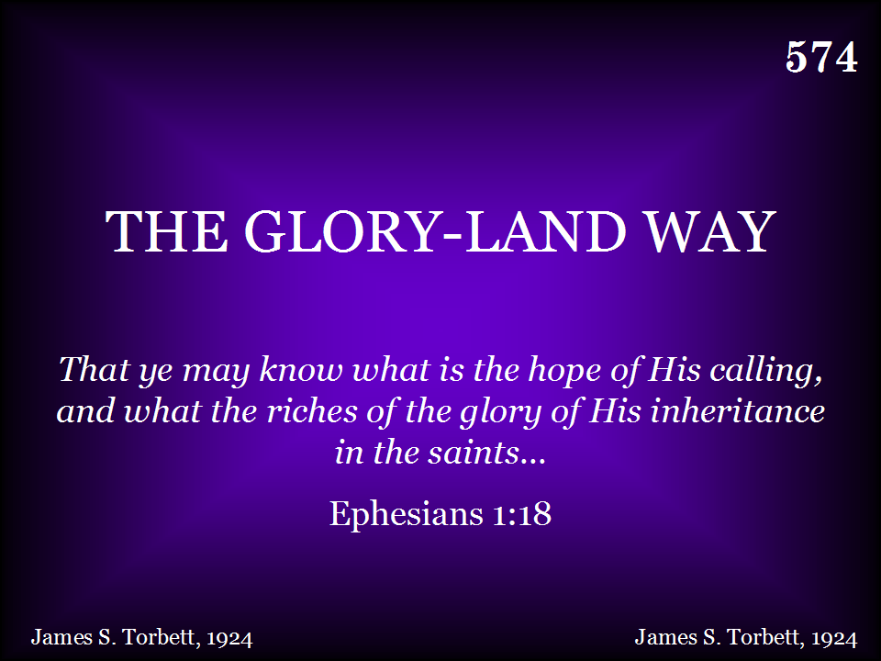
574 - The Gloryland Way - Title

Slide 22
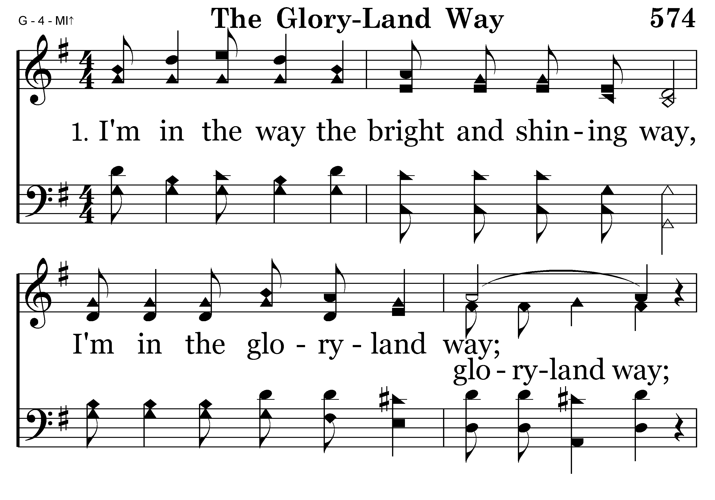
574 - The Gloryland Way - 1.1

Slide 23
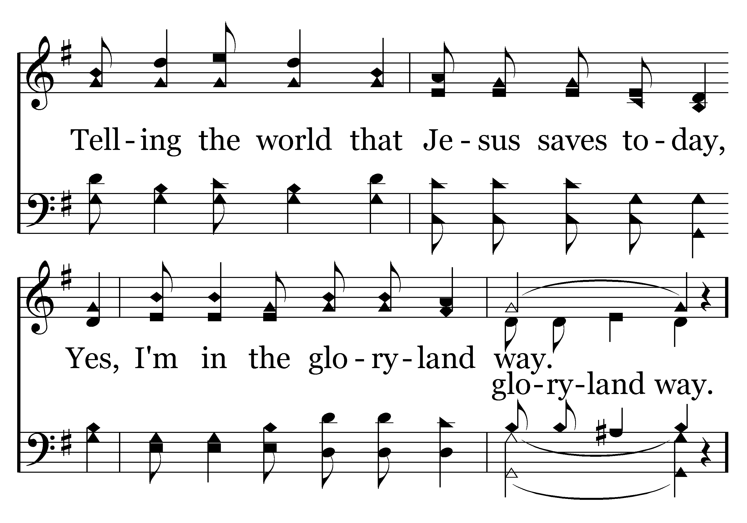
574 - The Gloryland Way - 1.2

Slide 24
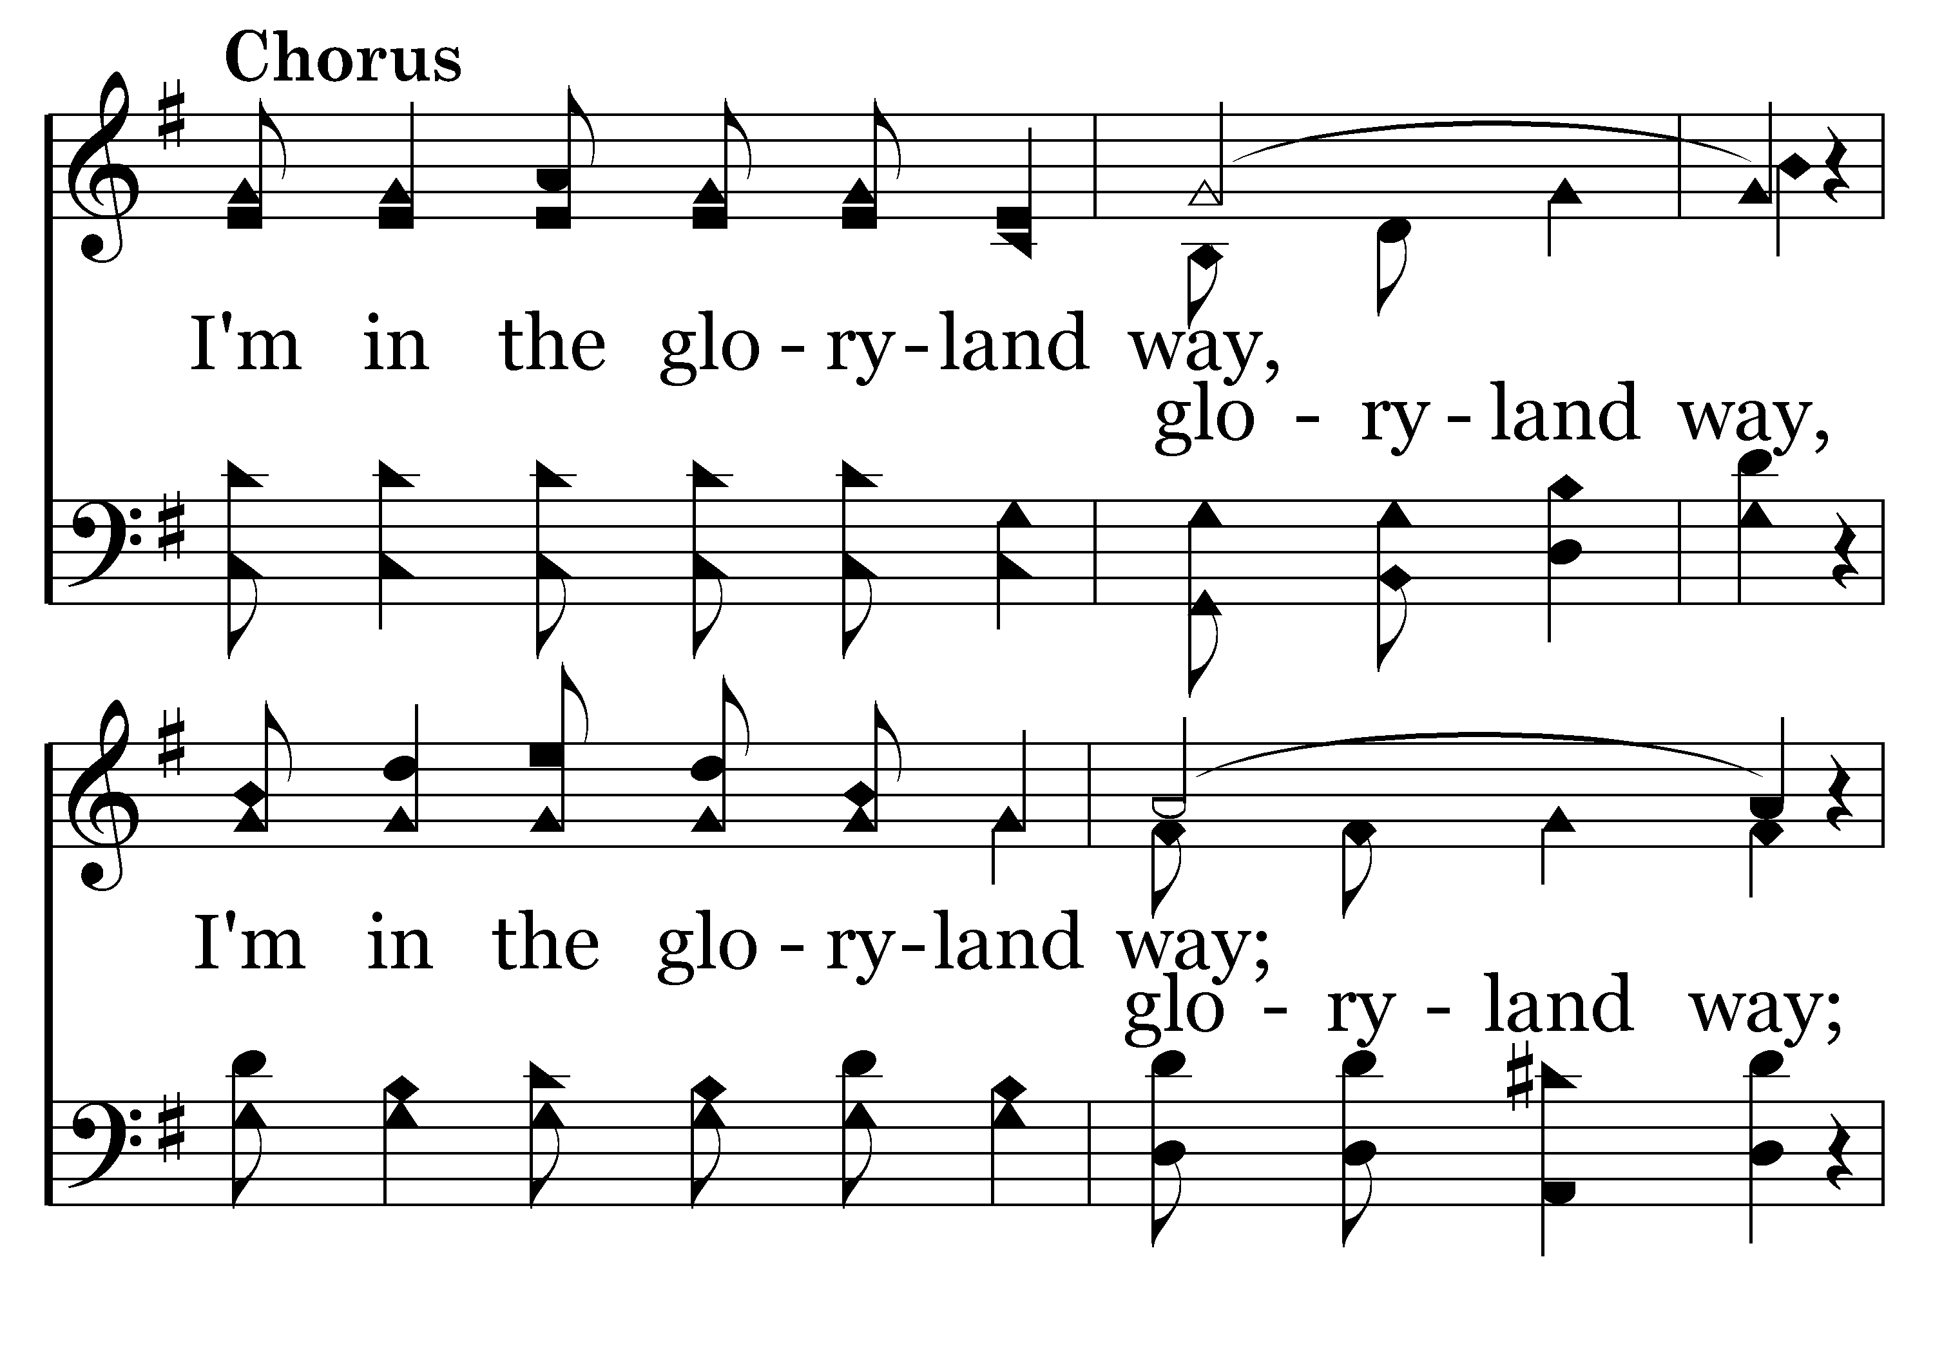
574 - The Gloryland Way - C.1

Slide 25
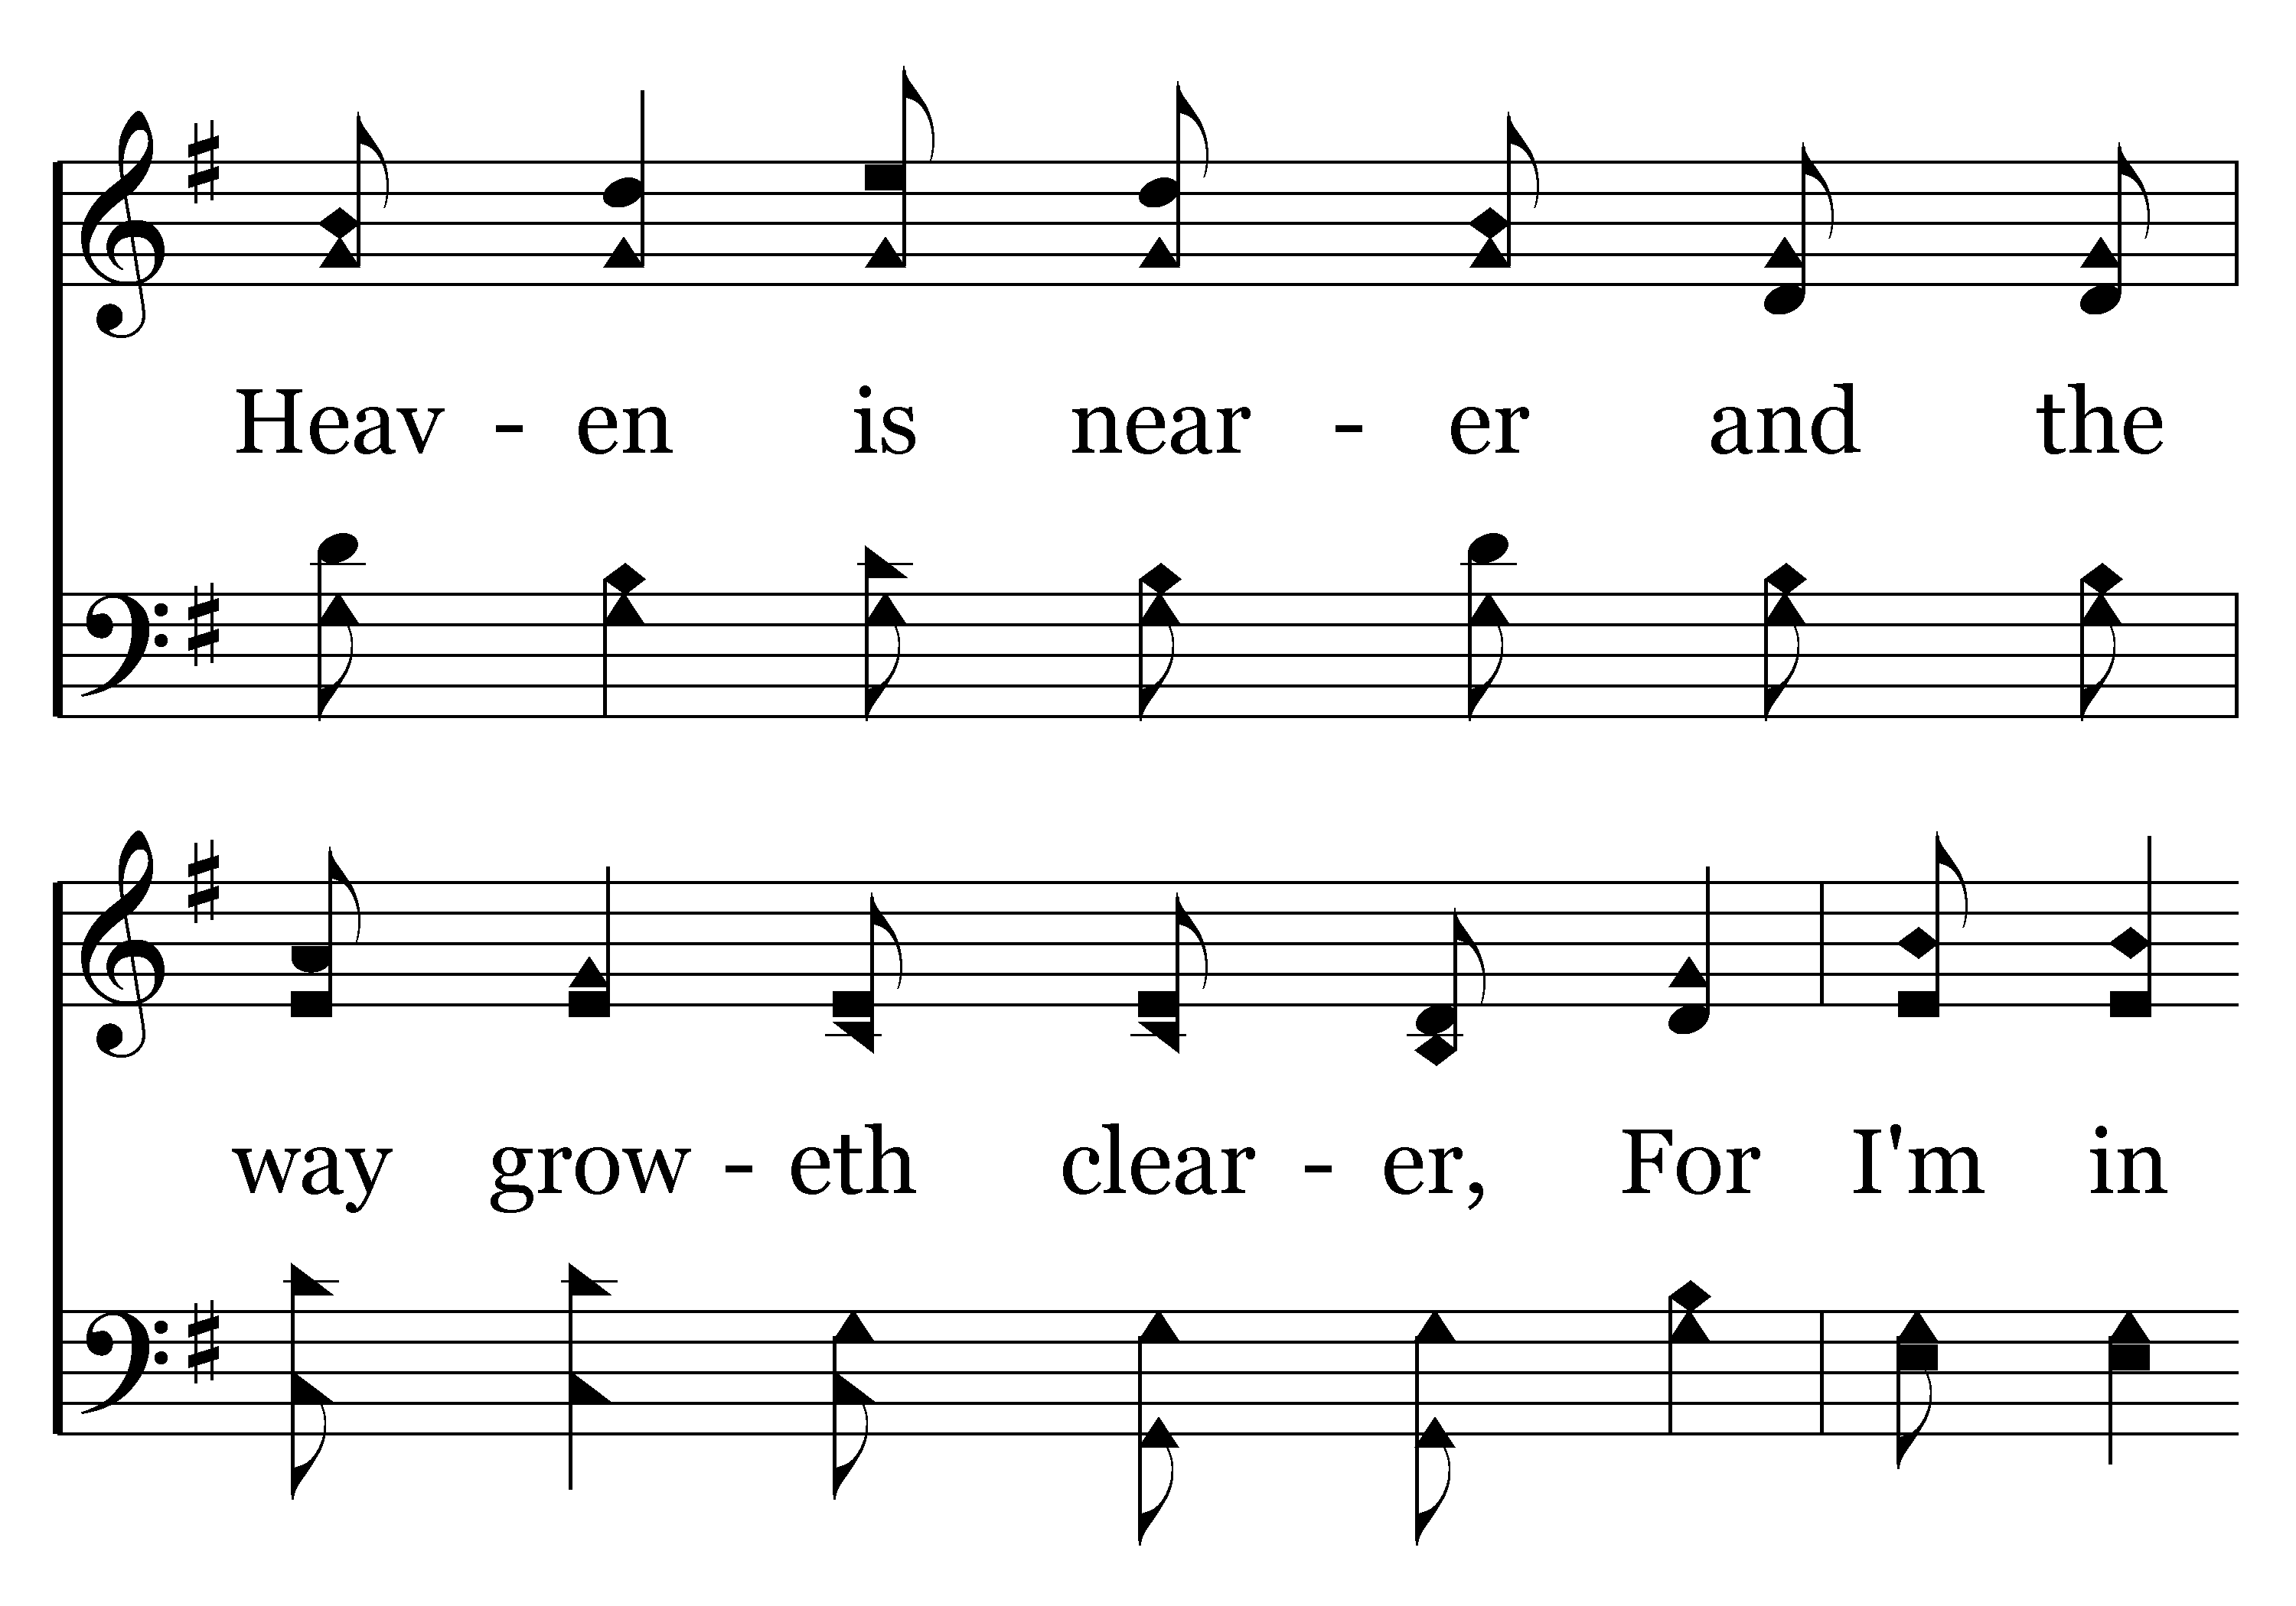
574 - The Gloryland Way - C.2

Slide 26
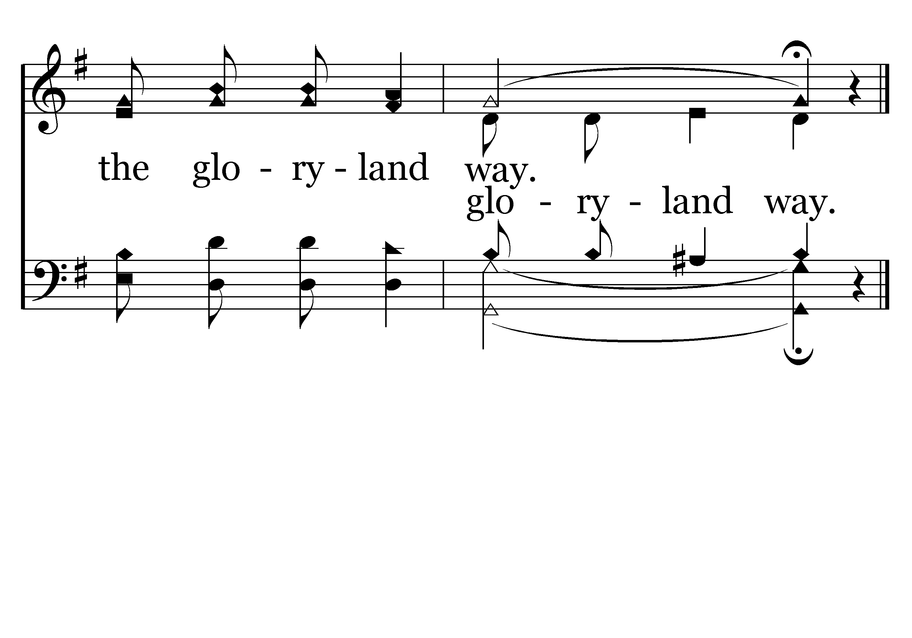
574 - The Gloryland Way - C.3
End of Verse 1

Slide 27

574 - The Gloryland Way - 2.1

Slide 28
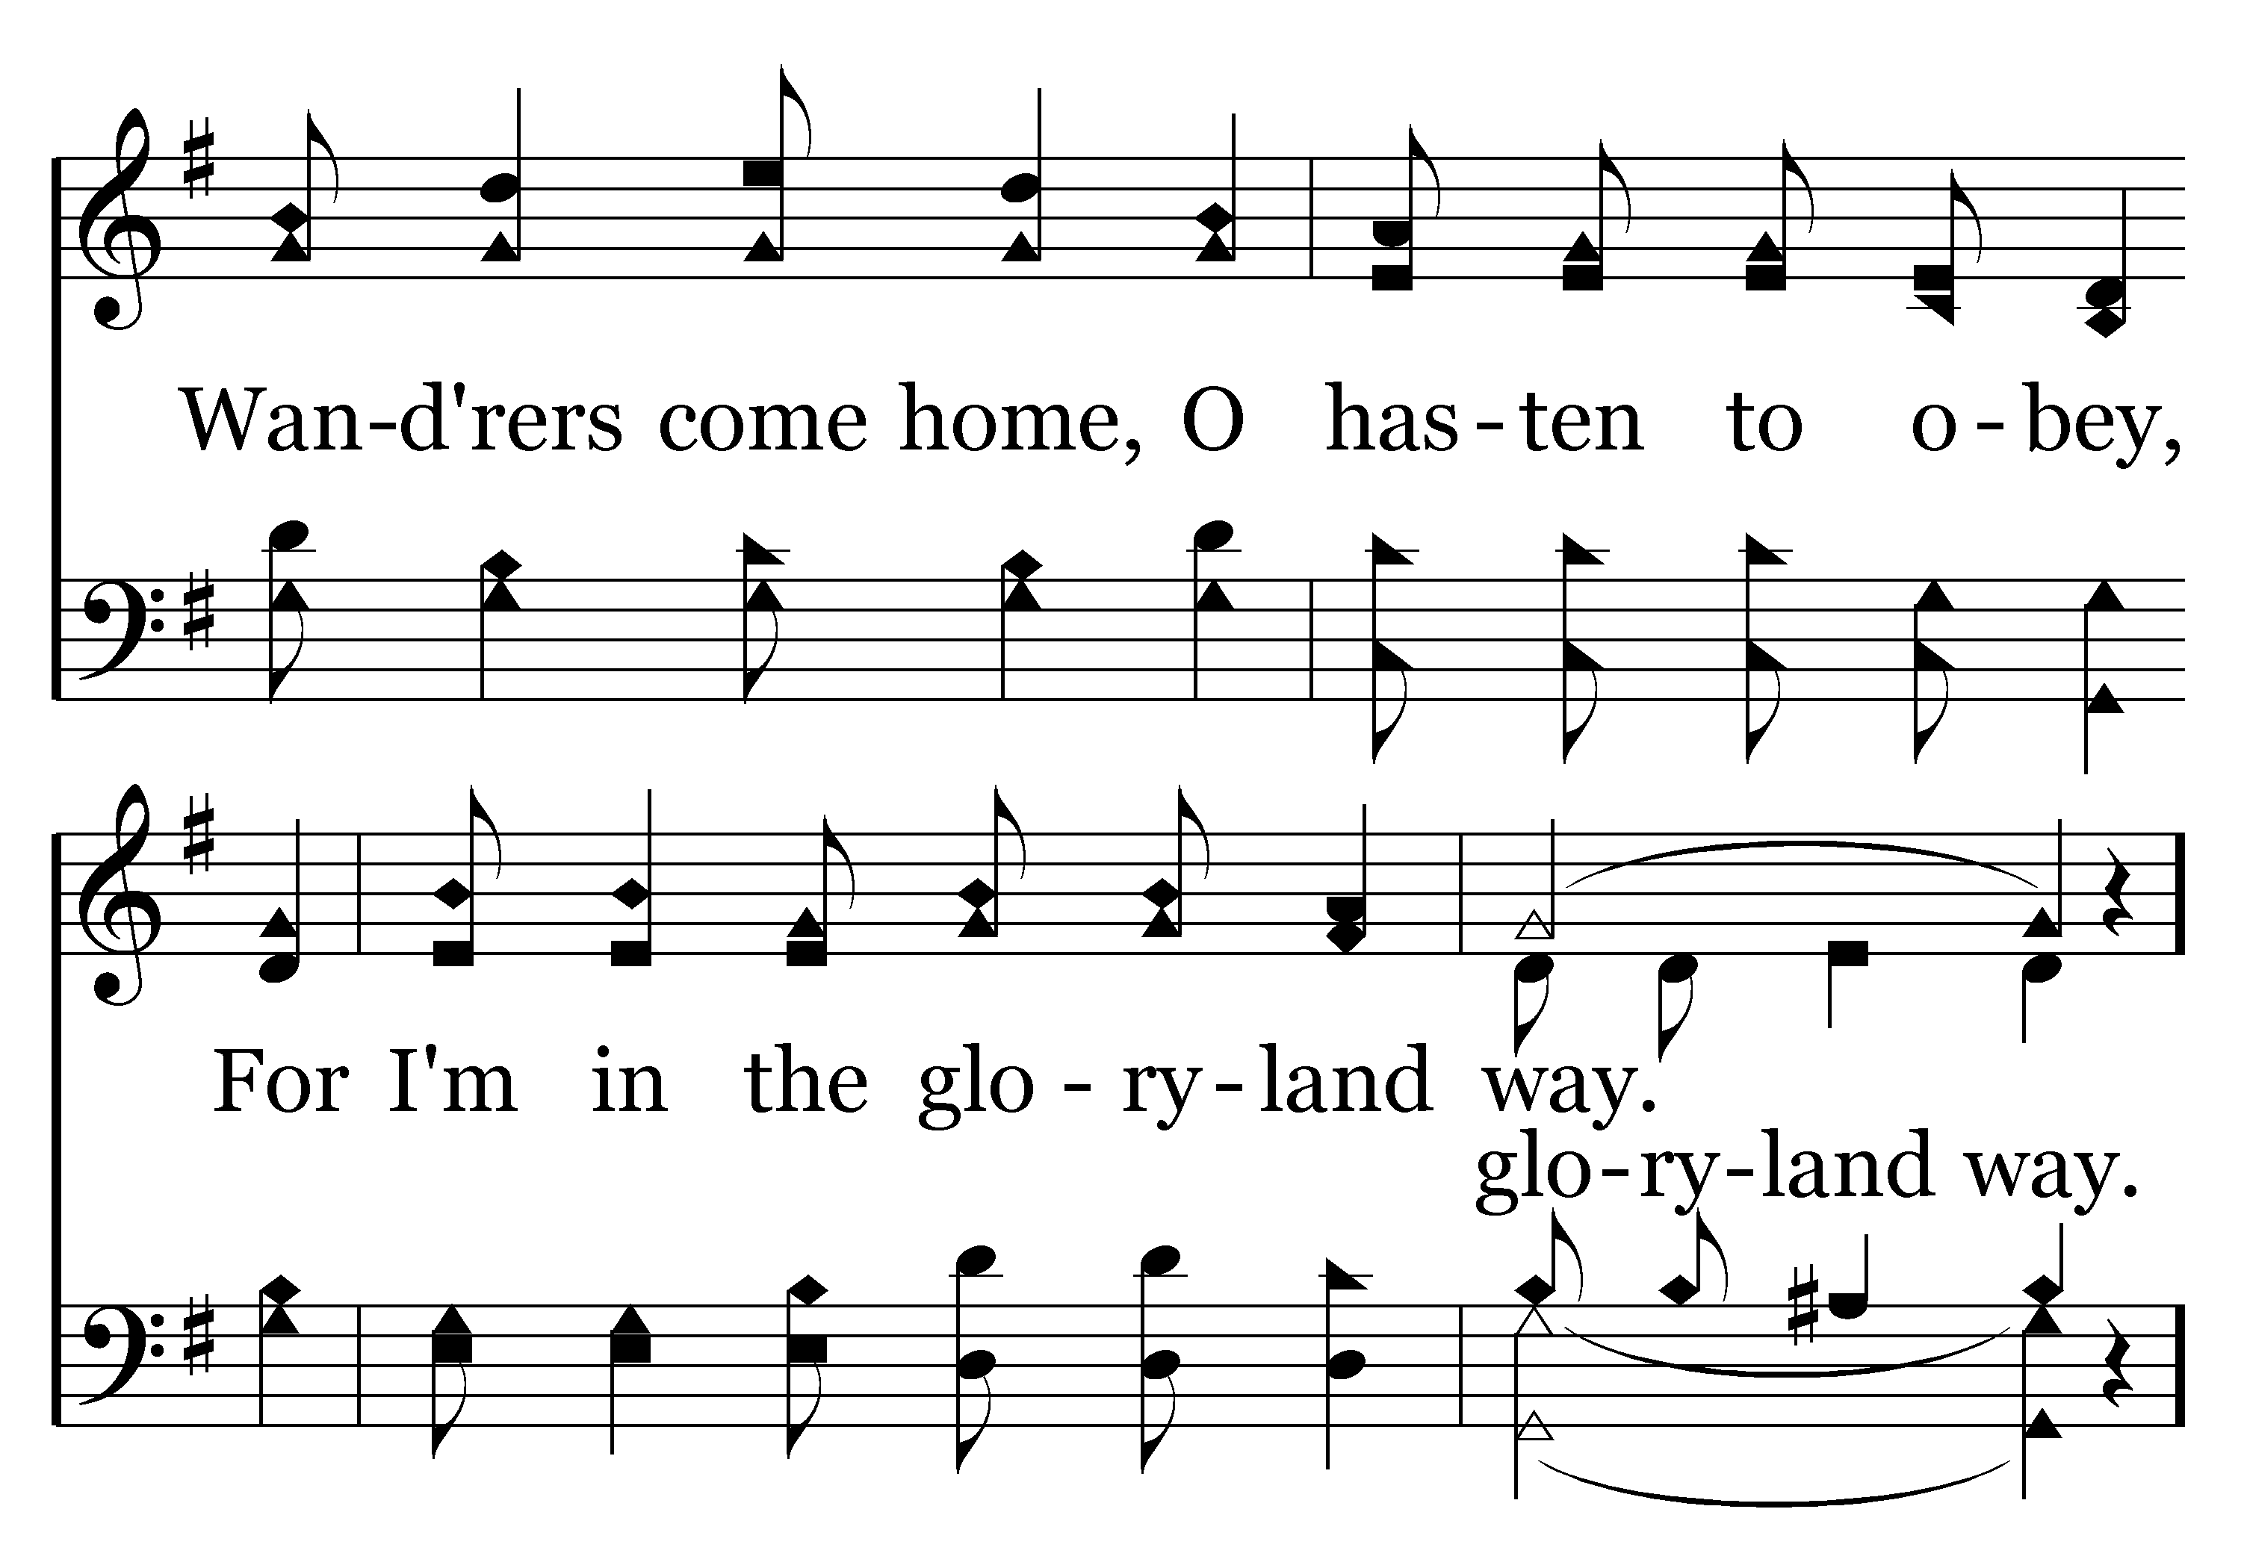
574 - The Gloryland Way - 2.2

Slide 29
574 - The Gloryland Way - C.1

Slide 30
574 - The Gloryland Way - C.2

Slide 31
574 - The Gloryland Way - C.3
End of Verse 2

Slide 32
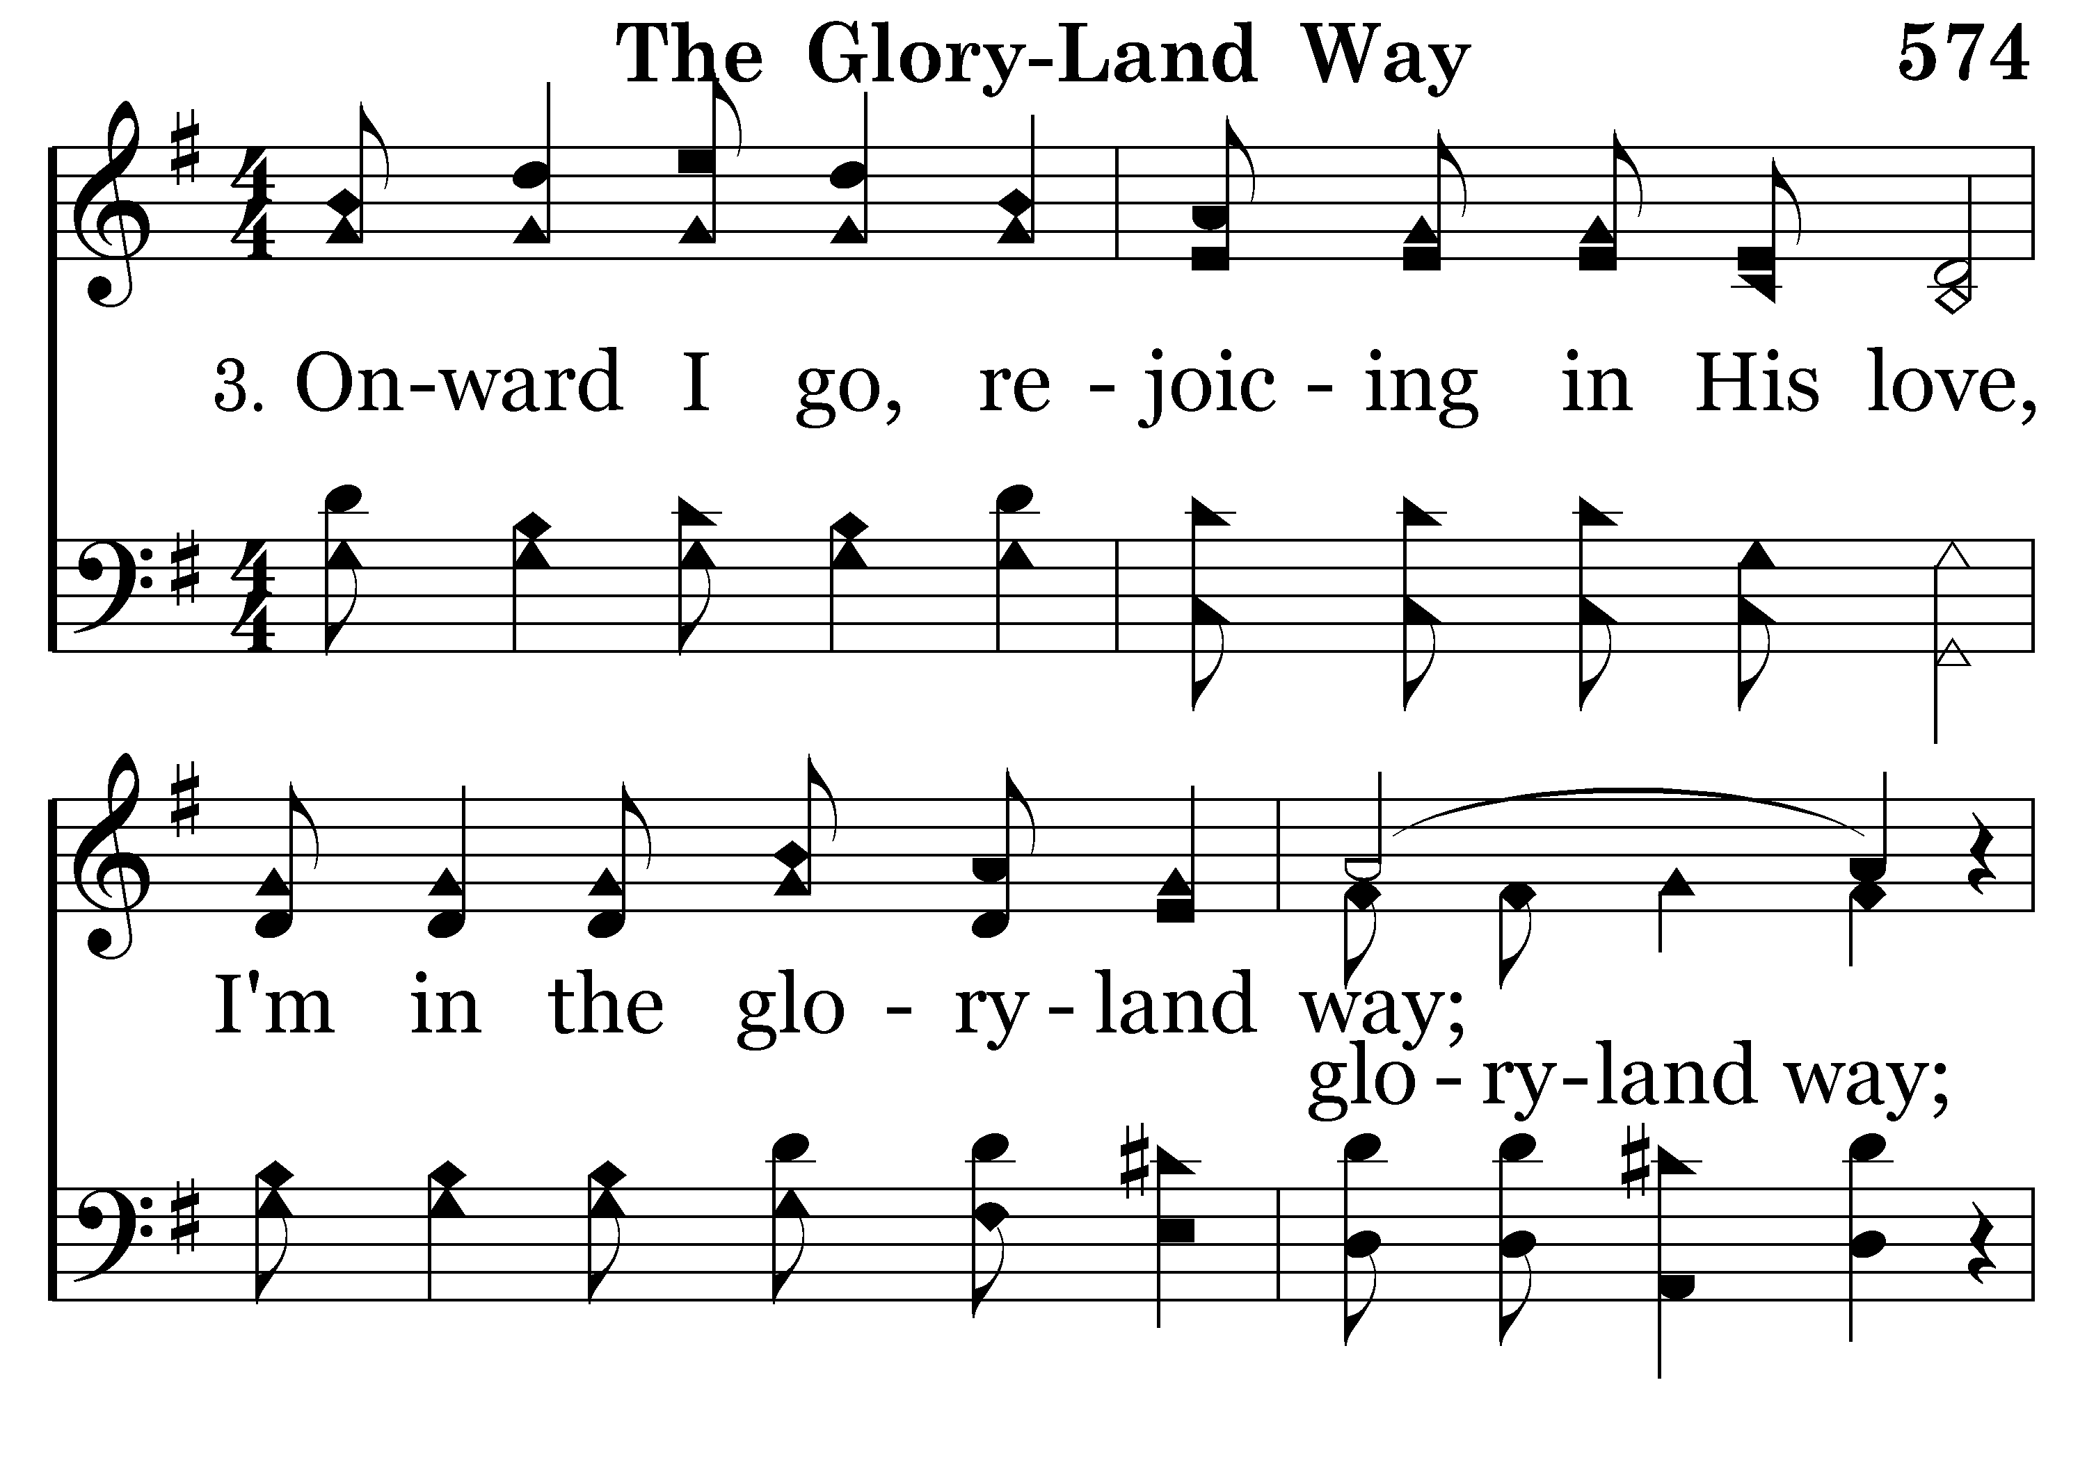
574 - The Gloryland Way - 3.1

Slide 33
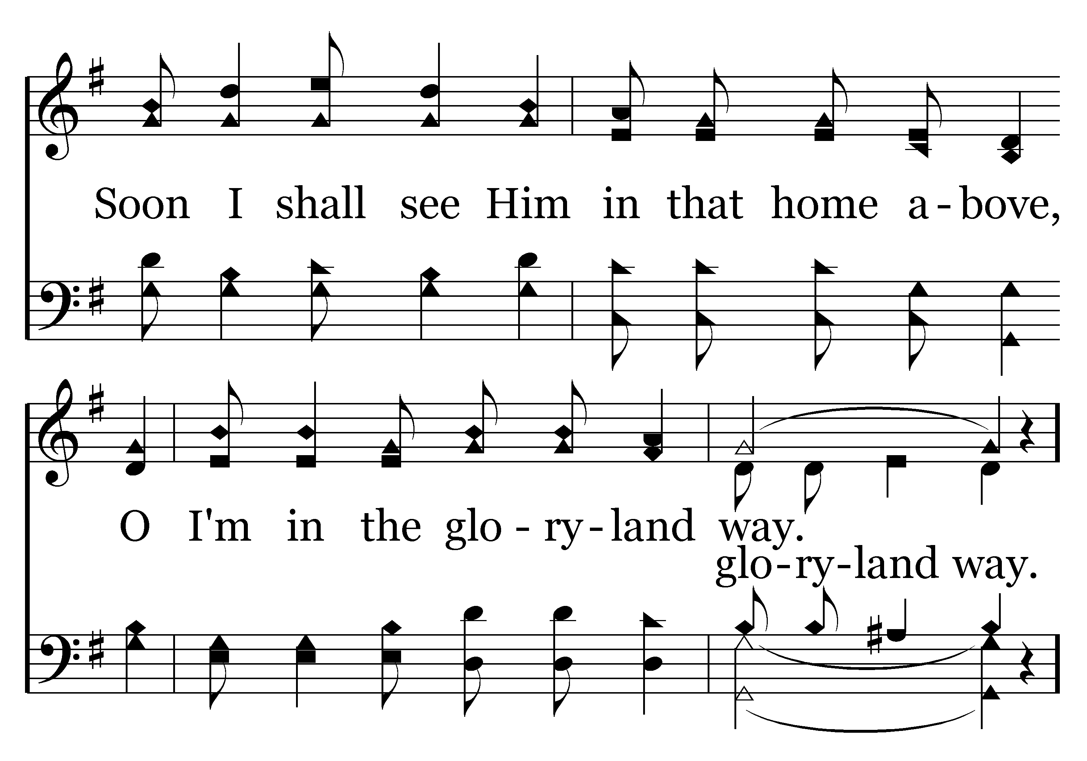
574 - The Gloryland Way - 3.2

Slide 34
574 - The Gloryland Way - C.1

Slide 35
574 - The Gloryland Way - C.2

Slide 36
574 - The Gloryland Way - C.3
End of Song

Slide 38
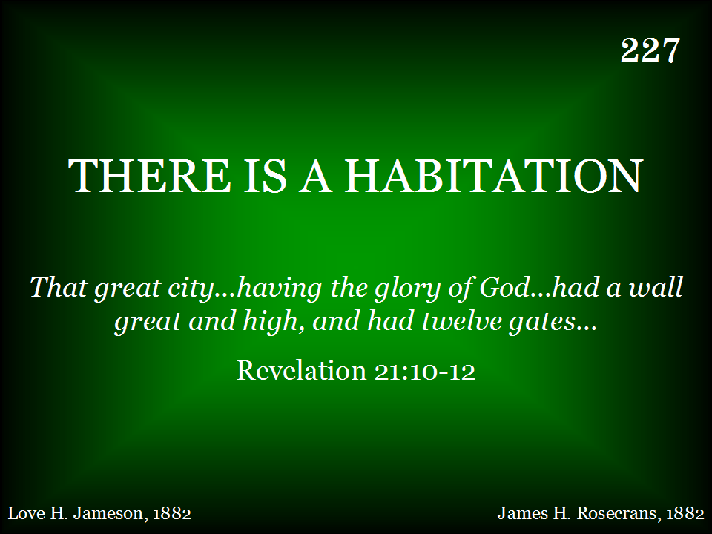
227 - There Is A Habitation - Title

Slide 39
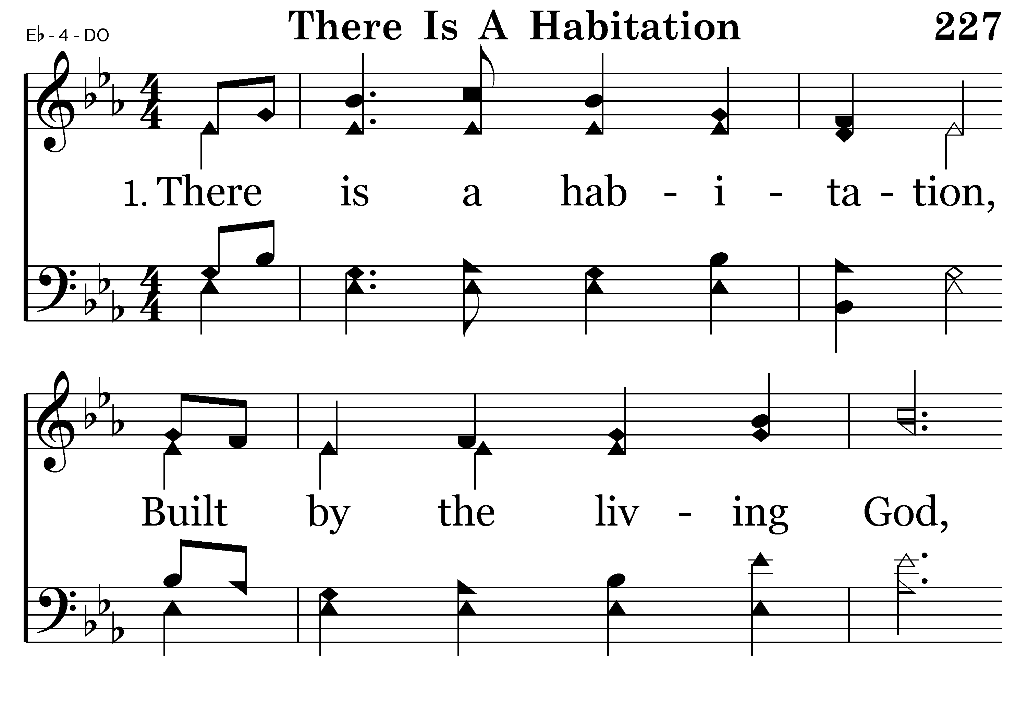
227 - There Is A Habitation - 1.1

Slide 40
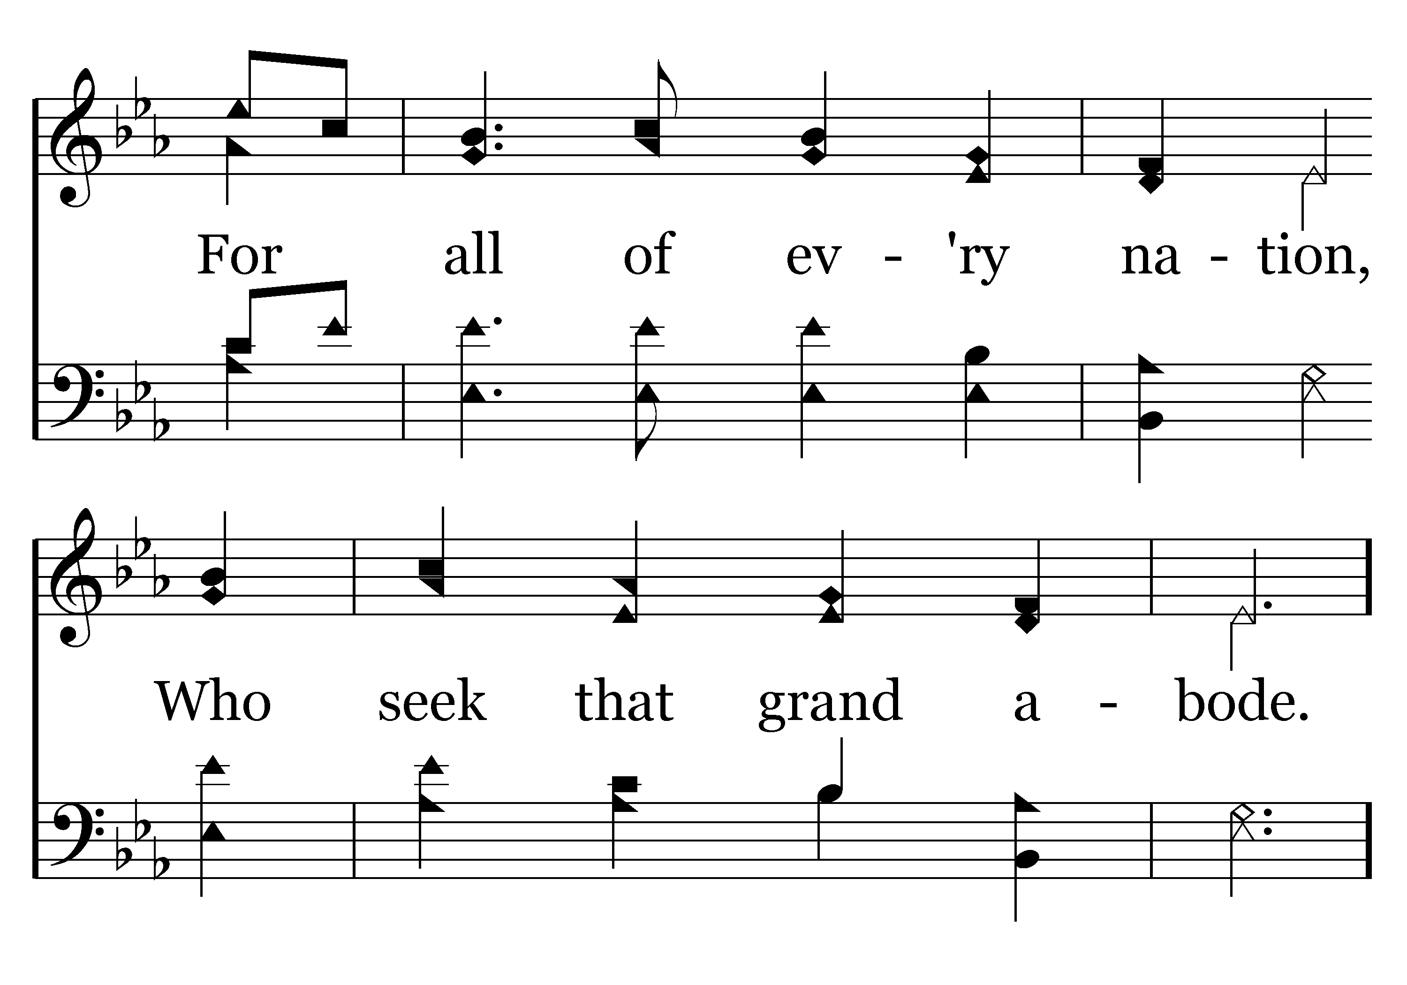
227 - There Is A Habitation - 1.2

Slide 41
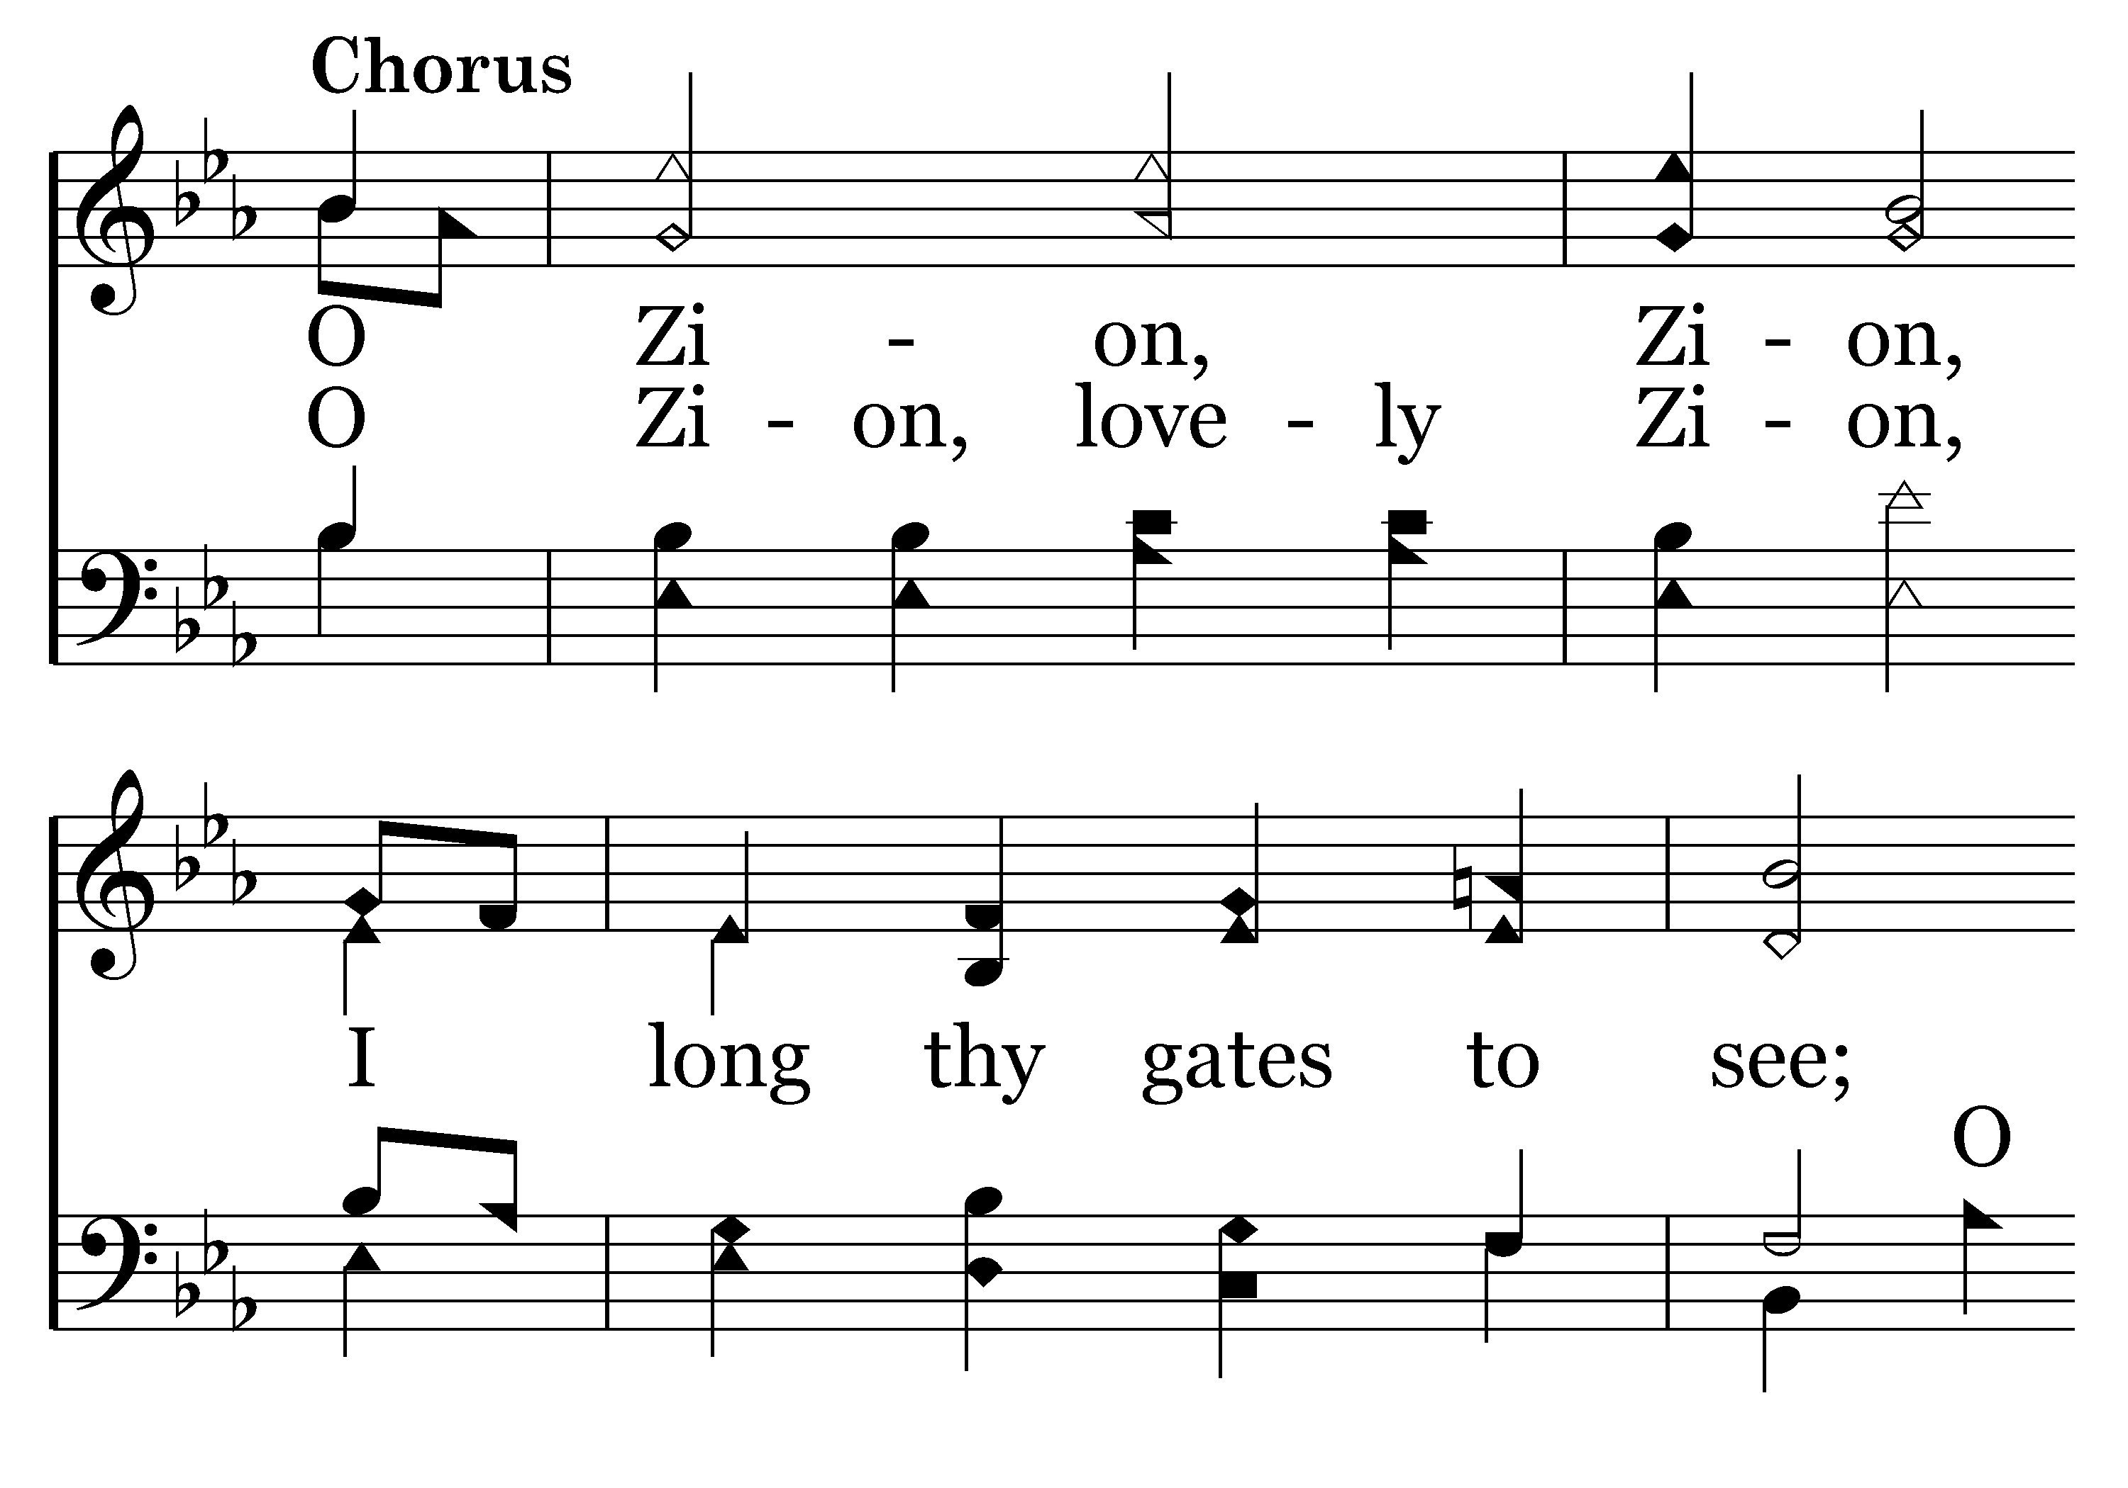
227 - There Is A Habitation - C.1

Slide 42
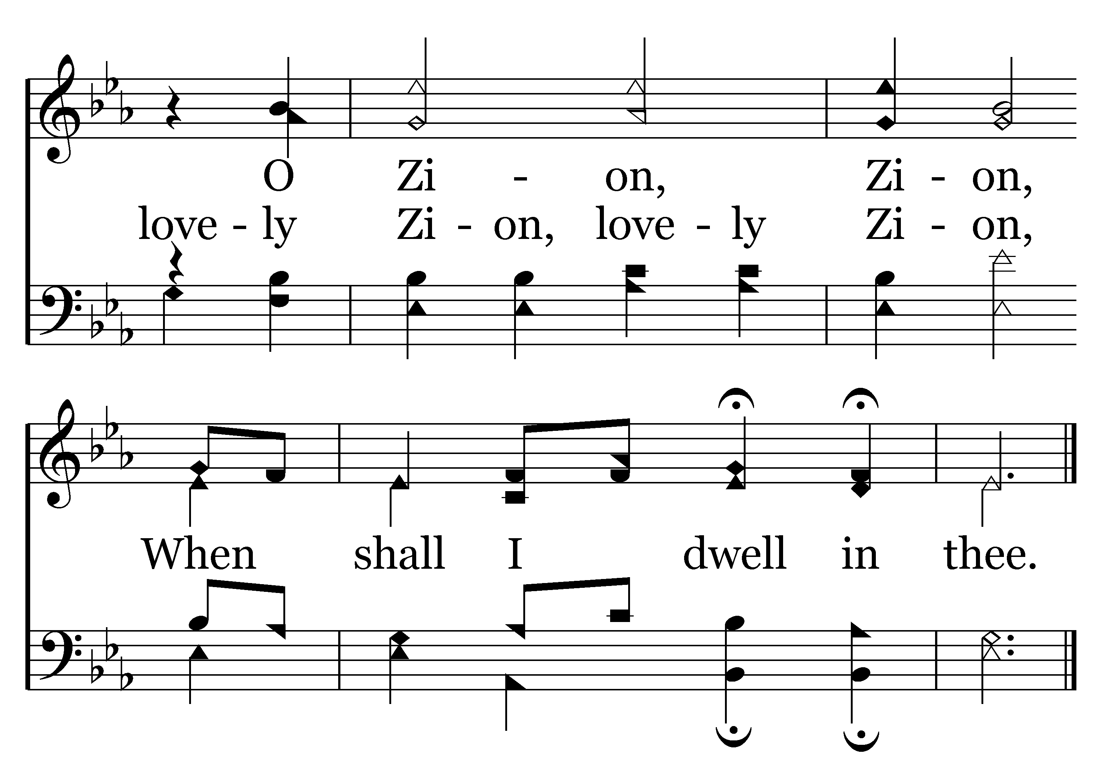
227 - There Is A Habitation - C.2
End of Verse 1

Slide 43
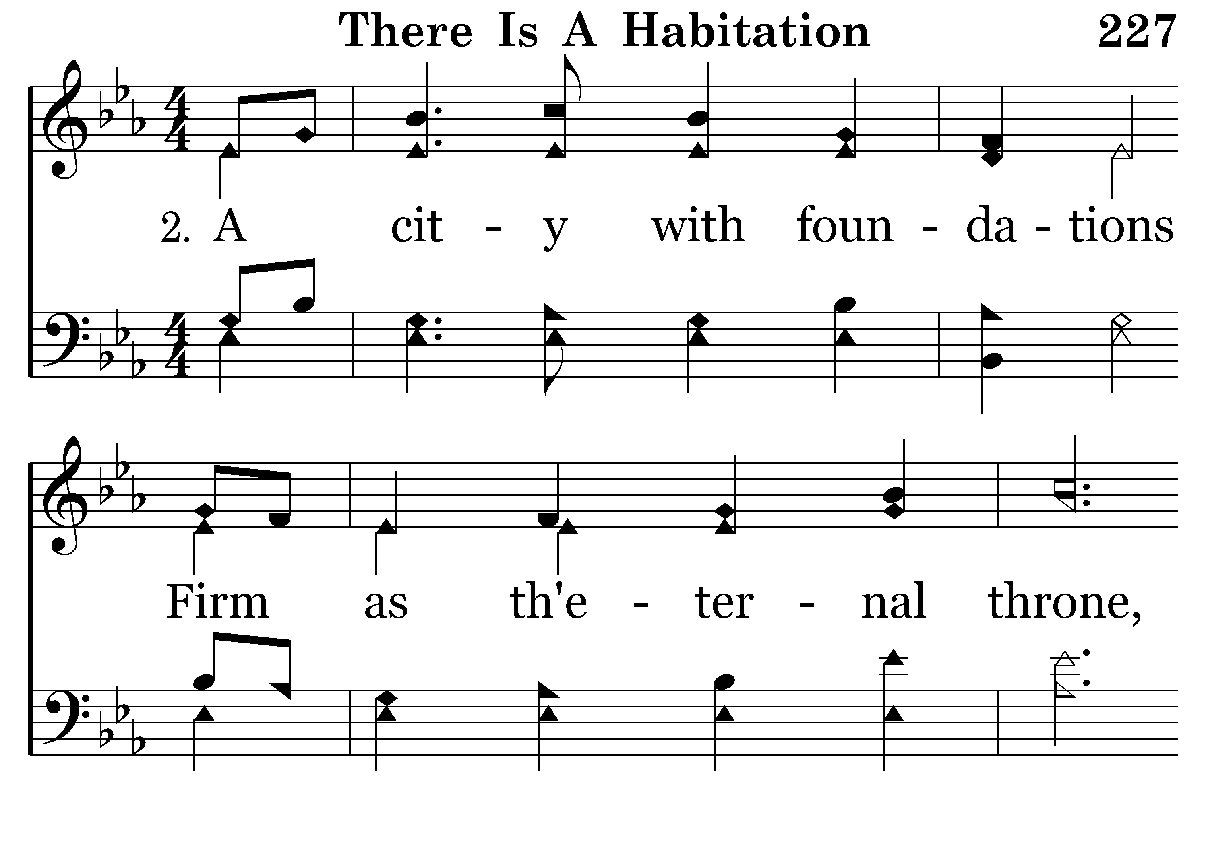
227 - There Is A Habitation - 2.1

Slide 44
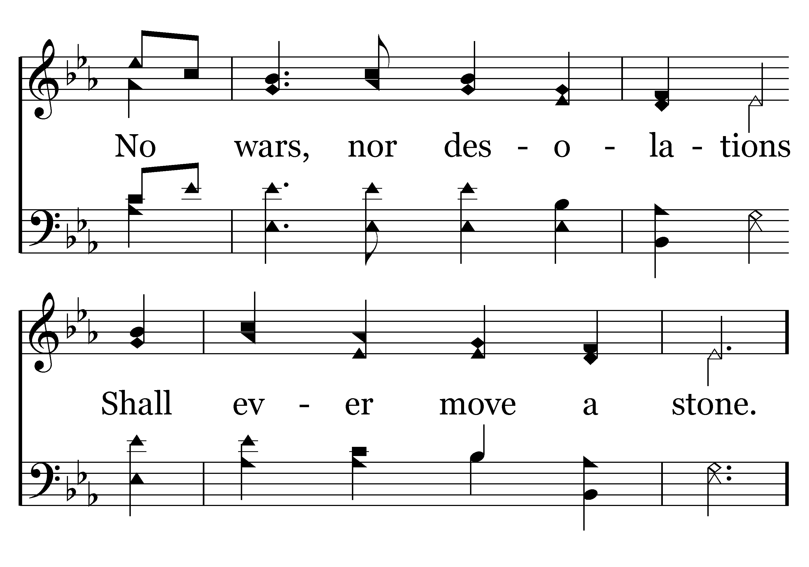
227 - There Is A Habitation - 2.2

Slide 45
227 - There Is A Habitation - C.1

Slide 46
227 - There Is A Habitation - C.2
End of Verse 2

Slide 47
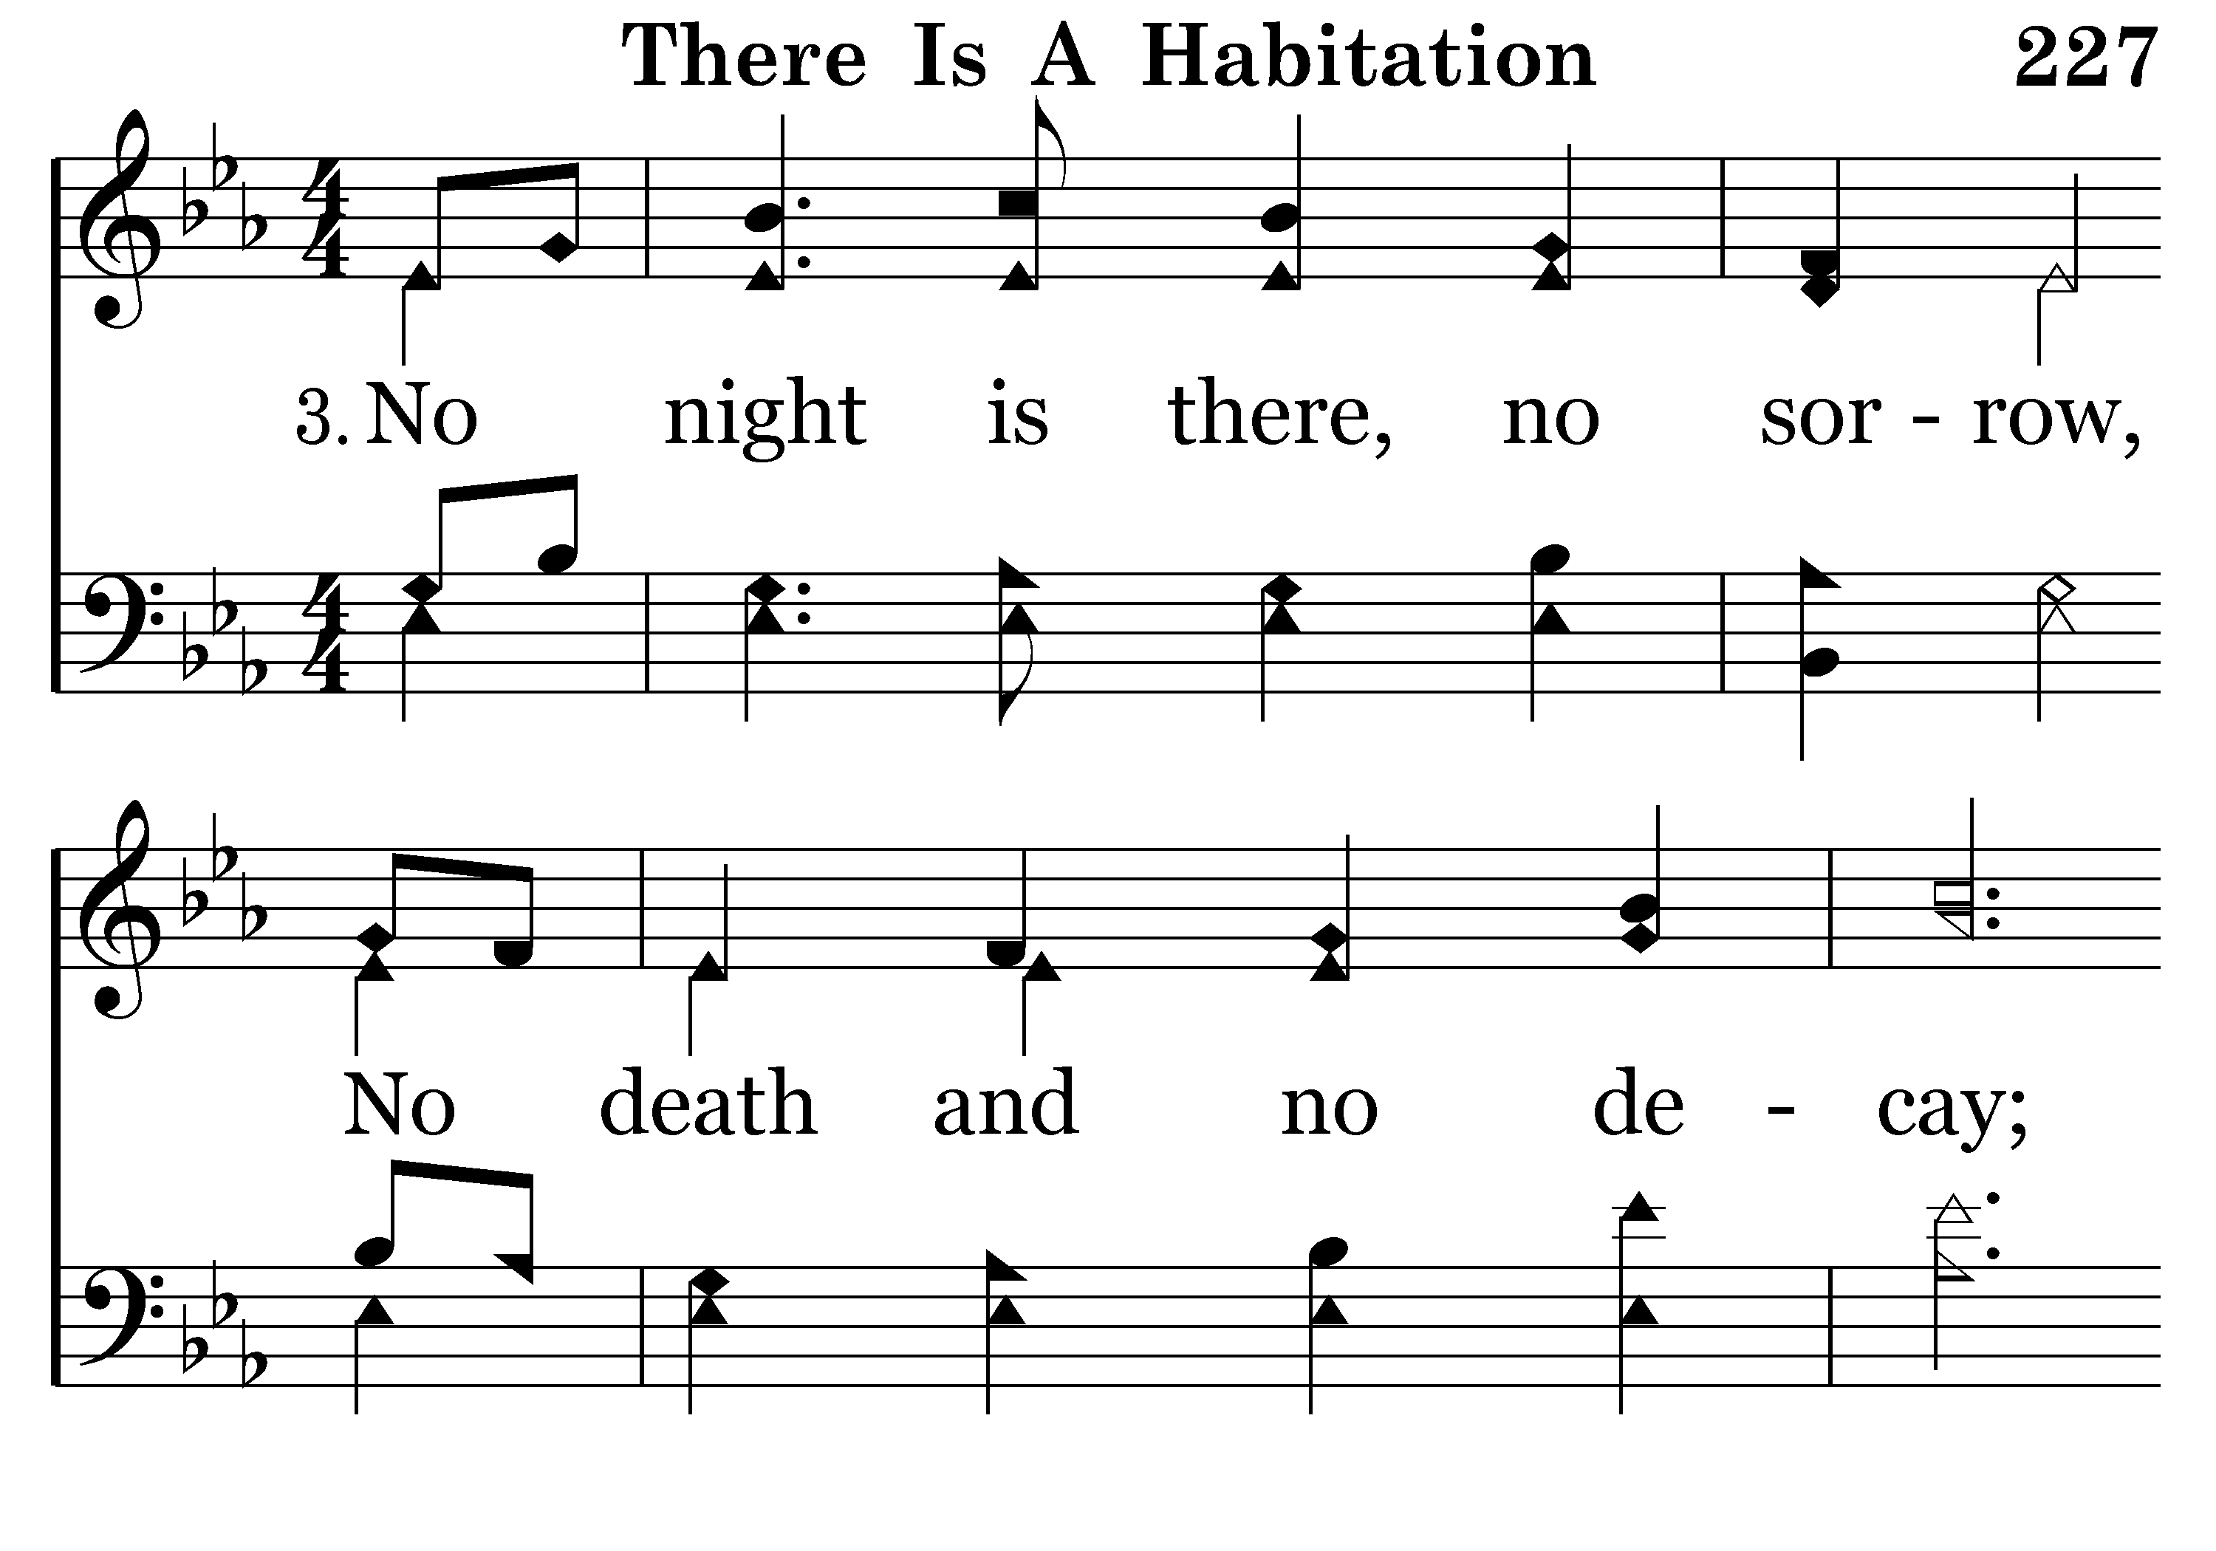
227 - There Is A Habitation - 3.1

Slide 48
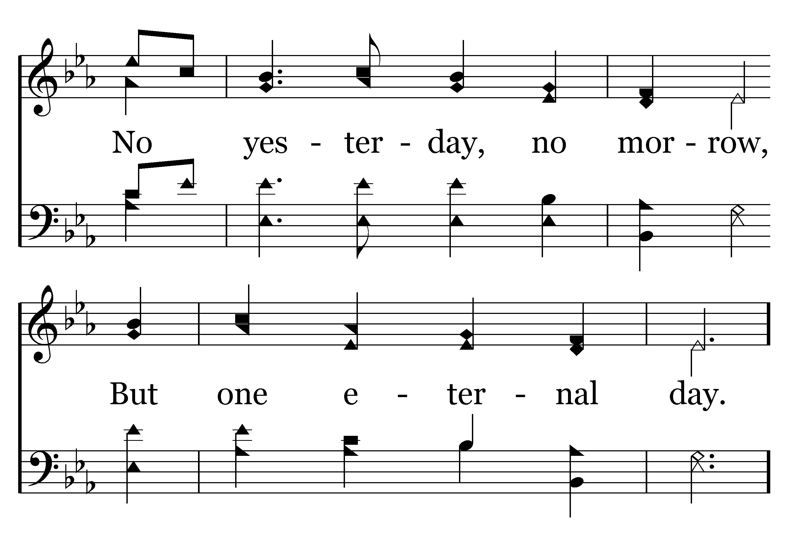
227 - There Is A Habitation - 3.2

Slide 49
227 - There Is A Habitation - C.1

Slide 50
227 - There Is A Habitation - C.2
End of Verse 3

Slide 51
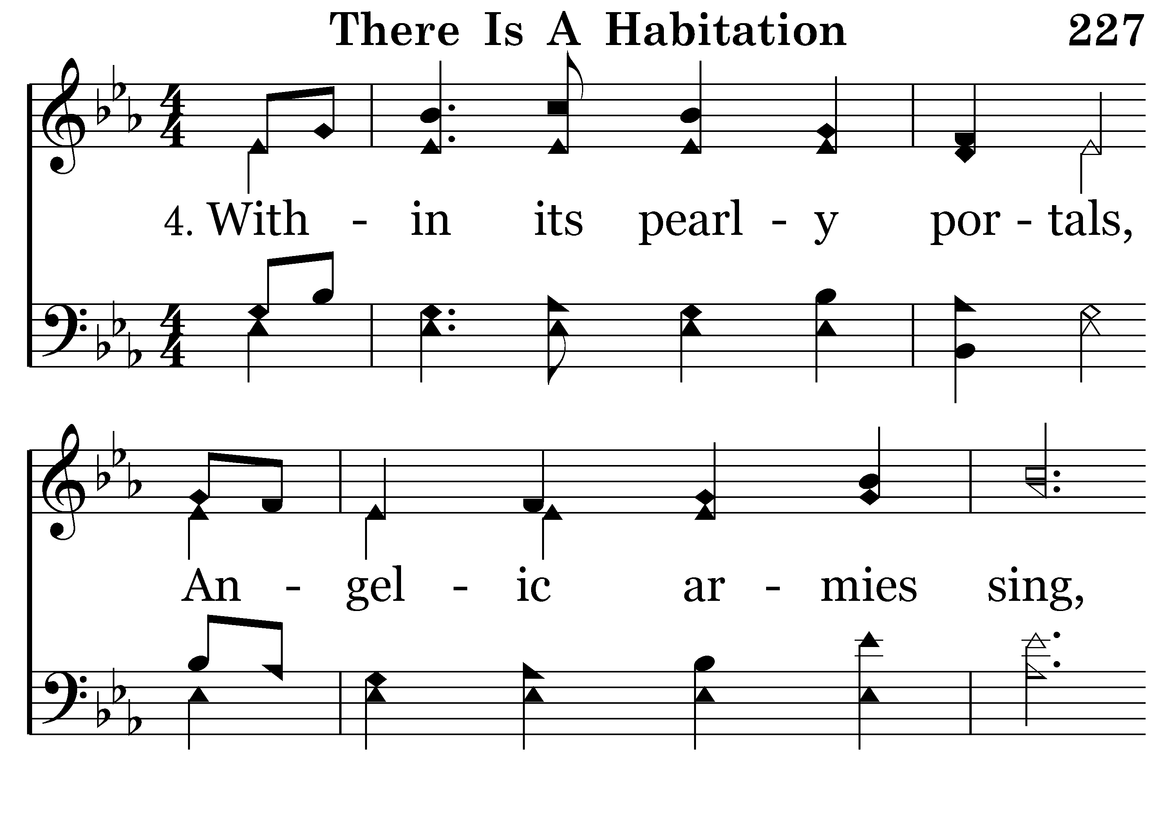
227 - There Is A Habitation - 4.1

Slide 52
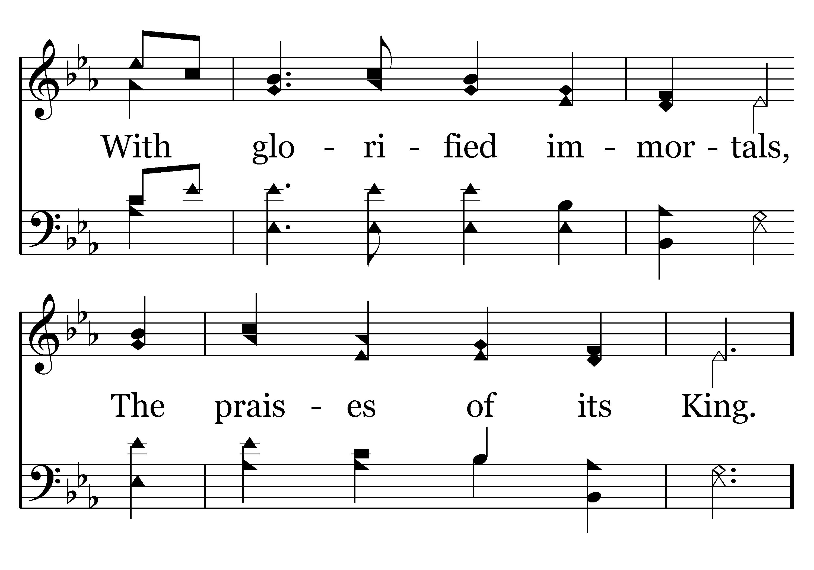
227 - There Is A Habitation - 4.2

Slide 53
227 - There Is A Habitation - C.1

Slide 54
227 - There Is A Habitation - C.2
End of Song

Slide 56
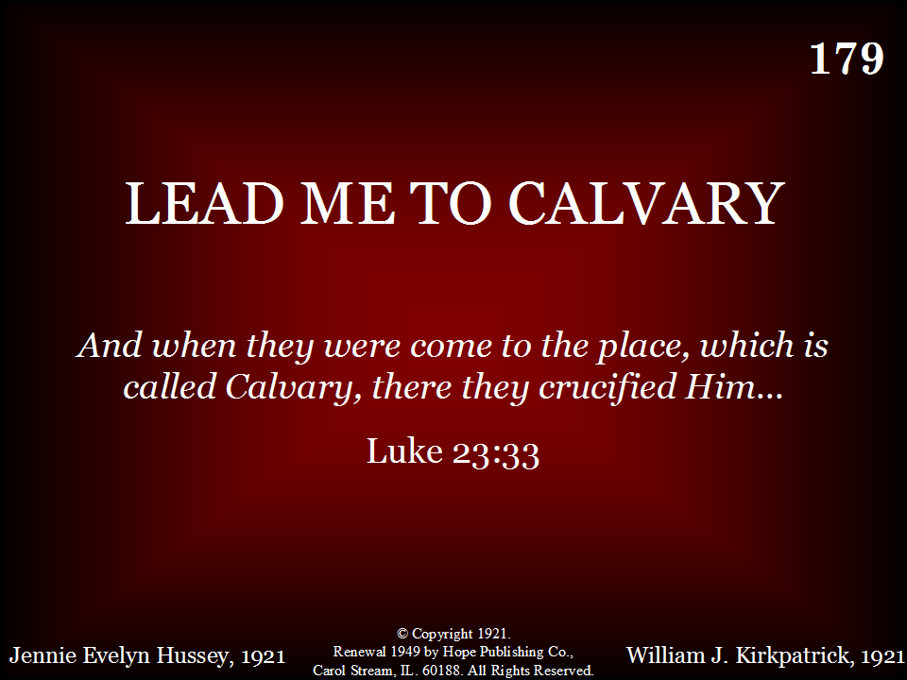
179 - Lead Me To Calvary - Title

Slide 57
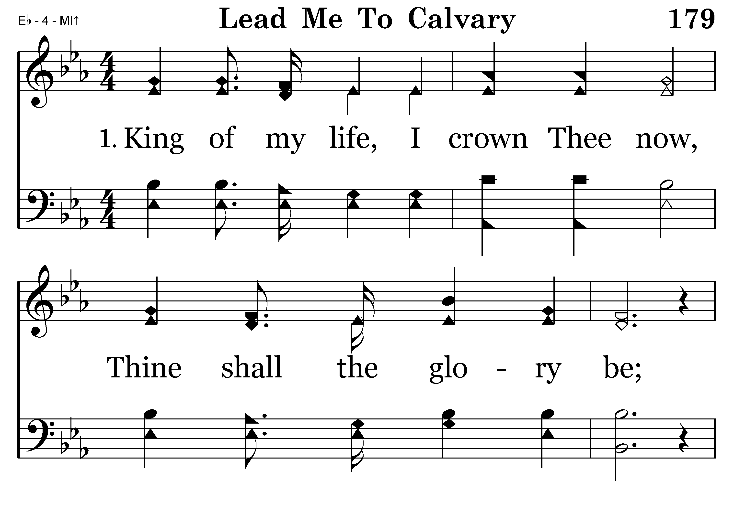
179 - Lead Me To Calvary - 1.1

Slide 58
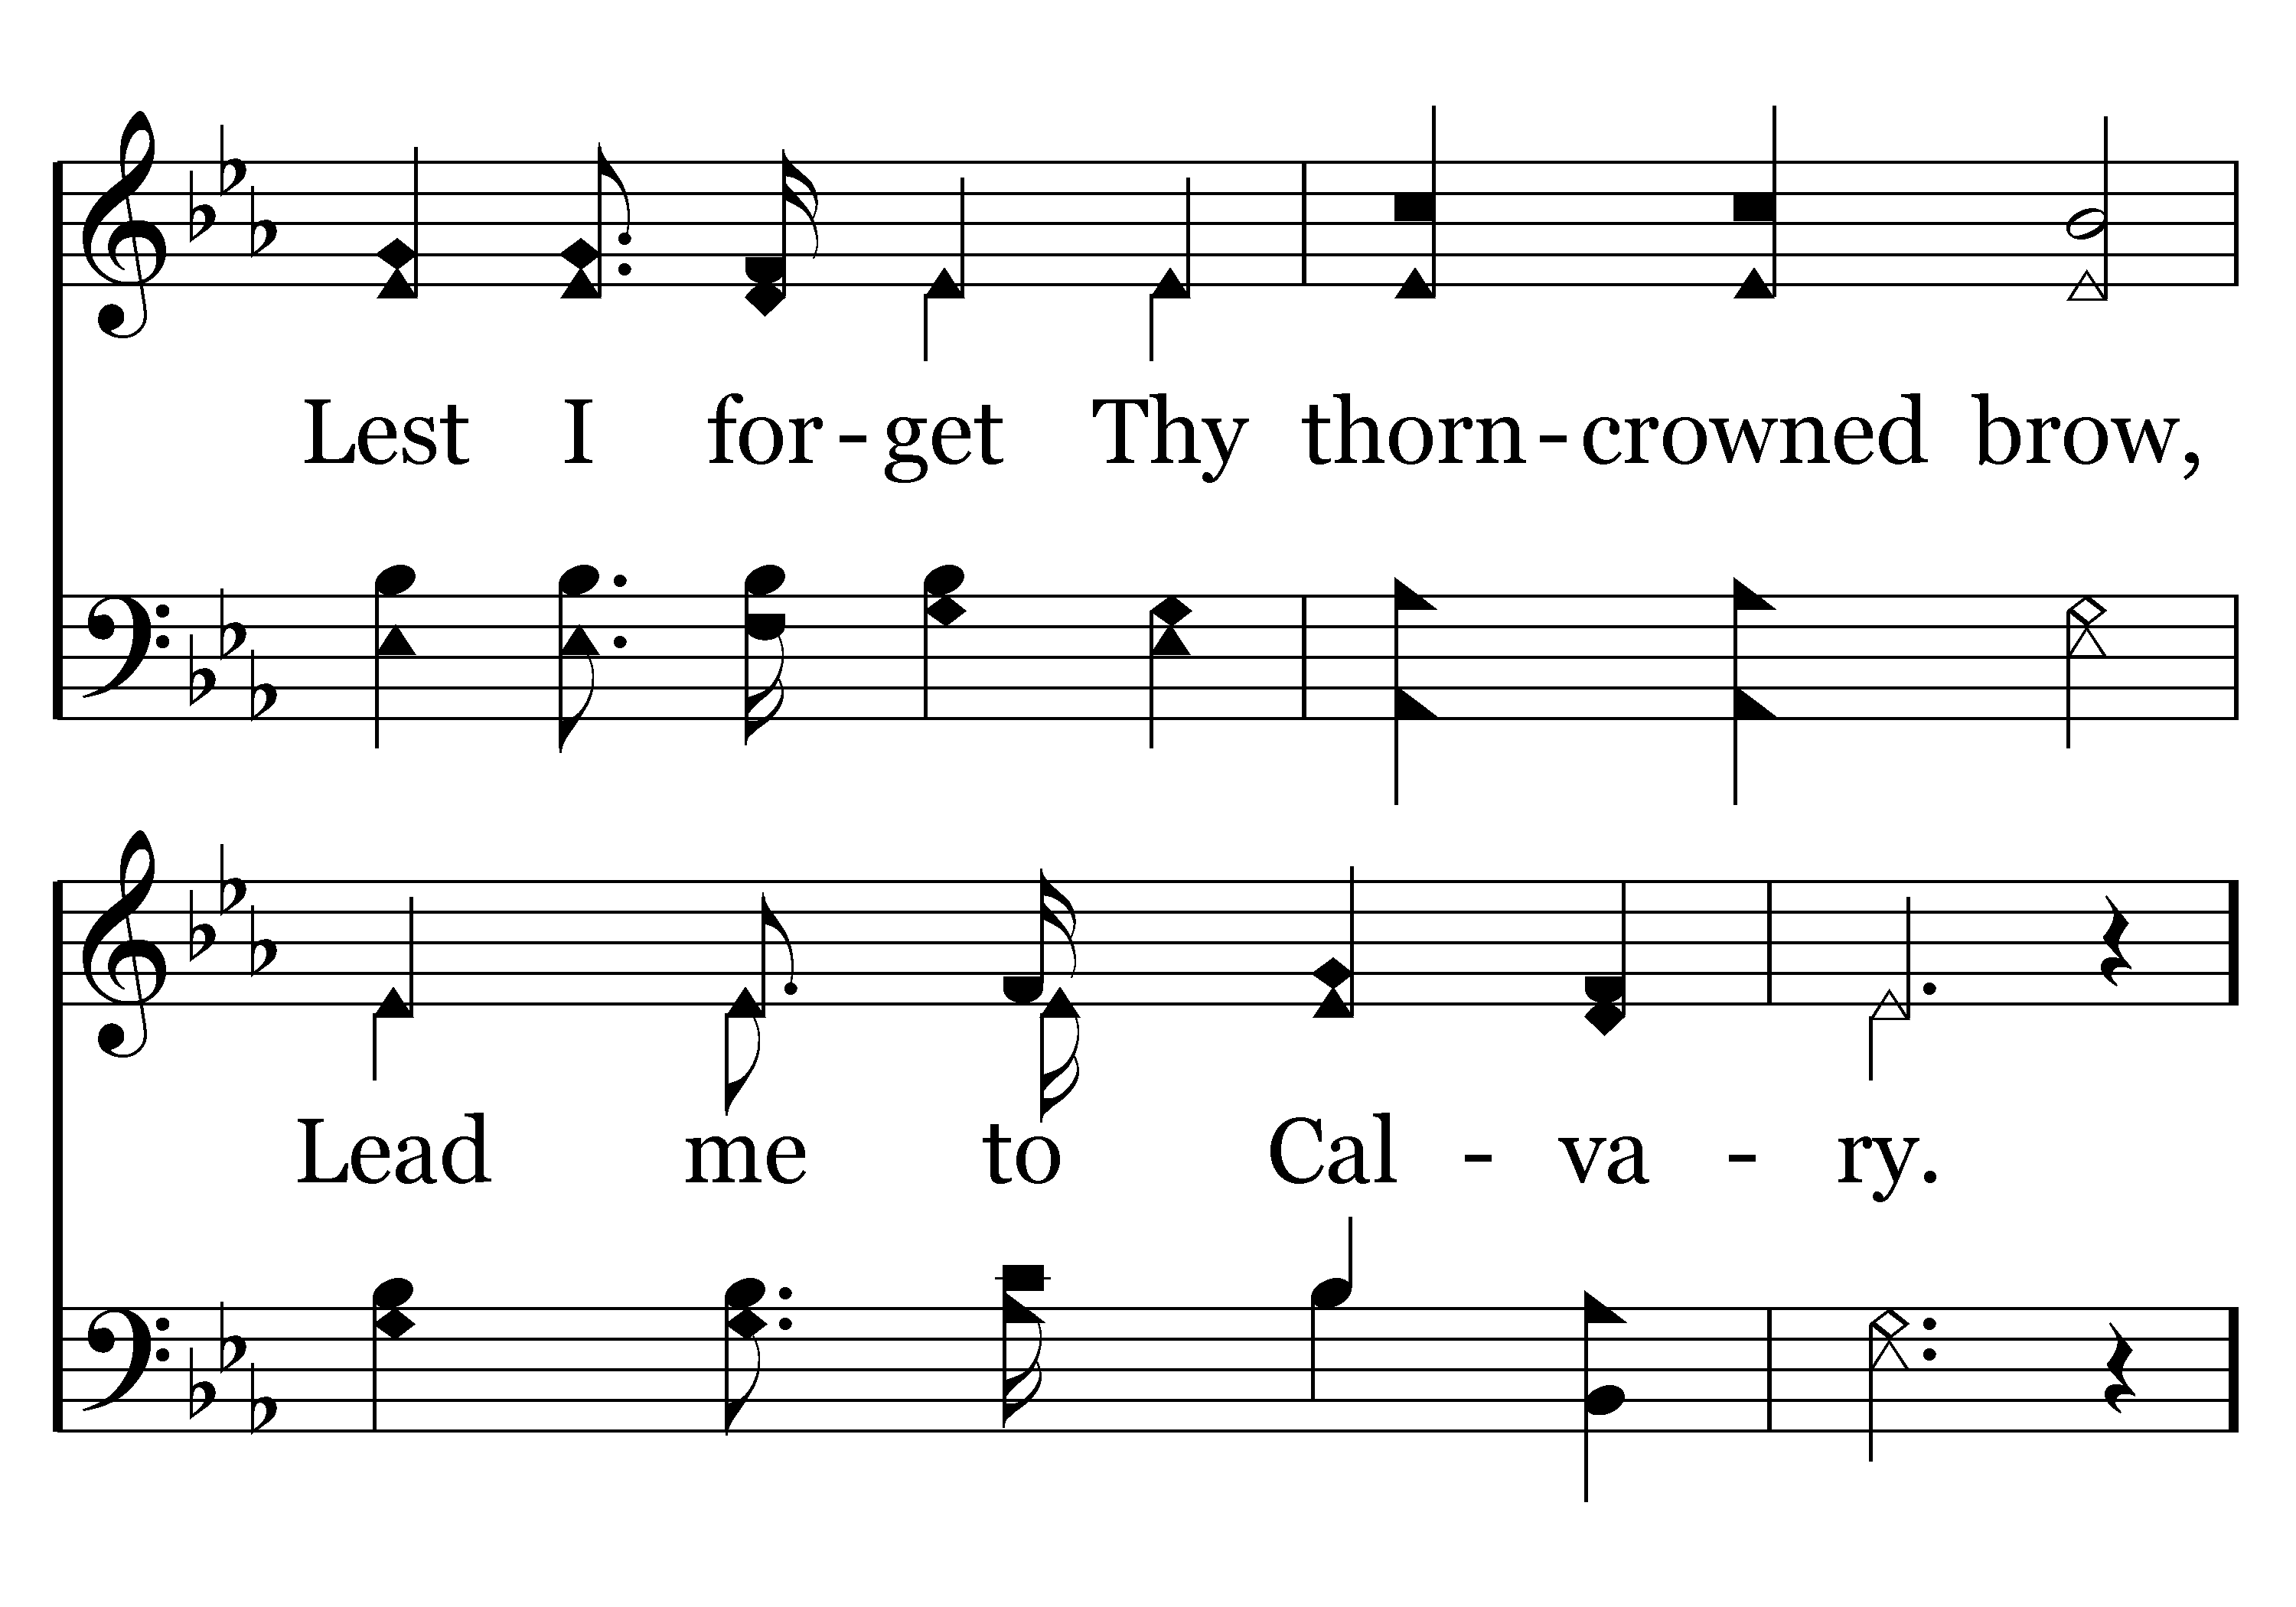
179 - Lead Me To Calvary - 1.2

Slide 59
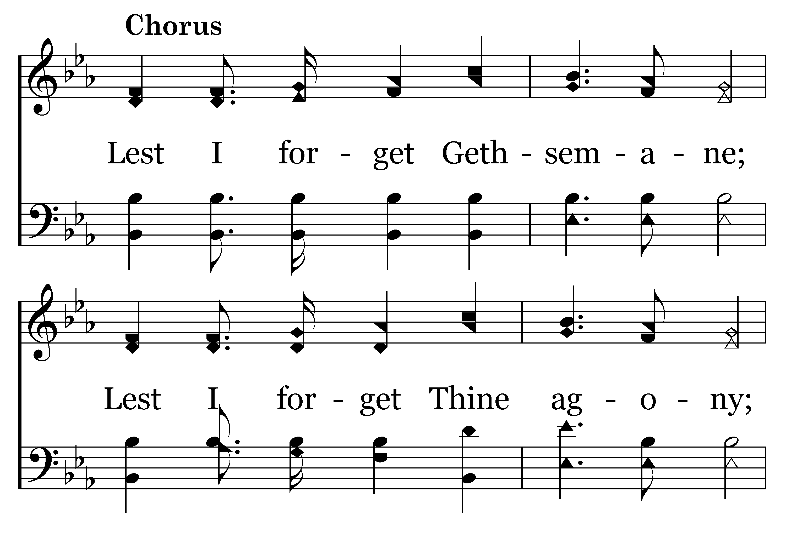
179 - Lead Me To Calvary - C.1

Slide 60
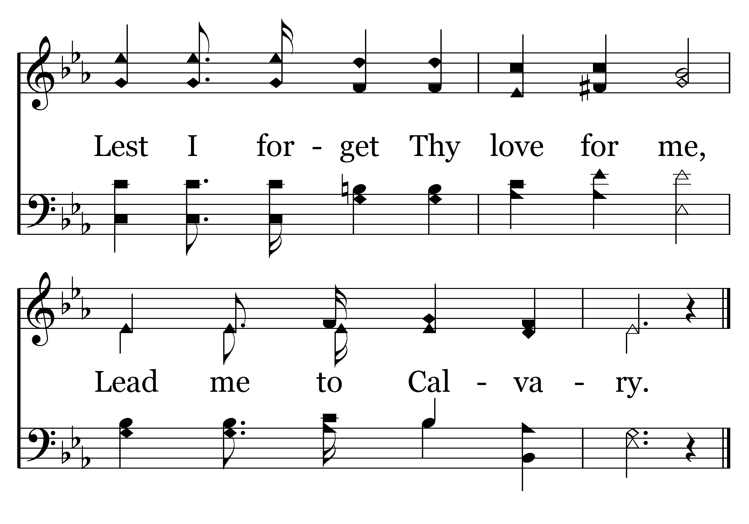
179 - Lead Me To Calvary - C.2
End of Verse 1

Slide 61
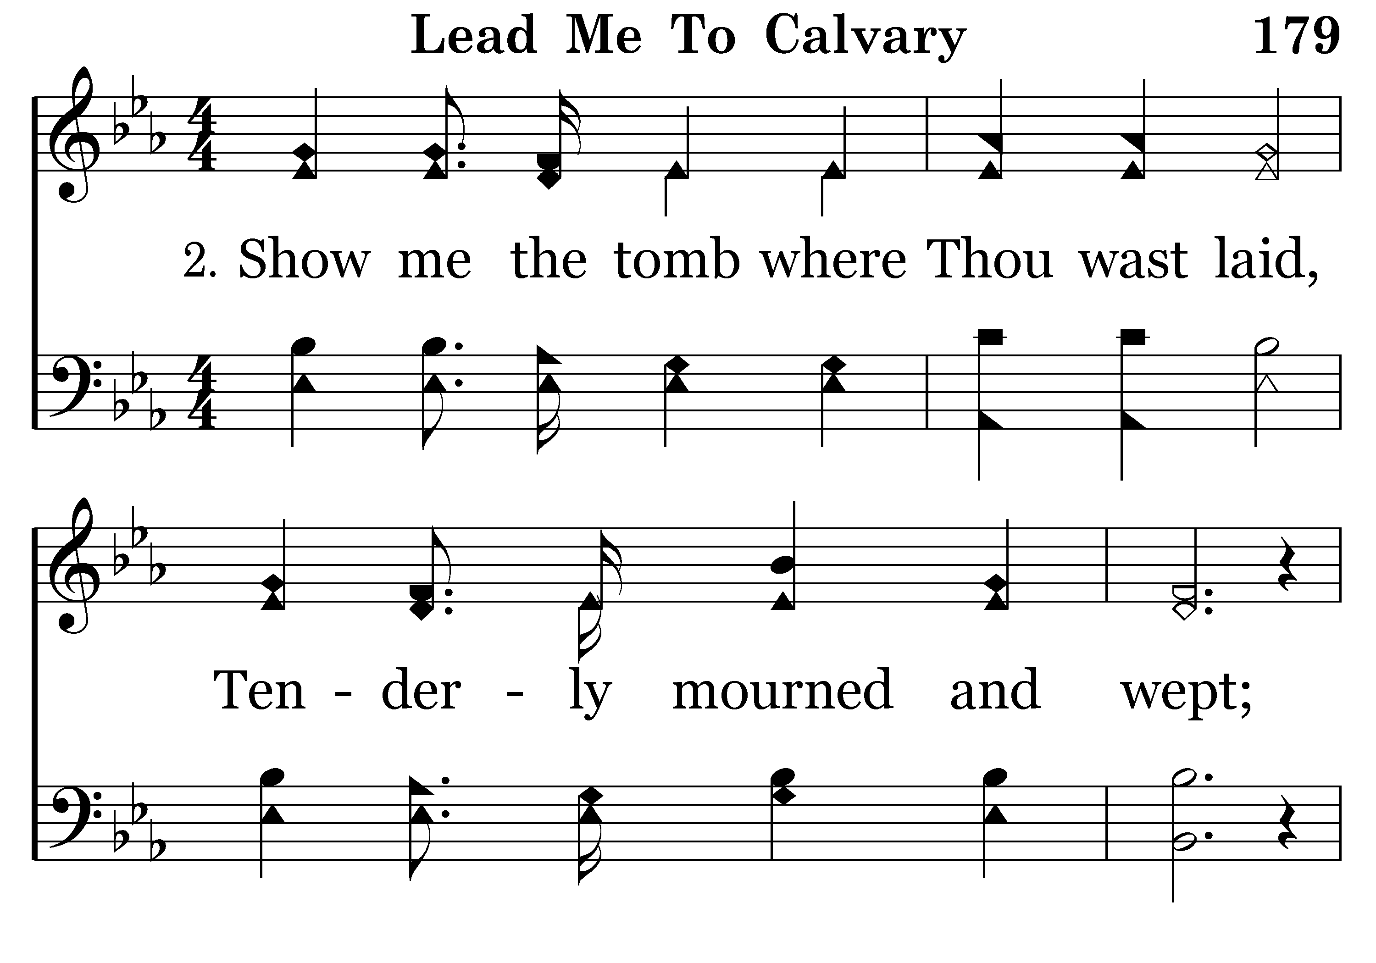
179 - Lead Me To Calvary - 2.1

Slide 62
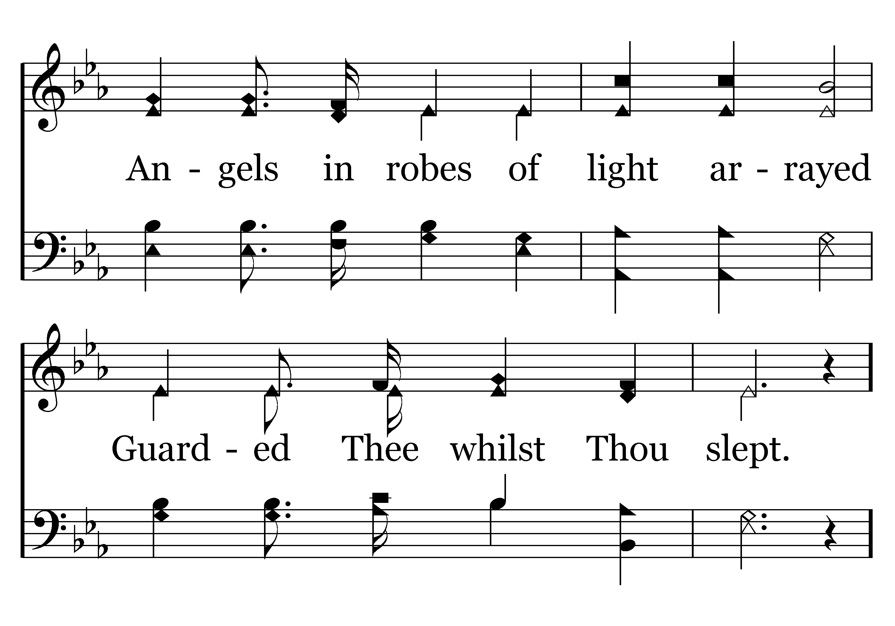
179 - Lead Me To Calvary - 2.2

Slide 63
179 - Lead Me To Calvary - C.1

Slide 64
179 - Lead Me To Calvary - C.2
End of Verse 2

Slide 65
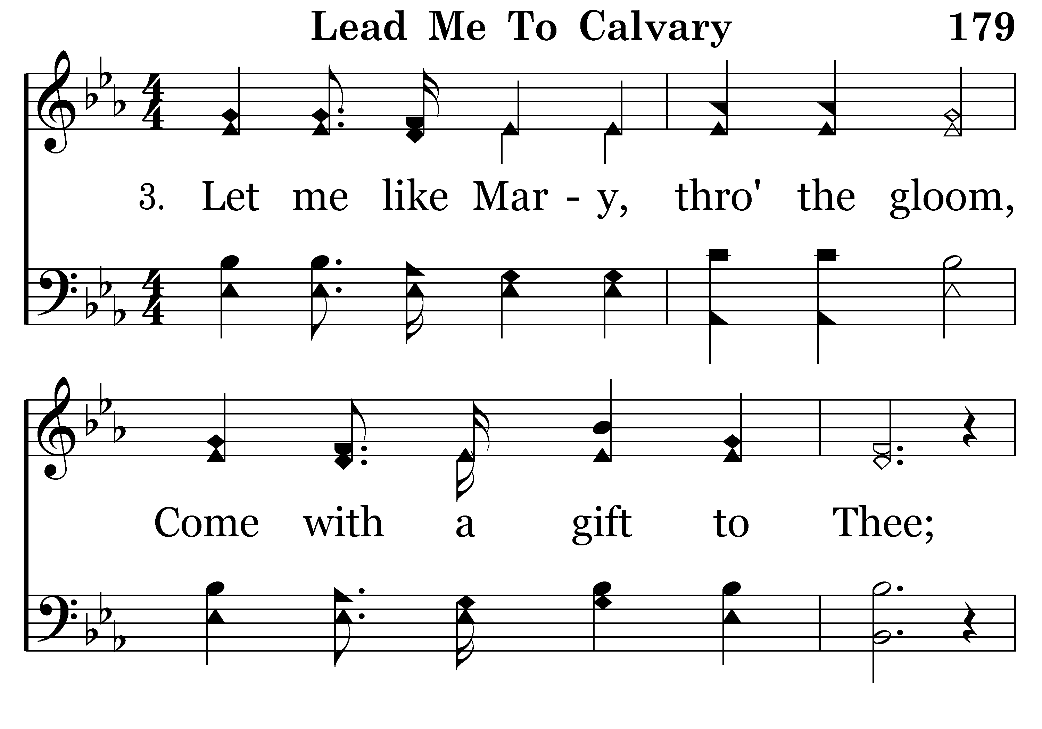
179 - Lead Me To Calvary - 3.1

Slide 66
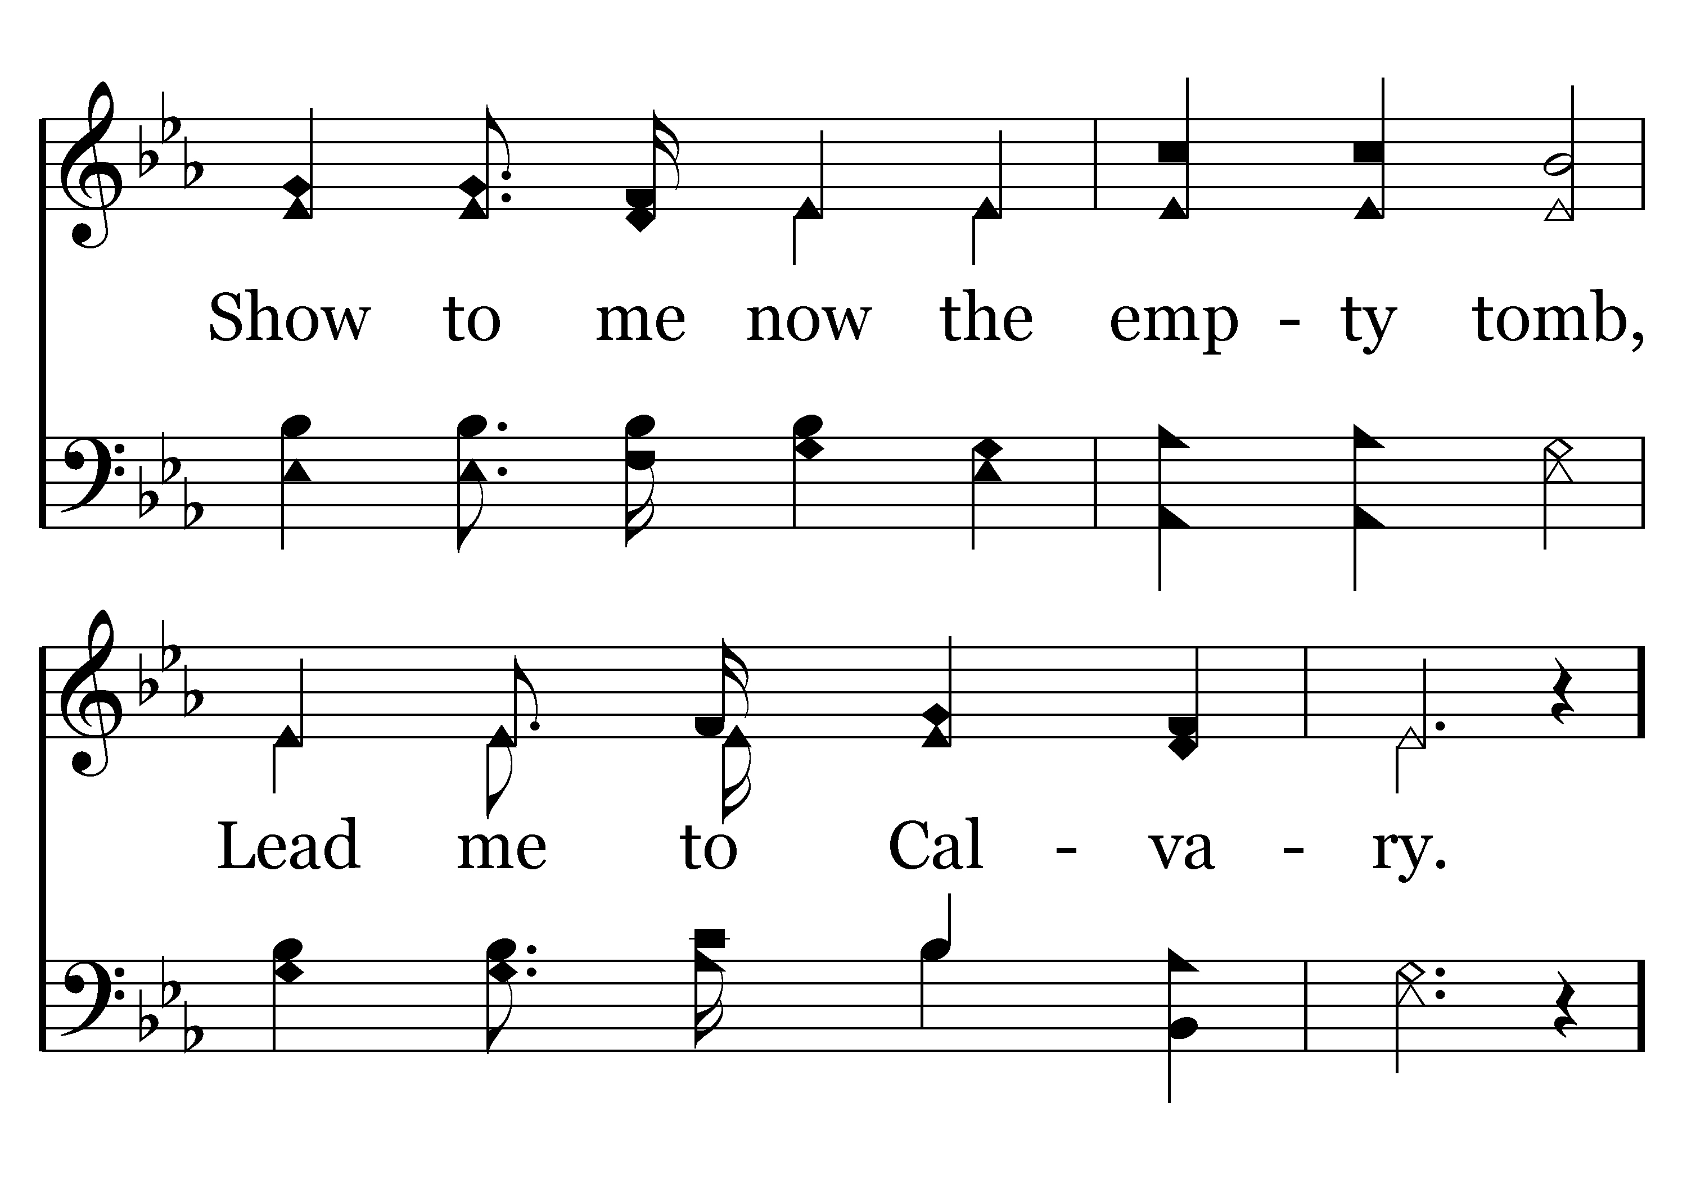
179 - Lead Me To Calvary - 3.2

Slide 67
179 - Lead Me To Calvary - C.1

Slide 68
179 - Lead Me To Calvary - C.2
End of Verse 3

Slide 69
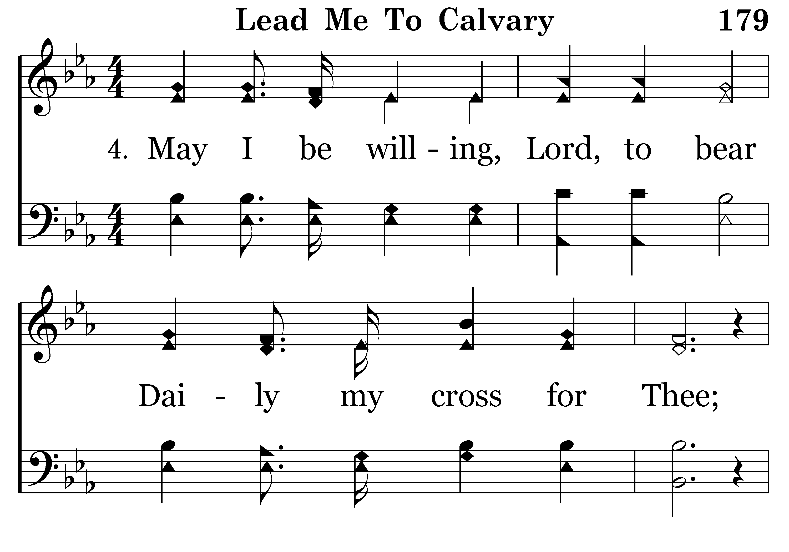
179 - Lead Me To Calvary - 4.1

Slide 70
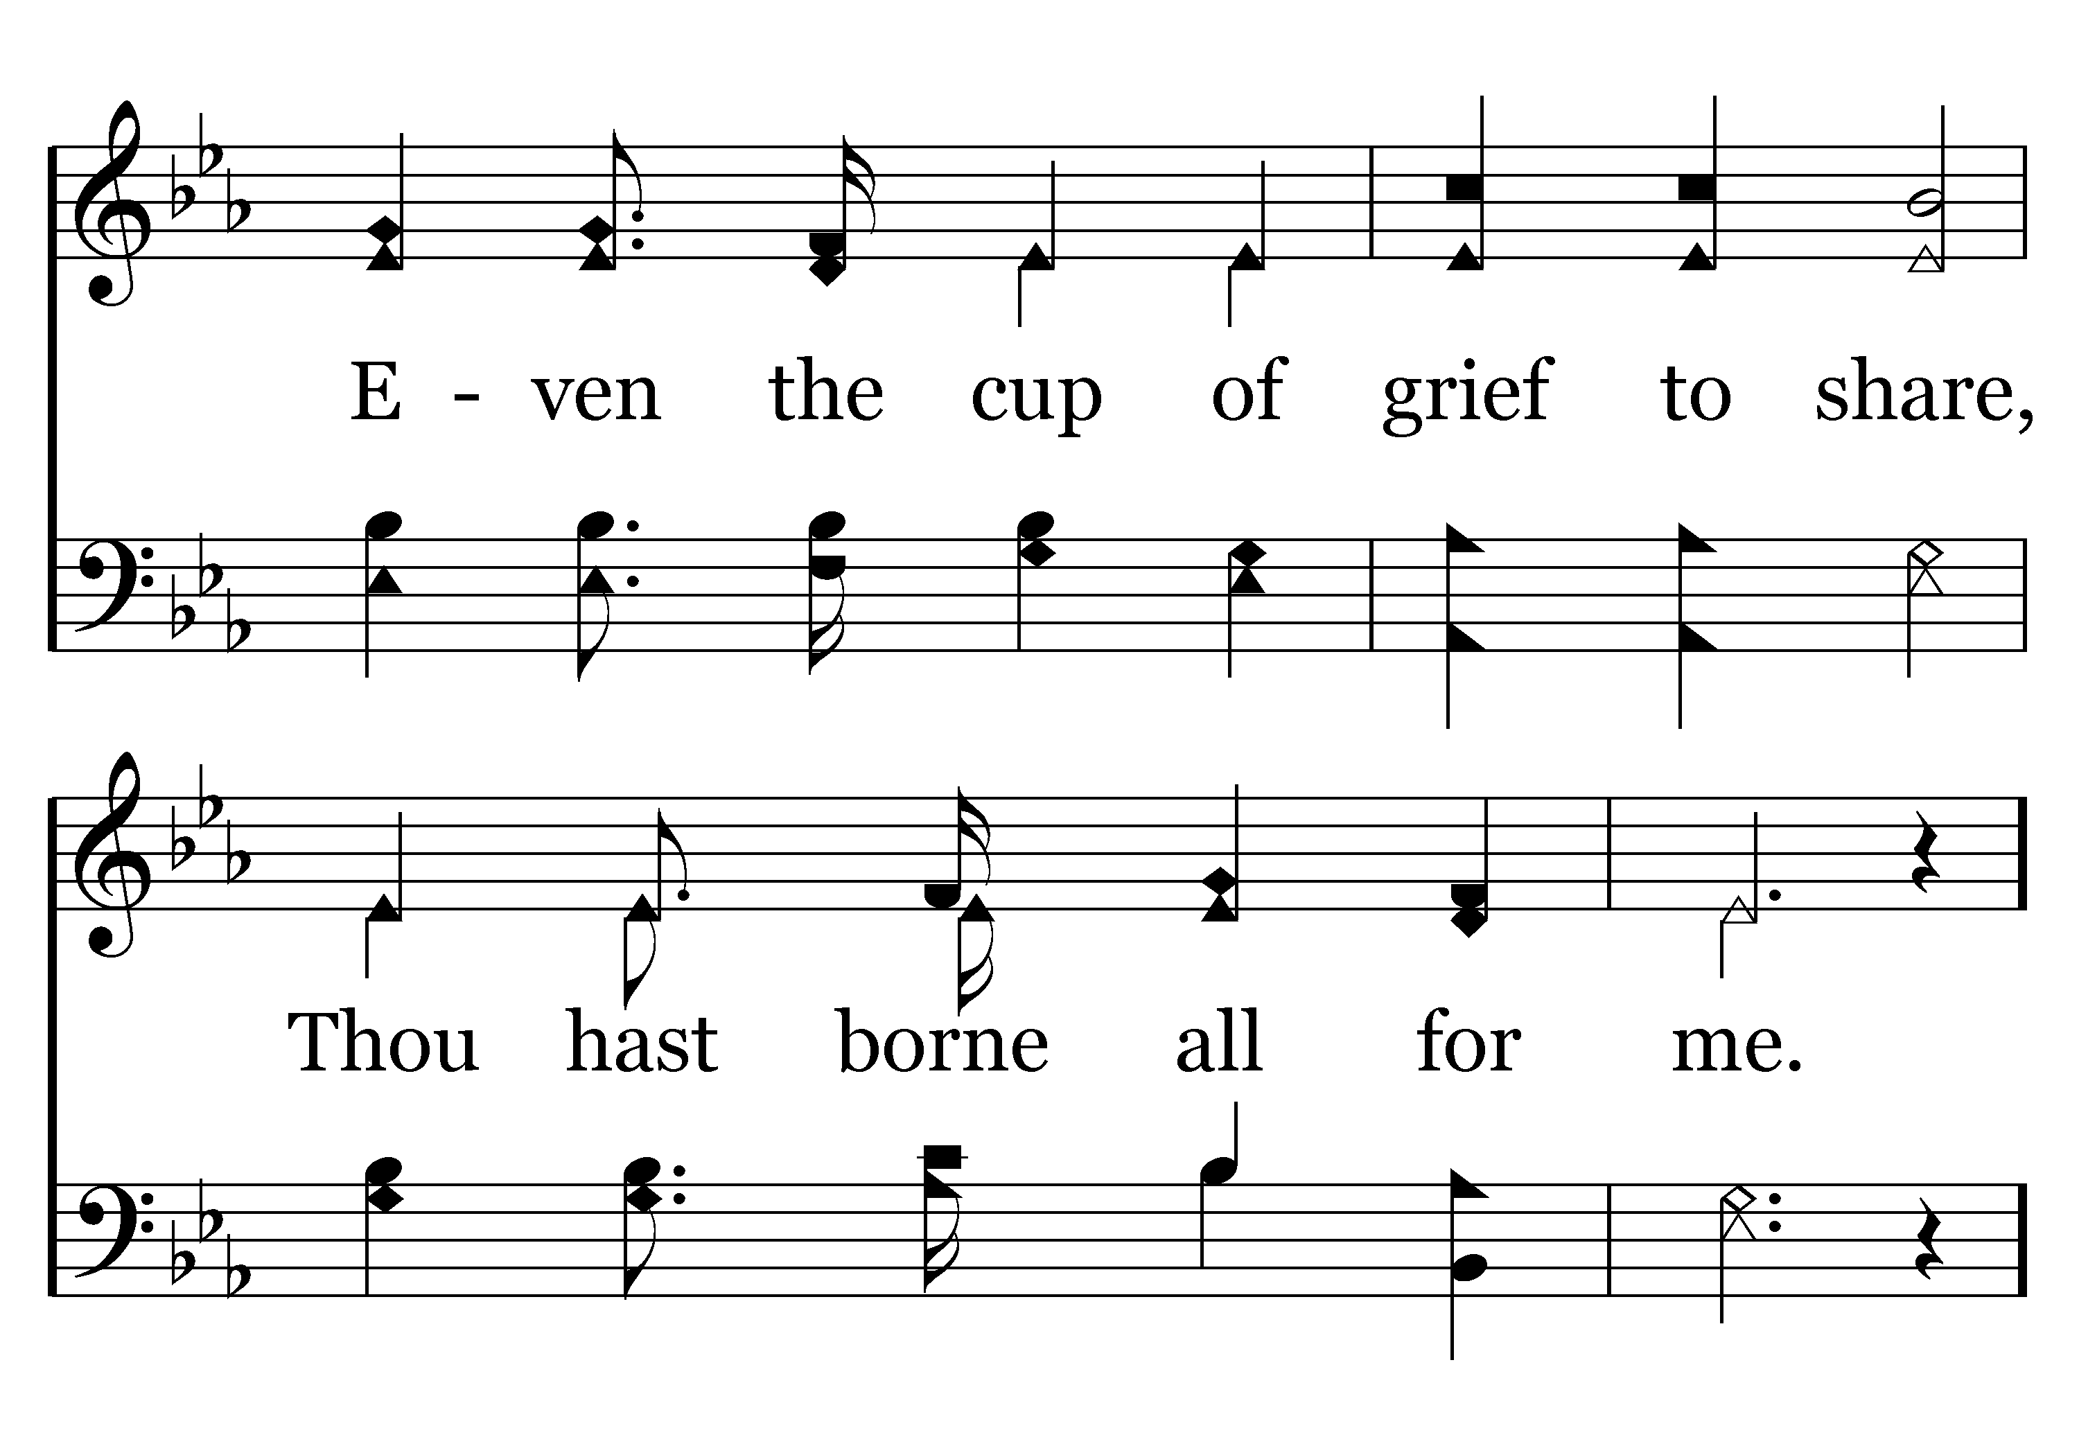
179 - Lead Me To Calvary - 4.2

Slide 71
179 - Lead Me To Calvary - C.1

Slide 72
179 - Lead Me To Calvary - C.2
End of Song

Slide 73
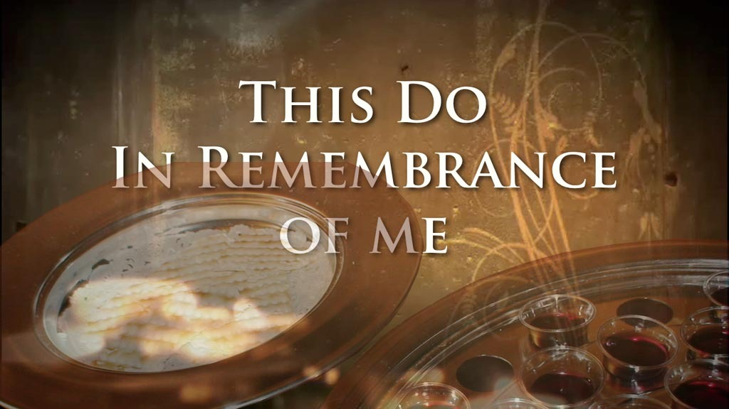

Slide 74
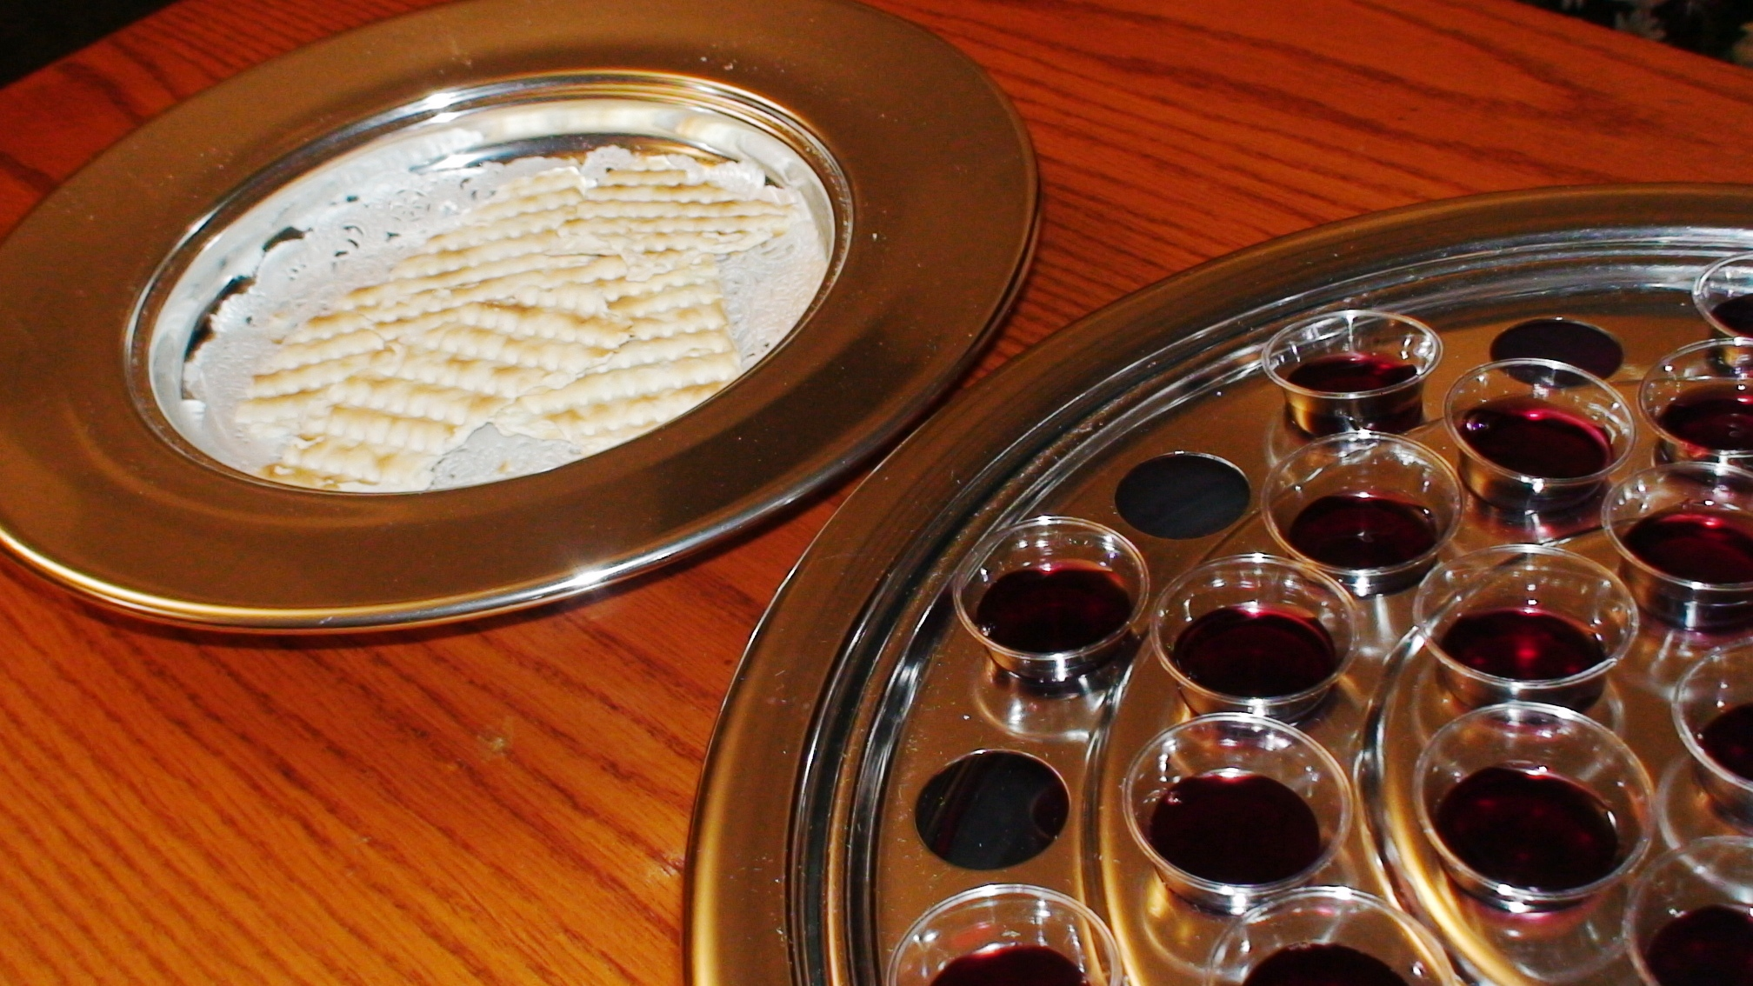
“As often as you eat this bread and drink this cup, you proclaim the Lord’s death….” 1 Corinthians 11:26

Slide 76
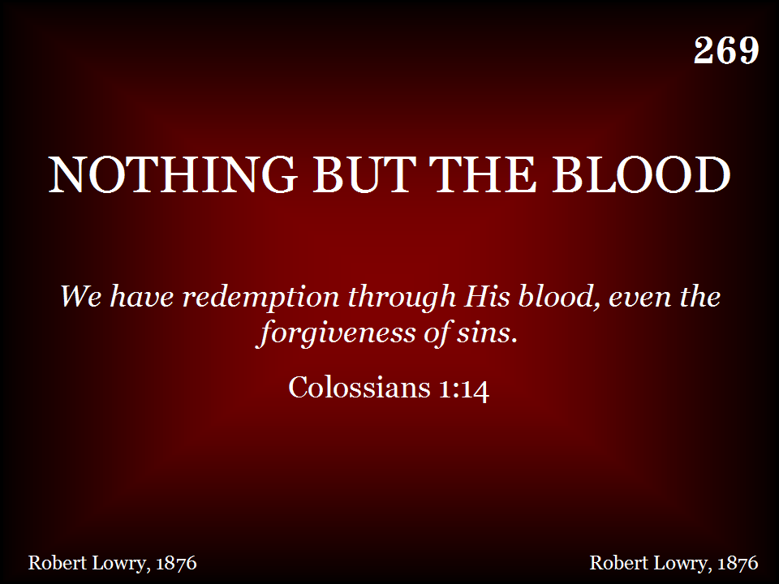
269 - Nothing But The Blood - Title

Slide 77
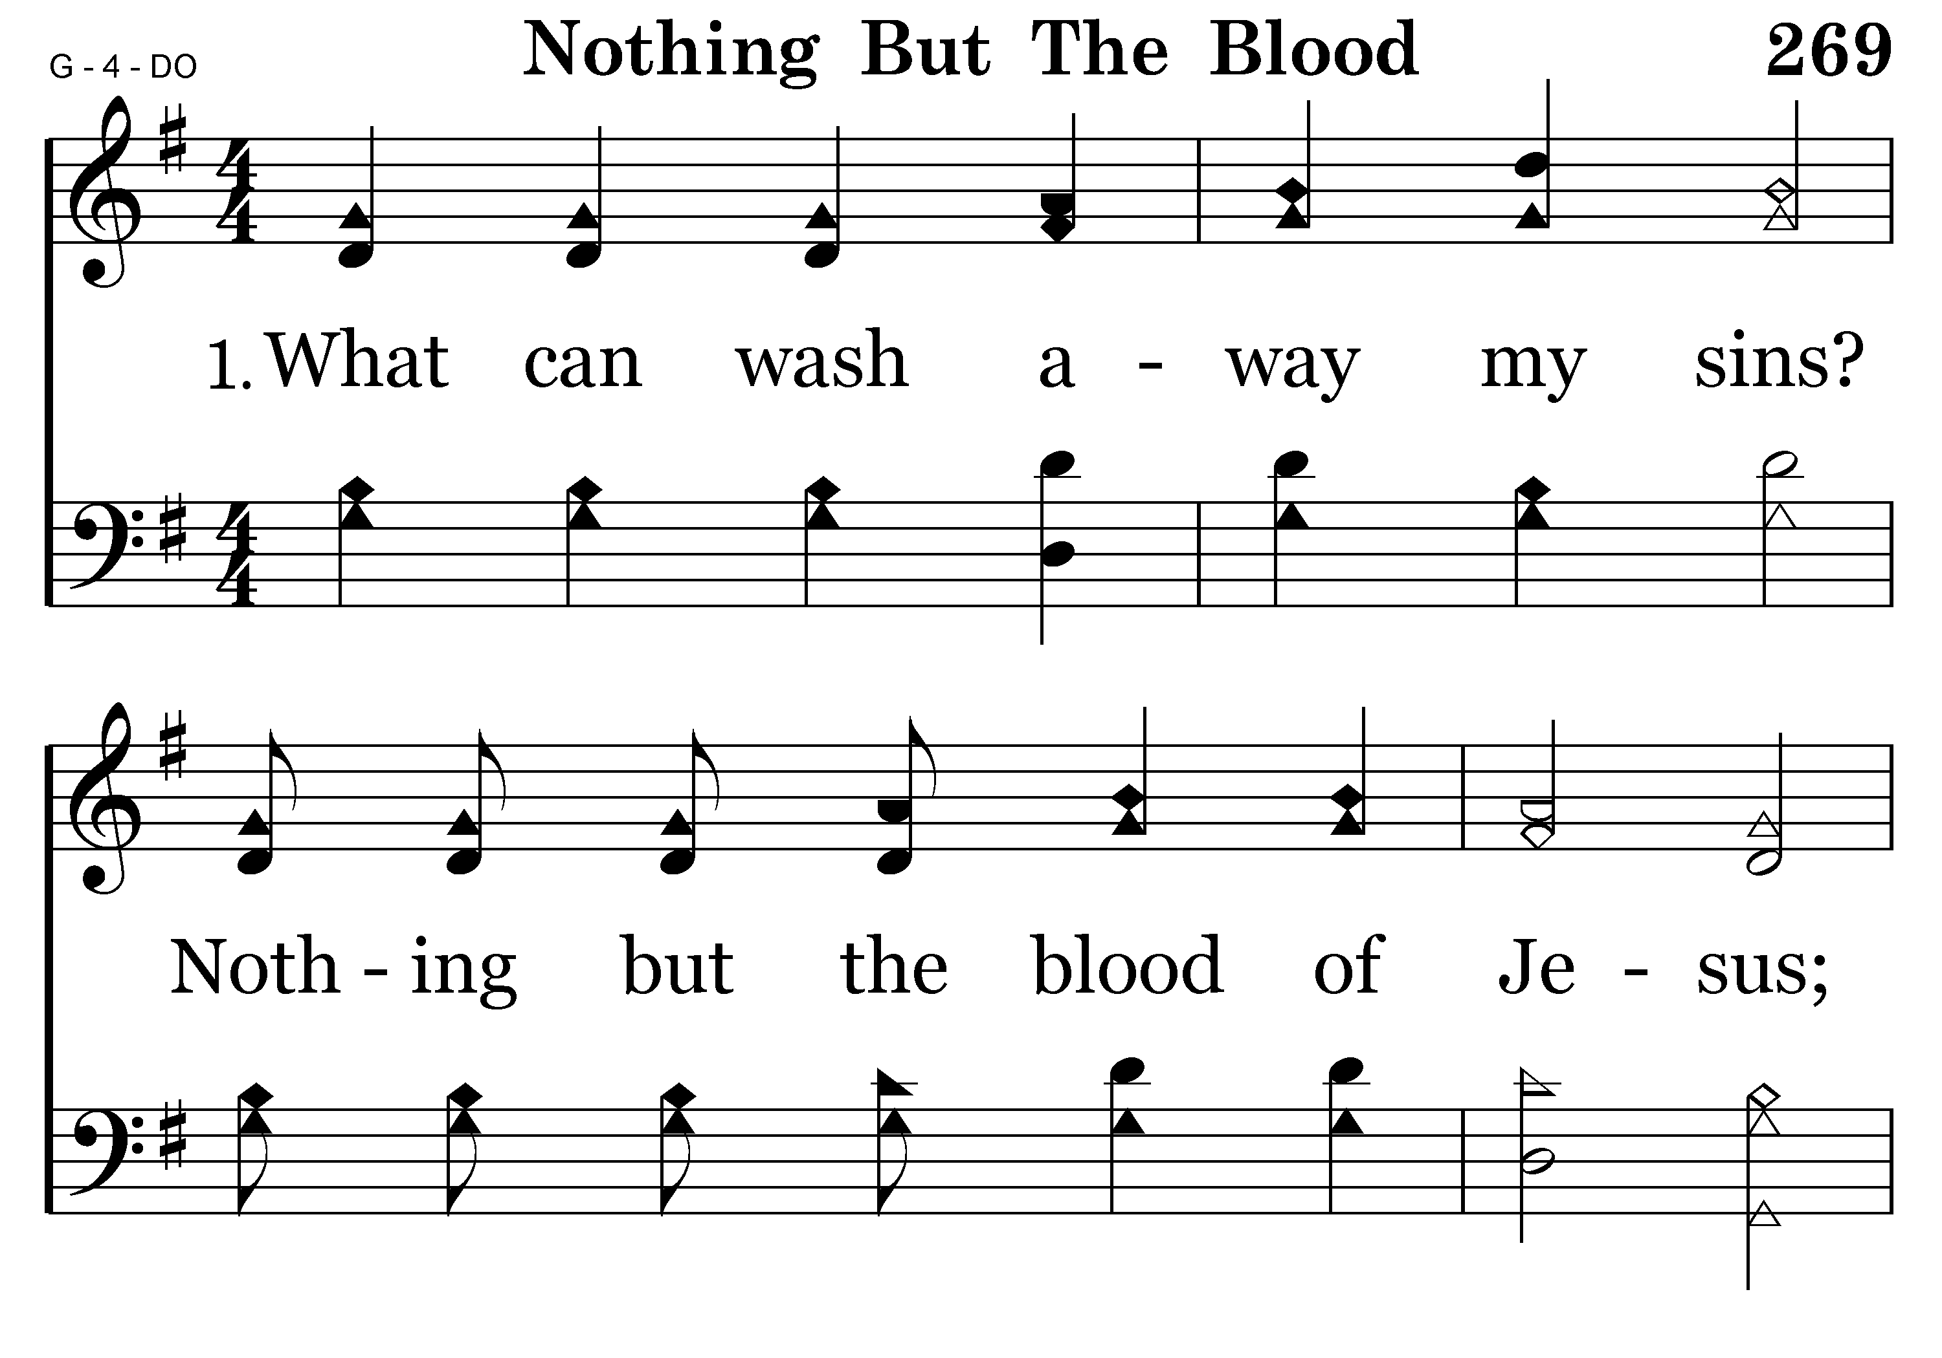
269 - Nothing But The Blood - 1.1

Slide 78
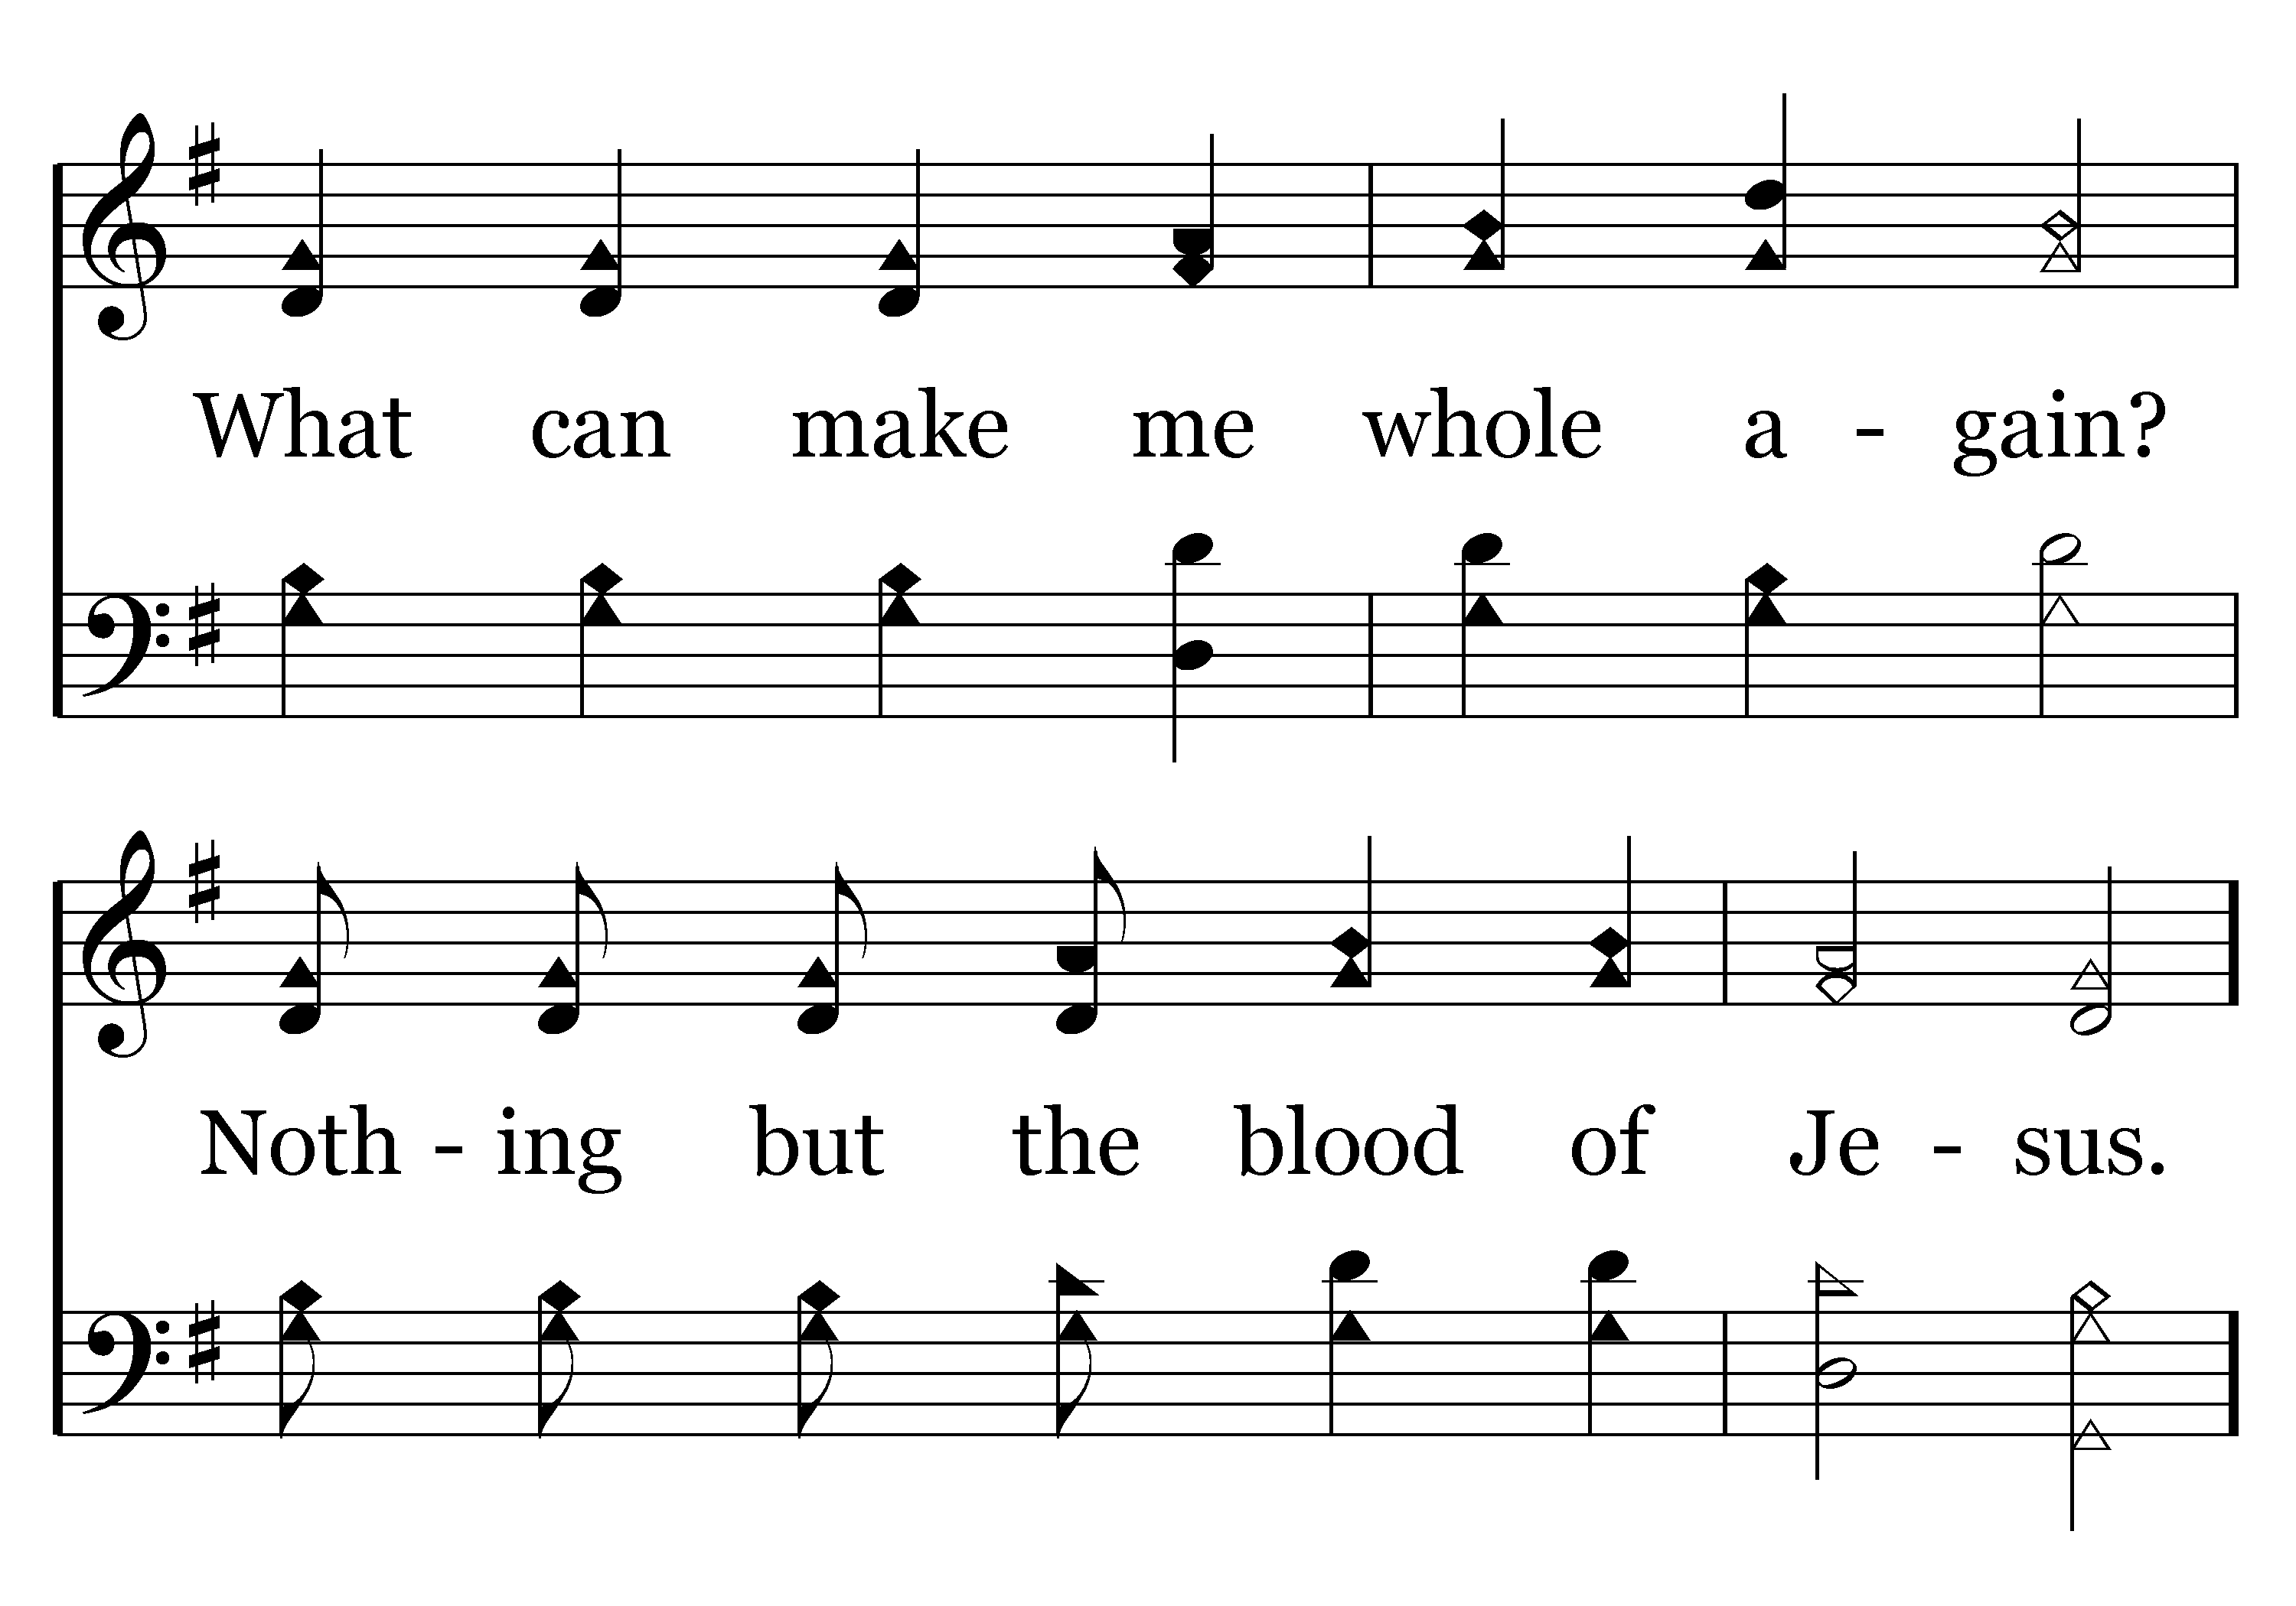
269 - Nothing But The Blood - 1.2
End of Verse 1

Slide 79
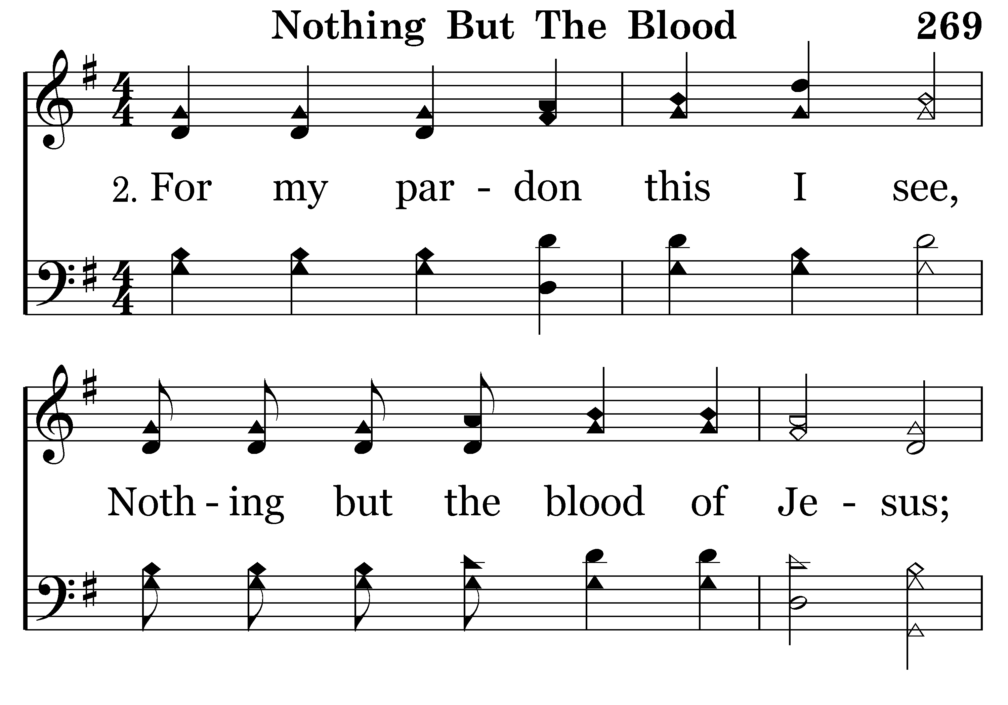
269 - Nothing But The Blood - 2.1

Slide 80
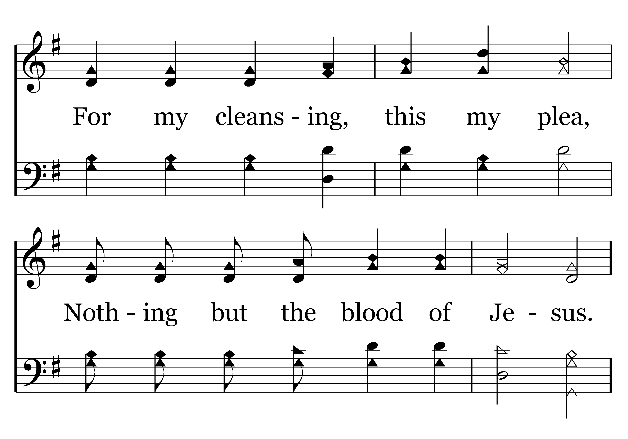
269 - Nothing But The Blood - 2.2
End of Verse 2

Slide 81
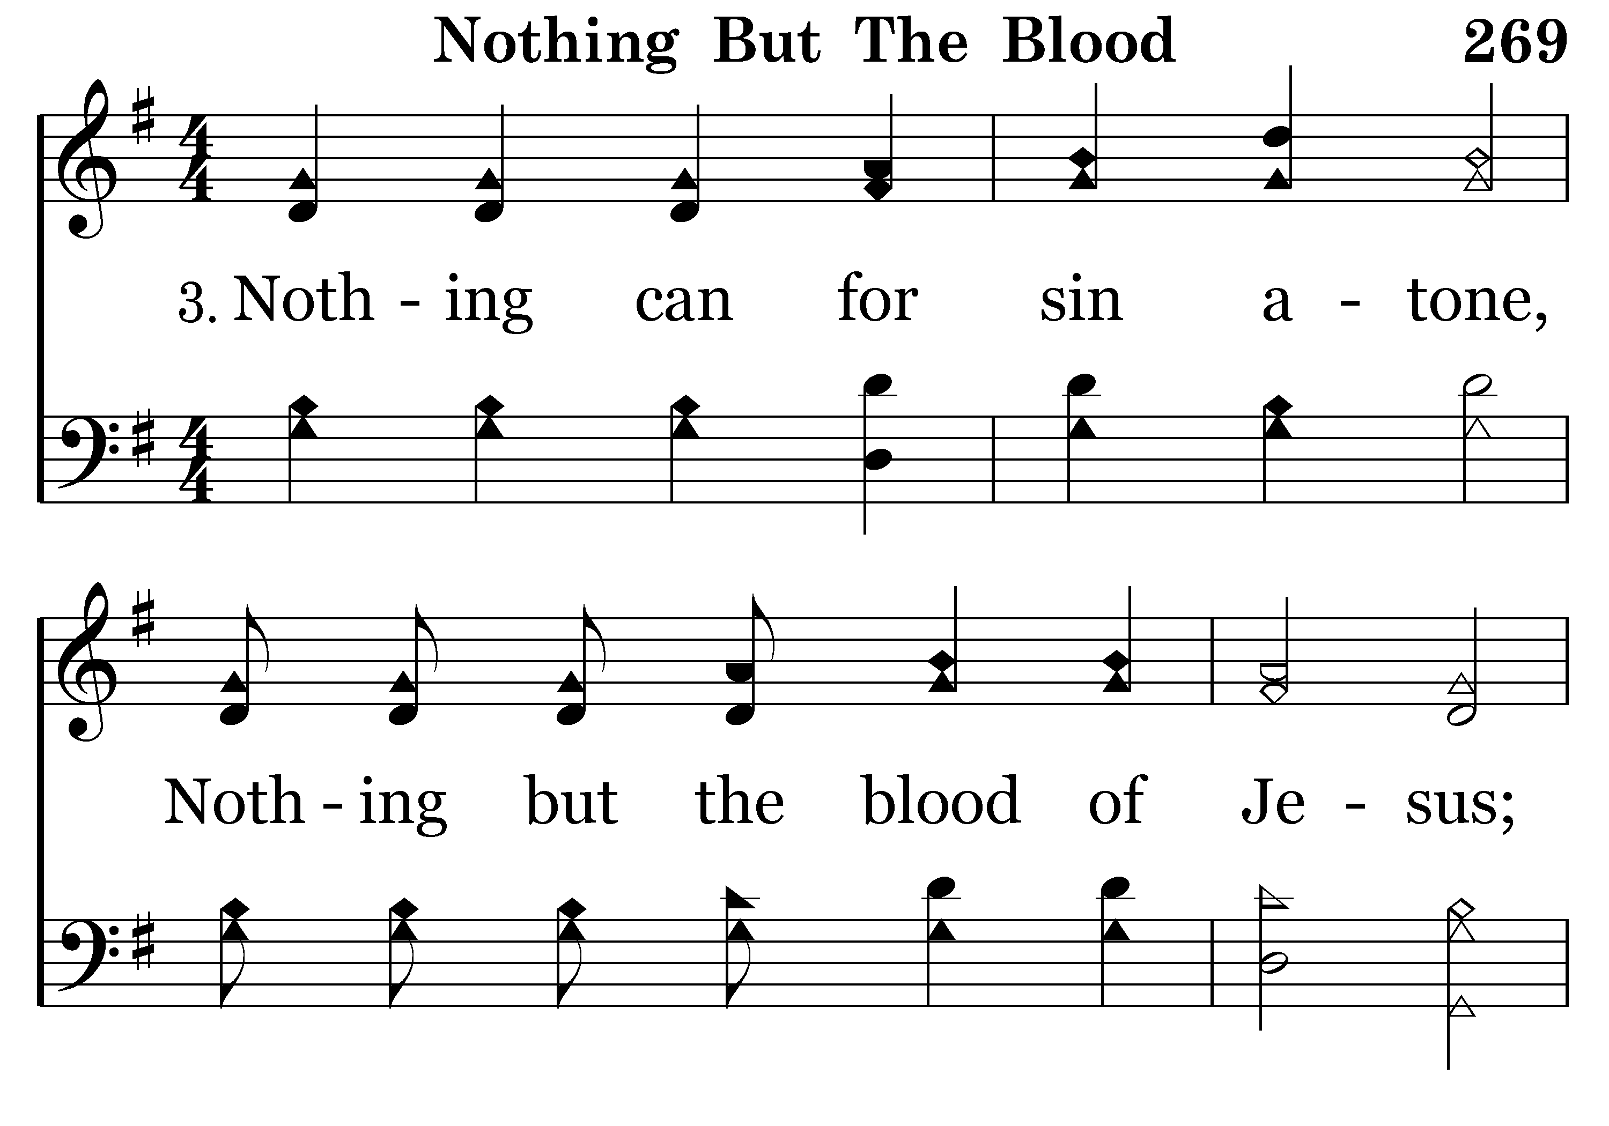
269 - Nothing But The Blood - 3.1

Slide 82
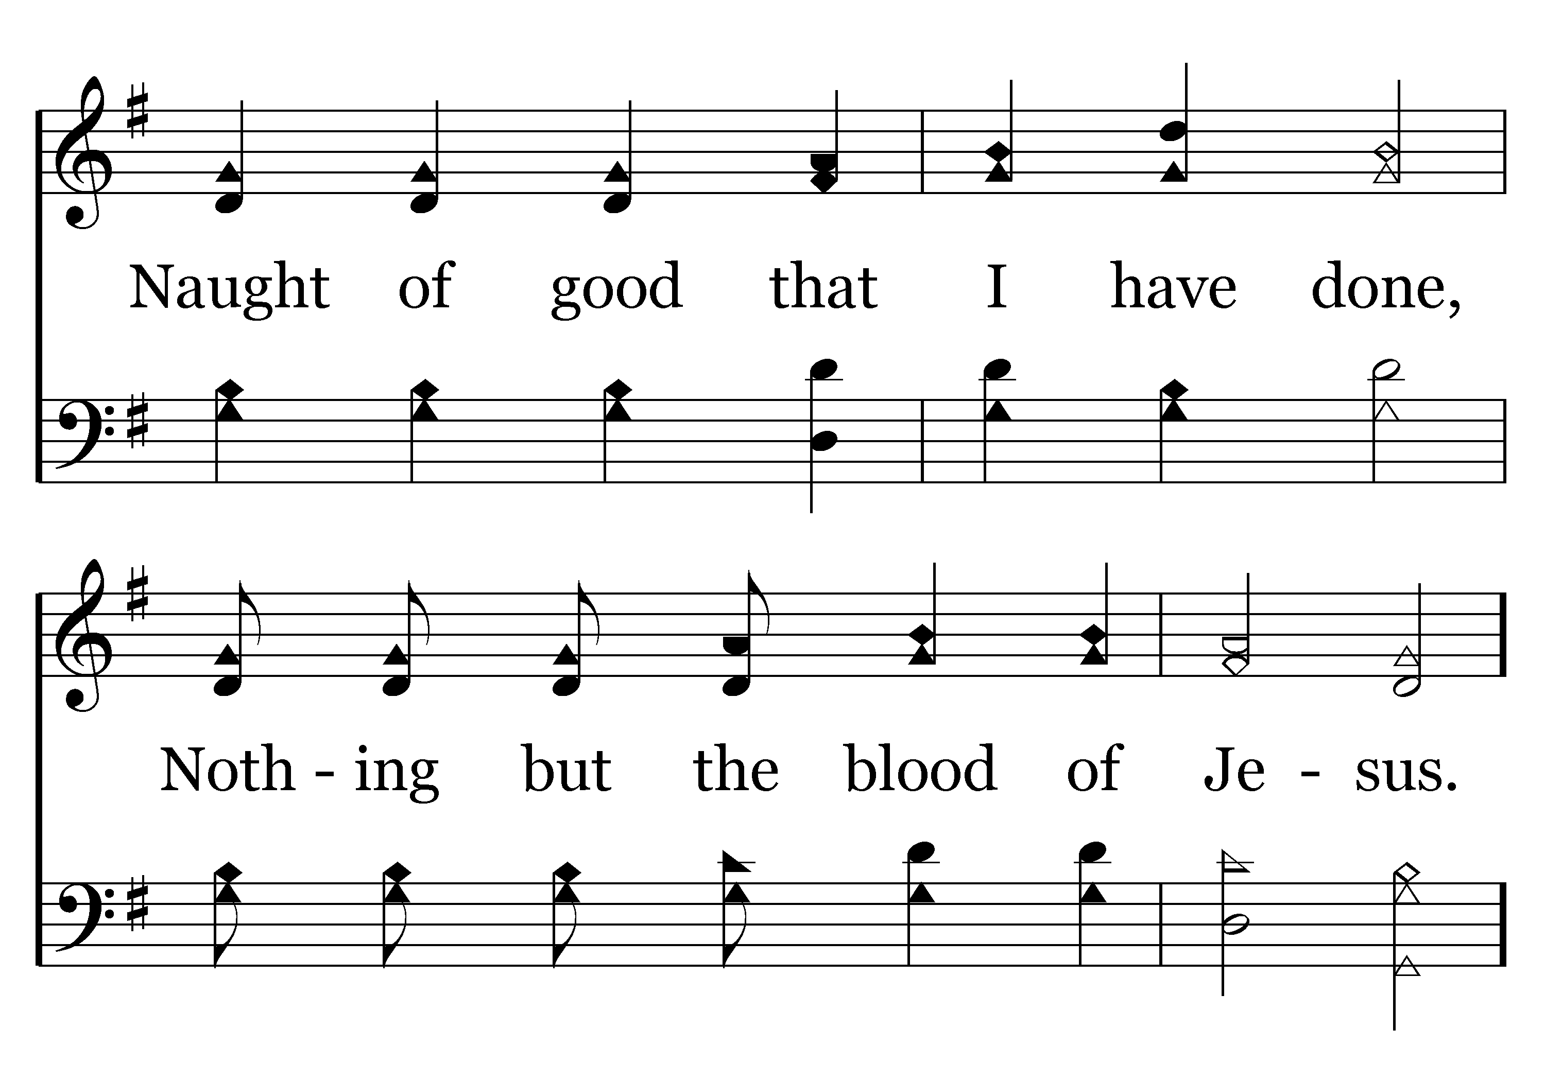
269 - Nothing But The Blood - 3.2

Slide 83

269 - Nothing But The Blood - C.1

Slide 84

269 - Nothing But The Blood - C.2
End of Song

Slide 86

683 - Sing And Be Happy - Title

Slide 87

683 - Sing And Be Happy - 1.1

Slide 88

683 - Sing And Be Happy - 1.2

Slide 89

683 - Sing And Be Happy - 1.3

Slide 90

683 - Sing And Be Happy - 1.4

Slide 91

683 - Sing And Be Happy - C.1

Slide 92

683 - Sing And Be Happy - C.2

Slide 93

683 - Sing And Be Happy - C.3

Slide 94

683 - Sing And Be Happy - C.4
End of Verse 1

Slide 95

683 - Sing And Be Happy - 2.1

Slide 96

683 - Sing And Be Happy - 2.2

Slide 97

683 - Sing And Be Happy - 2.3

Slide 98

683 - Sing And Be Happy - 2.4

Slide 99
683 - Sing And Be Happy - C.1

Slide 100
683 - Sing And Be Happy - C.2

Slide 101
683 - Sing And Be Happy - C.3

Slide 102
683 - Sing And Be Happy - C.4
End of Verse 2

Slide 103

683 - Sing And Be Happy - 3.1

Slide 104

683 - Sing And Be Happy - 3.2

Slide 105

683 - Sing And Be Happy - 3.3

Slide 106

683 - Sing And Be Happy - 3.4

Slide 107
683 - Sing And Be Happy - C.1

Slide 108
683 - Sing And Be Happy - C.2

Slide 109
683 - Sing And Be Happy - C.3

Slide 110
683 - Sing And Be Happy - C.4
End of Song

Slide 111

TODAY’S TEXT
DERRICK COWAN
HEBREWS 6:9-12

Slide 112
Heb 6:9-12 Even though we speak like this, dear friends, we are confident of better things in your case — things that accompany salvation. ¹⁰ God is not unjust; he will not forget your work and the love you have shown him as you have helped his people and continue to help them. ¹¹ We want each of you to show this same diligence to the very end, in order to make your hope sure. ¹² We do not want you to become lazy, but to imitate those who through faith and patience inherit what has been promised.

Slide 113
INVITATION SONG
# 322
BRING CHRIST YOUR BROKEN LIFE

Slide 114


Slide 115


Slide 116

BAGGAGE OF SIN

Slide 117
BAGGAGE OF ANXIETY

Slide 118
BAGGAGE OF BITTERNESS

Slide 119
BAGGAGE OF DOUBT AND DISTRUST

Slide 120
BAGGAGE OF INSECURITY AND INADEQUACY

Slide 121
BAGGAGE OF FEAR OF FAILURE

Slide 122


Slide 123


Slide 124
THERE ARE THINGS CHRISTIANS SHOULD CARRY WITH THEM AS THEY GO THROUGH LIFE
THINGS THAT SHOULD BE OUR “HOLY SUITCASES”
THERE ARE THINGS THAT SHOULD ACCOMPANY OUR SALVATION

Slide 125
Heb 6:9 Even though we speak like this, dear friends, we are confident of better things in your case — things that accompany salvation.
NIV

Slide 126
Heb 6:9 Even though we speak like this, dear friends, we are confident of better things in your case — things that accompany salvation.
THE WRITER TALKS ABOUT FOUR THINGS THAT SHOULD ACCOMPANY OUR SALVATION
THESE ARE PIECES OF LUGGAGE WE NEED TO CARRY WITH US THROUGHLIFE

Slide 127

ASSURANCE

Slide 128
Heb 6:10-11 God is not unjust; he will not forget your work and the love you have shown him as you have helped his people and continue to help them. ¹¹ We want each of you to show this same diligence to the very end, in order to make your hope sure.
NIV
THIS TELLS US THAT WE CAN HAVE THE ASSURANCE THAT GOD IS WATCHING WHAT WE ARE DOING FOR HIM AND FOR OTHERS

Slide 129
OUR SOCIETY HAS ATTACKED THIS PRINCIPLE
“NO GOOD DEED GOES UNPUNISHED”
WE ARE OFTEN AFRAID OF DOING GOOD BY HELPING SOMEONE
WE FEAR BEING SUED IF SOMETHING GOES WRONG
WE CAN CARRY ASSURANCE WITH US THAT GOD IS WATCHING WHEN WE HELP OUR FELLOWMAN

Slide 130
LOVE FOR GOD

Slide 131
Heb 6:10-11 God is not unjust; he will not forget your work and the love you have shown him as you have helped his people and continue to help them. ¹¹ We want each of you to show this same diligence to the very end, in order to make your hope sure.
NIV
OUR LOVE FOR GOD MUST BE “SHOWN”
EVERYTHING WE DO SHOULD BE TO SHOW OUR LOVE FOR GOD

Slide 132
Matt 22:34-40 Hearing that Jesus had silenced the Sadducees, the Pharisees got together. ³⁵ One of them, an expert in the law, tested him with this question: ³⁶ "Teacher, which is the greatest commandment in the Law?"
³⁷ Jesus replied: "'Love the Lord your God with all your heart and with all your soul and with all your mind.' ^{b} ³⁸ This is the first and greatest commandment. ³⁹ And the second is like it: 'Love your neighbor as yourself.' ^{c} ⁴⁰ All the Law and the Prophets hang on these two commandments."
NIVIV

Slide 133
Matt 22:34-40 Hearing that Jesus had silenced the Sadducees, the Pharisees got together. ³⁵ One of them, an expert in the law, tested him with this question: ³⁶ "Teacher, which is the greatest commandment in the Law?"
³⁷ Jesus replied: "'Love the Lord your God with all your heart and with all your soul and with all your mind.' ^{b} ³⁸ This is the first and greatest commandment. ³⁹ And the second is like it: 'Love your neighbor as yourself.' ^{c} ⁴⁰ All the Law and the Prophets hang on these two commandments."

Slide 134
THIS MEANS WE LOVE GOD WITH ALL THAT WE ARE AND ALL WE HAVE
LOVE WITH ALL OUR HEART
ALL OF OUR AFFECTIONS
LOVE WITH ALL OUR
SOUL
ALL OF OUR LIFE
LOVE WITH ALL OUR
MIND
ALL OF OUR INTELLECT

Slide 135

WE PRAY TO GOD

Slide 136

WE DO GOOD THINGS

Slide 137

WE LOVE OUR ENEMIES

Slide 138

WE PRACTICE FORGIVENESS AND COMPASSION

Slide 139

HONOR GOD’S NAME

Slide 140
LOVE FOR GOD COMES WITH SALVATION
WE CAN’T JUST LOVE GOD ON SUNDAY
LOVE IS A BY-PRODUCT OF OUR SALVATION
WHEN WE LEAVE HERE WE NEED TO CARRY THE SUITCASE OF LOVE FOR GOD

Slide 141
LOVE FOR ONE ANOTHER

Slide 142
Heb 6:10-11 he will not forget your work and the love you have shown him as you have helped his people and continue to help them. ¹¹

Slide 143
Heb 6:10-11 he will not forget your work and the love you have shown him as you have helped his people and continue to help them. ¹¹
NIV
Heb 6:11 We want each of you to show this same diligence to the very end, in order to make your hope sure.
Heb 6:11 Our great desire is that you will keep on loving others as long as life lasts, in order to make certain that what you hope for will come true. NLT

Slide 144
Matt 22:37-39 Jesus replied: "'Love the Lord your God with all your heart and with all your soul and with all your mind.' ³⁸ This is the first and greatest commandment.
NIVV
Matt 22:39 And the second is like it: 'Love your neighbor as yourself.'
NIV
Matt 22:40 All the Law and the Prophets hang on these two commandments."

Slide 145
THESE TWO THINGS COVER EVERYTHING
DOING THESE TWO THINGS FULFILL THE LAW AND THE PROPHETS
JESUS HAD MORE TO SAY ABOUT THIS
John 13:34-35 "A new command I give you: Love one another. As I have loved you, so you must love one another. ³⁵ By this all men will know that you are my disciples, if you love one another."

Slide 146

I AM A CHRISTIAN

Slide 147
I AM CORRECT IN DOCTRINE

Slide 148
I DO EVERYTHING RIGHT

Slide 149
I AM BETTER THAN OTHER PEOPLE

Slide 150

I LOVE OTHERS

Slide 151
THIS IS HOW WE PROVE TO THE WORLD THAT WE ARE FOLLOWERS OF CHRIST
IT IS NOT ABOUT US
WE CARRY THE SUITCASE OF LOVE AS WE GO THROUGH LIFE

Slide 152
SPIRITUAL STIMULATION

Slide 153
Heb 6:12 We do not want you to become lazy, but to imitate those who through faith and patience inherit what has been promised.
Heb 6:12 Then you will not become spiritually dull and indifferent. Instead, you will follow the example of those who are going to inherit God's promises because of their faith and endurance. NLT
Heb 10:24 And let us consider one another in order to stir up love and good works,

Slide 154
IF WE LOVE GOD WITH ALL OUR HEART, SOUL & MIND
IF WE LOVE EACH OTHER
IF WE CARRY THESE THINGS IN OUR “HOLY” SUITCASE
WE WILL NOT BECOME DULL SPIRITUALLY

Slide 155
WHEN WE FALL OUT OF FELLOWSHIP WITH GOD WE ARE NO LONGER EFFECTIVE WITNESSES
THE WORLD CAN NO LONGER SEE A DIFFERENCE BETWEEN US AND EVERYONE ELSE
THESE ARE THINGS THAT ACCOMPANY OUR SALVATION THAT WE MUST CARRY WITH US INTO THE WORLD

Slide 156
WHAT IS IN YOUR SUITCASE
DO YOU EVEN HAVE ONE
IS IT EMPTY?

Slide 157
WHAT THINGS ARE ACCOMPANING YOUR SALVATION?

Slide 158
WHAT WILL YOU CARRY OUT OF THIS BUILDING TODAY THAT WILL SHOW JESUS TO THE WORLD?

Slide 159
WHAT BAGGAGE DO YOU NEED TO GIVE TO GOD

Slide 160
GOD WILL HELP YOU FILL YOUR SUITCASE WITH THE PROPER THINGS TODAY

Slide 162

322 - Bring Christ Your Broken Life - Title

Slide 163

322 - Bring Christ Your Broken Life - 1.1

Slide 164

322 - Bring Christ Your Broken Life - 1.2
End of Verse 1

Slide 165

322 - Bring Christ Your Broken Life - 2.1

Slide 166

322 - Bring Christ Your Broken Life - 2.2
End of Verse 2

Slide 167

322 - Bring Christ Your Broken Life - 3.1

Slide 168

322 - Bring Christ Your Broken Life - 3.2
End of Song

Slide 170


Slide 172

JOE DRYER

Slide 173

ANNOUNCEMENTS AND
UPCOMING EVENTS

Slide 174


Slide 175


Slide 176
Rev 18:4-8 Then I heard another voice from heaven say:
"Come out of her, my people, so that you will not share in her sins, so that you will not receive any of her plagues; for her sins are piled up to heaven,
and God has remembered her crimes. Give back to her as she has given; pay her back double for what she has done. Mix her a double portion from her own cup.
⁷ Give her as much torture and grief as the glory and luxury she gave herself. In her heart she boasts,
'I sit as queen; I am not a widow, and I will never mourn.' Therefore in one day her plagues will overtake her: death, mourning and famine. She will be consumed by fire, for mighty is the Lord God who judges her.
NIV

Slide 177
Notice three more parallels to Old Covenant Jerusalem:
[1] The statement that her sins have reached to heaven (v. 5) is an apparent allusion to God’s assessment of Sodom in Genesis 18:21, and Sodom has already been used as a symbolic name for Jerusalem (Rev. 11:8).
[2] One of the provisions of the New Covenant was God’s promise that “I will remember no more” the sins and iniquities of His people (Jer. 31:34). This is one of the “better promises” (Heb. 8:6) by which the New Covenant outshines the first. Contrarily, it can be said of her who related to God on the basis of the Old Covenant, and violated it, that God has remembered her iniquities (v. 5). This was Jerusalem.

Slide 178
Notice three more parallels to Old Covenant Jerusalem:
[3] That God has determined to repay her double (v. 6) for her sins is another link to Jerusalem and Judah, of whom the prophet said, “I will repay double for their iniquity and their sin” (Jer. 16:18) and, “Bring on them the day of doom, and destroy them with double destruction!” (Jer. 17:18).

Slide 179
Verse 7: Here we read of Babylon’s pride, as she says in her heart, “I sit as a queen, I am no widow, and mourning I shall never see.”
The Jewish historian Josephus, writes of the over-confidence of the Jewish people regarding their city and the temple and the bitter anguish they experienced when the temple was destroyed by fire in 70 AD: “No one believed that God would permit His Temple to be destroyed, and when this finally did happen, everyone within the city, men and women, young and old, were crazed with despair. Thousands cast themselves into the fire while others fell on their own swords.”

Slide 180
Verse 7: Here we read of Babylon’s pride, as she says in her heart, “I sit as a queen, I am no widow, and mourning I shall never see.”
The Jewish historian Josephus, writes of the over-confidence of the Jewish people regarding their city and the temple and the bitter anguish they experienced when the temple was destroyed by fire in 70 AD: “No one believed that God would permit His Temple to be destroyed, and when this finally did happen, everyone within the city, men and women, young and old, were crazed with despair. Thousands cast themselves into the fire while others fell on their own swords.”

Slide 181
Verse 8: Just like Babylon in Isaiah’s day (Is. 47:9), the Babylon John was speaking of was to receive her plagues “in a single day”: death, mourning, famine, and burning with fire. It’s well documented that these very things took place in Jerusalem’s destruction in 70 AD.
Rev 18:9-10 "When the kings of the earth who committed adultery with her and shared her luxury see the smoke of her burning, they will weep and mourn over her. ¹⁰ Terrified at her torment, they will stand far off and cry:
"'Woe! Woe, O great city,
O Babylon, city of power!
In one hour your doom has come!'
NIV

Slide 182
Verses 9-10: Josephus, wrote the following graphic details in describing the burning of Jerusalem’s temple in 70 AD:
The Romans, exasperated to the highest pitch against the Jews, seized every person whom they could find, and, without the least regard to sex, age or quality, first plundered and then slew them. The old and the young, the common people and the priests, those who surrendered and those who resisted, were equally involved in this horrible and indiscriminate carnage. Meanwhile the Temple continued burning, until at length, vast as was its size, the flames completely enveloped the whole building; which, from the extent of the conflagration, impressed the distant spectator with an idea that the whole city was now on fire.

Slide 183
The tumult and disorder which ensued upon this event, it is impossible (says Josephus) for language to describe. The Roman legions made the most horrid outcries; the rebels, finding themselves exposed to the fury of both fire and sword, screamed dreadfully; while the unhappy people who were pent up between the enemy and the flames, deplored their situation in the most pitiable complaints. Those on the hill and those in the city seemed mutually to return the groans of each other. Such as were expiring through famine, were revived by this hideous scene, and seemed to acquire new spirits to deplore their misfortunes.

Slide 184
The lamentations from the city were re-echoed from the adjacent mountains, and places beyond Jordan. The flames which enveloped the Temple were so violent and impetuous, that the lofty hill on which it stood appeared, even from its deep foundations, as one large body of fire. The blood of the sufferers flowed in proportion to the rage of this destructive element; and the number of the slain exceeded all calculation. The ground could not be seen for the dead bodies, over which the Romans trampled in pursuit of the fugitives; while the crackling noise of the devouring flames mingled with the clamor of arms, the groans of the dying and the shrieks of despair, augmented the tremendous horror of a scene, to which the pages of history can furnish no parallel.

Slide 185
Rev 18:11-12 "The merchants of the earth will weep and mourn over her because no one buys their cargoes any more—
Verse 11 is the first of five verses which will speak of the permanency of Babylon’s fall, the others being verses 14, 21, 22, and 23. This lends credence to the earlier assertion that what is primarily being seen here is the fall of Old Covenant temple-based Judaism, even more so than simply the city of Jerusalem.

Slide 186
In verses 11-13 there is a list of 28 different types of cargo, no longer to be found in Babylon anymore after her downfall.
Rev 18:12-13 cargoes of gold, silver, precious stones and pearls; fine linen, purple, silk and scarlet cloth; every sort of citron wood, and articles of every kind made of ivory, costly wood, bronze, iron and marble; ¹³ cargoes of cinnamon and spice, of incense, myrrh and frankincense, of wine and olive oil, of fine flour and wheat; cattle and sheep; horses and carriages; and bodies and souls of men.

Slide 187
Most shocking on this list is the mention of “human souls” (verse 13)
Rev 18:12-13 cargoes of gold, silver, precious stones and pearls; fine linen, purple, silk and scarlet cloth; every sort of citron wood, and articles of every kind made of ivory, costly wood, bronze, iron and marble; ¹³ cargoes of cinnamon and spice, of incense, myrrh and frankincense, of wine and olive oil, of fine flour and wheat; cattle and sheep; horses and carriages; and bodies and souls of men.

Slide 188
In these streets and lanes everything might be purchased: the production of Palestine, or imported from foreign lands—nay, the rarest articles from the remotest parts. Exquisitely shaped, curiously designed and jeweled cups, rings, and other workmanship of precious metals; glass, silks, fine linen, woolen stuffs, purple, and costly hangings; essences, ointments, and perfumes, as precious as gold; articles of food and drink from foreign lands—in short, what India, Persia, Arabia, Media, Egypt, Italy, Greece, and even the far-off lands of the Gentiles yielded, might be had in these bazaars. Ancient Jewish writings enable us to identify no fewer than 118 different articles of import from foreign lands, covering more than even modern luxury has devised.” Alfred Edersheim

Slide 189
In these streets and lanes everything might be purchased: the production of Palestine, or imported from foreign lands—nay, the rarest articles from the remotest parts. Exquisitely shaped, curiously designed and jeweled cups, rings, and other workmanship of precious metals; glass, silks, fine linen, woolen stuffs, purple, and costly hangings; essences, ointments, and perfumes, as precious as gold; articles of food and drink from foreign lands—in short, what India, Persia, Arabia, Media, Egypt, Italy, Greece, and even the far-off lands of the Gentiles yielded, might be had in these bazaars. Ancient Jewish writings enable us to identify no fewer than 118 different articles of import from foreign lands, covering more than even modern luxury has devised.” Alfred Edersheim

Slide 190
“The wealth of Jerusalem was a direct result of the blessings promised in Leviticus 26 and Deuteronomy 28. God had made her a great commercial center, but she had abused the gift.

