Slide 1
LIFE IS FULL OF CHOICES—DECISIONS

Slide 5
IS THERE A WAY TO REMOVE THE STRESS OF DECISION MAKING?
Ps 23:3 He guides me in paths of righteousness for his name's sake.
The antidote to the stress of decision making is letting God guide us
He leads us in the paths of righteousness
He helps us make proper decisions

Slide 6
IS THERE A WAY TO REMOVE THE STRESS OF DECISION MAKING?
The problem is we often struggle through the maze of life wondering what we are suppose to do
God wants to guide us—help us with decision making
Why is knowing God’s will so difficult?
Why is it so hard to know what God wants us to decide?

Slide 7
WE OFTEN LOOK FOR THE WRONG THING WHEN WE ARE TRYING TO FIND GOD’S WILL
Some look for God’s will in the mystical approach
Some look for God’s will in a logical approach—look for a formula/recipe
Some look for God’s will in a magical approach—they are looking for some phenomenal sign—God will write it in the sky---send an angel
All of these ways lead to frustration and cause us to miss God’s will

Slide 8
SO HOW DO WE KNOW? HOW DO WE LET GOD GUIDE US IN OUR DECISIONS?
Ask in faith for direction
Listen for God’s response
Trust God when I don’t understand
Admit I need a guide

Slide 9
1. ADMIT I NEED A GUIDE
We don’t like to ask for directions when we are lost
Isa 53:6 We all, like sheep, have gone astray, each of us has turned to his own way;

Slide 10
SO HOW DO WE KNOW? HOW DO WE LET GOD GUIDE ME IN MY DECISIONS?
Admit I need a guide
Most people want to go their own way
We don’t like to admit we need direction
Isa 53:6 We all, like sheep, have gone astray, each of us has turned to his own way;

Slide 11
SO HOW DO WE KNOW? HOW DO WE LET GOD GUIDE ME IN MY DECISIONS?
Admit I need a guide
Most people want to go their own way
We don’t like to admit we need direction
Prov 14:12 There is a way that seems right to a man, but in the end it leads to death.

Slide 12
SO HOW DO WE KNOW? HOW DO WE LET GOD GUIDE ME IN MY DECISIONS?
Admit I need a guide
Most people want to go their own way
We don’t like to admit we need direction
Ps 25:9 He guides the humble in what is right
and teaches them his way.
The 1st step is to humbly admit I need help

Slide 13
SO HOW DO WE KNOW? HOW DO WE LET GOD GUIDE ME IN MY DECISIONS?
2. Ask in faith for directions
James 1:5 If any of you lacks wisdom, he should ask God, who gives generously to all without finding fault, and it will be given to him.
Have you ever asked God for something you didn’t expect to get?
Seeing life as God sees it
Making decisions the way God does
Realizing God works according to our faith
WISDOM?

Slide 14
POSITIVE NEGATIVE

Slide 15
SO HOW DO WE KNOW? HOW DO WE LET GOD GUIDE ME IN MY DECISIONS?
3. Listen for God’s response
Job 33:14 For God does speak — now one way, now another — though man may not perceive it.
How does God speak to us?
THROUGH THE BIBLE
Are you reading every day?
THROUGH TEACHERS
That lesson sure hit me
THROUGH CIRCUMSTANCES
God uses pain

Slide 16
SO HOW DO WE KNOW? HOW DO WE LET GOD GUIDE ME IN MY DECISIONS?
3. Listen for God’s response
Job 33:14 For God does speak — now one way, now another — though man may not perceive it.
How does God speak to us?
Prov 20:30 Blows and wounds cleanse away evil, and beatings purge the inmost being.

Slide 17
SO HOW DO WE KNOW? HOW DO WE LET GOD GUIDE ME IN MY DECISIONS?
3. Listen for God’s response
Job 33:14 For God does speak — now one way, now another — though man may not perceive it.
How does God speak to us?
Prov 20:30 Sometimes it takes a painful experience to make us change our ways. TEV
God can use pain to get our attention
He can use circumstances to teach us a lesson

Slide 18
SO HOW DO WE KNOW? HOW DO WE LET GOD GUIDE ME IN MY DECISIONS?
4. Trust God when you don’t understand
EXAMPLE: Children of Israel at the Red Sea
Ps 77:19 Your path led through the sea, your way through the mighty waters, though your footprints were not seen.

Slide 19
SO HOW DO WE KNOW? HOW DO WE LET GOD GUIDE ME IN MY DECISIONS?
4. Trust God when you don’t understand
EXAMPLE: Children of Israel at the Red Sea
Ps 77:19 Your road led by a pathway through the sea-a pathway no one knew was there! TLB

Slide 20
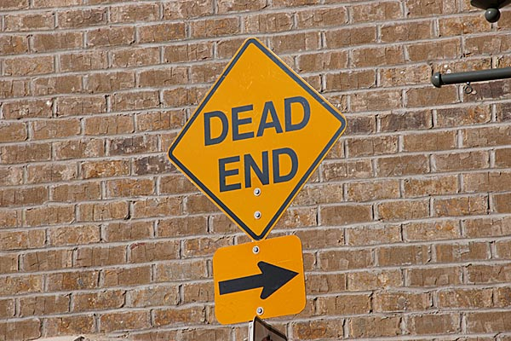

Slide 22
GOD CAN SEE A PATH WE DON’T KNOW ABOUT

Slide 23
SO HOW DO WE KNOW? HOW DO WE LET GOD GUIDE ME IN MY DECISIONS?
4. Trust God when you don’t understand
Prov 4:18 The path of the righteous is like the first gleam of dawn, shining ever brighter till the full light of day.

Slide 24
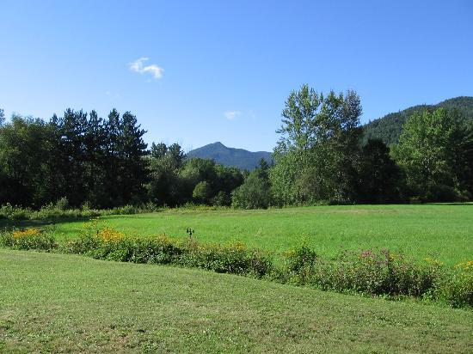
SO WHAT DO WE DO IN THE MEANTIME?

Slide 25
SO HOW DO WE KNOW? HOW DO WE LET GOD GUIDE ME IN MY DECISIONS?
4. Trust God when you don’t understand
Prov 3:5-6 Trust in the Lord with all your heart and lean not on your own understanding; 6 in all your ways acknowledge him, and he will make your paths straight.
WHAT DOES IT MEAN “DON’T LEAN ON YOUR OWN UNDERSTANDING”?
DON’T TRY TO FIGURE EVERYTHING OUT
WE ARE NOT GOING TO UNDERSTAND EVERYTHING THAT HAPPENS IN LIFE

Slide 26
SO HOW DO WE KNOW? HOW DO WE LET GOD GUIDE ME IN MY DECISIONS?
4. Trust God when you don’t understand
Ps 37:23 If the Lord delights in a man's way, he makes his steps firm; 24 though he stumble, he will not fall, for the Lord upholds him with his hand.
Ps 37:23 The steps of good men are directed by the Lord. He delights in each step they take.
GOD HAS A PLAN FOR YOUR LIFE—
THERE IS A PATH HE CREATED FOR YOU

Slide 27
SO HOW DO WE KNOW? HOW DO WE LET GOD GUIDE ME IN MY DECISIONS?
4. Trust God when you don’t understand
Ps 37:23 If the Lord delights in a man's way, he makes his steps firm; 24 though he stumble, he will not fall, for the Lord upholds him with his hand.
SO MUCH OF OUR STRESS IS UNNECESSARY
IT’S UNNEEDED
WE HAVE A GUIDE THAT SAYS WHEN WE STUMBLE IT’S OK

Slide 28
SO HOW DO WE KNOW? HOW DO WE LET GOD GUIDE ME IN MY DECISIONS?
4. Trust God when you don’t understand
Ps 37:23 If the Lord delights in a man's way, he makes his steps firm; 24 though he stumble, he will not fall, for the Lord upholds him with his hand.
WHAT PATH ARE YOU GOING TO FOLLOW?
WHAT WILL YOU USE AS A GUIDE FOR YOUR DECISIONS?

Slide 29
SO HOW DO WE KNOW? HOW DO WE LET GOD GUIDE ME IN MY DECISIONS?
4. Trust God when you don’t understand
Prov 4:18 The path of the righteous is like the first gleam of dawn, shining ever brighter till the full light of day.
THE PATH OF THE RIGHTEOUS
Not always the convenient path
Not always the easy path
Not always the popular path
Not always the path that will be the least risky

Slide 30
SO HOW DO WE KNOW? HOW DO WE LET GOD GUIDE ME IN MY DECISIONS?
4. Trust God when you don’t understand
SO WHY SHOULD I FOLLOW THE PATH OF RIGHTEOUSNESS?
Prov 12:28 In the way of righteousness there is life; along that path is immortality.
Good life here- eternal life in heaven
IF YOU GO GOD’S WAY
IF YOU GO YOUR WAY
Death

Slide 31
SO HOW DO WE KNOW? HOW DO WE LET GOD GUIDE ME IN MY DECISIONS?
Admit I need a guide
Ask in faith for direction
Listen for God’s response
Trust God when I don’t understand
THE GREATEST DECISION YOU CAN EVER MAKE IS TO FOLLOW JESUS

