Slide 1
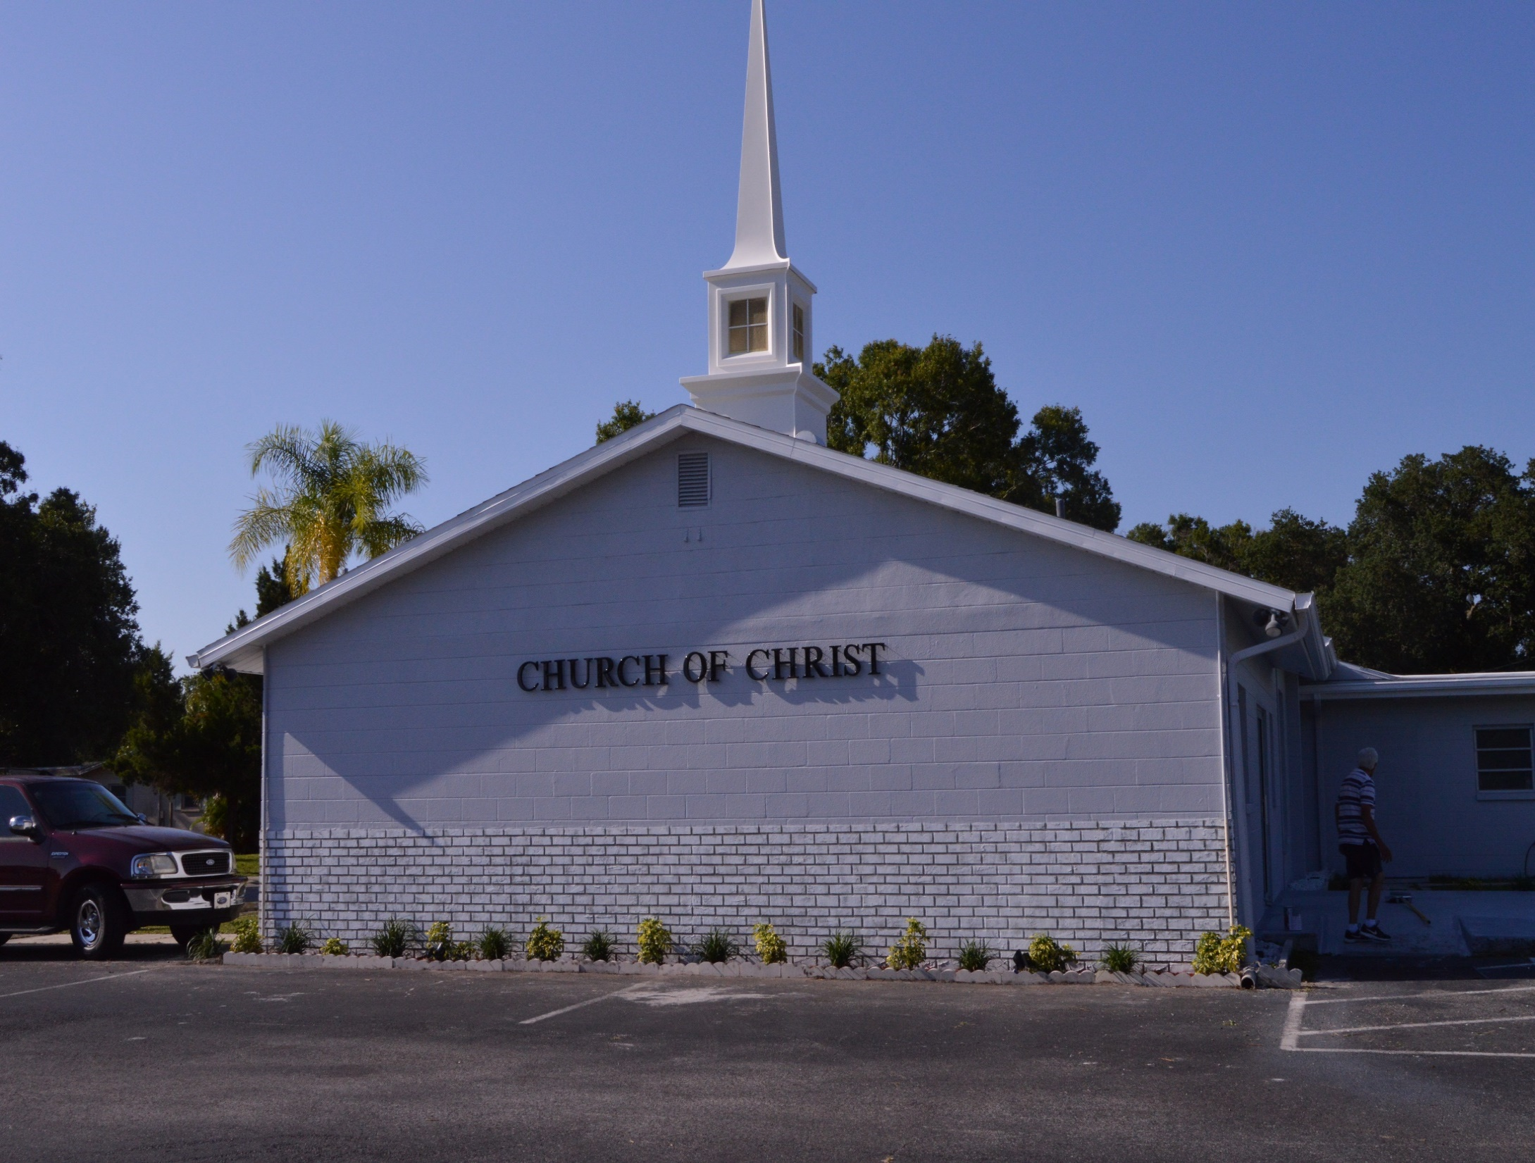
WELCOME TO SKYVIEW

Slide 2
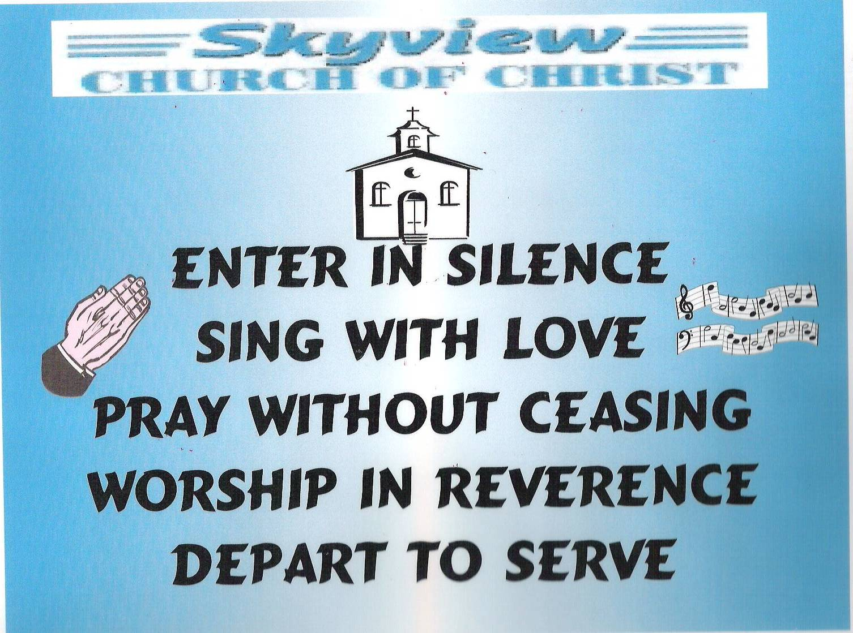
DESIGNED BY JIM INGRAM

Slide 3
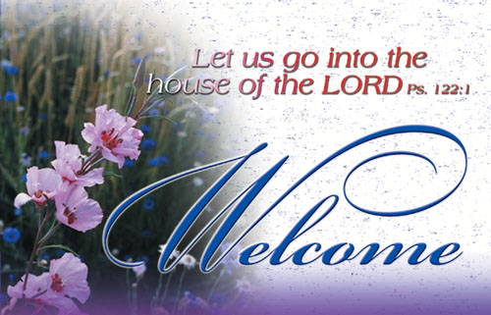

Slide 4
TODAY’S WORSHIP LEADERS
CALL TO WORSHIP
PRAYER
SONG LEADER
SCRIPTURE
HEADING TABLE
SERMON
CLOSING PRAYER
ANNOUNCEMENTS
Joe Dryer
Brad VanHaerents
Sander Fletcher
Harry Cowan
David Hammontree
Charles Murray
Pat Skidmore
Calvin McCoy

Slide 5

MONDAY NIGHT BIBLE STUDY 6:30PM
WEDNESDAY BIBLE STUDY will meet in the West Annex until further notice
LADIES BIBLE CLASS W.I.N.G.S (Women In God’s Service) Thursday 10:00 AM

Slide 6

FIVE MINUTE RULE

Slide 7


Slide 8
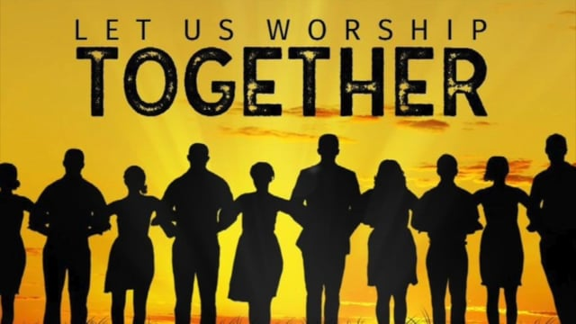

Slide 10
THE GOD ON THE MOUNTAIN
Not in our books

Slide 11
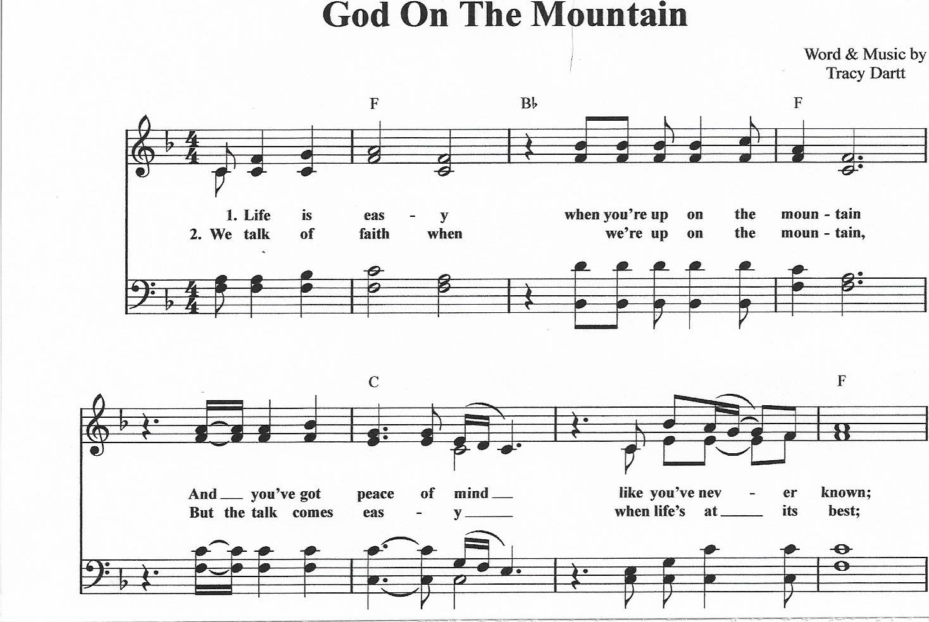

Slide 12
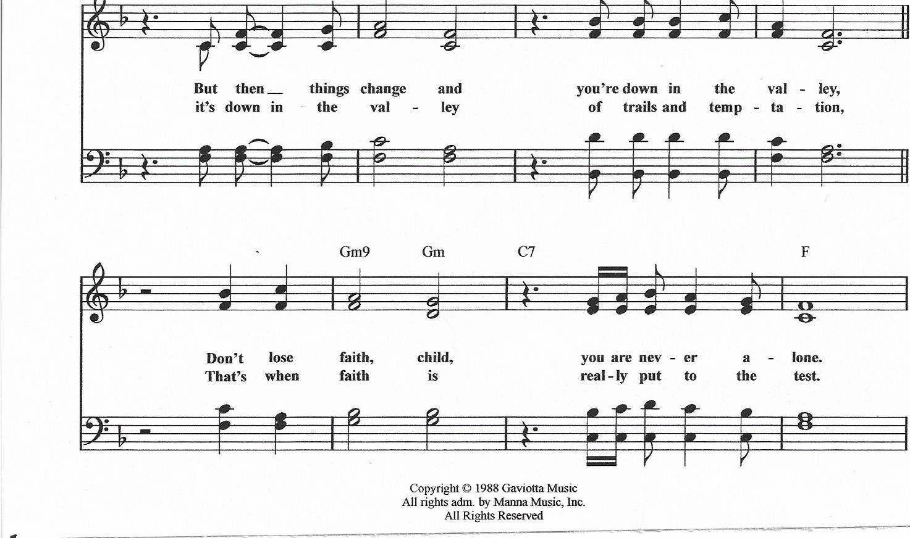

Slide 13
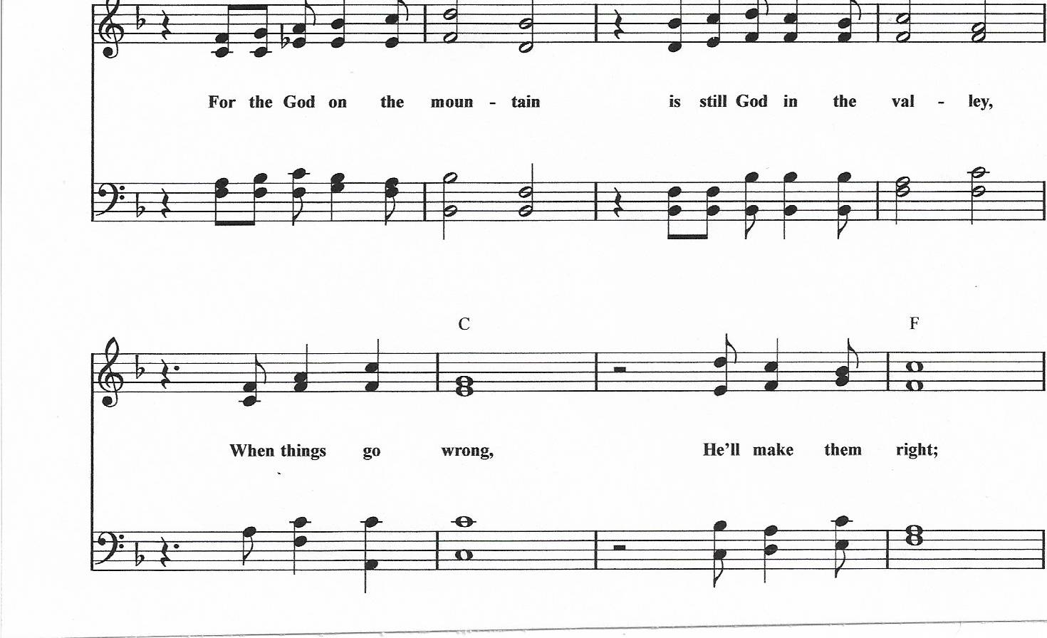
CHORUS

Slide 14
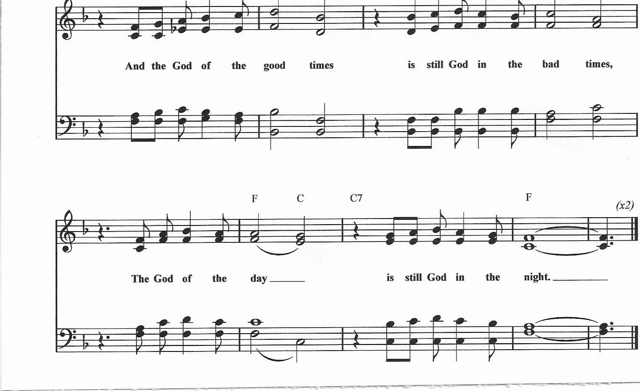

Slide 17
CHORUS

Slide 19
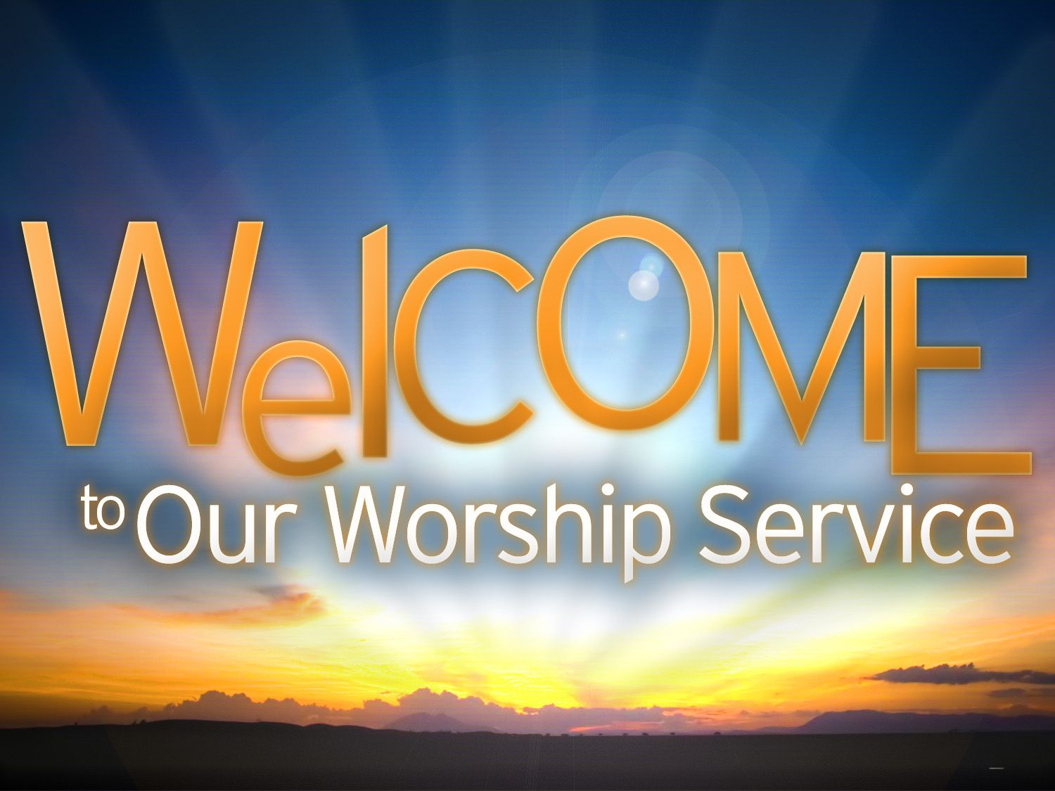

Slide 20
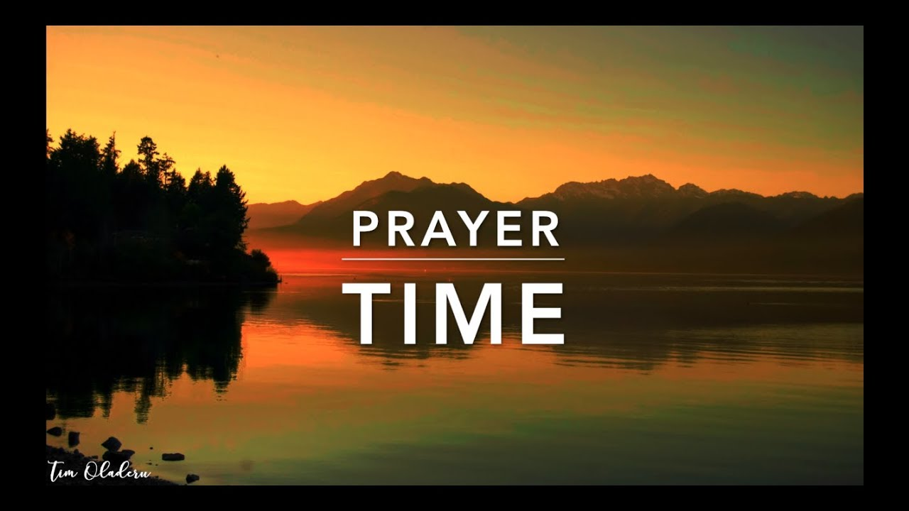
PRAYER
Jerry Mellish
LED BY BRAD VANHAERENTS

Slide 22
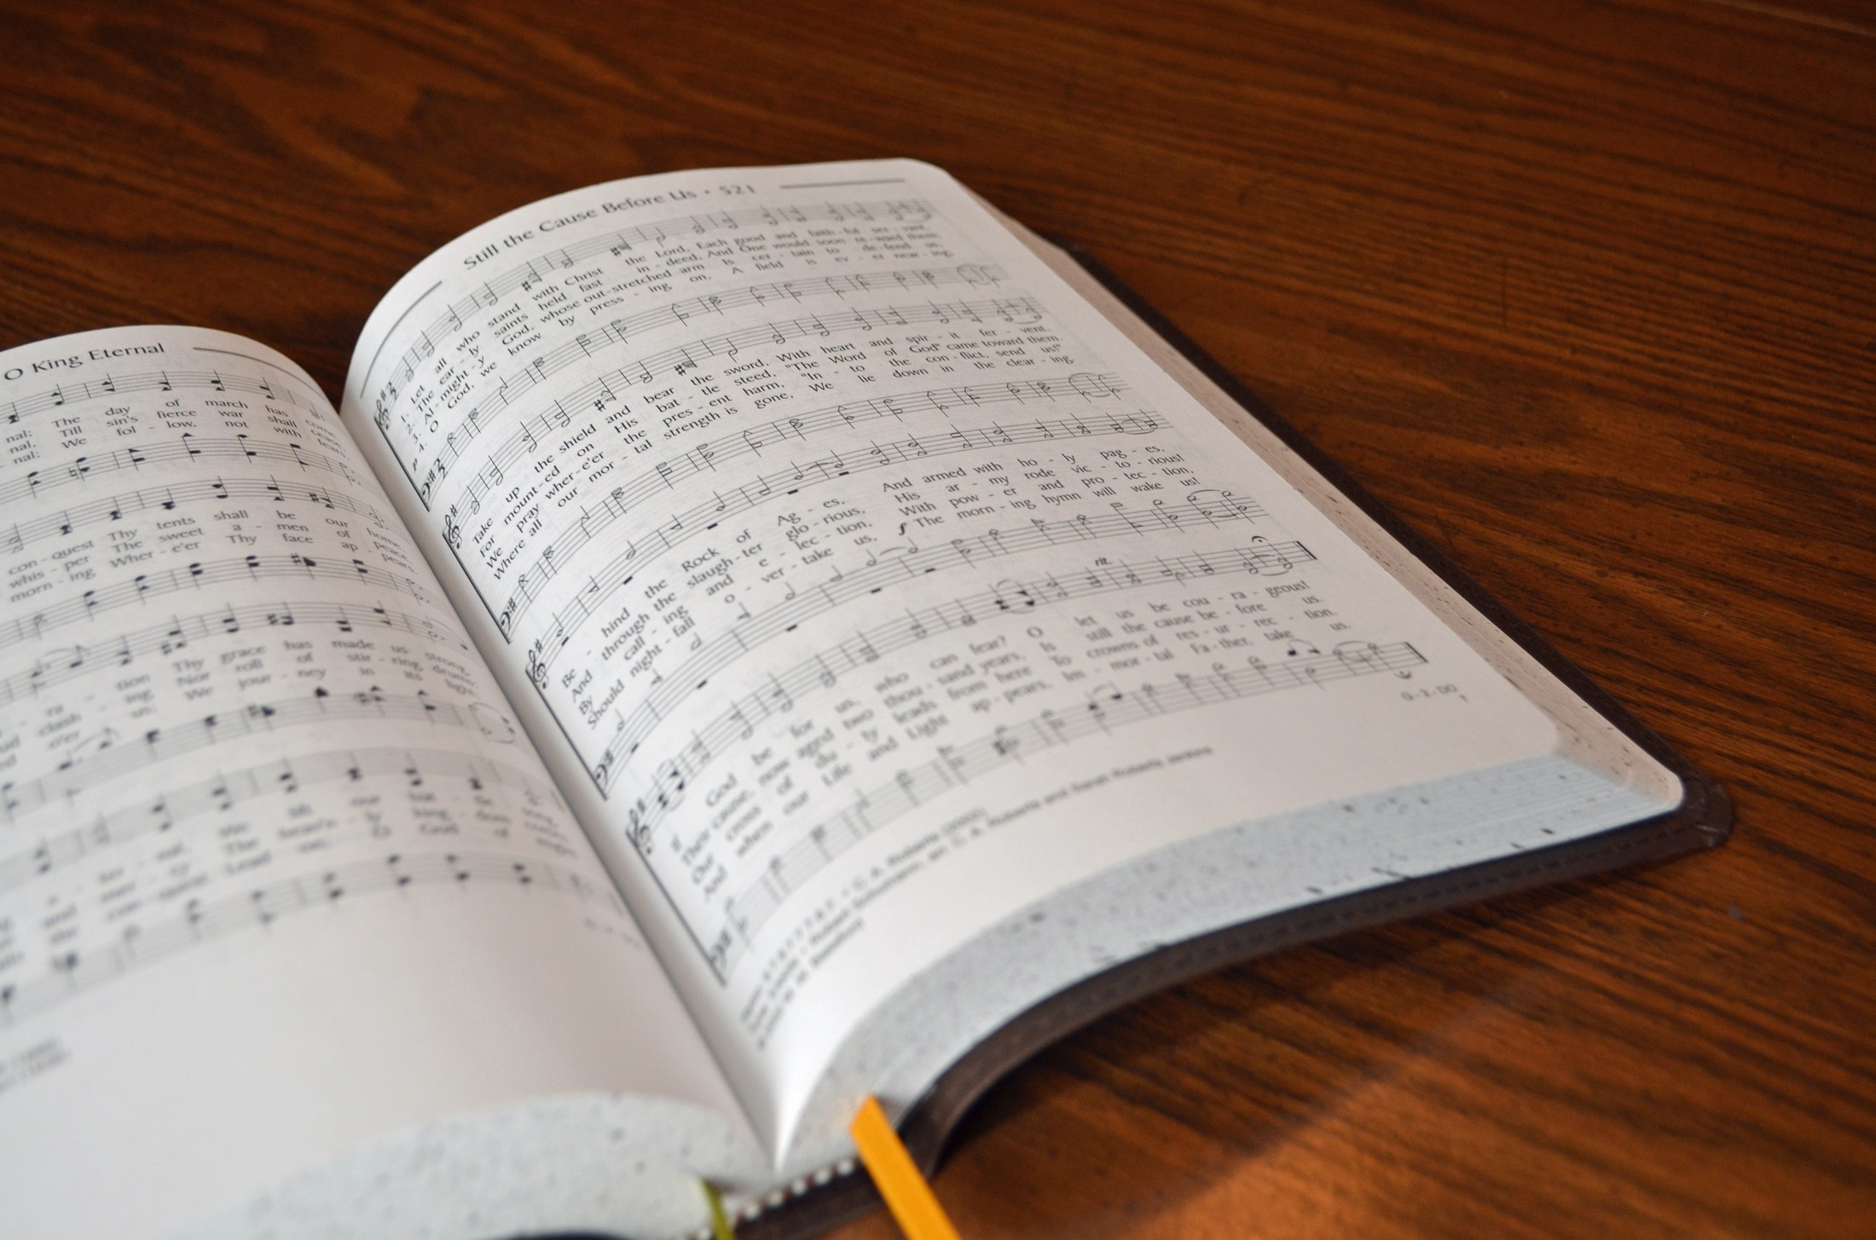
SONG LEADER
SANDER FLETCHER

Slide 23
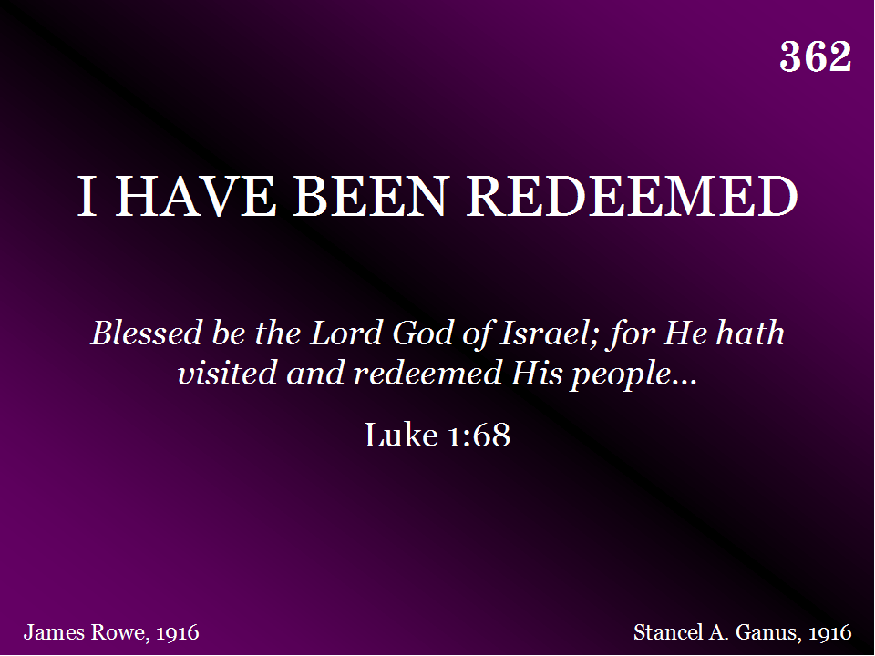
362 - I Have Been Redeemed - Title

Slide 24
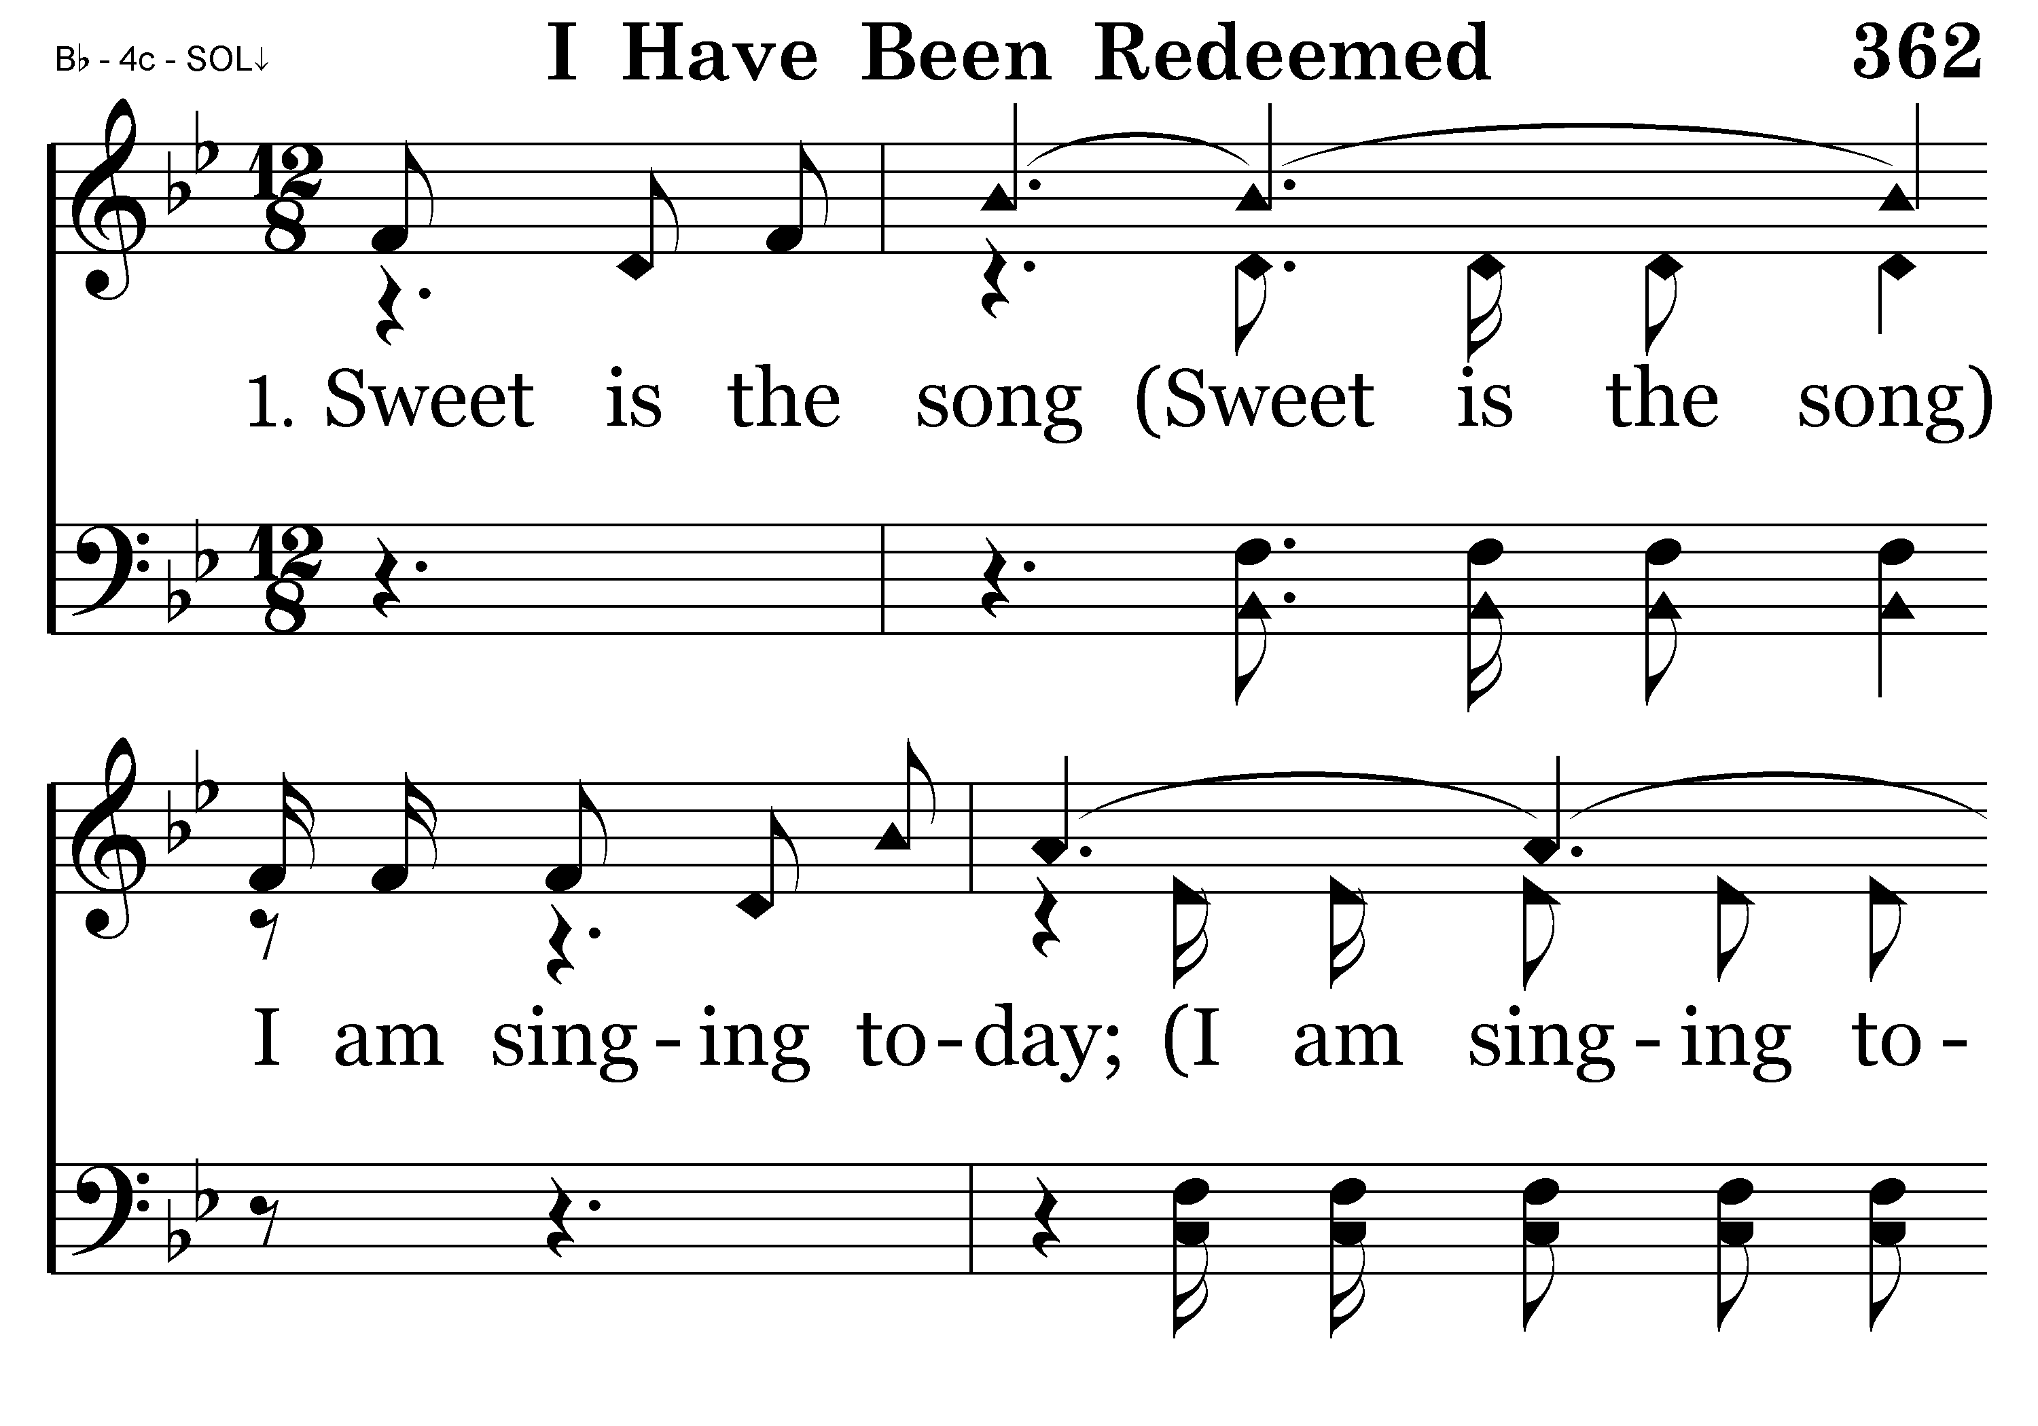
362 - I Have Been Redeemed - 1.1

Slide 25
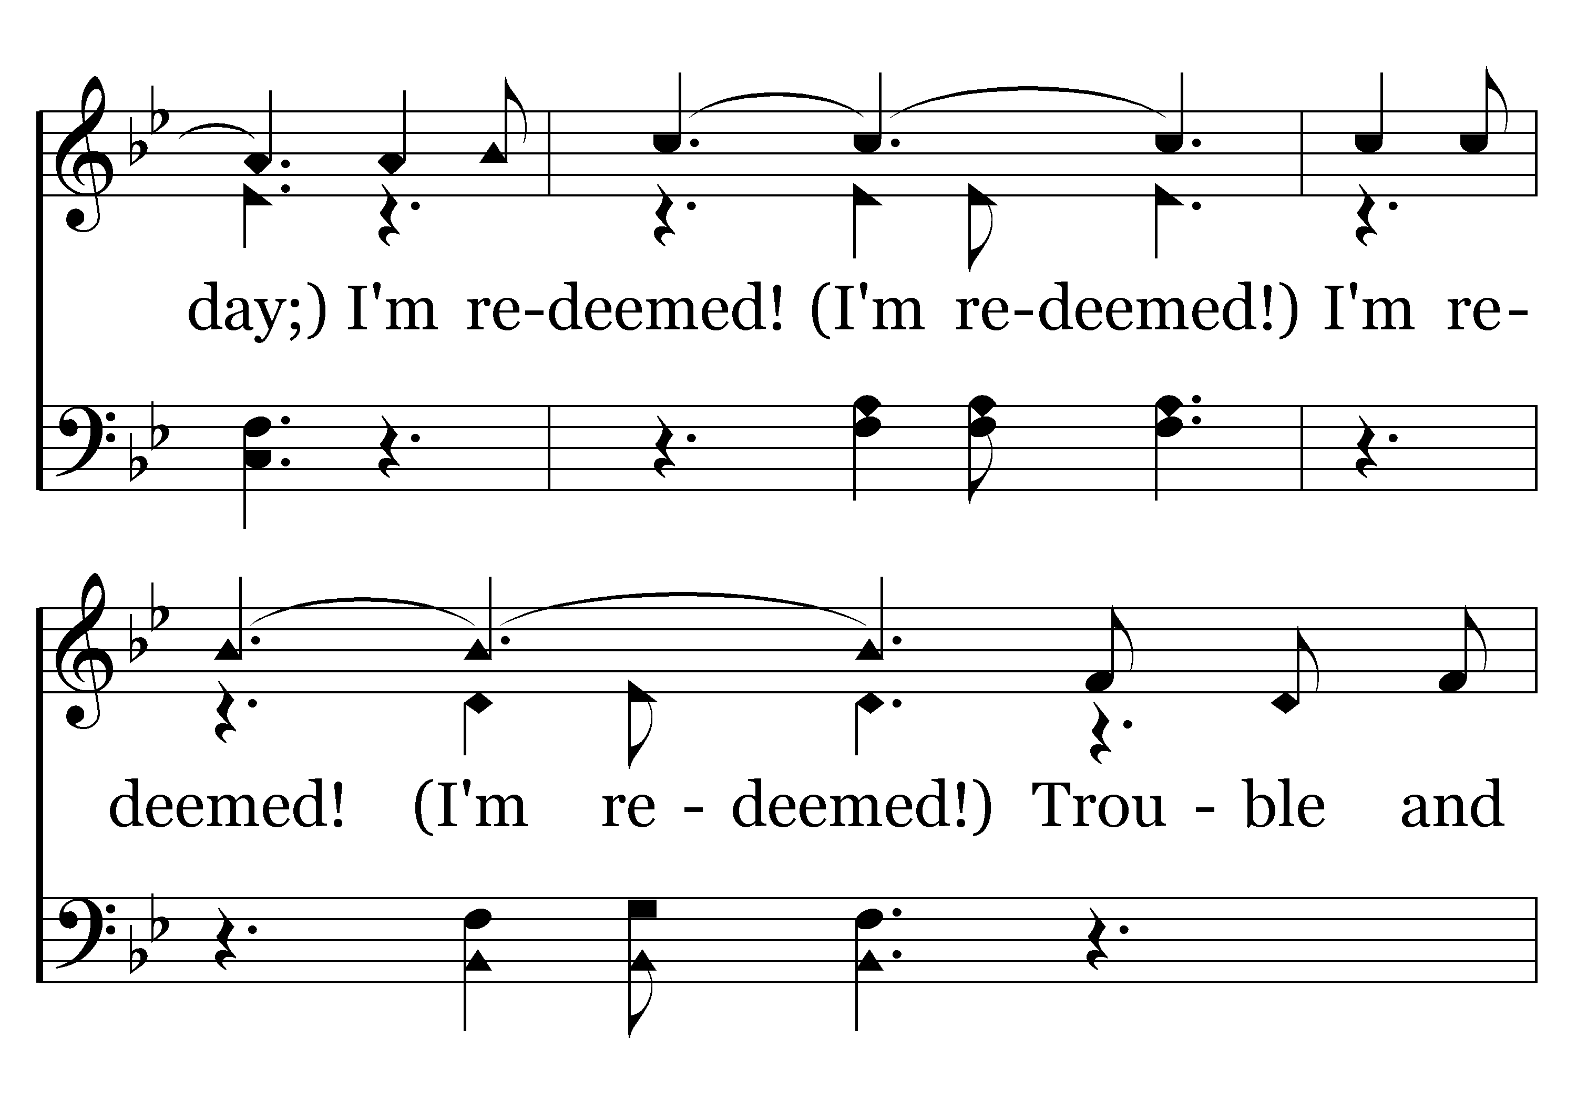
362 - I Have Been Redeemed - 1.2

Slide 26
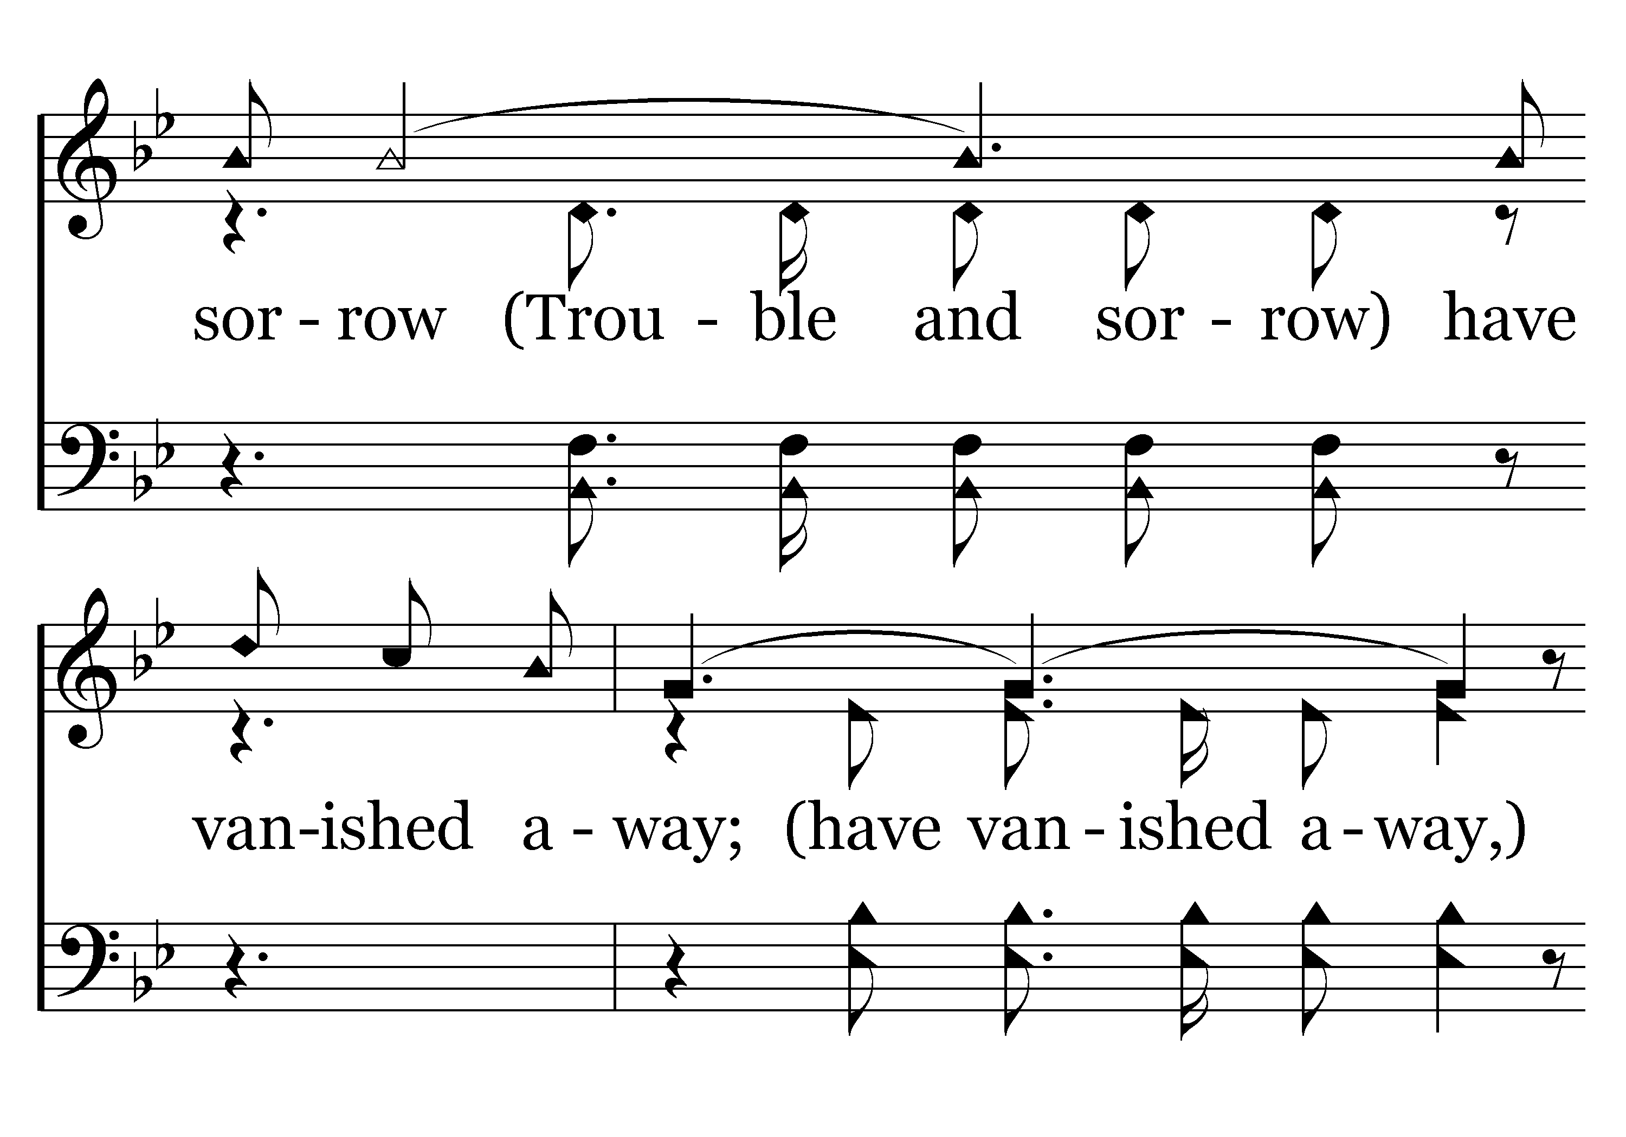
362 - I Have Been Redeemed - 1.3

Slide 27
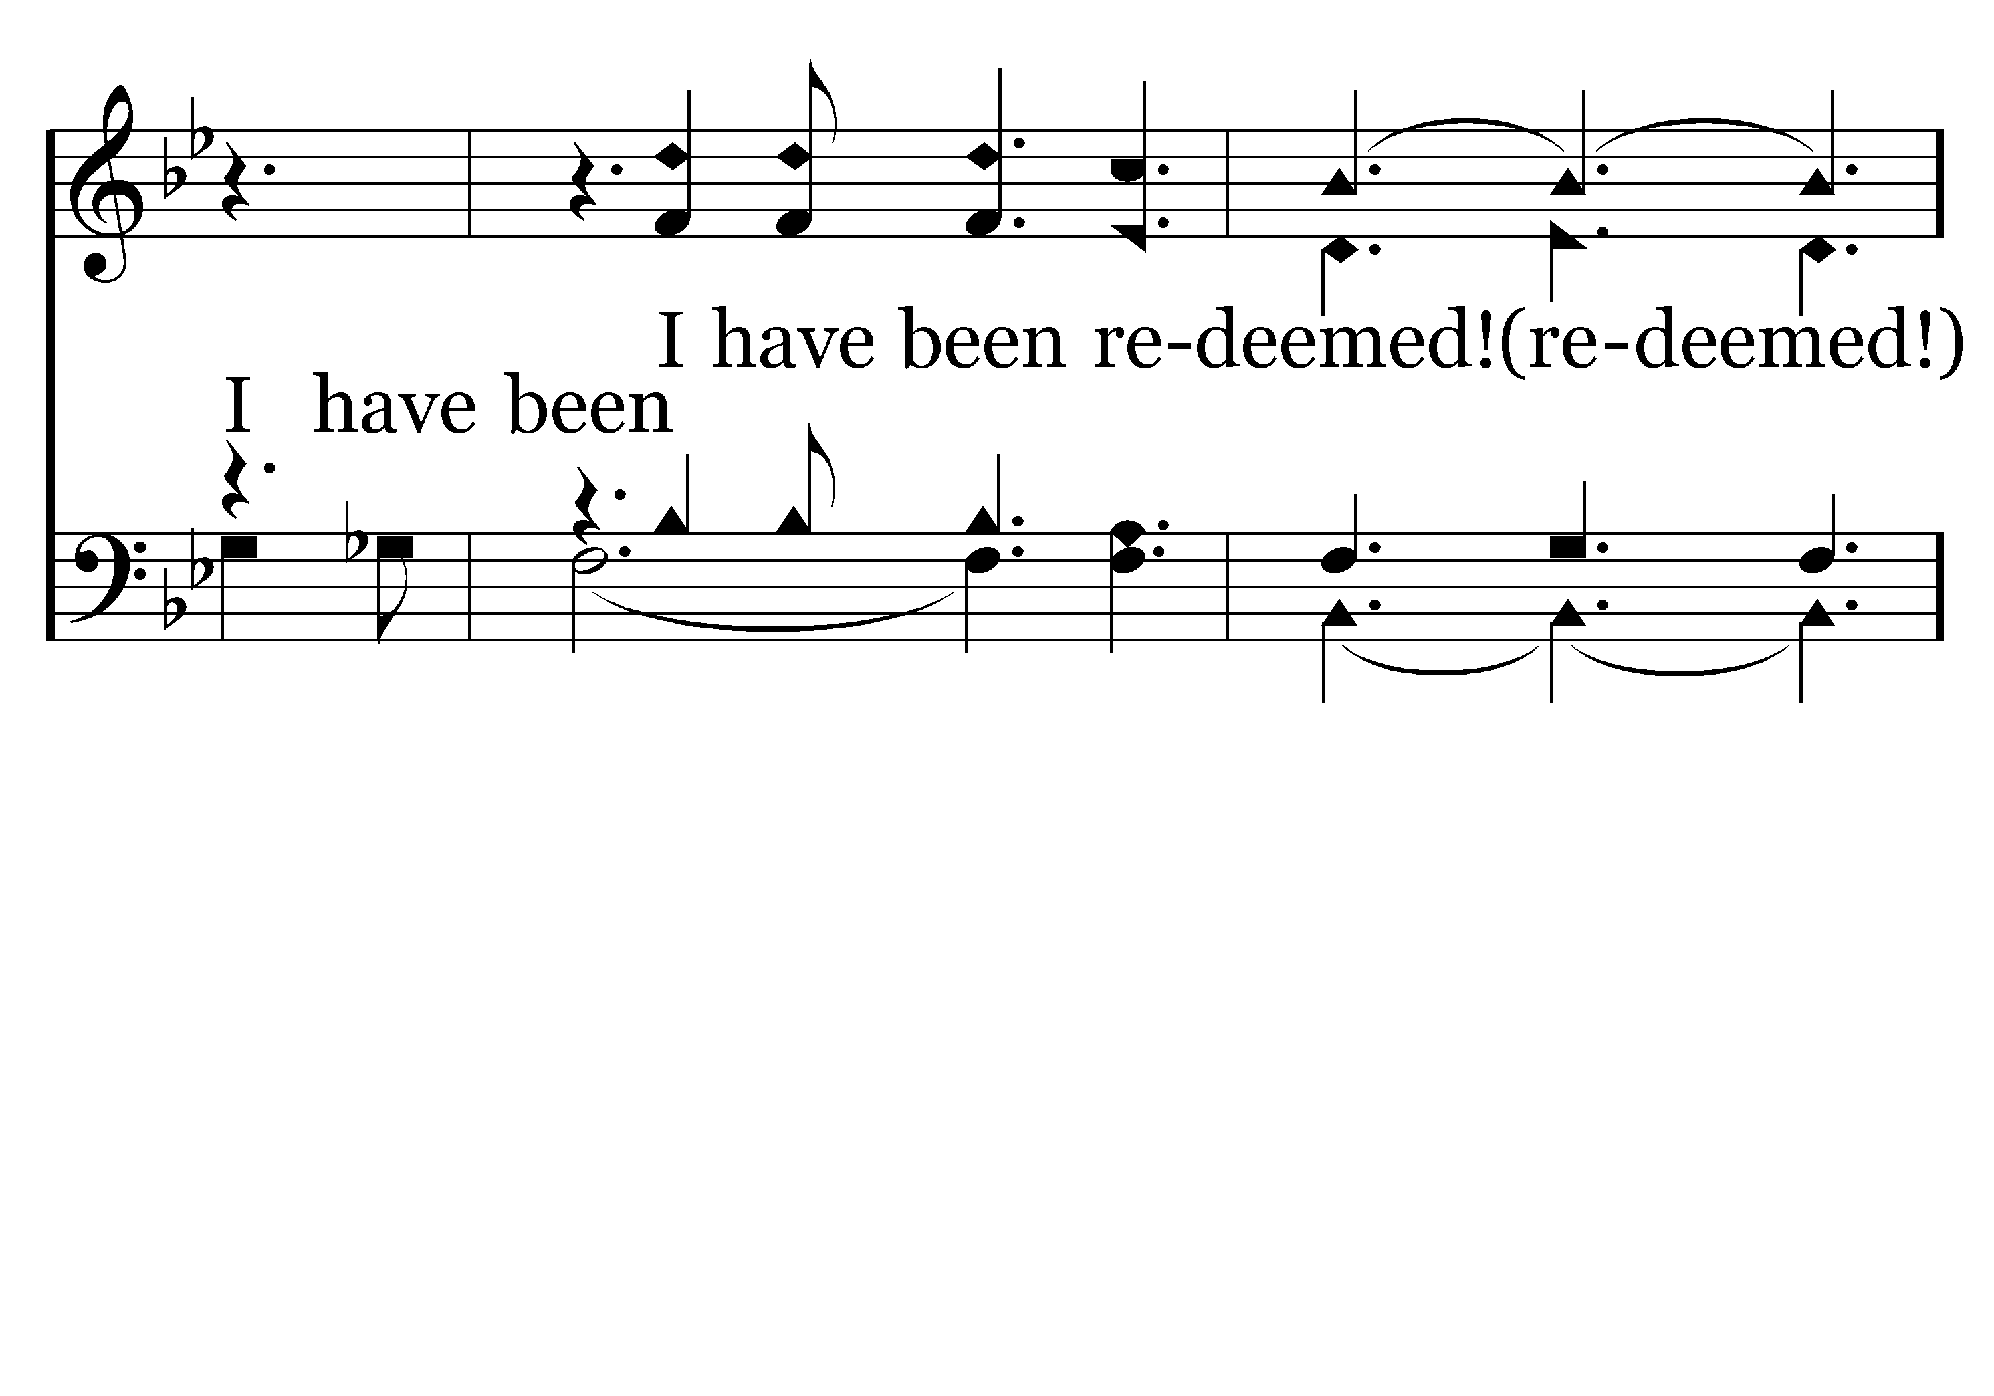
362 - I Have Been Redeemed - 1.4

Slide 28
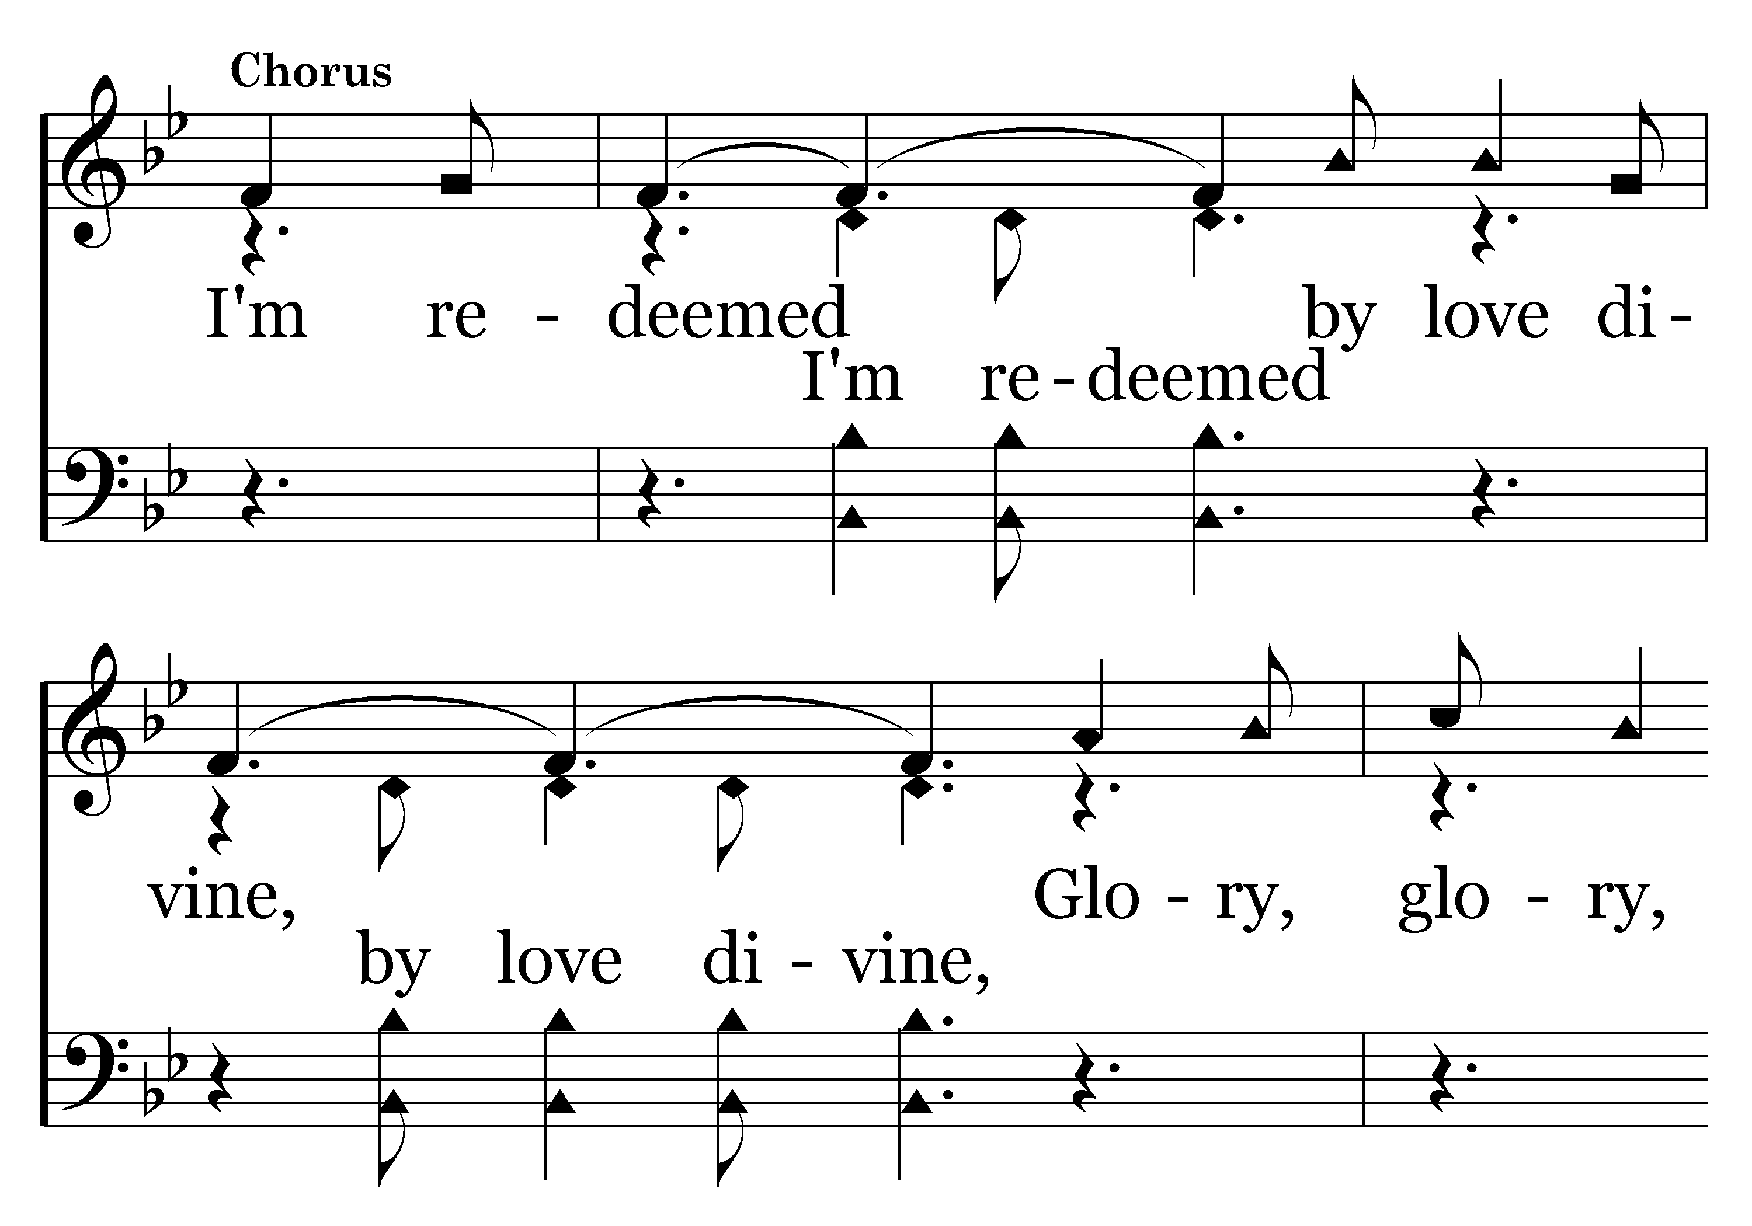
362 - I Have Been Redeemed - C.1

Slide 29
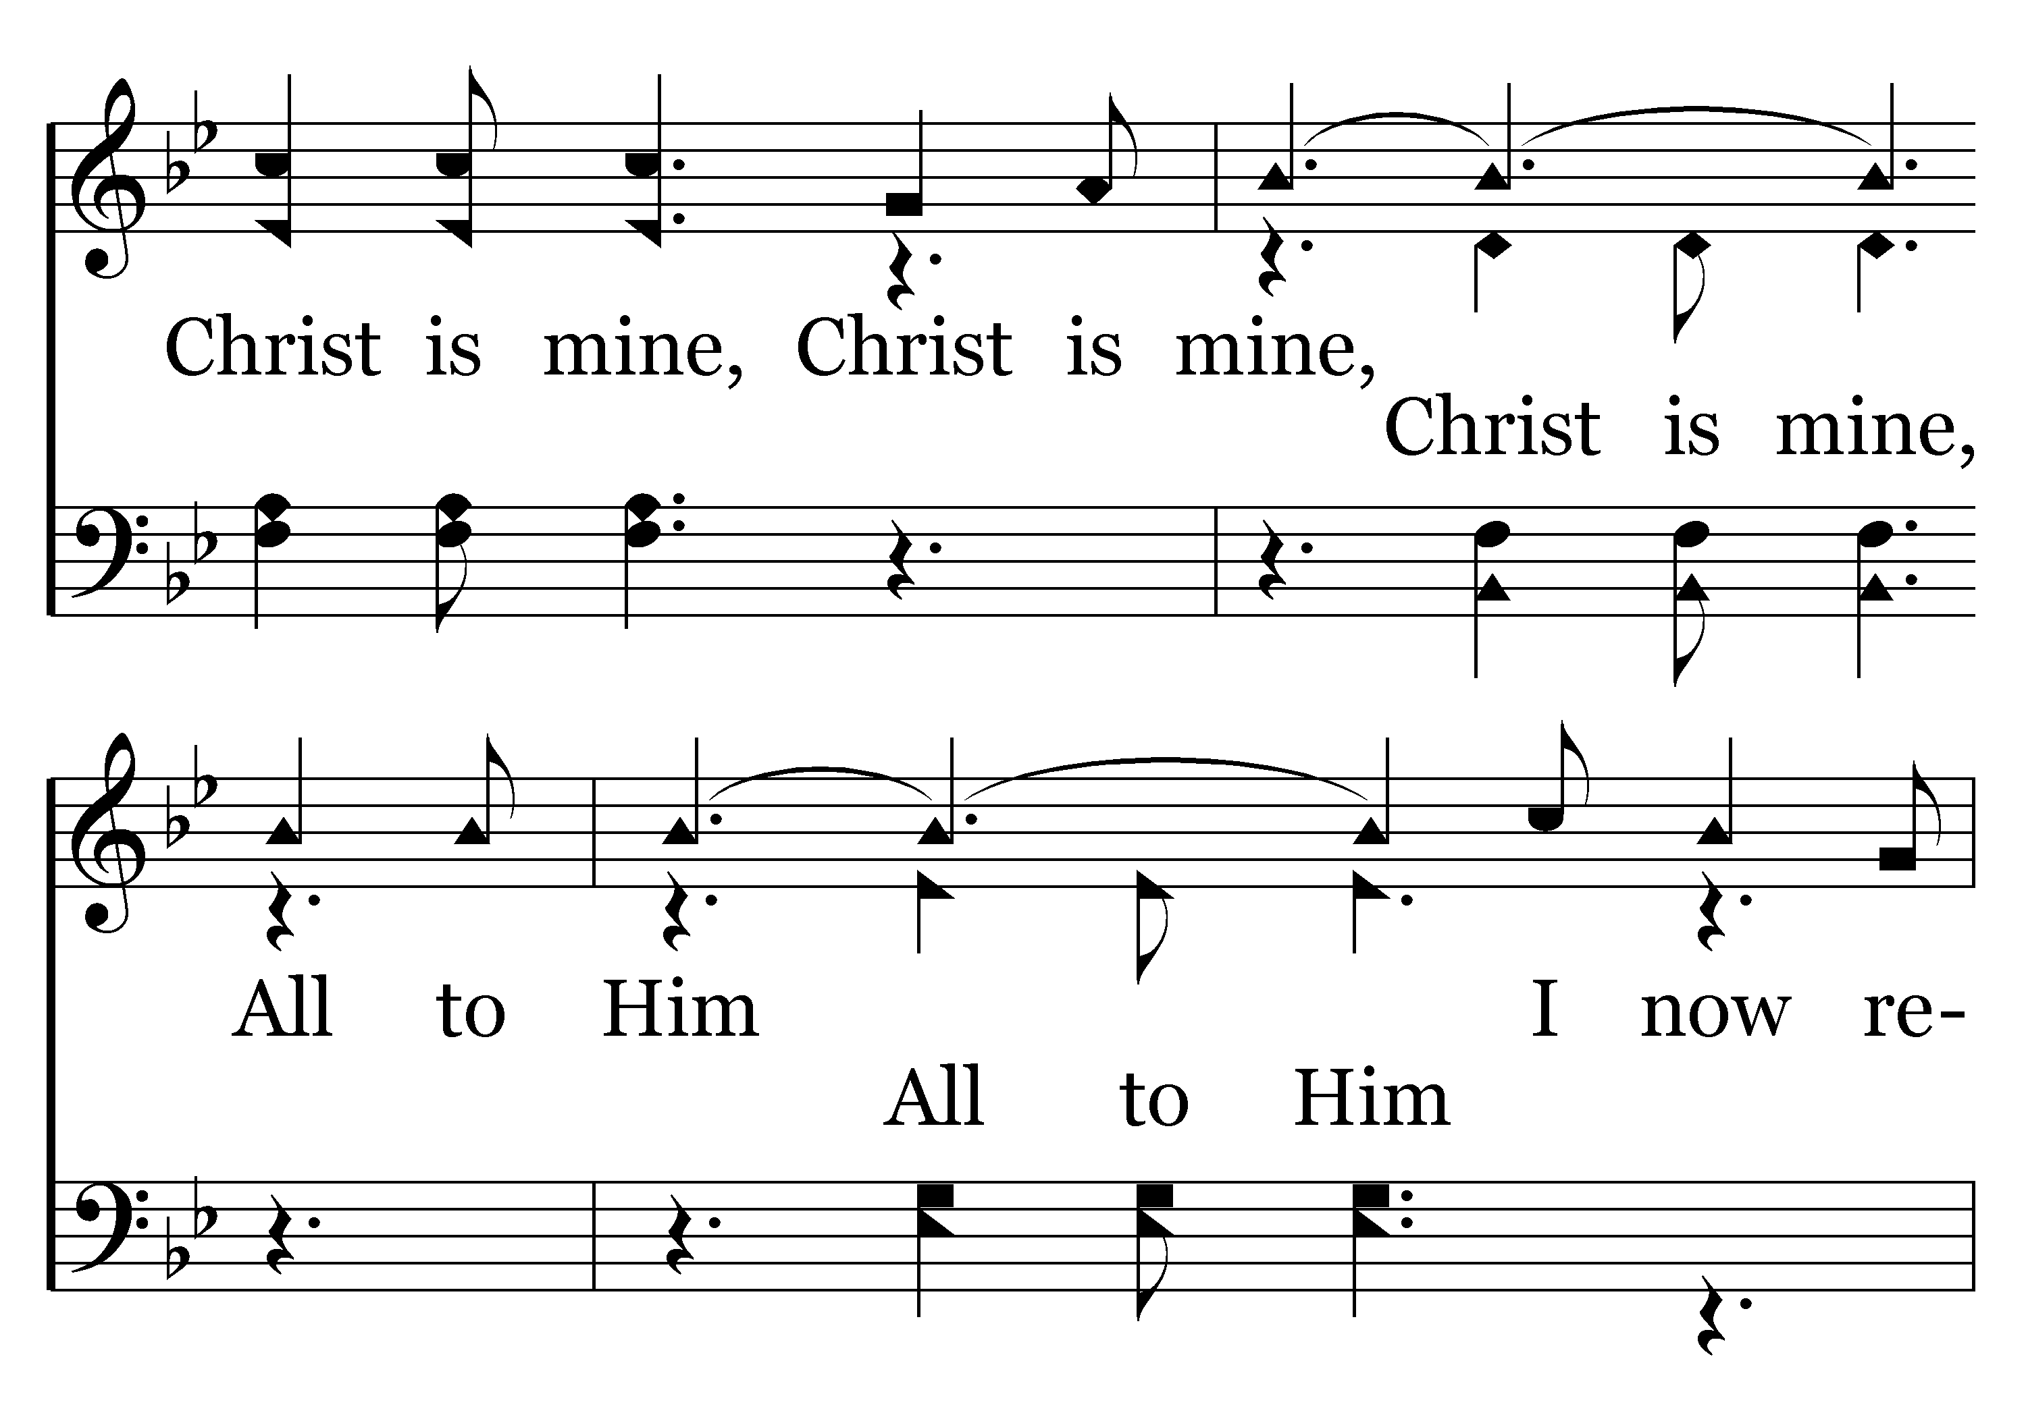
362 - I Have Been Redeemed - C.2

Slide 30
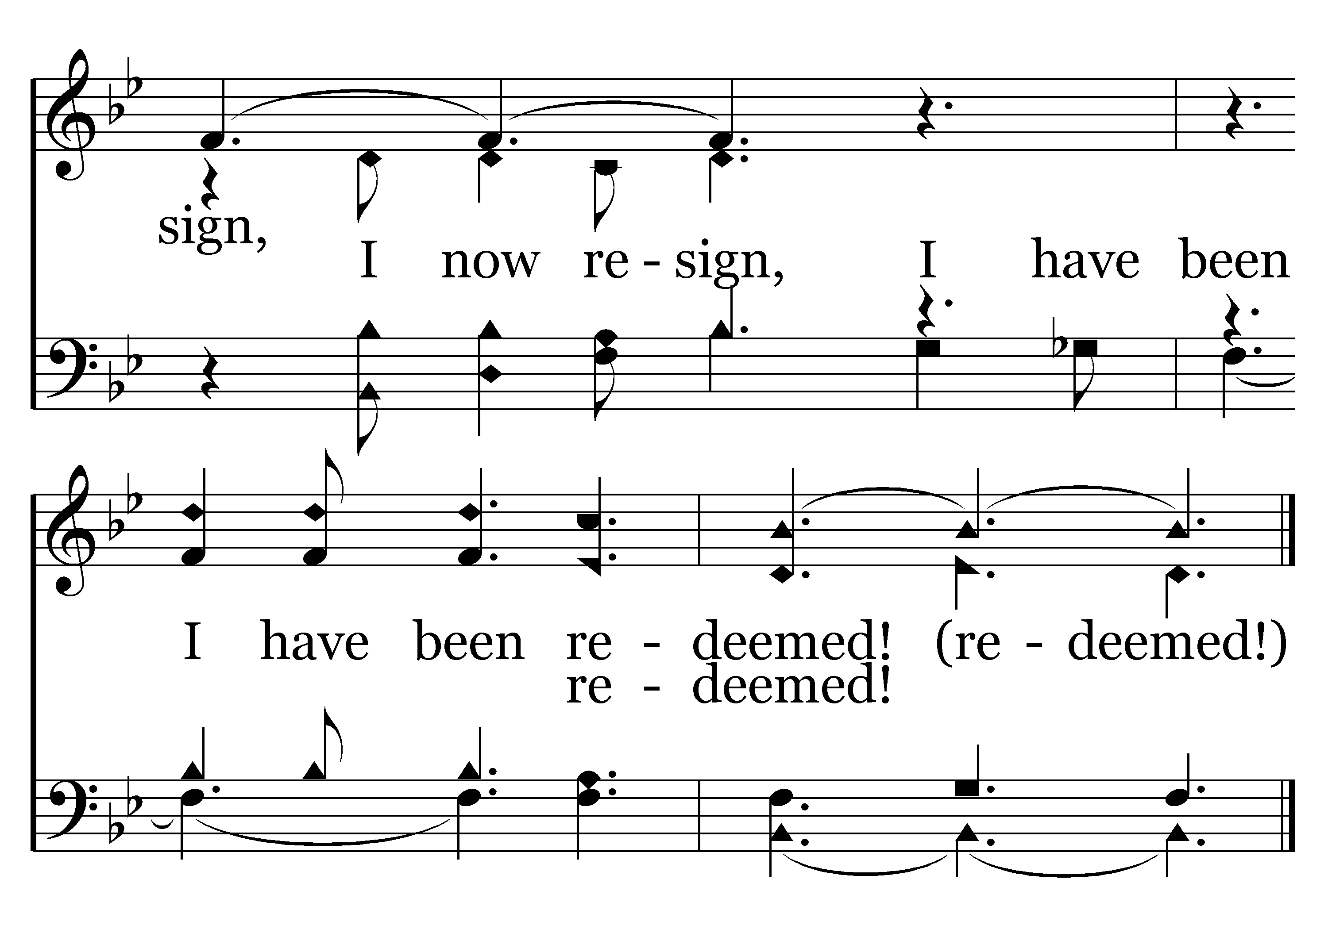
362 - I Have Been Redeemed - C.3
End of Verse 1

Slide 31
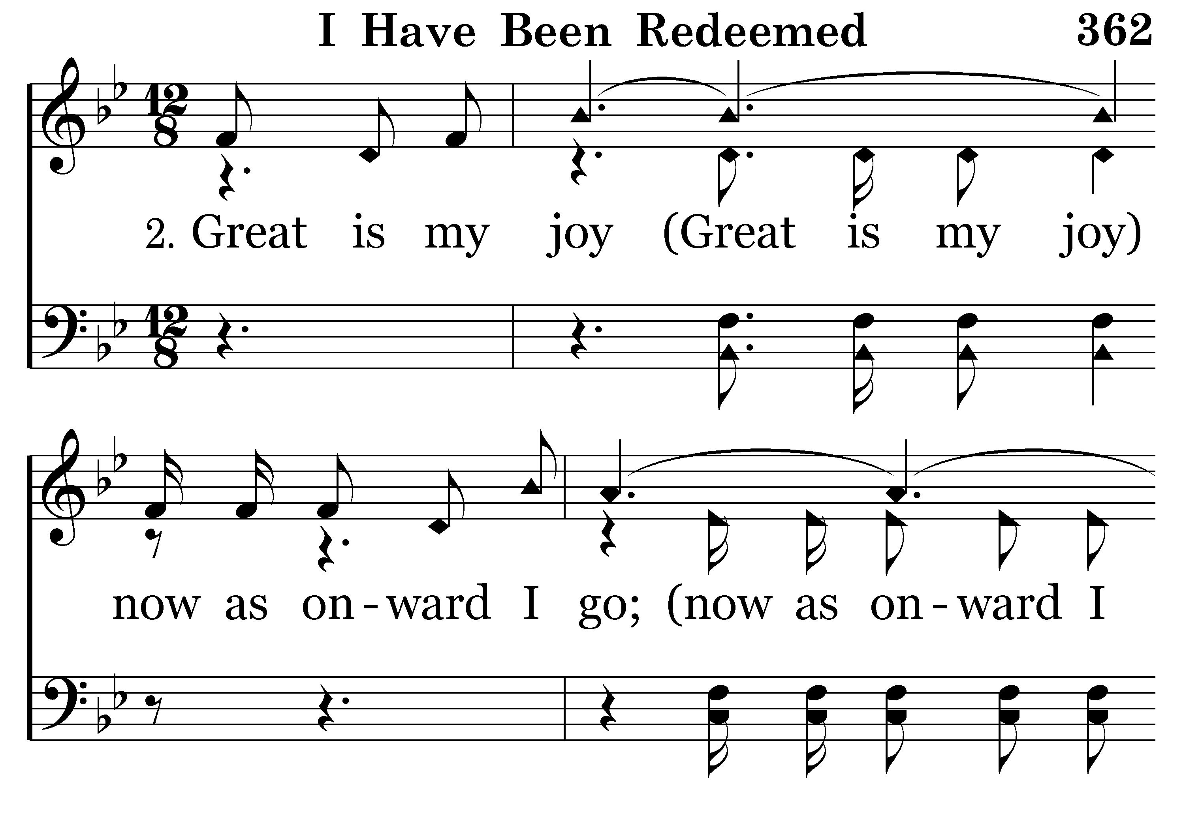
362 - I Have Been Redeemed - 2.1

Slide 32
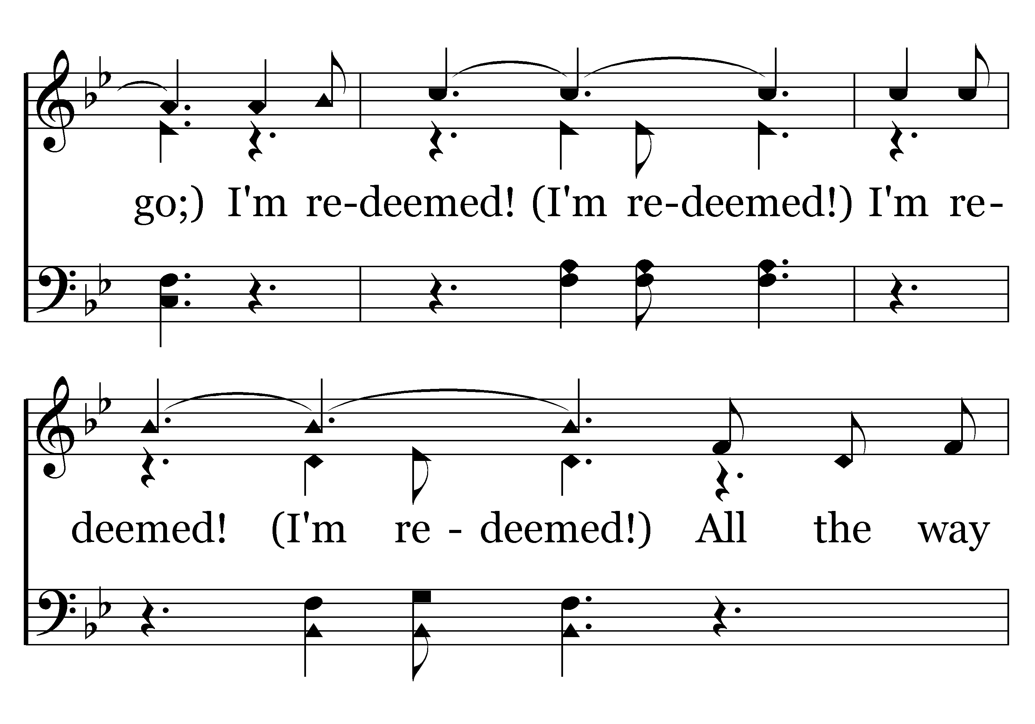
362 - I Have Been Redeemed - 2.2

Slide 33
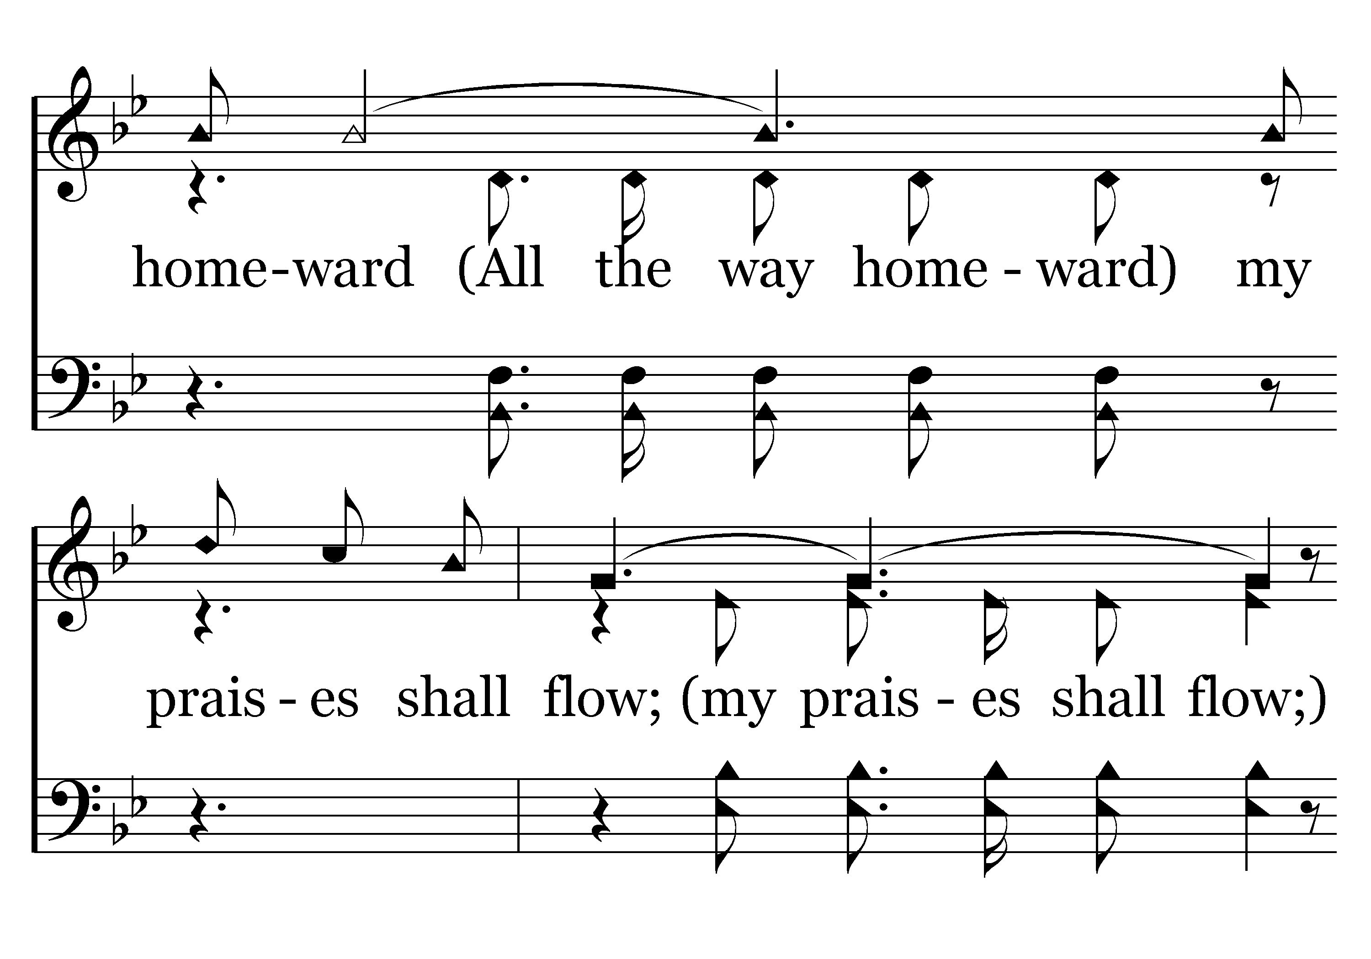
362 - I Have Been Redeemed - 2.3

Slide 34
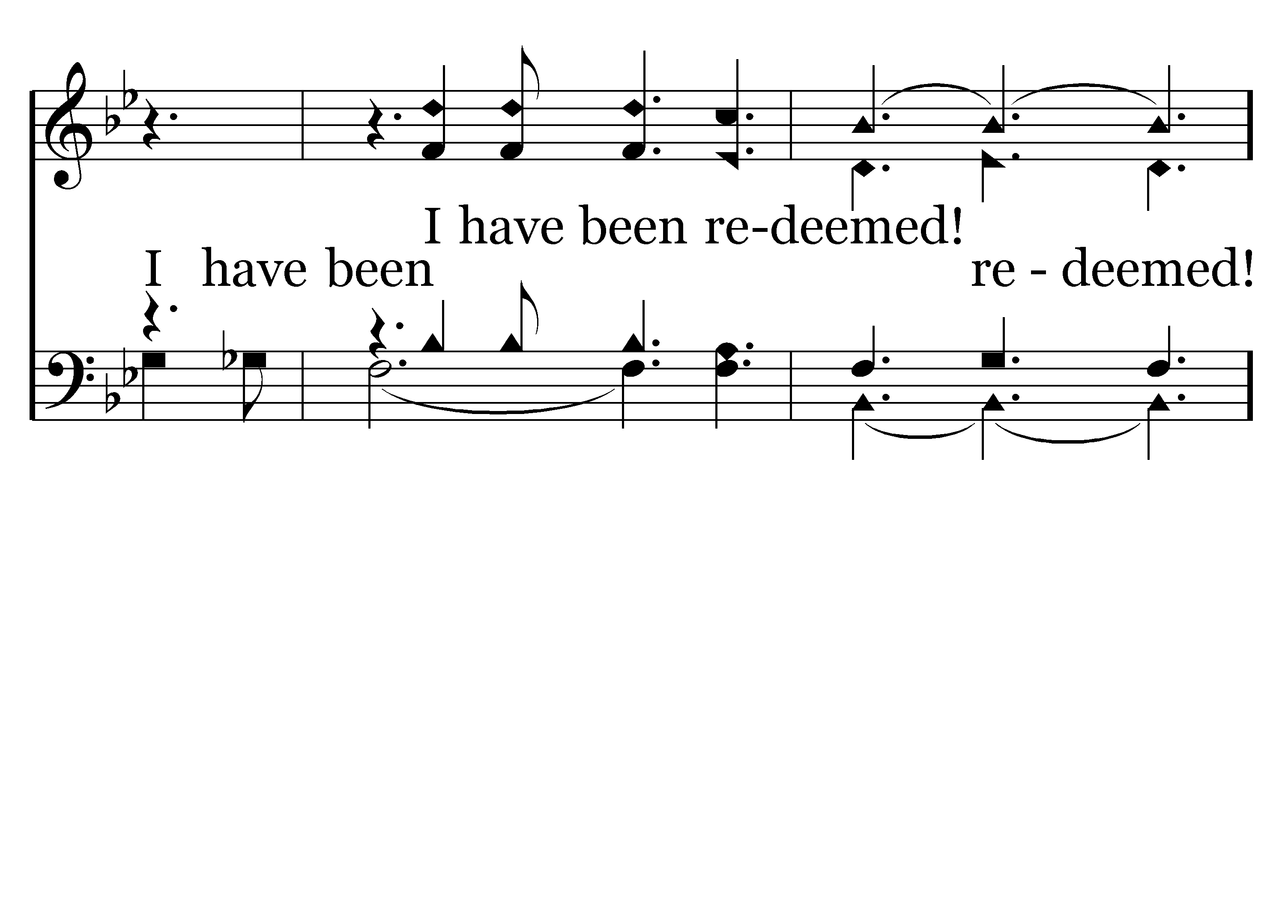
362 - I Have Been Redeemed - 2.4

Slide 35
362 - I Have Been Redeemed - C.1

Slide 36
362 - I Have Been Redeemed - C.2

Slide 37
362 - I Have Been Redeemed - C.3
End of Verse 2

Slide 38
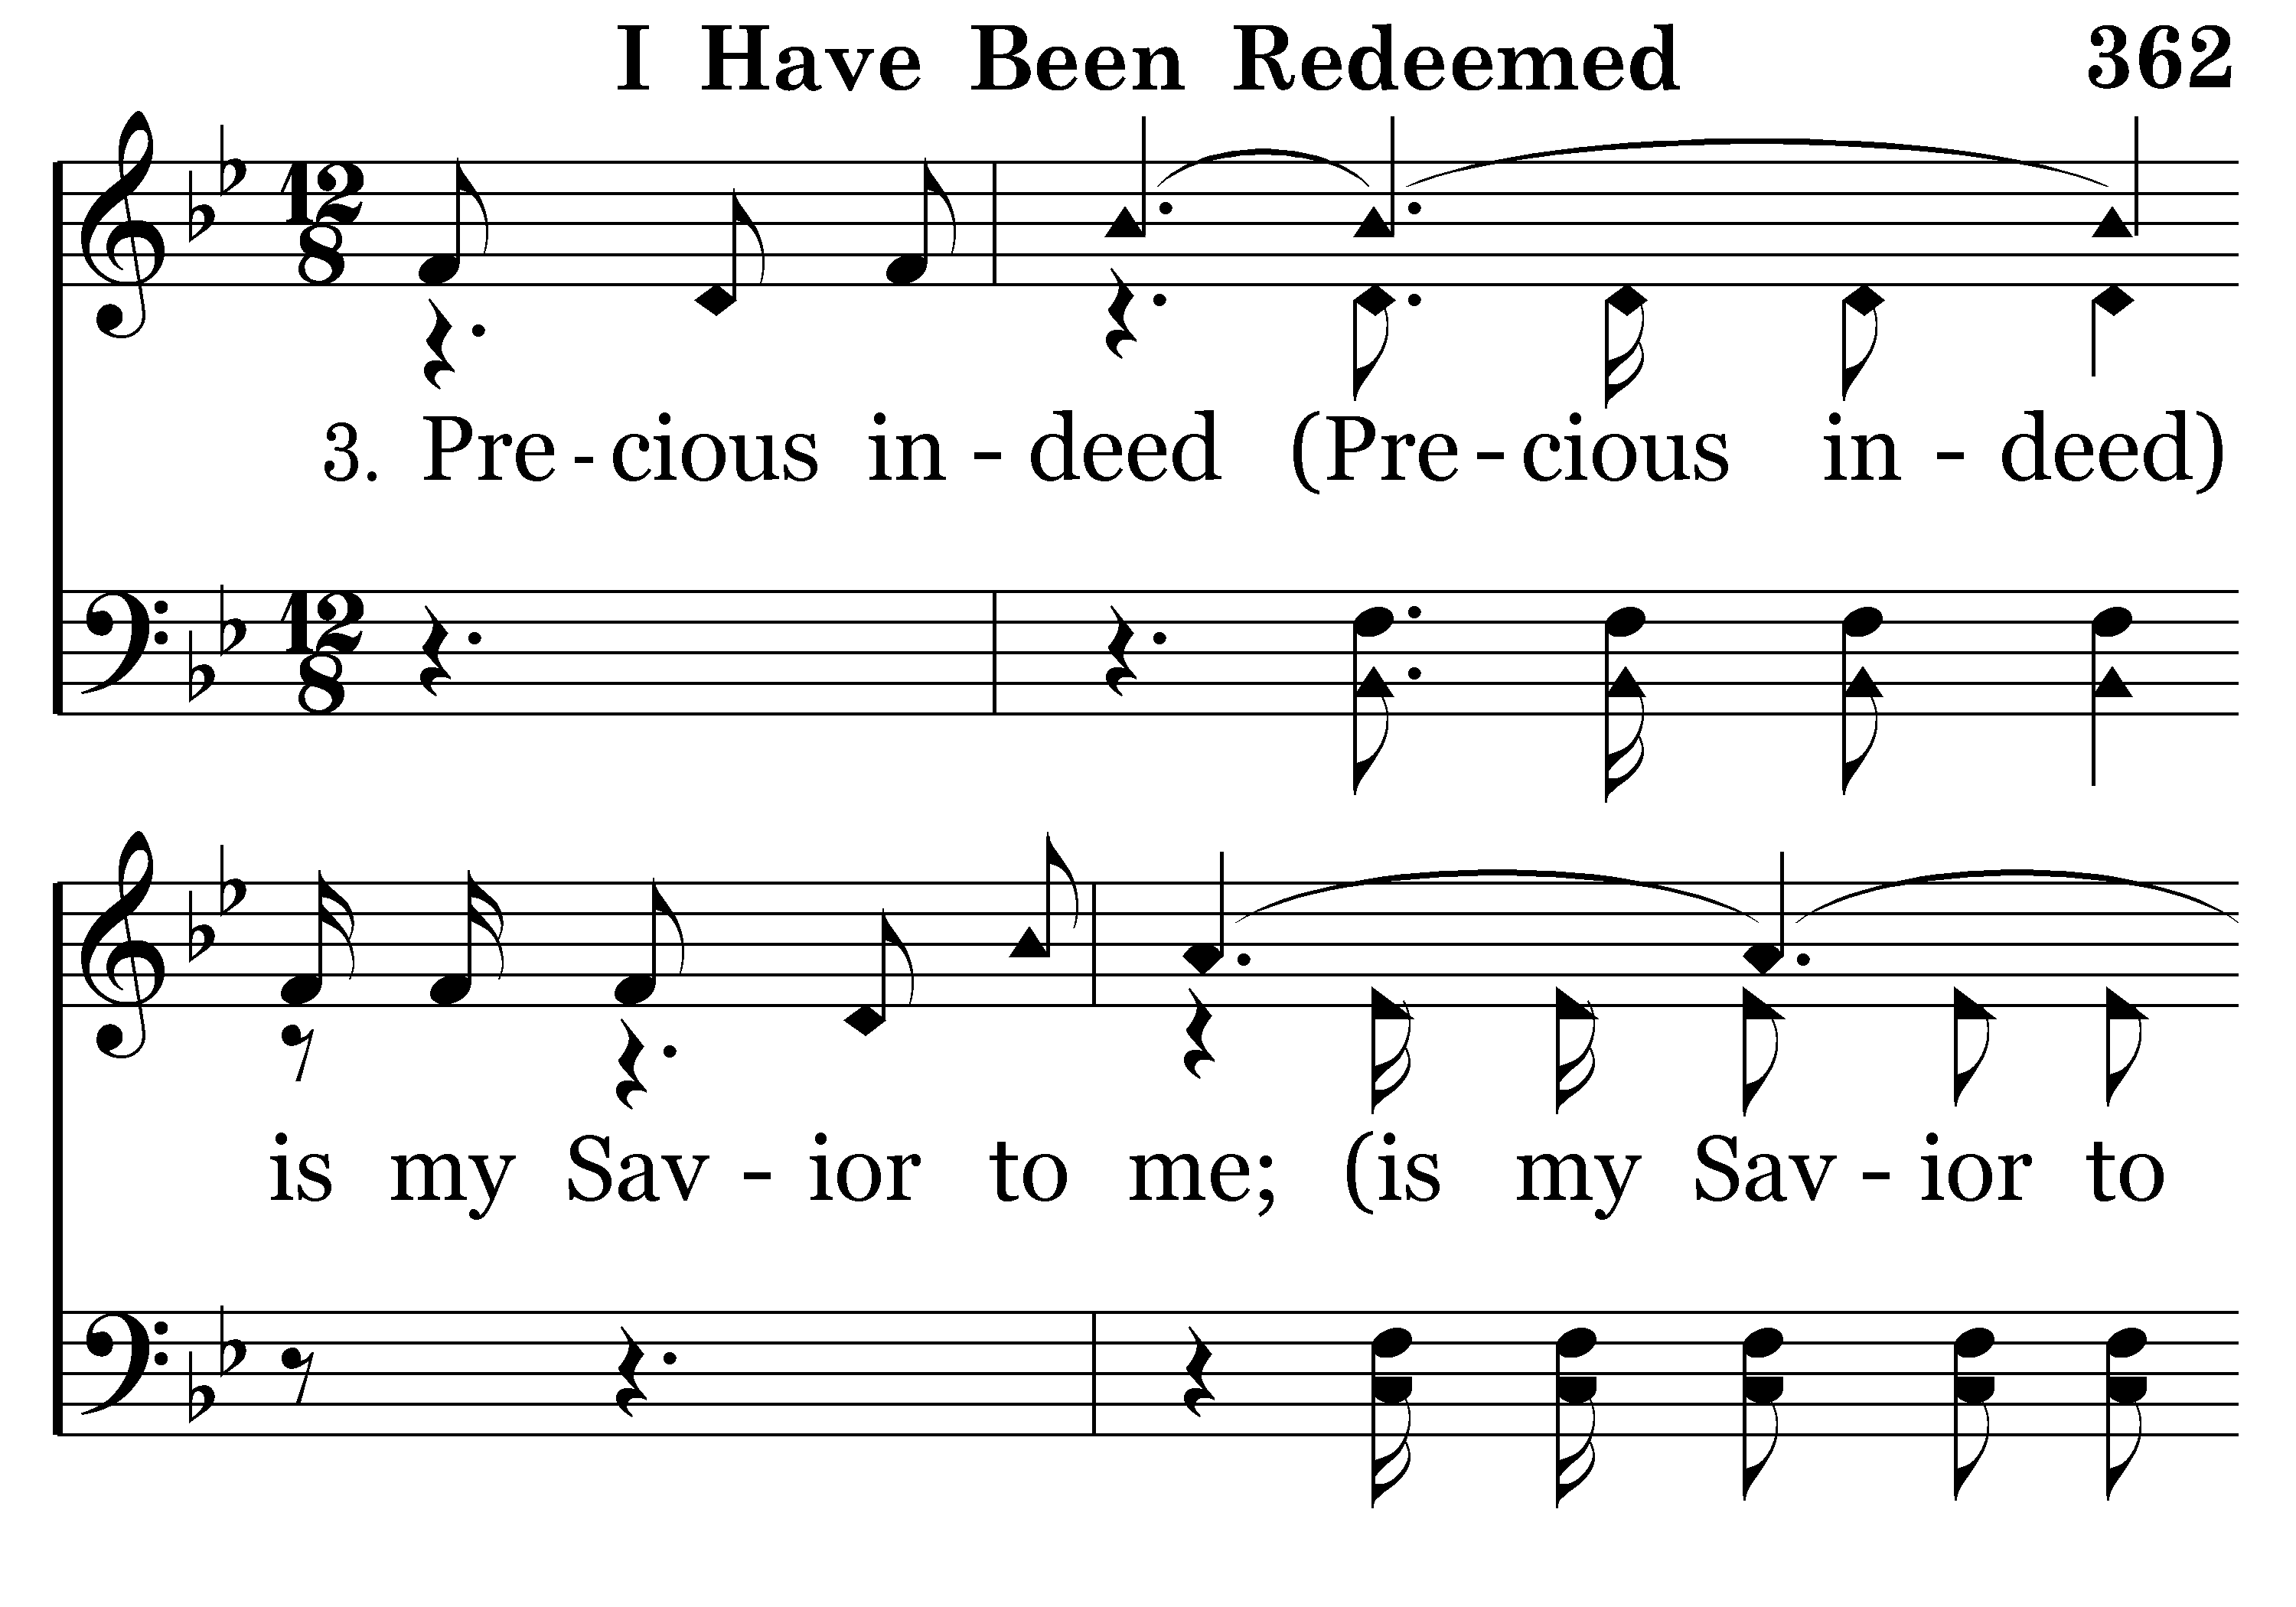
362 - I Have Been Redeemed - 3.1

Slide 39

362 - I Have Been Redeemed - 3.2

Slide 40
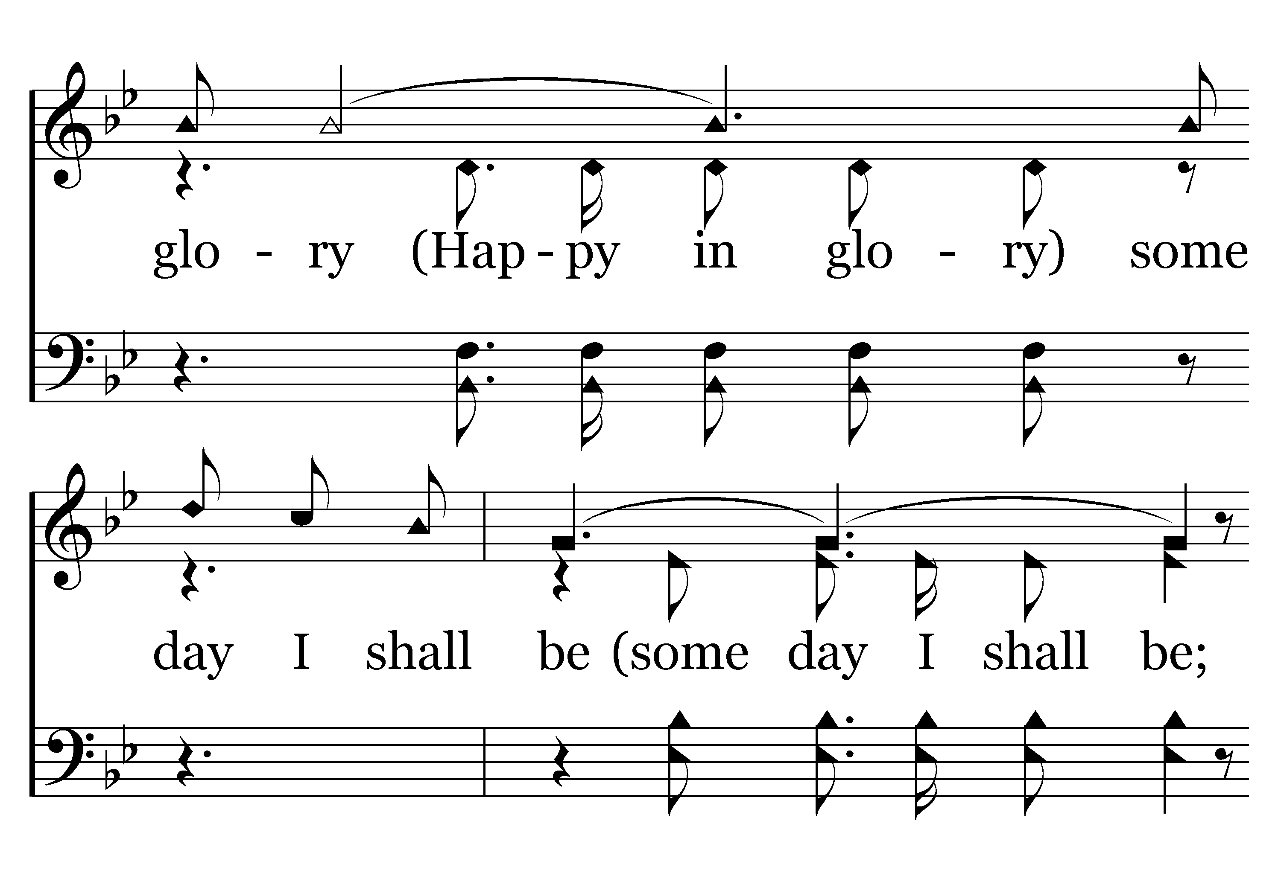
362 - I Have Been Redeemed - 3.3

Slide 41
362 - I Have Been Redeemed - 3.4

Slide 42
362 - I Have Been Redeemed - C.1

Slide 43
362 - I Have Been Redeemed - C.2

Slide 44
362 - I Have Been Redeemed - C.3
End of Song

Slide 46
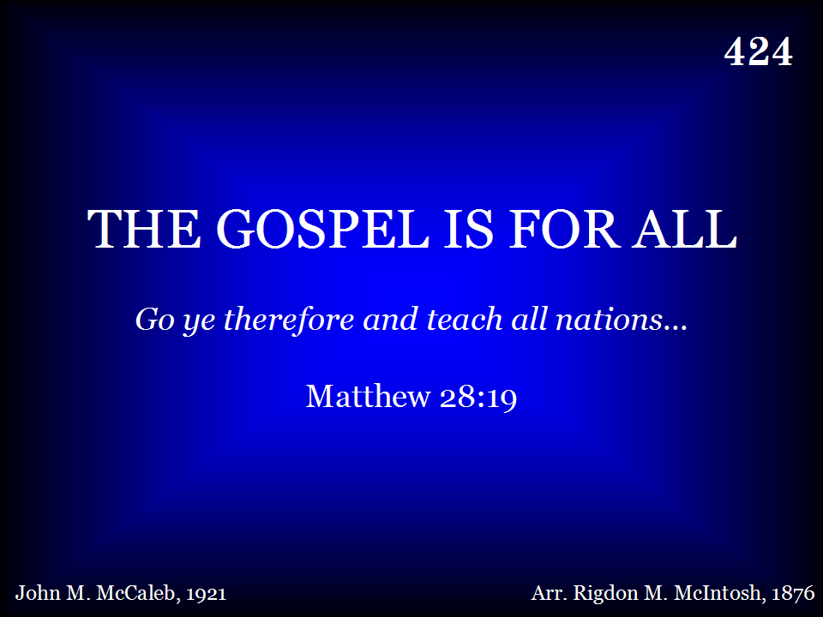
424 - The Gospel Is For All - Title

Slide 47
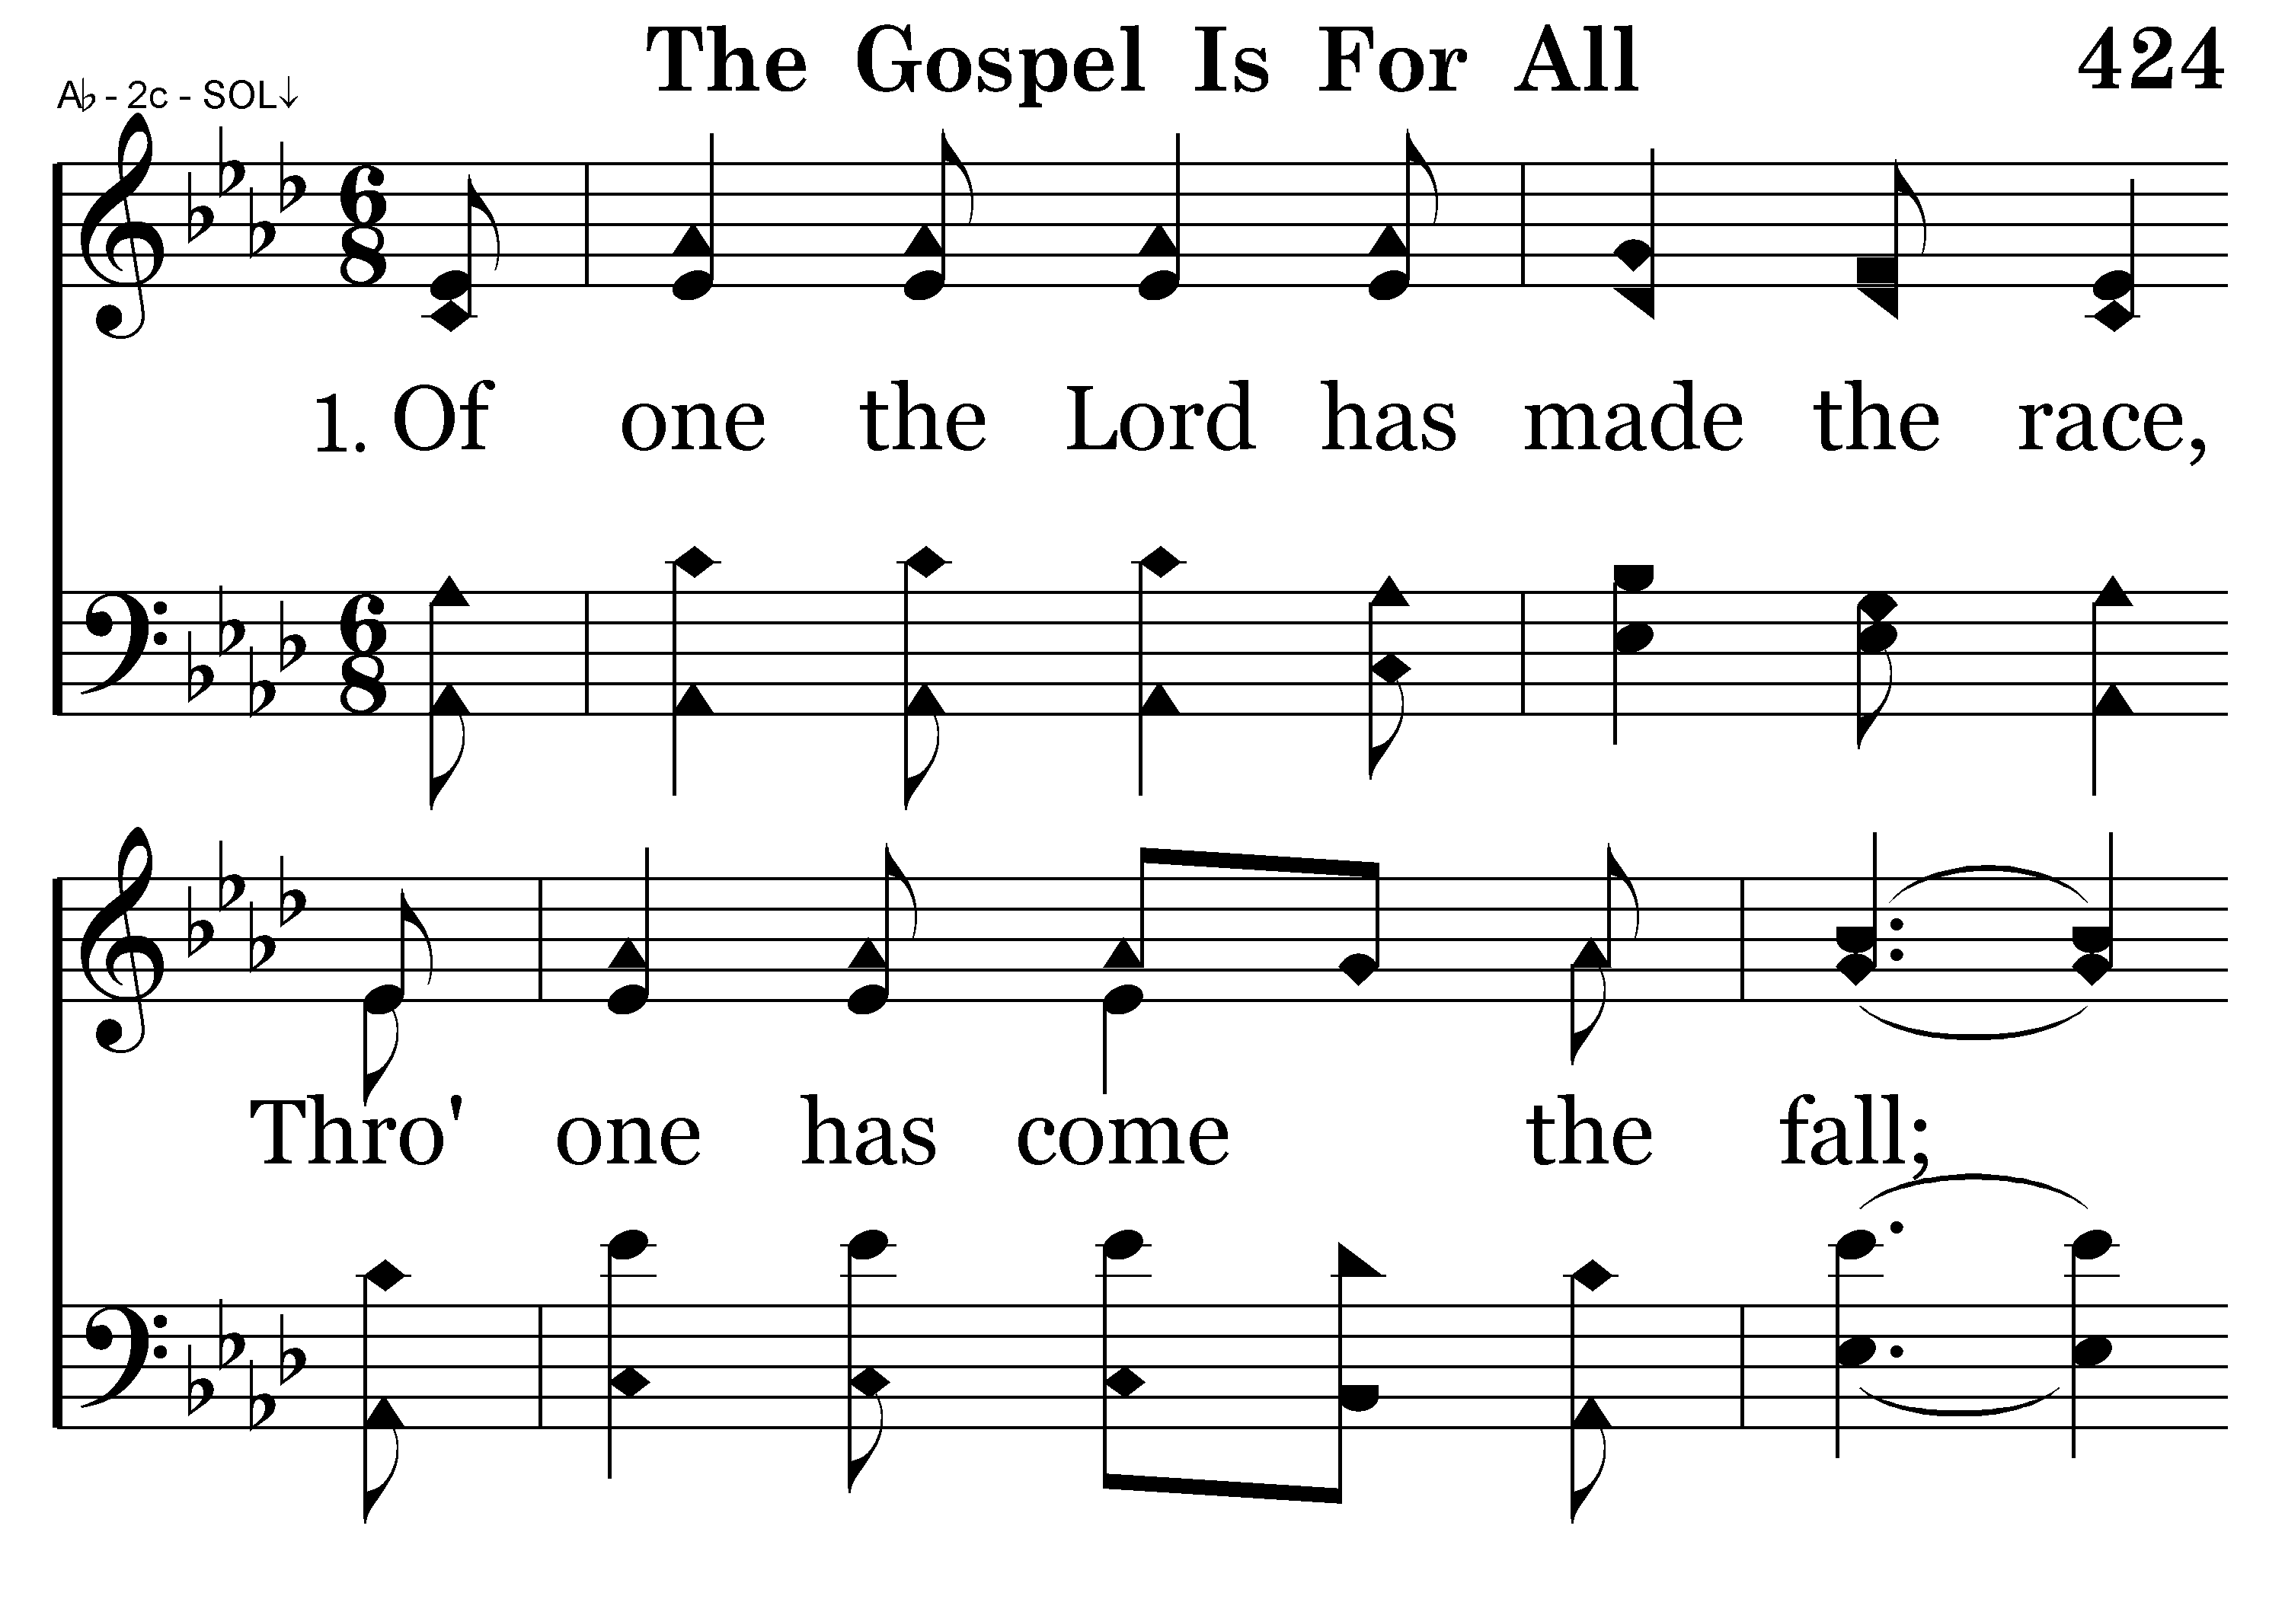
424 - The Gospel Is For All - 1.1

Slide 48
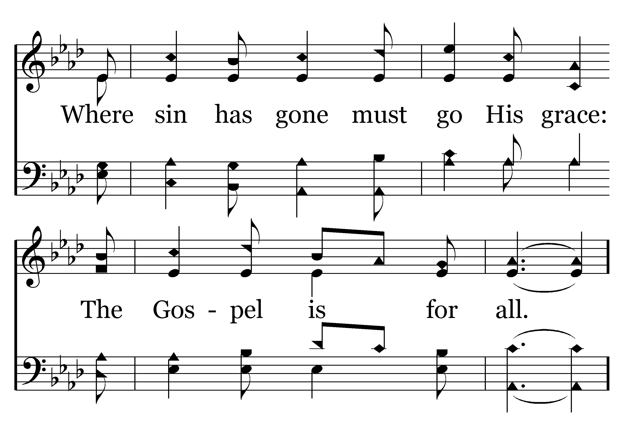
424 - The Gospel Is For All - 1.2

Slide 49
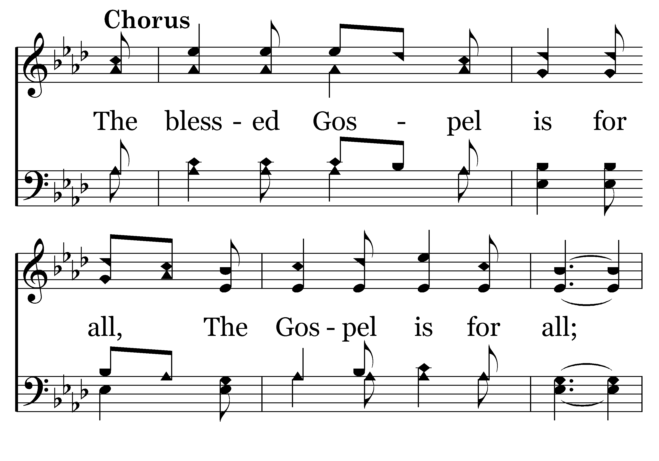
424 - The Gospel Is For All - C.1

Slide 50
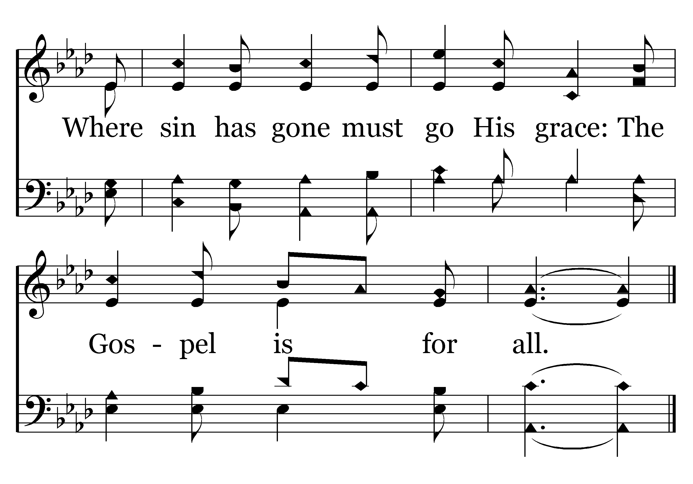
424 - The Gospel Is For All - C.2
End of Verse 1

Slide 51
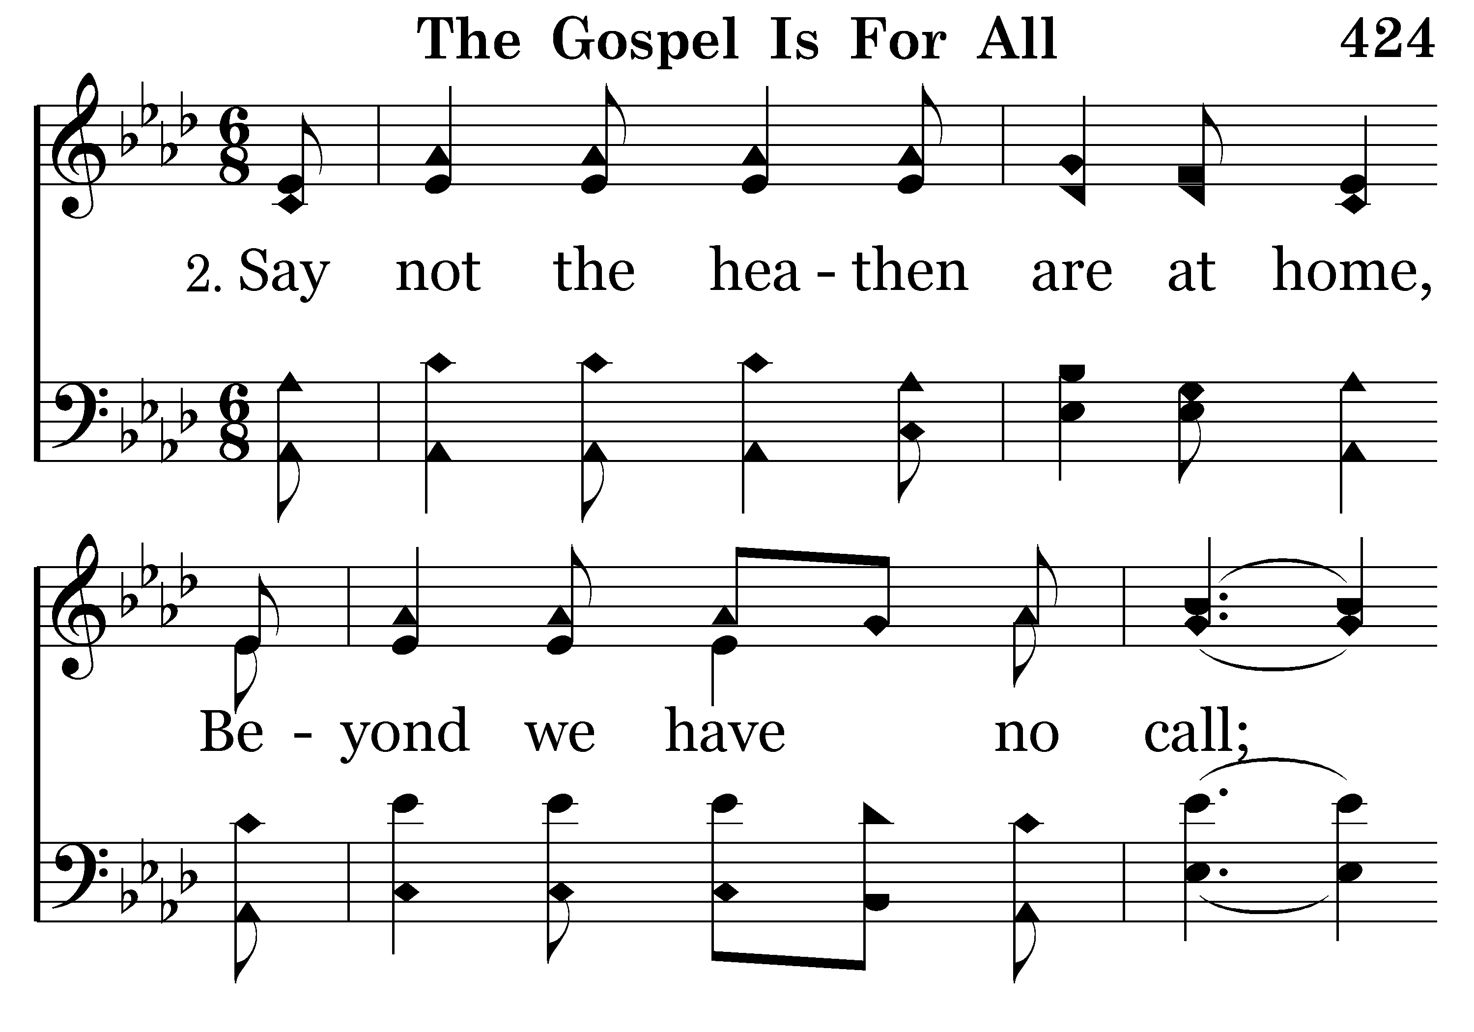
424 - The Gospel Is For All - 2.1

Slide 52
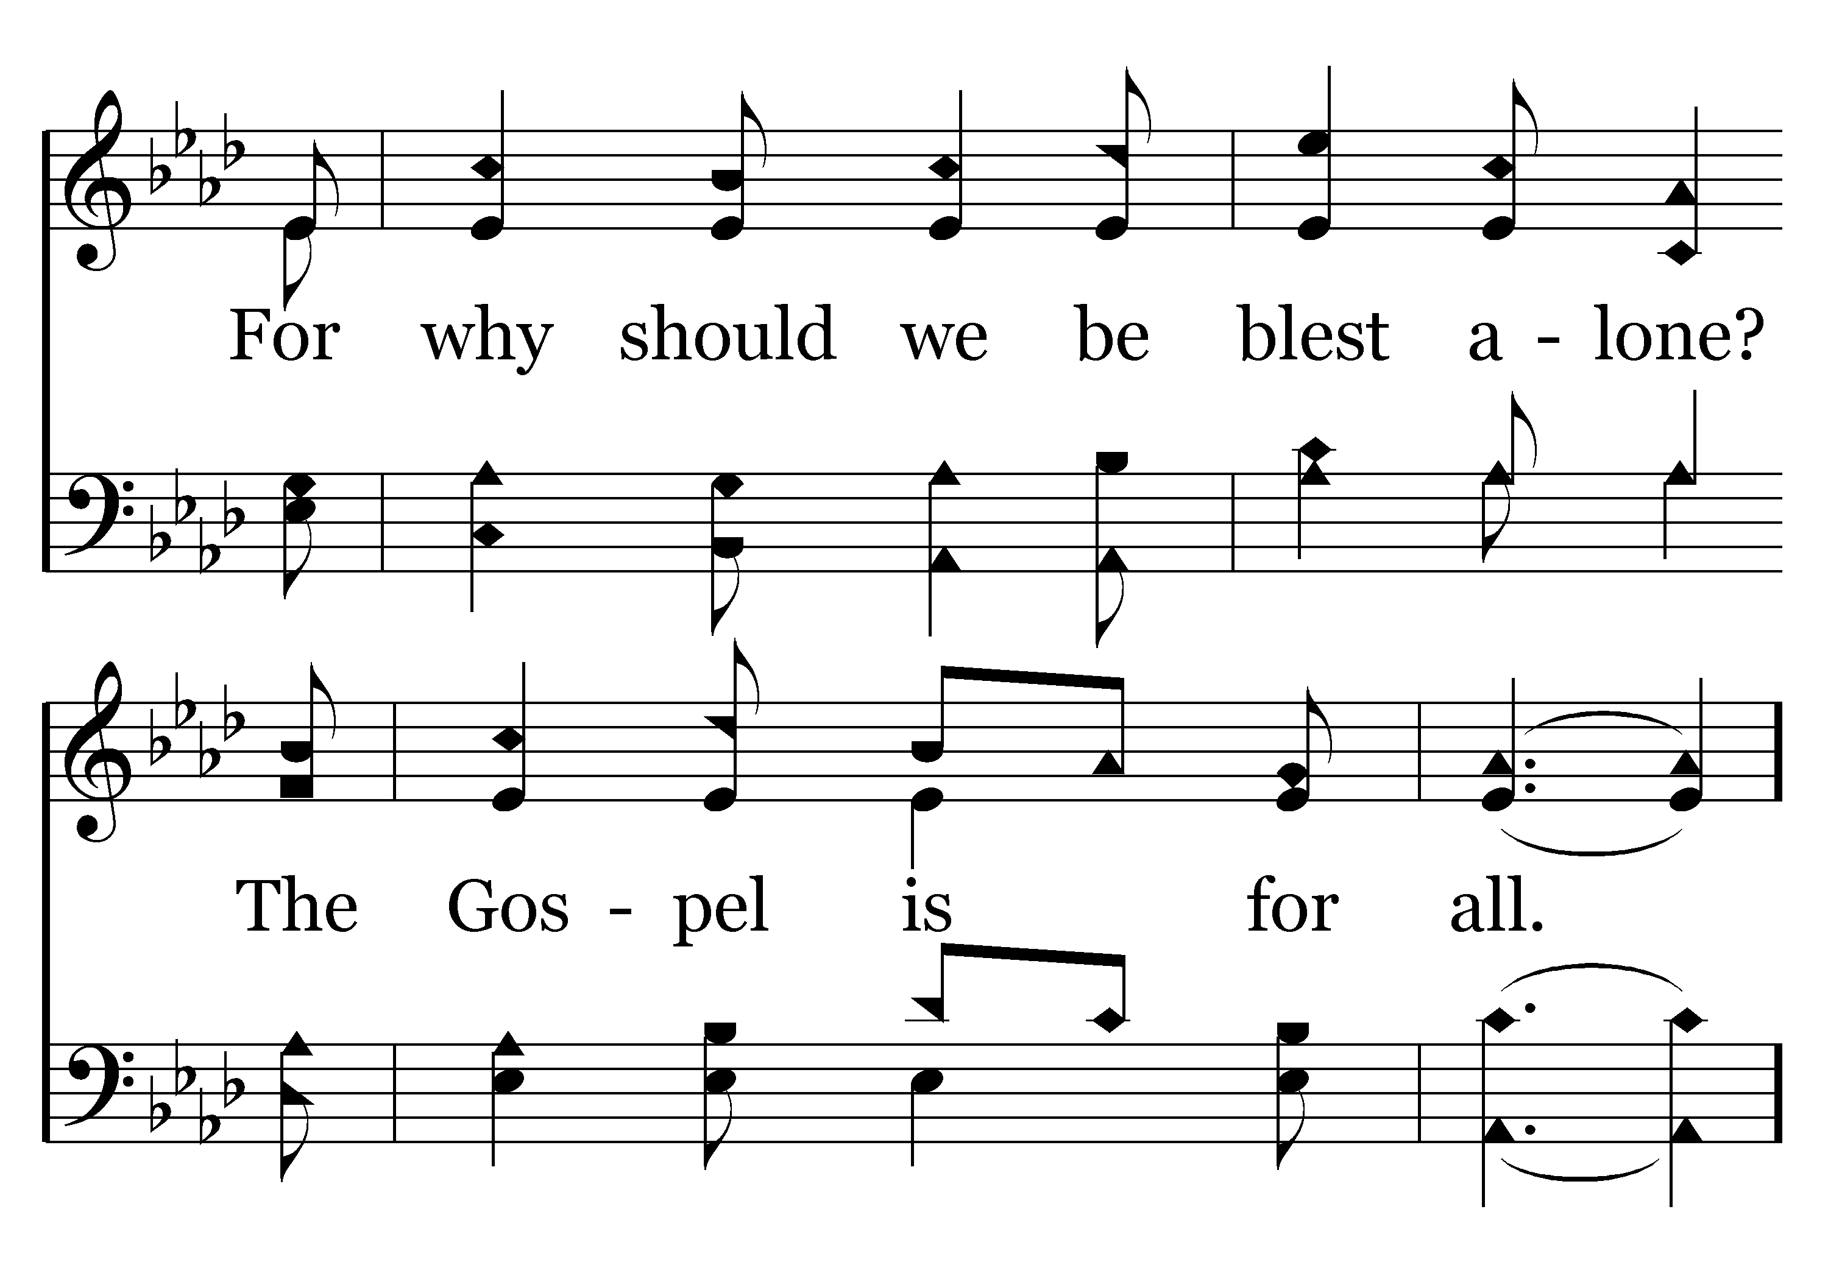
424 - The Gospel Is For All - 2.2

Slide 53
424 - The Gospel Is For All - C.1

Slide 54
424 - The Gospel Is For All - C.2
End of Verse 2

Slide 55
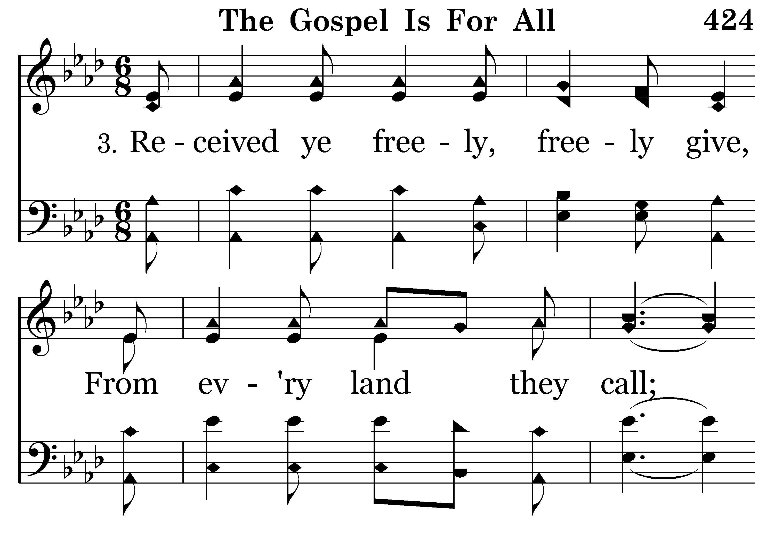
424 - The Gospel Is For All - 3.1

Slide 56
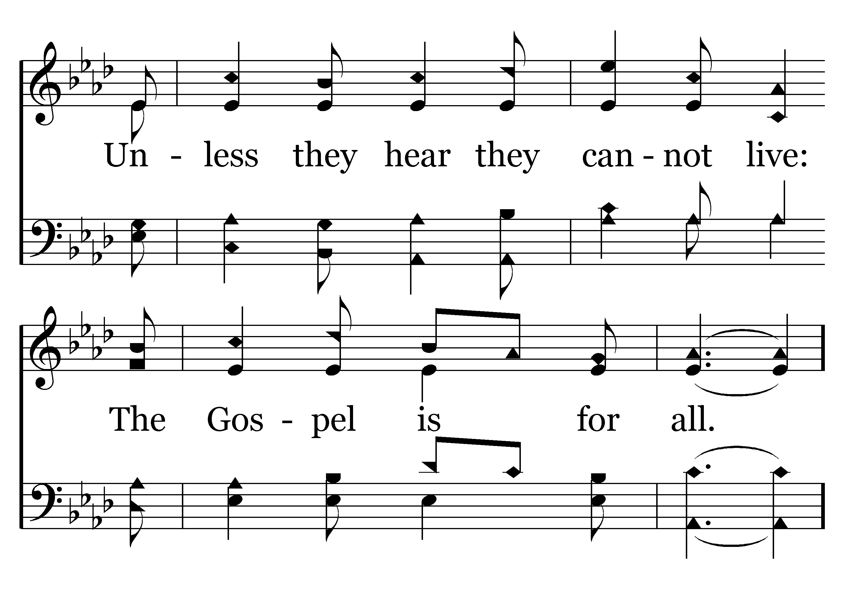
424 - The Gospel Is For All - 3.2

Slide 57
424 - The Gospel Is For All - C.1

Slide 58
424 - The Gospel Is For All - C.2
End of Song

Slide 60
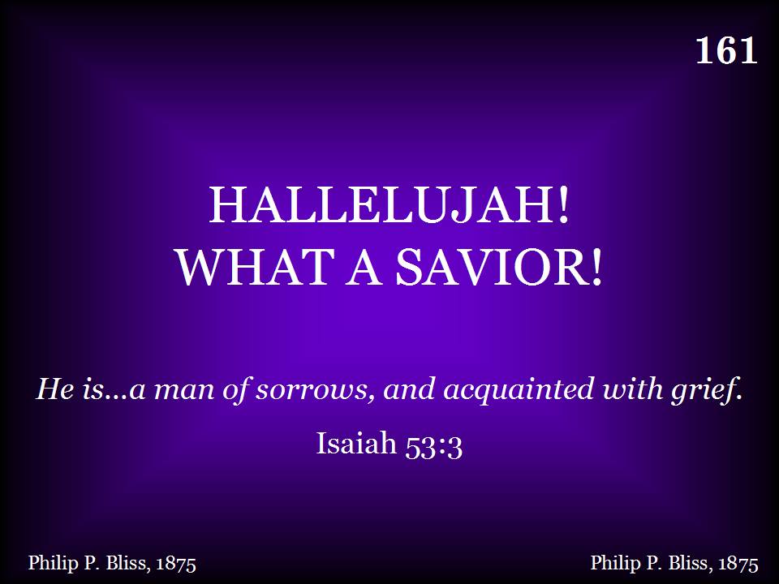
161 - Hallelujah! What A Savior! - Title

Slide 61
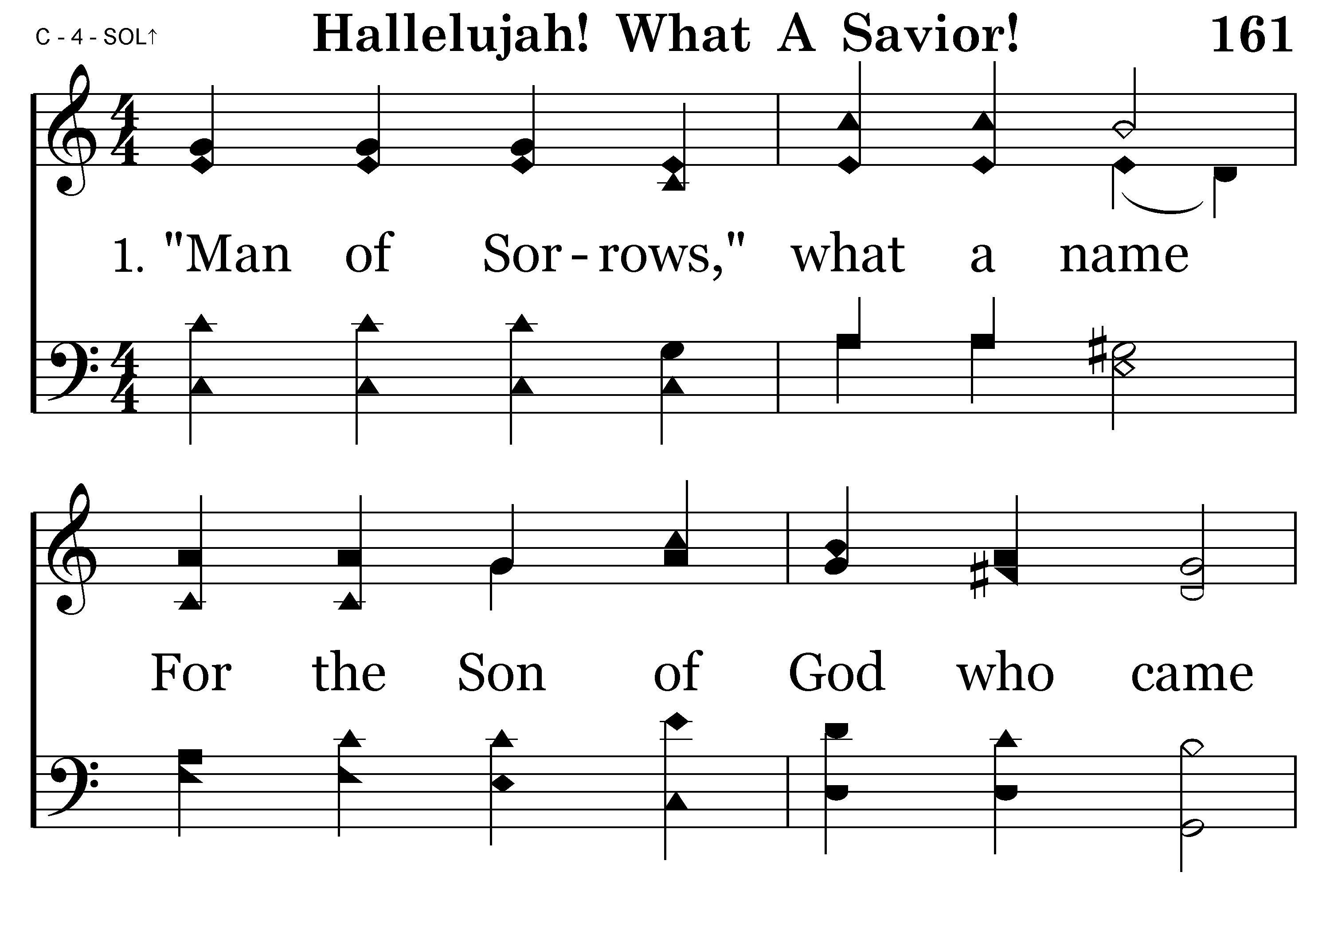
161 - Hallelujah! What A Savior! - 1.1

Slide 62
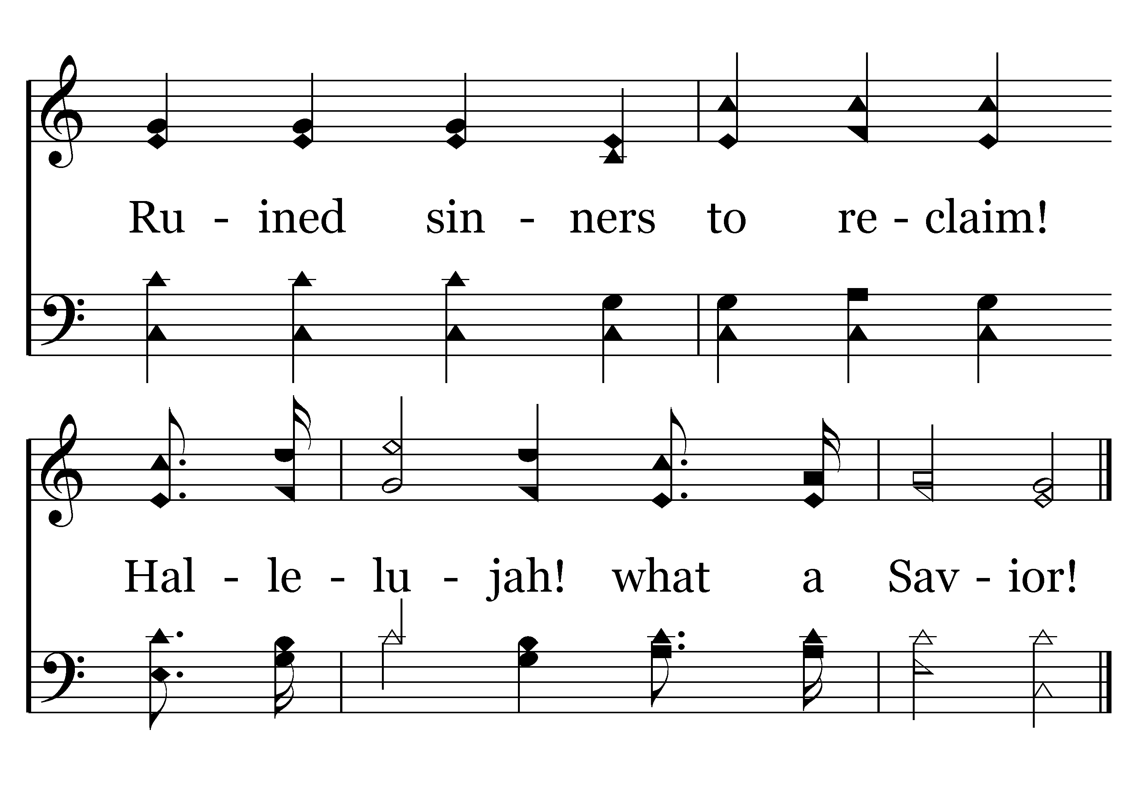
161 - Hallelujah! What A Savior! - 1.2
End of Verse 1

Slide 63
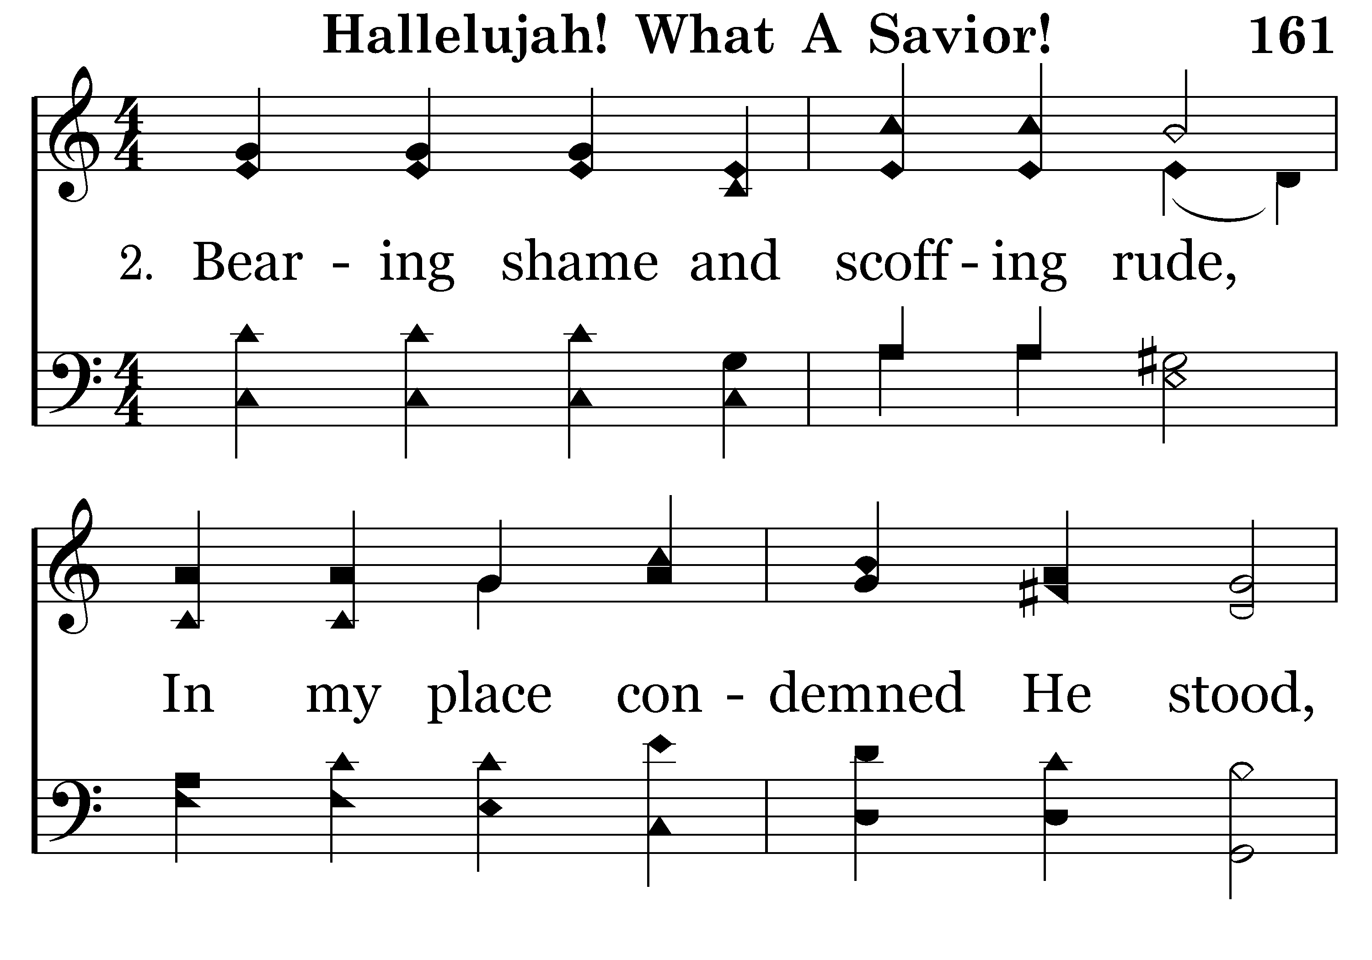
161 - Hallelujah! What A Savior! - 2.1

Slide 64
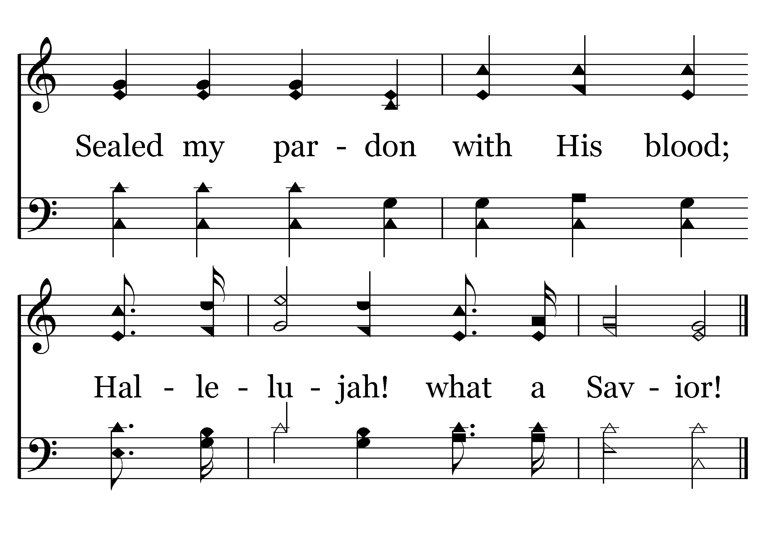
161 - Hallelujah! What A Savior! - 2.2
End of Verse 2

Slide 65
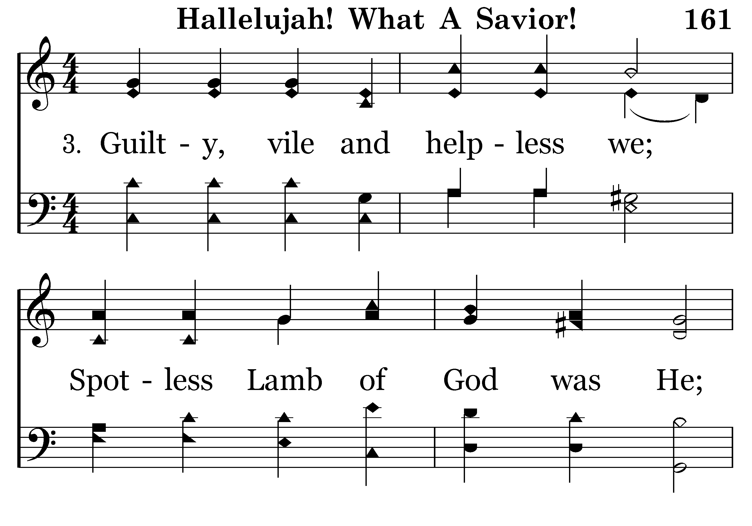
161 - Hallelujah! What A Savior! - 3.1

Slide 66
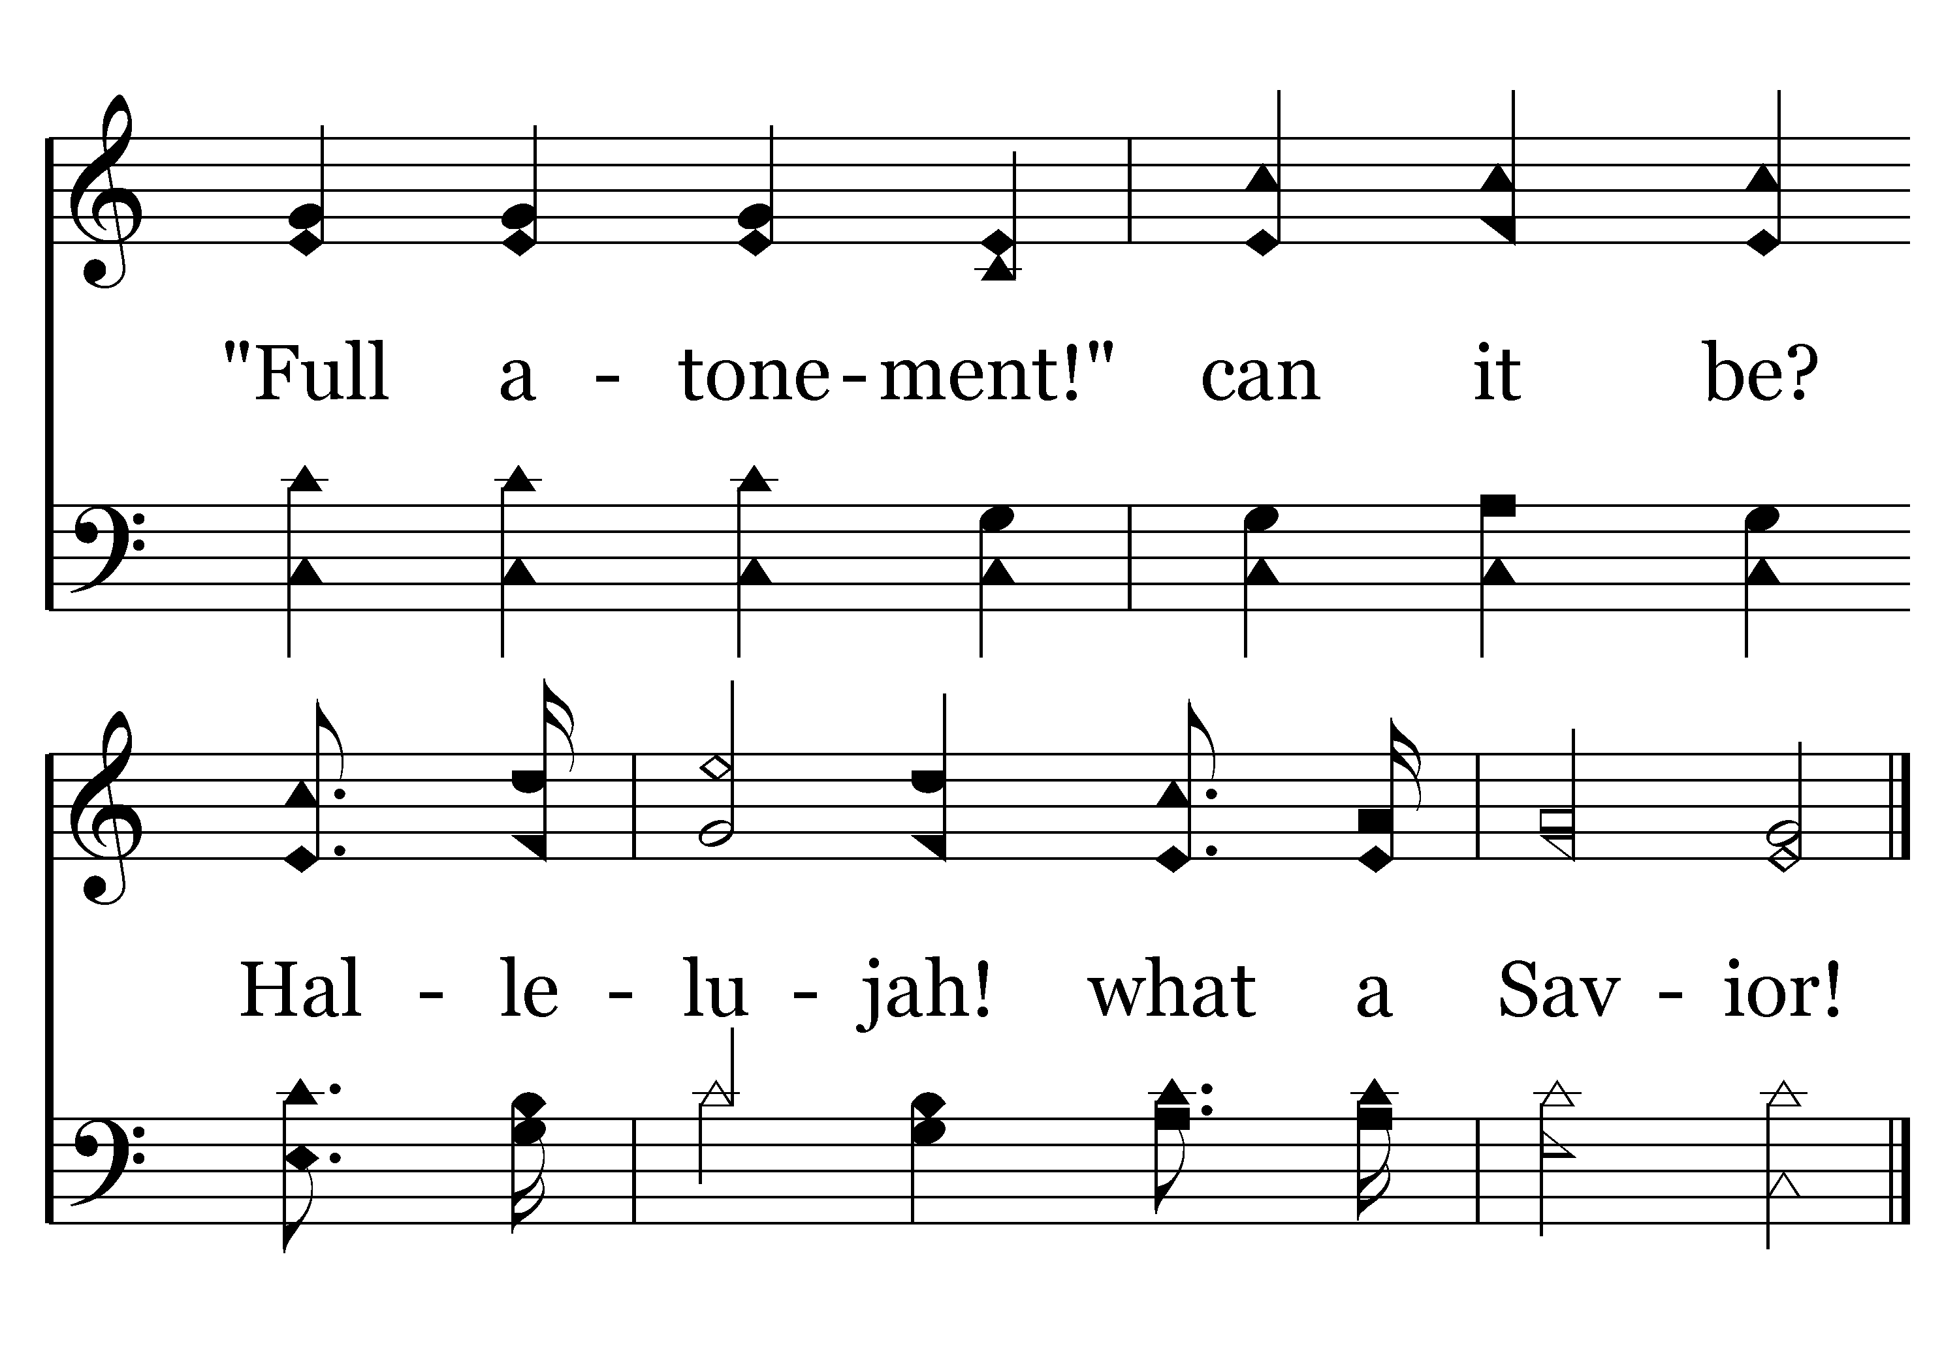
161 - Hallelujah! What A Savior! - 3.2
End of Verse 3

Slide 67
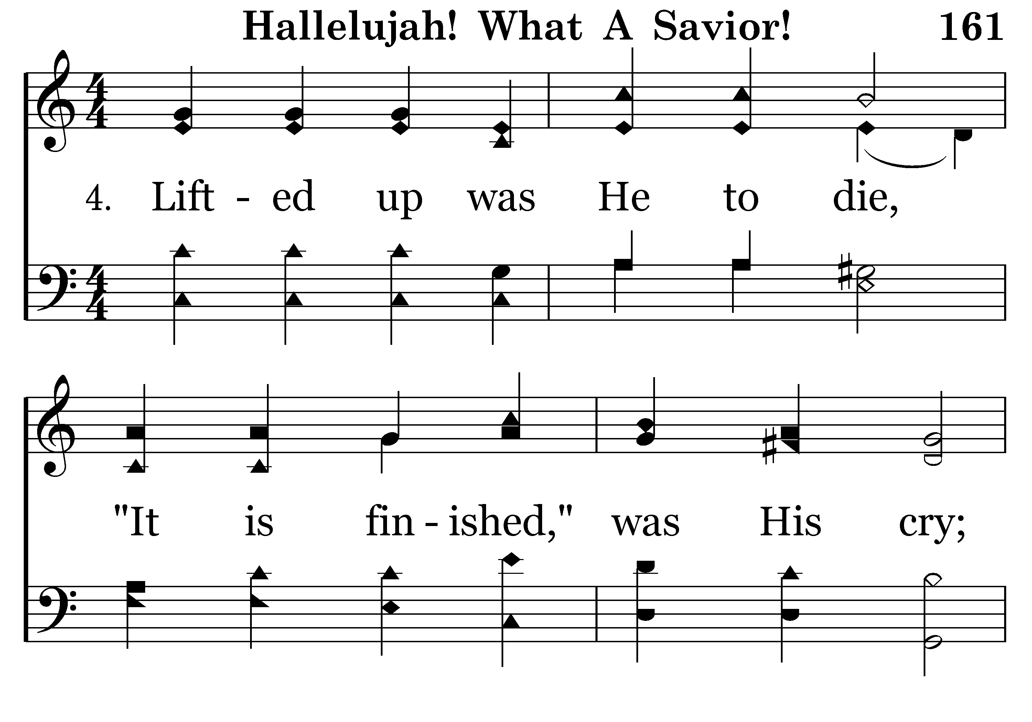
161 - Hallelujah! What A Savior! - 4.1

Slide 68
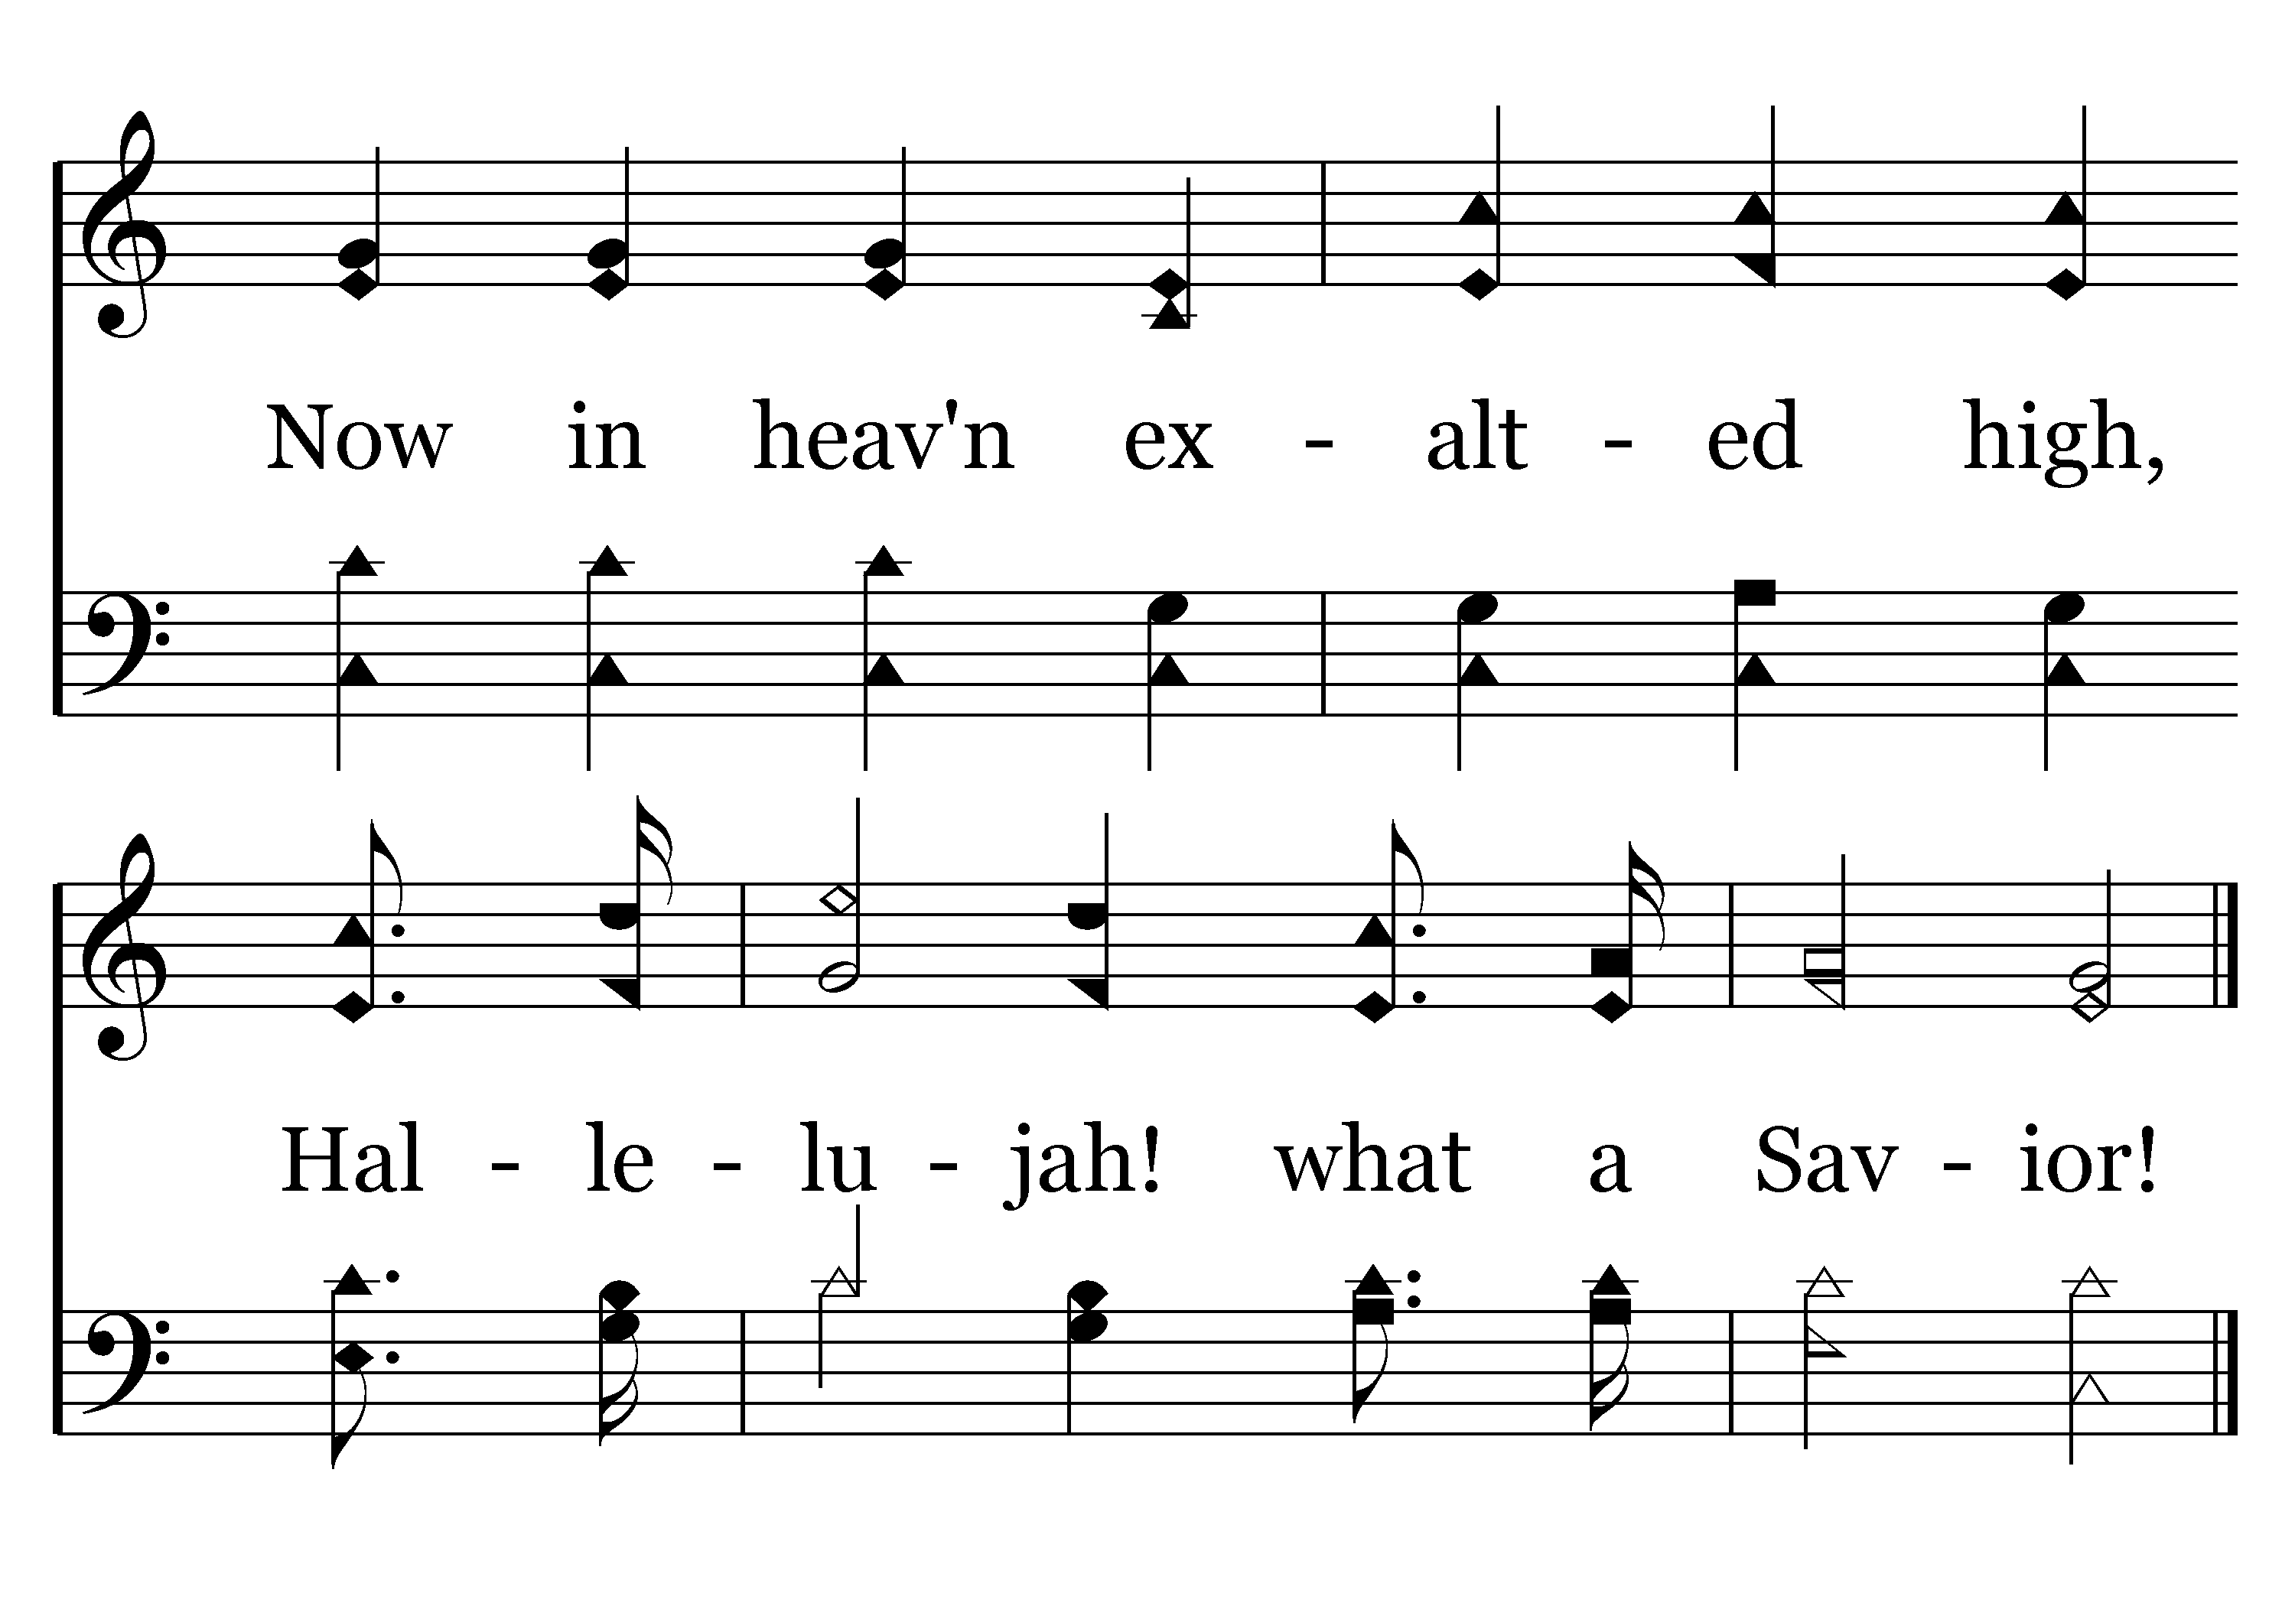
161 - Hallelujah! What A Savior! - 4.2
End of Verse 4

Slide 69
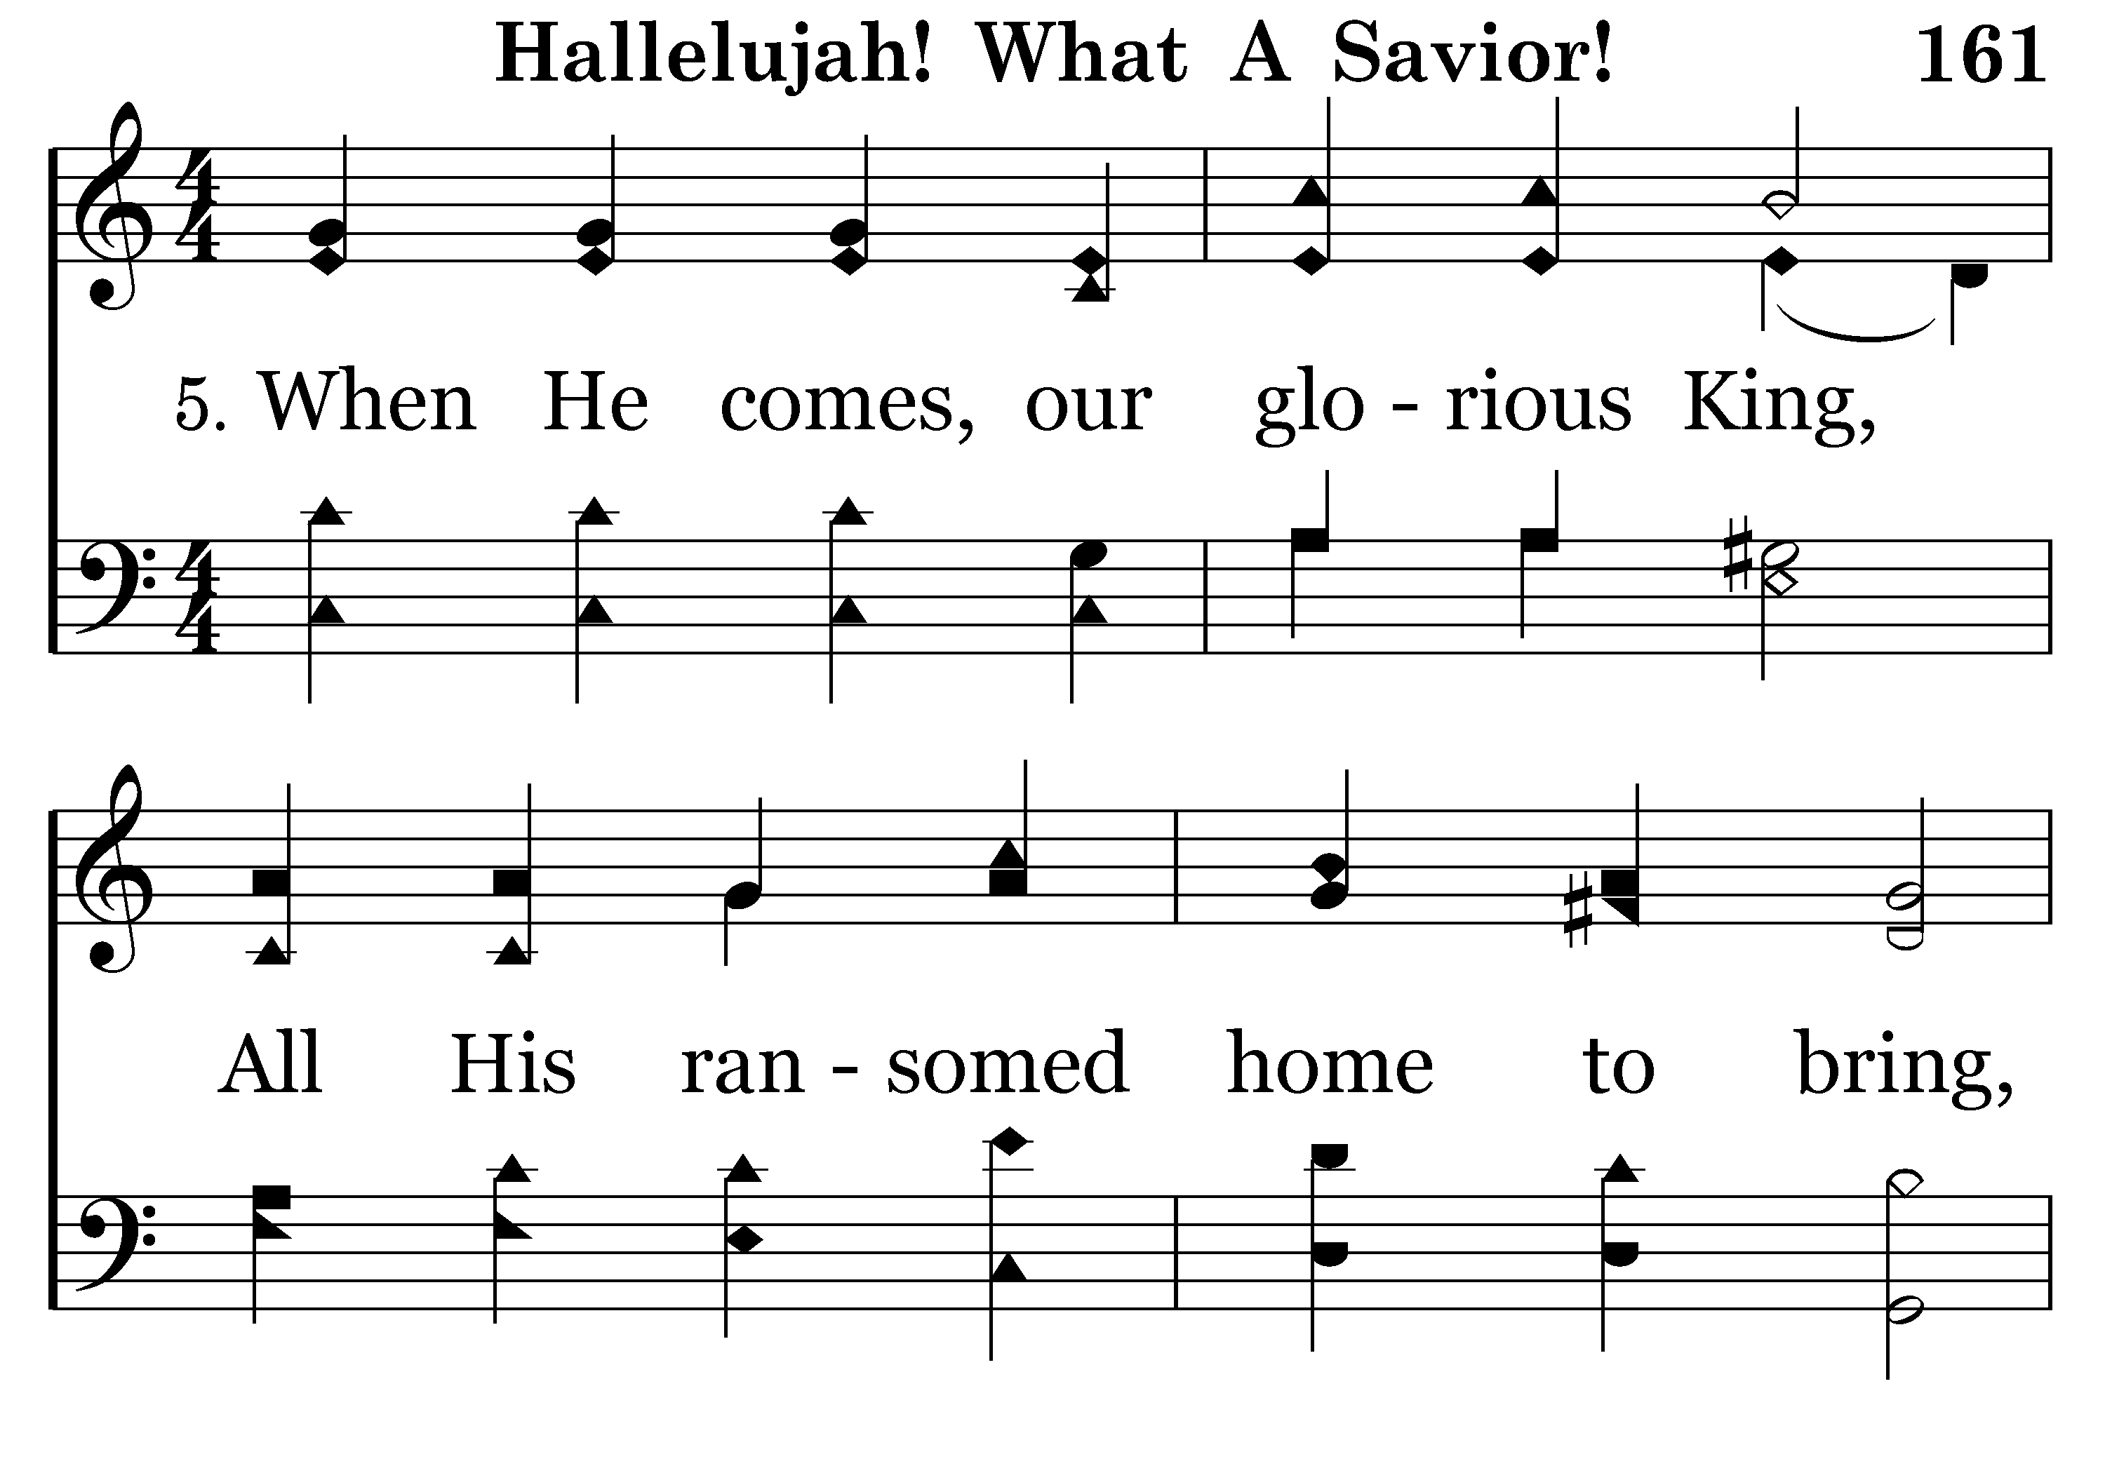
161 - Hallelujah! What A Savior! - 5.1

Slide 70
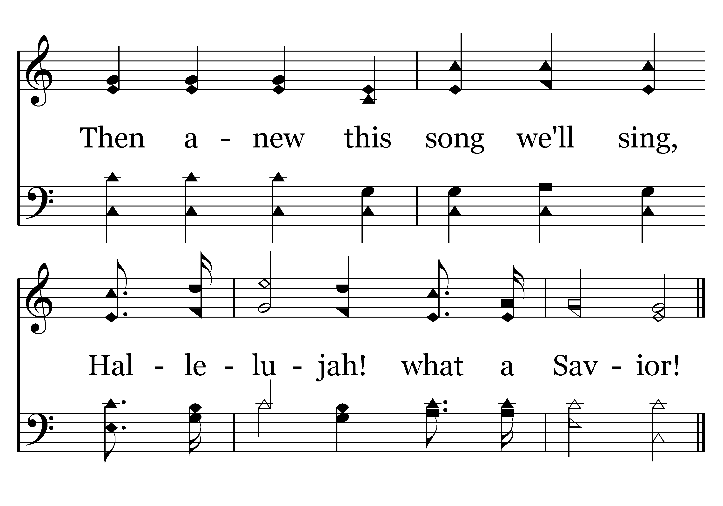
161 - Hallelujah! What A Savior! - 5.2
End of Song

Slide 71
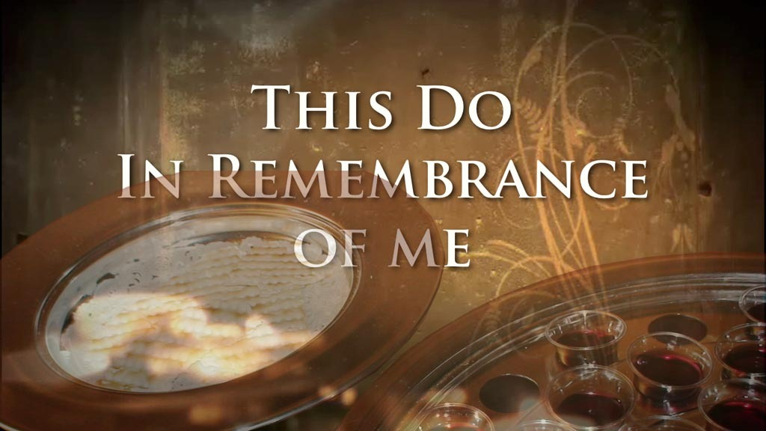

Slide 72
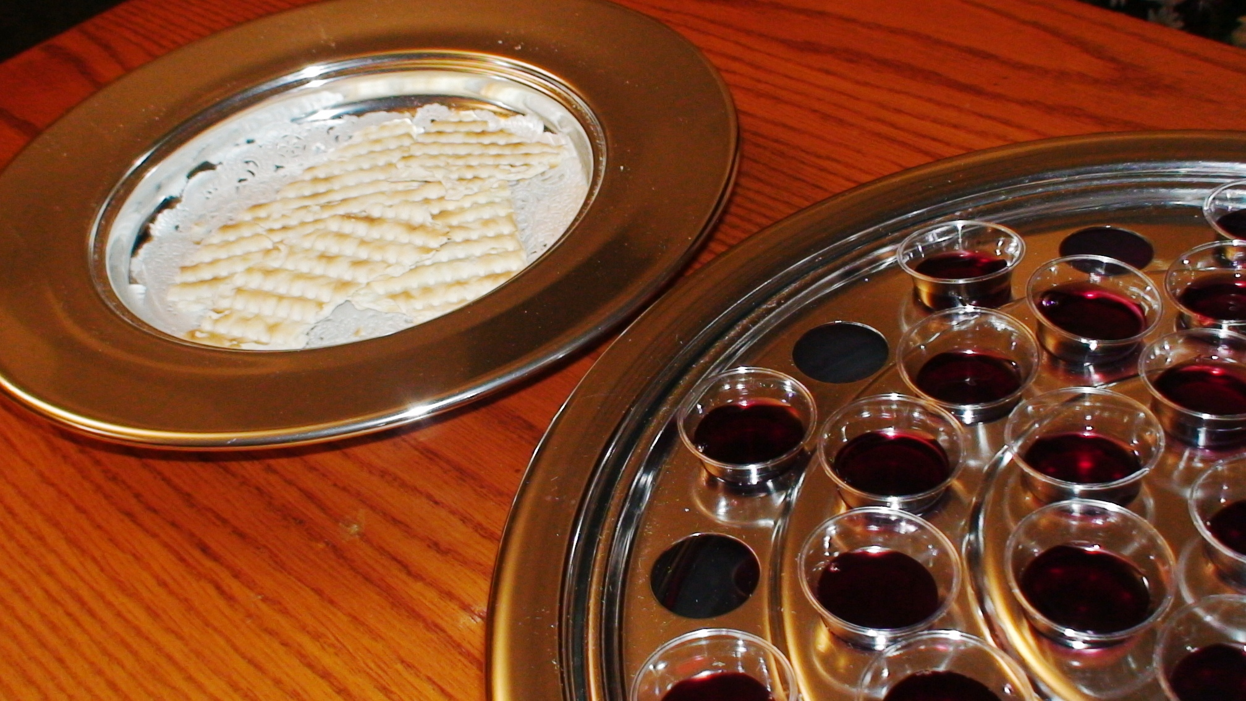
“As often as you eat this bread and drink this cup, you proclaim the Lord’s death….” 1 Corinthians 11:26

Slide 74
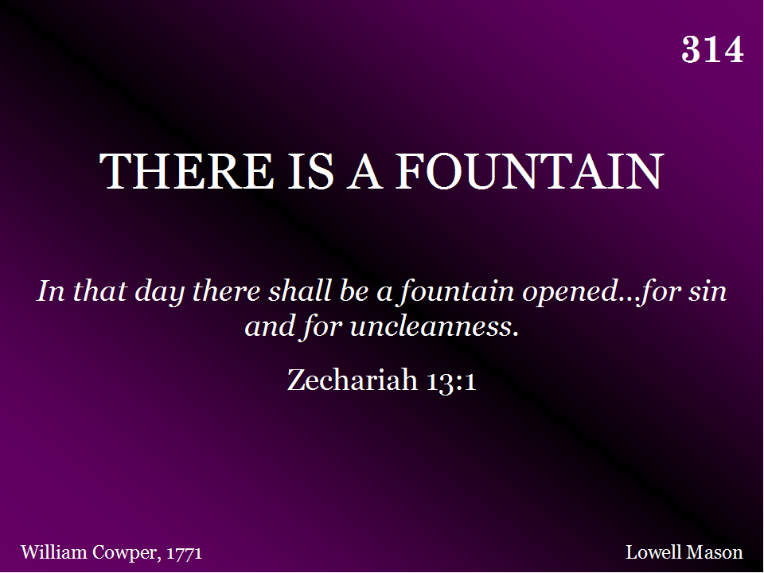
314 - There Is A Fountain - Title

Slide 75
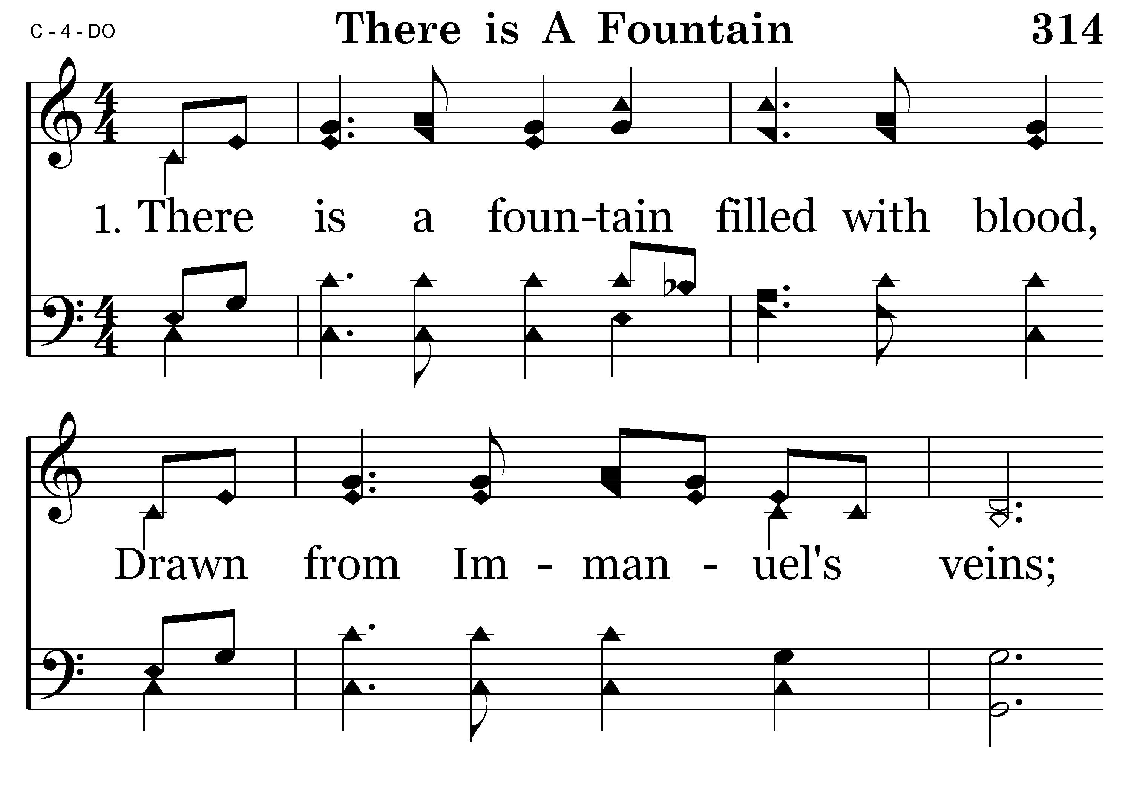
314 - There Is A Fountain - 1.1

Slide 76
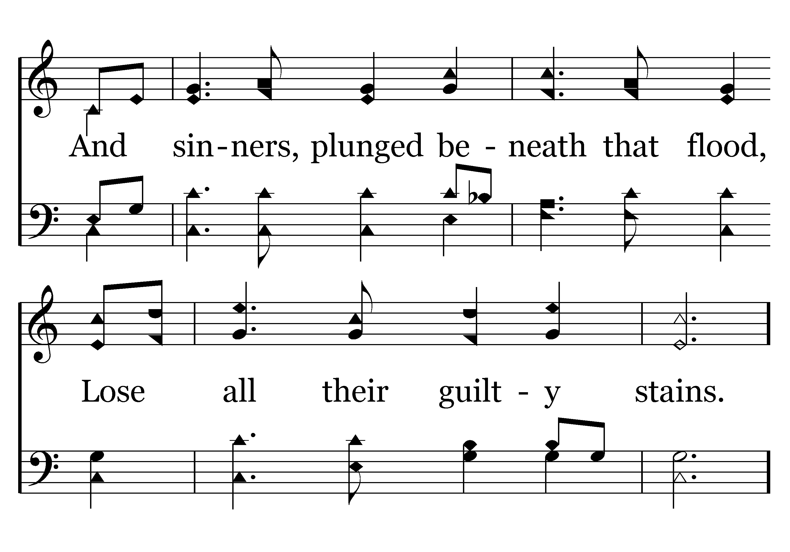
314 - There Is A Fountain - 1.2

Slide 77

314 - There Is A Fountain - 1.3

Slide 78

314 - There Is A Fountain - 1.4
End of Verse 1

Slide 79

314 - There Is A Fountain - 2.1

Slide 80

314 - There Is A Fountain - 2.2

Slide 81

314 - There Is A Fountain - 2.3

Slide 82

314 - There Is A Fountain - 2.4
End of Verse 2

Slide 83

596 - His Grace Reaches Me - Title

Slide 84

596 - His Grace Reaches Me - 1.1

Slide 85

596 - His Grace Reaches Me - 1.2

Slide 86

596 - His Grace Reaches Me - 1.3

Slide 87

596 - His Grace Reaches Me - C.1

Slide 88

596 - His Grace Reaches Me - C.2

Slide 89

596 - His Grace Reaches Me - C.3
End of Verse 1

Slide 90

596 - His Grace Reaches Me - 2.1

Slide 91

596 - His Grace Reaches Me - 2.2

Slide 92

596 - His Grace Reaches Me - 2.3

Slide 93
596 - His Grace Reaches Me - C.1

Slide 94
596 - His Grace Reaches Me - C.2

Slide 95
596 - His Grace Reaches Me - C.3
End of Song

Slide 97

TODAY’S TEXT
HARRY COWAN
Psalm 23

Slide 98
Ps 23:1- The Lord is my shepherd, I shall not be in want. He makes me lie down in green pastures, he leads me beside quiet waters, he restores my soul. He guides me in paths of righteousness for his name's sake. Even though I walk through the valley of the shadow of death, ª I will fear no evil, for you are with me; your rod and your staff,
they comfort me. You prepare a table before me in the presence of my enemies.
You anoint my head with oil; my cup overflows. Surely goodness and love will follow me all the days of my life, and I will dwell in the house of the Lord forever.
Mark 7:1-5 The Pharisees and some of the scribes gathered around Him when they had come ^{B} from Jerusalem, and had seen that some of His disciples were eating their bread with impure hands, that is, unwashed. (For the Pharisees and all the Jews do not eat unless they carefully wash their hands, thus observing the ^{A} traditions of the elders; ⁴ and when they come from the market place, they do not eat unless they ¹ cleanse themselves; and there are many other things which they have received in order to observe, such as the washing of cups and pitchers and copper pots.)
NASU

Slide 99
INVITATION SONG
# 397
STAND UP FOR JESUS
INVITATION SONG
# 278
GOD IS CALLING THE PRODIGAL

Slide 100


Slide 101

LIFE IS EASY WHEN YOU’RE UP ON THE MOUNTAIN
AND YOU’VE GOT PEACE OF MIND LIKE YOU’VE NEVER KNOWN

Slide 102

BUT THEN THINGS CHANGE AND YOU’RE DOWN IN THE VALLEY DON’T LOSE FAITH FOR YOU’RE NEVER ALONE

Slide 103
YOU TALK OF FAITH WHEN YOU’RE UP ON THE MOUNTAIN OH BUT TALK COMES EASY WHEN LIFE’S AT ITS BEST

Slide 104
BUT IT’S DOWN IN THE VALLEY OF TRIALS AND TEMPTATION THAT’S WHEN FAITH IS REALLY PUT TO THE TEST

Slide 105

FOR THE GOD ON THE MOUNTAIN IS STILL GOD IN THE VALLEY. WHEN THINGS GO WRONG, HE’LL MAKE THEM RIGHT. AND THE GOD OF THE GOOD TIMES IS STILL GOD IN THE BAD TIMES. THE GOD OF THE DAY IS STILL GOD IN THE NIGHT.

Slide 106
LIFE IS A MIXTURE OF PAIN AND PLEASURE
OF VICTORY AND DEFEAT
OF SUCCESS AND FAILURE
OF MOUNTAIN TOPS AND VALLEYS
BUT EVEN IN OUR DARKEST VALLEYS
IN OUR DARKEST DAYS
GOD IS THERE!

Slide 107
Ps 23:4 Even though I walk through the valley of the shadow of death, I will fear no evil, for you are with me; your rod and your staff, they comfort me.

Slide 108
IN PALESTINE THERE IS A REAL VALLEY OF THE SHADOW OF DEATH
IT IS STEEP-NARROW
THE SUN ONLY HITS THE BOTTOM WHEN DIRECTLY OVER-HEAD AT NOON
THE REST OF THE TIME—THE BOTTOM OF THE CANYON IS DARK
Ps 23:4 Even though I walk through the valley of the shadow of death, I will fear no evil, for you are with me; your rod and your staff, they comfort me.
David may have led sheep through this very valley

Slide 109
THE WORD “VALLEY” IN THE BIBLE
THE VALLEY OF ACHOR (CALAMITY)
Josh. 7:26
THE VALLEY OF BAKA (WEEPING)
Psa. 84:6
THE VALLEY OF AKOR (TROUBLE)
Hos. 2:15
The word “valley” in Ps 23:4 in Hebrew means
“The Valley of Deep Darkness”
HOW DO WE HANDLE THE DARK VALLEYS OF LIFE?
THERE ARE FIVE FACTS ABOUT VALLEYS THAT WE NEED TO REMEMBER WHENEVER WE GO THROUGH A TOUGH TIME

Slide 110
1. VALLEYS ARE INEVITABLE
They are going to happen!
You have just gone through a valley
Or you are in one right now
Or you are heading for one
John 16:33 In this world you will have trouble.

Slide 111
1. VALLEYS ARE INEVITABLE
They are going to happen!
You have just gone through a valley
Or you are in one right now
Or you are heading for one
John 16:33 In this world you will have trouble.
It’s not a matter of IF
It’s a matter of WHEN

Slide 112
1. VALLEYS ARE INEVITABLE
We are going to have:
THESE
THINGS
ARE GOING
TO HAPPEN
THEY ARE A
NORMAL
PART OF
LIFE
Difficulty
Disappointments
Discouragement
There will be times of:
Suffering
Sorrow
Sickness
Frustration
Failure
Fatigue

Slide 113
2. VALLEYS ARE UNPREDICTABLE
We can’t plan them
We can’t time them
We can’t schedule them
They come at the worst time

Slide 114

HAVE YOU EVER HAD A FLAT TIRE AT A GOOD TIME?

Slide 115
2. VALLEYS ARE UNPREDICTABLE
We can’t plan them
We can’t time them
We can’t schedule them
They come at the worst time
They come suddenly
A good day can become a bad day
A phone call
A letter
A freak accident
A routine doctor’s check-up

Slide 116
2. VALLEYS ARE UNPREDICTABLE
Jer 4:20 Disaster follows disaster;......In an instant my tents are destroyed, my shelter in a moment.
Valleys just happen
They are unpredictable

Slide 117
3. VALLEYS ARE IMPARTIAL
No one is immune to them.
No one is isolated from pain and sorrow
When bad things happen—it doesn’t mean you are a bad person
It just means you are a person
Matt 5:45 He causes his sun to rise on the evil and the good, and sends rain on the righteous and the unrighteous.

Slide 118
3. VALLEYS ARE IMPARTIAL
Our first reaction:
“WHY ME?”
We should ask:
“WHY NOT ME?”
Should we be exempt from the problems others are going through?
Do we think we are the only ones in the universe that has problems?
Remember:
Things are not perfect here
Tragedies happen to all of us

Slide 119
4. VALLEYS ARE TEMPORARY
They have an end
They don’t last
Ps 23:4 Even though I walk through the valley

Slide 120
4. VALLEYS ARE TEMPORARY
They have an end
They don’t last
Ps 23:4 Even though I walk through the valley
We don’t stay in our valley—we go through
Valleys don’t come into our lives to stay—they come to pass
1 Peter 1:6 In this you greatly rejoice, though now for a little while you may have had to suffer grief in all kinds of trials.

Slide 121
4. VALLEYS ARE TEMPORARY
They don’t last
They have an end
Ps 23:4 Even though I walk through the valley
We don’t stay in our valley—we go through
Valleys don’t come into our lives to stay—they come to pass
1 Peter 1:6 There is wonderful joy ahead, even though the going is rough for a while down here. TLB
We are going to go through some rough times
Life is tough
But it’s only for a while

Slide 122
4. VALLEYS ARE TEMPORARY
2 Cor 4:17 For our light and momentary troubles are achieving for us an eternal glory that far outweighs them all.
2 Cor 4:17 And this small and temporary trouble we suffer will bring us a tremendous and eternal glory, much greater than the trouble. TEV
There is an ETERNAL glory
This is IMPORTANT
WE MAY HAVE TEMPORARY HASSLES
BUT THERE IS THE LONG-TERM-ETERNAL BENEFIT

Slide 123
5. VALLEYS ARE PURPOSEFUL
GOD HAS A REASON FOR TAKING US THROUGH OUR VALLEYS
We have all kinds of trials
GOD WANTS
TO BUILD OUR
FAITH IN THE
VALLEYS
OF LIFE
Financial valleys
Relational valleys
Emotional valleys
All kinds of different trials

Slide 124
5. VALLEYS ARE PURPOSEFUL
GOD HAS A REASON FOR TAKING US THROUGH OUR VALLEYS
WE ENJOY THE MOUNTAIN TOPS
BUT WE DON’T BUILD FAITH ON THE MOUNTAIN TOP
WE BUILD FAITH IN THE VALLEYS OF LIFE
WHEN EVERYTHING IS GREAT—WE DON’T NEED GOD
WHEN WE COME FACE TO FACE WITH A DARK VALLEY—WE GET ON OUR KNEES

Slide 125
5. VALLEYS ARE PURPOSEFUL
GOD HAS A REASON FOR TAKING US THROUGH OUR VALLEYS
FAITH IS STRENGTHENED IN THE VALLEYS
“It’s down in the valley of trials and temptations, that’s when our faith is really put to the test”

Slide 126
5. VALLEYS ARE PURPOSEFUL
GOD HAS A REASON FOR TAKING US THROUGH OUR VALLEYS
FAITH IS STRENGTHENED IN THE VALLEYS
EVERY PROBLEM HAS A PURPOSE
Tiny ones
Inconsequential ones
Mere irritations
GOD USES
THEM TO
BUILD
CHARACTER
GOD IS MORE INTERESTED IN OUR HOLINESS
THAN IN OUR HAPPINESS

Slide 127
WHAT DO WE DO WHEN WE GO THROUGH DARK VALLEYS?
1. REFUSE TO BE DISCOURAGED
Ps 23:4 I will fear no evil, for you are with me; your rod and your staff, they comfort me.

Slide 128
WHAT DO WE DO WHEN WE GO THROUGH DARK VALLEYS?
1. REFUSE TO BE DISCOURAGED
Ps 23:4 I will fear no evil, for you are with me; your rod and your staff, they comfort me.
WE CAN’T GO AROUND THE VALLEY
WE CAN’T GO UNDER THE VALLEY
WE CAN’T GO OVER THE VALLEY
WE CAN ONLY GO THROUGH THE VALLEY

Slide 129
WHAT DO WE DO WHEN WE GO THROUGH DARK VALLEYS?
1. REFUSE TO BE DISCOURAGED
IF YOU ARE DISCOURAGED—YOU CHOOSE TO BE
YOU ARE LOOKING AT THE NEGATIVES
YOU ARE NOT LOOKING AT THE POSITIVES
THIS IS A CHOICE
Col 1:11 being strengthened with all power according to his glorious might so that you may have great endurance and patience

Slide 130
WHAT DO WE DO WHEN WE GO THROUGH DARK VALLEYS?
1. REFUSE TO BE DISCOURAGED
Ps 34:18 The Lord is close to the brokenhearted and saves those who are crushed in spirit.
Jer 29:11 For I know the plans I have for you," declares the Lord, "plans to prosper you and not to harm you, plans to give you hope and a future.

Slide 131
WHAT DO WE DO WHEN WE GO THROUGH DARK VALLEYS?
2. REMEMBER THAT GOD IS WITH ME
Ps 23:4 I will fear no evil, for you are with me;

Slide 132
WHAT DO WE DO WHEN WE GO THROUGH DARK VALLEYS?
2. REMEMBER THAT GOD IS WITH ME
Ps 23:4 I will fear no evil, for you are with me;
NOT ONLY DO WE HAVE GOD’S POWER IN OUR VALLEYS
WE HAVE HIS PRESENCE
Isa 43:2 When you pass through the waters, I will be with you; and when you pass through the rivers, they will not sweep over you. When you walk through the fire, you will not be burned; the flames will not set you ablaze.

Slide 133
AT VERSE 4 THERE IS A STRATEGIC CHANGE IN LANGUAGE
In the first part of the psalm—all the pronouns are in the 3rd person—the psalmist talks about GOD
Ps 23:2-3 He makes me lie down in green pastures, he leads me beside quiet waters, 3 he restores my soul. He guides me in paths of righteousness for his name's sake.
But when he gets in the valley—it changes to the 2nd person pronouns—he’s not talking about God but to God
Ps 23:4 Even though I walk through the valley of the shadow of death, I will fear no evil, for you are with me; your rod and your staff, they comfort me.

Slide 134
AT VERSE 4 THERE IS A STRATEGIC CHANGE IN LANGUAGE
It is the valleys of life that bring us face to face with GOD
When we are in our valley—we don’t want to talk ABOUT God--
We want to talk TO GOD!
WHEN WE ARE IN OUR VALLEYS—GOD BECOMES REAL—HE SAYS “I AM WITH YOU”
WE ENJOY THE MOUNTAIN TOPS—
BUT WE ARE NEVER CLOSER TO GOD THAN WHEN WE ARE IN THE VALLEY

Slide 135
WHAT DO WE DO WHEN WE GO THROUGH DARK VALLEYS?
3. RELY ON GOD’S PROTECTION & GUIDANCE
Ps 23:4 your rod and your staff, they comfort me.
Rod – about 2 feet long – hurled at anything that would attack the sheep
“When you go through your valley I will protect you”
Staff – long stick with crook at the end—used to guide and draw sheep close to shepherd—lift them up when down
“When you go through your valley I will guide you—lift you up when down”

Slide 136
WHAT DO WE DO WHEN WE GO THROUGH DARK VALLEYS?
3. RELY ON GOD’S PROTECTION & GUIDANCE
Prov 3:5-6 Trust in the Lord with all your heart and lean not on your own understanding;
6 in all your ways acknowledge him,
and he will make your paths straight.

Slide 137
WHAT DO WE DO WHEN WE GO THROUGH DARK VALLEYS?
3. RELY ON GOD’S PROTECTION & GUIDANCE
Ps 23:4 Even though I walk through the valley of the shadow of death, I will fear no evil, for you are with me; your rod and your staff, they comfort me.

Slide 138
WHAT DO WE DO WHEN WE GO THROUGH DARK VALLEYS?
3. RELY ON GOD’S PROTECTION & GUIDANCE
Ps 23:4 Even though I walk through the valley of the shadow of death, I will fear no evil, for you are with me; your rod and your staff, they comfort me.
When in a valley—the scary part are the shadows
One day a shadow is going to fall over your life
We will have “shadow moments”

Slide 139
WHAT DO WE DO WHEN WE GO THROUGH DARK VALLEYS?
3. RELY ON GOD’S PROTECTION & GUIDANCE
Ps 23:4 Even though I walk through the valley of the shadow of death, I will fear no evil, for you are with me; your rod and your staff, they comfort me.
When these times come we need to remember 3 things about shadows:
Shadows are bigger than the reality
Shadows cannot hurt you—they are image without substance
There is no shadow without light

Slide 140
WHAT DO WE DO WHEN WE GO THROUGH DARK VALLEYS?
Ps 34:19 A righteous man may have many troubles, but the Lord delivers him from them all;

Slide 141
WHAT DO WE DO WHEN WE GO THROUGH DARK VALLEYS?
Christians go through valleys like everyone else
Christians have disappointments
Christians get sick
Christians experience tragedies
Christians loose loved ones
Christians have financial problems
Christians have family problems

Slide 142
WHAT DO WE DO WHEN WE GO THROUGH DARK VALLEYS?
Christians go through valleys like everyone else
But there is a big difference
THE DIFFERENCE IS NOT THE ABSENCE OF VALLEYS
THE DIFFERENCE IS THE PRESENCE OF THE SHEPHERD
GOD IS WITH YOU

Slide 143
IS THE LORD YOUR SHEPHERD TODAY?
If you are not a Christian—make Christ your Shepherd today
If you are a Christian—let Christ lead you our of your dark valley

Slide 145

278 - God Is Calling The Prodigal - Title

Slide 146

278 - God Is Calling The Prodigal - 1.1

Slide 147

278 - God Is Calling The Prodigal - 1.2

Slide 148

278 - God Is Calling The Prodigal - 1.3

Slide 149

278 - God Is Calling The Prodigal - 1.4

Slide 150

278 - God Is Calling The Prodigal - C.1

Slide 151

278 - God Is Calling The Prodigal - C.2

Slide 152

278 - God Is Calling The Prodigal - C.3

Slide 153

278 - God Is Calling The Prodigal - C.4
End of Verse 1

Slide 154

278 - God Is Calling The Prodigal - 2.1

Slide 155

278 - God Is Calling The Prodigal - 2.2

Slide 156

278 - God Is Calling The Prodigal - 2.3

Slide 157

278 - God Is Calling The Prodigal - 2.4

Slide 158
278 - God Is Calling The Prodigal - C.1

Slide 159
278 - God Is Calling The Prodigal - C.2

Slide 160
278 - God Is Calling The Prodigal - C.3

Slide 161
278 - God Is Calling The Prodigal - C.4
End of Verse 2

Slide 162

278 - God Is Calling The Prodigal - 3.1

Slide 163

278 - God Is Calling The Prodigal - 3.2

Slide 164

278 - God Is Calling The Prodigal - 3.3

Slide 165

278 - God Is Calling The Prodigal - 3.4

Slide 166
278 - God Is Calling The Prodigal - C.1

Slide 167
278 - God Is Calling The Prodigal - C.2

Slide 168
278 - God Is Calling The Prodigal - C.3

Slide 169
278 - God Is Calling The Prodigal - C.4
End of Song

Slide 171


Slide 172

PAT SKIDMORE

Slide 173

ANNOUNCEMENTS AND
UPCOMING EVENTS

Slide 174


Slide 175


Slide 176
Rev 13:11-14 Then I saw another beast, coming out of the earth. He had two horns like a lamb, but he spoke like a dragon. He exercised all the authority of the first beast on his behalf, and made the earth and its inhabitants worship the first beast, whose fatal wound had been healed. And he performed great and miraculous signs, even causing fire to come down from heaven to earth in full view of men.
“

Slide 177
We are now told of a second beast coming up “out of the earth.” Thus far in the book of Revelation it seems that references to “the earth” (or “land”) refer to the nation of Israel. This second beast is one and the same with the “false prophet” spoken of in Rev. 16:13, 19:20, and 20:10. This second beast exercises the authority of the first beast (identified as Nero).
“

Slide 178
Rev 13:14-16 Because of the signs he was given power to do on behalf of the first beast, he deceived the inhabitants of the earth. He ordered them to set up an image in honor of the beast who was wounded by the sword and yet lived. ¹⁵ He was given power to give breath to the image of the first beast, so that it could speak and cause all who refused to worship the image to be killed.
“

Slide 179
This second beast is said to perform great signs on behalf of the first beast, and in this way deceives “those who dwell on earth” (Israel). The common people are compelled to create an image for the first beast (Rome) “that was wounded by the sword and yet lived.” This particular activity would have taken place, then, between 68-70 AD.
“

Slide 180
Rev 13:16- He also forced everyone, small and great, rich and poor, free and slave, to receive a mark on his right hand or on his forehead, ¹⁷ so that no one could buy or sell unless he had the mark, which is the name of the beast or the number of his name.
“
Selling and buying was limited only to those who bore the mark, i.e. “the name of the beast or the number of its name.” This was to boycott or ostracize the Christians, and deprive them of the common rights of citizens, or the common rights of humanity. The pressure of economic distress was to be laid on them to compel them to conform

Slide 181
Those under the jurisdiction of Rome were required by law to publicly proclaim their allegiance to Caesar by burning a pinch of incense and declaring, “Caesar is Lord”. Upon compliance with this law, the people were given a document called a “libellus”, which they were required to present when either stopped by the Roman police or attempting to engage in commerce in the Roman marketplace, increasing the difficulty of “buying or selling” without this mark
“

Slide 182
Nero had coins minted in which he was called “almighty God” and “Savior.” Nero’s portrait also appears on coins as the god Apollo playing a lyre. While earlier emperors were proclaimed deities upon their deaths, Nero abandons all reserve and demanded divine honors while still alive Those who worshipped the emperor received a certificate or mark of approval –charagma, the same word used in Revelation 13:16 [the famed mark of the beast].
“

Slide 183
The language John used primarily hearken back to classic Old Testament metaphors of the hand representing one’s deeds and the forehead representing one’s thoughts? Perhaps this is a reference to Moses’ instructions to the people of Israel that they were to bind the words of God “as a sign on your hand, and they shall be as frontlets between your eyes” (Deuteronomy 6:8).
“

Slide 184
Rev 13:18 This calls for wisdom. If anyone has insight, let him calculate the number of the beast, for it is man's number. His number is 666.
“
John appeals to the wisdom and understanding of the reader here, regarding the “number of the beast.” It’s clear in this instance that the beast is also an individual, indicated by the words “it is the number of a man.”

Slide 185
“John is saying to his readers [living in his own generation] that with wisdom and understanding they could discern the number of the Beast and the number of his name.
“
Let us remember that John is writing from the isle of Patmos, where he has been imprisoned. This letter would have been, in all likelihood, carried off the island by Roman soldiers. John had to send his message in ‘code’ lest his captors understand his reference to the emperor. Instead of openly stating who the ‘Beast’ was, he left them a clue that every Hebrew could easily discern.

Slide 186
The simple meaning behind the number 666 is to repeat “6th Caesar”, three times. So “666” equals “6th Caesar, 6th Caesar, 6th Caesar”. It is repeated three times for emphasis.
What is incredible is that not only was Nero the 6th Caesar, but that his name equals 666 transliterated into two different languages.
Nero name was a double marker using the number six, where his name equals his king succession number “6”.
“

Slide 187
Decoding 666 would be not be that difficult for the Greek speaking Jews in Asia to transliterate Nero into Hebrew to produce the sum of 666 on their own. 666 is only one clue given in Rev 13 to identify the beast. The second clue was in Rev 17 and every man woman and child, regardless of their spoken language, would know that the beast was the current Caesar in power: Nero. But the Hebrew speaking Jews in Jerusalem, for whom the book of Revelation was ultimately written for, they would immediately connect Nero with 666 as the number of the man which was immediately confirmed by their knowledge that Nero was the living Caesar.
“

Slide 188
In other words, Nero would be the very first name that came to mind and anybody who didn’t speak Hebrew could easily seek out those Hebrew speakers, who immediately solved the riddle that 666 = Nero.
“

Slide 189
The Roman Empire contained 10 Senatorial Provinces, and the governors of each one granted their authority to Rome and also exercised authority on its behalf. This included aiding in Nero’s persecution of the saints, and carrying out the Roman war against Israel which resulted in the burning of Jerusalem in 70 AD.
The beast was to have ten horns, which would carry it, give to it their own power and authority, persecute the saints, and finally turn on the “great prostitute” to the point of burning her with fire (Rev. 13:1; 17:3, 7, 12-14, 16-17).
“

Slide 190
The beast had seven heads. To John it was explained that the seven heads represented not only the “seven mountains on which the woman is seated,” but also “seven kings, five of whom have fallen, one is [in John’s day], the other has not yet come, and when he does come he must remain only a little while” (Rev. 13:1; 17:3, 7, 9-10).
Rome is the one city in history famous for its seven mountains, and first-century Rome celebrated the feast of the “seven-hilled city.” According to Josephus, Dio Cassius, Suetonius, and other historians, the first five Roman emperors (or “kings”; cf. John 19:15) were [1] Julius Caesar [2] Augustus [3] Tiberius [4] Caligula, and [5] Claudius. The sixth was Nero (54-68 AD), and the next emperor was Galba, who reigned for only six months before he was murdered.
“

Slide 191
The beast was to have a mouth like a lion (Rev. 13:2).
The apostle Paul, referring to his trial before Nero, testified that he was “rescued from the lion’s mouth” (II Timothy 4:16-17).
“

Slide 192
.One of the beast’s heads was to receive a mortal wound, but the beast’s wound would be healed, causing the whole earth to marvel “as they followed the beast” (Rev. 13:3, 12).
Nero committed suicide in June 68 AD, bringing an end to the blood line that had sustained Rome since it had become an empire. His death was followed by chaos and civil war, causing the empire to nearly collapse, and Josephus testified that “every part of the habitable earth” under the Romans “was in an unsettled and tottering condition” (Wars 7.4.2).
“

Slide 193
The “whole earth” would worship the beast, extolling it as incomparable and overwhelmingly powerful to any who would dare to oppose it. Only those whose names were “written before the foundation of the world in the book of life of the Lamb that was slain” would not worship the beast (Rev. 13:4, 8; 17:8).
Nero demanded extravagant worship.. This included offering sacrifices to Nero’s spirit in the public square even after his death. One statue of Nero stood more than 110 feet high, and coins and other inscriptions hailed him as “Almighty God” and “Savior.” He was hailed as Apollo, Hercules, “the only one from the beginning of time,” and even rulers from other lands had to publicly worship both Nero and his images which were set up on lofty platforms.
“

Slide 194
The “whole earth” would worship the beast, extolling it as incomparable and overwhelmingly powerful to any who would dare to oppose it. Only those whose names were “written before the foundation of the world in the book of life of the Lamb that was slain” would not worship the beast (Rev. 13:4, 8; 17:8).
As for the reference to “the whole earth,” this can either be understood as referring to the Roman Empire (cf. Luke 2:1), or to Israel
“

Slide 195
The beast was to be given authority “to make war on the saints and to conquer them” for a period of 42 months. The scope of his authority would be “over every tribe and people and language and nation” (Rev. 13:5-7).
It’s a historical fact that Nero began to persecute the Christians throughout the Roman Empire in mid-November 64 AD. This intense persecution only ended when Nero committed suicide in June 68 AD. Thus he made war on the saints for a period of exactly 42 months.
“

Slide 196
The saints were called to endure and remain faithful in light of the fact that the beast who so often wielded the sword would himself be killed by the sword (Rev. 13:10, 14).
In June 68 AD Nero ended his life by thrusting his sword through his own throat, with the help of his personal secretary, Epaphroditus, in part because he realized that his popularity had waned and also because of an attempted coup Nero lived by the sword, and died by the sword. Tertullian [145-220 AD] credited “Nero’s cruel sword” as providing the martyr’s blood as seed for the church.
“

Slide 197
The beast from the sea would be given much support from a second beast (“from the earth”), which would compel “the earth and its inhabitants” to worship the first beast. An image of the first beast would be given breath, so that it might “even speak and might cause those who would not worship the image of the beast to be slain” (Rev. 13:11-15).
A number of ancient and modern historians insist that those who refused to do so, both during and after Nero’s reign, were executed. These executions were carried out not only by Roman authorities, but also by Jewish authorities aligned with Rome: “[The Jewish leaders] organized economic boycotts against those who refused to submit to [Nero]
“

Slide 198
No one would be able to buy or sell unless he had the mark of the beast on his right hand or forehead, “that is, the name of the beast or the number of its name” (Rev. 13:16-17).
Those who worshipped Nero “received a certificate or mark of approval – charagma, the same word used in Revelation 13:16.” Upon compliance with this law, the people were given a papyrus document called a ‘libellus’, which they were required to present when either stopped by the Roman police or attempting to engage in commerce in the Roman marketplace, increasing the difficulty of ‘buying or selling’ without this mark
“

Slide 199
John’s first-century readers, if they had wisdom and understanding, were to be able to identify the beast by calculating his number, which was “666.” John wrote this as if the beast was already in power as he was putting these things down in writing (Rev. 13:18).
In Hebrew gematria, which John’s readers would have been familiar with (given the vast number of Hebrew references in Revelation), Nero’s name = 666. John’s code would have utilized the Hebrew language rather than Greek or Latin in order to avoid detection from Roman authorities, being that he had been exiled to Patmos (a Roman prison island) by Rome.
“

