Slide 1
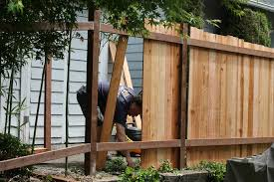

Slide 2
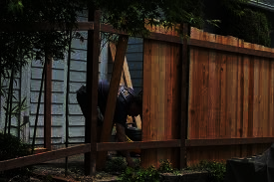
ARE FENCES GOOD THINGS OR BAD THINGS?
DO THEY EXIST TO KEEP THINGS IN OR KEEP THINGS OUT?
FENCES CAN BE GOOD OR BAD

Slide 3
“We all build fences. It is an essential part of the human condition. We categorize and re-categorize ourselves and others over and over again in order to protect our fragile egos and in order to minimize any complex thinking required to really see others. We are quick to identify differences which separate us and we “otherize” anyone we do not agree with or do not fully understand. We build fences. And we do this within the church.”

Slide 4
FENCES AND THE JEWISH LAW
THE PHARISEES HAD AN OBJECTIVE – TO BUILD A FENCE AROUND THE LAW

Slide 5
DETERMINE GOD’ S COMMANDMENTS IN THE FIRST FIVE BOOKS OF THE LAW KNOWN AS THE TORAH
GENESIS
EXODUS
LEVITICUS
NUMBERS
DEUTERONOMY
THIS WALL WAS TO PROTECT THEM FROM DISOBEYING

Slide 6
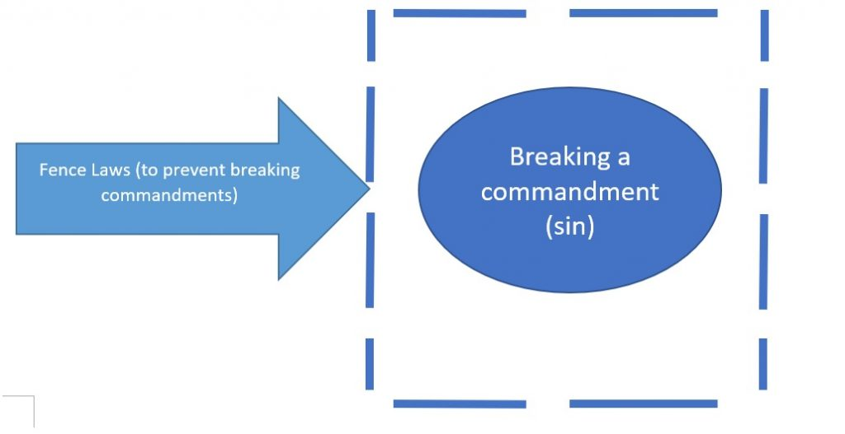

Slide 7
IF YOU PULL UP “JUDAISM 101”
YOU WILL FIND 733,000 REFERENCES TO FENCES AND JEWISH LAW
IF YOU PULL UP “JEWISH LAW” YOU FIND SOME INTERESTING THINGS

Slide 8
JUDAISM WAS MORE THAN A BASIC BELIEF ABOUT GOD—MAN—AND THE UNIVERSE
IT WAS A COMPREHENSIVE WAY OF LIFE BASED ON RULES AND PRACTICES

Slide 9
IT WAS INTENDED TO AFFECT EVERY ASPECT OF A PERSON’S LIFE
WHAT YOU DO WHEN YOU WAKE UP
WHAT YOU EAT
WHAT YOU WEAR
HOW YOU GROOM YOURSELF
HOW TO CONDUCT BUSINESS
WHO YOU CAN MARRY
HOW TO OBSERVE DAYS

Slide 10
IT WAS INTENDED TO AFFECT EVERY ASPECT OF A PERSON’S LIFE
HOW TO TREAT PEOPLE
HOW TO TREAT ANIMALS
“HALAKHAH” IS TRANSLATED “JEWISH LAW”
IT LITERALLY MEANS “THE PATH ONE WALKS”

Slide 11
THE LAW – OR TORAH CONTAINS 613 COMMANDMENTS
THESE CAME FROM GOD AND CANNOT BE CHANGED
248 POSITIVES
1 FOR EACH BONE
365 NEGATIVES
1 FOR EACH DAY
HUNDREDS MORE WERE ADDED WHICH BECAME FENCES AROUND THE LAW

Slide 12
THE 1ST FENCE WAS TO PROTECT PEOPLE FROM VIOLATING GOD’S LAW
1ST IDENTIFY THAT THE LAW CAME FROM GOD
2ND BUILD A FENCE AROUND THE LAW SO PEOPLE WILL NOT VIOLATE IT

Slide 13
AN EXAMPLE:
Ex 20:8-11Remember the Sabbath day by keeping it holy. ⁹ Six days you shall labor and do all your work, ¹⁰ but the seventh day is a Sabbath to the Lord your God. On it you shall not do any work, neither you, nor your son or daughter, nor your manservant or maidservant, nor your animals, nor the alien within your gates.

Slide 14
THIS SEEMED SIMPLE ENOUGH
KEEP THE SABBATH HOLY
KEEP IT HOLY BY NOT WORKING
SERVANTS—LIVESTOCK—VISITORS COULD DO NO WORK

Slide 15
HERE WAS THE PROBLEM
WHAT IS WORK?
WORK HAD TO BE DEFINED

Slide 16
MISHNAH – SABBATH– CPT 7, V2
“The main classes of work are 40, save one: sowing, plowing, reaping, binding sheaves, threshing, winnowing, cleansing crops, grinding, sifting, kneading, baking, shearing wool, washing, beating or dying it, spinning, weaving, making two loops,
Weaving two threads, tying or loosing a knot, sewing two stitches, tearing in two, hunting a gazelle, slaughtering or

Slide 17
flaying or salting it or curing its skin, scraping it or cutting it up, writing two letters, building, putting out a fire, lighting a fire, striking with a hammer, taking out aught from one domain to another. These are the main classes of work: forty save one.”

Slide 18
CENTURIES LATER FENCES WERE BUILT AROUND THESE LAWS
TOUCHING OR HANDLING AN IMPLEMENT OF WORK WAS FORBIDDEN TO PREVENT AN ACT OF WORK BEING PERFORMED
THE PHARISEES IN JESUS’ TIME WERE NOTORIOUS FOR BUILDING FENCES

Slide 19
Mark 7:1-4 The Pharisees and some of the teachers of the law who had come from Jerusalem gathered around Jesus and ² saw some of his disciples eating food with hands that were "unclean," that is, unwashed. ³ (The Pharisees and all the Jews do not eat unless they give their hands a ceremonial washing, holding to the tradition of the elders. ⁴ When they come from the marketplace they do not eat unless they wash.

Slide 20
And they observe many other traditions, such as the washing of cups, pitchers and kettles.
THERE WAS NOTHING IN THE LAW THAT REQUIRED THE WASHING OF HANDS BEFORE EATING
THIS WAS A TRADITION HANDED DOWN BY THE RELIGIOUS LEADERS

Slide 21
THIS WAS A FENCE BUILT AROUND THE LAW
Mark 7:7-8 They worship me in vain; their teachings are but rules taught by men.' You have let go of the commands of God and are holding on to the traditions of men."
THEY BUILT FENCES AROUND THE LAW WITH THEIR TRADITIONS

Slide 22
THE LAW SAID WASHING OF HANDS WAS REQUIRED OF PRIESTS BEFORE THEY OFFERED A SACRIFICE – EX 40:30-32
BUT NOTHING IS SAID ABOUT WASHING HANDS BEFORE EATING A MEAL

Slide 23
THE 2ND FENCE WAS BULT WITH THE TEACHINGS OF THE RABBIS
THESE RULINGS DEALT WITH SPECIFIC SITUATIONS AND HAD THE FORCE OF LAW
BUT THESE RULINGS WERE NOT THE SAME IN EVERY CONTEXT

Slide 24
EXAMPLE
MANY O.T. MEN OF FAITH WERE POLYGAMISTS
BUT NOT ALL JEWS COULD BE POLYGAMISTS
THIS WAS DETERMINED BY THE RULING OF THE RABBIS

Slide 25
A 3RD FENCE WAS BUILT BY CUSTOM AND WAS BINDING AS LAW BECAUSE IT HAD BEEN PRACTICED SO LONG
THE WASHING OF HANDS BEFORE EATING
STANDING WHILE PRAYING
OTHER JEWISH PRACTICES THAT WERE SIMPLY DONE AS CUSTOM BUT WERE CONSIDERED LAW

Slide 26
THE POINT IN BUILDING A FENCE AROUND THE LAW
IT WAS TO CONTROL EVERYONE’S ACTIONS
IT WAS TO “PROTECT” THEM FROM VIOLATING GOD’S LAW
IT WAS TO PROTECT SOMEONE FROM
ACCIDENTLY DOING SOMETHING WRONG

Slide 27
YOU IDENTIFY GOD’S LAW
YOU PREVENT A VIOLATION BY BUILDING A FENCE AROUND IT
THE 1ST FENCE IS IDENTIFYING WHAT THE LAW MEANS
THE 2ND FENCE IS THE RABBIS’ RULING
THE 3RD FENCE IS CUSTOM

Slide 28
WE HAVE MUCH MORE IN COMMON WITH THIS APPROACH THAN WE REALIZE
LIKE PHARISEES – AS WELL MEANING CHRISTIANS WE CAN ADD FENCES TO GOD’S LAW
THESE MODERN-DAY FENCES QUICKLY BECOME A LAW UNTO THEMSELVES REPLACING WHAT THEY WERE DESIGNED TO PROTECT

Slide 29
1ST MODERN DAY FENCE
IDENTIFY GOD’S LAW
IS WHAT I BELIEVE REALLY TAUGHT IN THE BIBLE?
DOES MY UNDERSTANDING COME FROM A FAILURE TO PROPERLY APPLY A TEXT?
IS THIS REALLY WHAT GOD SAYS OR HAVE I MADE A LAW THAT GOD DIDN’T?

Slide 30
1ST MODERN DAY FENCE
IDENTIFY GOD’S LAW
WE ARE OFTEN DIVIDED OVER WHAT THE BIBLE DOES NOT SAY
WE DISCUSS AND ARGUE OVER THINGS THE BIBLE DOESN’T MENTION
WE SAY “THE BIBLE DOESN’T SPECIFICALLY SAY THIS BUT THE PRINCIPLE IS THERE”

Slide 31
1ST MODERN DAY FENCE
IDENTIFY GOD’S LAW
2 Thess 3:6 But we command you, brethren, in the name of our Lord Jesus Christ, that you withdraw from every brother who walks disorderly and not according to the tradition which he* received from us.
THIS PASSAGE HAS BEEN USED AS AUTHORITY FOR WITHDRAWING FELLOWSHIP FROM BRETHREN

Slide 32
1ST MODERN DAY FENCE
THE PASSAGE SAYS TO WITHDRAW FELLOWSHIP FROM THOSE WHO WALK DISORDERLY
THE PROBLEM IS IN DETERMINING WHAT IS “WALKING DISORDERLY”
WE HAVE APPLIED IT TO ANYTHING WE CONSIDER TO BE A DISORDERLY WALK
EVEN TO MISSING WORSHIP

Slide 33
1ST MODERN DAY FENCE
THE PROBLEM IS THE CONTEXT DEFINES “WALKING DISORDERLY” IN NO UNCERTAIN TERMS
2 Thess 3:7 For you yourselves know how you ought to follow us, for we were not disorderly among you; ⁸ nor did we eat anyone's bread free of charge, but worked with labor and toil night and day,

Slide 34
1ST MODERN DAY FENCE
THE PROBLEM IS THE CONTEXT DEFINES “WALKING DISORDERLY” IN NO UNCERTAIN TERMS
2 Thess 3:10-11 For even when we were with you, this we commanded you, that if any would not work, neither should he eat.
¹¹ For we hear that there are some which walk among you disorderly, working not at all, but are busybodies.

Slide 35
2ND MODERN DAY FENCE
WE DON’T HAVE RABBIS TO MAKE RULINGS – BUT WE HAVE PREACHERS AND PERIODICAL EDITORS TO MAKE RULINGS
BROTHER SO-AND-SO TAUGHT THIS SO IT MUST BE CORRECT
A BROTHERHOOD PERIODICAL HAD AN ARTICLE ON THIS SUBJECT SO THIS HAS TO BE RIGHT

Slide 36
2ND MODERN DAY FENCE
MANY DECIDE WHAT TO BELIEVE ON A SUBJECT BY READING WHAT SOME BROTHER HAS WRITEN
IT IS MUCH EASIER TO READ “WHAT WE ARE SUPPOSE TO BELIEVE” RATHER THAN DIG DEEP INTO GOD’S WORD
IT IS MUCH EASIER TO ACCEPT AS TRUTH WHAT A PREACHER SAYS THAN TO STUDY ON OUR OWN

Slide 37
2ND MODERN DAY FENCE
PREACHERS AND BROTHERHOOD PERIODICALS ARE NOTORIUS FOR BUILDING FENCES AROUND GOD’S WORD
THESE FENCES DO JUST WHAT A FENCE IS DESIGNED TO DO
THEY KEEP SOME PEOPLE IN AND KEEP OTHERS OUT
WHAT IS THE DIFFERENCE IN THIS AND THE RABBIS MAKING A RULING?

Slide 38
2ND MODERN DAY FENCE
WE OFTEN BUILD A FENCE TO CONTROL WHO BECOMES A MEMBER OF A CONGREGATION – WE ONLY LET IN THOSE WHO ARE JUDGED WORTHY
SOME CONGREGATIONS DEMAND THAT A PERSON WANTING TO JOIN THEIR FELLOWSHIP HAVE AN INTERVIEW WITH THE ELDERS

Slide 39
CONGREGATION
WE PUT A GATE IN OUR FENCES TO CONTROL WHO COMES IN

Slide 40
2ND MODERN DAY FENCE
WHO CAME UP WITH THE IDEA TO INTERVIEW PROSPECTIVE MEMBERS?
WERE THE 3000 ON PENTECOST INTERVIEWED BY THE APOSTLES?
DO WE NOT REALIZE THAT GOD ADDS TO THE CHURCH – NOT MAN?

Slide 41
3RD MODERN DAY FENCES
OUR TRADITIONS
THINGS ARE OFTEN DONE BECAUSE THAT’S THE WAY THEY HAVE ALWAYS BEEN DONE
CUSTOMS BECOME LAWS AND ARE CONSIDERED BINDING

Slide 42
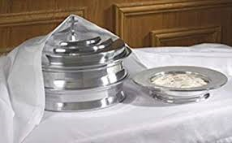

Slide 43
3RD MODERN DAY FENCES
WHAT DID JESUS THINK ABOUT TRADITIONS?
Mark 7:7-8 They worship me in vain;
their teachings are but rules taught by men.'You have let go of the commands of God and are holding on to the traditions of men."
Matt 15:3 Jesus replied, "And why do you break the command of God for the sake of your tradition?

Slide 44
ARE WE GUILTY OF TRYING TO IDENTIFY WHAT GOD DEMANDS?
DO WE BUILD FENCES AROUND THOSE COMMANDS TO CONTROL PEOPLE AND PREVENT VIOLTIONS?
GOD IS NOT PLEASED WITH THIS
MAY WE SIMPLY SERVE GOD – WITHOUT PLACING DEMANDS AND LAWS THAT GOD S HAS NOT MADE

Slide 45
DO BUILD FENCES AROUND THOSE COMMANDS TO CONTROL PEOPLE AND PREVENT VIOLTIONS?
GOD IS NOT PLEASED WITH THIS
MAY WE SIMPLY SERVE GOD – WITHOUT PLACING DEMANDS AND LAWS THAT GOD HAS NOT MADE

Slide 46
PERHAPS WE NEED TO TEAR DOWN SOME FENCES
LET’S NOT MAKE BEING A CHRISTIAN HARDER THAN GOD MAKES IT

